Slide 1

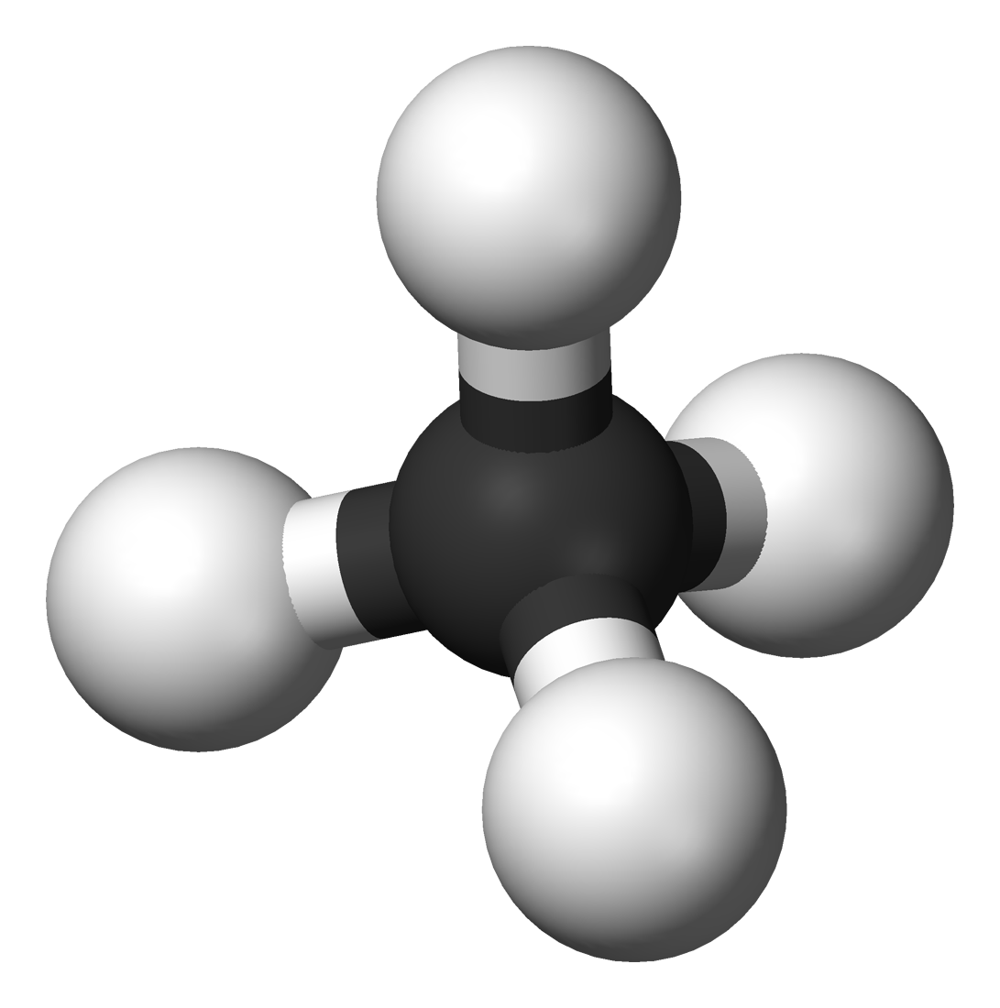
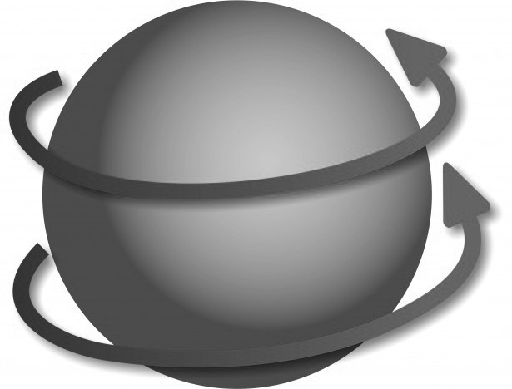
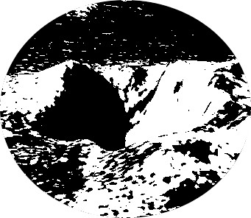
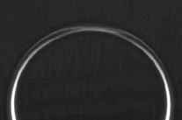
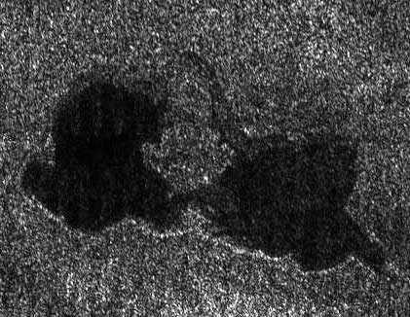
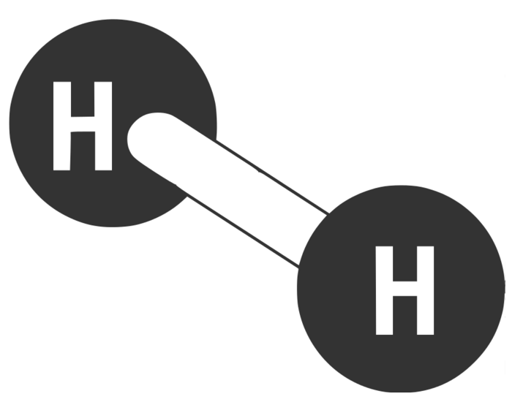

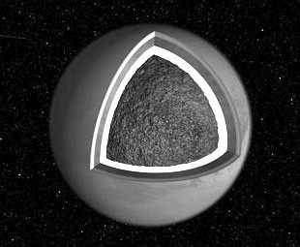
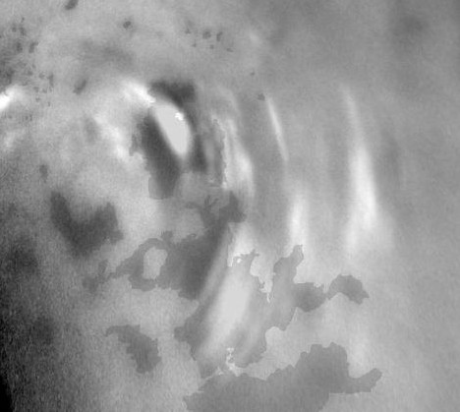
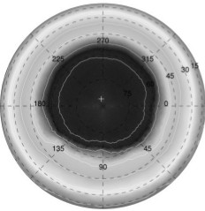
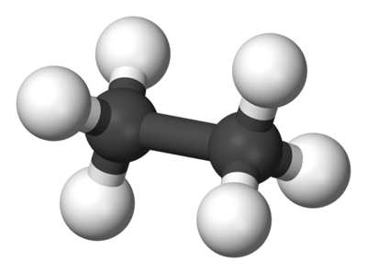
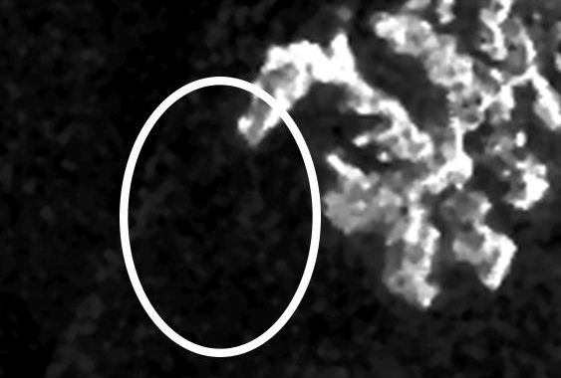
CASSINI-HUYGENS CHARM TELECON
TITAN: COLD CASE FILES
THE “DIRTY DOZEN” ENIGMAS – ARE THEY SOLVED OR UNSOLVED?
TUESDAY
OCTOBER 25
CONOR A. NIXON
NASA GSFC
FUGITIVE: methane
DISORDERLY:
ROTATION AXIS
Wanted: Cryo-volcanism
GETTING HIGH: DETACHED HAZE
NORTH VS SOUTH: lakes & seas
DISAPPEARING ACT: HYDROGEN
DISGUISED: surface ices
RIGOR MORTIS: CRUST VS GUTS
ENDANGERED: polar clouds
KEELING OVER: tilted pole
SAFE HOUSE: LIQUID ethane
CON ARTIST: MAGIC ISLAND

Slide 2
Titan “Cold Case Files” Workshop:
Cassini PSG Meeting Monrovia CA, 10/9-11/9 2016
Goals for the workshop were:
To revisit topics from early in the mission, and science questions that existed before Cassini arrival, and determine if new information is now available to answer these questions.
Where topics are still open, ask whether we can reasonably expect to answer them during the remainder of the mission, or whether a new mission is required, and what type.
To foster collaborations between instrument teams and science disciplines.
Most of topics discussed today were presented at the workshop.

Slide 3

Titan’s Cold Case Files
The Wobbly Spinning Top
What’s Hiding Inside?
The Invisible Volcanoes
Ices in Disguise
Northern Exposure: Lakes and Seas
Ethane Vanishes
The Magic Island
Too Many Sunny Days
The Tilted Pole
The Fugitive: Methane
The Mystery of the Disappearing Hydrogen
The Floating and Sinking Haze

Slide 4

Case 1: The Wobbly Spinning Top

Slide 5

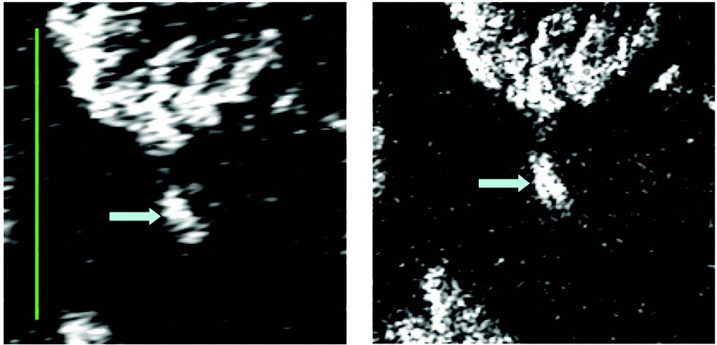
Investigation: does Titan spin at a constant rate?
Detective’s notes, 2008:
Titan is expected to rotate synchronously, keeping the same face to Saturn – like the Earth and Moon.
We have observed features on Titan’s surface with Cassini’s RADAR at different times, and they do not appear where expected! (Figure below)
Is Titan rotation speeding up? Is it wobbling on it’s axis?
Figure from Stiles et al. (2008)

Slide 6
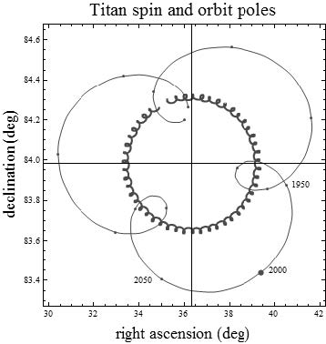
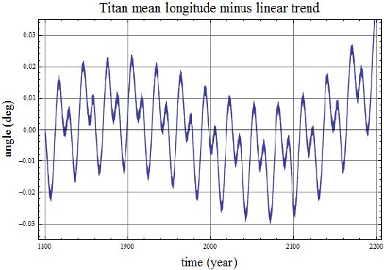

Detective’s notes, 2015:
Early research had a faulty computer program! After fixing the problem, the surface features do mostly appear where we expect. However…
We now have a lot more data. Although Titan rotates mostly synchronously it does have small wobbles, which we can predict.
These are: (i) a 700-year cycle due to the gravitational pull of Saturn bulging equator, and (ii) a 29.5-year cycle caused by orbiting the Sun.
Conclusion:
No anomalous rotation.

Slide 7
Case 2: What’s hiding inside?

Slide 8
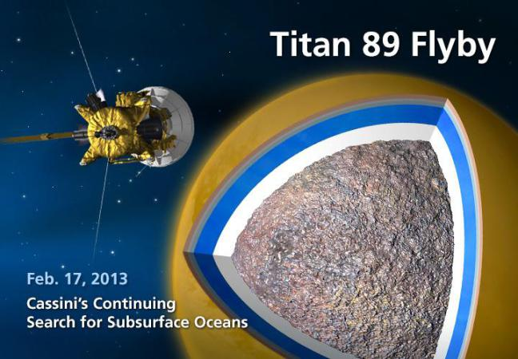
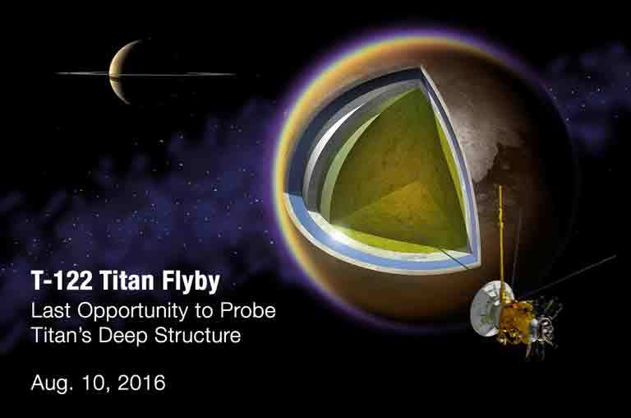
Investigation: does Titan have an internal water ocean?
Detective’s notes, 2004, start of mission:
Just prior to Cassini we know Titan has a density of 1.8 g/cm³ – about intermediate between water (1.0 g/cm³) and rock (3.3-4.0 g/cm³).
So, we expect Titan to be composed of about 50% rock and 50% ice.
But, how are these materials distributed? Inside Titan is it:
  Differentiated (rock and water separated, like the Earth)?
  Undifferentiated (rock and ice mixed together like a comet)?
We need to measure the moment of inertia (MoI) – in other words, is the mass distributed evenly throughout, or concentrated in the core?
We will use Cassini’s radio science equipment to measure the deflection of the spacecraft as it flies by Titan.

Slide 9
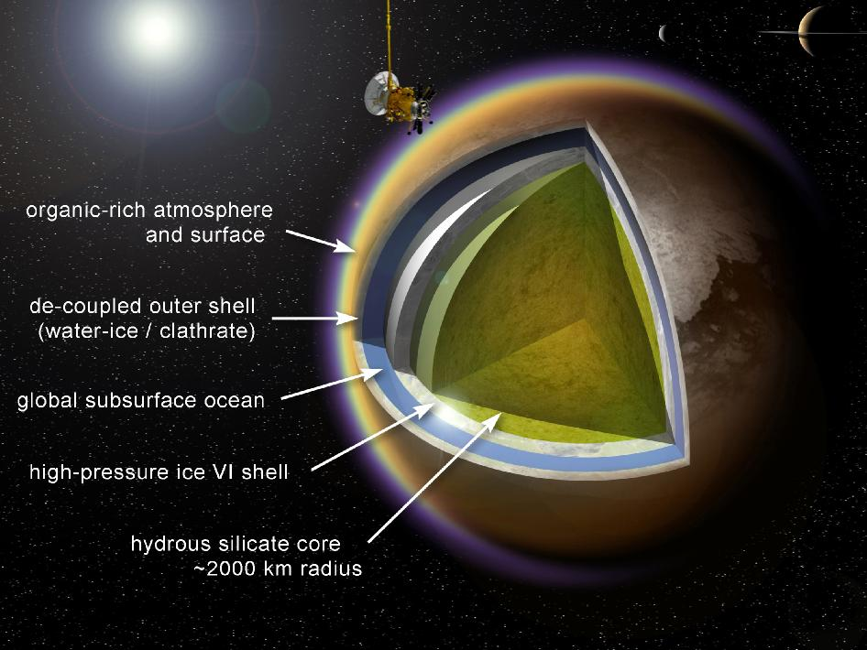
Detective’s notes, 2012:
FACT 1: Titan’s MoI (C/MR²) = 0.34. This is between Ganymede (0.31, differentiated) and Callisto (0.35, undiffentiated), so Titan is partially differentiated.
=> Titan may or may not have a liquid layer inside.
FACT 2: However in addition we find that Titan has a k₂ co-efficient* of ~0.6, intermediate between a water balloon (1.5) and solid ball (0.0).
=> Titan is flexing due to Saturn’s gravity and must have some liquid inside.
Conclusion:
Titan DOES have a water ocean!
Figure from Fortes (2012)
*k₂ co-efficient is the ratio between the perturbed and unperturbed quadrapole gravity fields of Titan.

Slide 10
Case 3: The Invisible Volcanoes

Slide 11
Investigation: does Titan have active geology?
Detective’s notes, 2005:
Titan has methane in the atmosphere, but we know this is destroyed by sunlight – the existing amount would only last for about 1% of the age of the solar system!
We believe that Titan must have internal activity to supply methane to the atmosphere, perhaps cryovolcanoes (ice volcanoes).
We found it! Or did we? Is this curious surface feature (Tortola Facula, aka “The Snail”) observed by the VIMS instrument the proof we need?
?
Figure from Sotin et al. (2005)

Slide 12
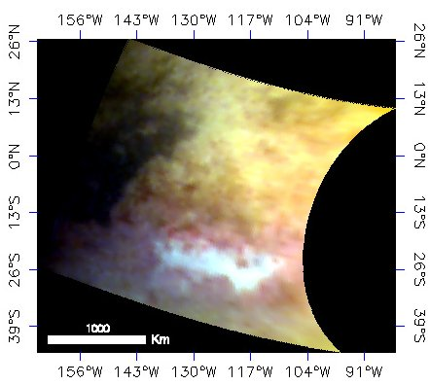
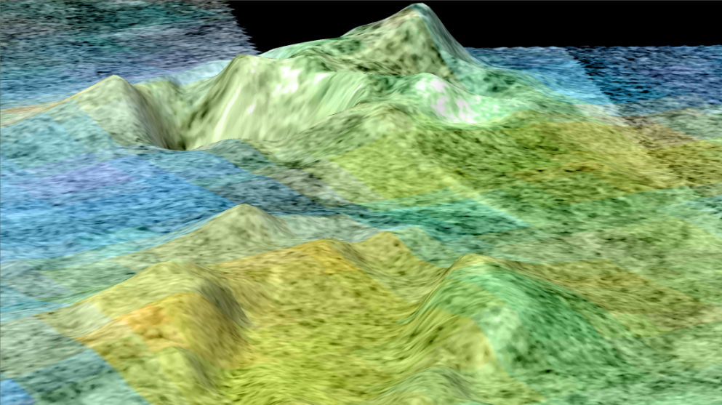

Detective’s notes, 2016:
Tortola turned out to be a bust! When we looked at the VIMS snail feature with RADAR, we didn’t see any topography resembled a volcano.
Although we have found several more intriguing features – most especially Sotra Facula (below right) – an apparent mountain with a deep hole beside it – we still can’t be sure.
Left: apparent bright icy terrain at Tui Regio (VIMS).
Above: the ‘maybe’ volcano, Sotra (RADAR).
Conclusion:
Case for cryovolcanism is still circumstantial.

Slide 13
Case 4: Ices in disguise

Slide 14
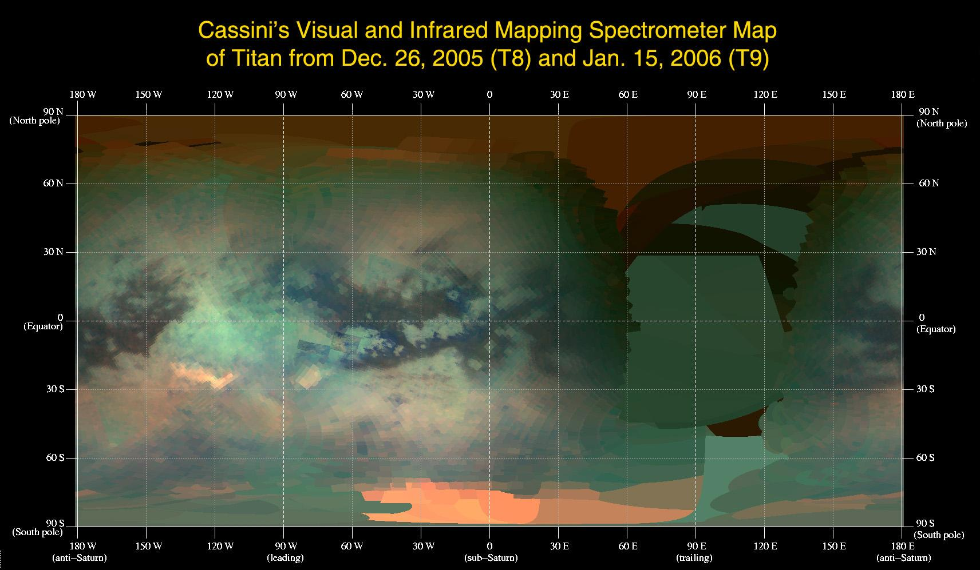
Investigation: do we see water ice on Titan’s surface?
Detective’s notes, 2006:
Titan is at least partially differentiated (Case 2), and therefore there could be ice on the surface, right? Unless is it covered by hydrocarbons…
Early imaging shows that the surface is confusing! There are bright and dark areas. We need spectroscopy to tell us what we are looking at.
RED =
5 microns GREEN =
2.01 micron
BLUE =
1.6 micron
Tui
Hotei

Slide 15
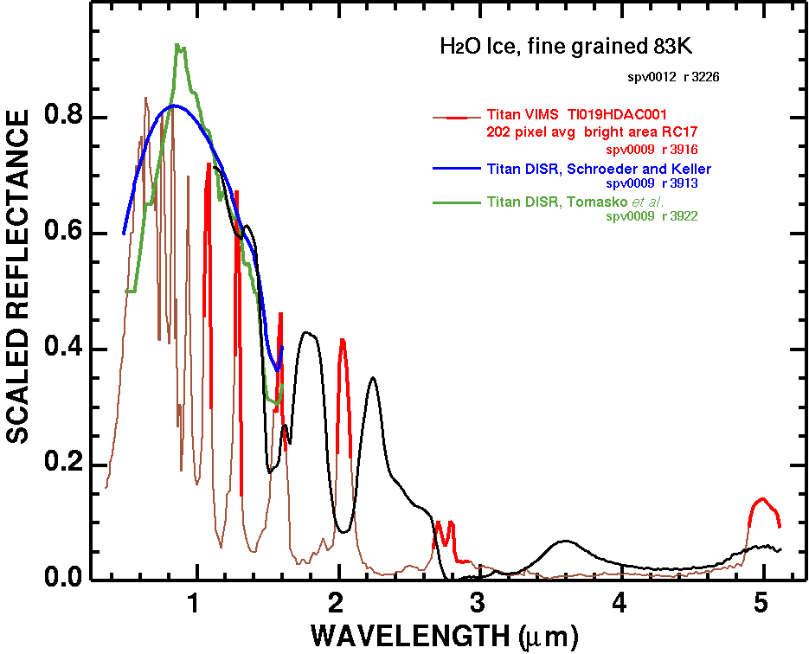
Detective’s notes, 2016:
Having conducted intensive spectroscopy of various ices in the lab, we find that Titan is too bright at several light wavelengths (colors) where water should make the surface dark.
Titan = red line
Water ice = black line
Titan (red) is too bright at these wavelengths where water ice (black) should be darkening
Conclusion:
There are no places on the surface where pure water ice is exposed.

Slide 16
Case 5: Northern Exposure
- Lakes and Seas

Slide 17
Investigation: why are all Titan lakes and seas in the north?
Detective’s notes, 2006:
We finally did it! During the July 22nd flyby of Titan (T16) we found the long-awaited lakes and seas on Titan’s surface!
But why don’t we see them everywhere else? We don’t just see lakes and seas in the north of the Earth!
NORTH
SOUTH

Slide 18
Detective’s notes, 2009:
We’ve really cracked this one: it’s to do with sunlight.
Saturn orbit is eccentric (oval or elliptical) so the seasons are not the same length and intensity.
Today, southern summer is hotter and shorter (a) than northern summer (b), so there is more evaporation and fewer lakes and seas.
But over a ~31,000 year cycle, this pattern reverses (c).
Another wrinkle is that methane is 10,000x more volatile than ethane at 94 K, so the methane moves from pole to pole, while ethane does not.
Conclusion:
This one is explained.

Slide 19
Case 6: Ethane Vanishes

Slide 20
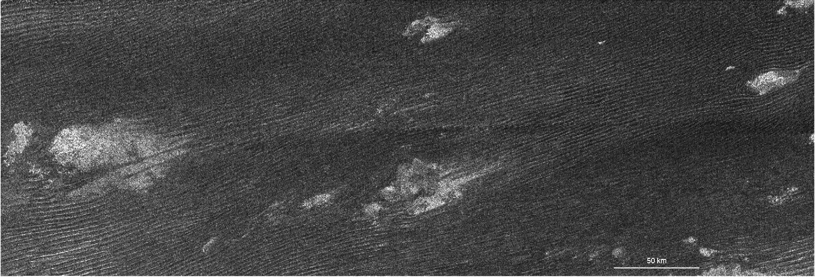
Investigation: where is Titan’s ethane?
Detective’s notes, 2008:
Titan’s atmosphere is producing about 15 million kg of ethane per day, according to our calculations. That’s a lot!
Over the age of the solar system, that’s an accumulation of around 25 million GT (giga-tonnes) – Titan should be 100s of meters deep In sloshing ethane!
But - we don’t see these wide oceans, although we do see wide dune fields of organic materials – so where is the ethane going to?
Figure from Radebaugh et al. (2008)

Slide 21
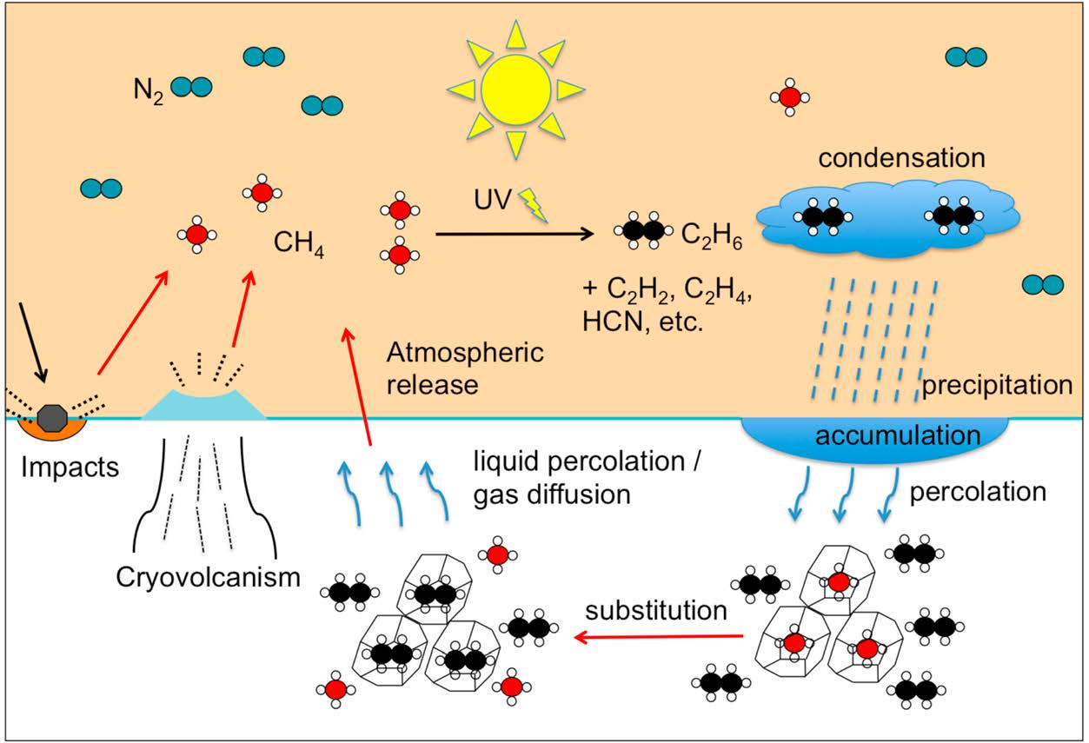
Detective’s notes, 2012:
We may have a clue to a partial answer! Titan’s poles are sunken compared to the equator, by about 300 m.
This may be because of ethane is raining down and replacing methane in Titan’s polar crust, making it denser and causing it to sink.
This mechanism would allow for about 300-1200 Myr of ethane production: not as long as the age of the solar system, but a significant way to it!
Figure from Choukroun et al. (2012)
Conclusion:
If Titan’s atmosphere is <1200 Myr old we may have an answer: case not quite closed...!

Slide 22
Case 7: The Magic Island

Slide 23
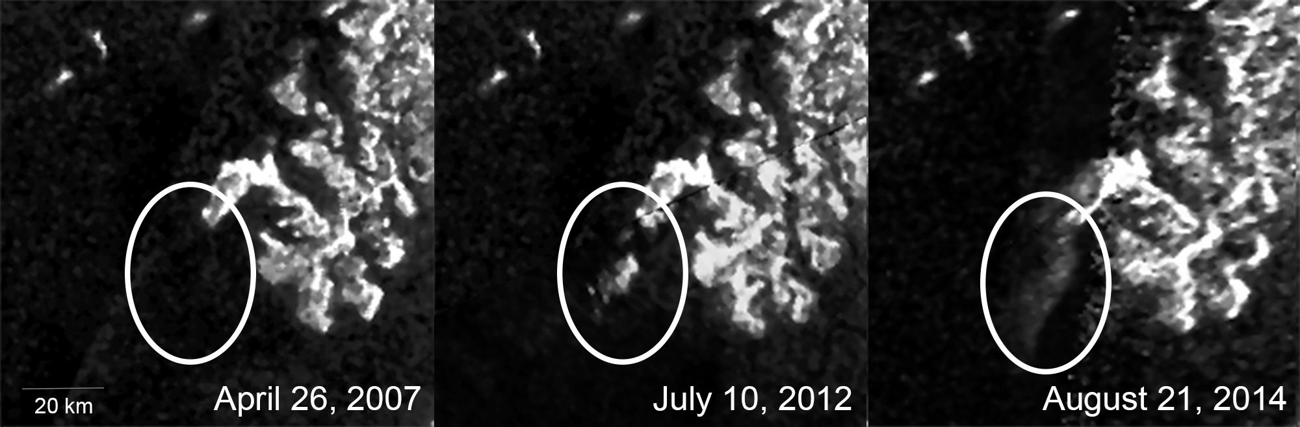
Investigation: what is the ’Magic Island’?
Detective’s notes, 2014:
A mysterious feature is vanishing and re-appearing in Titan’s Ligeia Mare! We call it the magic island.
But what is it? A real island? A patch of waves? Floating materials, bubbles, or even biota?

Slide 24
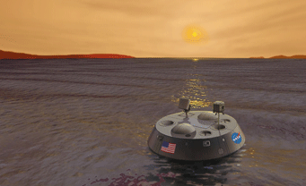
Detective’s notes, 2016:
After considering 7 possible hypotheses, we conclude that four are most likely: floating and suspended solids, bubbles and waves (Hofgartner 2016).
The most likely is waves: based on terrestrial experience.
We really need a new mission to get down to Titan’s surface and explore the lakes in details – perhaps something like the TiME mission that was proposed to NASA in 2009-2012, but not selected.
Conclusion:
The Magic Island is not ‘magic’, but we don’t really know what it is - yet!

Slide 25
Case 8: Too Many Sunny Days

Slide 26
Investigation: why aren’t there more clouds on Titan?
Detective’s notes, 2014:
We never thought we complain about sunny days, but Titan isn’t cloudy enough!
According to weather models, Titan should have a high density of clouds (red/yellow region) in the north (top right) following the 2009 equinox...
… but what we see is few clouds (black dots). Why so sunny?

Slide 27
Detective’s notes, 2016:
Titan’s clouds continue to be rare in the north and we don’t know why… but before we’ve even cracked this case a new mystery has arisen.
Cassini’s VIMS team sees bright region of apparent cloudiness over the north pole (left).
However the ISS camera team sees nothing! (right) This is the opposite to what we expect, since shorter wavelengths should be more sensitive to clouds, not less!
Conclusion:
Titan’s cloud mystery has not gone away.

Slide 28
Case 9: The Tilted Pole

Slide 29
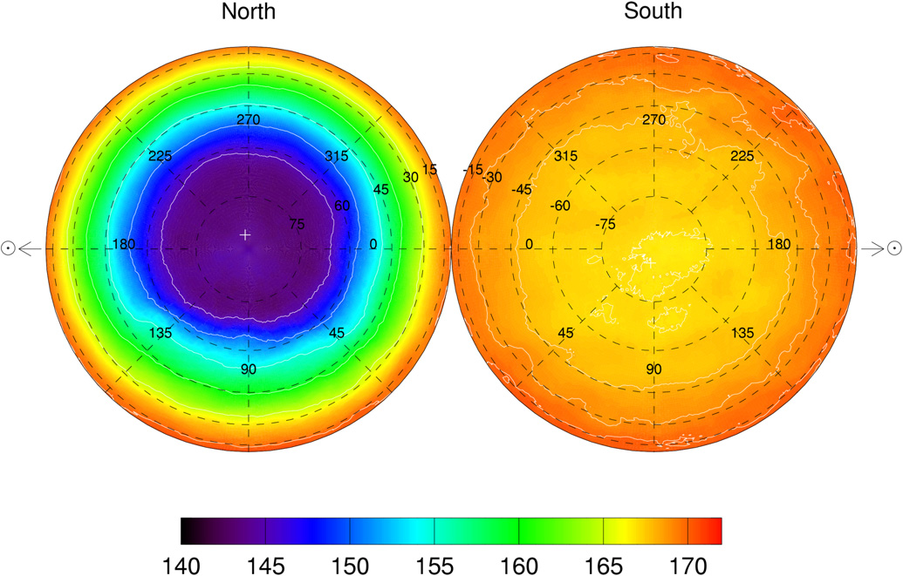
Investigation: why is Titan’s atmosphere tilted?
Detective’s notes, 2008:
Well here’s a curious thing: Titan’s atmosphere is seriously out of kilter!
Compared to the surface, the atmosphere is rotating around an axis that is tipped by more than 3 degrees.
If this is due to the Sun (solar tide) then as Saturn moves around the Sun the axis should follow that trend
Figure from Achterberg et al. (2008)

Slide 30
Detective’s notes, 2016:
New evidence is in, and the polar tilt is staying exactly where it was in 2008 – it isn’t following the Sun, but the stars instead!
Our earlier theory about solar forcing was incorrect.
Conclusion:
Titan has bamboozled us yet again.

Slide 31
Case 10: The Fugitive - Methane

Slide 32
Investigation: who is the getaway driver for methane escape?
Detective’s notes, 2008:
Titan’s methane (and hydrogen) are escaping from the top of the atmosphere, as fast as they can, in fact, even faster!
Cassini’s INMS instrument measured the profiles of several gases, including ⁴⁰Ar, H₂ and CH₄.
Models that fit the ⁴⁰Ar (dashed line) don’t fit the CH₄ and vice versa (dash dot line).
Only if methane is rising upwards fast (other lines) do we get agreement.

Slide 33
Detective’s notes, 2012:
The proposed model requires an upward flow of methane at a fantastic rate: the implied escape from the top of the atmosphere is 2x10²⁷ molecules of CH₄ per second.
Explanation 1: fast molecules exceeding the escape velocity (Jeans Escape) alone cannot explain it (1x10¹⁹).
Explanation 2: We also can’t get enough loss from sputtering – the effect where charged particles from the solar wind bump molecules into escaping (7x10²⁴) – still a thousand times too weak!
Explanation 3: We need a more powerful mechanism known as hydrodynamic escape.
This process normally only operates during the early period of a planet’s formation – why would it be operating today?
However if this is occuring all of Titan’s methane will disappear rapidly, in only ~10 Myr!
Can this be true?
Conclusion:
The only explanation is bizarre, but that’s all we have.

Slide 34
Case 11: The Mystery of the disappearing hydrogen

Slide 35
Investigation: where is Titan’s hydrogen going to?
Detective’s notes, 2008:
Hydrogen is 0.4% at the top of the atmosphere, but 0.1% at the bottom.
This implies a huge source in the upper atmosphere, and a ‘sink’ in the lower atmosphere, literally flowing into the surface!
Now the mystery deepens; hydrogen should be well-mixed in the atmosphere, but evidence from the CIRS instrument shows that it is varying with latitude as well at the surface – increasing to N. pole!
Figure from Courtin et al. (2012)

Slide 36
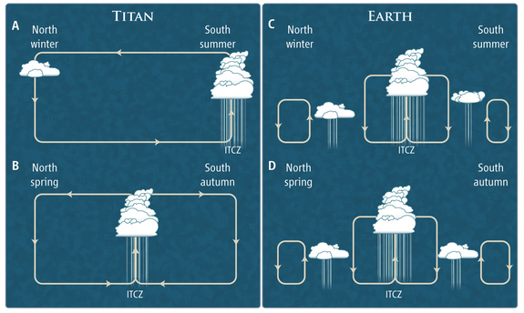
Detective’s notes, 2012:
  One possible explanation is that the global circulation on Titan is causing cool air to sink down at high northern latitudes during winter, to balance rising in the south.
  This might draft hydrogen downwards from the upper atmosphere.
Conclusion:
The hydrogen profile is not at all well understood!

Slide 37
Case 12: The Floating and Sinking Haze

Slide 38
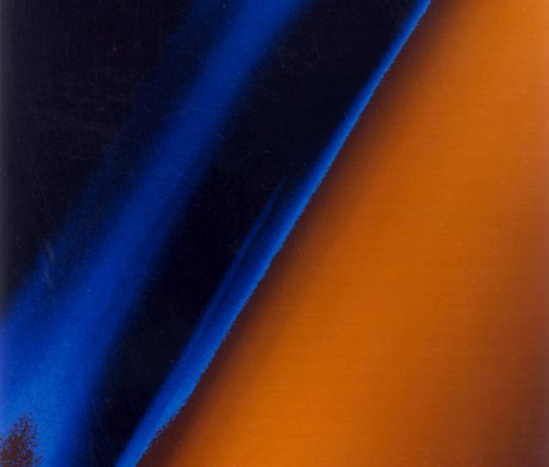
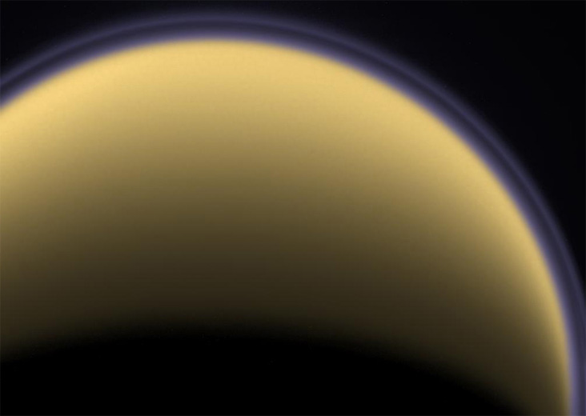
Investigation: what is causing Titan’s detatched haze layer?
Detective’s notes, 1980:
Way back in 1980, Voyager 1 flew by Titan and recorded beautiful images of a serenely ‘detatched’ haze floating above the main hazy atmospheric layers at 500 km (left).
Cassini, 24 years layer saw the same phenomenon. What causes this floating layer?

Slide 39
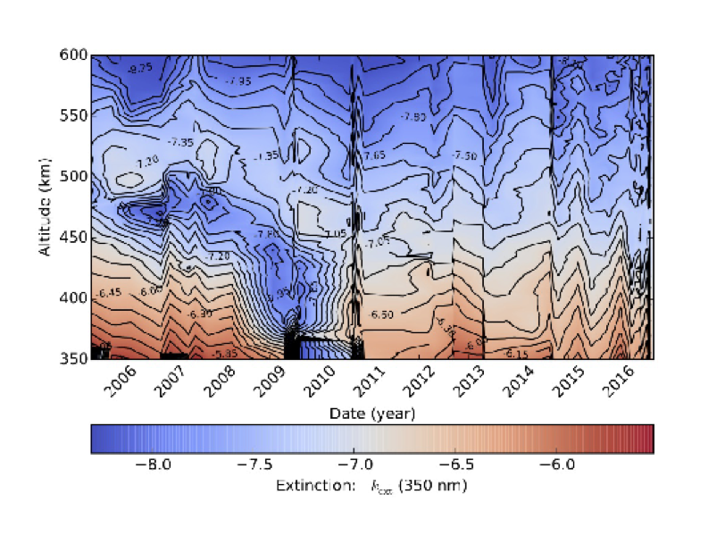
Detective’s notes, 2016:
More data: The detached haze began sinking around the time of equinox (2009) eventually merging with the main haze at 400 km.
But recent evidence shows a re-appearance… do we understand?
Is this due to dynamics or chemistry?
Conclusion:
The jury is still very much out on this one.

Slide 40
FUGITIVE: methane
DISORDERLY:
ROTATION AXIS
Wanted: Cryo-volcanism
GETTING HIGH: DETACHED HAZE
OPEN
OPEN
CLOSED
OPEN
NORTH VS SOUTH: lakes & seas
DISAPPEARING ACT: HYDROGEN
DISGUISED: surface ices
RIGOR MORTIS: CRUST VS GUTS
OPEN
CLOSED
OPEN
CLOSED
ENDANGERED: polar clouds
KEELING OVER: tilted pole
SAFE HOUSE: LIQUID ethane
CON ARTIST: MAGIC ISLAND
OPEN
OPEN
OPEN
CLOSED
Final Score: Titan 8, Scientists 4. But the scientists aren’t giving up!

Slide 41

Acknowledgements
The Wobbly Spinning Top (Bruce Bills, JPL)
What’s Hiding Inside? (L. Iess, Univ. Rome)
The Invisible Volcanoes (C. Sotin and R. Lopes, JPL)
Ices in Disguise (R. Clark, USGS)
Northern Exposure: Lakes and Seas (A. Hayes)
Ethane Vanishes (C. Sotin)
The Magic Island (J. Hofgartner)
Too Many Sunny Days (E. Turtle)
The Tilted Pole (R. Achterberg U. Maryland, and M. Flasar, GSFC)
The Fugitive: Methane (R. Yelle, UA and D. Strobel, JHU)
The Mystery of the Disappearing Hydrogen (D. Strobel, JHU)
The Floating and Sinking Haze (R. West, JPL)

Slide 42
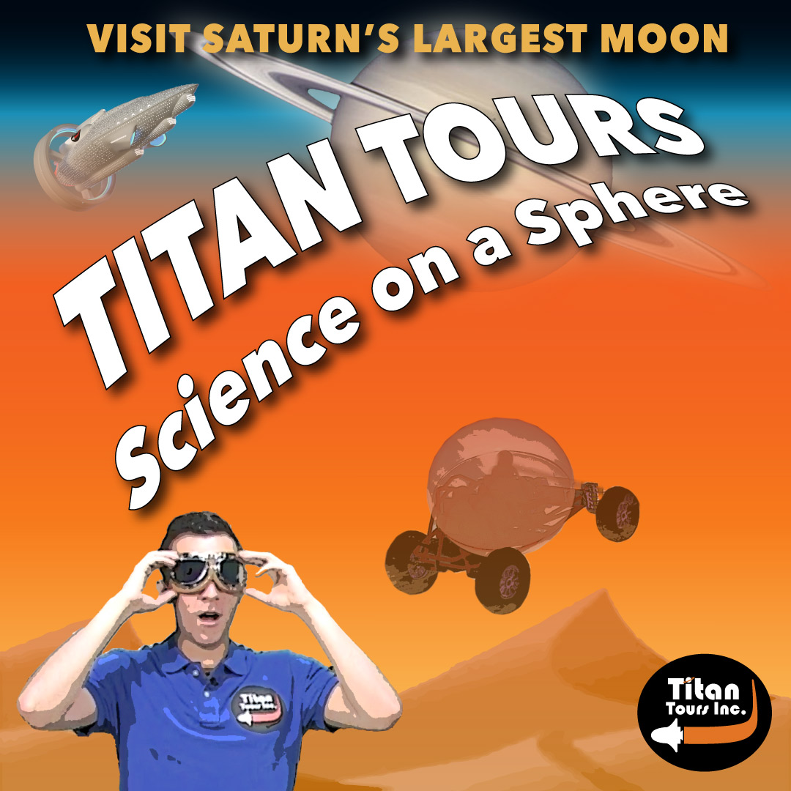

Slide 43

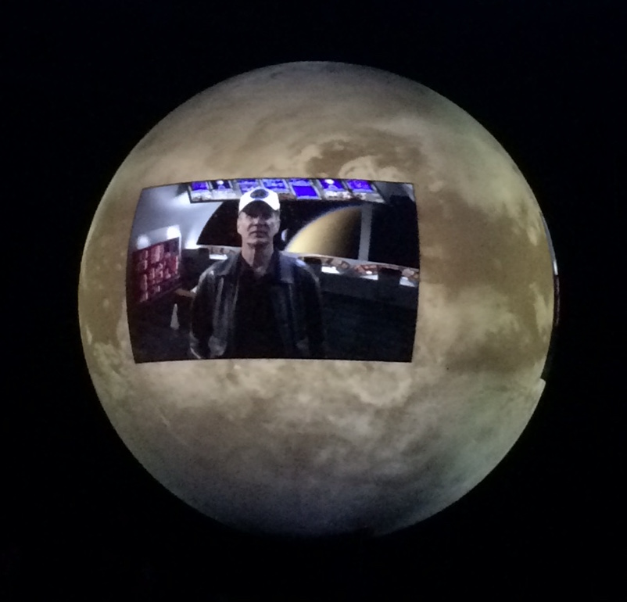
Concept
Use the “Science on a Sphere” medium to showcase recent scientific discoveries about Titan’s geography to a public audience.
Engage the audience interest through a “story telling” narrative (fictional travel commercial), rather than the traditional purely factual approach.

Slide 44
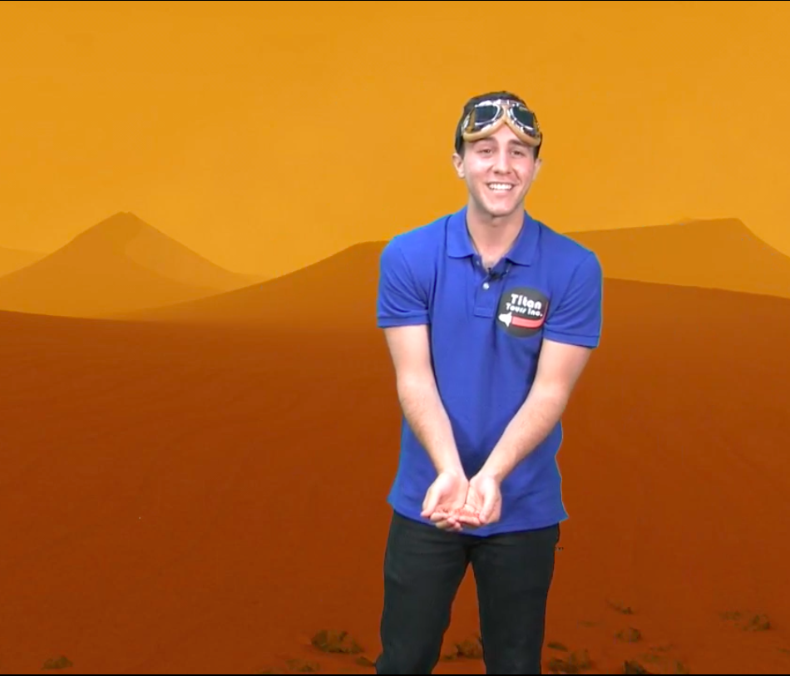
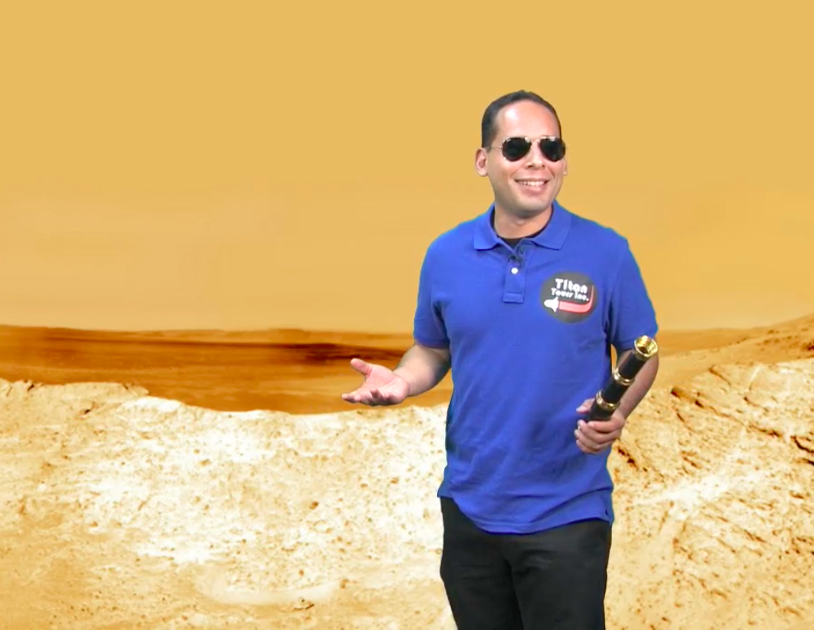
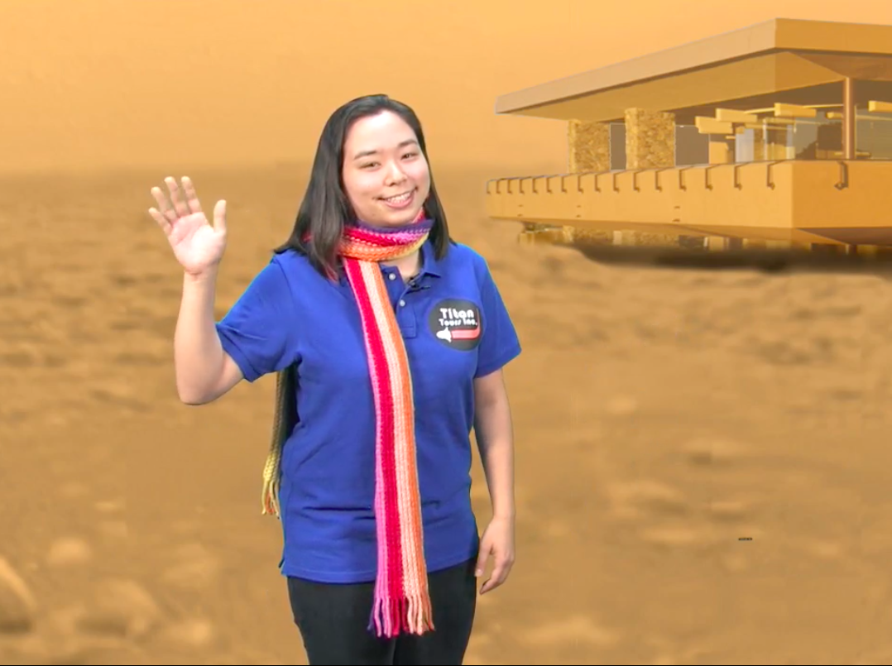
Storyline
“Titan Tours, Inc” takes the form of a fictional travel commercial for a tour company promoting an adventure holiday to Titan.
The journey begins as the travelers depart Earth on their cruise ship, meeting the ship’s captain.
The windows show short video narratives by “tour guides” extolling the virtues of specific locations.

Slide 45
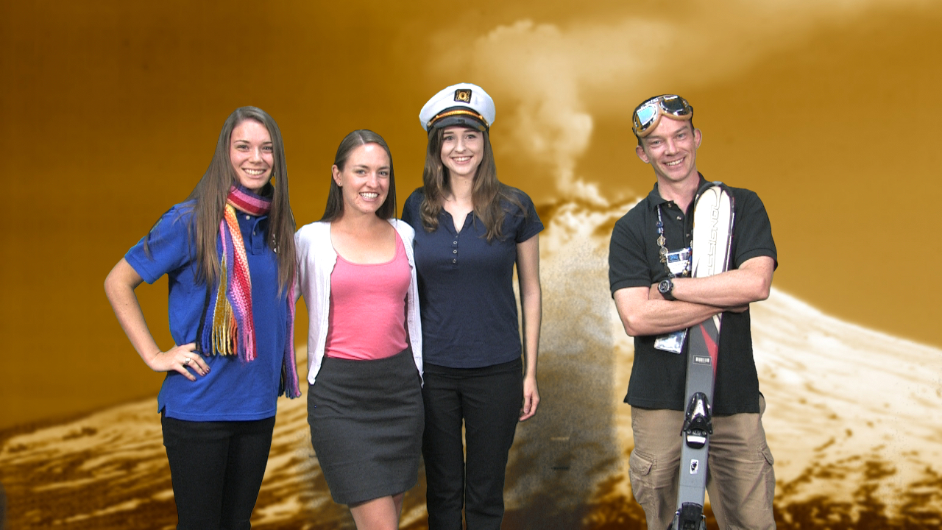

Production
Filming occurred during the summer of 2014 with student interns as the actors.
Most animation work was completed and the ship’s captain filmed, portrayed by a real-life astronaut!
Final production occurred in summer 2016, when another student intern added sound effects, music, credits and readied it for release.

Slide 46
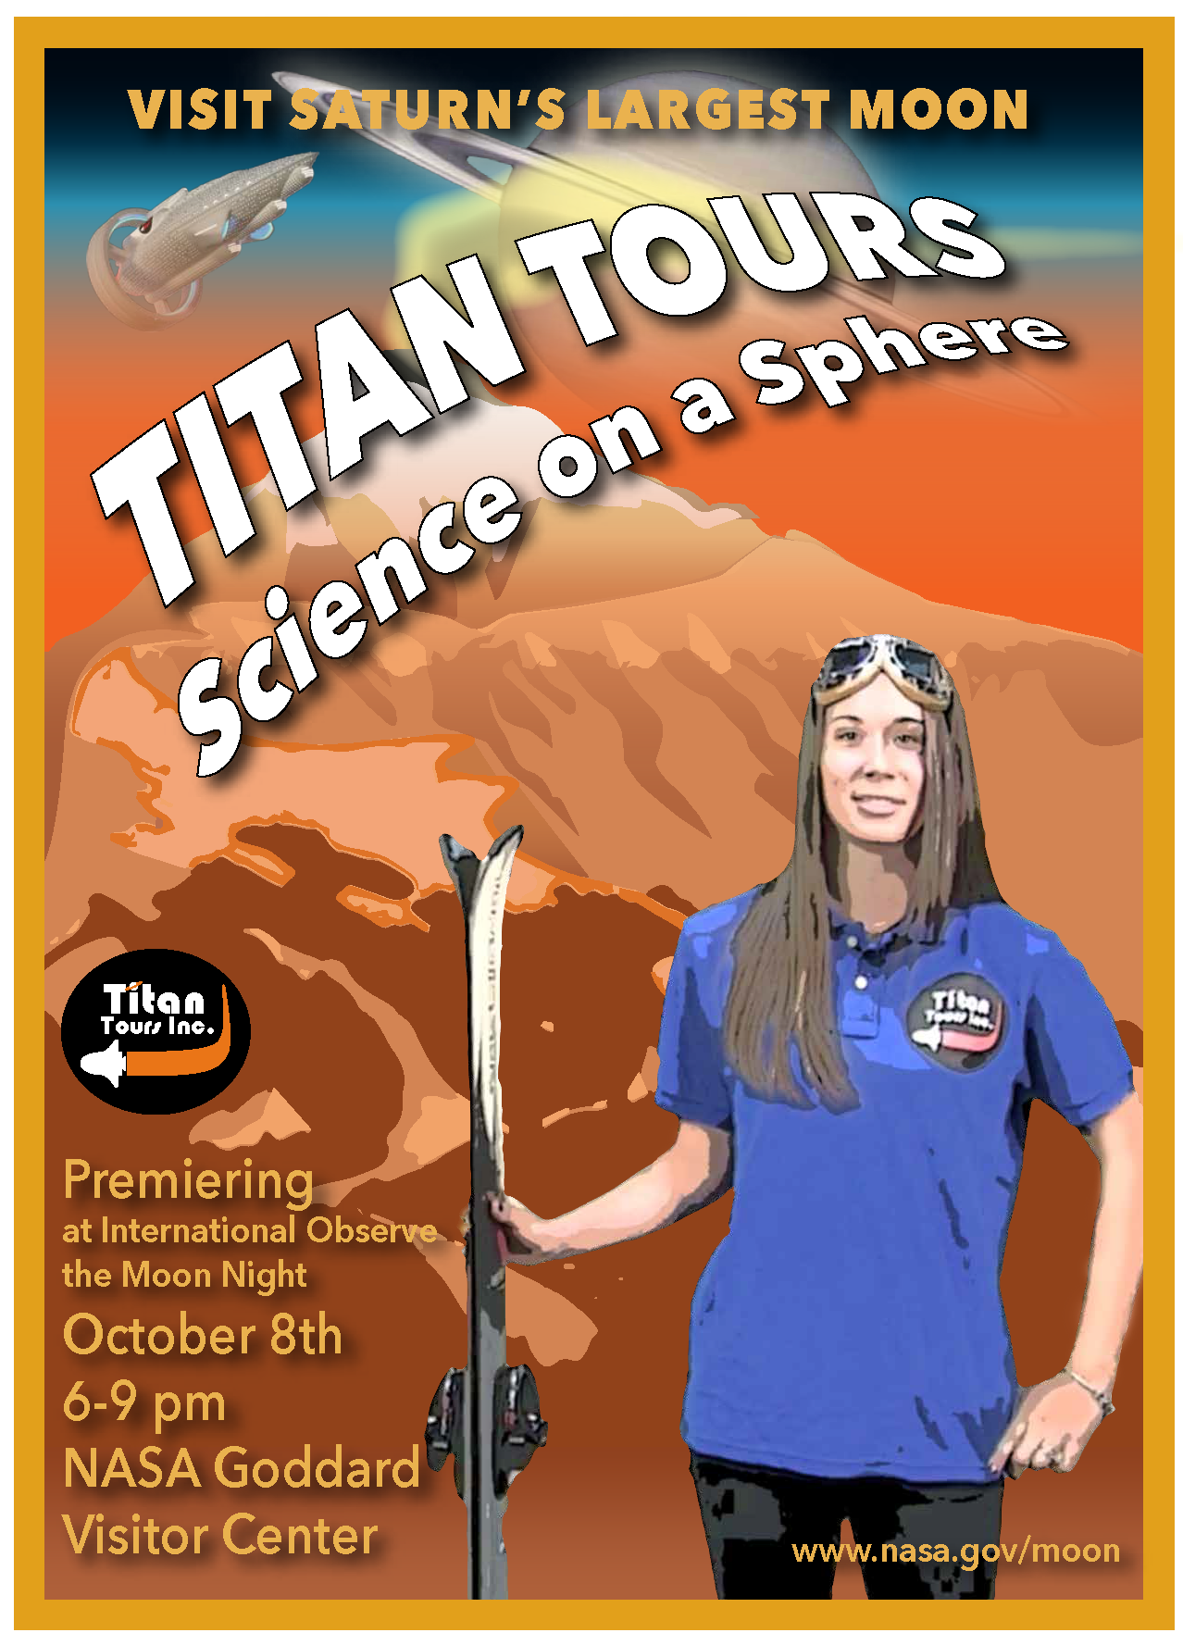
Release
The 3D version was premiered at “International Observed the Moon Night”, October 8th 2016.
A 2D Youtube version was subsequently completed and is now officially released!
https://www.youtube.com/watch?v=0dvCF3dS4ZI

