Slide 1
Our Evolving Understanding of Enceladus and its Plume and a few loose ends…
C. J. Hansen
25 April 2017

Slide 2
Evolving Questions
Pre-Cassini mysteries
The plume discovery
What is going on inside
What is driving the activity
Is Enceladus’ internal sea habitable
The biggest question of all
Notes:
We’ve been on a 12 year journey together

Slide 3
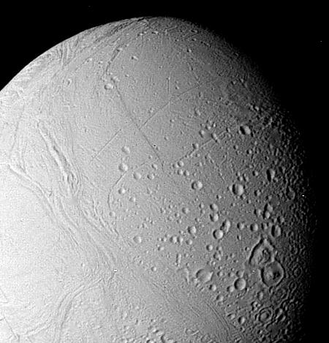
Pre-Cassini Mysteries
Enceladus was an important target for Cassini:
  The E ring coincides with the orbit of Enceladus – We speculated, could Enceladus be the source of the E ring?
  Voyager left us wondering - Why does Enceladus have such youthful geology?
Hypothesis: Eruptive activity on Enceladus is the source of the E ring
  Although we didn’t know Enceladus’ role, we asked: Where is all the OH in Saturn’s system coming from?
Best VGR – PIA01950
Notes:
We’ve been on a 12 year journey together
Will hit the highlights and note what remains unexplained

Slide 4
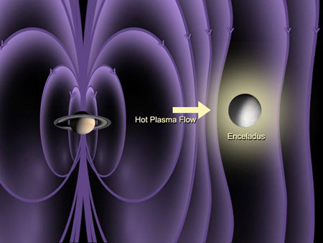
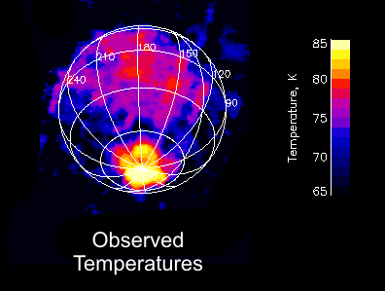
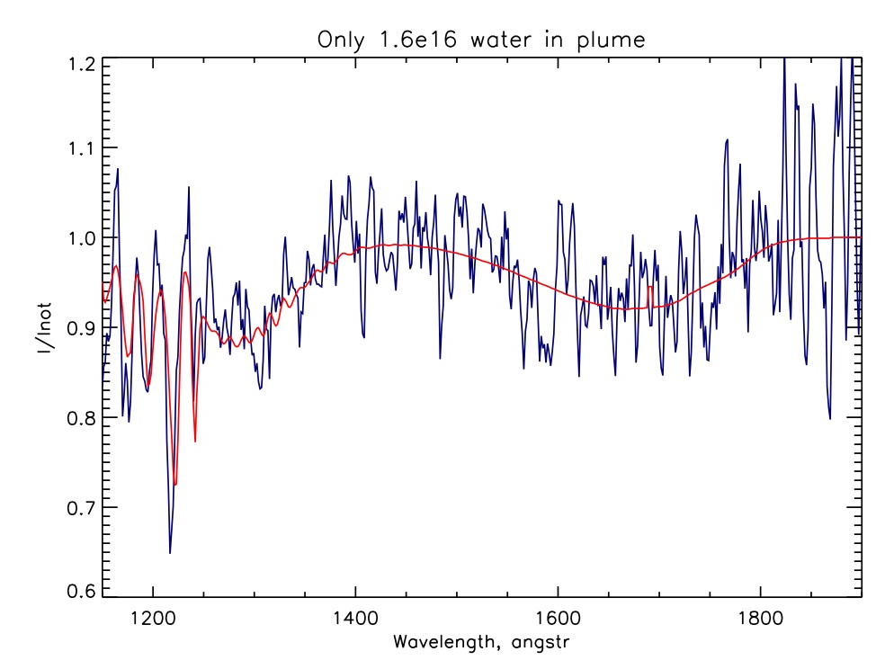
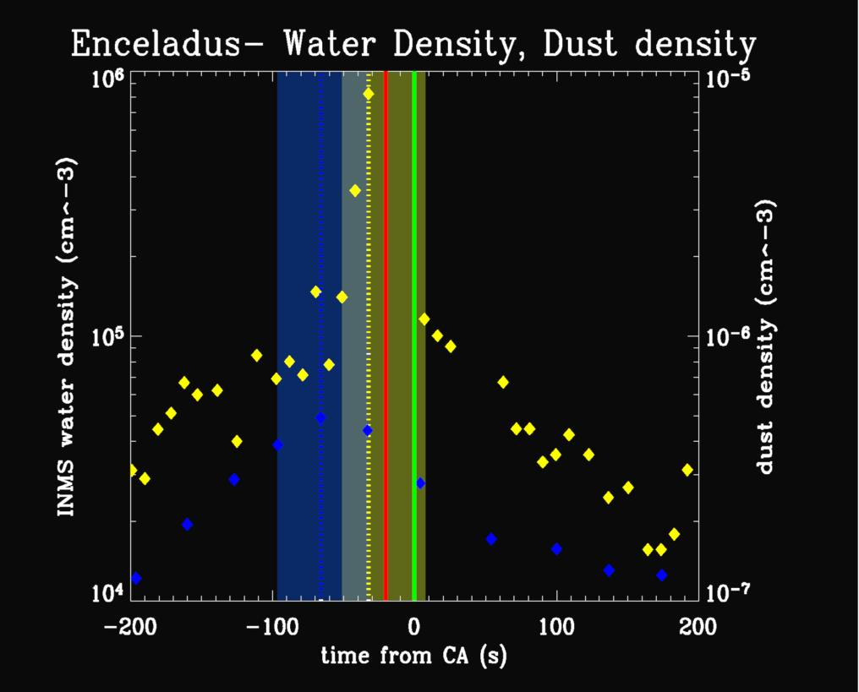
Cassini discovered: Enceladus is Geophysically Active
2005 Close Enceladus Flybys
February - The discovery of Enceladus’ plume influencing its environment
July – South polar hotspot, locally-confined water vapor moving away at escape velocity, ice particles

Slide 5
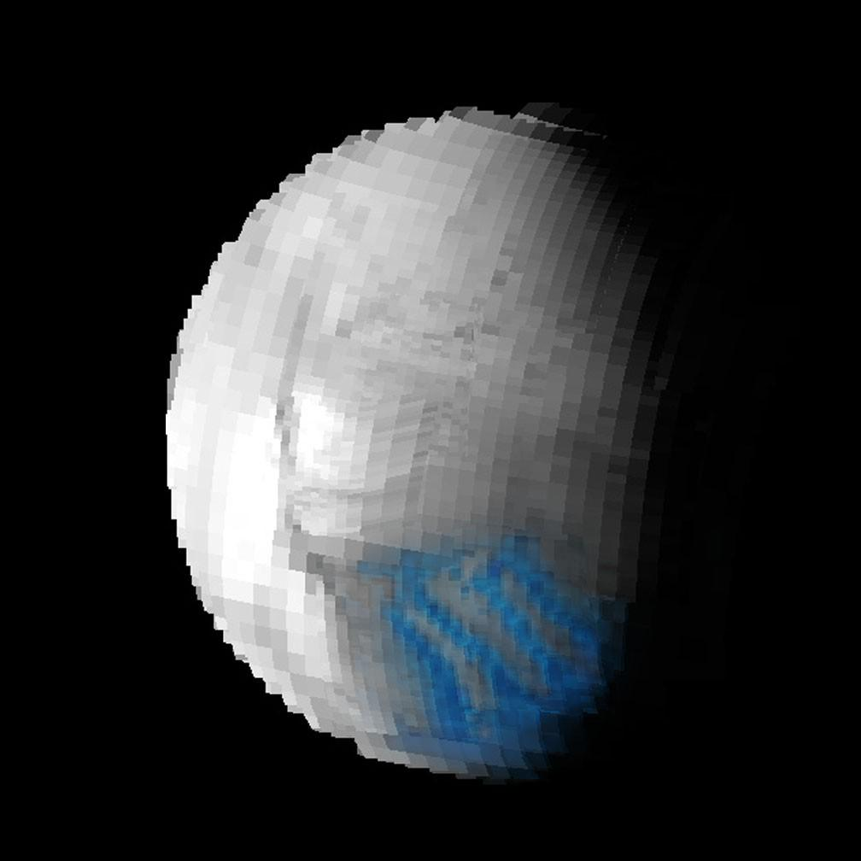
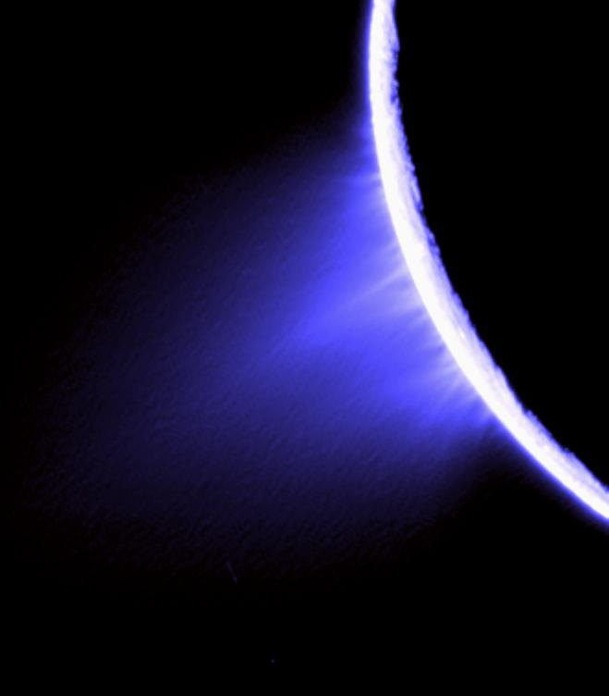
“Tiger Stripe” Fissures and
Ice Particle Jets
Alexandria, Cairo, Baghdad, and Damascus
  Water vapor and ice particles come from four fissures across the south pole
Porco et al., Science, 2006

Slide 6
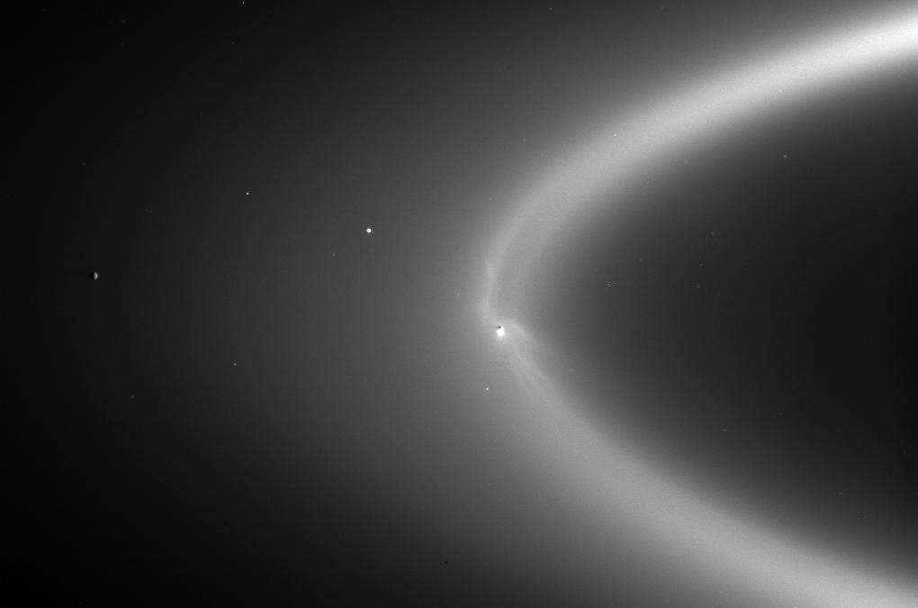
Questions answered? Check, check, check
  Is Enceladus the source of the E ring? YES
  Why is Enceladus’ surface geology so young? It is a geologically active body
Bonus Question: Where is the O and OH in the system coming from? The dissociation of the water molecules coming from Enceladus
Science Special Issue 311 (2006)

Slide 7
But that led to more Questions…
After the plume discovery, we asked about
The source
  Where is the gas coming from?
  Where are the particles coming from?
  Is there a body of liquid water inside Enceladus?
The location
  Why is the activity at the south pole and not the equator or also the north pole?
The energy
  Where is all this energy coming from? Is it tidal?

Slide 8
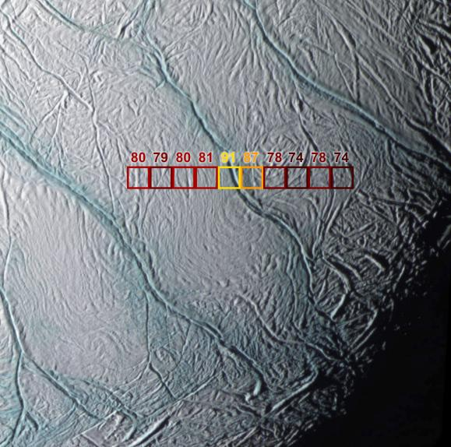
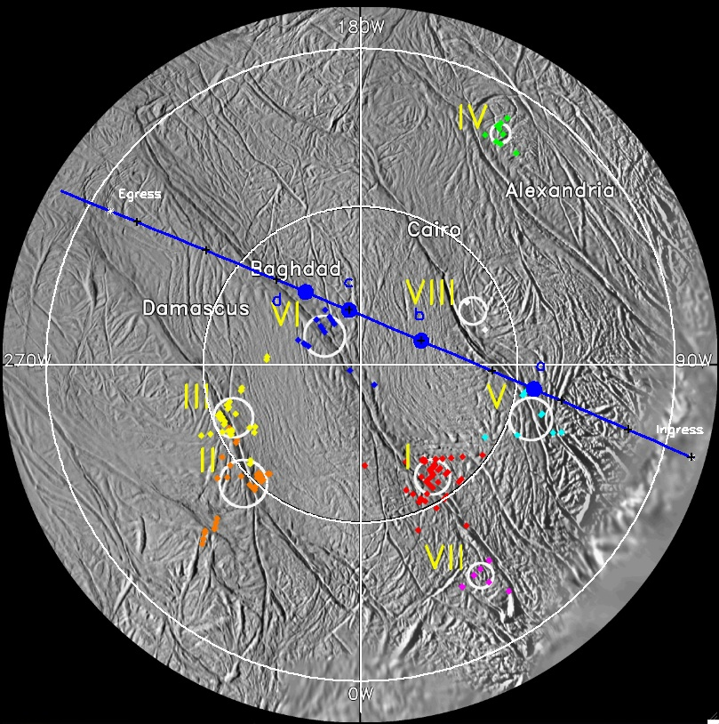
Where is the water coming from?
It quickly became obvious that the particles and gas were coming from the tiger stripe fissures
Localized heat [left], plume boundary
Particle jets coming from the tiger stripes and discovery of collimated gas jets [right]

Slide 9
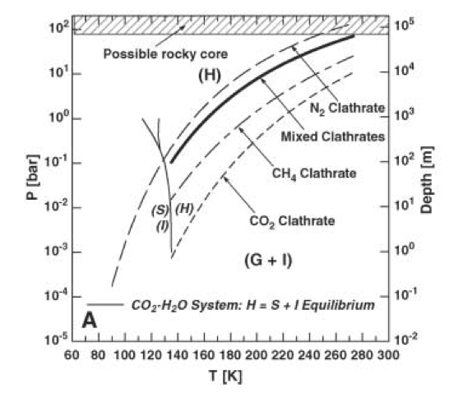
The Source Hypotheses
What is the source of the water vapor and ice particles?
Clathrate Reservoir Hypothesis
  Fractures cause degassing of a clathrate reservoir “Frigid Faithful”
  Fractures with melt entrain clathrates, then gas exsolves “Frothy Faithful”
Cosmic ray proton and magnetospheric electron bombardment production of surface oxidants which then cycle subsurface to react exothermically and then drive ice sublimation
A liquid water reservoir
  Low pressure, boiling “Cold Faithful”
  Localized heating vaporizes water
    Shear stresses
    Normal stresses
  A pressurized sub-surface ocean
Clathrate Hypothesis
Jumping to the answer…
H => hydrate, G+I => gas + ice
Notes:
2006, 2007

Slide 10
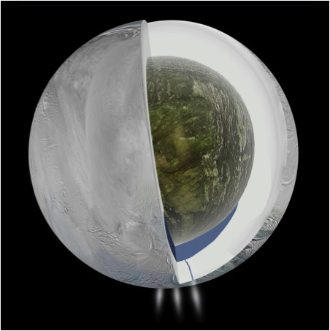
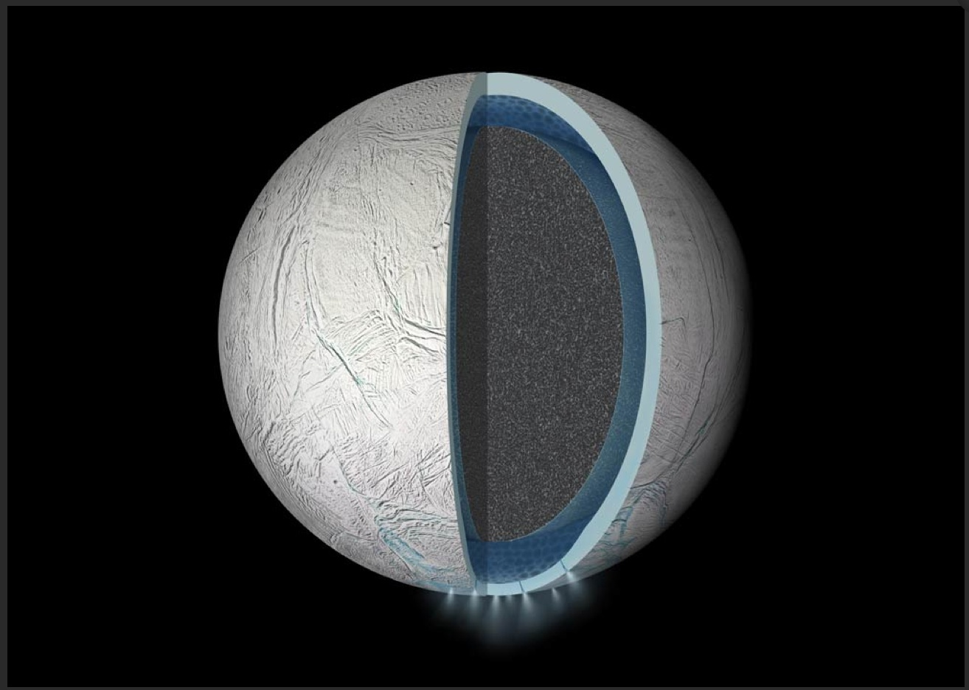
The Source Revealed
Answers:
Yes, there is a liquid body of water under the south pole
And it is global
Near the south pole it extends almost to the surface
Notes:
L. Iess et al, “The gravity field and interior structure of Enceladus”, Science (2014)

Slide 11
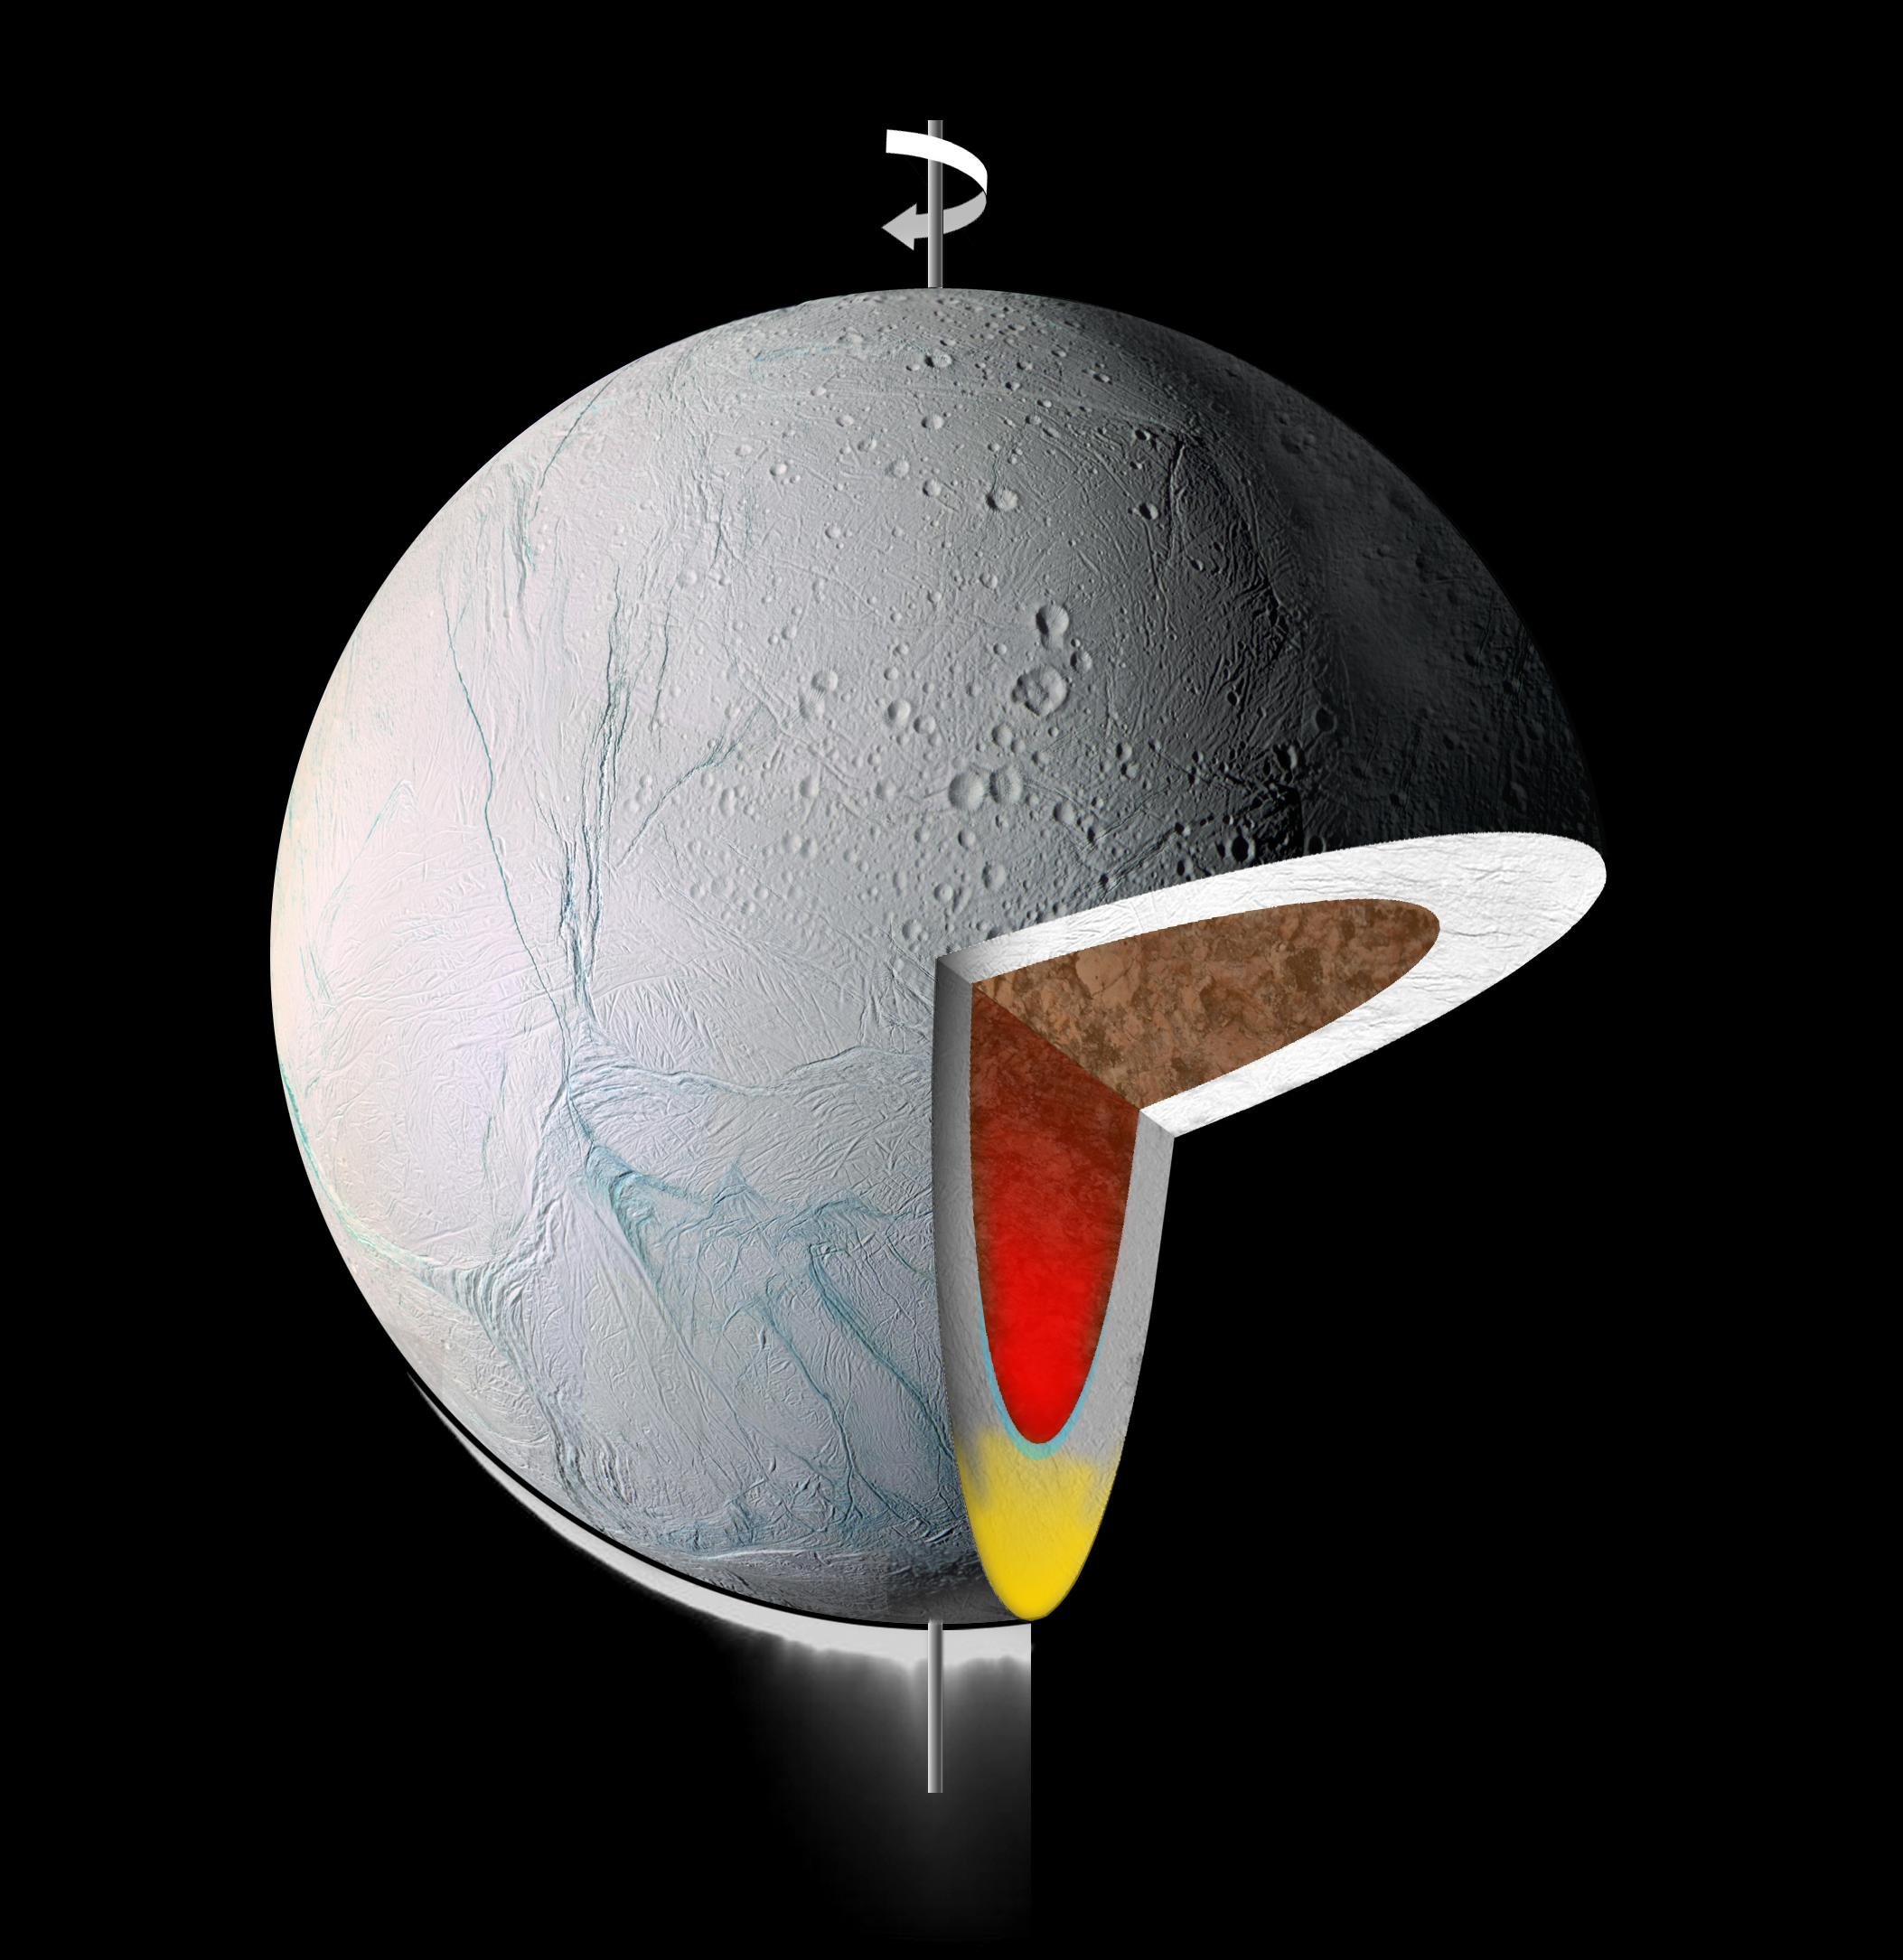
Why is the plume source sea at the south pole?
What is the geologic / tectonic history of Enceladus?
With a localized sea at the south pole
A density / gravity anomaly could cause re-orientation of Enceladus to put hot spot at south pole
OR other ideas:
Heterogeneous interior with low viscosity zone?
Was there a large impact?

Slide 12
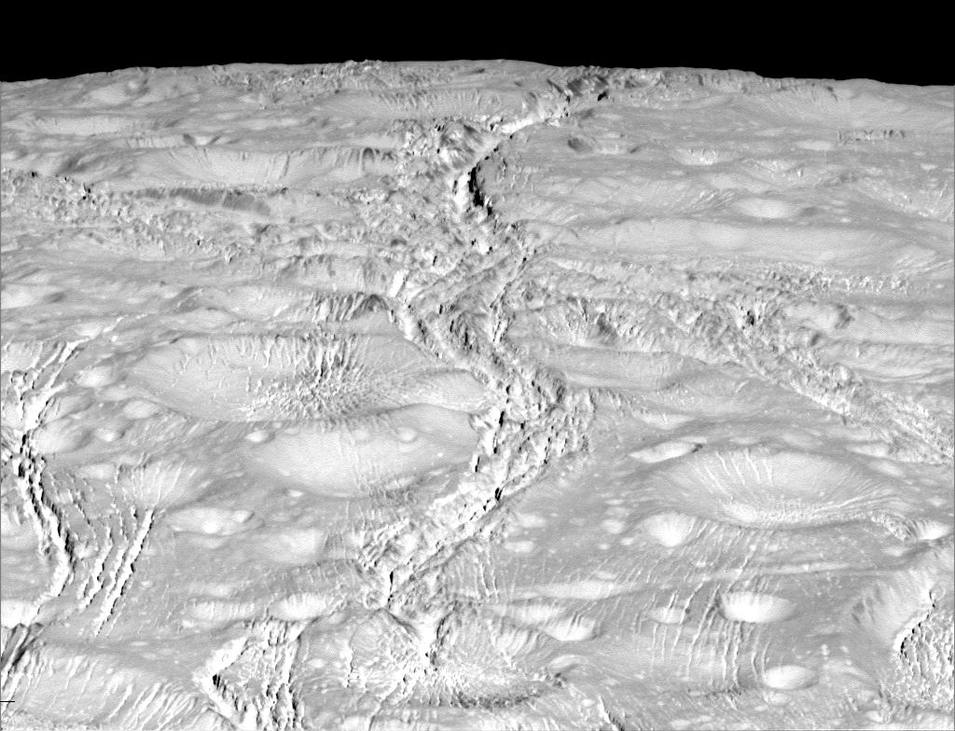
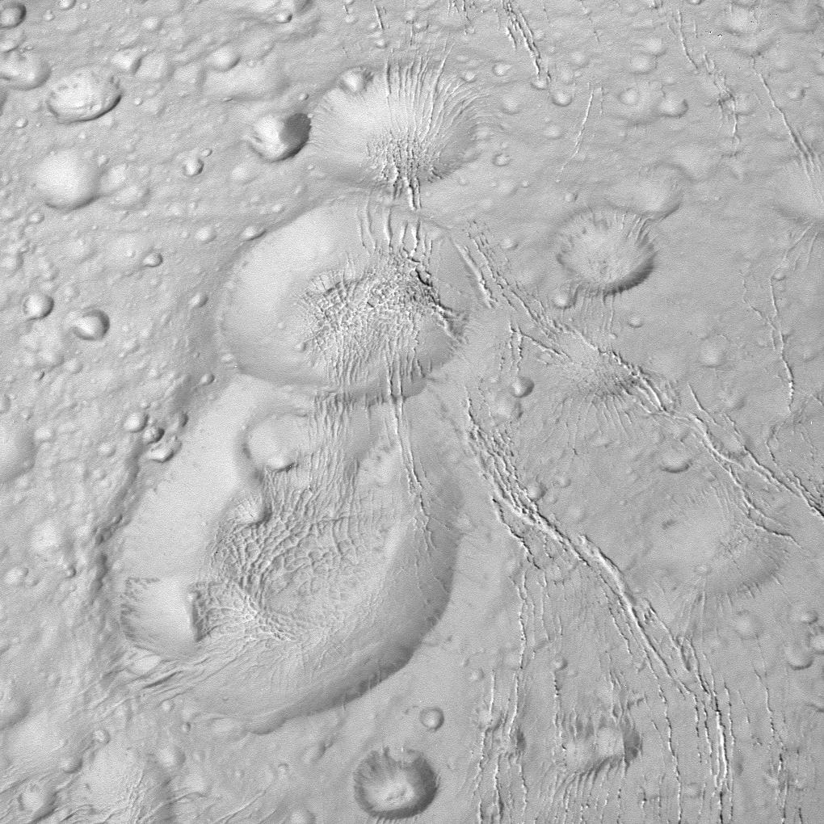
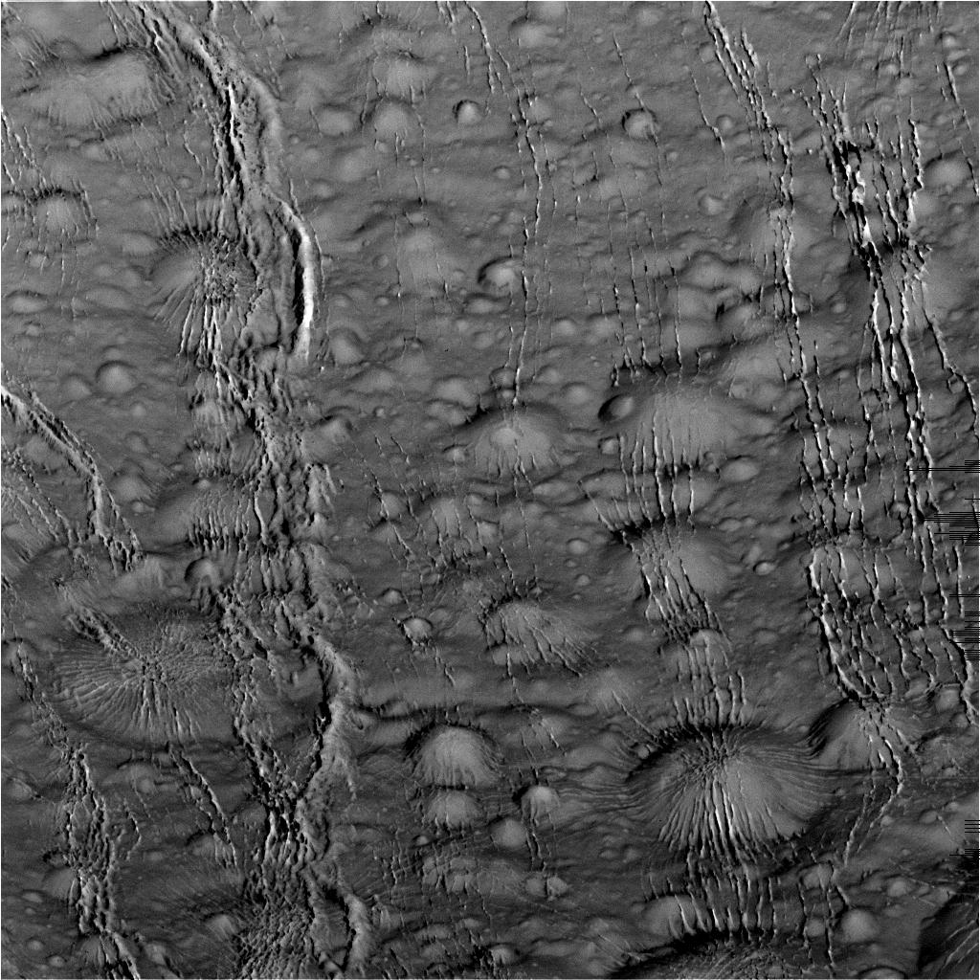
Why the localized heat at the south pole? Why not the north pole?
If the energy source is tidal shouldn’t we see plumes on both poles? But we don’t…
What is the geological history of the north polar region? Why does it look so different?
What is the tectonic history of Enceladus?

Slide 13
Energy Source
What is going on inside Enceladus / what is driving the plume activity? In 2006 we were looking for a source for ~6 GW of energy to provide the heat emanating from the south polar region
Is it a manifestation of tidal energy?
  Initial answer was no, equilibrium tidal heating = 0.12 GW, or, even considering past resonances, still < 1 GW
Where else could all the heat be coming from?
  Radiogenic heating today from a core is only ~0.1 GW
  Early short-lived heating from decay of ²⁶Al and ⁶⁰Fe could have melted interior, then liquid maintained by tidal heating
  Liquid state maintained by presence of NH₃ “antifreeze”
  Libration

Slide 14
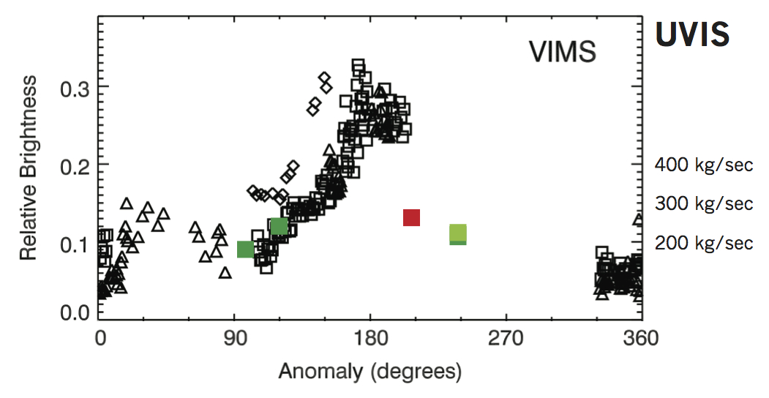
Energy
Tidal energy validated
Tidal energy will vary depending on where Enceladus is in its orbit (how close or far Enceladus is from Saturn) – other sources of energy don’t behave that way
  VIMS and ISS data show particle flux that is a function of Enceladus’ orbital longitude
But there still is a question of how it works

Slide 15

Tidal Energy Models
Normal stress model predicts tidally-controlled differences in eruption activity depending on where Enceladus is in its eccentric orbit
  Expect fissures to open and close (inconsistent with UVIS data)
Shear stress model also predicts tidally-controlled differences in eruption activity as a function of where Enceladus is in its eccentric orbit
  Expect strike-slip faulting
A later model combines the two and requires that conditions for shear failure be met for movement to occur
Careful analysis of years of images of the ice jets shows that the most likely culprit is normal stress but fractures do not open and close all the way

Slide 16
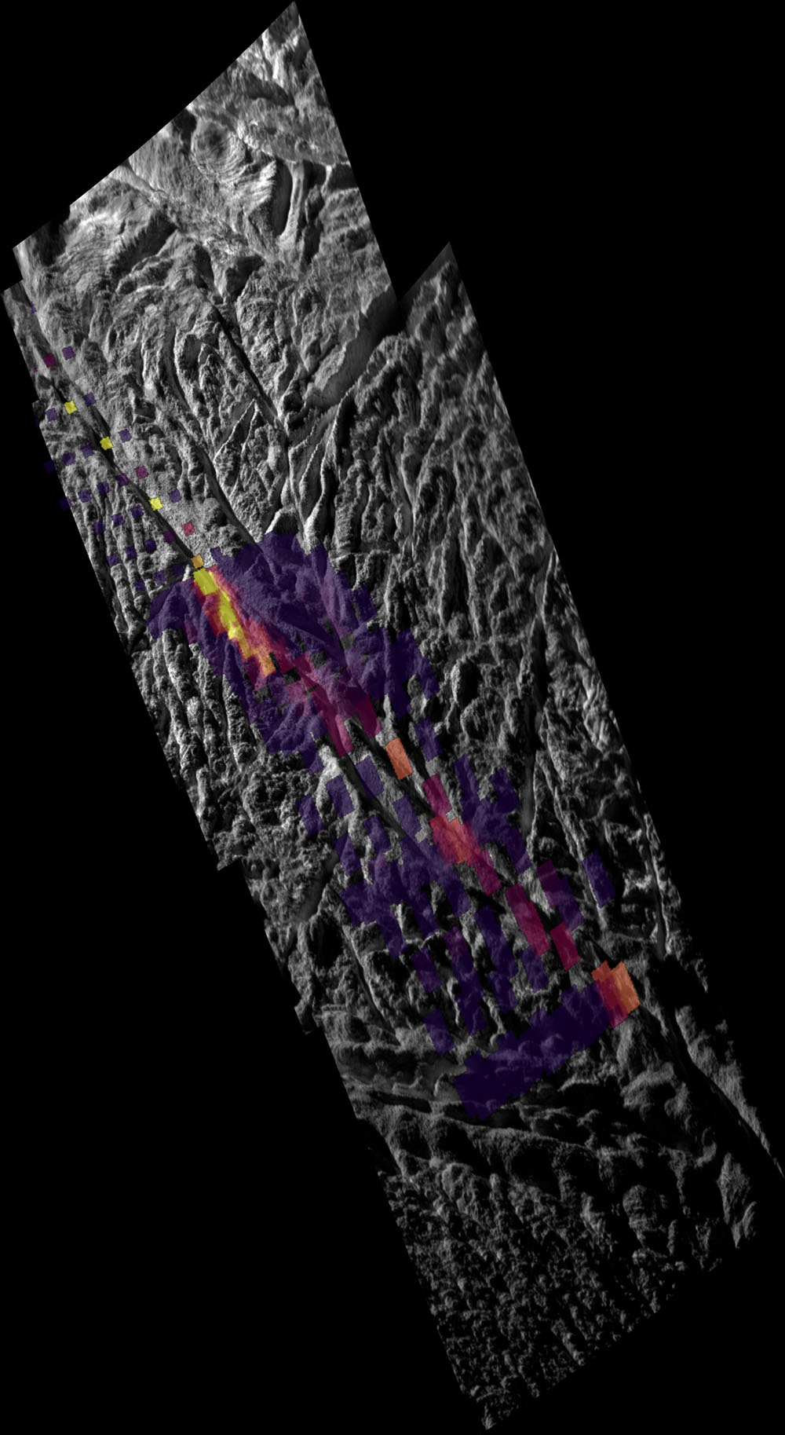
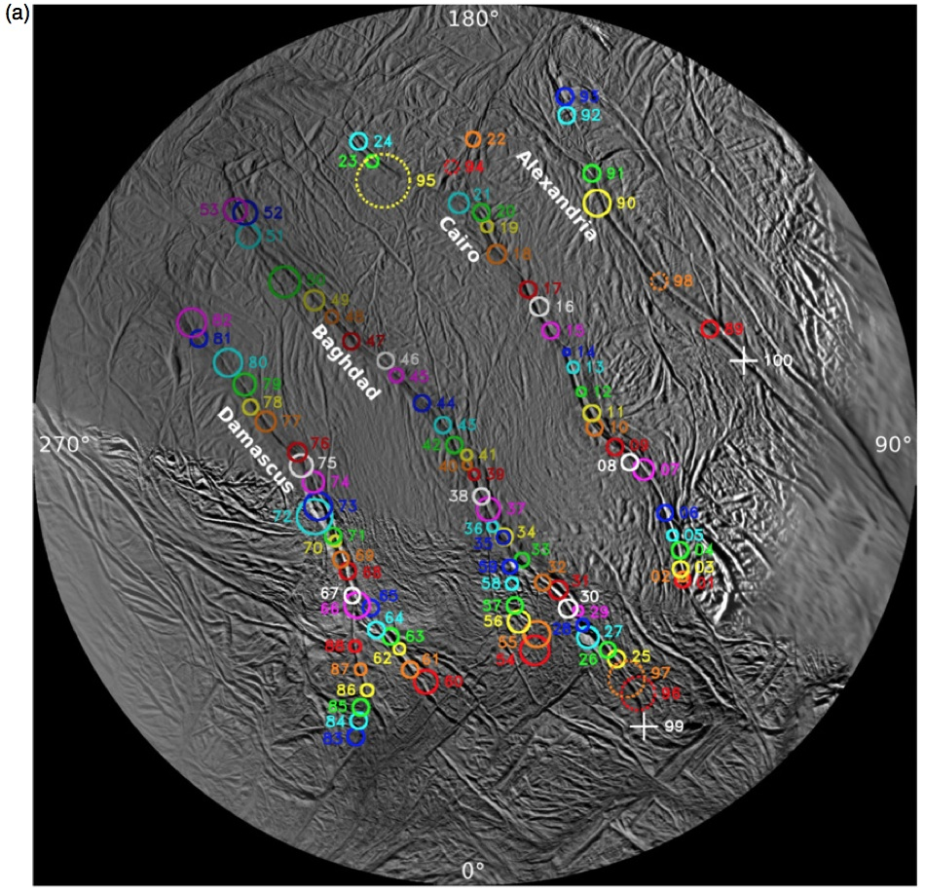
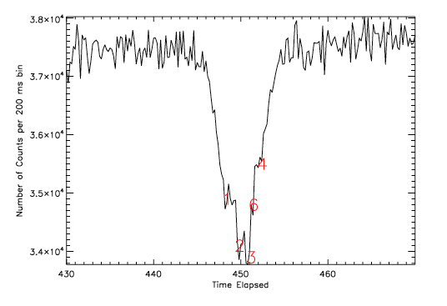
The Plumbing
We now know there are ~100 ice jets
Coming from openings just 9m wide
Hot spots discretely spaced along the tiger stripes
Supersonic gas jets with velocity > mach 6

Slide 17
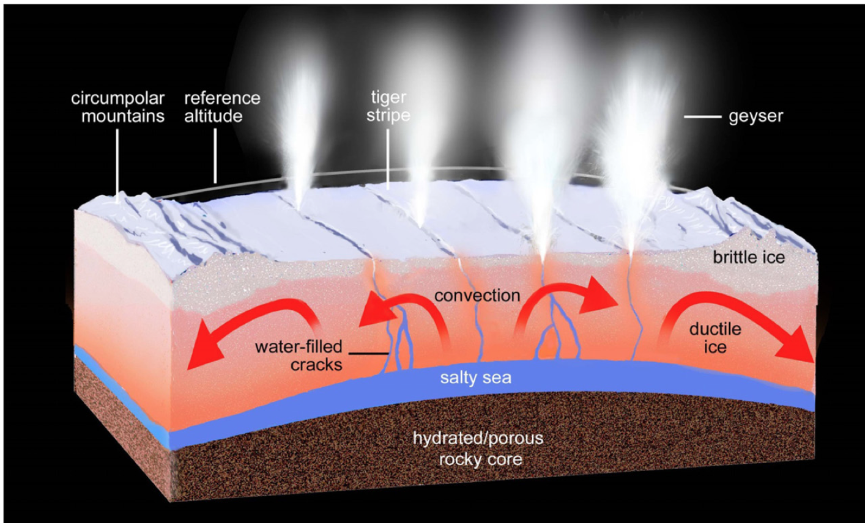
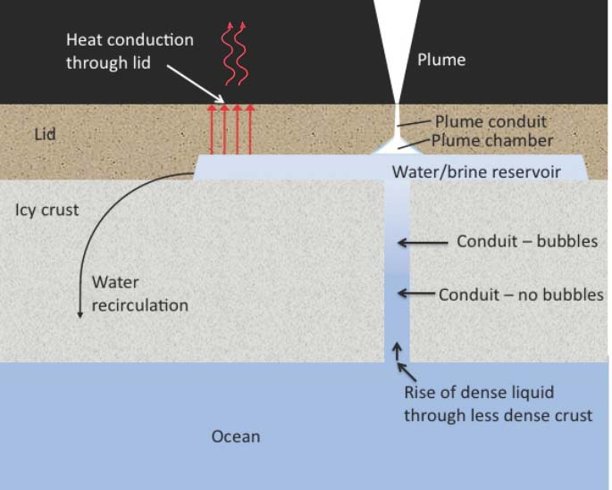
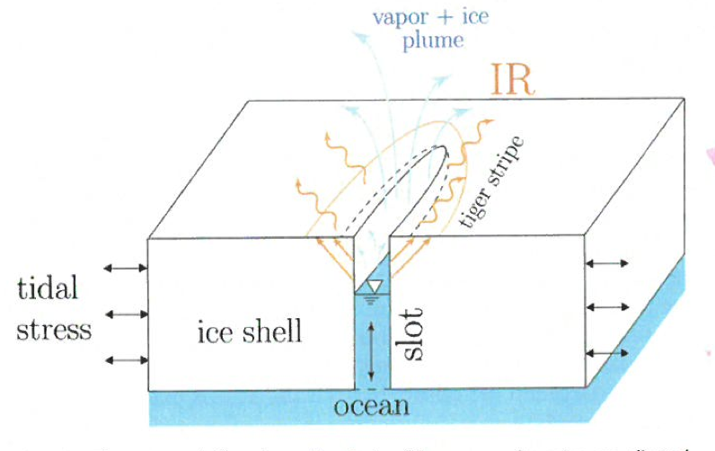
What is happening below the surface?
We can only see the products – must model what is below the surface
What is different at apokrone?
  Nozzle structure?
  Temperature?
  Dissolved gas?
Heat conduction through ductile ice
Slots sloshing, water can’t freeze
Perrier ocean – gas coming out of solution
Notes:
Add Kite and Rubin here

Slide 18

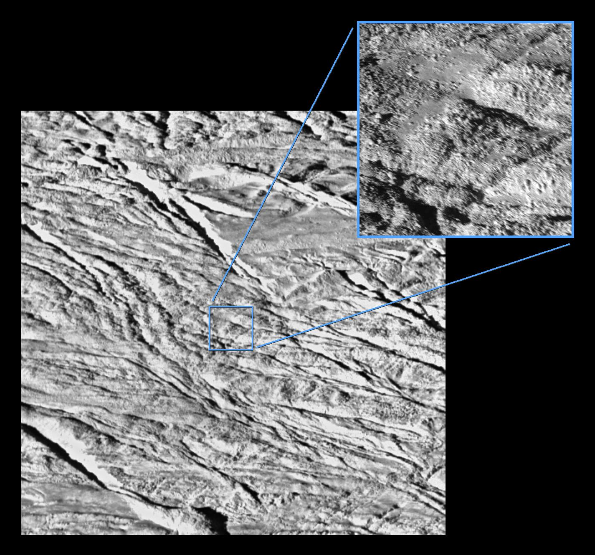
Temporal Variability
What is the long-term variability of Enceladus’ geologic activity?
  Is it controlled by the ~decadal eccentricity cycle?
  Are there giant outbursts that toss out large blocks of ice?
  Occasional large puffs?
    Oxygen in the system on approach
    INMS water vapor measurement at E5

Slide 19
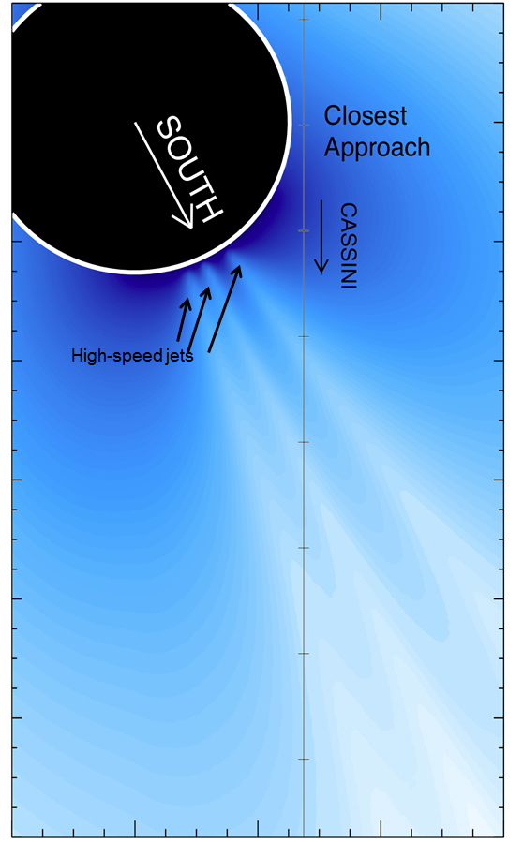
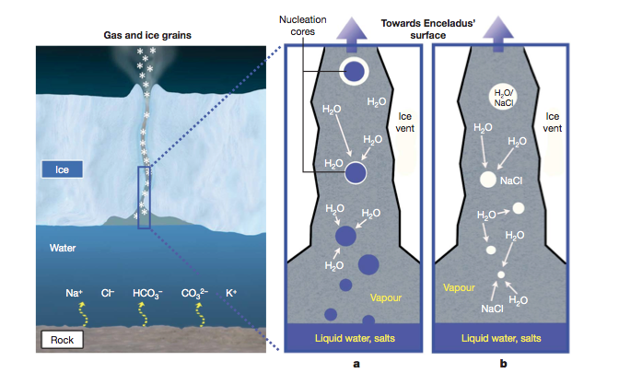
The Inside of Enceladus on the Outside – Plume Composition & Plume Fallout
What is the composition of the plume?
Mostly everything is water, but the minor constituents are very interesting!
CDA: Salty NaCl, NaHCO₃, Na₂CO₃ particles
  Small salt-poor grains in the E ring, salt-rich particles in Enceladus’ diffuse plume
VIMS: CO₂ ice
INMS: Organics

Slide 20
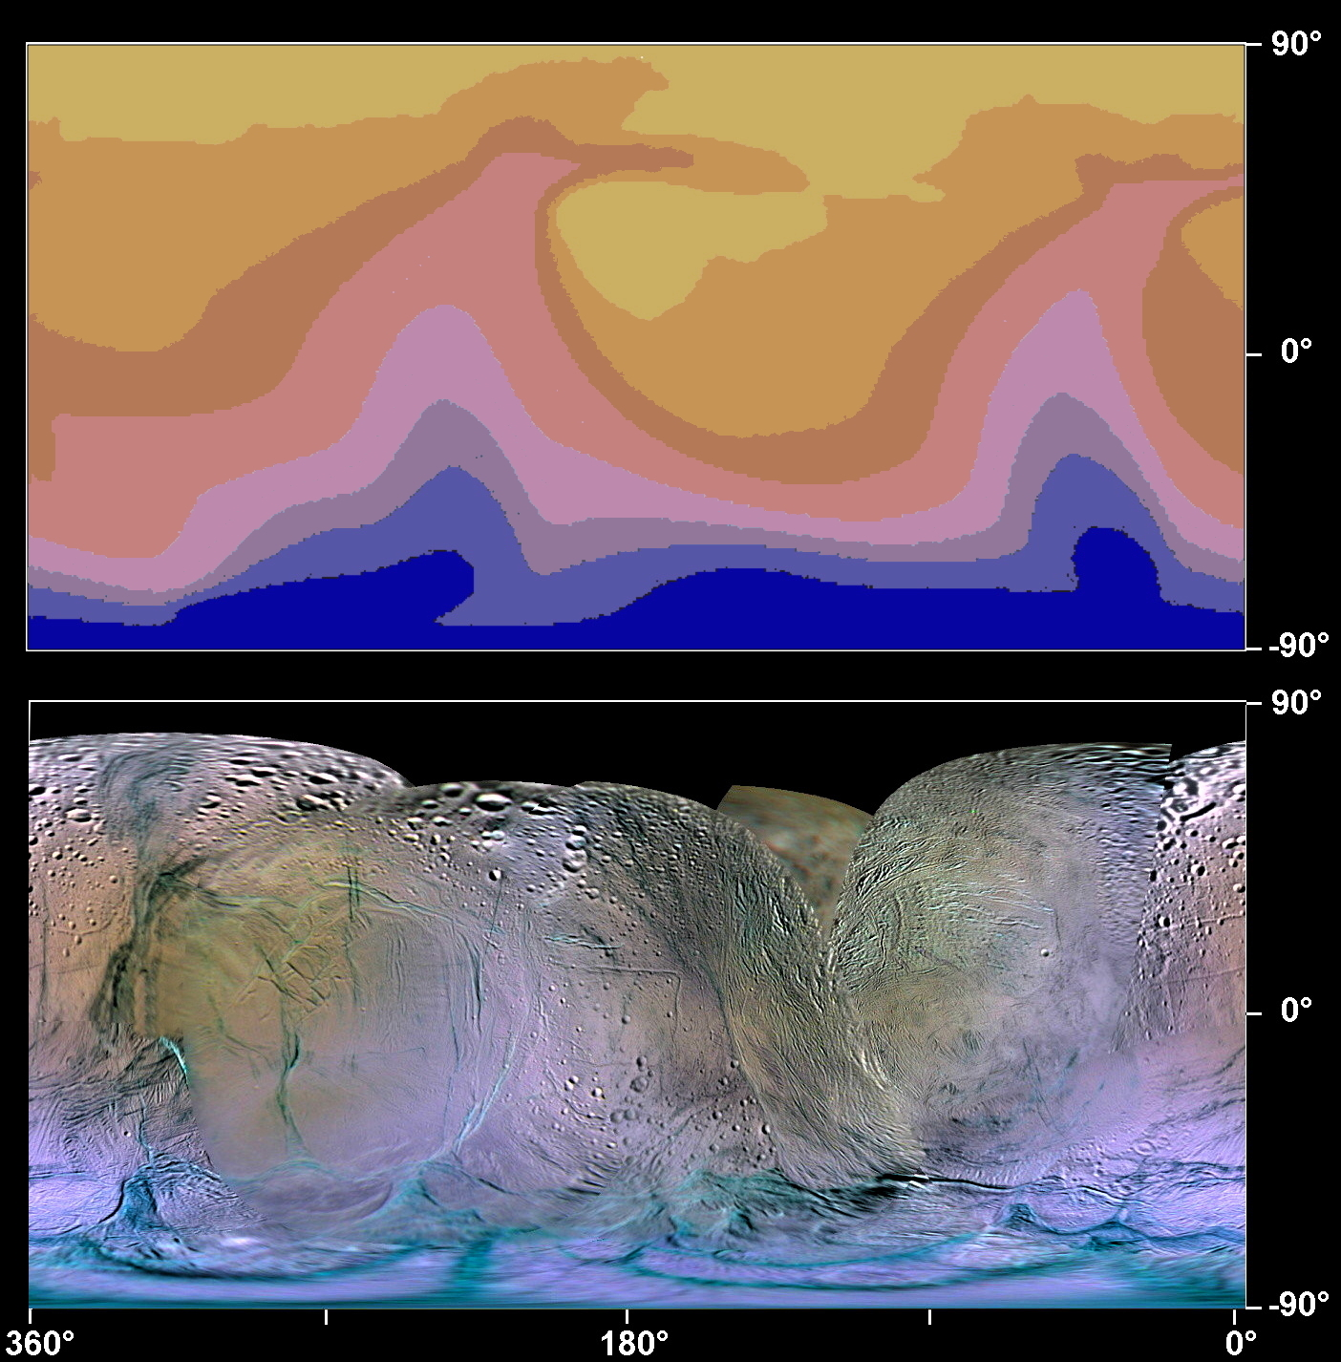
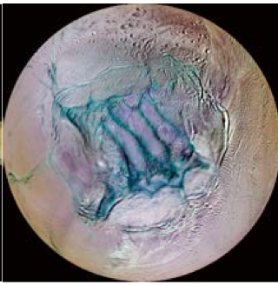
The Inside of Enceladus on the Outside – Plume Composition & Plume Fallout
Some plume particles are propelled to escape velocity and form the E ring
Most fall back to the surface in a distinctive, detectable pattern in color maps
VIMS detects CO₂ ice concentrated in the south polar region
IR3-G-UV3 at phase 10 - 40
Notes:
P. Schenk, LPSC, 2014

Slide 21
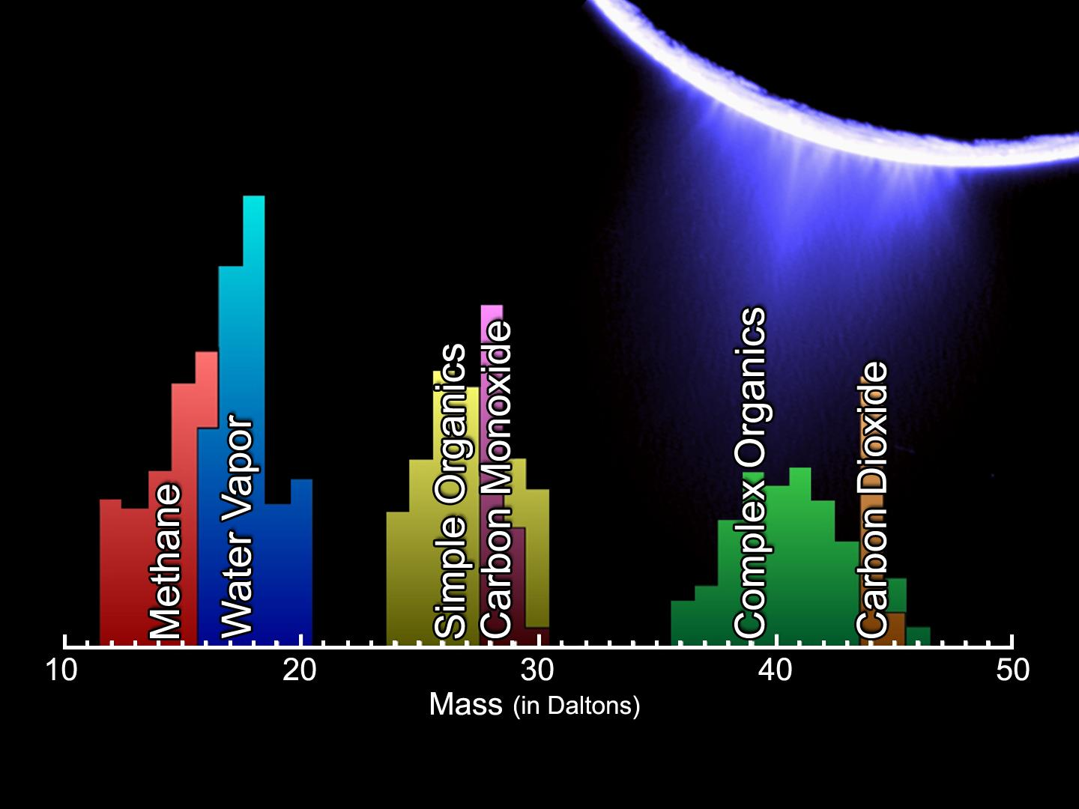
The Inside of Enceladus on the Outside – Plume Composition
Vapor Composition
UVIS: primarily water
  Also C₂H₄ (solving the 28 amu mystery)
INMS: >90% H₂O
Trace species include:
  ~1% each
    CO₂
    NH₃
    CH₄
  C2 group < 0.5%
  C3 group < 0.01%
New INMS result: H₂

Slide 22
Is Enceladus’ Internal Salty Sea Habitable?
Habitability wish list:
Liquid water - check
Organics - check
Are there hydrothermal vents at the bottom of Enceladus’ sea?
  These could supply minerals and other nutrients
What is the geochemistry of the water?
  What is the pH?
Does serpentinization provide H₂, chemical energy life could take advantage of?
Notes:
Redox energy

Slide 23
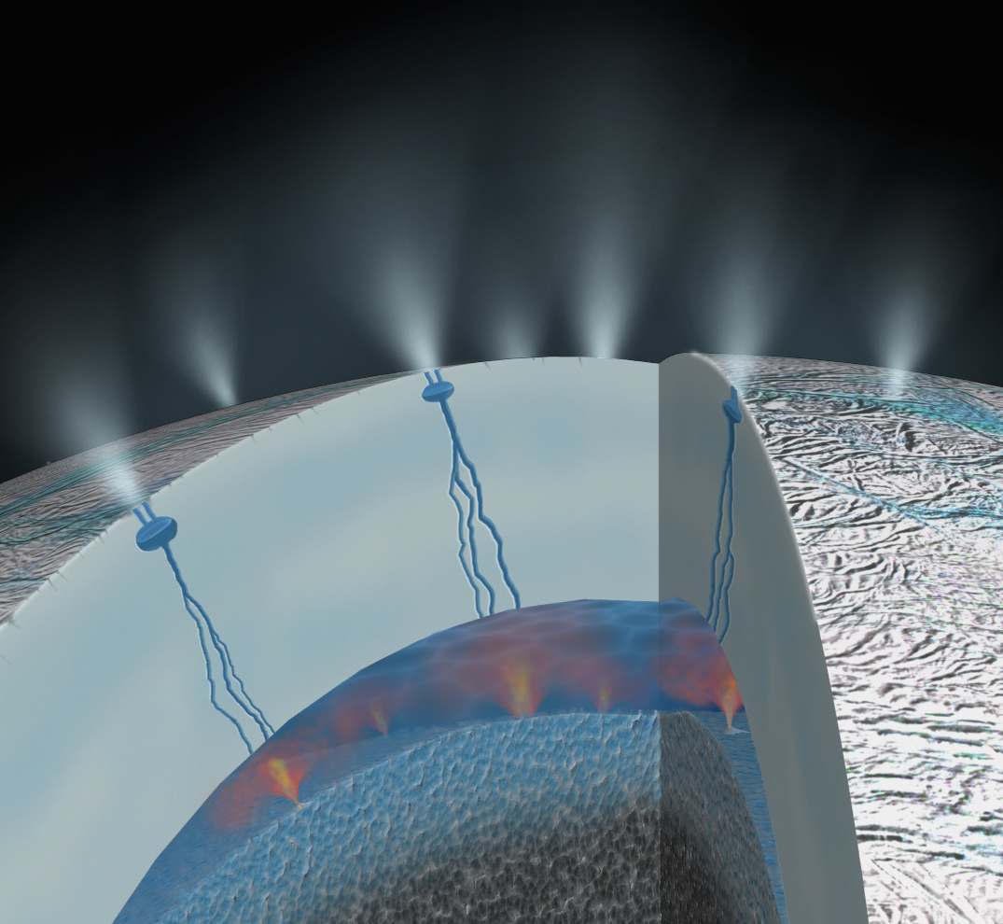
Are there hydrothermal vents?
Hydrothermal activity occurs when seawater infiltrates and reacts with a rocky core, emerging as a heated, mineral-laden liquid
Silica nanoparticles were captured by Cassini’s cosmic dust analyzer. Analysis revealed these particles came from Enceladus’ seafloor
Laboratory experiments indicate that these dust particles must have formed on the seafloor at temperatures above 90°C (194°F). This is a much hotter environment than scientists thought existed inside the icy moon, suggesting that seafloor hydrothermal activity is occurring
There is a strong possibility that hot water rises from seafloor vents on Enceladus. This raises the potential for habitable environments beneath the ice crust of this small, active moon.
This result shows that Enceladus’ plume activity is an eruptive process that begins in its core and is not limited to the near-surface
The new finding opens the possibility for prebiotic or even biotic chemical mixtures to “slow-cook” inside Saturn’s moon Enceladus, where the ocean meets hot rock
  Similar activity is observed around mid-Atlantic seafloor vents, where some extreme life forms reside

Slide 24
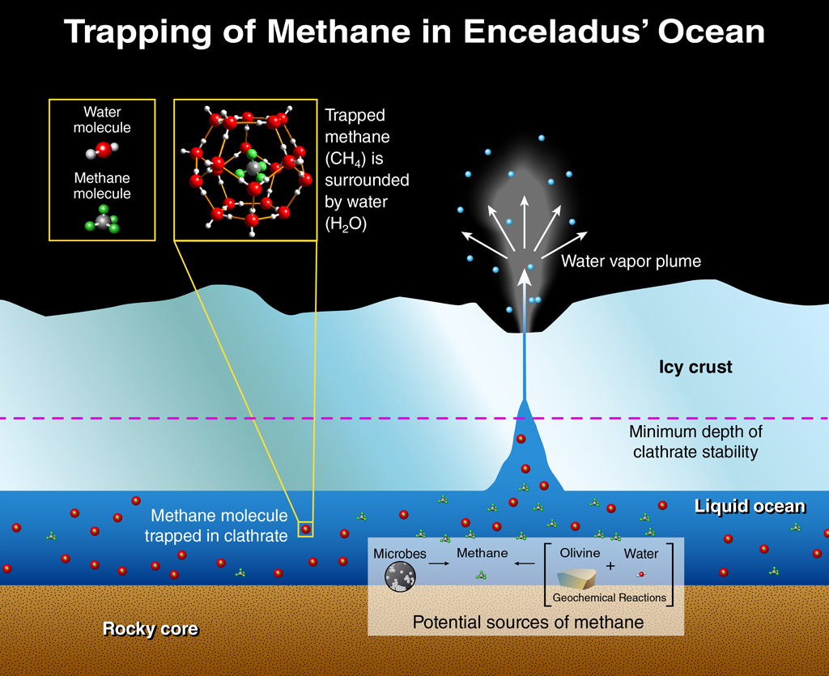
Are there hydrothermal vents (cont.)?
The presence of methane in the plume provides evidence of active seafloor hydrothermal vents, where seawater and the rocky core meet to form warm mineral-laden liquid
Ocean models show that methane molecules will be trapped in ice “cages”, called clathrates. So methane should not be abundant in the plumes – unless some source is rapidly adding methane in the ocean, faster than it is trapped into clathrates.
Chemical reactions near warm hydrothermal vents are the most likely candidate for producing additional methane.

Slide 25
Is Enceladus’ Internal Salty Sea Habitable?
Habitability wish list
Liquid water - check
Organics - check
Are there hydrothermal vents at the bottom of Enceladus’ sea?
  These could supply minerals and other nutrients
  Very likely, based on CDA detection of silica nano-particles
What is the geochemistry of the water?
  What is the pH? 8-10 (CDA); 11-12 (Glein et al., 2015)
  Methane in plume is not in equilibrium
  H₂ in plume provides evidence for water-rock interaction
Does the water-rock interaction provide H₂, chemical energy that life could take advantage of? H₂ has been detected, favoring production of CH₄ from CO₂:
  CO₂(aq) + 4H₂(aq) -> CH₄(aq) + 2H₂O
Enough “yes”s to ask…
Notes:
Redox energy

Slide 26
The Biggest Question of All
Is there life inside Enceladus?
We need to sample the plume (with the right set of instruments)

