Slide 1
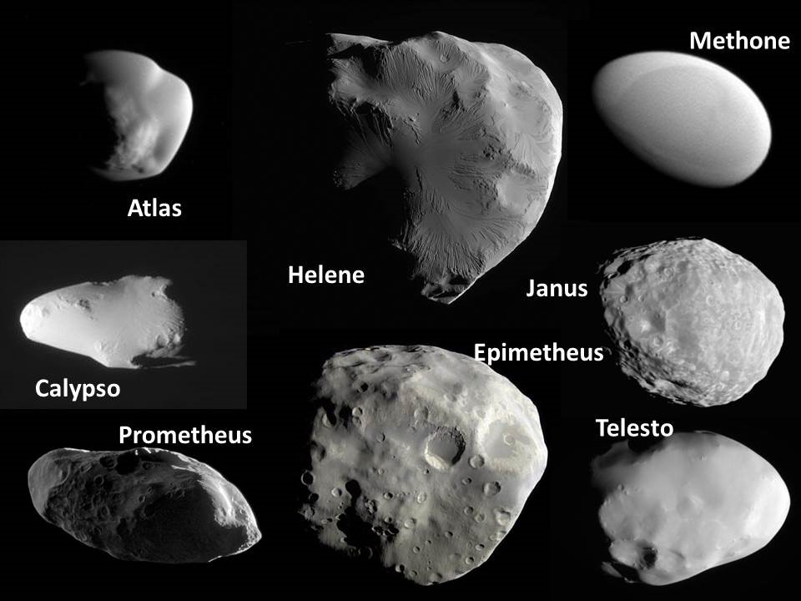
Atlas
Helene
Methone

Slide 2
Five Fabulous Flybys (Best ever!)
Atlas
Helene
Methone
Object | Date | Closest approach (km)
Pandora | 18 Dec 2016 | 20,000; closest by almost a factor of 3
Daphnis | 16 Jan 2017 | 17,600; closest by over an order of magnitude
Epimetheus | 30 Jan 2017 | 5900; closest by factor of 6
Pan | 7 March 2017 | 25,350; closest by a factor of 2
Atlas | 12 April 2017 | 13,170; Closest by factor of 2

Slide 3
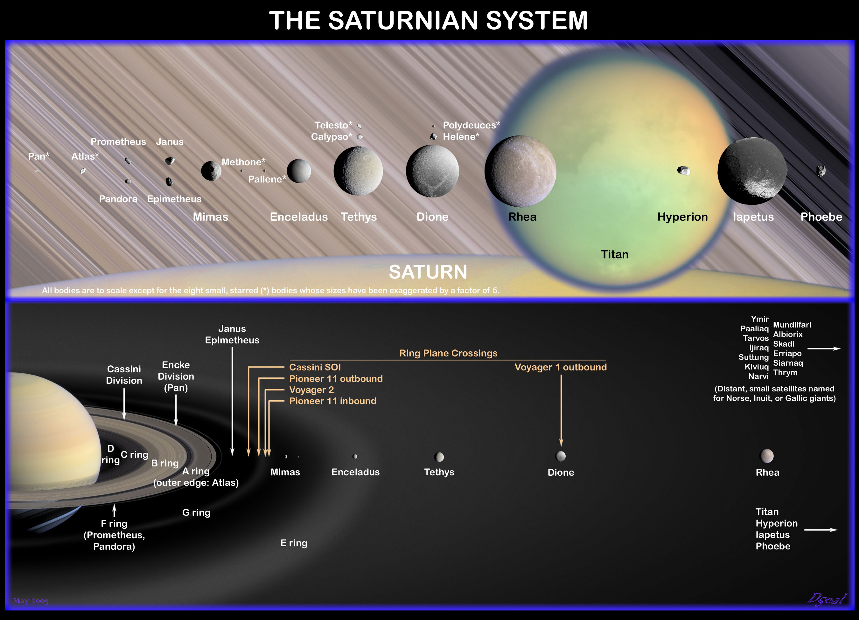

Slide 4
Pandora (F ring shepherd)

Slide 5
Daphnis (in Keeler gap)
Pandora (F ring shepherd)

Slide 6
Daphnis (in Keeler gap)
Epimetheus (A ring shepherd)
Pandora (F ring shepherd)

Slide 7
Daphnis (in Keeler gap)
Epimetheus (A ring shepherd)
Pandora (F ring shepherd)

Slide 8
Daphnis (in Keeler gap)
Epimetheus (A ring shepherd)
Pandora (F ring shepherd)

Slide 9
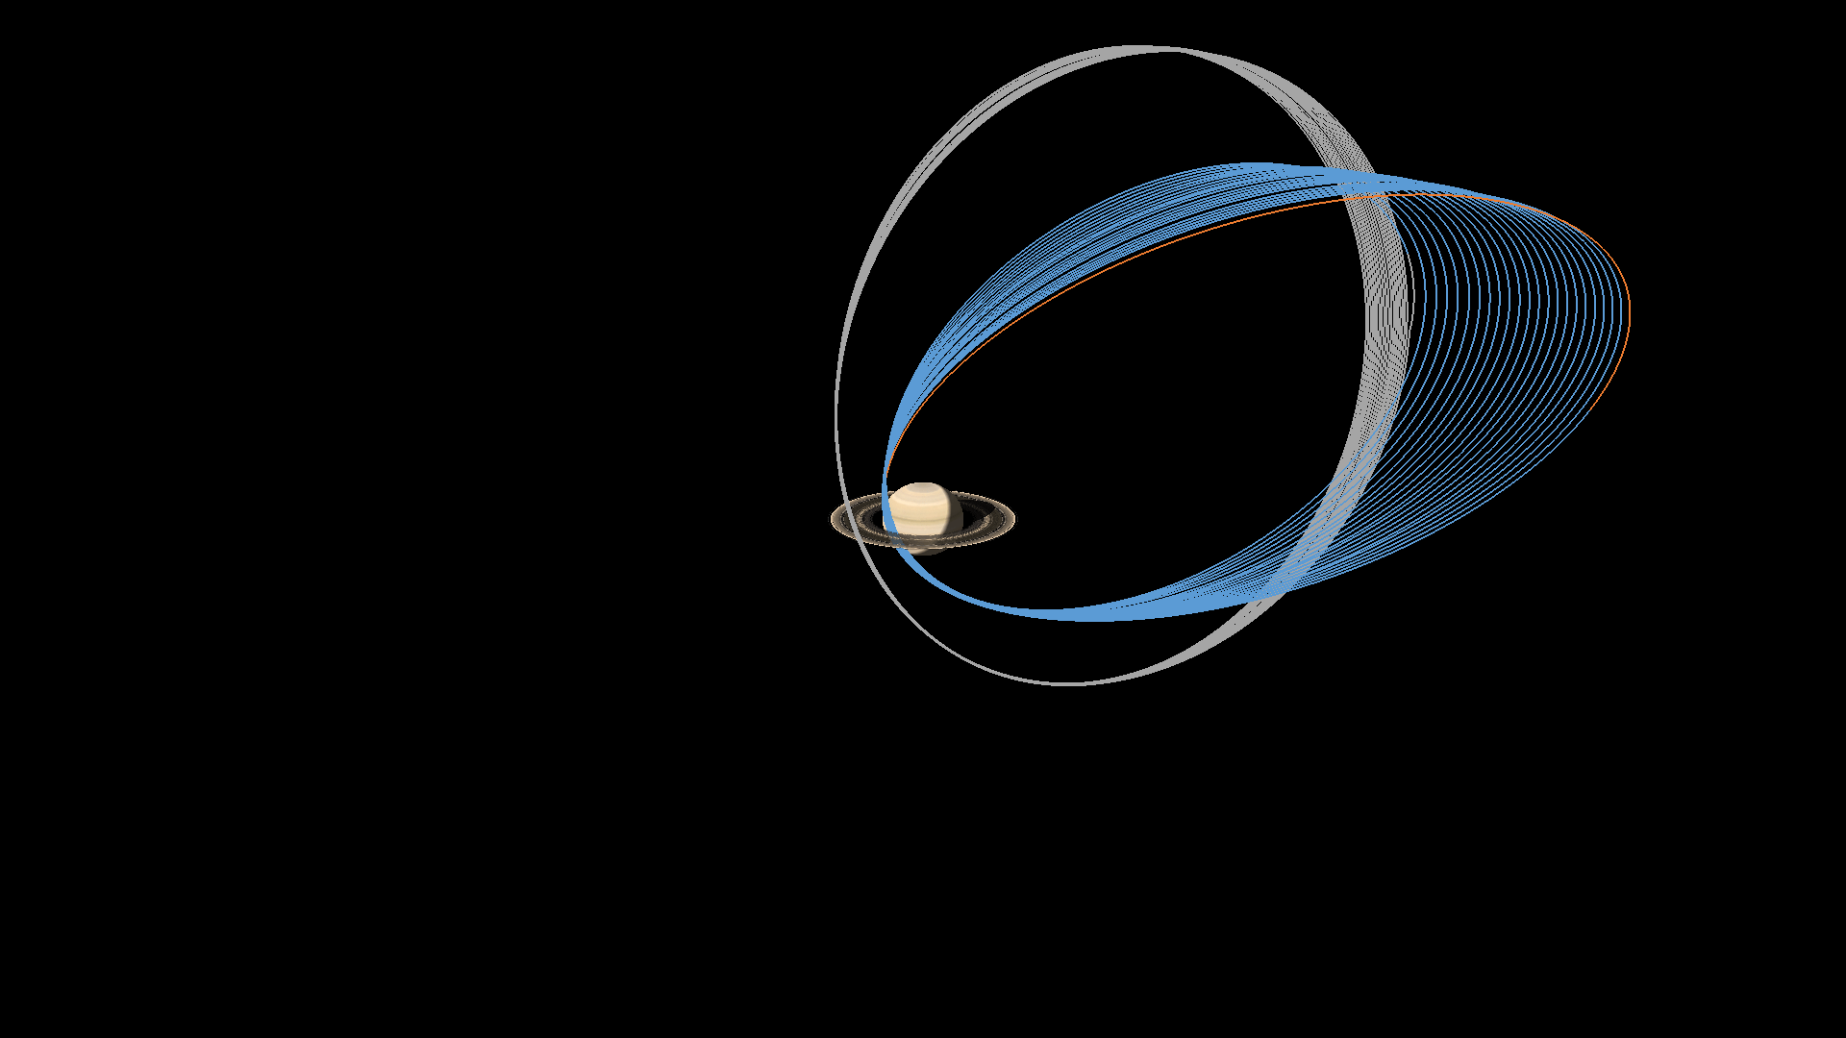
REV 253: Pandora (first views of northern hemisphere)
REV 257: Best-ever view of Daphnis
REV 259: Last view of Epimetheus
REV 264: Best-ever images of Pan
REV 269: Last and best views of Atlas

Slide 10
Some of Cassini’s best views of these moons prior to the fabulous 5…

Slide 11
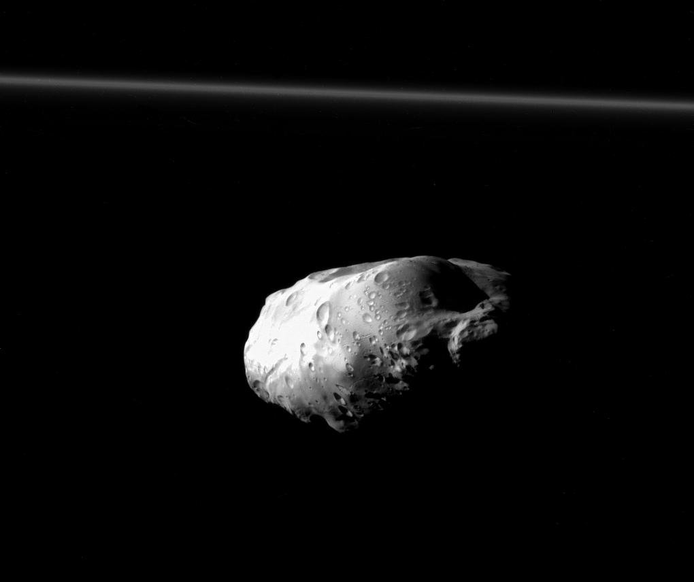
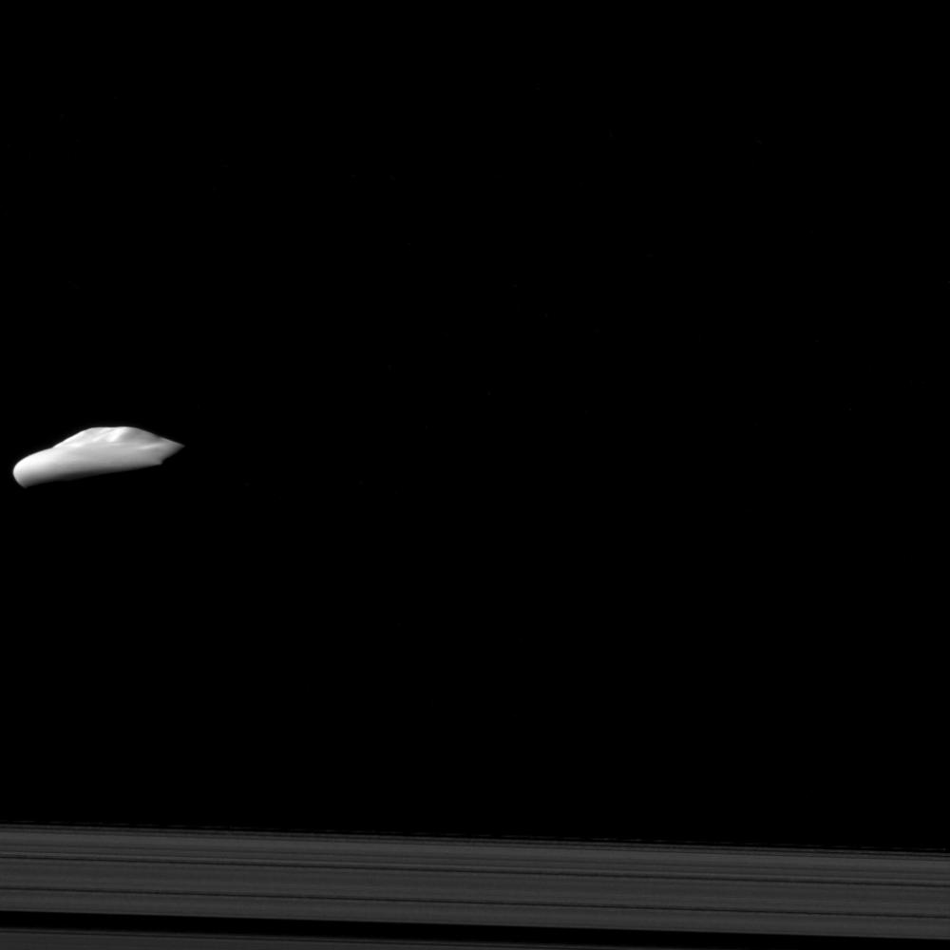
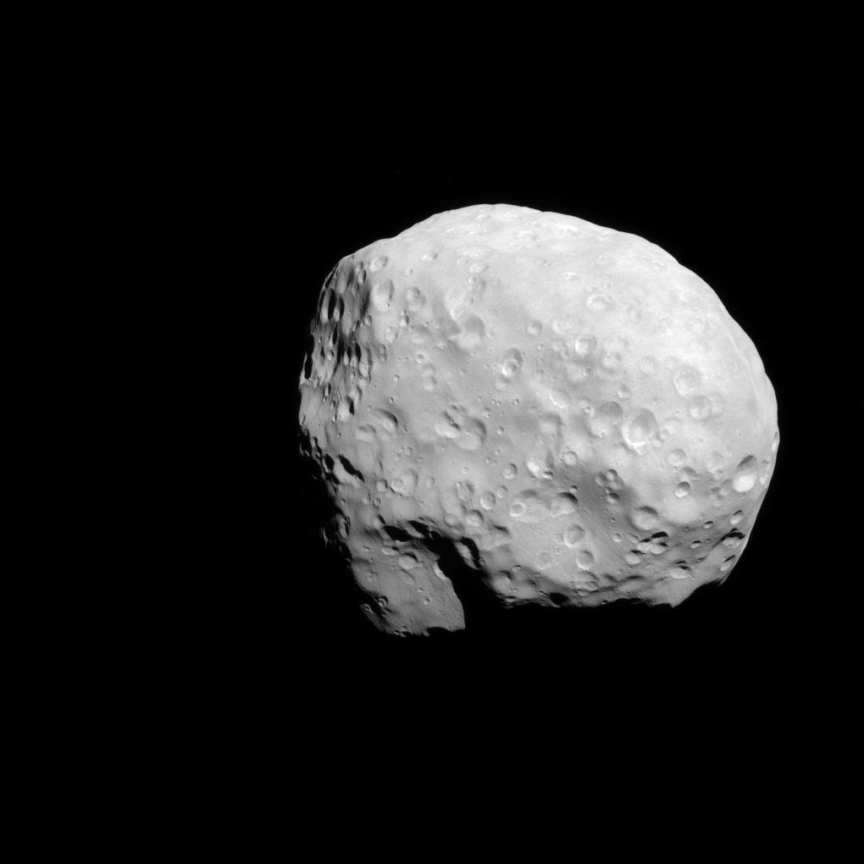
Dec. 6, 2015
Atlas: 30 km; 32,000 km
Epimetheus: 86 km; 35,000 km
Prometheus: 86 km wide; 37,000 km away
Notes:
From Bonnie

Slide 12
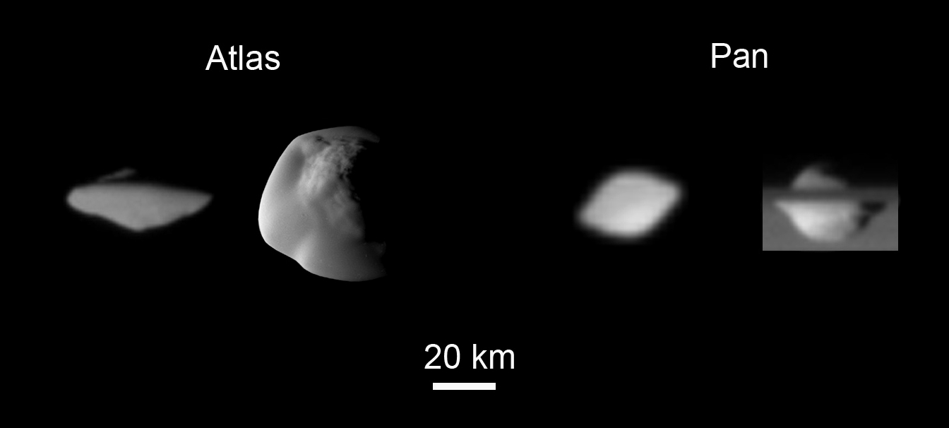

Slide 13
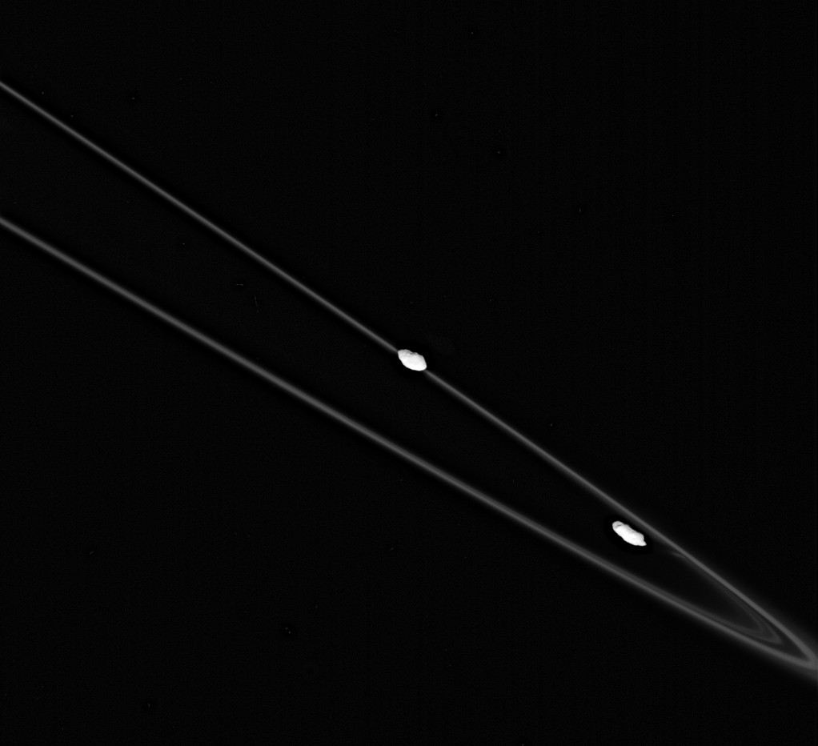
Prometheus and Pandora

Slide 14
Daphnis approaching equinox

Slide 15
Pandora, Nov 2005

Slide 16
#1 Pandora 18 Dec 2016

Slide 17
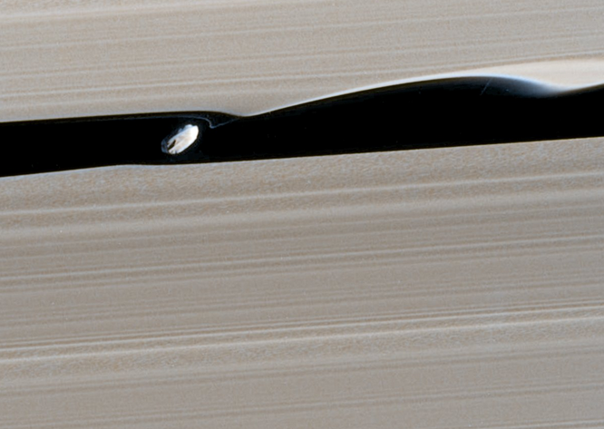
#2 Daphnis 16 January 2017

Slide 18
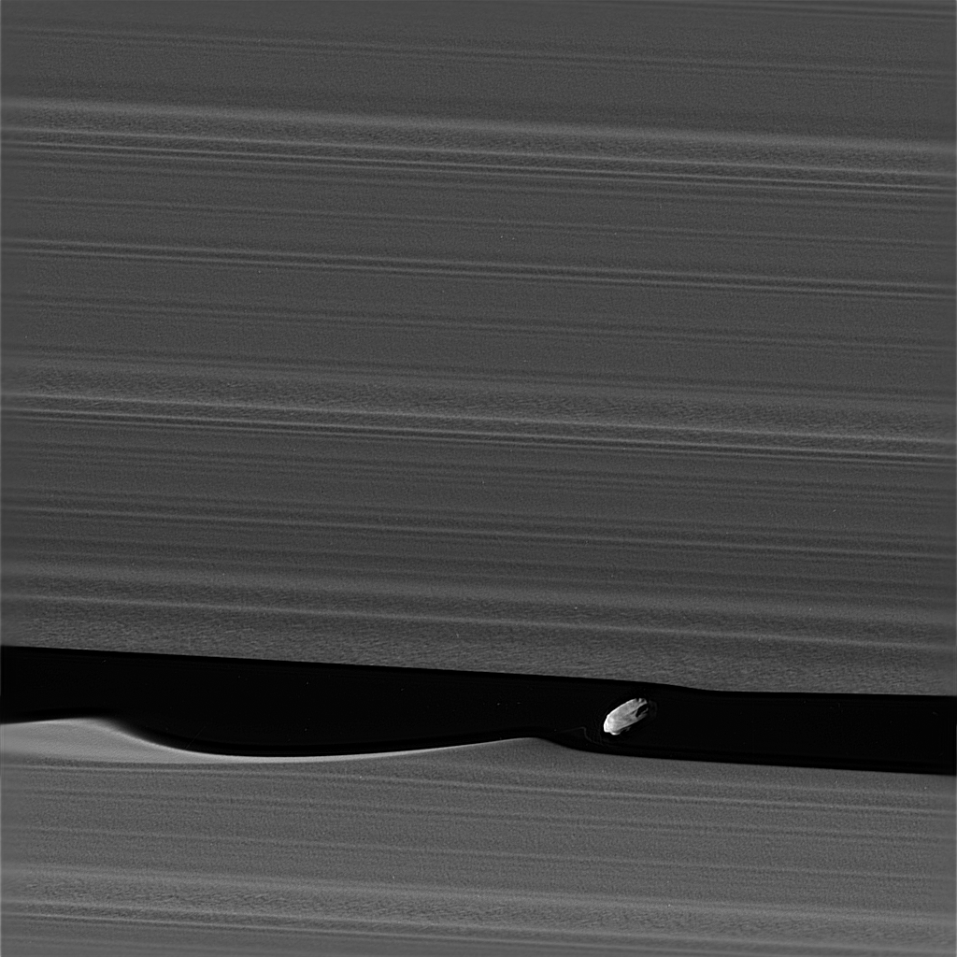

Slide 19
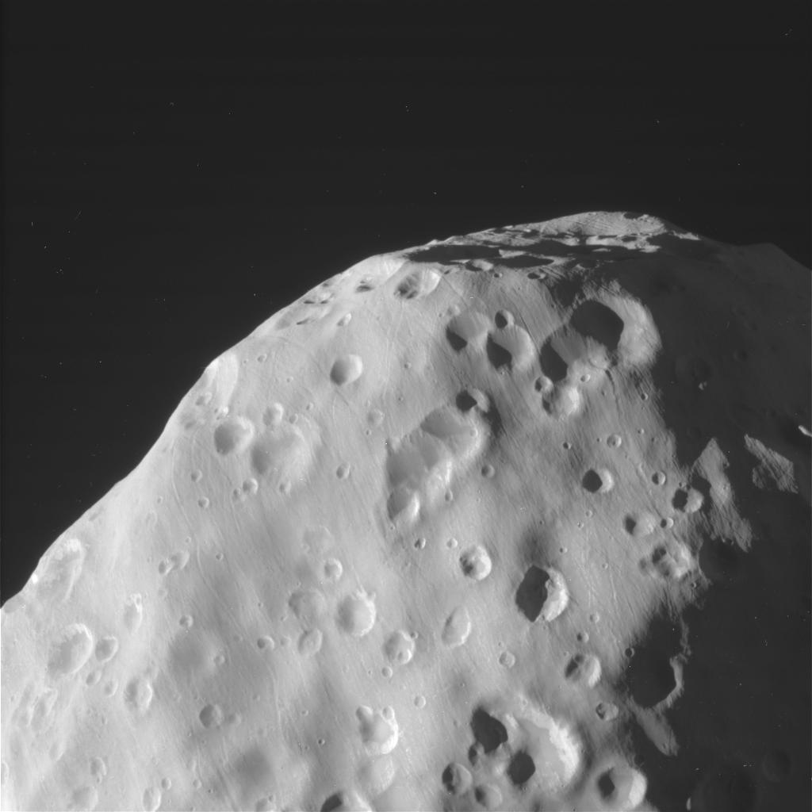
#3 Epimetheus 30 January 2017
129.8 × 114 × 106.2 km diam

Slide 20
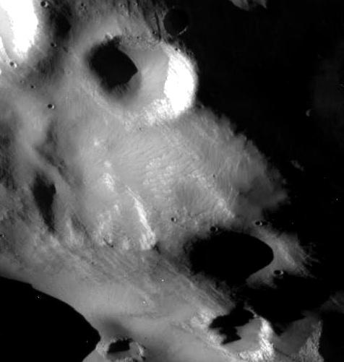
#3 Epimetheus 30 January 2017

Slide 21
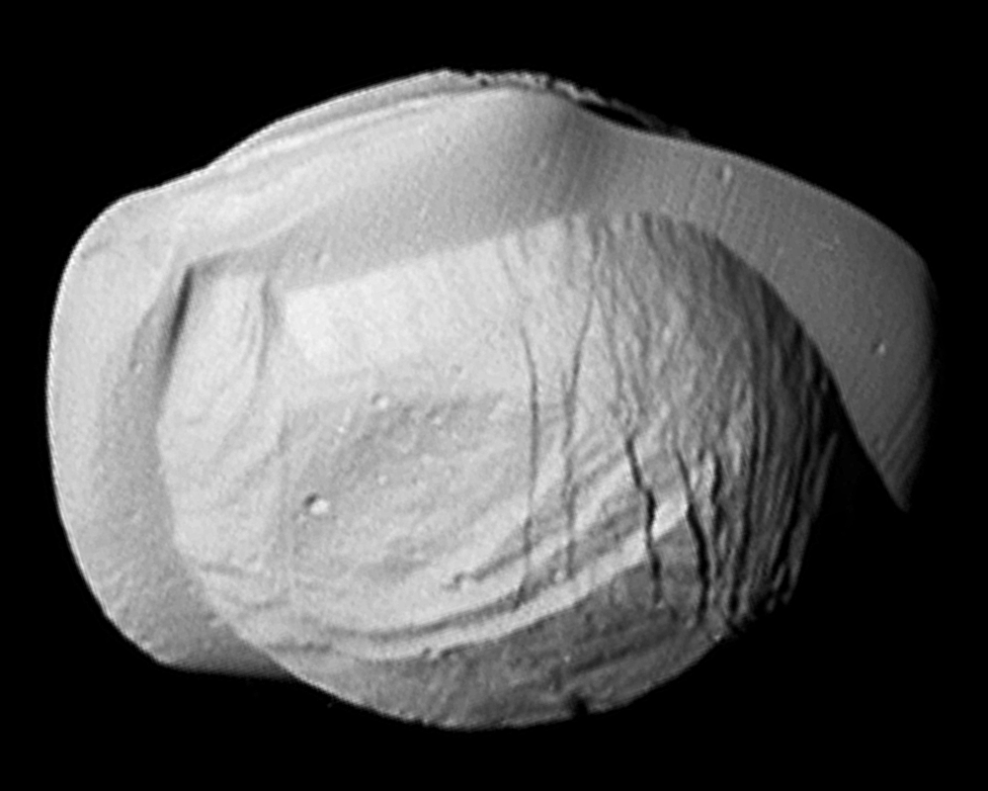
#4 Pan 7 March 2017

Slide 22
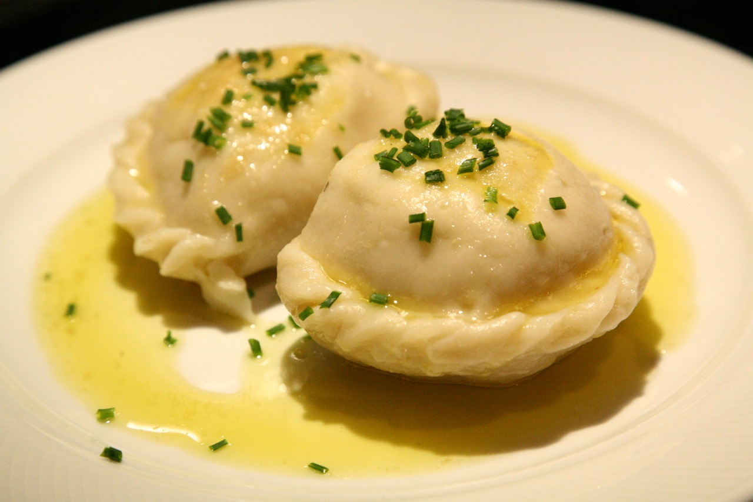

Slide 23
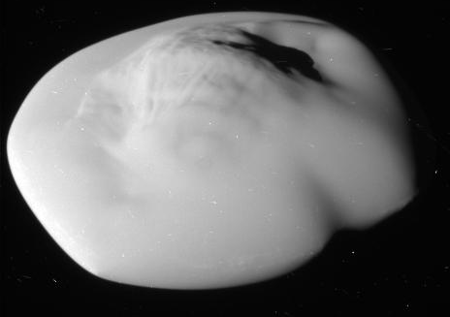
#5 Atlas 12 April 2017

Slide 24
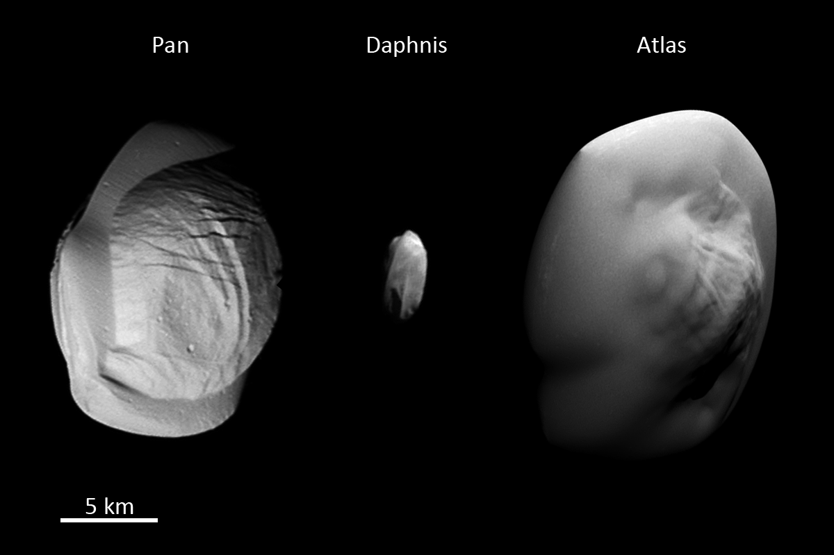
Notes:
Courtesy Tilmann Denk

