Slide 1
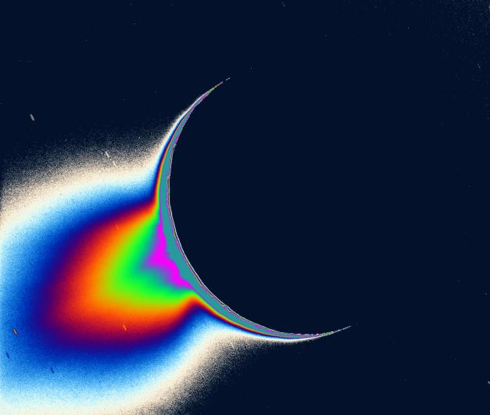
Using UVIS to investigate Enceladus’ Plume
How do we know what we know?
C. J. Hansen
27 January 2015

Slide 2
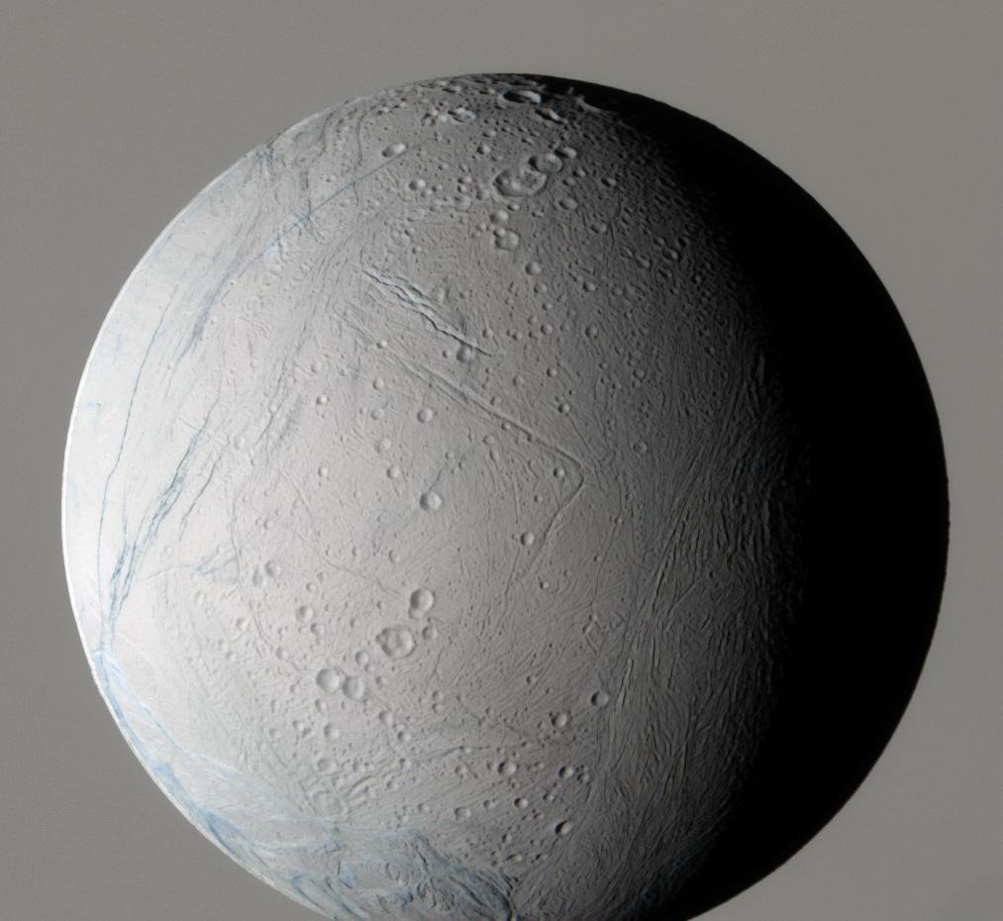
Outline
Enceladus
Quick Review
UltraViolet Imaging Spectrograph (UVIS) Observations
  Plume Composition
  Plume Structure
  Variability
  Questions, questions, questions
Future Observations
Notes:
Youthful surface

Slide 3
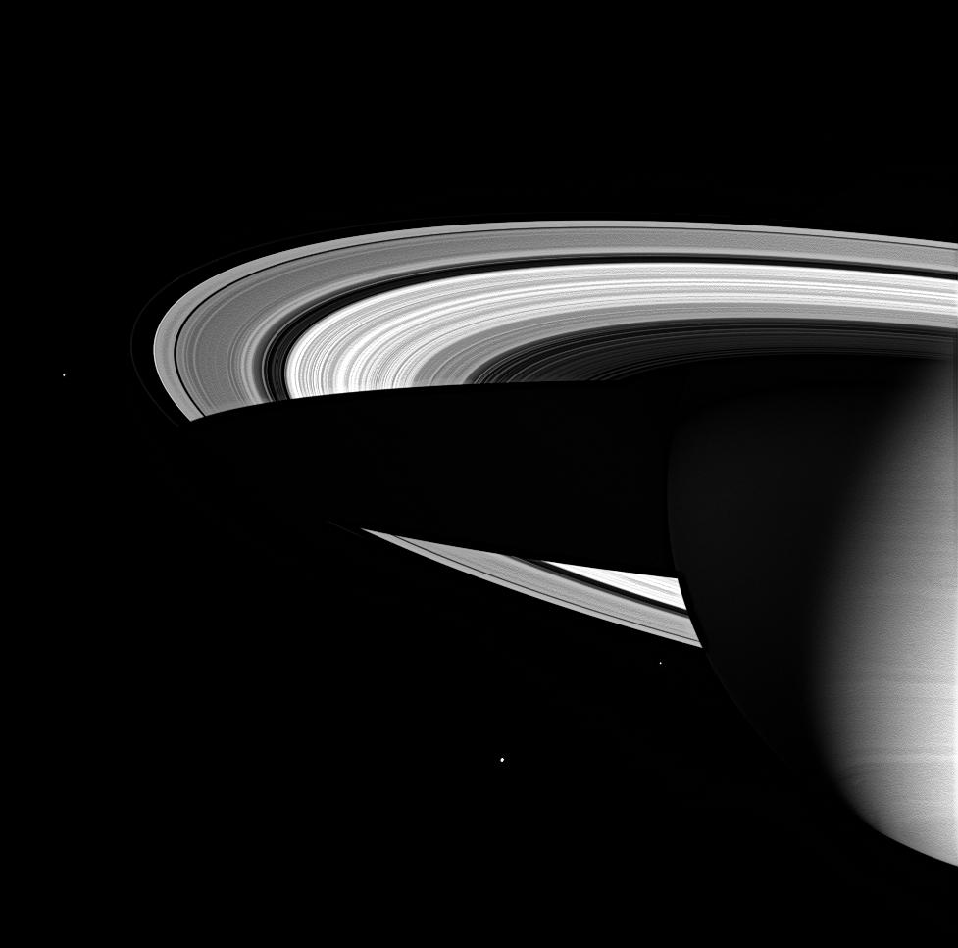
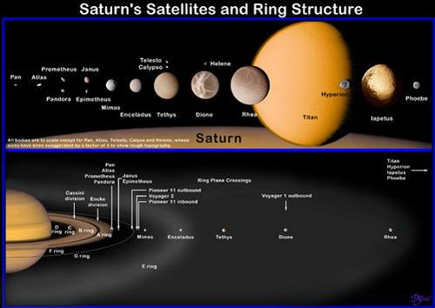
Enceladus
One of Saturn’s small icy moons
  Mean density ~ 1.6 gm/cm³
Radius ~252 km
Voyager images showed a geologically young surface
Enceladus
Enceladus’ orbit co-incides with the thickest portion of Saturn’s E ring at ~4 R_{s}
Notes:
3

Slide 4
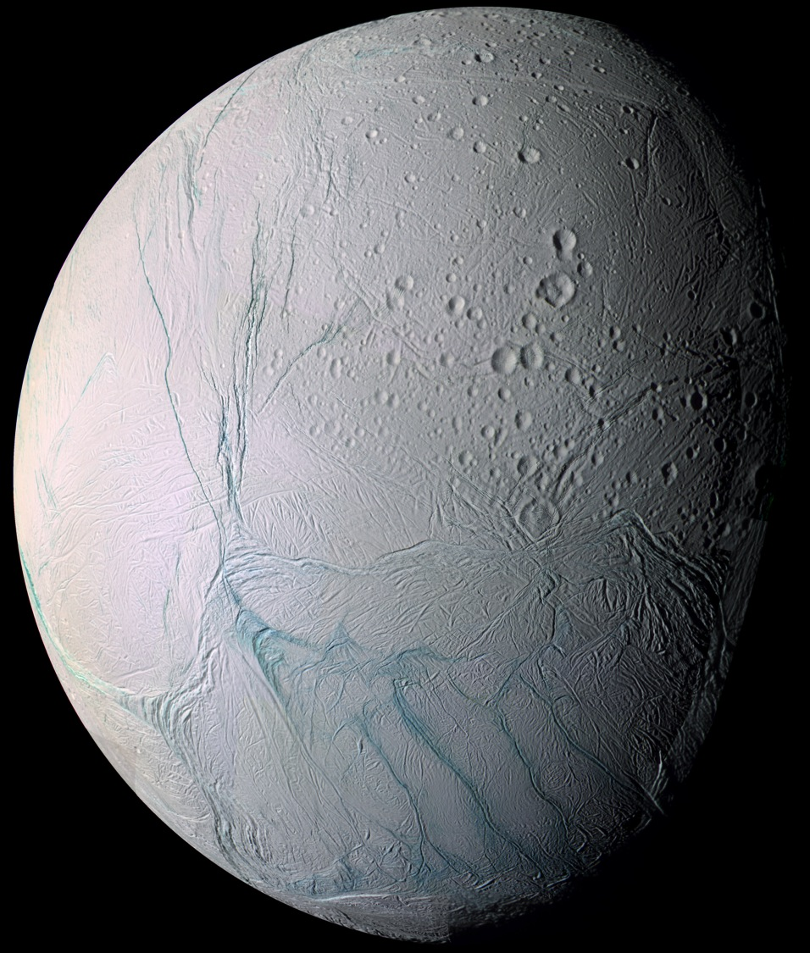
ISS Color Mosaic
Rev 11
July 2005
Cassini’s 2005 flyby of Enceladus was ~over the south pole
Enceladus’ youthful geology suddenly made sense when we realized we were seeing evidence in numerous instruments’ data for eruptions at the south pole
Bluish fractures crossing the south pole were dubbed “tiger stripes”
Notes:
Point out where south pole is on tiger stripes
Also note geologic boundary
Anti-Saturnian hemisphere, subs/c point = -24 / 326W

Slide 5
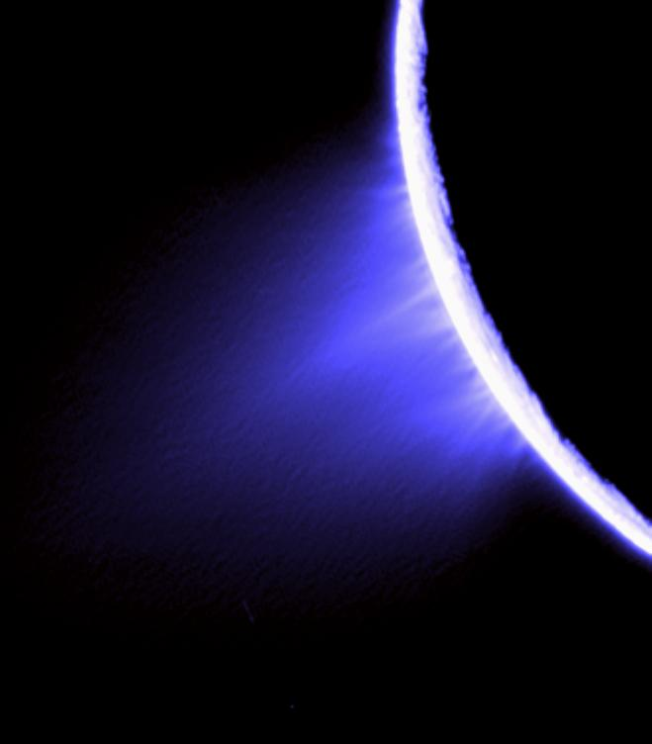
Enceladus is now known to be a geologically active body
We now know that
A plume of water vapor and jets of ice particles come from the “tiger stripe” fissures across the southern pole
Plume
Jets
How do we use UVIS to study the plume?

Slide 6
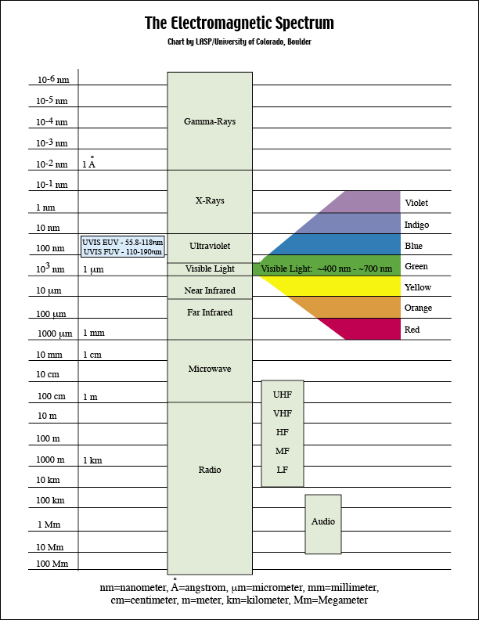
Ultraviolet Light
Gases absorb light at ultraviolet wavelengths
  The wavelengths are unique to the gas, so absorption wavelengths are diagnostic of composition
Gases emit light at ultraviolet wavelengths
Surfaces reflect light at ultraviolet wavelengths

Slide 7
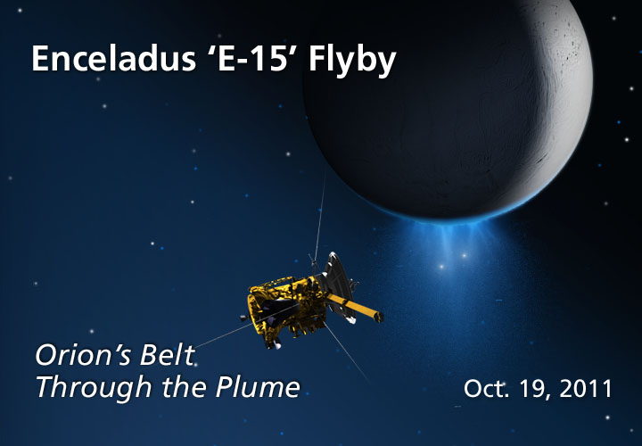
“Occultations” of Stars
The most important ultraviolet data is collected by watching a star or the sun go behind Enceladus’ plume as seen from the spacecraft
From this data
we can determine the composition of the gases in the plume
we see the structure of the plume

Slide 8
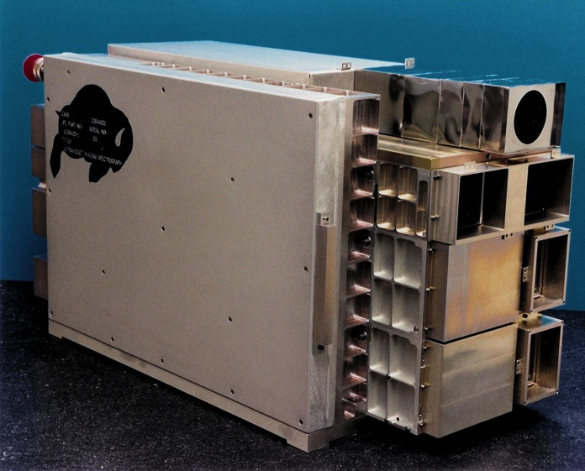
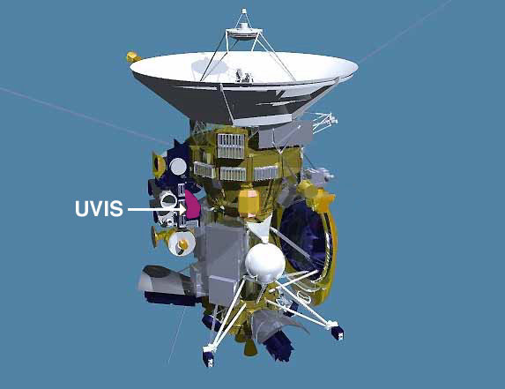
UVIS Characteristics
UVIS has 4 separate channels
For stellar occultations we use:
Far UltraViolet (FUV)
  1115 to 1915 Å
  2D detector: 1024 spectral x 64 one-mrad spatial pixels
    Binned to 512 spectral elements
  5 sec integration time
High Speed Photometer (HSP)
  2 or 8 msec time resolution
  Sensitive to 1140 to 1915 Å
For the solar occultation we used:
Extreme UltraViolet (EUV) solar port
  550 to 1100 Å
  2D detector: 1024 spectral x 64 one-mrad spatial pixels
  two windows of 27 rows each
  1 sec integration

Slide 9
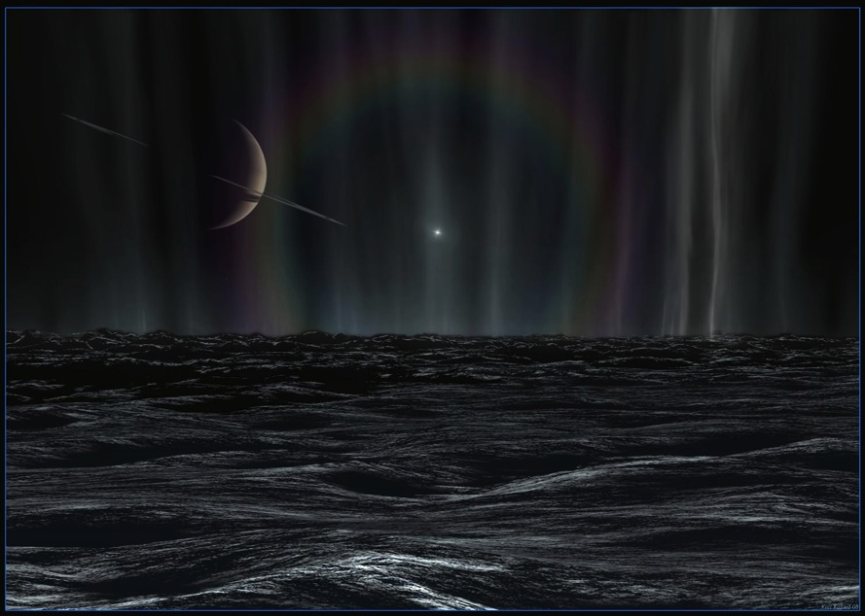
UVIS Observations of Enceladus’ Plume
Cassini’s Ultraviolet Imaging Spectrograph (UVIS) observes occultations of stars and the sun to probe Enceladus’ plume
  Composition, mass flux, and plume and jet structure
Four stellar and one solar occultation observed to-date
Feb. 2005 - lambda Sco
  No detection (equatorial)
July 2005 - gamma Orionis
  Composition, mass flux
Oct. 2007 - zeta Orionis
  Gas jets
May 2010 - Sun
  Composition, jets
Oct. 2011 – epsilon and zeta Orionis dual occultation
Notes:
What do we observe

Slide 10
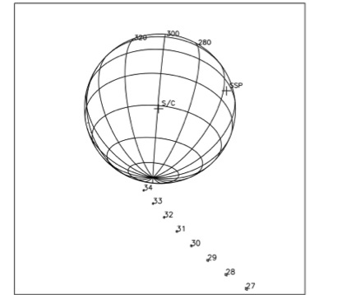
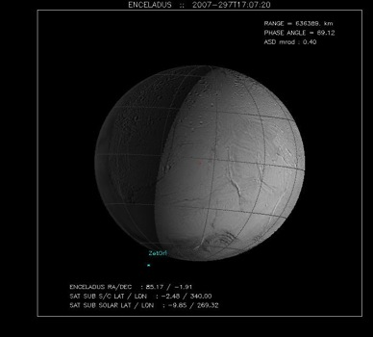
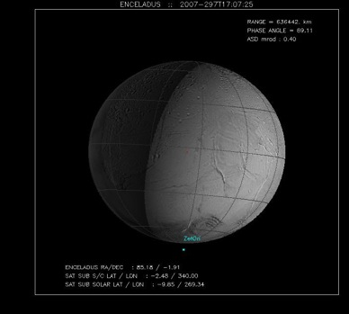
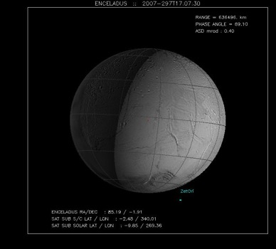
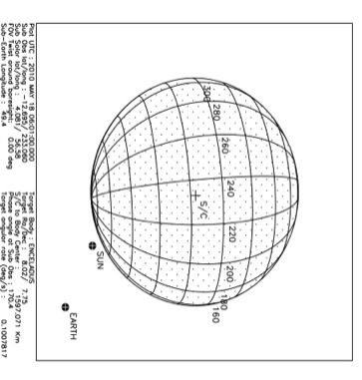
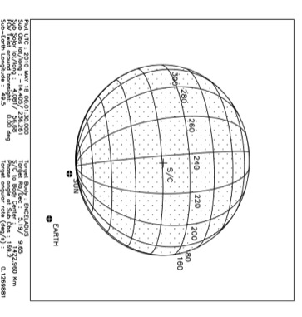
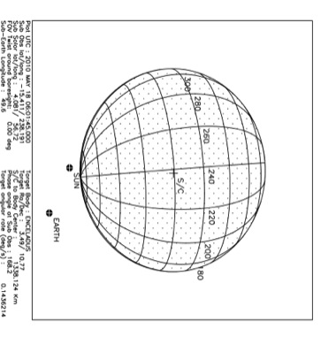
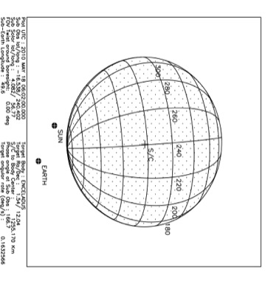
2010 - Solar Occultation
2005 - gamma Orionis Occultation
The Occultation Collection
2007 - zeta Orionis Occultation

Slide 11
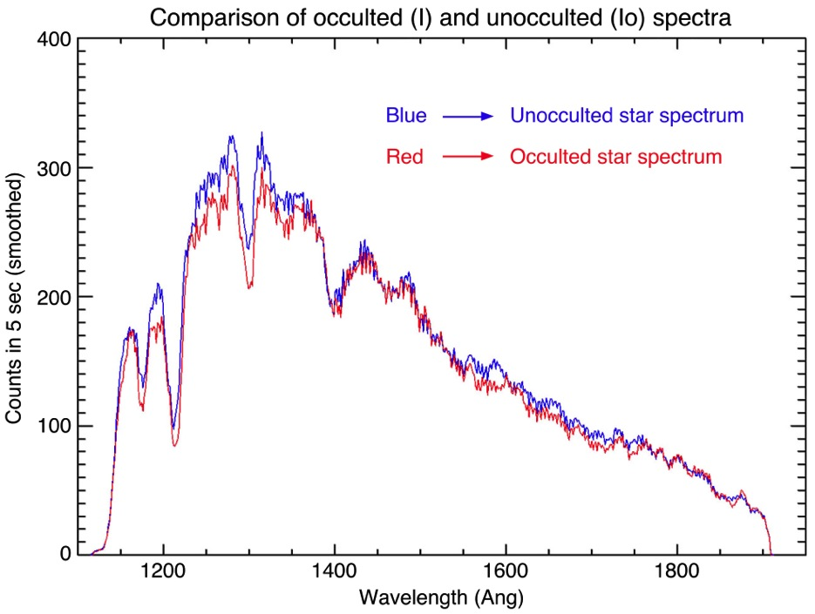
How do we know what the composition of the plume is?
Gamma Orionis Spectrum
Time record 33, the last full 5 sec integration prior to ingress, shows the deepest absorption. The ray altitude above Enceladus’ surface corresponding to time record 33 ranged from 30 to 7 km.
Clear signature of an absorbing gas is present – both relatively narrow and broad absorption features
What is it? How much is there?
Notes:
Note that I’m mixing nm and angstroms

Slide 12
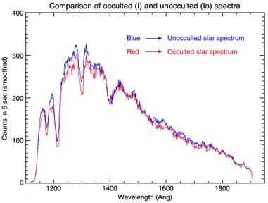
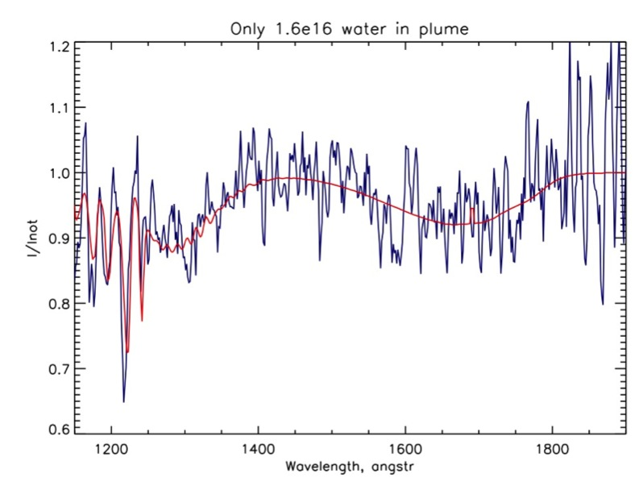
Ultraviolet Data Analysis – Composition and Quantity of Gases
Step 1: Wavelength by wavelength (512 channels) divide occulted data (I) by unocculted data (I₀) to see at which wavelengths starlight has been absorbed by the plume
Step 2: Plot I/I₀ to see absorption features
Step 3: Compare I/I₀ to various gas absorption spectra; At Enceladus we have a clear match to water vapor
Step 4: How much water vapor is obscuring the star?
  I=I₀ exp (-n*)
  Where n is “column density” and
  ⬧ is the cross-section (area) at each wavelength
Column density is the amount of water vapor along the line of sight
Crossections are measured in the lab
Step 5: Vary n until a good fit to the data is found
Blue => UVIS Spectrum
Red => Water absorption features
Best fit column density = 1.6 x 10¹⁶ H₂O molecules/ cm²

Slide 13
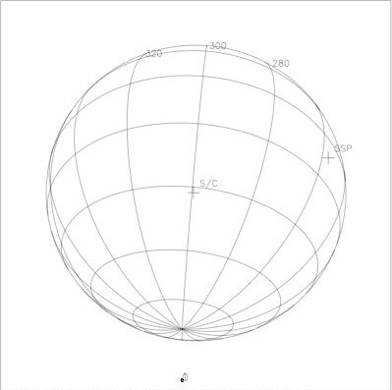
How much Water is coming from Enceladus?
S = source rate
  = N * h² * v
  = n/h * h² * v
  = n * h * v
Where
N = number density / cm³
h² = area
v = velocity
n = column density measured by UVIS
Estimate h from plume dimension ~ 80 km = 80 x 10⁵ cm
Estimate v from thermal velocity of water molecules in a gas with a temperature of 170K = 45,000 cm/sec
[note that escape velocity = 23,000 cm/sec]
h
v
S = 1.6 x 10¹⁶ * (80 x 10⁵) * (46 x 10³) = 5.8 x 10²⁷ H₂O molecules / sec = ~170 kg / sec
Is this enough to explain all the water products in the we see in the Saturn system?

Slide 14
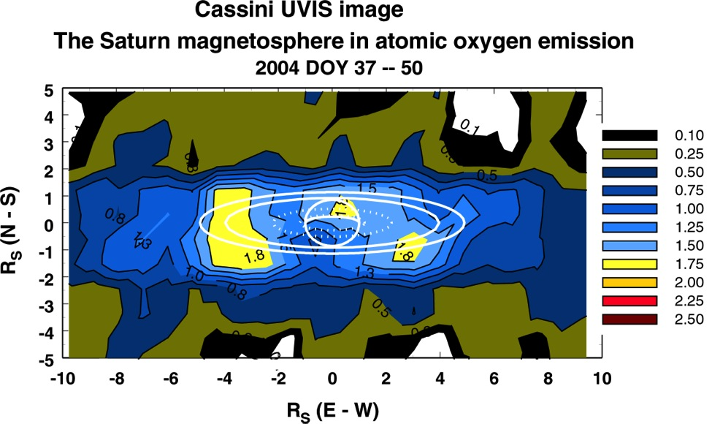
Water Products in Saturn’s System
The Saturnian system is filled with the products of water molecules:
  H detected by Voyager in 1980, 1981
  OH detected by Hubble Space Telescope in 1992
  Atomic Oxygen imaged by UVIS in 2004
Water and its products are lost from the system by collisions, photo- and electron- dissociation and ionization
Estimates of required re-supply rates range from 3 x 10²⁷ to 2 x 10²⁸ water molecules/sec
Notes:
The water budget

Slide 15
Water Vapor Plume
What is the rate of water vapor coming from Enceladus?
  Is it enough to explain all the atomic O in the system? Yes, mystery solved!
Are there other constituents?
  Up to ~10% of the plume could consist of other gases
  UVIS data can set upper limits on some of these

Slide 16
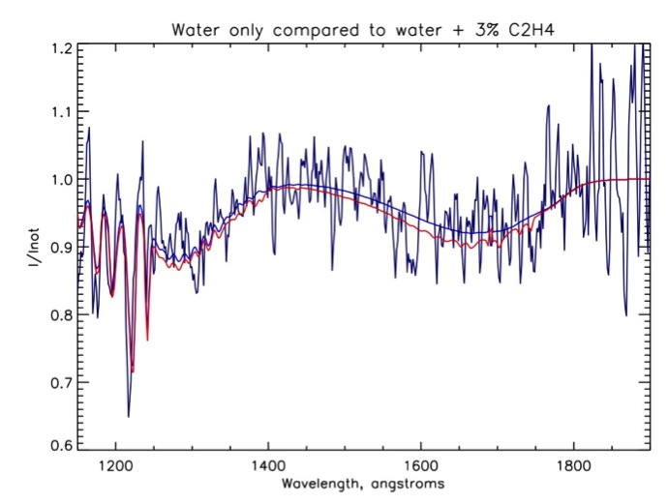
Any other constituents?
One of Cassini’s other instruments reported detection of a species with an atomic mass of 28 amu; candidates:
  CO, C₂H₄, N₂
We looked at ethylene (C₂H₄)
Ethylene plus water compared to water only
C₂H₄ column density = 4.8 x 10¹⁴ cm⁻²
H₂O column density = 1.6 x 10¹⁶ cm⁻²
Water only is still best fit to occulted spectrum although there are some interesting matches to small dips with ethylene added in
Similarly, UVIS does not detect CO
  formal 2-σ upper limit is 3.6 x 10¹⁴ cm⁻²
    corresponds to mixing ratio with H₂O of 3.0%
What about N₂?
Notes:
Used Mota (2005) cross-sections

Slide 17
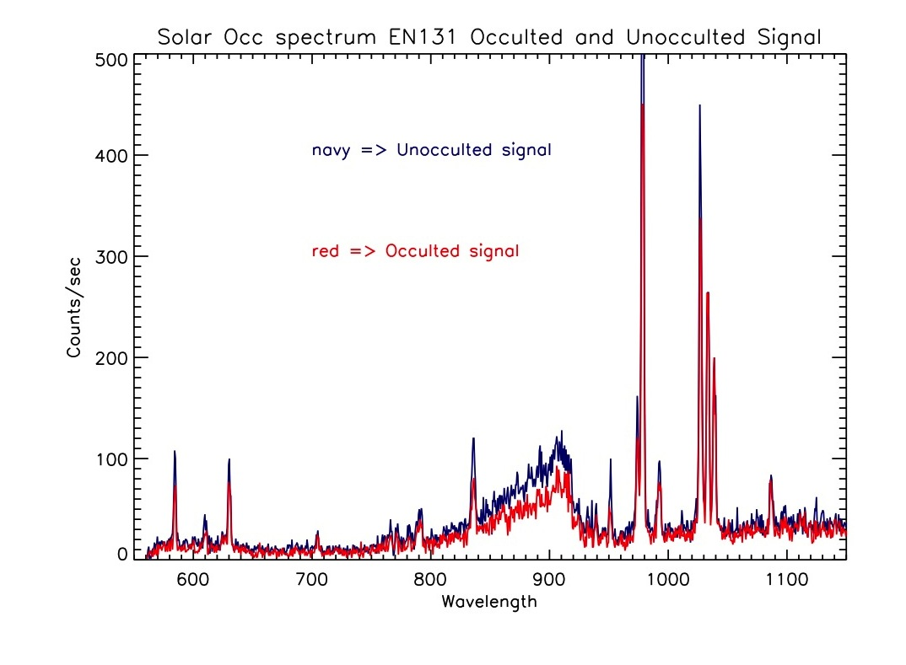
2010 EUV Spectrum from the
Solar Occultation
Navy is unocculted solar spectrum, with typical solar emissions
Red is solar spectrum attenuated by Enceladus’ plume – all attenuation is due to water vapor absorption

Slide 18
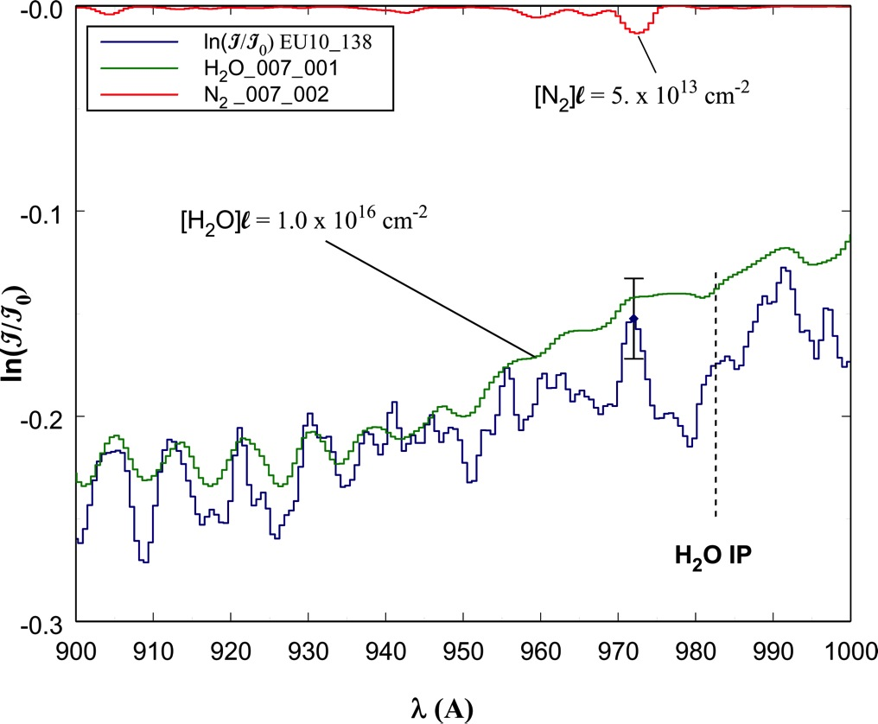
Solar Occultation results –
Plume Composition
H₂0 fit to absorption spectrum
Column density of H₂O = 0.9 x 10¹⁶ cm⁻²
No N₂ absorption feature -> N₂ upper limit of 5 x 10¹³ cm⁻²
Notes:
The (3 sigma) error bar is at the wavelength where we would expect to see the N2 absorption.
“IP” is the first Ionization Potential
N2 absorption is b3-X(0)

Slide 19
Jets in the Plume
What is the structure of Enceladus plume?
  We have several “cuts” through the plume, what do they tell us?
Do we see jets of gas that might correlate to the jets of ice particles?

Slide 20
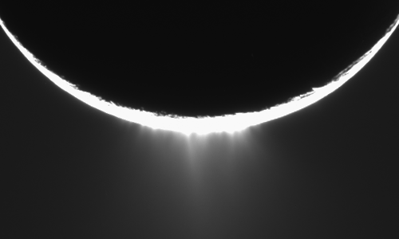
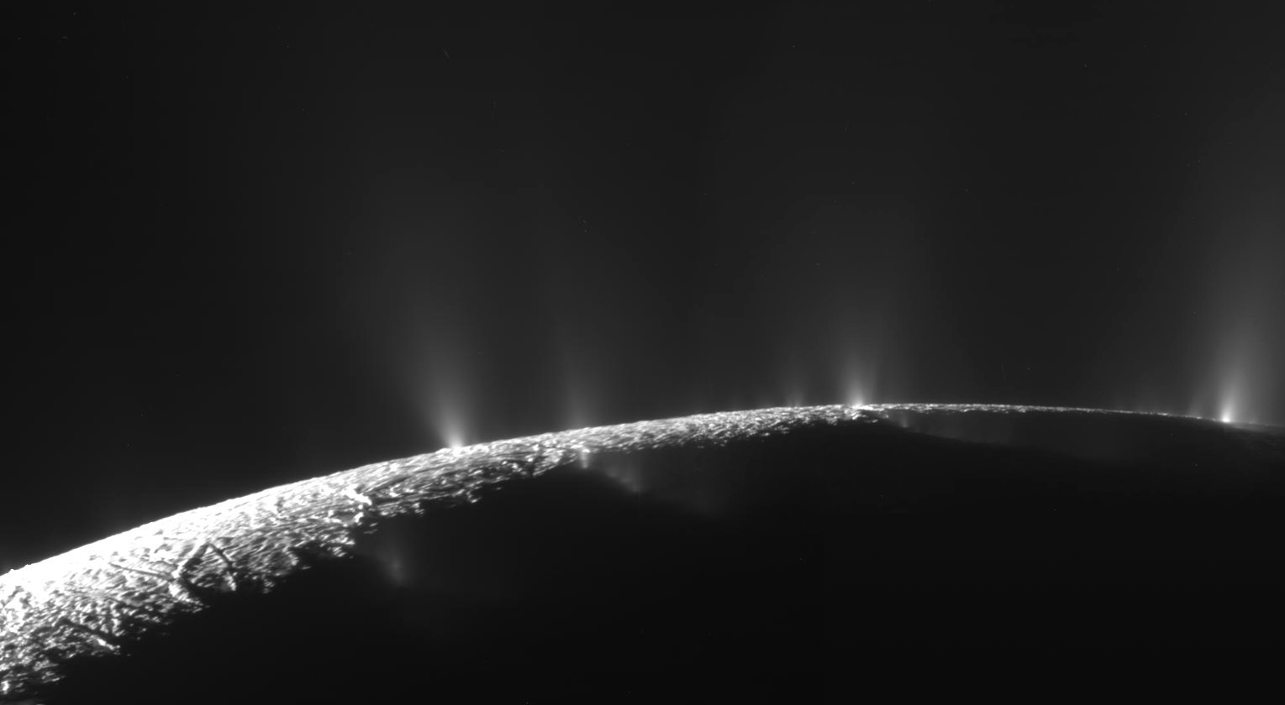
Jets
Numerous dust jets are observed coming from the tiger stripes
These are very small particles of ice, visible only when the jets are backlit
Are there also collimated gas jets that would be detectable by UVIS?
Can they be correlated?
Notes:
Insufficient solid mass (compared to vapor) -> need bigger eruption
Implies temporal variability

Slide 21
2010 - Solar Occultation
The Occultation Collection
Horizontal cuts through the plume
2007 - zeta Orionis Occultation

Slide 22
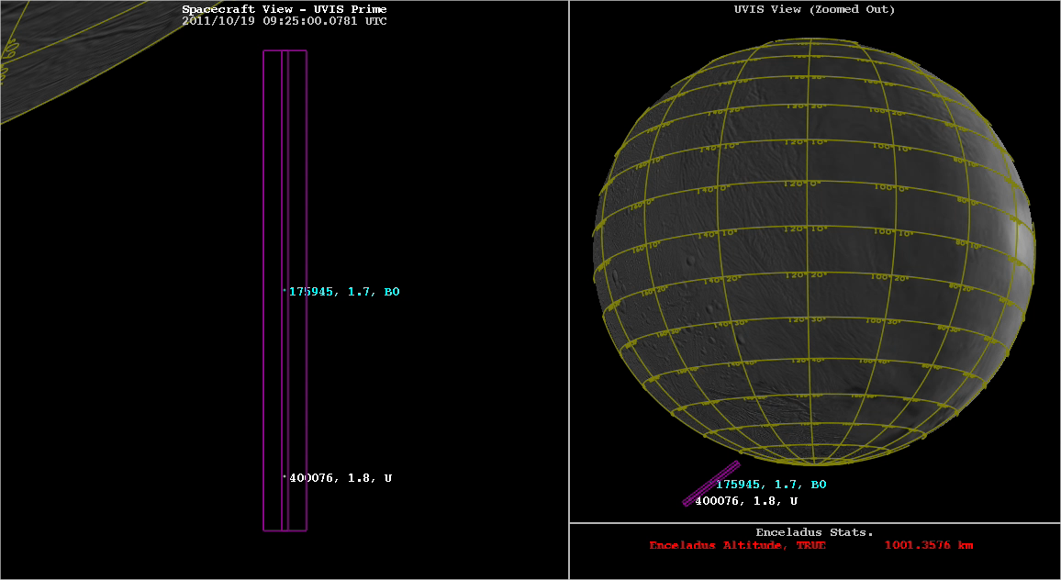
Orion’s Belt Dual Occultation Geometry
Dual stellar occultation by Enceladus’ plume, 19 October 2011, of epsilon Orionis (blue) and zeta Orionis (white)
Horizontal cut through plume
Notes:
22

Slide 23
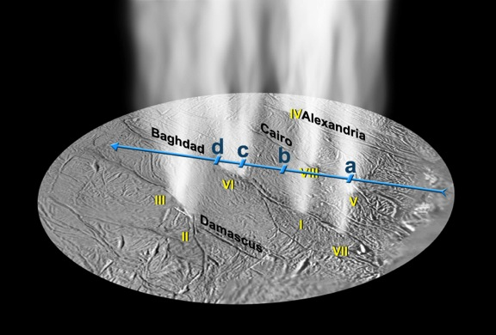
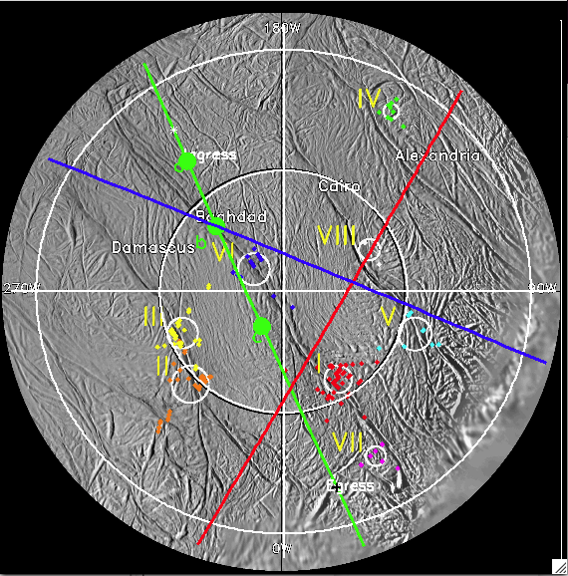
Plume Horizontal Cuts
Basemap from Spitale & Porco, 2007
Zeta Ori
2011
Solar occ
In all occultations we look through the plume
The groundtrack is the perpendicular dropped to the surface from the ray to the star
Zeta Ori
2007
Blue => zeta Orionis 2007
Red => Solar occ 2010
Green => zeta Orionis 2011

Slide 24
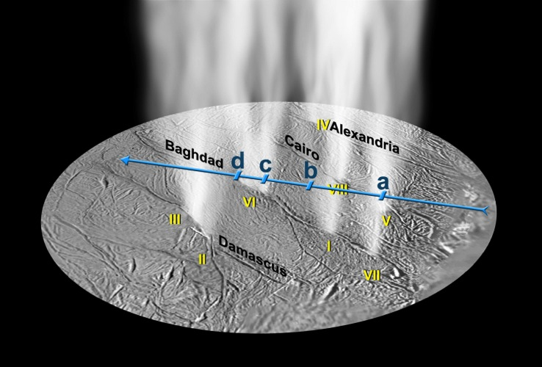
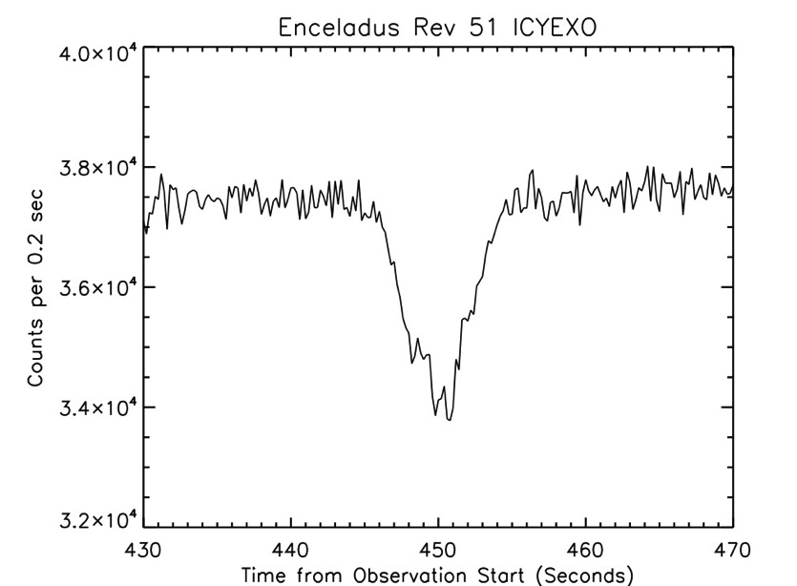
UVIS Discovery of Supersonic Gas Jets
We use the High Speed Photometer (HSP) to look for enhanced absorption indicative of jets
The High Speed Photometer (HSP) detects absorbed starlight over the same wavelengths as the FUV but with much higher time resolution
  FUV integrations are 5 sec duration
  HSP is 0.2 sec
Star not behind plume
Star behind plume
FUV time record 89
FUV time record 90

Slide 25

Zeta Orionis Occultation
Density in jets is twice the background plume
Gas jet typical width = 10 km at 15 km altitude
Egress
Ingress
a. Cairo (V)
d. Damascus (II)
c. Baghdad (VI)
b. Alexandria (IV)
Closest point
Notes:
25
Because the dimension of the two prominents jets is about 1/8 the width of the largest plume, their gas density needs to be twice that of the surrounding plume at 15 km to yield the 12% opacity increase seen in the jets.

Slide 26
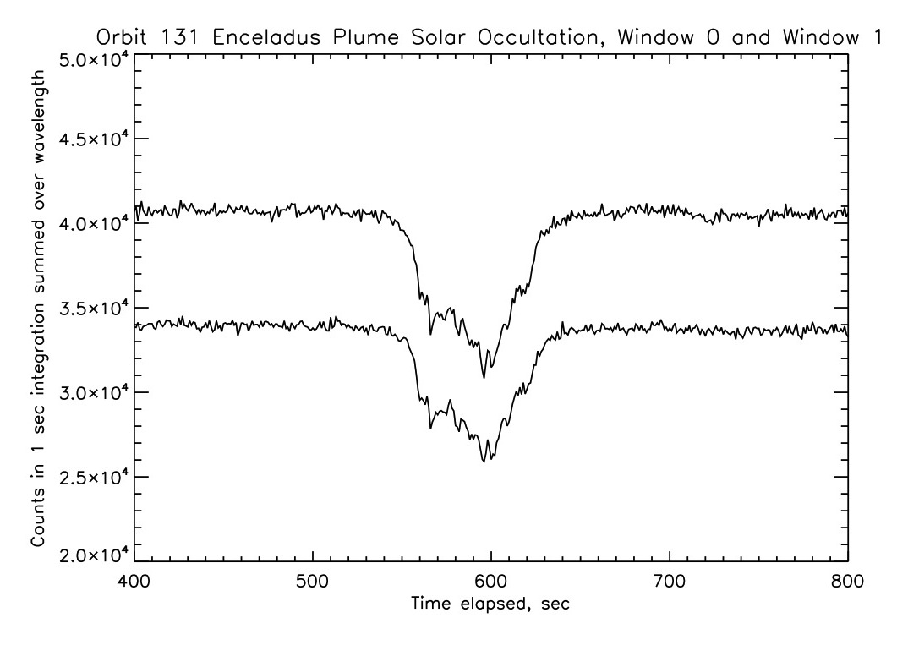
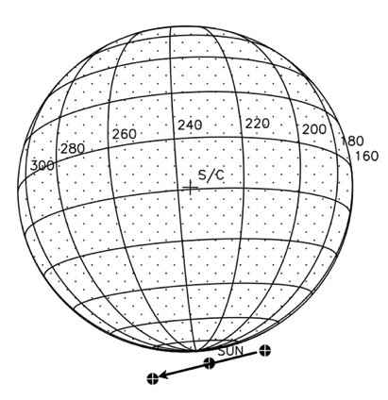
Solar Occ Jet Identifications
f
e
a
b
d
c
Minimum altitude
Window 0 and 1 matching features => jets
Repetition of features in window 0 and window 1 shows they are not due to shot noise, therefore likely to be real

Slide 27
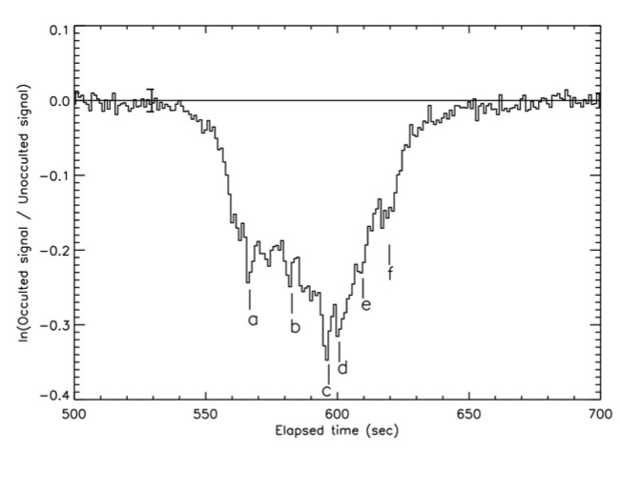
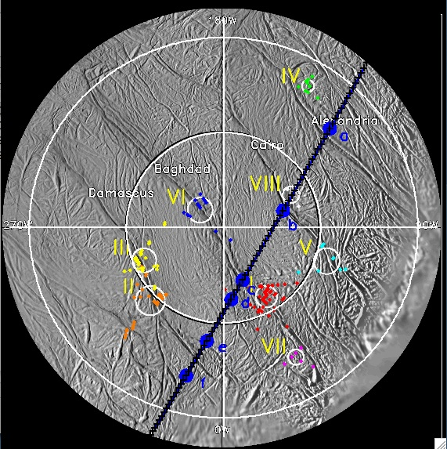
Jets vs. Tiger Stripes
Spacecraft viewed sun from this side
Ingress
◆
Minimum Altitude
Feature | Altitude (km) | Dust Jet
a | 20 | Alexandria IV
Closest approach | 19.7
b | 21 | Cairo V and/or VIII
c | 27 | Baghdad I
d | 30 | Baghdad VII
e | 38 | Damascus III
f | 46 | Damascus II
Egress
Higher time resolution because sun’s passage behind the plume was slower

Slide 28
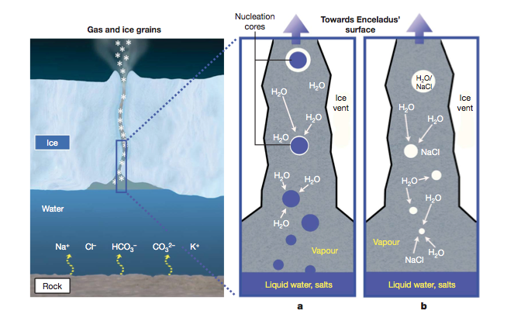
Supersonic Jets
Collimated jets are supersonic
The full width half max (FWHM) of jet c (Baghdad I) is ~10 km at a jet intercept altitude of 29 km (z₀)
Estimating the mach number as ~2 z₀/FWHM the gas in jet c is moving at a Mach number of 6; estimates for the other jets range from 5 to 8
Consistent with model that gas is accelerated in nozzles to the surface to supersonic speeds
Notes:
Jet intercept altitude is where the ray to the sun intercepts the jet, accounting for its rotation in front of or behind the limb

Slide 29
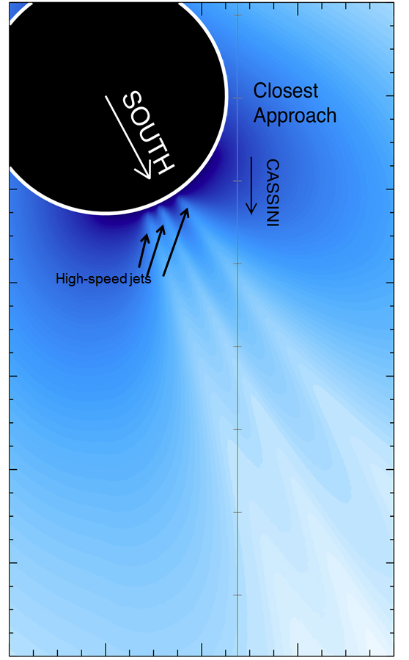
Particle Size and Composition
Cassini’s Dust Analyzer (CDA) detects two sizes of ice grains from Enceladus’ south pole:
  High speed gas jets, seen in UVIS data, propel mostly small (2 micron) pure ice (salt-poor) grains far out into space forming the E ring
  The more diffuse plume lofts bigger, mostly salt-rich ice grains; these heavier grains are primarily found closer to the surface, deeper in the plume, and fall back to the surface

Slide 30
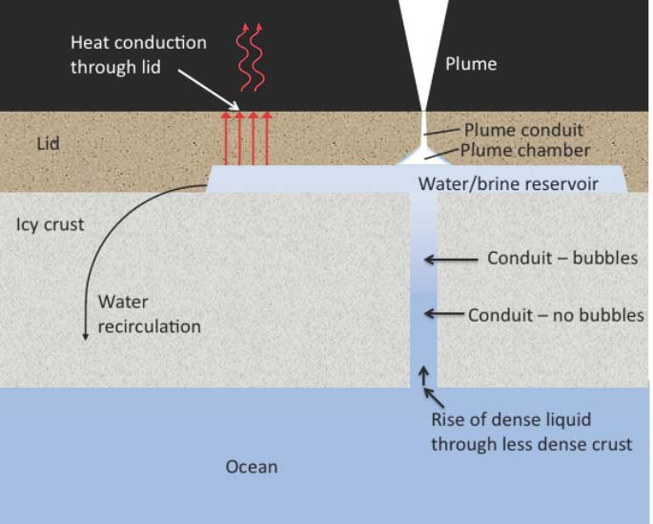
The “Perrier” Ocean
Perrier ocean model puts this all together, loosely
Subsurface ocean is charged with dissolved gases
Bubbles come out of solution as liquid rises, when they pop (in the water/brine reservoir) the salt-rich aerosols detected by CDA are formed
Gas and salt-rich particles escape along length of tiger stripe
Gas is also accelerated in nozzles to surface where the smallest grains condense; CDA sees salt-poor particles, UVIS sees supersonic jets
Tiger stripe / nozzle physical structure yet to be explained

Slide 31
Recap: What have we learned from occultations?
Composition
  The plume is primarily composed of water vapor
  Upper limits have been set for CO, N₂, C₂H₄
Source rate
  Flux of water is ~200 kg/sec
    Range is from 170 kg/sec to 220 kg/sec
    Suggests that Enceladus has been steadily erupting for past 7 years
    Enough to explain all the water products observed in the Saturn system (H, O, OH)
Plume / jet structure
  Collimated jets are detected with estimated mach number of > 5
  Propel small ice particles out to become Saturn’s E ring

Slide 32
We conclude…
Supersonic gas jets are consistent with the model of nozzle-accelerated gas coming from liquid water reservoir
High velocity jets are also consistent with Cassini Dust Analyzer data showing compositional partitioning: small salt-poor particles reaching the E ring and salt-rich particles in the diffuse component of the plume close to Enceladus
Lack of N₂ in presence of NH₃ means that a relatively cool liquid reservoir such as the “Perrier Ocean” proposed is viable
But this is not the end of the story

Slide 33
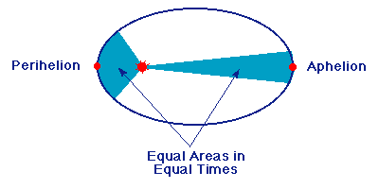
Why is all this happening at Enceladus?
What is the energy source for all of this action?
  Is it tidal energy?
Do we see variability in the rate of water spewing from Enceladus depending on where it is in its orbit?
  No? Maybe? Yes?
Enceladus is in an elliptical orbit around Saturn
We describe where Enceladus is by its “mean anomaly” or “orbital longitude”
Perikrone is the closest point, at 0⁰ orbital longitude; apokrone the furthest, at 180⁰
Stresses will be different, depending on where Enceladus is in its orbit

Slide 34


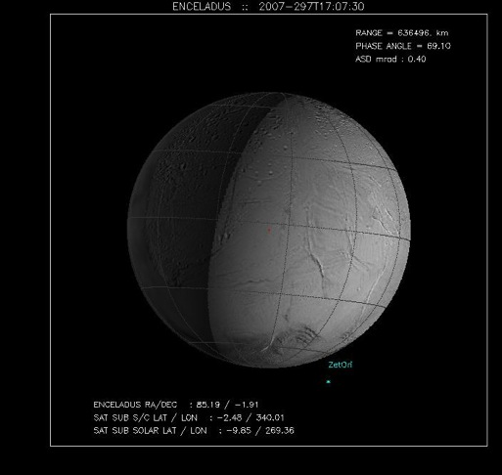
Do we see variability over an orbit?
2007 zeta Orionis
2010 solar occultation
Back to the flux calculation
With these horizontal cuts we get the boundary (full-width-half-max) of the plume
Notes:
34

Slide 35
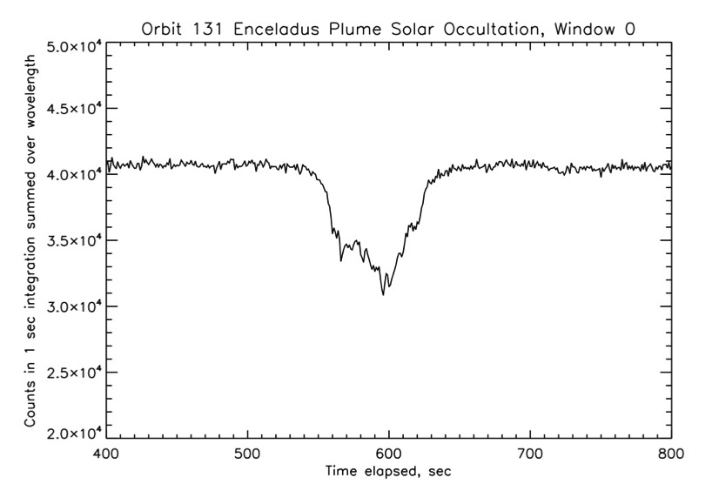
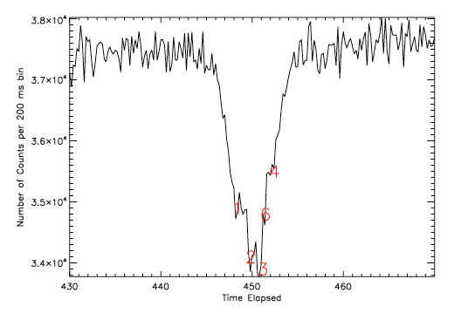
Calculate Plume Dimension
Total duration of Solar Occ:
2min 19sec
Duration for full-width half max:
56 sec
Line of sight velocity: 2.85 km/sec
Width of plume at FWHM:
56 sec * 2.85 = 160 km
FWHM
Zeta Orionis Occultation
  Zeta Orionis occultation lasted just 10 sec
  Line of sight velocity = 22.5 km/sec
  Width of plume at FWHM = 110 km
Zeta Orionis occultation

Slide 36
Estimate of Water Source Rate from Enceladus =
200 kg/sec
S = flux (source rate)
  = N * x * y * v_{th}
  = (n/x) * x * y * v_{th}
  = n * y * v_{th}
  Where
N = number density / cm³
x * y = area
y = v_{los} * t at FWHM
v_{th} = thermal velocity = 45,000 cm/sec for T = 170K
(note that escape velocity = 24,000 cm/sec)
n = column density measured by UVIS
2011:
v_{los} = 7.48 km/sec
y
The source rate has not changed much in >6 years
(deviation is <15%, not factors of 2)
x
v
Year | n (cm⁻²⁾ | Uncert-ainty +/- | y (x 10⁵ cm) | v_{th} (cm / sec) | Flux: Molecules / sec | Flux: Kg/sec | Fraction of orbit from periapsis
2005 | 1.6 x 10¹⁶ | 0.15 x 10¹⁶ | 80 (est.) | 45000 | 5.8 x 10²⁷ | 170 | 0.27
2007 | 1.5 x 10¹⁶ | 0.14 x 10¹⁶ | 110 | 45000 | 7.4 x 10²⁷ | 220 | 0.70
2010 | 0.9 x 10¹⁶ | 0.23 x 10¹⁶ | 150 | 45000 | 6 x 10²⁷ | 180 | 0.19
2011 - e | 1.35 x 10¹⁶ | 0.15 x 10¹⁶ | 120 | 45000 | 7.3 x 10²⁷ | 220 | 0.70
2011 - z | 1.2 x 10¹⁶ | 0.2 x 10¹⁶ | 135 | 45000 | 7.3 x 10²⁷ | 220
Notes:
36
36
Important message – flux has not changed much in 5 years. (Deviation is only 15%, not factors of 2)
Width (y) is at FWHM
Vlos is the line-of-sight velocity of the star across the plane of the sky
Given uncertainties our best estimate of water flux from Enceladus is 200 kg/sec

Slide 37
Plume Brightness vs. Orbital Phase
New data from Cassini’s near infrared spectrometer (VIMS) shows that the intensity of the eruption of particles from Enceladus varies, depending on where it is in its orbit
Implicates tidal forces
Notes:
Corrected equivalent width incorporates phase function, adjusts for differences in s/c – Enceladus range

Slide 38
These results are compelling…
So how do we explain what appears to be a fundamental inconsistency between UVIS and the near-infrared spectrometer (VIMS) results?
We have an opportunity in 2016 to figure this out

Slide 39
Enceladus Occultation Summary
Year | n (cm⁻²⁾ | Uncert-ainty +/- | y (x 10⁵ cm) | v_{th} (cm / sec) | Flux: Molecules / sec | Flux: Kg/sec | Mean anomaly (orbital position)
2005 | 1.6 x 10¹⁶ | 0.15 x 10¹⁶ | 80 (est.) | 45000 | 5.8 x 10²⁷ | 170 | 117
2007 | 1.5 x 10¹⁶ | 0.14 x 10¹⁶ | 110 | 45000 | 7.4 x 10²⁷ | 220 | 236.1
2010 | 0.9 x 10¹⁶ | 0.23 x 10¹⁶ | 150 | 45000 | 6 x 10²⁷ | 180 | 97.7
2011 - e | 1.35 x 10¹⁶ | 0.15 x 10¹⁶ | 120 | 45000 | 7.3 x 10²⁷ | 220 | ~237
2011 - z | 1.2 x 10¹⁶ | 0.2 x 10¹⁶ | 135 | 45000 | 7.3 x 10²⁷ | 220
2016 |  |  |  |  |  |  | 208.3
180 is where VIMS sees 3x enhancement in particle flux

Slide 40
UVIS Occultations compared to VIMS Results
New occ

Slide 41
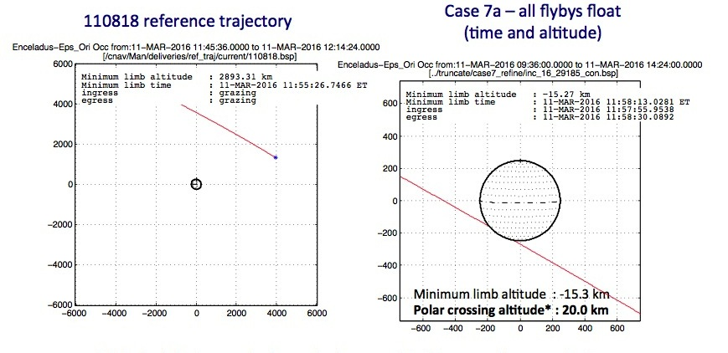
2016 Enceladus Occultation
The tour had a close (but not good enough) occultation in 2016
UVIS requested a study to determine if the Enceladus plume occultation could be restored on Rev 233
Nav agreed to take a look at the consequences of restoring the Enceladus occ – yes, it could be restored by using some fuel

Slide 42
Advantages of the new occultation observation
There are no VIMS measurements from ~210 to -30 to compare to UVIS at 236 –> UVIS data fills in an important gap
At 208 we should just overlap VIMS near the peak
The source rate determined by UVIS at mean anomaly = 236 is higher than that at 98 and 117, although in the past we did not consider that necessarily to be significant
New occ
UVIS data fills in gap in the VIMS data, will allow us to say whether gas production also depends on the position of Enceladus in its orbit

Slide 43
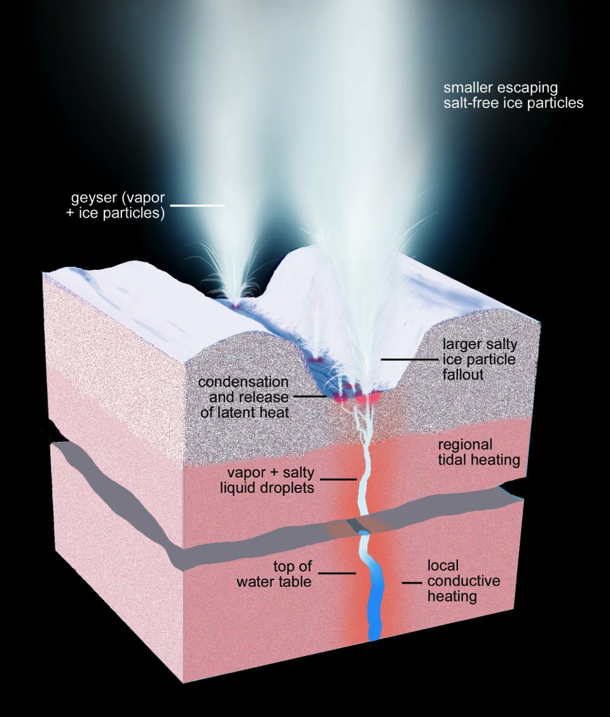
What is changing below the surface?
We can only see the products – must model what is below the surface
What is different at perikrone vs. apokrone?
  Gas / ice ratio?
  Nozzle diameter?
  Temperature?

Slide 44
Looking Forward to the new Data
Previous occultations have been at mean anomalies of 98⁰, 117⁰, 236⁰
The VIMS result is sharply peaked enough that UVIS would not have seen an unambiguous corresponding peak in gas flow at 236⁰, but should at 208⁰
UVIS detection of an enhancement in gas flow corresponding to the new VIMS result will motivate new models of Enceladus’ interior, jets, and the source of energy for its plume
A UVIS non-detection of enhanced gas flow will drive the need for a different explanation of the VIMS observations that could also lead to new understanding of Enceladus’ interior

Slide 45
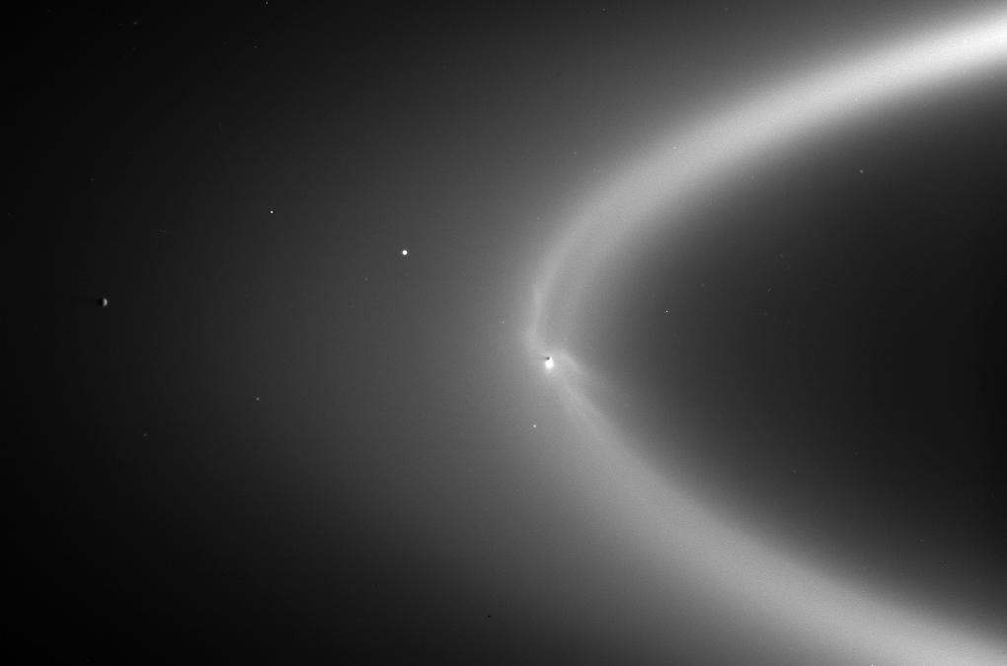
Enceladus Supplying the E Ring
A Question Answered…
But more remain!

