Slide 1
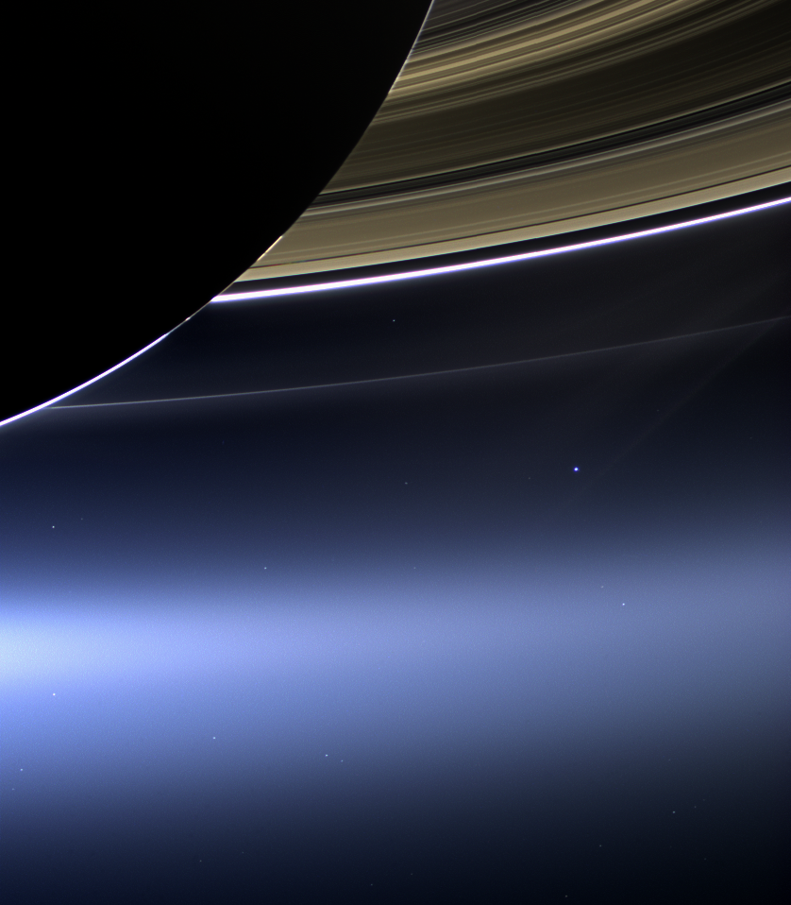
CHARM-X:
Rings in 2013-2014
Notes:
Still Active Spokes March 11, 2013 Full-Res: PIA14651
The ghostly spokes in Saturn's B ring continue to put on a show for the Cassini spacecraft cameras in this recent image. The spokes, believed to be a seasonal phenomenon, are expected to disappear as Saturn nears its northern hemisphere summer. Scientists continue to monitor the spokes to better understand their origin and evolution.
The small moon Atlas also appears here barely visible in between the A ring and the F ring, which is the thin ring located furthest from Saturn, as the fainter dot close to the A ring. Atlas is closer to the bottom of the image. A bright star also appears in the gap between the two rings, and there are six other stars visible (one through the C ring, near the planet).
This view looks toward the unilluminated side of the rings from about 49 degrees below the ringplane. The image was taken in visible light with the Cassini spacecraft wide-angle camera on Dec. 20, 2012. The view was obtained at a distance of approximately 840,000 miles (1.4 million kilometers) from Saturn and at a Sun-Saturn-spacecraft, or phase, angle of 105 degrees. Image scale is 48 miles (77 kilometers) per pixel.

Slide 2
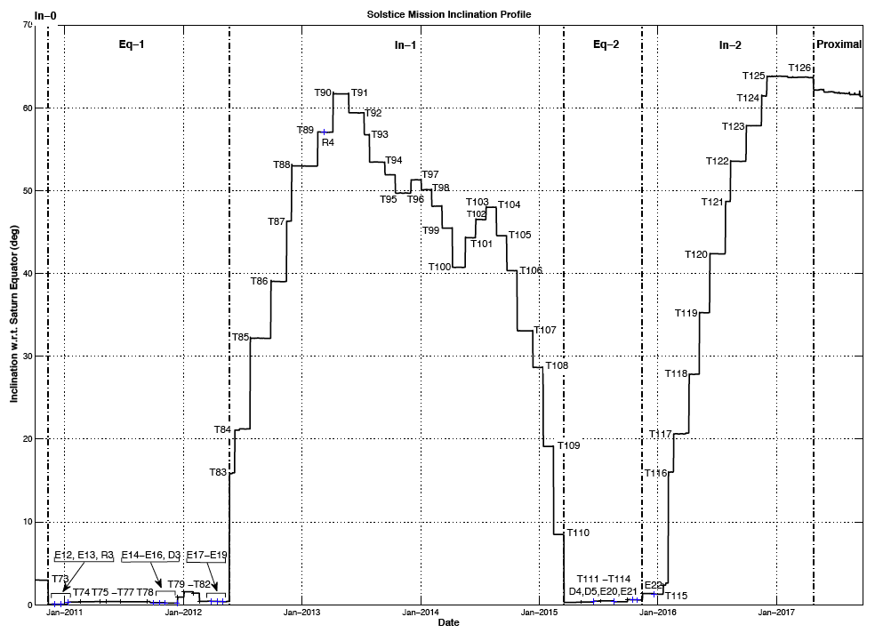
Spacecraft elevation now on the way back down
Notes:
Aug. 6, 2007 - NASA Quarterly Review - Cassini-Huygens Science Highlights

Slide 3
Highlights of 2013-2014*
Spoke update
Spectacular high-phase image, “waving at Saturn”
The true core of the F Ring: calm in the midst of chaos
“Noise” shows particle size varying with location
New object discovered at the outer edge of the A Ring
Wandering ringlet in the D Ring
Fine structure: Overstable oscillations of the rings
Digging for organic material in the rings
Infalling meteoroid Mass Flux measured; rings can be old
A look to the future
*An incomplete list!

Slide 4
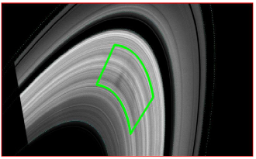
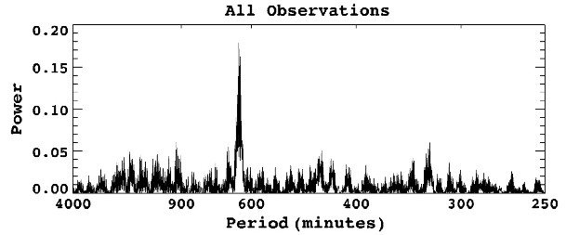
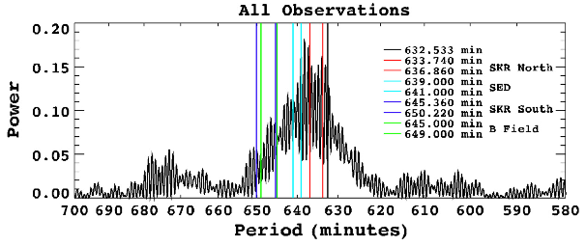
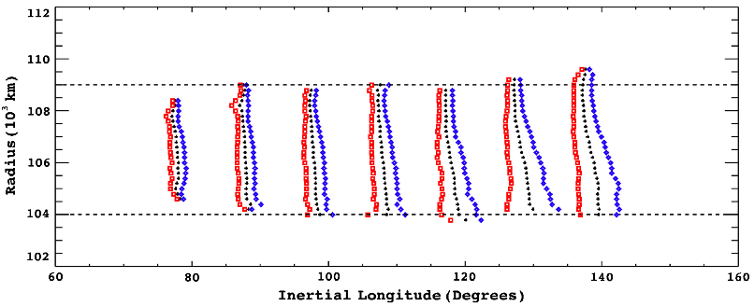
ISS: spokes
Mitchell et al (2013) study the evolution of “spokes” seen in the rings during periods that the sun is not far from the ring plane, and charging of the ring material is slight. The abundance of spokes was low during prime mission, peaked near Equinox, and has fallen off strongly since then, probably because solar photocharging of the rings and near-ring environment drives the dust that makes spokes visible back into the rings quickly when the sun is at elevation angles greater than 15 degrees. The curves at right show a strong peak in occurrence frequency near to several planet-related frequencies (the SKR period in the N Hemisphere is the closest match).
Notes:
Aug. 6, 2007 - NASA Quarterly Review - Cassini-Huygens Science Highlights

Slide 5
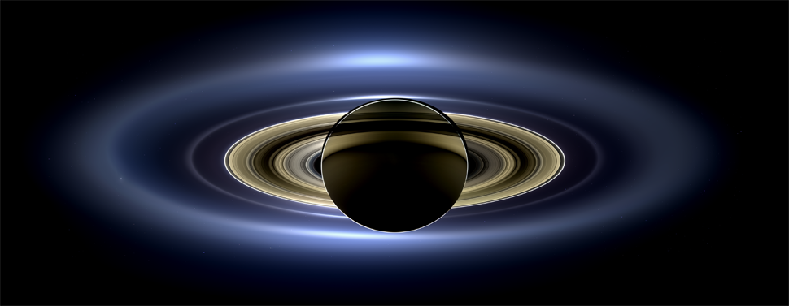
ISS: new high-phase angle portrait of the rings
CDA measured the mass flux of micrometeoroids into the Saturnian system
A new image mosic was released by ISS from carefully planned observations obtained when the Sun was eclipsed by Saturn. The E and G rings are especially obvious in bluish, forward scattered light, entirely due to diffraction which is dominated by the tiny dust particles residing there. The main rings have a redder color because multiple scattering from and between the larger main rigng particles plays a larger role and the main ring particles are reddish because of “pollution” by an unknown absorbing material.
C. Porco et al.

Slide 6
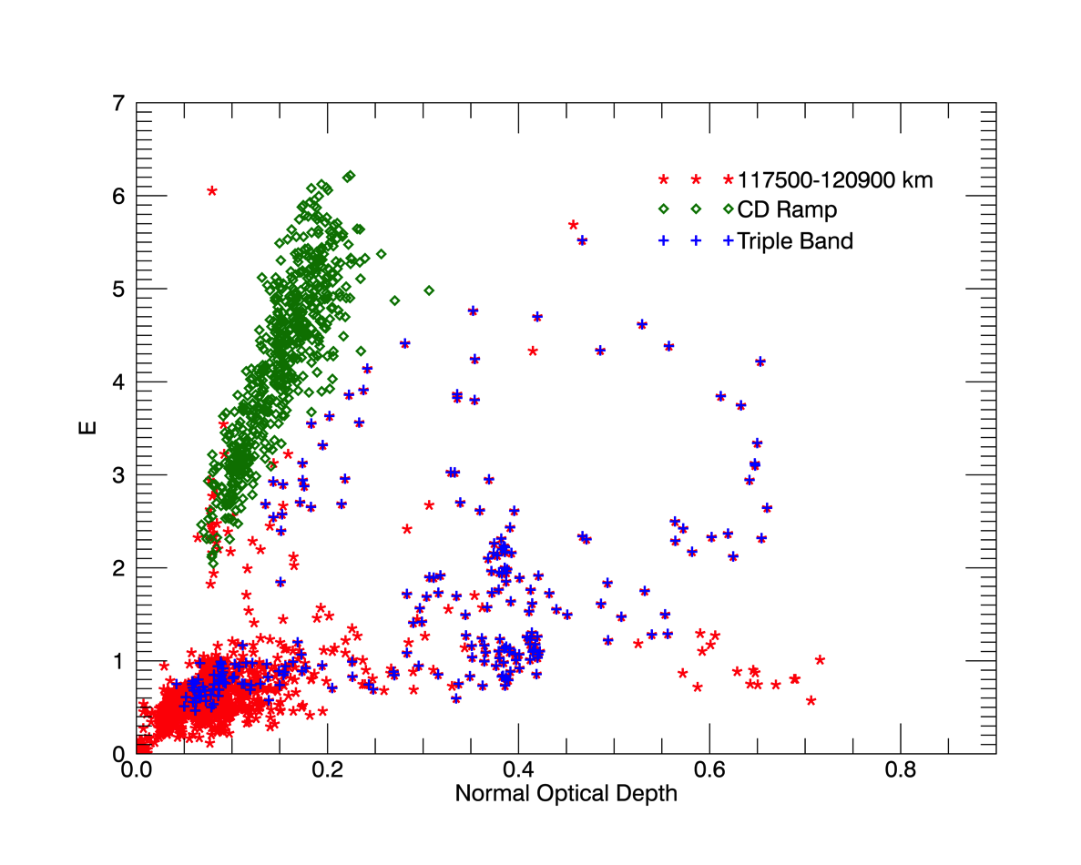
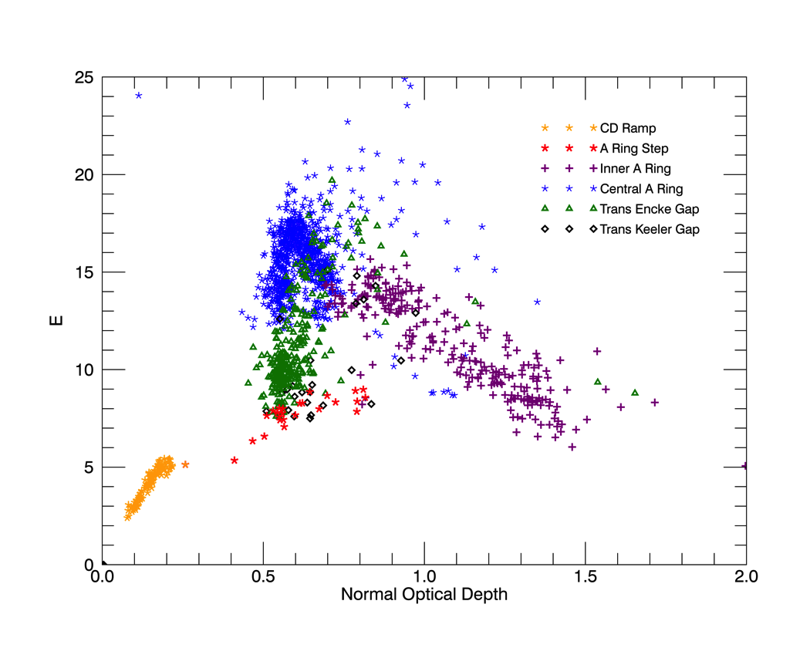
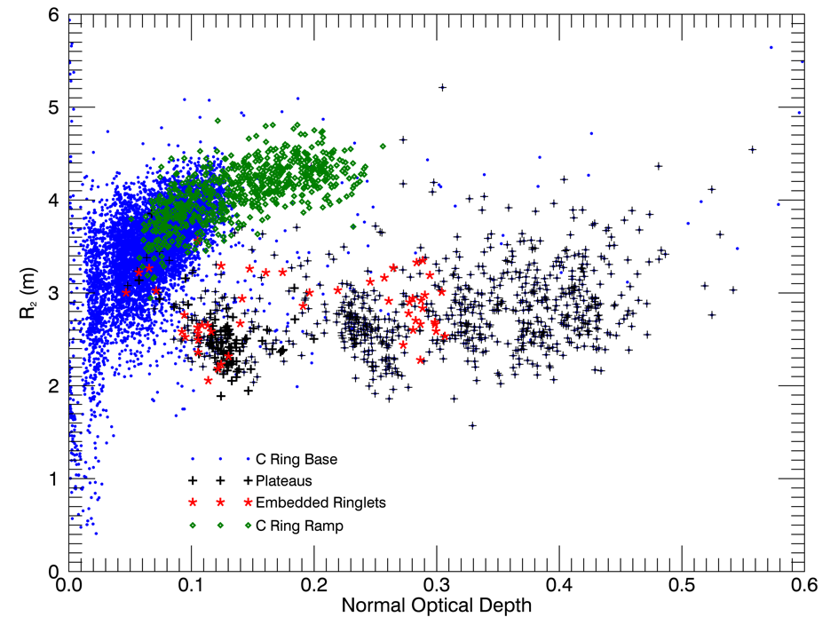
UVIS: particle size distributions vary with location
UVIS stellar occultations show variations in particle sizes and clumpiness across the rings
This scatter plots show how a stellar brightness variance paramteter changes with optical depth for different regions in the rings. If all regions were the same, then all the points would lie on a single curve. Different regions, identified by color, lie on distinctly different curves reflecting differences in their particle populations. This tool may provide important clues about particle size variations, and the underlying dynamics causing them, with very good radial resolution. This behavior can be compared with RSS profiles which independently measure particle size variations.
Different parts of
the Cassini Division
J. Colwell et al.
Different parts of the C Ring
Different parts of the A Ring

Slide 7
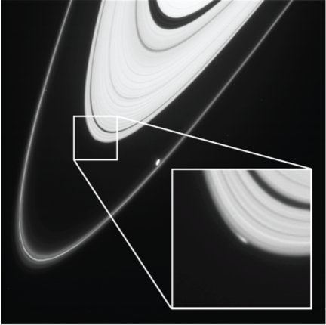
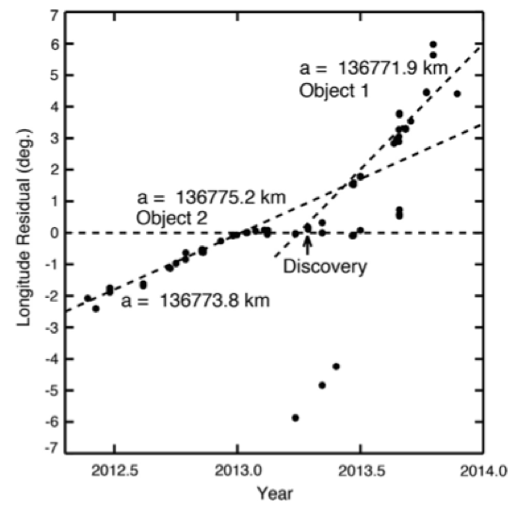
ISS: new object discovered at the very edge of the A Ring
ISS has discovered and tracked the orbital evolution of an object seen at the very outer edge of Saturn’s A Ring. The object, dubbed ‘Peggy’ informally, is possibly as large as 3 km in radius, but is not seen directly and its properties are inferred from the manner in which it perturbs nearby ring material. It is possible that this object is in the process of being expelled from the A Ring by gravitational torques, a process which is complicated by the Janus - Epimetheus 7:6 resonance at the A Ring edge. It has long been theorized that small moons are occasionally spun out of the main rings and it will be very exciting to track this object or group of objects over time. It is unknown if the object evolved to its current location by torques, or if the object was locally formed by compaction associated with the edge-forming resonances. Such an object, with such an explanation, has been studied near the outer edge of the B Ring.
The lower figure shows longitude residuals for, apparently, more than one object. “Peggy“ is represented by the single linear treand at bottom left; starting around 2013.1, a horizontal trend can be distinguished and starting around 2013.5, a steeper trend diverges. Each of these separate trends is caused by a separate object in a different orbit. The original object must have split into two or even more separate objects on slightly different orbits.
Murray et al (2014) Icarus, published online

Slide 8
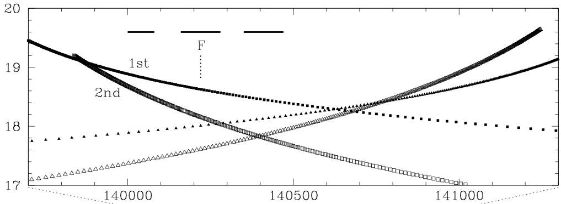
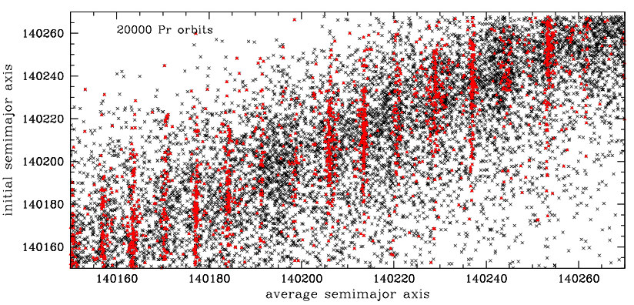
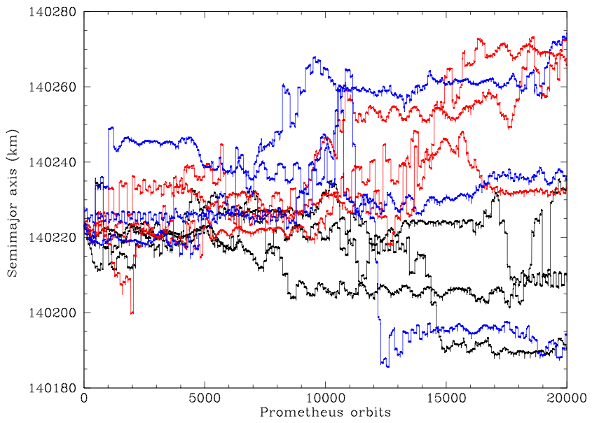
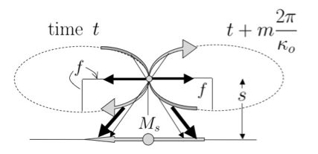
F Ring core: calm in the midst of chaos
The very existence of the km-wide F Ring core, which has kept a stable orbit since Voyager, is puzzling because it lies in a region so filled with resonances that particle orbits become chaotic very quickly. A new model shows how the unique properties of the region allow chaos-causing perturbations to be canceled and in fact for ring material to accumulate in one of a set of special locations determined by the precession period of the material.
The colored plot at left shows how the semimajor axis (SMA) of a particle at an arbitrary location in the F Ring region fluctuates wildly over only a decade or so. However, some brief periods of stability can be seen. The plot above shows the outcome of a long evolution, where the average SMA is plotted against the initial SMA for many particles. The red dots are particles with exceedingly stable orbits over the entire integration time; they lie at discrete locations not far from resonances with Prometheus. The F Ring core (arrow) lies in one of these stable predicted zones. The new theory shows how the rapid orbital precession in the region turns Lindblad resonances into stable sites by canceling each perturbation on the subsequent encounter.
Cuzzi et al (2014) Icarus, published online 1/12/2014

Slide 9
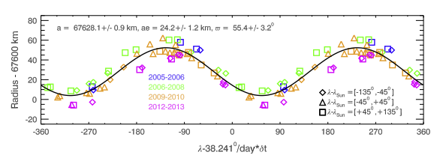
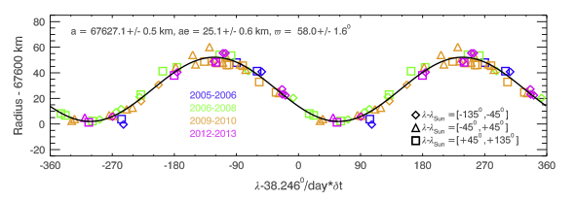
D68: eccentric ringlet in the D Ring
Elliptical and precessing only
D68 exhibits longitudinal brightness variations that rotate around the planet at around 1751.65 deg/day, and that might also evolve over time-scales of years.
D68 possesses a substantial eccentricity (ae =25 +/- 1km) and its precession rate is roughly consistent with current models of Saturn’s gravity field.
D68’s radial position does not exhibit obvious variations that can be attributed to normal mode oscillations with m=1.
D68’s mean radius decreased at a rate of 2.4 +/- 0.4 km/year between 2005 and 2013. D68 also seems to have moved outward between the Voyager and Cassini epochs, and the Cassini data hint that its mean radius may move back and forth with a period of around 15 Earth years.
Elliptical, precessing, and radially drifting at -2.38km/yr
Hedman et al (2014)

Slide 10
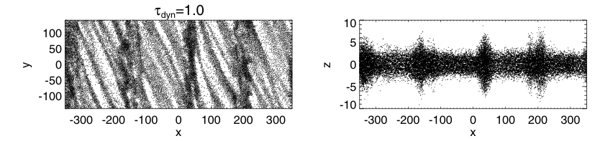
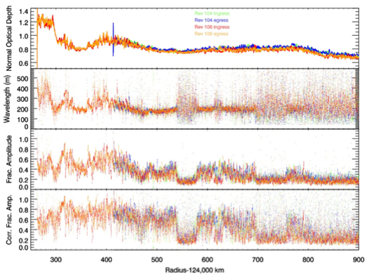
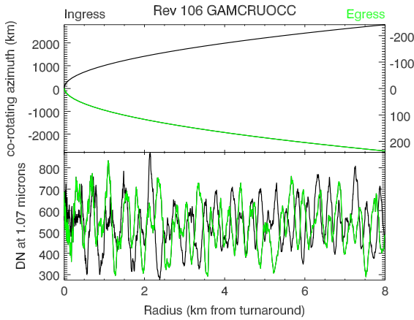
VIMS: occultations reveal “overstable” radial oscillations
Using results from ingress and egress occultations, Hedman et al (2014, A.J.) showed that viscous overstabilities permeate the entire inner A ring. Such structures result from an oscillating balance between viscous stress in collisions, and the natural orbital radial oscillations. The two figures directly below (black) show how these axisymmetric compressions can arise on top of ubiquitous trailing self gravity wakes; x is radial, y is angular, and z is vertical. The orange and blue curves show inferred wavelength (about 200m) and amplitude of the overstabilities.
In several regions, the wavelength becomes poorly defined and the amplitude drops to zero. These may be regions where the occulted star itself is too broad to resolve the pattern.
Comparing ingress and egress occultations that were separated in longitude by only a few thousand km, a longitudinal correlation length of about 2500km was determined.

Slide 11

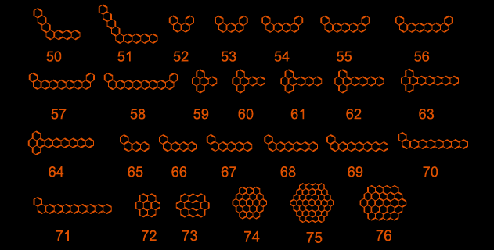

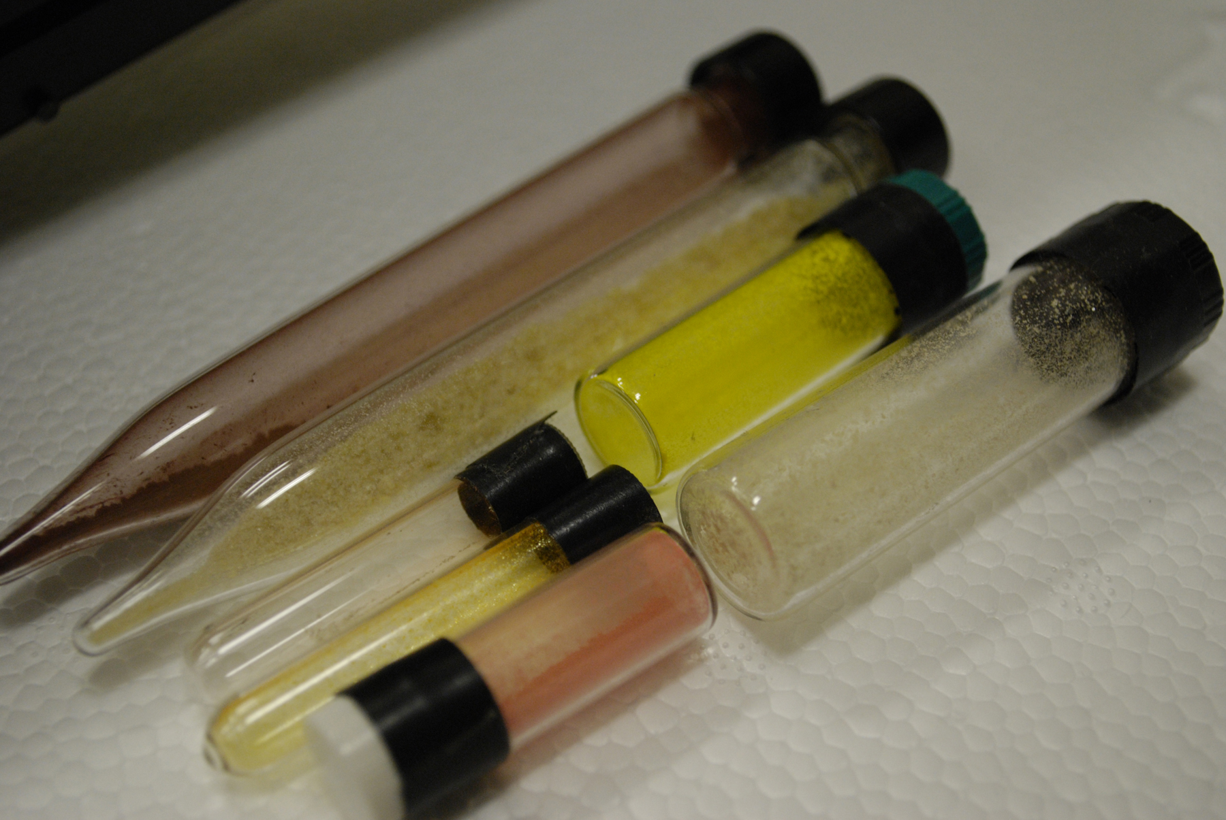

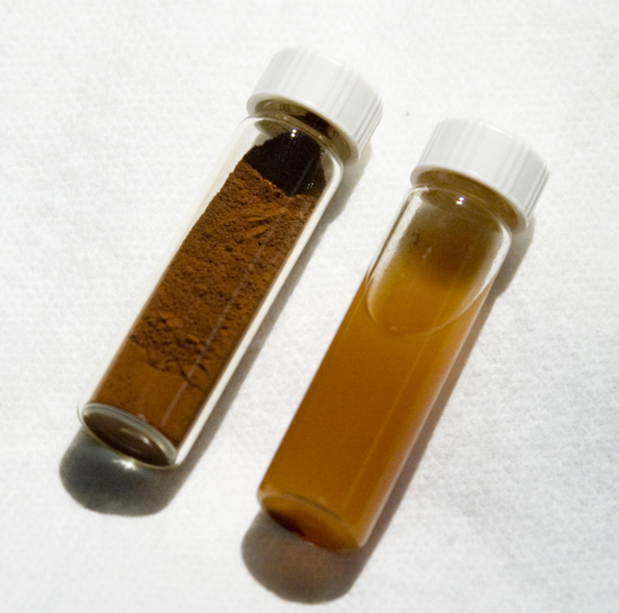
Why are the rings reddish? “organic” or inorganic origin?
Cuzzi et al 2009; Saturn from Cassini-Huygens
Clark et al this meeting
PAHs
(nano-)hematite
(nano-)iron
Notes:
THANKS TO LOU AND FARID FOR MANY CONVERSATIONS EXPLAINING THESE THINGS TO ME.

Slide 12
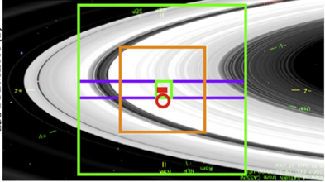
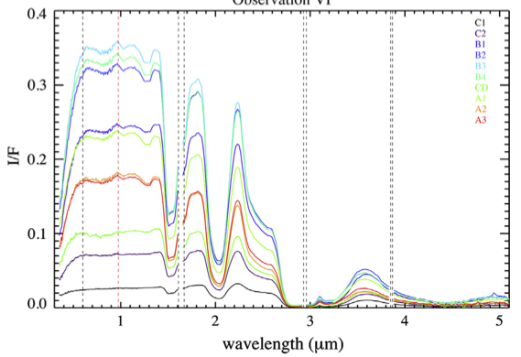
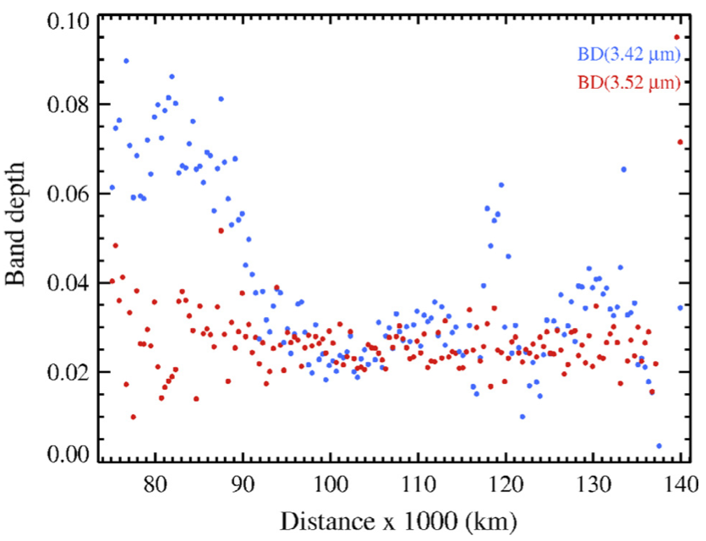
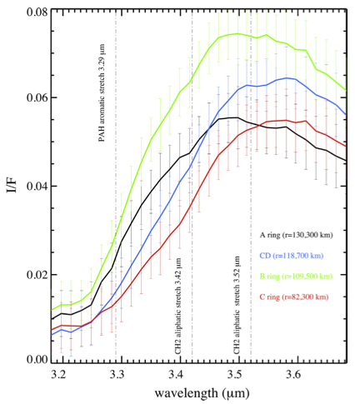
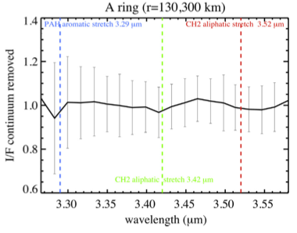
VIMS: Digging Deep for Organics
Filacchione et al 2014
“Aliphatic” (C-chains)
“Aromatic” (C-rings)
VIMS scientists have detected the spectral signature of what seems to be, at least one kind of organic material, and shown how it varies across the rings. The result supports the idea that the C Ring and Cassini Division are more “polluted” by C-chain material, like soot, plausibly from extrinsic bombardment. The C-Ring or aromatic material is not as definitively detected, but something of that nature appears to be pervasive, and therefore more likely to be primordial or intrinsic to the rings.

Slide 13
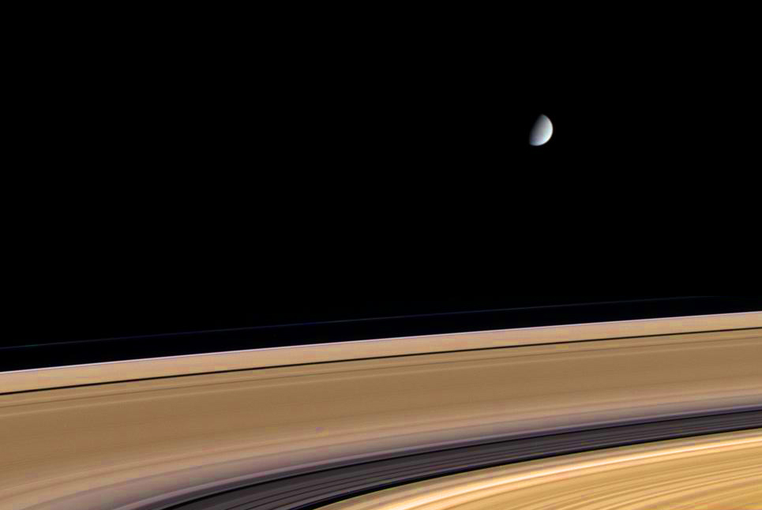
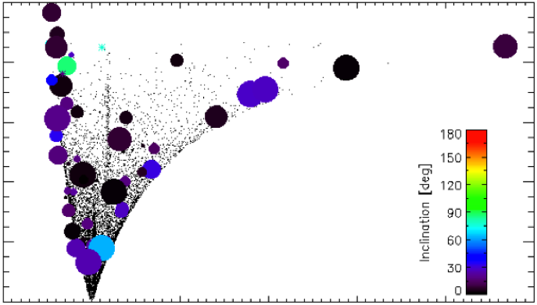
CDA: Mass flux of micrometeoroids is much smaller than expected
Kempf et al (2013) AGU Fall Meeting and 2014 Boulder Planetary Rings Workshop
Since Voyager, it has been thought that the rings must be much younger than the Solar System, or constant bombardment and pollution of the rings by interplanetary meteoroids would have darkened them more than observed.
One of the uncertainties is the ring mass (to be measured by Cassini in the late orbits) and the other is the mass flux of infalling meteoroids (mostly microns-to-mm-size).
CDA has now determined for the first time the mass flux into the Saturnian system
The measured flux implies that Saturn’s main rings could be as old as the solar system
Mass flux is dominated by particles originating from the Kuiper belt
eccentricity
Small dots: KBOs (model)
Semimajor axis

Slide 14
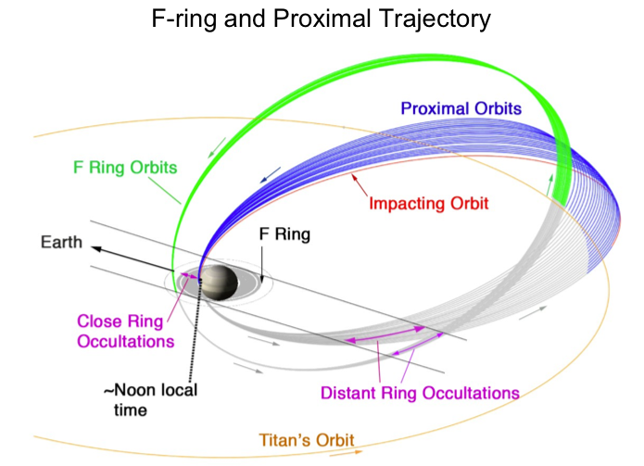
Planning a Terrific Finale
14

Slide 15
Publications (Aug 2013 to date)
Cooper, N. J.; Murray, C. D.; Williams, G. A. (2013) Local Variability in the Orbit of Saturn's F Ring; Astron. J. 145, article id. 161
Mitchell, C. J.; Porco, C. C.; Dones, H. L.; Spitale, J. N. (2013) The behavior of spokes in Saturn's B ring Icarus, 225, 446-474.
Bradley, E. T.; Colwell, J. E.; Esposito, L. W. (2013) Scattering properties of Saturn's rings in the far ultraviolet from Cassini UVIS; Icarus, 225, 726-739.
Hahn, J. M.; Spitale, J. N. (2013) An N-body Integrator for Gravitating Planetary Rings, and the Outer Edge of Saturn's B Ring; ApJ, 772, article id. 122
Spilker, L.; Ferrari, C.; Morishima, R. (2013) Saturn's ring temperatures at equinox; Icarus, 226, 316-322.
Deau, E.; Dones, L.; Charnoz, S.; West, R.A.; Brahic, A.; Decriem, J.; Porco, C.C. (2013) The opposition effect in Saturn's main rings as seen by Cassini ISS: 1. Morphology of phase functions and dependence on the local optical depth; Icarus, 226, 591-603.
Scharringhausen, Britt R.; Nicholson, Philip D. (2013) The vertical structure of the F ring of Saturn from ring-plane crossings; Icarus, 226, 1275-1293
Thomas, P. C.; Burns, J. A.; Hedman, M.; Helfenstein, P.; Morrison, S.; Tiscareno, M. S.; Veverka, J. (2013) The inner small satellites of Saturn: A variety of worlds; Icarus, 226, 999-1019
Harbison, R.A.; Nicholson, P. D.; Hedman, M.M. (2013) The smallest particles in Saturn's A and C Rings; Icarus, 226, 1225-1240
Kempf, S.; Altobelli, N.; Horanyi, M.; Srama, R. (2013) The Mass Flux of Micrometeoroids Into the Saturnian System; AGU Fall Meeting 2013, abstract #P21E-05

Slide 16
Attree, N. O.; Murray, C. D.; Williams, G.A.; Cooper, N. J. (2014) A survey of low-velocity collisional features in Saturn's F ring; Icarus, 227, 56-66
Nicholson, P. D.; French, R.G.; Hedman, M.M.; Marouf, E. A.; Colwell, J. E. (2014) Noncircular features in Saturn's rings I: The edge of the B ring; Icarus, 227, 152-175
Morishima, R.; Spilker, L.; Turner, N. (2014) Azimuthal temperature modulations of Saturn's A ring caused by self-gravity wakes; Icarus, 228, 247-259.
Cuzzi, J. N.; Whizin, A. D.; Hogan, R. C.; Dobrovolskis, A. R.; Dones, L.; Showalter, M. R.; Colwell, J. E.; Scargle, J. D. (2014) Saturn’s F Ring core: Calm in the midst of chaos; Icarus, 232, 157-175.
Hedman, M. M.; Burt, J. A.; Burns, J. A.; Showalter, M. R. (2014) Non-circular features in Saturn’s D ring: D68; Icarus, 233, 147-162.
Tamayo, D.l; Hedman, M. M.; Burns, J. A. (2014) First observations of the Phoebe ring in optical light; Icarus, 233, 1-8.
Murray, C.D.; Cooper, N. J.; Williams, G. A.; Attree, N. O.; Boyer, J.S. (2014) The discovery and dynamical evolution of an object at the outer edge of Saturn’s A ring; Icarus, 236, 165-168
Altobelli, N.; Lopez-Paz, D.; Pilorz, S.; Spilker, L.J.; Morishima, R.; Brooks, S.; Leyrat, C.; Deau, E.; Edgington, S.; Flandes, A. (2014) Two numerical models designed to reproduce Saturn ring temperatures as measured by Cassini-CIRS; Icarus, 238, 205-220.
Hedman, M. M.; Nicholson, P. D.; Salo, H. (2014) Exploring Overstabilities in Saturn's A Ring Using Two Stellar Occultations; The Astronomical Journal, 148, Issue 1, article id. 15
Filacchione, G.; Ciarniello, M.; Capaccioni, F.; Clark, R. N.; Nicholson, P. D.; Hedman, M. M.; Cuzzi, J. N.; Cruikshank, D. P.; Dalle Ore, C. M.; Brown, R. H.; Cerroni, P.; Altobelli, N.; Spilker, L. J. (2014) Cassini-VIMS observations of Saturn’s main rings: I. Spectral properties and temperature radial profiles variability with phase angle and elevation; Icarus, 241, 45-65.
French, R. S.; Hicks, S. K.; Showalter, M. R.; Antonsen, A. K.; Packard, D. R. (2014) Analysis of clumps in Saturn’s F ring from Voyager and Cassini; Icarus, 241, 200-220 (save for next year; Oct 2014).

