Slide 1
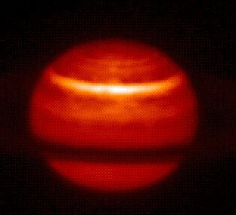
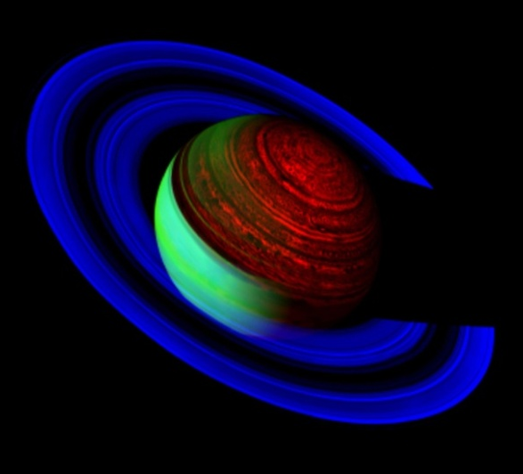
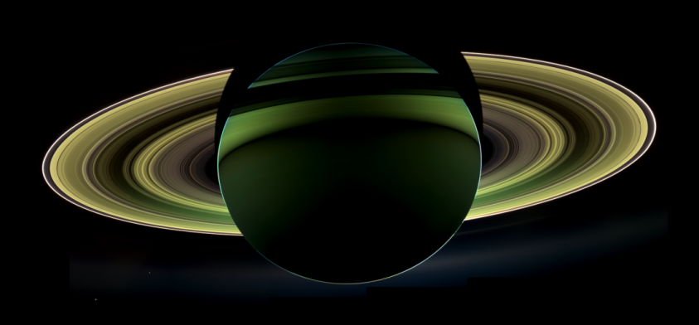
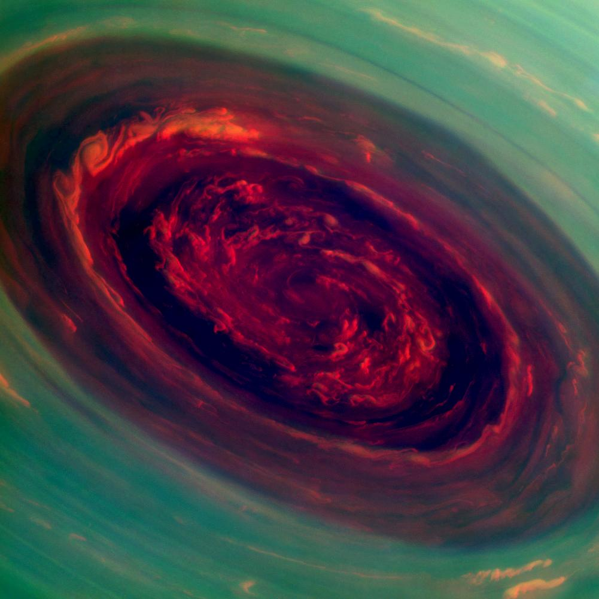
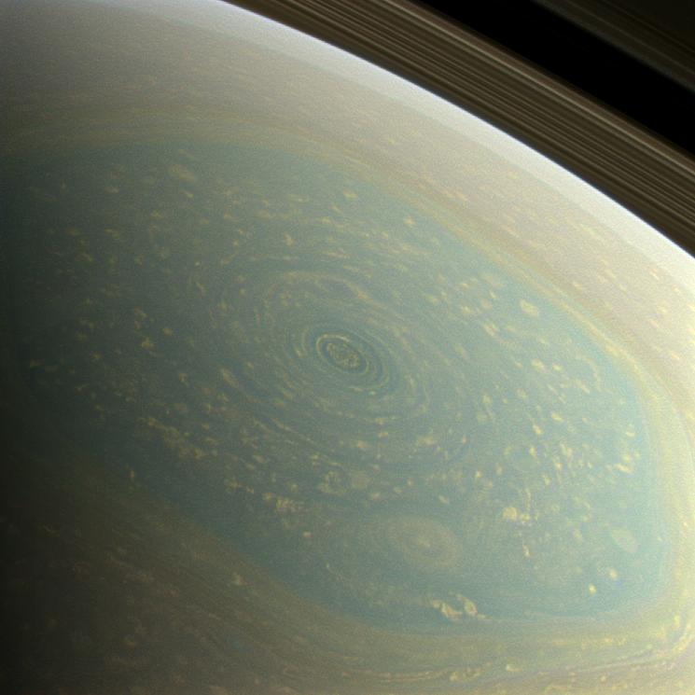
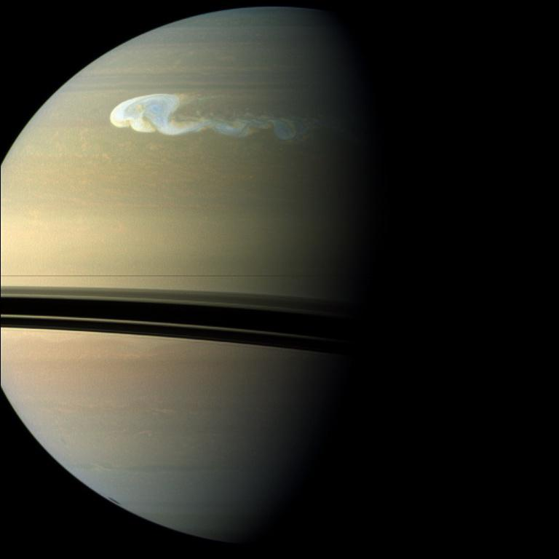
Cassini CHARM Presentation: Saturn
Andrew Ingersoll
July 29, 2014

Slide 2
Ammonia cloud relative humidity (RH) derived from 2.2-cm thermal maps (RADAR).
The head of the great 2010-2011 storm is at 30°-40° latitude, 180° longitude (arrow).
There is a smaller storm, probably also a lightning storm, at -45° latitude, 325° longitude.
Laraia et al. Icarus 226 (2013) 641-654; Janssen et al. Icarus 226 (2013) 522-535.

Slide 3
ISS: Daytime Lightning Observed!
NASA’s Cassini spacecraft has captured images of last year’s storm on Saturn, the largest storm seen up-close at the planet, with bluish spots in the middle of swirling clouds.
Those bluish spots indicate flashes of lightning and mark the first time scientists have detected lightning in visible wavelengths on the side of Saturn illuminated by the sun.
The lightning flashes appear brightest in the blue filter of Cassini’s imaging camera on March 6, 2011. Scientists aggressively heightened the blue tint of the image to determine its size and location.
Scientists are still analyzing why the blue filter catches the lightning. It might be that the lightning really is blue, or it might be that the short exposure of the camera in the blue filter makes the short-lived lightning easier to see.
What scientists do know is that the intensity of the flash is comparable to the strongest flashes on Earth. The visible energy alone is estimated to be about 3 billion watts lasting for one second. The flash is approximately 100 miles (200 kilometers) in diameter when it exits the tops of the clouds. From this, scientists deduce that the lightning bolts originate in the clouds deeper down in Saturn’s atmosphere where water droplets freeze.

Slide 4
Senior Review Saturn Figure 1

Slide 5
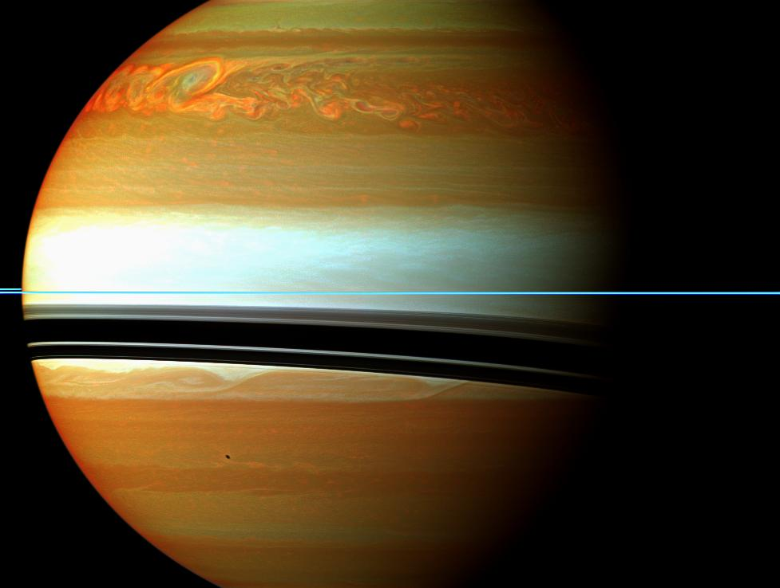
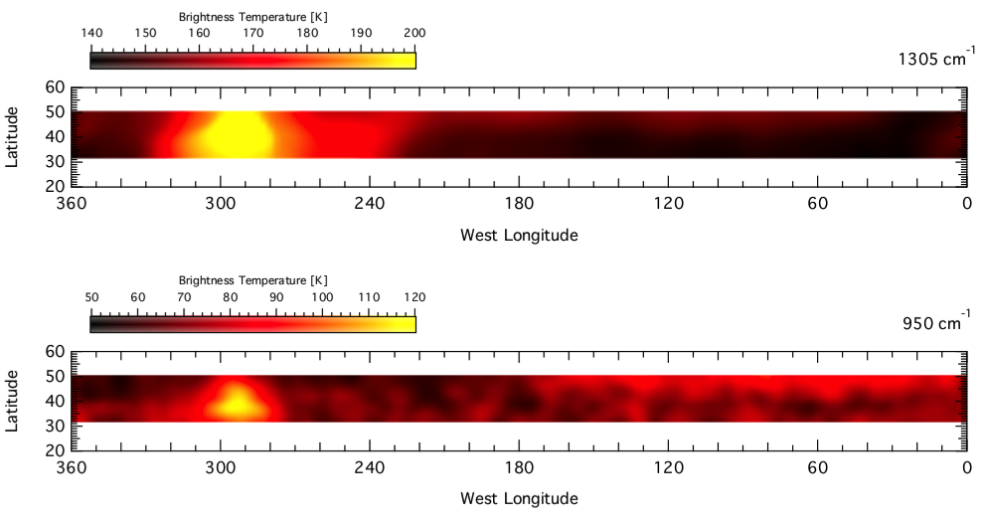
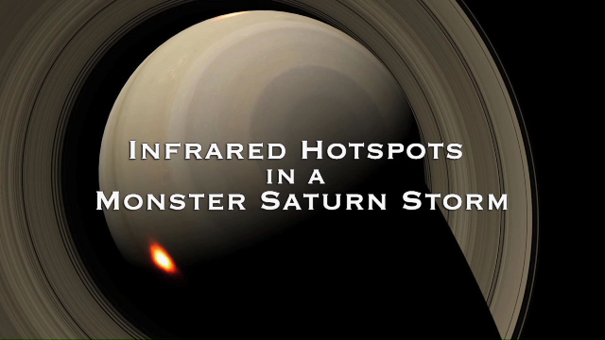
CIRS: Saturn Burps and Beacons
May 4, 2011 – CIRS Mid-infrared temperature map at 35N and 45N
CH₄ Emission
C₂H₄ Emission
CIRS tracked the evolution of the vortexes left behind in the stratosphere after the Northern Storm.
Temperature increases of ~80K have been observed in the stratosphere. Such temperature increases are unprecedented in the solar system.
Huge abundance increases was also detected for several molecules, including ethylene, which has previously never been observed in the atmosphere of Saturn. Why some molecular abundances changed drastically, while others did not, remains a mystery.
This is an excellent example of where the synergy of Cassini data and ground based observations (Celeste at Kitt Peak in this case) can enhance science return.

Slide 6
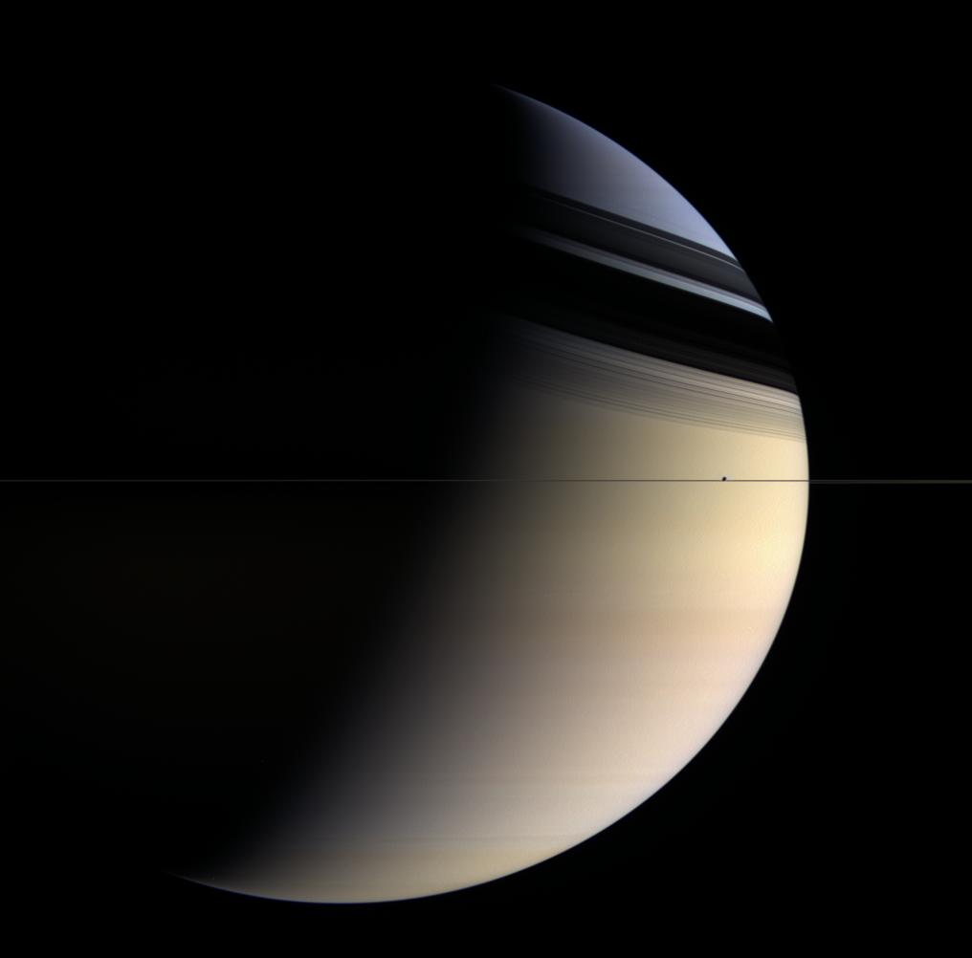
Saturn after solstice
(flipped north-south)

Slide 7
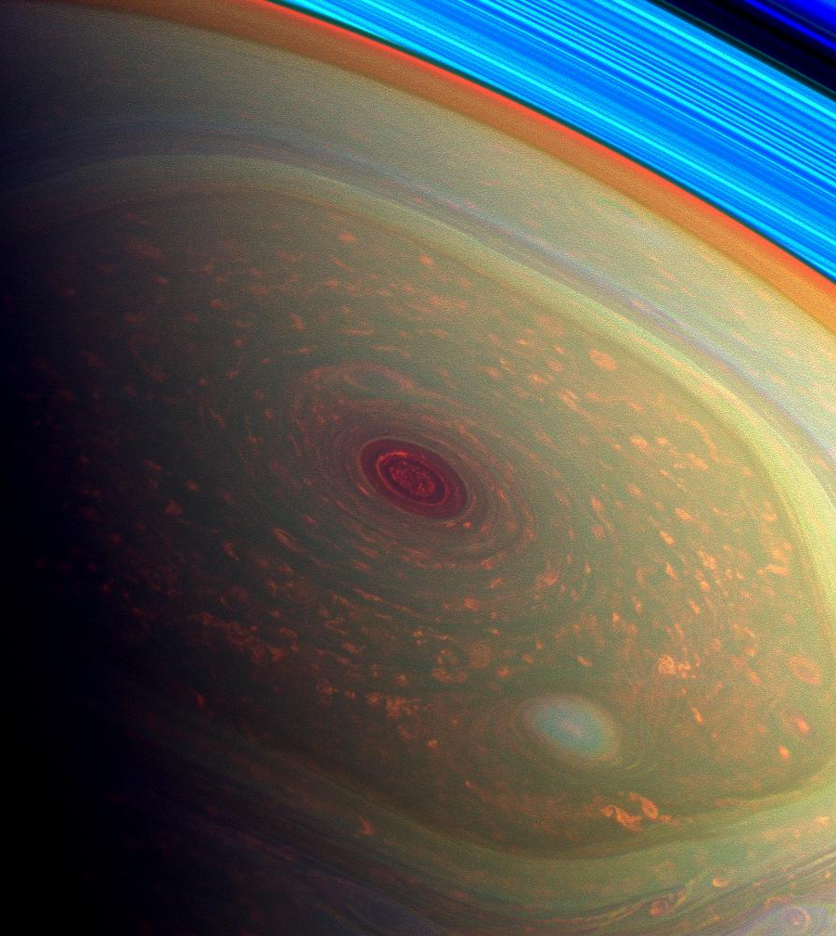
Hurricane “Eye” at the North Pole
Now that it is spring, the spacecraft was put into a series of inclined orbits that revealed the north pole in sunlight
Winds around the giant hexagon are 3 times faster than Earth’s jet streams
Eyewall clouds tower 50-70 km above the deep clouds at center (shown red in this false-color image)
Lightning is concentrated in the westward jets at 35° north and south latitudes
Northern polar hexagon and hurricane
Key Questions from Vision and Voyages for Planetary Science 2013-2022: “How do giant planets serve as laboratories to understand Earth, solar system and extrasolar planetary systems?”
Notes:
The yellow outline of the cloud indicates a substantial abundance of ammonia crystals dredged up from deeper in the atmosphere.
Green: continuum filter
Bottom, radar image, 2.2 cms: Bright is where the ammonia vapor is absent, allowing thermal radiation from deeper, warmer levels to escape.
the clouds look dark because ammonia ice is absorbing the light.

Slide 8

ISS: The Red Rose Of Saturn
For the first time ever, imaging scientists have processed stunning high resolution images and video of a massive storm swirling over Saturn’s north pole.
These videos and images have helped scientist estimate the wind speeds and size of the storm.
Images processed in false color allow scientists to more easily view cloud formations as well as the various levels of the clouds, as low lying clouds appear differently than higher level clouds.
Being called “The Red Rose of Saturn” this image shows, in great detail, the cloud patterns that make up the vortex of the north polar storm of Saturn.

Slide 9
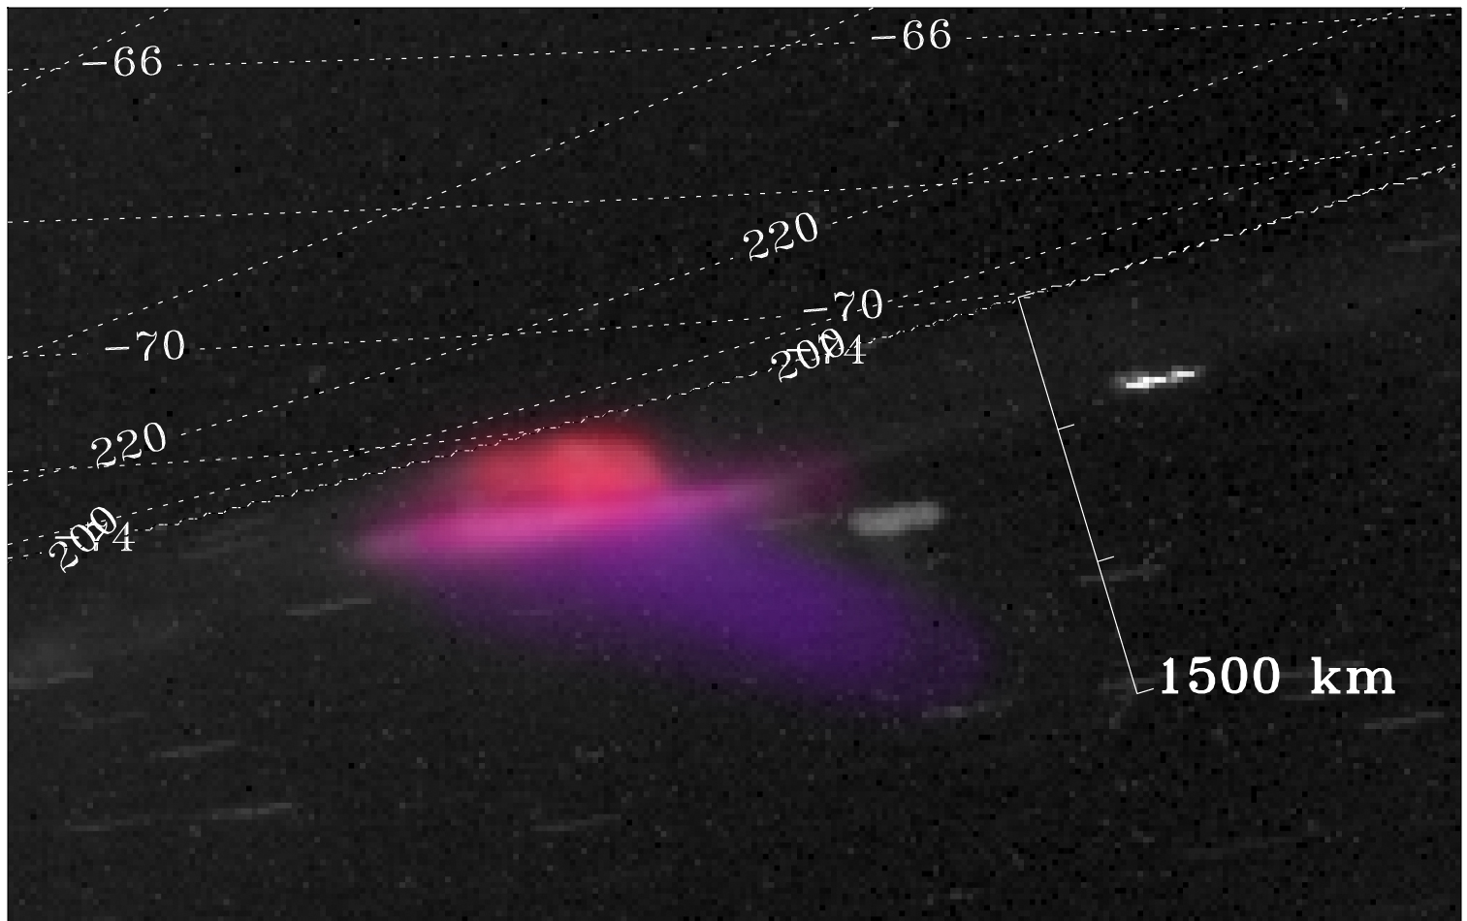
Southern hemisphere aurora. Quasi-true color in visible light

Slide 10
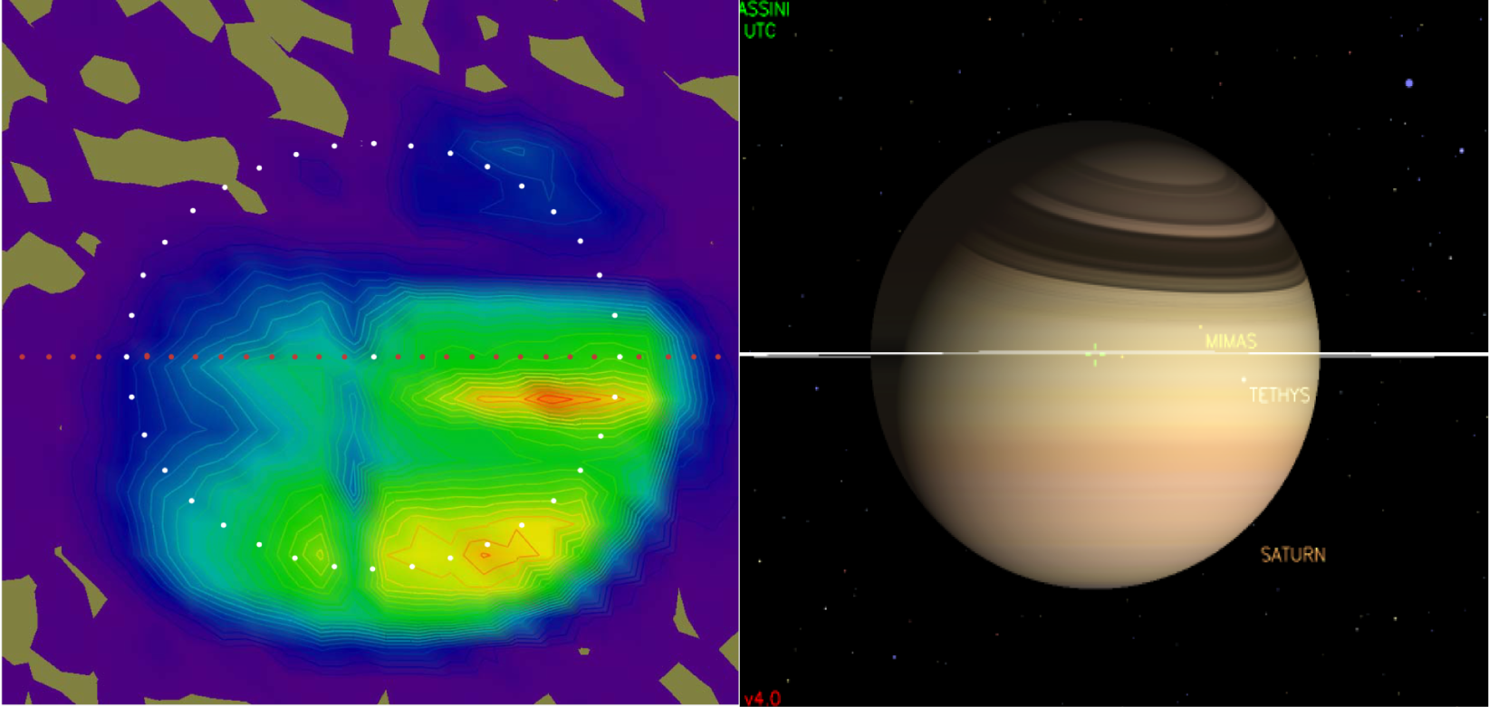
F1: UVIS 2005 image of the Saturn thermosphere in H₂ resonance emission
Brightness contours of the UVIS system scan image of one of several resonance features of H₂ that appear in the sunlit thermosphere, compared to the image of Saturn in the visible in the same time frame. The emission is directly related to heat deposition at the top of the atmosphere. Properties of the emission definitively establish the electron excitation process as electrodynamic, and not electron precipitation as in aurorae. Emission properties indicate that ~95% of electron excitations result in H₂ dissociation (and subsequent heating) compared to ~7% in the aurora. Forcing of the process is the combined effect of electrodynamics and solar deposition in non LTE H₂. The vertical depression near planet center is caused by dropout in coverage. The rings are edge-on in this image.

Slide 11
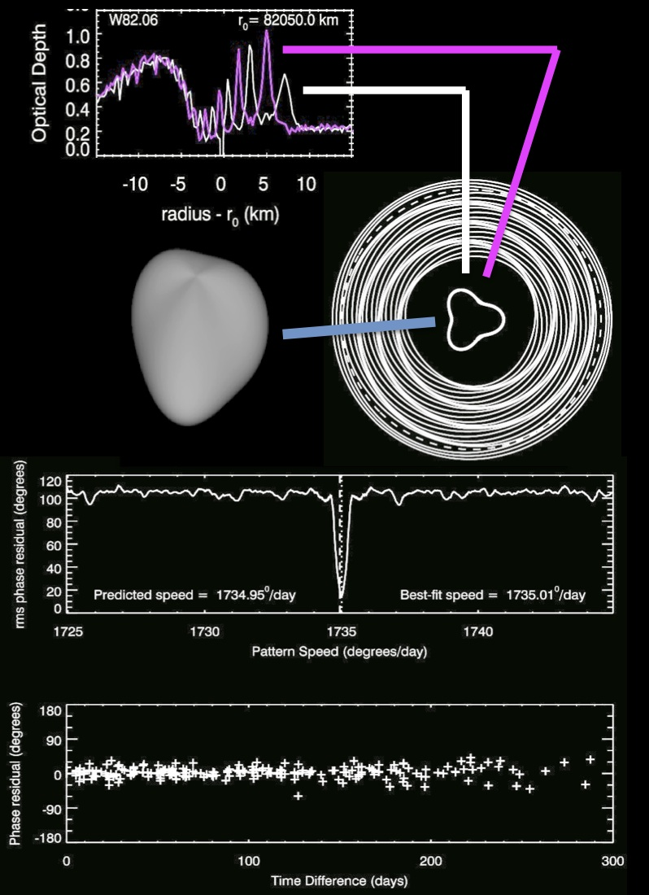
Kronoseismology:
Using Saturn’s rings as
a giant seismometer to
measure internal
structure and rotation.
What causes the planet
to oscillate is still a
mystery. Earthquakes
are unlikely in a fluid
planet. Convection is a
more likely source.

Slide 13
Cassini Images of Saturn in February 2012 (left) and Jupiter in December 2000 (right)

