Slide 1

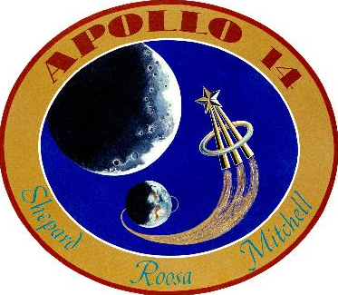

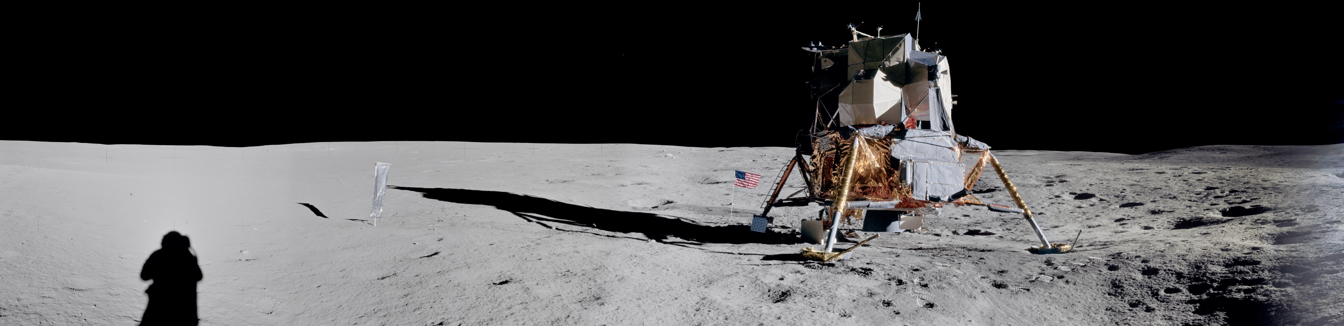
Apollo 14
Presenter’s name
Presenter’s title/position
Notes:
-Image source: https://www.lpi.usra.edu/resources/apollopanoramas/pans/?pan=JSC2007e045377
-For mission patch image, see https://history.nasa.gov/apollo_patches.html
-Tips:
You do not need to use everything in this presentation!
Feel free to alter/edit this presentation to fit your specific needs/audience
-If you have any questions, please contact presentation author Staci Tiedeken (staci.l.tiedeken@nasa.gov, NASA GSFC)
-Updated January 2023

Slide 2
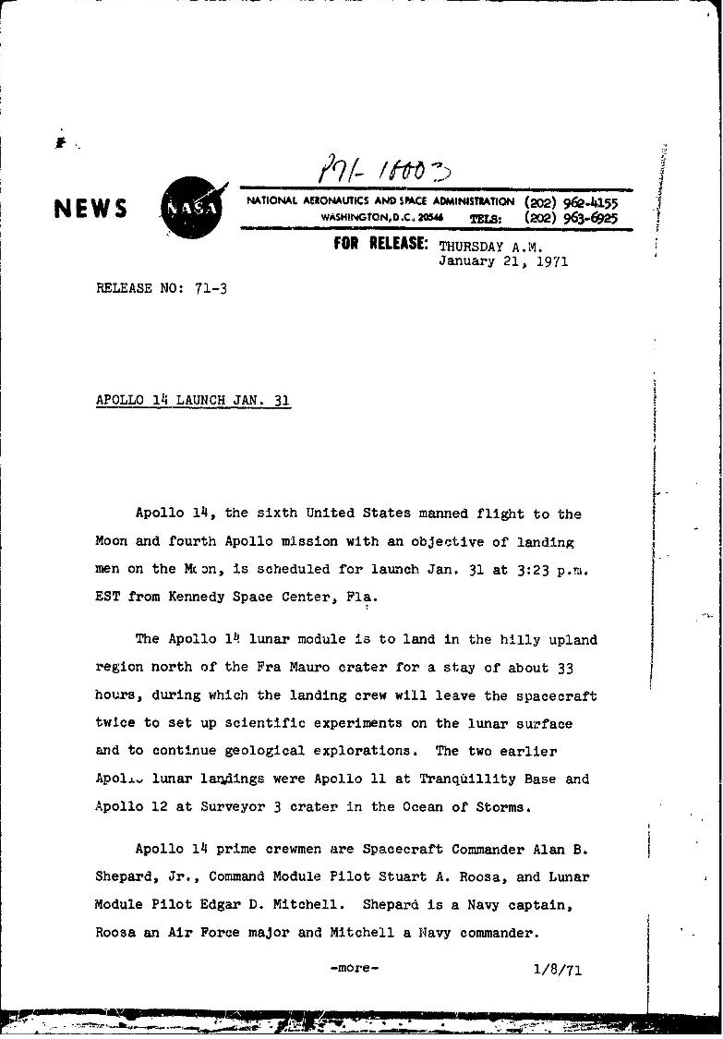
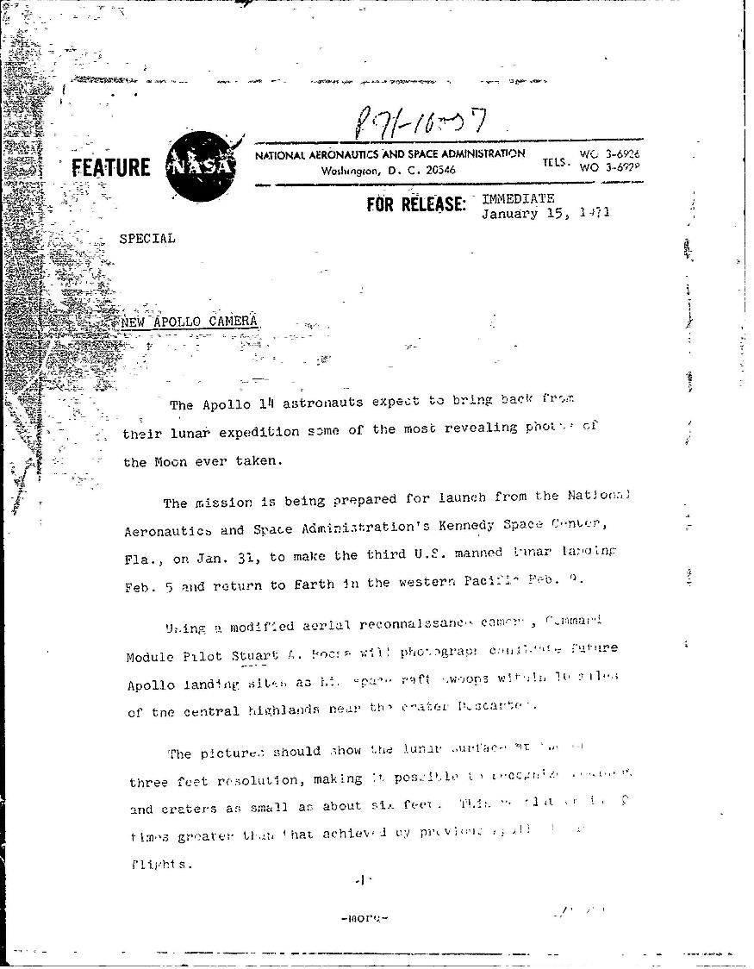
NASA Press Releases
Notes:
-NASA press releases (Jan. 1971): https://historydms.hq.nasa.gov/sites/default/files/DMS/e000041728.pdf

Slide 3
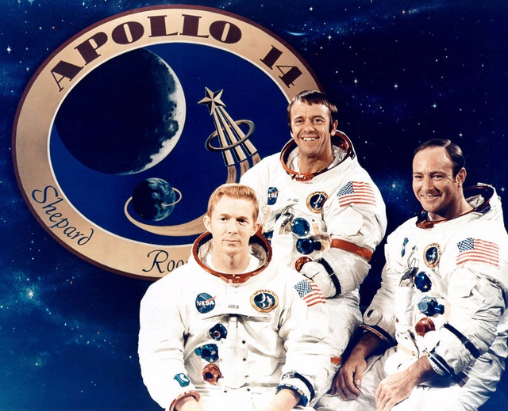
Overview
Overview
January 31-February 9, 1971
Stuart A. Roosa, Alan B. Shepard, Jr., Edgar D. Mitchell
Notes:
-Image credit: NASA → Apollo 14 crew. From left: Stuart Roosa (command module pilot), Alan Shepard Jr. (commander), and Edgar Mitchell (lunar module pilot).
-Third human Moon landing – Shepard & Mitchell set foot on the lunar surface on February 5, 1971, almost ten months after Apollo 13’s intended landing date.
-The mission plan for Apollo 14 had several objectives for the crew to accomplish: investigate the lunar surface near a preselected point in the Fra Mauro formation (Apollo 13’s intended landing site), deploy and activate an Apollo Lunar Surface Experiments Package (ALSEP), further develop the ability to work in the lunar environment, and obtain photographs of candidate exploration sites.
-Alan Shepard Jr. was the mission commander and was the first U.S. astronaut in space as the pilot of the Mercury 3 mission, Freedom 7 (May 5, 1961). He was back-up pilot for Mercury 9 and then was grounded due to an inner ear ailment until May 7, 1969. In June 1971, he resumed duties as Chief of the Astronaut Office, the position he had held while grounded.
-Stuart Roosa was the command module pilot and was the backup command module pilot for Apollo 16.
-Edgar Mitchell was the lunar module pilot and was the backup lunar module pilot for Apollo 10 and Apollo 16.

Slide 4
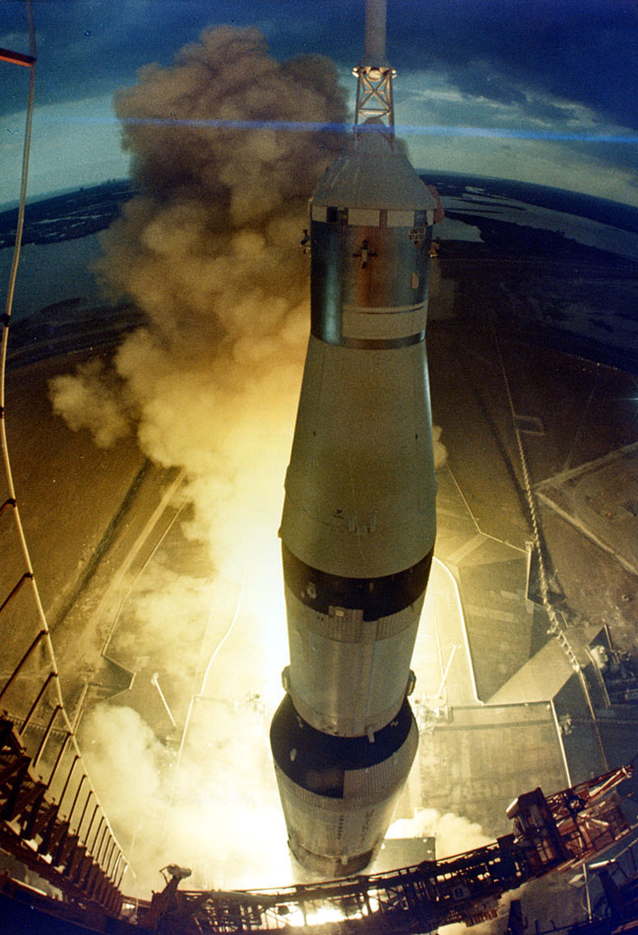
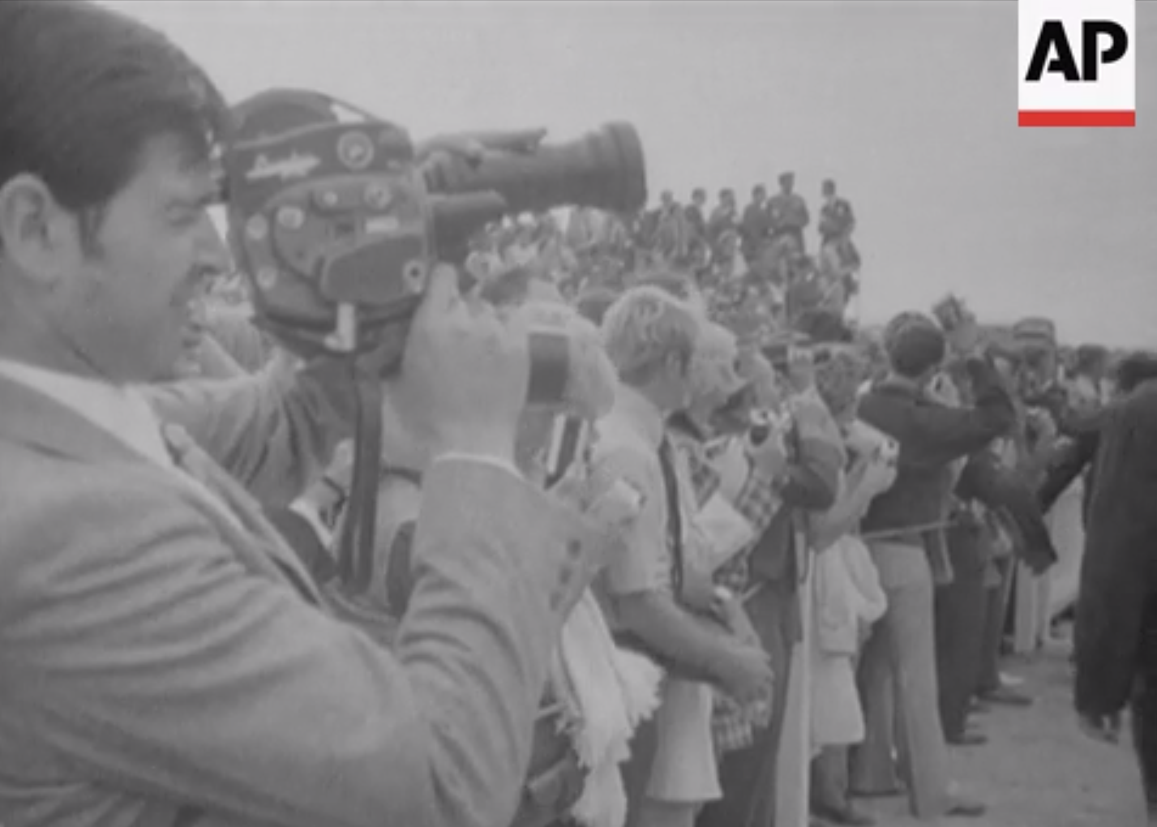
Launch
Launch
Notes:
-Image credits: Left: Associated Press; link to video from which the image was taken: https://bit.ly/2G8eL2O; Right: NASA (Image: KSC-71PC-106)
-Because of unsatisfactory weather conditions, the launch was delayed about 40 minutes, for the first time in the Apollo program.
-The 363-foot-tall Apollo 14 space vehicle was launched from Pad A, Launch Complex 39, Kennedy Space Center, at 4:03 p.m. EST on January 31, 1971.
-As with the previous Apollo crewed missions, adjacent to Kennedy Space Center (~3.5 miles away), thousands of spectators camped out on beaches and roads to watch the launch of Apollo 14.

Slide 5
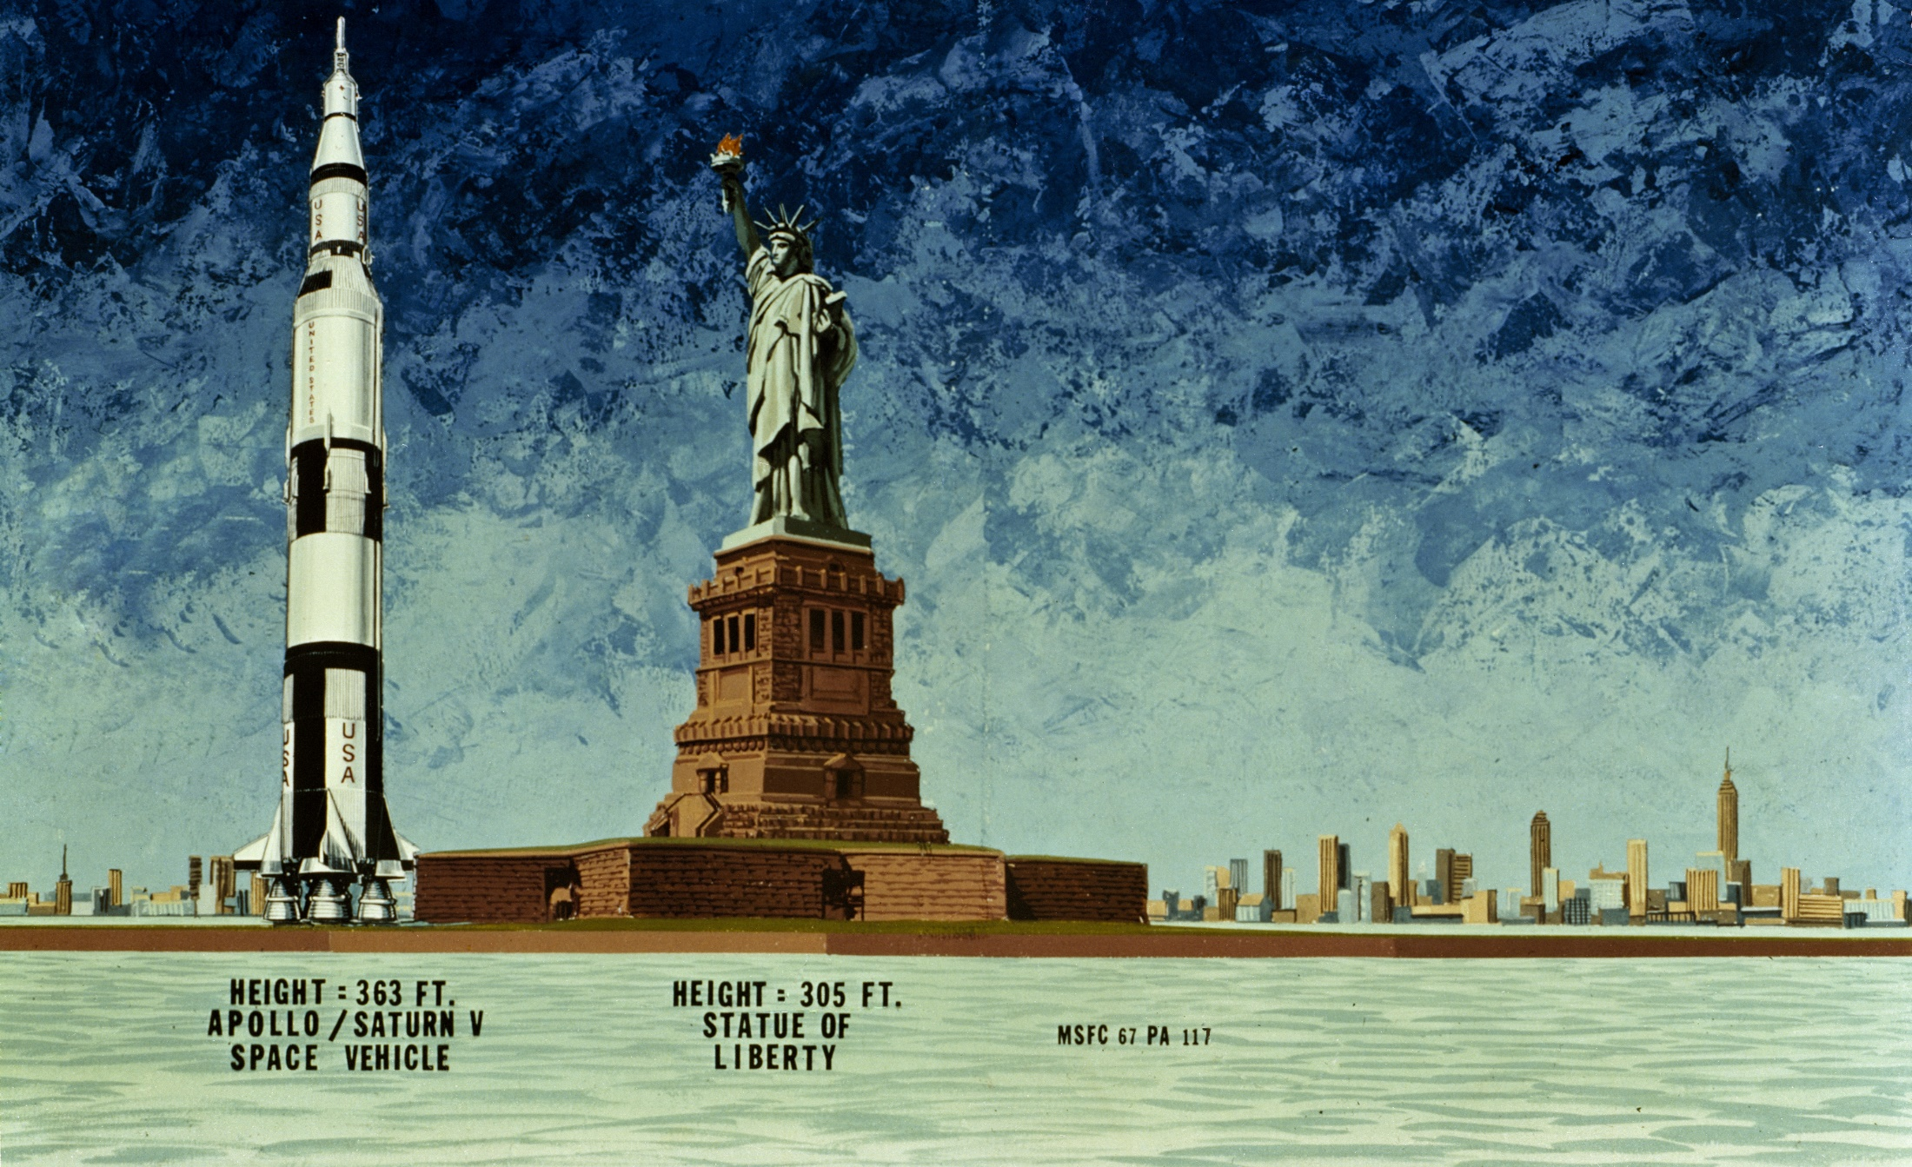
Saturn V Size Comparison
Notes:
-Image credit: NASA → 1967 illustration compares the Apollo Saturn V spacecraft (363 ft) of the Moon Landing era to the Statue of Liberty (305 ft).
-A Saturn V rocket has 3 stages, 11 powerful rocket engines, and huge tanks for kerosene (RP-1) and liquid hydrogen and oxygen. It’s still the largest crewed rocket ever flown and the only one to carry humans beyond Earth orbit.
Height: 111 meters (363 feet)
Diameter: 10 meters (33 feet)
Mass: 2,840,622 kg (6,262,500 pounds) at liftoff (about 100 fully loaded tractor-trailers – only 1% of this actually goes to the Moon)
Maiden Flight: Nov. 9, 1967 (uncrewed)
The rocket generated 34.5 million newtons (7.6 million pounds) of thrust at launch, creating more power than 85 Hoover Dams.
Could launch about 43,500 kg (50 tons) to the Moon (about the same as 4 school buses).
The Apollo 14 launch vehicle was the ninth in the Apollo Saturn V series and was the seventh crewed Saturn V vehicle.
More info on Saturn V: https://solarsystem.nasa.gov/news/337/what-was-the-saturn-v/

Slide 6
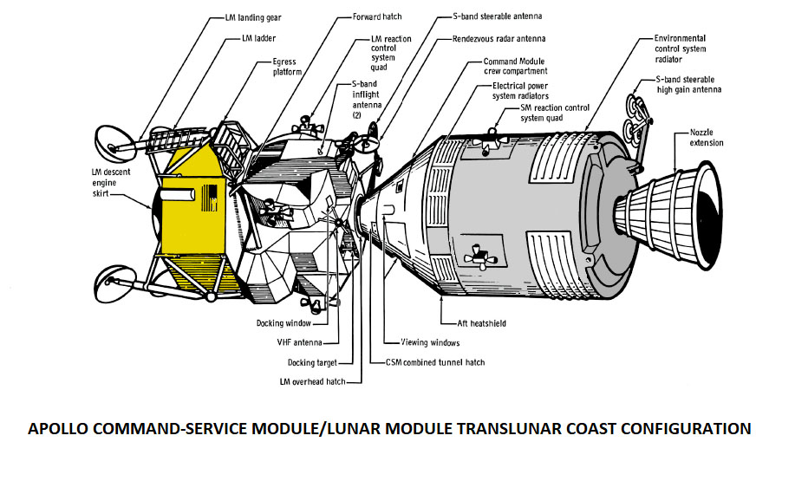
Apollo Spacecraft Design
Apollo Spacecraft
Antares Lunar Module
Kitty Hawk
Thrusters
Command Module
Service Module
High-Gain Antenna
Thrusters
Thrusters
Descent Stage
Ascent Stage
Notes:
-Image credit: NASA → Diagram of the combined Apollo command and service module/lunar module translunar coast configuration.
-The lunar module was named Antares while the command module was named Kitty Hawk for Apollo 14.
-Source: https://history.nasa.gov/afj/ap13fj/04day1-end.html

Slide 7
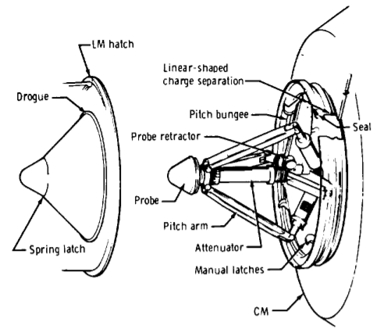
Overview
Docking Issues
Lunar module hatch
Linear-shaped charge separation
Drogue
6 attempts were required to achieve docking of the lunar module with the command module
Probe retractor
Seal
Probe
Pitch arm
Spring
latch
Attenuator
Manual latches
Command module
Notes:
-Image credit: NASA → From page 3 of the “Apollo experience report: The docking system” – https://ntrs.nasa.gov/api/citations/19720018207/downloads/19720018207.pdf
The probe and drogue docking system used to dock the lunar module with the command module consisted of a probe mounted on the command module and a drogue installed in the lunar module.
The probe consisted of a probe head, a single center piston for impact energy attenuation, three pitch arms with bungees for lateral loads and vehicle alignment, and an electrical reel mechanism to effect retraction after initial capture.
The drogue was a funnel-shaped structure that guided the probe head to the initial capture position, where drogue-mounted latches engaged the probe head.
For crew transfer after hard docking, both the probe and the drogue had to be removed to provide a clear passageway.
-During Apollo 14’s transposition and docking following translunar injection (a propulsive maneuver used to set a spacecraft on a trajectory that will cause it to arrive at the Moon), 6 attempts were required to achieve docking of the lunar module and command module because of mechanical issues.
The capture latch assembly must not have been in the locked configuration during the first 5 attempts. The problem was most likely caused by failure of the capture latch spider to reach the forward locked position.
The failure to achieve capture latch engagement was either due to foreign material restricting the normal function of the capture latch mechanism or jamming of the translation cam.
Two possible causes could have prevented the capture latch spider from moving properly.
The first possibility is that of a side load being introduced into the torque shaft by the torsion spring or by other means; this may cause the ball end of the torque shaft to bind against the cam. This failure occurred on another probe during acceptance tests and it was possible to demonstrate this same failure on the Apollo 14 probe by applying a side load, but the failure did not occur consistently.
The second possibility is that some small foreign material may have been lodged in the probe in a manner that prevented operation of the mechanism. Burrs from an unknown source were discovered in the bore of the tension tie plug. A foreign particle might have caused the problem.
-More info: page 34 of https://ntrs.nasa.gov/api/citations/19720018207/downloads/19720018207.pdf

Slide 8
Apollo 12 Landing Site
Moon on February 5, 1971
Notes:
-Image credit: NASA's Scientific Visualization Studio → The second green dot from the left marks the site of the Apollo 14 landing in the Fra Mauro formation. The green dot next to Apollo 14’s landing site is that of Apollo 12 which landed in Oceanus Procellarum (“Ocean of Storms”). Apollo 11’s landing site in Mare Tranquillitatis is shown as the green dot at the far right.
-The Apollo 14 landing in the Fra Mauro formation occurred at 4:18 a.m. EST on February 5, 1971.
Fra Mauro is a widespread hilly geological area covering large portions of the lunar surface around Mare Imbrium and is thought to be composed of ejecta from the impact which formed Imbrium.
Shepard and Mitchell landed only 175 feet (53 meters) from their targeted landing site in a hilly upland region north of Fra Mauro crater, a scientifically important site that had been the destination of the aborted Apollo 13 mission.
Roosa lifted Kitty Hawk (the command module) to a higher, circular orbit, where he would conduct a number of tasks including photographing the Descartes region, which became Apollo 16’s landing site, and conveying observations of prominent lunar landmarks to make landing accuracy on future missions even better.
-A waxing gibbous Moon phase was chosen since the terminator was reasonably close to the landing site.
This meant that the Sun would be behind the lunar module as it came in for landing. This provided the most favorable lighting conditions to enable the astronauts to better discern and avoid craters, because the craters would have more elongated shadows.
It also kept the surface temperatures at a reasonable level once the astronauts got outside, since it was effectively “lunar morning.”

Slide 9
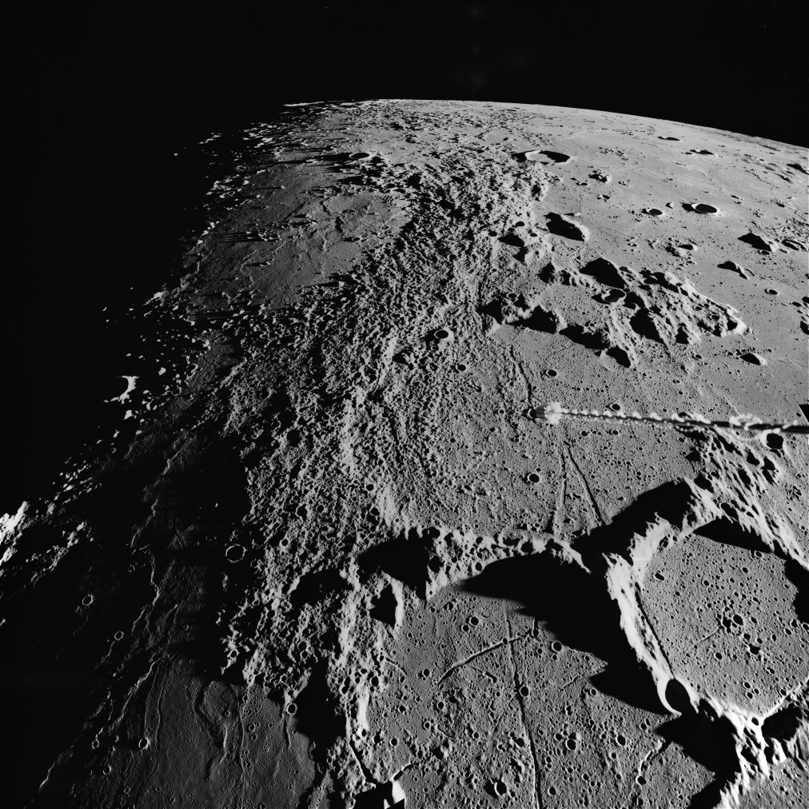
Overview
Fra Mauro Formation
Notes:
-Image credit: NASA → The hummocky (hilly) terrain covering much of the left portion of the photograph is the Fra Mauro formation, material interpreted to be ejecta from the Imbrium Basin.
The arrow points to the Apollo 14 landing site in the Fra Mauro formation.
The low illumination angle emphasizes the undulating surface texture of the Fra Mauro formation.
NASA image: AS16-1420 (https://history.nasa.gov/SP-362/ch3.2.htm)
http://wms.lroc.asu.edu/apollo/view?image_id=AS16-M-1420
-More info on Fra Mauro & Apollo 14: http://lroc.sese.asu.edu/posts/105

Slide 10
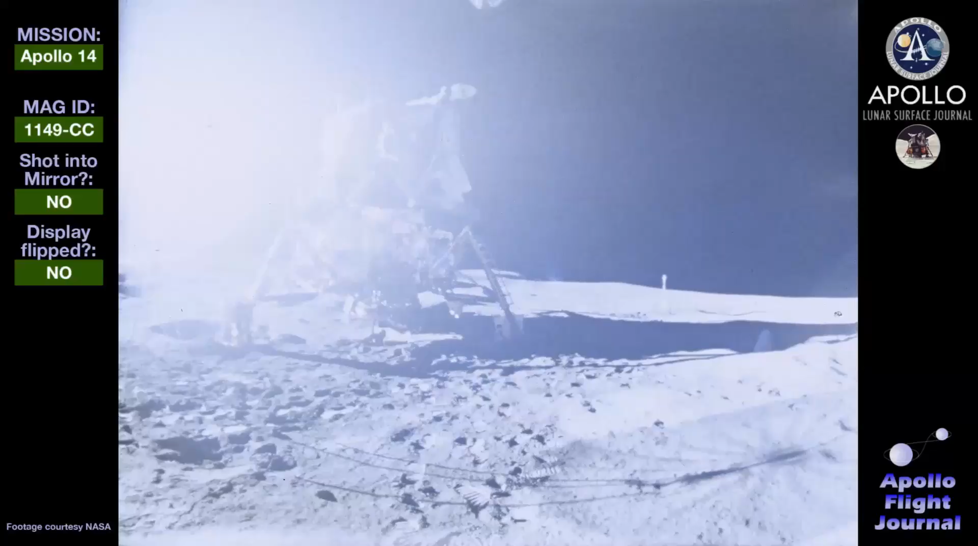
Pete Conrad stepping on the lunar surface
Down the Ladder
Notes:
-Video credit: NASA; link to video: https://history.nasa.gov/afj/ap14fj/a14-videoindex.html (7th video, about 0:25 to 0:44)
Lunar Module Antares on the surface filmed by Alan Shepard. Ed Mitchell exits the lunar module hatch and descends the ladder.
This video is presented at 24 frames per second, regardless of the original shooting speed.
-At 11:50 p.m. EST on February 4, 1971, the lunar module detached from the command module, and then landed on the Moon at 4:18 a.m. EST on February 5, 1971 in the Fra Mauro formation.
-At 9:42 a.m. EST on February 5, the first extravehicular activity began.
Capsule Communicator (CapCom) Bruce McCandless: (As Al Shepard descends the ladder to the lunar surface) “Okay, Al. Beautiful! We can see you coming down the ladder right now. It looks like you’re about on the bottom step. (Pause) And on the surface. Not bad for an old man.”
Al was born on November 18, 1923. At 47, he was the oldest of the Apollo Moonwalkers. Charlie Duke of Apollo 16 was the youngest at 36.
Relevant video showing Shepard descending the ladder: https://history.nasa.gov/alsj/a14/video14.html#Ladder

Slide 11
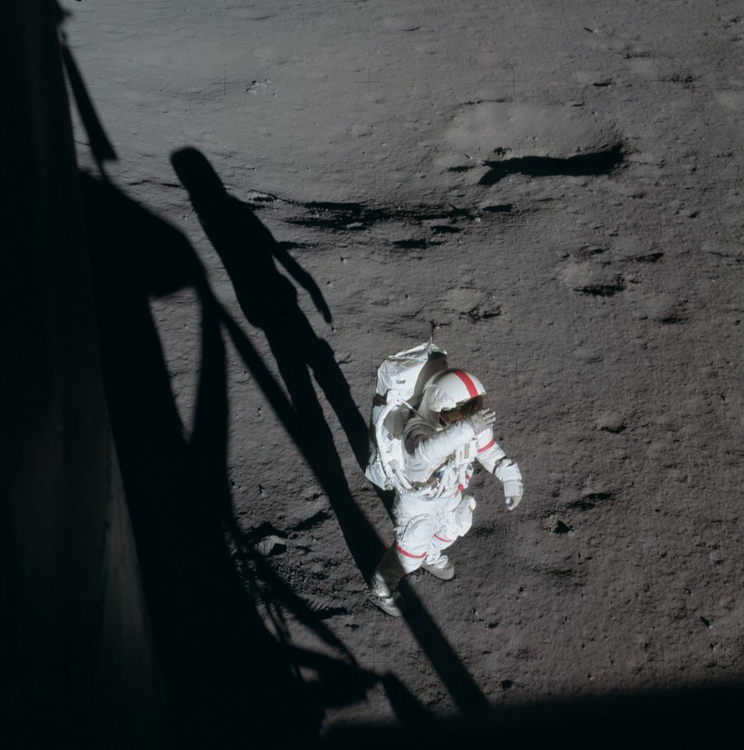
Pete Conrad coming down the ladder from the lunar module
Notes:
-Image credit: NASA
-Ed Mitchell took this photo of Al Shepard out the right-hand lunar module pilot window. Al is shading his eyes, probably looking up toward Cone crater.
Note the red stripe on the top of Al’s helmet. This and similar stripes on his arms and legs help distinguish him from Ed, who has no stripes.
After Apollo 13, the commander’s spacesuit had red stripes on the helmet, arms, and one leg, to help identify them in photographs.

Slide 12
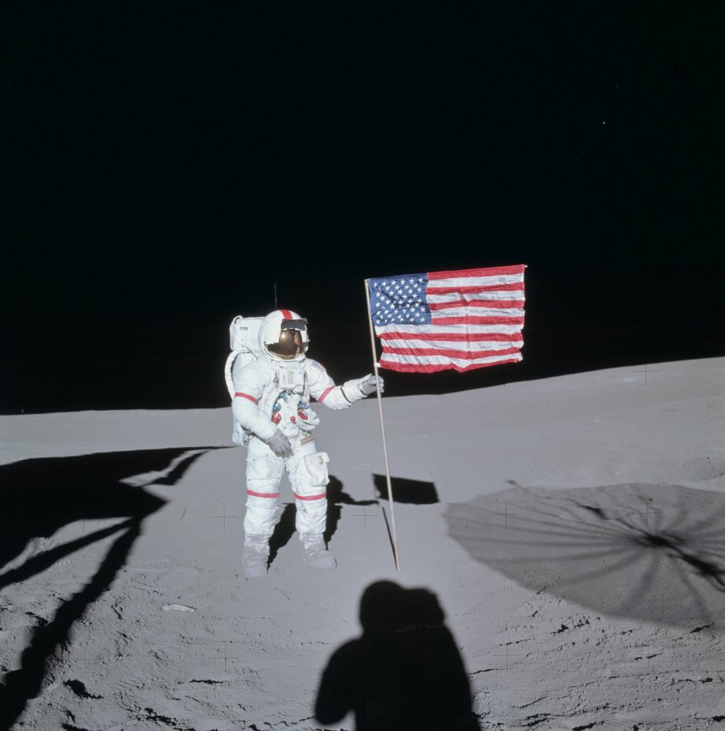
Pete Conrad coming down the ladder from the lunar module
Science-focused Mission
Lunar geology studies
Lunar sample collection
Lunar surface science experiments
Orbital science experiments
  Lunar-focused
  Space environment-focused
Notes:
-Image credit: NASA → Image of Al Shepard taken after deployment of the U.S. flag. NASA image: AS14-66-9232.
-The traverse up Cone crater was the main science goal for Al Shepard and Ed Mitchell. Impact craters spread out ejecta in a very predictable manner. The outer edges of the ejecta are mostly composed of material from or near the surface where the bolide (asteroid or comet) impacted, while the ejecta at the rim of the crater comes from deepest regions within the crater. So it is a simple matter of walking towards the crater and collecting samples to reconstruct an accurate picture of the original subsurface. However, this turned out to be not quite so simple for the astronauts (see later slides).
-Apollo 14’s crew carried out the longest list of experiments on the lunar surface and in lunar orbit as of that time.
-In addition to their geologic studies and lunar sample collection, the Apollo 14 crew performed several experiments on the lunar surface.
Soil Mechanics Investigation
Lunar Portable Magnetometer
Solar Wind Composition Experiment
Laser Ranging Retroreflector
Apollo Lunar Surface Experiments Package (ALSEP) deployment:
Each ALSEP experiment was connected by a cable to the ALSEP central station, which provided radio communication to Earth and electrical power from a radioisotope thermal generator.
Passive Seismic Experiment
Active Seismic Experiment
Suprathermal Ion Detector Experiment
Cold Cathode Ion Gauge
Charged Particle Lunar Environmental Experiment
Lunar Dust Detector
-In addition to their studies on the lunar surface, the Apollo 14 crew performed several studies of the Moon from lunar orbit.
The S-Band Transponder Experiment
The Bistatic Radar Experiment
-In addition to lunar studies, several other experiments were performed from orbit to study the space environment.
The Window Meteoroid experiment studied impacts on the windows of the Apollo 14 Command Module to obtain information about the size distribution of very small micrometeorites.
The Composite Casting Experiment studied the solidification of immiscible compositions in microgravity.
The Electrophoresis Demonstration studied the separation of organic molecules in an electric field.
The Heat Flow and Convection Demonstration studied convective flow and heat transport driven by surface tension.
The Liquid Transfer Demonstration studied how different types of tank design influenced the pumping of liquids between tanks in microgravity.
The Light Flashes Experiment studied light flashes seen by the crew that are related to charged particles in space.
-More info: https://www.lpi.usra.edu/lunar/missions/apollo/apollo_14/experiments/index.shtml#surface; https://www.hq.nasa.gov/alsj/a14/a14mr03.htm

Slide 13
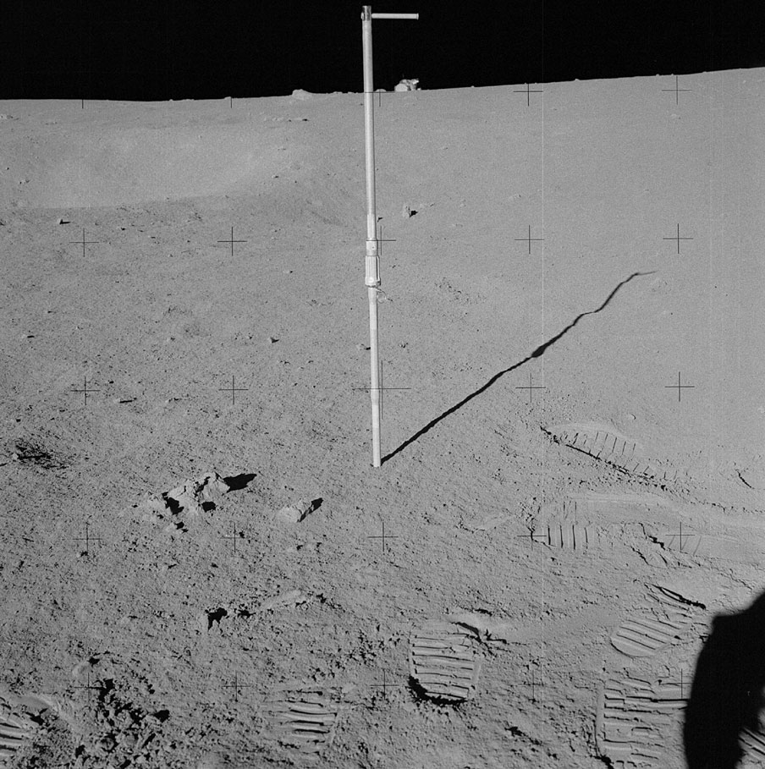
Apollo Lunar Surface Experiment Package
Lunar Sample Collection: Core Tube
Notes:
-Image credit: NASA → Al Shepard took this “locator” of the Geology Station A core tube sample with the lunar module in the background during the second extravehicular activity. NASA image: AS14-64-9048.
-Core tubes were used to obtain samples from below the Moon’s surface and were either pounded into the surface with a hammer or with the Apollo Lunar Surface Drill (Apollos 15-17).
-Two styles of core tubes were used on the Moon to obtain continuous soil columns down to 70 cm in depth.
The initial style, used on Apollos 11, 12, & 14, was a thick-walled, small diameter (2 cm) tube called a core tube. This tube was designed to be easily opened in the laboratory; however, the soil column obtained in this type tube was disturbed by the collection process.
Therefore, a wider diameter (4 cm) tube with thinner walls was designed and fabricated for the last three missions (Apollos 15, 16, & 17). This tube was called a drive tube to distinguish it from the earlier core tube (both tubes took cores and both tubes were driven into the lunar regolith). A soil column collected in a drive tube was not significantly distorted by the coring process.
-More info on Apollo lunar surface geological sampling tools: https://curator.jsc.nasa.gov/lunar/catalogs/other/jsc23454toolcatalog.pdf

Slide 14
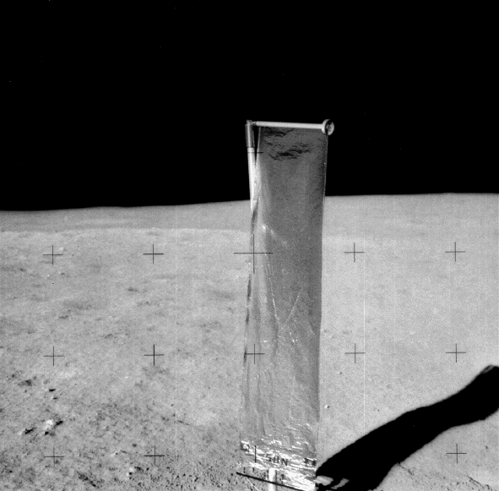
Surface Experiments on the Moon
On the Moon
Surface experiments
  Soil Mechanics Investigation
  Lunar Portable Magnetometer
  Solar Wind Composition Experiment
  Laser Ranging Retroreflector
Notes:
-Image credit: NASA → Solar Wind Composition Experiment.
-In addition to their geologic studies and collecting samples, the Apollo 14 astronauts deployed a set of experiments during their time on the lunar surface.
The Soil Mechanics Investigation studied the properties of the lunar soil.
The Lunar Portable Magnetometer measured the strength of the Moon’s magnetic field.
On Apollos 12, 15, and 16, the Lunar Surface Magnetometer was included in the Apollo Lunar Surface Experiments Package (ALSEP).
On Apollos 14 and 16, the Lunar Portable Magnetometer was carried to measure how the Moon’s magnetic field varies in local regions.
The Solar Wind Composition Experiment collected particles of the solar wind (electrically charged particles emitted by the Sun), allowing the chemical composition of the solar wind to be measured.
The Solar Wind Composition Experiment was performed on Apollos 11, 12, 14, 15, and 16.
On Apollo 14, the experiment was deployed on the lunar surface and was exposed to the solar wind for approximately 21 hours. Afterward, the foil was removed and placed in a Teflon bag and returned to Earth for analysis.
Laser Ranging Retroreflector: Lasers fired from Earth are bounced back by the Laser Ranging Retroreflector to precisely measure the distance to the Moon.
-More info: https://www.lpi.usra.edu/lunar/missions/apollo/apollo_14/experiments/index.shtml#surface; https://www.hq.nasa.gov/alsj/a14/a14mr03.htm

Slide 15
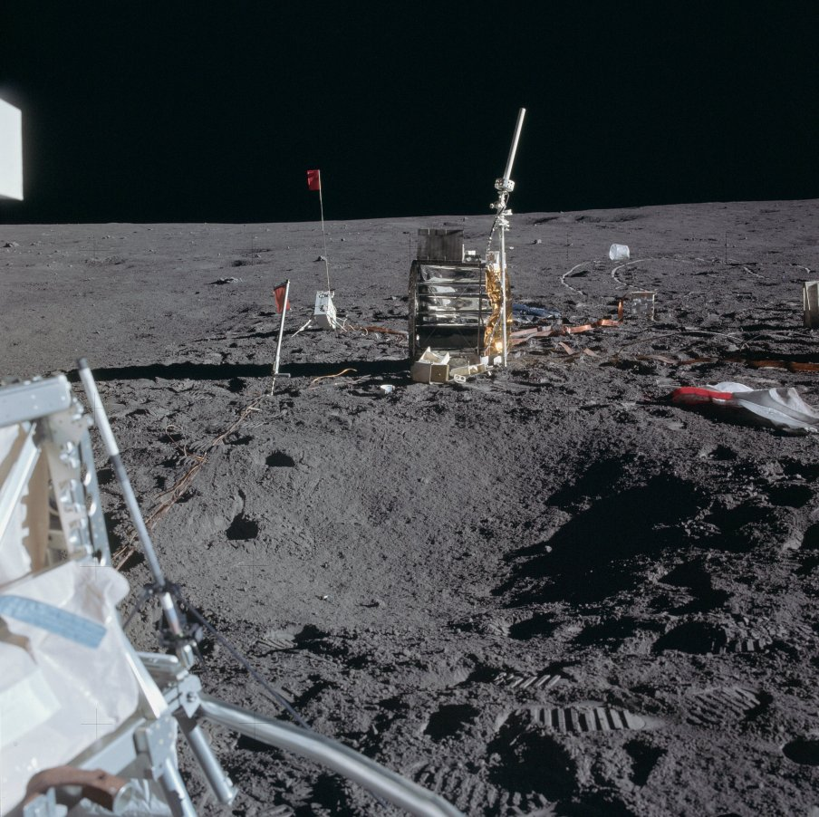
Apollo Lunar Surface Experiment Package
On the Moon
Apollo Lunar Surface Experiments Package (ALSEP)
  Passive Seismic Experiment
  Active Seismic Experiment
Notes:
-Image credit: NASA → Geophone/thumper anchor flag, mortar pack, Apollo Lunar Surface Experiments Package (ALSEP) Central Station, Charged Particle Lunar Environmental Experiment (CPLEE), and assorted packing material. NASA image: AS14-67-9376.
-The Apollo Lunar Surface Experiments Package (ALSEP) system consisted of a central station with a communications package and with leads running out to the instruments placed around it.
DC power was supplied by a radioisotope thermo-electric generator (RTG) – a plutonium fuel element was used.
The power required by the whole station and experiments was less than the power of a 75-watt light bulb!
-Apollo 14’s ALSEP consisted of 6 experiments:
Passive Seismic Experiment: detected lunar “moonquakes” and provided information about the internal structure of the Moon.
Active Seismic Experiment: provided information about the structure of the upper 100 meters of the lunar regolith.
Suprathermal Ion Detector Experiment
Cold Cathode Ion Gauge
Charged Particle Lunar Environmental Experiment
Lunar Dust Detector
-More info on ALSEP: https://www.hq.nasa.gov/alsj/HamishALSEP.html

Slide 16
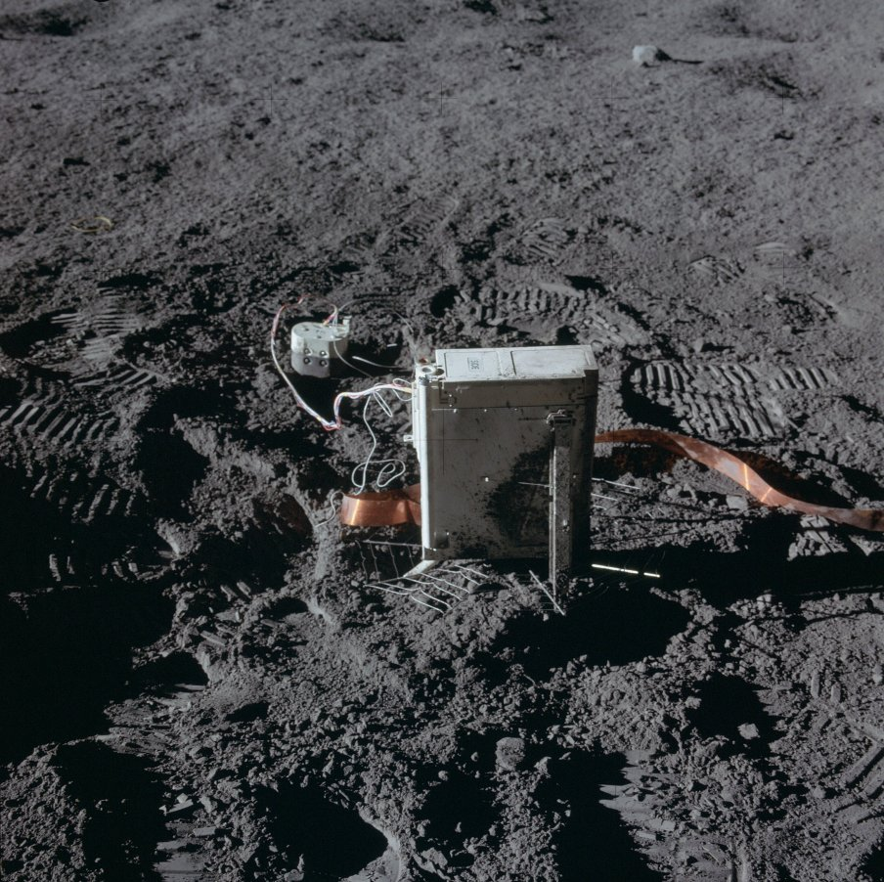
Apollo Lunar Surface Experiment Package
On the Moon
Suprathermal Ion Detector Experiment
Cold Cathode Ion Gauge
Notes:
-Image credit: NASA → This photo shows the Cold Cathode Ion Gauge (CCIG) and the Suprathermal Ion Detector Experiment (SIDE). The SIDE is the large box while the CCIG is the smaller instrument next to it. NASA image: AS14-67-9369.
Two experiments, the Suprathermal Ion Detector Experiment (SIDE) and the Cold Cathode Ion Gauge (CCIG) were used to measure the number and types of ions (an electrically charged molecule, either positive or negative) on the Moon. These ions are chiefly hydrogen and helium and are largely derived from the solar wind. The SIDE was used to measure the flux, number, density, velocity, and relative energy of the positive ions near the lunar surface.
The Suprathermal Ion Detector Experiment (SIDE): studied the lunar ionosphere.
The Cold Cathode Ion Gauge (CCIG): measured the abundance of gases in the lunar atmosphere.

Slide 17
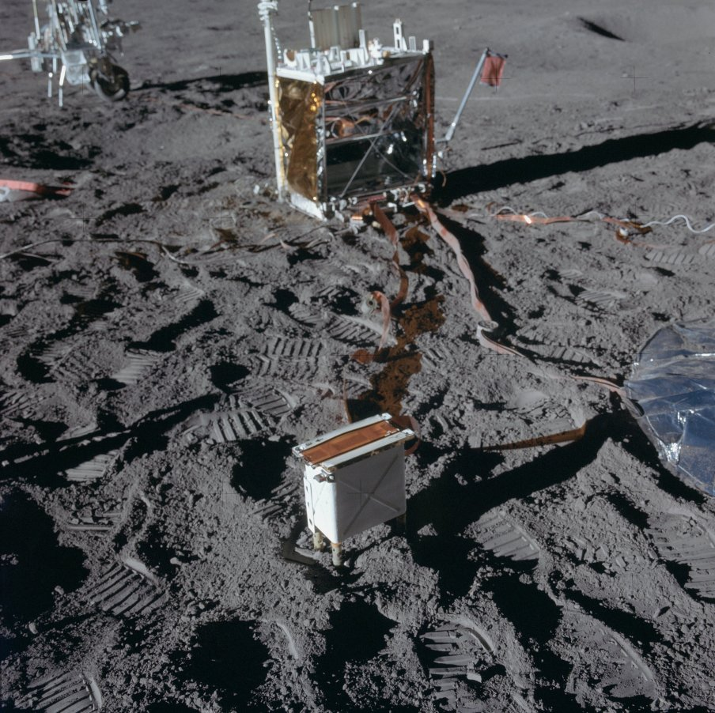
Apollo Lunar Surface Experiment Package
On the Moon
Charged Particle Lunar Environmental Experiment
Lunar Dust Detector
Notes:
-Image credit: NASA → This image shows the location of the Charged Particle Lunar Environment Experiment (CPLEE), which is in the foreground, relative to the ALSEP Central Station. The thermal skirt of the Passive Seismic Experiment (PSE) is at the right edge of the picture, and the Modular Equipment Transporter (MET) is in the upper left corner. NASA image: AS14-67-9365.
The Charged Particle Lunar Environmental Experiment: Only used on Apollo 14, this experiment measured the particle energies of solar protons and electrons that reach the lunar surface. It provided data on the energy distribution of these solar particles and their effect on the Earth/Moon system, as well as the relationship of the solar wind to Earth auroras; the Van Allen radiation belt; processes taking place at the shock front of the solar wind striking the lunar surface; characteristics of Earth’s magnetic field; and the effect of charged particles on the lunar environment.
The Lunar Dust Detector: studied the effects of lunar dust on the operation of the experiment package.

Slide 18
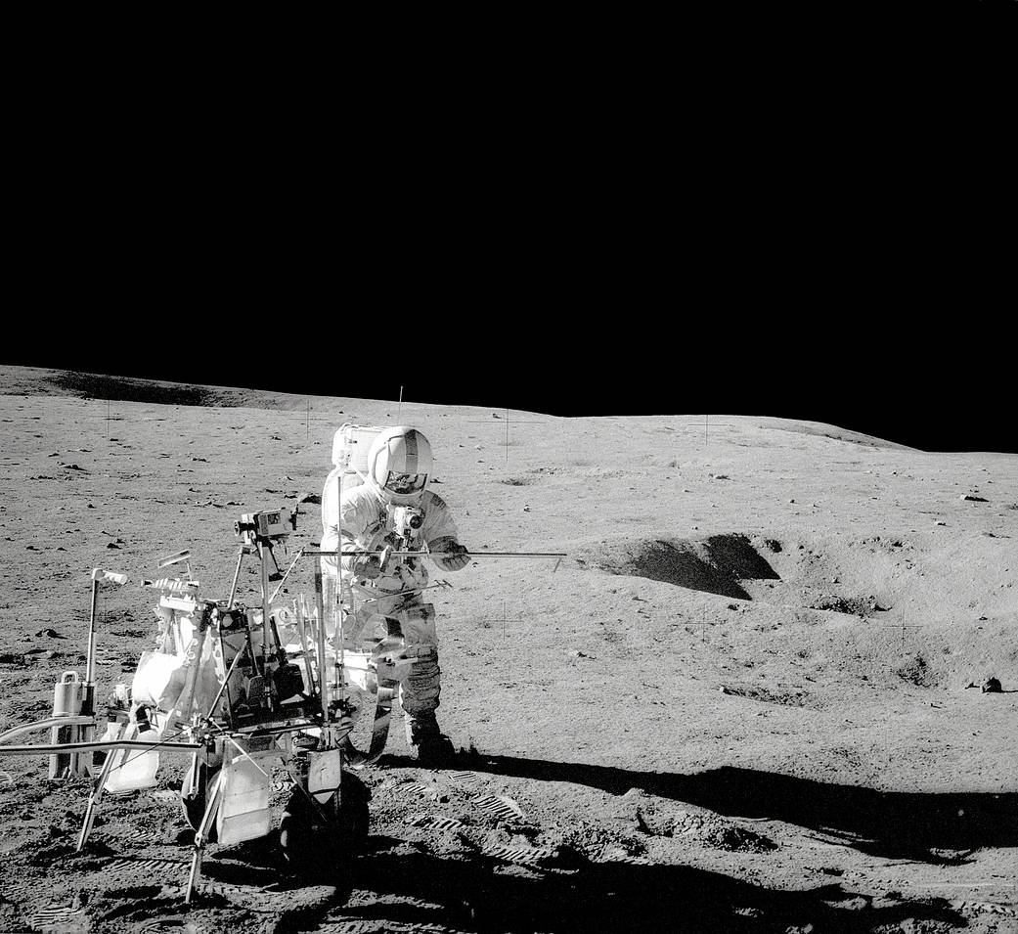
Pete Conrad coming down the ladder from the lunar module
Modular Equipment Transporter (MET)
Notes:
-Image credit: NASA → In this photo, Shepard stands by the Modular Equipment Transporter (MET).
-The Modular Equipment Transporter (MET), used on this mission for the first time, assisted the crew in carrying equipment and lunar samples.
-The MET was a two-wheeled, hand-pulled vehicle used to carry around tools, cameras, and rock sample cases on the lunar surface.
-Designed after Apollo 12 astronauts Pete Conrad and Alan Bean had difficulties lugging their equipment significant distances to and from their lunar module, the MET primarily functioned as a portable workbench with a place for hand tools and other equipment.
-The MET was planned to be used on Apollo 15 but was used only on Apollo 14 – Apollo 15 instead became the first to employ the motorized Lunar Roving Vehicle, which transported both astronauts and equipment.

Slide 19
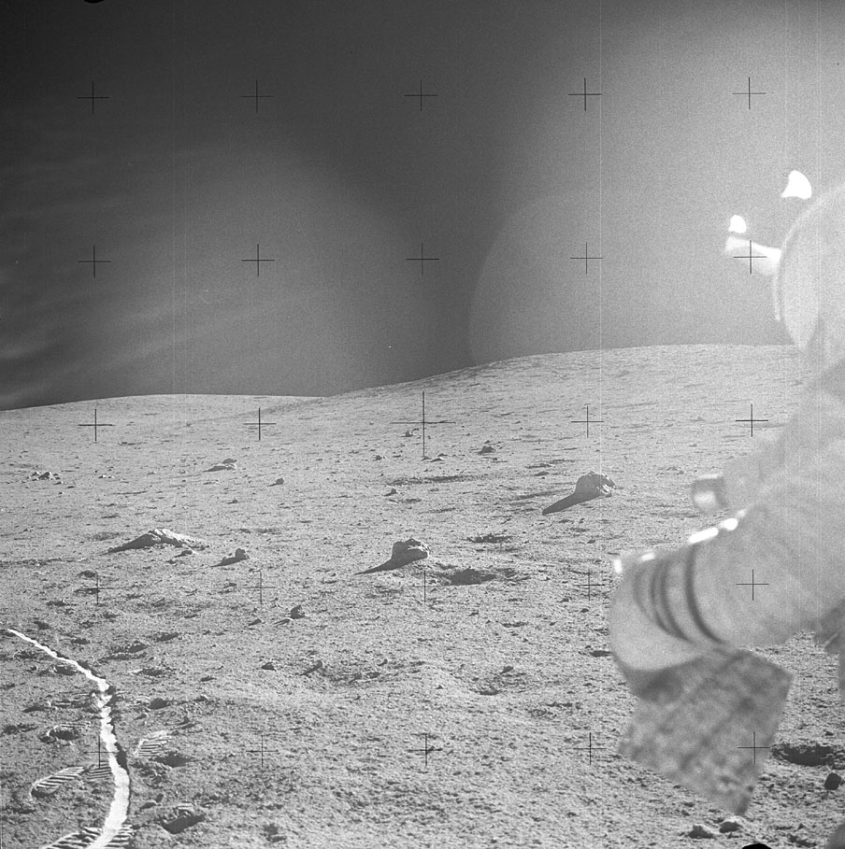
Pete Conrad coming down the ladder from the lunar module
Climbing Cone Ridge
Notes:
-Image credits: NASA → On the way to the rim of Cone crater. Ed Mitchell is holding the map. Smooth Modular Equipment Transporter (MET) tracks are at left. NASA image: AS14-64-9059.
-During the second extravehicular activity, Alan Shepard and Ed Mitchell ventured on an excursion to the rim of Cone crater (0.7 mi or 1.3 km east-northeast of their landing site).
-On their way, they experienced difficulties in navigating the slopes as the intervening ridges hid features, causing problems with spotting landmarks.
Also, because the astronauts had no references to help them judge size and distance, they couldn’t tell whether or not some features on their traverse map were in sight.
The different slopes also caused the Sun angle to change, making features look different (some craters looked sharper due to shadows).
They also experienced difficulties dragging the MET up the ridge.
-Because of these struggles, the astronauts fell 30 minutes behind schedule and thus had to abandon their quest for the rim of Cone crater and continue with the rest of their EVA.
As a result, they just reached a point within 20-30 m (66-98 ft) of the rim of the crater.
-Nevertheless, the objectives associated with reaching the vicinity of this crater were achieved.
En route to Cone crater, photographs, various samples, and terrain descriptions were obtained.
Rock and soil samples were also collected in a blocky field near the rim.
-More on the difficulties Al & Ed had in navigating Cone Ridge: https://history.nasa.gov/alsj/a14/a14.tocone.html
-See this Lunar Reconnaissance Orbiter Camera feature: http://lroc.sese.asu.edu/posts/363

Slide 20
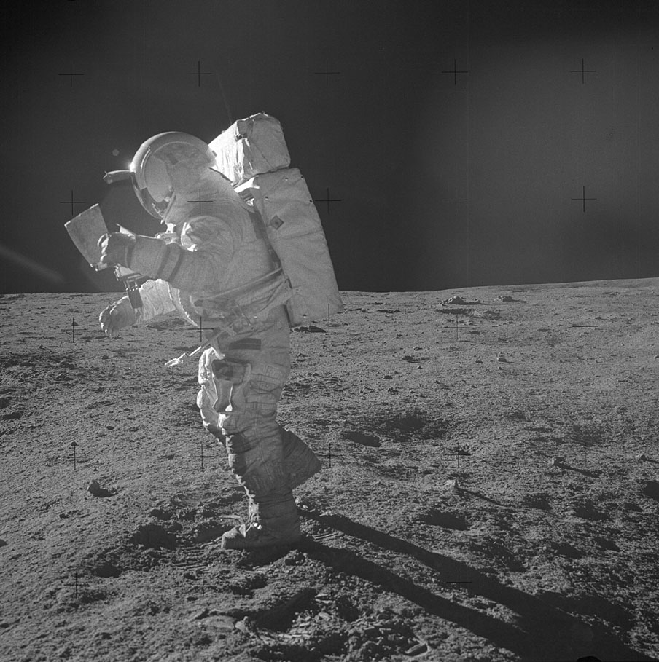
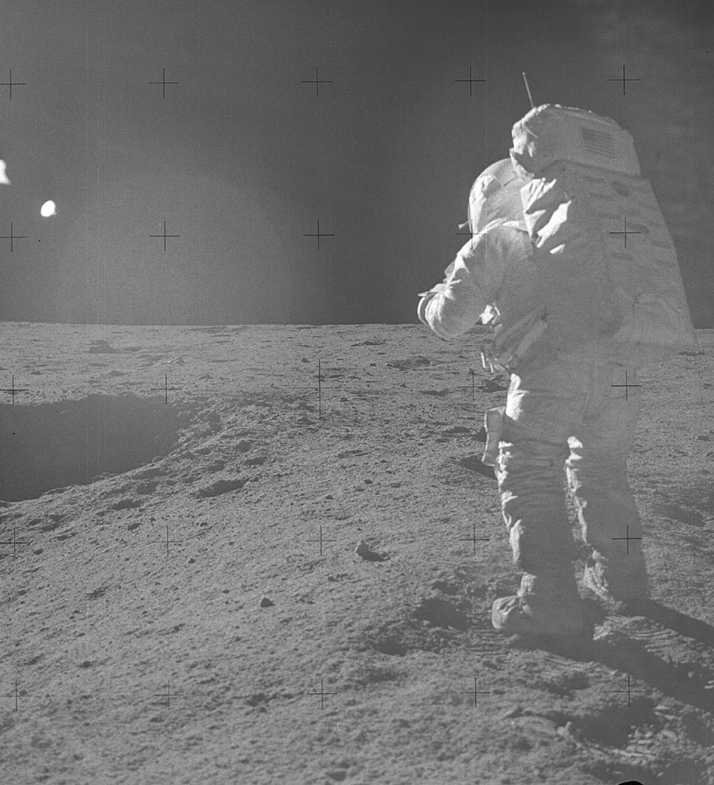
Pete Conrad coming down the ladder from the lunar module
Where Are We?
Notes:
-Image credits: NASA
Left: Image from Al Shepard’s Station B1 panorama, showing Ed Mitchell studying the traverse map. Ed is trying to figure out where they are. NASA image: AS14-64-9089.
Right: Image from Al Shepard’s Station B1 panorama, showing Ed Mitchell trying to figure out where they are. NASA image: AS14-64-9088.
-More on the difficulties Al & Ed had in navigating Cone Ridge: https://history.nasa.gov/alsj/a14/a14.tocone.html

Slide 21
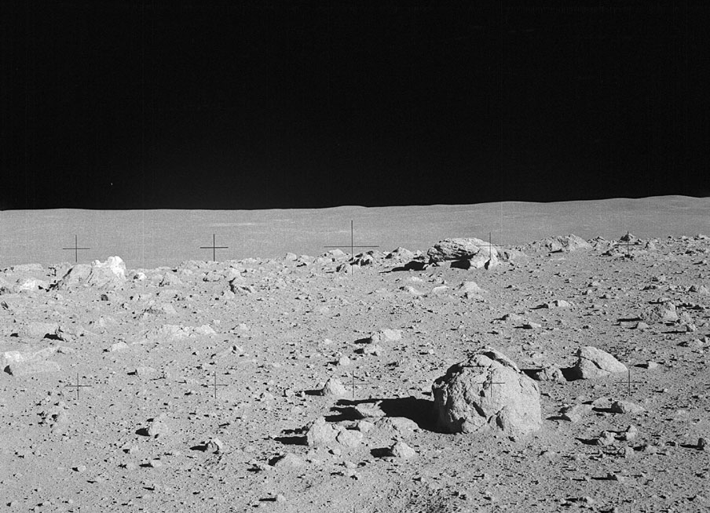
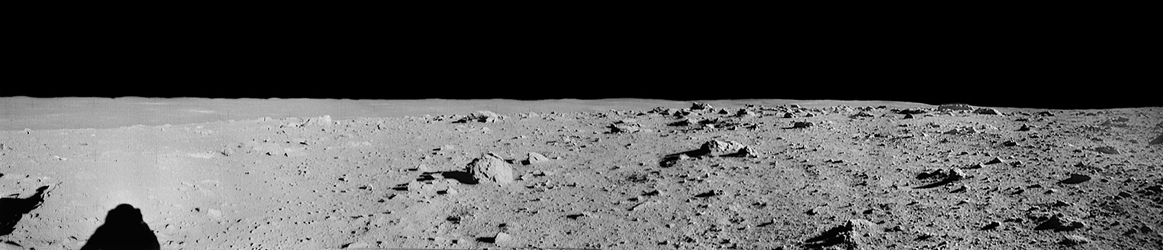
Pete Conrad coming down the ladder from the lunar module
Turning Back
Saddle Rock
“You know you’re close. You can’t be very far away.”
– Ed Mitchell
Notes:
-Image credits: NASA → Alan Shepard’s panorama of Station C-Prime. https://history.nasa.gov/alsj/a14/a14pan1332340.html
Image inset: The rim of Cone crater is out of sight just to the right of center. The Station C1 white boulder (known as Saddle Rock) where the astronauts collected samples is on the local horizon at left. NASA image: AS14-64-9101.
-Had the astronauts passed Saddle Rock, another 20-30 m (66-98 ft) would have been the south edge of the rim of Cone crater.
-From an interview with Ed Mitchell (https://history.nasa.gov/alsj/a14/a14.tocone.html#1332340):
“Right now, as I listen to this, I feel an enormous sense of frustration, just like I did then. It was terribly, terribly frustrating; coming up over that ridge that we were going up, and thinking, finally, that was it; and it wasn’t - suddenly recognizing that, really, you just don’t know where the hell you are. You know you’re close. You can’t be very far away. You know you got to quit and go back. It was probably one of the most frustrating periods I’ve ever experienced. There’s no feeling of being lost. I mean, the LM is there; we can get back to the LM. It’s not reaching and looking down into that bloody crater. It’s terribly frustrating.”
-Alan Shepard, from the 1971 Technical Debrief: “If we’d gotten to the point where we’d been willing to do away with the rest of the traverse (that is, do their work at the Cone rim and then proceed directly back to the LM without stopping), we could have made the rim all right. But I personally wasn’t willing to do that. I felt that gathering more samples was the better of the two choices. We looked at the map again today and described two boulder fields that indicate that we were probably within 150 to 300 feet - depending on these two boulder fields - of the rim and still were not able to see it. That was a pretty good-sized lunar feature, to be that close to the top of the thing and not see it. That is just part of the navigation problem.”
-Ed Mitchell, from the 1971 Technical Debrief: “At this point, in spite of personal frustration - and I know Al felt frustrated in the same way - to have us stop at that point and turn around and come back was the proper decision.”
-More on the difficulties Al & Ed had in navigating Cone Ridge: https://history.nasa.gov/alsj/a14/a14.tocone.html

Slide 22

Pete Conrad coming down the ladder from the lunar module
Notes:
-Video credit: NASA’s Scientific Visualization Studio → This video describes the hike toward Cone crater by Apollo 14 astronauts Al Shepard and Ed Mitchell, using a visualization created from Lunar Reconnaissance Orbiter data.
-Link to video: https://www.youtube.com/watch?v=qmCz7vfnXWI

Slide 23
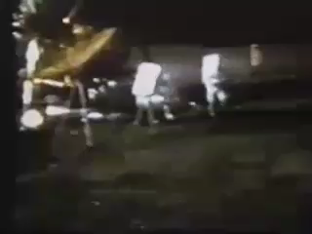
Pete Conrad coming down the ladder from the lunar module
Sports on the Moon
Alan Shepard – lunar golfer
  Hit two golf balls on the Moon at end of last extravehicular activity
Ed Mitchell – lunar javelin thrower
Notes:
-Video credit: NASA → https://history.nasa.gov/alsj/a14/a14.clsout2.html#1350811 (includes a link to the video file and a transcript)
-At the end of the second EVA, Al Shepard hit two golf balls on the Moon with the head of a six-iron attached to the handle of a sample-collection tool. One of Shepard’s golf balls landed in a crater about 50 ft (15 m) away, making this the first extraterrestrial hole in one (and is just visible as a white spot below Mitchell’s javelin in the image on the next slide).
-In addition to Al Shepard’s golf game, and in a lesser known but no less significant sports milestone, Ed Mitchell threw an improvised “javelin” (the pole from the Solar Wind Composition Experiment which was no longer needed), which landed just beyond one of Shepard’s golf balls.

Slide 24
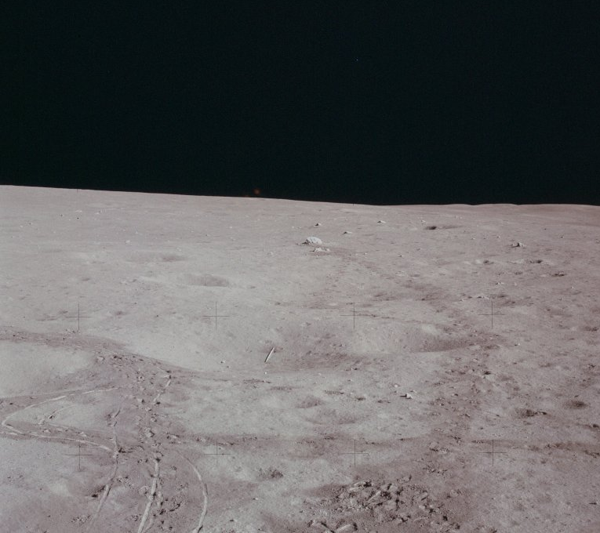
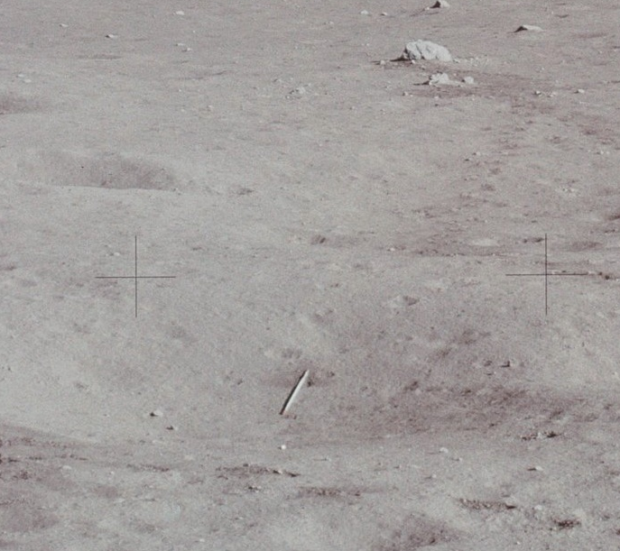
Pete Conrad coming down the ladder from the lunar module
Sports on the Moon
“Javelin”
Golf ball
“Javelin”
Golf ball
Notes:
-Image credit: NASA → Post-EVA-2 photo out Ed Mitchell’s window showing the “javelin” and one of the golf balls in a crater northwest of the lunar module. The javelin is lined up with Turtle Rock in the distance and with the golf ball, which is slightly closer to us than the “javelin”. The two fuzzy orange spots at the horizon to the left of center are likely the reflection of a light inside the cabin off the two panes of Mitchell’s window. NASA image: AS14-66-9337.
The zoomed-in image shows the crater containing the javelin and golf ball.
-At the end of the second EVA, Al Shepard hit two golf balls on the Moon with the head of a six-iron attached to the handle of a sample-collection tool. One of Shepard’s golf balls landed in a crater about 50 ft (15 m) away, making this the first extraterrestrial hole in one (and is just visible as a white spot below Mitchell’s javelin).
-In addition to Al Shepard’s golf game, and in a lesser known but no less significant sports milestone, Ed Mitchell threw an improvised “javelin” (the pole from the Solar Wind Composition Experiment which was no longer needed), which landed just beyond one of Shepard’s golf balls.

Slide 25
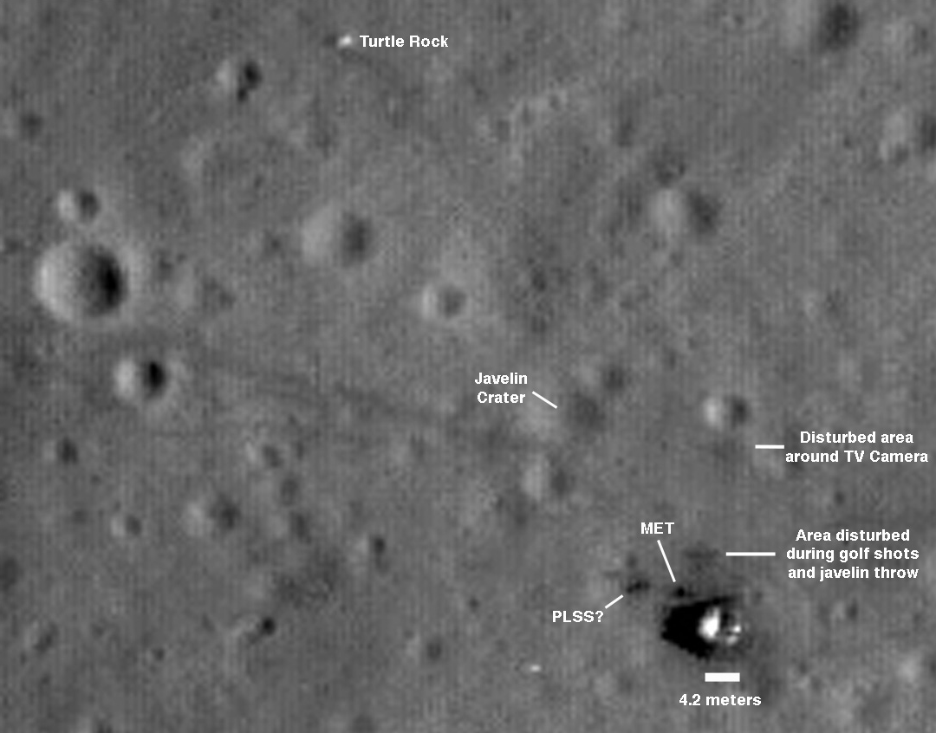
Pete Conrad coming down the ladder from the lunar module
Sports on the Moon
Notes:
-Image credit: NASA → Javelin Crater (the crater in which the golf ball and javelin landed) is labeled in a 5x enlargement of a detail from NASA image: AS14-66-9337. This zoomed in version was taken by the Lunar Reconnaissance Orbiter Camera in November 2009.

Slide 26
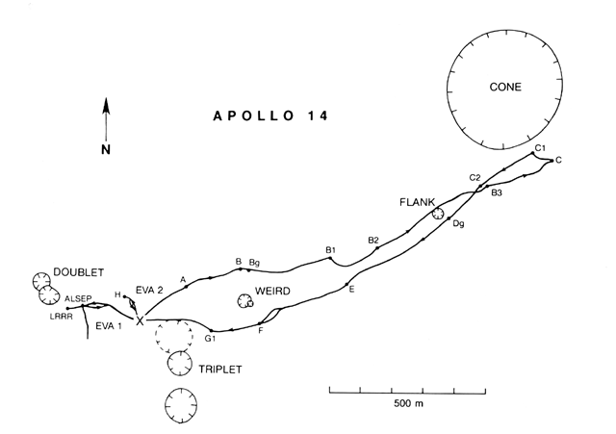
Apollo 12 Traverses
Notes:
-Image source: https://www.lpi.usra.edu/publications/slidesets/apollolanding/ApolloLanding/slide_19.html
-The Apollo 14 traverses.
-The thick lines indicate the paths taken by the astronauts during the two extravehicular activities (EVAs). The lunar module location is designated by the X. The letters identify sampling stations along the traverse of the second EVA.
During the first EVA: the crew deployed the television, S-band antenna, and solar wind experiment; deployed and loaded the modularized equipment; collected samples; and photographed activities, panoramas, and equipment.
During the second EVA: the crew prepared for an excursion to the area of Cone crater, 0.7 mi (1.3 km) east-northeast of the landing site, collected samples, took photographs, documented terrain descriptions, obtained magnetometer measurements, played golf, and threw a javelin.
-The diagram is based on the Apollo 11, 12, and 14 traverse map prepared by the U.S. Geological Survey and published by the Defense Mapping Agency for NASA.

Slide 27
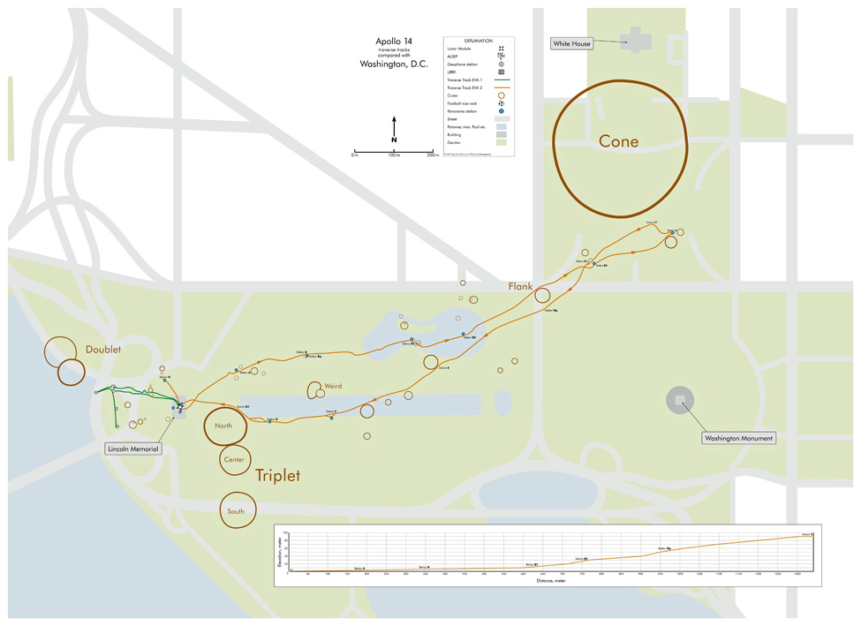
Apollo 12 Traverses
Notes:
-Image credit: Thomas Schwagmeier
-Overlay of the Apollo 14 traverse map, derived from high-resolution Lunar Reconnaissance Orbiter Camera images, on a simplified map of Washington D.C.
-With the lunar module placed at the Lincoln Memorial, the center of Cone crater is on E Street between the South Lawn of the White House and the Ellipse.
-Source: https://www.hq.nasa.gov/alsj/TraverseMapsEarth.html

Slide 28
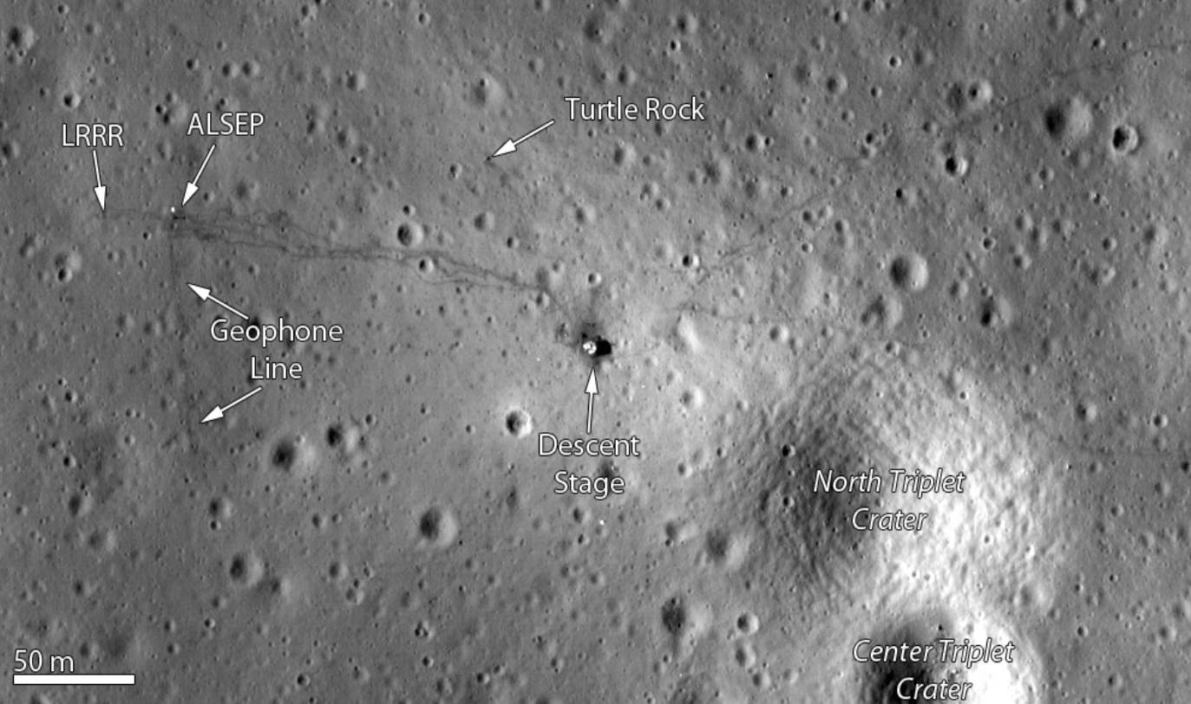
Apollo 12 landing site, as imaged by the Lunar Reconnaissance Orbiter Camera
Notes:
-Image credit: LROC → http://lroc.sese.asu.edu/featured_sites/view_site/3
-A zoomed in version of the Apollo 14 landing site, as imaged by the Lunar Reconnaissance Orbiter Camera (taken on January 25, 2011).

Slide 29
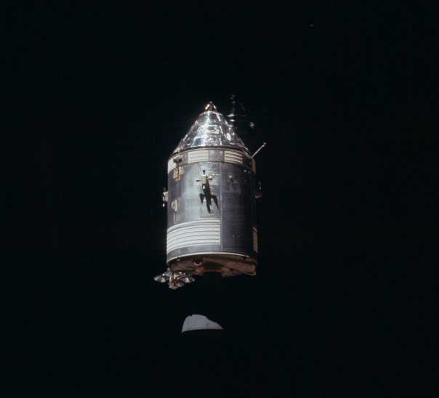
Surface Experiments on the Moon
Science Experiments in Orbit
S-Band Transponder Experiment
Bistatic Radar Experiment
Notes:
-Image credit: NASA → Command and Service Module “Kitty Hawk” from the Lunar Module at rendezvous; NASA image: AS14-66-9344.
-In addition to their studies on the lunar surface, the Apollo 14 crew performed several studies of the Moon from lunar orbit.
The S-Band Transponder Experiment measured regional variations in the Moon’s gravitational acceleration.
The Bistatic Radar Experiment measured scattering of radar waves from the lunar surface.
-More info: https://www.lpi.usra.edu/lunar/missions/apollo/apollo_14/experiments/index.shtml

Slide 30
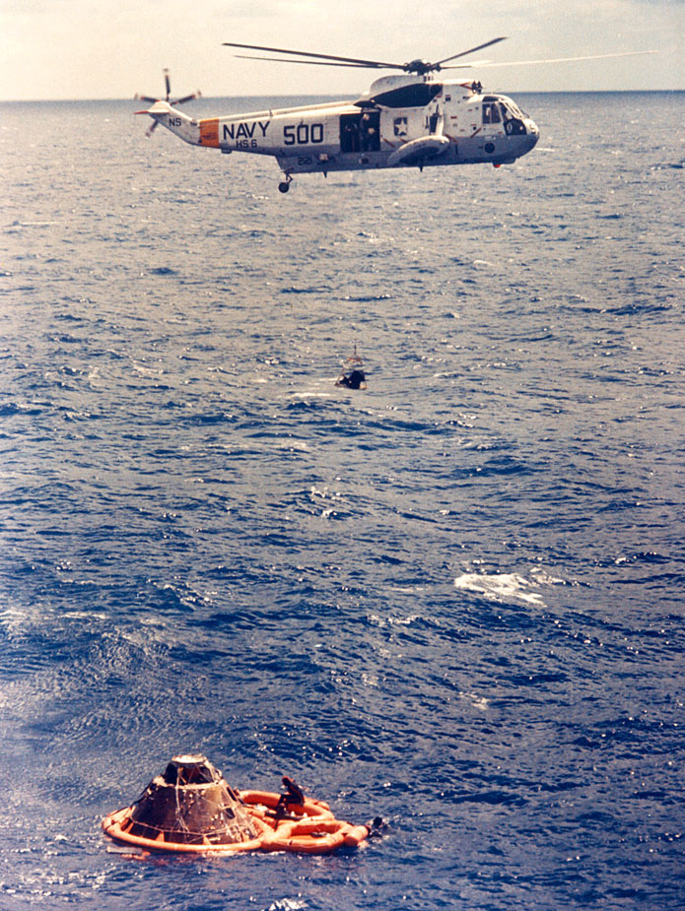
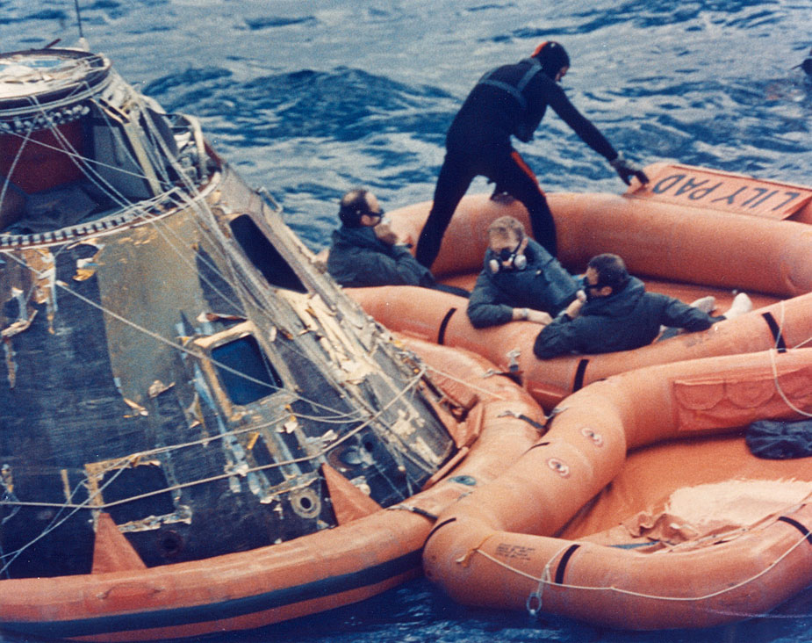
Splashdown
Splashdown
Notes:
-Image credits: NASA
Left: The Apollo 14 crew sit in a life raft beside their command module in the South Pacific Ocean as they await a helicopter that will take them aboard USS New Orleans, the prime recovery ship. Right to left are astronauts Al Shepard, Stuart Roosa, and Ed Mitchell. Two Navy underwater demolition team swimmers assist in the recovery operations. NASA image: S71-19475.
Right: Astronaut Stuart Roosa is hoisted inside a Billy Pugh net to a Navy helicopter assisting in Apollo 14 recovery operations in the South Pacific Ocean. Visible in a life raft beside the command module are astronauts Al Shepard, back to camera; and Ed Mitchell (partially obscured by the spacecraft). Three Navy underwater demolition team swimmers who assisted in the recovery operations are pictured in and around the life raft. NASA image: S71-19476.
-The Apollo 14 splashdown occurred at 4:05 p.m. EST on February 9, 1971 in the Pacific Ocean, some 880 mi (1,417 km) south of American Samoa.

Slide 31
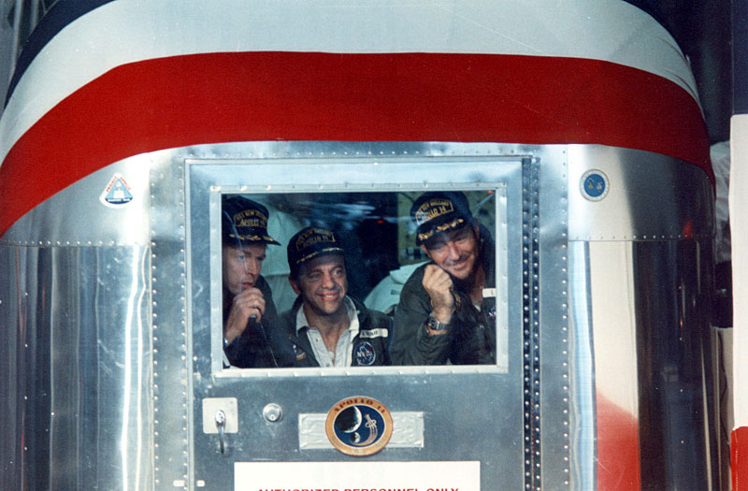
Quarantine
Quarantine
Notes:
-Image credit: NASA → Stu Roosa (left), Al Shepard (center), and Ed Mitchell (right) in the isolation van. Roosa is using the microphone to talk to bystanders. NASA image: S71-18557.
The Apollo 14 astronauts, along with a flight surgeon and a vehicle technician, lived inside this Mobile Quarantine Facility (MQF) from February 9-12, 1971.
The actual Apollo 14 quarantine trailer in the image is now part of the permanent exhibit on the U.S.S. Hornet in Alameda, California.
More: https://uss-hornet.org/history/splashdown
-This was the final Apollo mission in which the astronauts were placed in quarantine upon their return to Earth.

Slide 32
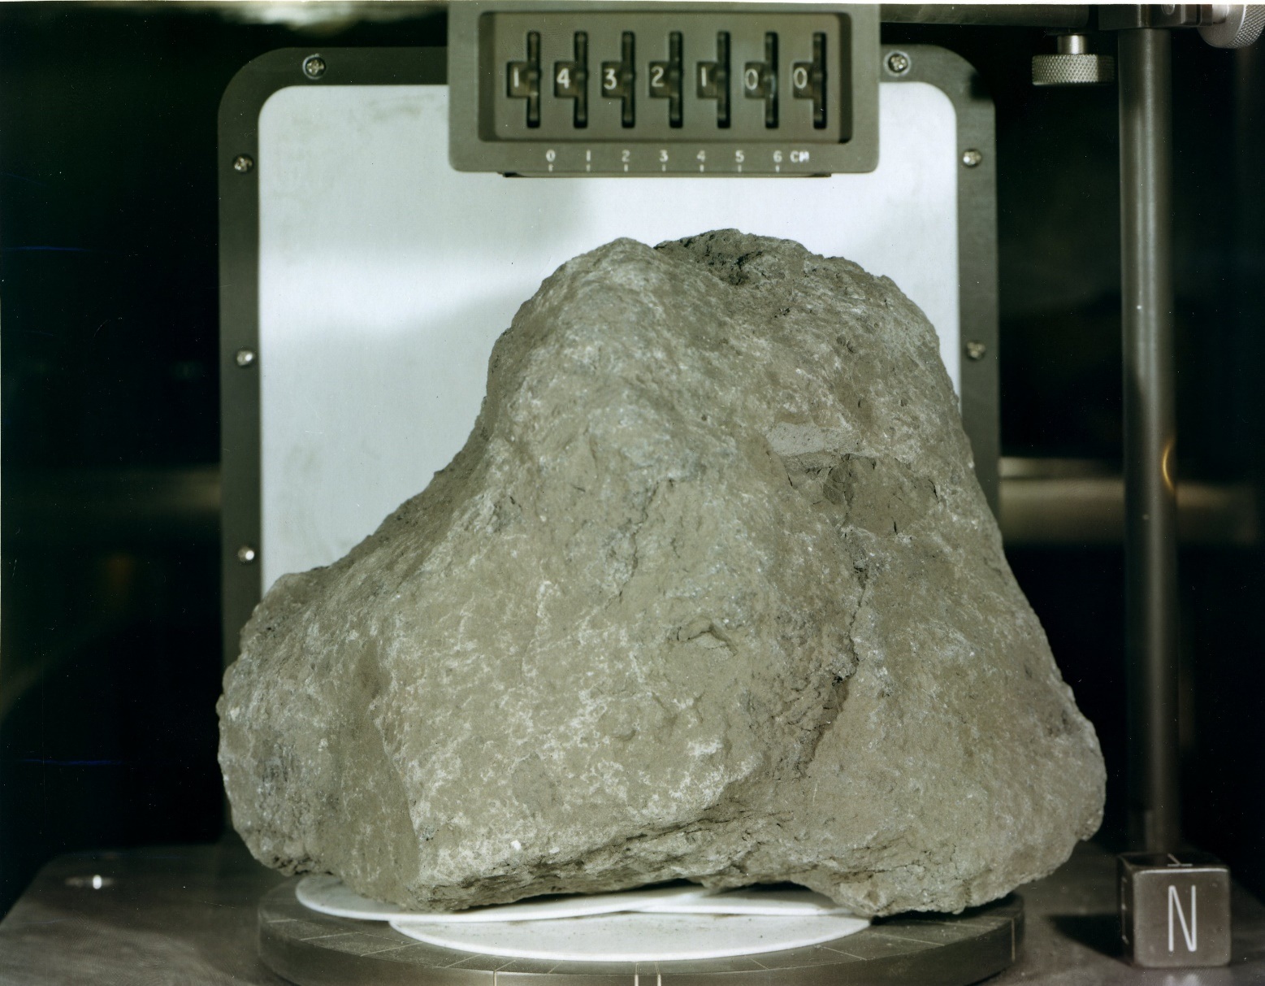
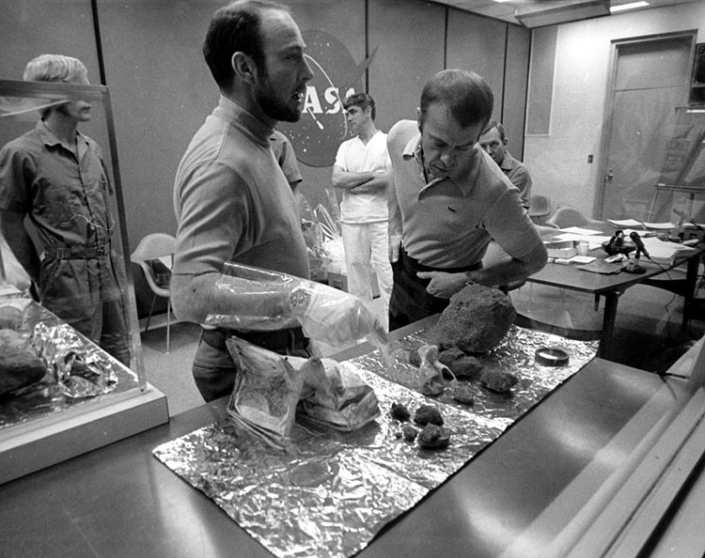
Returned Samples
Returned Samples
Notes:
-Image credits: NASA
Left image: Sample 14321, aka Big Bertha, a 9.0 kg breccia that was collected at Station C1 near the rim of Cone crater. “North” face, photographed in the Lunar Receiving Lab at Johnson Space Center.
Right image: Ed Mitchell and Al Shepard examine some of the samples during a post-mission debrief with geologists. (18 February 1971)
-As one would expect in a region formed by impact-basin debris, most of the 42 kg of rocks and soil collected on Apollo 14 are breccias (rocks that are composed of fragments of other, older rocks).
Many of these breccias include material enriched in KREEP. KREEP was first discovered on Apollo 12 but is much more abundant in Apollo 14 samples.
Such rocks are enriched in potassium (denoted as K by chemists), rare earth elements (REE), and phosphorus (P).
KREEP is believed to have formed early in the history of the Moon during the solidification of the Moon’s molten stage, known as the magma ocean.

Slide 33
By the Numbers
By the Numbers
9 hrs, 23 min spent outside the lunar module
93 lbs (42 kg) of samples collected
216 hrs, 1 min, 58 sec (~9 days) total mission time
Notes:
-Farthest point traveled from the LM: 4,770 ft (1453.9 m)
-Compare to Apollo 11:
60 m – farthest point traveled from the LM
2.5 hrs spent outside the lunar module
47.8 lbs of samples collected
195 hrs, 18 min, 35 sec (~8 days) total mission time

Slide 34
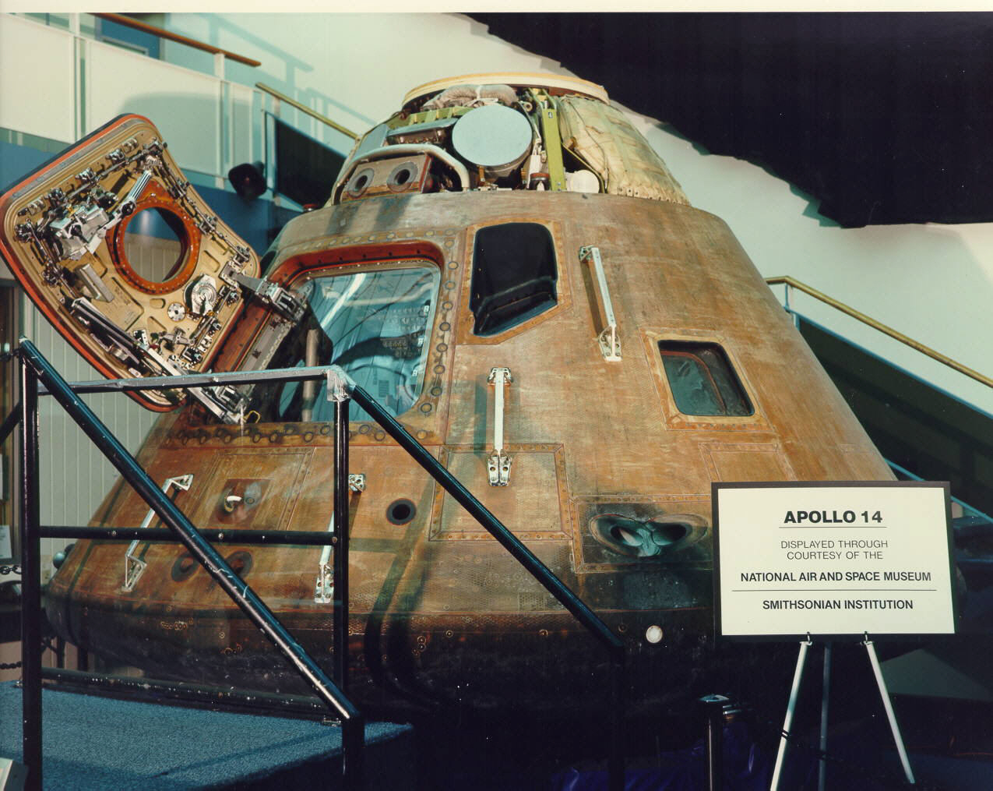
Apollo 12 Command Module
Apollo 14 Command Module
Name: “Kitty Hawk”
Location:
  NASA Kennedy Space Center
  Merritt Island, FL
Notes:
-Image credit: National Air and Space Museum → https://airandspace.si.edu/collection-objects/command-module-apollo-14
-Color of the command module is due to the mylar material used.

Slide 35
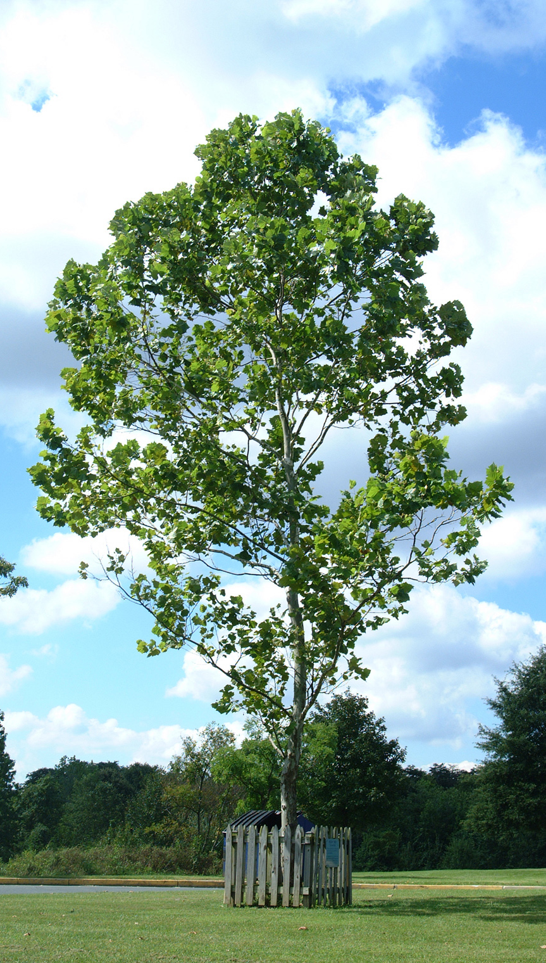
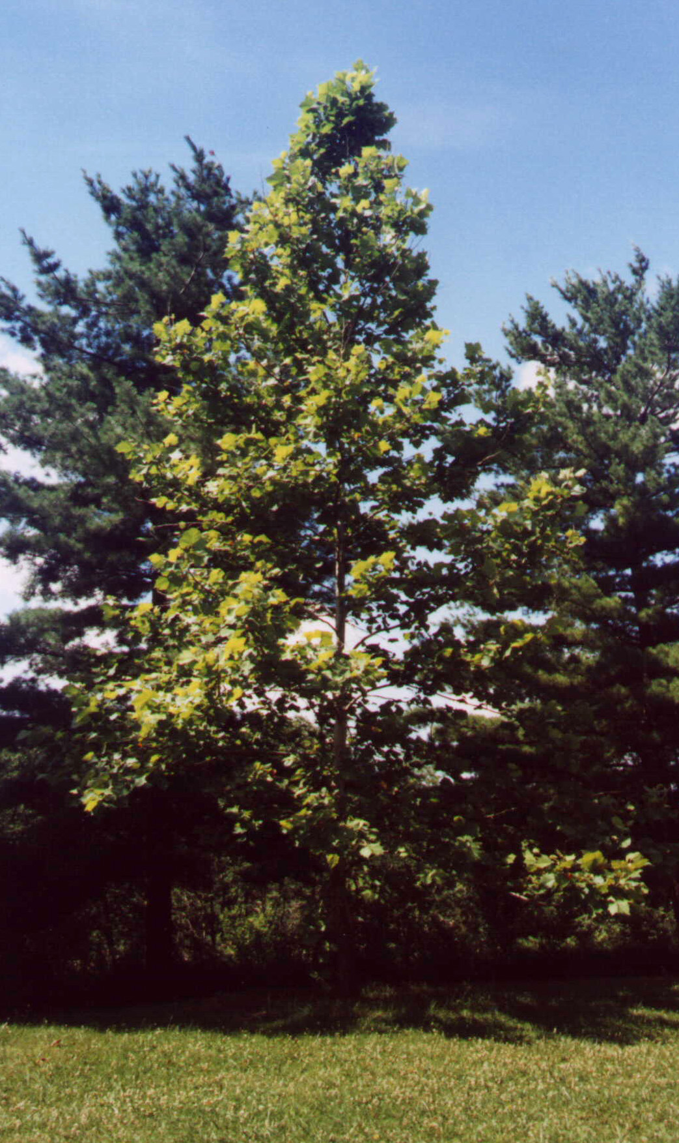
Pete Conrad coming down the ladder from the lunar module
Moon Trees
Stuart Roosa – Moon trees!
  Brought hundreds of tree seeds with him → many now growing on Earth
NASA Goddard Space Flight Center, Greenbelt, MD
Jay Friedlander
Jefferson County, OH
Bob Jankowski
Notes:
-Image credits:
Right: Bob Jankowski → Jefferson County, OH Moon tree (https://web.archive.org/web/20090723012951/http://nssdc.gsfc.nasa.gov/planetary/lunar/moon_trees/friendship_park_tree.html).
Left: Jay Friedlander → NASA Goddard Moon tree (https://web.archive.org/web/20090723012311/http://nssdc.gsfc.nasa.gov/planetary/lunar/moon_trees/goddard_tree.html).
-Astronaut Stuart Roosa – who had formerly worked as a smokejumper for the U.S. Forest Service – packed several hundred seeds from redwoods, loblolly pines, sweetgums, sycamores, and firs in his personal kit (the small tube in which crew members can stow sentimental stuff unrelated to the mission).
Scientists were curious to know if the seeds, after their journey into the microgravity of space, would sprout and look the same as Earth-grown trees.
Indeed, they look the same as normal Earth trees.
The seeds spent a total of 9 days in space, but no one really heard of their journey until they were planted.
-The seedlings, now known as Moon trees, were planted across the United States and throughout the world.
-They grow at national landmarks, such as the White House, Independence Square in Philadelphia, state capitols, and university campuses.
-More info on Moon trees: https://www.atlasobscura.com/articles/what-happened-to-moon-trees; https://www.nasa.gov/centers/kennedy/news/moon_trees.html
-List of Moon tree locations: https://nssdc.gsfc.nasa.gov/planetary/lunar/moon_tree.html

Slide 36
More Info
More Info
Notes:
-Image source: https://www.lpi.usra.edu/resources/apollopanoramas/pans/?pan=JSC2007e045377

Slide 37
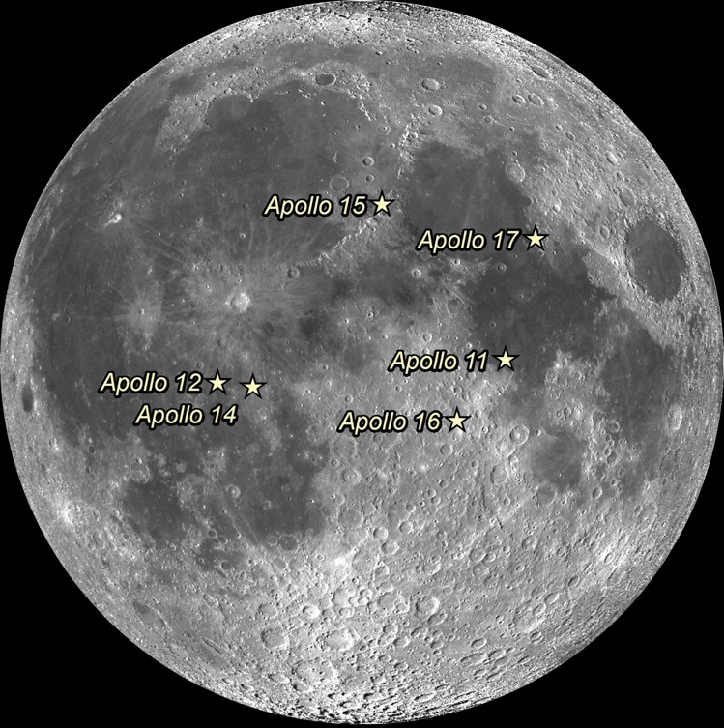
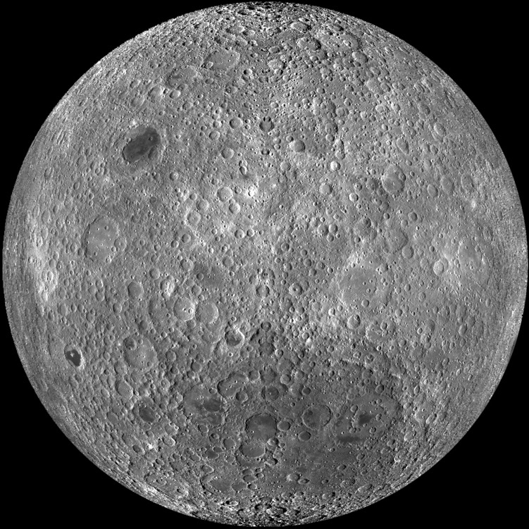
Apollo Landing Sites
Apollo Landing Sites
Notes:
-Image credit: NASA/GSFC/Arizona State University
-Left: Apollo landing sites (lunar near side)
-Right: Lunar far side
(captured by the Lunar Reconnaissance Orbiter spacecraft)

Slide 38
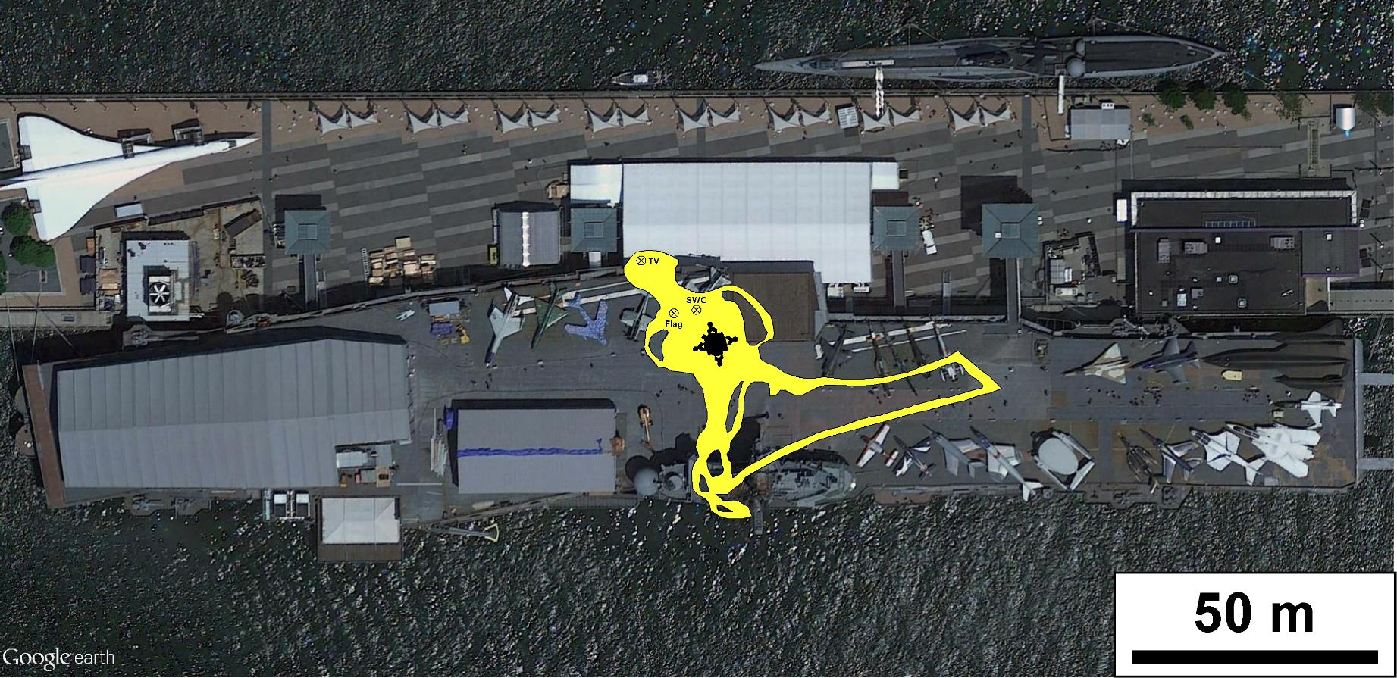
Apollo 11 Traverses
Apollo 11 Traverses
Notes:
-Image credit: NASA/GSFC/Brent Garry
-Apollo 11 tracks overlain on the Intrepid Sea, Air & Space Museum in New York City, NY.
-Date: July 20, 1969
-Future Apollo missions would travel up to ~5 mi from the lunar module (Apollo 17).

Slide 39
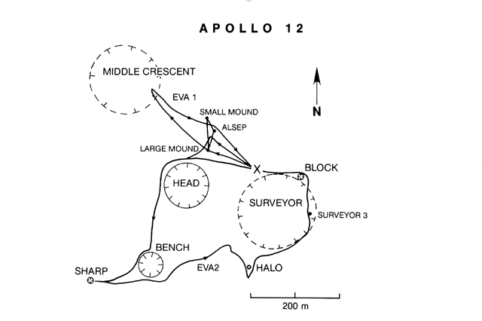
Apollo 12 Traverses
Notes:
-Image source: https://www.lpi.usra.edu/publications/slidesets/apollolanding/ApolloLanding/slide_13.html
-The Apollo 12 traverses.
-The thick lines indicate the paths taken by the astronauts during the two EVAs. The Lunar Module location is designated by the X.
The first EVA was devoted to the setup of the Apollo Lunar Surface Experiments Package (ALSEP), a series of instruments that could be monitored and controlled from the Earth.
The second EVA included an investigation of several craters and the Surveyor 3 spacecraft.

Slide 40
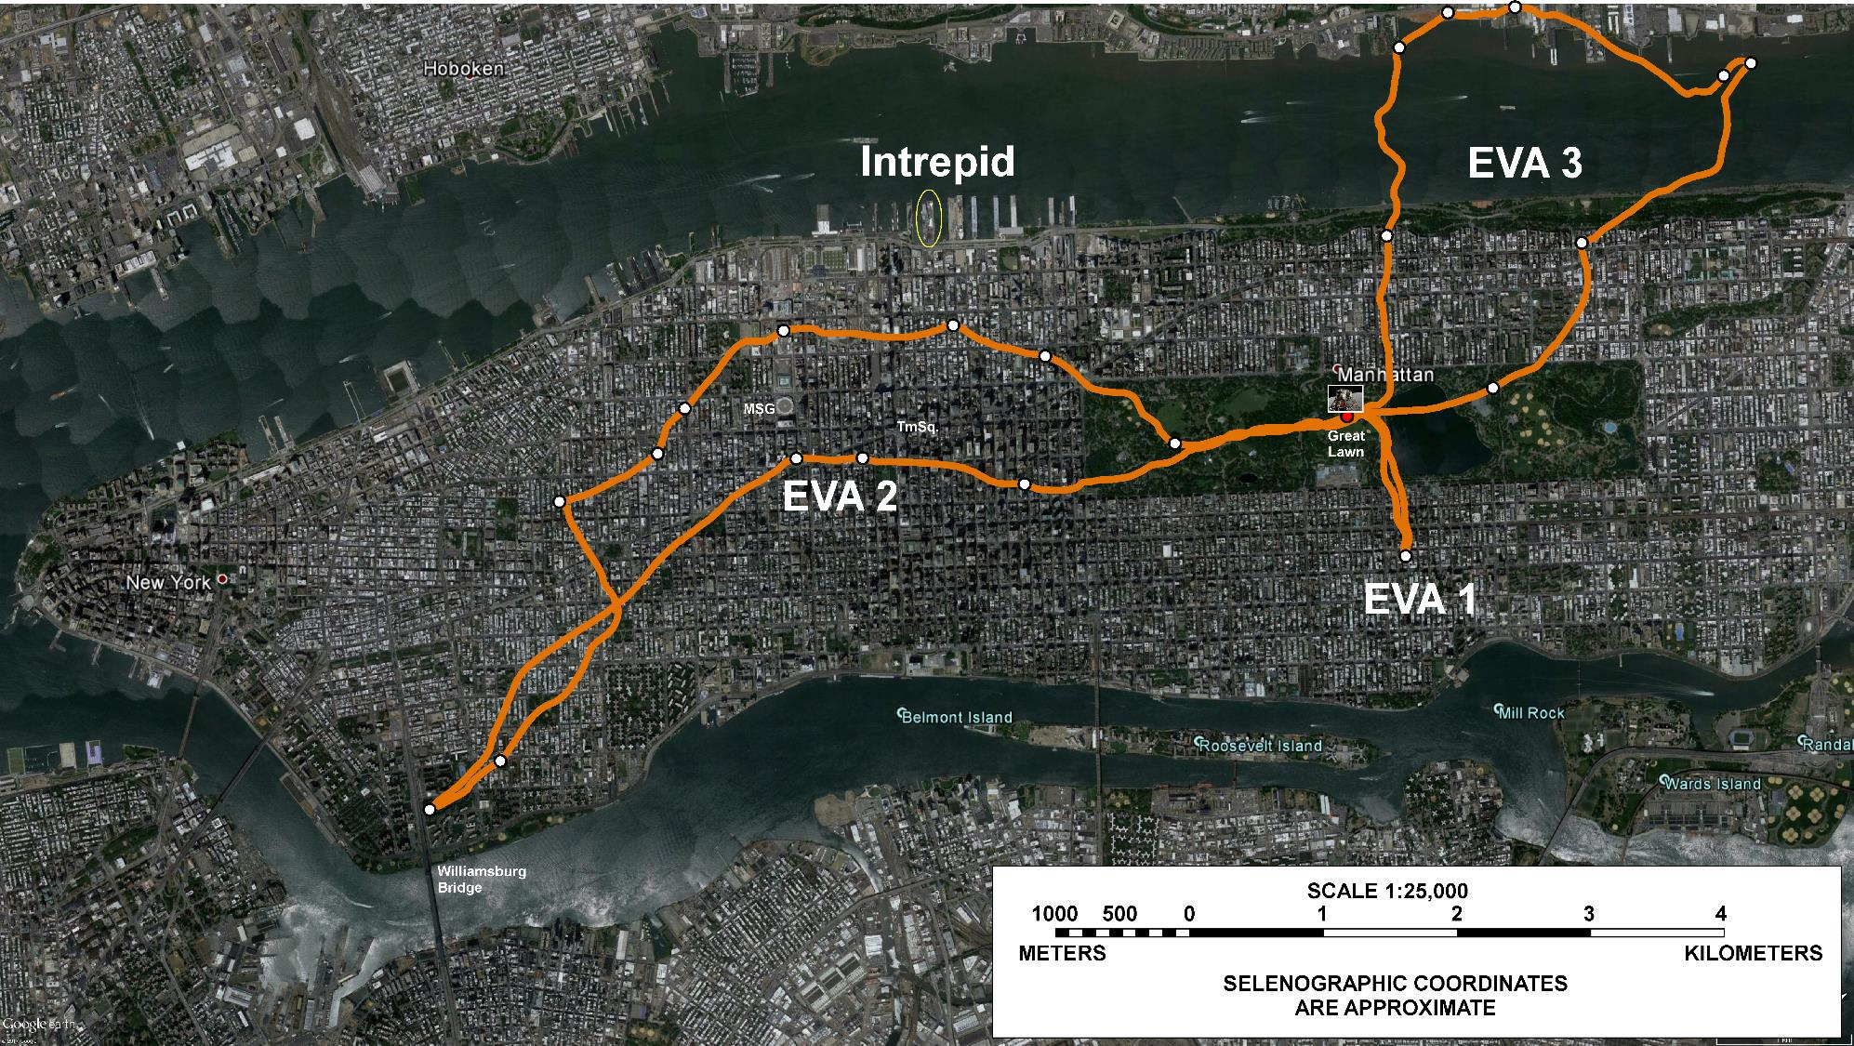
Apollo 17 Traverses
Apollo 17 Traverses
Notes:
-Image credit: NASA/GSFC/Brent Garry
-Apollo 17 tracks overlain on New York City, NY.
-Dates: December 11, 12, 13; 1972 (almost 2 years after Apollo 14)
-Notice how much farther the Apollo 17 astronauts were able to travel than the Apollo 14 astronauts (since they had a lunar roving vehicle).

Slide 41
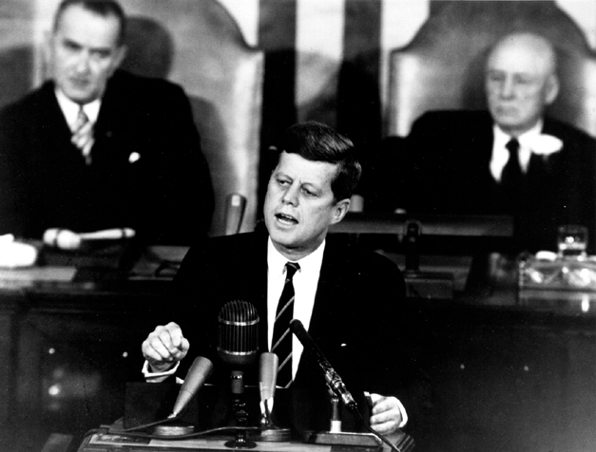
JFK’s Speech
JFK’s Speech
The Decision to Go to the Moon
  May 25, 1961
We Choose to Go to the Moon
  September 12, 1962
Notes:
-Image source: https://history.nasa.gov/moondec.html → JFK’s address to Congress.
-”The Decision to Go to the Moon”: President John F. Kennedy's May 25, 1961 Speech before Congress. JFK announced before a special joint session of Congress the dramatic and ambitious goal of sending an American safely to the Moon before the end of the decade.
-”We choose to go to the Moon” is the famous tagline of a speech about the effort to reach the Moon delivered by President John F. Kennedy to a large crowd gathered at Rice Stadium in Houston, Texas on September 12, 1962.

Slide 42
Additional Resources
Additional Resources
Apollo Images:
  https://images.nasa.gov/
  https://www.hq.nasa.gov/alsj/a14/images14.html
  http://lroc.sese.asu.edu/featured_sites#ApolloLandingSites
Apollo Videos:
  https://svs.gsfc.nasa.gov/Gallery/apollo.html
Apollo 14 General:
  https://nssdc.gsfc.nasa.gov/planetary/lunar/apollo14info.html
  https://www.lpi.usra.edu/lunar/missions/apollo/apollo_14/overview/
  Preliminary Science Report: https://www.hq.nasa.gov/alsj/a14/as14psr.pdf
Notes:
-USGS report that augments the Preliminary Science Report: “Geology of the Apollo 14 Landing Site in the Fra Mauro Highlands” → https://pubs.er.usgs.gov/publication/pp880

