Slide 1
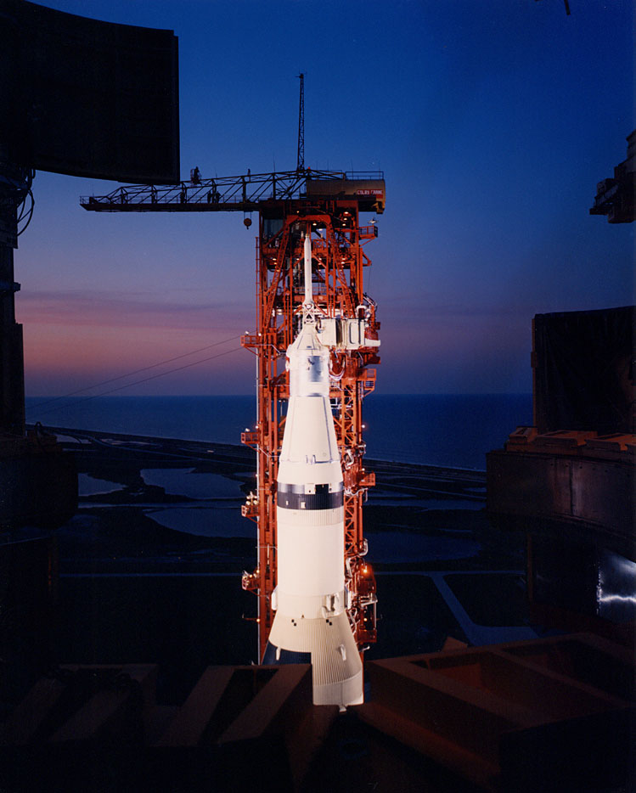
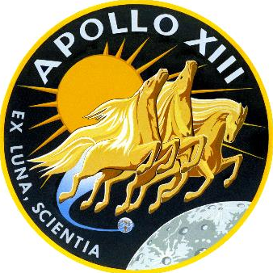
Apollo 13
Presenter’s name
Presenter’s title/position
Notes:
-Image source: NASA → The Apollo 13 Command & Service Module (CSM) and Escape Tower from the Mobile Service Structure, March 25, 1970. Research by J.L. Pickering. (Image identification: KSC-70C-1049); https://www.hq.nasa.gov/alsj/a13/images13.html
-For mission patch image, see https://history.nasa.gov/apollo_patches.html
-Tips:
You do not need to use everything in this presentation!
Feel free to alter/edit this presentation to fit your specific needs/audience
-If you have any questions, please contact presentation author Staci Tiedeken (staci.l.tiedeken@nasa.gov, NASA GSFC)
-Updated January 2023

Slide 2
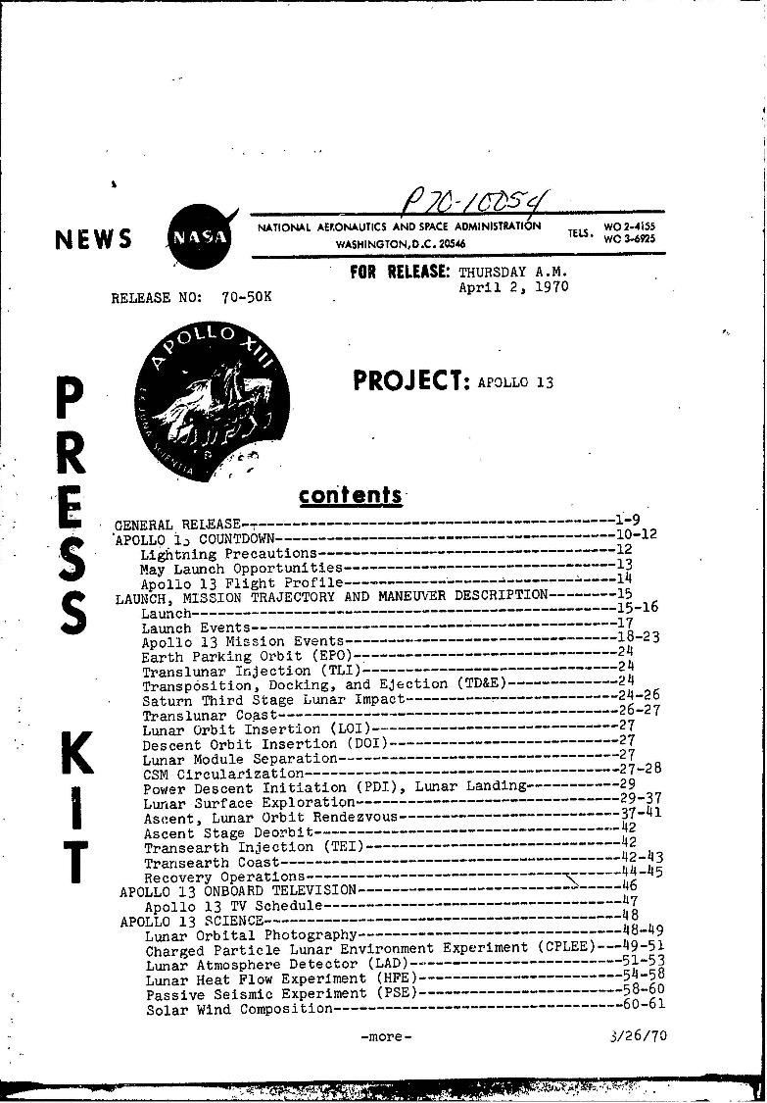
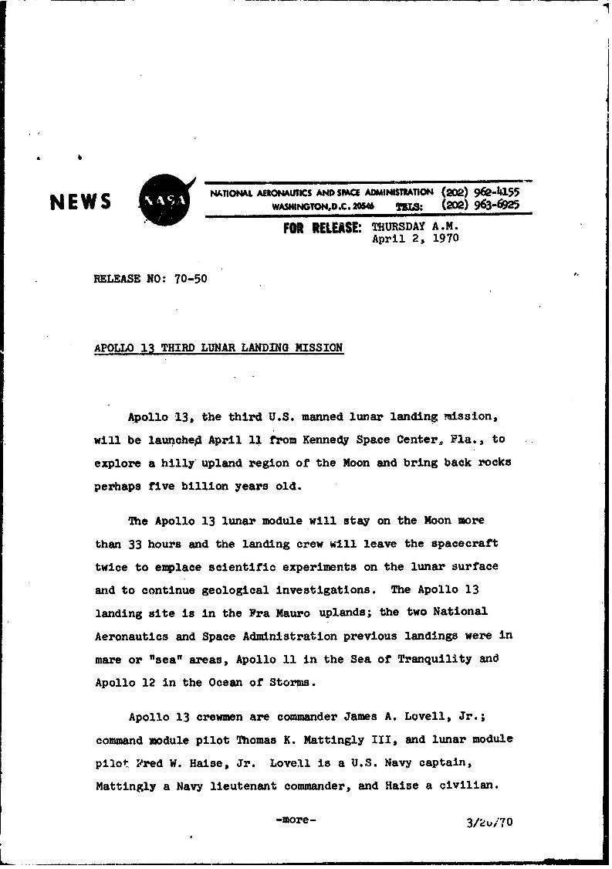
NASA Press Releases
Notes:
-NASA press releases (April 1970): https://historydms.hq.nasa.gov/sites/default/files/DMS/e000013879.pdf

Slide 3
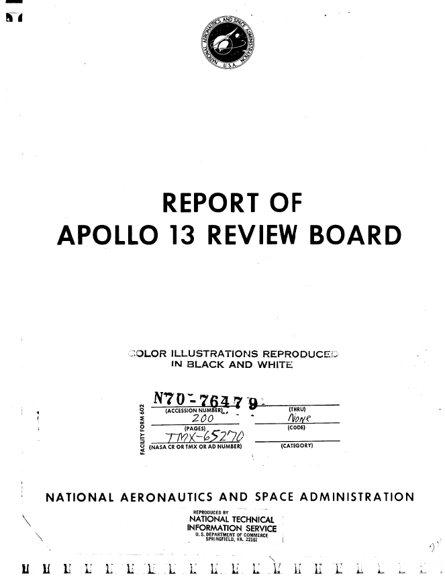
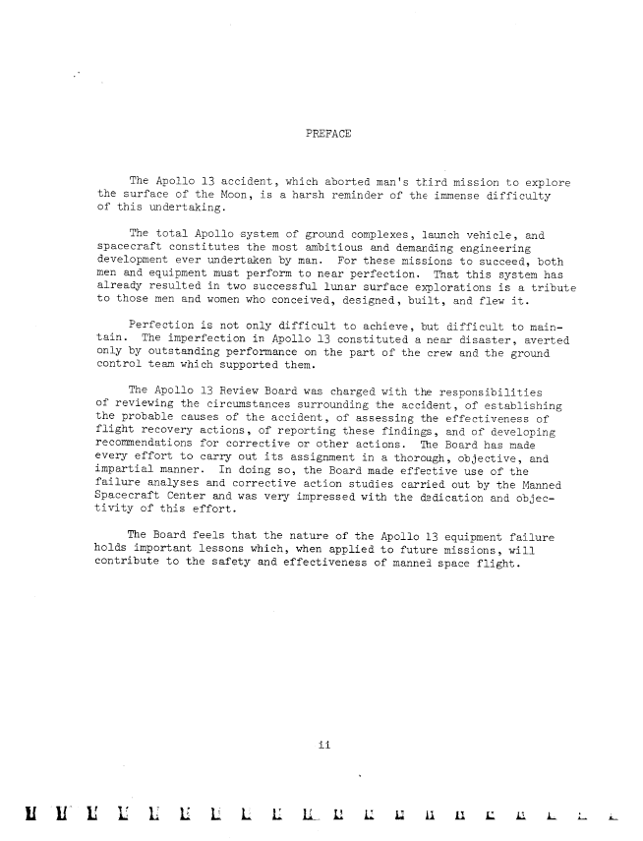
Apollo 13 Review Board Report
Notes:
-Apollo 13 Review Board report: https://history.nasa.gov/afj/ap13fj/pdf/report-of-a13-review-board-19700615-19700076776.pdf

Slide 4
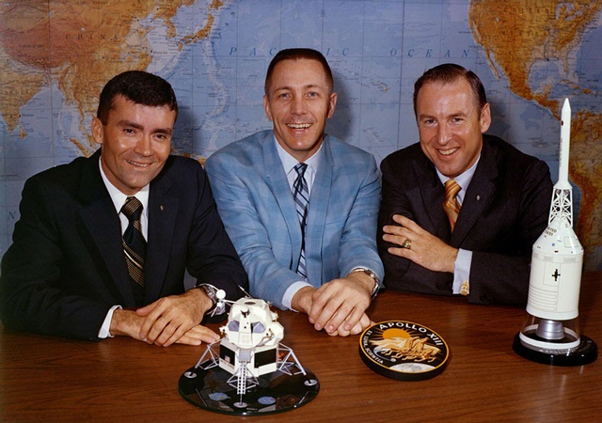
Overview
Overview
April 11-17, 1970
Fred W. Haise, Jr., John “Jack” L. Swigert, Jr., James A. Lovell, Jr.
Notes:
-Image credit: NASA → Apollo 13 crew. From left: Fred Haise Jr. (lunar module pilot), Jack Swigert Jr. (command module pilot), and James Lovell Jr. (commander).
-Apollo 13 was to be the third human Moon landing; Haise and Lovell were to land in the Fra Mauro Formation, but due to an explosion in the command and service module (CSM), the lunar landing was aborted. The intended landing site became the site for Apollo 14 instead.
-Jim Lovell was the mission commander and was back-up pilot for Gemini 4, pilot of Gemini 7, back-up command pilot for Gemini 9, command pilot for Gemini 12, command module pilot of Apollo 8, and back-up commander for Apollo 11.
-Jack Swigert was the command module pilot. He was scheduled to be the back-up command module pilot for Apollo 13 but was moved to the prime crew 72 hours before the launch in place of Ken Mattingly who had been exposed to measles.
-Fred Haise was the lunar module pilot and was back-up lunar pilot for Apollo 8 and Apollo 11 and backup commander for Apollo 16.

Slide 5
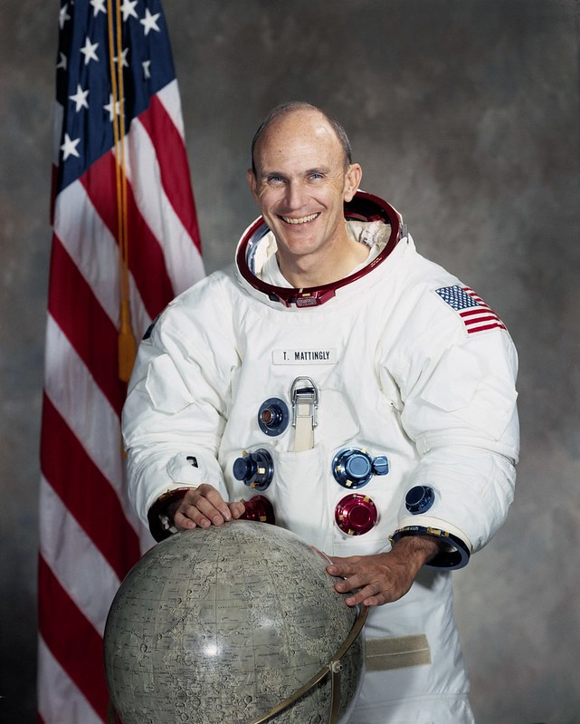
Apollo 12 Landing Site
Change of Crew
Jack Swigert replaced command module pilot Ken Mattingly
Exposed to the German measles during training
Notes:
-Image credit: NASA → Astronaut Thomas K. (Ken) Mattingly, II, Apollo 16 command module pilot.
-Command module pilot Ken Mattingly was removed 72 hours prior to scheduled launch due to presumed exposure to the German measles through backup crew member Charles Duke. He later flew on Apollo 16.
-The back-up command module pilot, Jack Swigert, replaced Mattingly.

Slide 6
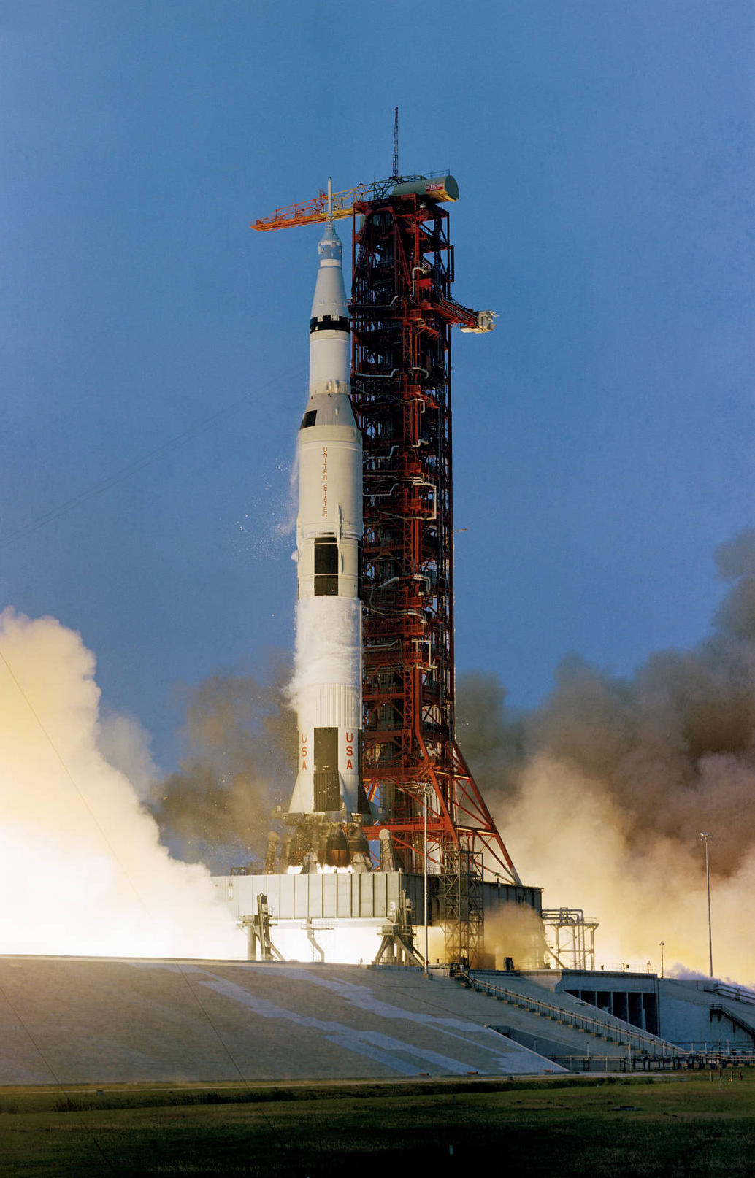
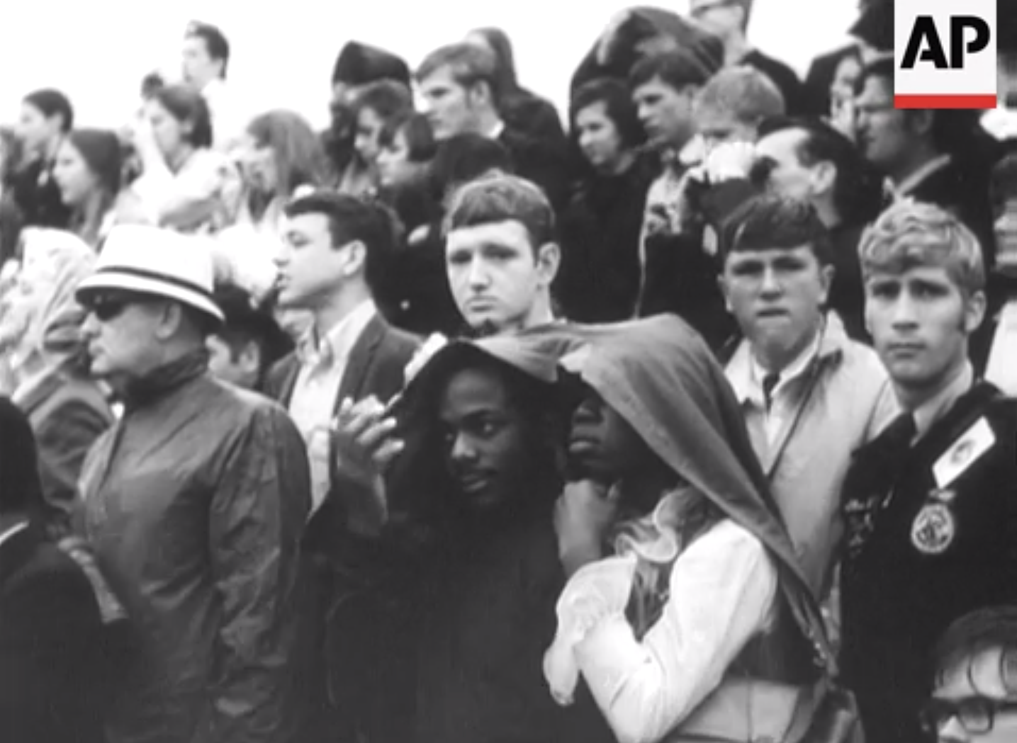
Launch
Launch – April 11, 1970
Notes:
-Image credits: Left: Associated Press, link to video from which the image was taken: https://bit.ly/3bA2v5Z; Right: NASA
-The 363-foot-tall Apollo 13 space vehicle was launched from Pad A, Launch Complex 39, Kennedy Space Center, at 2:13 p.m. EST, April 11, 1970.
-During the launch, the second-stage inboard engine shut down early because of high-amplitude longitudinal oscillations; however, near-nominal trajectory parameters were achieved at orbital insertion. The Earth-orbital and translunar injection phases went as planned.
-As with Apollos 11 and 12, adjacent to Kennedy Space Center (~3.5 miles away), spectators gathered to watch the launch of Apollo 13.

Slide 7
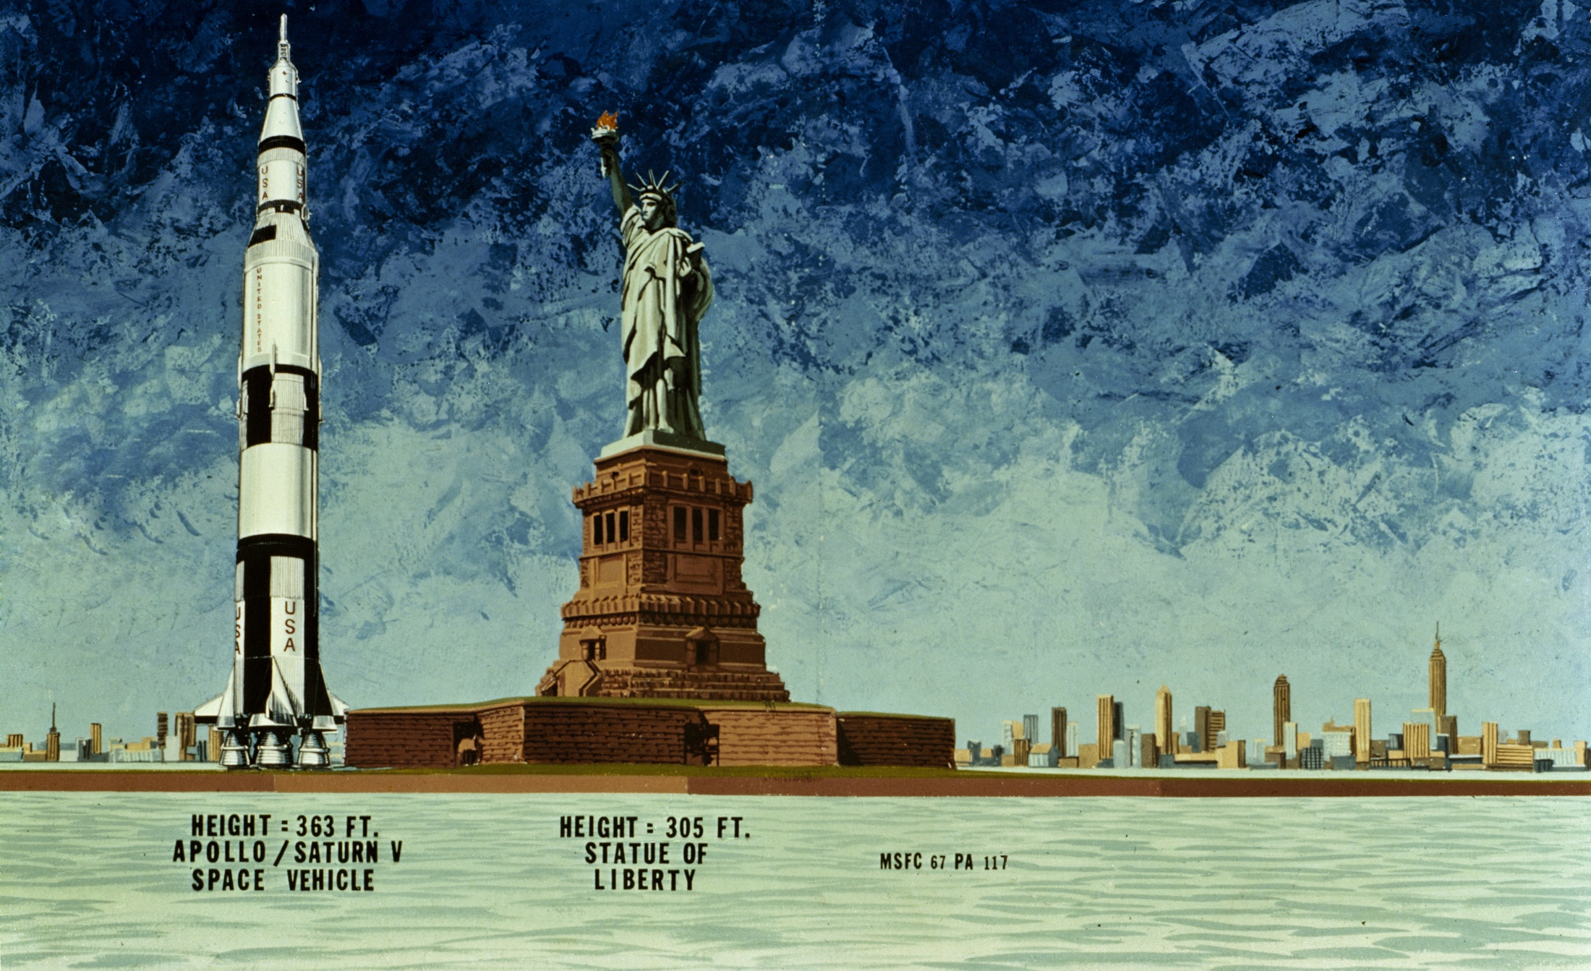
Saturn V Size Comparison
Notes:
-Image credit: NASA → 1967 illustration compares the Apollo Saturn V spacecraft (363 ft) of the Moon Landing era to the Statue of Liberty (305 ft).
-A Saturn V rocket has a rocket engine, three stages, a solid fuel motor, two interstages, a payload, a parachute, an aerodynamic nose cap, avionics, a fuel tank, an oxidizer tank, and stabilizing fins.
Height: 111 meters (363 feet)
Diameter: 10 meters (33 feet)
Mass: 2,840,622 kg (6,262,500 pounds) at liftoff (the weight of 400 elephants)
Maiden Flight: Nov. 9, 1967 (uncrewed)
The rocket generated 34.5 million newtons (7.6 million pounds) of thrust at launch, creating more power than 85 Hoover Dams.
Could launch about 43,500 kg (50 tons) to the Moon (about the same as 4 school buses).
The Apollo 13 launch vehicle was the eighth in the Apollo Saturn V series and was the sixth crewed Saturn V vehicle.
More info on Saturn V: https://solarsystem.nasa.gov/news/337/what-was-the-saturn-v/

Slide 8
Apollo Spacecraft Design
Apollo Spacecraft
Aquarius Lunar Module
Odyssey
Thrusters
Command Module
Service Module
High-Gain Antenna
Thrusters
Thrusters
Descent Stage
Ascent Stage
Notes:
-Image credit: NASA → Diagram of the combined Apollo command and service module/lunar module translunar coast configuration.
-The lunar module was named Aquarius while the command module was named Odyssey.
-Source: https://history.nasa.gov/afj/ap13fj/04day1-end.html
-Link to animation showing the Apollo 13 spacecraft and the damage from the oxygen tank explosion: https://media.apolloinrealtime.org/A13/apollo13_rotate8_2.mp4

Slide 9
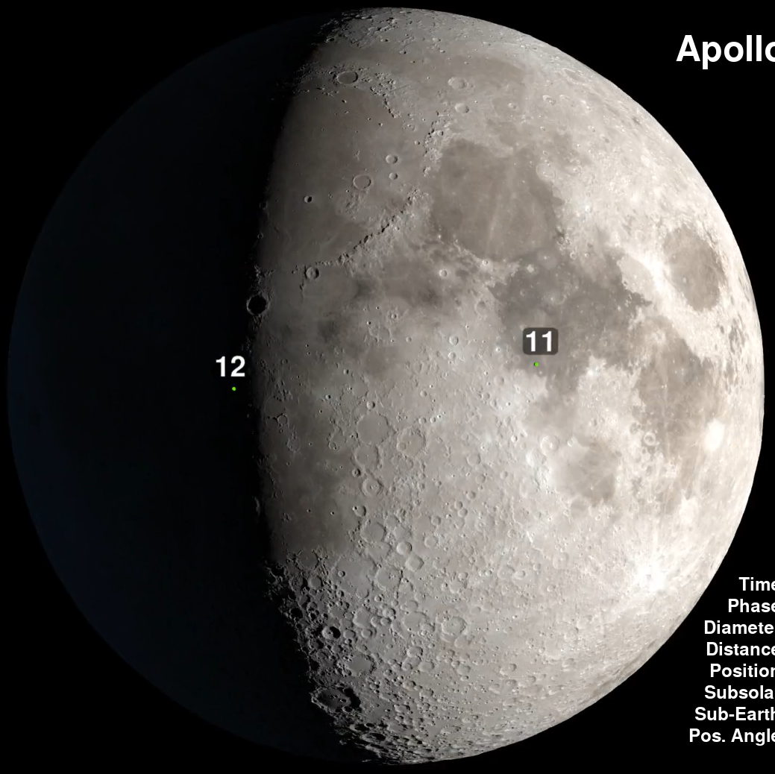
Moon Phase on April 15, 1970
Moon on April 15, 1970
Notes:
-Image credit: NASA's Scientific Visualization Studio → The green dot at left marks the site of the Apollo 12 landing in Oceanus Procellarum (“Ocean of Storms”). Apollo 11’s landing site in Mare Tranquillitatis is shown as the green dot at right.
Apollo 13 would have landed about 181 km (112 mi) east of the Apollo 12 landing site, in the Fra Mauro Formation.
Lunar surface touchdown was scheduled to take place at 9:55 p.m. EST on April 15, 1970.
-Source: https://svs.gsfc.nasa.gov/4731

Slide 10
Friendly banter between the crew
Taxes!
024:18:10 Kerwin: …Today's favorite pastime across the - Uh oh; have you guys completed your income tax?
024:18:28 Lovell: How do I apply for an extension?
024:18:31 Kerwin: [Laughter.]
024:18:32 Swigert: Yeah, Joe. I got to - hey, listen - It ain't too funny; things kind of happened real fast down there, and I do need an extension.
024:18:43 Kerwin: [Laughter.]
024:18:44 Swigert: I didn't get mine filed. I'm really serious; would you...
024:18:47 Kerwin: You're breaking up the room down here.
Notes:
-Image credits: NASA
-Jack Swigert forgot to file his federal income tax return (due April 15) because of the last minute crew change/rush.
This is noted in this transcript from the mission (which also includes the traditional news report of what was happening at the time).
-Transcript between Apollo 13 astronauts and Houston Mission Control (times are elapsed time after launch):
024:18:10 Kerwin: Okay. Some truck lines are being struck in the Midwest, and the school teachers have walked off the job in Minneapolis. Today's favorite pastime across the - Uh oh; have you guys completed your income tax?
[The Minneapolis Strike of April 1970 saw pay rises and wider rights for bargaining among the civil servants in the state.]
024:18:28 Lovell: How do I apply for an extension?
024:18:31 Kerwin: [Laughter.]
024:18:32 Swigert: Yeah, Joe. I got to - hey, listen - It ain't too funny; things kind of happened real fast down there, and I do need an extension.
024:18:43 Kerwin: [Laughter.]
024:18:44 Swigert: I didn't get mine filed. I'm really serious; would you...
024:18:47 Kerwin: You're breaking up the room down here.
[Laughter is heard in the background on the open comm loop, from Mission Control enjoying the news about Jack's taxes.]
024:18:49 Swigert: ...because I may be spending time in a...
024:18:51 Kerwin: We'll see...
024:18:52 Swigert: I may be spending time in a - I may be spending time in another quarantine besides the one that they are planning for me.
024:18:59 Kerwin: We'll see what we can do, Jack. We'll get with Recovery and see if we can get the agent out there in the Pacific when you come back. By golly, let's see. In professional basketball, the Nicks beat the Milwaukee Bucks 110 to 102, and Billy Casper is leading the Masters after 54 holes with a 208, and spring football practice is in full swing. And that's about all the news we got; the updated plan of the day for you guys, the uniform will be service dress inflight coverall garments with swords and medals, and tonight's movie shown in the Lower Equipment Bay will be John Wayne, Lou Costello, and Shirley Temple in the 'The Flight of Apollo 13.' Over.
-Source: W. David Woods, Johannes Kemppanen, Alexander Turhanov, and Lennox J. Waugh; https://history.nasa.gov/afj/ap13fj/05day2-mcc2-tv.html

Slide 11
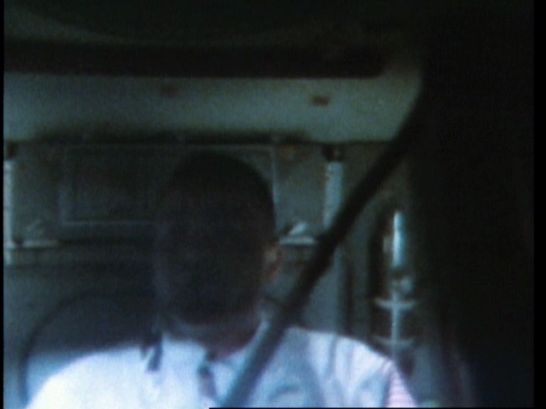
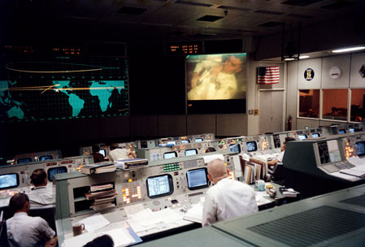
Onboard TV Broadcast
Onboard TV Broadcast
Notes:
-Image credits: NASA → Left: Fred Haise is the first thing to appear on the live TV broadcast; he is in the Lower Equipment Bay.
Right: The controllers watch the TV show, with Fred Haise on the big screen. Flight Director Gene Kranz is sitting near the center. To his left, Jack Lousma and Vance Brand watch from the Capsule Communicator (CapCom) station.
-The Apollo 13 crew conducted a live TV broadcast showing their living quarters, how they work in zero gravity, and the equipment they’d be using during the mission.
-At 55 hours, 46 minutes (late on April 13) into the flight, as the crew finished their 49-minute TV broadcast, Jim Lovell said, “This is the crew of Apollo 13 wishing everybody there a nice evening, and we’re just about ready to close out our inspection of Aquarius and get back for a pleasant evening in Odyssey. Good night.”
9 minutes after the broadcast came the explosion in the service module.
-Note that unknown to the crew, none of the major U.S. TV networks broadcasted the TV show live, despite the good hour of 8:30pm CST.
Instead, television viewers got to enjoy baseball, The Dick Cavett Show, and a rerun of “I Love Lucy.”
So, only the people in Mission Control saw the transmission.
-More info: https://history.nasa.gov/afj/ap13fj/07day3-before-the-storm.html

Slide 12
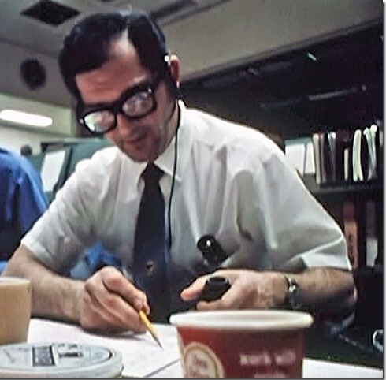
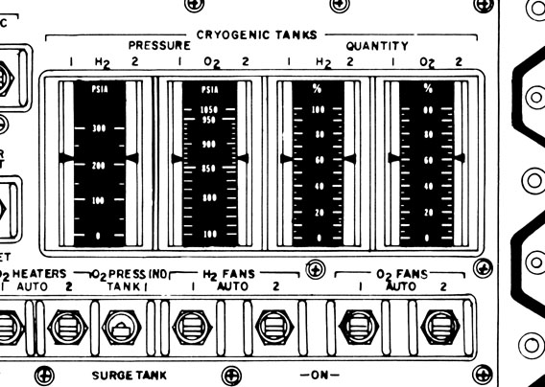
Pete Conrad stepping on the lunar surface
Stirring of the Cryogenic Tanks
Notes:
-Image credits: Left: Sy Liebergot → EECOM Sy Liebergot at his station. He made the request to Flight Director Gene Kranz that he’d “sure like to have a cryo stir, all 4 tanks.”
Right: heroicrelics.org → Master Display Console (MDC) controls and displays for the cryogenic tanks and the switches for controlling heaters and fans.
-Late on April 13, 1970, when the crew was about 200,000 miles from Earth, Mission Control asked Jack Swigert to stir the cryogenic tanks. This was to homogenize their contents in order to gain a more accurate reading of their quantities.
-Electrical, Environmental, and Consumables Manager (EECOM) Sy Liebergot had requested more frequent stirs of the tanks, in particular the two oxygen tanks, because earlier in the day, the quantity sensor for tank 2 had failed.
If tank 2’s sensor couldn’t be trusted, then it would become important to keep a closer eye on tank 1’s quantity and extrapolate tank 2’s depletion from that.
This is the reason for an evening stir when normally these would only be carried out in the crew’s morning period.
-Source: https://history.nasa.gov/afj/ap13fj/08day3-problem.html

Slide 13
“Houston, we’ve had a problem.”
“Houston, we’ve had a problem.”
Notes:
-After Jack Swigert flipped the switch to stir oxygen tank 2, an explosion occurred in the service module. Below is commentary from Houston Mission Control to the Apollo 13 crew:
055:55:19 Swigert: Okay, Houston...
055:55:19 Lovell: ...Houston...
055:55:20 Swigert: I believe we've had a problem here. [Pause.]
055:55:28 Lousma: This is Houston. Say again, please.
055:55:35 Lovell: Aaah, Houston, we've had a problem. We've had a Main B Bus Undervolt.
055:55:42 Lousma: Roger. Main B Undervolt. [Long pause.]
055:55:58 Lousma: Okay, stand by, 13. We're looking at it. [Pause.]
-Note: The legendary line delivered by Jim Lovell is “Houston, we’ve had a problem” and not the familiar “Houston, we have a problem” made especially popular by the Tom Hanks movie.
-Source: W. David Woods, Johannes Kemppanen, Alexander Turhanov and Lennox J. Waugh; https://history.nasa.gov/afj/ap13fj/08day3-problem.html

Slide 14
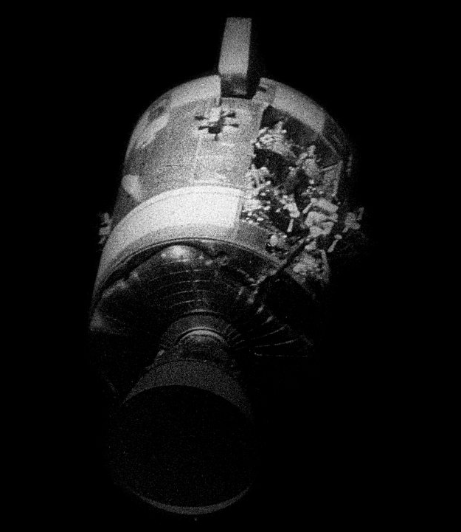
Explosion
Explosion
Micrometeoroid impact?
Or something else…
Notes:
-Image credit: NASA, scan by Kipp Teague → April 17, 1970 image of the severely damaged service module following its jettison from the command module.
-No one knew what had caused the spacecraft to be crippled – an impact by a micrometeoroid was initially thought of as a possibility.
-The force of the explosion had profound effects within the service module.
Two of the three fuel cell units that supplied the spacecraft with its electrical power were knocked out, causing a temporary dip in the supply voltage. This was picked up by the Caution & Warning system.
The remaining fuel cell, number 2, was still working and was being fed oxygen from the other tank, tank 1. However, the pipework leading from tank 1 was also damaged, and its contents began leaking away into space – it was essentially empty three hours later.

Slide 15
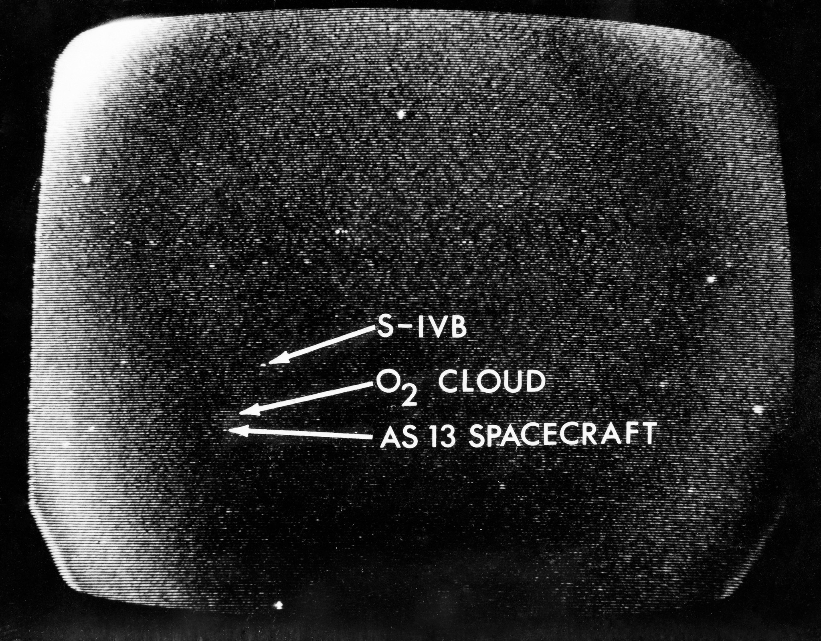
Venting into Space
Venting into Space
Oxygen leaking from tank 1
Acts like a rocket thruster
Notes:
-Image credit: NASA → Image S70-34857 (April 13, 1970): A telescopic photograph showing the Apollo 13 spacecraft in trans-lunar trajectory in the distant sky. Arrows point to the spacecraft, to the oxygen cloud, and to the expended Saturn V third stage. Apollo 13 was tracked at the Manned Spacecraft Center (now Johnson Space Center) using a 16 inch Schmidt-Cassegrain telescope. https://flic.kr/p/ffkrbx
-13 minutes after the explosion, Jim Lovell happened to look out the left-hand window and saw evidence pointing toward potential catastrophe.
056:09:07 Lovell: That's AC, okay. Yes, that's good AC and it looks to me, looking out the hatch, that we are venting something. We are venting something out into the - into space.
[In this comment, Jim calmly finishes talking about the AC power situation before he announces the terrifying news that he can see something leaking from the ship.]
056:09:22 Lousma: Roger. We copy your venting.
056:09:29 Lovell: It's a gas of some sort. [Long pause.]
[Jim is seeing the leakage from oxygen tank 1 (the second, and last, oxygen tank).]
-The astronauts can see gas spewing from the service module at the same time that the meter for oxygen tank 1 is showing decreasing pressure.
The venting of the spacecraft’s oxygen supply is acting like a rocket thruster, constantly pushing them out of their desired attitude.
This is then fought by the Reaction Control System (RCS) thrusters. If the attitude goes too far in the wrong direction, it can cause the guidance platform to reach 'gimbal lock', a condition whereby two of the three axes of the gimbals line up, reducing the degrees of freedom of the arrangement from three to two. In this condition, the platform's orientation cannot be kept separate from the spacecraft's attitude and their attitude reference is therefore lost.
The RCS attitude control jets can be fired through two control paths, Auto or Direct. In Direct mode, the automatic control is bypassed and moving the hand controller in the command module causes the jets to fire under manual control.
The astronauts use manual control (Direct mode) to try to correct the drifting attitude.
-At 56 hours, 45 minutes into the flight, Jack Swigert observes that the number of particles outside the window has diminished greatly.
[The oxygen leak is growing weaker because the pressure in the tank has dropped due to the loss of oxygen. By now a whole cloud of oxygen surrounds the spacecraft and is even visible to telescopic observers on Earth.]
-Source of commentary: W. David Woods, Johannes Kemppanen, Alexander Turhanov and Lennox J. Waugh; https://history.nasa.gov/afj/ap13fj/08day3-problem.html

Slide 16
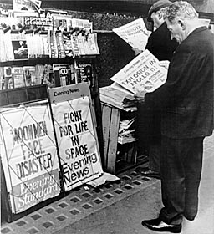
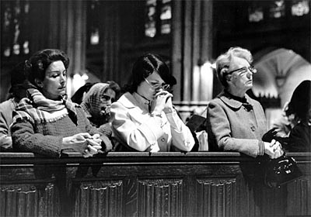
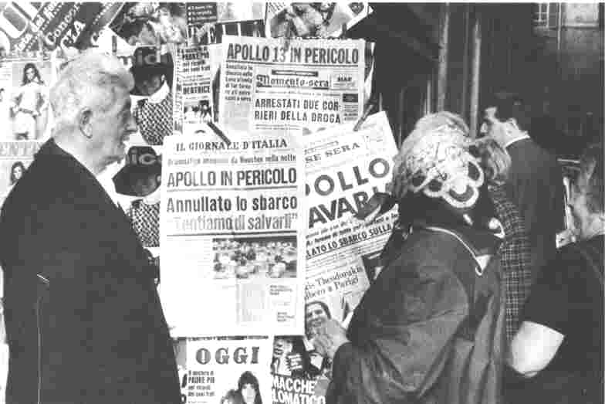
Splashdown
Global Support
New York City
London
Italy
Notes:
-Image credits: Left: The Associated Press → London workers read evening newspapers recounting the troubles aboard the Apollo 13 spacecraft on April 14, 1970.
Middle: https://er.jsc.nasa.gov/seh/pg15.htm → Italian press reaction was typical of worldwide concern.
Right: Eddie Hausner/The New York Times → Worshipers prayed for the safe return of the Apollo 13 crew at St. Patrick’s Cathedral in New York City, NY.
-Left & right images via: https://archive.nytimes.com/www.nytimes.com/library/national/science/nasa/041570sci-nasa-arnold.html

Slide 17
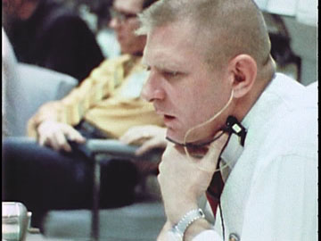
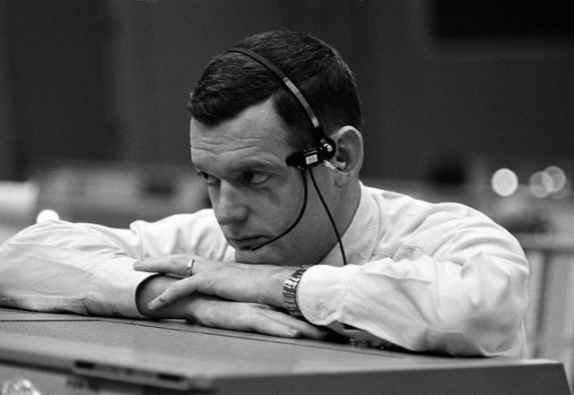
Shift Change
Shift Change
Gene Kranz’s “White Team” (also “Tiger Team”)
Glynn Lunney's “Black Team”
Notes:
-Image credits: Left: NASA, via NARA → Flight Director Gene Kranz
Right: NASA → Flight Director Glynn Lunney
-At 57 hours, 6 minutes into the mission, there was a change of shift in Mission Control.
Gene Kranz’s White Team was replaced by Glynn Lunney's Black Team, and they continued to troubleshoot the spacecraft's problems.
-Gene Kranz’s White Team became the Tiger Team after their shift in Mission Control ended – they shut themselves in a separate room to work on setting the constraints for the consumption of spacecraft consumables (oxygen, electricity, and water), as well as the power-up procedures that allowed the astronauts to land safely back on Earth in the command module.
-Once Lunney’s shift was complete, Milt Windler’s Maroon Team took over, then Gerry Griffin’s Gold Team.

Slide 18
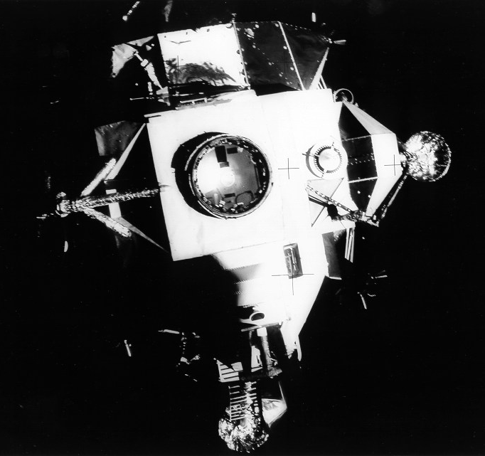
Aquarius, the Lifeboat
Aquarius, the Lifeboat
Notes:
-Image credit: NASA, scan by Kipp Teague → View of the top of the Apollo 13 lunar module (LM) Aquarius after separation from the command module (CM) Odyssey.
-Because of the situation in the command module, the astronauts were instructed to use the lunar module Aquarius as a lifeboat.
The LM had untapped supplies of oxygen, water, and electric power to support the crew, and there were two powerful engines, the most useful of which was the Descent Propulsion System (DPS, pronounced “dips”). Well-developed plans existed for using the DPS engine to perform an abort burn once the astronauts passed the Moon to get them back home, but using the LM for extended life support was something Mission Control had to figure out.
Odyssey wouldn’t be able to support the crew in deep space, but it wouldn’t be useless, as it would be their only means to get through Earth's atmosphere without burning up.
-More info: https://history.nasa.gov/afj/ap13fj/09day3-lifeboat.html

Slide 19
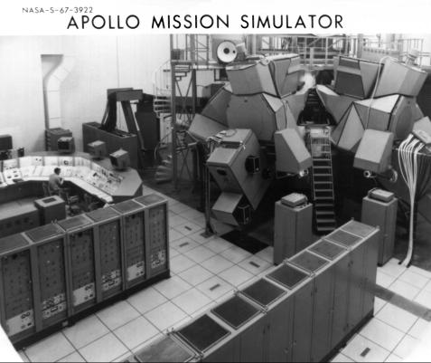
Apollo Mission Simulator
Notes:
-Image credit: NASA → Mission Control had back-up astronauts use the Lunar Module Simulator to verify the adapted procedures that the flight controllers came up with and that were then sent up to the crew for implementation.
-More info: https://history.nasa.gov/afj/ap13fj/09day3-lifeboat.html

Slide 20
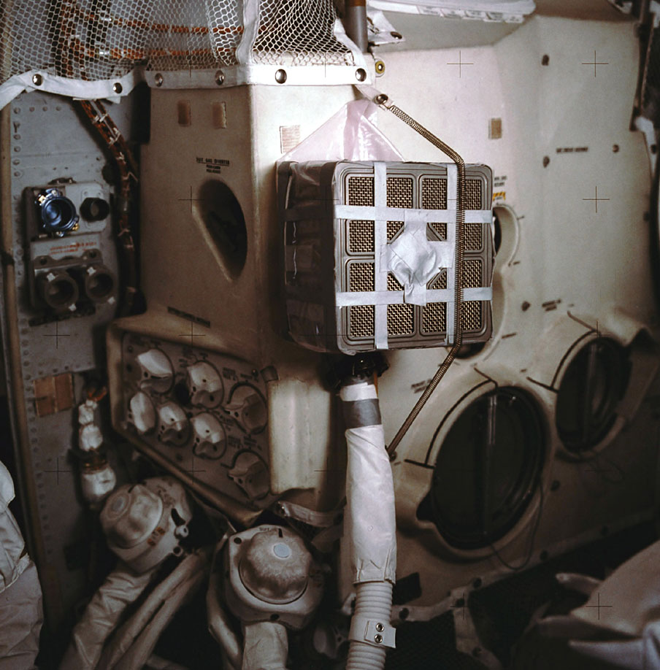
Jury-rigged Air Filter
Improvised Air Filter
Notes:
-Image credit: NASA, scan by John Fongheiser → In-flight photo of the air filter device constructed by the crew from duct tape, plastic bags from the liquid cooling garments, and other materials they had on hand as per instructions provided by Mission Control.
This device allowed the use of box-shaped CM lithium hydroxide (LiOH) canisters in conjunction with the LM Environmental Control System, which is the large white unit that fills most of the frame. The LM LiOH canisters were cylindrical in shape and fit into the receptacles at the lower left.
Without this device, the air in the spacecraft wouldn’t have been able to be filtered (since the command module had different shaped LiOH canisters than the lunar module), and the astronauts would have suffocated from their own respiration.
-More info: https://www.hq.nasa.gov/alsj/a13/a13_LIOH_Adapter.html

Slide 21
Return to Earth
Return to Earth
Notes:
-Video credit: NASA Goddard → This video uses data gathered from the Lunar Reconnaissance Orbiter (LRO) spacecraft to recreate some of the stunning views of the Moon that the Apollo 13 astronauts saw on their journey in 1970.
Data from LRO now makes it possible to show what the Apollo 13 astronauts saw as they flew around the far side of the Moon.
This video showcases visualizations in 4K resolution of many of those lunar surface views, starting with earthset and sunrise, and concluding with the time Apollo 13 reestablished radio contact with Mission Control.
Also depicted is the path of the free return trajectory around the Moon, and a continuous view of the Moon throughout that path.
All views have been sped up for timing purposes - they are not shown in "real-time."
-Video source: https://svs.gsfc.nasa.gov/13537

Slide 22
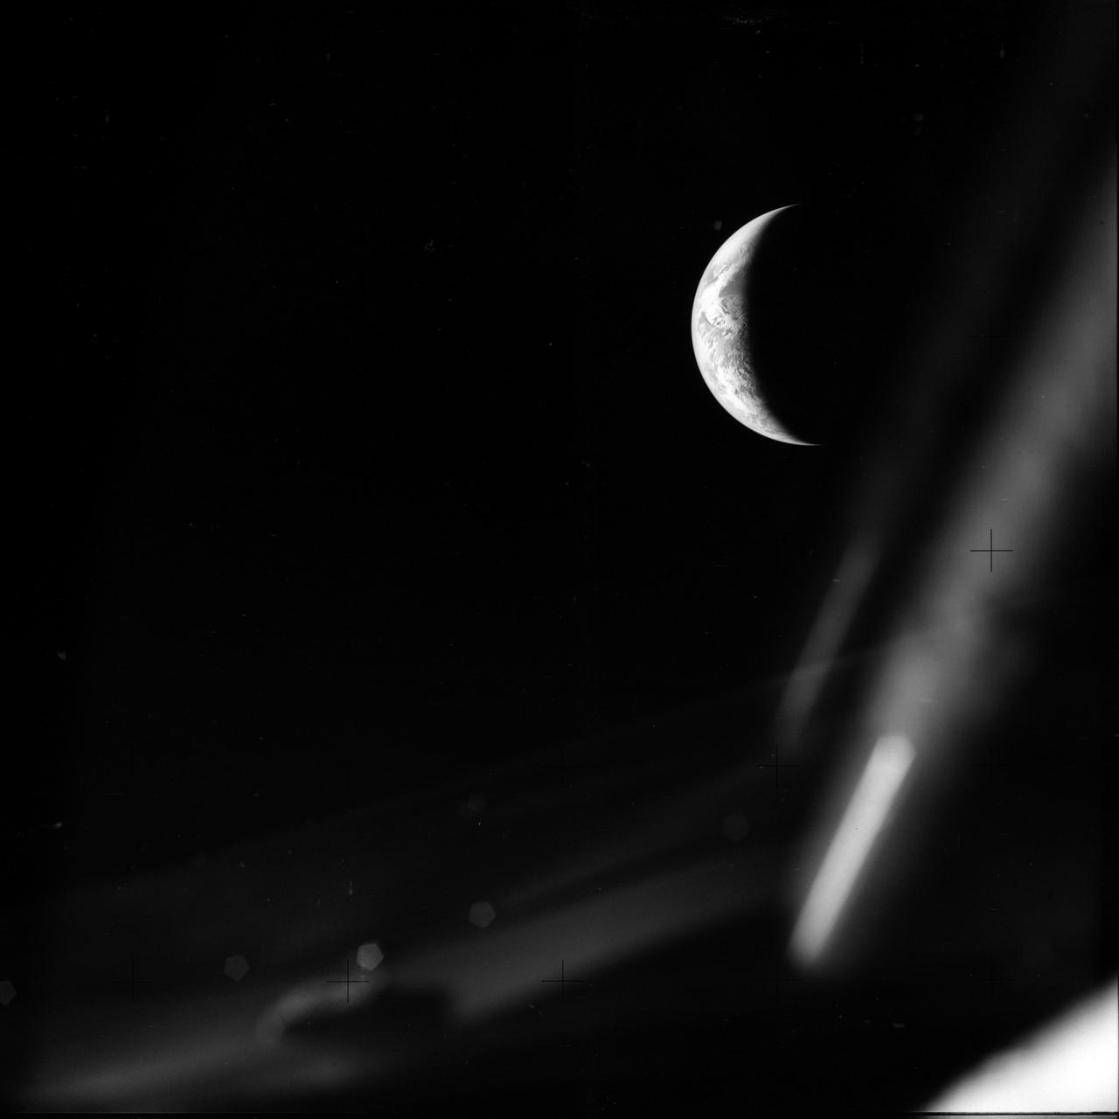
Return to Earth
Return to Earth
Service module jettison
Return to Odyssey
Farewell, Aquarius
Notes:
-Image credit: NASA → View of Earth from Apollo 13 on the return journey, April 17, 1970. (Image #: AS13-59-8493)
-On the Apollo spacecraft, the service module (SM) was intended to provide most of the consumables such as oxygen, water, and power for the mission. It was also designed to serve as the primary propulsion and maneuvering system of the spacecraft. However, the explosion of one of the oxygen tanks led to the loss of the consumables and rendered the SM nonfunctional.
The SM was retained until just before reentry to protect the command module’s heat shield from potential damage due to the long exposure to the cold of space.
-Normally, the command module (CM), which was equipped with couches, served as the crew compartment and control center. Able to accommodate all three astronauts, the CM was also designed for reentry. Although the CM had sufficient power and consumables for a reentry, the SM provided these necessities during the rest of the mission.
The CM had to be “powered down” after the accident to avoid depleting its systems and rendering it incapable of performing the reentry operation.
Once the astronauts were ready for reentry, they returned to the CM from the lunar module.
-The lunar module (LM) was designed to be used only for the actual Moon landing (and providing an operating base and living quarters while on the lunar surface).
As noted previously, the LM acted as a lifeboat for Apollo 13. With its separate systems for power and consumables, it allowed the crew to preserve the CM supplies for reentry operations. And, as the SM could no longer provide propulsion, the LM descent engine was used to perform the maneuvers necessary to alter the spacecraft trajectory for the return to Earth.
Once the astronauts were ready for reentry, they returned to the CM, and the LM was jettisoned.
-More info: https://www.lpi.usra.edu/lunar/missions/apollo/apollo_13/overview/

Slide 23
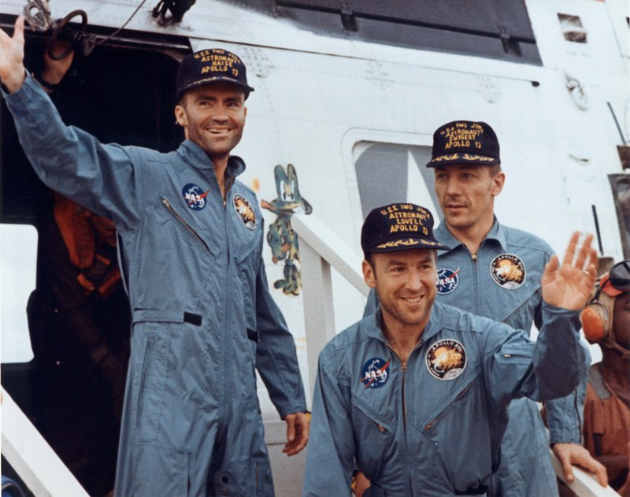
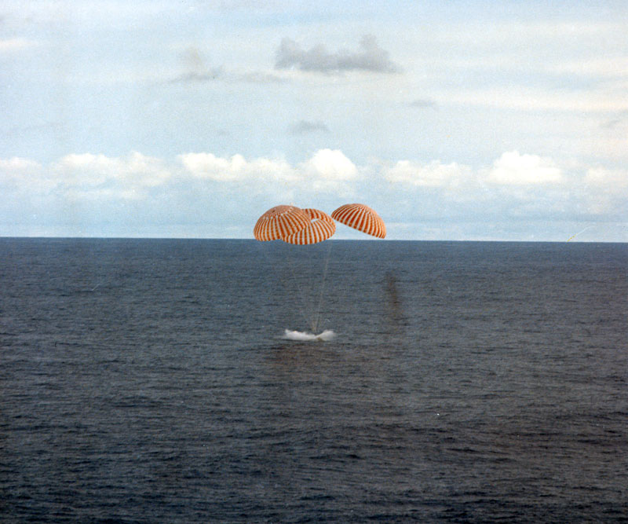
Splashdown - Astronauts
Splashdown
Notes:
-Image credits: NASA, scans by Ed Hengeveld
Left image: Fred Haise (left), Jim Lovell, and Jack Swigert emerge from the recovery helicopter on-board the aircraft carrier Iwo Jima; April 17, 1970.
Right image: Apollo 13 splashdown; April 17, 1970.
-The Apollo 13 splashdown occurred at 1:07 p.m. EST on April 17, 1970 in the South Pacific Ocean.

Slide 24
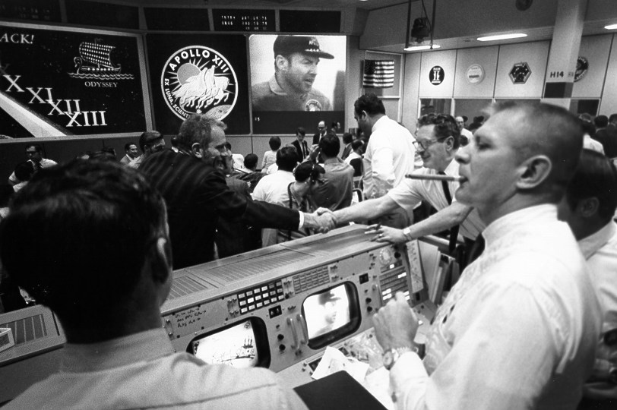
Splashdown – Mission Control
Splashdown
Notes:
-Image credit: NASA, scan by Kipp Teague → Mission Control in Houston celebrates the safe return of the Apollo 13 crew. Gene Kranz is smoking a celebratory cigar at the right while Deke Slayton, in front of the mission patch, shakes hands; April 17, 1970.

Slide 25
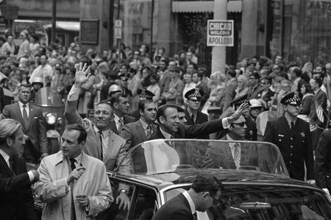
Ticker Tape Parade
Ticker Tape Parade
Notes:
-Image credit: Associated Press → On May 1, 1970, Apollo 13 astronauts Jack Swigert (at left, with his arm raised) and Jim Lovell (at right, with his arm raised) received a heroes welcome and ticker tape parade in Chicago. Fred Haise missed the parade due to illness (he developed a kidney infection during the mission, likely from not drinking enough water).
-Link to video of the parade: http://www.aparchive.com/metadata/youtube/37b81f1c0b49083ddc3f8982076deea7 or https://www.youtube.com/watch?v=pFvQB0qk75s

Slide 26
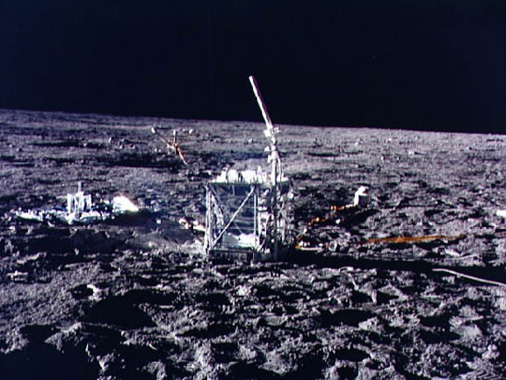
Lunar Impact of S-IVB Rocket Stage
Lunar Impact of S-IVB Rocket Stage
Notes:
-Image credits: Left: Image Science and Analysis Laboratory, NASA Johnson (color correction by David Woods) → Apollo 13’s spent S-IVB rocket stage drifting away after separation.
Right: NASA → The seismometer left on the Moon at the Apollo 12 site. The instrument (left) is protected by metal foil against the varying temperatures on the lunar surface that produce large thermal stresses.
-Despite the Apollo 13 mission being aborted, we were still able to gain scientific knowledge, particularly in looking at the seismic effects of a large object impacting the Moon.
-Instead of sending the third stage of the launch vehicle into solar orbit, as had been done on previous missions, the trajectory of the Saturn V third stage (S-IVB) was designed to cause it to hit the lunar surface. A target site was selected to allow the seismic signals to be recorded using the seismometer left behind by the Apollo 12 astronauts.
By measuring this artificial moonquake (and by studying how seismic energy passes through the Moon), scientists were able to learn more about the structure of the lunar interior.

Slide 27
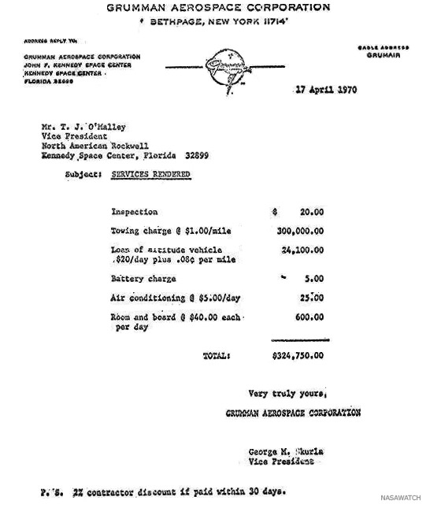
Grumman’s Mock Invoice
Grumman’s Mock Invoice
Notes:
-Image credit: SpaceRef → Copy of the invoice sent by Grumman Aerospace to North American Rockwell for charges associated with the Grumman lunar module (LM) towing Rockwell’s command and service module (CSM) back to Earth.
The company that built the lunar module, Grumman Aerospace, sent a mock invoice to the maker of the command module, following the successful return of Apollo 13 for the lunar module’s “towing” service.

Slide 28
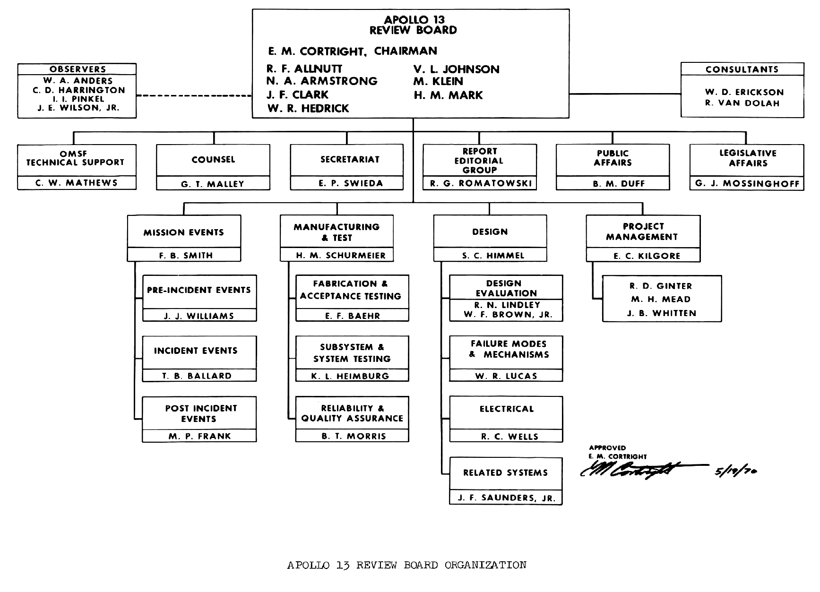
Apollo 13 Review Board Members
Notes:
-Image source: https://history.nasa.gov/afj/ap13fj/30postflight.html
-By April 17, 1970, NASA Administrator Thomas O. Paine and Deputy Administrator George M. Low had already established an official commission to handle the investigation into the events of the mission. Officially known as the Apollo 13 Review Board, it was put under the responsibility of Edgar Cortright, the Director of NASA’s Langley Research Center.
Notable members included astronauts Neil Armstrong and William Anders, the latter already serving the U.S. government as a specialist in spaceflight.
The Board divided itself into four Panels, which would each investigate a different aspect of the mission and its event.
In addition to this, NASA's Manned Spaceflight Center was conducting its own investigation under the command of Colonel James A. McDivitt.
The Review Board operated until June 15, 1970, when their report was presented.

Slide 29
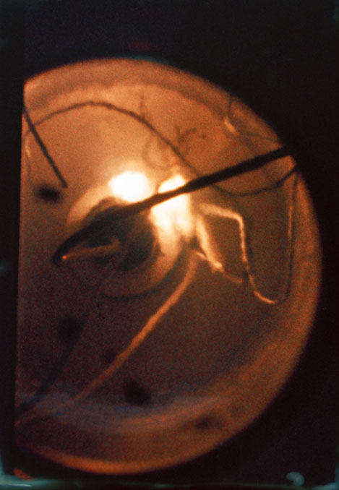
Oxygen Tank No. 2 Findings
Oxygen Tank No. 2 Findings
Previously installed in Apollo 10’s SM, removed for modification, damaged in process
Tank installed in Apollo 13’s SM & tested
Didn’t empty properly
Remaining oxygen was “boiled off” using electrical heater w/in tank
Tank’s internal heating elements severely damaged
Spark → Fire → Explosion
Notes:
-Image credit: NASA (photo S70-41146) → Oxygen tank test article showing the insulation in the wiring burning in a liquid oxygen environment. (From later forensic study of the accident).
-By throwing the switch to stir oxygen tank 2, Jack Swigert sent power to a pair of fans via Teflon-shielded wires within the tank. Unfortunately, this Teflon insulation had been damaged prior to flight by excessive heat. This cracked Teflon insulation around the wires allowed the wires to come close enough to spark, and in an environment of pure oxygen at extremely high pressure, the Teflon ignited, and a fire ensued. The fire engulfed every flammable substance it reached, and the pressure in the tank rose rapidly until its structure failed, and the tank exploded with a force equivalent to about 7 pounds of TNT.
History of Oxygen Tank No. 2:
-The heat that damaged the Teflon insulation was the result of an attempt to boil the tank empty after a ground test. During that attempt, thermostatic switches should have cut the power to the tank’s internal heaters if the temperature within the tank had risen above 27°C (80°F), but they failed to do so. The reason they failed was that they were rated for the wrong voltage.
When the tank was being built, an important instruction did not reach a company who was supplying thermostatic switches to the tank’s subcontractor. Although the spacecraft worked on 28V DC, the ground systems at the launch pad were changed to work on 65V DC.
This change to 65V occurred during Apollo’s development, and the word had gone out to ensure that all systems could tolerate this higher voltage. However, the supplier of the thermostatic switches had missed this change. Therefore, when their switches had been called upon to operate and interrupt the power to the heaters, thereby protecting the tank after the ground test, the devices had instead welded themselves shut due to the higher operating voltage. As a result, the heaters within the tank continued to operate, raising its internal temperature to around 500°C (1,000°F).
The intense heat damaged the electrical insulation within the tank.
-The leading theory for why the heaters had to be called upon to empty the tank concerns an event that occurred 18 months earlier, on October 21, 1968.
The tank that became Apollo 13’s No. 2 oxygen tank was being removed from the Apollo 10 SM during modifications. As this operation was being carried out, a bolt snapped, and the tank dropped about 5 cm. The theory suggests that the jolt could have caused slight damage to the fitting that was used to fill and drain the tank. Despite having suffered the jolt, the tank was considered to be flight ready as no problems were indicated at the time.
It was then installed in Apollo 13’s SM.
-Following the Countdown Demonstration Test on March 16, 1970, the fill/drain system for oxygen tank 2 failed to allow it to empty properly. Eleven days later, technicians at the pad decided to use the heaters to boil off the remaining oxygen in the tank. A technician was tasked to monitor a gauge and ensure it didn’t rise above a reading of 80°F, this being despite the fact that 80°F was the highest reading the gauge could display. For 8 hours, the tank's innards baked. A second test of the tank 3 days later repeated the mistake.
-So, on April 13, 1970, when the Apollo 13 spacecraft was 178,000 nautical miles from Earth, the cracked and flaked Teflon insulation around the wires finally failed, and the wires came close enough to spark. In an environment of pure oxygen at extremely high pressure, the Teflon ignited and a vigorous fire ensued which began to engulf every flammable substance it reached. The pressure in the tank rose rapidly until its structure failed and, at 055:54:53 GET, the tank exploded with a force equivalent to about 7 pounds of TNT.
As a result, the outer skin panel of the SM is blown off by a pressure of about 60,000 psi. In response to the force, the spacecraft stack begins to rotate wildly and RCS thrusters fire to restore attitude.
-More info: https://www.nasa.gov/mission_pages/apollo/missions/apollo13.html; https://history.nasa.gov/afj/ap13fj/08day3-problem.html

Slide 30
By the Numbers
“Successful Failure”
Notes:
-Even though Apollo 13 didn’t land on the Moon, the mission was considered a “successful failure” because of the work involved in rescuing the crew.
Problem solving and teamwork were key to the safe return of the Apollo 13 astronauts.

Slide 31
Apollo 13 Mirror
Apollo 13 Mirror
Notes:
-Image credit: Renna Warren (source: https://www.houstonchronicle.com/local/space/mission-moon/article/MIRROR-IMAGE-Apollo-13-astronauts-gift-honors-13895337.php#photo-17552525) → The mirror the Apollo 13 crew presented to Mission Control for helping them return safely to Earth.
-Following their landing back on Earth, the Apollo 13 astronauts presented a mirror from their spacecraft to Gene Kranz and the rest of the control team. Ever since, the mirror has hung on a plaque above the Mission Control room’s water fountain “to ‘reflect the image’ of the people in Mission Control who got us back.”
The mirror was temporarily removed during the restoration efforts of Apollo Mission Control but was placed back in its original spot after the restoration was completed (in 2019).
The plaque reads “This mirror flown on Aquarius, LM-7, to the Moon April 11-17, 1970. Returned by a greatful Apollo 13 crew to ‘reflect the image’ of the people in Mission Control who got us back!”

Slide 32
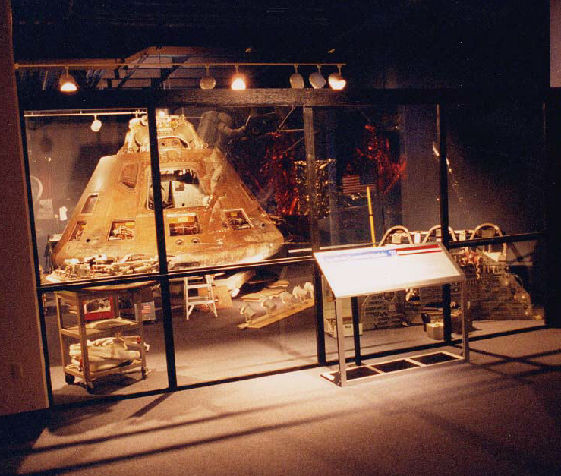
Apollo 12 Command Module
Apollo 13 Command Module
Name: “Odyssey”
Location:
Kansas Cosmosphere and Space Center
Hutchinson, KS
Notes:
-Image credit: National Air and Space Museum → https://airandspace.si.edu/collection-objects/command-module-apollo-13
-Color of the command module is due to the mylar material used.

Slide 33
More Info
More Info
Notes:
-Image source: https://www.hq.nasa.gov/alsj/a13/images13.html

Slide 34
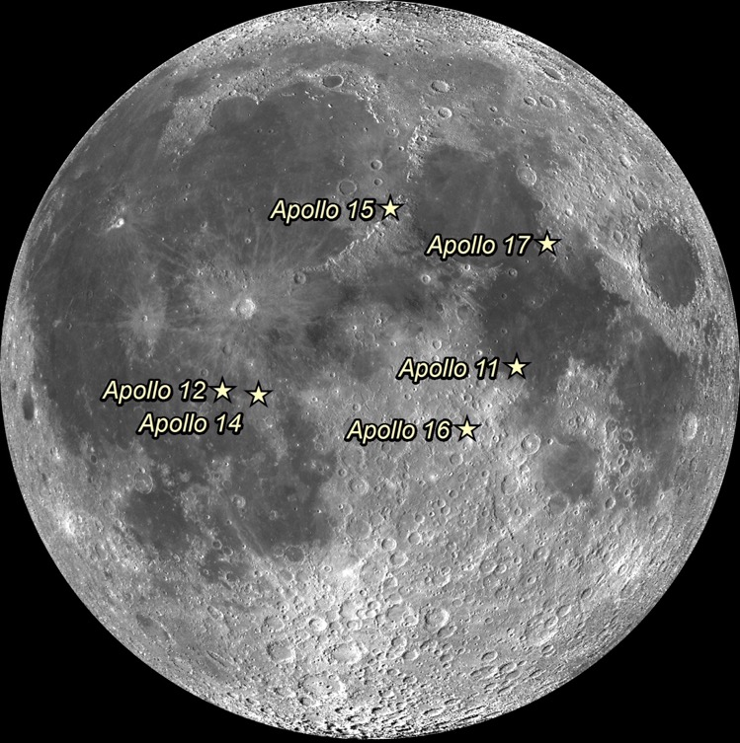
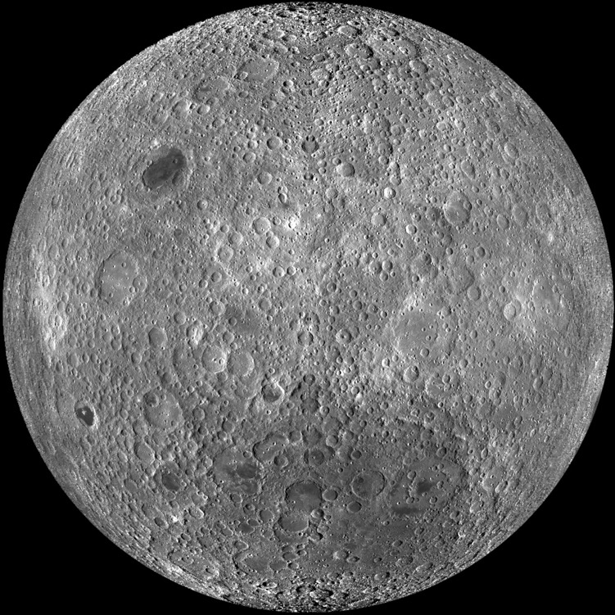
Apollo Landing Sites
Apollo Landing Sites
Notes:
-Image credit: NASA/GSFC/Arizona State University
-Left: Apollo landing sites (lunar near side)
-Right: Lunar far side
(captured by the Lunar Reconnaissance Orbiter spacecraft)

Slide 35
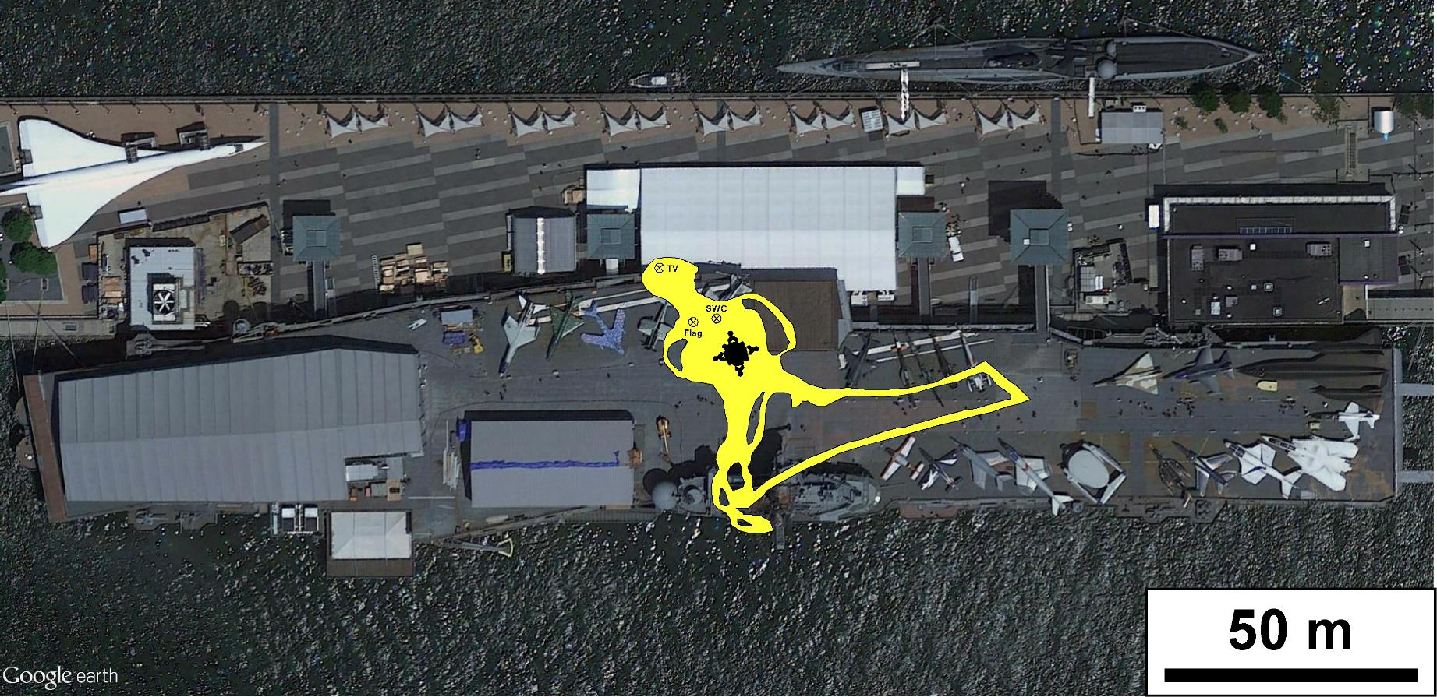
Apollo 11 Traverses
Apollo 11 Traverses
Notes:
-Image credit: NASA/GSFC/Brent Garry
-Apollo 11 tracks overlain on the Intrepid Sea, Air & Space Museum in New York City, NY.
-Date: July 20, 1969
-Future Apollo missions would travel up to ~5 mi from the lunar module (Apollo 17).

Slide 36
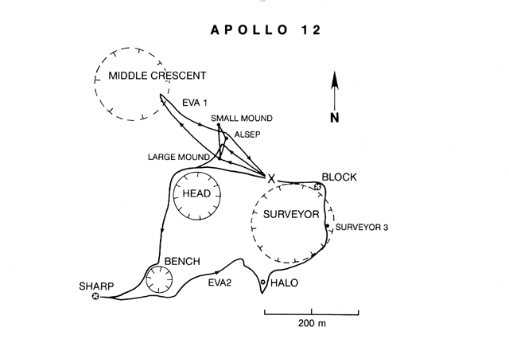
Apollo 12 Traverses
Notes:
-Image source: https://www.lpi.usra.edu/publications/slidesets/apollolanding/ApolloLanding/slide_13.html
-The Apollo 12 traverses.
-The thick lines indicate the paths taken by the astronauts during the two EVAs. The Lunar Module location is designated by the X.
The first EVA was devoted to the setup of the Apollo Lunar Surface Experiments Package (ALSEP), a series of instruments that could be monitored and controlled from the Earth.
The second EVA included an investigation of several craters and the Surveyor 3 spacecraft.

Slide 37
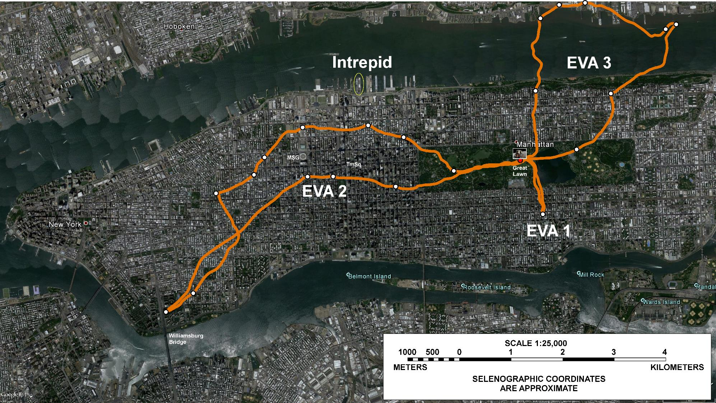
Apollo 17 Traverses
Apollo 17 Traverses
Notes:
-Image credit: NASA/GSFC/Brent Garry
-Apollo 17 tracks overlain on New York City, NY.
-Dates: December 11, 12, 13; 1972
-Notice how much farther the Apollo 17 astronauts were able to travel than the Apollo 11 and 12 astronauts (since they had a lunar roving vehicle).

Slide 38
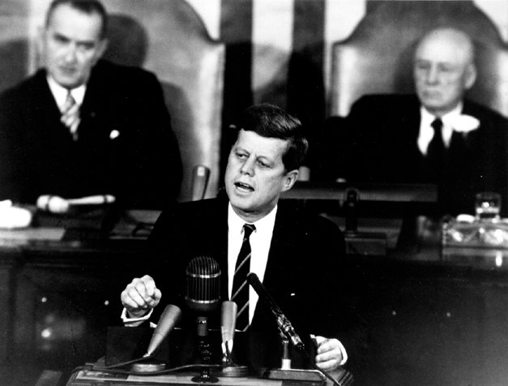
JFK’s Speech
JFK’s Speech
The Decision to Go to the Moon
May 25, 1961
We Choose to Go to the Moon
September 12, 1962
Notes:
-Image source: https://history.nasa.gov/moondec.html → JFK’s address to Congress.
-”The Decision to Go to the Moon”: President John F. Kennedy's May 25, 1961 Speech before Congress. JFK announced before a special joint session of Congress the dramatic and ambitious goal of sending an American safely to the Moon before the end of the decade.
-”We choose to go to the Moon" is the famous tagline of a speech about the effort to reach the Moon delivered by President John F. Kennedy to a large crowd gathered at Rice Stadium in Houston, Texas on September 12, 1962.

Slide 39
Additional Resources
Additional Resources
Apollo Images:
https://images.nasa.gov/
https://www.hq.nasa.gov/alsj/a13/images13.html
http://lroc.sese.asu.edu/featured_sites#ApolloLandingSites
Apollo Videos:
https://svs.gsfc.nasa.gov/Gallery/apollo.html
Apollo 13 General:
http://apolloinrealtime.org/
https://history.nasa.gov/afj/ap13fj/index.html
https://nssdc.gsfc.nasa.gov/planetary/lunar/apollo13info.html
https://www.lpi.usra.edu/lunar/missions/apollo/apollo_13/overview
Notes:
-Image source: https://www.hq.nasa.gov/alsj/a13/images13.html

