Slide 1

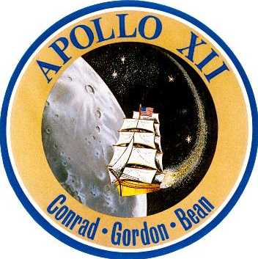

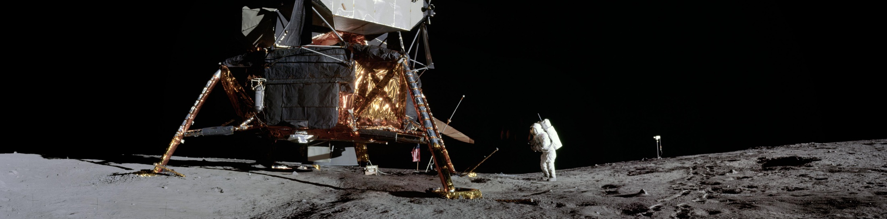
Apollo 12
Notes:
-Image source: https://www.lpi.usra.edu/resources/apollopanoramas/pans/?pan=JSC2011e118358
-For mission patch image, see https://history.nasa.gov/apollo_patches.html
-Note that the Apollo 12 mission patch has four stars – the extra star was added in honor of astronaut C.C. Williams who would have been the lunar module pilot on Apollo 12 had he lived (he died on Oct. 5, 1967 when the plane he was flying experienced a mechanical failure and crashed).
-Tips:
You do not need to use everything in this presentation!
Feel free to alter/edit this presentation to fit your specific needs/audience
-If you have any questions, please contact presentation author Staci Tiedeken (staci.l.tiedeken@nasa.gov, NASA GSFC)
-Updated January 2023

Slide 2
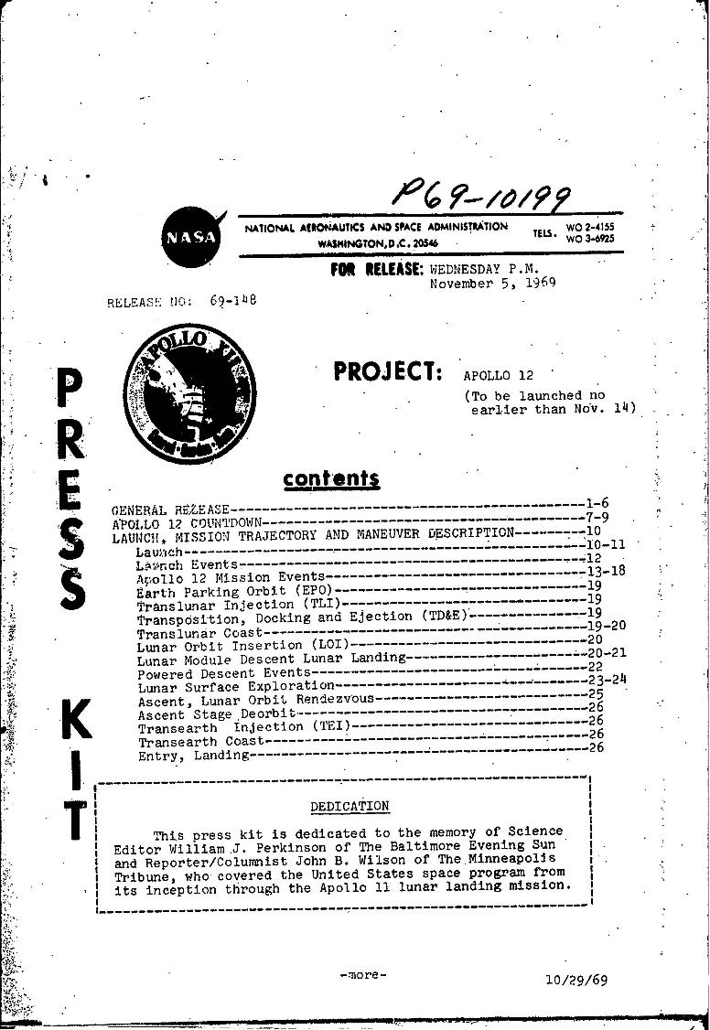
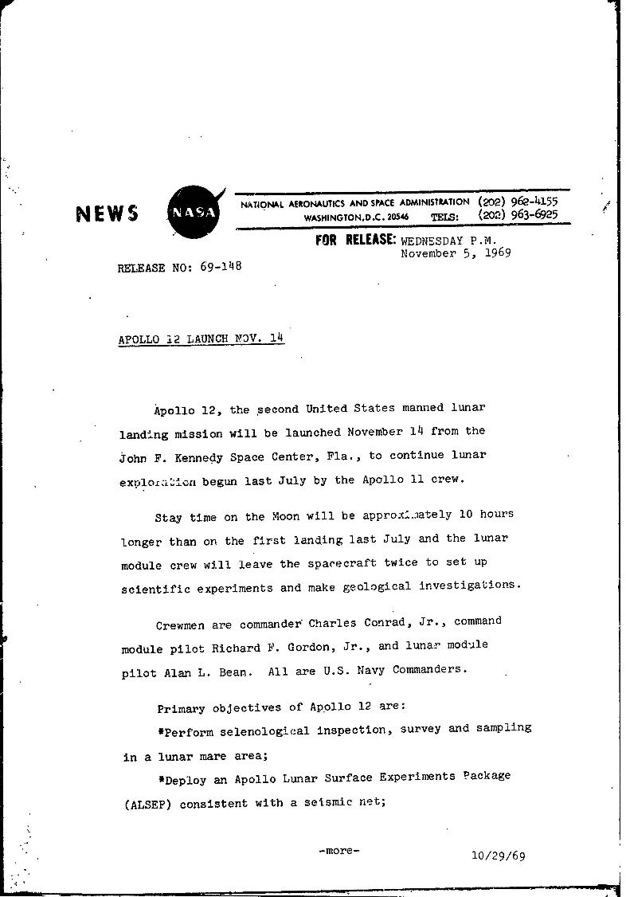
NASA Press Releases
Notes:
-NASA press releases (November 1969): https://historydms.hq.nasa.gov/sites/default/files/DMS/e000041717.pdf and https://historydms.hq.nasa.gov/sites/default/files/DMS/e000041718.pdf

Slide 3
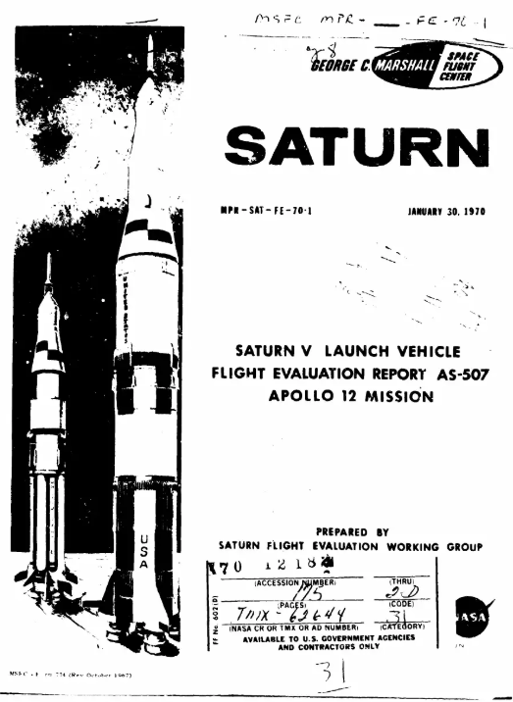
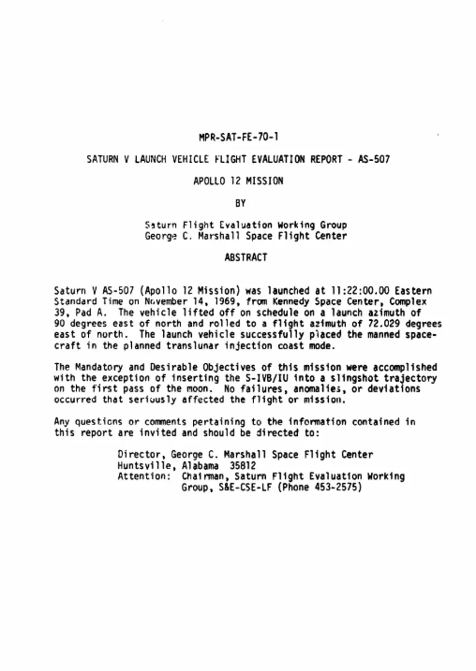
Saturn V Launch Vehicle Flight Evaluation Report
Notes:
-Saturn V Launch Vehicle Flight Evaluation Report - AS-507 Apollo 12 Mission
-Source: https://www.scribd.com/document/47696842/Saturn-VLaunch-Vehicle-Flight-Evaluation-Report-AS-507-Apollo-12-Mission

Slide 4
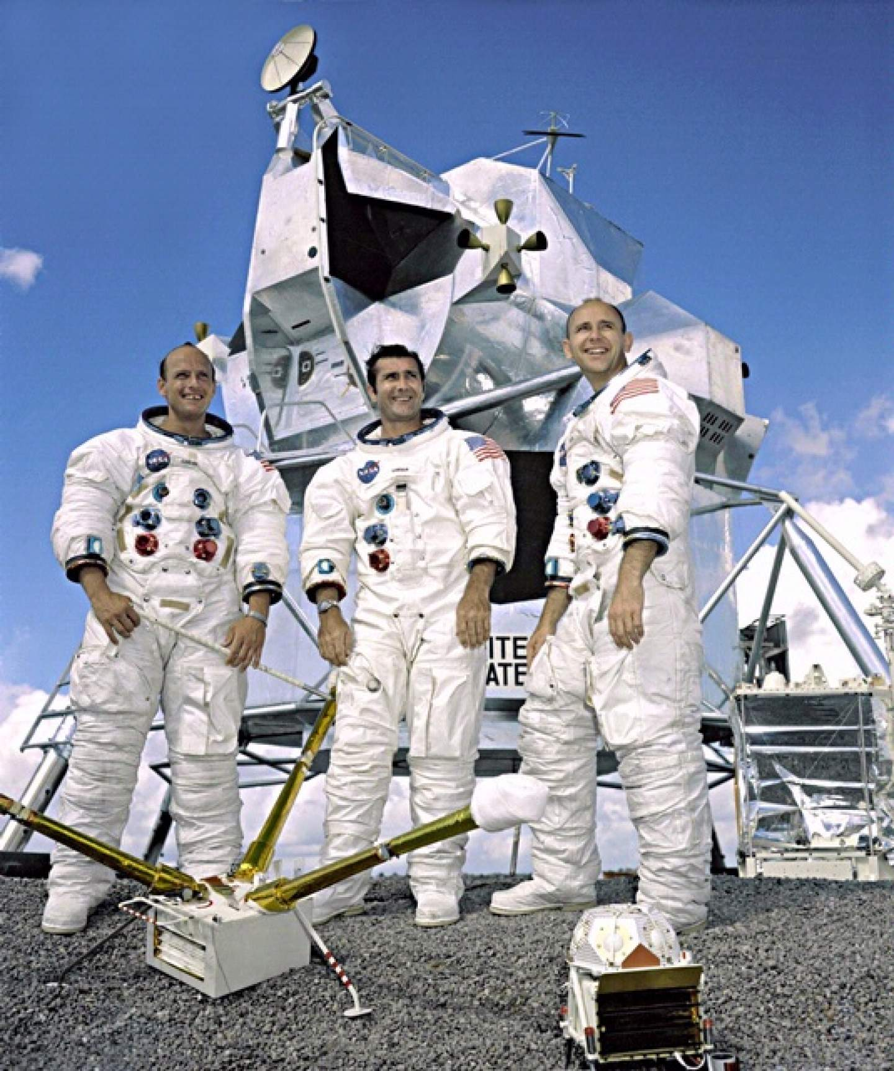
Overview
Overview
November 14-24, 1969
Charles “Pete” Conrad, Jr., Richard “Dick” F. Gordon, Jr., Alan L. Bean
Notes:
-Image credit: NASA → The Apollo 12 crew at Johnson Space Center, September 1969. From left: Pete Conrad Jr. (commander), Dick Gordon Jr. (command module pilot), and Alan Bean (lunar module pilot).
-Second human Moon landing – Conrad & Bean set foot on the lunar surface on November 19, 1969, just 4 months after Apollo 11.
-The mission plan for Apollo 12 had several objectives for the crew to accomplish: perform a survey of the area & collect samples; deploy a number of experiments; develop techniques for point landing capability; further develop the capability to work in the lunar environment; and obtain photographs of candidate exploration sites.
-Pete Conrad was the mission commander and was the pilot of Gemini 5 and command pilot for Gemini 11.
-Dick Gordon was the command module pilot and was the pilot for Gemini 11.
-Al Bean was the lunar module pilot and was the backup command pilot for Gemini 10.

Slide 5
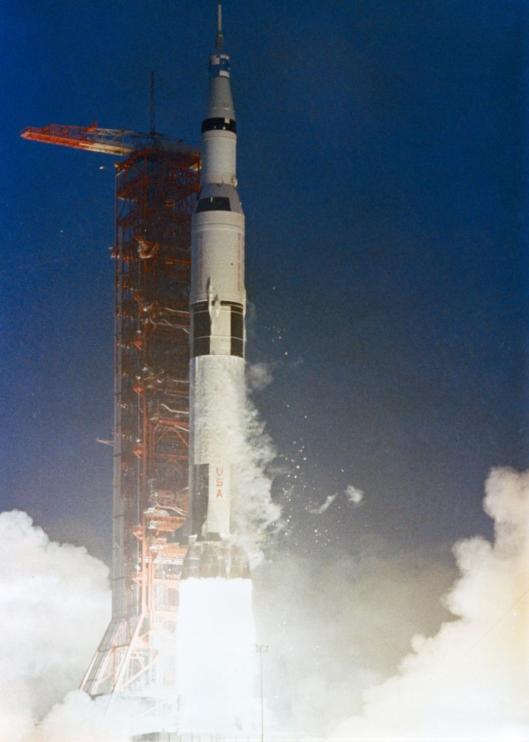
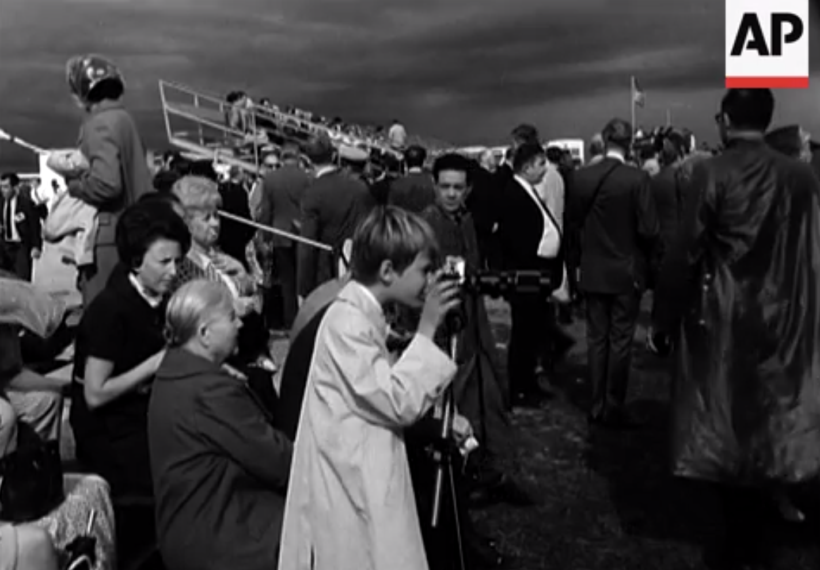
Launch
Launch
Notes:
-Image credits: Left: Associated Press; link to video from which the image was taken: http://www.aparchive.com/metadata/youtube/1a7ebc8b23ed43458847227135a39312# or https://www.youtube.com/watch?v=22yT4mvIru8; Right: NASA
-The 363-foot-tall Apollo 12 space vehicle was launched from Pad A, Launch Complex 39, Kennedy Space Center, at 11:22 a.m. EST, November 14, 1969.
-As with Apollo 11, adjacent to Kennedy Space Center (~3.5 miles away), thousands of spectators camped out on beaches and roads to watch the launch of Apollo 12.
-Lightning!
Apollo 12 was the first Saturn vehicle launched in rainy weather.
Shortly after 36.5 seconds into the flight, there were numerous space vehicle indications of a massive electrical disturbance, followed by a second disturbance at 52 seconds.
The lightning discharge at 36.5 seconds was triggered by the vehicle, and the 52-second disturbance may have been due to a lesser lightning discharge.

Slide 6
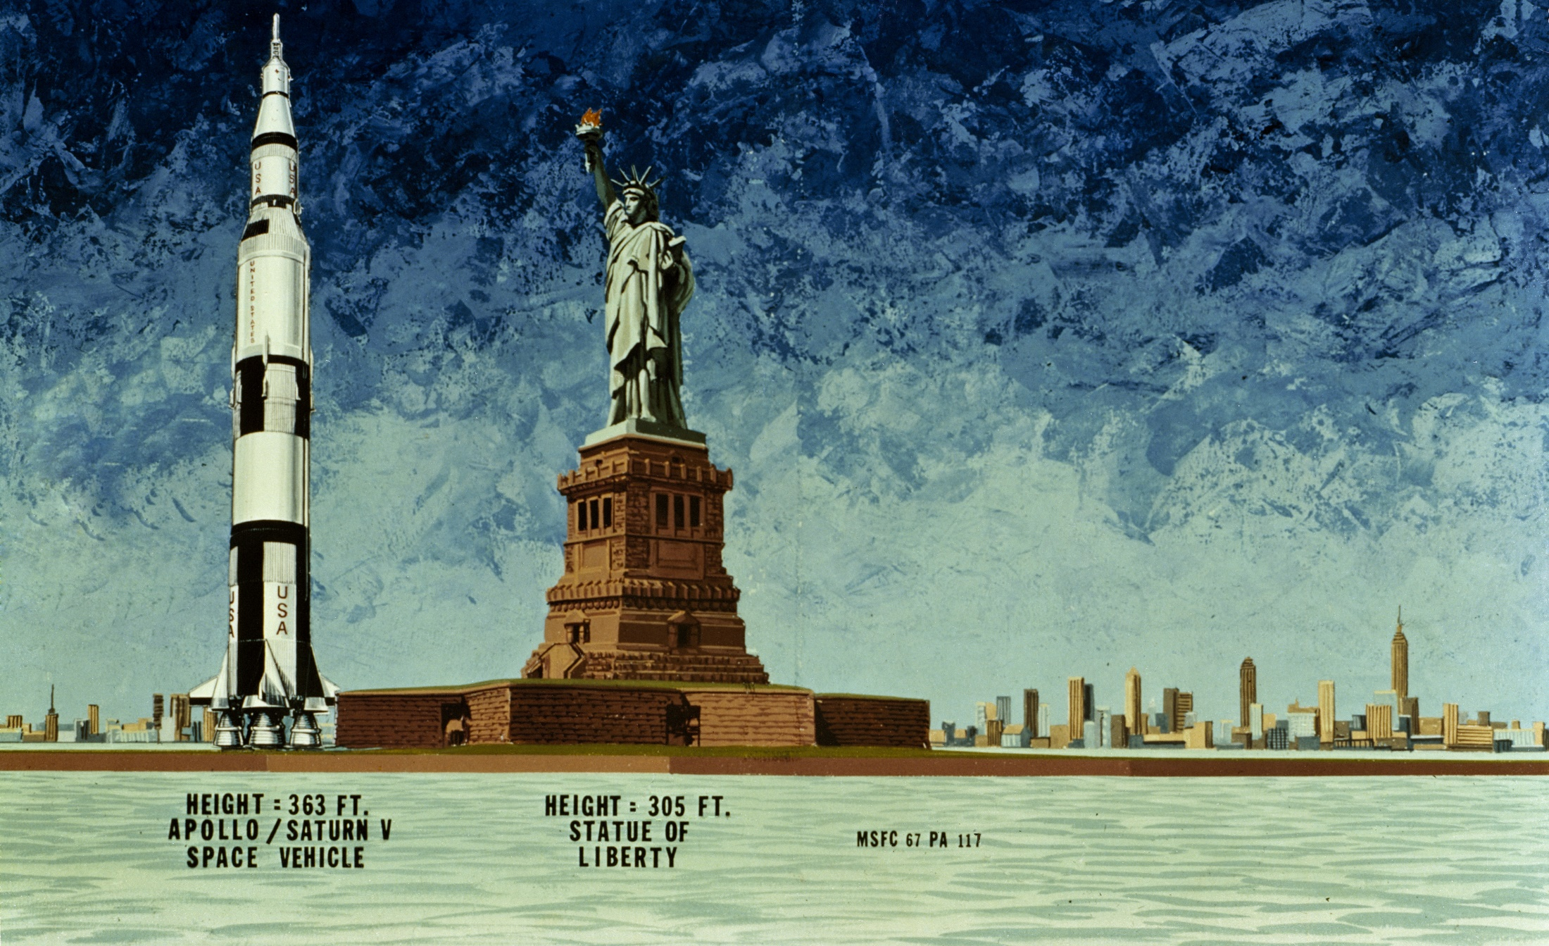
Saturn V Size Comparison
Notes:
-Image credit: NASA → 1967 illustration compares the Apollo Saturn V spacecraft (363 ft) of the Moon Landing era to the Statue of Liberty (305 ft).
-A Saturn V rocket has a rocket engine, three stages, a solid fuel motor, two interstages, a payload, a parachute, an aerodynamic nose cap, avionics, a fuel tank, an oxidizer tank, and stabilizing fins.
Height: 111 meters (363 feet)
Diameter: 10 meters (33 feet)
Mass: 2,840,622 kg (6,262,500 pounds) at liftoff (the weight of 400 elephants)
Maiden Flight: Nov. 9, 1967 (uncrewed)
The rocket generated 34.5 million newtons (7.6 million pounds) of thrust at launch, creating more power than 85 Hoover Dams.
Could launch about 43,500 kg (50 tons) to the Moon (about the same as 4 school buses).
The Apollo 12 launch vehicle was the seventh in the Apollo Saturn V series and was the fifth crewed Saturn V vehicle.
More info on Saturn V: https://solarsystem.nasa.gov/news/337/what-was-the-saturn-v/

Slide 7
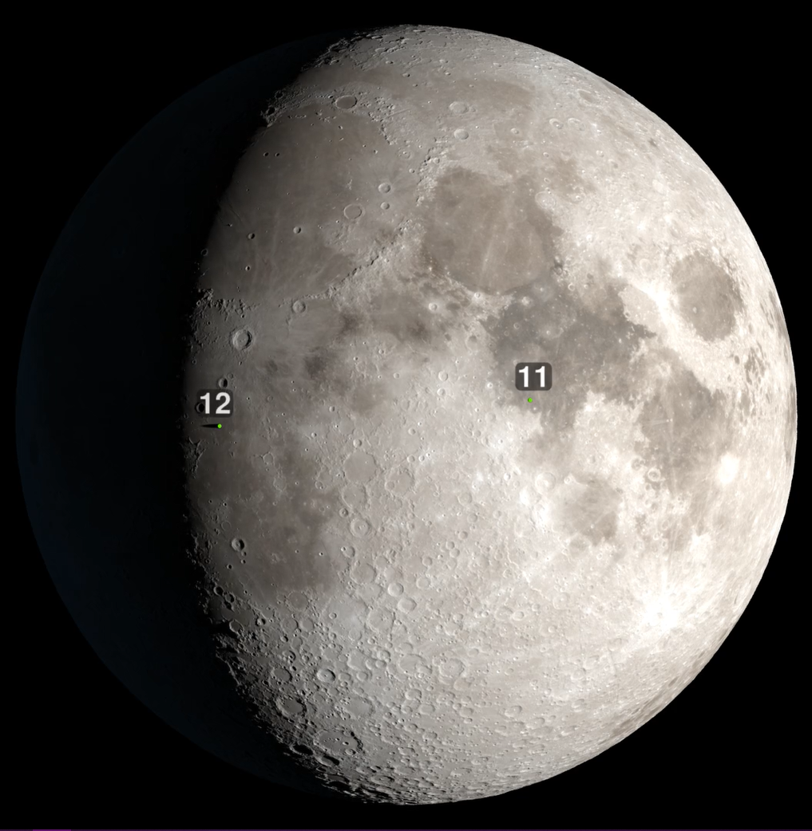
Apollo 12 Landing Site
Moon on November 19, 1969
Notes:
-Image credit: NASA's Scientific Visualization Studio → The green dot at left marks the site of the Apollo 12 landing in Oceanus Procellarum (“Ocean of Storms”). Apollo 11’s landing site in Mare Tranquillitatis is shown as the green dot at right.
-Landing occurred at 1:54 a.m. EST on November 19, 1969.
-A waxing gibbous Moon phase was chosen since the terminator was reasonably close to the landing site.
This meant that the Sun would be behind the lunar module as it came in for landing. This provided the most favorable lighting conditions to enable the astronauts to better discern and avoid craters, because the craters would have more elongated shadows.
It also kept the surface temperatures at a reasonable level once the astronauts got outside, since it was effectively “lunar morning.”

Slide 8
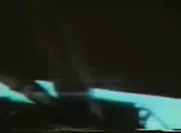
Pete Conrad stepping on the lunar surface
“That may have been a small one for Neil…”
Notes:
-Video credit: NASA (credit to Ken Glover for digitization); link to video: https://www.hq.nasa.gov/alsj/a12/video12.html#Step
-At 11:16 p.m. EST on November 18, 1969, the lunar module detached from the command module, and then landed on the Moon at 1:54 a.m. EST on November 19, 1969.
-At 6:32 a.m. EST, the first extravehicular activity began.
Conrad: (As he lands) “Whoopie! Man, that may have been a small one for Neil, but that's a long one for me.”
Neil Armstrong was 5’11” tall while Pete Conrad was 5’6” tall.

Slide 9
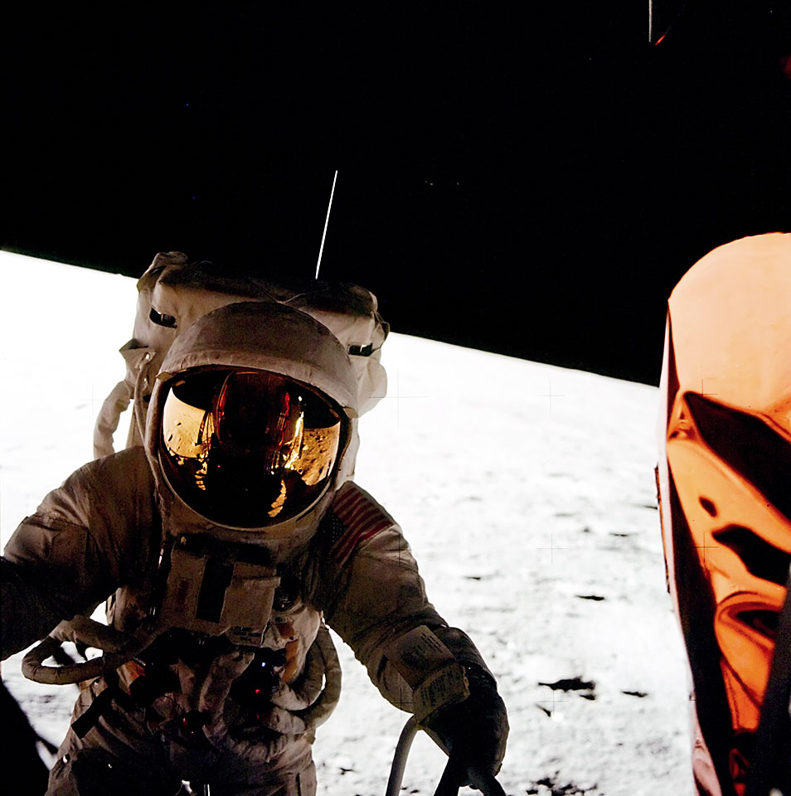
Pete Conrad coming down the ladder from the lunar module
“That may have been a small one for Neil…”
Notes:
-Image credit: NASA (credit to Eric Nelson for enhanced version)
-Pete Conrad coming down the ladder from the LM; image captured by Al Bean.

Slide 10
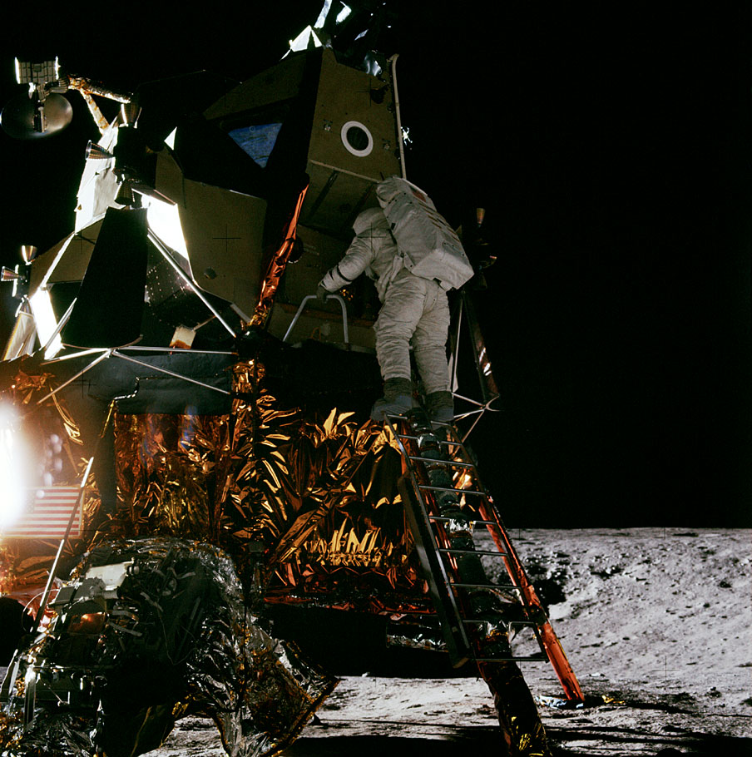
Al Bean standing on the lunar module’s ladder
Notes:
-Image credit: NASA (Source: Eric M. Jones; https://www.hq.nasa.gov/alsj/a12/images12.html#6726)
-Al Bean stands on the top rung of the ladder with his hands on the porch rails. The TV camera is on the Modularized Equipment Stowage Assembly (MESA), at the lower left, pointed at the bottom of the ladder.

Slide 11
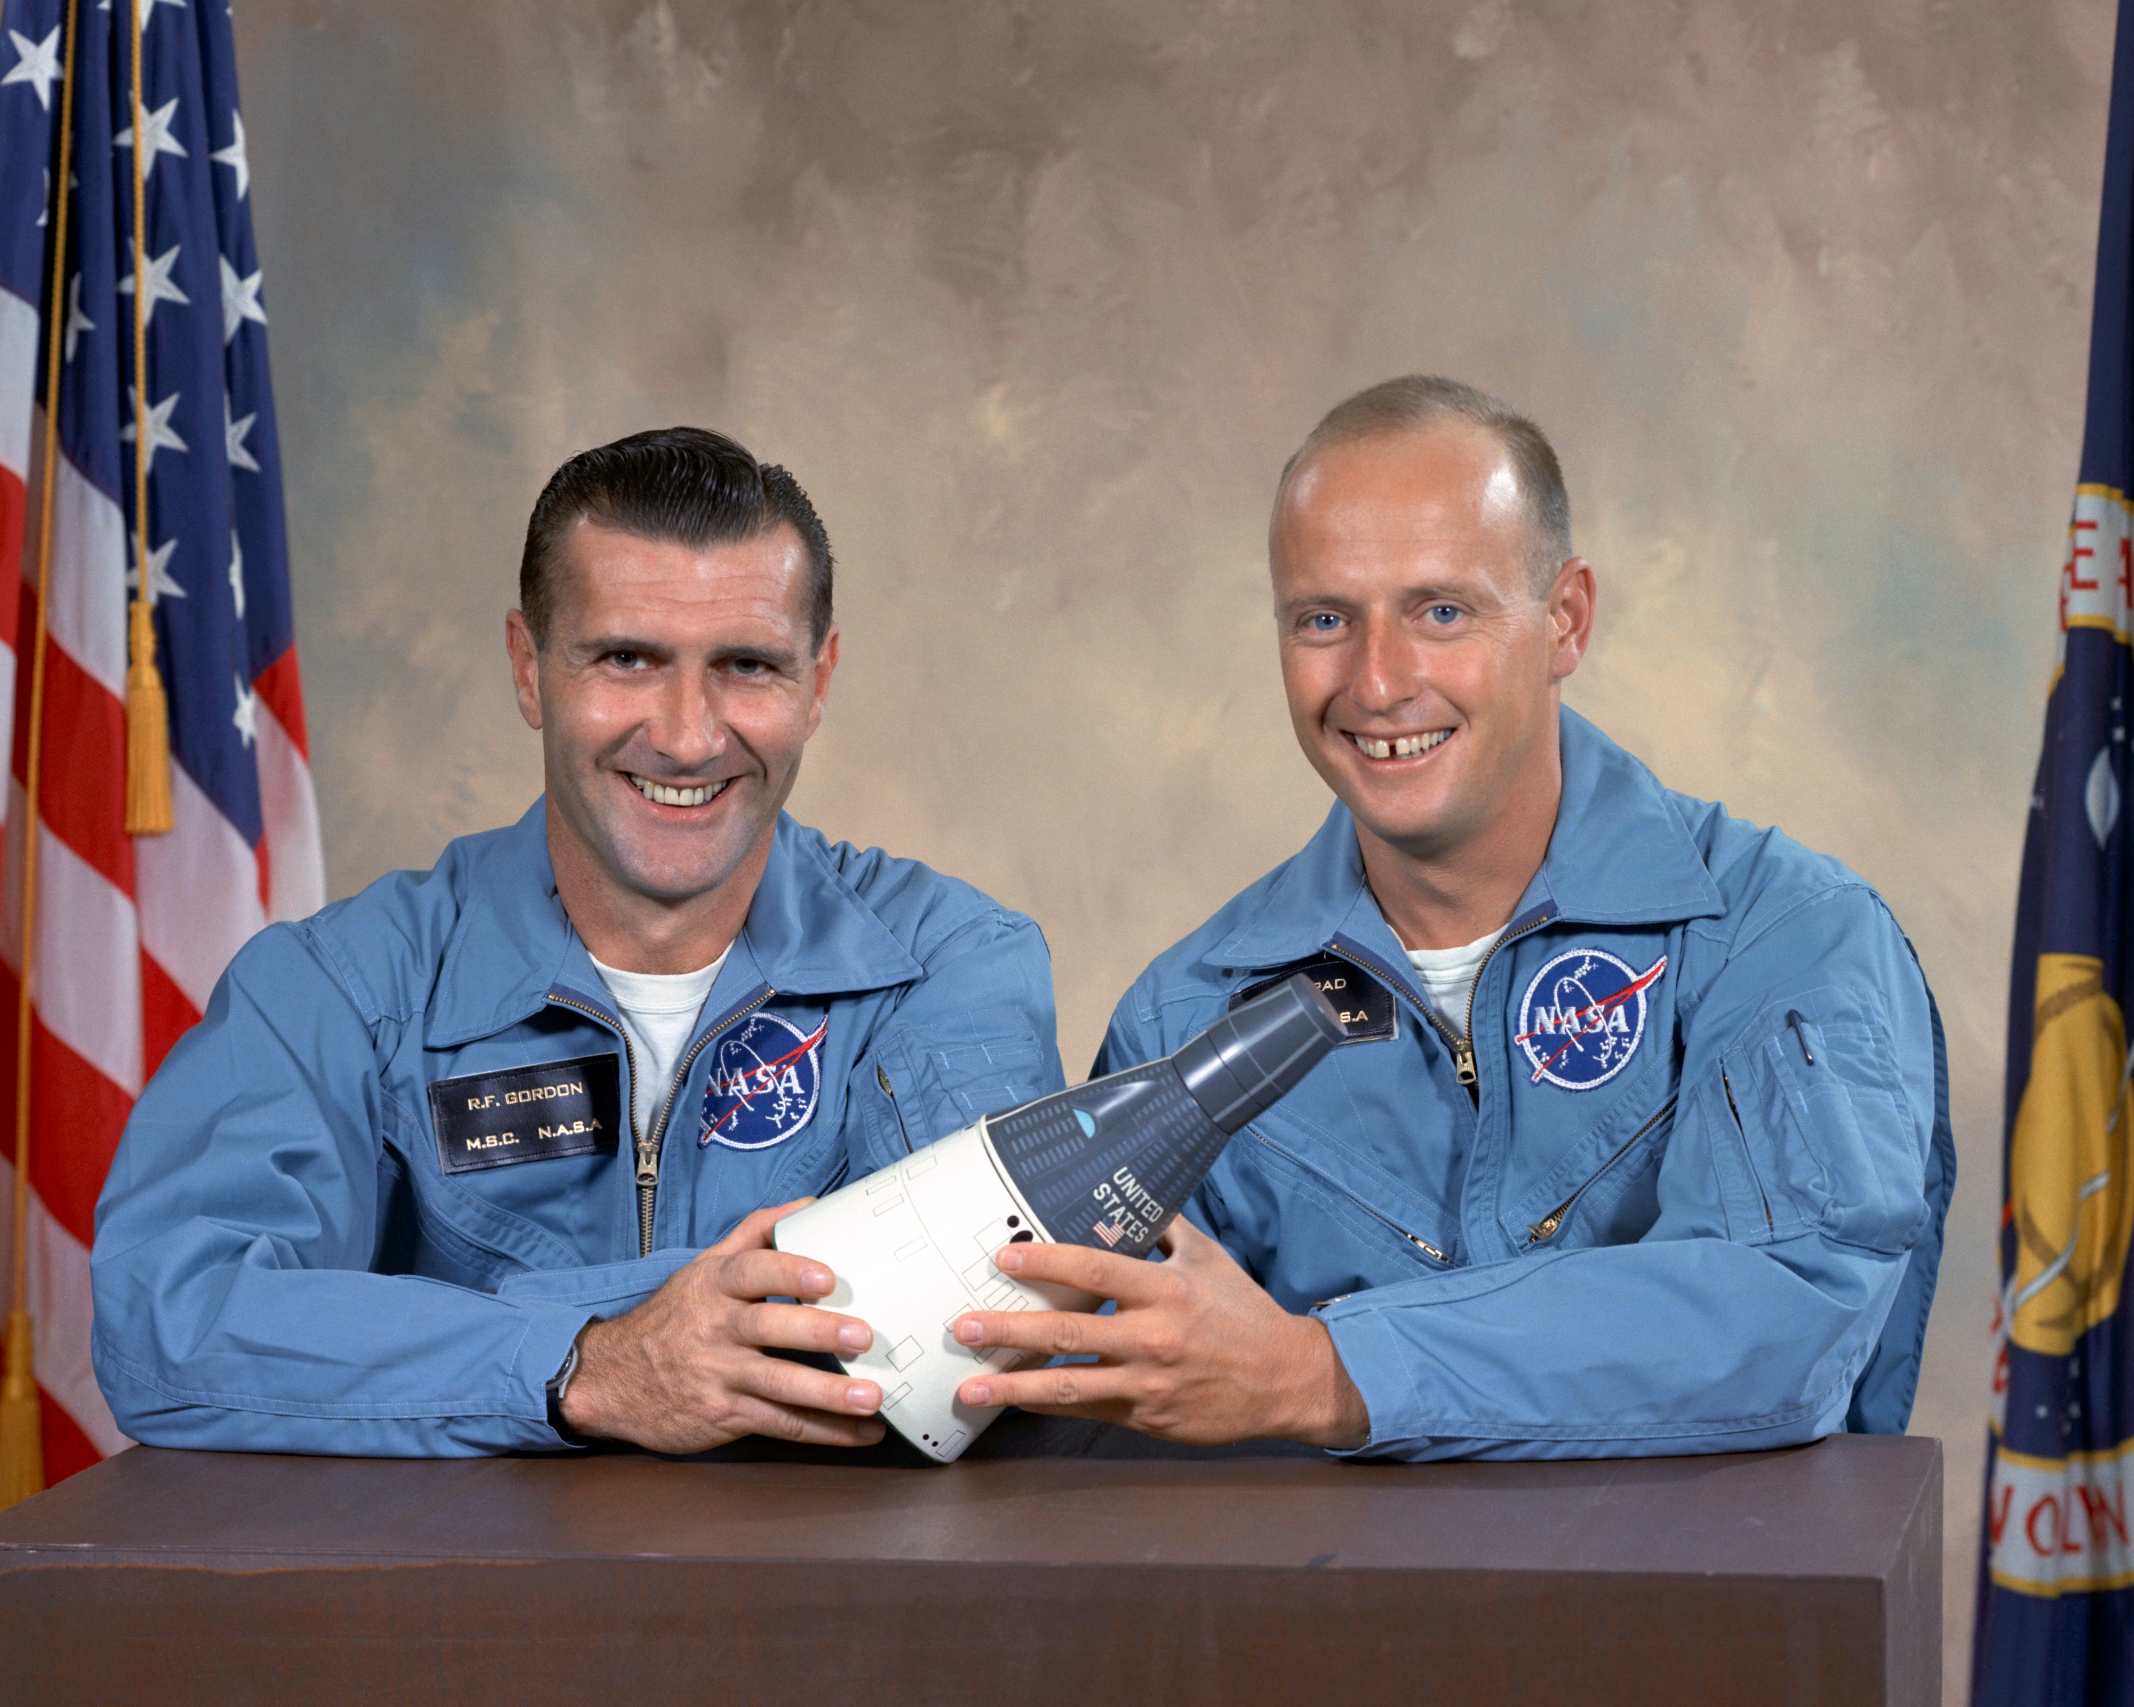
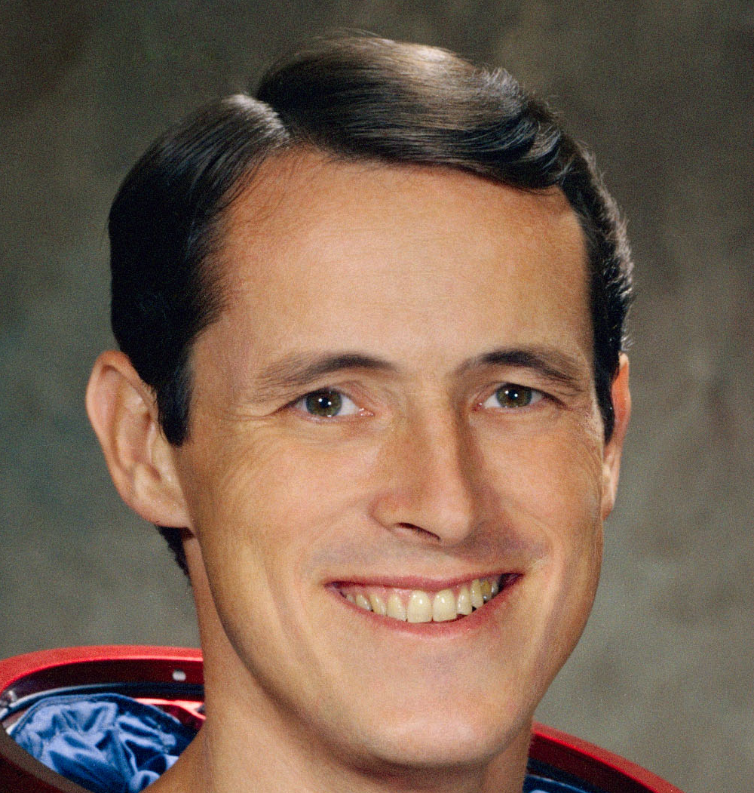
Friendly banter between the crew
Friendly Banter
112:37:07 Conrad: Soon as we get done eating here, we'll get with it. We're pretty hungry.
112:37:16 Gibson: Roger, Intrepid. You deserve it. (Pause)
112:37:24 Gordon: This is Yankee Clipper. (Joking in response to Ed's "You deserve it.") No, they don't. Tell them to get to work.
112:37:32 Gibson: Roger, Clipper.
112:37:36 Gordon: For heaven's sakes, Ed, they're down there having all the fun, and you and I are doing all the work.
112:37:44 Gibson: They'll get with it soon, Clipper. (Long Pause)
Notes:
-Image credits: NASA
-Transcript between Apollo 12 astronauts and Houston Mission Control (times are elapsed time after launch):
112:37:07 Conrad: Soon as we get done eating here, we'll get with it. We're pretty hungry.
112:37:16 Gibson: Roger, Intrepid. You deserve it. (Pause)
112:37:24 Gordon: This is Yankee Clipper. (Joking in response to Ed's "You deserve it.") No, they don't. Tell them to get to work.
112:37:32 Gibson: Roger, Clipper.
112:37:36 Gordon: For heaven's sakes, Ed, they're down there having all the fun, and you and I are doing all the work.
112:37:44 Gibson: They'll get with it soon, Clipper. (Long Pause)
-Source: Eric M. Jones; https://history.nasa.gov/alsj/a12/a12.postland.html

Slide 12
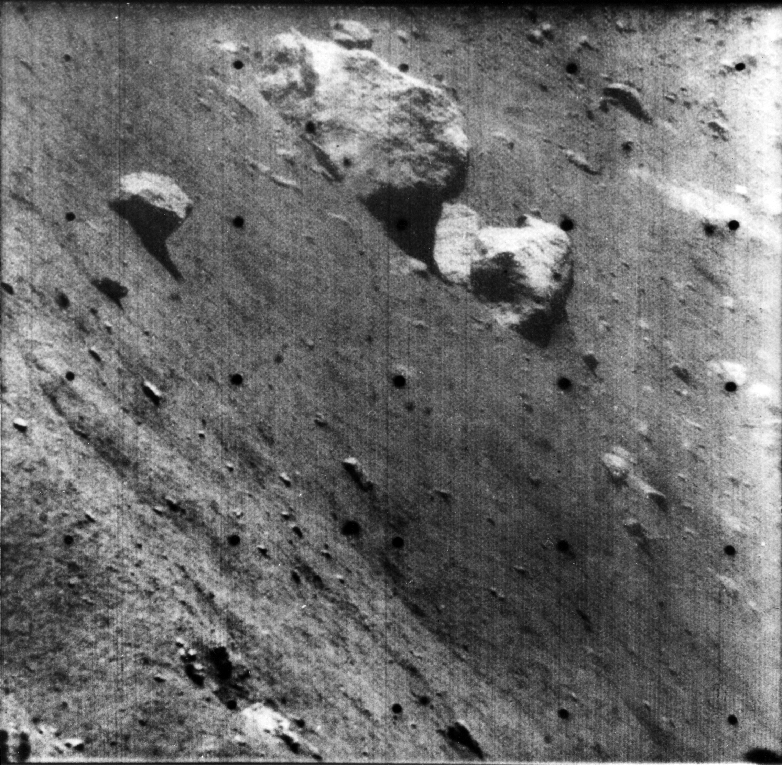
Surveyor 3
Surveyor 3
Landed in the Ocean of Storms in April 1967
Notes:
-Image credit: NASA → A narrow angle Surveyor 3 TV picture of large twin boulders north of the spacecraft taken at 7:47 a.m. April 30, 1967.
-Surveyor 3, the second of 5 uncrewed explorers to land on the Moon, touched firmly down on the Ocean of Storms in April 1967.
-Its television camera took 6,000 photographs and a soil-mechanics/surface-sampler scoop performed a number of successful experiments.
-Its mission completed, Surveyor 3 rested quietly on the 13-degree slope of the 656-foot-diameter crater where it landed (until Apollo 12 astronauts visited it over two years later).

Slide 13
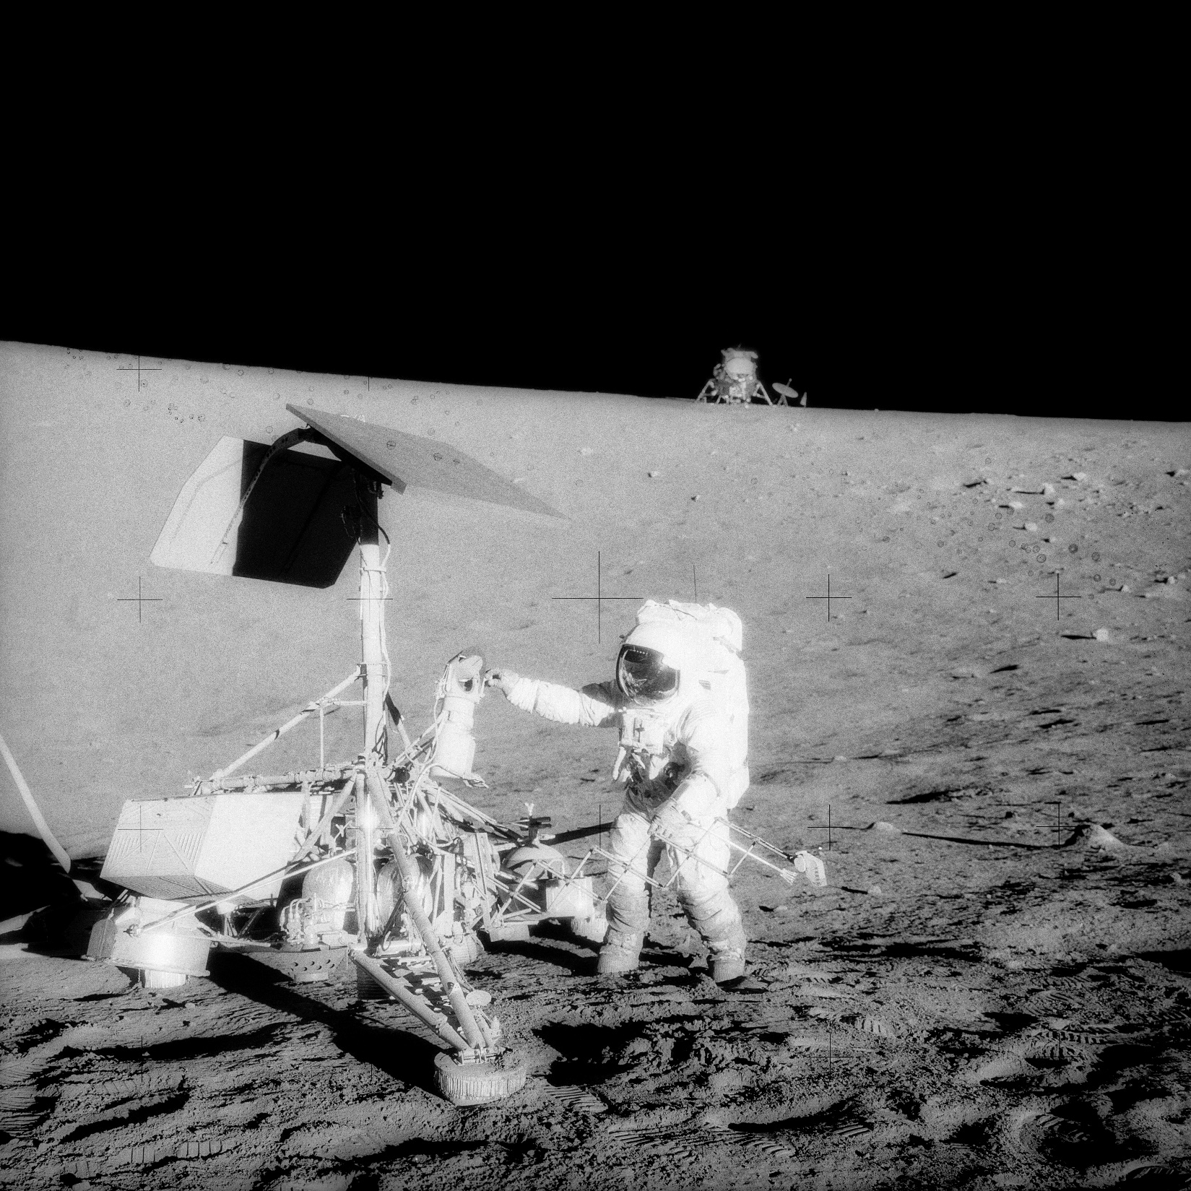
Surveyor 3
Surveyor 3
Notes:
-Image credit: NASA → This unusual photograph, taken during the second Apollo 12 EVA, shows two U.S. spacecraft on the surface of the Moon.
The Apollo 12 Lunar Module (LM) is in the background. The uncrewed Surveyor 3 spacecraft is in the foreground.
In the image, Conrad examines the Surveyor's TV camera prior to detaching it.
-The Apollo 12 LM, with astronauts Pete Conrad and Al Bean aboard, landed about 600 feet from Surveyor 3 in the Ocean of Storms (precision targeting w/use of Doppler effect radar was used to pinpoint the landing).
-The television camera, the scoop, a piece of cable, and an unpainted support strut were taken from Surveyor 3 and brought back to Earth for scientific examination.
No failures or serious adverse environmental effects on the hardware were uncovered.
The radiation-induced discoloration on various surfaces was found to be proportional to the degree of solar illumination (i.e. exposure to solar radiation caused parts of the spacecraft to become discolored).
Almost all surfaces on the camera were partially covered with a fine layer of lunar dust.
More info: https://www.lpi.usra.edu/lunar/documents/NTRS/collection2/NASA_SP_284.pdf
-It was a unique opportunity to evaluate the influence of prolonged exposure to the lunar environment on typical spacecraft systems.

Slide 14
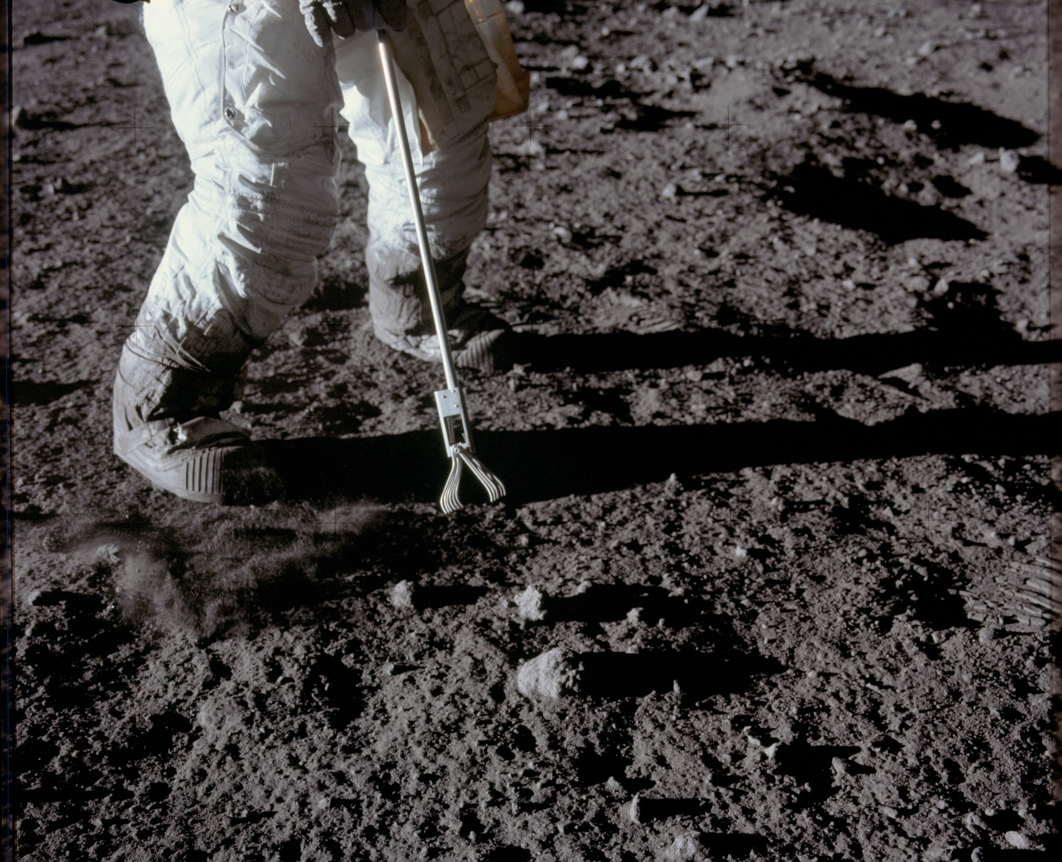
Sample Collecting on the Moon
On the Moon
Notes:
-Image credit: NASA → Close-up view of a set of tongs, an Apollo Lunar Hand Tool, being used by astronaut Pete Conrad to pick up lunar samples during an Apollo 12 extravehicular activity. This photograph shows Conrad's legs and a good view of the lunar soil.
-Soon after touching the lunar surface, the astronauts collected the contingency sample (six scoops were taken, amounting to ~1.9 kg of material).
This was done early to make sure that some material from this landing site would be returned to Earth in case the mission had to be cut short.
-They had specially designed tools (like those t-rex claw grabbers) made out of either stainless steel or aluminum to pick up the rocks. They also had sieves and some rakes to collect the rocks.
After collecting the rocks, the astronauts put them inside a Teflon bag and then put the bag in a special box.

Slide 15
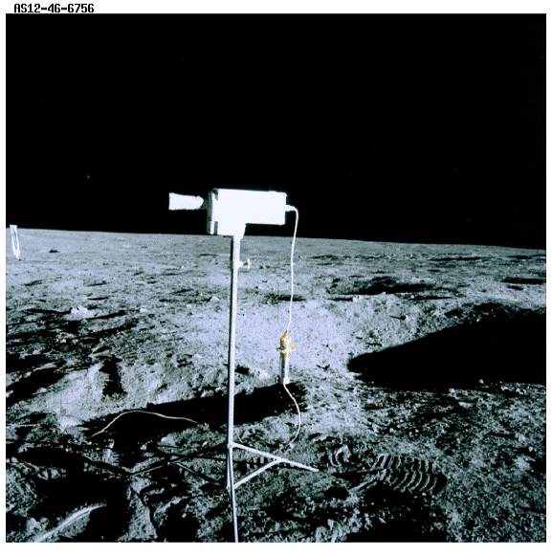
TV Camera on the Moon
On the Moon
Deployment of the TV camera
Notes:
-Image credit: NASA → The TV camera from Apollo 12.
-The TV camera was removed from the LM for deployment on the surface. However, during the transfer, the camera was accidentally pointed at the Sun or the Sun's reflection on the descent stage and the vidicon tube apparently burned out. This ended the TV coverage of the lunar surface activities.
-More info: https://www.hq.nasa.gov/alsj/a12/a12.tvtrbls.html

Slide 16
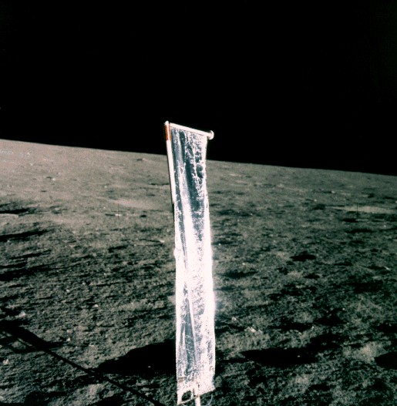
Surface Experiments on the Moon
On the Moon
Surface experiments
  Soil Mechanics Investigation
  Solar Wind Composition
Notes:
-Image credit: NASA → Solar Wind Composition experiment.
-In addition to collecting samples, the Apollo 12 astronauts deployed a set of experiments during their time on the lunar surface.
The Soil Mechanics Investigation studied the properties of the lunar soil.
The Solar Wind Composition Experiment collected particles of the solar wind (electrically charged particles emitted by the Sun), allowing the chemical composition of the solar wind to be measured.
The Solar Wind Composition experiment on Apollo 12 was the same as the experiment flown on Apollo 11. The experiment was deployed on the lunar surface and was exposed to the solar wind for 18 hours and 42 minutes. Afterward, the foil was removed and placed in a Teflon bag and returned to Earth for analysis.
-More info: https://www.lpi.usra.edu/lunar/missions/apollo/apollo_12/experiments/

Slide 17
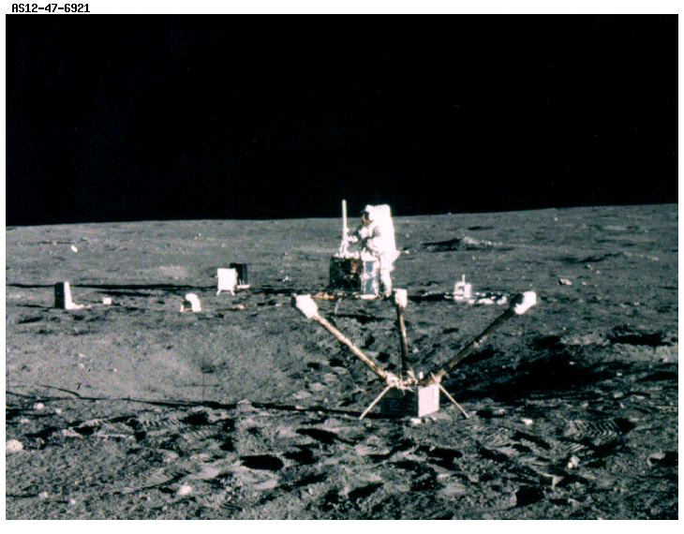
Apollo Lunar Surface Experiment Package
On the Moon
Apollo Lunar Surface Experiment Package (ALSEP)
  Lunar Surface Magnetometer
Notes:
-Image credit: NASA → Commander Pete Conrad aligns the antenna on the central station for the ALSEP.
The ALSEP's Lunar Surface Magnetometer is in the foreground.
In the center background near Conrad are other ALSEP components.
-The Apollo Lunar Surface Experiment Package (ALSEP) system consisted of a central station with a communications package and with leads running out to the instruments placed around it.
DC power was supplied by a radioisotope thermo-electric generator (RTG) – a plutonium fuel element was used.
The power required by the whole station and experiments was less than the power of a 75-watt light bulb!
-The Apollo Lunar Surface Experiment Package (ALSEP) consisted of 6 experiments:
Lunar Surface Magnetometer: measured the strength of the Moon's magnetic field.
More info: https://www.lpi.usra.edu/lunar/missions/apollo/apollo_12/experiments/lsme/index.shtml

Slide 18
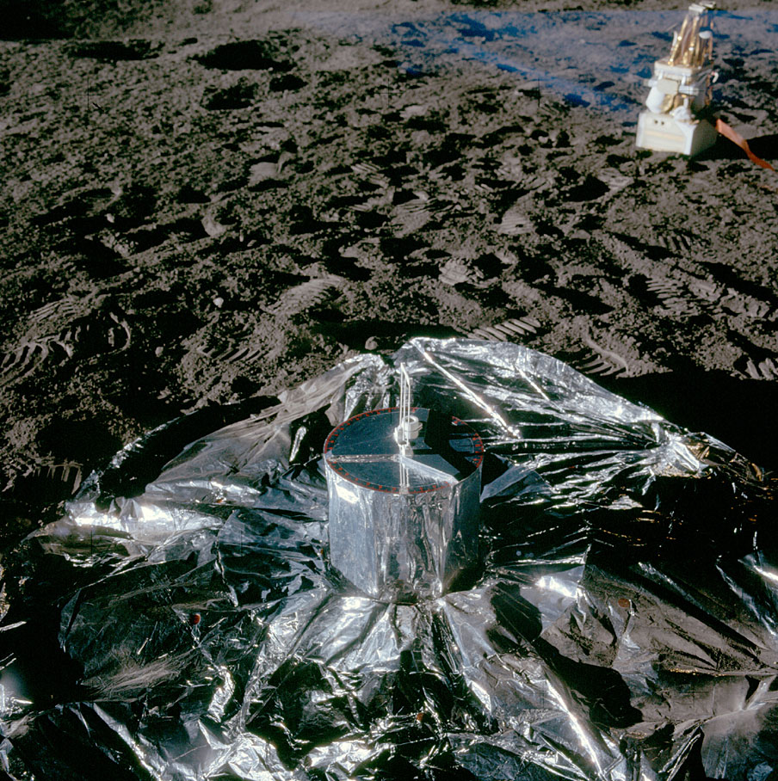
Apollo Lunar Surface Experiment Package
On the Moon
Passive Seismic Experiment
Cold Cathode Gauge
Notes:
-Image credit: NASA (Source: Eric M. Jones; https://www.hq.nasa.gov/alsj/a12/images12.html#6726) → The Passive Seismic Experiment (PSE), which is surrounded by its thermal skirt. The skirt protects the ground underneath the instrument from temperature swings as the Sun moves across the lunar sky. The blue coloration at the top right is undoubtedly an artifact.
Passive Seismic Experiment: detected lunar "moonquakes" and provided information about the internal structure of the Moon.
More info: https://www.lpi.usra.edu/lunar/missions/apollo/apollo_12/experiments/pse/index.shtml
Cold Cathode Gauge: measured the abundance of gases in the lunar atmosphere.
More info: https://www.lpi.usra.edu/lunar/missions/apollo/apollo_12/experiments/ccg/index.shtml

Slide 19
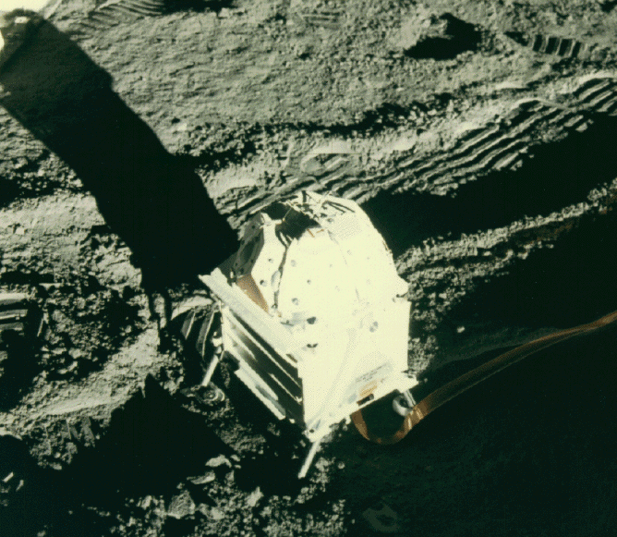
Apollo Lunar Surface Experiment Package
On the Moon
Suprathermal Ion Detector Experiment
Solar Wind Spectrometer
Lunar Dust Detector
Notes:
-Image credit: NASA → The Solar Wind Spectrometer Experiment.
The Suprathermal Ion Detector Experiment (SIDE): studied the lunar ionosphere.
More info: https://www.lpi.usra.edu/lunar/missions/apollo/apollo_12/experiments/side/index.shtml
The Solar Wind Spectrometer: measured the composition of the solar wind (electrically charged particles emitted by the Sun).
Although the solar wind contains ions of most chemical elements (including the noble gases measured by the Solar Wind Composition Experiment), over 95% of the particles in the solar wind are electrons and protons, in roughly equal numbers.
This instrument measured the flux (rate of flow) of protons and electrons as a function of particle velocity.
Because this instrument made continuous measurements, it was possible to measure how the Earth’s magnetic field affects arriving solar wind particles.
For ~2/3 of each orbit, the Moon is outside Earth’s magnetic field. At these times, a typical proton density was 10-20 per cubic cm, w/most protons having velocities between 400-650 km/s.
More info: https://www.lpi.usra.edu/lunar/missions/apollo/apollo_12/experiments/swc/index.shtml
The Lunar Dust Detector: studied the effects of lunar dust on the operation of the experiment package.
More info: https://www.lpi.usra.edu/lunar/missions/apollo/apollo_12/experiments/ldd/index.shtml

Slide 20
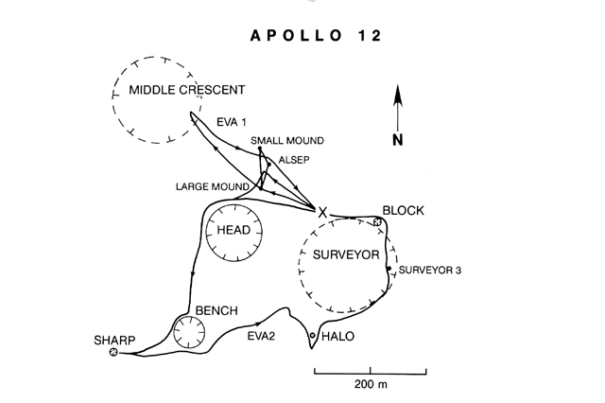
Apollo 12 Traverses
Notes:
-Image source: https://www.lpi.usra.edu/publications/slidesets/apollolanding/ApolloLanding/slide_13.html
-The Apollo 12 traverses.
-The thick lines indicate the paths taken by the astronauts during the two EVAs. The Lunar Module location is designated by the X.
The first EVA was devoted to the setup of the Apollo Lunar Surface Experiments Package (ALSEP), a series of instruments that could be monitored and controlled from the Earth.
The second EVA included an investigation of several craters and the Surveyor 3 spacecraft.

Slide 21
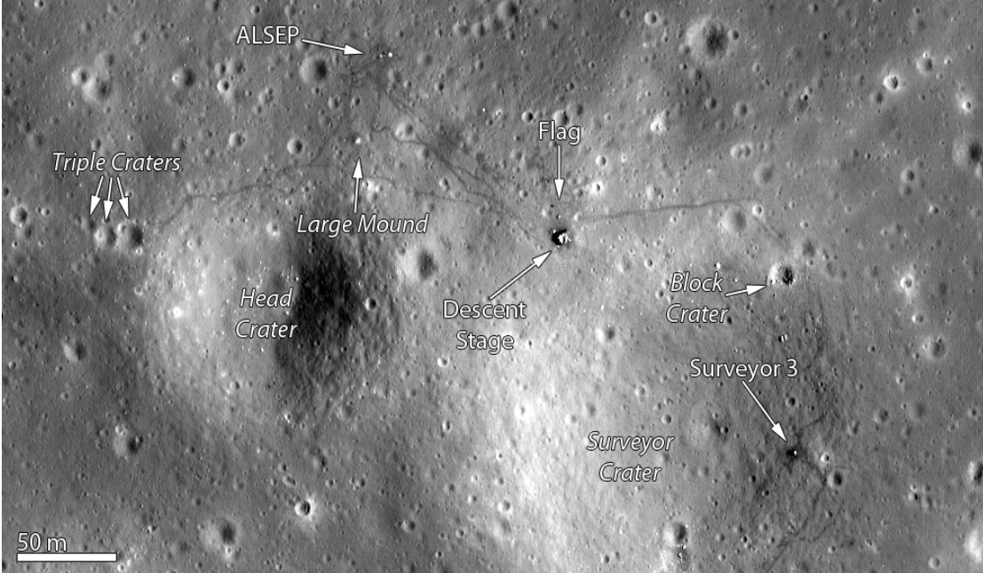
Apollo 12 landing site, as imaged by the Lunar Reconnaissance Orbiter Camera
Notes:
-Image credit: LROC → https://www.lroc.asu.edu/featured_sites/view_site/2
-The Apollo 12 landing site, as imaged by the Lunar Reconnaissance Orbiter Camera (taken on 11/8/2011).

Slide 22
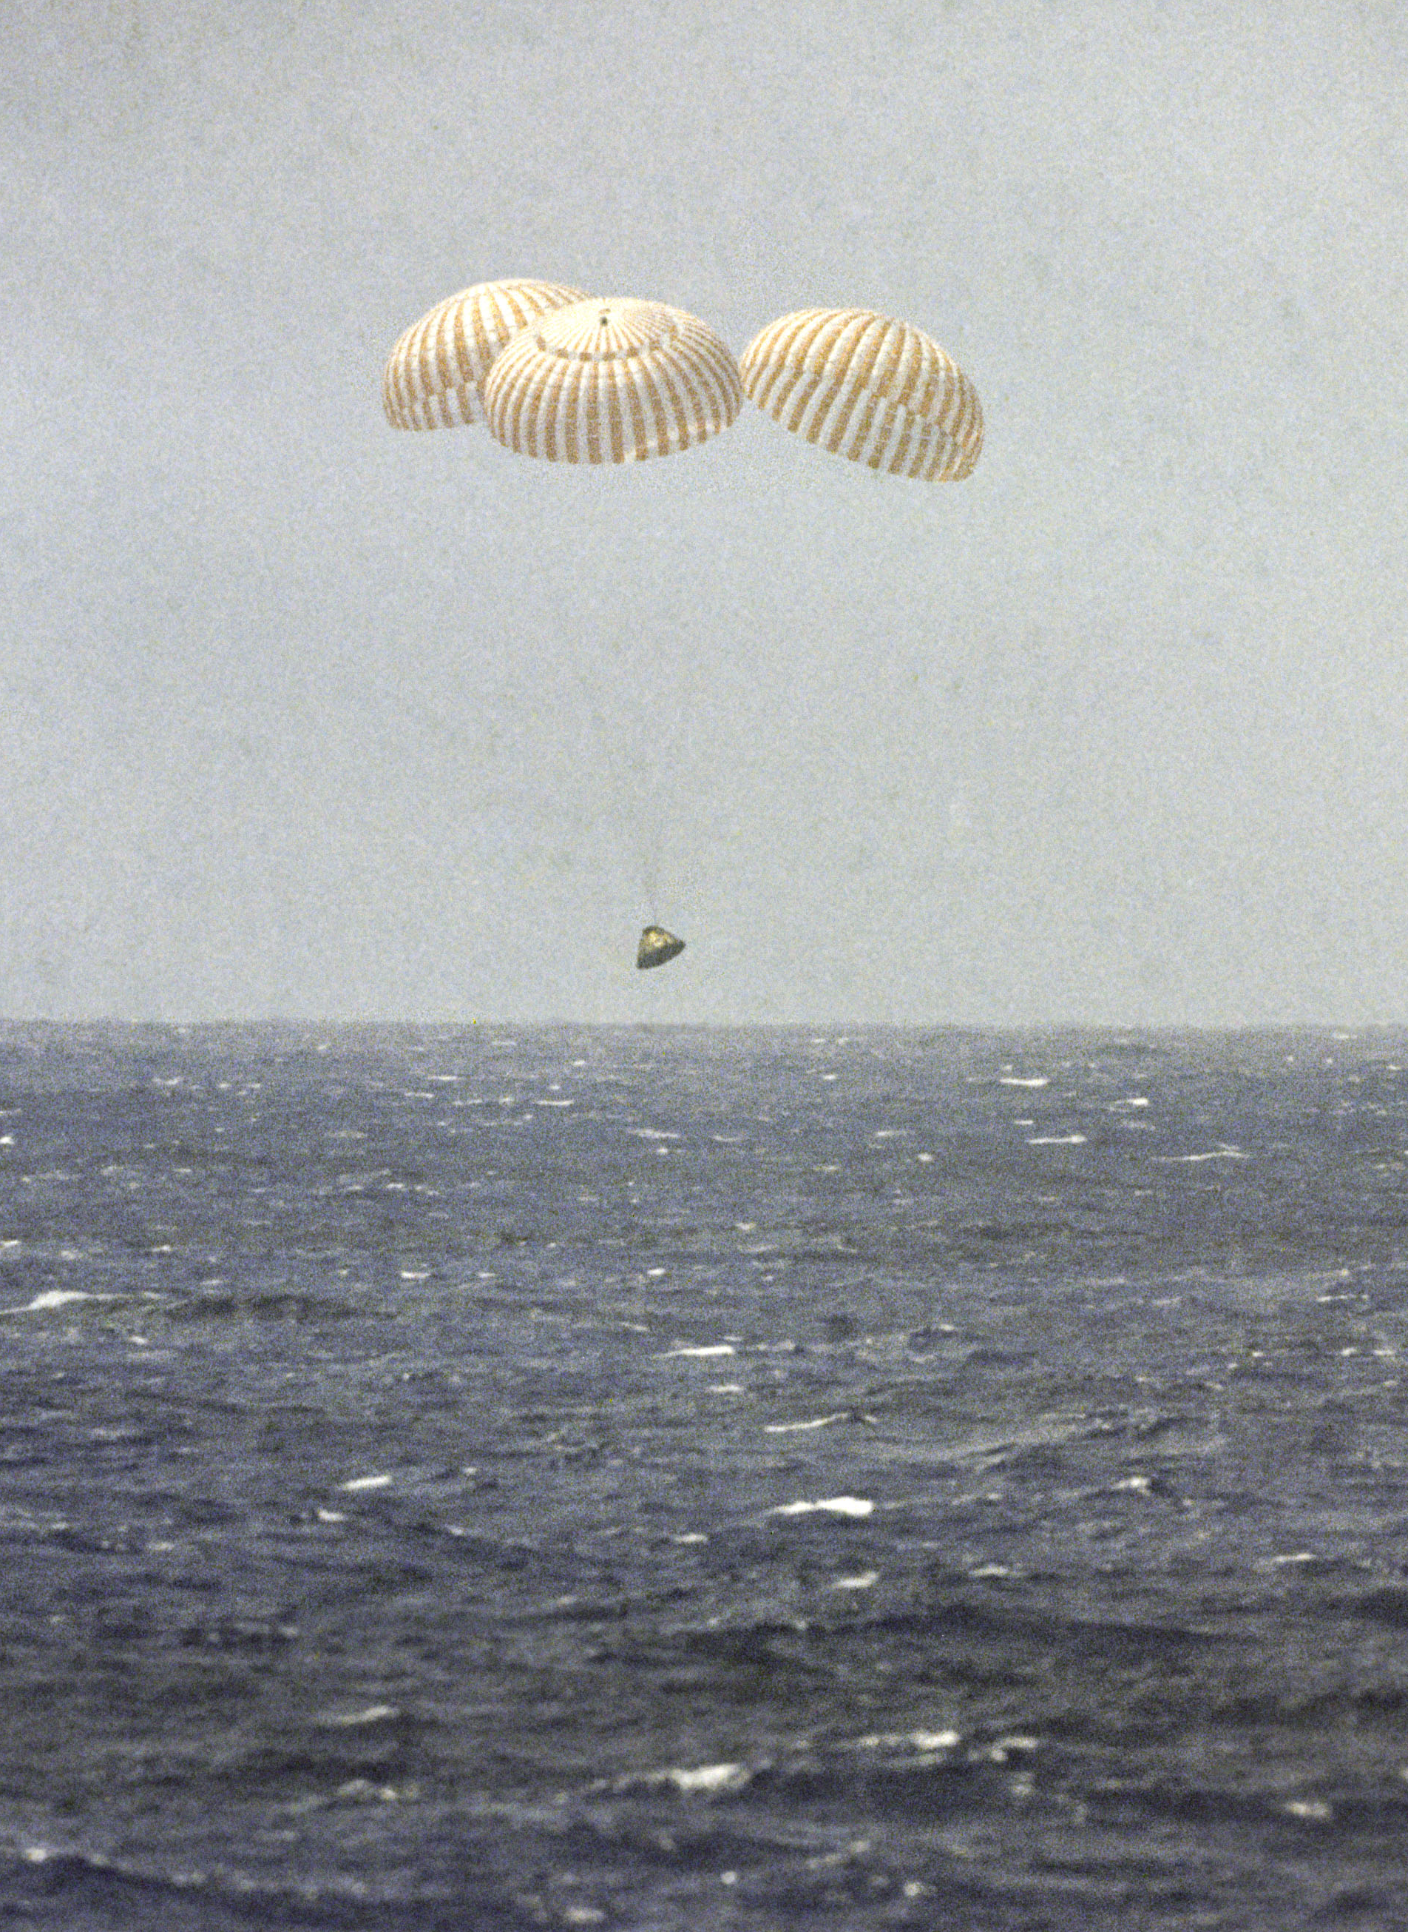
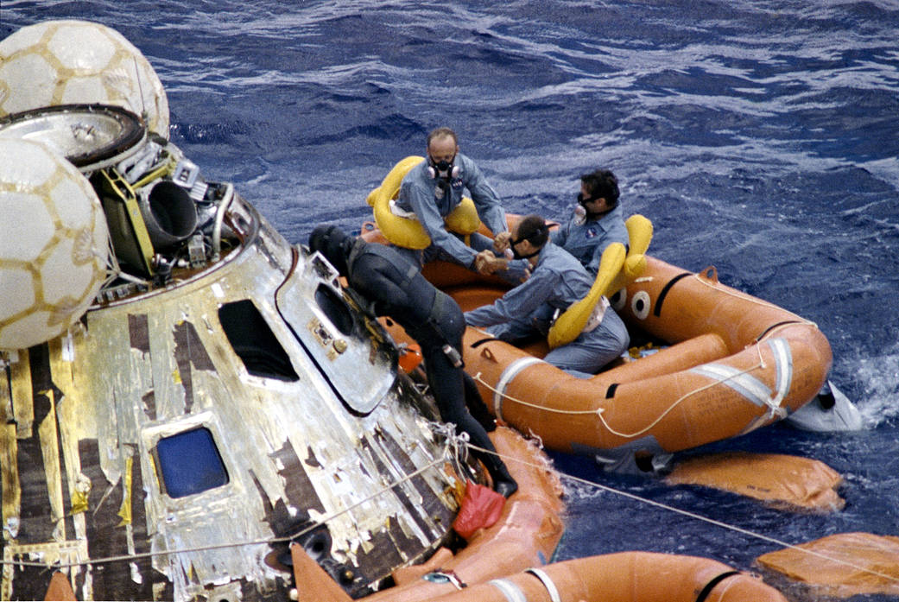
Splashdown
Splashdown
Notes:
-Image credits: NASA
-Left image: A U.S. Navy Underwater Demolition Team swimmer assists the Apollo 12 crew during recovery operations in the Pacific Ocean. In the life raft are astronauts Pete Conrad (facing camera), Dick Gordon (middle), and Al Bean (nearest camera). The three crew men were picked up by helicopter and flown to the prime recovery ship, USS Hornet (same ship as Apollo 11).
-Right image: The Apollo 12 Command Module, with astronauts Pete Conrad, Dick Gordon, and Al Bean aboard, nears splashdown in the Pacific Ocean to conclude the second lunar landing mission.
-The Apollo 12 splashdown occurred at 3:58 p.m. EST, Nov. 24, 1969, near (800 km east of) American Samoa.

Slide 23
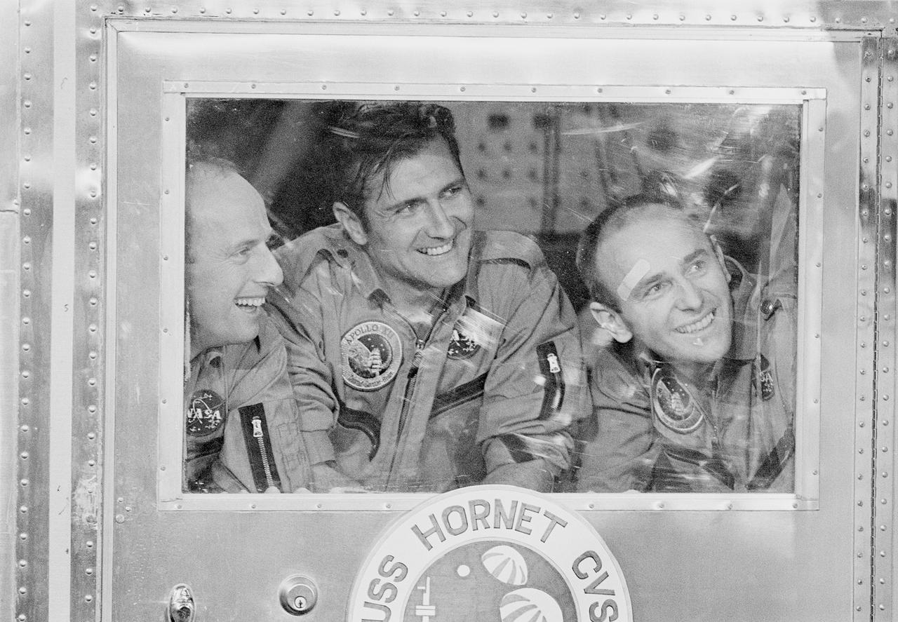
Quarantine
Quarantine
Notes:
-Image credit: NASA → The smiling Apollo 12 astronauts peer out of the window of the mobile quarantine facility aboard the recovery ship, USS Hornet. Pictured (left to right) are Pete Conrad, Dick Gordon, and Al Bean. The crew were housed in the quarantine facility immediately after the Pacific recovery operation took place.
-Upon splashdown, a camera in the capsule came loose and hit Bean in the head, knocking him out (hence the Band Aid on his forehead in the image).

Slide 24
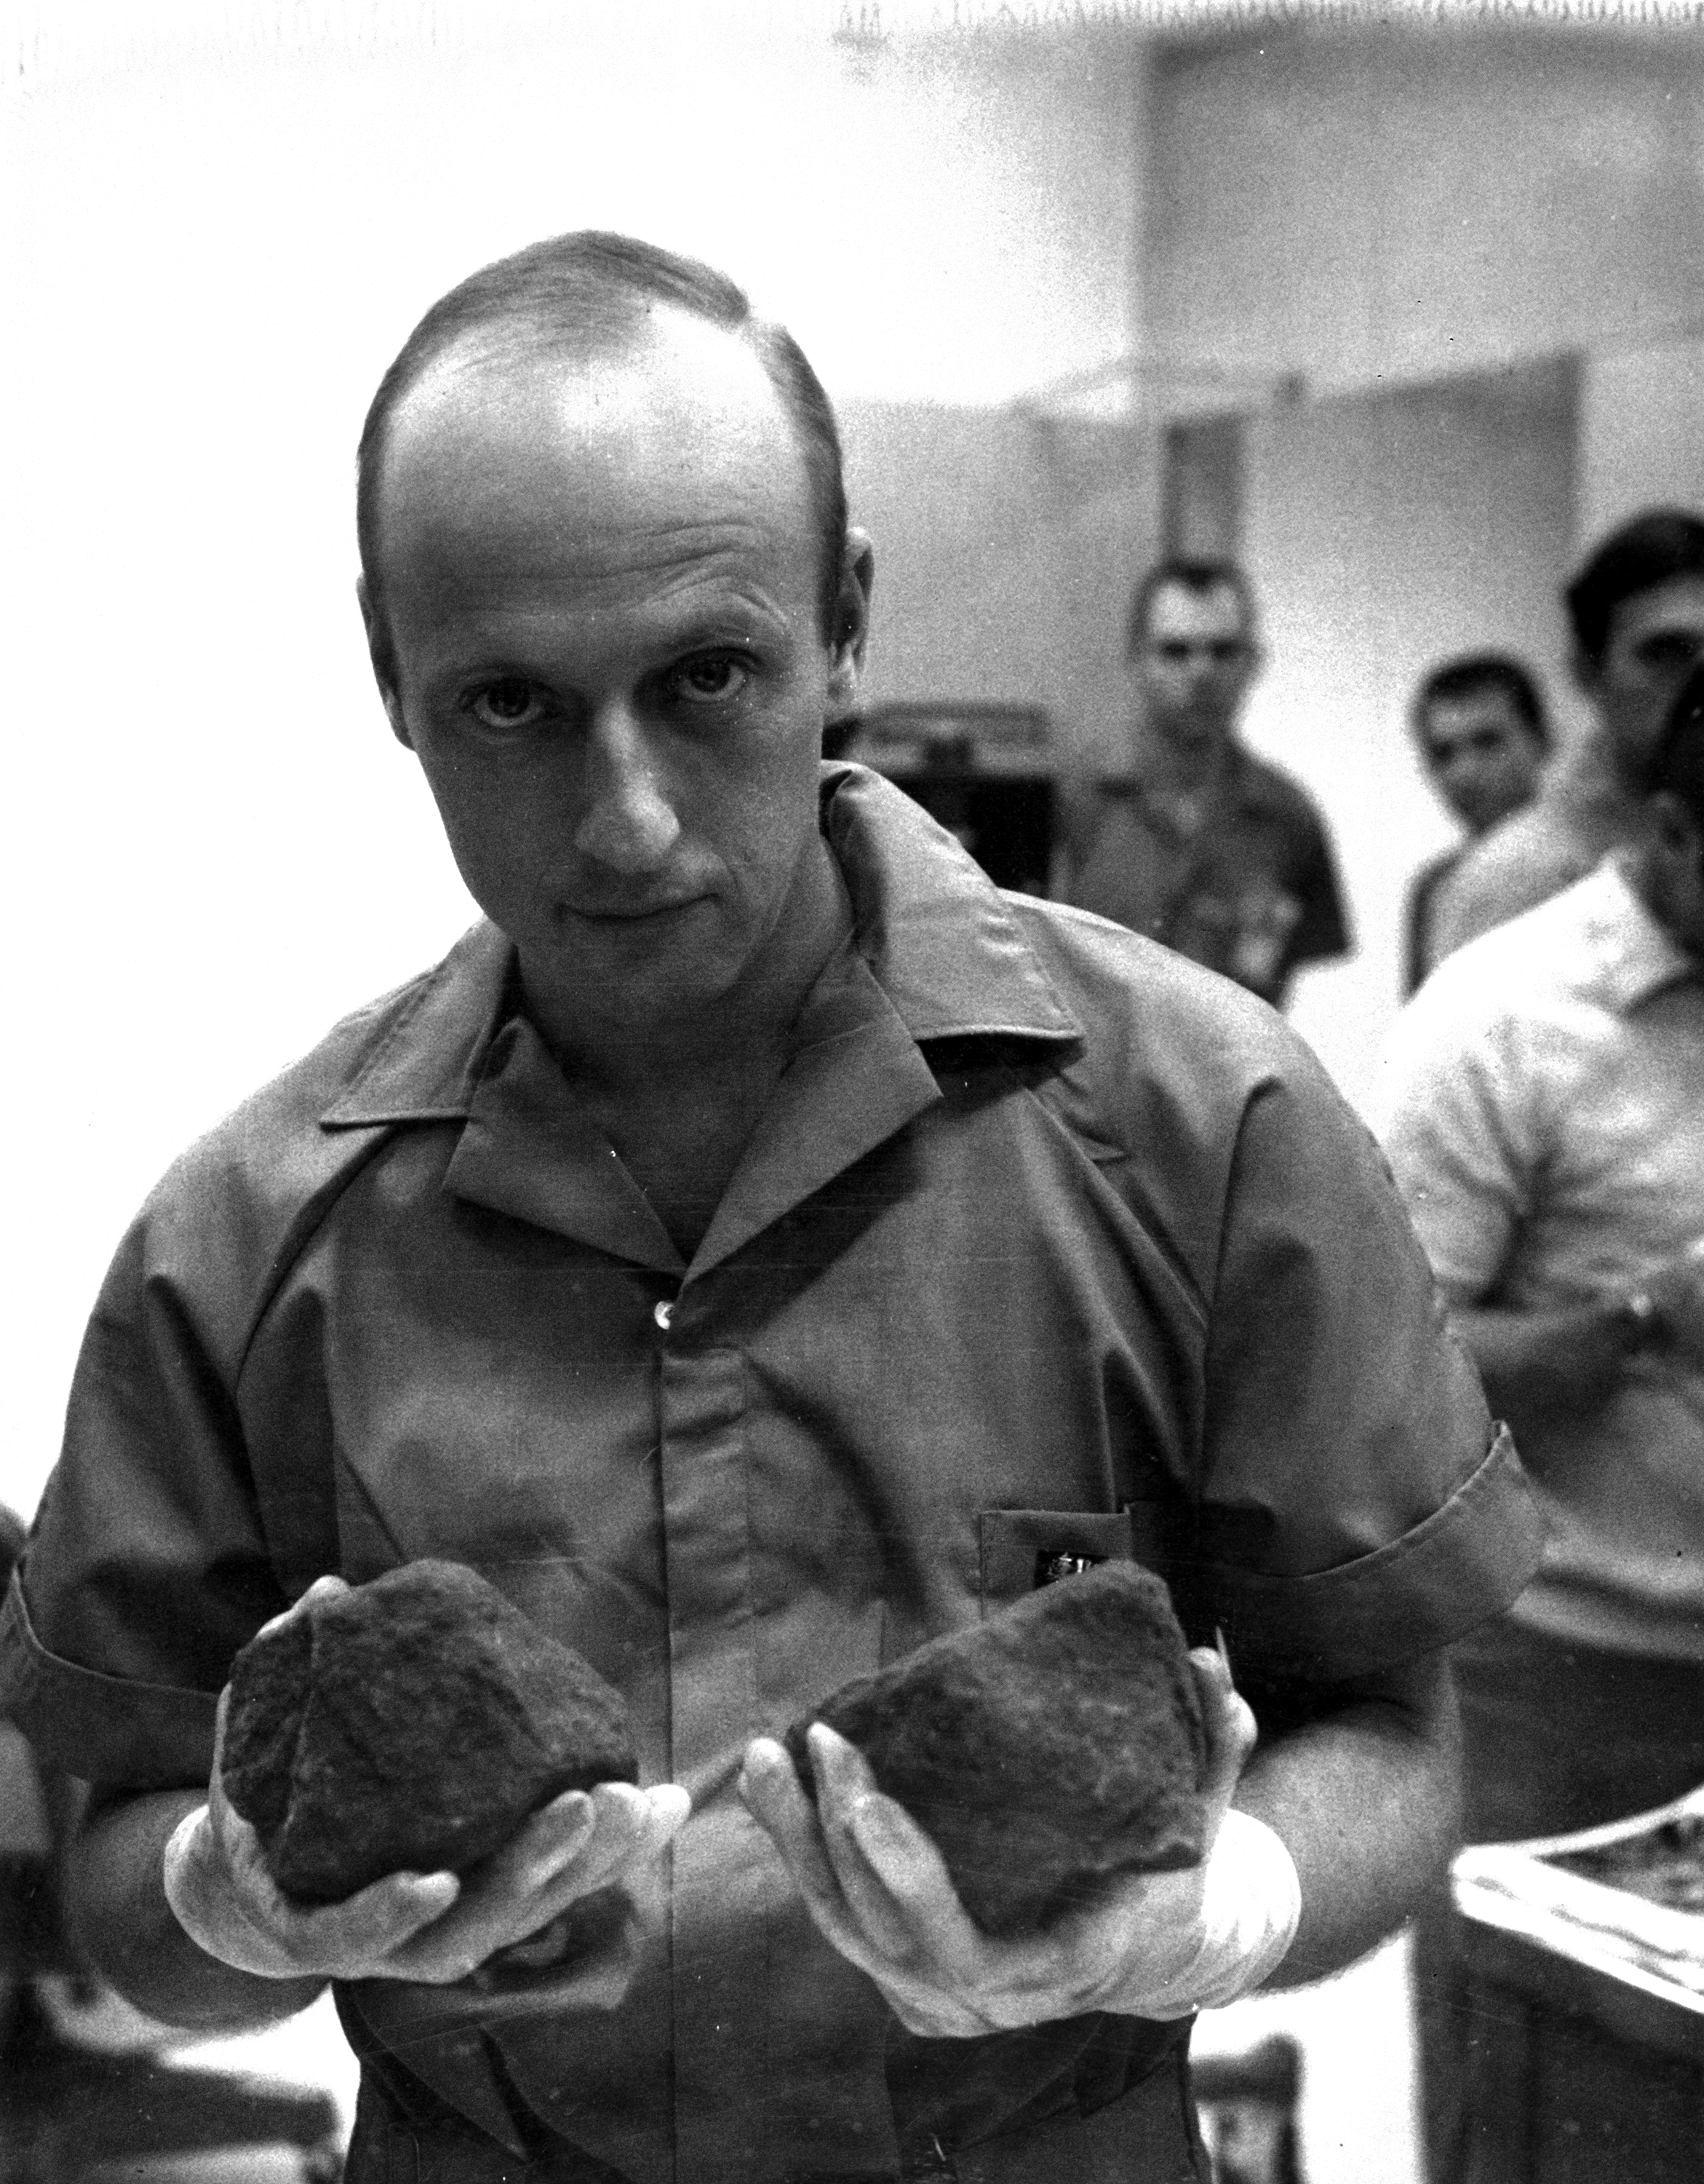
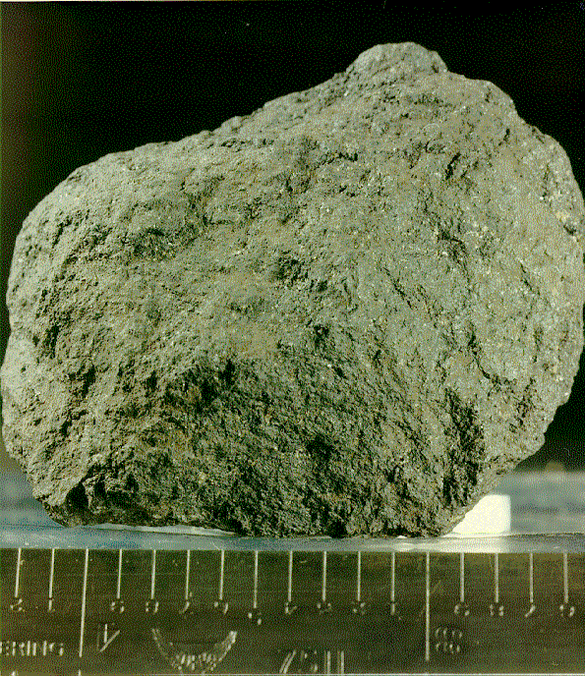
Returned Samples
Returned Samples
Notes:
-Image credits: NASA
-Left image: Apollo 12 basalt 12008. This sample has a mass of 58 grams and is up to 5 centimeters across. Basalts are dark-colored rocks solidified from molten lava – they are a common type of volcanic rock on Earth.
-Right image: Astronaut Pete Conrad holds two lunar rocks which were among the samples brought back from the Moon by the Apollo 12 astronauts. The samples are stored in Johnson Space Center (JSC)’s Lunar Receiving Laboratory.

Slide 25
By the Numbers
By the Numbers
7 hrs, 45 min spent outside the lunar module
75.7 lbs of samples collected
244 hrs, 36 min, 24 sec (~10 days) total mission time
Notes:
-Farthest point traveled from the LM: 1,350 ft (411.48 m) → a bit farther than the height of the Empire State Building (1,250 ft)
-Compare to Apollo 11:
60 m – farthest point traveled from the LM
2.5 hrs spent outside the lunar module
47.8 lbs of samples collected
195 hrs, 18 min, 35 sec (~8 days) total mission time

Slide 26
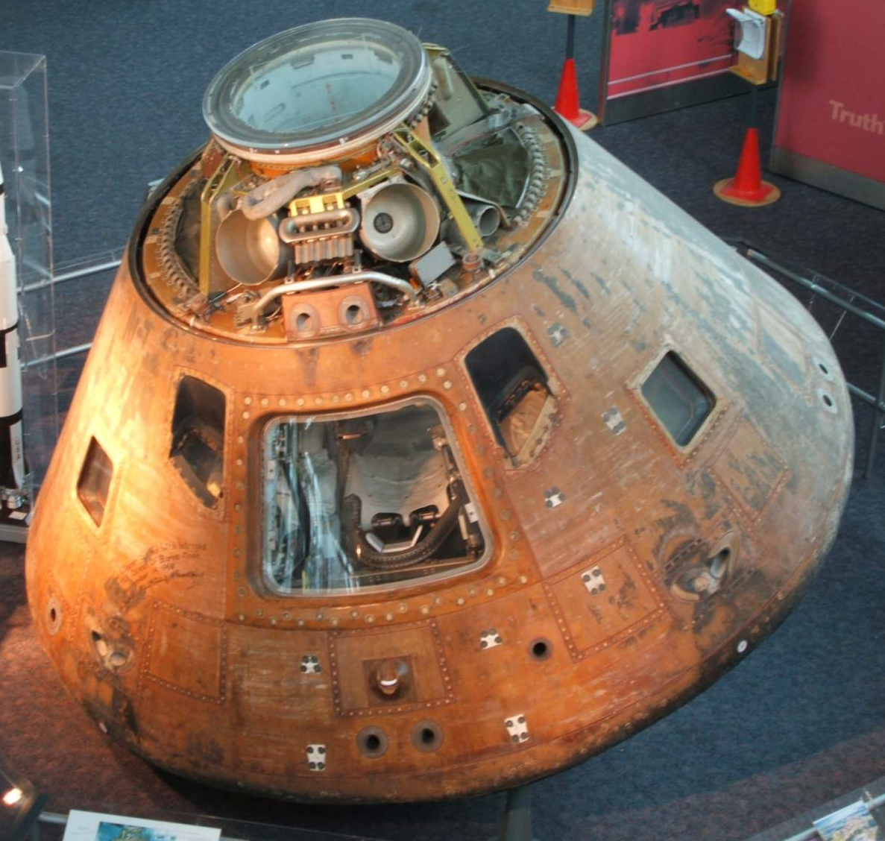
Apollo 12 Command Module
Apollo 12 Command Module
Name: “Yankee Clipper”
Location:
  Virginia Air & Space Center
  Hampton, VA
Notes:
-Image credit: National Air and Space Museum → https://airandspace.si.edu/collection-objects/command-module-apollo-12
-Color of the command module is due to the mylar material used.

Slide 27
More Info
More Info
Notes:
-Image source: https://www.lpi.usra.edu/resources/apollopanoramas/pans/?pan=JSC2011e118358

Slide 28
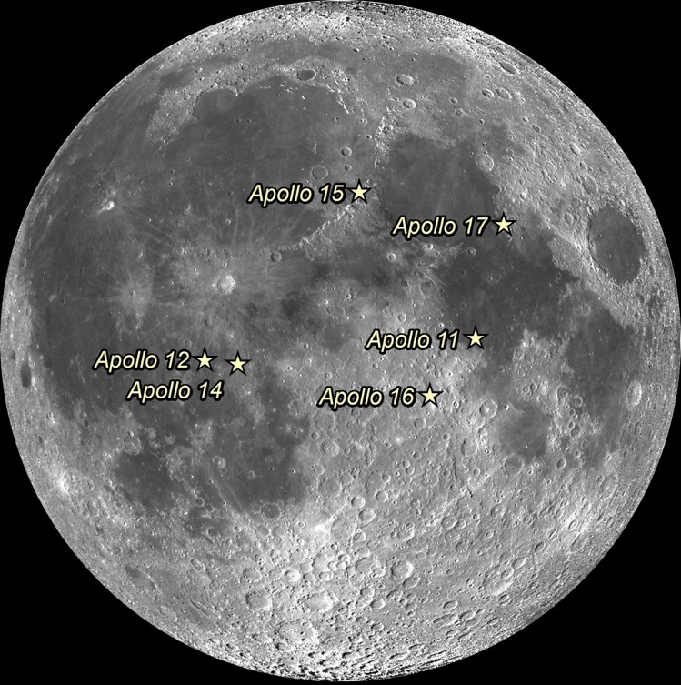
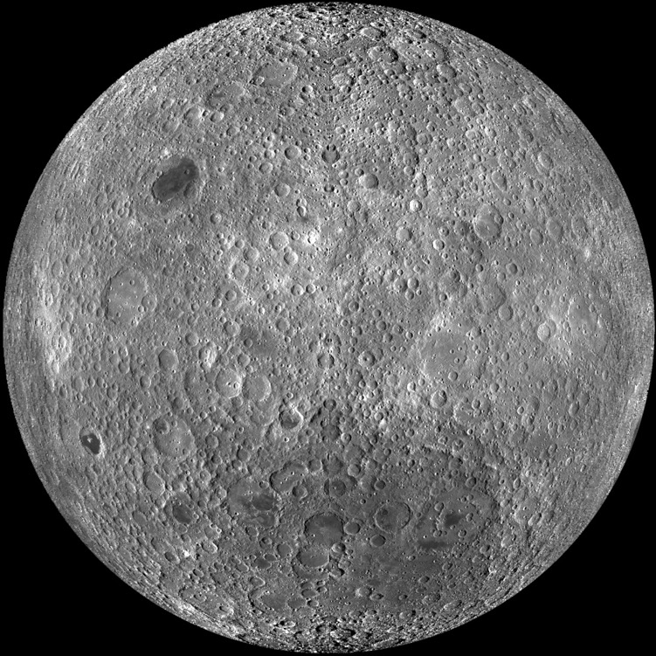
Apollo Landing Sites
Apollo Landing Sites
Notes:
-Image credit: NASA/GSFC/Arizona State University
-Left: Apollo landing sites (lunar near side)
-Right: Lunar far side
(captured by the Lunar Reconnaissance Orbiter spacecraft)

Slide 29
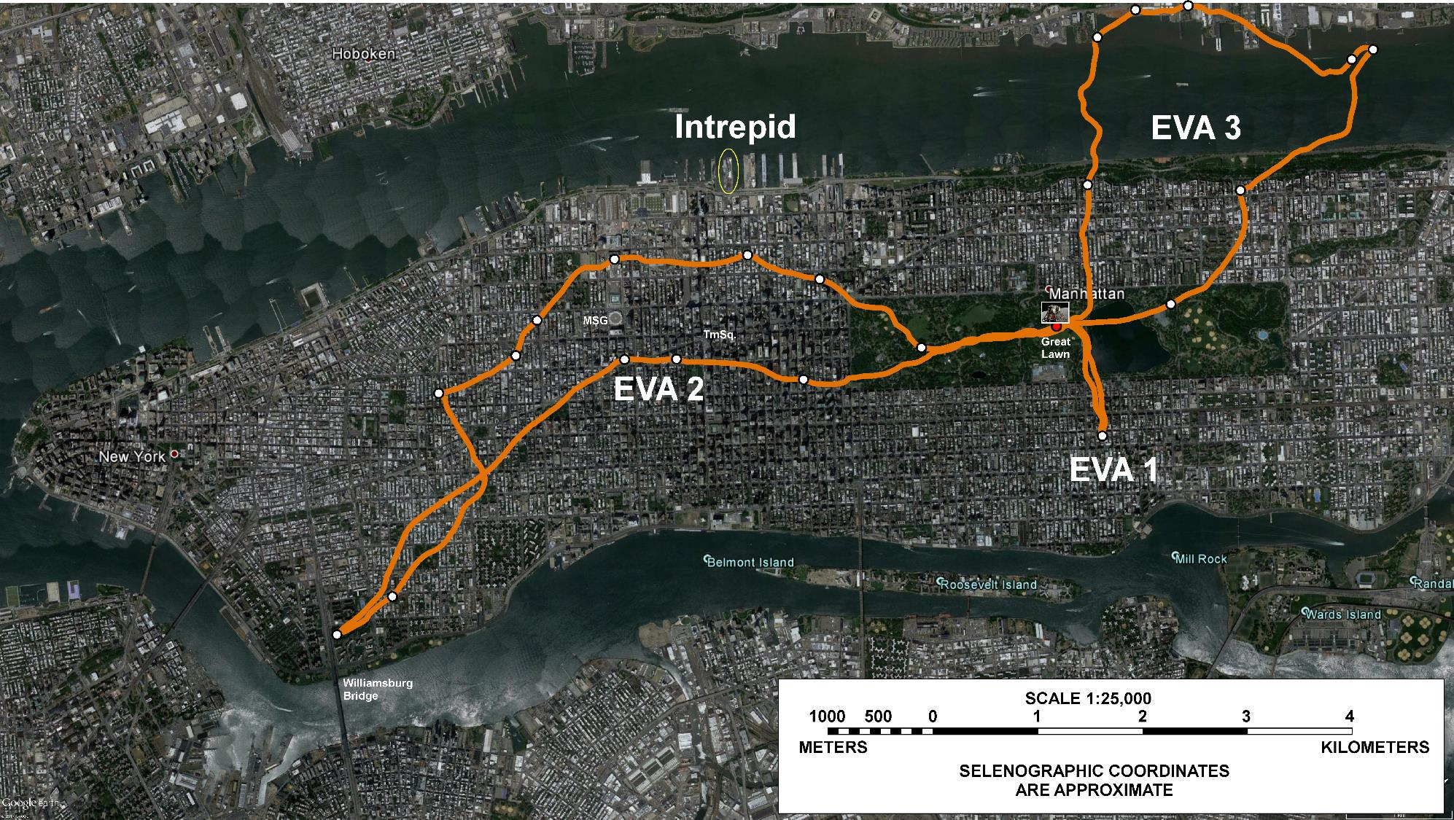
Apollo 17 Traverses
Apollo 17 Traverses
Notes:
-Image credit: NASA/GSFC/Brent Garry
-Apollo 17 tracks overlain on New York City, NY.
-Dates: December 11, 12, 13; 1972 (3 years after Apollo 12)
-Notice how much farther the Apollo 17 astronauts were able to travel than the Apollo 12 astronauts (since they had a lunar roving vehicle).

Slide 30
Apollo 12 Traverses
Notes:
-Image source: https://www.lpi.usra.edu/publications/slidesets/apollolanding/ApolloLanding/slide_13.html
-The Apollo 12 traverses.
-The thick lines indicate the paths taken by the astronauts during the two EVAs. The Lunar Module location is designated by the X.
The first EVA was devoted to the setup of the Apollo Lunar Surface Experiments Package (ALSEP), a series of instruments that could be monitored and controlled from the Earth.
The second EVA included an investigation of several craters and the Surveyor 3 spacecraft.

Slide 31
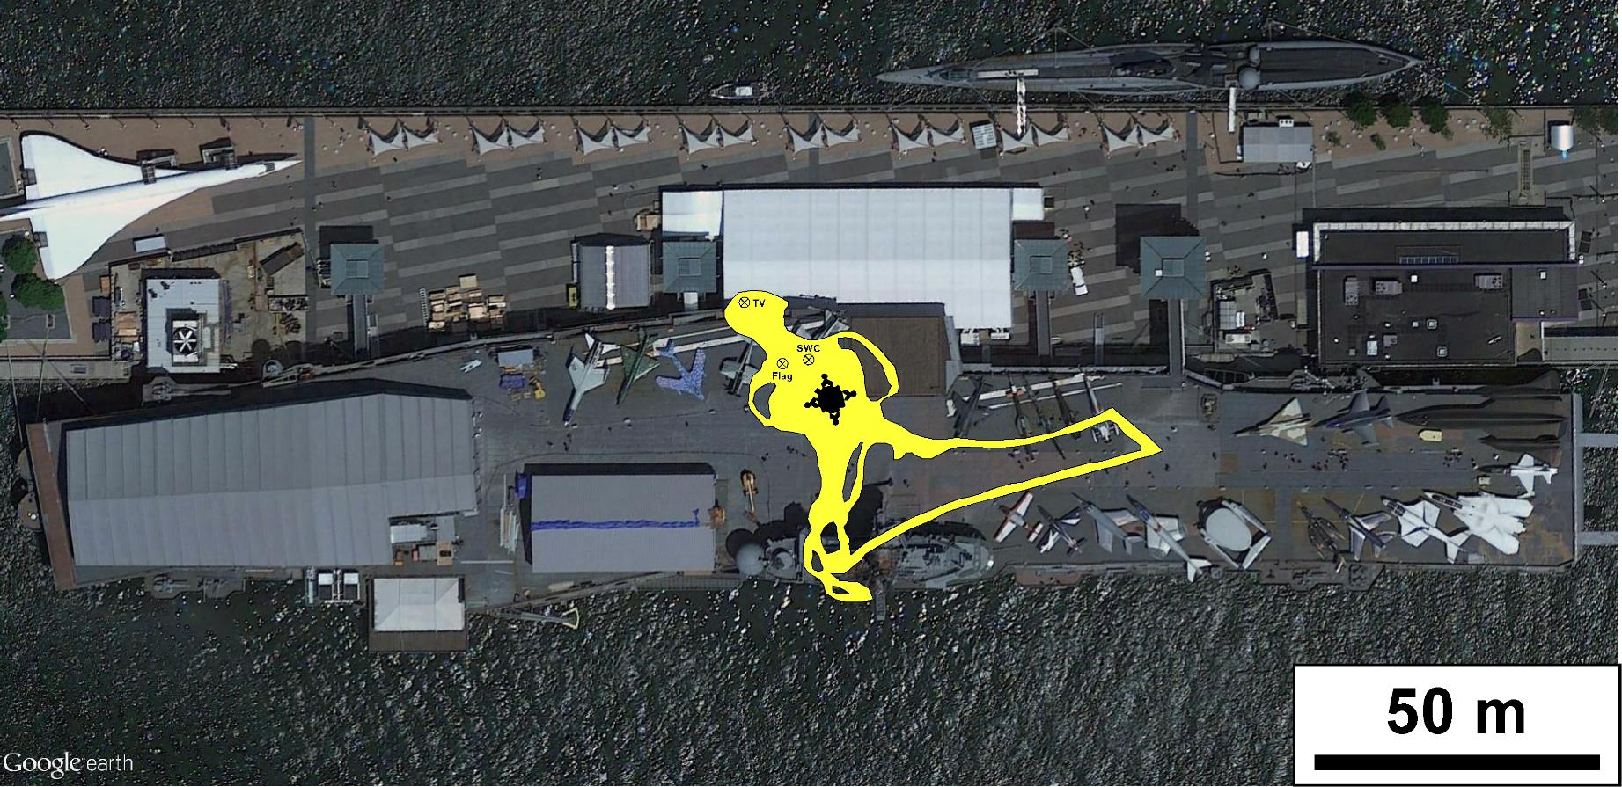
Apollo 11 Traverses
Apollo 11 Traverses
Notes:
-Image credit: NASA/GSFC/Brent Garry
-Apollo 11 tracks overlain on the Intrepid Sea, Air & Space Museum in New York City, NY.
-Date: July 20, 1969
-Future Apollo missions would travel up to ~5 mi from the lunar module (Apollo 17).

Slide 32
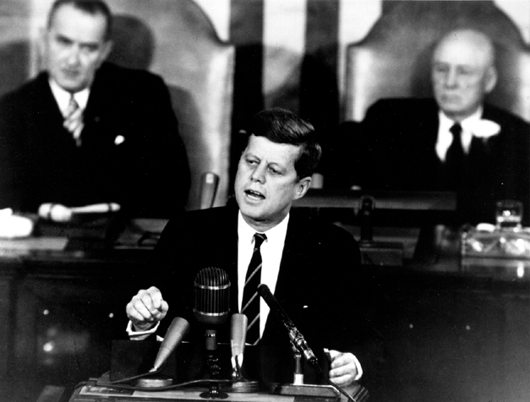
JFK’s Speech
JFK’s Speech
The Decision to Go to the Moon
  May 25, 1961
We Choose to Go to the Moon
  September 12, 1962
Notes:
-Image source: https://history.nasa.gov/moondec.html → JFK’s address to Congress.
-”The Decision to Go to the Moon”: President John F. Kennedy's May 25, 1961 Speech before Congress. JFK announced before a special joint session of Congress the dramatic and ambitious goal of sending an American safely to the Moon before the end of the decade.
-”We choose to go to the Moon" is the famous tagline of a speech about the effort to reach the Moon delivered by President John F. Kennedy to a large crowd gathered at Rice Stadium in Houston, Texas on September 12, 1962.

Slide 33
Additional Resources
Additional Resources
Apollo Images:
  https://images.nasa.gov/
  https://www.hq.nasa.gov/alsj/a12/images12.html
  http://lroc.sese.asu.edu/featured_sites#ApolloLandingSites
Apollo Videos:
  https://svs.gsfc.nasa.gov/Gallery/apollo.html
Apollo 12 General:
  https://nssdc.gsfc.nasa.gov/planetary/lunar/apollo12info.html
  https://www.lpi.usra.edu/lunar/missions/apollo/apollo_12/overview/
  http://lroc.sese.asu.edu/featured_sites#ApolloLandingSites

