Slide 1
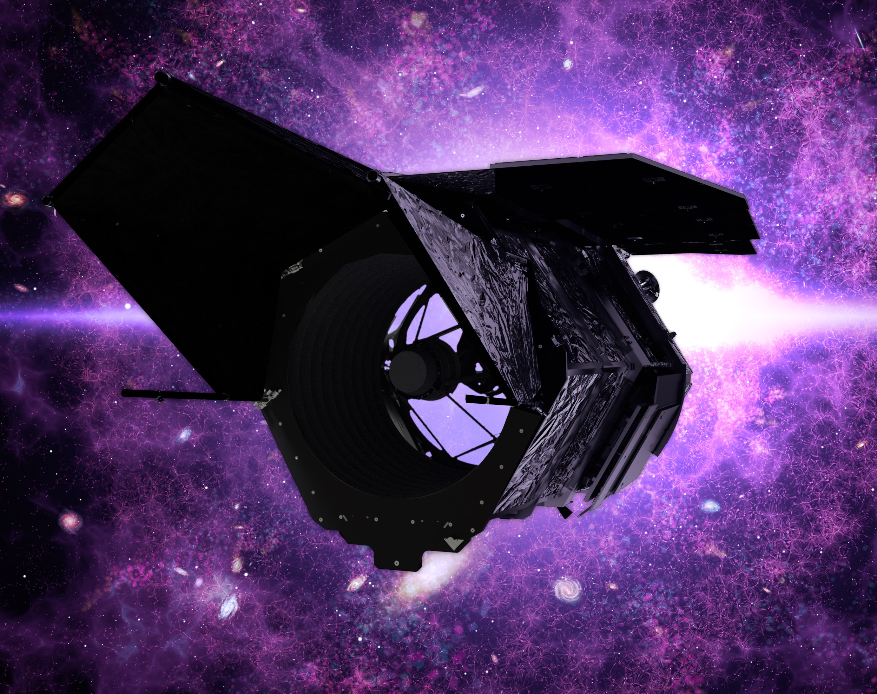

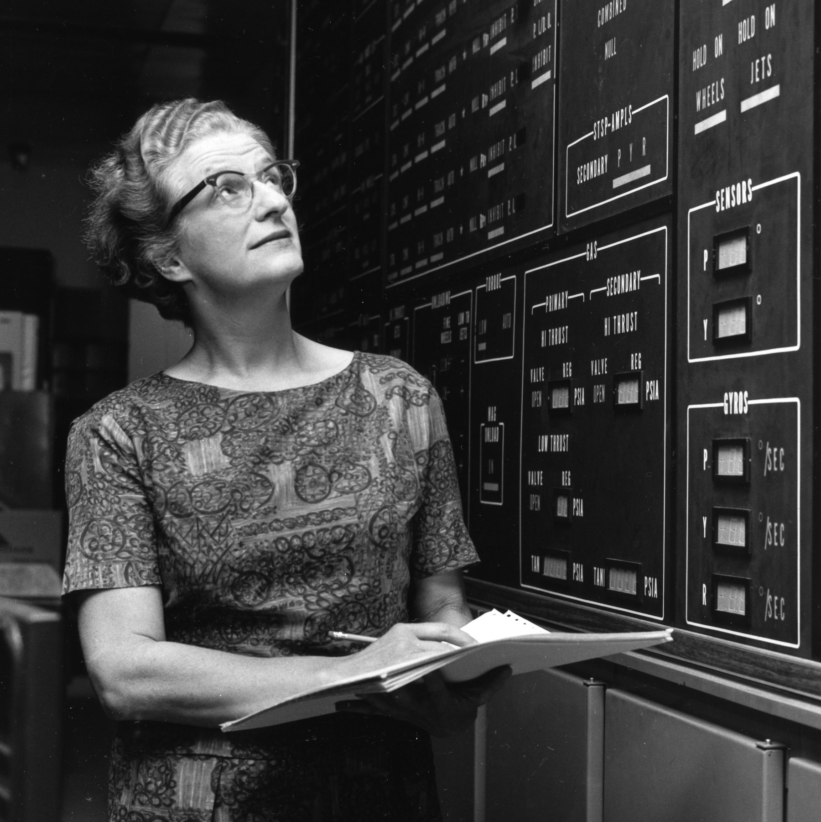

Notional Parameters, Extensions, and Auxiliary Science of the Roman Galactic Bulge Time Domain Survey Exploring the Transient Universe with the Nancy Grace Roman Space Telescope February 9, 2022
Scott Gaudi
The Ohio State University

Slide 2
Science Requirements
Roman shall be capable of measuring the mass function of exoplanets with masses in the range 1 M_{Earth} < m < 30 M_{Jupiter} and orbital semi-major axes ≥ 1 AU to better than 15% per decade in mass.
Roman shall be capable of measuring the frequency of bound exoplanets with masses in the range 0.1 M_{Earth} < m < 0.3M_{Earth} to better than 25%
Roman shall be capable of determining the masses of, and distances to, host stars of 40% of the detected planets with a precision of 20% or better.
Roman shall be capable of measuring the frequency of free floating planetary-mass objects in the Galaxy from Mars to 10 Jupiter masses in mass. If there is one M_{Earth} free-floating planet per star, measure this frequency to better than 25%.
Roman shall be capable of estimating η_{Earth} (defined as the frequency of planets orbiting FGK stars with mass ratio and estimated projected semimajor axis within 20% of the Earth-Sun system) to a precision of 0.2 dex via extrapolation from larger and longer-period planets.

Slide 3
Survey Requirements
Monitor hundreds of millions of bulge stars continuously on a time scale of ~10 minutes.
Event rate ~10⁻⁵/year/star.
Detection probability ~0.1-1%.
Shortest features are ~30 minutes.
Relative photometry of a few %.
Deviations are few – 10%.
Resolve main sequence source stars for smallest planets.
Resolve unrelated stars for lens flux measurements.
Longest possible time baseline for proper motion measurements.

Slide 4
Free and Fixed Survey Parameters
Fixed Parameters
Duration of a ‘bulge season’
Set by field of regard
Slew & Settle time
Detector size
Pixel size
Field of View
Non-microlensing filters
Etc.
Free Parameters
Microlensing filter
Cadence of primary filter
Number of fields
Field location
Exposure time
Total survey time
Choice of bulge seasons
Cadence of secondary filters

Slide 5
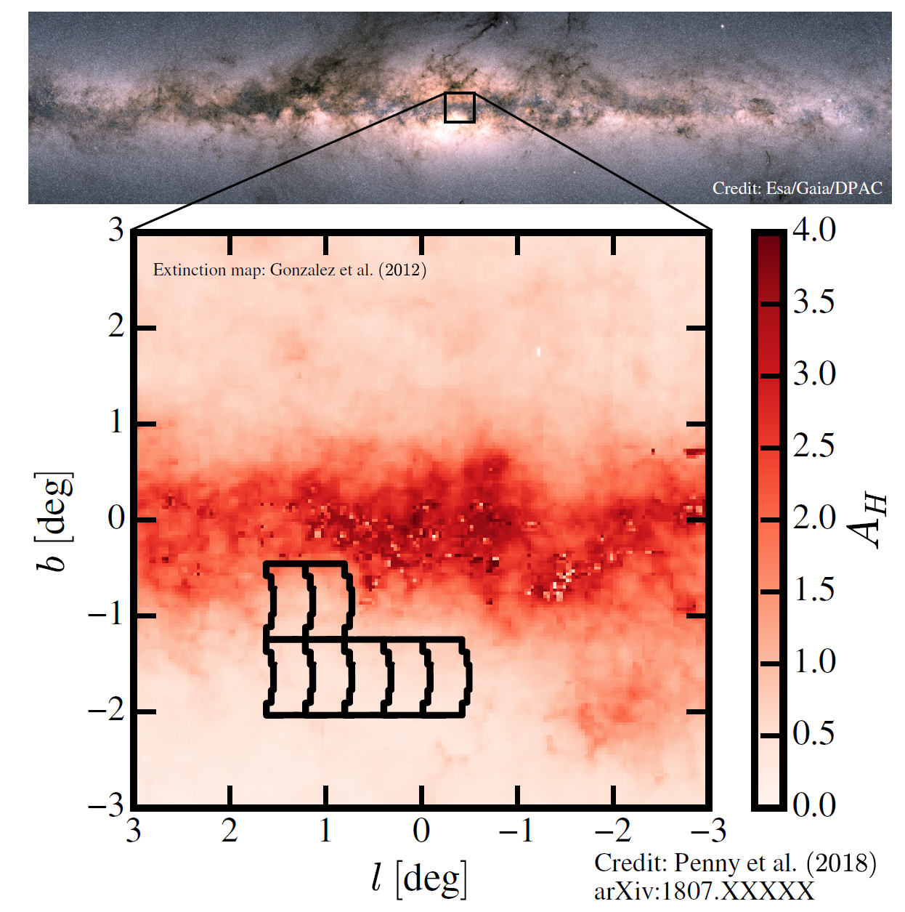
Roman Galactic Exoplanet Survey
(notional*)
7 fields for a total of ~2 deg²
Wide F146_{AB} (0.93-2 μm) filter**.
15-minute cadence.
~50s exposures.
Observations every at 6 hours in alternating filters (e.g., F087,F219), 2 x 450 total obs.
6 x 72-day seasons.
~41,000 exposures in W149_{AB}.
~432 total days spread over 5-year mission.
*Notional time allocation; exact survey strategy to be determined based on broad community input.
Penny et al. 2019
**One photon per second for F146_{AB} ~27.6

Slide 6
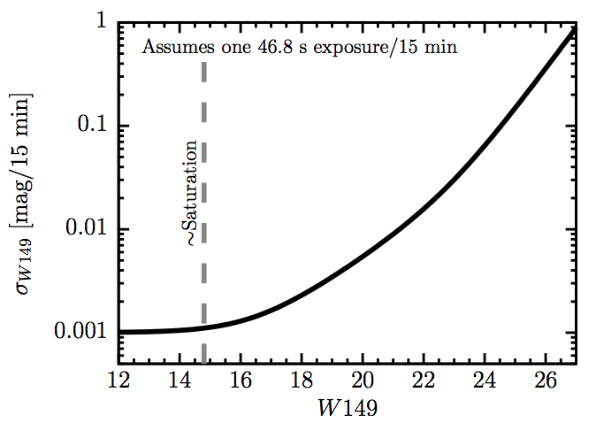

Statistical Power
For a F146_{AB}~21.15 star:
Photon-noise relative photometric precision of σ~0.01 mag per exposure.
Total of ~10⁹ photons over the survey.
Saturation @ F146_{AB} ~14.8.
Root N: $\sqrt[2]{41,000}$ ~ 200.
Penny et al. 2019

Slide 7
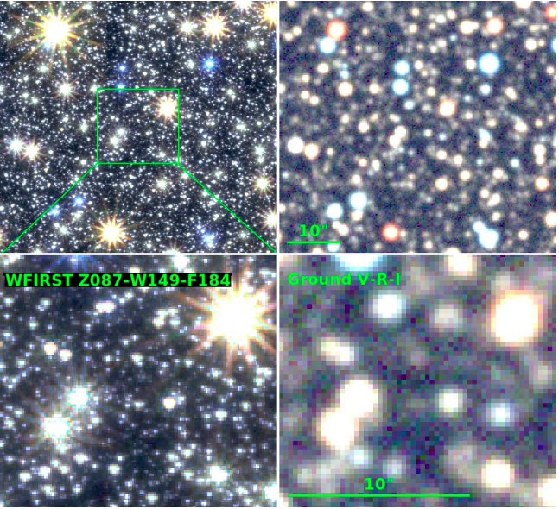
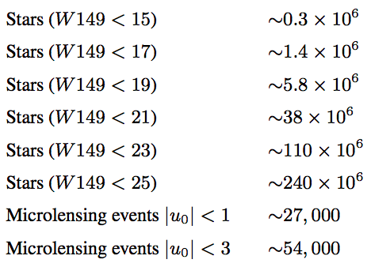
Sample Size and Microlensing Events
Penny et al. 2019

Slide 8
Photometric and Astrometric Precision
(Relative, Poisson Noise Only)
H_{AB} | # of Stars | Relative photometric precision (per exp.) | Astrometric precision (per exp.)
<19 | 6 x 10⁶ | ~0.8% | ~0.6 mas
<21 | 40 x 10⁶ | ~1% | ~1.5 mas
Penny et al. 2019

Slide 9
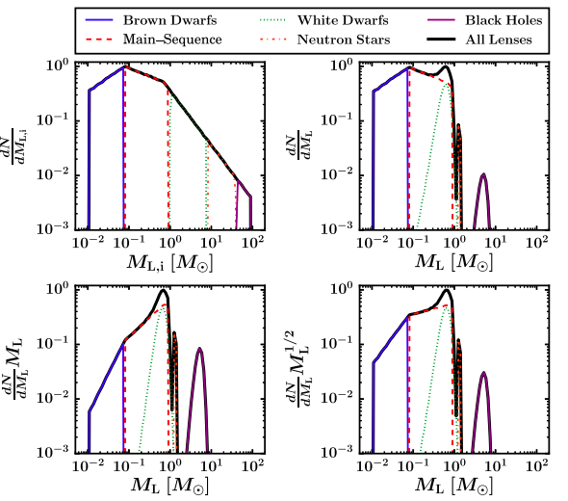
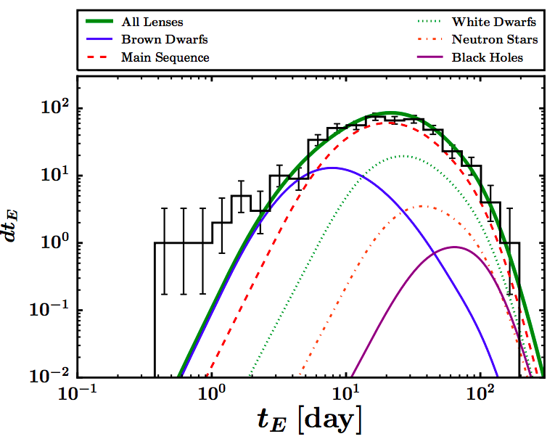
Probe the Compact Object Mass Function
from ~30 M⊙…
Clanton & Gaudi 2017

Slide 10
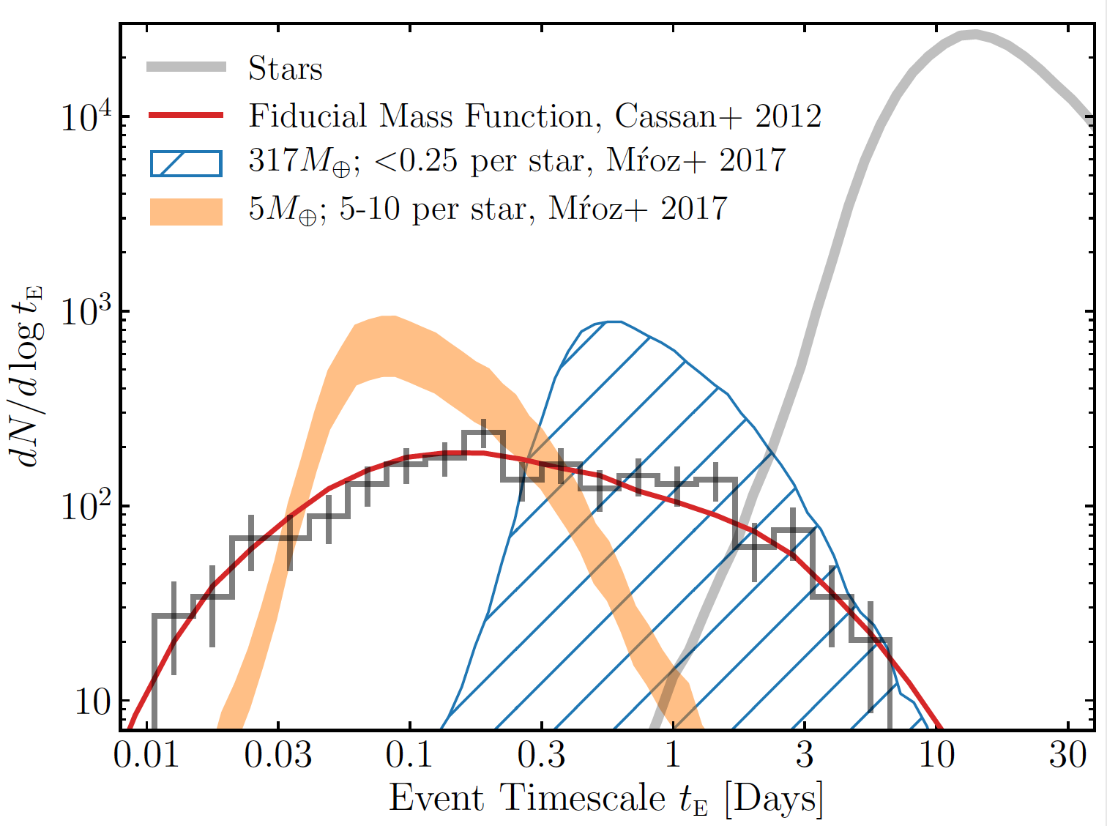
…to Free-Floating Planets!
(Johnson et al. 2020)

Slide 11
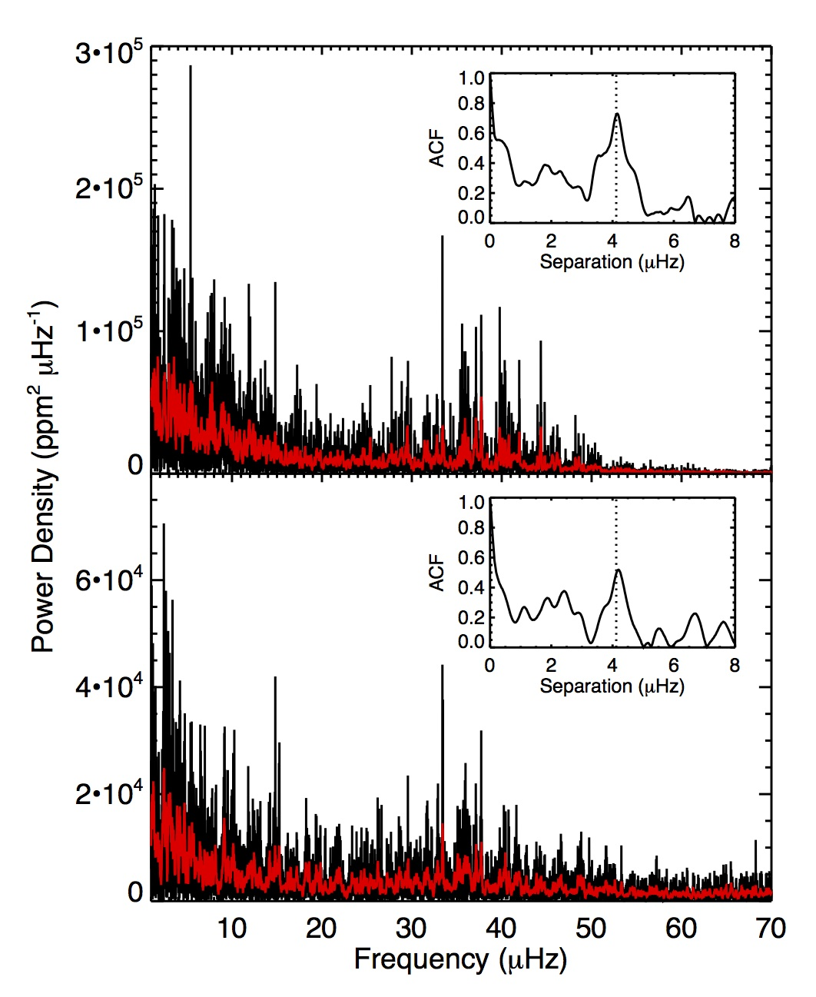
Asteroseismology of ~10⁶ giants
Roman will be able to measure ν_{max} and Δν for the ~10⁶ H_{AB}<14 red giant stars in the survey fields.
Only measure ν_{max} for fainter stars.
Will also be able to measure precise (~0.3%) distances to these stars via parallax (if photon-noise limited).
Kepler
Simulated
WFIRST
Gould et al. 2015

Slide 12
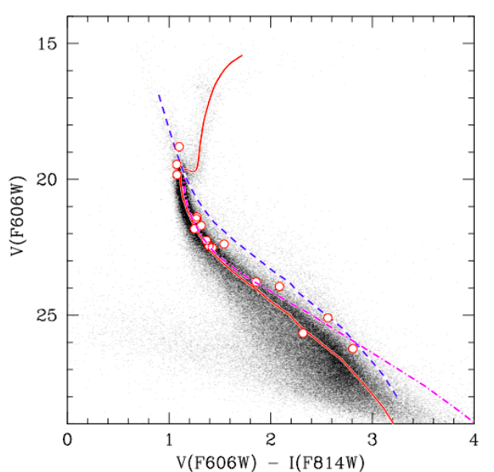
Resolved Stellar Populations
Roman will obtain one of the deepest fields ever taken.
~2x10⁶s in F146.
~3x10⁵s in F087.
Compare to the SWEEPS 9x10⁴s in F606W (V) and F814W (I).
Sahu et al. 2006

Slide 13
Galactic Structure
Photon noise-limited parallaxes of <10% and proper motion measurements of 0.3% (0.01 mas/yr) for ~4x10⁶ bulge and disk stars with F146_{AB}<21.
Deep multicolor photometry in a least one narrower bluer filter (e.g., F087) and one narrower red filter (e.g., F213) for these stars.
Shallow photometry in all filters.
With this dataset, it will be possible to:
Estimate T_{eff}, [M/H], Age, Luminosity, and A_{H} for all these stars.
Probe the disk and Galactic bulge mass and velocity distribution (including Galactic bar structure).
Probe the metallicity and age distribution of the disk and bulge.
Create an exquisite extinction map in the survey area.

Slide 14
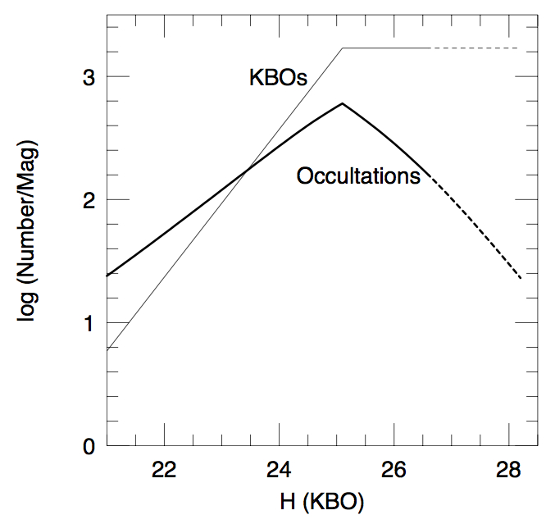
Solar System Science
Roman will detect ~5000 TNOs down to F146_{AB}<30 (corresponding to D~10 km) of 17 deg².
Substantially below the collisional break.
Orbital elements will be determined to a few %, allowing for dynamical classification.
~1000 of these will occult stars, and several dozen will occult more than one star.
Gould 2014

Slide 15
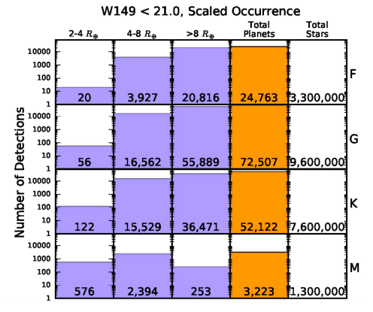
10⁵ Transiting Planets
Roman will detect ~10⁵ transiting planets with radii down to ~2R⊕.
Most host stars will have measured distances.
Several thousand can be confirmed by the detection of their secondary eclipses.
Some systems will have measured transiting timing variations.
Bennett & Rhie 2002
Montet et al. 2017
Expected yield of transiting planets orbiting dwarfs with W149_{AB}<21 (Montet et al. 2017)

Slide 16
Auxiliary Science with the RGES Survey
Measurement of the Compact Object Mass Function over 10 Orders of Magnitude.
Detection of ~10⁵ Transiting Planets.
Astroseismology of ~10⁶ Bulge Giants.
Resolved Stellar Populations and Galactic Stucture.
Detection of ~5x10³ Trans-Neptunian Objects.
Parallaxes and Proper Motions of ~6x10⁶ Bulge and Disk Stars.
Oh, and some planets found by microlensing too…

Slide 17
Control of Systemics:
Detector Characterization.
Many of these applications will require new data reduction algorithms in order to realize their full science potential.
Excellent-to-exquisite control of systematics will be required for many of these applications.
The extent to which systematics can be controlled in unclear.
However, with its ~4x10⁴ dithered images of ~10⁸ mostly constant point sources of known fluxes, positions, and colors, the microlensing survey may provide the best dataset to characterize the WFI detectors, including artifacts such as:
Persistence, Inter-pixel Capacitance, Count Rate Nonlinearity, and Intra-pixel Response Variations.

Slide 18

‘Tweaks’ of the Survey.
Many ways in which the survey strategy can be ‘tweaked’ to yield additional science without significantly impacting the requirements of the microlensing survey.
To first order, Yield $∝$ Total Time
For example:
Periodic observations of the GC.
Periodic observations of the survey fields in all filters.
Periodic observations of a much larger survey area.
Others?

Slide 19
Extensions of the Survey?
There are many possible extensions to the RGBTDS that may yield additional science, e.g., during an extended mission.
Extending the survey for N additional seasons
Very high cadence observations of a smaller area
Lower-cadence observations of a larger area
High-cadence observations in alternate filters
Surveying Northern Galactic fields
High cadence observations of the GC

Slide 20
Summary and Path Forward
The properties of an ~optimized GBTD survey that can achieve the science requirements flow directly from these requirements and the fixed parameters.
There is not a lot of freedom in choosing these survey properties.
Nevertheless, small teaks in the survey strategy can lead to additional science without jeopardizing the science requirements.
Questions for the community:
What additional science can be extracted from the survey as is?
What additional science might be extracted from small tweaks in the survey strategy?
Consider very ‘out of the box’ ideas for extending the scientific grasp of the microlensing survey. Many of these ideas will be unfeasible, but some of them may not.
As a survey mission, past experience tells us that ancillary science is guaranteed, and this science may ultimately eclipse the science that the survey was designed to do.

