Slide 1

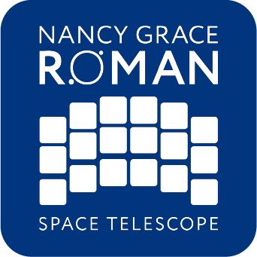
About This Slide Deck
Enable Content
Some slides have externally linked resources such as videos. You will need to ”Enable Content” by clicking the button on the alert bar.
This presentation can be tailored for your needs:
  Each slide, including the script in its notes pane, has been designed to stand alone so that you can remove slides if preferred.
  If you’d like to add videos to the presentation, you can refer to slide 35, which is an optional video embed slide.
  The slide content is customizable. Graphics, formatting, and text are editable.
  Once the slides are presentation-ready, we recommend locking them so that the slide elements do not accidentally shift.
  To lock a slide, you can right click and select the “lock” option.
  Each slide in the PowerPoint file contains alt text.
You will find the following in every notes pane:
  Key Points: These are the essential messaging elements of the Roman Slide Deck. Just covering the key points approximately equates to a 30-minute presentation.
  More Messaging: This information is optional and offers additional context that supports the information expressed in the Key Points. The content in this section should be used selectively based on audience, time, and desired scope.
  Supportive Resources: Links to relevant sources, such as news releases, websites, videos, and activities.
Some slides have information about the imagery used, technical information, and definitions of scientific terms. This content can be used as the presenter sees fit.

Slide 2



Expanding Our View
Notes:
Introduction to the Nancy Grace Roman Space Telescope
Key Points:
The Nancy Grace Roman Space Telescope is NASA's most recent Astrophysics flagship mission.
The telescope is named after Dr. Nancy Grace Roman, NASA’s first Chief of Astronomy and a pioneer of modern space-based astronomy.
In a similar spirit to Dr. Roman’s dedication to advancing our understanding of astrophysics, the Roman Space Telescope is intentionally designed and built to answer some of the biggest questions we have about the universe.
Together, we’ll explore:
What Roman is, including its unique qualities and capabilities.
What we’ll discover about our universe with Roman during its five-year primary mission.
Why Roman matters: How this recently launched space telescope fits in the overall picture of astronomy, complements other science missions, and ultimately improves our understanding of the universe and our place in it.
Image Credit: STScI
Supportive Resources:
[Webpage] NASA’s Universe of Learning Roman Launch Resources: https://www.universe-of-learning.org/informal-educators/roman-launch-resources
[Webpage] Roman Space Telescope Education and Outreach: https://science.nasa.gov/mission/roman-space-telescope/education-and-outreach-materials
[Webpage] Roman’s Science Themes: https://science.nasa.gov/mission/roman-space-telescope
[Webpage] Roman Visuals Library: https://outerspace.stsci.edu/display/SRO/Library+of+Roman+Visuals
[Webpage] Roman Scientific Visualization Studio: https://svs.gsfc.nasa.gov/gallery/roman
[Video] Roman Science Writer’s Workshop: https://www.youtube.com/playlist?list=PLm0MBdI3VlBX6CsHwHGbfEUxbD3laKvKr
[Blog] Roman Blog: https://science.nasa.gov/blogs/roman
Roman partner institution websites:
Space Telescope Science Institute: https://www.stsci.edu/roman
NASA’s Goddard Space Flight Center: https://roman.gsfc.nasa.gov
IPAC Caltech https://roman.ipac.caltech.edu
NASA’s Jet Propulsion Laboratory: https://www.jpl.nasa.gov/missions/the-nancy-grace-roman-space-telescope
Last Updated: September 30, 2026

Slide 3
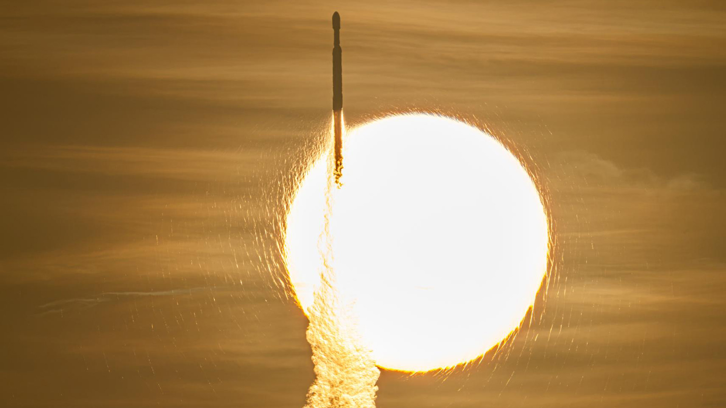
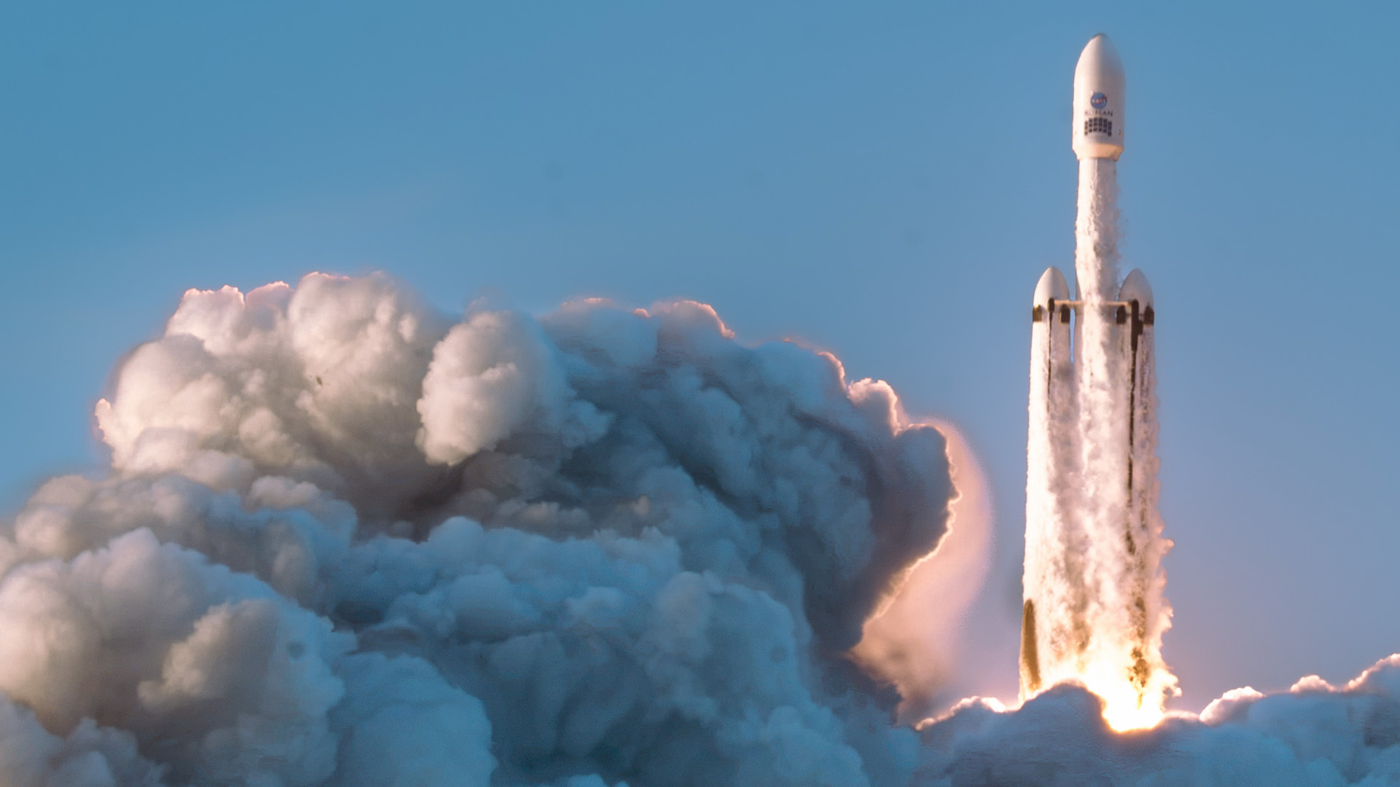
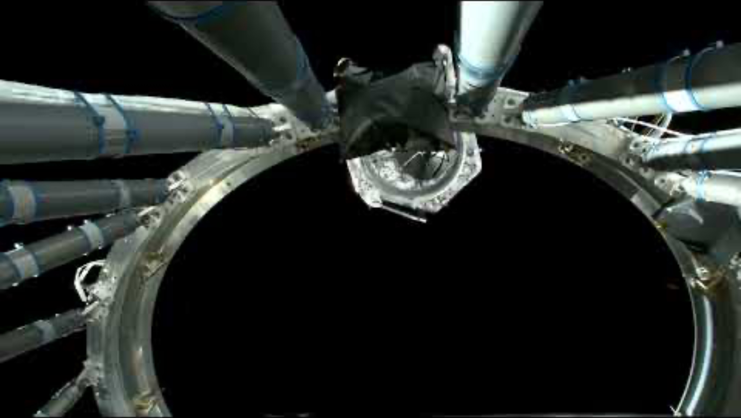
Roman On Its Way
Launch from Kennedy Space Center on August 30, 2026
Notes:
Roman On Its Way
Key Points:
NASA’s Nancy Grace Roman Space Telescope successfully launched from Kennedy Space Center in Florida on August 30, 2026 at 7:26 a.m. EDT on a SpaceX Falcon Heavy rocket.
Roman separated from the SpaceX Falcon Heavy’s second stage about 20 minutes later, at 7:57 a.m. Since then, the telescope has been flying on its own.
Mission controllers are monitoring the observatory as it travels toward its final observation post: orbiting the second Sun-Earth Lagrange point, or L2, about 1 million miles (150 million kilometers) from Earth.
Roman’s two instruments, the Wide Field Instrument (WFI) and coronagraph, have been successfully activated and are going through calibration and testing over the course of three months during Roman’s commissioning period.
NASA estimates that Roman has enough fuel to operate for 22 years, more than twice as long as originally projected. This is possible in part because of the precision and efficiency of its launch and initial course corrections.
More Messaging (Optional):
Roman established communications with mission controllers through a NASA Tracking and Data Relay Satellite less than 10 minutes after launch, at 7:33 a.m.
An hour and 23 minutes after launch, Roman began to emerge from the tight configuration that allowed it to fit in the rocket fairing. The solar panels and sunshade deployed, shading the rest of the observatory and providing power to the systems.
Over the next couple of days, the antenna was engaged and the visor-like aperture cover moved into position to permanently reveal and shade the primary mirror.
As it makes its three-month journey from Earth to L2, Roman is undergoing a process called commissioning, where systems are turned on, adjusted, calibrated, and prepared for science operations.
Image Credit: NASA/Sydney Rohde (Rocz)
Video Credit: NASA’s Kennedy Space Center
About the Image:
The video on the left shows NASA's Nancy Grace Roman Space Telescope as it separates from the second stage of the SpaceX Falcon Heavy rocket.
The image on the right shows the Nancy Grace Roman Space Telescope, aboard a SpaceX Falcon Heavy rocket, launched from Launch Complex 39A at the Kennedy Space Center in Florida on August 30, 2026 at 7:26 a.m. EDT.
Supportive Resources:
[Webpage] https://science.nasa.gov/mission/roman-space-telescope/roman-launch
[Blog] https://science.nasa.gov/blogs/roman
[Blog] NASA’s Roman Space Telescope Flying on Its Own: https://science.nasa.gov/blogs/roman/2026/08/30/nasas-roman-space-telescope-flying-on-its-own
[Blog] Fuel Savings Double Potential Lifetime for NASA’s Roman Mission: https://science.nasa.gov/blogs/roman/2026/09/14/fuel-savings-double-potential-lifetime-for-nasas-roman-mission
[Interactive] Eyes on the Solar System – Roman Space Telescope: https://solarsystem.nasa.gov/faq/88/what-are-lagrange-points
[Webpage] What are Lagrange Points: https://solarsystem.nasa.gov/faq/88/what-are-lagrange-points
[Webpage] Roman Commissioning: https://science.nasa.gov/missions/roman-space-telescope/roman-commissioning

Slide 4
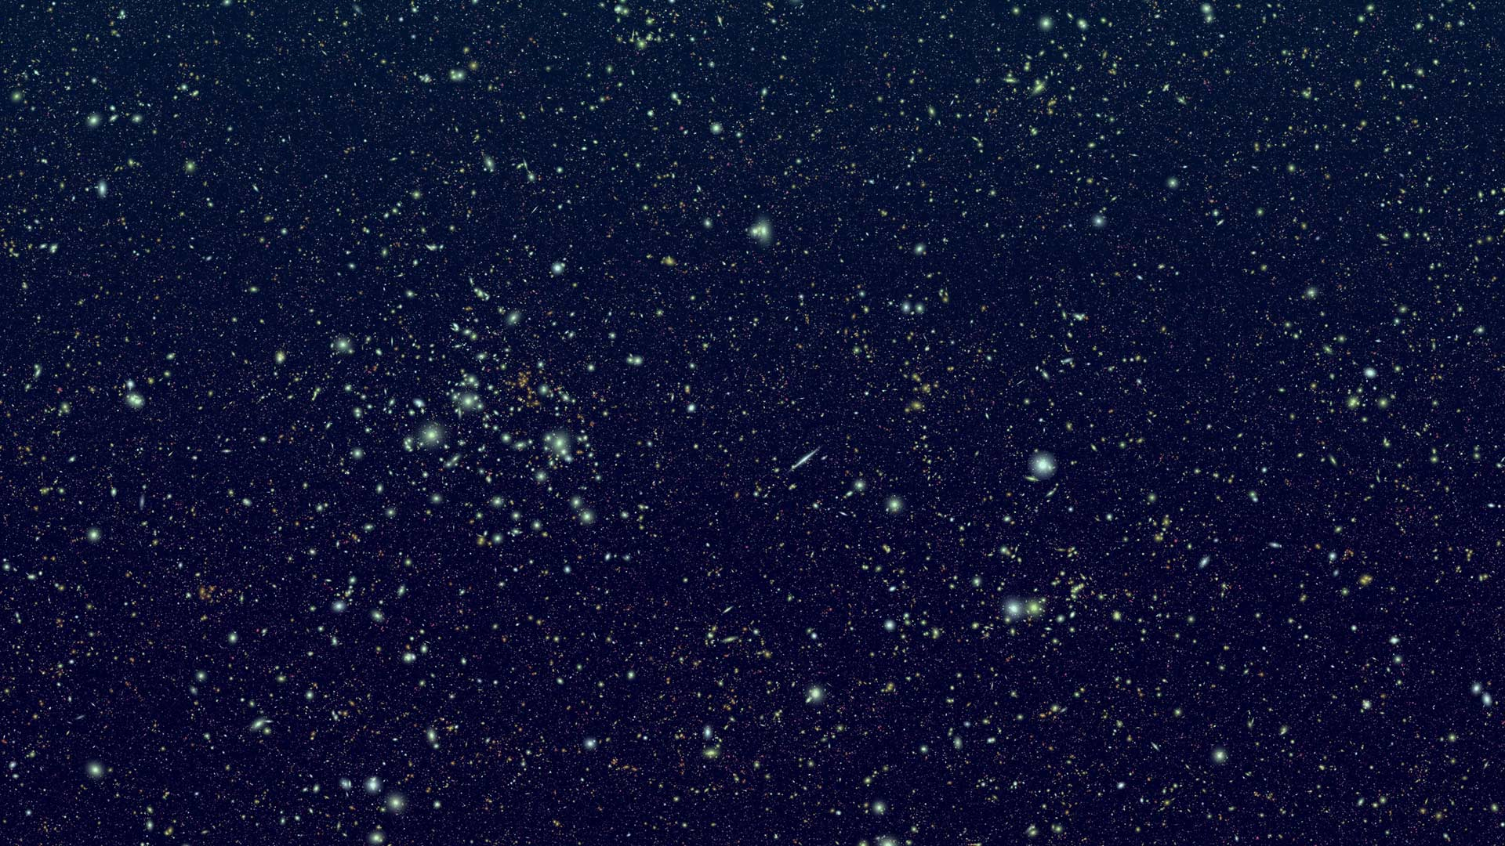



Roman’s Scientific Scope
The questions driving Roman
How did the universe form into what we see today?
What are dark energy and dark matter?
How do they influence the universe’s evolution?
What are planets beyond
our solar system like?
Are we alone?
Notes:
Roman’s Scientific Scope
Key Points:
Roman is a survey telescope. This means it will observe large patches of the sky at a time.
Because Roman looks broadly, it can help scientists study patterns across huge numbers of galaxies, stars, and planets.
Through its surveys, Roman will help us answer some of the most compelling questions in astronomy such as:
How did the universe form into what we see today?
What are dark matter and dark energy?
How do they influence the universe’s evolution?
What are planets beyond our solar system like?
Are we alone?
And perhaps one of the most exciting things as we look even further ahead is that Roman science won’t just stop once we explore these questions. Roman’s observations will pave the way for even more questions and science curiosities!
More Messaging (Optional):
Roman is not just collecting more pictures of space. With its survey science approach, it is designed to help us answer some of astronomy’s biggest unresolved questions.
Dark matter: Approximately 27% of the universe is made up of dark matter, but not much is known about this invisible glue that holds the universe together.
Dark energy: Approximately 68% of the universe is made up of dark energy, but astronomers don’t know much about the nature of this mysterious force that is accelerating the universe’s expansion.
Exoplanets: So far, more than 6,000 planets beyond our solar system have been confirmed, but that’s only the tip of the exoplanet iceberg.
These questions have been formed and shaped by ground- and space-based observatories across various wavelengths of light, including some of NASA’s space telescope missions. For example:
The Hubble Space Telescope enabled astronomers to make the key observations that led to the discovery of dark energy.
Hubble and the now-retired Spitzer Space Telescope’s infrared capabilities showed us the scientific value and beauty of our infrared universe. Their observations shaped our desire to see the universe in infrared light at a high-quality level, which we now can with the James Webb Space Telescope.
The Transiting Exoplanet Survey Satellite (TESS) and now-retired Kepler Space Telescope have revealed to us many distant worlds outside our solar system, shaping the field of exoplanet science.
Image Credit: STScI
Supportive Resources:
[Webpage] Roman’s Science Themes: https://science.nasa.gov/mission/roman-space-telescope/
[Webpage] Roman’s Science Themes: https://www.stsci.edu/roman/about/science-themes
[Webpage] Dark Energy with Roman: https://science.nasa.gov/mission/roman-space-telescope/dark-energy
[Webpage] Dark Matter with Roman: https://science.nasa.gov/mission/roman-space-telescope/dark-matter
[Webpage] Exoplanets with Roman: https://science.nasa.gov/mission/roman-space-telescope/exoplanets
Referenced Mission Websites:
Hubble Space Telescope: https://science.nasa.gov/mission/hubble
Spitzer Space Telescope: https://science.nasa.gov/mission/spitzer
Transiting Exoplanet Survey Satellite: https://science.nasa.gov/mission/tess
Kepler Space Telescope: https://science.nasa.gov/mission/kepler

Slide 5
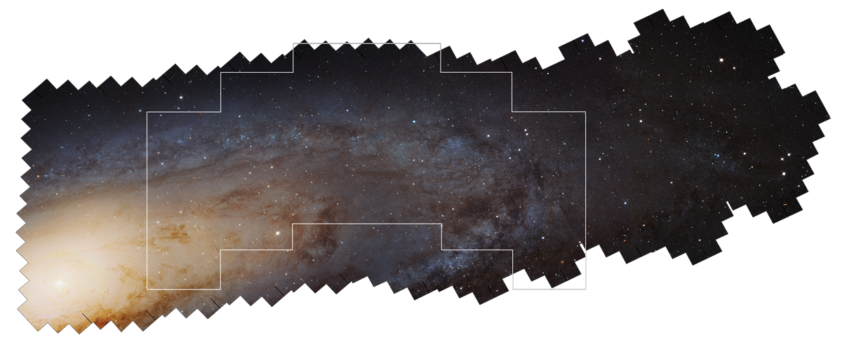
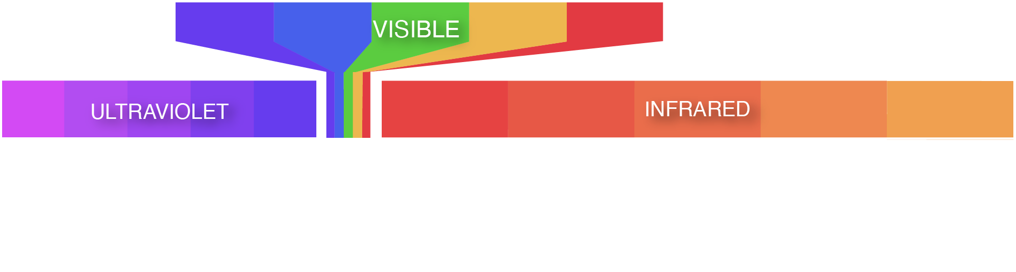
Understanding
the Big, Detailed
Picture
Field of View
Roman
Survey Observations
Scanning more of the sky faster
at high resolution
Webb
Hubble
Targeted Observations
Notes:
Understanding the Big, Detailed Picture
Key Points:
Roman is designed to collect a large quantity of very detailed data in near-infrared light, a combination that makes this telescope truly unique and will help researchers detect patterns across the universe — not just study individual objects.
Near-infrared light, a type of light our eyes cannot see, will allow us to peer far across the cosmos and deep into dusty regions of space.
The telescope’s large field of view enables it to survey the sky quickly, meaning it can observe more of the cosmos faster while maintaining scientific quality.
The on-screen graphic compares Roman’s field of view to those of Hubble and Webb:
Defining Large-Scale Views: Roman’s field of view is at least 100 times greater than Hubble’s.
Defining Speed: Roman will survey the sky 1,000 times faster than Hubble can while maintaining similar sensitivity and infrared resolution.
More high-quality data in less time is a win for astronomy.
More Messaging (Optional):
How does Roman compare to other space telescopes, like Hubble and Webb? Roman’s wide field of view and fast survey speeds will allow it to explore broad areas of sky, which will lead to the identification of key galaxies, supernovae, exoplanets, and more. Telescopes like Hubble and Webb can then observe these cosmic objects and events in greater detail.
Roman’s ability to provide large quantities of high-quality data could be what astronomers need to finally make progress on some cosmic mysteries that have been difficult to solve, including dark energy, dark matter, and the history and evolution of the universe.
About the Image:
This panoramic image shows approximately one-third of the Andromeda Galaxy and was taken as part of Hubble’s Panchromatic Hubble Andromeda Treasury (PHAT) survey program. To understand the vastness of Roman’s views, this graphic shows the Hubble and Webb space telescopes’ fields of view in comparison to what the Nancy Grace Roman Space Telescope will be able to observe at Hubble-like resolution. Each outlined area shows what each telescope would capture in a single pointing/shot.
At the bottom is an infographic that illustrates a portion of the electromagnetic spectrum. Visible light, the type of light that our eyes can see, makes up only a small portion of the entire electromagnetic spectrum. Hubble sees ultraviolet, visible, and near-infrared light. Webb observes the universe in near- and mid-infrared light. And Roman will be able to survey large portions of the cosmos with Hubble-like infrared resolution.
Image Credit: STScI
Supportive Resources:
[Video] Nancy Grace Roman Space Telescope Field-of-View Zooms: https://svs.gsfc.nasa.gov/13672
[Activity Guide] Fields of View: Tube “Telescopes”: https://universe-of-learning.org/files/live/sites/uol/files/home/informal-educators/roman-launch-resources/_documents/roman-FOV-tube-telescopes-activity-guide.pdf
[Activity Guide] Fields of View: Flip and Stamping: https://universe-of-learning.org/files/live/sites/uol/files/home/informal-educators/roman-launch-resources/_documents/roman-FOV-stamping-activity-guide.pdf
[Interactive] WorldWide Telescope Roman View Finder: https://projects.cosmicds.cfa.harvard.edu/roman-view-finder
[Video] Imagining a Roman Space Telescope Ultra Deep Field Image: https://svs.gsfc.nasa.gov/13793
[PDF] Nancy Grace Roman Space Telescope: https://www.stsci.edu/files/live/sites/www/files/home/roman/_documents/roman-expanding-our-view.pdf
[News Release] A Tale of Two Telescopes: WFIRST and Hubble: https://www.nasa.gov/missions/roman-space-telescope/a-tale-of-two-telescopes-wfirst-and-hubble
[Webpage] Infrared Waves: https://science.nasa.gov/ems/07_infraredwaves
[Interactive] Forms of Light: Seeing Through Smoke: https://viewspace.org/interactives/unveiling_invisible_universe/forms_of_light/seeing_through_smoke
[Interactive] Forms of Light: Infrared Animals: https://viewspace.org/interactives/unveiling_invisible_universe/forms_of_light/infrared_animals
[Video] Insight Into: Electromagnetic Spectrum: https://viewspace.org/video_library/videos/236-322871998?page=3&tags=111#step-light-and-distance-video-segments
[Science Briefing]: Exploring the Infrared Universe: https://universe-of-learning.org/contents/events/science-briefings/science-briefing-exploring-the-infrared-universe
[Interactive] Why Roman? https://projects.cosmicds.cfa.harvard.edu/why-roman

Slide 6
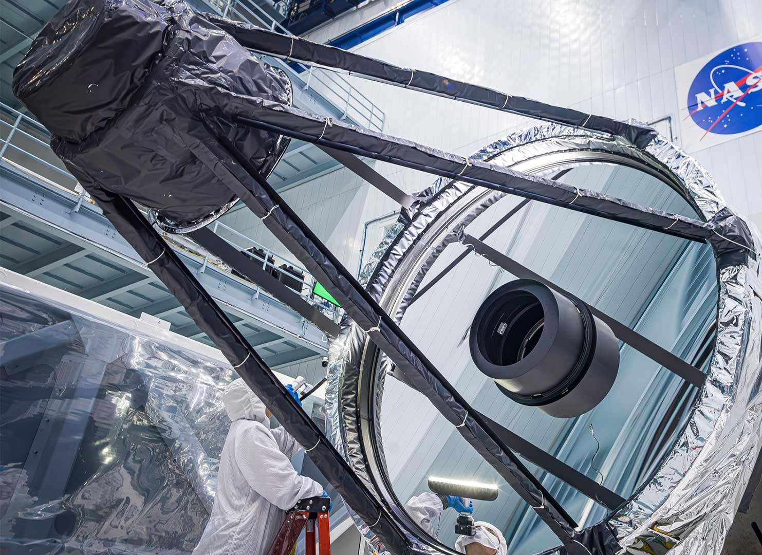
The Roman
Spacecraft
Innovative tools for success
Notes:
The Roman Spacecraft
Key Points:
Many pieces come together to compose a telescope like Roman and enable its science capabilities, including its:
Mirror, which gathers the near-infrared light. It’s the same size as Hubble’s primary mirror, 7.9 feet (2.4 meters) in diameter.
Science instrument, the Wide Field Instrument (WFI), which captures wide and deep views of our universe. The WFI is a near-infrared camera.
Technology demonstration, a coronagraph that will block out the bright light of stars to reveal exoplanets.
High-gain antenna, which is the communication link between the telescope and the ground.
And its observatory support systems, which you can consider to be the “vessel” that houses all of these components.
More Messaging (Optional):
Roman’s cutting-edge and innovative technologies will map more of the universe than ever before, and will also demonstrate new capabilities. These technologies, and the spinoffs they inspire, have broad benefits to government, industry, and society.
There’s a difference between a science instrument and technology demonstration instrument:
Roman has one science instrument, the Wide Field Instrument, which is the near-infrared light camera that will help us see far across space and into dusty regions.
The coronagraph will test hardware that can block out distant stars’ bright light to reveal faint exoplanets — 100 million times fainter — orbiting them, and that has never before flown in space. It is intended to inform future missions like the Habitable Worlds Observatory, which will be specifically designed to search for signs of life on exoplanets.
About the Image:
This image of Roman’s primary mirror, which is being inspected, and some of the observatory’s supporting structures.
Image Credit: NASA/Chris Gunn
Supportive Resources:
[Webpage] The Roman Observatory: https://roman.gsfc.nasa.gov/observatory.html
[Webpage] Roman Observatory: https://www.stsci.edu/roman/observatory
[Video] Take a Spin With NASA's Nancy Grace Roman Space Telescope: https://svs.gsfc.nasa.gov/13295
[Interactive] Roman: https://roman.gsfc.nasa.gov/interactive
[Webpage] The Roman Coronagraph Instrument: https://www.jpl.nasa.gov/missions/the-nancy-grace-roman-space-telescope

Slide 7
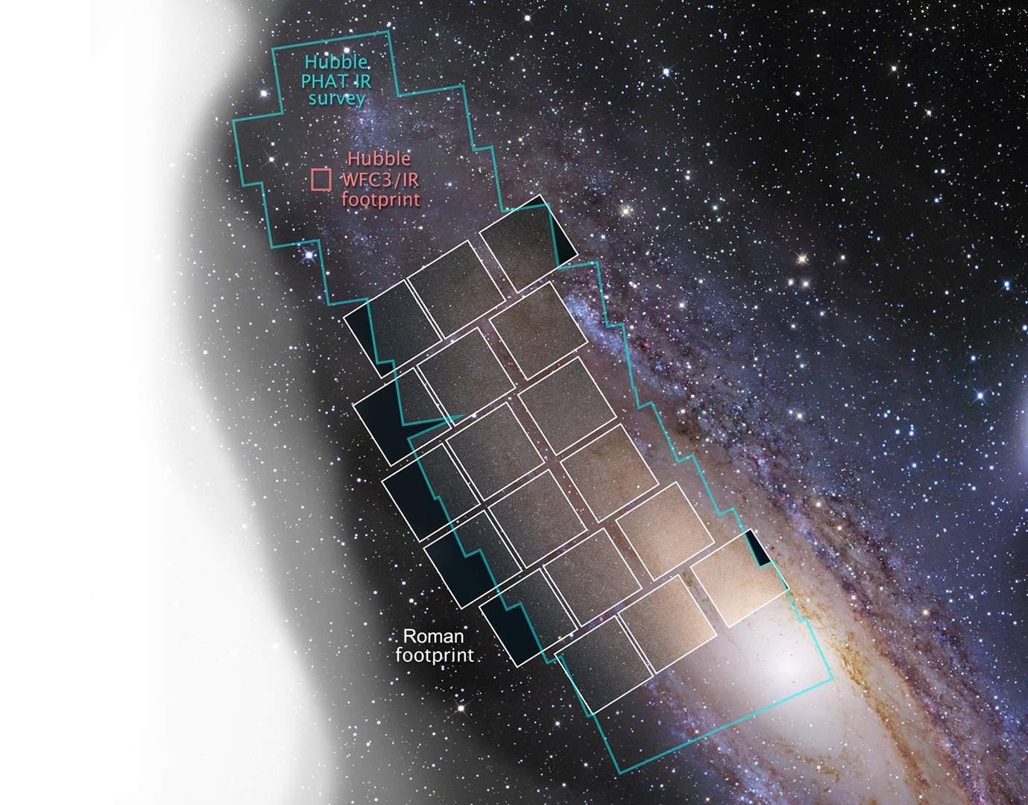
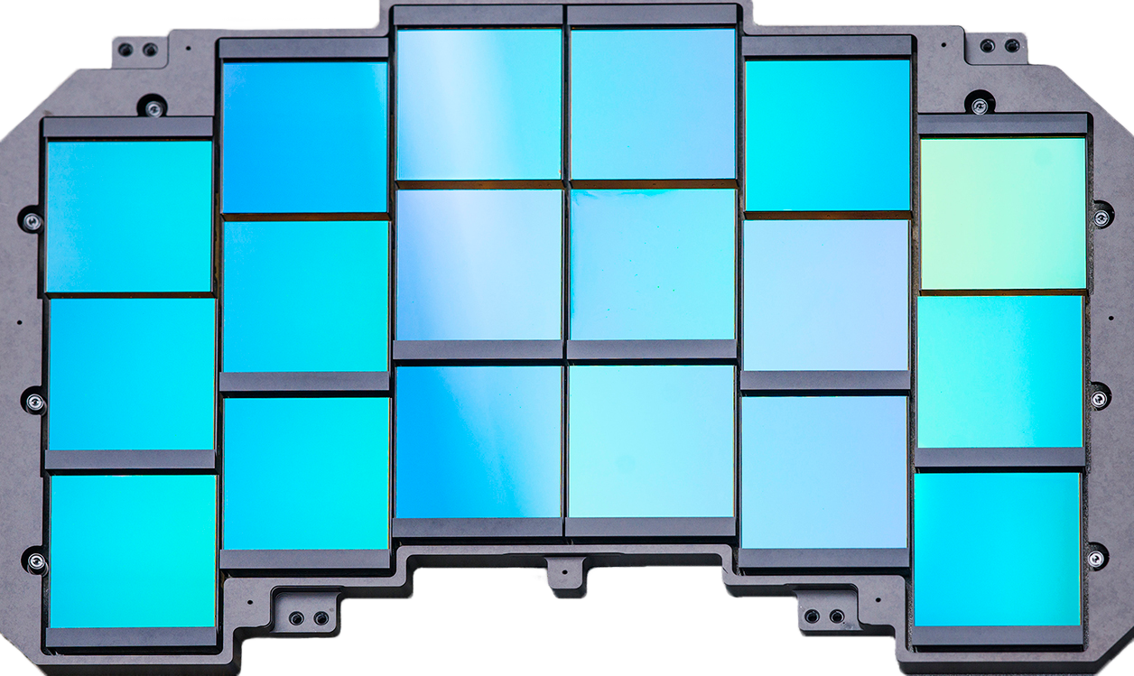
INNOVATIVE TOOLS FOR SUCCESS
The Wide Field Instrument (WFI)
Roman’s eyes to the near-infrared universe
Notes:
The Wide Field Instrument (WFI)
Key Points:
The Wide Field Instrument is Roman’s science instrument. Composed of 18 detectors, the WFI can do two important things:
Take images. The 300-megapixel camera is like Roman’s “eyes.” The WFI will help capture the scientific wonders of our universe by taking very detailed near-infrared light images.
Analyze the light the telescope gathers. This type of data collection method, also known as spectroscopy, can provide important details about cosmic objects, like their distances. (Think: information you can’t glean from an image alone!)
More Messaging (Optional):
Its eight imaging filters will let specific bands of near-infrared light pass through to the detectors, which will allow astronomers to study specific features of a given region.
Roman’s detectors are arranged in an arch-shaped mosaic to match the telescope’s curved focal plane, helping keep the entire field of view sharp.
Roman is designed as a survey telescope, so observations are normally taken with dithers—small shifts of the telescope between exposures. These will fill in the gaps between detectors.
Technical Information (Optional):
Eight imaging filters spanning 0.48–2.3 microns
Two slitless spectroscopic modes spanning 0.75–1.93 microns
18 near-IR detectors, each with 4,096×4,096 pixels
~100 times the field of view of Hubble’s Advanced Camera for Surveys (ACS) instrument, and ~200 times the field of view of Hubble’s Wide Field Camera 3/Infrared (WFC3/IR) instrument
About the Image:
This is a simulated image showing a portion of the Andromeda Galaxy. The red square represents the field of view of Hubble’s Wide Field Camera 3/Infrared (WFC3/IR) instrument. It took Hubble more than 650 hours between 2010 and 2013 to observe the portion of the image outlined in blue-green, which was done as part of Hubble’s Panchromatic Hubble Andromeda Treasury (PHAT) survey program. Roman’s field of view during a single pointing/shot is represented by the collection of white squares. Calculations suggest Roman could observe the same area as the PHAT survey in three hours or less.
Image Credit: Background: Digitized Sky Survey and R. Gendler; Roman Simulation: NASA, STScI, B. F. Williams (University of Washington)
Supportive Resources:
[Video] NASA's Nancy Grace Roman Space Telescope's Wide Field Instrument: https://svs.gsfc.nasa.gov/13235
[Webpage] Wide Field Instrument: https://science.nasa.gov/mission/roman-space-telescope/wide-field-instrument
[Visual] Roman’s Wide Field Instrument Poster: https://science.nasa.gov/image-article/wide-field-instrument-poster
[Interactive] Wide Field Instrument: https://roman.gsfc.nasa.gov/interactive/parts/wfi
[Webpage] WFI Reference Information: https://science.nasa.gov/mission/roman-space-telescope/wfi-technical
[Video] Spectroscopy, Explained: https://svs.gsfc.nasa.gov/12956
[Science Explainer] Spectroscopy 101: https://science.nasa.gov/mission/webb/science-overview/science-explainers/spectroscopy-101-introduction
[Interactive] Roman View Finder: https://projects.cosmicds.cfa.harvard.edu/roman-view-finder
[Campaign] Adopt a Pixel: https://science.nasa.gov/mission/roman-space-telescope/adopt-a-pixel

Slide 8
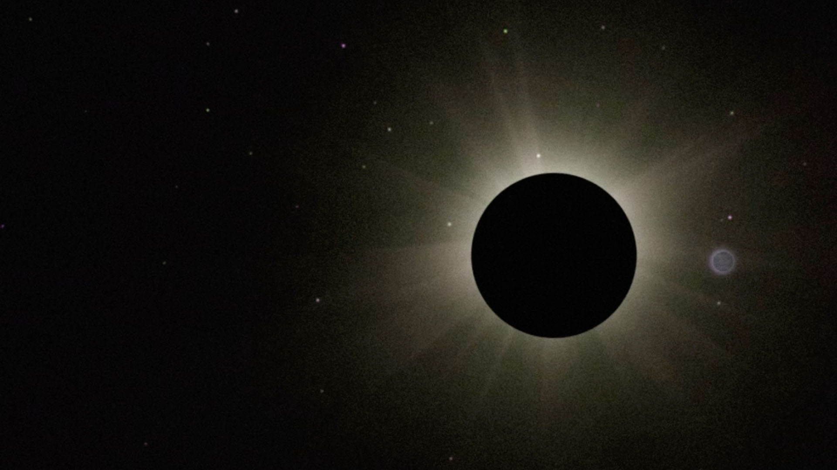
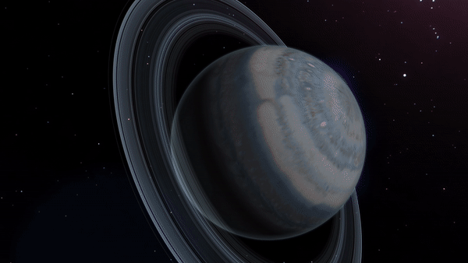
INNOVATIVE TOOLS FOR SUCCESS
The Coronagraph
A planet-imaging tool that will help shape
future space-based technology
Notes:
The Coronagraph
Key Points:
Although the main science goals and overall mission will be enabled by the Wide Field Instrument, Roman also carries a technology demonstration: an advanced coronagraph. This tool will test hardware that can block out distant stars’ bright light to reveal faint exoplanets — 100 million times fainter — orbiting them, and that has never before flown in space.
The technology being tested by the Roman Coronagraph has the potential to reveal smaller, older, and colder worlds around nearby stars than any previous direct imaging efforts.
More Messaging (Optional):
While this is a technology demonstration, not a science instrument, a coronagraph could play a key role in future missions that will search for and image Earth-like planets at Earth-Sun distances from their parent stars.
The coronagraph will demonstrate key capabilities necessary for NASA to take the next step in advancing revolutionary astrophysics and the search for life with future missions like the Habitable Worlds Observatory.
Following the completion of the technology demonstration’s primary objectives, Roman leadership may consider proposals from the science community for additional studies using the coronagraph.
Although this is not the first coronagraph in space, it is the highest-performing coronagraph ever onboard a space-based telescope.
Roman’s coronagraph is designed to detect planets 100 million times fainter than their stars. This level of sensitivity is 100 to 1,000 times better than the sensitivity of existing space-based coronagraphs.
About the Image:
Left: The animation shows how a planet can “disappear” due to its host star’s bright light, and how a coronagraph can block out the starlight to reveal if there are exoplanets.
Right: The image shows how a coronagraph blocks starlight to reveal if the star has exoplanets.
Image Credit: NASA
Supportive Resources:
[Video] The Roman Space Telescope's Coronagraph Instrument: https://www.youtube.com/watch?v=_1zfz-OEKH8
[Webpage] Direct Imaging: https://science.nasa.gov/mission/roman-space-telescope/direct-imaging
[Webpage] Coronagraph: https://science.nasa.gov/mission/roman-space-telescope/coronagraph
[Webpage] The Roman Coronagraph Instrument: https://www.jpl.nasa.gov/missions/the-roman-coronagraph-instrument
[Video] Seeing Exoplanets Like Never Before With the Roman Coronagraph (Instrument Overview): https://www.jpl.nasa.gov/videos/seeing-exoplanets-like-never-before-with-the-roman-coronagraph-instrument-overview
[Activity Guide] Lights, Coronagraph, Action! An Exoplanet Direct Imaging Demo: https://universe-of-learning.org/contents/products/lights-coronagraph-action

Slide 9

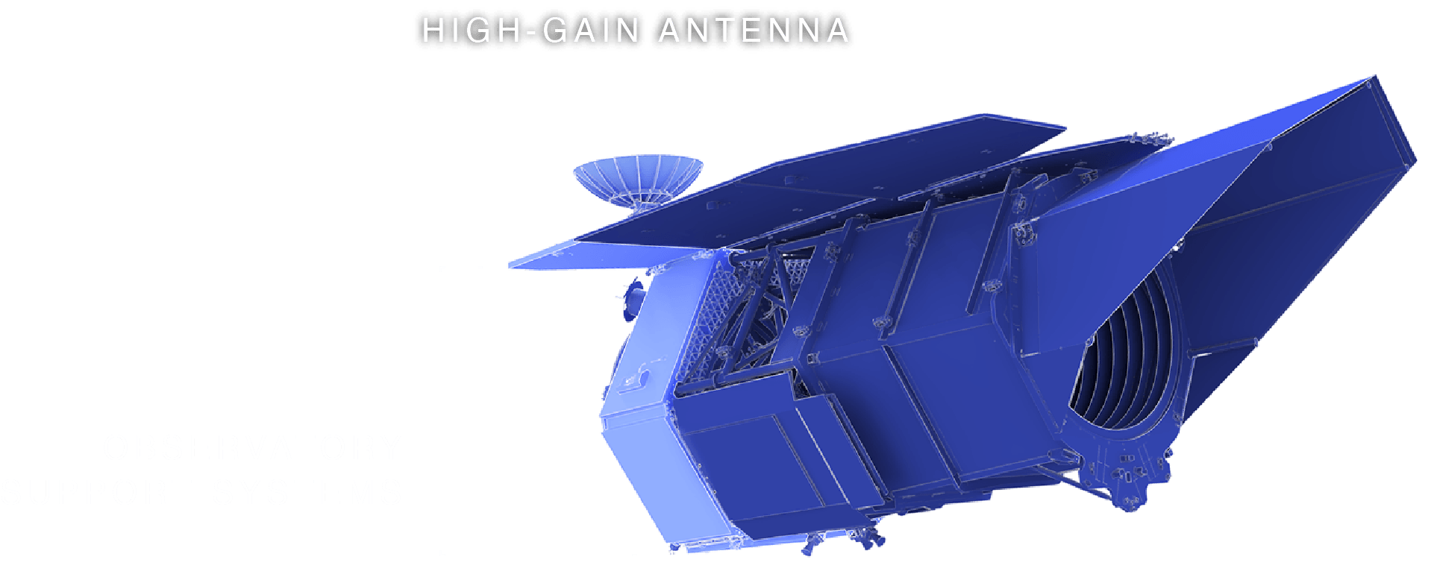
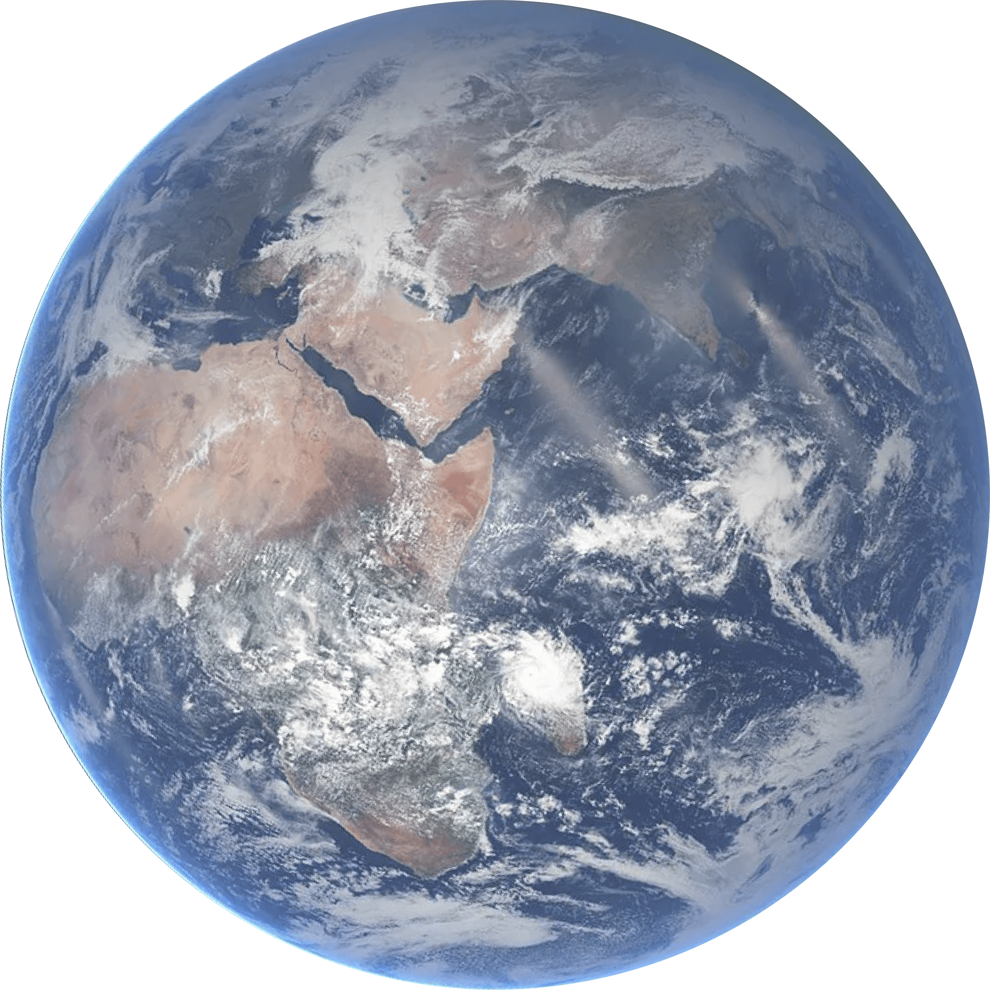
INNOVATIVE TOOLS FOR SUCCESS
High-Gain Antenna & Observatory
Support Systems
The foundation that allows Roman
to collect and send data to Earth
Notes:
High-Gain Antenna and Observatory Support Systems
Key Points:
Roman’s observatory support systems can be considered as the main body and overall structure. They house the electronics and equipment that enable Roman to do its science.
Its high-gain antenna forges the connection between the telescope and the ground systems, which is essential to receive Roman’s science data.
More Messaging (Optional):
Roman’s antenna dish spans 5.6 feet (1.7 meters) in diameter, about as tall as a refrigerator. With its antenna, Roman will send radio signals across a million miles of space to Earth.
At one frequency (2 gigahertz), the antenna will receive commands and send information about the telescope’s status. Data will be transmitted to ground stations in New Mexico, Australia, and Japan via a different frequency (26 gigahertz). These ground stations are strategically spread out around the world so that the Roman team will be able to consistently communicate with the spacecraft.
Image Credit: NASA
Supportive Resources:
[Webpage] Direct Imaging: https://science.nasa.gov/mission/roman-space-telescope/direct-imaging
[News Release] High-Gain Antenna for NASA’s Roman Mission Clears Environmental Tests: https://www.nasa.gov/image-article/high-gain-antenna-nasas-roman-mission-clears-environmental-tests
[Video] Roman High-Gain Antenna Dish Integration: https://svs.gsfc.nasa.gov/14409
[Interactive] High-Gain Antenna & Observatory Support System: https://science.nasa.gov/mission/roman-space-telescope/interactive

Slide 10
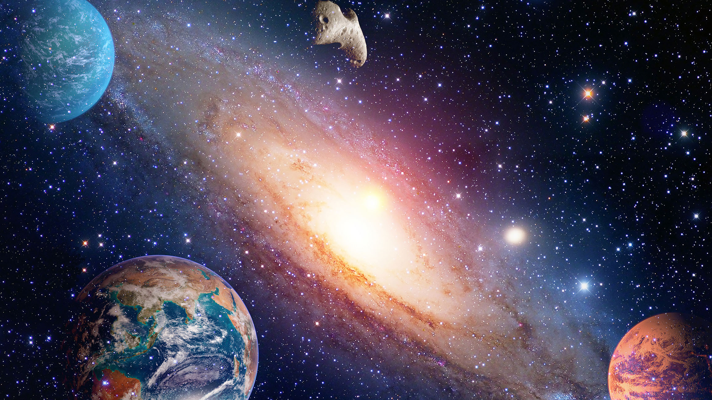

Broad
Scientific
Surveys
Planets by the thousands, stars by
the billions, galaxies by the millions
Notes:
Broad Scientific Surveys
Key Points:
Instead of homing in on one object at a time, Roman will scan large regions of the sky, enabling scientists to find patterns, populations, and rare events that would be hard to spot otherwise.
To address the Roman mission’s science goals, the telescope will observe the sky in different ways through three Core Community Surveys and selected General Astrophysics Surveys.
We’ll explore the three Core Community Surveys and the first-defined General Astrophysics Survey in more detail in the following slides.
More Messaging (Optional):
All the factors that make Roman the telescope we’ve come to know — its huge field of view, ability to survey the sky at a faster speed than other NASA Astrophysics missions, and the expected Hubble-like resolution of the infrared universe — are designed for making scientific breakthroughs and answering big scientific questions.
Some of these questions — like what are dark energy and dark matter? — arose after discoveries by other ground- and space-based missions, including some of NASA’s telescopes. Others are age-old questions: Are there other planets similar to our own? Does life exist elsewhere in the universe?
In addition to its main science goals, Roman can conduct extraordinary science that builds on our general astrophysics knowledge, including:
Deep surveys of star clusters and star formation regions.
Identifying new solar system objects that may be threats to Earth.
Conducting tandem observations with other observatories.
About the Surveys:
Core Community Surveys: These observing programs will explore the key science questions and themes of the Roman mission.
Think: the history of the universe, its structure, and exoplanet demographics.
Roman’s Core Community Surveys were shaped by the science community. The Roman mission solicited input from more than 1,000 scientists from over 350 institutions to help ensure the telescope’s survey designs are optimized for science.
General Astrophysics Surveys: These observing programs, which will also be proposed by the astronomical community over the course of Roman’s primary mission, will explore general astrophysics themes.
Think: star populations and formation, black holes, solar system objects, and neighboring galaxies.
The General Astrophysics Surveys, which Roman will dedicate a minimum of 25% of observing time to during its five-year primary mission, differ in design. These surveys will be primarily selected through calls for proposals.
Image Credit: STScI
Supportive Resources:
[Webpage] Roman’s Surveys and Programs: https://www.stsci.edu/roman/surveys-and-programs
[Webpage] Roman’s Science Themes: https://www.stsci.edu/roman/about/science-themes
[Webpage] Roman’s Core Community Surveys: https://science.nasa.gov/mission/roman-space-telescope/core-community-surveys
[Webpage] General Astrophysics Surveys: https://science.nasa.gov/mission/roman-space-telescope/general-astrophysics
[Webpage] Roman Community-defined Surveys: https://roman-docs.stsci.edu/roman-community-defined-surveys
[Newsletter Article] What Can Roman Do for You? Explore Its Four Fully Defined Surveys: https://www.stsci.edu/contents/newsletters/2025-volume-42-issue-02/what-can-roman-do-for-you-explore-its-four-fully-defined-surveys
[News Release] NASA’s Roman Mission Shares Detailed Plans to Scour Skies: https://www.nasa.gov/missions/roman-space-telescope/nasas-roman-mission-shares-detailed-plans-to-scour-skies
[Video Playlist] Roman Space Telescope – Observing Programs: https://www.youtube.com/playlist?list=PLm0MBdI3VlBV6atJO-wb04zG32hIosyTR

Slide 11
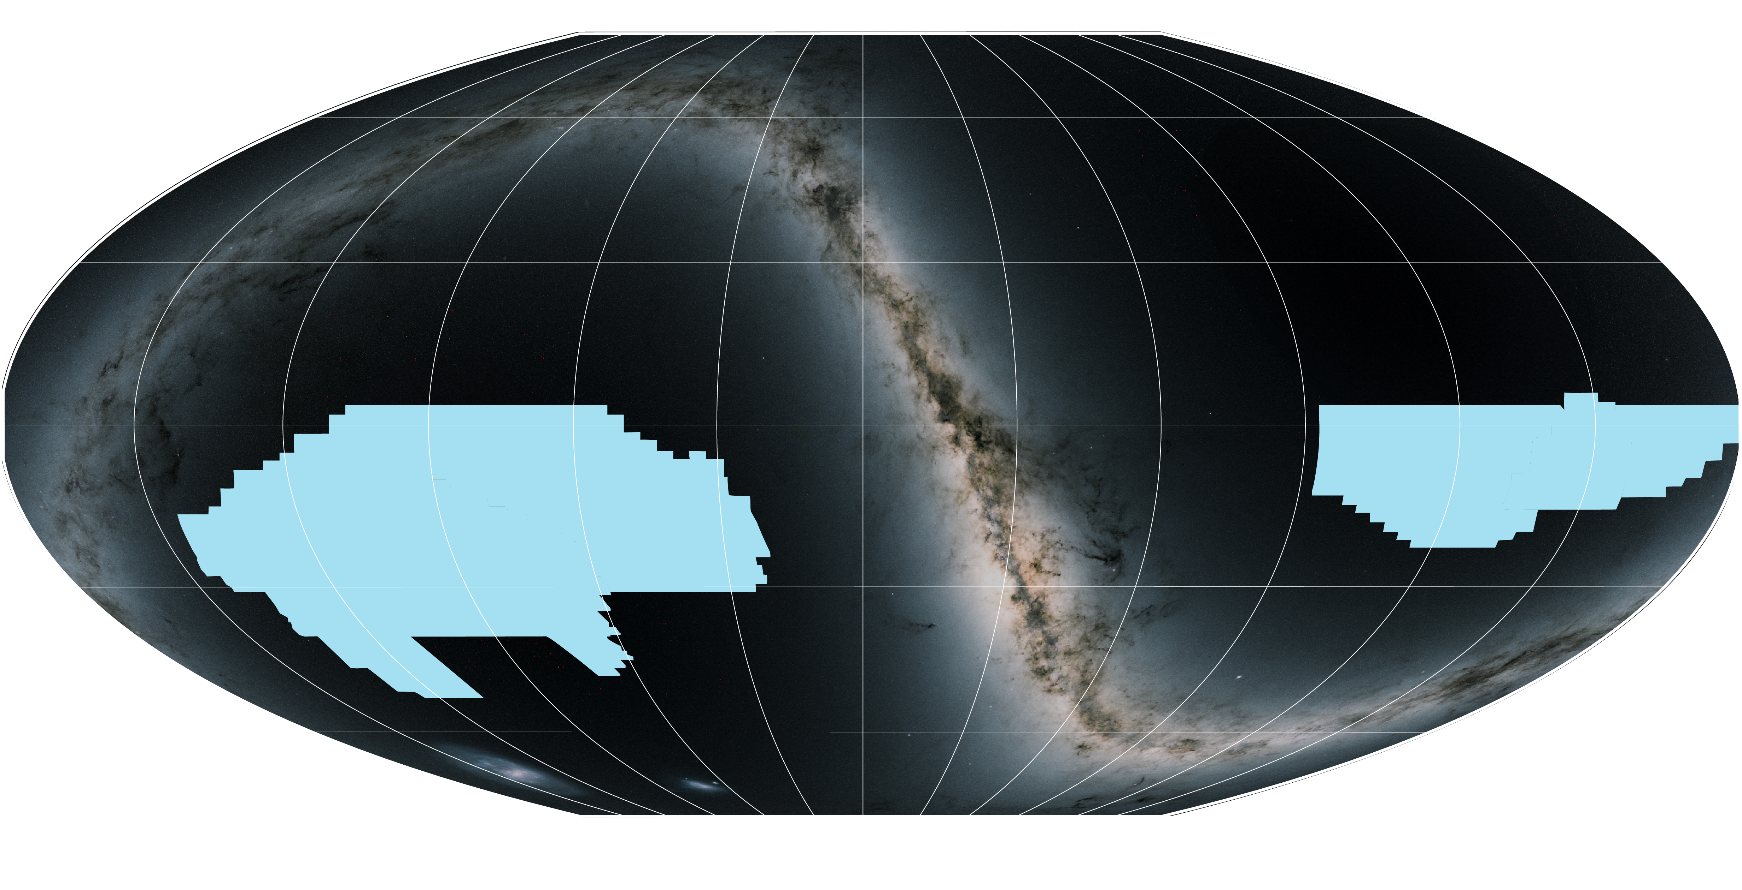
BROAD SCIENTIFIC SURVEYS / HIGH-LATITUDE WIDE-AREA SURVEY
High-Latitude Wide-Area Survey
Mapping the universe in 3D
Notes:
High-Latitude Wide-Area Survey
Key Points:
To understand the universe’s large, and mostly hidden, structure, astronomers need both depth and breadth.
These two elements are evident in Roman’s High-Latitude Wide-Area Survey, which will help us see the bigger, more intricate picture of the cosmos.
Breaking down the survey name:
High Latitude: Observing beyond — above and below — the plane of our own galaxy.
Wide Area: This survey will observe a large portion of the sky. (about 12% or the equivalent area of 25,000 full moons)
Through this survey, Roman will chart a detailed map of our universe with its high-resolution imaging and spectroscopy capabilities. The blue regions indicate the area of sky Roman will observe during this survey.
This will include uncovering hundreds of millions of galaxies, including some dating back to when the universe was just a few hundred million years old, which will help astronomers investigate the universe’s hidden structure and understand:
What is dark matter?
The effects of dark energy
Why the universe’s expansion is accelerating
More Messaging (Optional):
The universe is so large that if we ever want to get a glimpse of how the universe changes over time, we need to look far back into the past (which is looking at objects far away), and we need to capture a lot of the sky too. Past deep surveys have been pencil-beams in the sky compared to what Roman will capture.
Seeing this bigger picture of the universe with Roman will shed light on big mysteries in astrophysics, where currently it is “dark.” Roman’s detailed view of the universe will help astronomers uncover the underlying structure of the universe, including the contributions of dark energy, dark matter, and regular matter.
This survey’s scientific return goes even further than its defined core goals. Researchers will be able to learn all about galaxies (satellite, interacting, and distant), including the dense groupings of stars within them, which are known as globular clusters. Roman’s expected tally of hundreds of millions of galaxies will also improve our current understanding of galaxy evolution.
Definition:
Spectroscopy: A type of data collection method that splits the light into a rainbow, providing even more details about an object than an image can alone.
Technical Information (Optional):
Survey duration: 520 days altogether over Roman’s five-year primary mission
Coverage: 12% of the entire sky, or about 25,500 full moons
Exposure Time: Ranging from 11-150 minutes
About the Image:
This all-sky map shows the area covered by Roman’s High-Latitude Wide-Area Survey. The survey is represented in blue and takes up big chunks of the sky at left and right.
Image Credit: Background: M. Troxel and Caltech-IPAC/R. Hurt; Graphic: J. Olmsted (STScI)
Supportive Resources:
[Video] Nancy Grace Roman Space Telescope: Mapping the Universe: https://www.youtube.com/watch?v=PbY8JFpimIs&list=PLm0MBdI3VlBV6atJO-wb04zG32hIosyTR&index=1
[Webpage] High-Latitude Wide-Area Survey: https://science.nasa.gov/mission/roman-space-telescope/high-latitude-wide-area-survey
[Webpage] High-Latitude Wide-Area Survey Technical Information: https://roman-docs.stsci.edu/roman-community-defined-surveys/high-latitude-wide-area-survey
[Event] Training Webinars for Subject Matter Experts: Helping Audiences Learn About Dark Energy and Dark Matter: https://universe-of-learning.org/contents/events/training-webinars-for-subject-matter-experts-helping-audiences-learn-about-dark-energy-and-dark-matt
[Video] Spectroscopy, Explained: https://svs.gsfc.nasa.gov/12956
[Science Explainer] Spectroscopy 101: https://science.nasa.gov/mission/webb/science-overview/science-explainers/spectroscopy-101-introduction

Slide 12

BROAD SCIENTIFIC SURVEYS / HIGH-LATITUDE WIDE-AREA SURVEY
Understanding Dark Matter with Imaging
Revealing the hidden universe
Notes:
Understanding Dark Matter with Imaging
Key Points:
Dark matter cannot be directly observed by telescopes, but we know it exists because we can see its gravitational effects, including how galaxies move and how light from distant objects bends as massive objects warp spacetime — a phenomenon called gravitational lensing.
Because of its wide and high-resolution views, Roman will observe hundreds of millions of galaxies in detail. This large sample size is necessary to measure the very subtle distortions in galaxy shapes caused by the gravitational pull of matter, primarily dark matter, which cannot be identified visually.
This visually indiscernible influence of dark matter is known as weak lensing.
With this survey, astronomers will create a detailed map of how matter — seen and unseen — is distributed.
This will help them understand how the distribution of matter has changed over cosmic time.
More Messaging (Optional):
Dark matter’s mass warps space and acts as a gravitational lens, redirecting light that passes by it. Uncovering the mysteries about dark matter will require mapping out the curved paths of light and back-tracking to figure out the distribution of dark matter that causes gravitational lensing. Dark matter can also cause the shape of galaxies to be warped, which requires the high-precision imaging that only Roman can provide for a very large number of very distant galaxies.
About the Image:
This animation is a simulation that shows the type of science that astronomers will be able to do with future Roman deep field observations. The gravity of intervening galaxy clusters and dark matter can lens the light from farther objects, warping their appearance. By studying the distorted light, astronomers can study elusive dark matter, which can only be measured indirectly through its gravitational effects on visible matter. This lensing also makes it easier to see the most distant galaxies whose light they magnify.
Animation Credit: Caltech-IPAC/R. Hurt
Supportive Resources:
[Webpage] Dark Matter: https://science.nasa.gov/mission/roman-space-telescope/dark-matter
[News Release] NASA’s Roman to Search for Signs of Dark Matter Clumps: https://roman.ipac.caltech.edu/news/nasa-s-roman-to-search-for-signs-of-dark-matter-clumps
[News Release] Millions of Galaxies Emerge in New Simulated Images from NASA’s Roman: https://www.nasa.gov/missions/roman-space-telescope/millions-of-galaxies-emerge-in-new-simulated-images-from-nasas-roman
[Webpage] Weak Lensing: https://science.nasa.gov/mission/roman-space-telescope/weak-lensing
[Video] Warped Light and Dark Matter: https://viewspace.org/video_library/videos/1042-STScI-H-BeyondTheHeadlines_WarpedLightandDarkMatter-1280x720-459520367?tags=1639
[Webpage] Dark Matter: https://science.nasa.gov/dark-matter
[Interactive] Dark Matter: Supernova Refsdal: https://viewspace.org/interactives/unveiling_invisible_universe/dark_matter/supernova_refsdal
[Interactive] Dark Matter: Bullet Cluster: https://viewspace.org/interactives/unveiling_invisible_universe/dark_matter/bullet_cluster

Slide 13
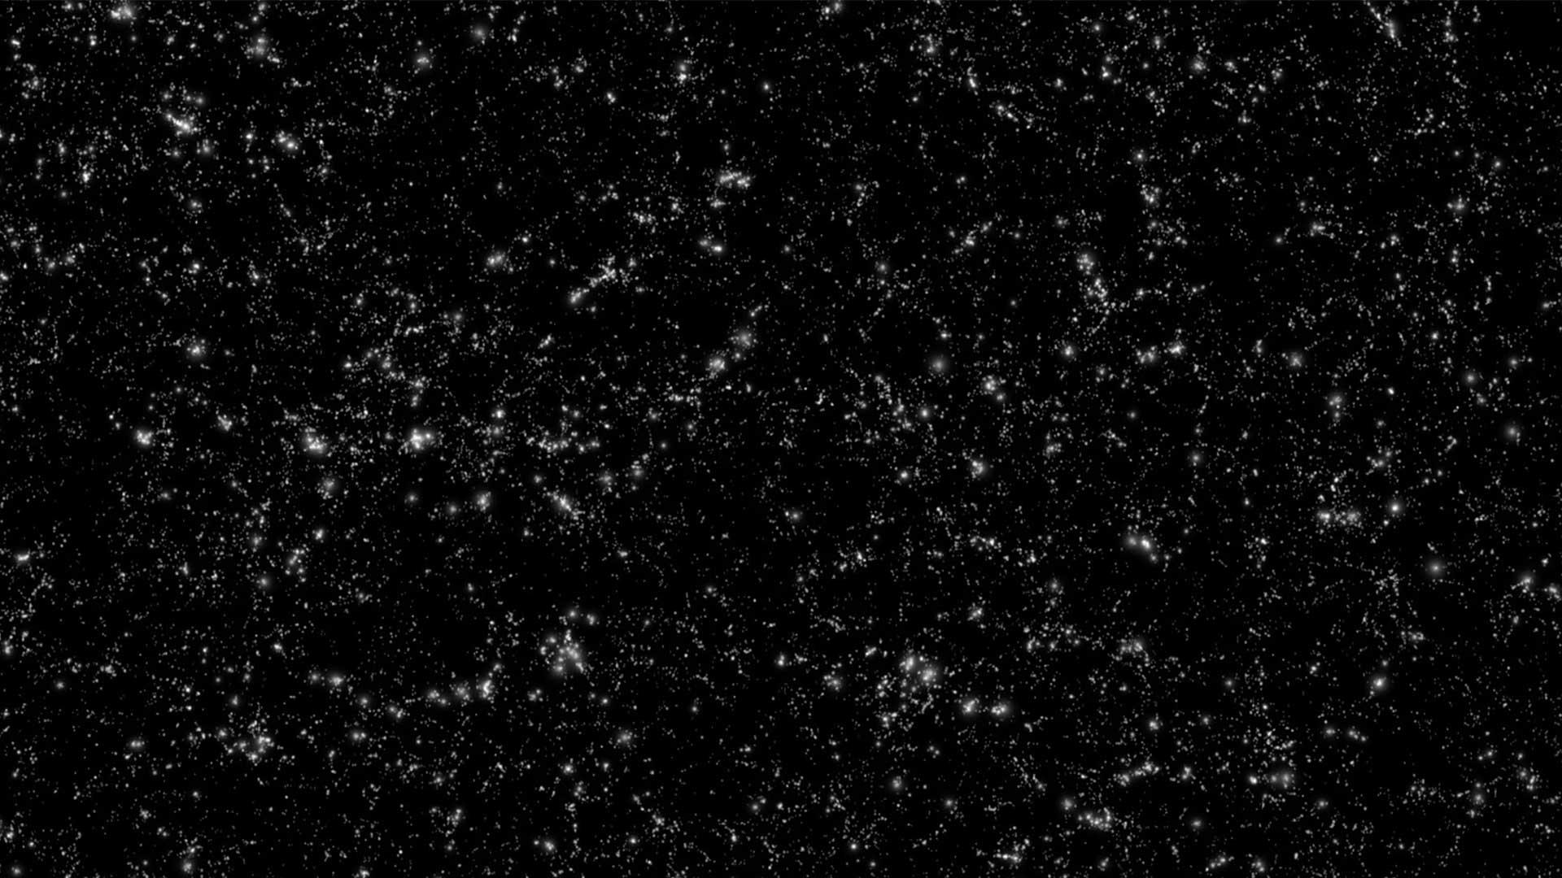
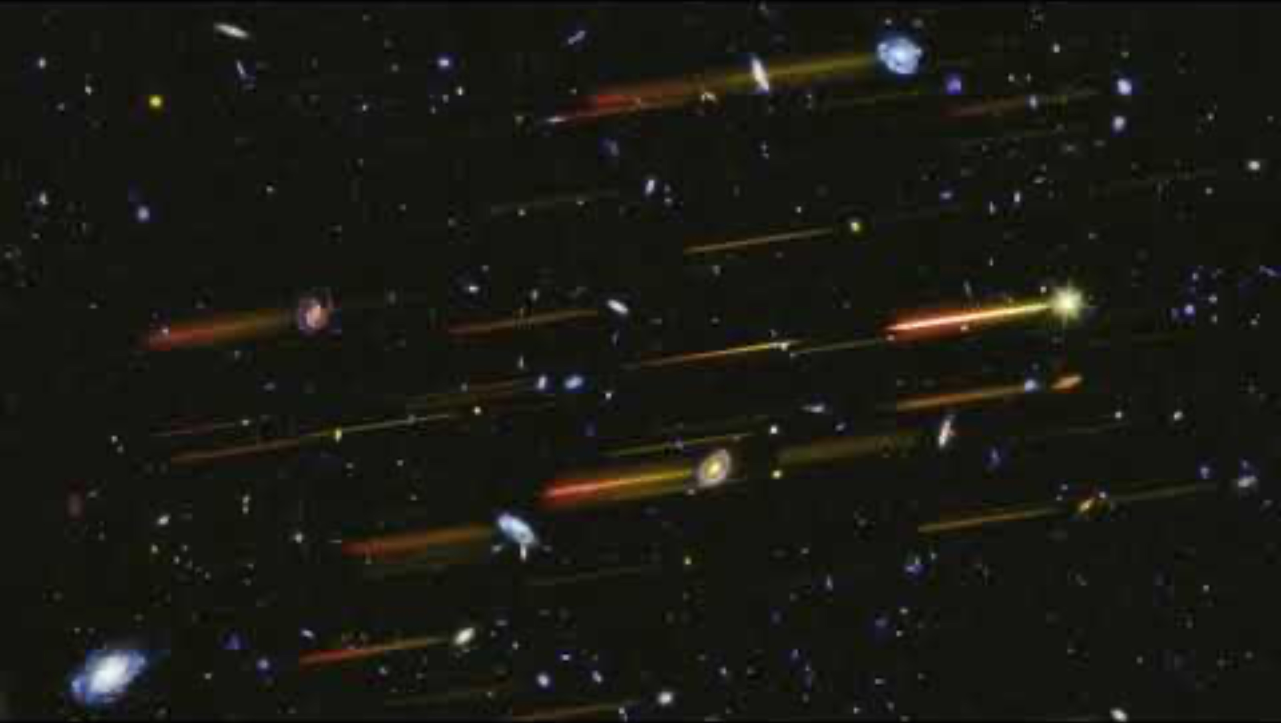
BROAD SCIENTIFIC SURVEYS / HIGH-LATITUDE WIDE-AREA SURVEY
Understanding
Dark Energy
with Imaging
and Spectroscopy
Accelerating our knowledge
of the universe’s expansion
Notes:
Understanding Dark Energy with Imaging and Spectroscopy
Key Points:
We don’t know what dark energy is, but we know it exists because this mysterious force is making the universe expand at increasing speed.
Because of its wide, infrared views and its spectroscopy capabilities, Roman will measure distances and distributions of millions of galaxies. The telescope’s observations will essentially produce a 3D map of all the galaxies to about 11.5 billion light-years away. (The universe is around 13.8 billion years old.)
These measurements will enable astronomers to trace how the expansion of the universe has changed over time, helping reveal the nature of dark energy.
More Messaging (Optional):
Roman will impact all areas of astronomy, but the investigation of dark energy has been a major mission goal from the very beginning of the Roman mission concept.
The changing rate of the universe’s expansion is a huge question astronomers are trying to answer. Detailed studies have led to different results that cannot both be true, which means that there is likely an important piece of the puzzle that is missing from our understanding of the laws of physics.
One method scientists can use to understand the dynamics of dark energy is by detecting sound wave relics known as Baryon Acoustic Oscillations (BAOs). These subtle fluctuations once rippled through the early universe, leaving their imprint on the 3D distributions of galaxies. Studying their changes will help astronomers trace the evolution of the universe.
Definition:
Spectroscopy: A type of data collection method that splits the light into a rainbow, providing even more details about an object than an image can alone.
About the Video:
The animation portrays the complementary nature of imaging and spectroscopy to understand galaxies. Rainbow-colored lines called spectra are added next to selected galaxies, but in reality, every star and galaxy has its light spread out. The underlying image later fades away to highlight the galaxies’ spectra, which contain a wealth of information including distances (redshifts). The image and spectra were obtained by Hubble and illustrate what will be done with Roman over a vastly larger number of galaxies.
Image Credit: Background: NASA; Graphic: NASA, ESA, Joseph DePasquale (STScI)
Supportive Resources:
[Video] Animation of Spectroscopy with Roman: https://www.stsci.edu/contents/media/videos/2021/048/01FF86JNN52KFZYQWPNNS9FQH7
[Webpage] Dark Energy: https://science.nasa.gov/mission/roman-space-telescope/dark-energy
[Webpage] Dark Energy and the Universe: https://roman.ipac.caltech.edu/page/darkenergy
[News Release] NASA’s Roman Space Telescope to Uncover Echoes of the Universe’s Creation: https://www.nasa.gov/feature/goddard/2020/nasa-s-roman-space-telescope-to-uncover-echoes-of-the-universe-s-creation
[Webpage] Baryon Acoustic Oscillations: https://science.nasa.gov/mission/roman-space-telescope/baryon-acoustic-oscillations
[Video] Spectroscopy, Explained: https://svs.gsfc.nasa.gov/12956
[Science Explainer] Spectroscopy 101: https://science.nasa.gov/mission/webb/science-overview/science-explainers/spectroscopy-101-introduction

Slide 14
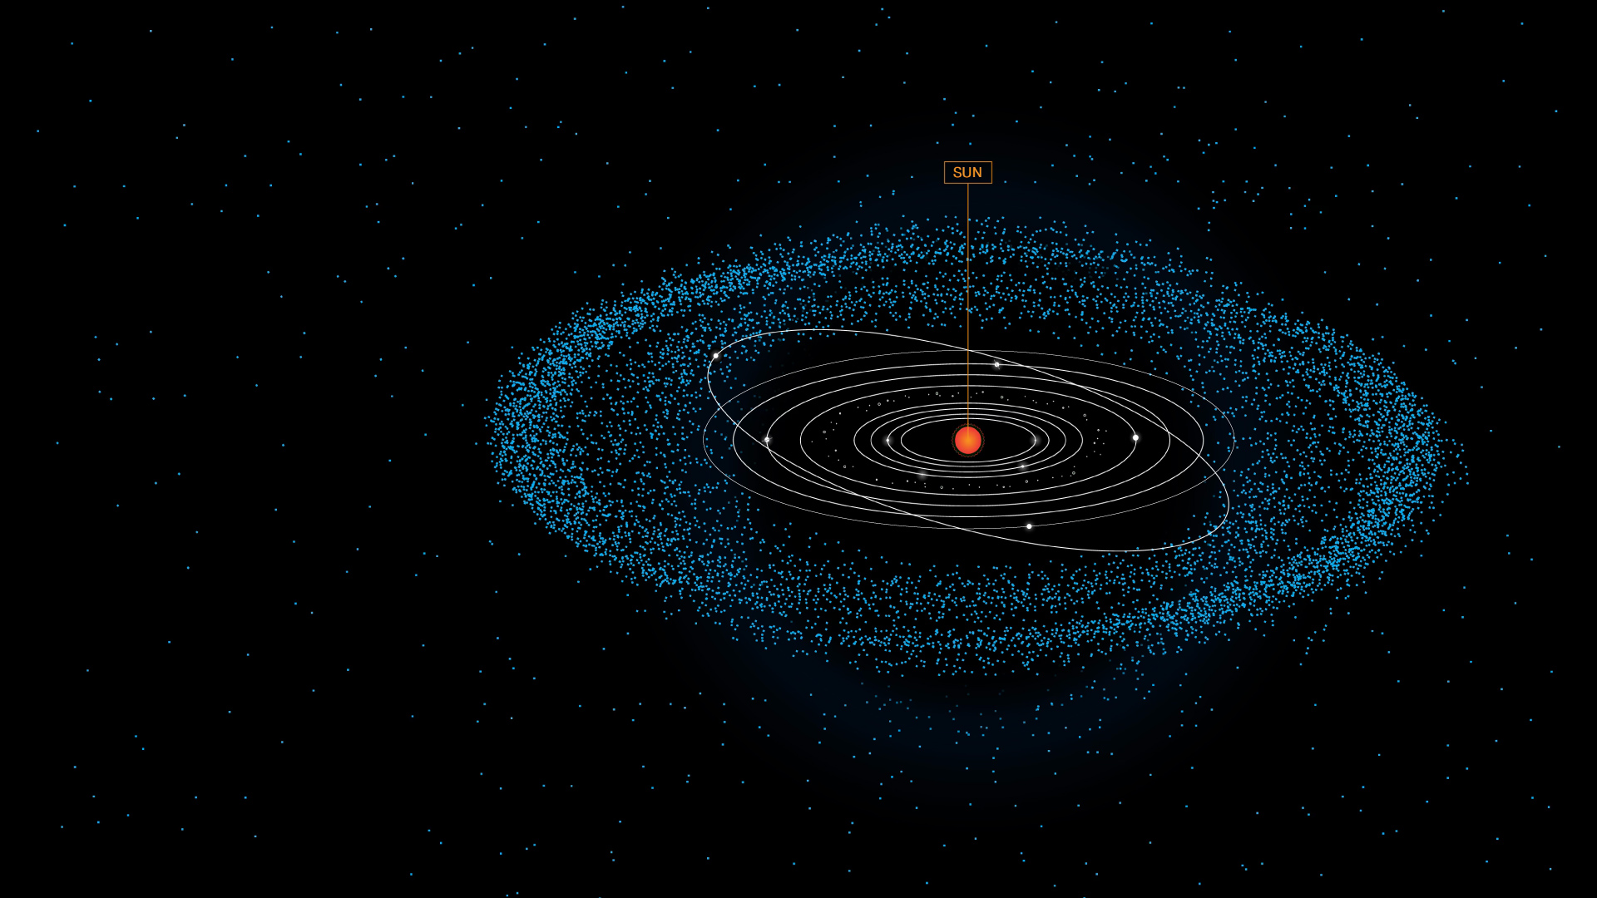
BROAD SCIENTIFIC SURVEYS / HIGH-LATITUDE WIDE-AREA SURVEY
Our Solar System
Conducting science while looking through our planetary system
Notes:
Our Solar System
Key Points:
To study the distant universe with its wide surveys, Roman must look through our own solar system. This means the telescope will be simultaneously capturing a lot of information about our planetary system.
Roman will provide a wealth of data on solar system objects, including dwarf planets, moons, asteroids, and potentially even the eight planets.
With its near-infrared sensitivity, Roman will be able to detect small, faint objects like trans-Neptunian objects.
Because their locations are farther than Neptune’s orbit, observing these objects is difficult because they tend to be more than 100 million times fainter than objects visible to our eyes.
Roman’s observations of our solar system’s contents will contribute to our broader understanding of small-body populations and help enhance our planetary defense capabilities.
More Messaging (Optional):
Roman's infrared sensitivity, large field of view, and repeated survey observations will enable discoveries of faint objects in the solar system that have previously gone unseen. As Roman looks through the solar system into deep space, the telescope will collect a wealth of data that can shed light on the solar system’s history and development over time.
For instance, because water ice provides a “fingerprint” of its presence in certain parts of infrared light, Roman’s sharp infrared vision can be applied toward astronomers’ search for signatures of water in Kuiper belt objects.
Image Credit: NASA, J. Kang (STScI)
Supportive Resources:
[Science Paper] Exploring the Solar System with the Roman Space Telescope: https://ui.adsabs.harvard.edu/abs/2025AAS...24533802H/abstract
[Science Paper] Solar system science with the Wide-Field Infrared Survey Telescope: https://ui.adsabs.harvard.edu/abs/2018JATIS...4c4003H/abstract

Slide 15
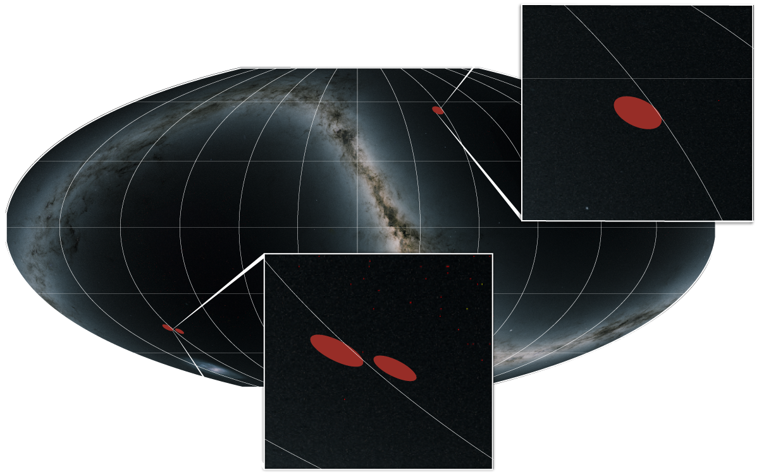
BROAD SCIENTIFIC SURVEYS / HIGH-LATITUDE TIME-DOMAIN SURVEY
High-Latitude
Time-Domain
Survey
A front row seat to our
changing universe
Notes:
High-Latitude Time-Domain Survey
Key Points:
Through the High-Latitude Time-Domain Survey, Roman will visit the same regions of sky (represented by red circles in this all-sky map) again and again over a period of years, allowing astronomers to see sporadic events as they unfold and changes in our universe.
Breaking down the survey name:
High Latitude: Observing beyond — above and below — the plane of our own galaxy.
Time Domain: This branch of astronomy studies how cosmic objects change over time.
This survey’s design provides the opportunity to discover a particular type of exploding star that astronomers can use to trace the evolution of the universe and probe possible explanations for its accelerated expansion.
More Messaging (Optional):
With this survey, we will be able to study our dynamic universe, including witnessing rare events and discovering exotic phenomena, like extremely bright star explosions, explosions caused by the merging of two stars, and accreting black holes at the center of their galaxies. Observing the changes that are occurring within deep space will help us enrich our current understanding of cosmic history.
Technical Information (Optional):
Survey duration: 180 days altogether. These observations will primarily occur throughout the middle of Roman’s five-year mission.
Coverage: Total of 19 square degrees, or a region of sky as large as 95 full moons
Frequency: About every five days
About the Image:
This all-sky map shows the area to be covered by Roman’s High-Latitude Time-Domain Survey. The survey is represented by red circles, with one circle appearing toward the top center and two circles toward the bottom left.
Image Credit: Background: M. Troxel and Caltech-IPAC/R. Hurt; Graphic: J. Olmsted (STScI)
Supportive Resources:
[Video] Nancy Grace Roman Space Telescope: Tracking Change Over Time: https://www.youtube.com/watch?v=i4TDwzti0T4&list=PLm0MBdI3VlBV6atJO-wb04zG32hIosyTR&index
[Webpage] High-Latitude Time-Domain Survey: https://science.nasa.gov/mission/roman-space-telescope/high-latitude-time-domain-survey
[Webpage] High-Latitude Time-Domain Survey Technical Information: https://roman-docs.stsci.edu/roman-community-defined-surveys/high-latitude-time-domain-survey
[News Release] NASA Roman Core Survey Will Trace Cosmic Expansion Over Time: https://www.stsci.edu/contents/news-releases/2025/news-2025-202
[Sonification] Sonification of the High-Latitude Time-Domain Survey (Simulated Data): https://www.youtube.com/watch?v=szV5ON231DI

Slide 16
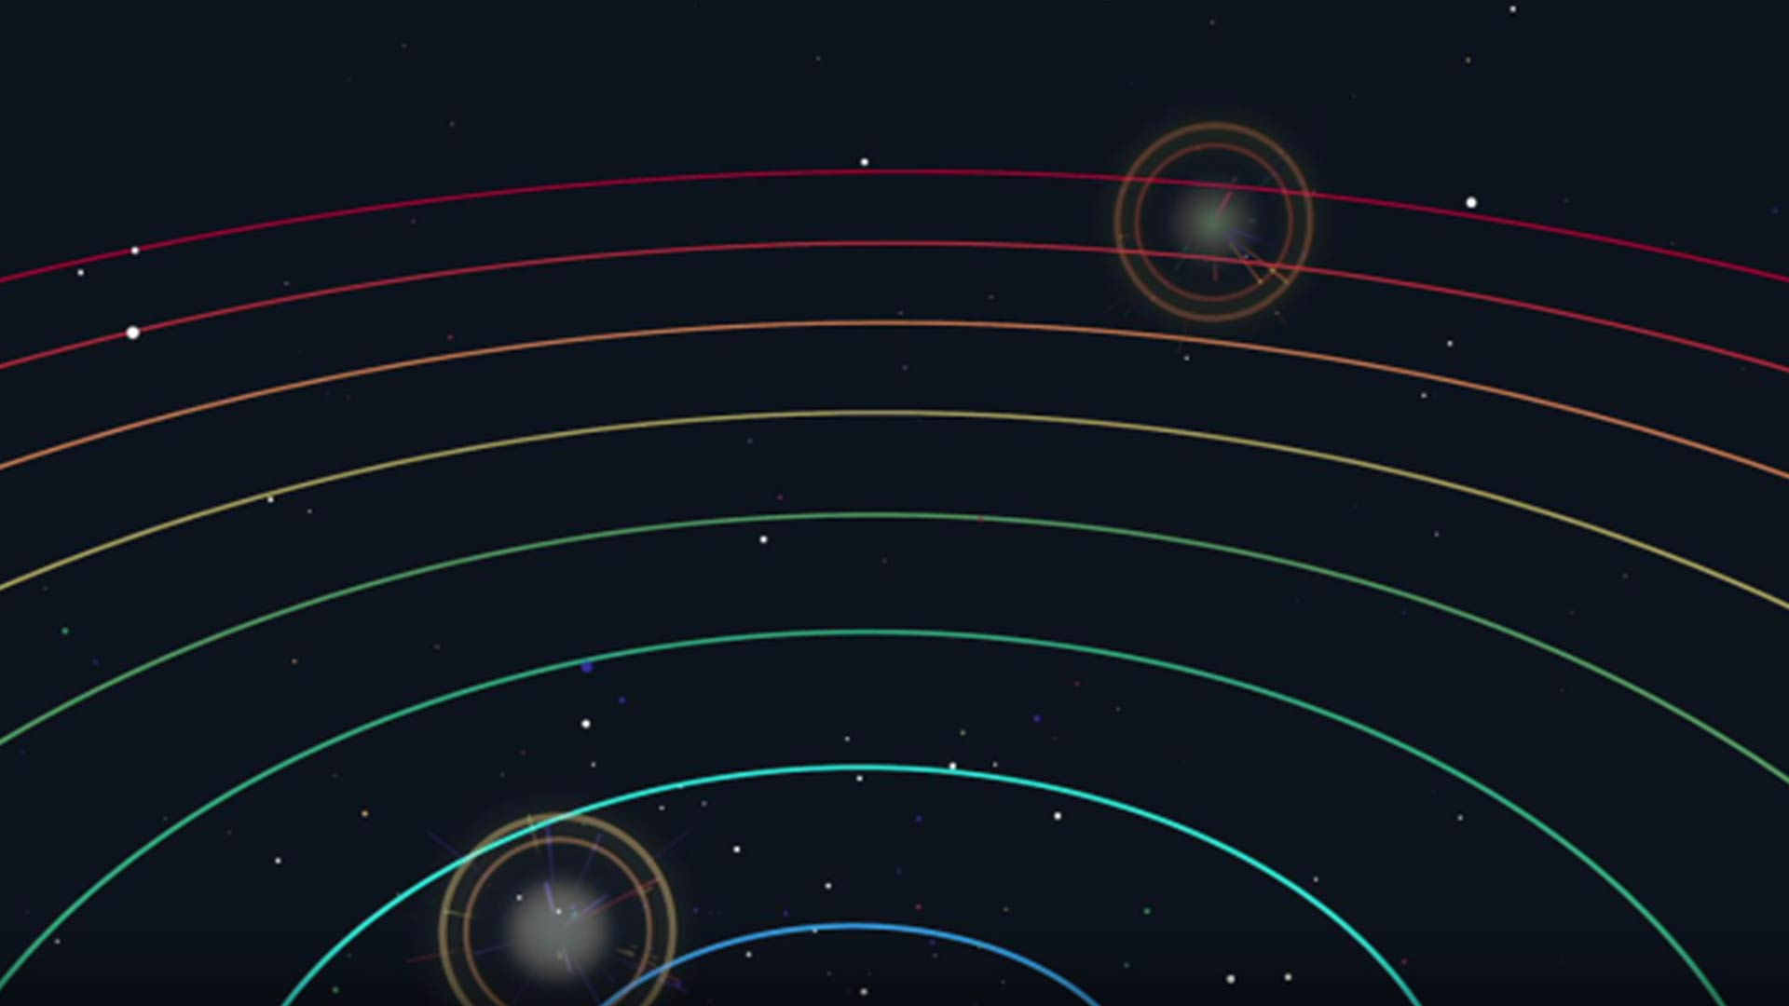
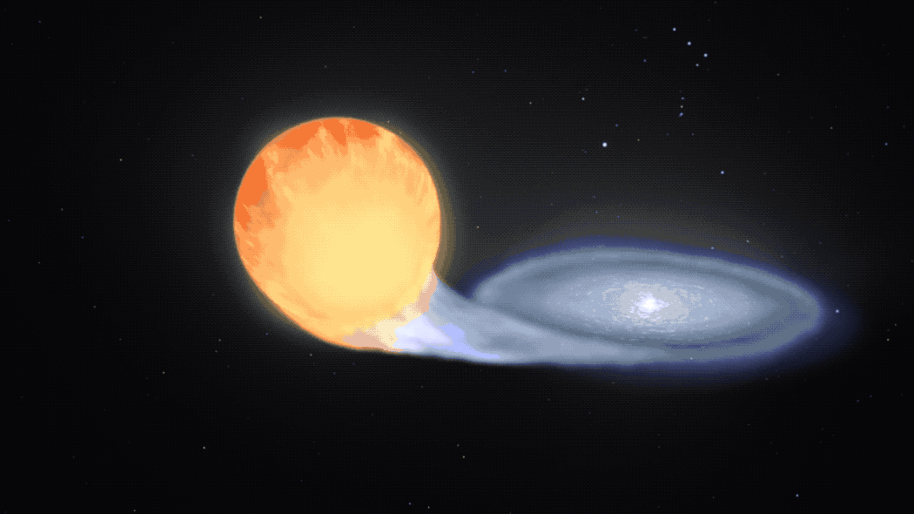
BROAD SCIENTIFIC SURVEYS / HIGH-LATITUDE TIME-DOMAIN SURVEY
Hunting for
Exploding Stars
Tracking supernovae to understand
the universe’s expansion
Notes:
Hunting for Exploding Stars
Key Points:
Dark energy is one of the biggest and most mysterious scientific discoveries of modern times. In addition to mapping the universe to understand how its large-scale structure has evolved, Roman will also use another approach to understand dark energy.
Astronomers can use a type of exploding star known as Type Ia supernovae to measure the universe’s expansion rate.
Because of its repeated observations, Roman will find many of these across cosmic time — an estimated 20,000 Type Ia supernovae! The sheer number of expected supernovae detections will allow astronomers to track how the universe changes over time.
This includes finding possible explanations for its accelerating expansion.
More Messaging (Optional):
By observing a big patch of the sky over and over again, the odds of Roman finding these objects at very large distances increase. Because Type Ia supernovae can be calibrated to a common intrinsic brightness, researchers can use them as cosmic distance indicators to study how the universe is expanding.
By studying their spectra, astronomers can determine how rapidly they appear to be moving away at different distances, which can inform scientists about the expansion of space and whether dark energy’s influence has caused the universe’s expansion to change throughout time.
Roman’s ability to find distant Type Ia supernovae means it will track the universe’s expansion history farther back in time than has ever been possible.
Definition:
Type Ia Supernovae: They occur from certain types of two-star systems that contain a white dwarf — the small, hot core remnant of a Sun-like star — siphoning material from its companion. This triggers a runaway nuclear reaction that detonates the white dwarf.
About the Image:
Left: This animation shows one of the scenarios in which Type Ia supernovae originate. Type Ia supernova can form from some binary star systems that contain at least one white dwarf — the small, hot core remnant of a Sun-like star. In some cases, the dwarf may siphon material from its companion, triggering a runaway reaction that detonates the white dwarf star once it reaches a specific point where it has gained so much mass that it becomes unstable.
Background: Roman will measure dark energy by tracking exploding stars called Type Ia supernovae. The farther away these objects are, the fainter the explosions look. By measuring how bright Type Ia supernovae appear to be, we have a way to measure their distances. The illustration shows these types of events at different cosmic distances.
Image Credit: NASA
Supportive Resources:
[Article] Type Ia Supernovae: https://science.nasa.gov/mission/roman-space-telescope/type-ia-supernovae
[News Release] Team Preps to Study Dark Energy via Exploding Stars With NASA’s Roman: https://www.nasa.gov/missions/roman-space-telescope/team-preps-to-study-dark-energy-via-exploding-stars-with-nasas-roman
[Video] How Do We Know the Universe is Accelerating: https://www.youtube.com/watch?v=tXkBfkeJJ5c
[Video] Mystery of Cosmic Expansion Deepens: https://viewspace.org/video_library/videos/885-VS-BtH-HubbleConstant-1920x1080-363907575?
[Webpage] Dark Energy: https://science.nasa.gov/mission/roman-space-telescope/dark-energy
[News Release] NASA’s Roman Mission Will Test Competing Cosmic Acceleration Theories: https://www.nasa.gov/missions/roman-space-telescope/nasas-roman-mission-will-test-competing-cosmic-acceleration-theories

Slide 17
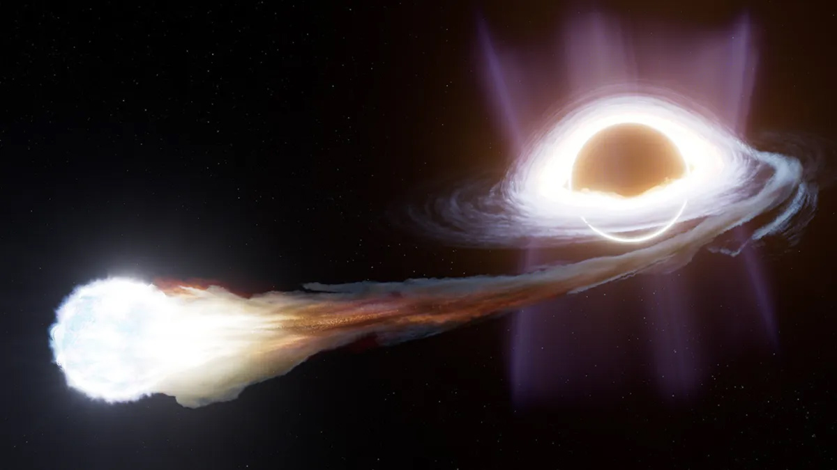
BROAD SCIENTIFIC SURVEYS / HIGH-LATITUDE TIME-DOMAIN SURVEY
Time-Domain and
Transient Events
Seeing change in real time
Notes:
Time-Domain and Transient Events
Key Points:
Because of the way this survey will observe the cosmos, repeating observations of the same area of sky, Roman will also spot other rare phenomena and short-lived events that would otherwise be missed.
Scientists estimate Roman will collect data from more than 100,000 dynamic events, like the deaths of massive stars via supernovae and tidal disruption events.
The survey will also allow astronomers to explore other transient events and variable objects, like stars that change in brightness over time.
Definitions:
Tidal Disruption Event: When a star wanders too close to a supermassive black hole and is torn apart.
Transient Event: Astrophysical phenomenon that shows changes in brightness over short timescales.
About the Image:
This is an illustration of a tidal disruption event: a star being torn apart by a black hole. The black sphere represents a black hole, and the bright white sphere represents a star.
Image Credit: R. Crawford (STScI)
Supportive Resources:
[News Release] One Survey by NASA’s Roman Could Unveil 100,000 Cosmic Explosions: https://www.nasa.gov/missions/roman-space-telescope/one-survey-by-nasas-roman-could-unveil-100000-cosmic-explosions
[Sonification] Sonification of the High-Latitude Time-Domain Survey (Simulated Data): https://www.youtube.com/watch?v=szV5ON231DI
[Science Briefing] The Dynamic Universe — From Exoplanets to Stars and Black Holes: https://universe-of-learning.org/contents/events/science-briefings/2025/science-briefing-time-domain-astronomy

Slide 18
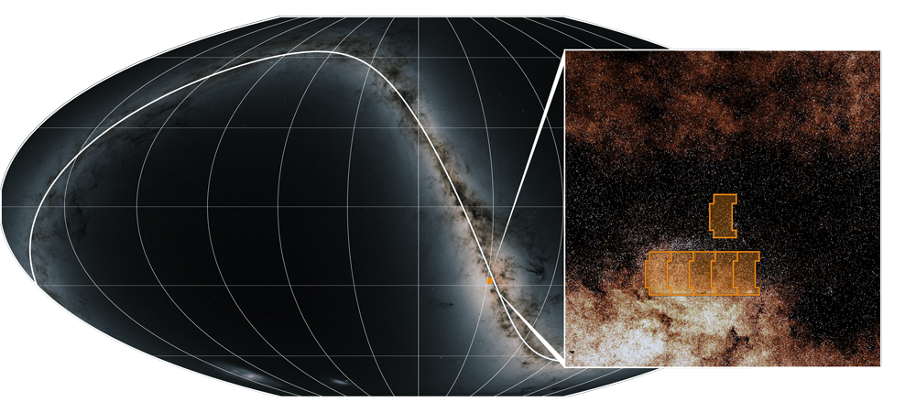
BROAD SCIENTIFIC SURVEYS / GALACTIC BULGE TIME-DOMAIN SURVEY
Galactic Bulge Time-Domain Survey
Finding scientific gems within our galaxy’s heart
Notes:
Galactic Bulge Time-Domain Survey
Key Points:
The Galactic Bulge Time-Domain Survey will consist of repeating observations of six fields (seen here as orange outlines) toward the bulge of our Milky Way galaxy, one of which includes the galactic center. It will see beyond the clouds of dust in the galaxy’s central region that have historically blocked our view in visible light.
Breaking down the survey name:
Galactic Bulge: This refers to the galaxy’s dense, central hub, which is located approximately 26,000 light-years from Earth.
Time Domain: This branch of astronomy studies how cosmic objects change over time.
Roman’s infrared sensitivity along with this survey’s cadence is the ideal combination for us to study our Milky Way galaxy in ways previous observations could not.
Through this survey, astronomers will be able to do different types of science, including exoplanets, stellar populations, and time-domain astronomy within our galaxy.
Definitions:
Exoplanet: A planet outside our solar system.
Transient Event: Astrophysical phenomenon that shows changes in brightness over short timescales.
Technical Information (Optional):
Survey duration: 438 days altogether over its five-year primary mission, primarily in six sets of 72 days each
Coverage: 1.7 square degrees, or about 8.5 full moons
Frequency: Each field will be observed every 12 minutes
About the Image:
This all-sky map shows the area to be covered by Roman’s Galactic Bulge Time-Domain Survey. The survey is represented in orange and appears as a dot toward the bottom center of the all-sky map. A pull-out of the selected area shows the six fields in greater detail.
Image Credit: Image Credit: Background: M. Troxel and Caltech-IPAC/R. Hurt; Graphic: J. Olmsted (STScI)
Supportive Resources:
[Webpage] Galactic Bulge Time-Domain Survey: https://science.nasa.gov/mission/roman-space-telescope/galactic-bulge-time-domain-survey
[Webpage] Galactic Bulge Time-Domain Survey Technical Information: https://roman-docs.stsci.edu/roman-community-defined-surveys/galactic-bulge-time-domain-survey
[Video] Nancy Grace Roman Space Telescope: Exploring the Dynamic Heart of the Milky Way: https://www.youtube.com/watch?v=TM26_fVTNWM&list=PLm0MBdI3VlBV6atJO-wb04zG32hIosyTR&index=3
[Event] The Roman Galactic Bulge Time Domain Survey: https://roman.ipac.caltech.edu/event/aug-2025-lecture

Slide 19
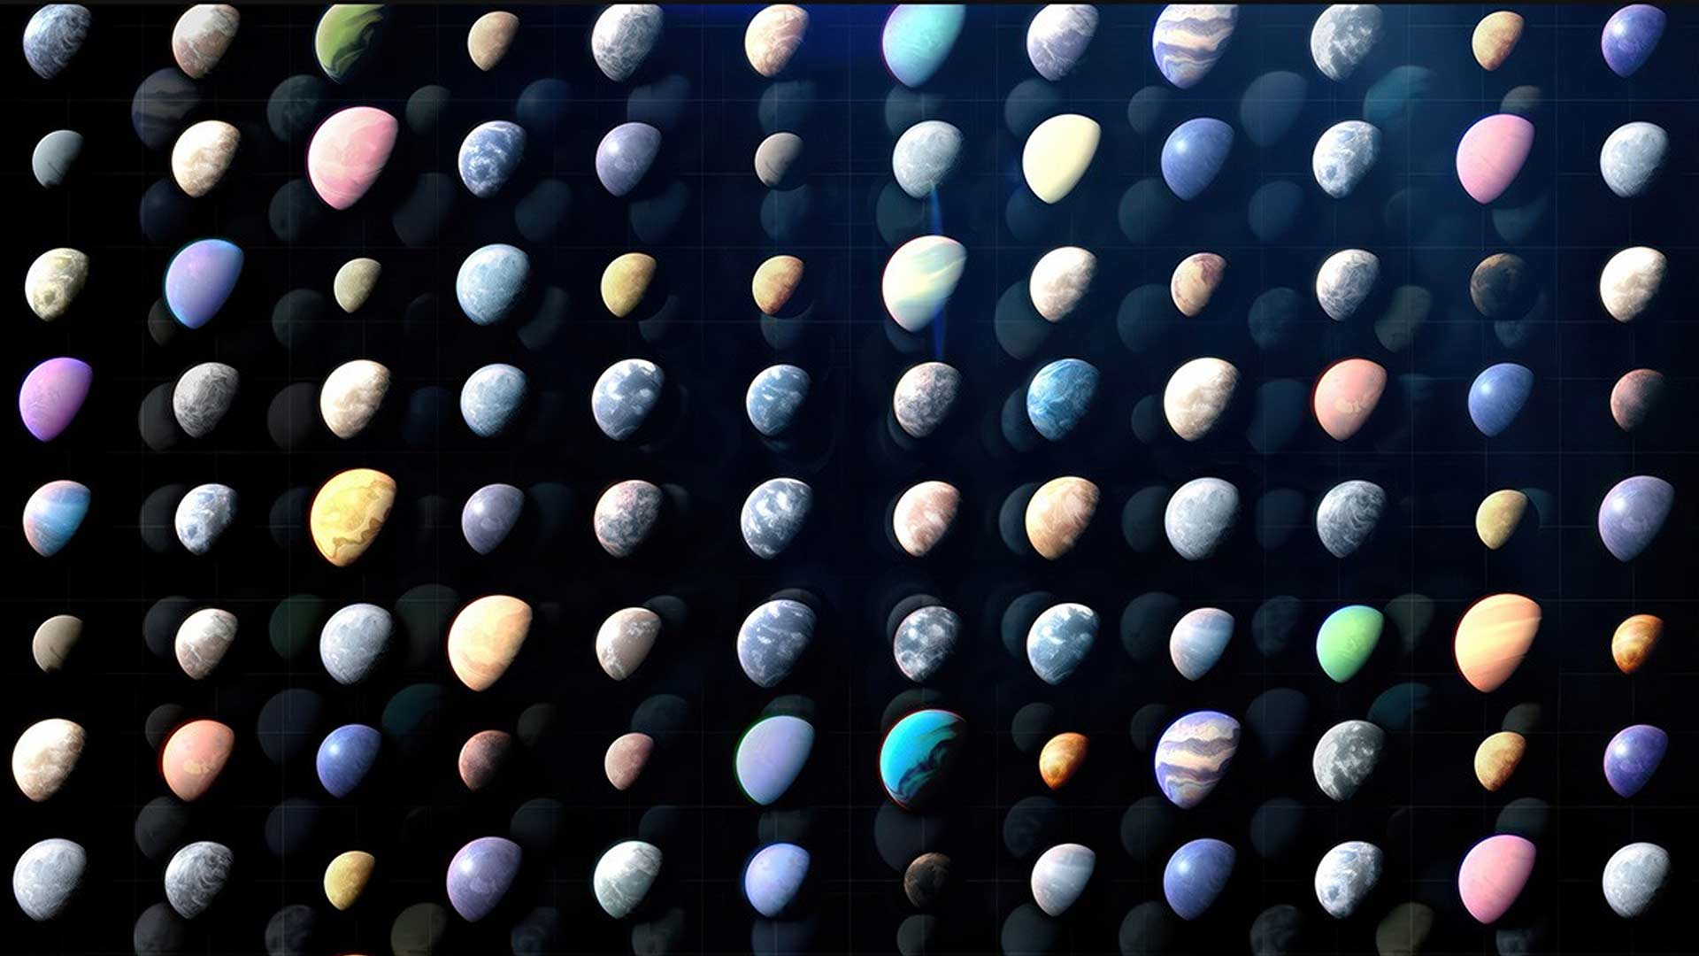
BROAD SCIENTIFIC SURVEYS / GALACTIC BULGE TIME-DOMAIN SURVEY
Exoplanets
Expanding the exoplanet census within our galaxy
Notes:
Exoplanets
Key Points:
More than 6,000 exoplanets have been confirmed to date. With Roman, our exoplanet count is expected to rise rapidly.
The Galactic Bulge Time-Domain Survey is expected to find more than 100,000 exoplanets in our galaxy by using two different exoplanet-finding methods:
Transit: When a planet crosses the face of its host star, blocking some of the star’s light.
Microlensing: When the gravity of a planet briefly magnifies light from a more distant star.
By discovering thousands of exoplanets, scientists will be able to uncover how common smaller, rocky planets like Earth are; understand the demographics of distant worlds; and find out how common or unusual our own solar system is compared to the rest of our galaxy.
More Messaging (Optional):
The first planets outside the solar system — exoplanets — were discovered in the 1990s. Since then, more than 6,000 exoplanets have been confirmed, and scientists now estimate that most stars have at least one planet orbiting them.
This means there are countless other solar systems waiting to be discovered, and Roman will have the unique ability to find solar system analogs.
Roman will use the transit and microlensing methods to find distant worlds.
More than 250 exoplanets have been discovered using the microlensing technique with ground-based telescopes.
Microlensing is effective at finding large planets; small, rocky planets orbiting close to their host stars; and free-floating exoplanets.
Combined with results from other planet-detecting missions like Kepler and TESS, plus those in the future, Roman will provide a much fuller census of exoplanets, and a better understanding of how unique — or not — our home planet and solar system are in the universe.
Note: Since Roman’s coronagraph is a technology demonstration, it is not part of any of the surveys.
Image Credit: NASA’s Goddard Space Flight Center
Supportive Resources:
[Webpage] Exoplanets: https://roman.gsfc.nasa.gov/exoplanets.html
[Webpage] Microlensing: https://science.nasa.gov/mission/roman-space-telescope/microlensing
[Webpage] Transit Method: https://science.nasa.gov/mission/roman-space-telescope/transit-method
[News Release] NASA’s Roman Mission Predicted to Find 100,000 Transiting Planets: https://www.nasa.gov/feature/goddard/2021/nasa-s-roman-mission-predicted-to-find-thousands-of-transiting-planets
[News Release] NASA’s Tally of Planets Outside Our Solar System Reaches 6,000: https://www.nasa.gov/universe/exoplanets/nasas-tally-of-planets-outside-our-solar-system-reaches-6000
[News Release] NASA’s Roman Mission Will Probe Galaxy’s Core for Hot Jupiters, Brown Dwarfs: https://www.nasa.gov/missions/roman-space-telescope/nasas-roman-mission-will-probe-galaxys-core-for-hot-jupiters-brown-dwarfs
[News Release] Unveiling Rogue Planets With NASA’s Roman Space Telescope: https://www.nasa.gov/missions/roman-space-telescope/unveiling-rogue-planets-with-nasas-roman-space-telescope
[Website] NASA Exoplanet Archive: https://exoplanetarchive.ipac.caltech.edu
[Activity Guide] Exoplanet Detectives: A Transit Method Activity: https://universe-of-learning.org/contents/products/exoplanet-detectives
[Program Guide] Finding Exoplanets: https://universe-of-learning.org/contents/products/program-theme-5-finding-exoplanets
[Program Guide] Cosmic Canvas: Exoplanets Program Guide: https://universe-of-learning.org/informal-educators/program-facilitator-guides/cosmic-canvas-exoplanets-program-guide

Slide 20
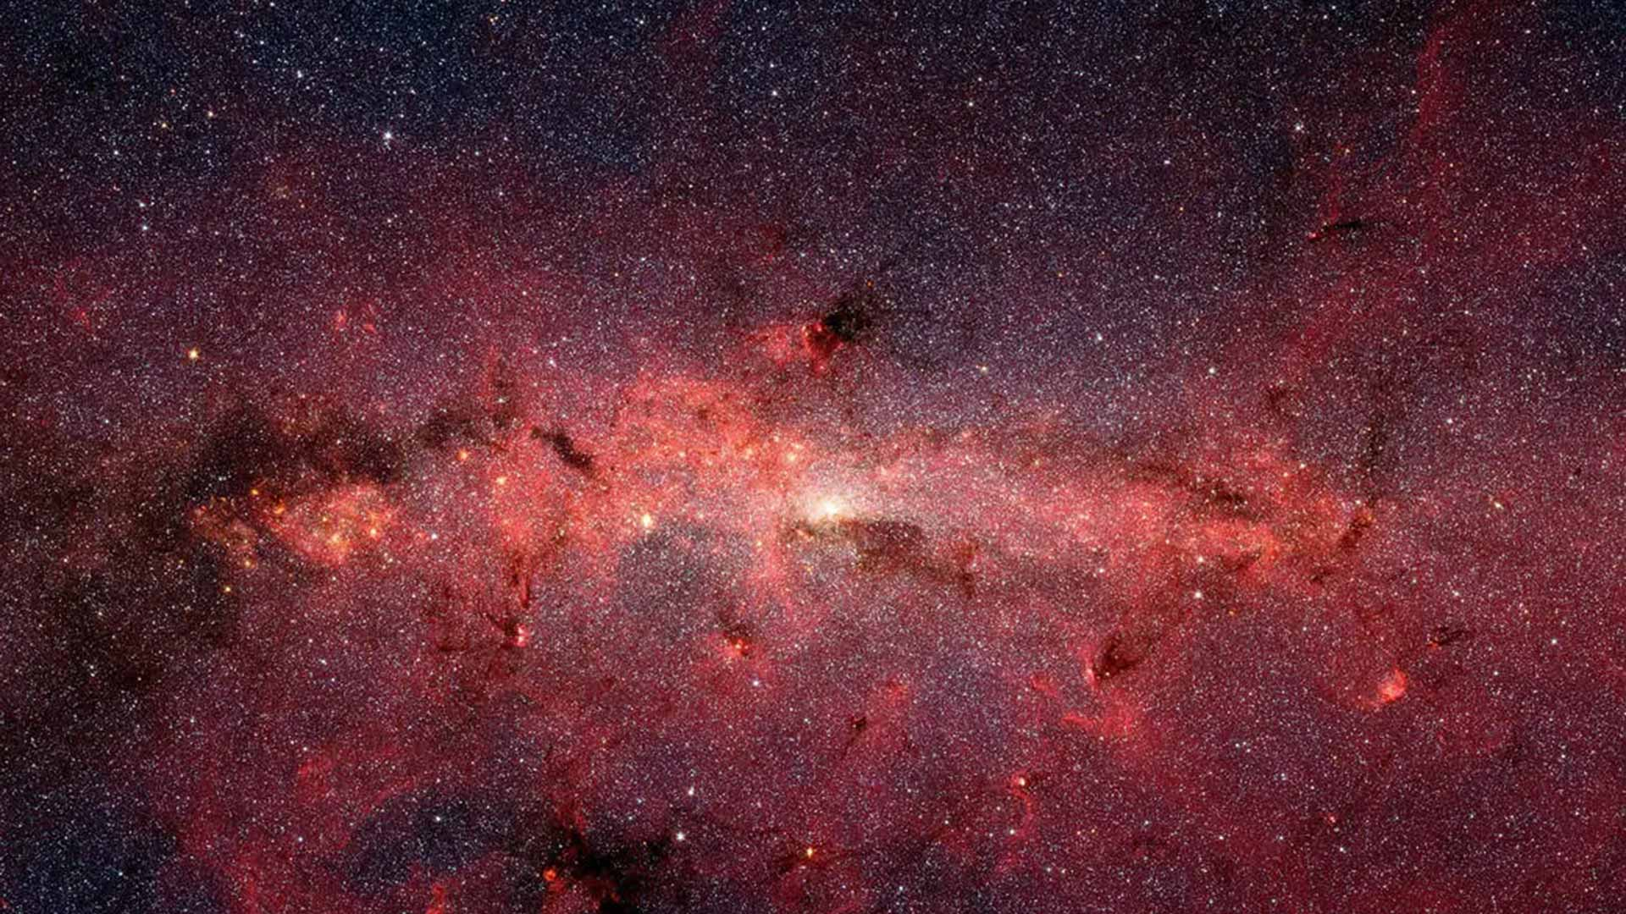
BROAD SCIENTIFIC SURVEYS / GALACTIC BULGE TIME-DOMAIN SURVEY
Witnessing More in Our Dynamic Galaxy
Additional discoveries in the same data
Notes:
Witnessing More in Our Dynamic Galaxy
Key Points:
The Galactic Bulge Time-Domain Survey will also discover and provide information on other celestial objects within our Milky Way galaxy.
These include small objects in the outskirts of our solar system, objects that change in brightness over time, and stellar life cycles.
Roman’s observations as part of this survey will also include data collection on Sagittarius A*, the black hole in the center of our galaxy.
More Messaging (Optional):
This survey will also allow us to identify transient events, such as isolated black holes via gravitational microlensing, and interacting double stars, also known as interacting binaries.
Examples of stellar-related science include characterizing different stellar populations, improving our knowledge of stellar characteristics, and monitoring how stars move in the sky.
Astronomers will study oscillations, or patterns of waves within the interiors of stars, to learn more about their properties. This method of study is known as asteroseismology.
Roman is expected to provide asteroseismology-based characterization of more than 100,000 stars.
About the Image:
Infrared-light image of the center of our Milky Way galaxy by NASA's Spitzer Space Telescope.
Image Credit: NASA, JPL-Caltech, Susan Stolovy (SSC/Caltech) et al.
Supportive Resources:
[News Release] How NASA’s Roman Space Telescope Will Uncover Lonesome Black Holes: https://www.nasa.gov/feature/goddard/2021/how-nasa-s-roman-space-telescope-will-uncover-lonesome-black-holes
[News Release] NASA’s Roman Could Bring New Waves of Information on Galaxy’s Stars: https://www.nasa.gov/missions/roman-space-telescope/nasas-roman-could-bring-new-waves-of-information-on-galaxys-stars
[News Release] Why NASA’s Roman Mission Will Study Milky Way’s Flickering Lights: https://www.nasa.gov/missions/roman-space-telescope/why-nasas-roman-mission-will-study-milky-ways-flickering-lights

Slide 21
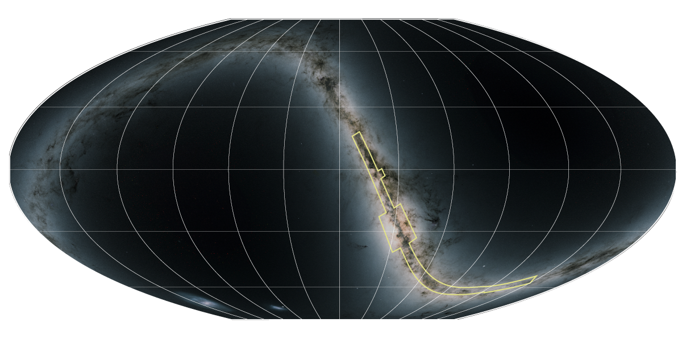
BROAD SCIENTIFIC SURVEYS / GALACTIC PLANE SURVEY
Galactic Plane Survey
Understanding our neighborhood
Notes:
Galactic Plane Survey
Key Points:
To understand our cosmic home more deeply, Roman will complete the Galactic Plane Survey — seeing beyond the dust to map regions that have been historically obscured. A thin, yellow outline marks the area that will be observed.
This is Roman’s first defined General Astrophysics Survey.
This survey will allow us to see through the dust to study the densest parts of our galaxy to the mysterious far end of the disk, for the first time ever.
More Messaging (Optional):
The Galactic Plane Survey is the first defined General Astrophysics Survey. It is not one of the three Core Community Surveys. Members of the astronomy community will be able to submit proposals for General Astrophysics Surveys throughout Roman’s primary mission.
Definition:
Galactic Plane: The flat region where most of a disk-shaped galaxy’s mass — including its stars, gas, and dust — is located.
Time Domain: This branch of astronomy studies how cosmic objects change over time.
Spectroscopy: A type of data collection method that splits the light into a rainbow, providing even more details about an object than an image can alone.
Technical Information (Optional):
Survey duration: 29 days altogether during the first two years of Roman’s five-year primary mission
Coverage: 691 square degrees, or about 3,455 full moons
Frequency: While most of the study area will be surveyed just once, a few select regions covering a total of 19 square degrees, equivalent to about 95 full moons, will be observed repeatedly.
This survey will feature three different aspects: a wide view of the galactic plane and bulge, a time-domain component, and deep observations and spectroscopy.
About the Image:
This all-sky map shows the area to be covered by Roman’s Galactic Plane Survey. The survey is represented in yellow and appears as a long, thin, stepped outline that traces a thin region at the center.
Image Credit: Background: M. Troxel and Caltech-IPAC/R. Hurt; Graphic: J. Olmsted (STScI)
Supportive Resources:
[Video] Nancy Grace Roman Space Telescope: Capturing Our Cosmic Home: https://www.youtube.com/watch?v=gVPyadHvYK0
[Webpage] Galactic Plane Survey Technical Information: https://roman-docs.stsci.edu/roman-community-defined-surveys/galactic-plane-survey
[News Release] NASA’s Roman Team Selects Survey to Map Our Galaxy’s Far Side: https://www.nasa.gov/missions/roman-space-telescope/nasas-roman-team-selects-survey-to-map-our-galaxys-far-side
[Video] Spectroscopy, Explained: https://svs.gsfc.nasa.gov/12956
[Science Explainer] Spectroscopy 101: https://science.nasa.gov/mission/webb/science-overview/science-explainers/spectroscopy-101-introduction

Slide 22
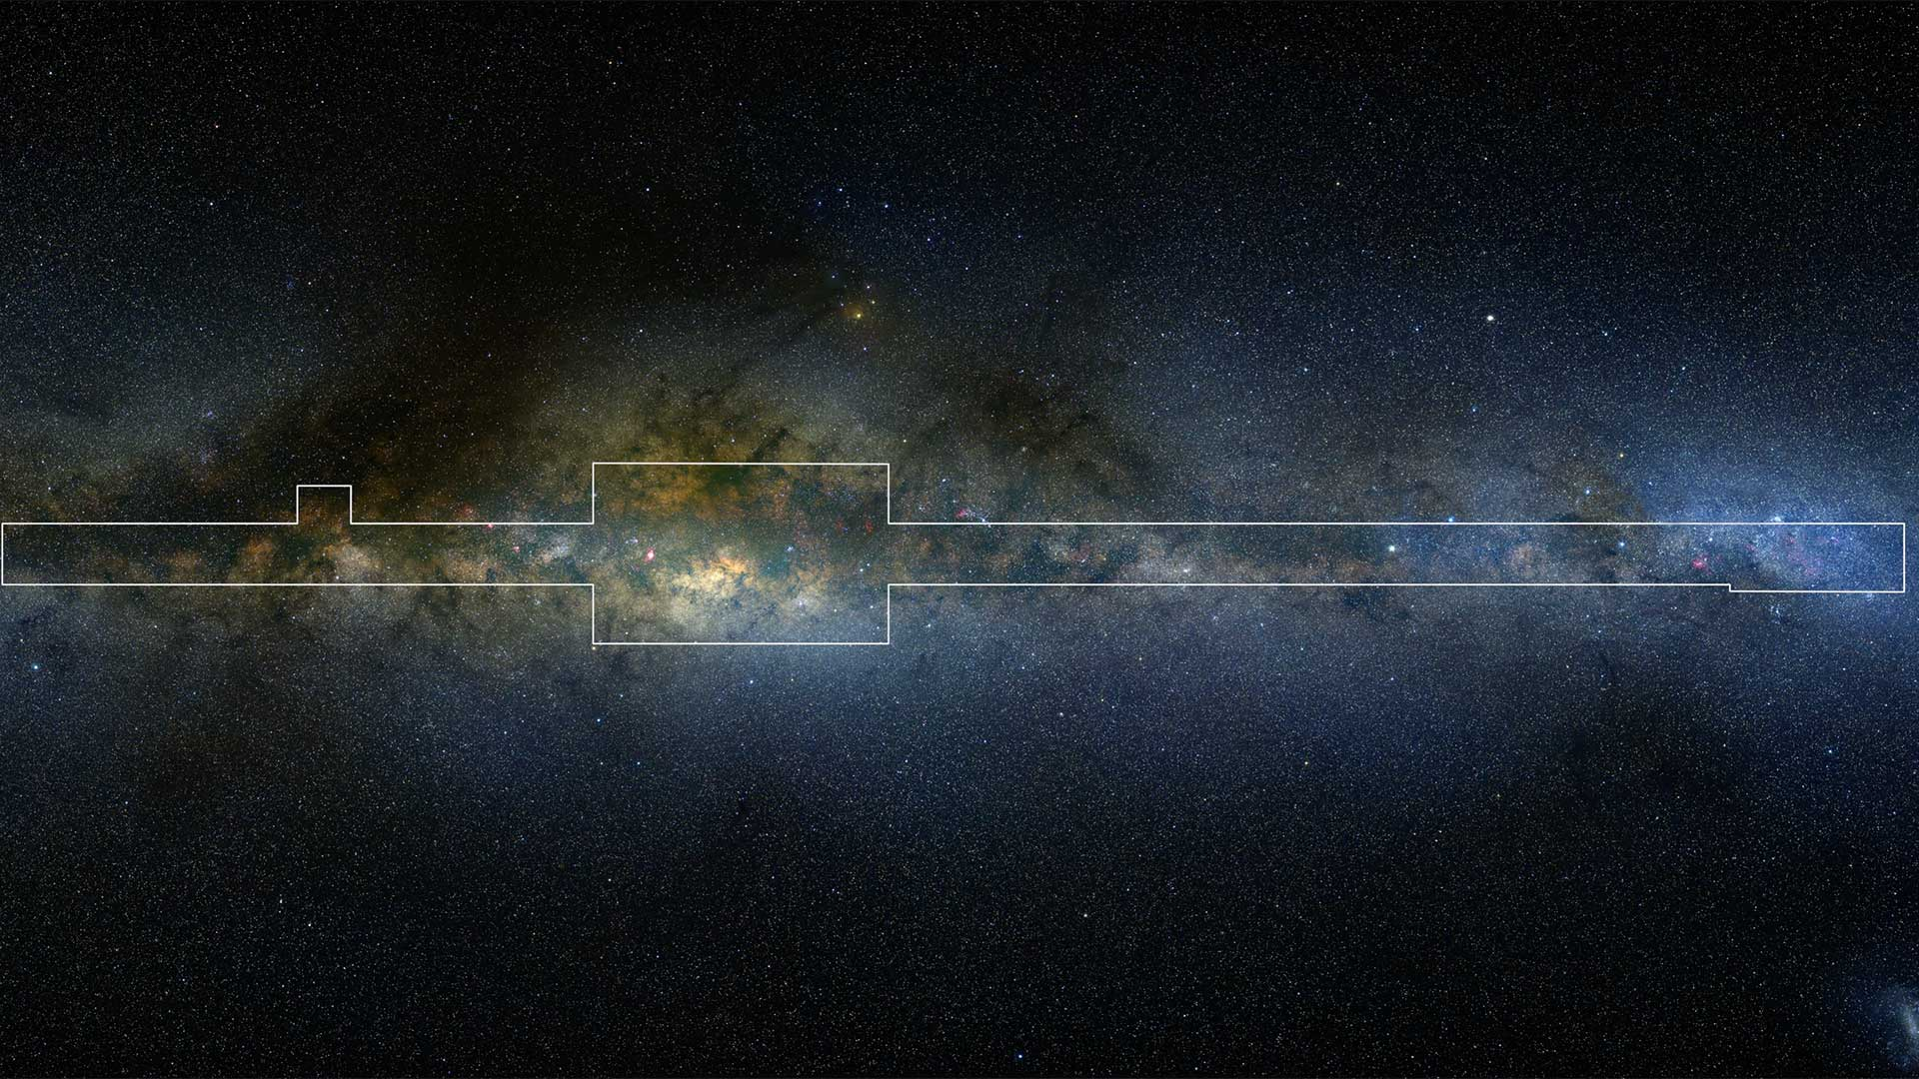
BROAD SCIENTIFIC SURVEYS / GALACTIC PLANE SURVEY
Our Milky Way Galaxy
Revealing our home in great detail
Notes:
Our Milky Way Galaxy
Key Points:
Roman will observe billions of stars within our Milky Way galaxy, including large swaths of stars deep inside the dusty regions that were inaccessible to us before.
Astronomers will track the exact locations of more than 20 billion stars, taking note of their movement over time, and trace back how our Milky Way galaxy formed and how it has changed over time.
About the Image:
This image shows an edge-on view of the Milky Way galaxy. The outlined area represents the total region Roman will observe as part of its Galactic Plane Survey. The survey will be conducted over the course of Roman’s first two years, taking 29 days altogether.
Image Credit: Axel Mellinger
Supportive Resources:
[News Release] How NASA’s Roman Mission Will Unveil Our Home Galaxy Using Cosmic Dust: https://www.nasa.gov/missions/roman-space-telescope/how-nasas-roman-mission-will-unveil-our-home-galaxy-using-cosmic-dust

Slide 23


BIG DATA
Big Data
Information-packed views
Notes:
Big Data
Key Point:
Roman’s surveys create huge datasets because answering big questions and investigating foundational mysteries requires seeing patterns — and deviations from them — at scale.
Image Credit: Background: M. Troxel and Caltech-IPAC/R. Hurt; Graphic: J. Kang (STScI)

Slide 24
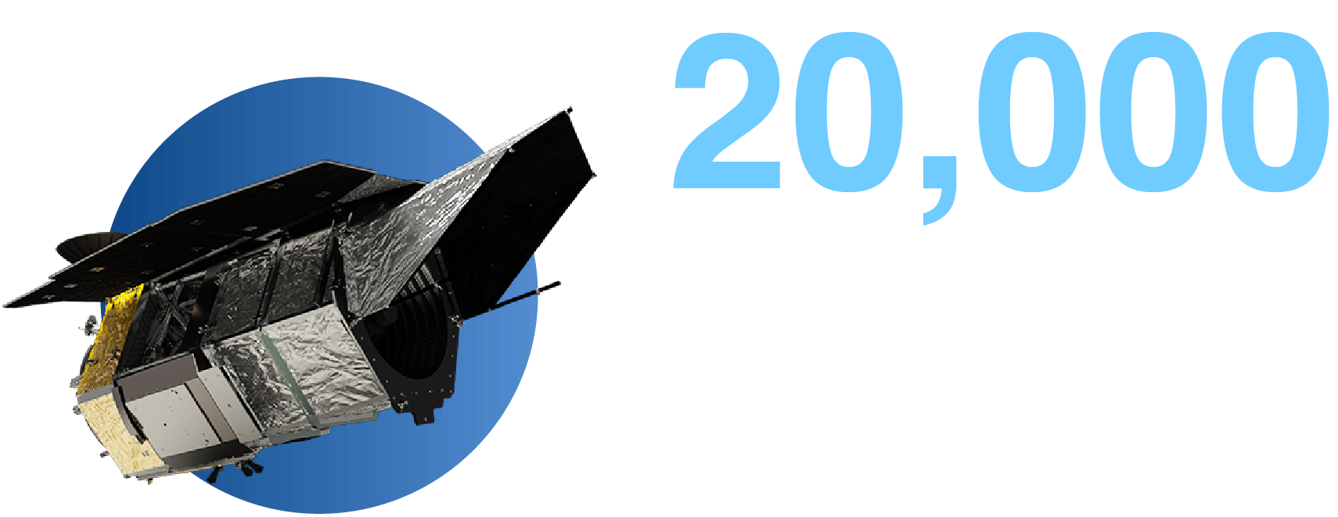
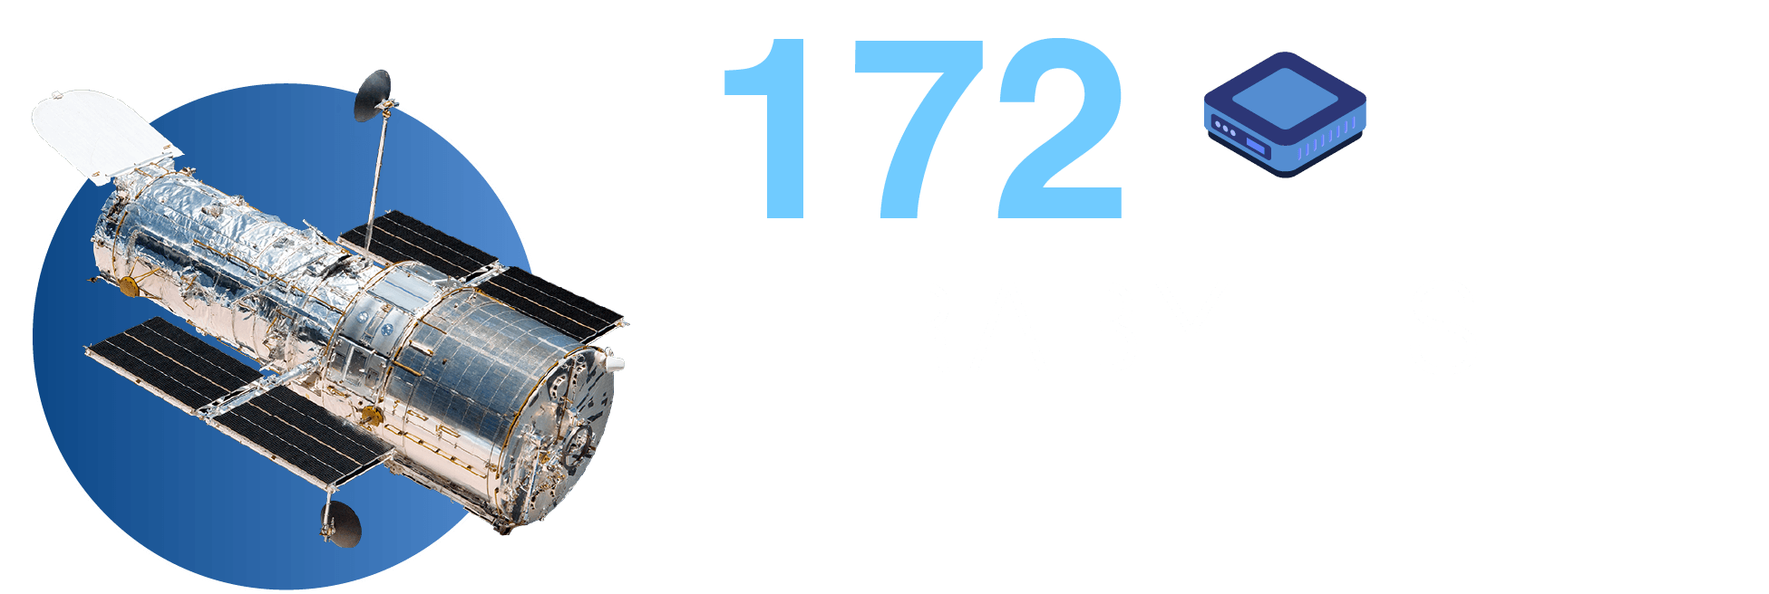
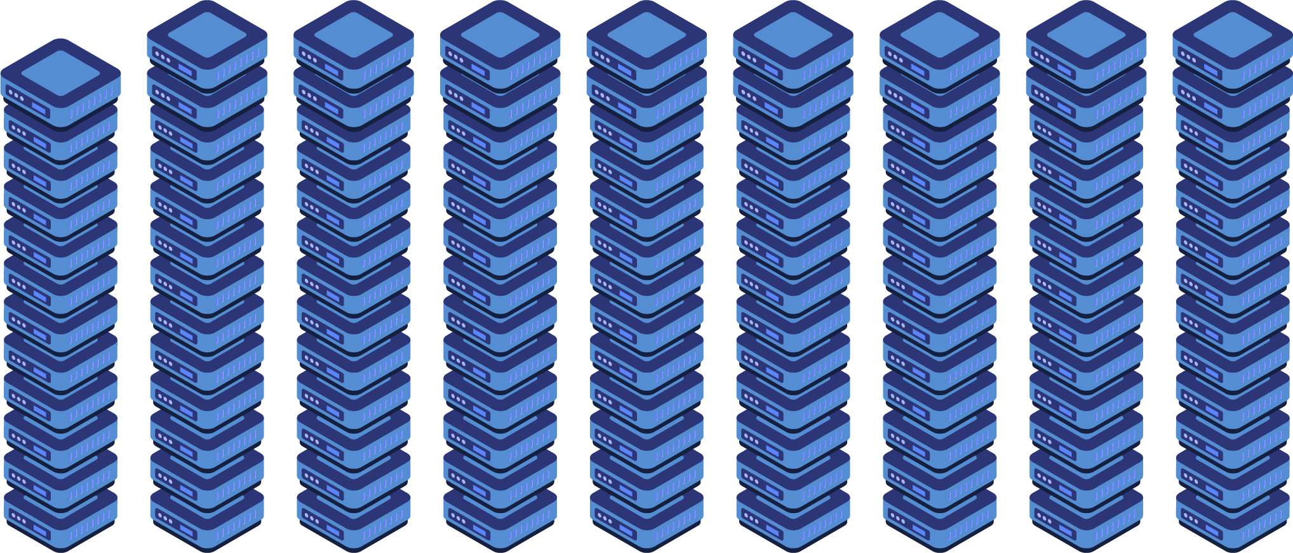
BIG DATA
Data Comparison
Roman’s Data Archive
Five-year primary mission (projected)
Hubble’s Data Archive, First 30 Years
(1990-2020)
Notes:
Data Comparison
Key Points:
What do we mean when we say that Roman’s large-scale surveys will provide us with lots of information about the cosmos? Can we quantify the amount of information?
This illustration compares Roman’s expected data volume at the end of its five-year primary mission to the amount of data Hubble collected during its first thirty years.
After its five-year primary mission, Roman will have collected 20,000 terabytes of data. This is the same amount of data as 10,000,000 HD movies.
This is 100 times the amount of data that Hubble collected in its first 30 years. The first 30 years of Hubble data totaled 172 terabytes.
Or another way of looking at it: In just one month, Roman will generate approximately twice the data volume produced by Hubble during its first 30 years.
With this amount of expected data, we can’t help but think about the richness of Roman’s observations: the sheer number of cosmic objects it will detect, the unfolding events that we’ll witness, and the underlying structure and patterns that make up our universe.
About the Image:
Infographic comparing Hubble and Roman data volume in both text and visuals. A hard drive depicted as a blue square represents Hubble’s data archive from its first thirty years. By the end of its five-year primary mission, Roman is expected to collect a total of 20,000 terabytes of data. To represent this amount, there is a total of nine stacks of hard drives. Eight of the stacks contain 13 hard drives each, and the leftmost stack contains 12 hard drives, for a total of 116 blue squares.
Image Credit: Background: M. Troxel and Caltech-IPAC/R. Hurt; Graphic: J. Kang (STScI)
Supportive Resources:
One (1) terabyte = 1,024 GB, or: 200,000 5-minute songs; 310,000 pictures; or 500 hours of movies. Via: https://www.howtogeek.com/353116/how-big-are-gigabytes-terabytes-and-petabytes
Where can we find terabytes on Earth? A typical internal hard disk drive may hold two terabytes of data, whereas some servers and high-end workstations that contain multiple hard drives may have a total storage capacity of over 10 terabytes. Source: https://www.geeksforgeeks.org/understanding-file-sizes-bytes-kb-mb-gb-tb-pb-eb-zb-yb
[Newsletter Article] Roman: Delivering Data That Unlocks Discovery: https://www.stsci.edu/contents/newsletters/2026-volume-43-issue-01/roman-delivering-data-that-unlocks-discovery
[Newsletter Article] Preparing for Roman as a Big Data Survey Mission: https://www.stsci.edu/contents/newsletters/2024-volume-41-issue-02/preparing-for-roman-as-a-big-data-survey-mission
[Graphic] The Roman Space Telescope’s Immense Data Volume: https://svs.gsfc.nasa.gov/13667
[Webpage] Announcing the Opening of the Roman Research Nexus: https://science.nasa.gov/astrophysics/programs/cosmic-origins/community/announcing-the-opening-of-the-roman-research-nexus

Slide 25

BIG DATA
Roman Research Nexus
A cloud-based meeting space between Roman data and researchers
Notes:
Roman Research Nexus
Key Points:
All of Roman’s data will be open access and immediately available to the scientific community.
Instead of downloading massive datasets, scientists will be able to work in the cloud where the data already lives.
Researchers around the world will be able to access, explore, and analyze Roman’s data. This innovative, virtual environment will also promote real-time collaboration among research team members.
More Messaging (Optional):
There will be no waiting period to access the Roman data. It will be available to all.
To support data analysis, the mission will release ready-to-use science products, such as catalogs, calibrated images, mosaics, and spectra.
The Roman Research Nexus is an evolving environment. Resources and tools will be created to help support researchers as they sift through the Roman data.
These assets will make it easier to access and analyze huge datasets.
Image Credit: Background: M. Troxel and Caltech-IPAC/R. Hurt; Graphic: J. Kang and A. James (STScI)
Supportive Resources:
[Webpage] Announcing the Opening of the Roman Research Nexus: https://science.nasa.gov/astrophysics/programs/cosmic-origins/community/announcing-the-opening-of-the-roman-research-nexus
[News Article] Roman Space Telescope Science Platform Will Open New Frontiers in Space Science: https://www.stsci.edu/contents/news-releases/2026/news-2026-401
[Newsletter Article] Join the Roman Research Nexus: Plug into a Full Suite of Resources and Simulated Data: https://www.stsci.edu/contents/newsletters/2026-volume-43-issue-01/join-the-roman-research-nexus-plug-into-a-full-suite-of-resources-and-simulated-data

Slide 26
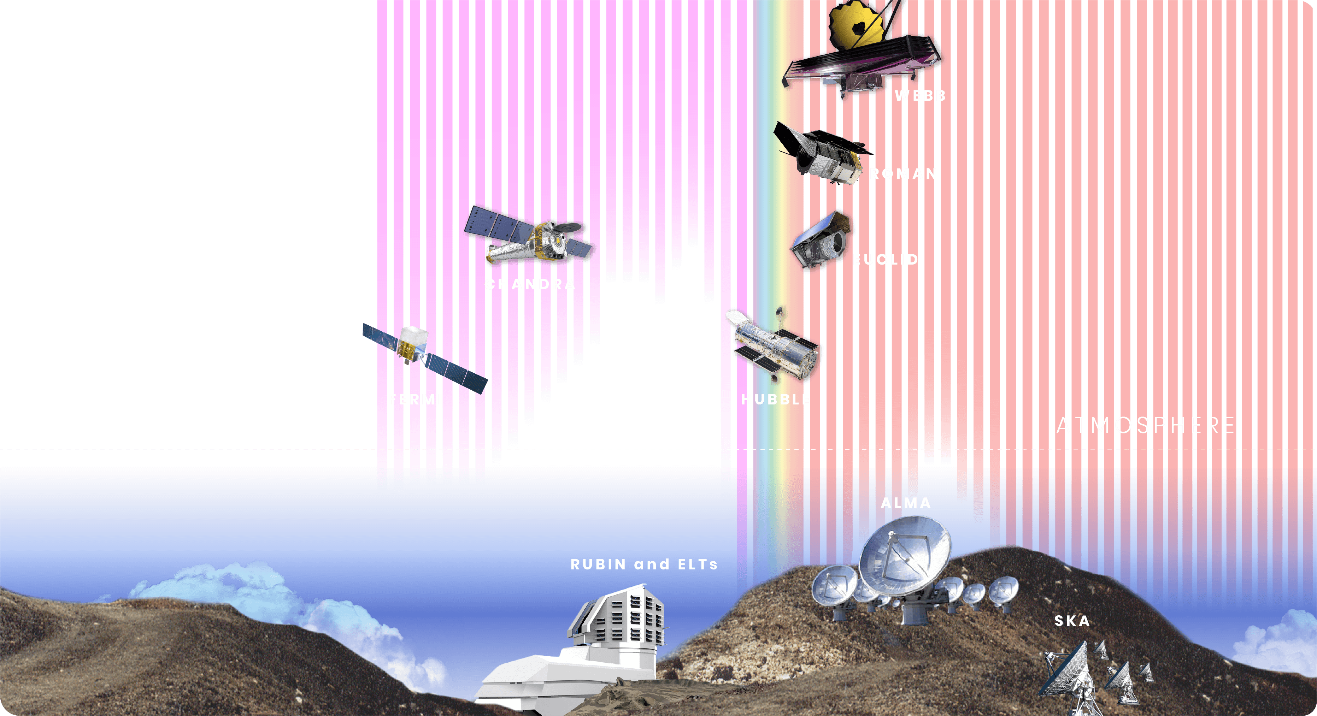
BIG DATA
Collaboration
Part of a larger ecosystem
Notes:
Collaboration
Key Points:
Roman is part of a larger astronomy ecosystem.
As a survey telescope, Roman will image and study broad swaths of our universe to discover unique objects and patterns that space- and ground-based observatories can follow up on to study in greater detail, helping build a more comprehensive picture of the universe.
Think: NASA’s Hubble and Webb space telescopes, ESA’s Euclid mission, and the Vera C. Rubin Observatory.
Even when missions are not observing the same patch of sky or astronomical target at the same time, telescope archival data will always be able to be cross-referenced.
More Messaging (Optional):
Areas where the telescopes overlap on wavelength sensitivity allow them to support and follow up on each other’s observations.
Roman takes the broad view, encompassing a lot of data, while telescopes like Hubble and Webb can take a more focused view on specific objects.
Roman isn’t just doing Hubble and Webb science faster, it’s doing fundamentally different science that could not be done with either of the other observatories. Together the three missions will complement each other, giving us a more complete picture of the cosmos and advancing our understanding of the universe.
ESA’s Euclid mission, which can observe even larger areas of the sky with less sensitivity, provides an opportunity for collaboration. Roman and Euclid will work together to make 3D maps of the universe and answer fundamental questions about its history and structure.
Finding synergies between missions means that the data will be richer, and we can observe our universe more powerfully.
Most astrophysics missions have scientific value far beyond the years they actively observe and collect data. Data collected by many missions are archived in the Barbara A. Mikulski Archive for Space Telescopes (MAST) and are available for future astronomers to reference and compare with new observations.
For example, observations taken by Roman in 2030 could be compared with Hubble’s observations from 1995, and new discoveries could be made using both the new and archived data.
Image Credit: NASA, STScI
Supportive Resources:
[News Release] NASA’s Roman and ESA’s Euclid Will Team Up To Investigate Dark Energy: https://www.nasa.gov/missions/roman-space-telescope/nasas-roman-and-esas-euclid-will-team-up-to-investigate-dark-energy
[Webpage] Roman and Webb: https://science.nasa.gov/roman-and-webb
[Webpage] Roman and Hubble: https://science.nasa.gov/roman-and-hubble

Slide 27
Looking Ahead with Roman
Roman launched on August 30, 2026
Launch
Commissioning
First Look
Observations
Science Operations
NASA’s Kennedy Space Center in Florida.
Three-month commissioning period during which the telescope and its tools will be tested and calibrated.
Five-year primary mission,
with support for an additional five-year extended mission.
Initial observations
will showcase Roman’s
key capabilities.
Notes:
Looking Ahead with Roman
Key Points:
Key Points:
So what happens next, and when do we see Roman’s first discoveries?
Roman launched ahead of schedule, on August 30, 2026.
Roman will eventually be orbiting the second Sun-Earth Lagrange point (L2).
Following launch, Roman goes through a three-month commissioning period during which the telescope and its tools are tested and calibrated.
By early 2027, Roman will complete its initial images, known as its First Look Observations.
Imagine the discoveries that Roman will reveal!
More Messaging (Optional):
Now that it has launched, Roman is traveling to its observation location, approximately 1 million miles (1.5 million kilometers) away from Earth.
The telescope’s destination is a quasi-halo orbit around the second Sun-Earth Lagrange point (L2).
L2 is one of five places in space where objects can stay aligned with Earth and the Sun, and keep steady without much manual assistance.
L2 may sound familiar because of the James Webb Space Telescope, which also orbits around L2.
Image Credit: J. Kang (STScI)
Supportive Resources:
[Webpage] What are Lagrange Points: https://solarsystem.nasa.gov/faq/88/what-are-lagrange-points
[News Release] NASA Completes Nancy Grace Roman Space Telescope Construction: https://www.nasa.gov/missions/roman-space-telescope/nasa-completes-nancy-grace-roman-space-telescope-construction
[Webpage] History of the Roman Mission: https://science.nasa.gov/mission/roman-space-telescope/timeline
[Webpage] Roman Launch Resources: https://www.universe-of-learning.org/informal-educators/roman-launch-resources
[Blog] Roman Blog: https://science.nasa.gov/blogs/roman
[Campaign] Adopt a Pixel: https://science.nasa.gov/mission/roman-space-telescope/adopt-a-pixel

Slide 28



How to Get Involved
Launch Resources
Share Roman’s story and science with your community
Be part of the Roman story
Roman Community Events
Get involved and learn about the Roman Space Telescope to host your own Roman-themed event for first images!
Notes:
How to Get Involved
Key Points:
Roman is not just a mission that people will watch, it is a mission that people participate in, support, follow, and learn from.
This means you are part of the Roman story too.
To get involved, you can stay up to date on Roman-related news, attend Roman-related events, or explore hands-on activities that connect to Roman science.
More Messaging (Optional):
By attending this presentation, you have already engaged with the Roman mission and are part of the exciting Roman story that is still being written. But there are other ways that you can get involved.
You can stay up to date with the Roman mission through social media and news pieces, find or create a community event that connects you to other enthusiasts and the Roman mission, or explore resources to learn more about the ins and outs of Roman’s science areas and goals.
Image Credit: J. Kang (STScI)
Supportive Resources:
[Webpage] Roman Launch Resources: https://www.universe-of-learning.org/informal-educators/roman-launch-resources
[Webpage] Roman Social Media Accounts: https://science.nasa.gov/mission/roman-space-telescope/roman-social-media
[Webpage] Roman News Releases: https://www.stsci.edu/roman/news-and-events/press
[Webpage] Roman: https://science.nasa.gov/mission/roman-space-telescope
[Campaign] Adopt a Pixel: https://science.nasa.gov/mission/roman-space-telescope/adopt-a-pixel

Slide 29
Questions?
Notes:
Image Credit: STScI

Slide 30
FAQ
Notes:
Image Credit: STScI

Slide 31
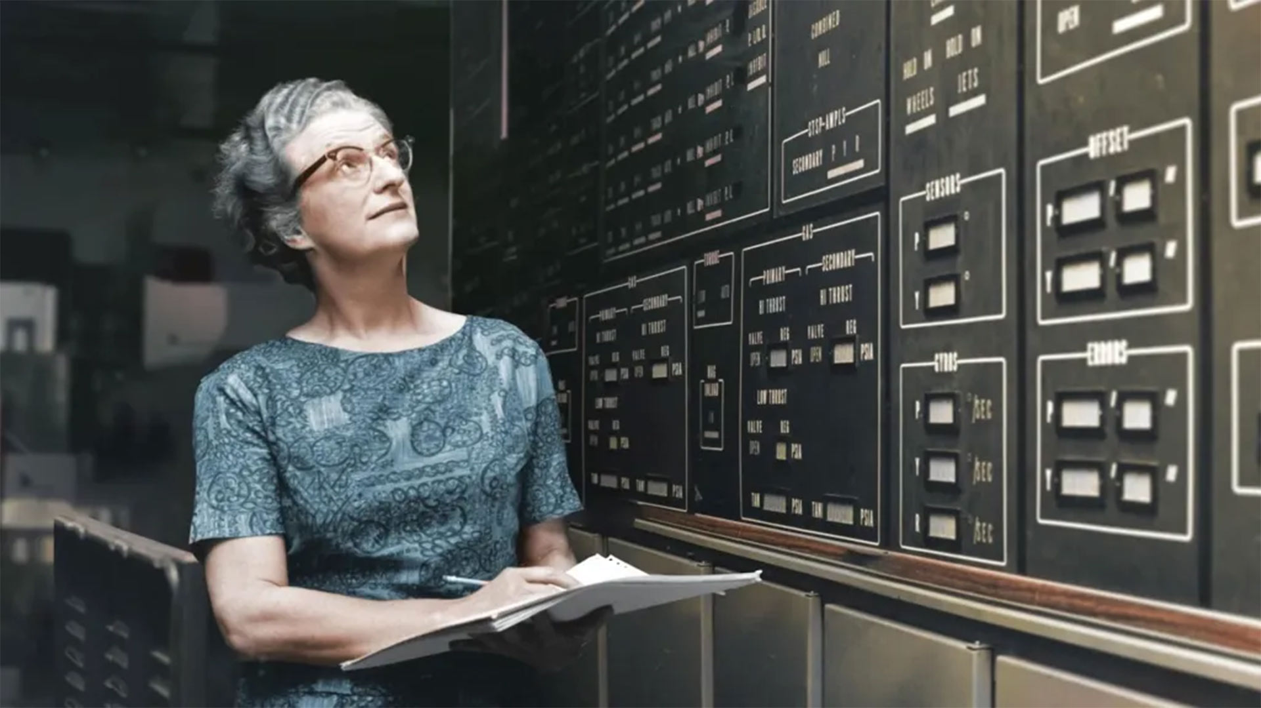
FAQ
Why is it called the
Nancy Grace Roman
Space Telescope?
Notes:
Why is it called the Nancy Grace Roman Space Telescope?
Dr. Nancy Grace Roman was an astronomer who joined NASA in 1959 when the agency was only six months old. Despite the many obstacles she faced as a woman in astronomy, she was the first female executive at NASA and the first Chief of Astronomy.
She worked diligently to plan for a robust suite of satellites and rockets to be managed by NASA, including space-based observatories that could gain a better vantage point for observing the universe above the atmosphere that clouds our vision from the ground.
Dr. Roman shepherded the Hubble Space Telescope through the political approval process in Congress. Without Dr. Roman, there very well may not have been a Hubble Space Telescope.
Dr. Nancy Grace Roman advanced space-based astronomy and general astrophysics knowledge, and the telescope bearing her name will take up that legacy by addressing big questions crucial to the future of the field.
Image Credit: NASA
Supportive Resources:
[Webpage] Dr. Nancy Grace Roman (1925-2018): https://solarsystem.nasa.gov/people/225/nancy-roman-1925-2018
[News Release] NASA Telescope Named For ‘Mother of Hubble’ Nancy Grace Roman: https://www.nasa.gov/news-release/nasa-telescope-named-for-mother-of-hubble-nancy-grace-roman
[Video] NASA's First Chief Astronomer, the Mother of Hubble: https://www.youtube.com/watch?v=m5fC3FIUngk
[Video] Nancy Grace Roman, The Mother of Hubble - Media Resources: https://svs.gsfc.nasa.gov/12634
[Article] Nancy Grace Roman and the Dawn of Space Astronomy: https://www.annualreviews.org/doi/abs/10.1146/annurev-astro-091918-104446
[Video] Meet Dr. Nancy Grace Roman, NASA’s first Chief of Astronomy: https://www.youtube.com/watch?v=3yK_EVdO1r4

Slide 32

FAQ
What is a survey telescope?
How is it different from Hubble and Webb?
Notes:
What is a survey telescope?
A survey telescope is designed to observe large swaths of the sky instead of focusing on specific targets. Astronomers can create maps of the sky and detect changes more quickly based on the collected data from survey missions. NASA’s Roman Space Telescope is a survey mission.
How is it different from Hubble and Webb?
Hubble and Webb observe specific objects and regions. With Roman, scientists will be able to collect enough data to see the large picture. This information will enable researchers to identify patterns and take censuses of astronomical objects that Hubble, Webb, and other observatories can follow up on to provide additional insights. Observations of the same object or region by different observatories give us a more complete picture of the cosmos, advancing our understanding of the universe.
Image Credit: NASA
Supportive Resources:
[Webpage] Roman and Webb: https://science.nasa.gov/roman-and-webb
[Webpage] Roman and Hubble: https://science.nasa.gov/roman-and-hubble
[Webpage] Eyes on the Solar System – Nancy Grace Roman Space Telescope: https://eyes.nasa.gov/apps/solar-system/#/sc_roman_space_telescope

Slide 33
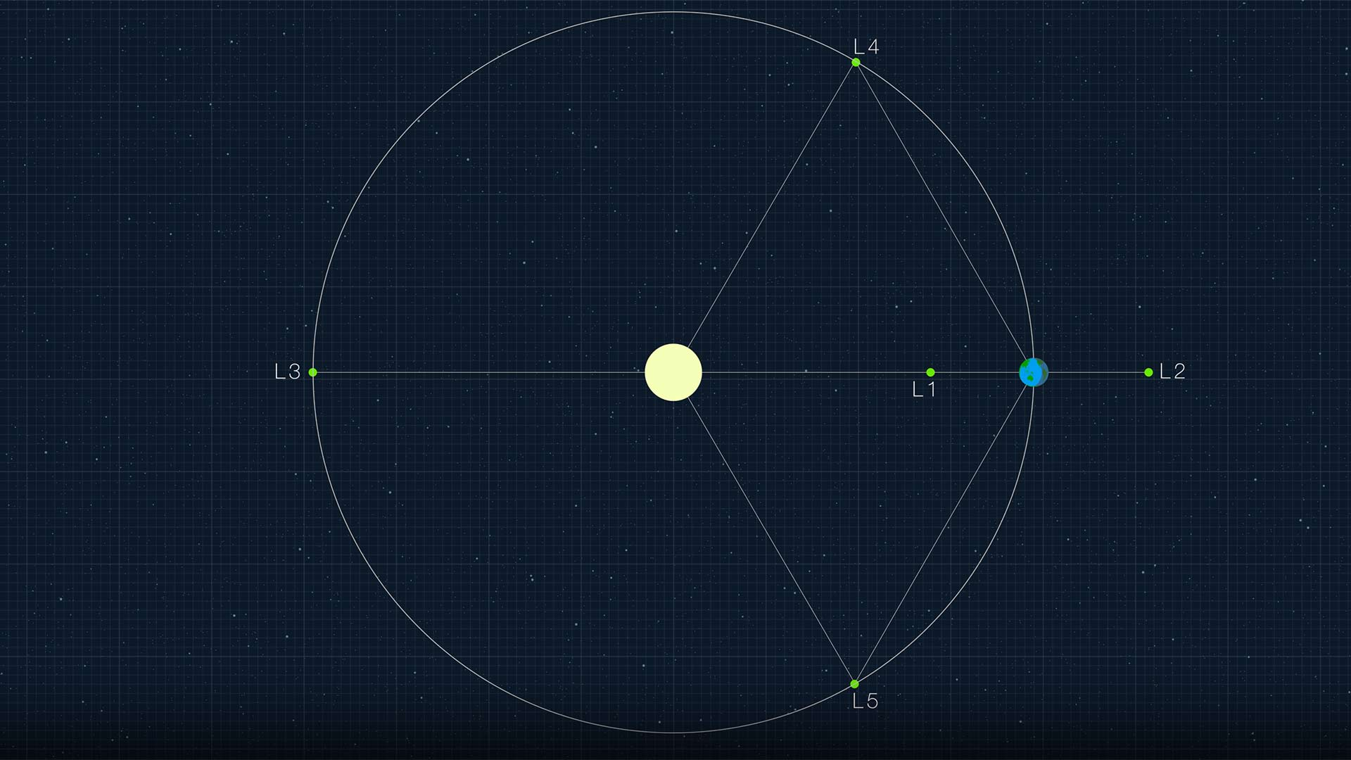
FAQ
Sun
Earth
Where will Roman be located?
Notes:
Where will Roman be located?
Roman will be located approximately 930,000 miles (1.5 million kilometers) from Earth. The telescope will orbit around the second Sun-Earth Lagrange point (L2), a place in space where the gravitational forces are balanced such that objects are able to stay in a fixed position without much manual assistance.
Image Credit: NASA
Supportive Resources:
[Webpage] What are Lagrange Points: https://solarsystem.nasa.gov/faq/88/what-are-lagrange-points
[Webpage] Eyes on the Solar System – Nancy Grace Roman Space Telescope: https://eyes.nasa.gov/apps/solar-system/#/sc_roman_space_telescope

Slide 34

FAQ
What is dark energy?
What is dark matter?
Notes:
What is dark energy?
Dark energy is the mysterious force that is accelerating the universe’s expansion. Astronomers don’t know much about the nature of this force.
How do we know it exists?
Based on galactic observations made by his associate, astronomer Milton Humason, American astronomer Edwin Hubble confirmed in 1929 that the universe was expanding.
And while scientists previously theorized that the universe’s expansion would gradually slow down over time, in 1998, two different teams of scientists observed distant Type Ia supernovae and found they were dimmer than expected, meaning that they moved farther away from us faster than anticipated.
How much of the universe is made up of dark energy?
Astronomers estimate that approximately 68% of the universe is made up of dark energy.
What is dark matter?
Dark matter is the invisible glue that holds the universe together.
How do we know it exists?
The concept of dark matter was first proposed in the 1930s. In 1933, Swiss-born astronomer Fritz Zwicky reported that galaxies in the Coma Cluster moved too quickly for the gravitational forces caused by ordinary matter. In the 1970s, American astronomer Vera Rubin observed this strange behavior when looking at the stars located in spiral galaxies’ outer edges. To account for why these stars moved as fast as they did while still being part of their galaxies, respectively, Rubin concluded that there must be a large amount of matter holding them in place.
How much of the universe is made up of dark matter?
Although not much is known about dark matter, scientists do know that approximately 27% of the universe is made up of this material, and they’ve been able to collect even more evidence of its existence. Even though we can’t see dark matter, we can observe its gravitational effects, like when light emitted by massive, distant objects is bent.
Image Credit: J. Kang (STScI)
Supportive Resources:
[Webpage] Dark Energy with Roman: https://science.nasa.gov/mission/roman-space-telescope/dark-energy
[Webpage] Dark Matter with Roman: https://science.nasa.gov/mission/roman-space-telescope/dark-matter
[Webpage] Dark Energy: https://science.nasa.gov/dark-energy
[Webpage] Dark Matter: https://science.nasa.gov/dark-matter
[Webpage] Discovering the Runaway Universe: https://science.nasa.gov/mission/hubble/science/science-highlights/discovering-a-runaway-universe

Slide 35
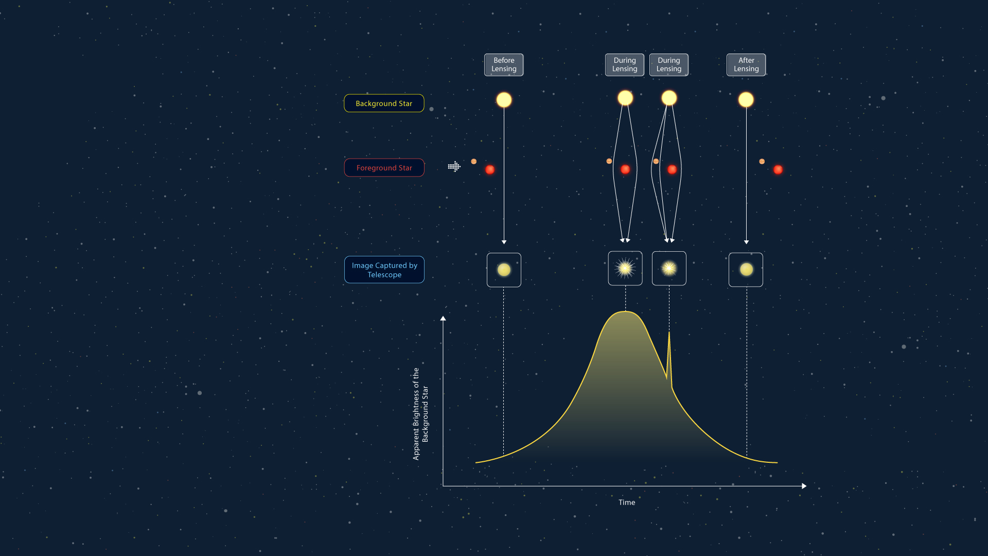
FAQ
What is
microlensing?
Notes:
What is microlensing?
Scientists will use a variety of methods to find exoplanets with Roman, including microlensing. Astronomers can find planets farther out from their host stars, like ice giants, with this approach. When two stars are closely aligned from Roman’s viewpoint, the nearer star and its orbiting planets — if it has any — temporarily bend the light from the star farther away, magnifying it.
About the Image:
The graphic illustrates a microlensing event via four panels. At the bottom of the panels there is a graph that tracks the distant star’s apparent brightness before, during, and after the microlensing event. In this example, a planet and its host star are moving in between a distant star and the observer.
Panel 1 shows the undisturbed path of light coming from the distant star and reaching the observer. As the planet-star system moves in front of the distant star, astronomers see that the distant star’s apparent brightness gradually grows, which is seen in the first half of the mostly bell curve-like graph at the bottom.
Panel 2 shows the star in the foreground star-planet system is aligned with the distant star and the observer. Because of this placement, the foreground star acts as a lens, bending and magnifying the light coming from the distant star. This is represented as the peak of the graph at the bottom.
Panel 3 shows that the planet orbiting the foreground star also contributes to the bending of the distant star's light. This is seen as an additional “blip” on the graph. Since astronomers cannot resolve the system, this “blip” in the mostly bell curve-like graph is a sign that the foreground star has an orbiting planet.
Panel 4 shows that as the planet-star system moves across the sky, the distant star’s light reaches the telescope undisturbed again. The apparent brightness of the background star gradually decreases, as seen on the graph.
Image Credit: J. Kang (STScI)
Supportive Resources:
[Webpage] Microlensing: https://science.nasa.gov/mission/roman-space-telescope/microlensing

Slide 36

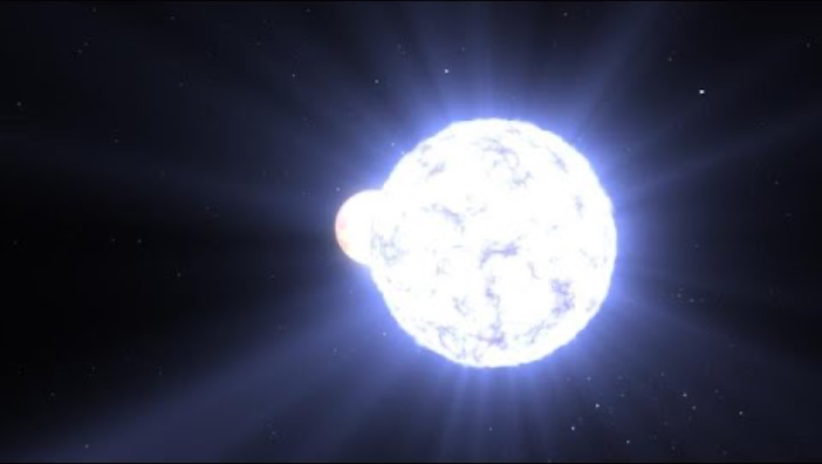
Optional Video Embed Slide

Slide 37

The Nancy Grace Roman Space Telescope is managed at NASA’s Goddard Space Flight Center in Greenbelt, Maryland, with participation by NASA’s Jet Propulsion Laboratory in Southern California; Caltech/IPAC in Pasadena, California; the Space Telescope Science Institute in Baltimore; and a science team comprising scientists from various research institutions. The primary industrial partners are BAE Systems Inc. in Boulder, Colorado; L3Harris Technologies in Rochester, New York; and Teledyne Scientific & Imaging in Thousand Oaks, California

