Slide 1
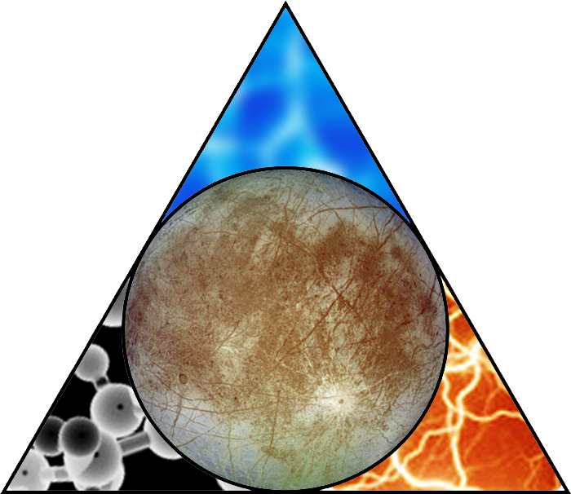
Europa Clipper Pre-Project - Update to ICEE Teams
Kari Lewis
Jet Propulsion Laboratory, California Institute of Technology
June 8, 2014
Copyright 2014 California Institute of Technology. Government sponsorship acknowledged.
Pre-Decisional — For Planning and Discussion Purposes Only

Slide 2
Introduction
The material in this package is a compilation of information the ICEE teams may find useful based on recent discussions and requests the Europa Clipper Pre-Project team has received since the last update (dated March 19, 2014).
The spacecraft and trajectory information is subject to change as the design matures.
For additional information or questions, please contact:
    Kari Lewis Melora Larson
    kari.a.lewis@jpl.nasa.gov melora.e.larson@jpl.nasa.gov
    818-393-1103 818-354-8751
    Jet Propulsion Laboratory, California Institute of Technology
Pre-Decisional — For Planning and Discussion Purposes Only
3/19/14

Slide 3
Model Payload Resources Summary
Instrument | Unshielded Mass (kg) | Shielding Mass (kg) | Total CBE Mass (kg) | CBE Power (W) | Data Volume (Gb/flyby) | Comments
Ice Penetrating Radar (IPR) | 31.7 | 5 | 36.7 | 57 | 23.5 | Bringing down data between ± 1000 km
Topographical Imager (TI) | 3.8 | 1.5 | 5.3 | 7.9 | 4.8 | 3:1 lossy compression; each additional 4 k x 4 k image is 0.07 Gbit compressed
ShortWave IR Spectrometer (SWIRS) | 14.4 | 5.9 | 20.3 | 21.1 | 0.53 | 3:1 lossy compression; 2 full disk scans on approach; 2 full images during flyby
Reconnaissance Camera (RC) | 13.5 | 2 | 15.5 | 22 | up to 6 | Data volume varies with flyby altitude; max for 25-km flyby
Thermal Imager (ThI) | 7.2 | 1.3 | 8.5 | 11 | 0.23 | Operating for ~8 hr/flyby
Neutral Mass Spectrometer (NMS) | 6.1 | 2 | 8.1 | 25 | 0.012 | 18 Kbps rate, acquiring data between ±5000 km from surface
Magnetometer (MAG) | 2.7 | 0 | 2.7 | 4.5 | 0.1 per orbit | Operates continuously; increased sample rate E±2 hr
Langmuir Probe (LP) | 2.9 | 0.4 | 4.3 | 2.8 | 1.2 per orbit | Operates continuously
Totals: | 82.3 | 18.1 | 100.4 | 151.3 | 36.4
New: Increased NMS power and data volume; Decreased RC data volume
Pre-Decisional — For Planning and Discussion Purposes Only
3/19/14

Slide 4
General Questions
Can we get a STEP file of the S/C or at least of the nadir deck and any S/C structure visible from the deck?
  We continue to try to get a STEP file approved for unlimited release. There is a lot of design information included in STEP files, so it is difficult to have them meet ITAR restrictions.
Can we get a S/C thermal model? Or at least provide the external temperatures of the MMRTGs and the back of the HGA.
  We do not have a thermal model of the S/C yet
  MMRTG temperature is 180 °C
  HGA MLI temperature is -160°C
Can we get a trajectory file that covers launch to Jupiter?
  Posted to the ICEE website
  http://solarsystem.nasa.gov/europa/iceedocs.cfm
Is it possible to interchange the positions of the recon camera and SWIRS on the nadir deck
  Yes

Slide 5
Radiation Questions
How do we account for zone-specific shielding effect of spacecraft structure (e.g., on the instrument deck, the edge of HGA, etc.)?
  No zone-specific radiation environments have been established. Each location strongly depends upon hardware in the immediate vicinity, which is in flux. Components such as the HGA will not contribute to shielding in a significant manner. The instrument deck will have highly-variable shielding contributions from spacecraft and other instruments.
Will the project provide radiation environment definition per mission phase (e.g., cruise-to-JOI and JOI-to-EOM, and orbit-by-orbit)?
  The vast majority of TID occurs during the Europa fly-by pedals. Each pedal is roughly equal in dose (approx. 35 krad/flyby for 100-mils Al spherical shell). The Environmental Requirements Document (ERD), available on the ICEE website, provides the Solar Energetic Particles (SEP) and Galactic Cosmic Radiation (GCR) environments, which are relevant throughout the entire mission (somewhat less important at Jupiter, due to magnetic shielding).

Slide 6
Radiation Questions
What is the guideline of TID exposure if we want to avoid the bake-out to meet the planetary protection requirement?
  TID would need to be ≥ 10Mrad
  This would also imply simple electrical and mechanical interfaces to facilitate aseptic integration, using Vaporized Hydrogen Peroxide to sterilize the interface.
What is the IESD environment that we will have to use?
  IESD environment is shielding dependent. The dominant environment for IESD is the trapped electron spectrum. The ERD includes design guidelines. NASA-HDBK-4000A provides general guidance.
Is it possible to provide us with the differential quantities or give directions on the accepted way to calculate the differential fluxes and fluences?
  This information is currently going through approval for unlimited release

Slide 7
Topo Imager Questions (1 of 2)
In the kickoff slide package, slide 128 has a conflict regarding the altitude where TI imaging switches from stereoscopic to monoscopic imaging. The figure indicates 1000 km and text indicates 1600 km. Slide 61 also indicates 1000 km. Which value should we use?
  The 1600 km mentioned in the Slide 128 text is an upper limit and is not intended to imply that continuous stereo imaging would occur below that altitude. Stereo imaging continuously below 1000 km is required to support IPR sounding.
According to slides 127 & 128 of the kickoff package, the spacecraft is nadir pointed throughout the entire flyby (≤66,000 km altitude). This is different than the Summer Study report (Europa Summer Study Final Report Part 1, slide 82), which included “pointed Instrument observations” between 2000 and 4000 km altitude. Is this why the model TI FOV was changed from two line arrays to a single area array?
  The current Project position is that only nadir pointing will be provided. Various alternatives for obtaining monoscopic nadir or areal coverage above 1600 km at acceptable emission angles are possible. The use of an area array is one solution. Another would be to point one of the stereo line arrays near nadir and the other either forward or aft.

Slide 8
Topo Imager Questions (2 of 2)
How was the 58° cross-track FOV (kickoff slides 49 & 69) for TI calculated? It appears that a cross-track FOV of 53° is sufficient to cover the 100 km swath width required for the IPR at 100 km altitude using the following equation: crosstrack FOV=2 × tan-1swathwidth2 ×altitude
  The planning payload TI IFOV was selected to be 250 µrad to meet the required spatial resolution of 250 m at an altitude of 1000 km. The FOV was set as 4096 pixels × IFOV = 1 rad. This FOV met the original SDT requirement for 100 km swath width from 100 km altitude with a little margin. The SDT has since changed its requirement on stereo coverage swath width to be a function of radar penetration depth and S/C altitude. The planning payload FOV meets the current swath width requirement for a 3-km penetration depth down to an altitude of 25 km.
The TI mass breakdown provided in the January update includes 0.45 kg for a harness. Is the mass of the ~ 3-m long (slide 8) TI cable from the nadir deck to the electronics vault included in that mass value?
  Yes

