Slide 1
A-Train Web Site
Candidate material
  The following collection of slides were assembled from various presentations and from the Afternoon Constellation Operations Coordination Plan.
  As mentioned at the meeting, several of the slides are out-dated – they typically do not take into account later missions, i.e., OCO-2, GCOM-W1, or Glory.
  March 1, 2010

Slide 2
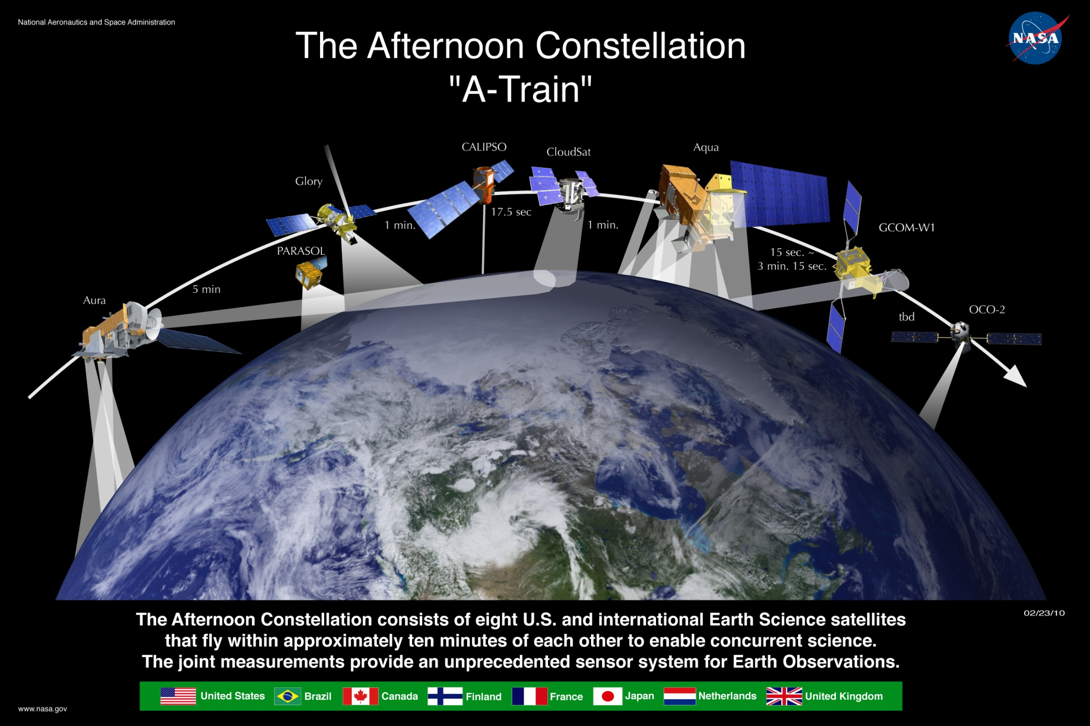
Note: This is the latest graphic.

Slide 3
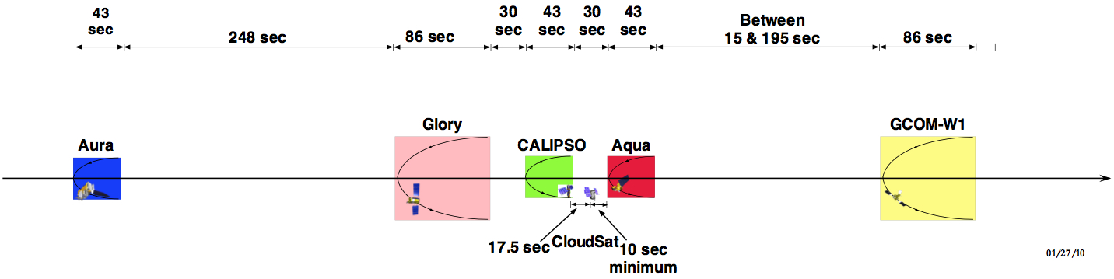
A-Train Orbital Configuration
(Through launch of GCOM-W1)
Additional drawings are available for other time periods

Slide 4
Afternoon Constellation Project Scientists & Mission Operations Control Centers

Slide 5




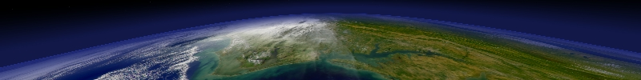
Afternoon Constellation Science Opportunities
Aura
CALIPSO
OCO
Glory
PARASOL
CloudSat
Aqua
OCO - CO₂ column
OMI - Cloud heights
OMI & HIRLDS – Aerosols
MLS& TES - H₂O & temp profiles
MLS & HIRDLS – Cirrus clouds
CALIPSO- Aerosol and cloud heights
Cloudsat - cloud droplets
PARASOL - aerosol and cloud polarization
OCO - CO₂
MODIS/ CERES
IR Properties of Clouds
AIRS Temperature and H₂O Sounding
Updates include: MLS-CloudSat coincidence plus others

Slide 6
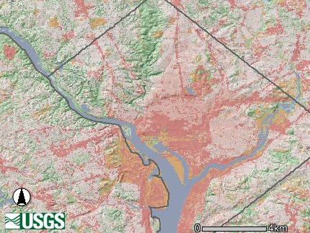
“A-Train” Nadir Footprints
6x7 km POLDER
Cloud
1. 4 km Cloudsat
0.09 km CALIPSO
13.5 km AIRS IR; AMSU & HSB μ wave
OCO
1x1.5 km
0.5 km MODIS Band 3-7
5.3 x 8.5 km TES
Washington DC
USGS Map

Slide 7
Vertical Resolution of the “A Train”
Aura
Aqua
CALIPSO
30
Cloudsat
25
OCO
20
15
10
Km
5
AMSU
HSB
MLS
HIRDLS
TES
AIRS
0
1.5-2
1.5
2.3
1
2
0.03
0.5
Vertical resolution in km

Slide 8
A-Train Science Goals and Requirements for Coincident Observations
The Afternoon Constellation enables near-coincident, co-located observations for some instruments on different constellation spacecraft.. By combining the information from several sources the scientists derive more complete answers to many questions than would be possible from any single satellite. Some of the most important science questions are listed here followed by examples of how the data from the Afternoon Constellation are used by scientists to answer these questions.
What are the major aerosol types and how do observations match global emission and transport models?
Aerosol height information obtained by CALIOP (on CALIPSO) will be combined with data on aerosol size distribution and composition obtained by the Polarization and Directionality of the Earth's Reflectances (POLDER) instrument on PARASOL, MODIS (on Aqua), and APS (on Glory). CALIOP also provides additional information on aerosol shape and a qualitative classification of aerosol size; scientists plan to use profile data from CALIPSO to improve information from OMI (on Aura) on the global distribution of absorbing aerosols. The combination of APS and MODIS views of ocean glint will allow the determination of absorption by aerosols to be extended from the UV (from OMI) into the visible and near infrared. APS estimates of aerosol mixed layer depth will also allow for improved estimates of aerosol absorption by OMI.
How do aerosols contribute to the Earth Radiation Budget (ERB)/climate forcing?
Data from CALIOP, POLDER, APS, MODIS and OMI will all help answer this question. Data from CERES is crucial for providing information on the ERB. Data from AIRS, HSB and AMSR-E (all on Aqua) will provide information on how aerosol climate forcing changes with atmospheric humidity. In conjunction with data from CloudSat’s Cloud Profiling Radar (CPR), these sensors offer an unprecedented opportunity to understand what role aerosols play in changing cloud properties and thus changing the ERB.

Slide 9
A-Train Science Goals and Requirements for Coincident Observations (concluded)
  How does cloud layering affect the Earth Radiation Budget?
Data obtained by CloudSat’s CPR, augmented by data from both CALIPSO’s CALIOP and Aqua’s MODIS, will provide the first global survey of vertical cloud structure. Scientists plan to use data from CALIOP and MODIS to help augment the cloud detection capabilities of the CPR.
  What is the vertical distribution of cloud water/ice in cloud systems?
Information from CALIOP, CPR, HSB, AMSR-E, and MLS will be combined to produce vertical profiles of cloud systems. Combining information from CPR, CALIOP, POLDER and APS is expected to shed light on the nature of mixed phase clouds (clouds composed of both water and ice) and help improve parameterizations of these processes in atmospheric models. The combination of APS and MODIS and/or AIRS will allow for a more detailed examination of the conditions under which super-cooled water clouds exist and facilitate physically based parameterizations of this phenomenon in atmospheric models.
  What is the role of Polar Stratospheric Clouds in ozone loss and denitrification of the Arctic vortex?
CALIOP data will provide direct information on polar stratospheric cloud height and, in some instances, on cloud type. HIRDLS will also provide some cloud height information. Combined with temperature readings, nitric acid, and chlorine oxide concentrations obtained by MLS and column ozone amounts from OMI, information will be obtained on the role of polar stratospheric clouds in Arctic chemical processes.
Source:
Afternoon Constellation Operations Coordination Plan. Derived from “Formation Flying: The Afternoon (A-Train) Satellite Constellation”, NASA Facts, FS-2003-1-053-GSFC, February 2003, and from the Afternoon Constellation MOWG Presentations, March 2003

Slide 10
Source: Afternoon Constellation Operations Coordination Plan. GCOM-W1 needs to be added
A-Train Mission Summary
Satellite | Summary Of | Instruments | Launch Date | Responsible Organization
Aqua | A synergistic instrument package measuring at visible, infrared, and microwave frequencies allows comprehensive studies of water in the Earth/atmosphere system, including its solid, liquid and gaseous forms, plus studies of vegetation, both on the land and in the ocean. | AIRS/AMSU-A/HSB AMSR-E CERES MODIS | May 4, 2002 | NASA/GSFC
Aura | Observations from limb sounding and nadir imaging allow studies of the horizontal and vertical distribution of key atmospheric pollutants and greenhouse gases and how these distributions evolve and change with time. | HIRDLS MLS OMI TES | July 15, 2004 | NASA/GSFC
CALIPSO | Observations from space-borne lidar, combined with passive imagery, will lead to improved understanding of the role aerosols and clouds play in regulating the Earth’s climate. | CALIOP IIR WFC | April 28, 2006 | NASA/GSFC NASA/LaRC CNES
CloudSat | Cloud Profiling Radar will allow for the most detailed study of clouds to date and should better characterize the role clouds play in regulating the Earth’s climate. | CPR | April 28, 2006 | NASA/GSFC NASA/JPL
PARASOL | Polarized light measurements will allow better characterization of clouds and aerosols in the Earth’s atmosphere. | POLDER | December 18, 2004 | CNES
OCO | Three grating spectrometers will make global, space-based observations of the column-integrated concentration of CO₂, a critical greenhouse gas. | Three grating spectrometers | TBD | NASA/GSFC NASA/JPL
Glory | Increase understanding of aerosols as agents of climate change and continue the total solar irradiance monitoring mission | APS TIM | 2010 | NASA/GSFC

Slide 11
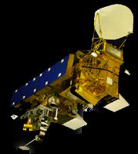
EOS Aqua
Investigates the Earth's water cycle, including evaporation from the oceans, water vapor in the atmosphere, clouds, precipitation, soil moisture, sea ice, land ice, and snow cover on the land and ice.
Instruments
AIRS: Atmospheric Infrared Sounder – Obtains highly accurate temperature profiles within the atmosphere
AMSU-A: Advanced Microwave Sounding Unit – Obtains temperature profiles in the upper atmosphere (especially the stratosphere) and provides a cloud-filtering capability for tropospheric temperature observations
HSB: Humidity Sounder for Brazil – 4-channel microwave sounder aimed at obtaining humidity profiles throughout the atmosphere.
AMSR-E: Advanced Microwave Scanning Radiometer for EOS – Uses a twelve-channel, six-frequency, microwave radiometer system to measures precipitation rate, cloud water, water vapor, sea surface winds, sea surface temperature, ice, snow, and soil moisture
MODIS: Moderate Resolution Imaging Spectroradiometer – Similar to Terra
CERES: Clouds and the Earth's Radiant Energy System – Similar to Terra

Slide 12
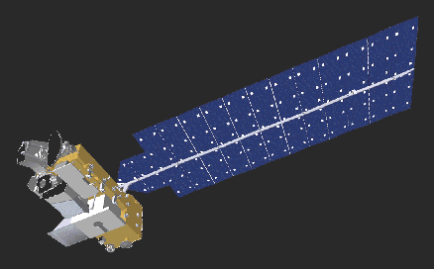
EOS Aura
Researches the composition, chemistry, and dynamics of the Earth’s atmosphere as well as study the ozone, air quality, and climate.
Instruments
HIRDLS: High Resolution Dynamics Limb Sounder – Observes global distribution of temperature and composition of the upper troposphere, stratosphere, and mesosphere
MLS: Microwave Limb Sounder – Uses microwave emission to measure stratospheric temperature and upper tropospheric constituents
OMI : Ozone Monitoring Instrument – Distinguishes between aerosol types, such as smoke, dust, and sulfates. Measure cloud pressure and coverage, which provide data to derive tropospheric ozone.
TES: Tropospheric Emission Spectrometer – High-resolution infrared-imaging Fourier transform spectrometer that offers a line-width-limited discrimination of essentially all radiatively active molecular species in the Earth's lower atmosphere.

Slide 13
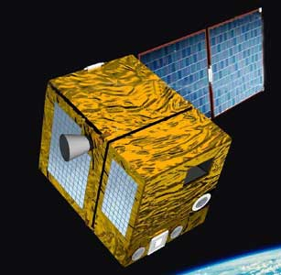
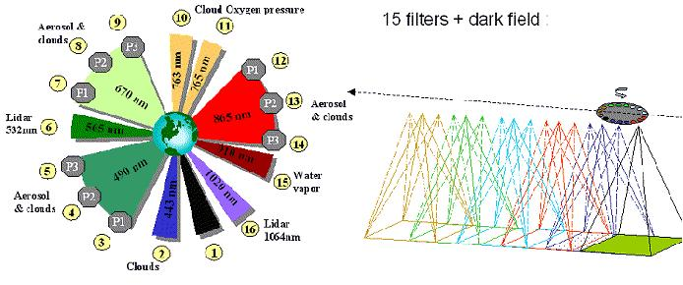
PARASOL
(Polarization and Anisotropy of Reflectances for Atmospheric Science coupled with Observations from a LIDAR)
A CNES satellite that studies the role of clouds and aerosols
Instrument
POLDER: Improve the microphysical and radiative property characterization of clouds and aerosols for model improvement.
Source: CNES

Slide 14
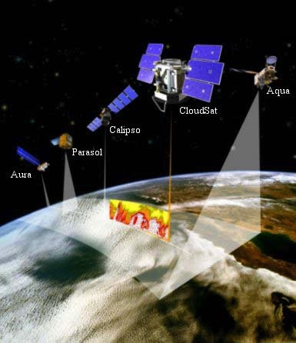
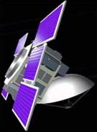
CloudSat
NASA satellite with the Cloud Profiling Radar (CPR) instrument, a 94-GHz nadir-looking radar
  Measures the power backscattered by clouds as a function of distance from the radar.
Developed jointly by NASA’s Jet Propulsion Laboratory (JPL) and the Canadian Space Agency (CSA).
Will advance our understanding of cloud abundance, distribution, structure, and radiative properties.
First satellite-based millimeter-wavelength cloud radar
  > 1000 times more sensitive than existing ground weather radars
  Able to detect the much smaller particles of liquid water and ice (ground-based weather radars use centimeter wavelengths)
Cloud Profiling Radar

Slide 15
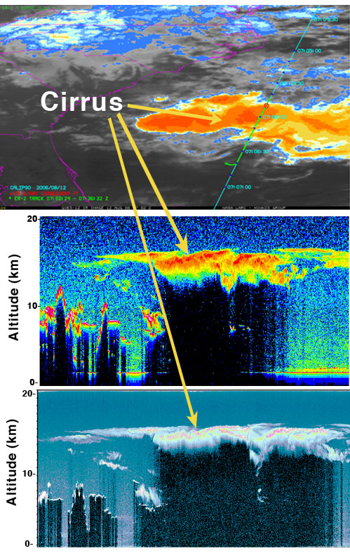
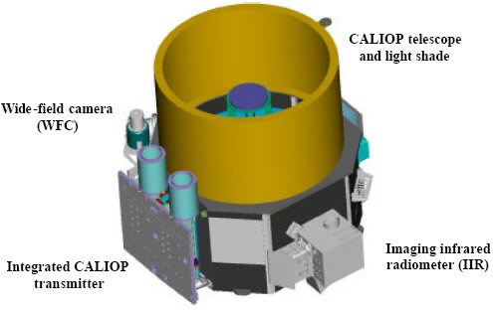
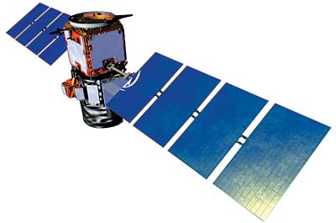
CALIPSO
Joint NASA/CNES satellite
Three instruments:
  Cloud-Aerosol Lidar with Orthogonal Polarization (CALIOP): Two wavelength polarization-sensitive Lidar that provides high-resolution vertical profiles of aerosols and clouds
  Wide Field Camera (WFC): Fixed, nadir-viewing imager with a single spectral channel covering the 620-670 nm region
  Imaging Infrared Radiometer (IIR): Nadir-viewing, non-scanning imager

Slide 16

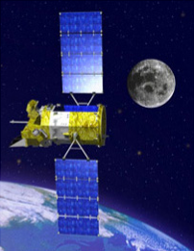
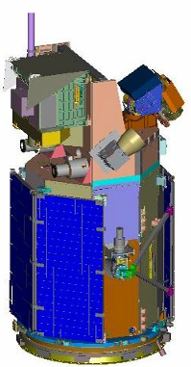
Aerosol Polarimetry Sensor
(APS)
Total Irradiance Monitor
(TIM)
Cloud Camera

Slide 17
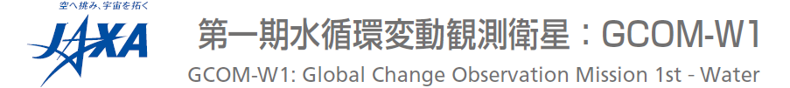
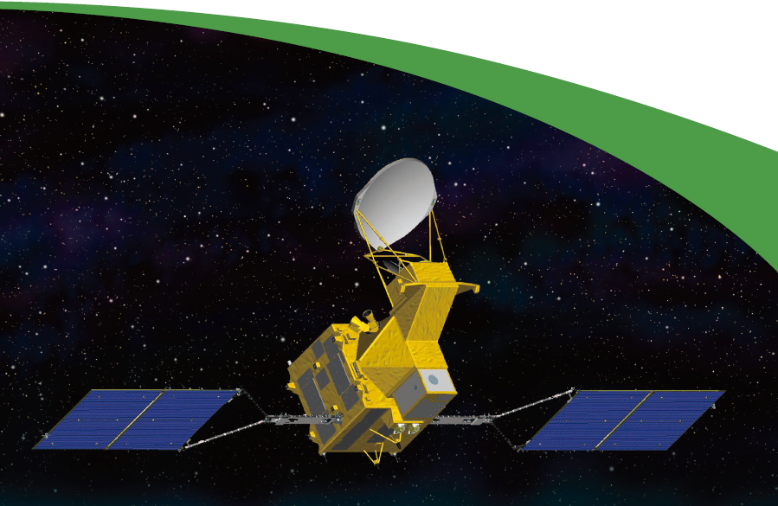

Slide 18
Afternoon Constellation Mission Operations Working Group (MOWG) Charter
Ensure the integrity and safety of the constellation through cooperative agreements and actions
Agree on the baseline Constellation orbital configuration
Provide forum for defining changes to the baseline Constellation configuration
Define the data to be exchanged and the means of doing so
Facilitate coordination of cooperative science campaigns
Review specific mission plans that might impact the other Constellation missions
Provide the forum for discussing and resolving issues between member satellites

Slide 19
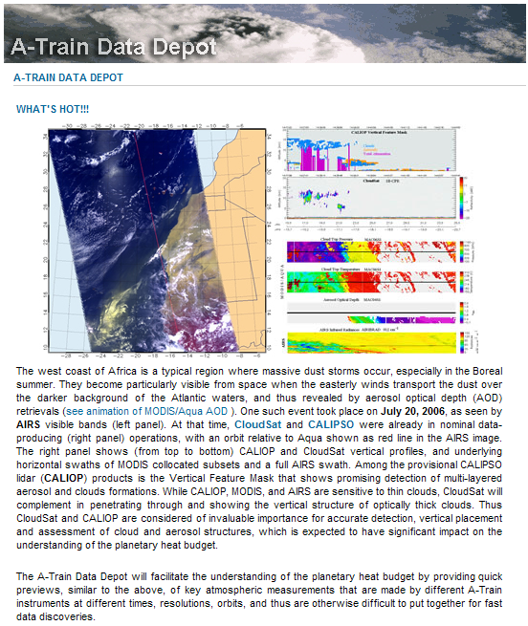

A-Train Data Depot
The primary objective of Data Depot (ATDD), is to process, archive, provide access, visualize, analyze and correlate distributed atmosphere measurements from various A-Train instruments along A-Train tracks.
The Depot will enable the free movement of remotely located A-Train data so that they are combined to create a consolidated, almost synoptic, vertical view of the Earth's atmosphere.
Once the infrastructure of the Depot is in place, it will be easily evolved to serve data from all A-Train data measurements: one-stop-shopping.
URL: http://disc.gsfc.nasa.gov/atdd/

Slide 20
The A-Train Data Depot Goals
Provide a tool that allows A-Train sensor data to be provided with first order temporal and spatial correlations (coincidence) already performed for the scientist.
Be responsive to the data and service needs of the A-Train Cloud/Aerosol community
Provide services (i.e., expertise) that will facilitate the effortless access to and usage of ATDD data
Collaborate with scientists to facilitate the use of data from multiple sensors for long term atmospheric research

Slide 21
2009 02 24
Notes:
Widened orbit lines near viewer to give 3-D effect

