Slide 1
The JPL lidar atmospheric composition observations for NDACC:
A review of the multi-decadal ozone, temperature, aerosol, and water vapor
profiles at JPL Table Mountain Facility, California (TMF)
and Mauna Loa Observatory, Hawaii (MLO)
Thierry Leblanc
Jet Propulsion Laboratory, California Institute of Technology
Wrightwood, CA USA
With well-deserved credits for present TMF Lidar Team Members:
Mark Brewer
Fernando Chouza
Darryl Koon
Patrick Wang
… and well-deserved credits for past Lidar Team Members:
Maria-Jose Granados-Munoz
Tony Grigsby
Dave Haner
Jeff Howe
Guillaume Kirgis
Stuart McDermid
Marty Schmoe
Dan Walsh
© 2022 California Institute of Technology Government sponsorship acknowledged

Slide 2
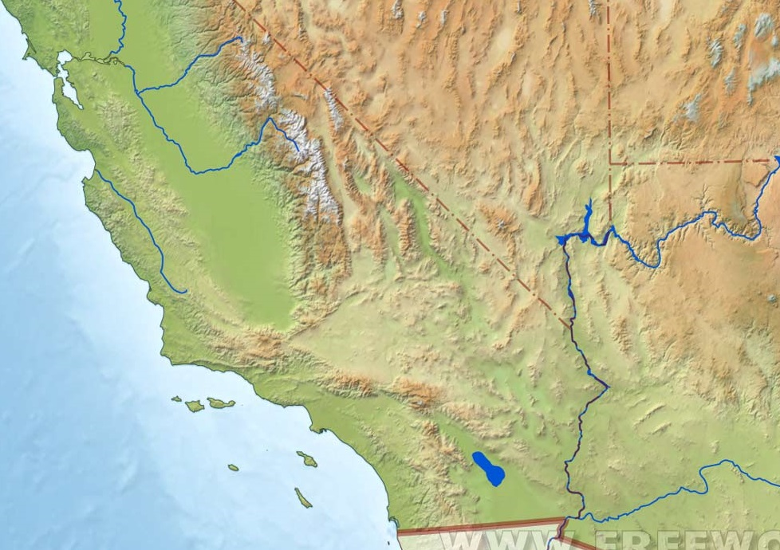
Where is TMF?
TMF
In the San Gabriel Mountains
Elevation: 2285 m (7300 Ft)
2-hour drive from JPL Pasadena
JPL

Slide 3
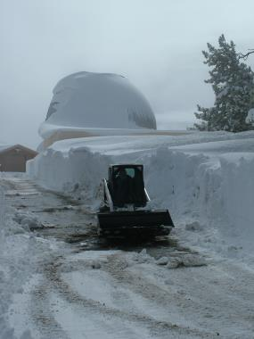
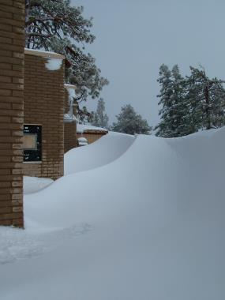
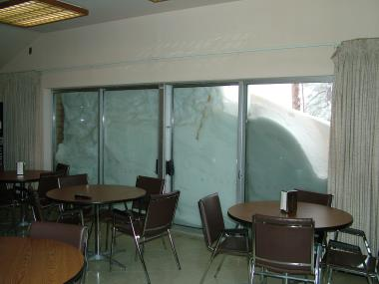
Southern California?...
Access to lidar building
Dining area
Microwave radiometer
somewhere under…

Slide 4
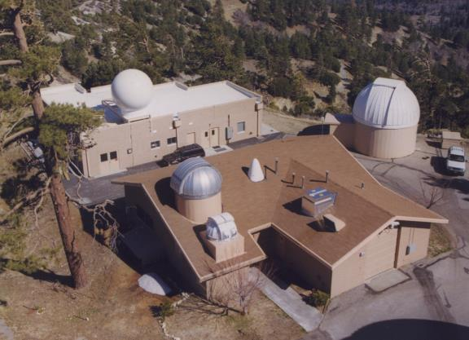
JPL-TMF Lidar Group Home Base
1988-present: Stratospheric ozone,
aerosols and temperature lidar (NDACC)
GPS TPW
Microwave
radiometer
(NDACC)
ECC
ozonesonde
2005-present:
Water vapor lidar
(NDACC)
PTU
radiosonde
1999-present:
Tropospheric
ozone lidar
(NDACC)
Frost-point
hygrometer
sonde
Surface
ozone monitor

Slide 5
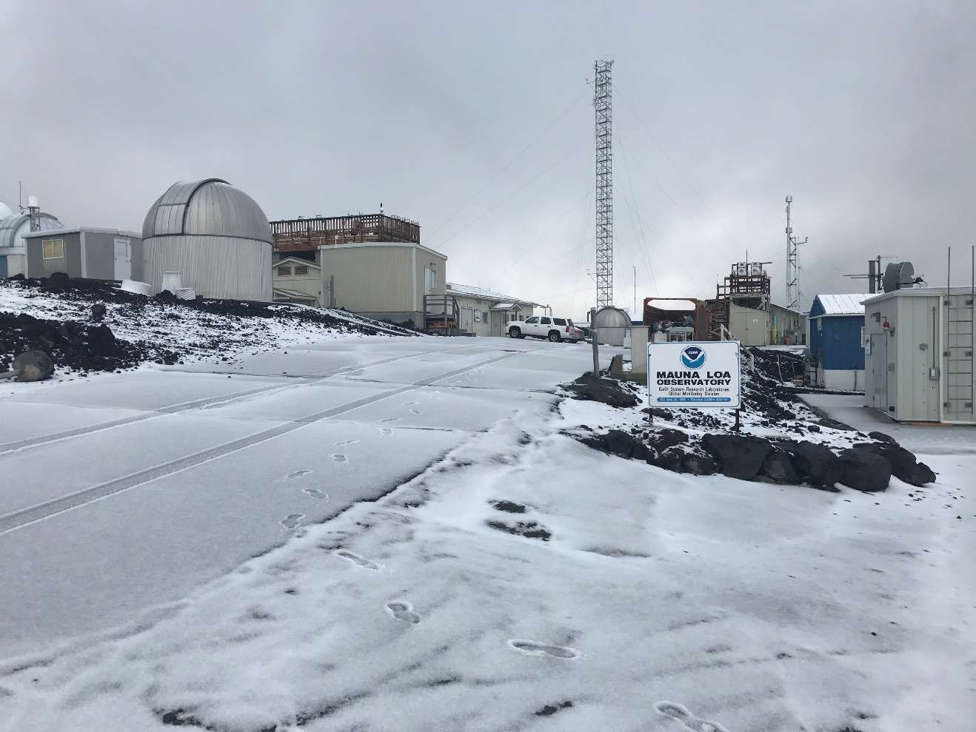
Also managed by the JPL-TMF Lidar Group
1993-present: Stratospheric ozone, aerosols and temperature lidar (NDACC)
At Mauna Loa Observatory, Hawaii (MLO)
The TMF Lidar Group (4.5 FTE) manages 15 long-term atmospheric products,
including 8 products archived at NDACC

Slide 6

What is NDACC?
Network for the Detection of Atmospheric Composition Change
(formerly known as “NDSC”)
International network of 70+ high-quality, remote-sensing research stations
Observe and understand the physical and chemical state of the stratosphere
and upper troposphere
Assess the impact of stratosphere changes on the underlying troposphere
and on global climate
Detect trends in overall atmospheric composition and understand their impacts
on the stratosphere and troposphere
Establish links between climate change and atmospheric composition
NDACC Website: http://www.ndaccdemo.org/
NDACC Data Handling Center: https://www-air.larc.nasa.gov/missions/ndacc/
NDACC Lidar Working Group website: https://lidar.jpl.nasa.gov/ndacc/index_ndacc.php

Slide 7
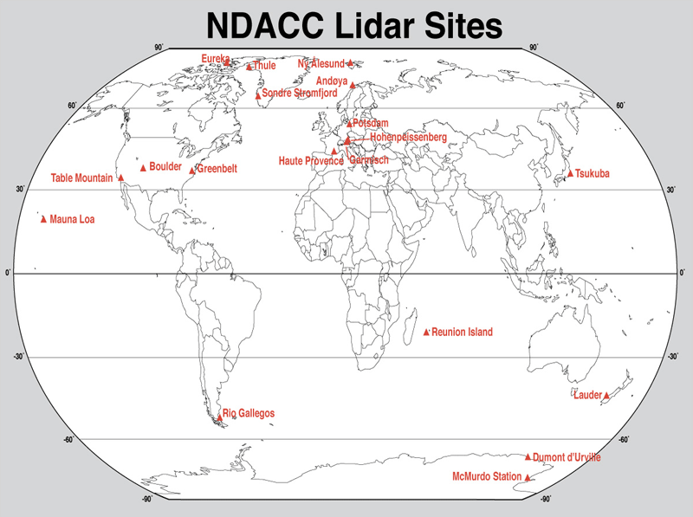
NDACC Lidars: (Almost) Global Network
Sodankyla
London
Payerne
Rome
Potenza
Huntsville
TMF and MLO are
the 2 NDACC sites
managed by the
TMF Lidar Group
Dome C
Deep tropics not covered!

Slide 8
What is Lidar?
Lidar (LIght Detection And Ranging) is an active remote sensing technique
One or more laser beam(s) sent in the atmosphere
Laser light backscattered by atmospheric molecules and particles, collected by telescope
Amount of light (raw lidar signal) analyzed as a function of time, i.e., altitude
(high temporal and vertical resolution)
Lidar atmospheric composition applications:
Vertical profiles of ozone, water vapor, temperature, wind, cloud and aerosol properties
(also, CO₂, CH₄, NO₂, and more)
Temporal resolution can range from seconds to days
Vertical resolution can range from meters to a few kilometers

Slide 9
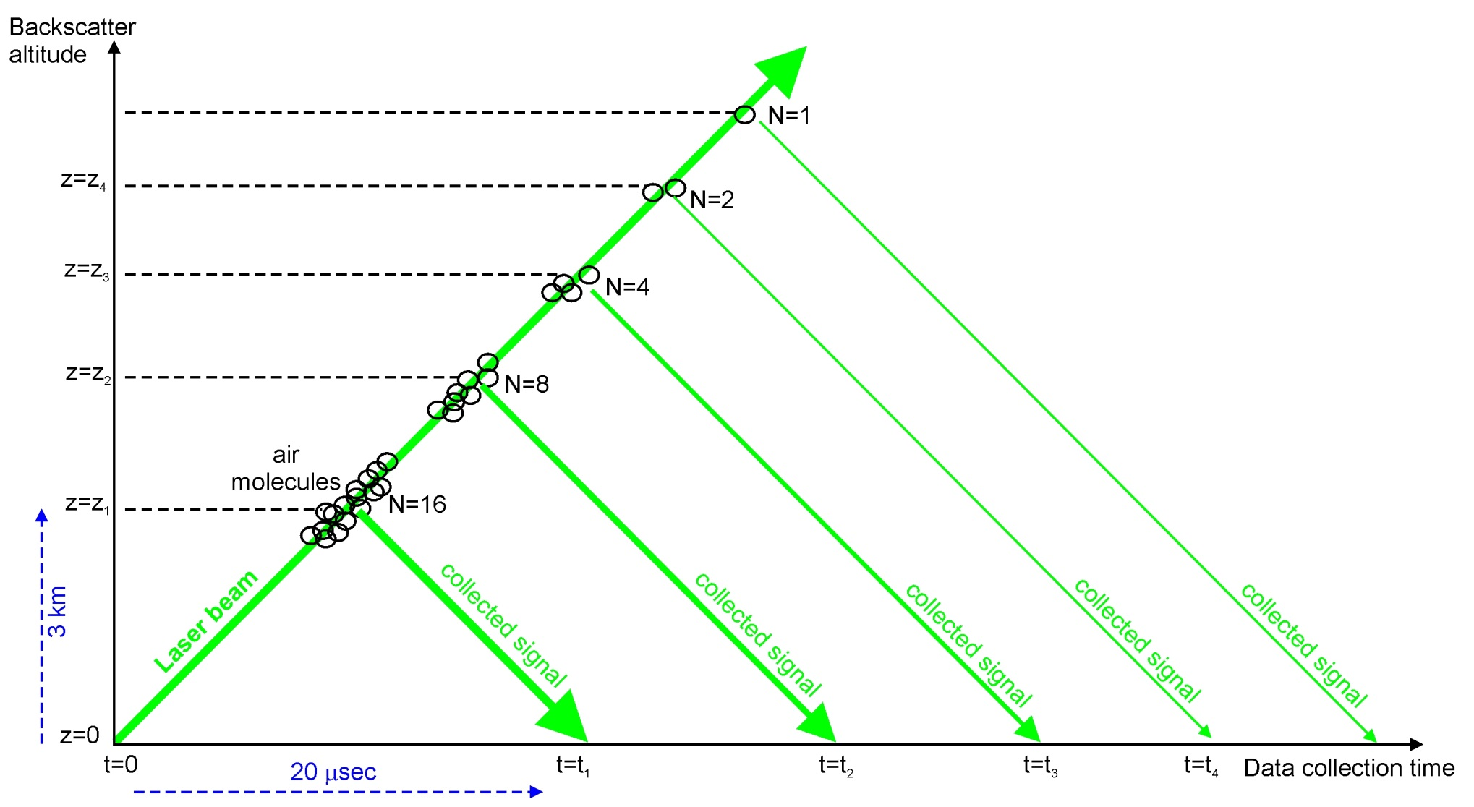
Lidar Specificity
1. Active remote sensing:
Signals sampled as a function of time,
i.e., geometric altitude
➔ High sampling resolution (~meters)
2. Eulerian measurement:
Signals reflect the temporal evolution of the atmosphere at a fixed location
➔ Produce “2D curtain plots” at various timescales (alt. vs. time)
3. Integration/averaging:
Signals may be acquired continuously for hours/days at a time
➔Large number of profile averaging options, and therefore science applications
➔ Wide range of associated uncertainties
4. Backscatter:
Collected signal is proportional to the number of backscattering molecules
➔ Intensity decreases exponentially with altitude (5+ orders of magnitude in 20 km)

Slide 10
Lidar Equation
Photon
counts
detected
Backscatter
intensity
Lidar receiver
efficiency terms and
viewing geometry
Photon counts
emitted by laser
Laser beam
extinction
on the way back
Laser beam
extinction
on the way up
r = range
δr = sampling resolution
subscript E = emitted
subscript D = detected
subscript L = lidar
subscript M = molecule
The idea behind the lidar technique:
Build receiver channels at specific wavelengths
and spectral widths to target specific types
of scattering or extinction process

Slide 11
JPL Lidar Capabilities
What species?
➔
1- Ozone DIAL (stratosphere): 12-50 km Prec. 1-20% Accur. 4%
➔
2- Ozone DIAL (troposphere): 0-20 km Prec. 1-20% Accur. 4%
➔
3- Temperature Rayleigh: 20-90 km Prec. 0-10 K Accur. 0.5 K
➔
4- Temperature vib.-Raman: 8-40 km Prec. 0-10 K Accur. 0.5 K
➔
5- Water vapor vib.-Raman: 0-20 km Prec. 0-20% Accur. 3-10%
➔
6- Clouds and aerosols: 10-50 km Prec. 1-20% Accur. 1-10%
Precision degrades with altitude and improves with integration time
Accuracy depends on altitude and species measured

Slide 12
JPL-TMF Lidar Capabilities: Stratospheric Ozone
What species?
➔
1- Ozone DIAL (stratosphere): 12-50 km Prec. 0-20% Accur. 4%
➔
2- Ozone DIAL (troposphere): 0-20 km Prec. 0-20% Accur. 4%
➔
3- Temperature Rayleigh: 20-90 km Prec. 0-10 K Accur. 0.5 K
➔
4- Temperature vib.-Raman: 8-40 km Prec. 0-10 K Accur. 0.5 K
➔
5- Water vapor vib.-Raman: 0-20 km Prec. 0-20% Accur. 6%
➔
6- Clouds and aerosols: 0-50 km Prec. 1-20% Accur. 1-10%
Precision degrades with altitude and improves with integration time
Accuracy depends on altitude and species measured

Slide 13

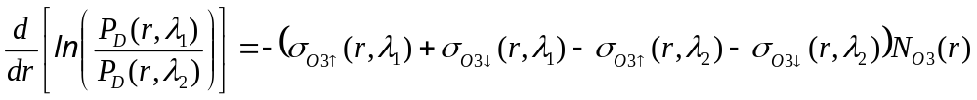
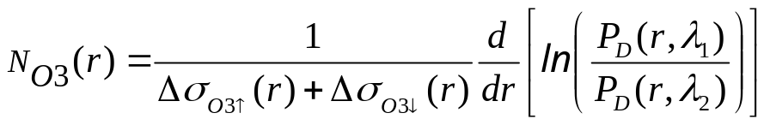
Ozone Differential Absorption Lidar (DiAL)
Use the extinction part of the lidar equation,
more specifically: the absorption by ozone
Laser beam is partially absorbed along the laser beam path
Intensity of absorption depends on wavelength
➔ Use 2 wavelengths λ₁ and λ₂ with different absorptions
The Lidar equation is reverted to access N_{O3}: P_{D} ➔ d/(log(P_{D}))/dz
Self calibrating method:
No need for calibration

Slide 14
TMF and MLO Stratospheric Ozone DIAL
Ozone, 10-50 km
Emitter:
- 1 Excimer laser: 308 nm, 60 W, 200 Hz rep. rate
- 1 Nd:YAG laser: 355 nm, 5 W, 50 Hz rep. rate
- Mirrors, beam expanders, motion controller for beam alignment
Receiver:
- 1 large telescope (91 cm diam.) for high-intensity Rayleigh (25-50 km)
and Raman channels (10-35 km)
- 2 small telescopes (10 cm diam.) for low-intensity Rayleigh channels (10-35 km)
- Mechanical chopper, dichroic beam splitters and interference filters for spectral separation
- Fast transient recorders for high sampling rate (e.g., 40 ns for 15 m sampling resolution)
Strengths:
- Mature technique (30+ years)
- DIAL technique does not require calibration
Caveats:
- 3% accuracy limited by uncertainty in the ozone absorption cross-sections
- Requires expensive excimer laser
- Daytime measurements not possible with standard equipment
Applications:
- satellite validation
- long-term monitoring (ozone depletion and recovery)
- process studies (ozone chemistry, stratosphere-troposphere exchanges)

Slide 15
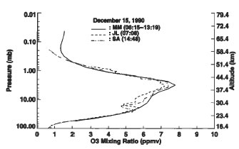
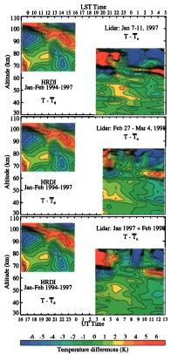
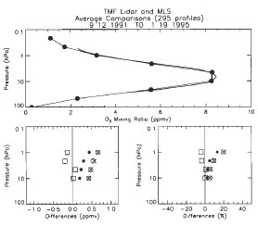
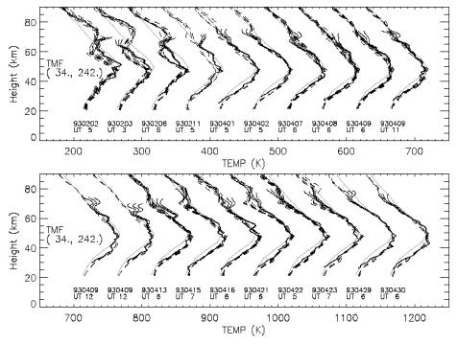
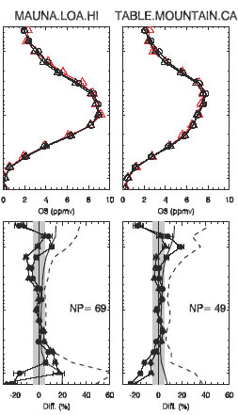
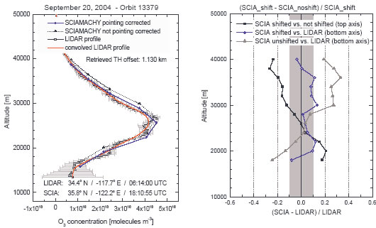
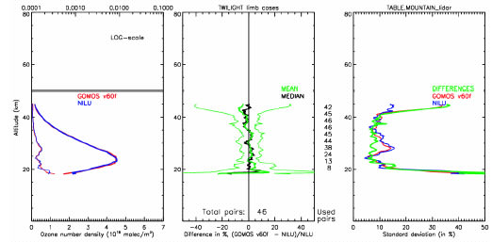
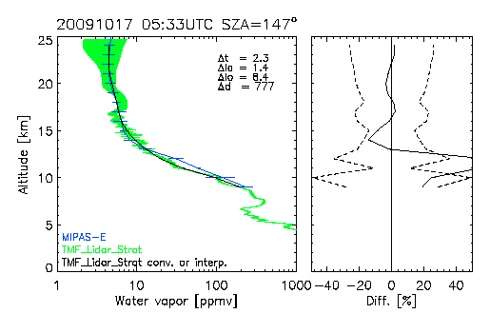
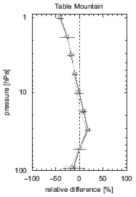
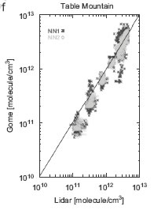
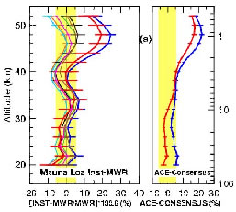
JPL Lidar Group: 3 Decades of Satellite Validation
SAGE-II O3
Tsou et al., 1995
UARS-MLS O3
Froidevaux et al.,
JGR, 1996
HRDI T
Leblanc et al.
JGR, 1999
UARS-MLS T
Wu et al.,
JASTP, 2002
SCIAMACHY O3
Von Savigny,
ACP, 2005
Validation of 30+ products
measured onboard satellites
GOMOS O3
Meijer et al., 2006
MIPAS H2O
Stiller et al.,
AMT, 2012
Aura-MLS O3
Jiang, JGR, 2007
GOME O3
Iapaolo, JQSRT, 2007
ACE FTS O3
Dupuy et al., ACP, 2008

Slide 16
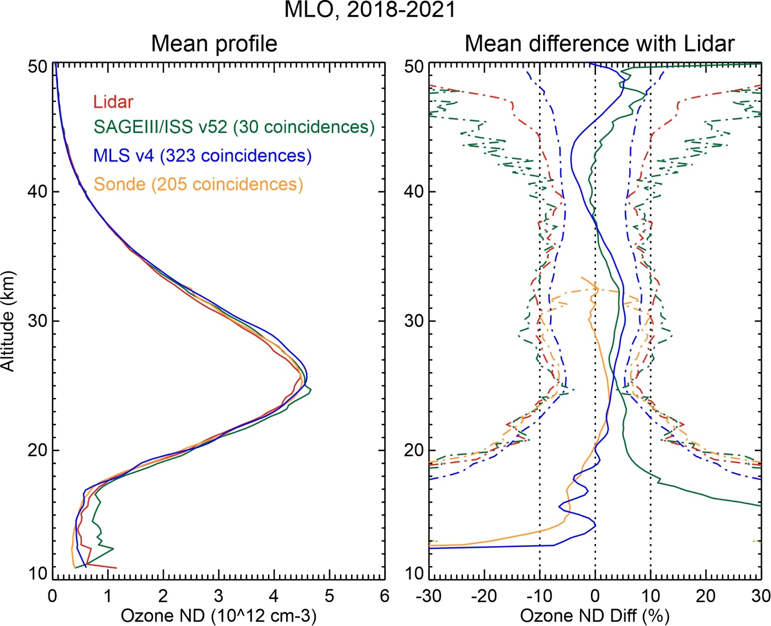
Stratospheric Ozone
Lidar-satellite-sonde comparison (MLO)
SAGEIII/ISS v52
within 0-5% of lidar
20—45 km
High bias below 20 km
MLS v4
within 0-5% of lidar
13—50 km
O3sonde (Hilo)
within 0-5% of lidar
15—33 km

Slide 17
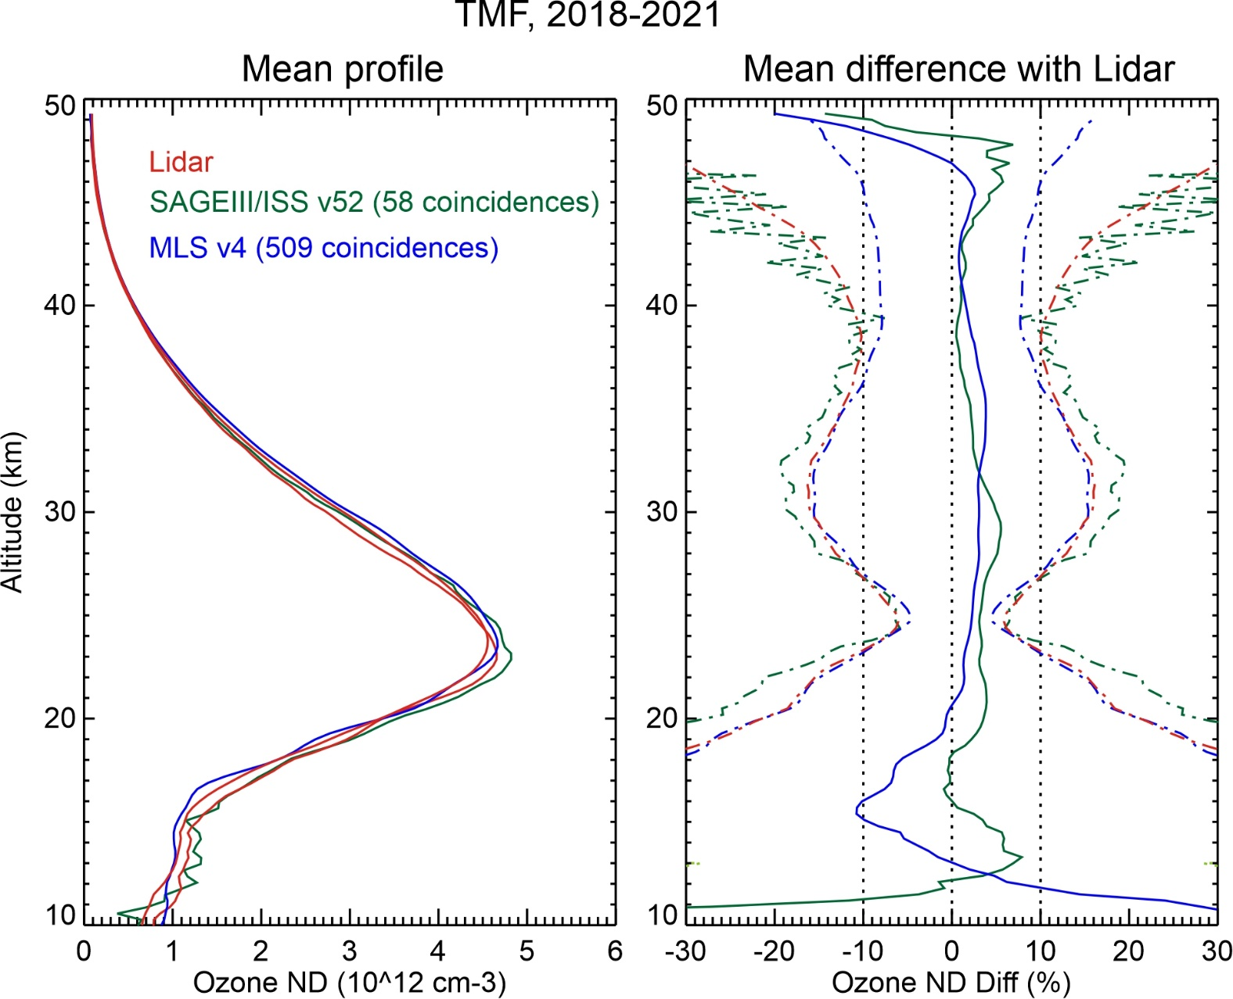
Stratospheric Ozone
Lidar-satellite-sonde comparison (TMF)
SAGEIII/ISS v52
within 0-5% of lidar
15—48 km
MLS v4
within 0-5% of lidar
18—49 km
Low bias
14-18 km

Slide 18
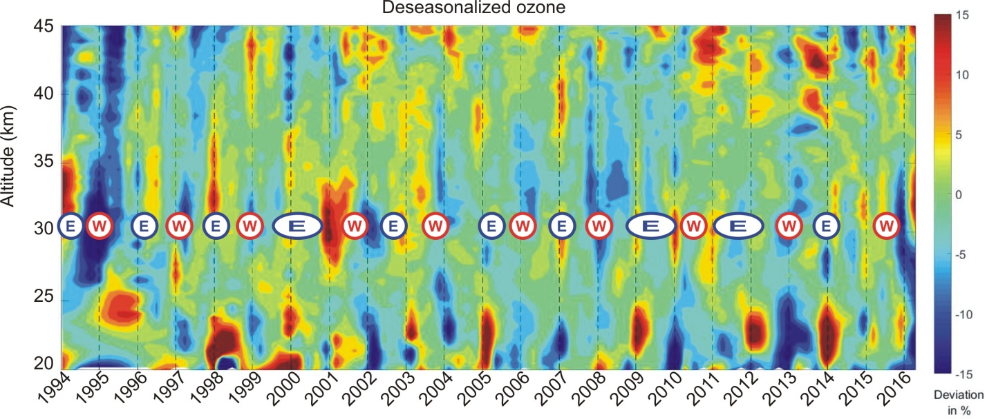
Long-term Variability of Ozone Monitoring at MLO
The Quasi-Biennial Oscillation (QBO):
(Adapted from
Leblanc et al., 2001)
At MLO, ozone positive anomalies typically
correlate with the Easterly phase of the QBO

Slide 19
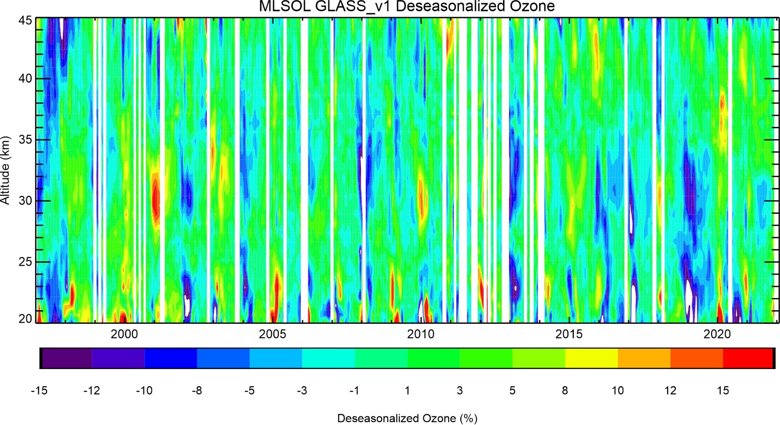
Long-term Variability of Ozone Monitoring at MLO (2)
Hints of trends?….

Slide 20
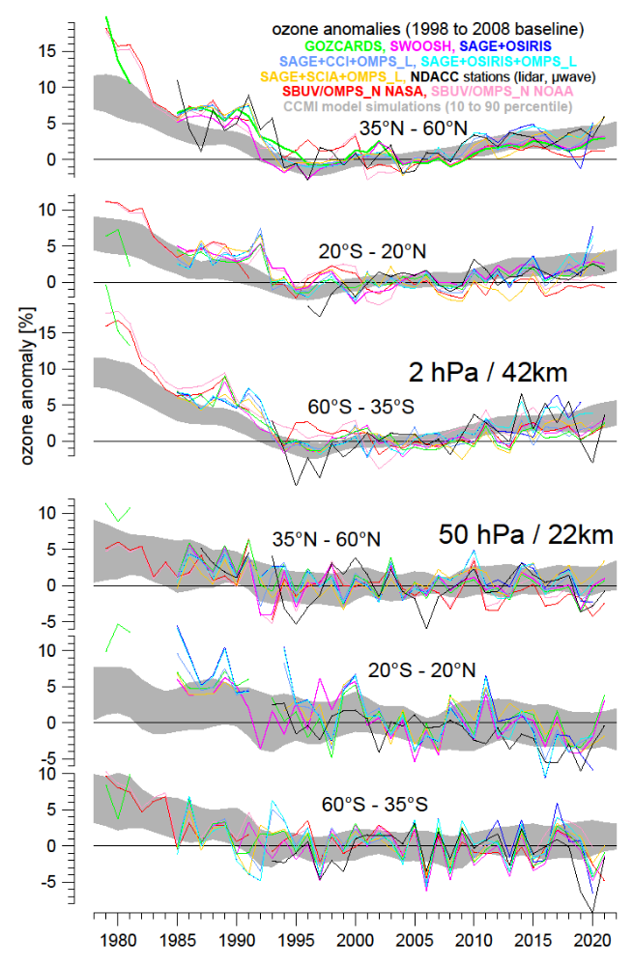
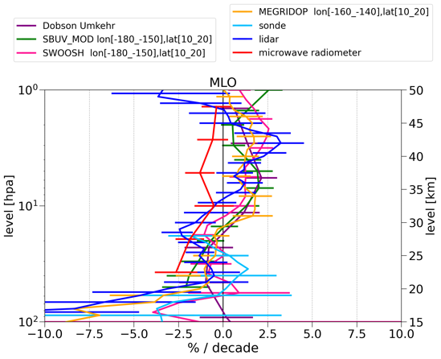
MLO lidar contribution to
WMO Ozone Assessments and SPARC LOTUS/LOTUS2
(Godin-Beekman et al., submitted, 2022)
(Steinbrecht, Person. Comm., 2022)

Slide 21
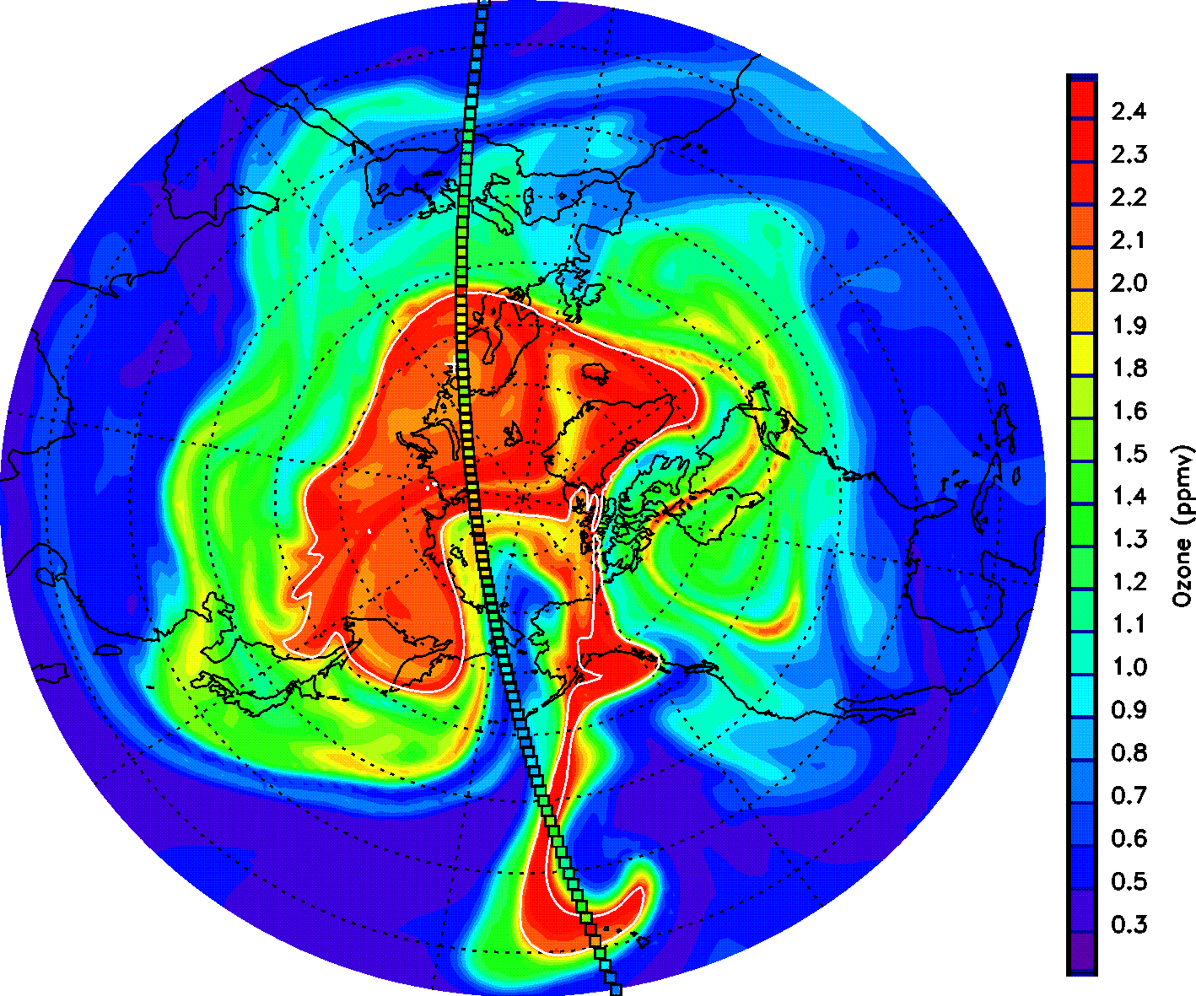
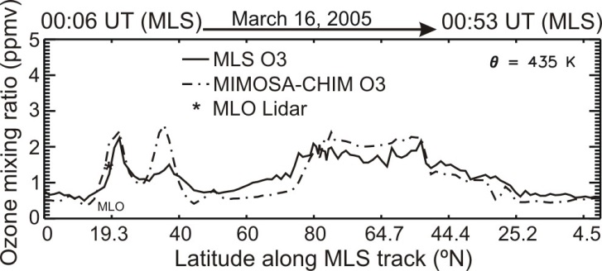
Lidar vs. Model and Satellite
Springtime polar ozone transported
to the tropics (March 2005):
Ozone modeled by MIMOSA CTM at 435 K
(approx. 18 km)
Aura-MLS ozone superimposed
(small colored squares)
High ozone (>1.5 ppmv) simultaneously
observed by MLO lidar (star), MLS and
MIMOSA
(Leblanc et al., 2006)

Slide 22
JPL-TMF Lidar Capabilities: Temperature
What species?
➔
1- Ozone DIAL (stratosphere): 12-50 km Prec. 0-20% Accur. 4%
➔
2- Ozone DIAL (troposphere): 0-20 km Prec. 0-20% Accur. 4%
➔
3- Temperature Rayleigh: 20-90 km Prec. 0-10 K Accur. 0.5 K
➔
4- Temperature vib.-Raman: 8-40 km Prec. 0-10 K Accur. 0.5 K
➔
5- Water vapor vib.-Raman: 0-20 km Prec. 0-20% Accur. 6%
➔
6- Clouds and aerosols: 0-50 km Prec. 1-20% Accur. 1-10%
Precision degrades with altitude and improves with integration time
Accuracy depends on altitude and species measured

Slide 23
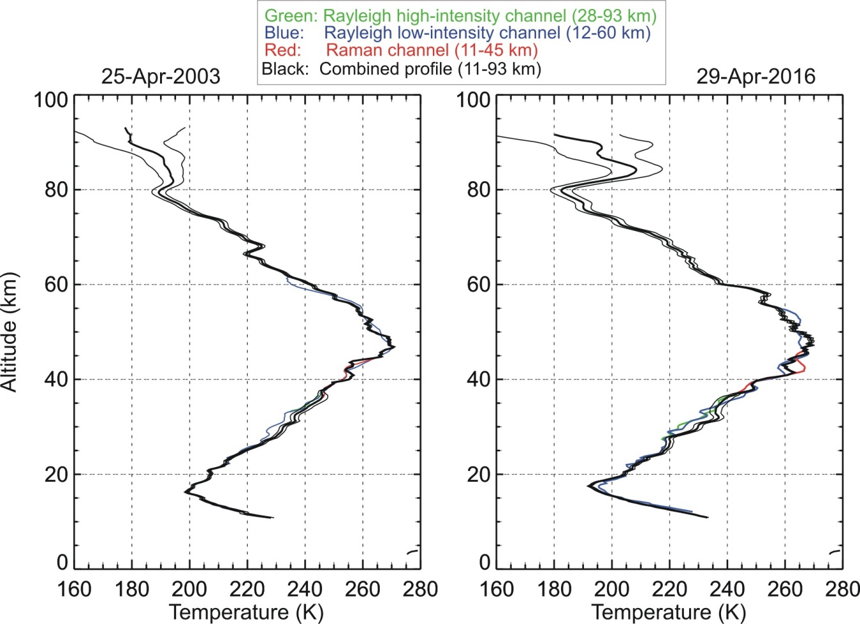
Two Examples of Rayleigh/Raman
Temperature Profiles (MLO)
Larger uncertainty
at the top, due to:
1) Lower precision
(STNR)
2) Large uncertainty
on a priori “tie-on”
temperature
Impact of
aerosols:
- Rayleigh channel
yields too cold
temperatures
➔ Must use Raman
channel below
30 km

Slide 24
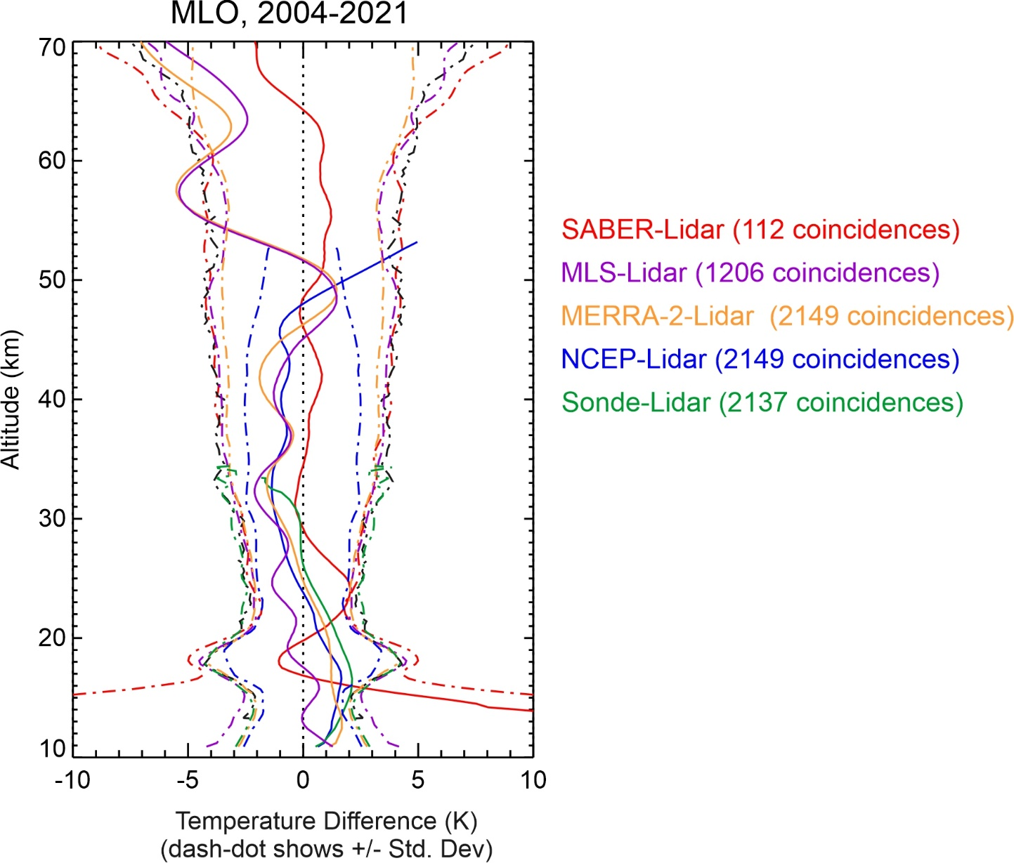
Temperature
Validation example (Mauna Loa)
Main take-home messages:
- MLS (purple) shows 3-6 K cold
bias in mesosphere
Possibly a tidal bias
- MERRA-2 (yellow) driven by MLS
in upper strato. and mesosphere
- Agreement within +/-2K
between SABER (red) and
lidar (30-65 km)
- NCEP (blue) too warm
above 47 km (warm bias)
- MERRA-2 and NCEP driven
by sonde (green) below 27 km
- 1-2 K bias at the tropopause
➔ Lidar cold bias suspected
(aerosol extinction)

Slide 25
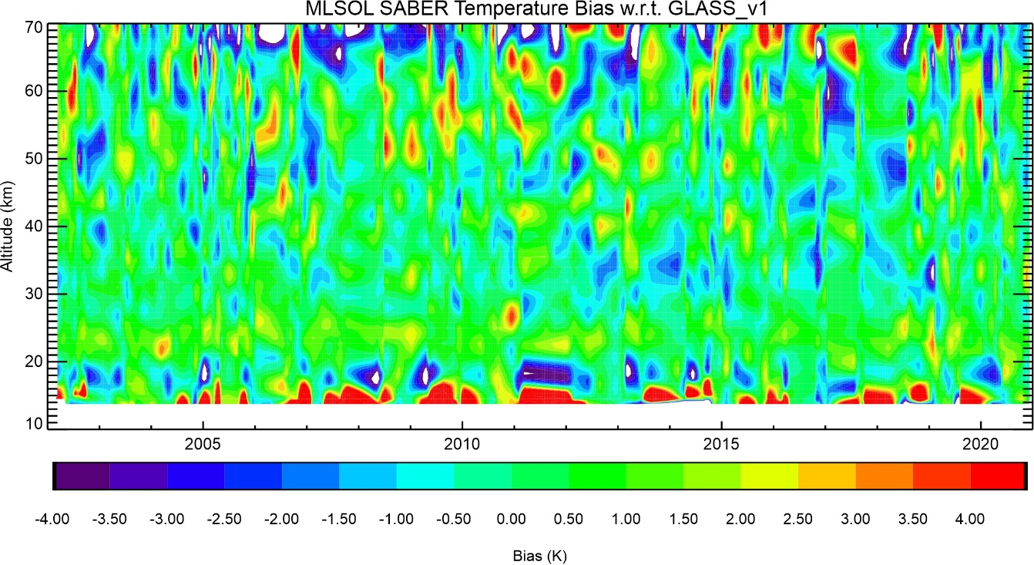
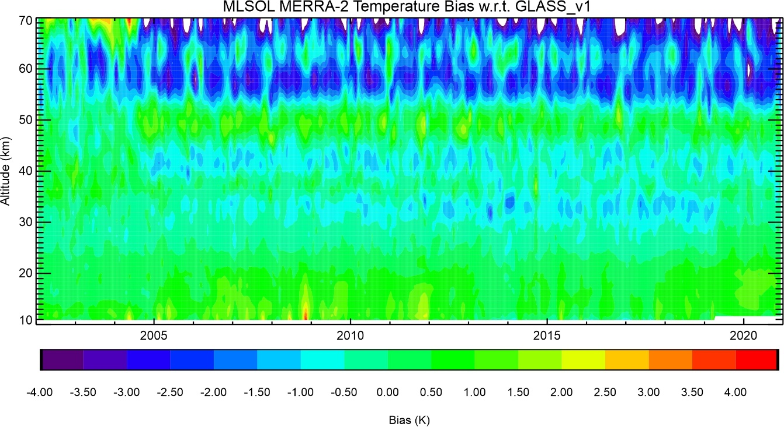
Using lidar to validate long-term consistency
SABER - Lidar
Lidar serves as transfer standard
to identify discontinuities
MERRA2 - Lidar
Is MERRA2 driven by MLS
Temp assimilation?

Slide 26
JPL-TMF Lidar Capabilities: Tropospheric Ozone
What species?
➔
1- Ozone DIAL (stratosphere): 12-50 km Prec. 0-20% Accur. 4%
➔
2- Ozone DIAL (troposphere): 0-20 km Prec. 0-20% Accur. 4%
➔
3- Temperature Rayleigh: 20-90 km Prec. 0-10 K Accur. 0.5 K
➔
4- Temperature vib.-Raman: 8-40 km Prec. 0-10 K Accur. 0.5 K
➔
5- Water vapor vib.-Raman: 0-20 km Prec. 0-20% Accur. 6%
➔
6- Clouds and aerosols: 0-50 km Prec. 1-20% Accur. 1-10%
Precision degrades with altitude and improves with integration time
Accuracy depends on altitude and species measured

Slide 27
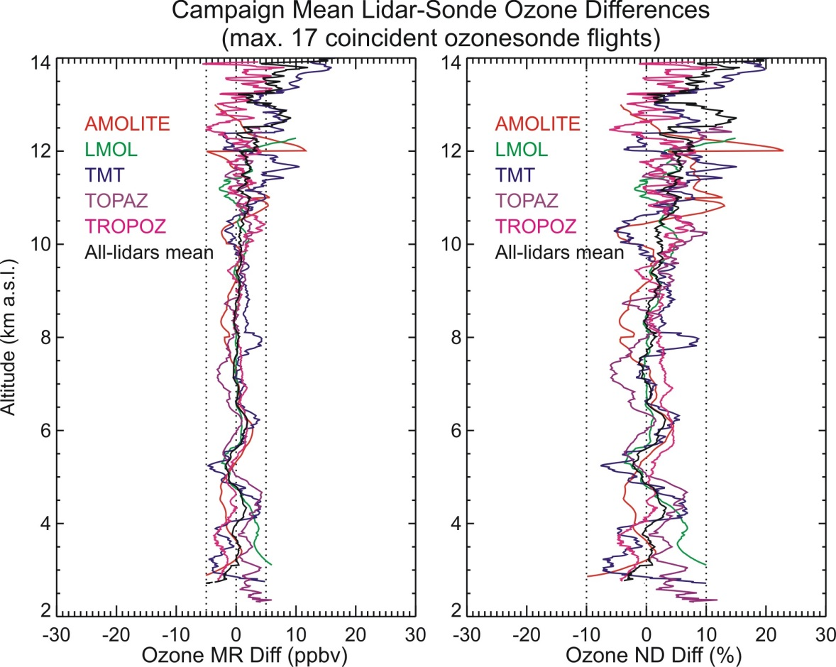
TMF Tropospheric Ozone DIAL Validation
During SCOOP Campaign (August 2016)
4 visiting lidars during
SCOOP campaign
(TOLNet lidars)
All-lidar-mean bias
with ozonesonde:
+0.1 ppbv (0.6%)
RMS: 0.9 ppbv (2%)
All differences are within
the ozonesonde and lidar
combined uncertainties
➔TOLNet lidars form a mature, robust ground-based reference network
(Leblanc et al., 2018)

Slide 28
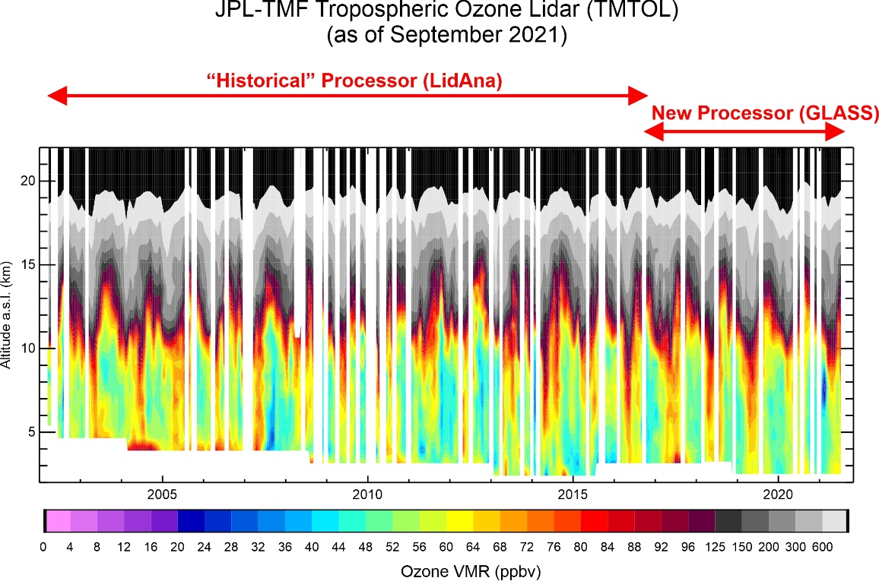
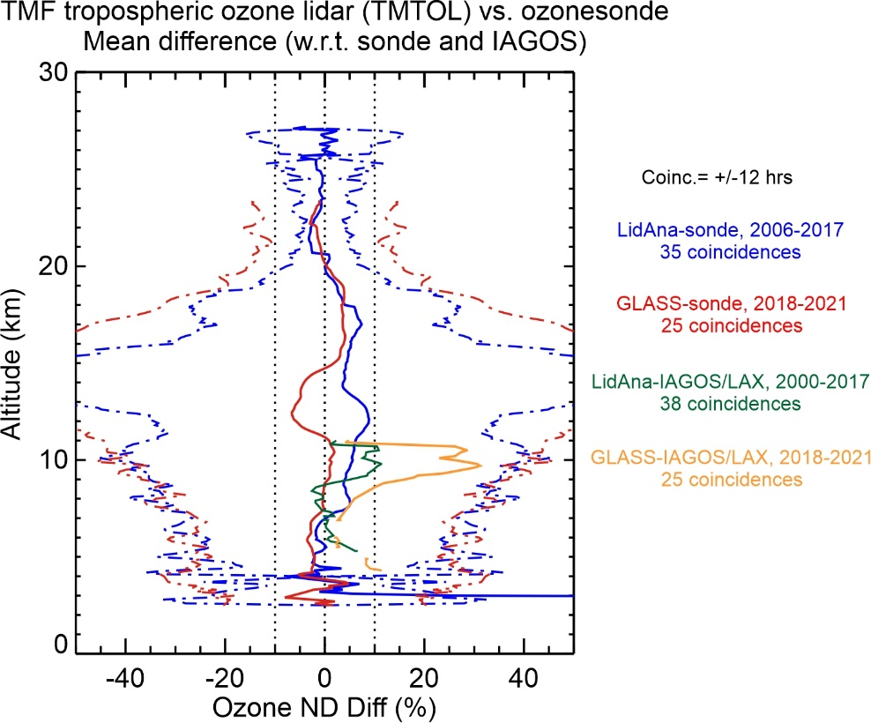
Tropospheric Ozone DIAL
Validation contributions
Below: diff between lidar and others
High ozone variability in 8-15 km layer combined with
different instrument representativeness lead to
largest differences in UTLS

Slide 29
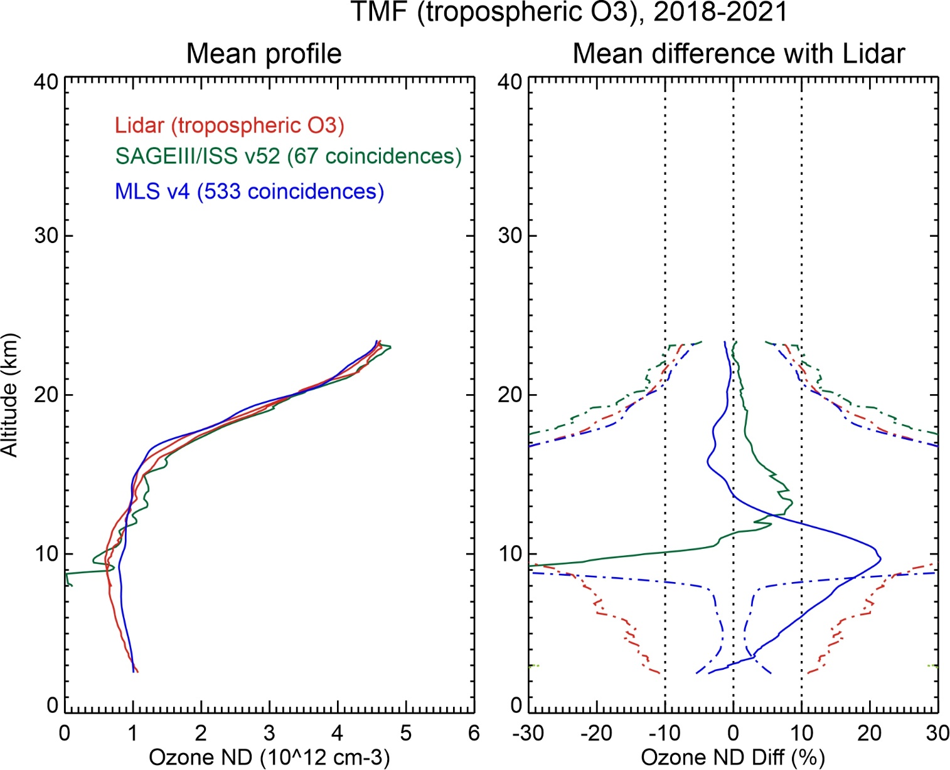
Tropospheric Ozone
Lidar-satellite-sonde comparison (TMF)
SAGEIII/ISS v52
high bias 5%
13—16 km
MLS v4
low bias 3%
14-18 km
high bias 20%
at 7-12 km
➔ Lower limit at TMF for
- SAGEIII/ISS: approx. 10 km
- MLS: approx. 13 km

Slide 30
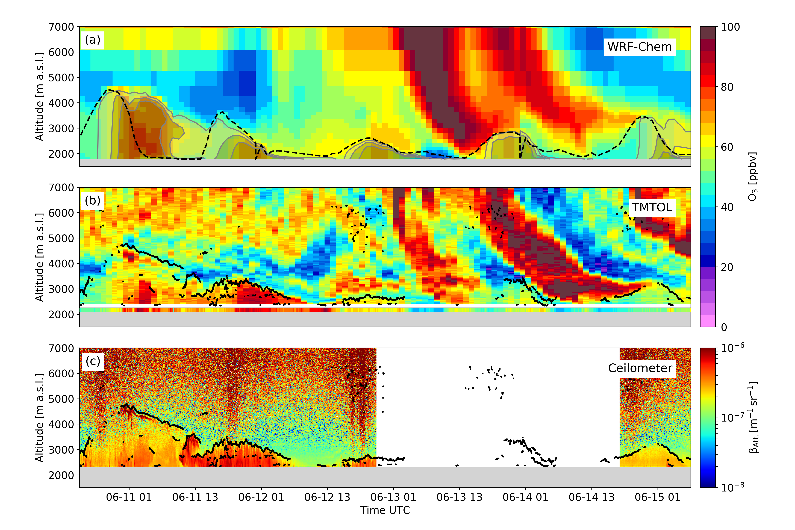
TMF Tropospheric Ozone vs. model
Air Quality Monitoring (June 2020)
PBL ozone
enhancement
on June 11-12
Followed by
Stratospheric ozone intrusions
on June 13-14
➔ Lidar is best suited instrument for multi-day profiling and AQ monitoring
(Chouza et al., 2021)

Slide 31
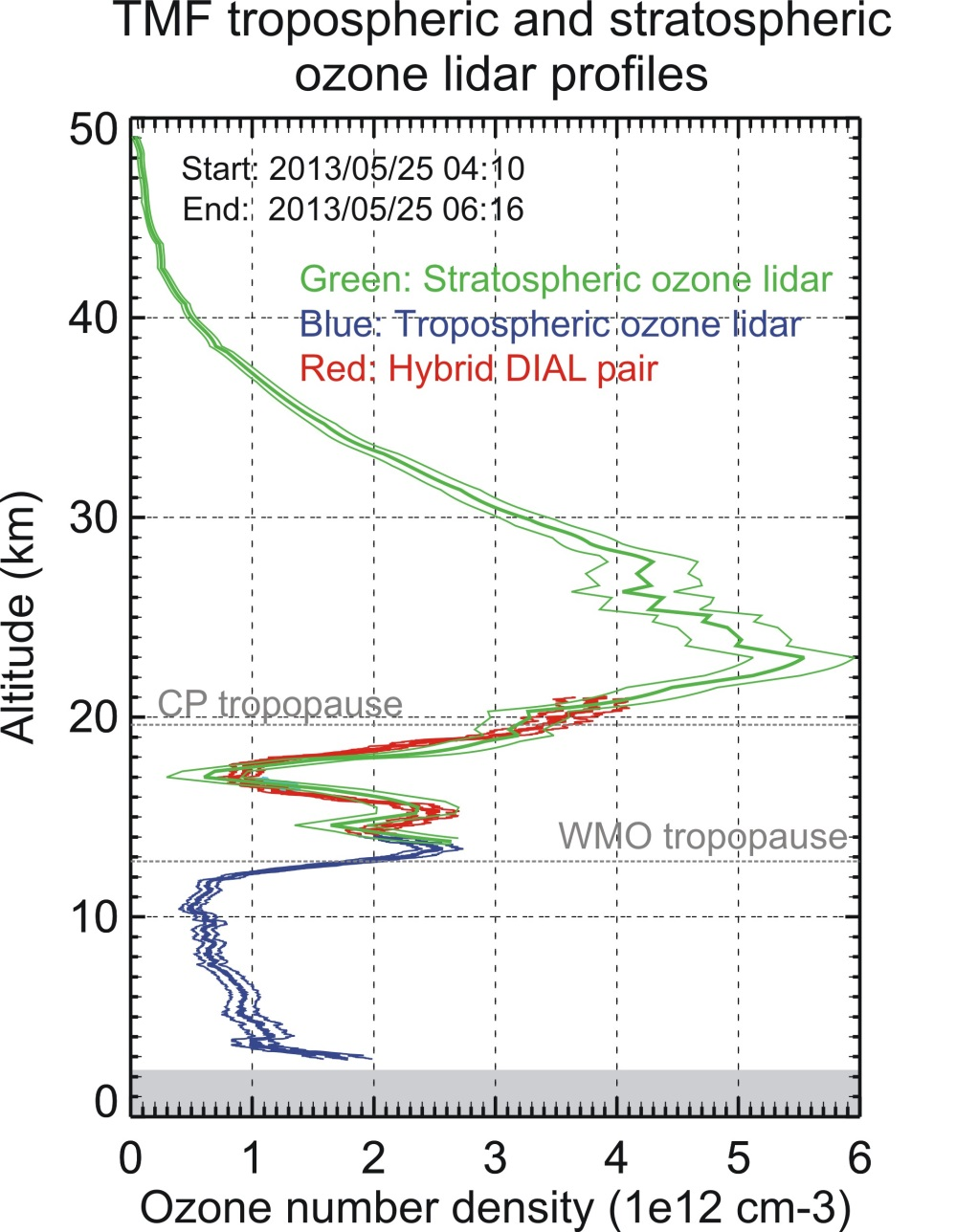
Combining strato. and tropo. O3 Lidars at TMF
Hybrid DIAL:
Use 1 channel of tropo O₃ DIAL
and 1 channel of strato O₃ DIAL
Green (15-50 km): Strato. O₃ DIAL
Red (15-22 km): “Hybrid” DIAL
Blue ( 3-15 km): Tropo. O₃ DIAL
➔ Hybrid DIAL:
excellent technique for the upper
troposphere and lower stratosphere
(McDermid et al., 2012)

Slide 32
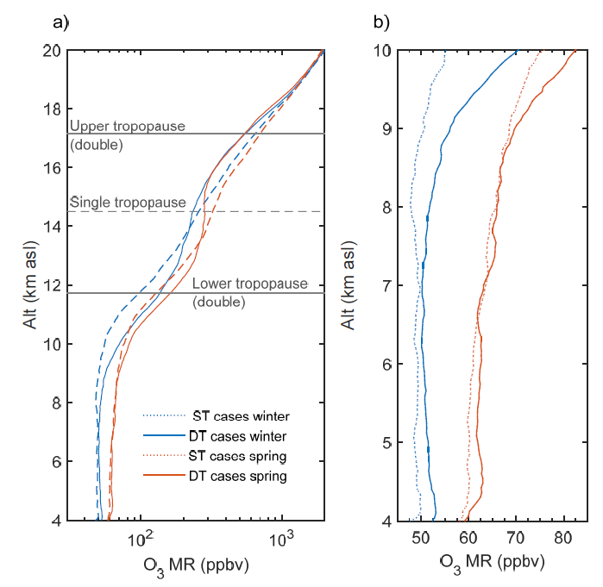
Ozone Long Range Transport and Intrusions
within tropopause folds
Distinguishing air parcels
within tropopause folds
Dash curves: 15-year climato. without tropopause folds
Solid curves: 15-year climato. with tropopause folds
Low ozone
in upper half
of the fold
(upper tropical tropo.)
High ozone
in lower half
of the fold
(“middleworld”)
Ozone anomalies
extend well below
tropopause folds!
(Granados-Munoz and Leblanc, 2016)

Slide 33
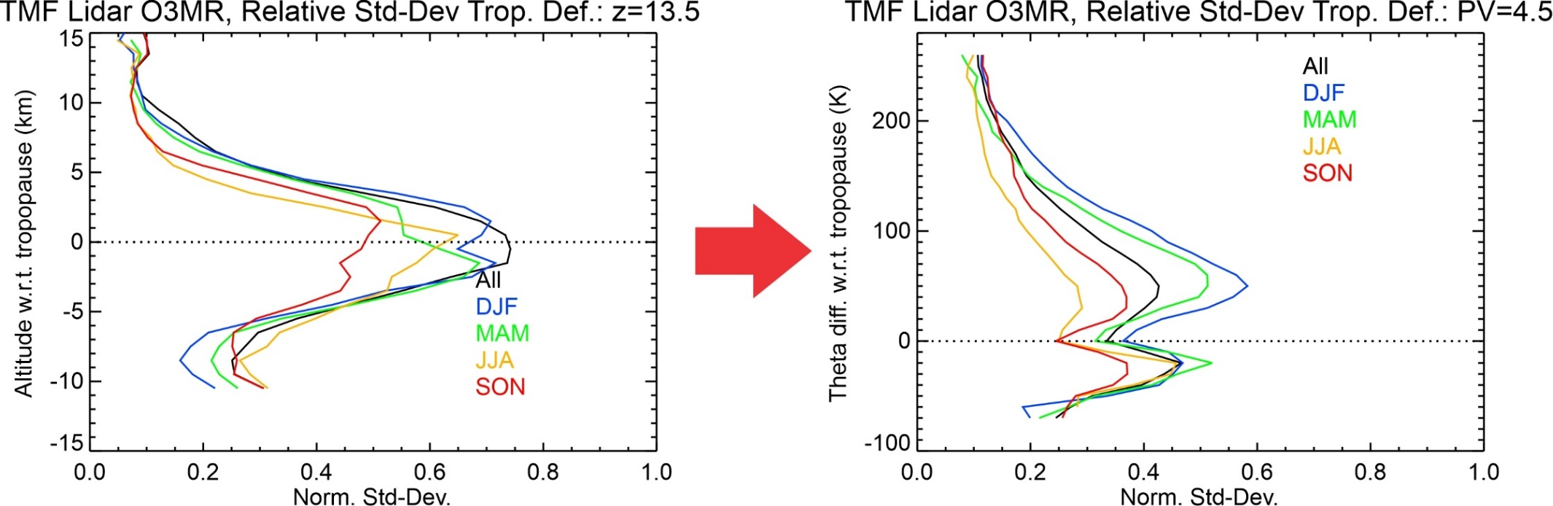
Ozone variability in the UTLS
before and after coordinate change
Geometric altitude
Potential temperature and PV
Reduced variability (now 30%-55%)
From SPARC Newsletter July 2020 (OCTAV-UTLS Activity)

Slide 34
JPL-TMF Lidar Capabilities
What species?
➔
1- Ozone DIAL (stratosphere): 12-50 km Prec. 0-20% Accur. 4%
➔
2- Ozone DIAL (troposphere): 0-20 km Prec. 0-20% Accur. 4%
➔
3- Temperature Rayleigh: 20-90 km Prec. 0-10 K Accur. 0.5 K
➔
4- Temperature vib.-Raman: 8-40 km Prec. 0-10 K Accur. 0.5 K
➔
5- Water vapor vib.-Raman: 0-20 km Prec. 0-20% Accur. 6%
➔
6- Clouds and aerosols: 0-50 km Prec. 1-20% Accur. 1-10%
Precision degrades with altitude and improves with integration time
Accuracy depends on altitude and species measured

Slide 35
Long-term Monitoring of Stratospheric Aerosol
(JPL Lidar at Mauna Loa Observatory)
Top: Extinction coefficient
Bottom: Stratospheric Aerosol Optical Depth
2019/2020: 20-year high in stratospheric aerosol loading
Emergence of a new “chronic” source: Wildfires (through PyCb)

Slide 36
JPL-TMF Lidar Capabilities
What species?
➔
1- Ozone DIAL (stratosphere): 12-50 km Prec. 0-20% Accur. 4%
➔
2- Ozone DIAL (troposphere): 0-20 km Prec. 0-20% Accur. 4%
➔
3- Temperature Rayleigh: 20-90 km Prec. 0-10 K Accur. 0.5 K
➔
4- Temperature vib.-Raman: 8-40 km Prec. 0-10 K Accur. 0.5 K
➔
5- Water vapor vib.-Raman: 0-20 km Prec. 0-20% Accur. 6%
➔
6- Clouds and aerosols: 0-50 km Prec. 1-20% Accur. 1-10%
Precision degrades with altitude and improves with integration time
Accuracy depends on altitude and species measured

Slide 37
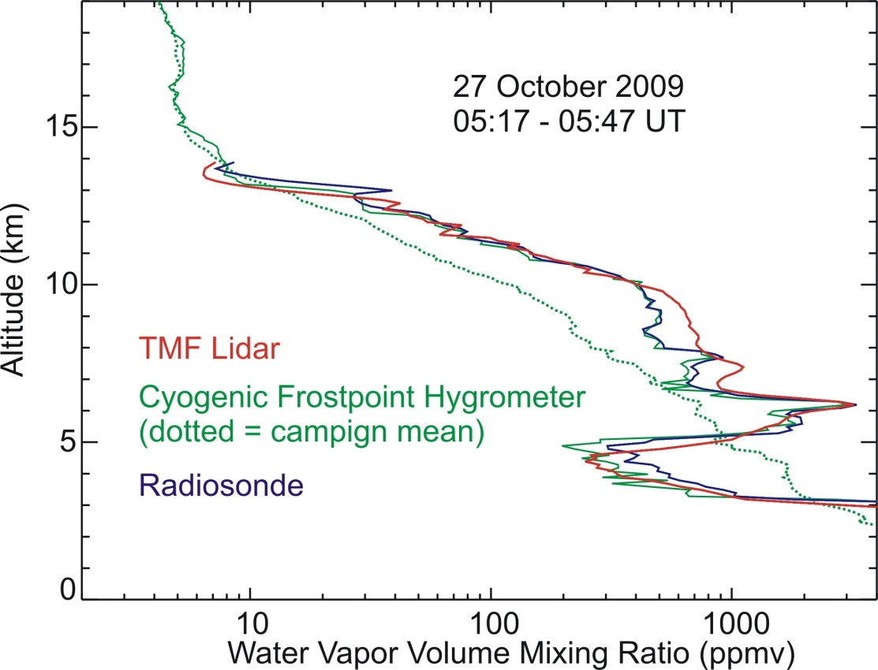
H₂O Raman Lidar Profile Example
Lidar validation during
MOHAVE 2009 Campaign
Cryogenic Frost-point Hygrometer (green)
is research-grade reference hygrometer
for upper air (10-30 km)
30-min lidar profile reaches 14 km
i.e., same as radiosonde
Very high variability at small vertical
and temporal scales (e.g., 4-6 km)
(Leblanc et al., 2011)

Slide 38
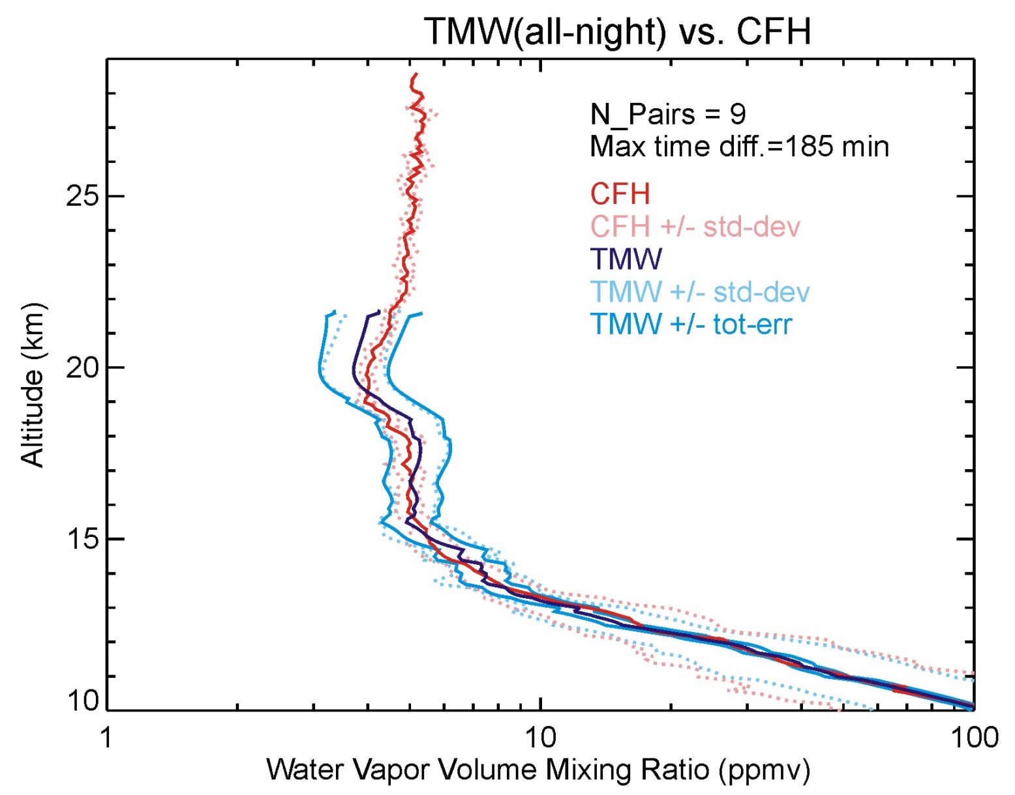
H₂O Raman Lidar for UTLS studies
TMF Raman lidar
Optimized for
UTLS measurements
Average 9 profiles
MOHAVE 2009
campaign
Very challenging
for H2O lidars
to reach the LS
Good for UT
(+/-5% diff.
with Frost-Point)
➔ Long integration times required for LS
(Leblanc et al., 2012)

Slide 39
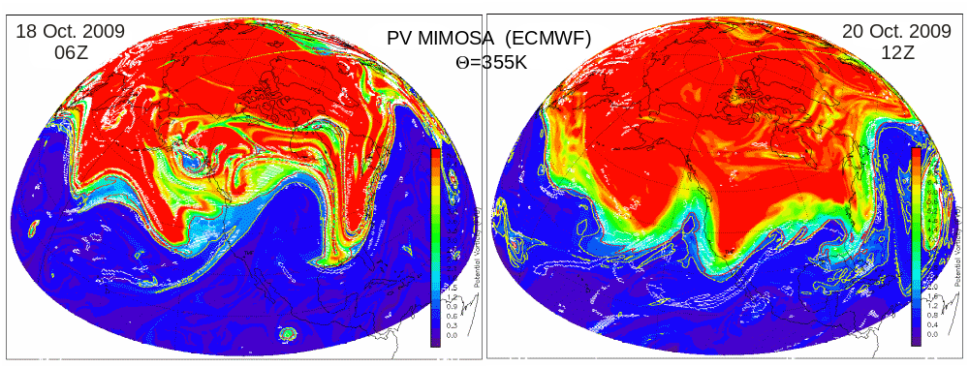
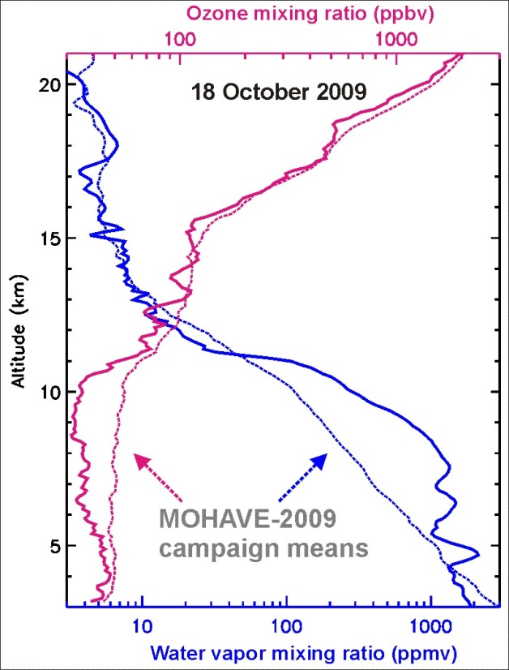
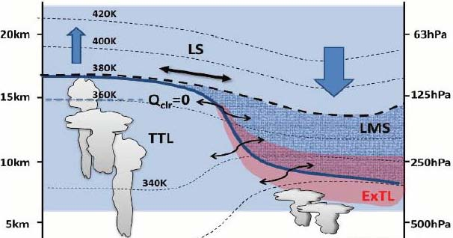
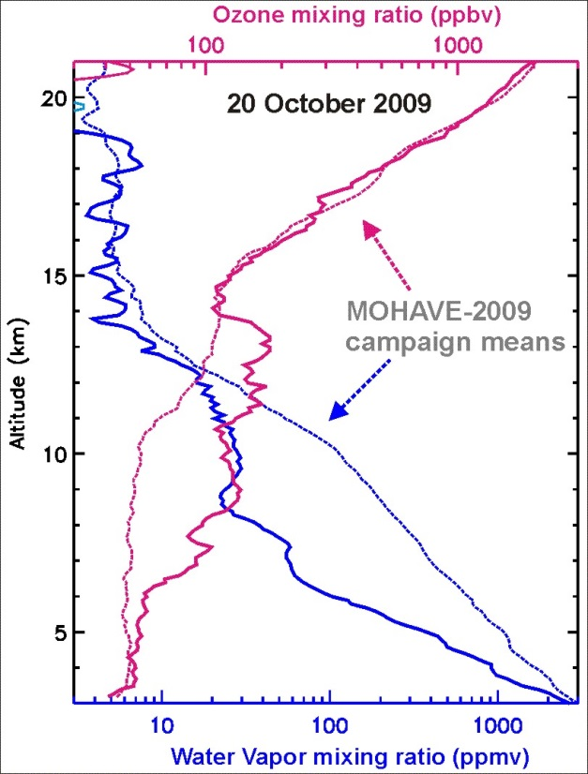
TMF Tropospheric Ozone and Water vapor
O₃ & H₂O lidar observations
of a stratospheric intrusion
during the MOHAVE 2009 Campaign
TMF
tropopause
Adapted from Hegglin, 2009
Sensing
extratropical LMS
Sensing
subtropical UT
Wet
O3-rich
O3-poor
Dry
TMF
EQ
34N
Pole

Slide 40
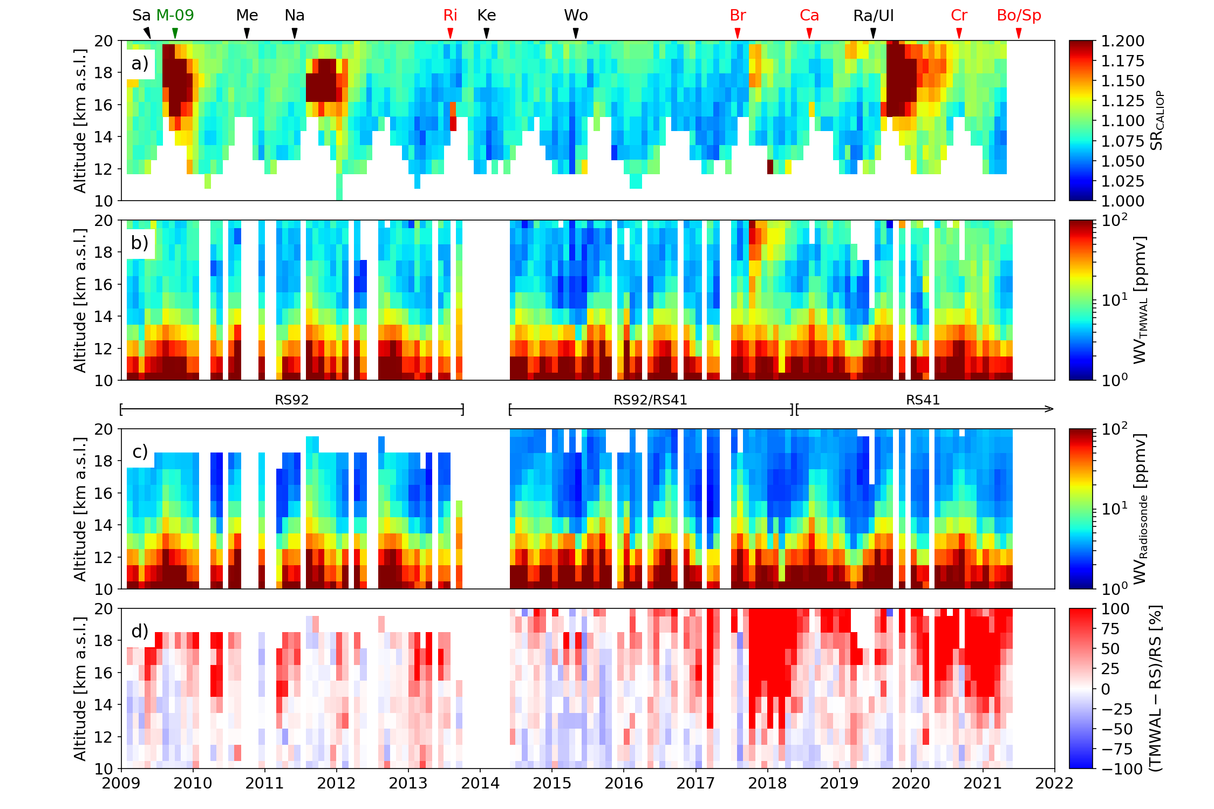
H₂O Raman Lidar for UTLS Long-Term Monitoring
Top panel: CALIOP aerosol scattering ratio
Third panel: H2O VMR from TMF radiosonde
Second panel: H2O VMR from TMF Raman lidar
Bottom panel: lidar-sonde difference
H2O high bias correlated
with biogenic aerosols,
not with volcanic aerosols
New “chronic” source: wildfires (through PyCb)
(Chouza et al., in prep. 2022)

Slide 41
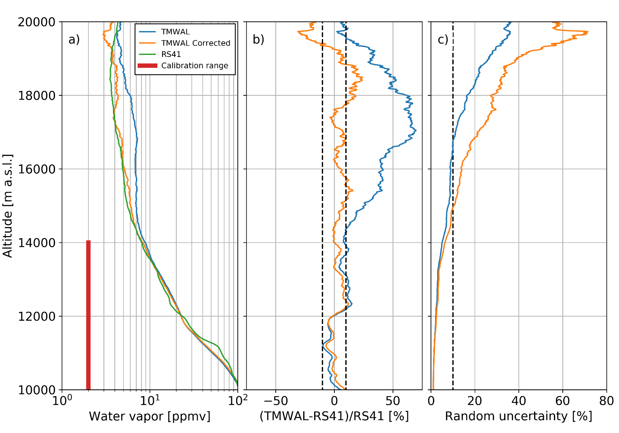
H₂O Raman Lidar in UV:
Need aerosol fluorescence correction in the UTLS
Fluorescence contamination
by biogenic aerosols is a new
reality
New correction technique
developed at JPL-TMF
NDACC H2O Lidar long-term measurement strategy needs to be re-considered:
Option 1: Apply (improved) fluorescence correction
Option 2: Forget UV (355 nm), use 532 nm emission instead
(Chouza et al., in prep. 2022)

Slide 42
Future Activities of the JPL-TMF Lidar Group
Continue long-term monitoring by lidar:
- Ozone, temperature, aerosol, and water vapor lidar measurements will continue
- Shortage of satellite upper atmosphere observations is expected in near future
➔ continuation of ground-based measurements is essential to guarantee future
monitoring of atmospheric composition without any gap
Design and build new mobile, autonomous tropospheric ozone lidar:
- Use tropospheric ozone experience of the past 20 years and more recent
automation experience to deploy and run ozone lidar on the field without attendance
Design and build new cloud/aerosol lidar capability:
- Driven by 1) increase in wildfire activity and 2) climate science needs (Decadal Survey)
- Aerosol capability needs multi-wavelength, including 532 nm ➔ new H2O Raman lidar
- High lidar expertise within the TMF Lidar Group should be used to address those needs
THANK YOU
Visit the JPL-TMF Lidar Group website: https://lidar.jpl.nasa.gov/

