Slide 1
The Copernicus Atmosphere Monitoring Service (CAMS) stratospheric ozone
Quentin Errera
& the CAMS Evaluation and Quality Control team
23-Aug-2022

Slide 2
Outline
Introduction on CAMS
Introduction of the Evaluation and Quality Control (EQC) of CAMS global products
EQC of CAMS NRT stratospheric ozone
CAMS monitoring of the ozone hole
EQC of CAMS reanalysis
Future development in CAMS
Summary

Slide 3
EU Copernicus services
« Copernicus is the EU Earth Observation Programme, which monitors our planet and its environment for the ultimate benefit of the citizens of Europe. »
6 services
  Land
  Marine
  Atmosphere
  Climate
  Emergency
  Security
Supported by satellite and in situ programmes for Earth observations
More information on www.copernicus.eu/en

Slide 4
Copernicus Atmosphere Monitoring Service (CAMS)
CAMS provides continuous consistent and quality-controlled data and information on atmospheric composition by monitoring and forecasting constituents such as greenhouse gases, reactive gases, ozone and aerosols
CAMS delivers information useful to help policymakers, businesses and citizens address environmental concerns
This is done by NRT data assimilation of observations, model forecast and making reanalysis
CAMS is running by ECMWF…
… but model development, emission inventories, product evaluation… are done by subcontractant
More information on atmosphere.copernicus.eu

Slide 5
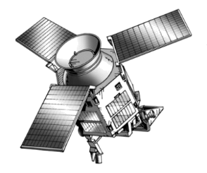
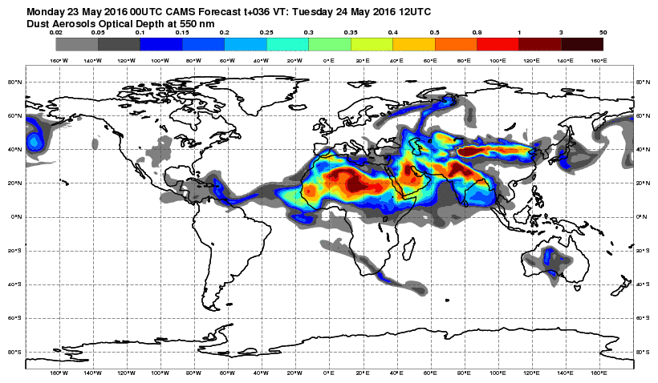
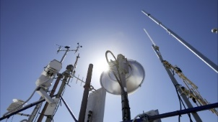
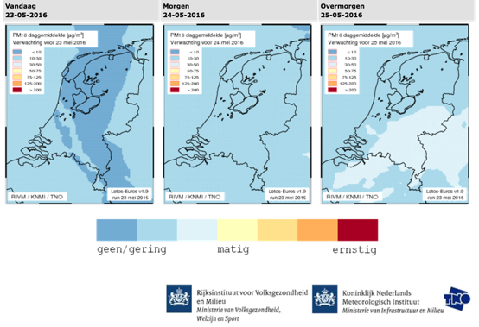
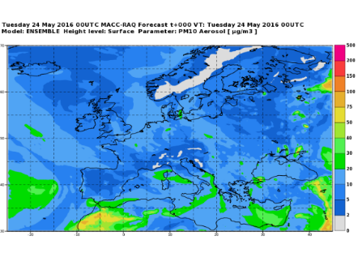
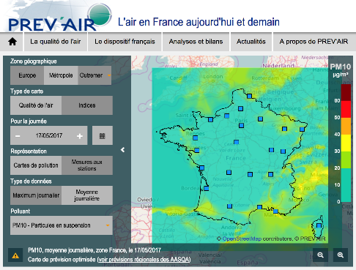
CAMS system overview
Space Agencies
In-situ observations
National scale
11 regional CTMs
ECMWF/IFS
15

Slide 6
CAMS global model and data assimilation configurations
Global NRT based on ECMWF IFS (Integrated Forecasting System):
  daily analysis at 3 and 15 UT
  5 day forecasts with 3 hourly outputs
  control run without composition assimilation reactive gases + aerosols
Current IFS 47r3 model includes (Flemming et al., 2015, 2017, Morcrette et al., 2009):
  TM5 tropospheric chemistry
  Linearized stratospheric ozone chemistry
  Aerosol (sea-salt and desert dust, organic mattar and black carbon, sulfate, nitrate and ammonium)
  Anthropogenic, biogenic and fire emissions
  50 km horizontal resolution (T511), 137 levels from the surface to 0.01 hPa
Upgrades of IFS, at least 1x per year
Global reanalysis 2003-2021 (updated every year) based on IFS 42r1 + control run
More info here: doi.10.24380/9z4h-5niy

Slide 7
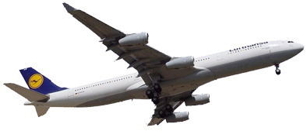

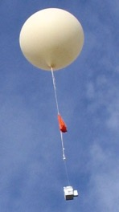
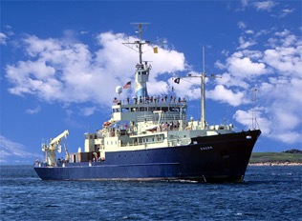
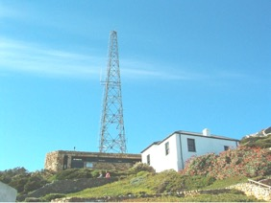
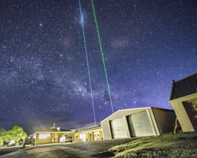
The global observing system
Airplanes
Satellites
Balloons
Ships
Ground-based stations

Slide 8
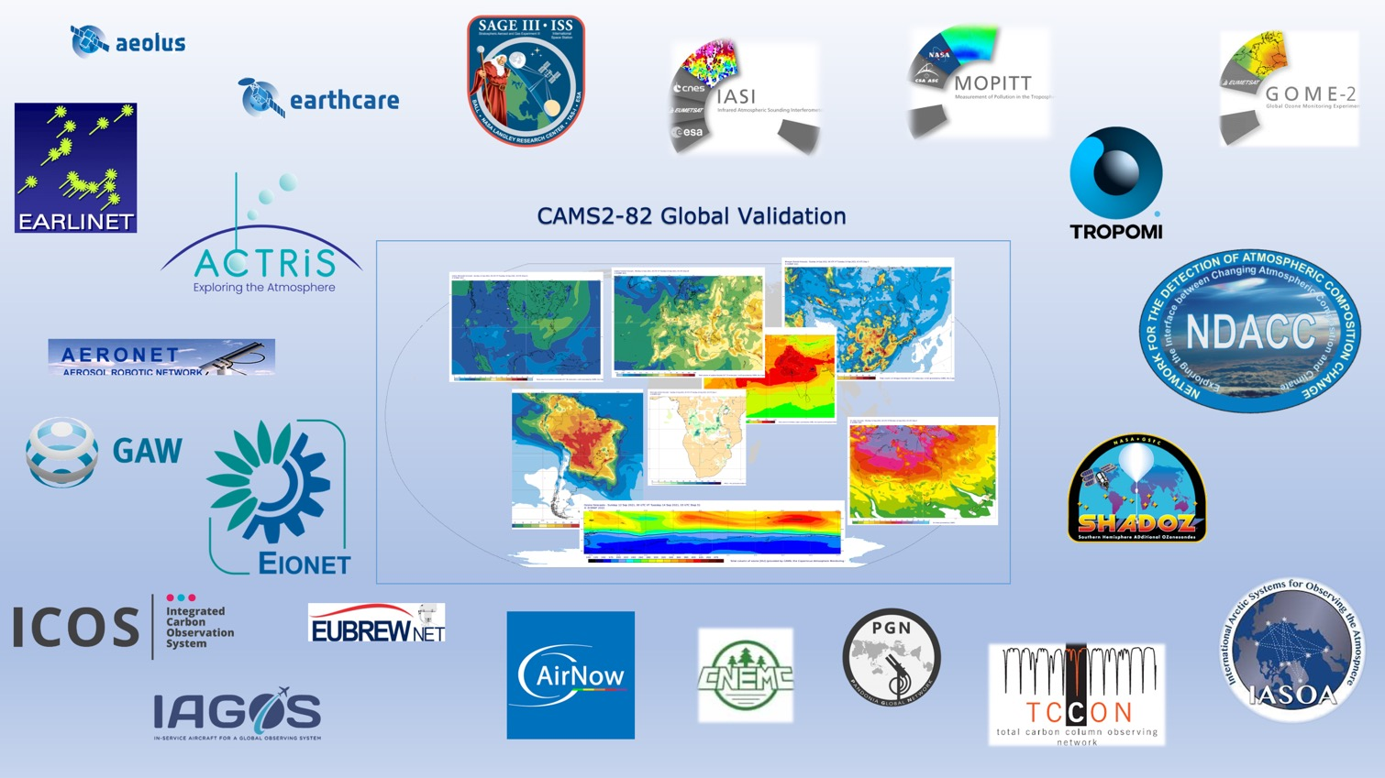
The global observing system

Slide 9
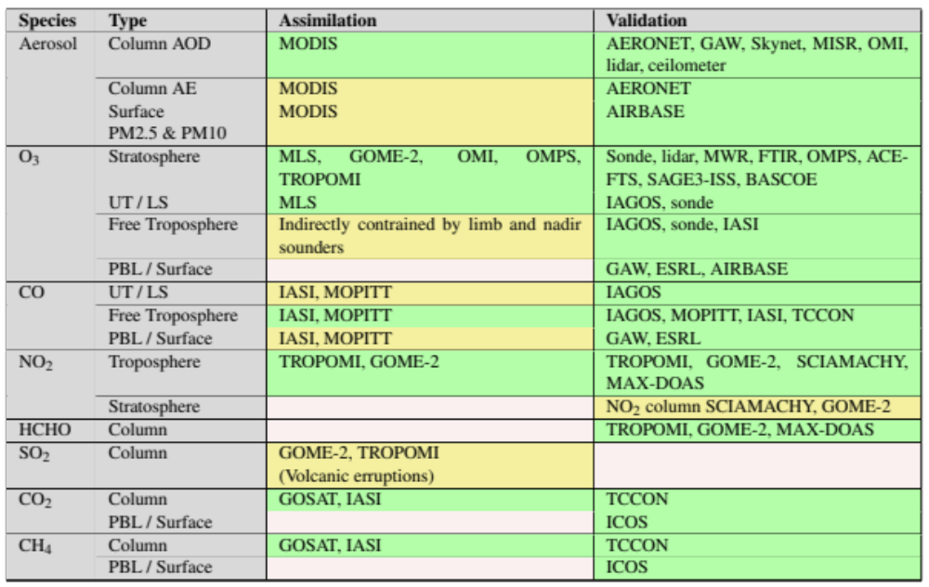
The global observing system
NRT
MLS offline

Slide 10
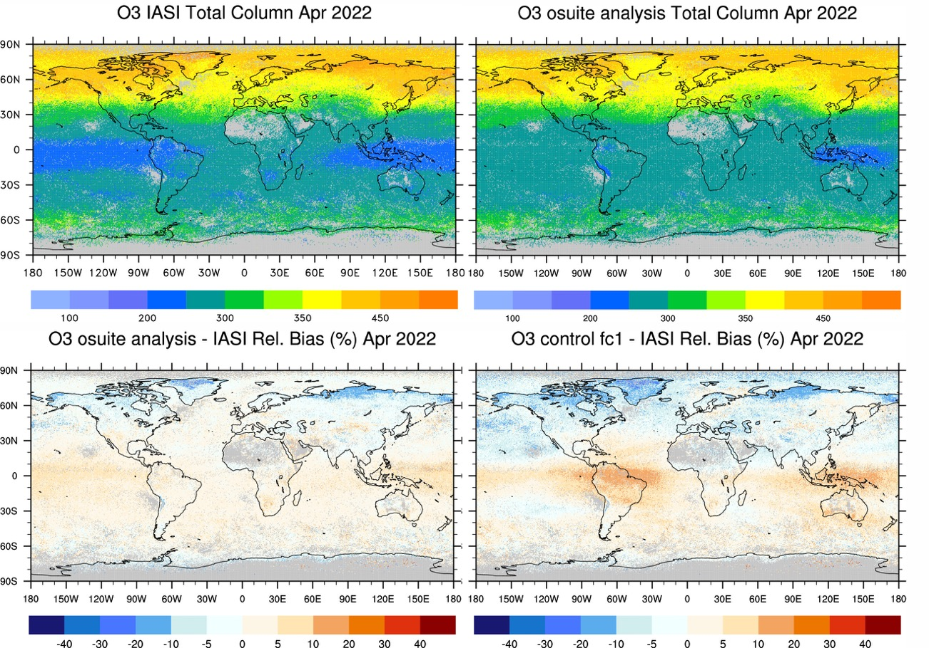
Evaluation of CAMS-NRT stratospheric ozone
Evaluation of CAMS vs IASI TC during April 2022

Slide 11
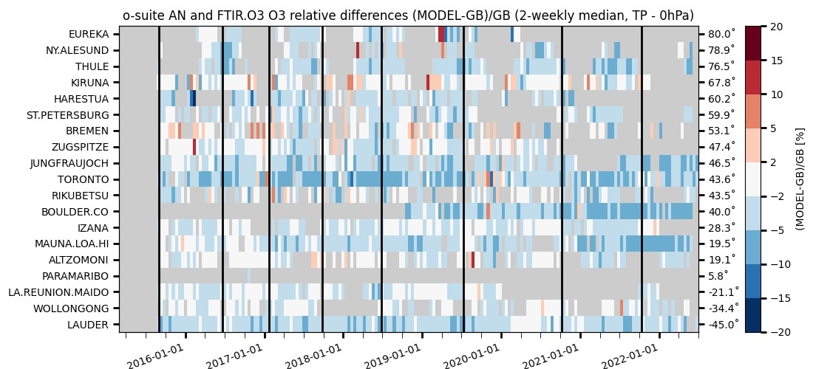
Observations for CAMS global product validation
Evaluation of CAMS vs NDACC FTIR stratospheric column upto MAM2022

Slide 12
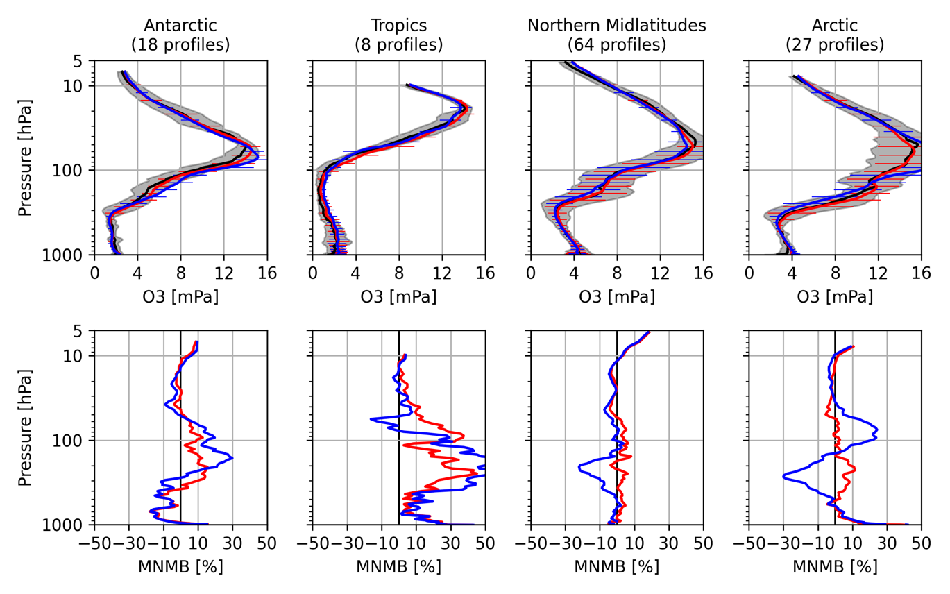
Evaluation of CAMS-NRT stratospheric ozone
o3sondes
CAMS analysis
CAMS control run
Evaluation of CAMS vs o3sondes during MAM2022
CAMS an - o3s
CAMS cr - o3s

Slide 13
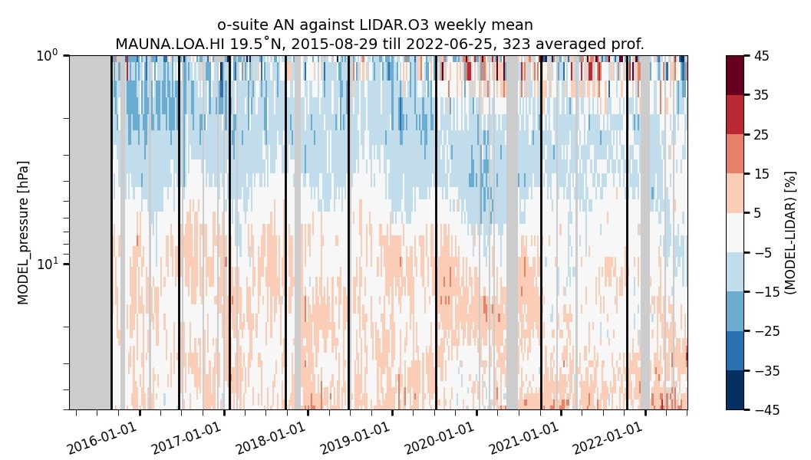
Evaluation of CAMS-NRT stratospheric ozone
Evaluation of CAMS vs Mauna Loa NDACC lidar since 2016

Slide 14
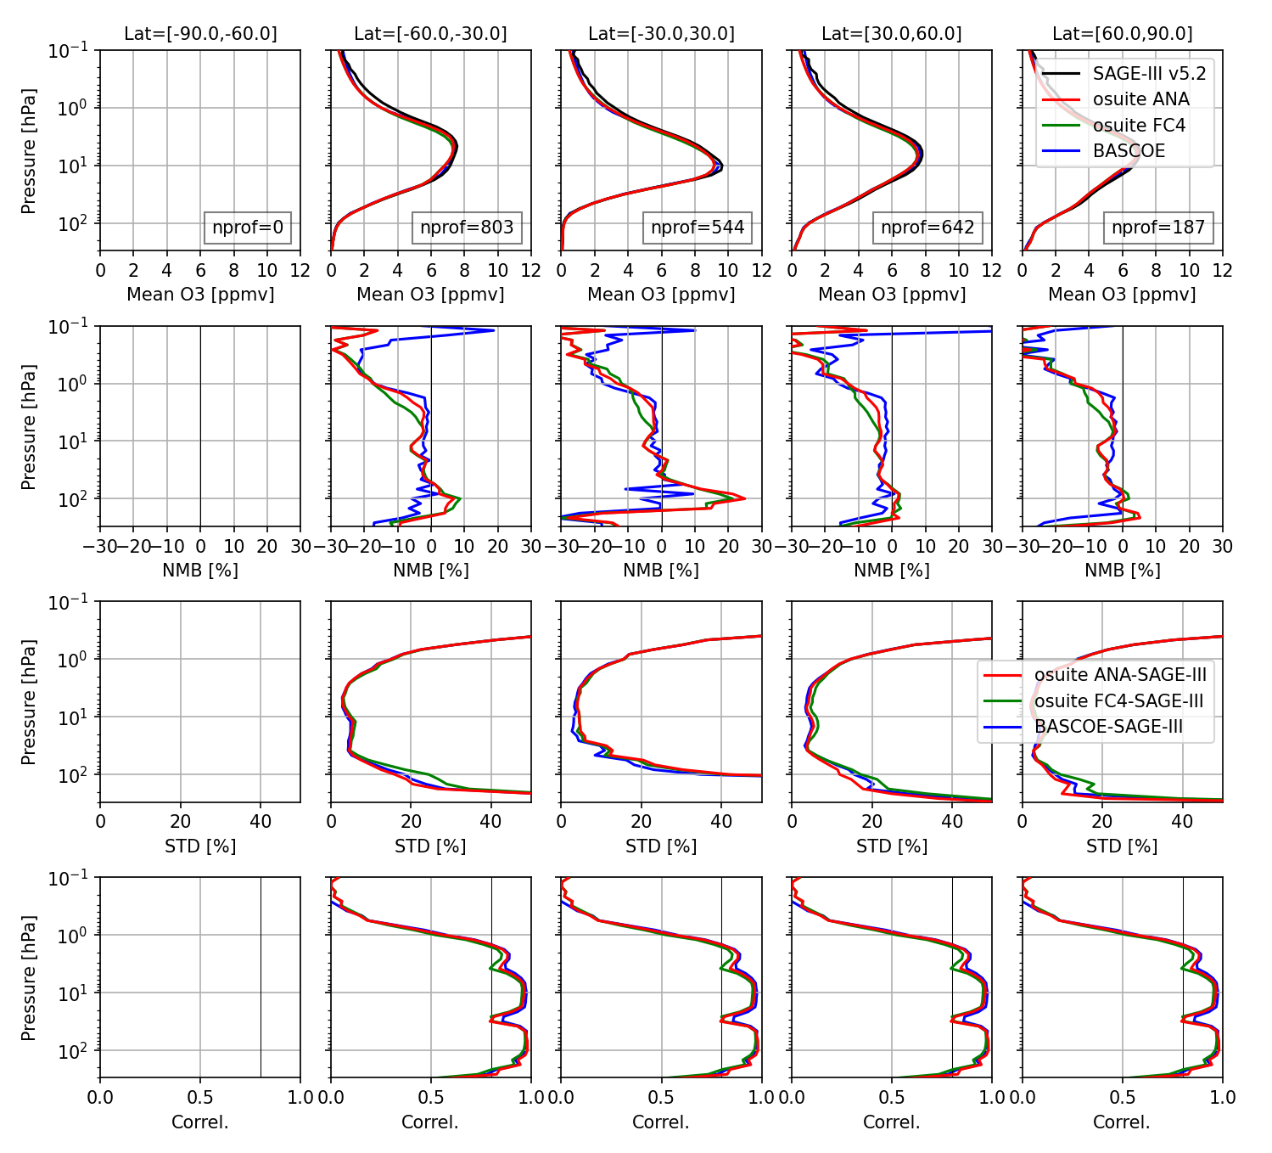
Evaluation of CAMS-NRT stratospheric ozone
Evaluation of CAMS vs SAGE-III/ISS v5.2 during MAM2022

Slide 15
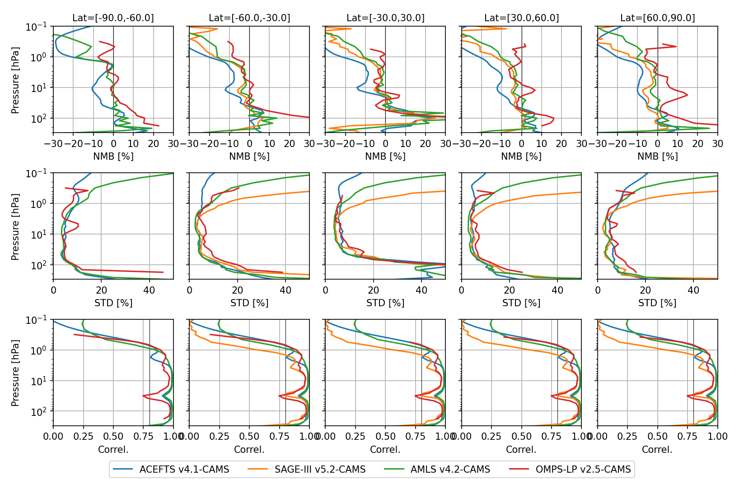
Evaluation of CAMS-NRT stratospheric ozone
Evaluation of CAMS vs limb profiles in MAM2022

Slide 16
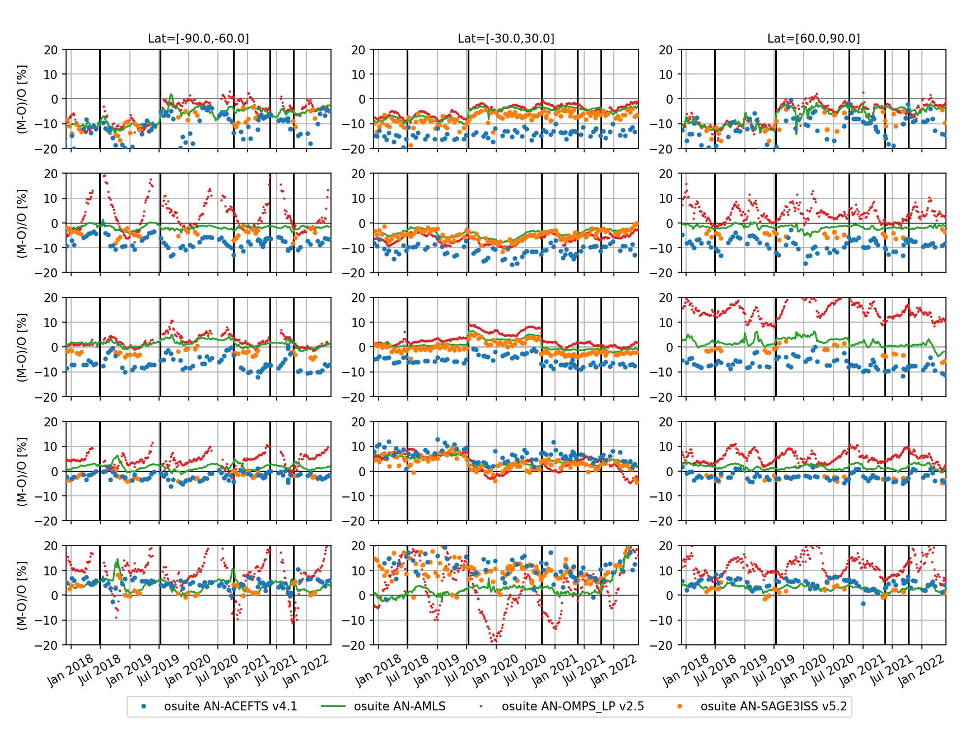
Evaluation of CAMS-NRT stratospheric ozone
1-3 hPa
3-10 hPa
Evaluation of CAMS vs limb profiles in since 2018
10-30 hPa
30-70 hPa
70-100 hPa

Slide 17

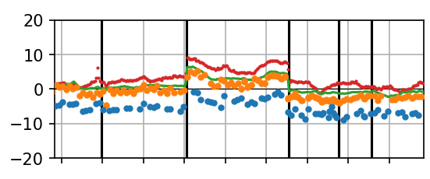

Evaluation of CAMS-NRT stratospheric ozone
Switch from L60 to L137
Update O3 climatology used in the linearized scheme
Evaluation of CAMS vs limb profiles in since 2018
10-30 hPa

Slide 18
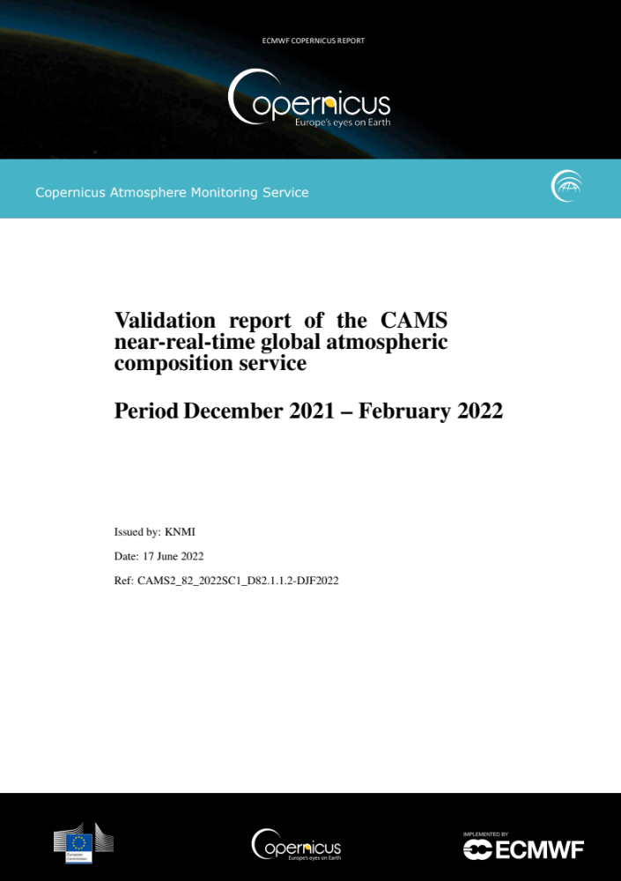
CAMS global evaluation reports
CAMS-global real-time forecast/analyses validation reports
Every 3 months
Evaluation of forecasts/analyses plus control run (without DA)
Reactive gases, aerosols and greenhouse gases
Event studies
About 200 pp of figures & validation results
Stand-alone summary
Need for “real-time” observations, available
within 1 month after sensing
Importance of quarterly updates:
document the latest upgrade of the CAMS system
Similar report for CAMS reanalysis (every year) and preoperational versions
doi: 10.24380/9z4h-5niy
https://atmosphere.copernicus.eu/eqa-reports-global-services

Slide 19
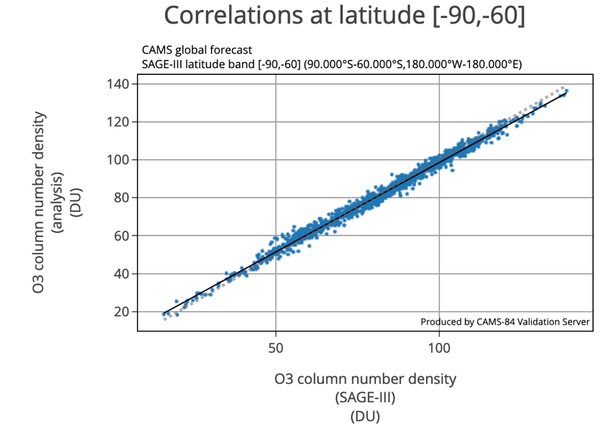
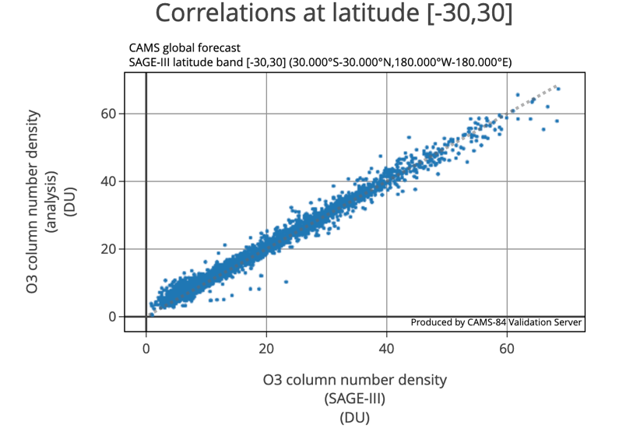
CAMS validation server
Online intercomparison between CAMS-NRT and 60 independent datasets
Including
  O3sondes
  Aircraft O3
  Sat. O3 TC
  Lidar and MW groundbased
  ACE-FTS and SAGE-III/ISS
Reducing SAGE-III/ISS L2 production time would be greatly appreciated
https://global-evaluation.atmosphere.copernicus.eu

Slide 20
CAMS monitoring of the Antarctic ozone hole
more info at https://atmosphere.copernicus.eu/monitoring-ozone-layer

Slide 21
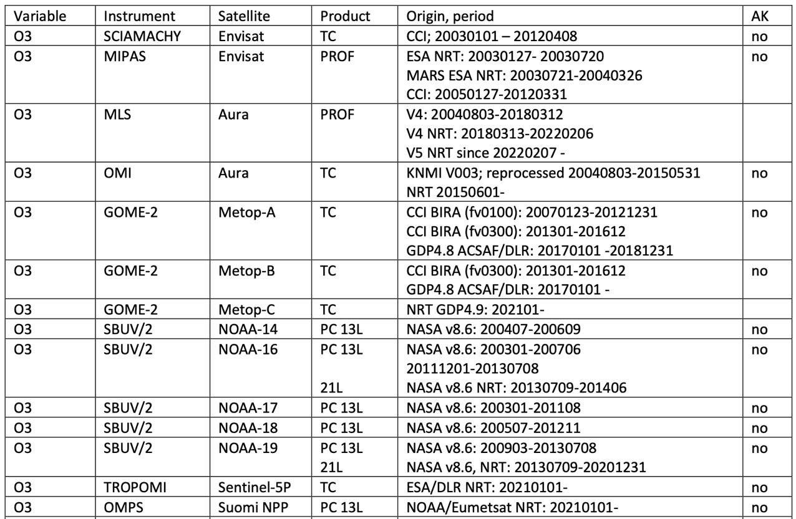
CAMS Reanalysis (Inness et al., ACP, 2019)
  IFS 42r1 (TM5 tropospheric chemistry, Linearized stratospheric ozone chemistry)
80 km horizontal resolution (T255), 60 levels from the surface to 0.1 hPa
Profiles
Part. Col.
Tot. Col.

Slide 22
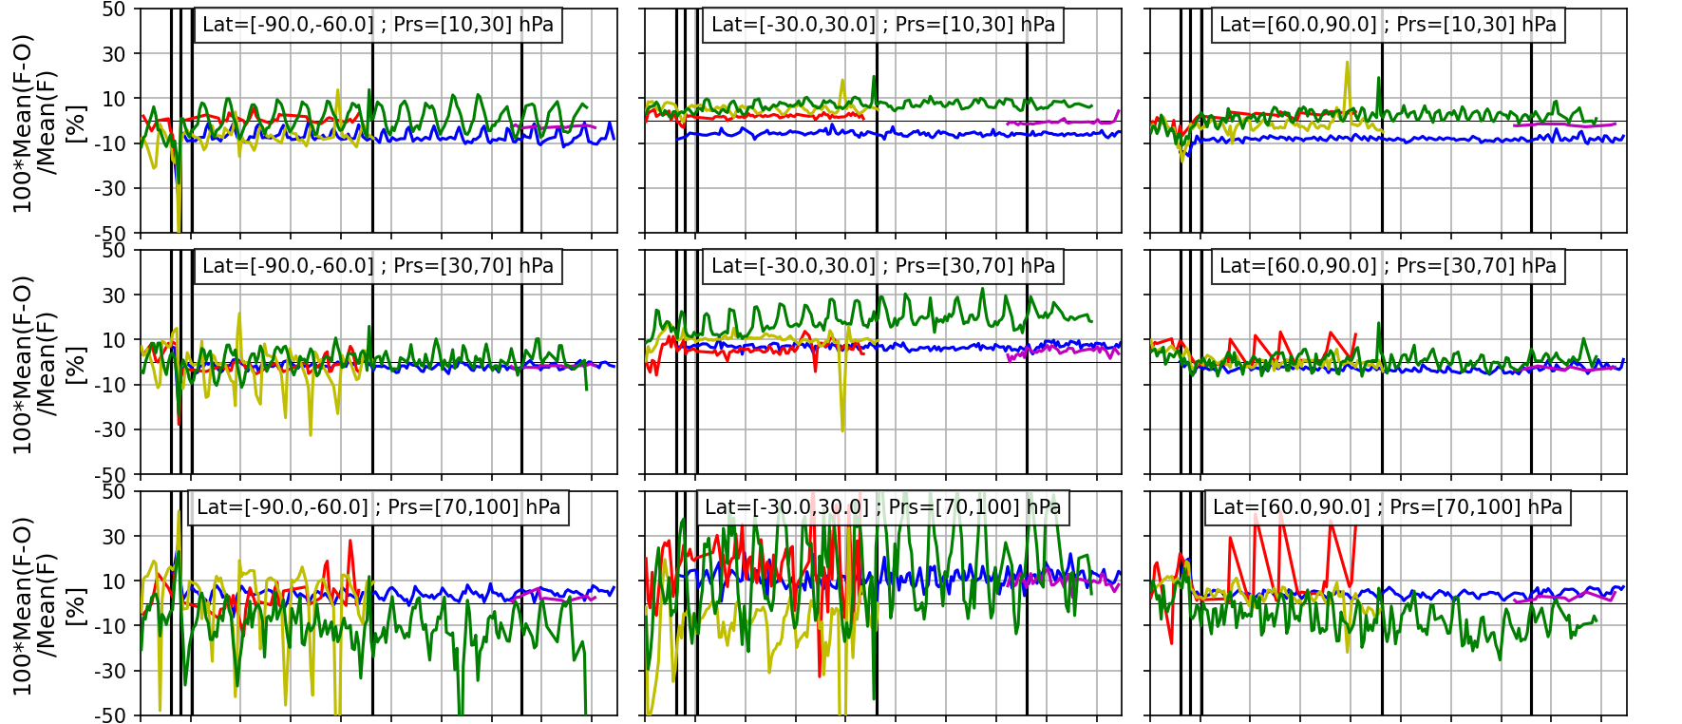
CAMS Reanalysis
From CAMS Reanalysis validation report 2003-2021

Slide 23
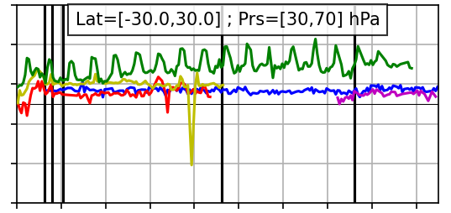

CAMS Reanalysis
End of MIPAS NRT
Start of MLS
Start of MIPAS ESA_cci
End of ENVISAT
Switch MLS OL->NRT

Slide 24
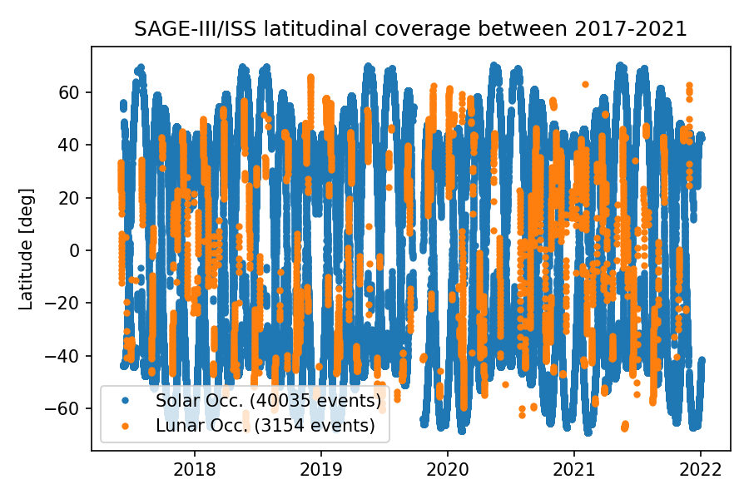
Evaluation of CAMS-NRT ozone using SAGE-III/ISS lunar occultations

Slide 25
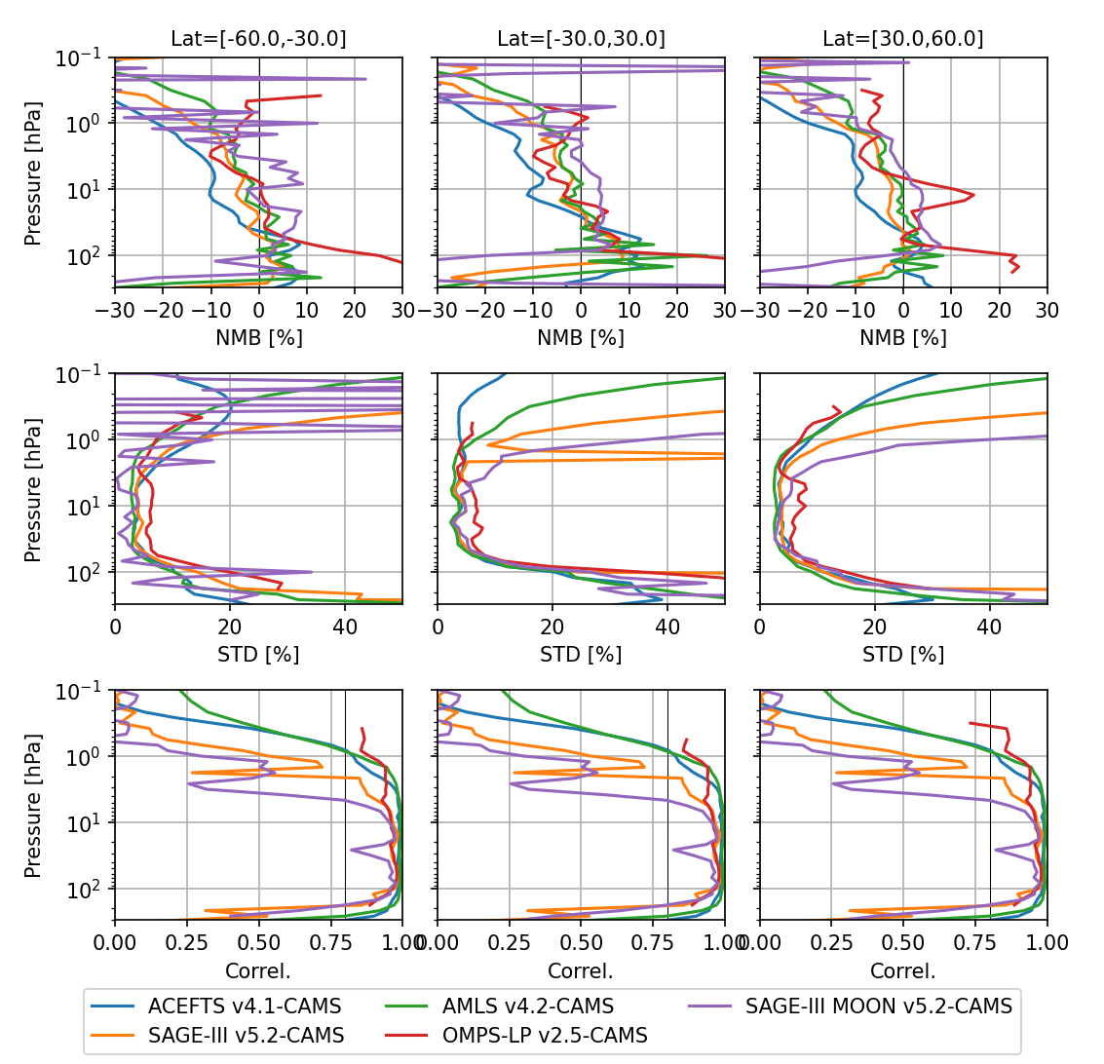
Evaluation of CAMS-NRT ozone using SAGE-III/ISS lunar occultations
Evaluation of CAMS vs limb profiles in SON2021

Slide 26
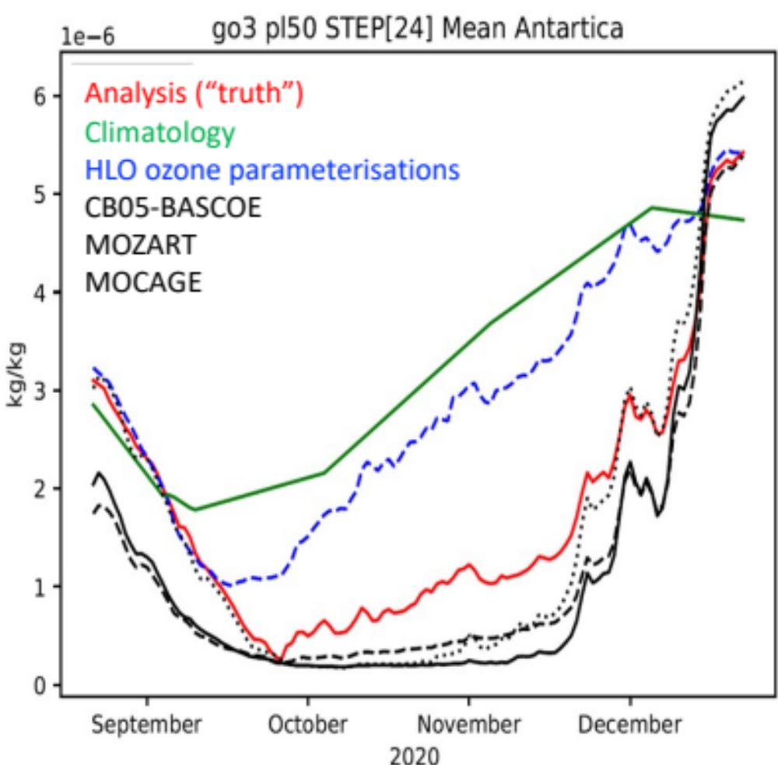
Future development in CAMS
IFS 48r1 will be implemented operationaly in 2023 including BASCOE chemical scheme for the stratosphere (Huijnen et al., GMD, 2016), i.e.:
  NO_{y}, HO_{x}, Cl_{y}, Br_{y} chemistry
  N₂O, CH₄, CFCs, HCFc… emissions and stratospheric loss
  PSC parameterization
New reanalysis 2003-present with stratospheric chemistry is planned in 2024
Validation of CAMS stratosphere will be extended to NO_{y}, Cl_{y}, H₂O, CH₄ & CFCs
Figure from J. Flemming, talk at CAMS GA 2022 https://atmosphere.copernicus.eu/sites/default/files/2022-07/Flemming_GAMS_GA_2022.pdf

Slide 27
Conclusions
CAMS (NRT and reanalysis) stratospheric ozone agree well againts independent observations
SAGE-III/ISS are very important in CAMS ozone validation
Improving the timelyness would be very much appreciated by CAMS
CAMS will be extended to stratospheric composition beyond ozone (NO_{y}, HO_{x}, Cl_{y}, Br_{y}, N₂O, CH₄, CFCs, HCFc…) in 2023
This requires stratospheric independent observations for the evaluation (including SAGE-III/ISS NO₂ and H₂O)

