Slide 1
The SAGE III/ISS Quicklook Website
Updates for 2026 Edition
Rick Farmer, ADNET Systems Inc
SAGE III/ISS Ground Systems Engineer

Slide 2
Overview
The Quicklook (and Expedited) Website(s)
The Website Team
2026 Updates
  A Look Into Making A Better User Experience
What’s Next?

Slide 3
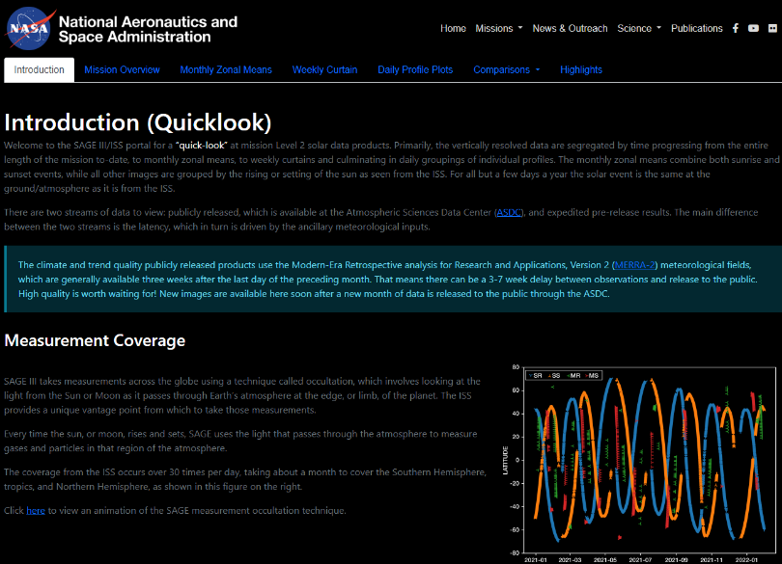
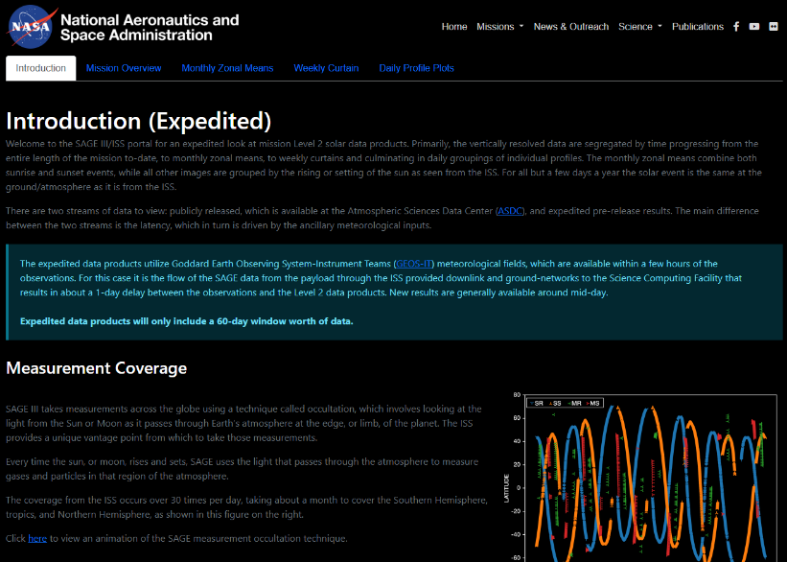
The Quicklook Website
Quicklook – Release Product Version
https://sage.nasa.gov/sageiii-iss/browse_images/quicklook/
Expedited – Pre-Release internal product using GEOS
https://sage.nasa.gov/sageiii-iss/browse_images/expedited/

Slide 4

The Quicklook Website
Our home URL
https://sage.nasa.gov

Slide 5

The Quicklook Website
SAGE III also lives on Science-Data
  https://science-data.larc.nasa.gov/sage-data/
Quicklook
https://science-data.larc.nasa.gov/sage-data/quicklook/
Expedited
https://science-data.larc.nasa.gov/sage-data/expedited/

Slide 6
The Website Team
Science Content
Kevin Leavor
  Processing, Management
Mary Cate McKee
  Ground validation
David Flittner
  Science objectives, content review
Marilee Roell
  Science management, content review
Web Content and Support
Rick Farmer
  Web development, backend
Greg Paxton
  Ground systems management, process review
Caitlyn Stone
  Operations, Partner communication

Slide 7
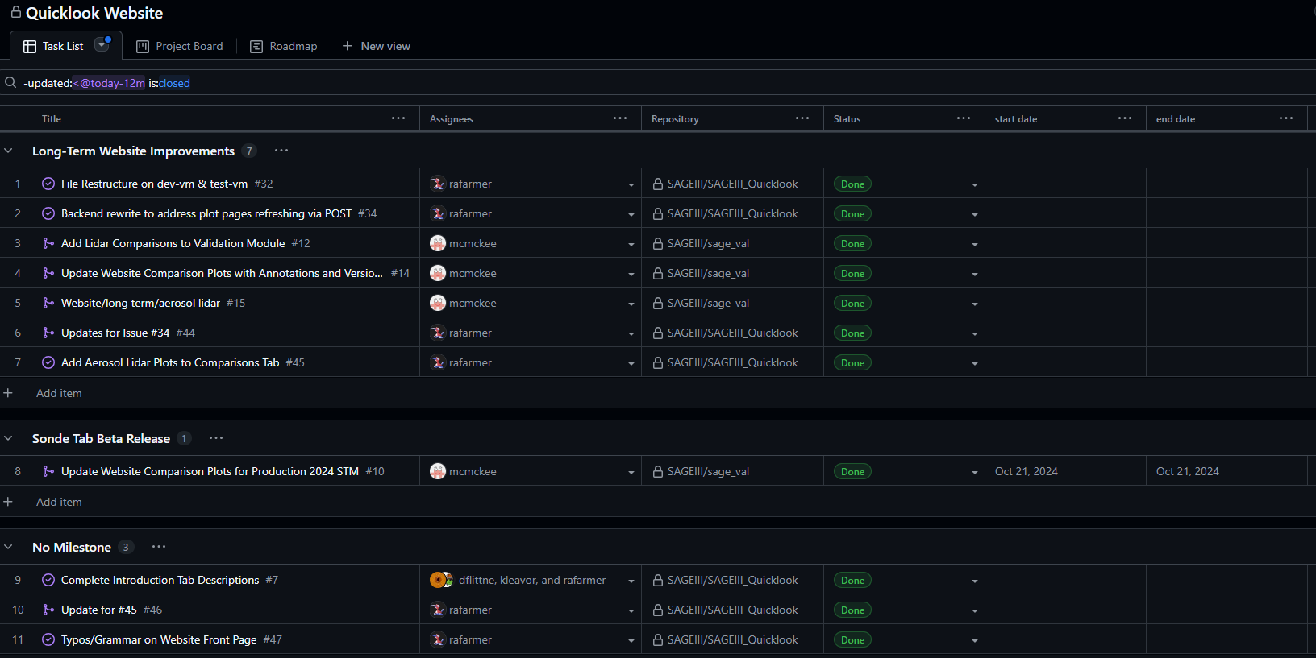
2026 Updates: Another Busy Year

Slide 8
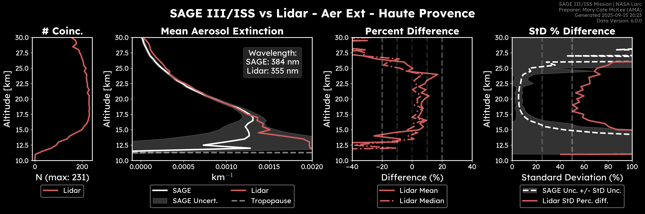
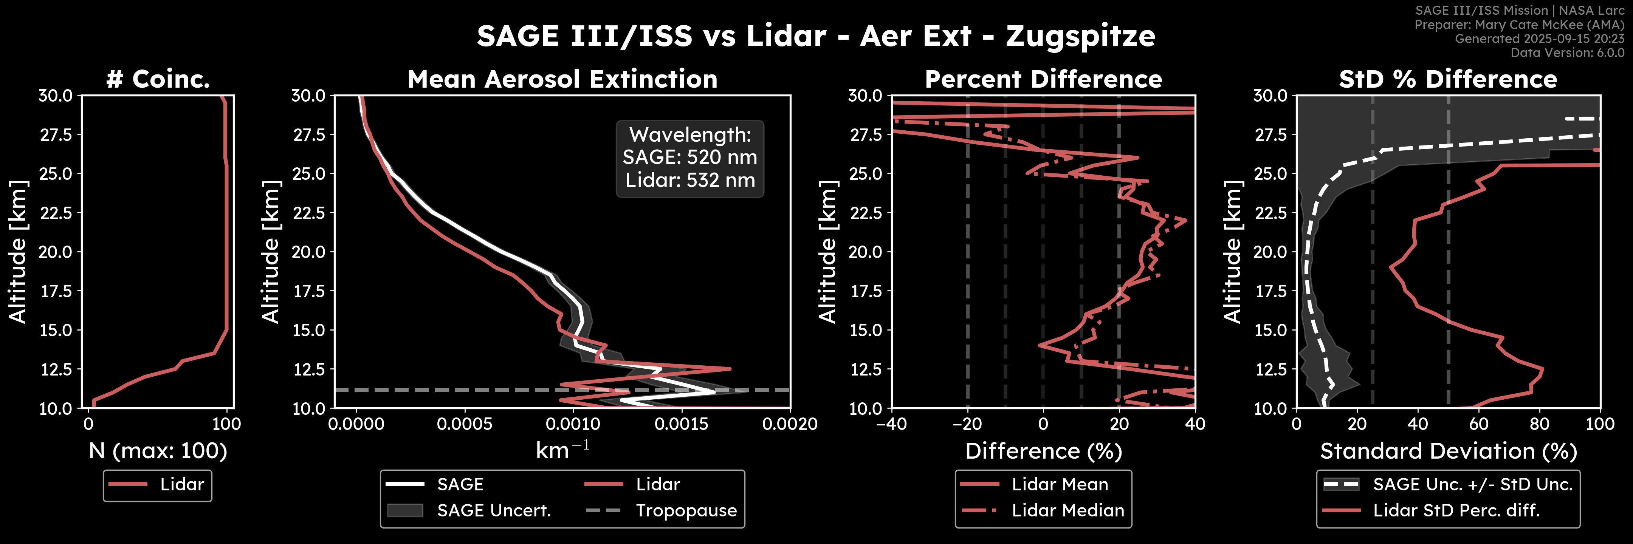
2026 Updates
Features added since last year
  New Lidar Comparisons
  New QoL updates throughout Quicklook & Expedited
    Major backend updates
    Development environment restructure

Slide 9
2026 Updates
A Look Into Making A Better User Experience
  New JS Ajax was implemented
  Added 7 new php scripts
  Made numerous edits throughout each index.php
    About 50% of Quicklook was rewritten
    About 40% of Expedited was rewritten
    Added unique identifiers to every plot image for the following sections
      Mission Overview
      Monthly Zonal Means
      Weekly Curtain
      Daily Curtain
    New Thumbnails were added for each plot image for the above sections as well
      This reduced the load times considerably
      The original sized images are still available on click

Slide 10
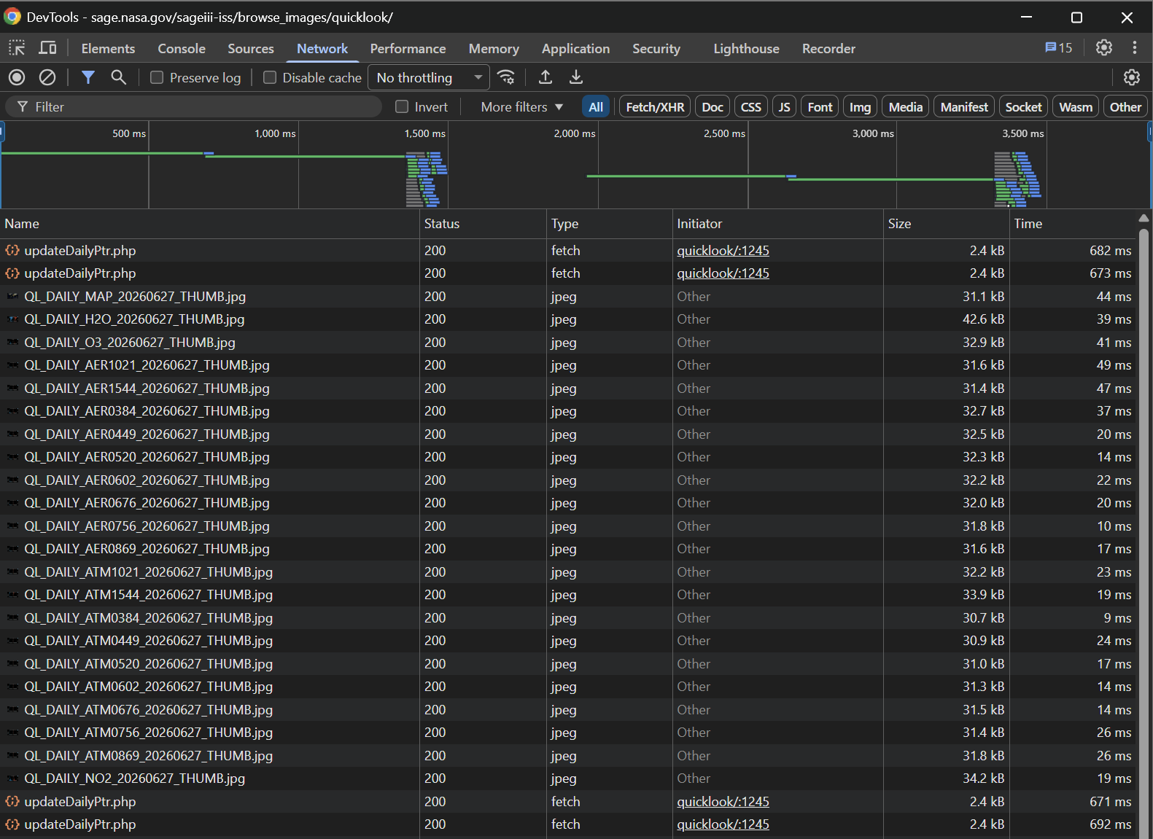
2026 Updates
A Look Into Making A Better User Experience

Slide 11
2026 Updates: What’s Coming
Miscellaneous Tab for Quicklook
  Focuses on a variety of topics
    Sunspot Numbers
    Total Stratospheric Aerosol Optical depth (cloud filtered)
    Total Stratospheric Water Vapor
    And potentially more!
Changelog
  Adding a tab dedicated to all the new updates
Lunar Comparisons

Slide 12

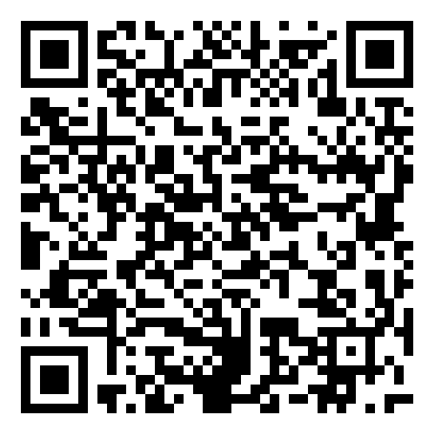
Still More to Come
Additional highlights
Hover content on maps
Homogenized data comparisons
Suggestions from YOUR FEEDBACK!
Current plans for updates are through EOY
Quicklook
Expedited

