Slide 1



For Stratospheric Aerosol Observations
J.-P. Vernier ^{1,2,3} N. Dumelié², A. K. Pandit¹*, G. Souza⁴, J. Flaten⁵, V. Ravi Kiran⁶, R. C. Das¹, H. Vernier^{3,1}, L. Joly³, D. Quintao⁷, B. Biazon⁷, M.Venkat Ratnam⁶, T.V. Rao⁸, N. Rastogi⁹, G. Berthet¹⁰, R. Benoit¹¹, P. Dagaut¹¹, B. Grosselin¹¹, S. Delpeux¹¹, E. Landulfo⁴⁺, H. Liu^{1,2}, M. Fromm¹², D. Peterson ¹³, F. Wienhold¹⁴, M. Kovilakam^{2,15}, S. Fadvanis¹⁶, B. Abiodun¹⁷, L. Xia¹⁸ and E. Aboutanios¹⁹
1. National Institute of Aerospace, Hampton, VA, USA; 2. NASA Langley Research Center, Hampton, VA, USA; 3. Université de Reims Champagne Ardennes CIEL/AEROLAB EMR CNRS 7007; 4. Instituto de Pesquisas Energéticas e Nucleares IPEN-CNEN, São Paulo, SP, Brasil; 5. Aerospace Engineering and Mechanics Department, University of Minnesota, Minneapolis, MN, USA; 6. National Atmospheric Research Laboratory, Gadanki, India; 7. Centro de Meteorologia de Bauru IPMet-UNESP, Bauru, SP, Brasil; 8. Balloon facility, Tata Institute of Fundamental Research, Hyderabad, India; 9. Physical Research Laboratory, Ahmedabad, India; 10. LPC2E, UMR CNRS 7328, CNRS, Université d’Orléans, CNES, Orléans, France; 11. ICARE, UPR3021, CNRS, Orléans, France; 12. Naval Research Laboratory, Washington DC, USA; 13. Naval Research; Laboratory, Monterey, CA, USA 14. Institut für Atmosphäre und Klima, ETH Zürich, Zürich, Switzerland 15. ADNET Systems, Inc., Hampton, USA; 16. Indian Institute of Tropical Meteorology, Pune, India; 17. University of Cape Town, Cape Town, South Africa; 18. Degrees Initiative, USA; 19. University of New South Wales, Australia
* Former employee of NIA, + passed away
SAGE III/ISS Science Team meeting 19-20 August 2026

Slide 2
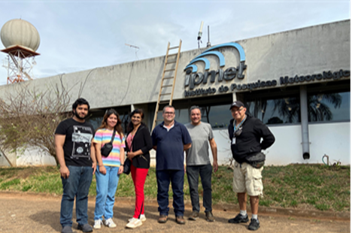
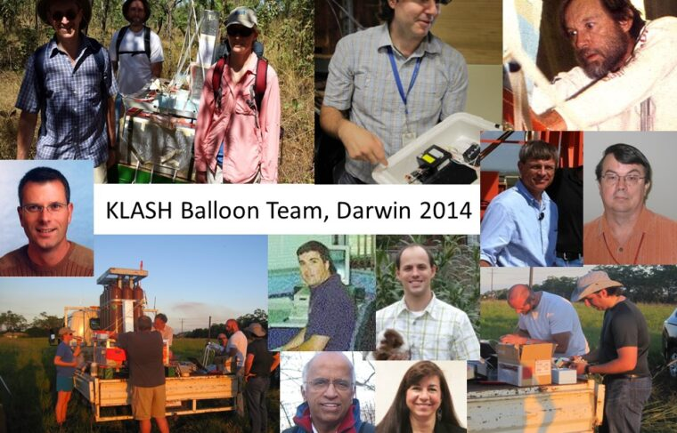
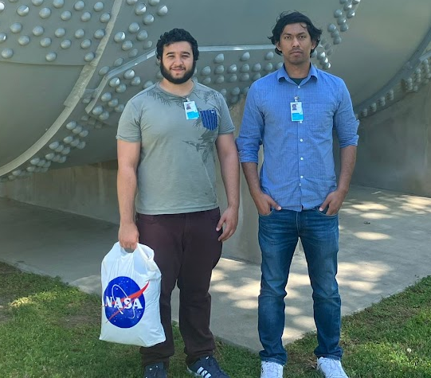
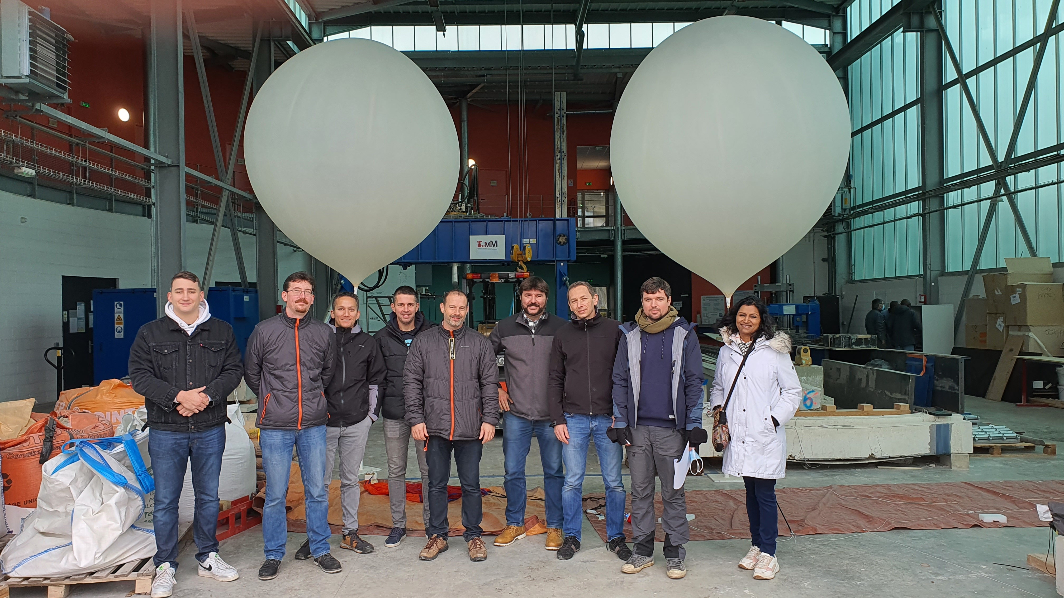
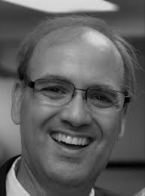
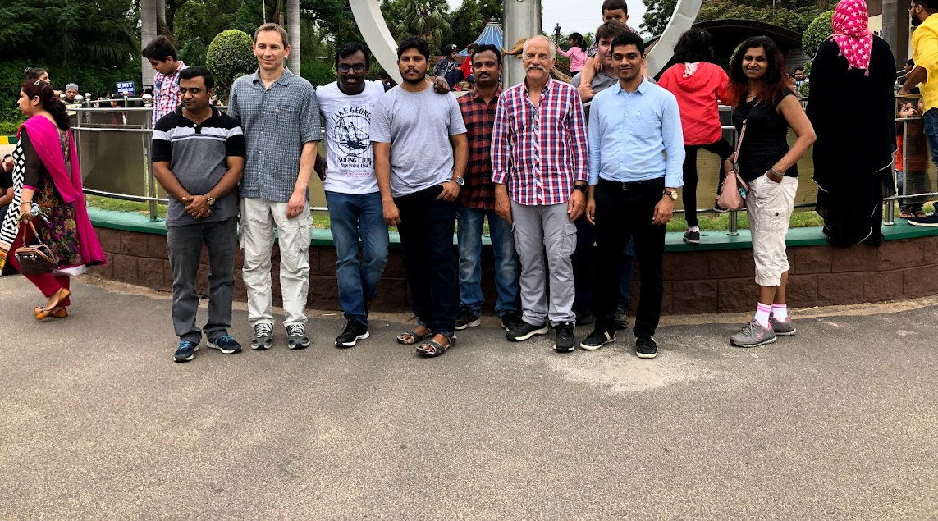
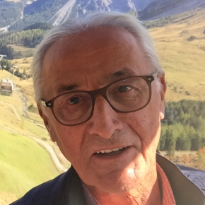
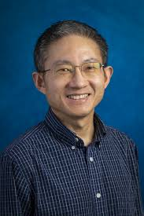
Team adventure of almost two decades
BraVo team/Brazil 2022
KLASH team/Australia 2014
LaRC 2023
BATAL team/India 2019
REAS team/France 2021

Slide 3
Motivations
Stratospheric aerosol sources are complex (Volcanic Eruptions, PyroCbs, Asian Monsoon, Rocket plumes…)
The lifetime cycle is still poorly understood especially in the tropical UTLS regarding organics (Ming Lyu et al., 2026)
Challenges to observe aerosols near the tropopause due to the presence of clouds and their interactions
Important for Strato. Ozone Chemistry and Climate

Slide 4
History of balloon-borne stratospheric aerosol measurements
Stratospheric aerosols monitored using OPC measurements since 1971 (e.g. Deshler et al., 2003)
Backscatter sonde technique was introduced in 1991 (Rosen and Kjome, 1991) (both efforts at Univ. of Wyoming)
Recent developments of smaller counters and backscatter sondes (COBALD/ETH in 2012, POPS/NOAA in 2015, LOAC/LPC2E in 2016, LASP OPC 2022) to be launched on weather balloons
2014 HQ funded our LaRC group (D. Fairlie, M. Natarajan, T. Knepp and myself) and T. Deshler’s group to deploy after the Kelud volcanic eruption in Australia

Slide 5
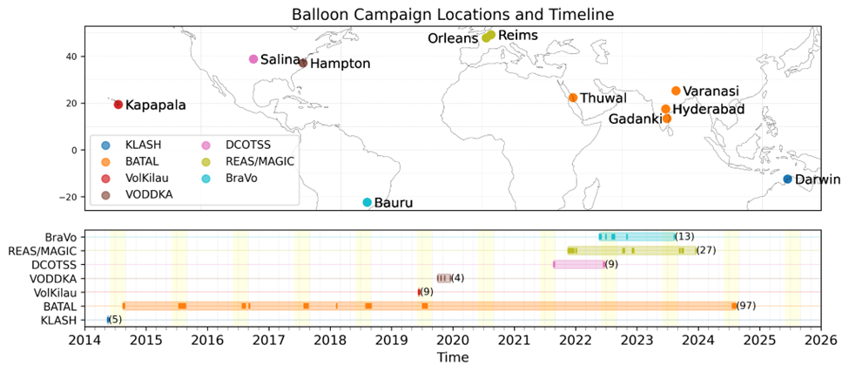
12 years of balloon campaigns with NASA LaRC
From KLASH to BalNeO
BraVo
VODDKA
VolKilau
BATAL
REAS/MAGIC
KLASH
DCOTSS
Vernier J.P. et al. 2026, BAMS, under review

Slide 6
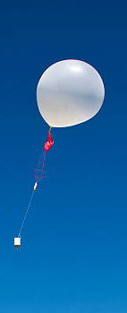
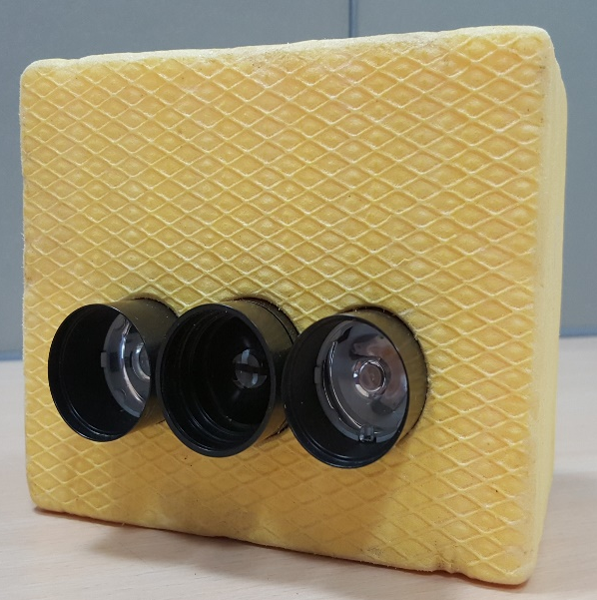
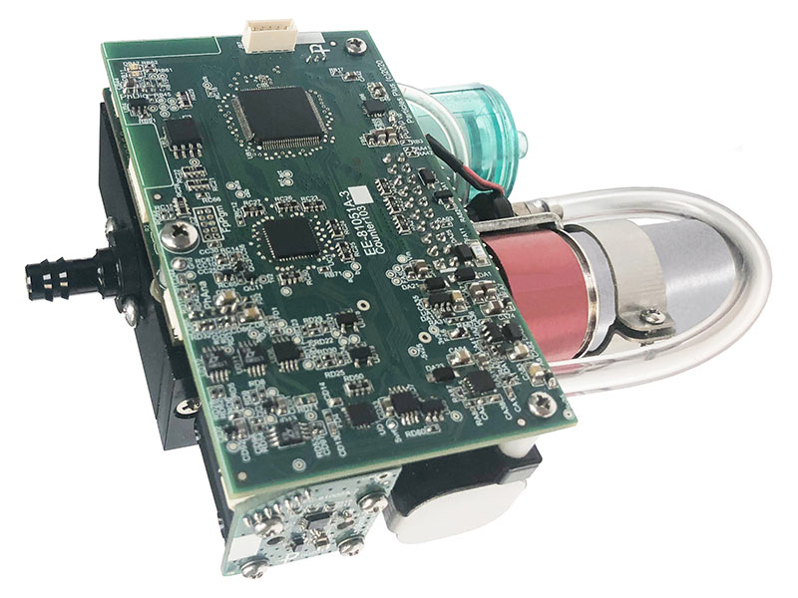
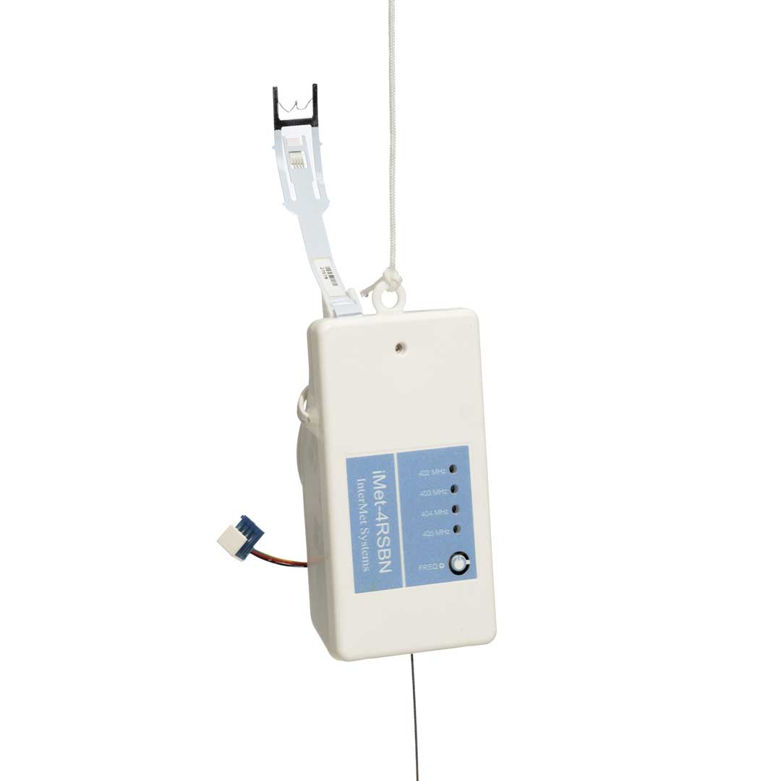
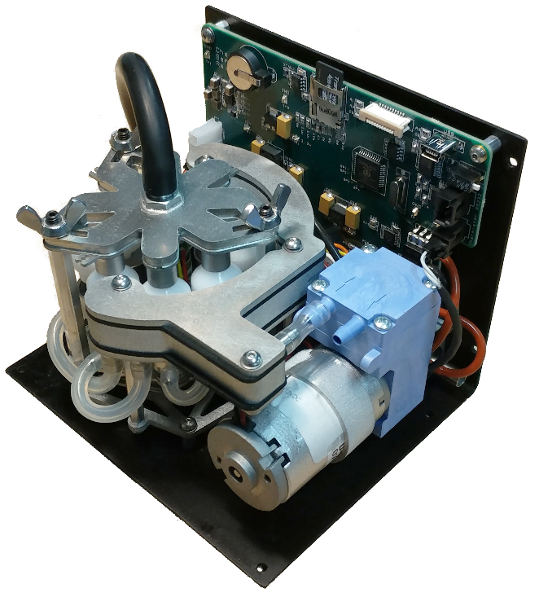
Lightweight Payloads used within the framework of BalNeO
To study aerosol properties
Profiling Optical Particle Counter
iMet-4 Radiosonde
Compact Optical Backscatter
AerosoL Detector (COBALD)
A two-wavelength backscatter sonde
Backscatter ratio (BSR) at 455 nm (blue)
& 940 nm (IR) wavelengths.
Color Ratio = BSR₉₄₀/BSR₄₅₅
Laser diode based optical particle counter
Particle counts at 30 size channels /2s
Size range: 0.3 -10 µm (diameter)
Flow: 2.83 LPM (0.1 CFM)
T, P, RH, u, & v
GPS location
Filter Sampler
Eight filters or TEM grids with software actuated sampling.
Samples collected on filters used for ion-chromatography

Slide 7





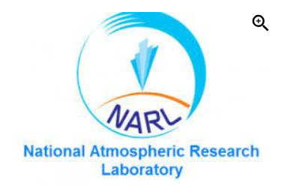
BalNeO Partners
Reims, France
Saskatoon, Canada
Minneapolis, USA
Bauru, Brazil
Hyderabad, India
- 4 active MoUs with different institutes/Universities across the world
Leasing of equipment to facilitate balloon activities
Encourage student teams to be involved

Slide 8
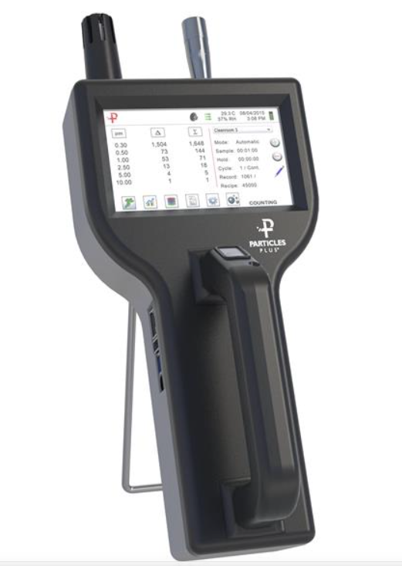
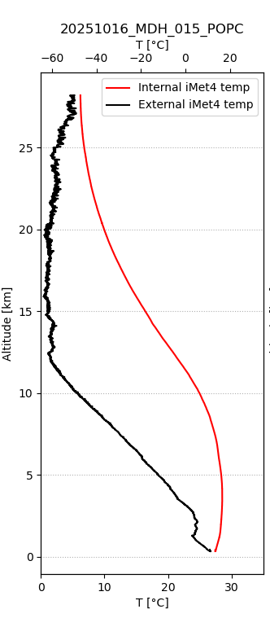
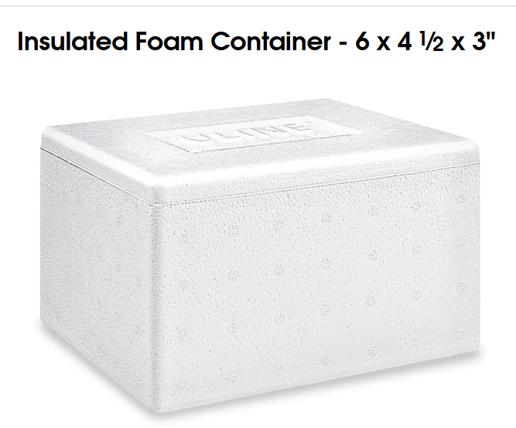
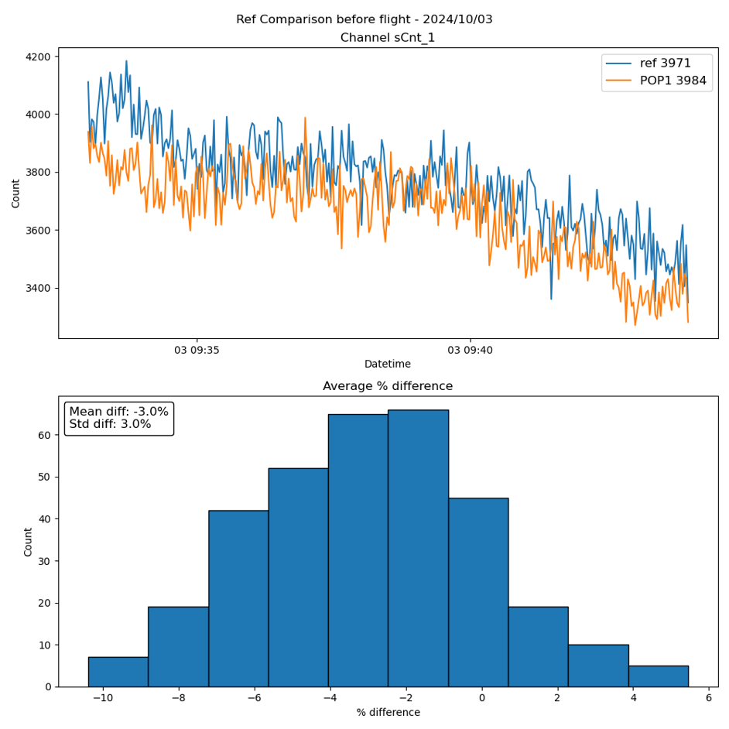
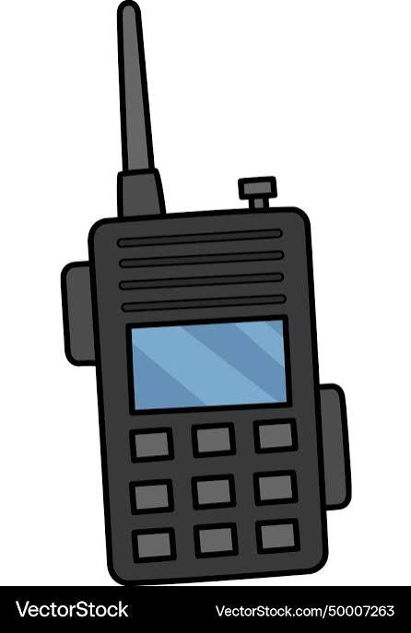
POPC adaptation for Balloon measurement
1. Miniaturization (800 g)
2. Thermal Insulation
External
9˚C<IN<30 ˚C
4. Ground-check
-60 ˚C <OUT< 30 ˚C
3. Data Transmission
Internal
Vernier J.P. et al., 2026 AMTD

Slide 9
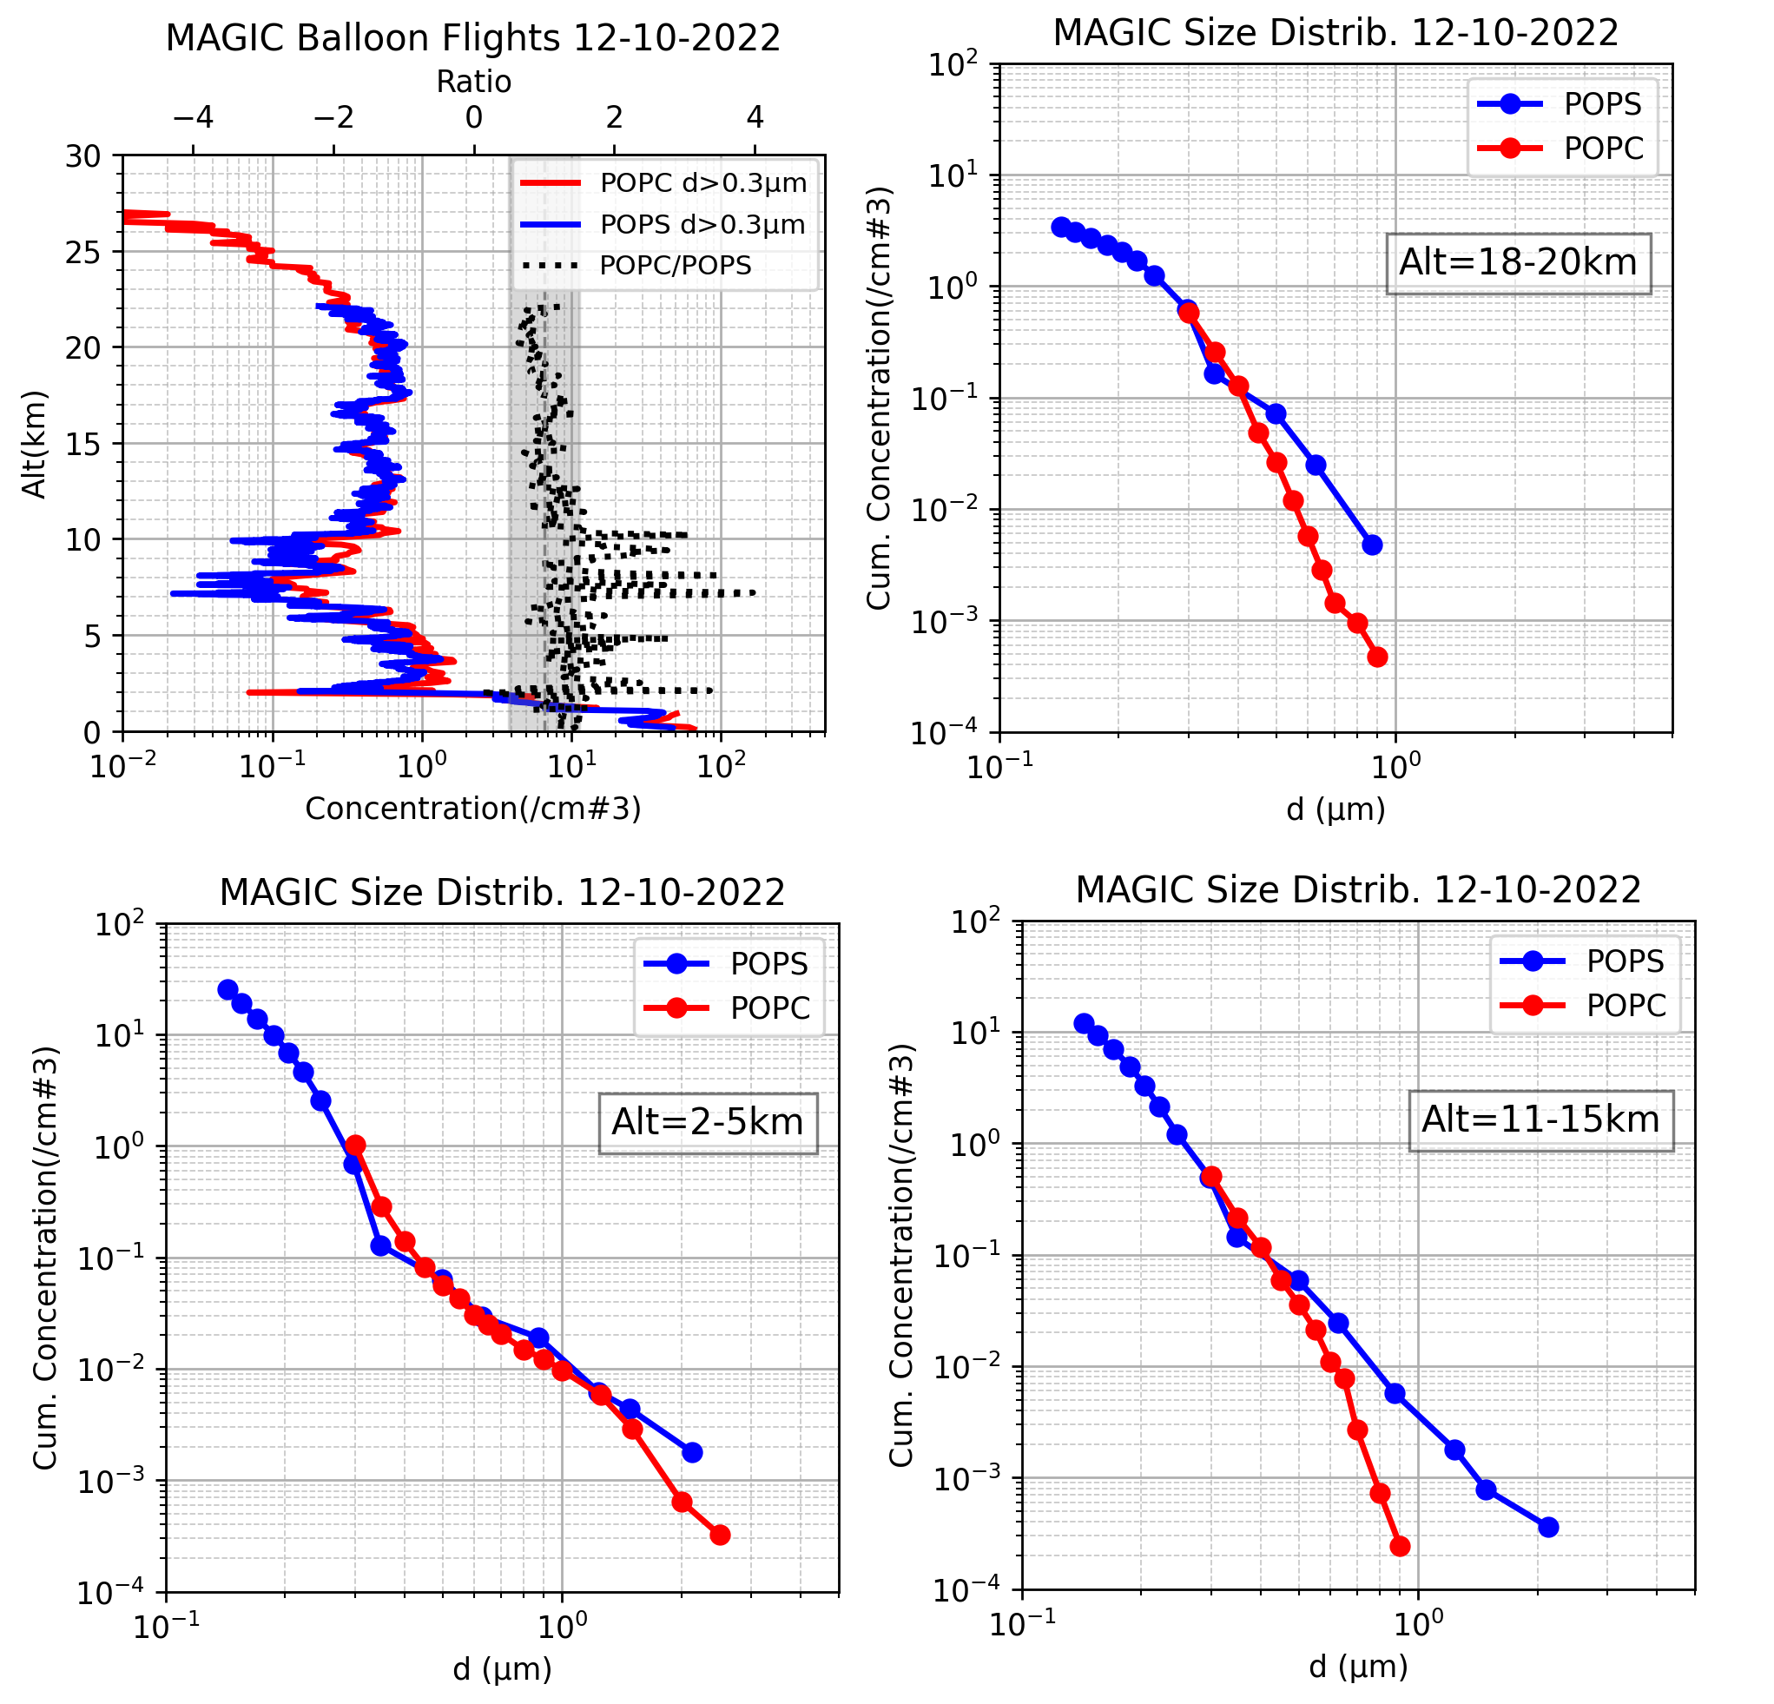
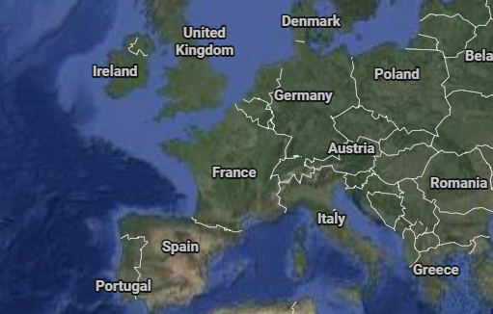
Validation
POPC vs POPS
Reims

Slide 10
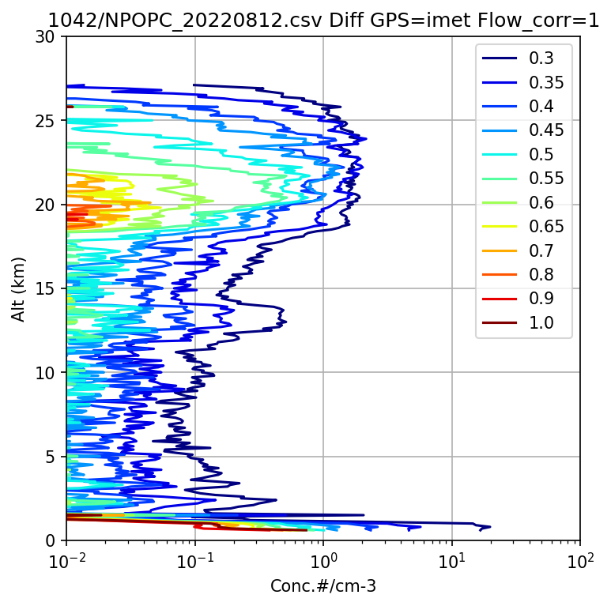
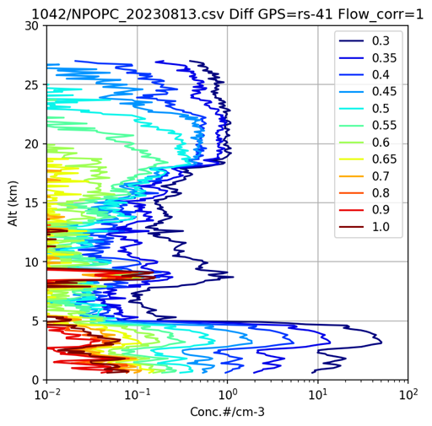
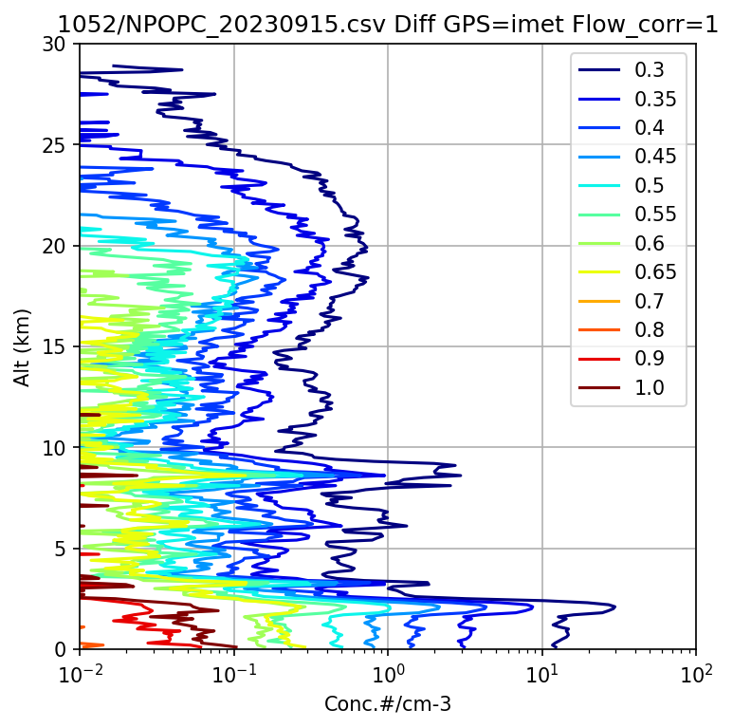
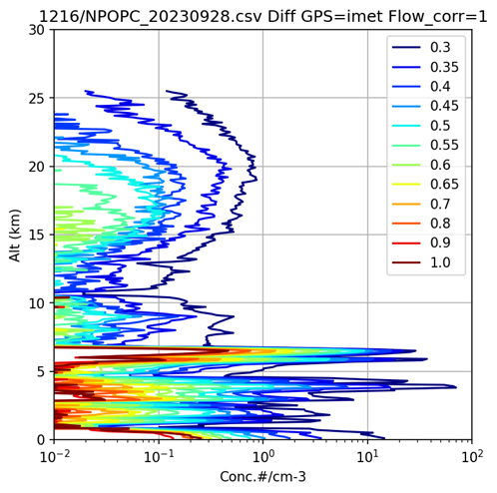
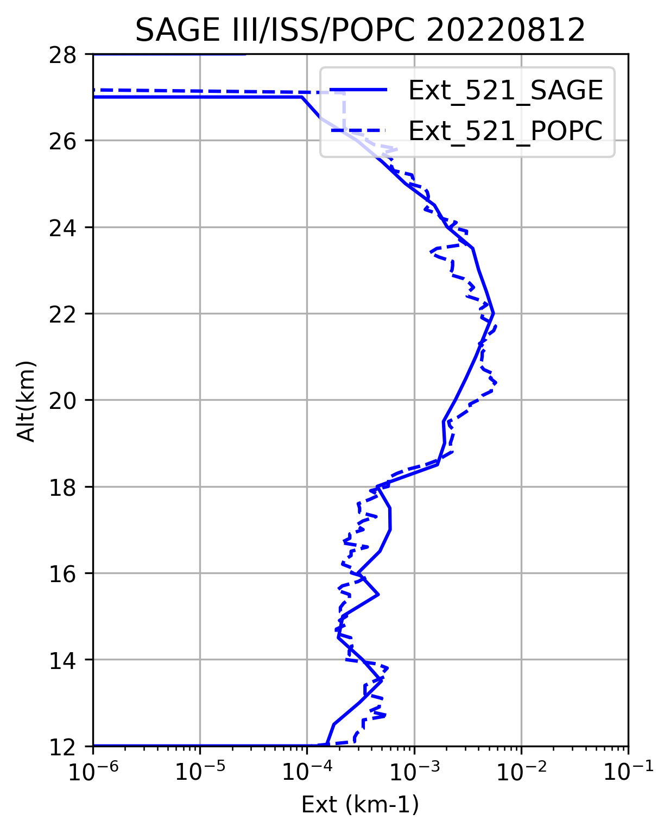
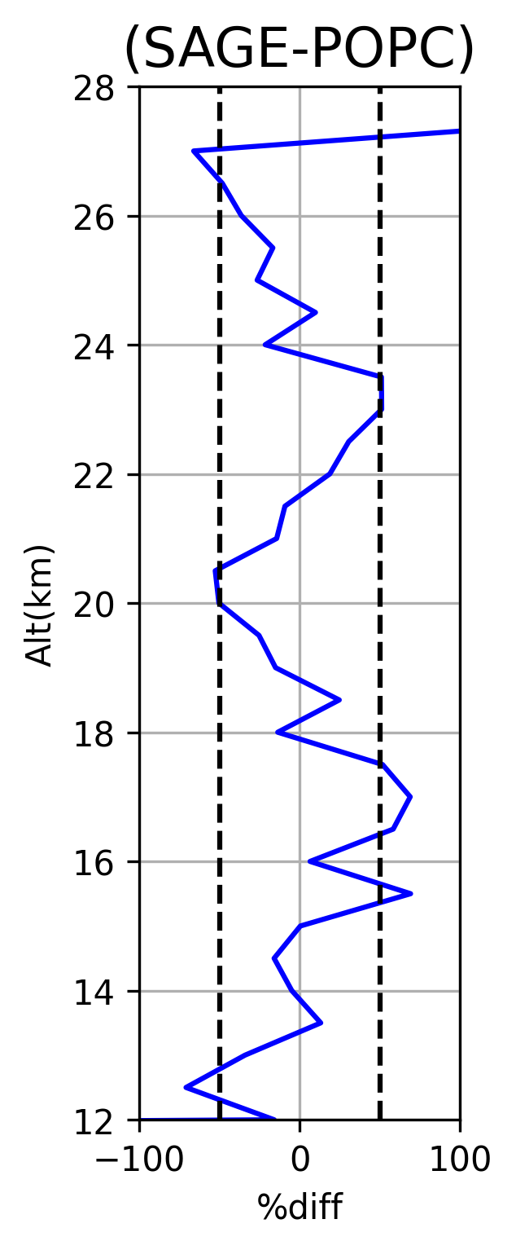
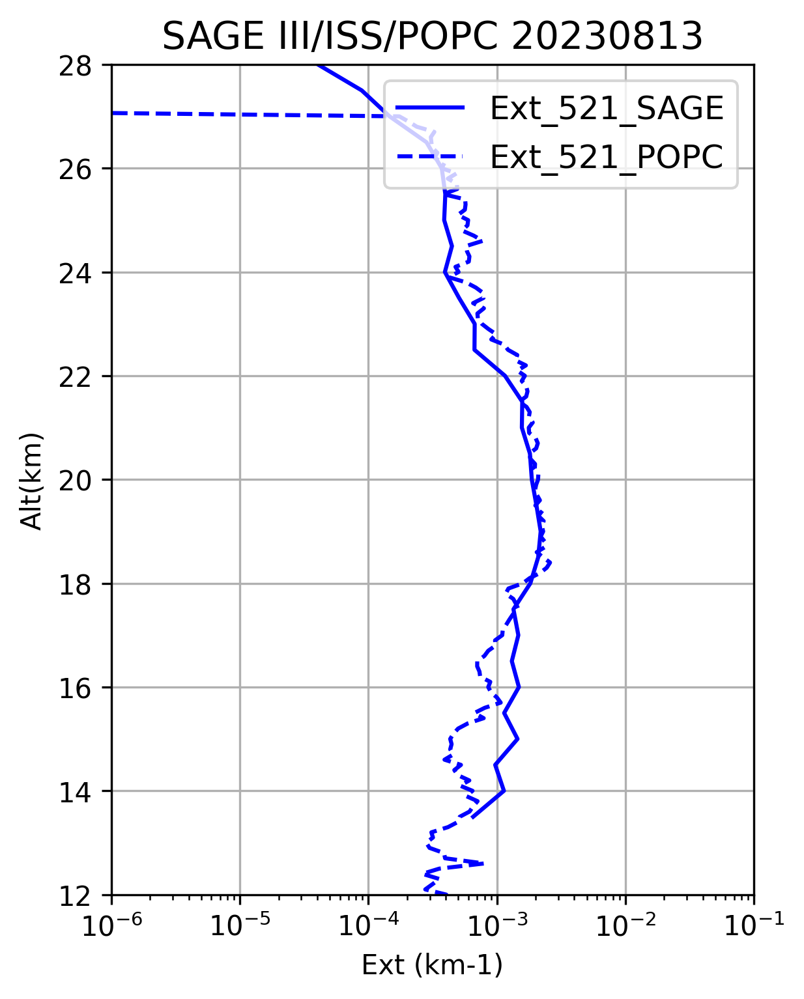
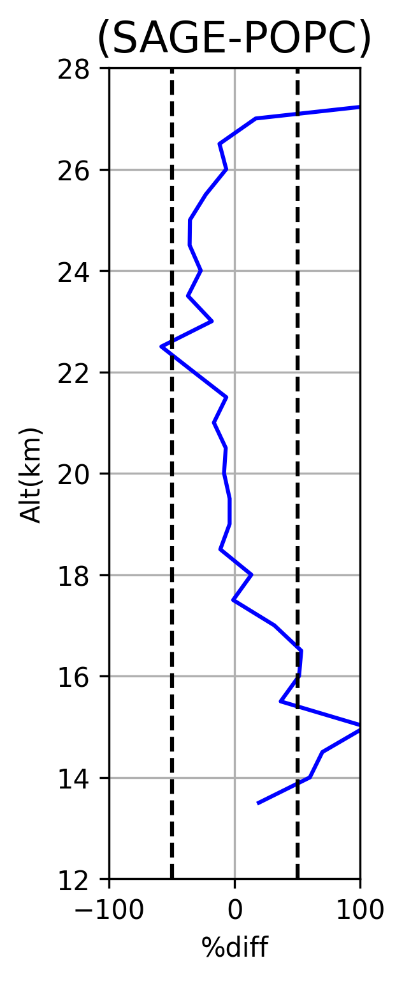
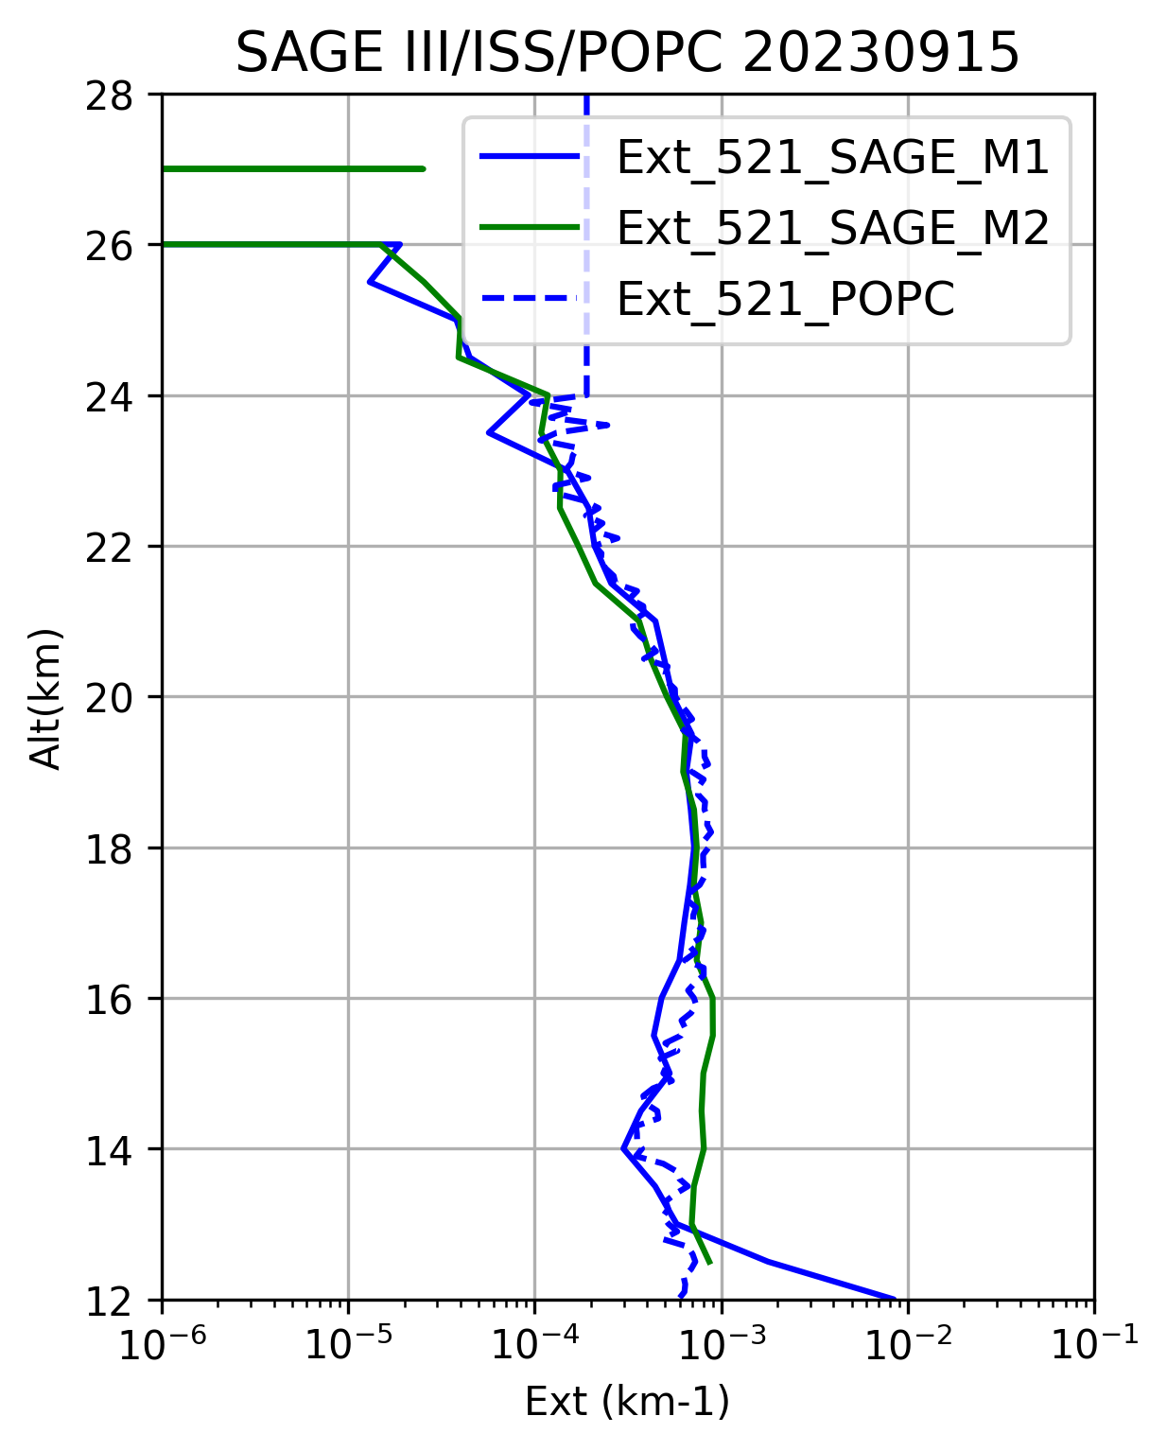
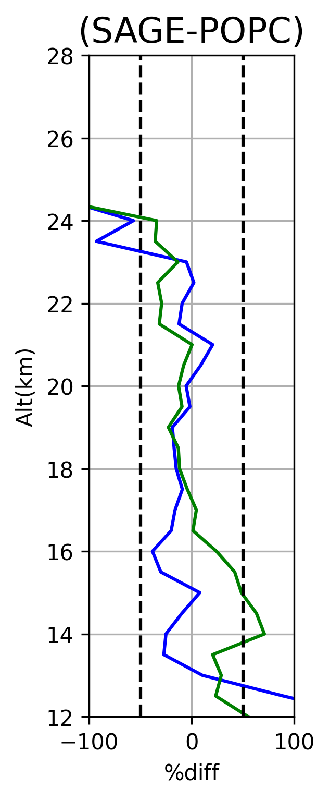
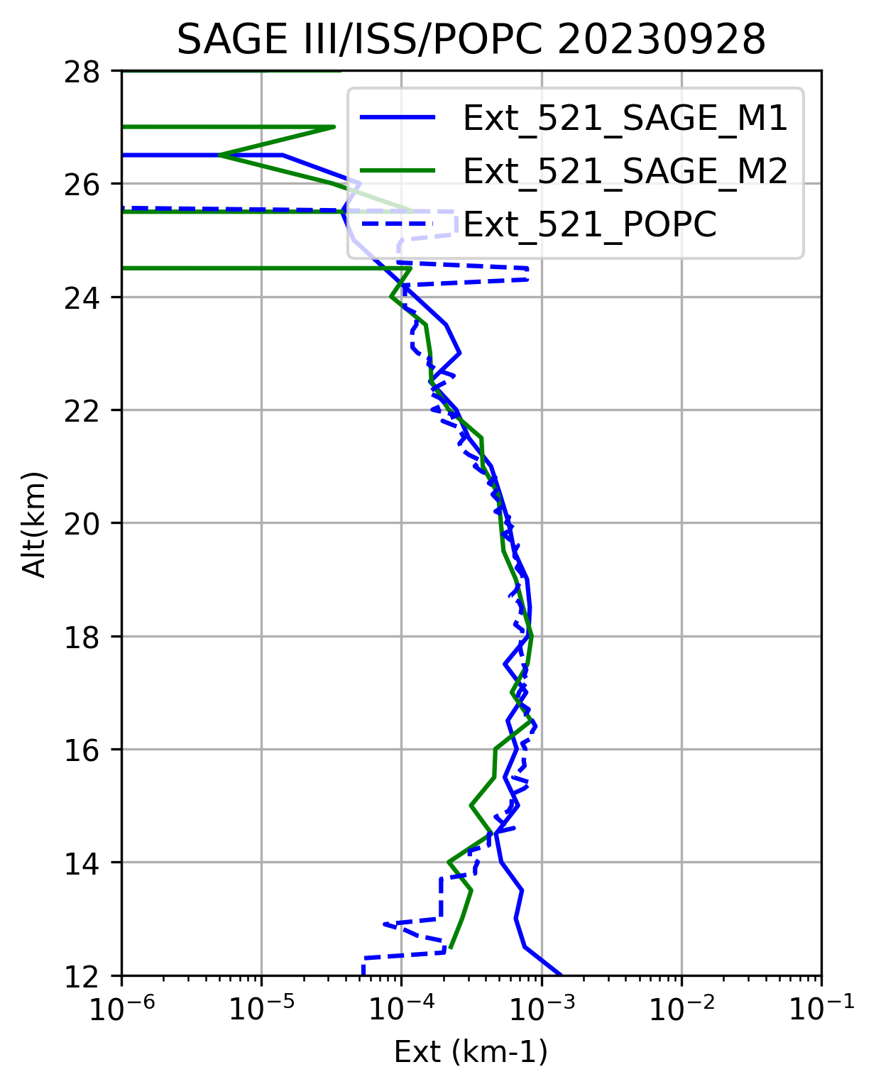
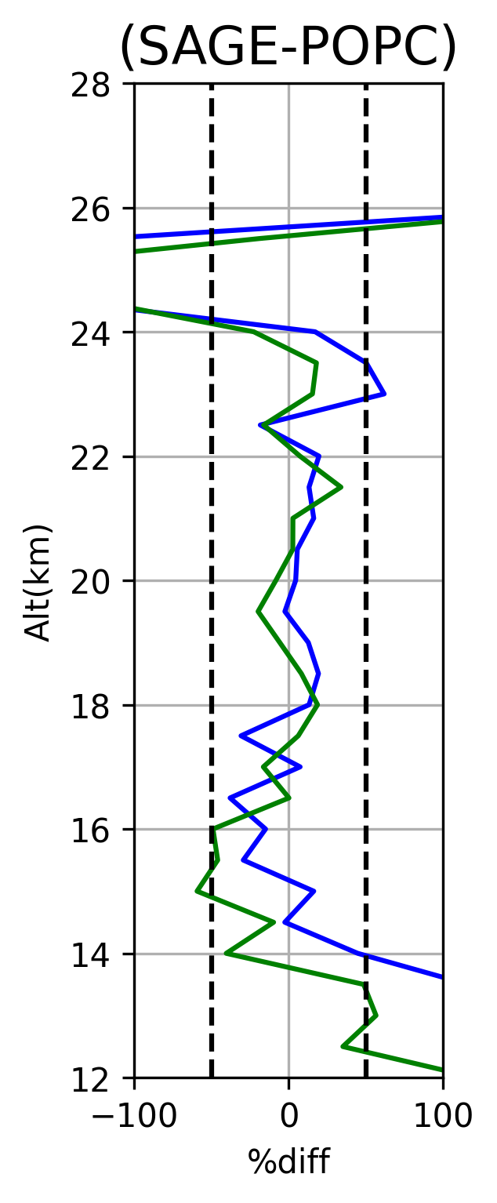
Collocated flights between POPC and SAGE III/ISS
Brazil 08/12/22
Brazil 08/13/23
France 09/15/23
France 09/28/23
a)
b)
e)
f)
Tropical background
NH background
NH background
Hunga plume
c)
d)
g)
h)
Extinction coefficient derived from POPC agree within +/-50% with SAGE III/ISS at 521 nm

Slide 11

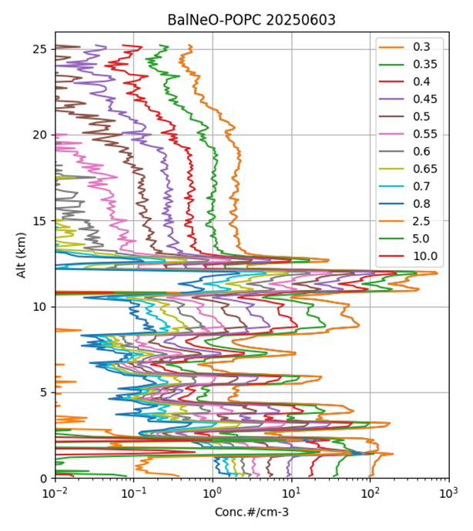
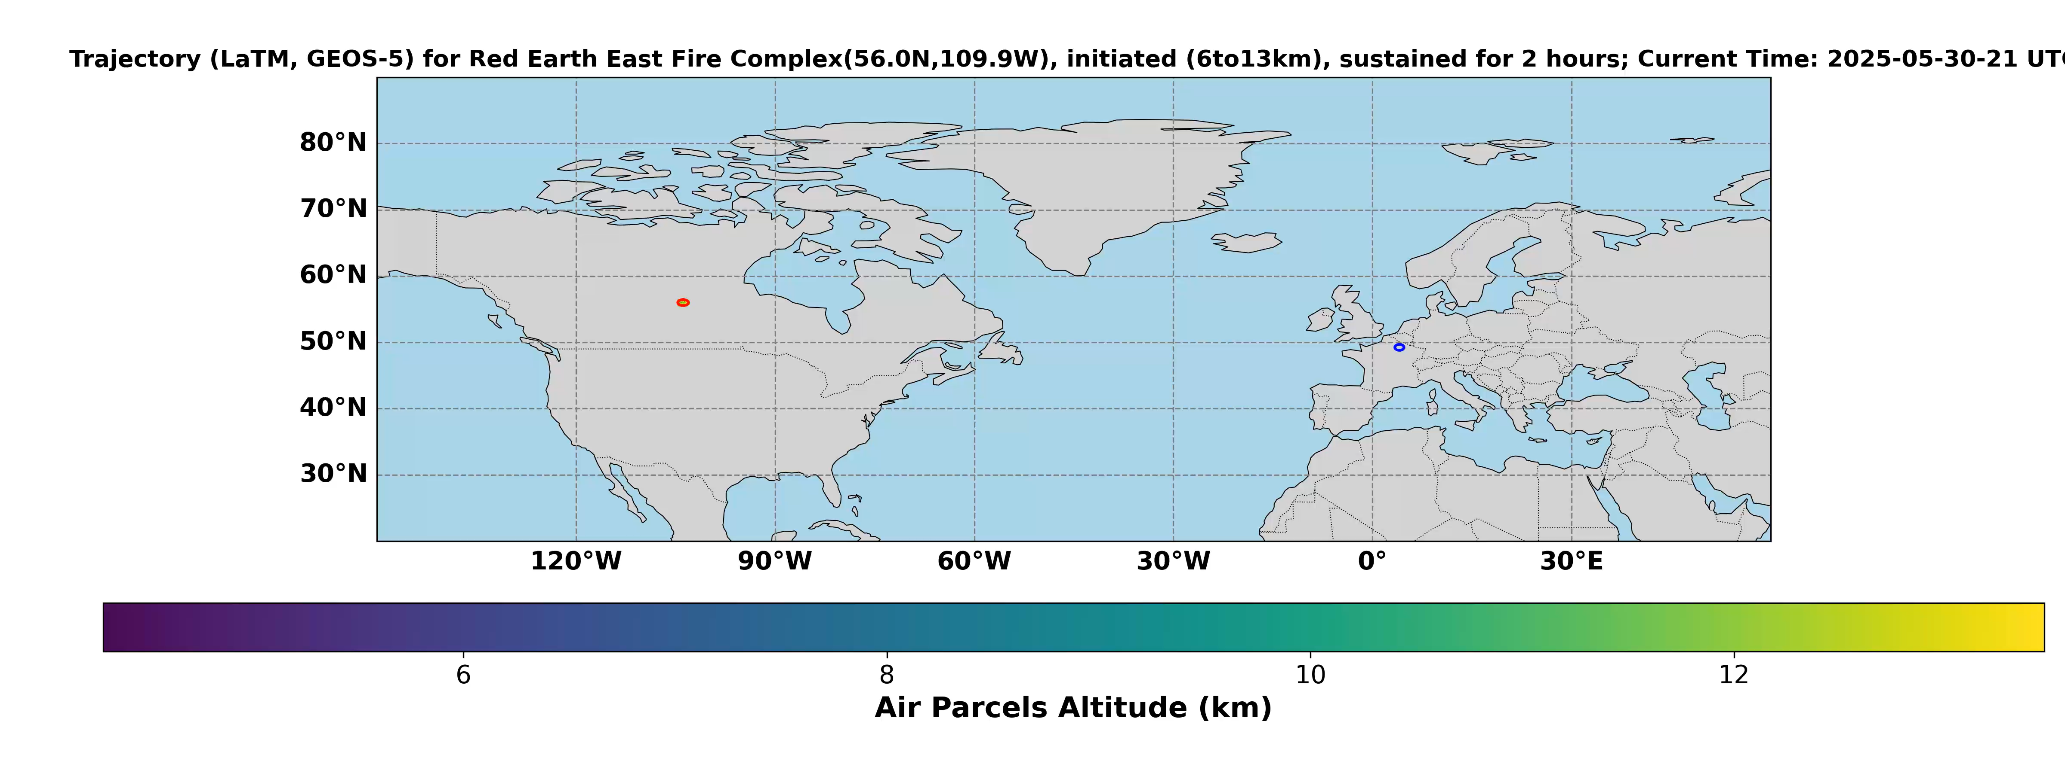
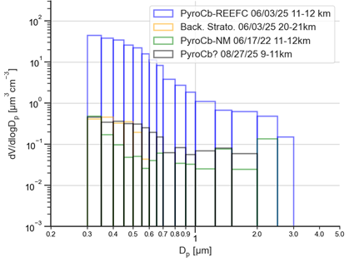
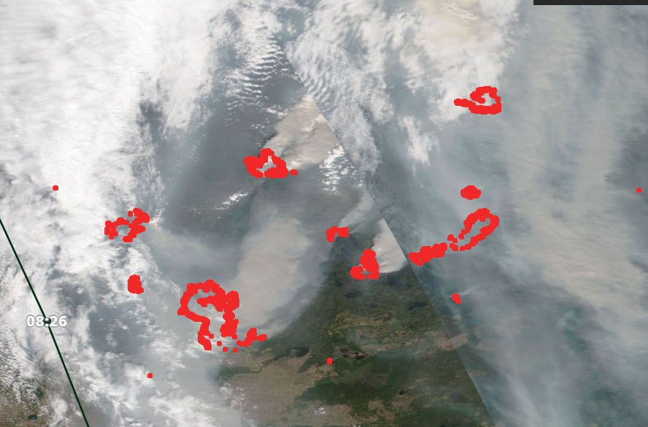
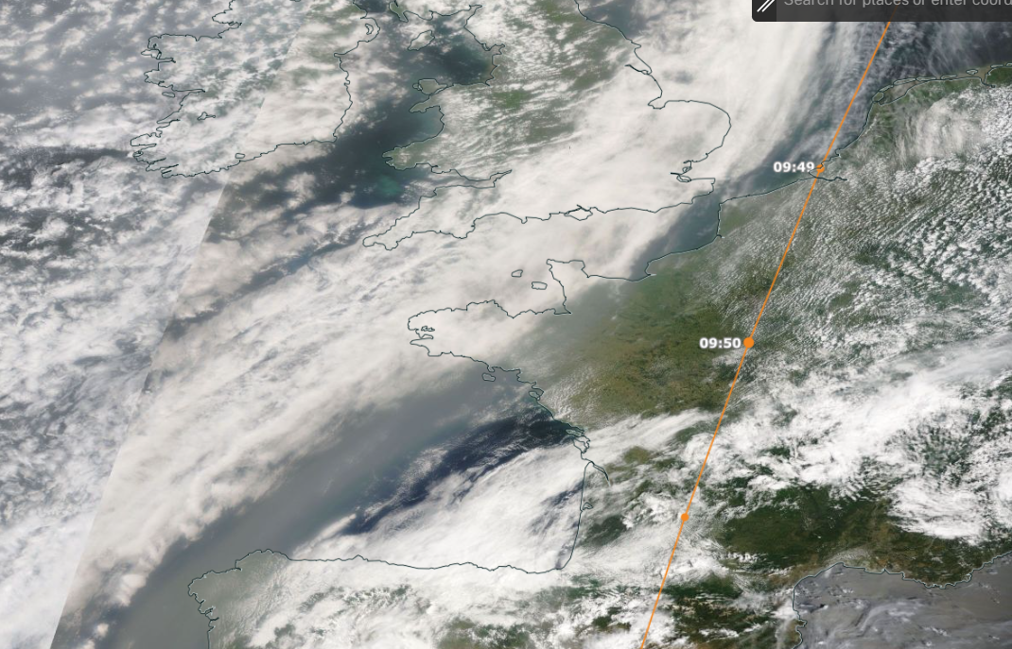
Trajectory modelling support to plan the balloon flights
Langley Trajectory Model
PyroCb plume
Das et al., 2026 ACPD
Red Earth East Fire Complex, 5/30/2025
Transport over France, 6/3/2025
POPC balloon flight Reims, France
Mode of large particles

Slide 12
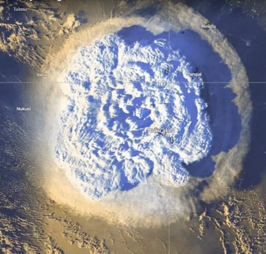
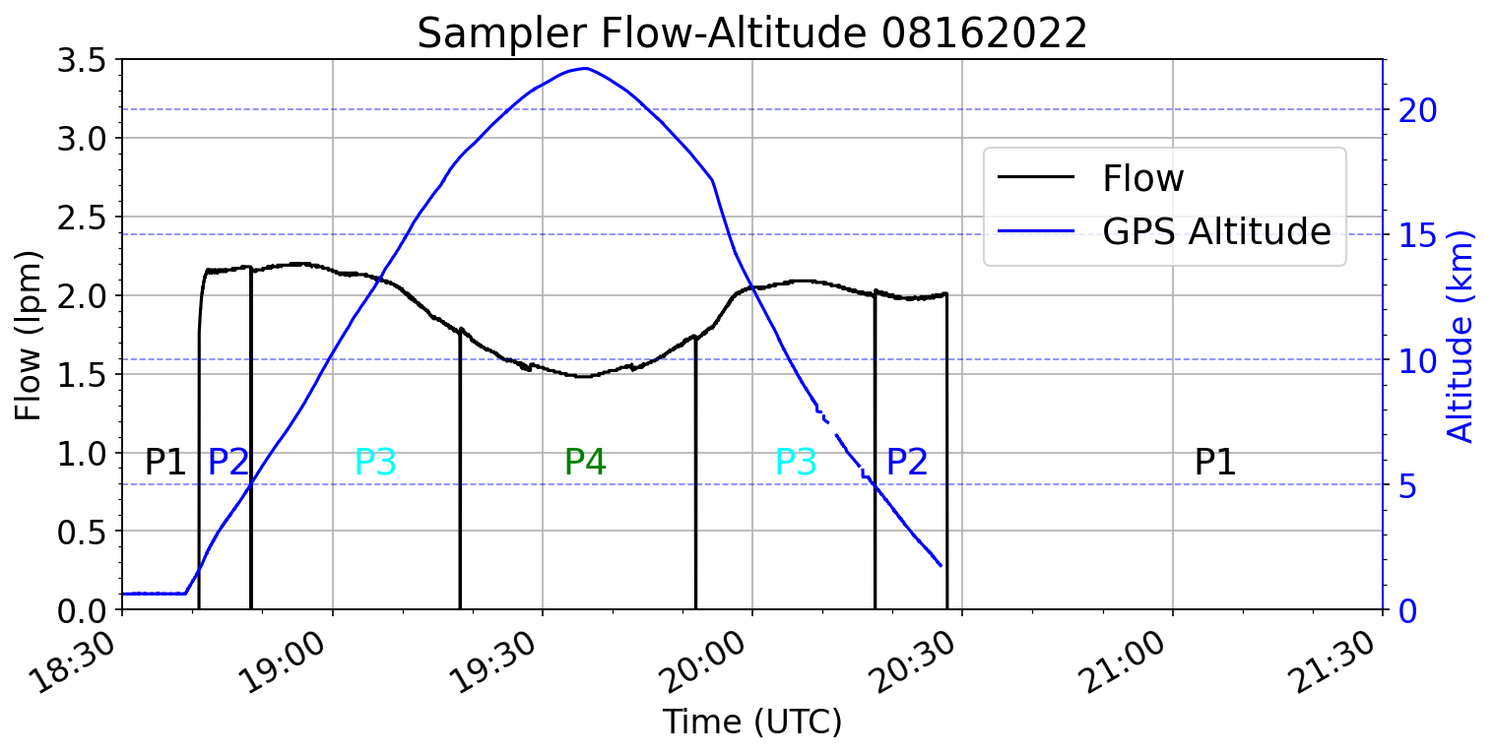
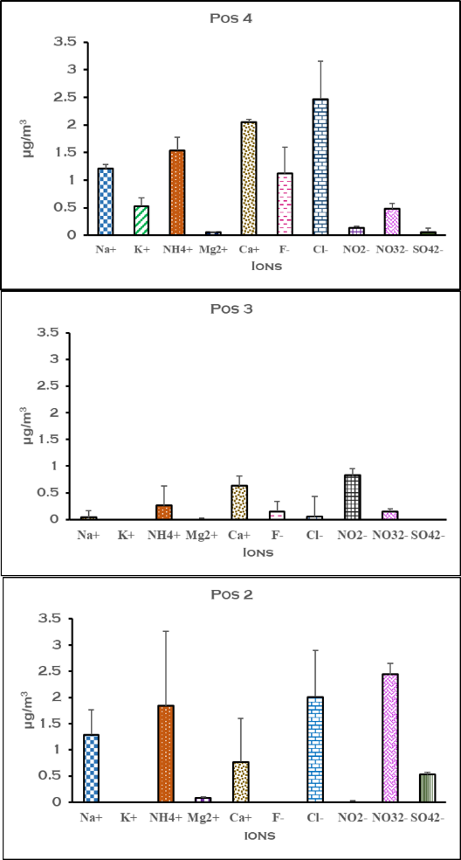
Sampling stratospheric aerosols with lightweight instrument
a)
Hunga Plume
“Wheel” Sampler
Float
P6
Opened Valve
Ascent
P7
P5
Descent
Closed Valve
P8
P4
P1
P3
P2
NaCl
8 flights with the Chem. Sampler in Brazil, France and India
Results of one flight within Hunga plume show significant amount of NaCl.
Unusual results as more Sulfate was expected (Still under investigation..)
H2SO4
Vernier H. et al., 2026 ACPD

Slide 13
Conclusions/Perspectives
BalNeO emerged after 10 years of balloon deployments to study the Asian Monsoon, Volcanic and PyroCb plumes
5 active sites across the world with current support from NASA UACO program
Adaptation of new payloads for balloon-borne measurements
Synergy between BalNeO and SAGE III/ISS to address science questions: e.g. Cloud-aerosol interaction/discrimination (A. Pandit, R. Das)
→ Sedimentation of the Hunga volcanic plume: G. Souza/Hunga
https://www.nasa.gov/langley/science/balneo/

Slide 14
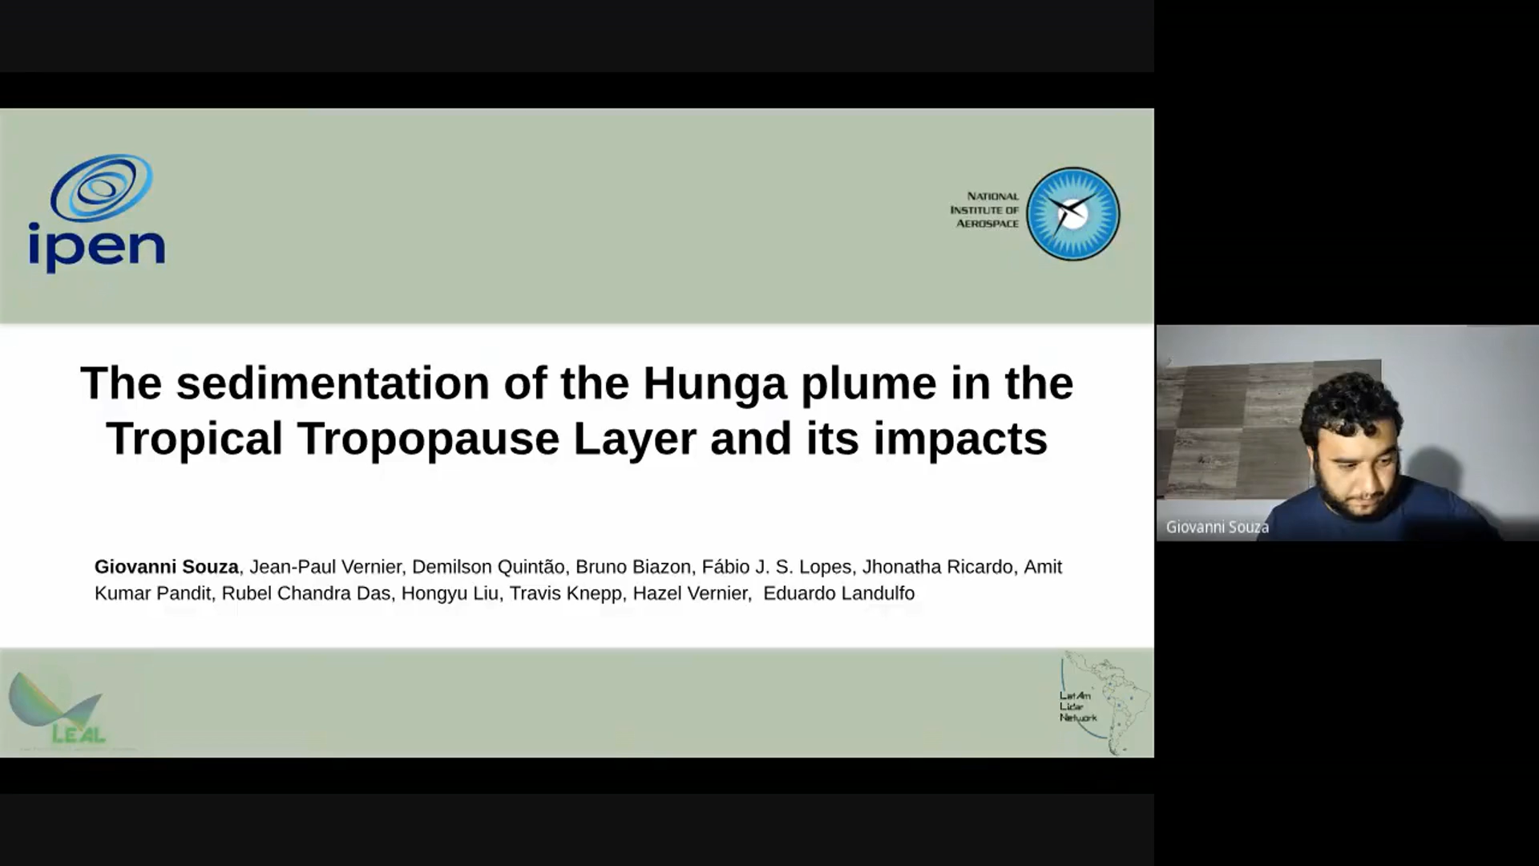

Slide 15
Extra slides

Slide 16
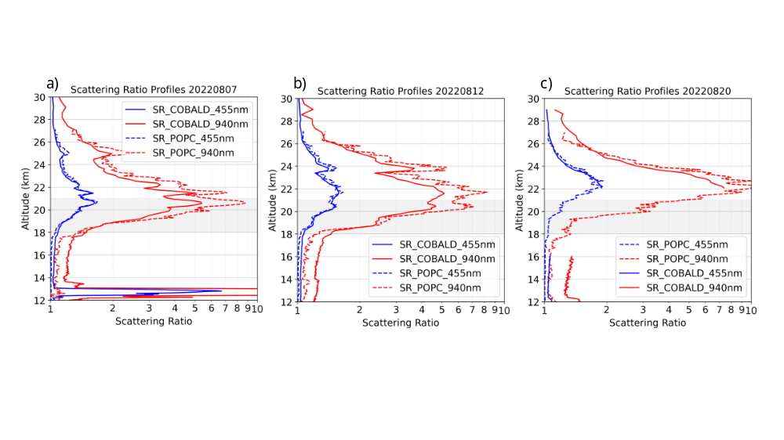

Validation POPC vs COBALD

Slide 17
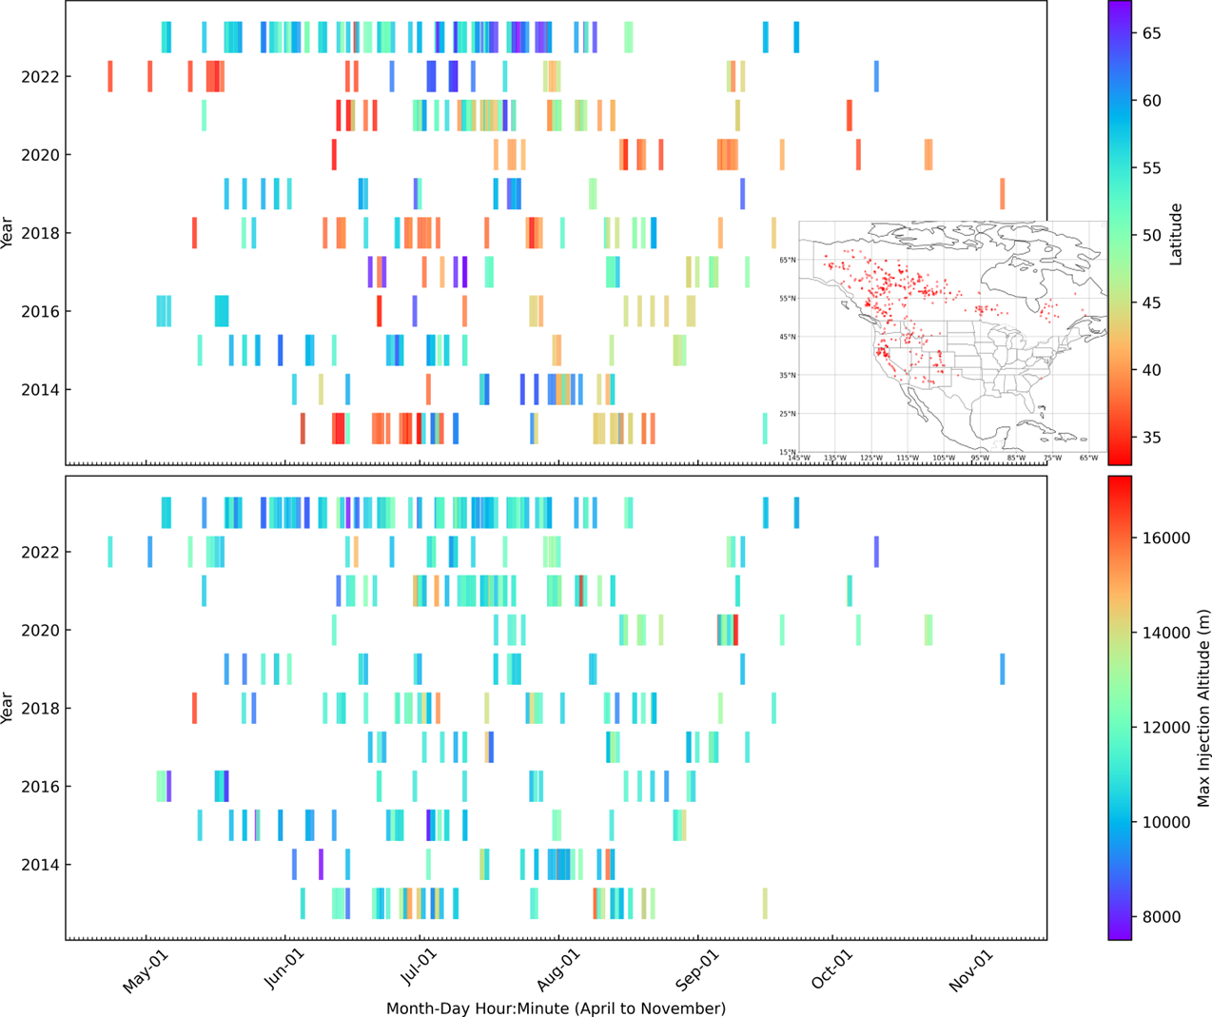
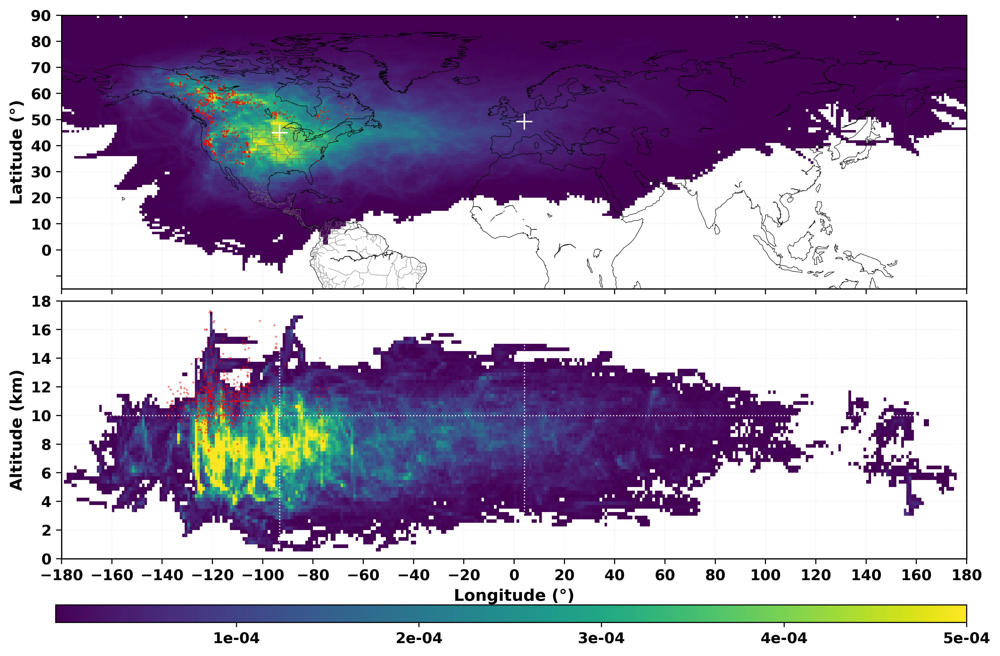
BalNeO activities during the pyroCb season
BalNeO
INSPYRE
BalNeO
Variability of pyroCb occurrence (Peterson et al., 2025)
Planned balloon activities will start in early May to study pyroCbs from Canada (spring)
Balloon activities will take place during INSPYRE
PyroCb smoke transport study using Langley Trajectory Model (See Das et al. Poster)
Sakatoon, Canada
Reims, France
2 locations to study Fresh pyroCb plumes
Long-range transport will be studied over Europe
Minneapolis, USA
Trajectory PDF
Das et al. 2026, ACPD

Slide 18
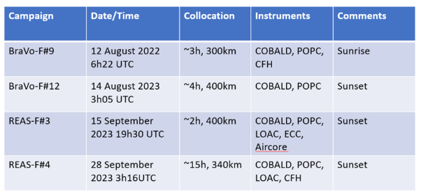
Ask Giovanni
Launch= 06:22:25
2022081221SR
SAGE III: 09:34:33
Launch 00:03:05
468.96 km
2023081340SS*
SAGE III: 20:38:47
2023091524SS
Launch: 19:36:12
733.54 km
SAGE III :17:18:28
2023091527SS*
Launch:03:15:06
SAGE III: 18:10:04
688.05 km
2023092836SS
2023092839SS

