Slide 1
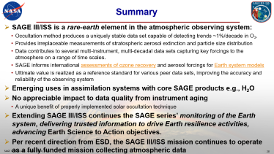
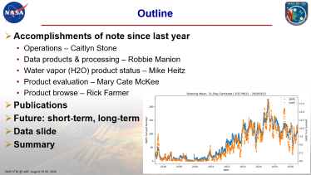
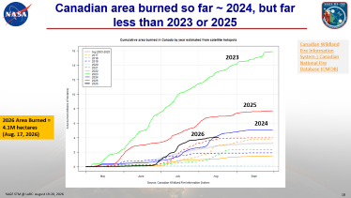
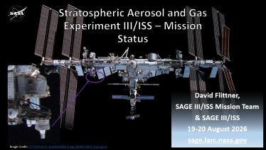
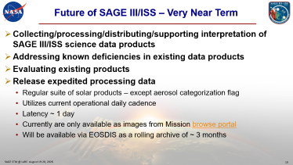
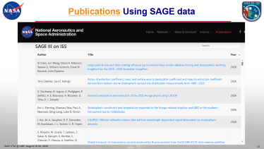
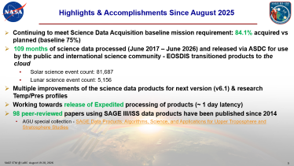

Slide 2
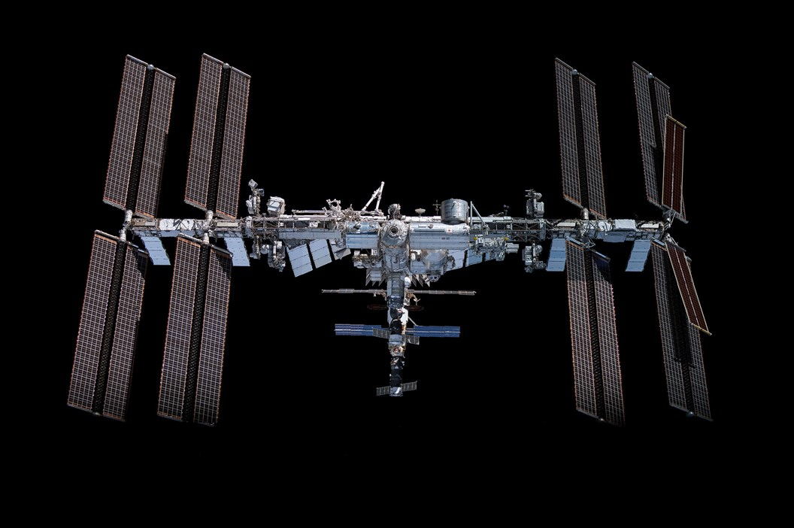

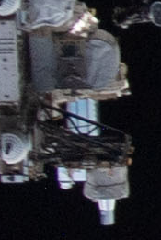
Stratospheric Aerosol and Gas Experiment III/ISS – Mission Status
Courtesy of R. Manion
David Flittner,
SAGE III/ISS Mission Team
& SAGE III/ISS
19-20 August 2026
sage.larc.nasa.gov
Image Credit: 51752252125_be036501b8_k.jpg (2048×1361) (nasa.gov)
Notes:
Observe the instrument in the Space Walk photo.

Slide 3
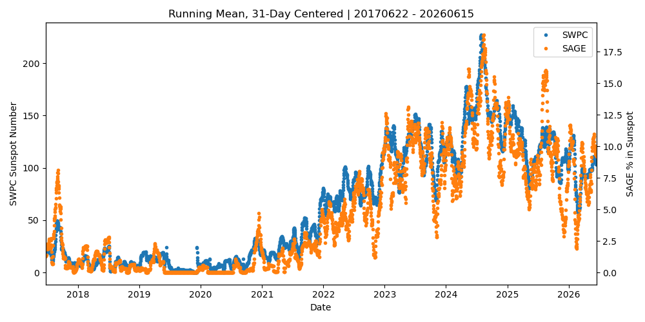
Outline
Accomplishments of note since last year
  Operations – Caitlyn Stone
  Data products & processing – Robbie Manion
  Water vapor (H2O) product status – Mike Heitz
  Product evaluation – Mary Cate McKee
  Product browse – Rick Farmer
Publications
Future: short-term, long-term
Data slide
Summary

Slide 4
SAGE III/ISS STM 2026 - Thank You!
Thank you to Tracy May & Allison McMahon for planning, organizing and making it happen!
Thank you to Jun Wang & Emma Knowland for crafting the meeting.
Thank you for taking the time to join the meeting and contributing to science advancements fueled by SAGE data and your curiosity.

Slide 5
Highlights & Accomplishments Since August 2025
Continuing to meet Science Data Acquisition baseline mission requirement: 84.1% acquired vs planned (baseline 75%)
109 months of science data processed (June 2017 – June 2026) and released via ASDC for use by the public and international science community - EOSDIS transitioned products to the cloud
  Solar science event count: 81,687
  Lunar science event count: 5,156
Multiple improvements of the science data products for next version (v6.1) & research Temp/Pres profiles
Working towards release of Expedited processing of products (~ 1 day latency)
98 peer-reviewed papers using SAGE III/ISS data products have been published since 2014
  AGU special collection - SAGE Data Products: Algorithms, Science, and Applications for Upper Troposphere and Stratosphere Studies

Slide 6
Highlights & Accomplishments Since August 2025 – cont.
Proposal to ESD Review of Operating Missions (aka ESD Senior Review) for 2027-2029; awaiting outcome
Assisted SMD/ESD Flight with exploring interest in partnerships for SAGE III and two other International Space Station (ISS) instruments using an ISS NASA Research Announcement
The Ninth Science Team meeting August 2026 hosted at Langley Research Center
CMP subsystem data has been invaluable and is recognized as crucial for ISS and external payload environment knowledge
Exploring alternate information to flag mechanical disturbances to replace DMP data after failure
End-of-life ground support hardware replacement progressing to allow mission operations to 2030

Slide 7
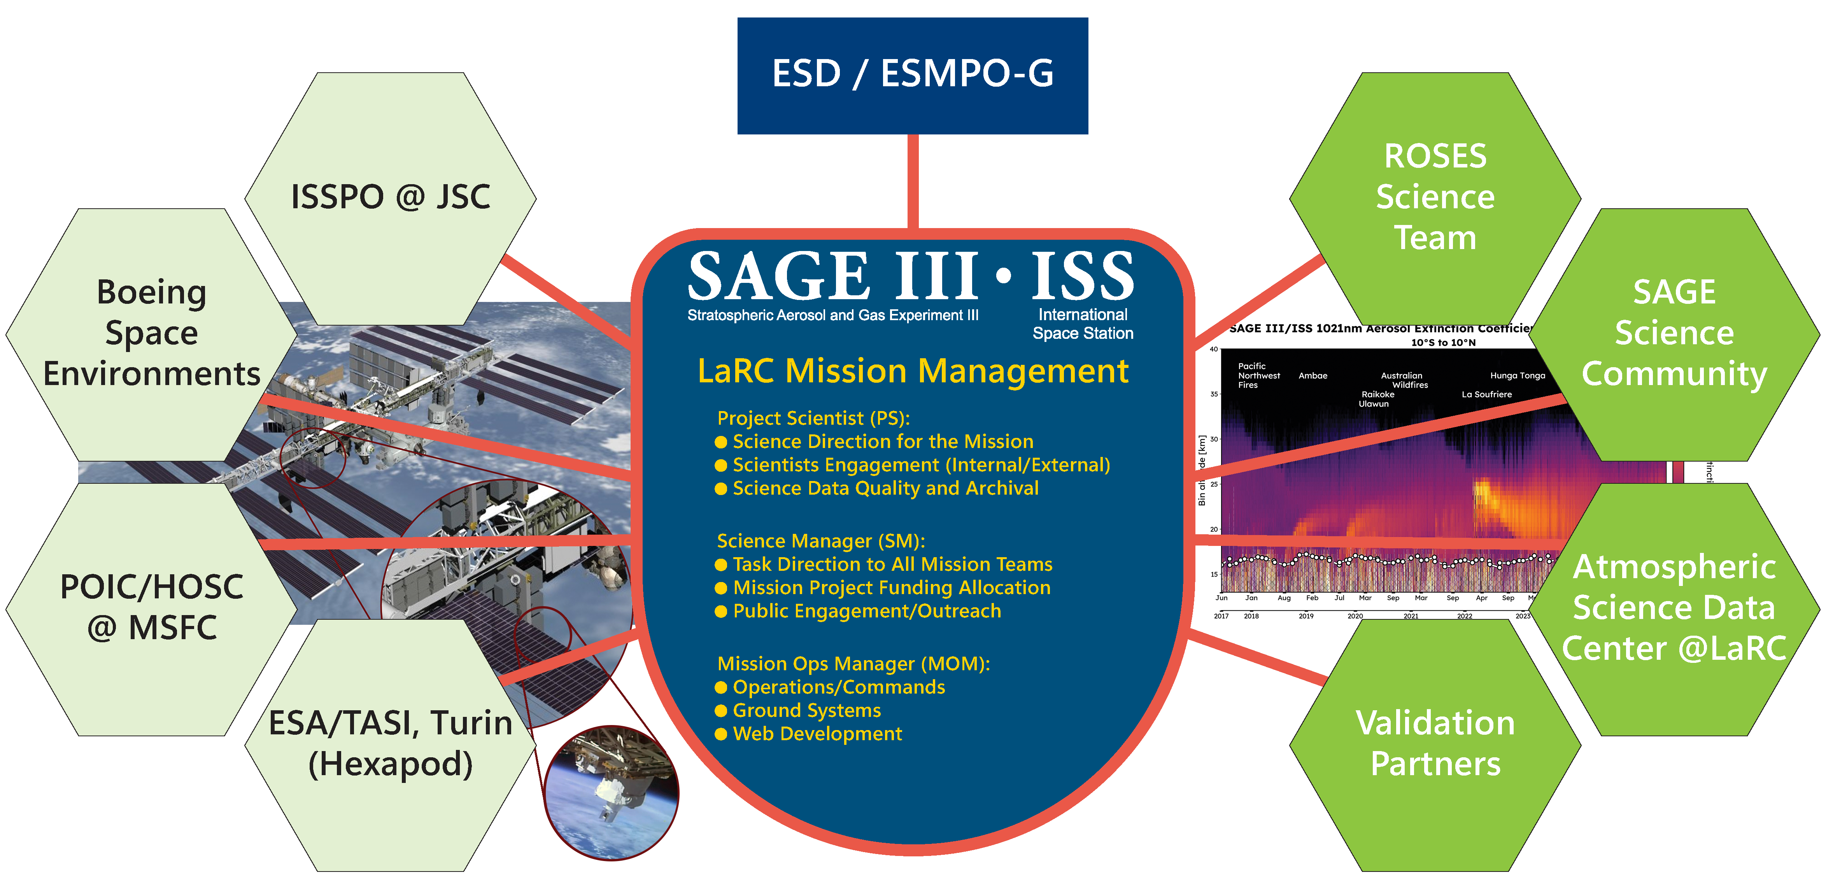
SAGE III/ISS Mission Org and Connections
Notes:
The SAGE III/ISS mission is a collaboration internally within NASA between the Science
Mission Directorate (SMD)/Earth Science Division (ESD) and the Space Operations Mission
Directorate (SOMD)/ISSP and an external collaboration between NASA and ESA, who
supplied the vital Hexapod pointing system. The mission is managed by LaRC and reports
to the NASA Earth Systematic Missions Program Office - Goddard (ESMPO-G) . The Project Scientist
interfaces with the science community including the ROSES funded SAGE III/ISS Science
Team and provides guidance to the Science Manager (SM) and the Mission Operations
Manager (MOM) on meeting overall science mission goals. Overall mission activities and
reporting to ESMPO and ESD are managed by the SM and day-to-day mission operations
are managed by the MOM. Communication and interface with the ISSP are led by the MOM.
The MOM also interfaces with ESA and subcontractor Thales Alenia Space–Italy (TAS-I)
for Hexapod engineering support.

Slide 8
SAGE III/ISS Mission Teams
Management – Marilee Roell, Dave Flittner, Sherry Beimler, Charles Hill
Operations –Caitlyn Stone, Chris Brown, Donald Cleckner, James Losey,
Kenta Funada, Bob Borchardt, Robbie Manion, Riley Runyon
Ground Systems – Greg Paxton, Rick Farmer
Science – David Flittner, Charles Hill, Rob Damadeo, Kevin Leavor,
Mary Cate McKee, Mahesh Kovilakam, Travis Knepp, Nick Ernest
Science Processing – Robbie Manion, Mike Heitz, Marsha Larosee,
Riley Runyon, James Losey, Rob Damadeo
Validation - Kevin Leavor, Mary Cate McKee, Caitlyn Stone
Public Engagement – Allison McMahon
Web Development – Rick Farmer, Kevin Leavor
Emergencies – Shane Wolf, Tom Johnson

Slide 9
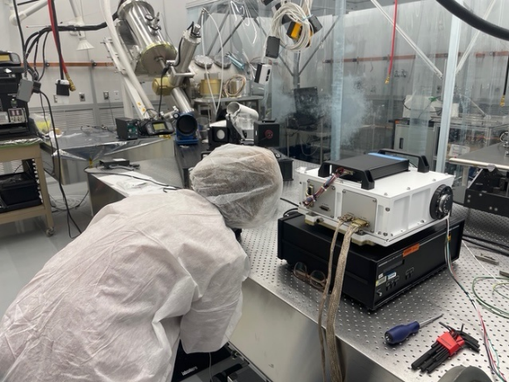
Interns
NASA Internship and Fellowship opportunities: NASA Intern
SAGE III/ISS has a vibrant & sought-after internship program
  3-5 interns during summer
Interns work on real tasks benefiting the SAGE III/ISS mission
Fantastic program teaching necessary skills/habits for successful science/engineering careers, e.g.:
  Python programing
  Configuration management (git)
  Self documenting code techniques
  Linux shells and scripting
Exceptional candidates should contact charles.a.hill@nasa.gov

Slide 10
Who are the consumers
Unique Users by Country
Courtesy of David Westberg

Slide 11
Unique User by Affiliation
Courtesy of Cheyenne Land

Slide 12
Unique User by Primary Study Area
Courtesy of Cheyenne Land

Slide 13
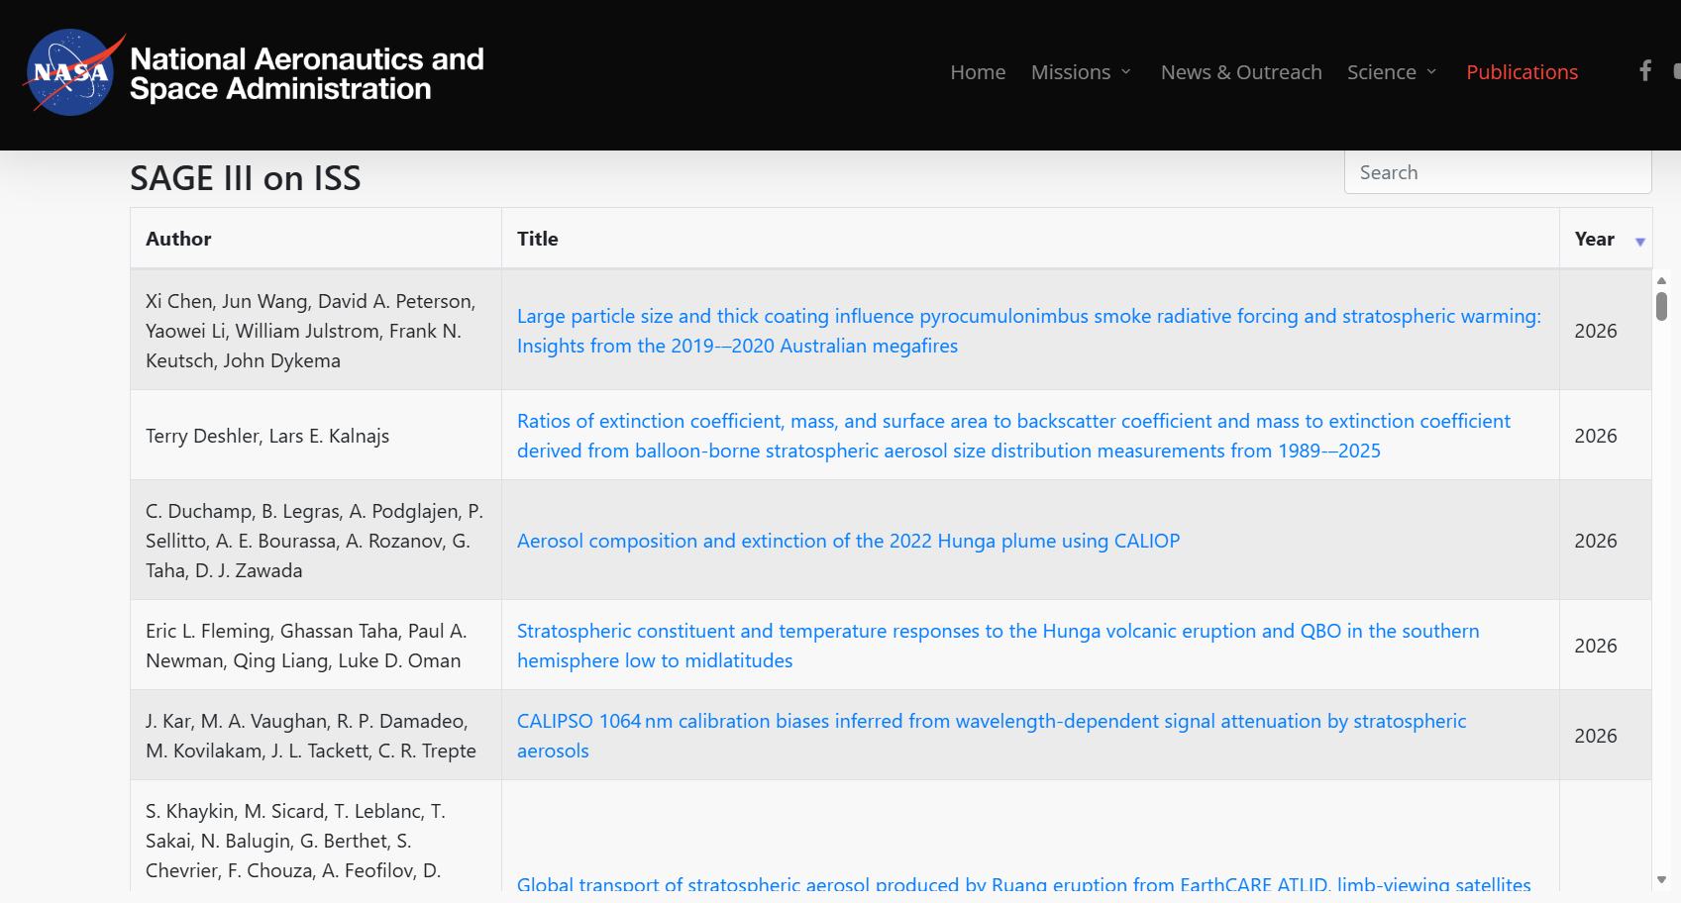
Publications Using SAGE data

Slide 14
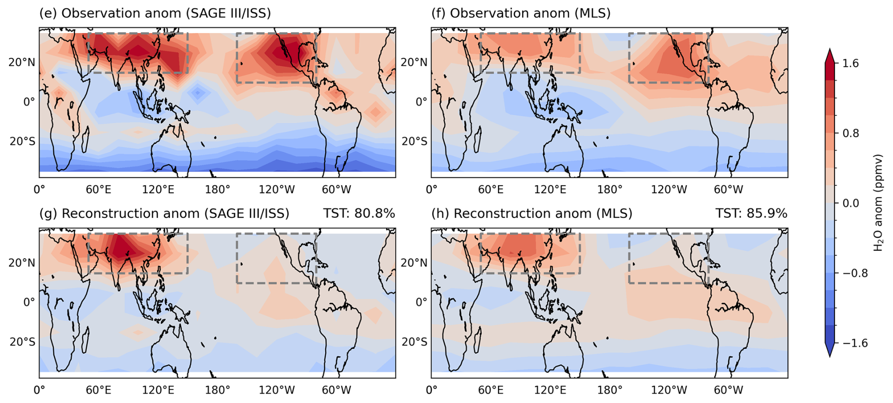
Wang et al. Understanding boreal summer UTLS H2O variations in monsoon regions
Lagrangian reconstruction vs. SAGE
for boreal summer monsoon UTLS
  Cold temp. at tropopause determines H2O
  entering stratosphere – driven by ERA5 field
Findings:
  Reconstructions consistently exhibit a
  1.5 ppmv dry bias across the tropics
  Reproduces UTLS H2O variations and structures well in Asia, but poorly in NA
  ASM, UTLS H2O controlled by local tropopause temp. over southern Asia.
  NAM, H2O is strongly influenced by long-range transport from southern Asia and hence by tropopause temp. in that region - the moistest air masses locally controlled by NAM temp.
Failure of NAM UTLS H2O reconstruction arises primarily from underestimation of local moistening processes such as deep convection and ice injection
  Errors in long-range transport likely contribute further to the particularly large dry bias in the NAM reconstructions.

Slide 15
Future of SAGE III/ISS – Very Near Term
Collecting/processing/distributing/supporting interpretation of SAGE III/ISS science data products
Addressing known deficiencies in existing data products
Evaluating existing products
Release expedited processing data
  Regular suite of solar products – except aerosol categorization flag
  Utilizes current operational daily cadence
  Latency ~ 1 day
  Currently are only available as images from Mission browse portal
  Will be available via EOSDIS as a rolling archive of ~ 3 months

Slide 16
Product Mission Extension Activities - 1
Continue science operations, data processing & distribution
Deliver on proposed product improvements from the 2026 Senior Review (some activities outlined in SR23 were for FY24–29)
  Awaiting review results and guidance from Earth Science Division
  Meanwhile, proceed as planned within the allocated budget
Work in development for next proposed release (2027):
  Details in Data Processing presentation

Slide 17
Product Mission Extension Activities - 2
Follow-on Development (possible release in 2028/2029)
  Implement PSD retrieval updates recommended by Ernest et al. (2025)
  Correct for biases from diurnal variability in stratospheric NO₂ (Dube,AMT,2021)
  Correct for biases from diurnal variability in mesospheric O₃ (Dube,AMT,2021)
  Revisit non-linear retrievals to reduce noise and increase stability (H₂O, P/T)
  Experimental correction for inhomogeneity biases from clouds in troposphere
  Revisit lunar retrievals to improve NO₂ and NO₃ and investigate OClO
  Produce an "absolute" pointing algorithm
    Recent analyses of in-orbit and laboratory testing data has reconciled discrepancies between relative pointing (used by solar) and instrument subsystem readings
    Would significantly improve lunar pointing registration
    Finally enables production of Level 1B radiance profiles from limb scatter measurements (>32K total limb events, ~80K total solar events)

Slide 18
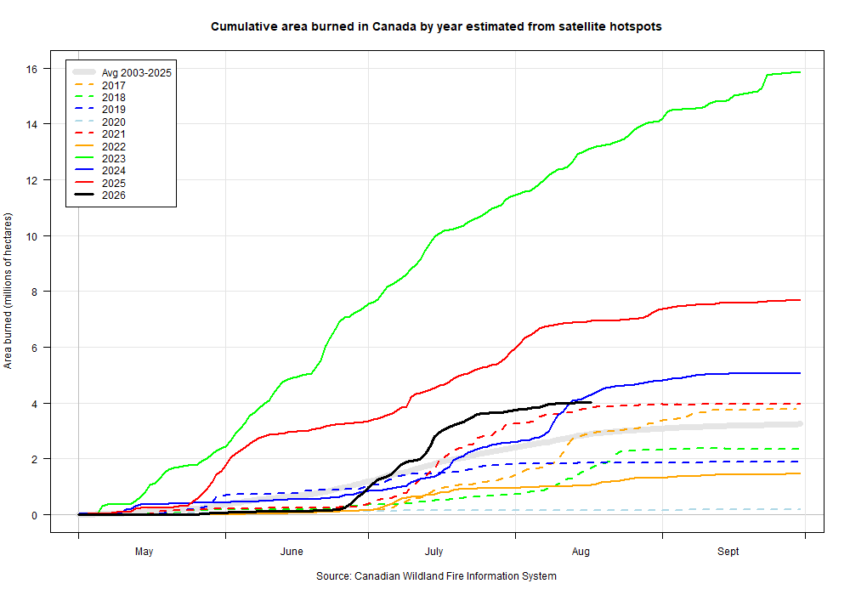
Canadian area burned so far ~ 2024, but far less than 2023 or 2025
Canadian Wildland Fire Information System | Canadian National Fire Database (CNFDB)
2023
2025
2026 Area Burned = 4.1M hectares (Aug. 17, 2026)
2024
2026
Notes:
Terms and Conditions - Natural Resources Canada

Slide 19
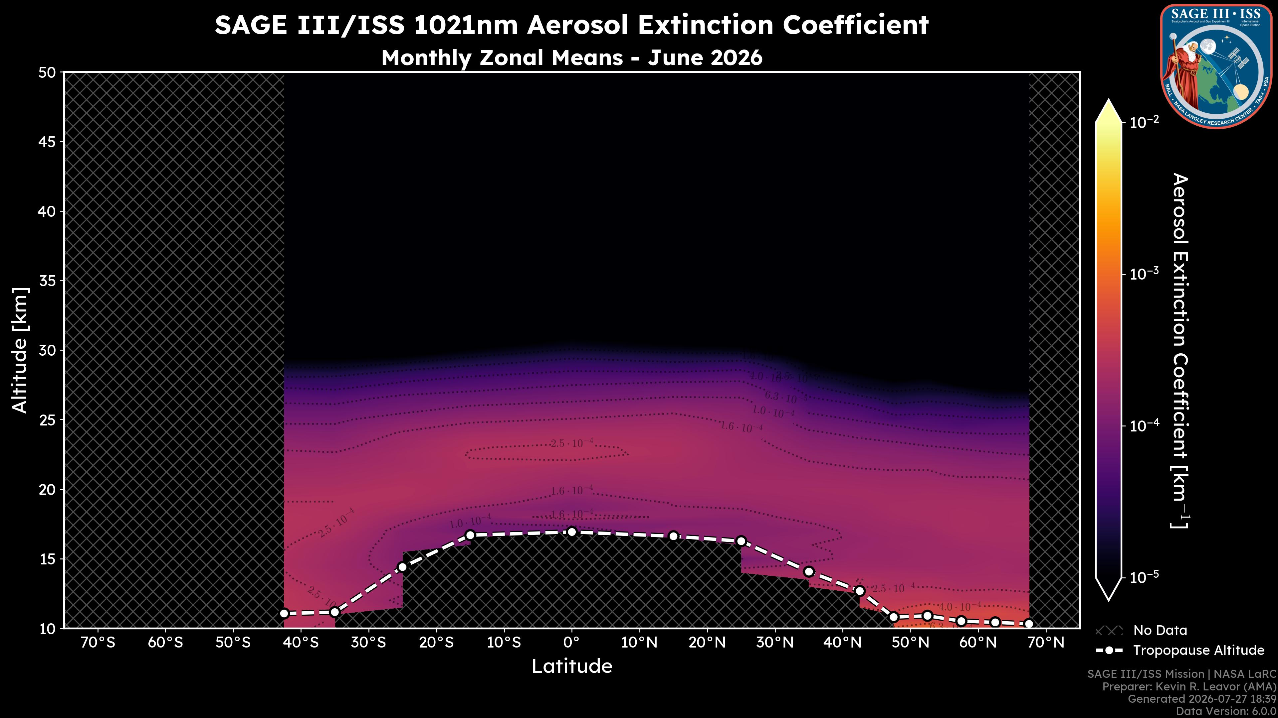
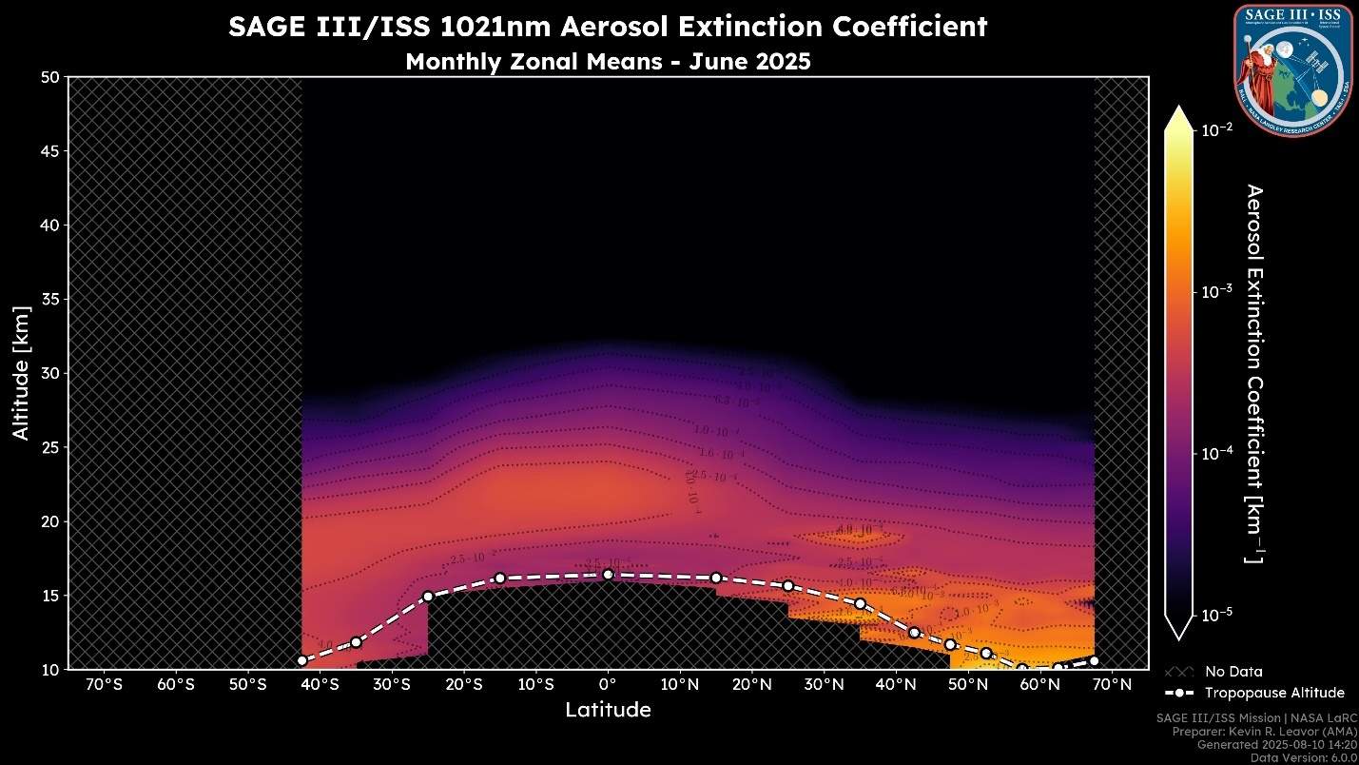
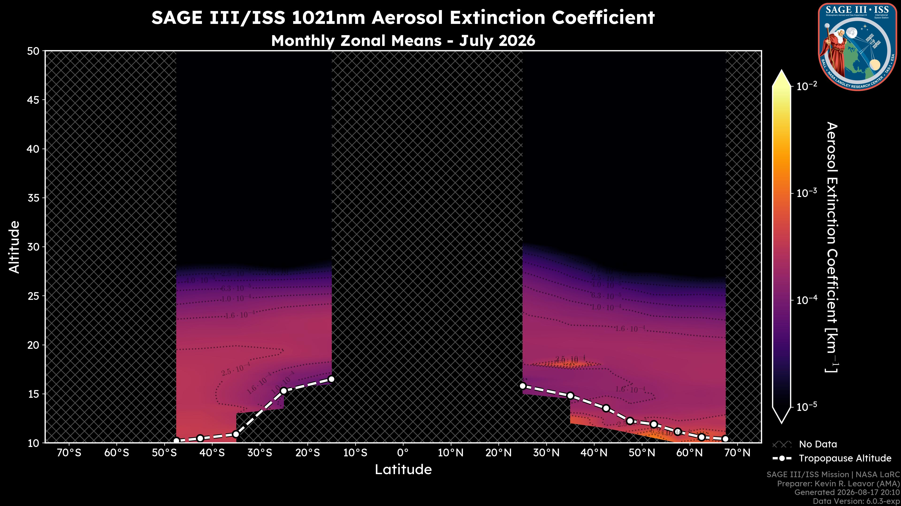
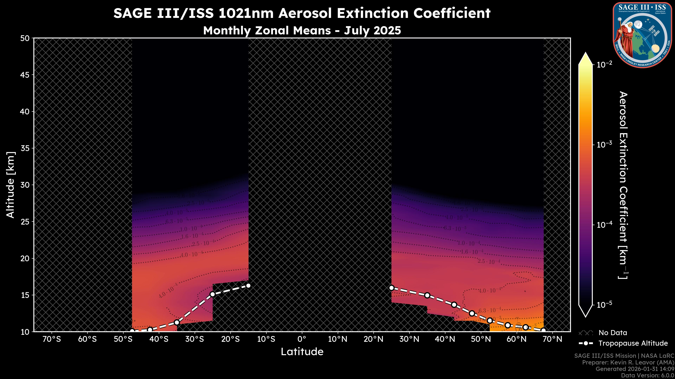
2026 vs 2025
AEROSOL
CLOUD

Slide 20
Summary
SAGE III/ISS is a rare-earth element in the atmospheric observing system:
  Occultation method produces a uniquely stable data set capable of detecting trends ~1%/decade in O₃.
  Provides irreplaceable measurements of stratospheric aerosol extinction and particle size distribution
  Data contributes to several multi-instrument, multi-decadal data sets capturing key forcings to the atmosphere on a range of time scales.
  SAGE informs international assessments of ozone recovery and aerosol forcings for Earth system models
  Ultimate value is realized as a reference standard for various peer data sets, improving the accuracy and reliability of the observing system
Emerging uses in assimilation systems with core SAGE products e.g., H₂O
No appreciable impact to data quality from instrument aging
  A unique benefit of properly implemented solar occultation technique
Extending SAGE III/ISS continues the SAGE series’ monitoring of the Earth system, delivering trusted information to drive Earth resilience activities, advancing Earth Science to Action objectives.
Per recent direction from ESD, the SAGE III/ISS mission continues to operate as a fully funded mission collecting atmospheric data
Notes:
Salawitch, R. J., and Coauthors, 2025: The Imminent Data Desert: The Future of Stratospheric Monitoring in a Rapidly Changing World. Bull. Amer. Meteor. Soc., 106, E540–E563, https://doi.org/10.1175/BAMS-D-23-0281.1.
mention SAGE III/ISS can assist in crossing the data desert for O3 and H2O.
SAGE III/ISS continues atmospheric monitoring, delivering trusted data to inform research and action

