Slide 1
Update to the SAGE III/ISS Particle Size Distribution Data Product
Nicholas Ernest – nicholas.a.ernest@nasa.gov
Travis Knepp – travis.n.knepp@nasa.gov

Slide 2
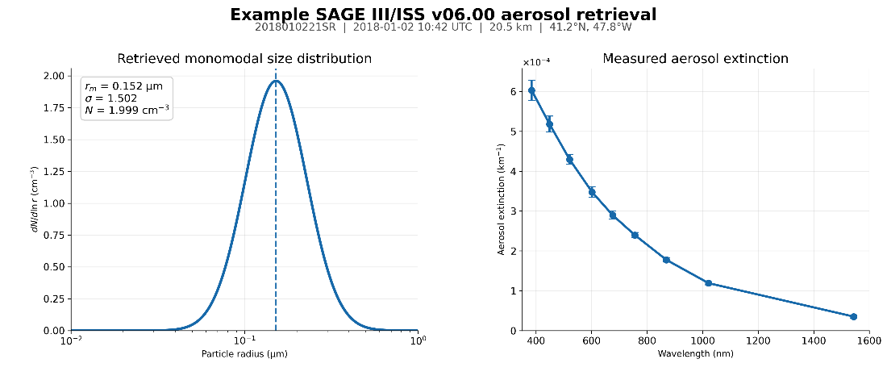
Particle Size Distribution Data Product
Utilizes 384, 448, 520, 755, 869, 1021 & 1543 nm (drops 601 & 676 nm).
Retrieval of mono-modal log-normal PSD parameter values.
All possible solutions within SAGE error envelope are weighted by a multivariate-normal PDF.
Median, percentiles for rₘ, σ, N, SAD, VD, effective radius.
Update : refractive index derivation and number density calculation

Slide 3
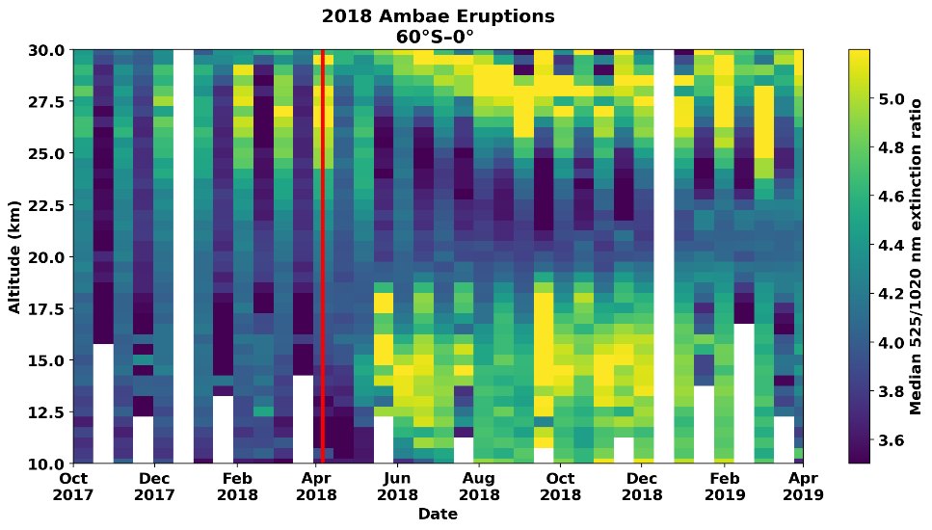
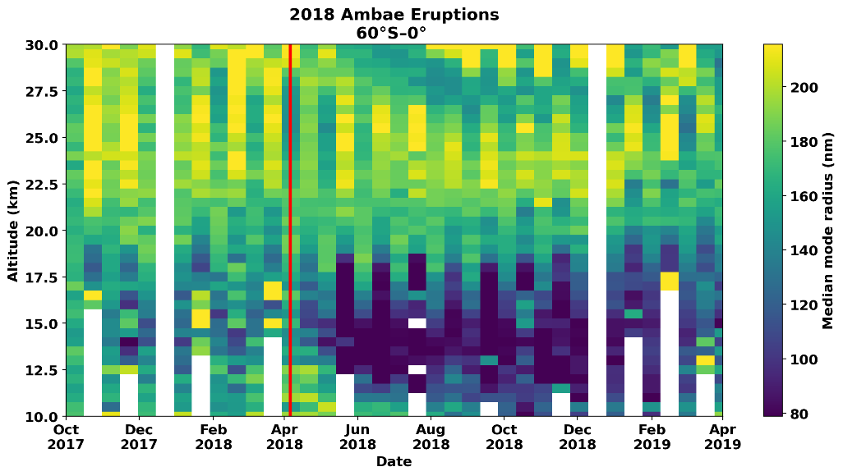
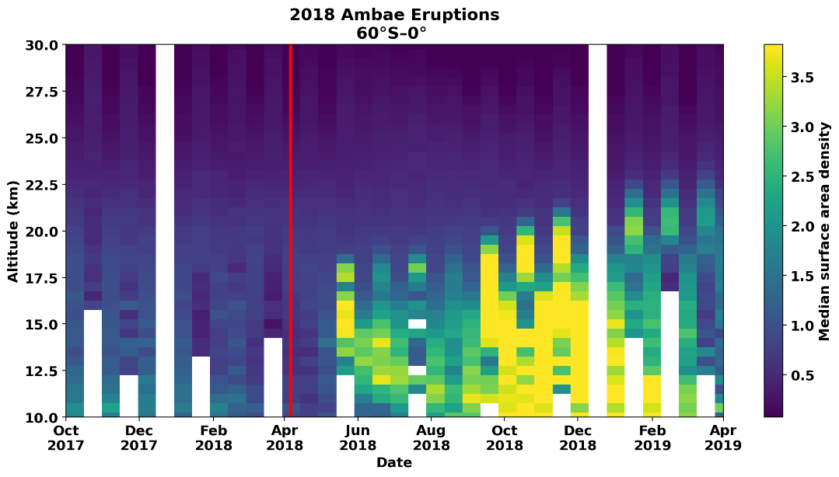

520/1021 nm extinction ratio
2018 Ambae
Eruptions
Wrana et al. 2023
$$\frac{{\text{μ}m}^{2}}{cm^{3}}$$
Mode Radius
Surface Area Density

Slide 4
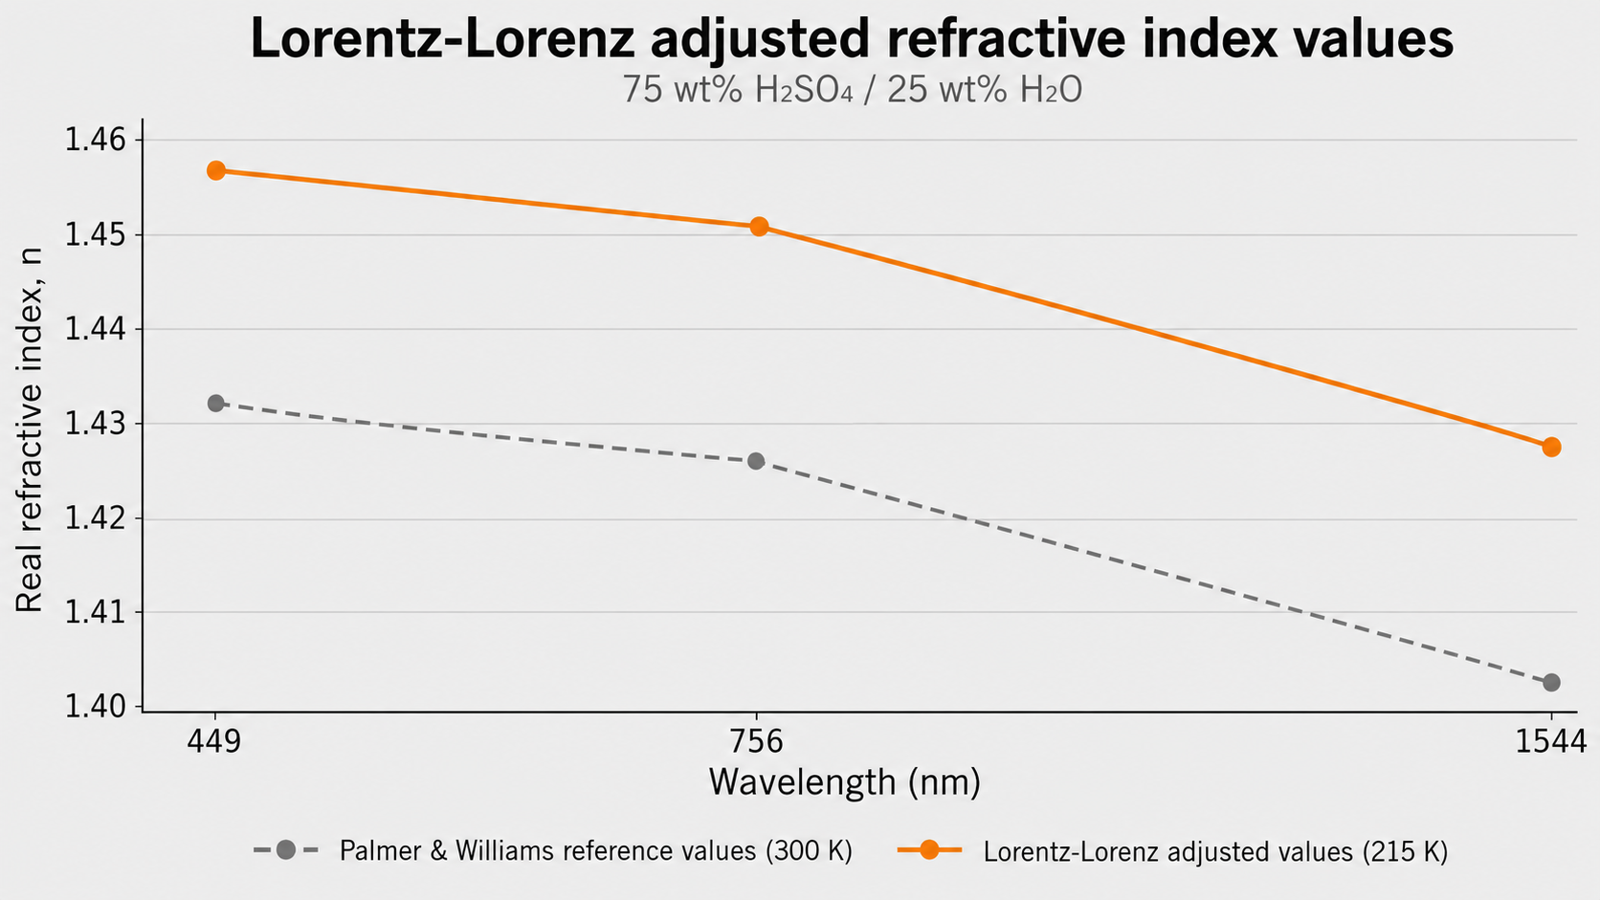
Temperature Change Adjustment
Palmer and Williams – Lorentz-Lorenz (215 K)

Slide 5
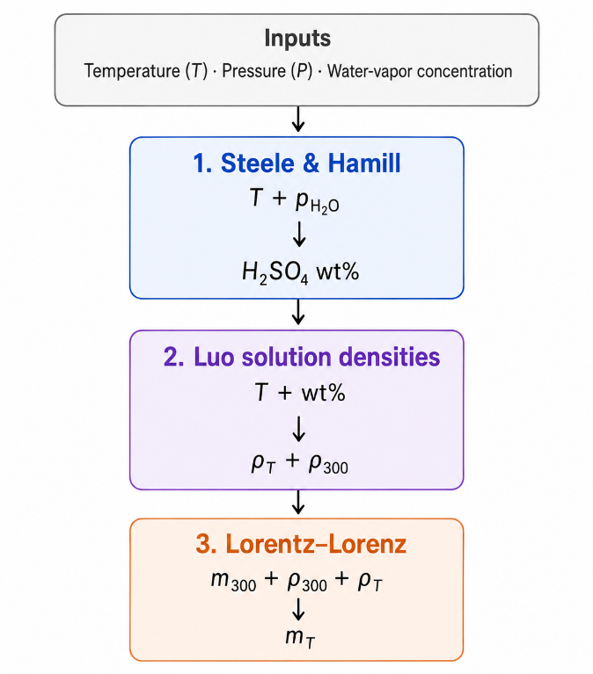
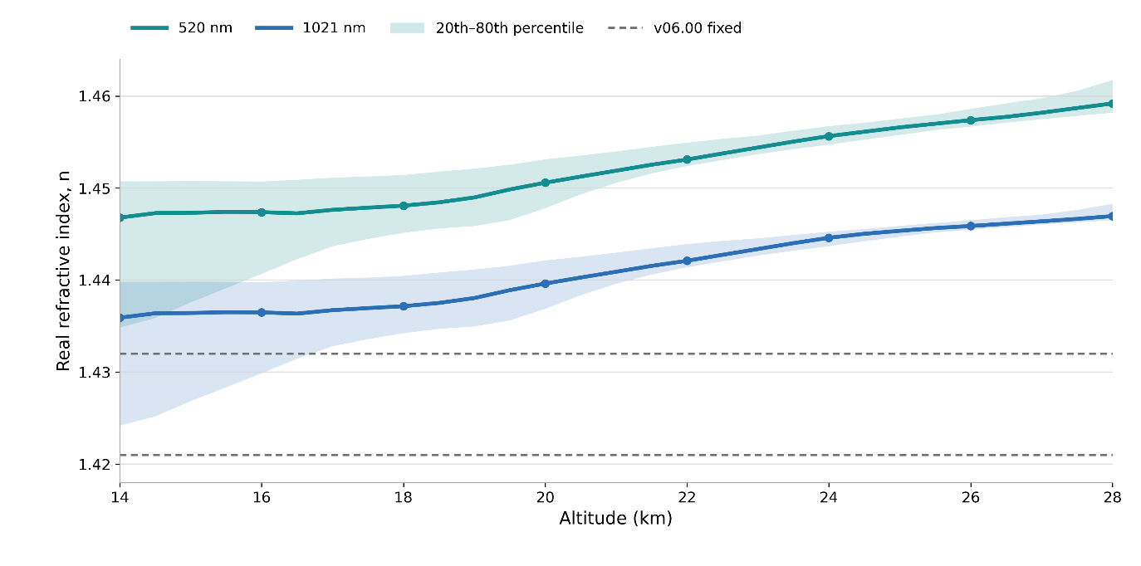
Atmospheric state variables method of deriving refractive index
January 2018 Measurements
Many look-up tables based on solution density and weight composition pairs

Slide 6
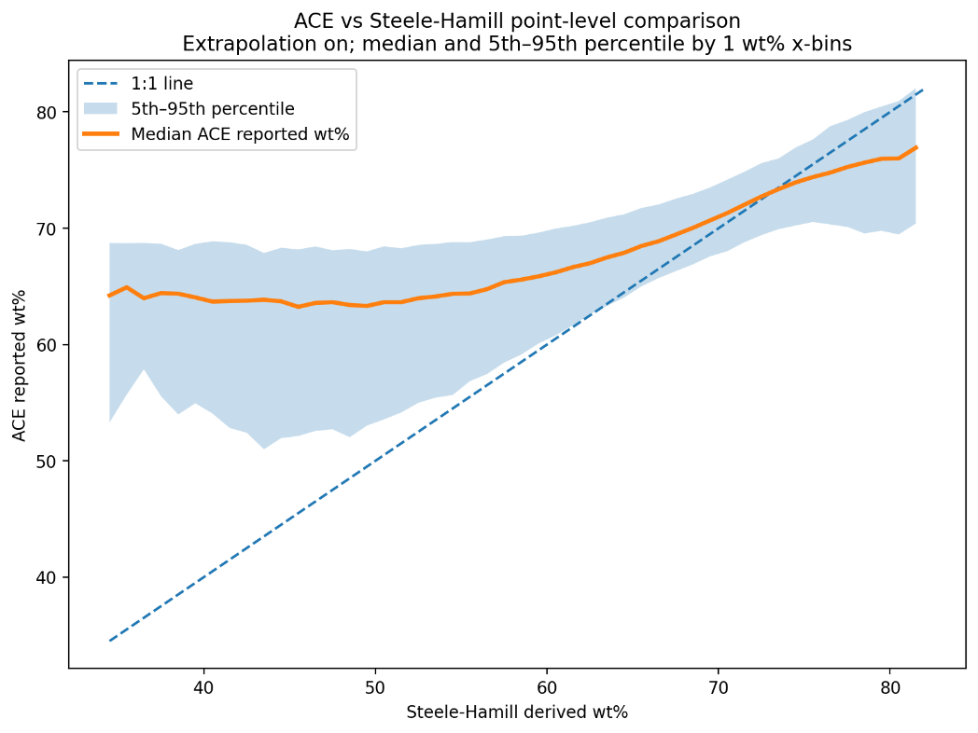
Incongruence with ACE measurements

Slide 7
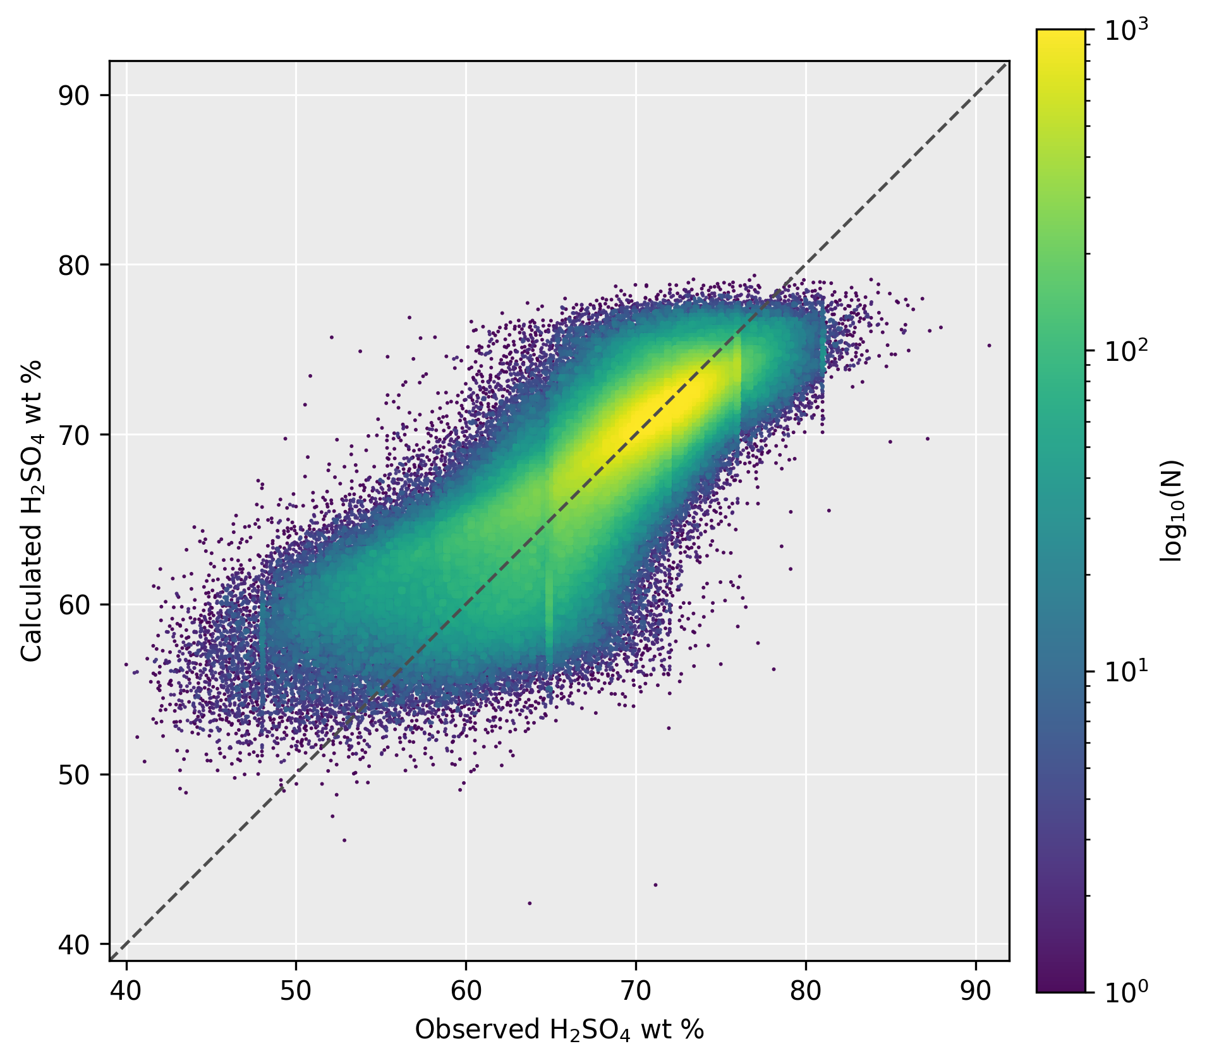
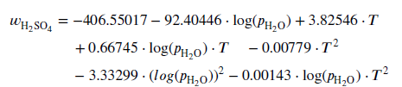
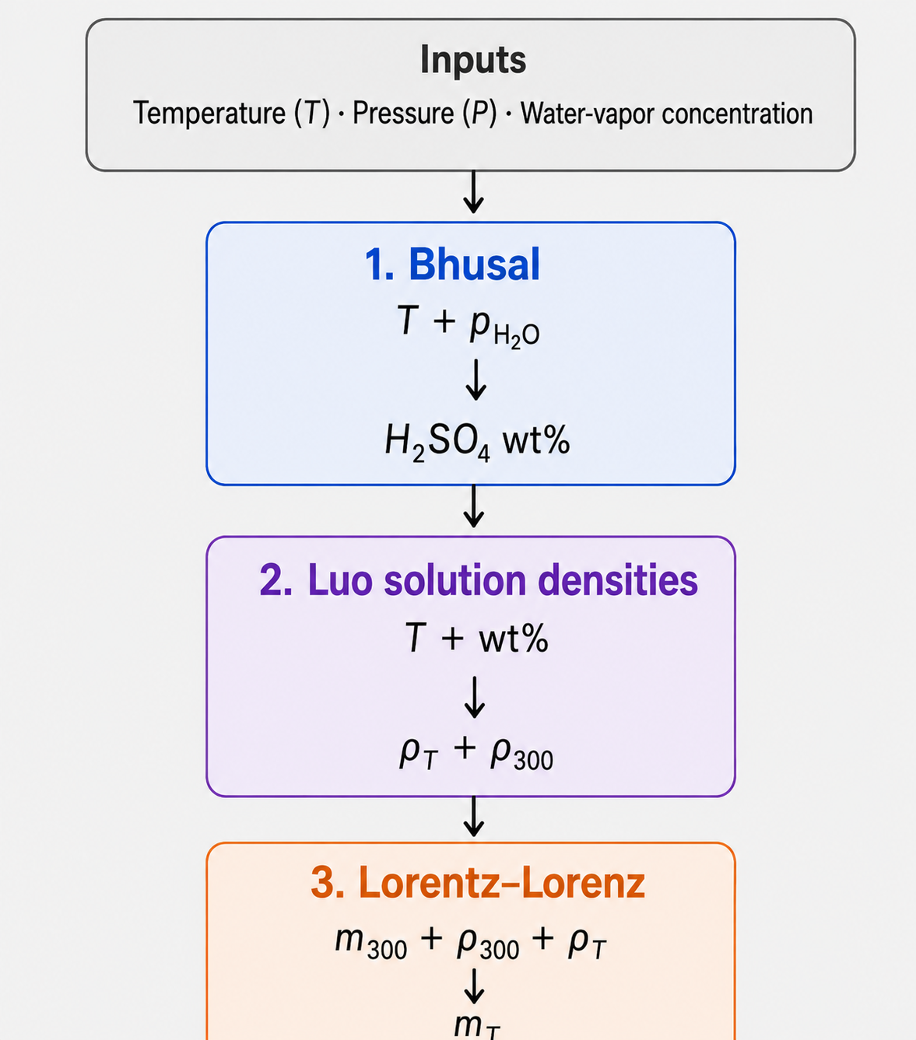
ACE empirical relationship
Bhusal et al. (2026)
ACE reported

Slide 8
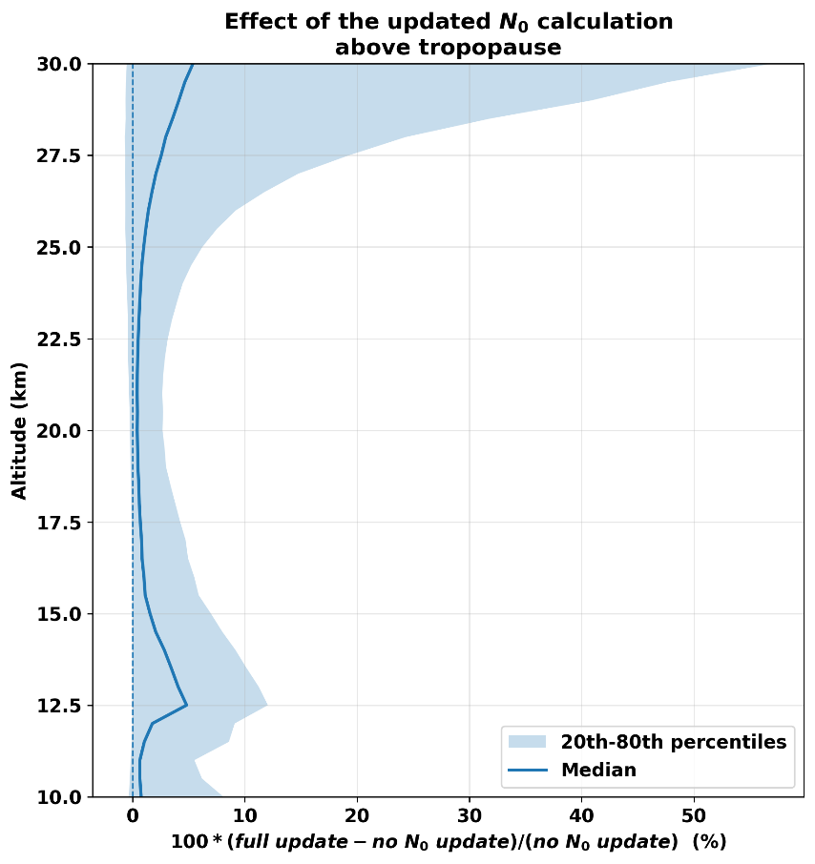
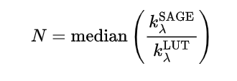
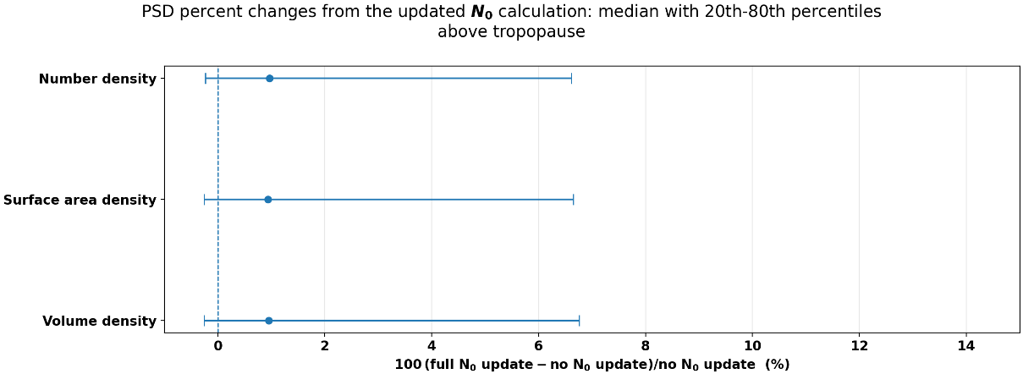
Number density calculation update
median of number density calculated from each wavelength

Slide 9
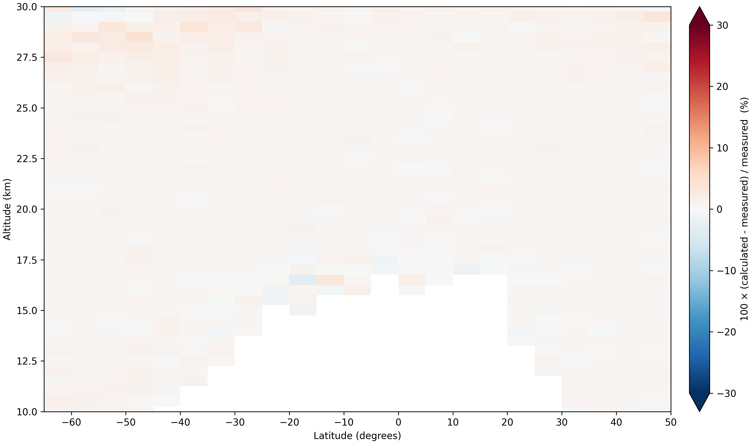
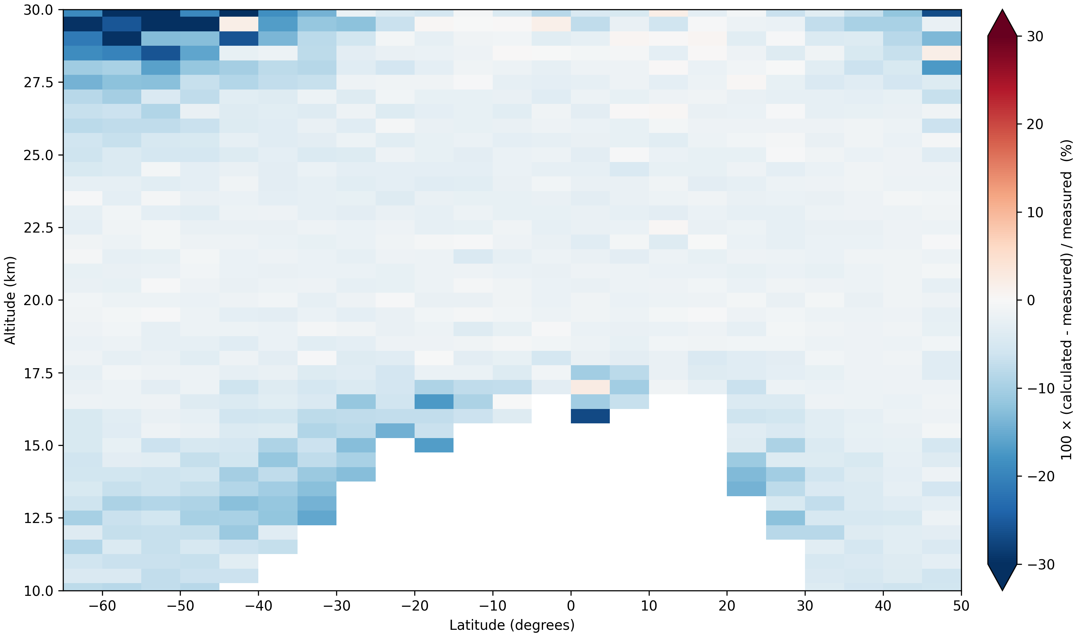
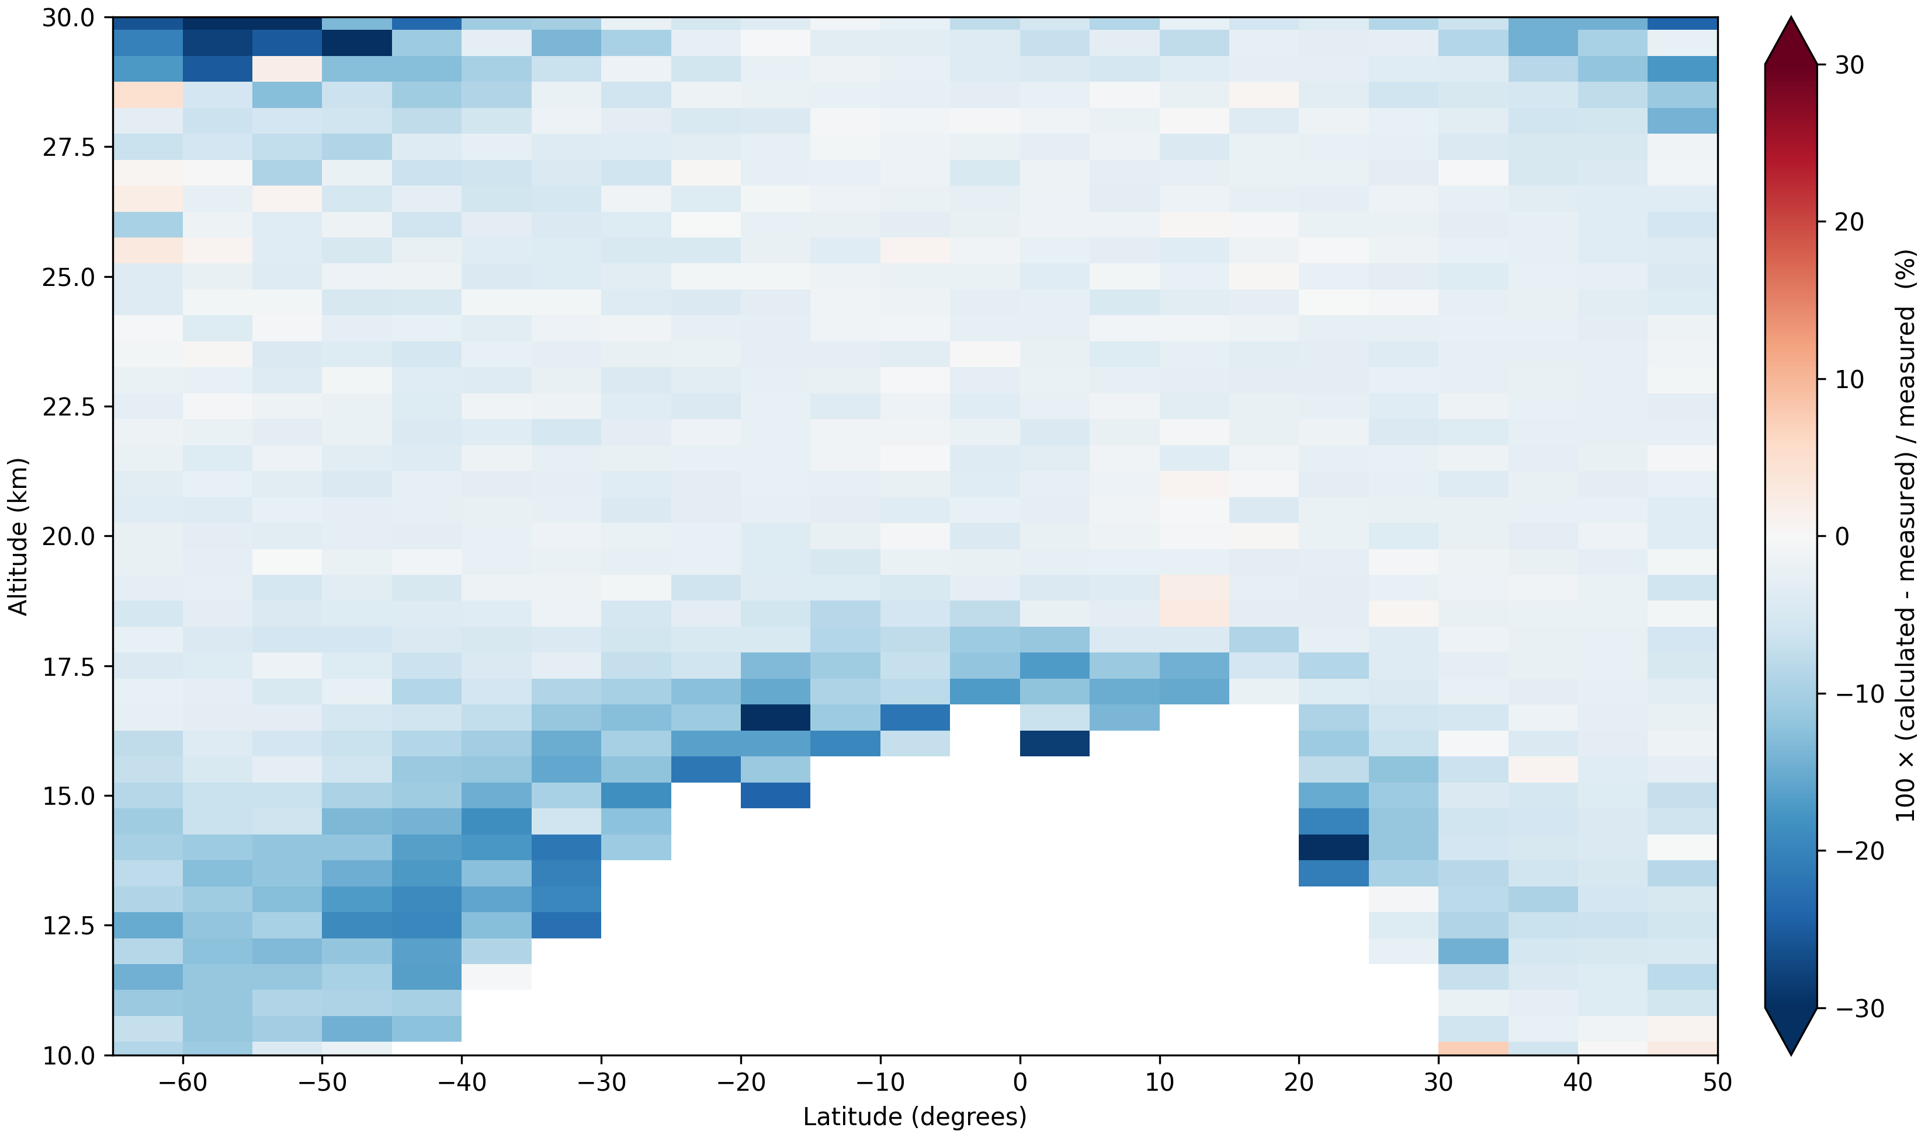
1021 nm
median = +0.58%
V06.00 calculated extinction to measured
January 2018
755 nm
448 nm
median = -3.50%
median = -2.54%

Slide 10
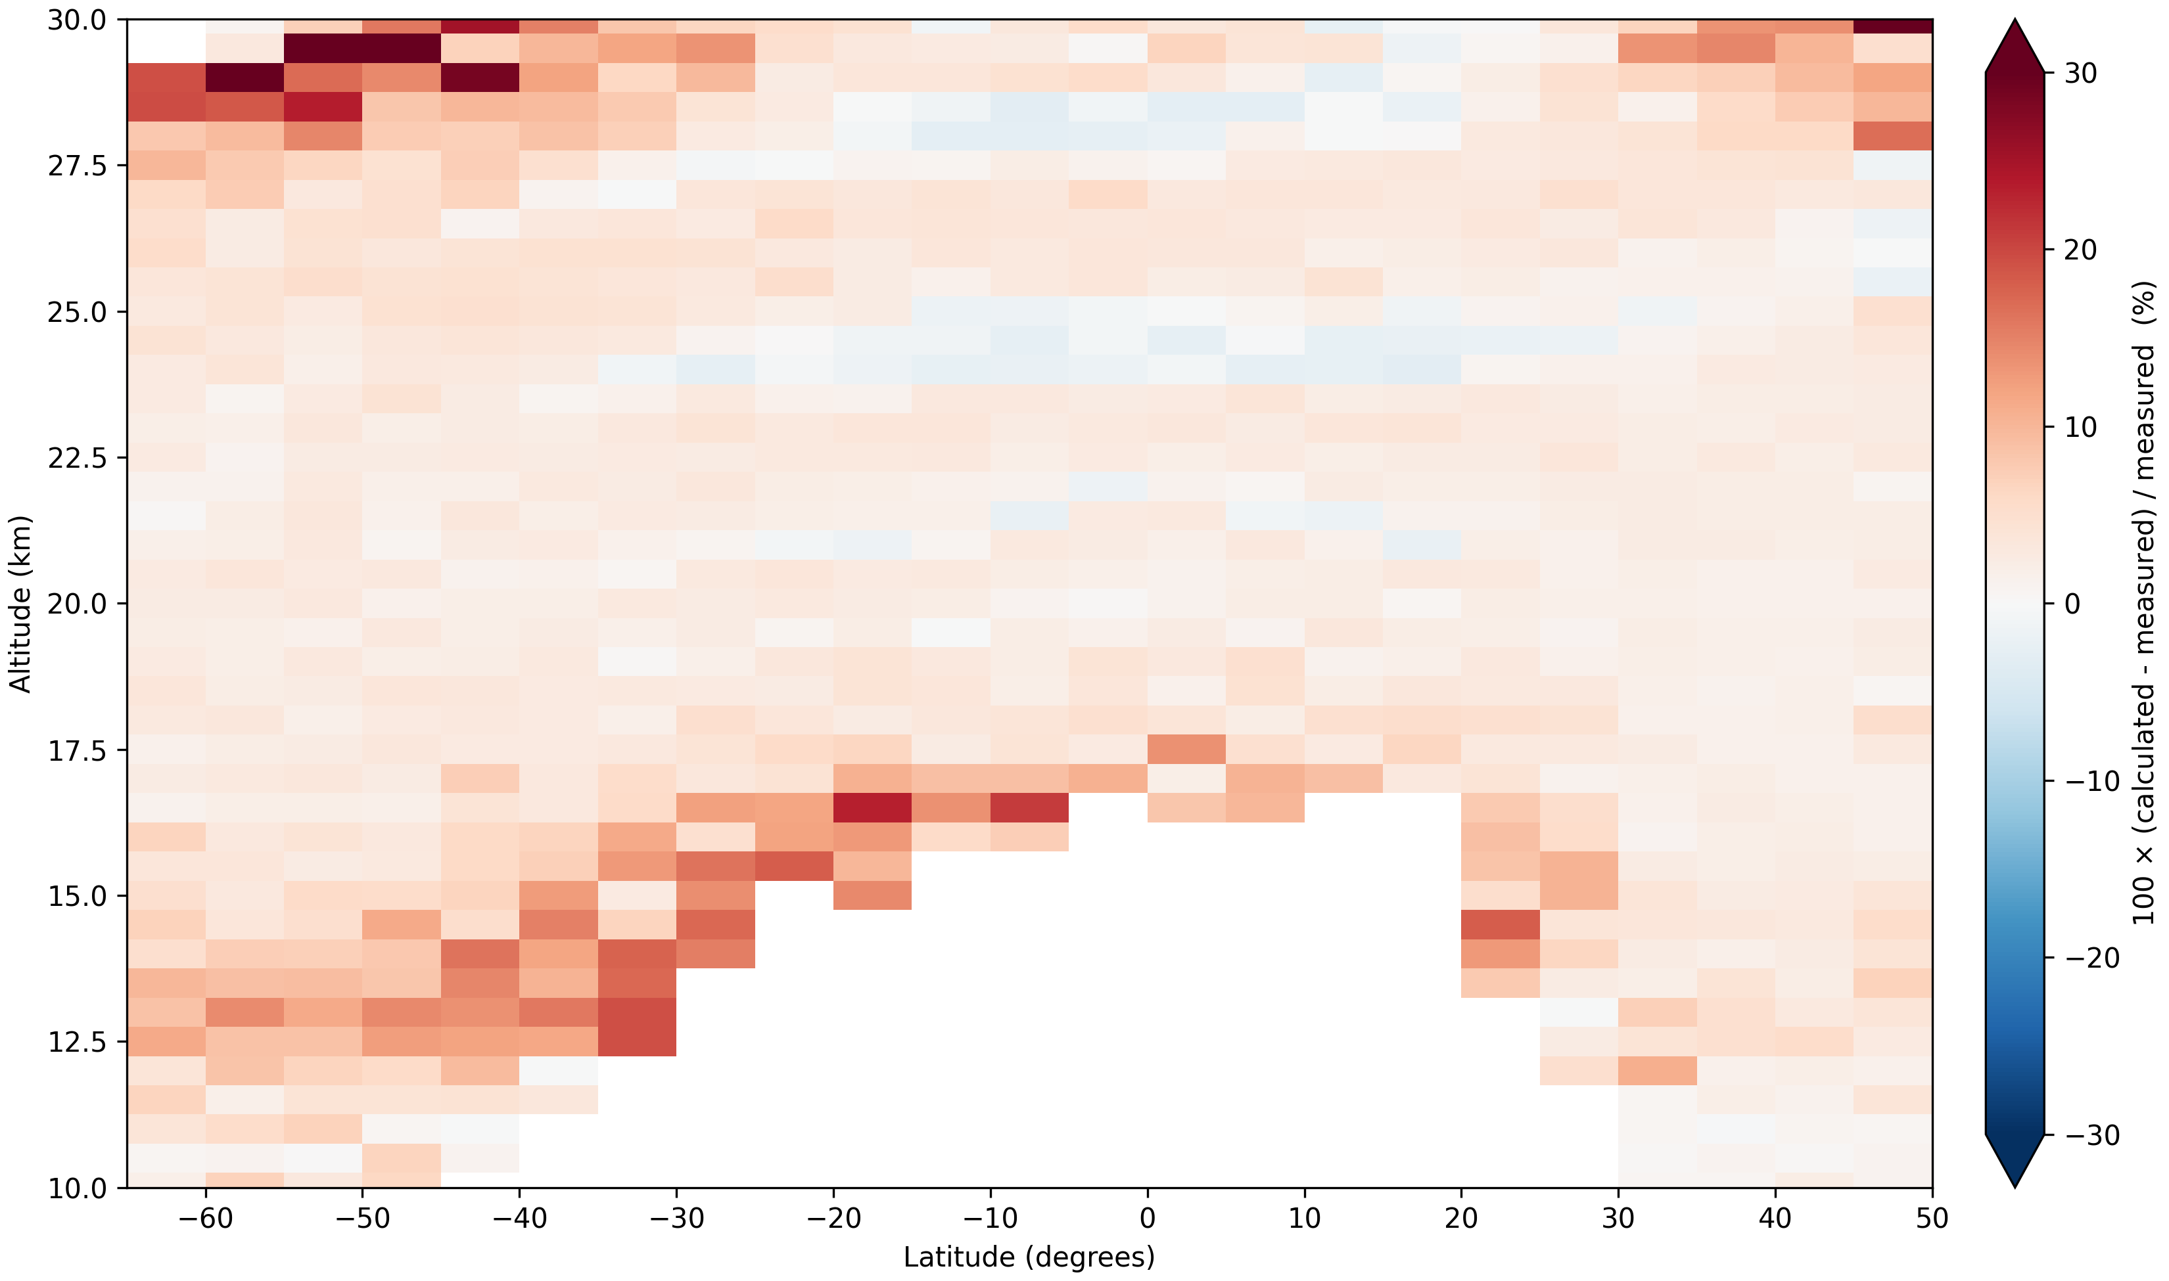
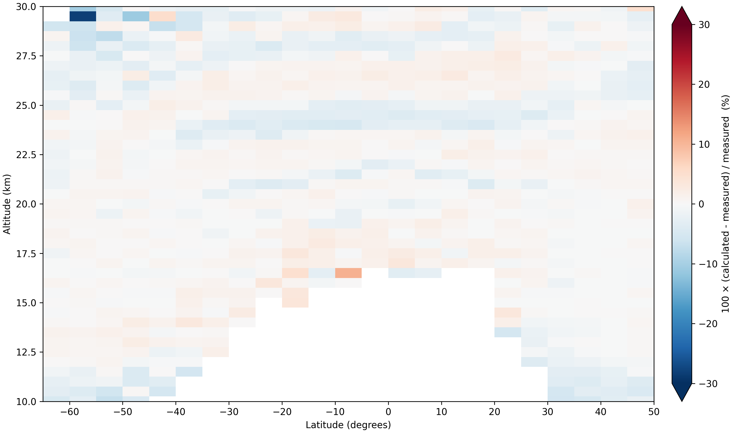
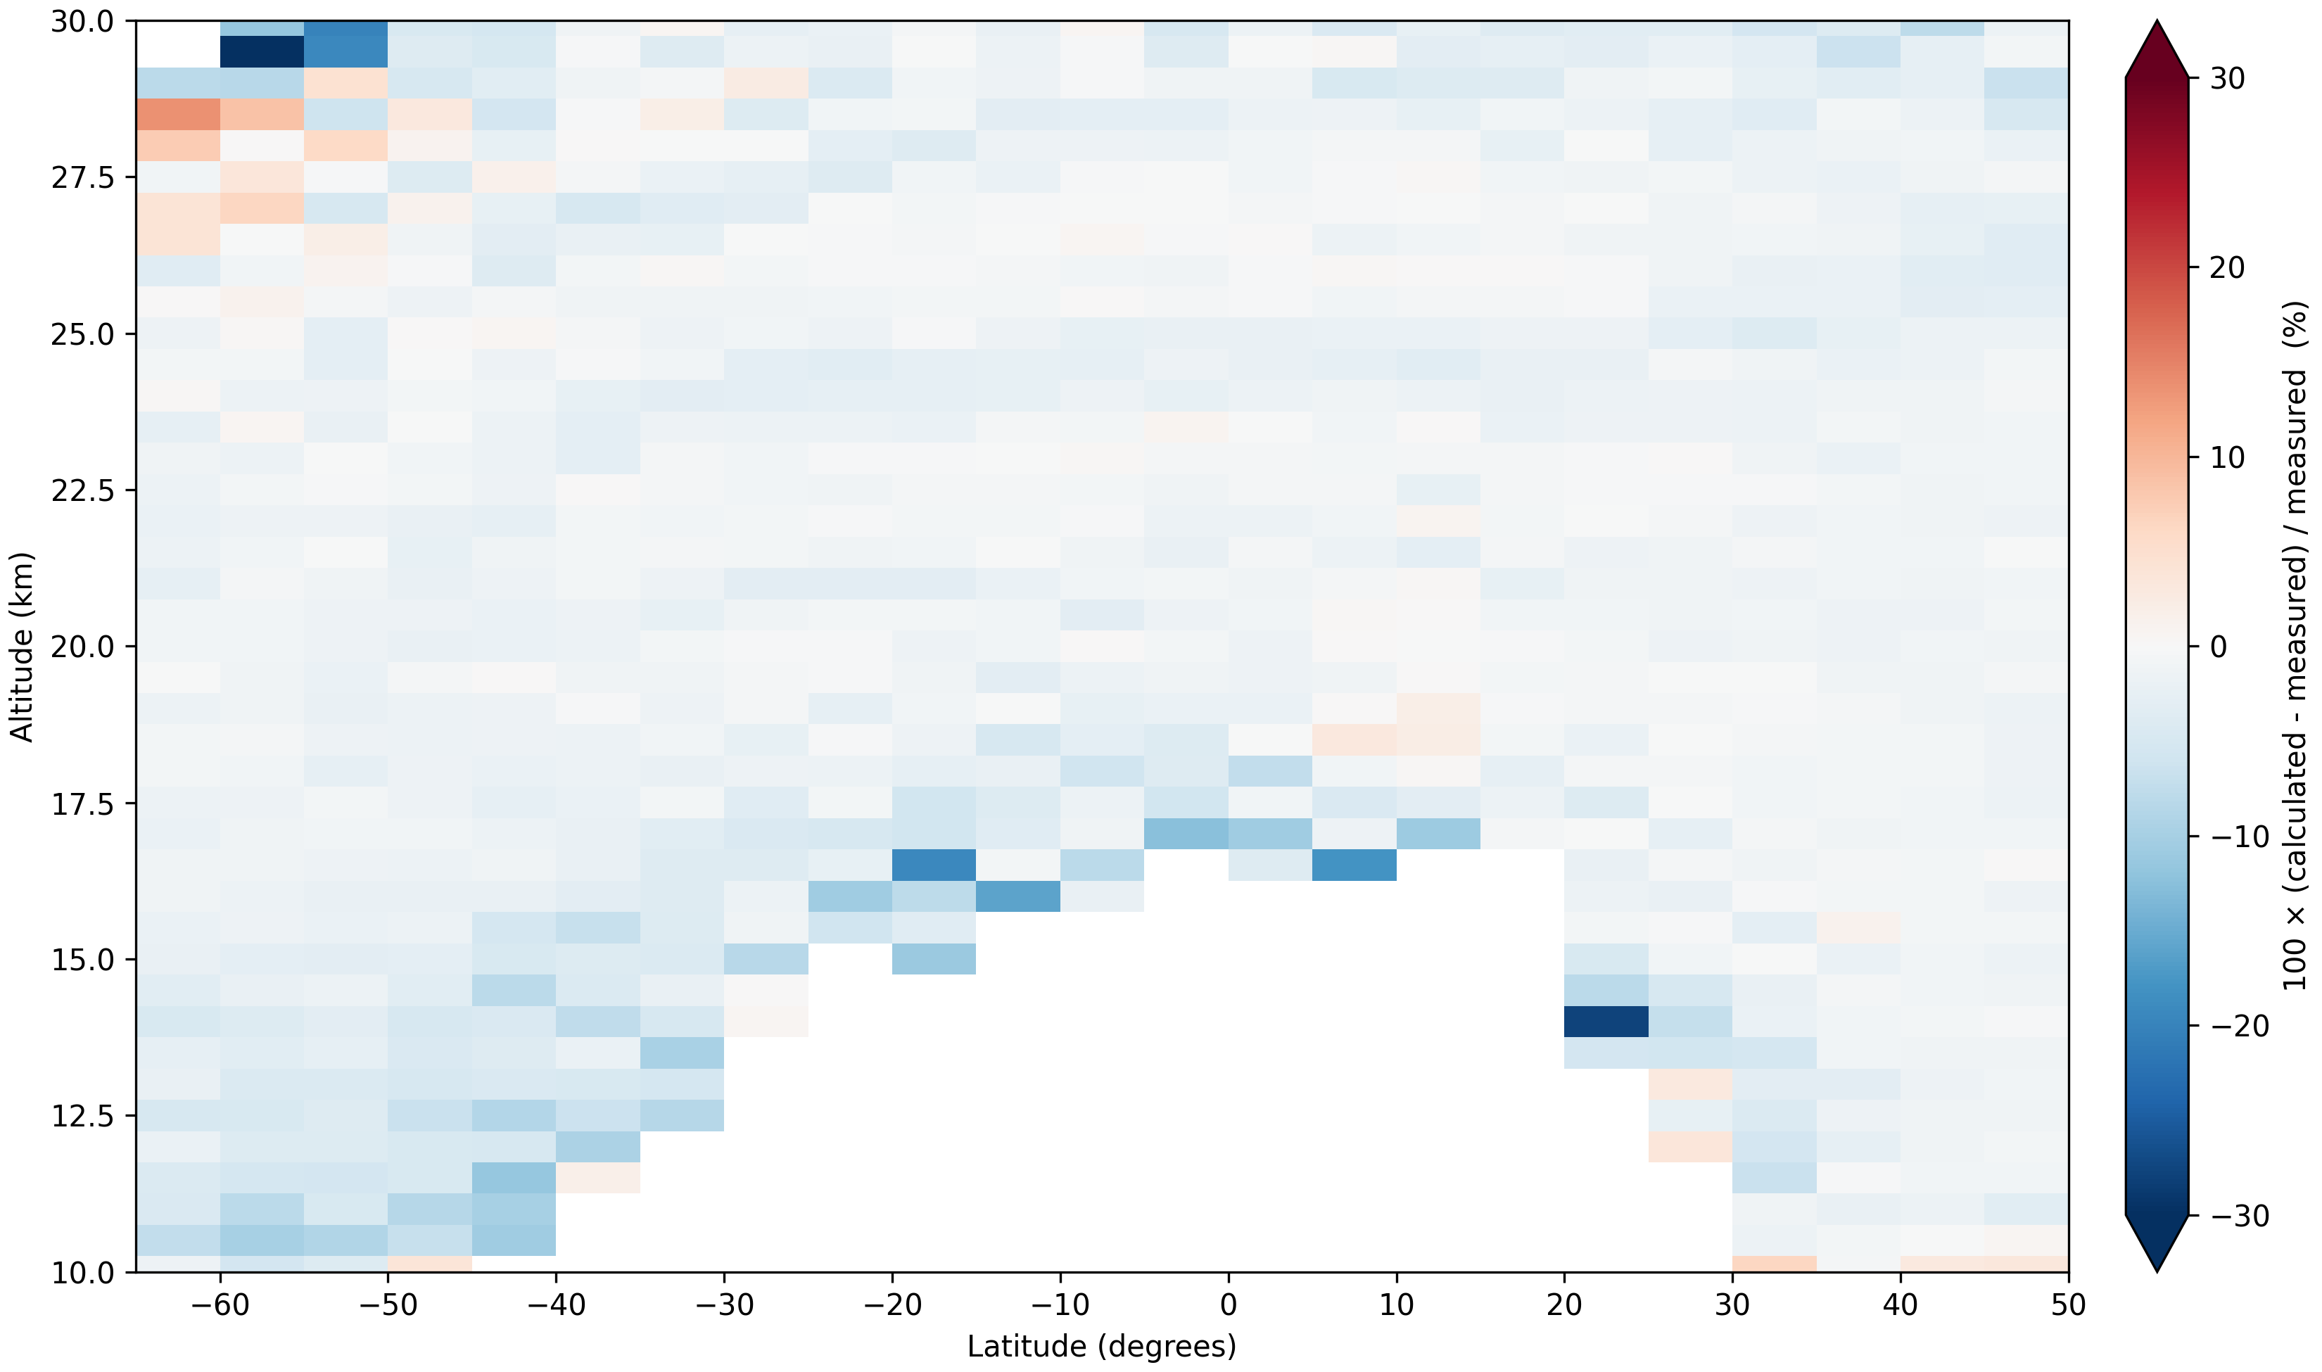
1021 nm
median = +2.25%
update calculated extinction to measured
January 2018
755 nm
448 nm
median = -0.69%
median = -0.04%

Slide 11
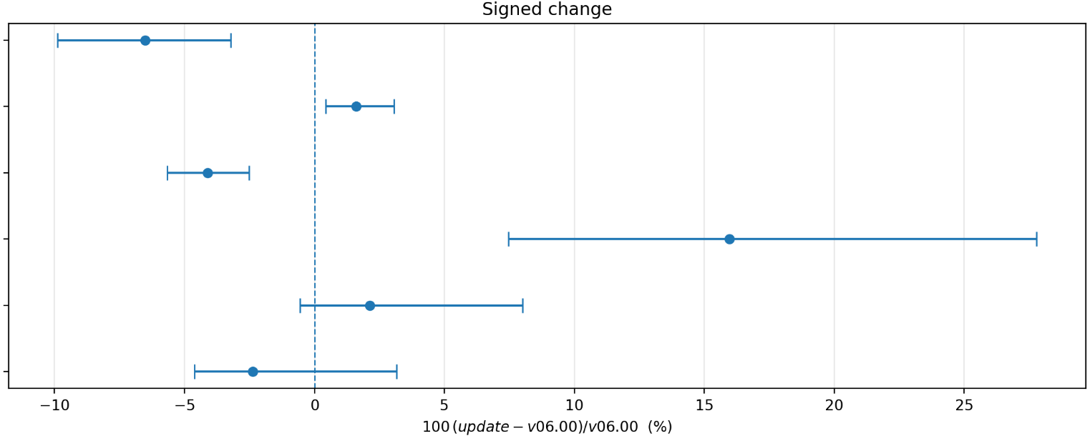
Full update comparison with v06.00
Above tropopause
with 20th – 80th percentiles
Mode radius
Distribution width
Effective radius
Number density
Surface area density
Volume density

Slide 12
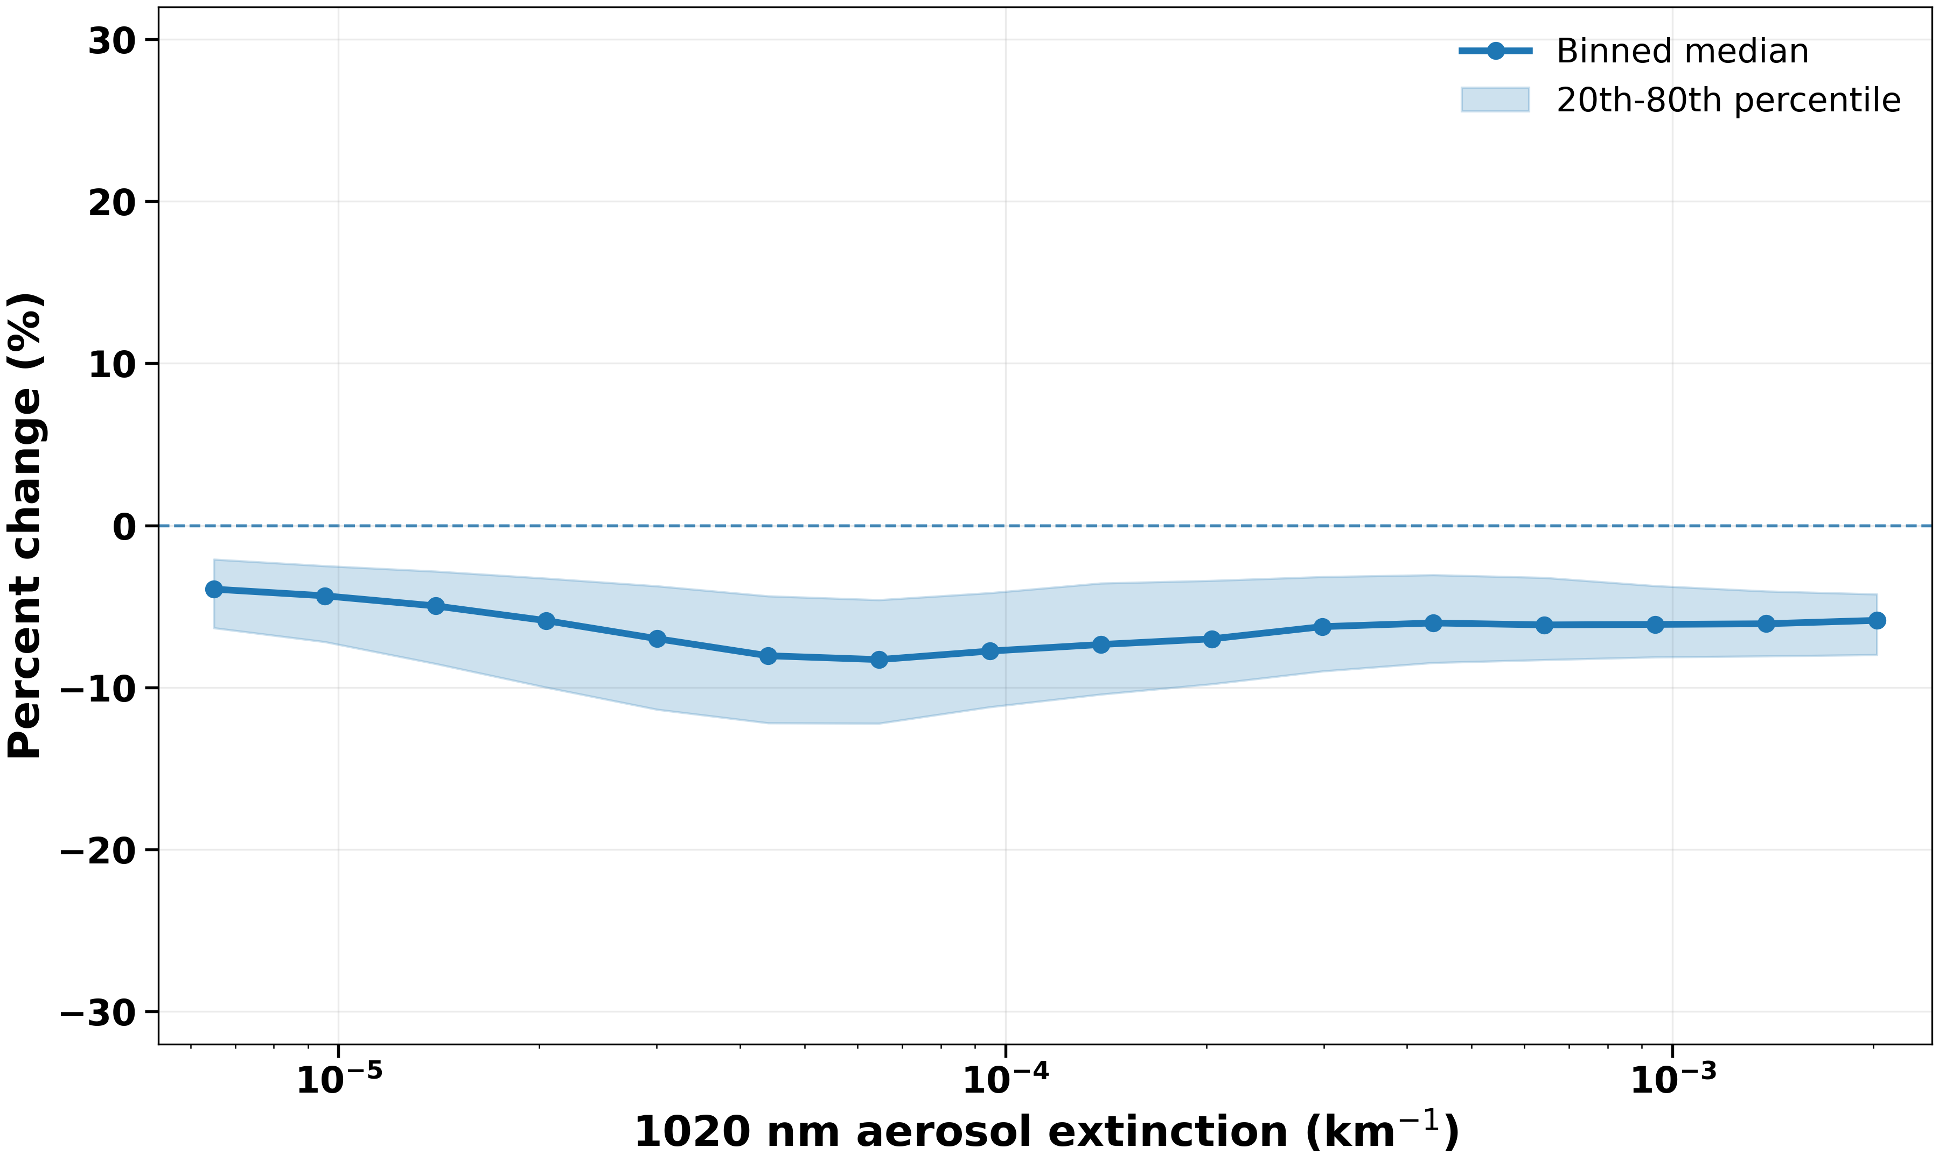
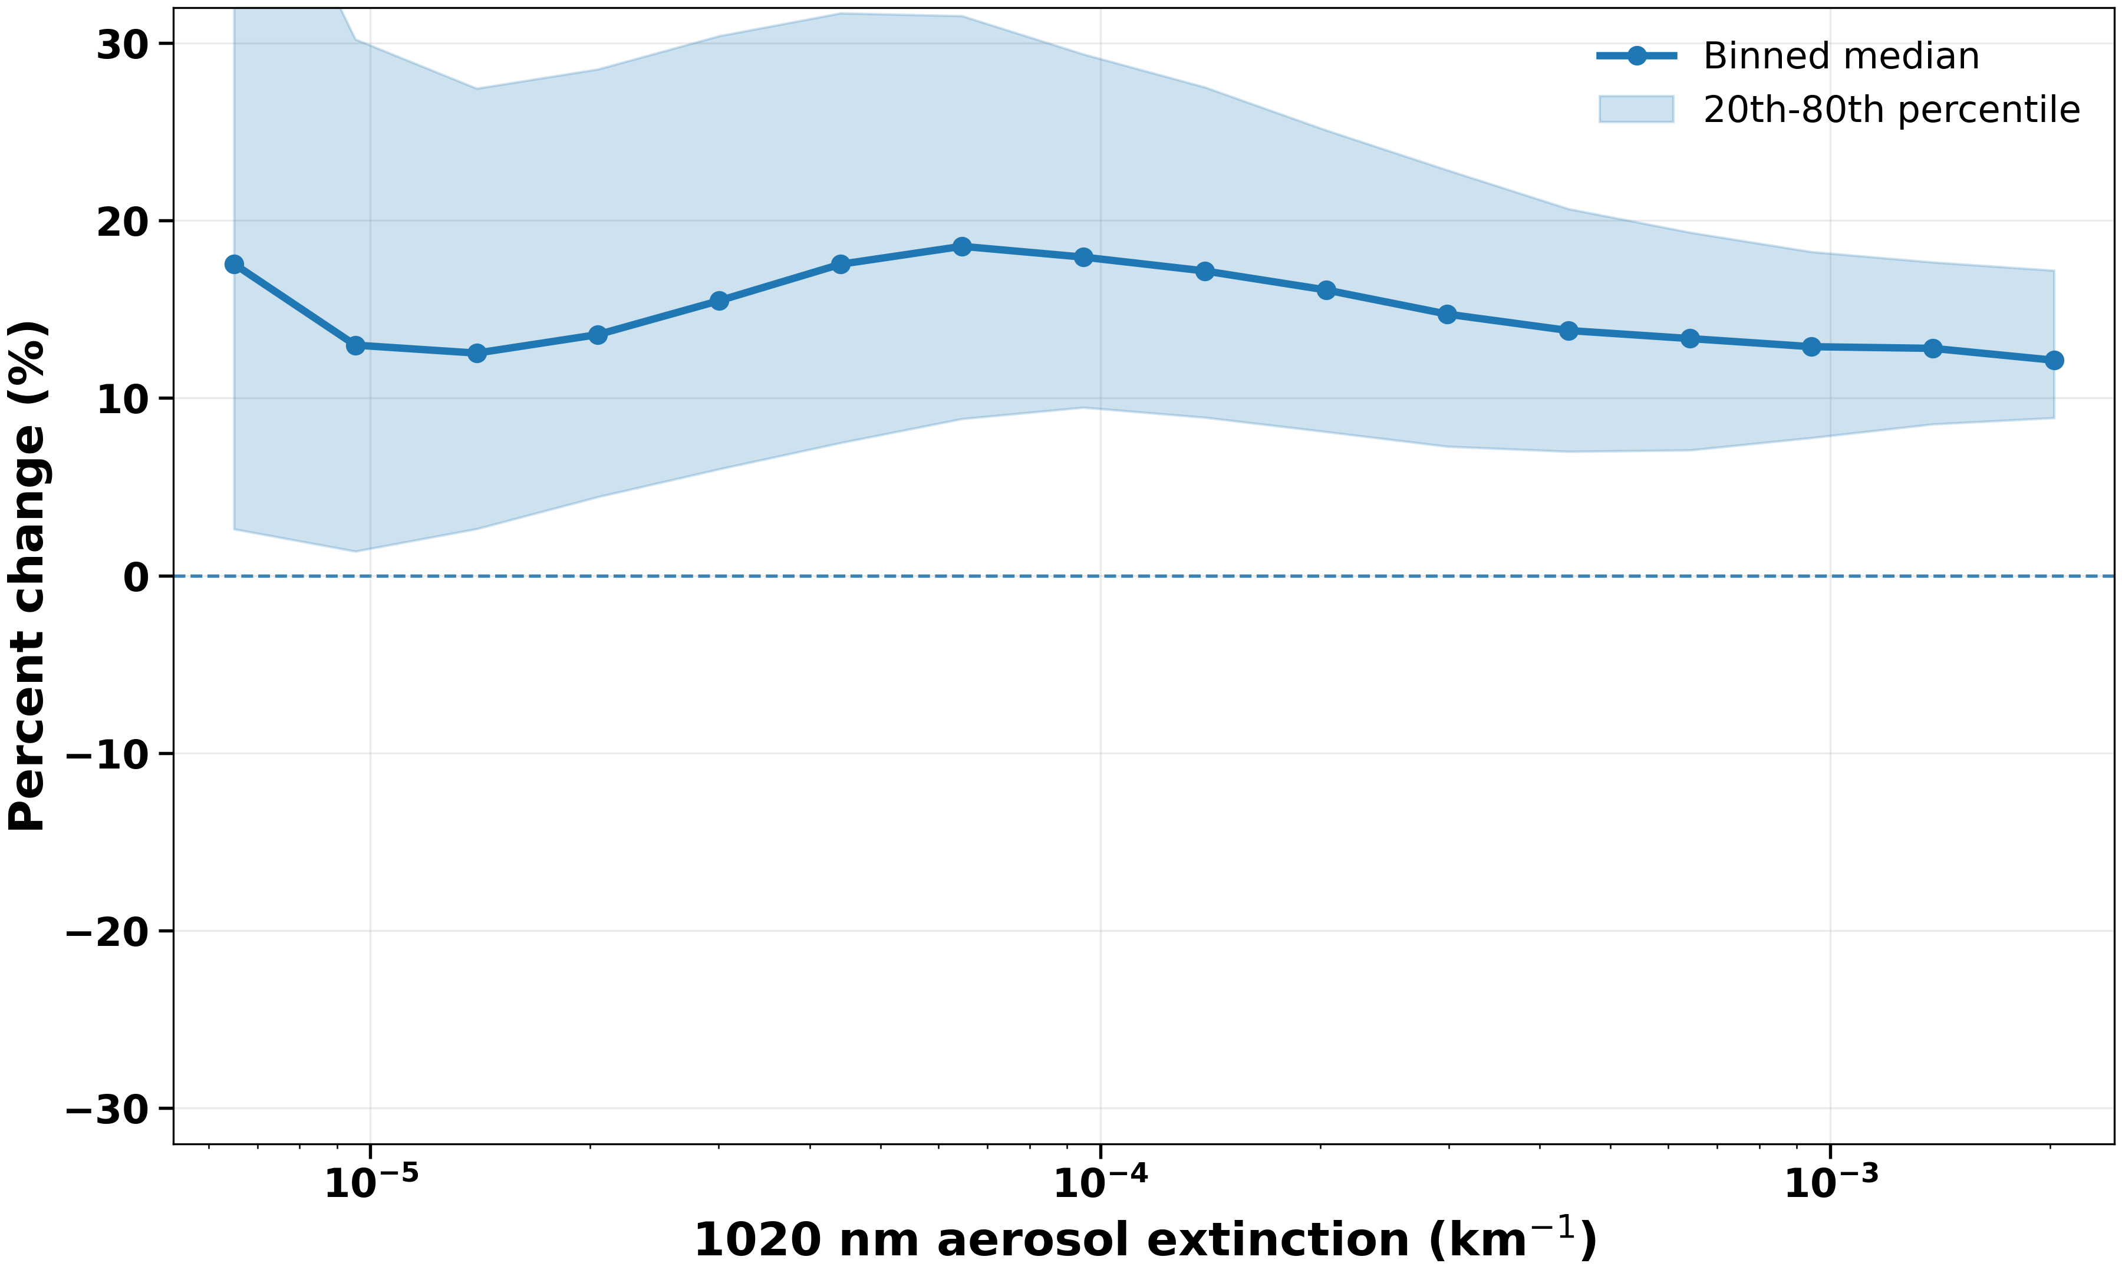
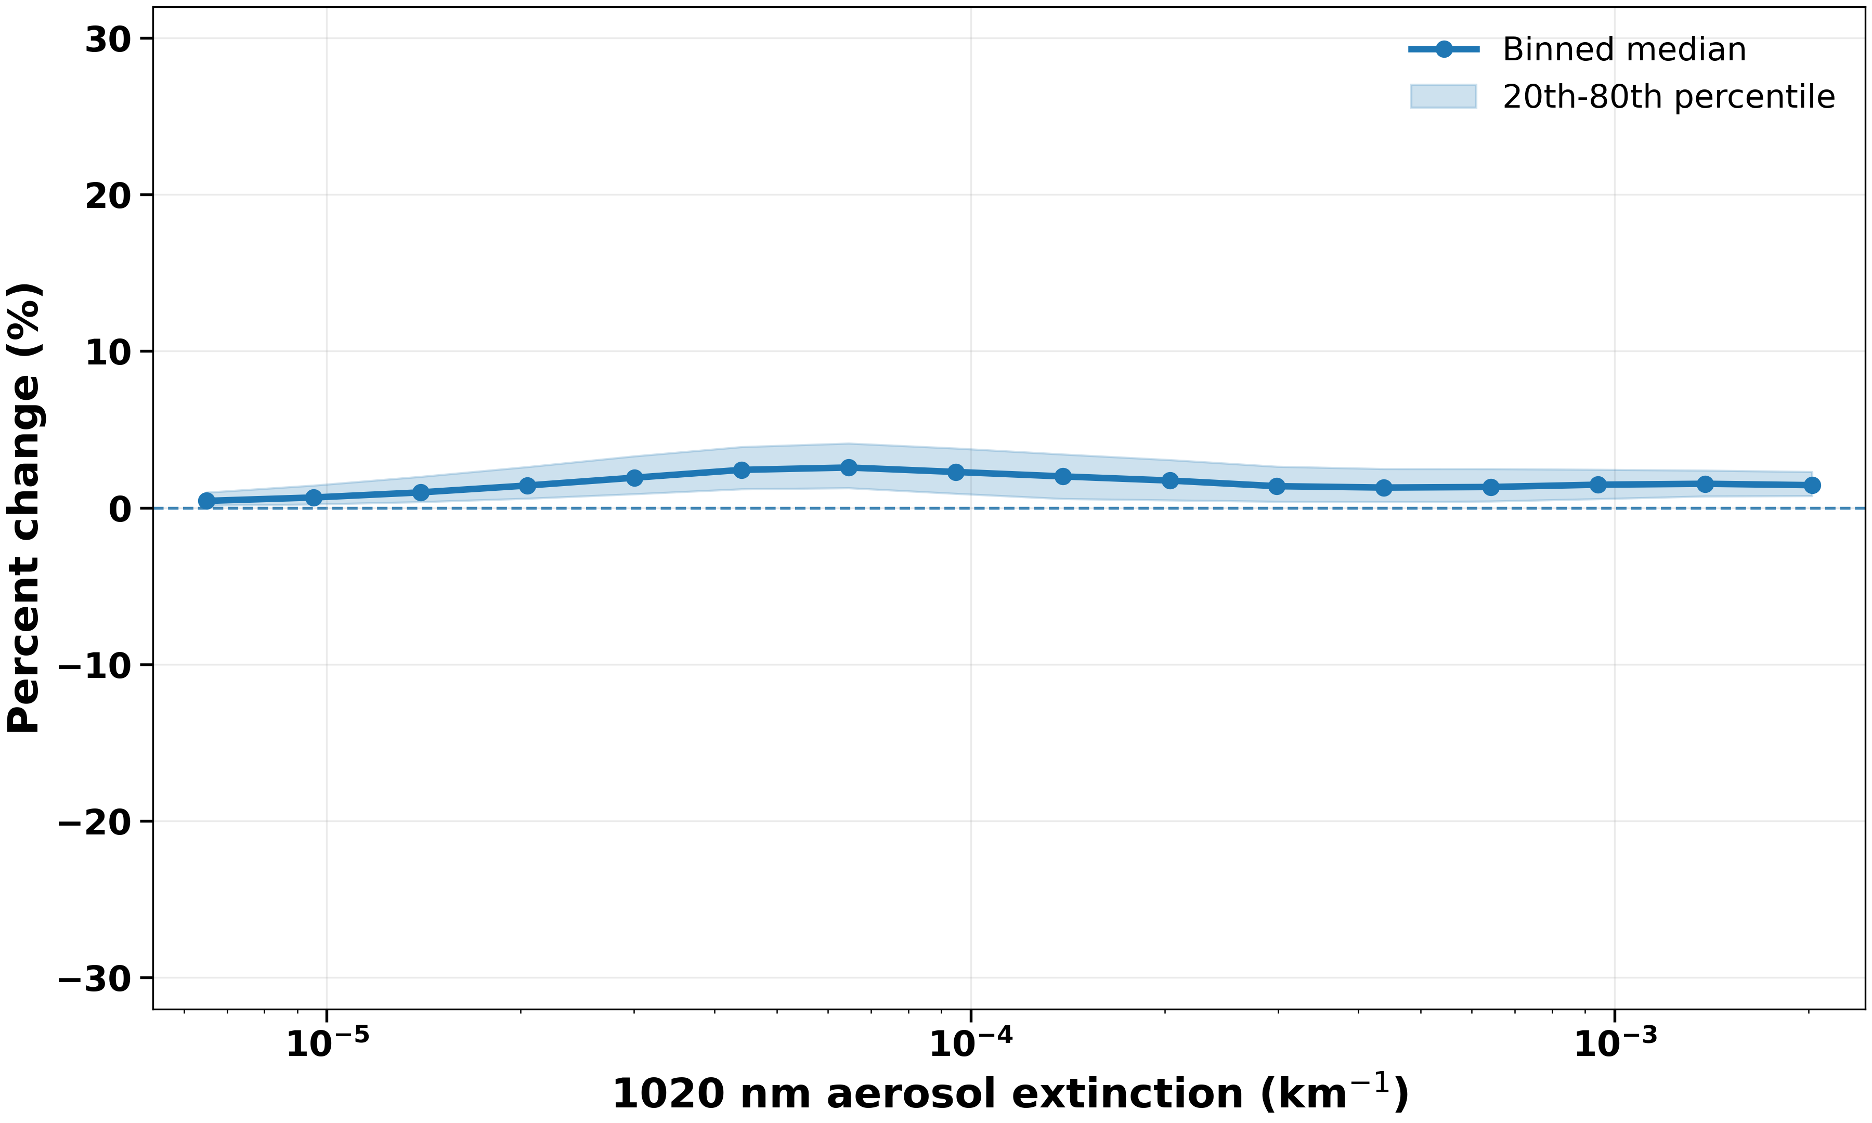
Full update comparison with v06.00
Mode Radius
Number Density
100 * (update – v06.00)/v06.00
Mode Width

Slide 13
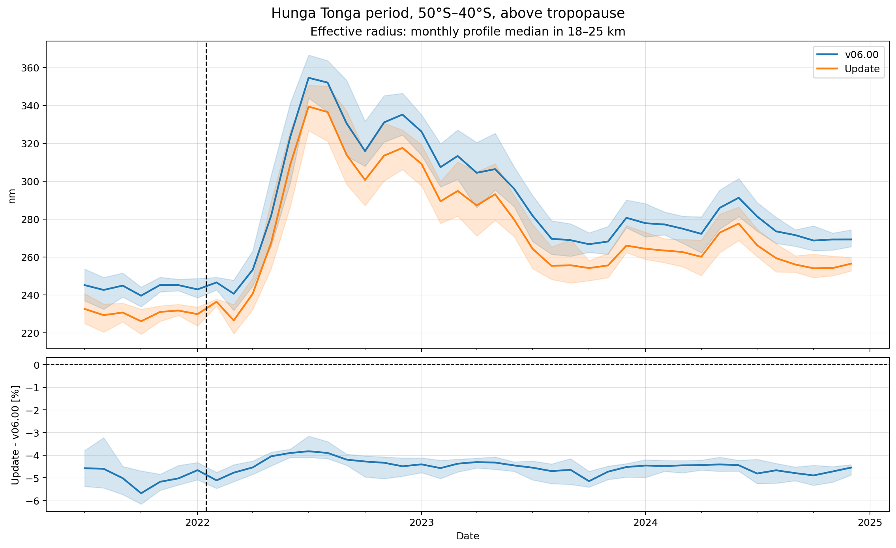
Full update comparison with v06.00
with 20th – 80th percentiles

Slide 14
Future Work
Refractive indices:
  Test edge cases
  QA testing
Finalize the updated algorithm for next release
Testing of weight composition and solution density accuracy

Slide 15
References
Bhusal, M., Boone, C. D., Bernath, P. F., Lecours, M., & Petera, L. (2026). Variation in composition and size distribution of stratospheric sulfate aerosol derived from Atmospheric Chemistry Experiment (ACE). Journal of Quantitative Spectroscopy and Radiative Transfer, 362, 110012. https://doi.org/10.1016/j.jqsrt.2026.110012
Knepp, T. N., Kovilakam, M., Thomason, L., & Miller, S. J. (2024). Characterization of stratospheric particle size distribution uncertainties using SAGE II and SAGE III/ISS extinction spectra. Atmospheric Measurement Techniques, 17(7), 2025-2054. https://doi.org/10.5194/amt-17-2025-2024
Wrana, F., Niemeier, U., Thomason, L. W., Wallis, S., and von Savigny, C.: Stratospheric aerosol size reduction after volcanic eruptions, Atmos. Chem. Phys., 23, 9725–9743, https://doi.org/10.5194/acp-23-9725-2023, 2023.
Wrana, F., von Savigny, C., Zalach, J., and Thomason, L. W.: Retrieval of stratospheric aerosol size distribution parameters using satellite solar occultation measurements at three wavelengths, Atmos. Meas. Tech., 14, 2345–2357, https://doi.org/10.5194/amt-14-2345-2021, 2021.

Slide 16
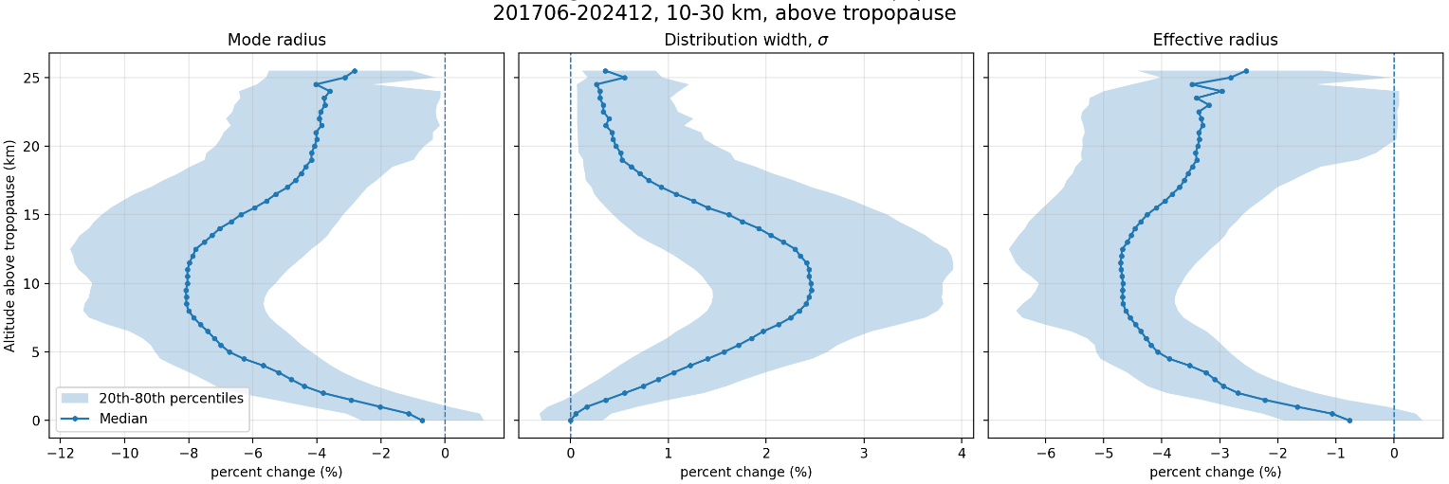
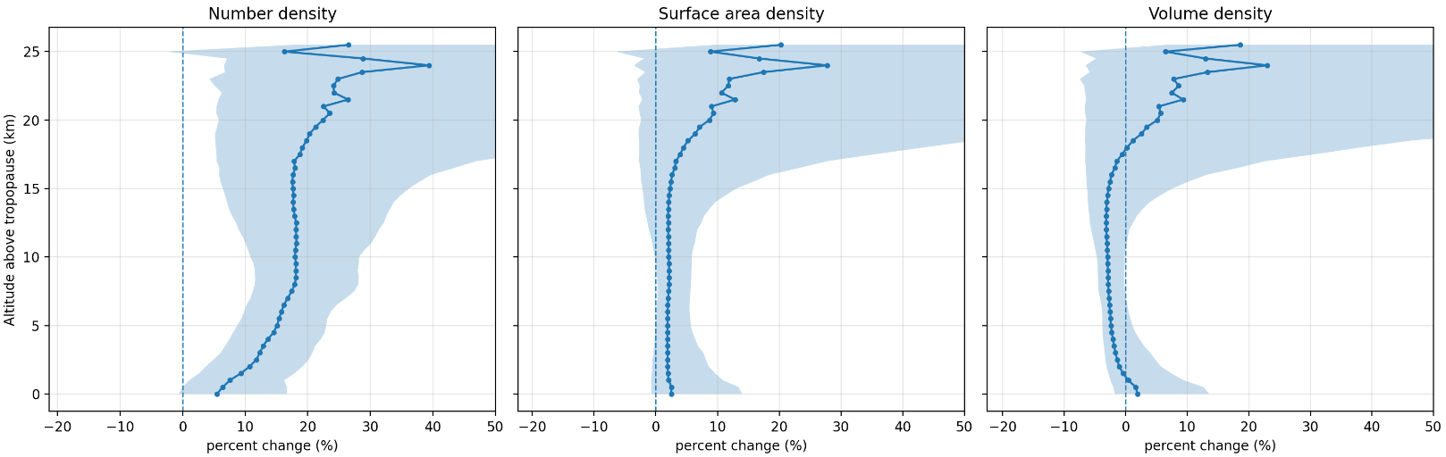
Full update comparison with v06.00

Slide 17
