Slide 1
The Stratospheric Aerosol and Gas Experiment IV
Robert Damadeo
Charles Hill
NASA Langley Research Center

Slide 2
The Problem(s) at Hand
NASA Atmospheres meeting in April 2026
Continuous measurements of stratospheric composition are necessary
  UTLS O3 trends are still uncertain and have discrepancies with models
  Tracer species needed to track circulation and strat-trop exchange
  Halogen and NOx species necessary to understand chemistry
  Significant recent aerosol loading events affecting the stratosphere in new ways
    Very large wildfires challenged our understanding of smoke aerosols
    Massive water vapor injection from Hunga Tonga eruption
A minimum set of key stratospheric constituents are sufficient for monitoring most stratospheric process: O3, temperature, aerosol, H2O, N2O, ClO, HCl
  Data should be vertically resolved, global, daily (day & night), stable

Slide 3
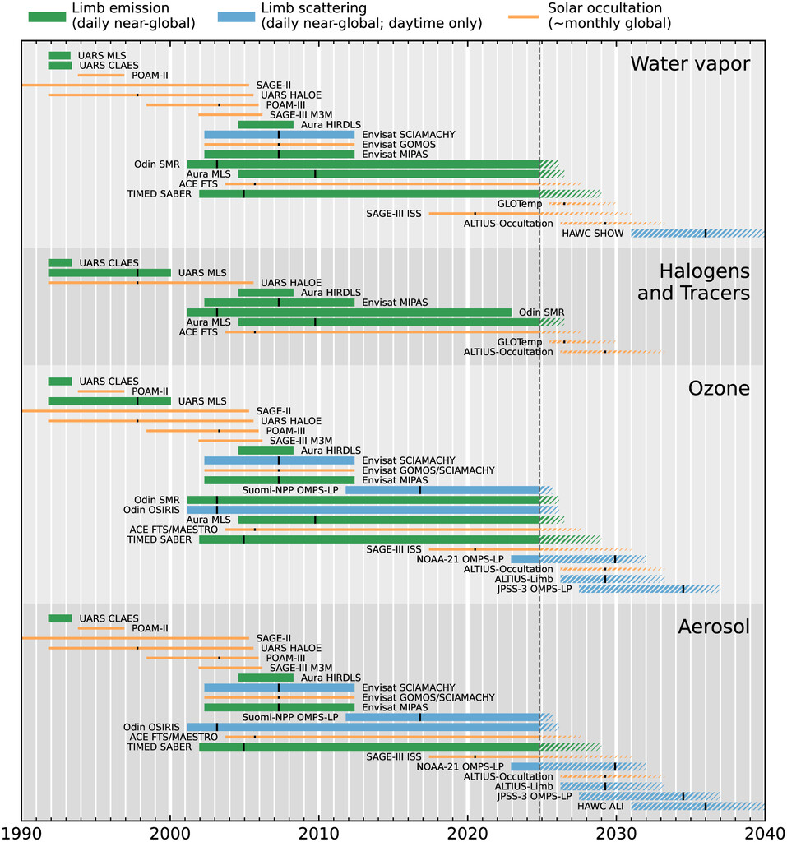
The Upcoming Data “Desert”
Impending loss of several instruments will significantly reduce available data
  For some constituents, measurement gaps are now unavoidable
Funding agencies are operating in austere environments
  Ability to fund new instruments will be extremely limited
  Need to optimize observation portfolio to maximize science return
A sustainable strategy to meet observational needs requires all three limb-viewing techniques
Figure 1 of Salawitch et al., BAMS, 2025

Slide 4
What is the role of occultation?
Observing known target (e.g., Sun, Moon, star) as it rises/sets through atmosphere
  High vertical resolution measurements with semi-global coverage at monthly time scales, which is sufficient for most stratospheric processes
  Solar occultation provides a calibration/validation standard for concurrent, less precise, less stable, high-density samplers to ensure proper continuity of the measurement system ensemble over time
  Lunar/Stellar occultation have weaker SNR but can provide nighttime observations
UV/VIS/NIR measurements provide coverage of O3, aerosols, NO2, H2O (potentially more with high spectral resolution UV measurements)
SWIR/MWIR/LWIR measurements provide coverage of aerosols (adds composition) and significantly more trace gas species
Unique observational geometry for aerosol extinction measurements

Slide 5

What is SAGE IV?
SAGE IV is a stratospheric composition continuity mission concept
focused on key constituents in the stratosphere and upper troposphere
Utilizes the observation method of solar occultation
  Builds on the heritage of previous SAGE instruments to provide data with the same or better quality
New imaging technique simplifies the observation, significantly reducing pointing requirements and thus instrument complexity, size, and cost
Highly adaptable design for maximum science utility
Enables cost-effective sustainability of measurements
Small constellation (3–4) can enable coverage at weekly time scales

Slide 6
What have we been working on?
SAGE IV was funded in 2017 via NASA Earth Science Technology Office’s Instrument Incubator Project (IIP) for a three-year technology development program.
Objectives:
Develop a laboratory SAGE IV prototype enabling a follow-on transition to a low-risk flight mission
  Demonstrate the radiometric performance of the system through laboratory and Sunlook testing
  Utilize commercially available parts to the extent possible (i.e., no R&D) with a clear path to flight
IIP completed in late 2020 (with some delays from COVID-19)
Various development activities since then

Slide 7
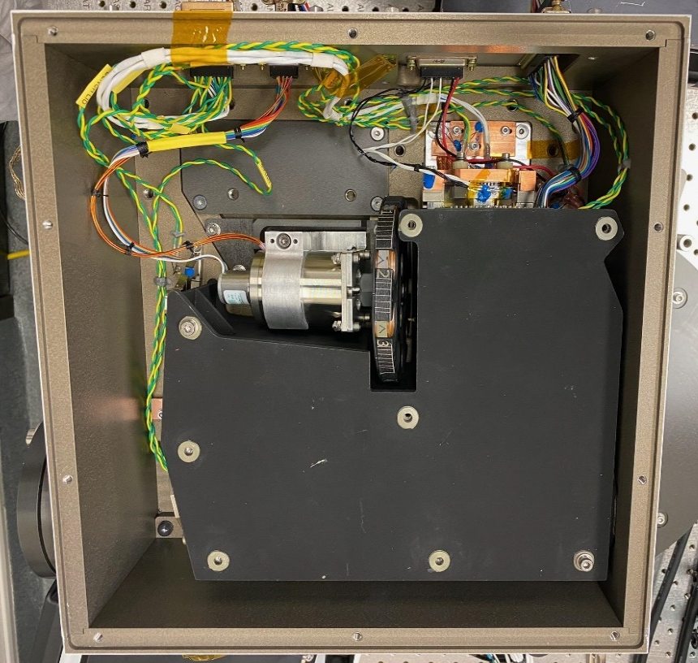
SAGE IV Instrument Design
Telescope:
Compact (<20x20x10cm), state-of-the art fabrication
Excellent stray light mitigation demonstrated by testing at SDL
  Designed to work for both solar occultation and limb
Low- and matched-CTE materials meet requirements across an extended spectral range (200 nm – 5 µm) over potential CubeSat temperature ranges
Detector:
2D array for instantaneous spatial imaging
Deep-well photodiode array for high-SNR in shot noise regime
Identified detector family that meets measurement requirements but can come with different photosensitive substrates (Si/InGaAs/MCT) for different spectral ranges
Filter Wheel:
Can potentially have up to 9 (6U) or 11 (12U) science channels
Enables on-orbit characterization during active science events

Slide 8
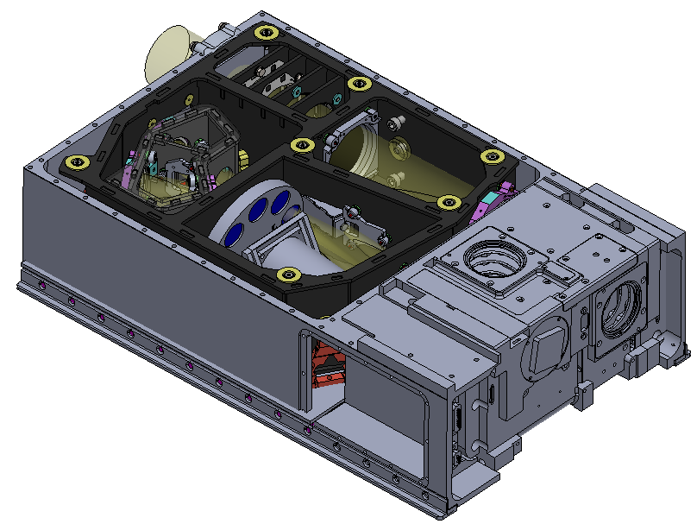
1st Gen. Concept: SAGE Follow-on
ESTO-Funded IIP: SAGE IV Vis/NIR instrument to continue SAGE science goals
Solar occultation imager capable of meeting or exceeding SAGE-quality ozone, aerosol, and water vapor measurements
Instrument and spacecraft small enough to fit in a 6U CubeSat form factor for a significant size and cost reduction (~1/10th)
Accelerated schedule that ensures measurement
validation by operating concurrently with SAGE III
Simple design offers extensibility for greater utility:
  Constellation for better coverage
  IR extensibility for new target species
  Expansion to 12U to include spectrometer
  Potential inclusion of limb scatter mode
  Solar occultation at Venus or Mars

Slide 9
SAGE IV “Viz” Science
Ozone Concentration:
Precision (≤1%) and vertical resolution (≤1 km) required for trend assessments
Necessary stability derives from measurement technique and on-board instrument characterization (SAGE II was ≤2%/dec)
Aerosol Extinction:
Unique data product intrinsic to solar occultation that does not require modeling of particle size or type
Precision (≤5%) and vertical resolution (≤1 km) same as previous SAGE instruments (exceeds other non-SAGE instruments)
Multi-wavelength measurements can be used to infer aerosol properties (e.g., size and type) and can improve other instrument retrievals (e.g., limb scatter/emission)
Water Vapor & NO2 Concentrations:
Precision (≤10–20%) and vertical resolution (≤2 km) same as previous SAGE instruments
Neutral Density / Temperature:
Imaging offers intrinsic measurement of refraction and inference of neutral density and temperature
Spectral Channel | Target
Light Block | Dark Current
Diffuser | Flat-Fielding
448 ± 1 nm | NO2 / Aerosol
452 ± 1 nm | NO2 / Aerosol
525 ± 5 nm | Aerosol
600 ± 10 nm | Ozone
676 ± 5 nm | Aerosol
945 ± 15 nm | Water Vapor
1020 ± 10 nm | Aerosol
Possible Additions | Purpose
Split H2O into 2 | Better Water Vapor
756 / 868 nm | Better Aerosol
385 nm | Density in Mid-Atm.
O2 A-band | Better Dens/Temp

Slide 10
SAGE IV Status
The SAGE IV “Viz” concept was essentially “shovel-ready” in 2021
Would deliver EDU and flight instrument yielding SAGE solar occultation science at low cost and short development time
A Vis/NIR solar occultation instrument would be a strong / necessary complement to planned aerosol instruments
There have been no NASA AOs to propose to since completion of IIP
  NEW: Earth Venture Orbital opportunity in FY26/27
As it pertains to ozone and aerosol continuity, OMPS-LP (SNPP [2011], NOAA-21 [2022], JPSS-4 [2027]) and SAGE III (ISS [2017]) are carrying the record along for the near future with ALTIUS also launching soon [2028]
Explore extensibility options!

Slide 11
2nd Gen. Concept: SAGE IV IR
Implement extensibility of “Viz” instrument to enable observations in the infrared
IR measurements (1–4 µm or 1–5 µm) enable enhanced science
  Similar O₃ and aerosol quality as “Viz”
  10x better H₂O measurements than “Viz”
  Add CH₄, CO₂, N₂O, and CO (5 µm version)
  Can start to differentiate aerosol composition
New species and spectral regime are beyond the heritage of previous SAGE measurements
  New modeling to optimize channel locations and determine error budget
  New engineering challenges to consider

Slide 12
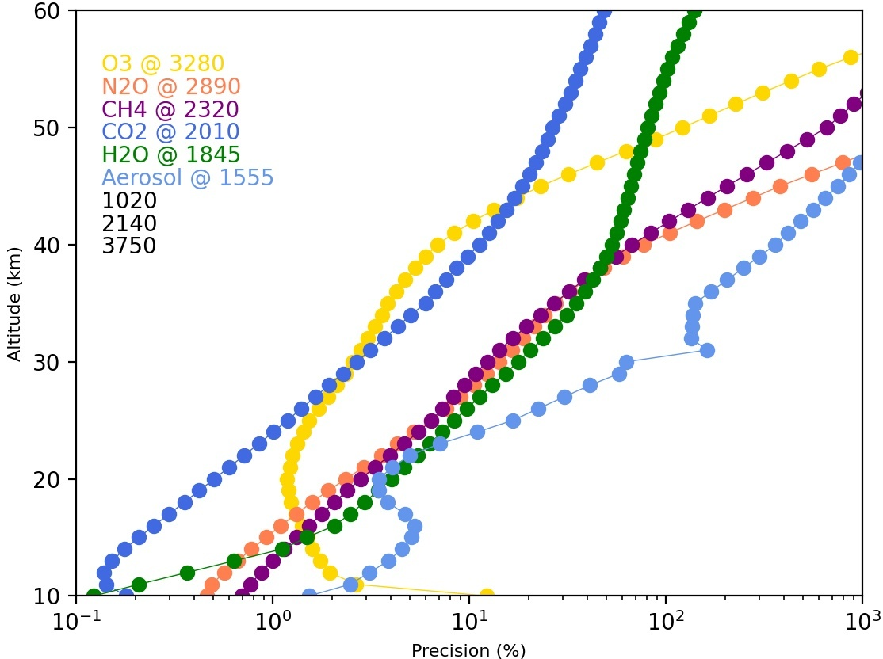
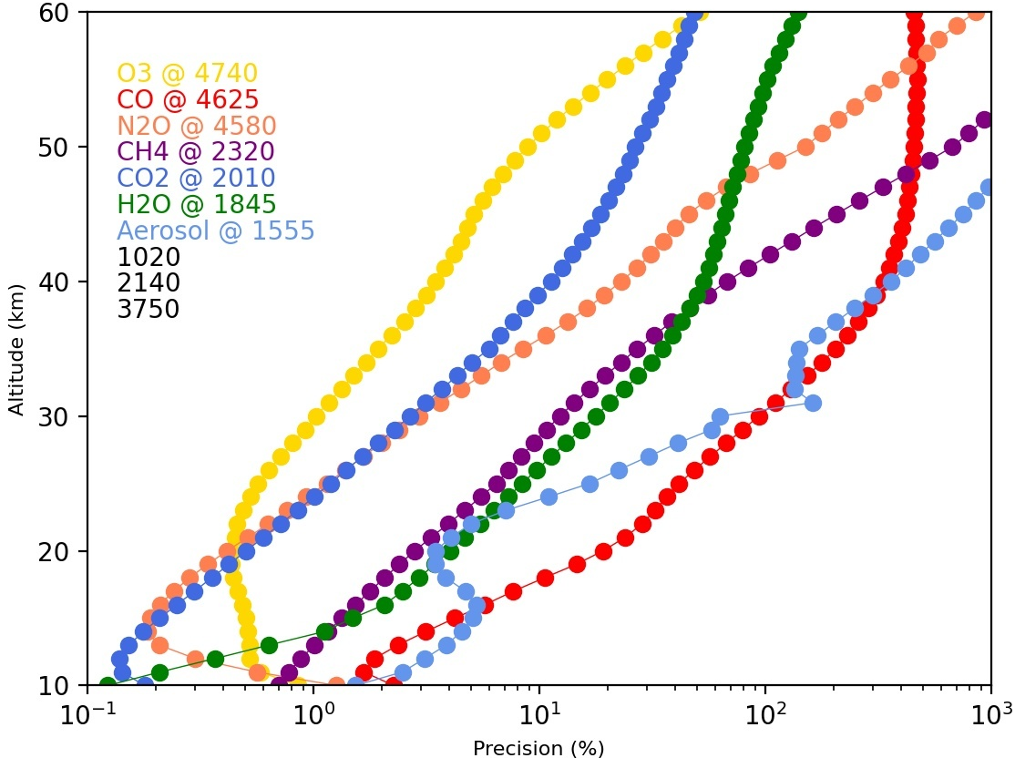
SAGE IV IR: Science Modeling
Spectral Channel | Target
Light Block | Dark Measurement
Diffuser | Flat-Fielding
1020 (10nm FWHM) | Aerosol
1555 (15nm FWHM) | Aerosol
1850 (35nm FWHM) | Water Vapor
2010 (15nm FWHM) | Carbon Dioxide
2135 (10nm FWHM) | Aerosol
2315 (20nm FWHM) | Methane
4 um Version: 2885 (40nm FWHM) 3285 (35nm FWHM) 3 Aerosol Channels | Nitrous Oxide Ozone Aerosol
5 um Version: 4550 (50nm FWHM) 4625 (75nm FWHM) 4725 (75nm FWHM) 2 Aerosol Channels | Nitrous Oxide Carbon Monoxide Ozone Aerosol
For broadband radiometry, there are several possible
channel choices for each species of interest
Optimized channel choice (both general location and
specific bandpass) to maximize precision and
minimize biases to bandpass knowledge and
interference from other species

Slide 13
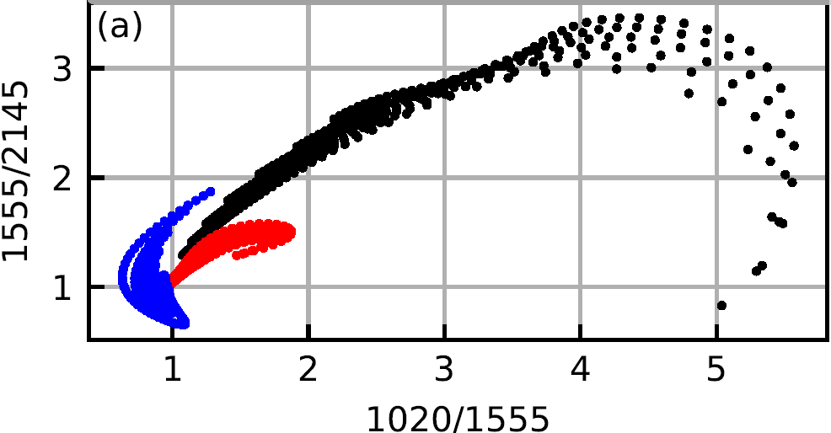
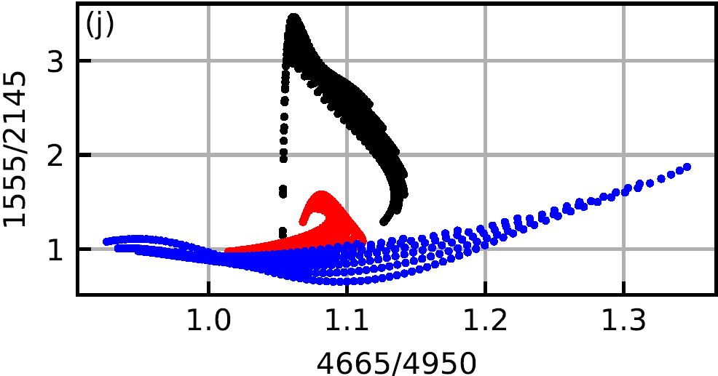
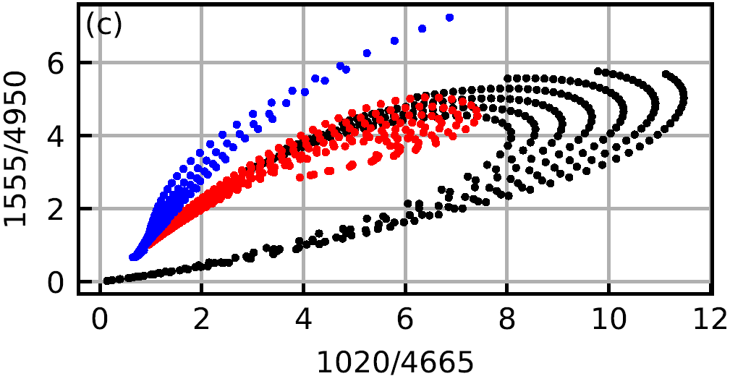
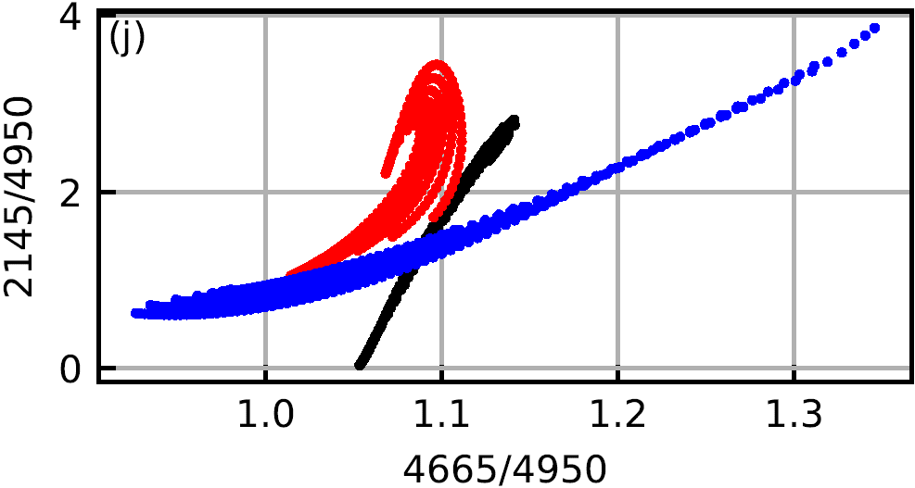
SAGE IV IR: Aerosol Modeling
Aerosol modeling shows how IR channels enable differentiation of not only particle sizes but also composition

Slide 14
SAGE IV IR: Self-Characterization
Solar occultation technique is “self-calibrating” from orbit-to-orbit and month-to-month, but not over the few minutes of each observation
SAGE IV is designed with “active” characterization in mind (i.e., characterization of instrument performance throughout the active science mode)
  Dark current and Reimager TSE via light block (0.5 Hz, channel independence)
  Beam Reducer TSE via image outskirts (0.5 Hz, each channel)
  Pixel-to-pixel cross-calibration via diffuser (0.5 Hz over exoatmospheric range)
  Other thermal transient behaviors via analysis over exoatmospheric range
Special characterization events are also planned to improve calibration of images
  Dark current trending
  Beam Reducer TSE temperature dependence
  Special flat-fielding “scans” to analyze diffuser performance/sensitivities
Instrument design and algorithm experience will enable SAGE IV data stability

Slide 15
SAGE IV IR Status
SAGE IV IR offers a sustainable solution for composition continuity observations
  Ozone layer
  Greenhouse gases
  Transport tracer species
  Aerosols and properties to observe volcanic and wildfire events
SAGE IV will offer a calibration-quality reference standard for future missions
Instrument design is mature, with only minor engineering analyses remaining
Concept is amenable to upcoming AOs (i.e., EVO-1) depending on HQ programmatics

Slide 16
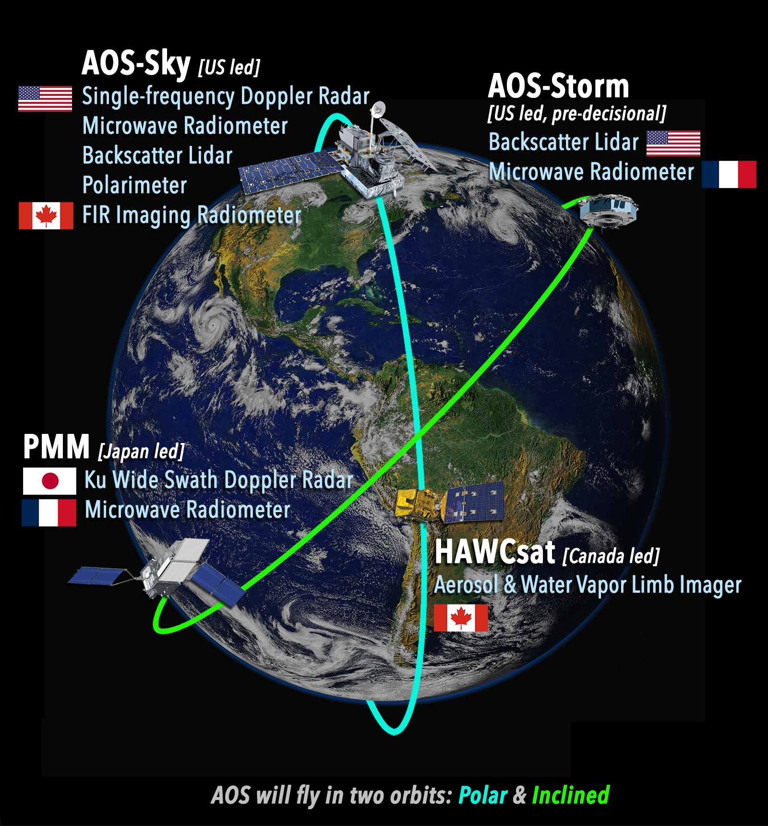
Planned/Potential Missions and Synergy
ALTIUS (BIRA/ESA) (2028+): Solar(+stellar) occultation & limb scatter
OMPS-LP (JPSS-4/3) (2027/2032+): Limb scatter
ACCP/FALCON (2030+)
Backscatter Lidar (532 and/or 1064 nm)
Aerosol Limb Imager (10 bands, 610–1560 nm)
Water Vapor Limb Imager (1362.00–1368.32 nm)
NASA Earth System Explorer (2030+)
STRIVE: ALICE + ARGOS
  LWIR (3–14 µm) Limb Emission of trace gases
  NIR Limb Scatter of aerosols
Each of these measurement systems can and should have a concurrent solar occultation mission to ensure proper continuity of their respective science targets

Slide 17
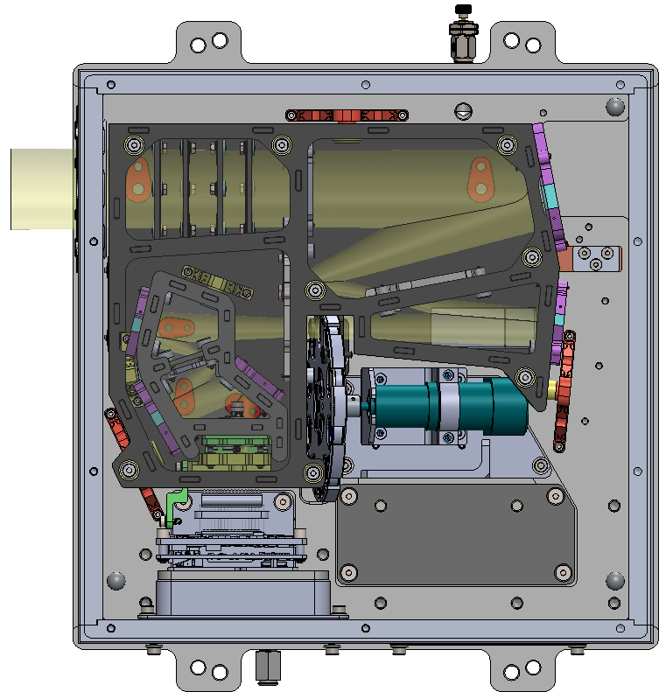
Future Development (3rd Gen. Concept)
TELESCOPE
Add Spectrometer
  Tried to leave room for a beam splitter
  Spectrometer assembly can be added out-of-plane
  Requires additional stray light analyses (not yet modeled)
  Enables high-resolution spectroscopy (FTS?) with
  broadband channels chosen to be complementary
Limb Scatter
  Telescope performance meets in/out-of-field stray light requirements
  Vertical spectrometer slit could take observations similar to OMPS-LP approach
  Broadband imaging would be complementary and assist with pointing knowledge
Planetary Observations
  Instrument design is amenable to perform solar occultation at Venus and Mars
One conformal instrument design could be used for many purposes
REIMAGER
FPA

Slide 18
Questions?

Slide 19
Backup

Slide 20
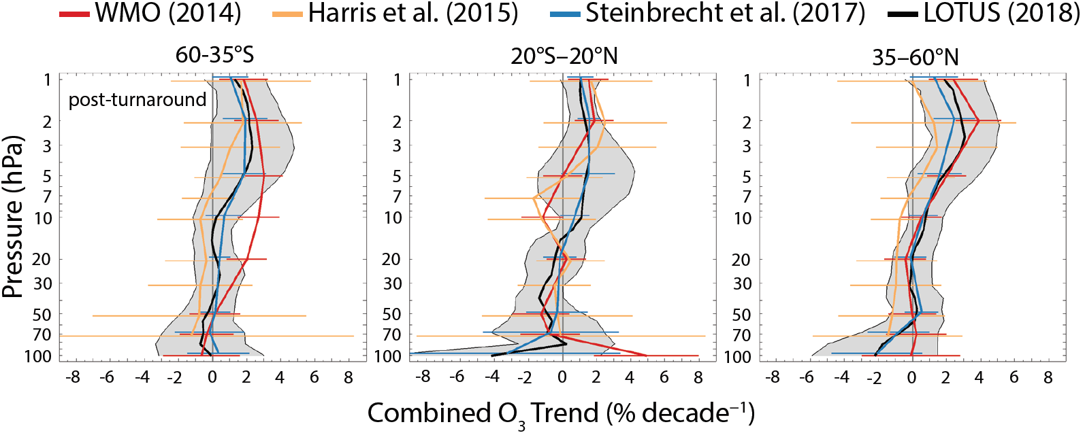
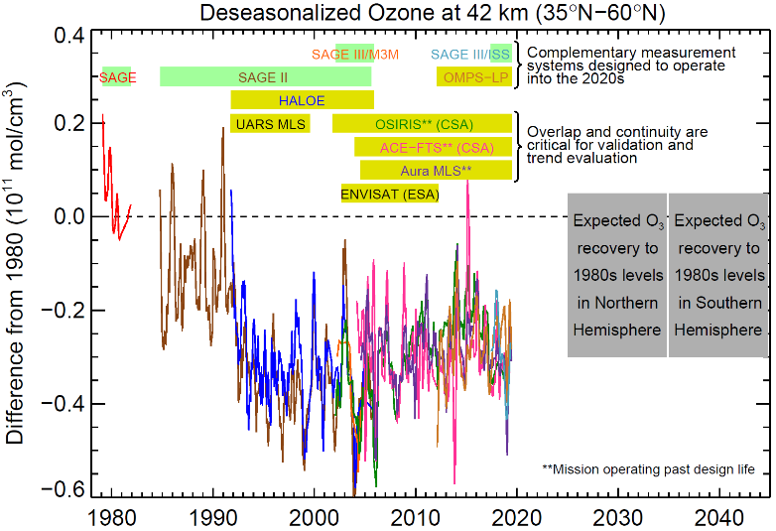
Stratospheric Ozone Requirements
Scientific Needs:
Satellite ozone data is used to monitor the effectiveness of the Montreal Protocol.
Results discussed in the 2018 Ozone Assessment show signs of recovery in the upper stratosphere from decreasing ODSs but a continual decline (uncertain) in the lower stratosphere from increasing GHGs. Additional data is necessary to improve uncertainties (i.e., longer record).
Data sets used for trend studies require excellent precision (≤1%), vertical resolution (≤3 km), and stability (≤1-2%/dec) to reliably extract small trends.
NASA’s Needs:
The Clean Air Act mandates NASA to monitor atmospheric ozone and the 2017 Decadal Survey targets ozone as an Explorer class observable.
OMPS-LP is the “Program of Record” and makes daily global maps but lacks the required precision (~5-8%) and stability (≤5%/dec) to be solely relied upon for future trend studies.
A concurrent measurement source is required to ensure proper continuity and a solar occultation instrument is ideal.
Future systems need to be validated against other current instruments with the same or better precision.

Slide 21
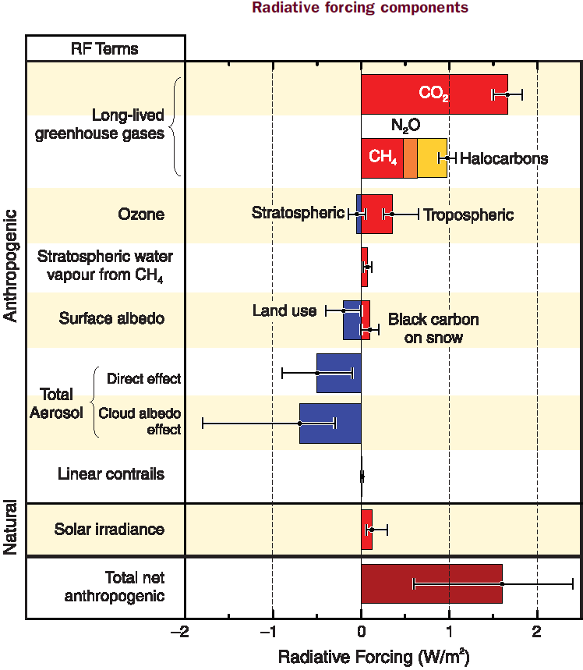
Stratospheric Aerosol Requirements
Scientific Needs:
While aerosols tend to be (relatively) short-lived, they complicate our ability to accurately model climate change.
The 2014 IPCC Report makes several statements on this topic.
“The difference between models and observations may also contain contributions from inadequacies in the solar, volcanic and aerosol forcings used by the models …”
“Confidence in the representation of processes involving clouds and aerosols remains low.”
“Aerosols continue to contribute the largest uncertainty to the total radiative forcing estimate.”
A continued record of aerosol measurements and a better understanding of aerosol-cloud interactions is necessary.
NASA’s Needs:
The 2017 Decadal Survey lists Aerosol as a Designated Observable.
ACCP is the current program goal to satisfy this need.
Observations of stratospheric aerosol are complementary to ACCP (ACCP focuses on aerosol-cloud interactions)
OMPS produces a stratospheric aerosol extinction product, but lacks precision (≤25%) and is dependent on inaccurate assumptions
SAGE observations have provided the majority of the currently existing stratospheric data record and are well-suited to provide continuity.

Slide 22
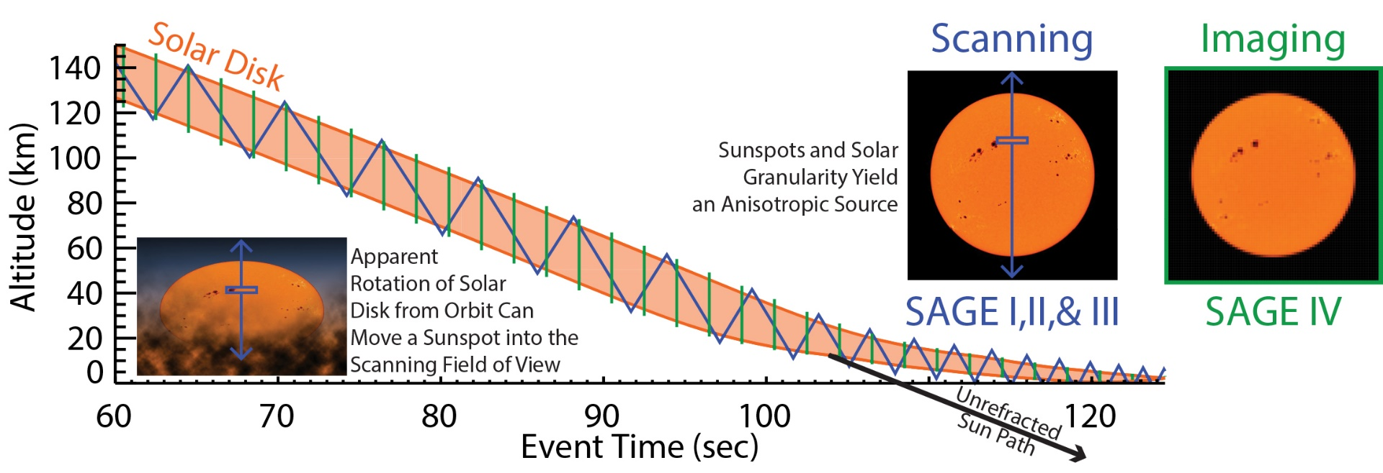
Why Imaging?
Challenges with Scanning | Benefits of Imaging
When using a scanning spectrometer, pointing knowledge becomes critical and subsequently requires heavy (~350 kg) and expensive mechanisms | Absolute pointing is intrinsic to solar imaging
Assumptions must be made about the instrument’s mechanical stability during an event. Linearity of scan mirror motion Azimuthal tracking expects a uniform image Non-orthogonal transient behaviors | No assumptions are required for tracking mechanisms as all that is needed is to keep the full solar disk inside the field of view (though not necessarily centered)
External meteorological data are required to compute refraction for tropospheric and lower stratospheric pointing | Atmospheric refraction is independently retrievable
Radiometric symmetry of the solar disk must be assumed | Anisotropy of the solar disk (e.g., sunspots and granularity) is measured

Slide 23
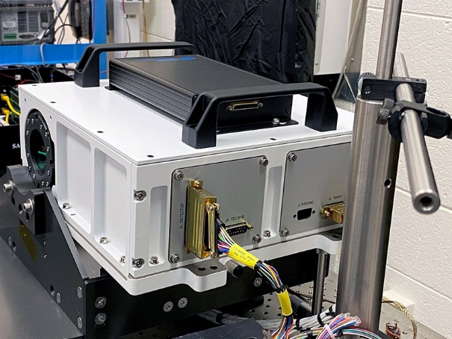
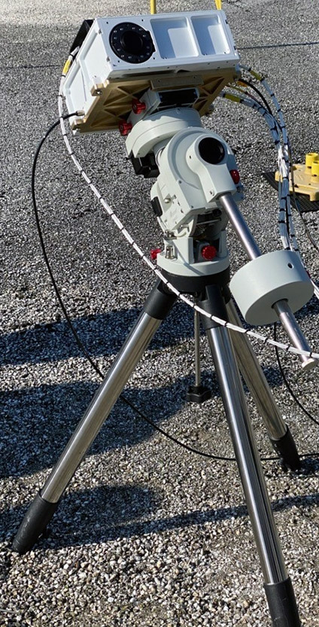
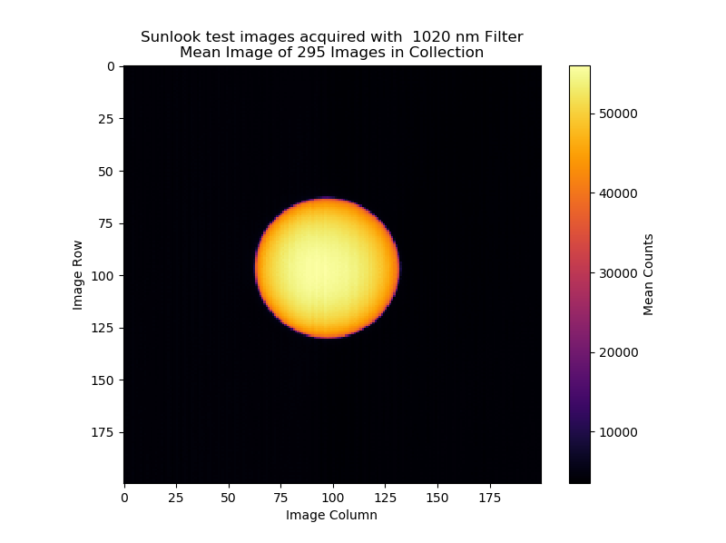
Instrument Testing
SAGE IV prototype integrated into surrogate chassis for testing.
Extensive system testing and characterization performed in laboratory clean room with calibrated light source.
Sunlook testing occurred outdoors with instrument surrogate chassis positioned on equatorial mount.
Closed-loop control of the system maintained the Sun in the instrument FOV.
Laboratory and Sunlook testing successfully assessed the integrated system performance.

Slide 24
SAGE IV IR: Hardware Changes
Necessary Changes from Vis/NIR instrument:
  Change detector from Silicon to MCT – Same family from same manufacturer
  Encase detector in a cold chamber – Simple design modification
  Cryocool detector and cold chamber – Small form-factor cryocoolers available
  Larger volume required for cooling hardware – Commercial 12U CubeSat
  Different science channels – Simple purchase from filter vendors
Thermal emission from internal hardware, optics in particular, creates additional source of noise and/or bias
  How much bias and/or noise is created?
  Is cooling the optics required?
  Is a cold window required?

Slide 25
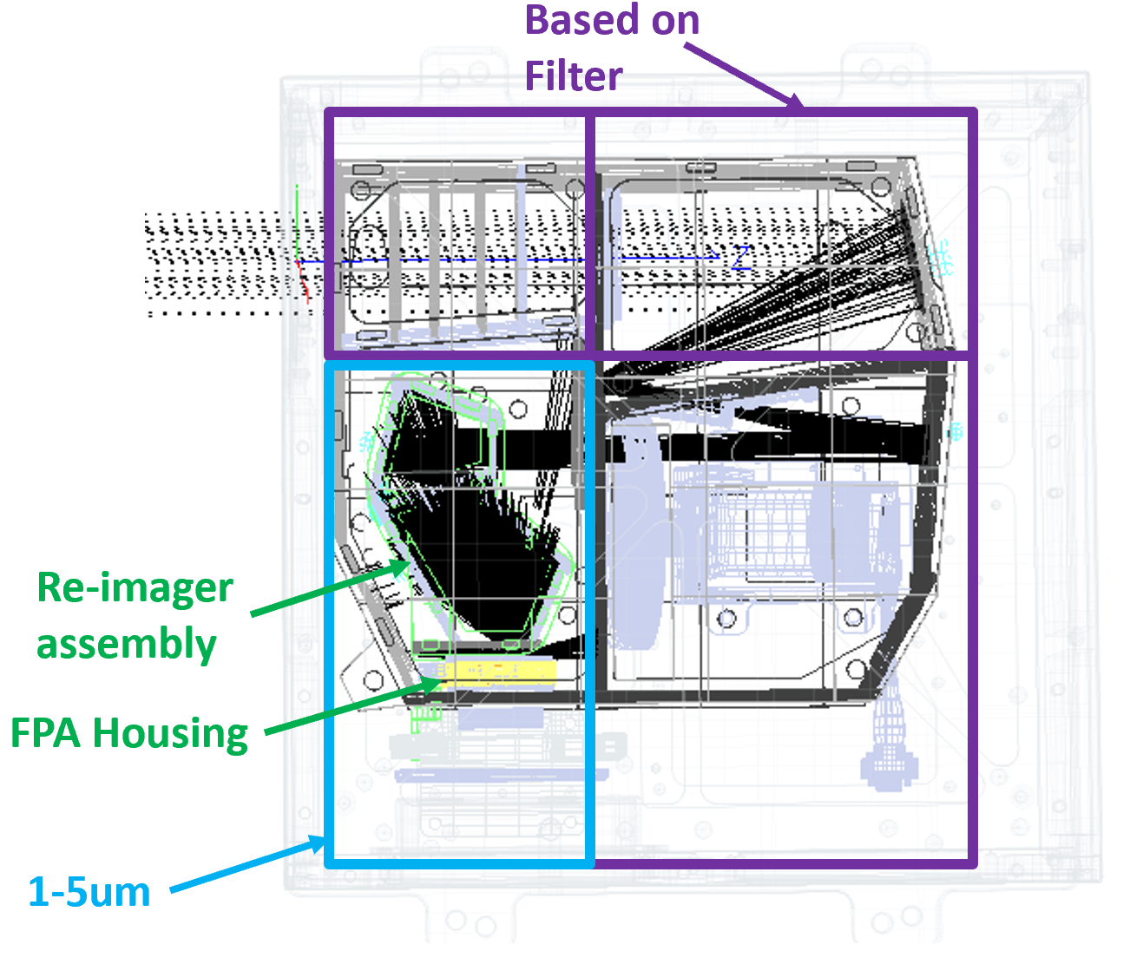
SAGE IV IR: Thermal Optical Modeling
MCT spectral sensitivity can be strongly restricted (1–5 µm)
Thermal Self Emission (TSE) contribution
  Front-end Optics “Beam Reducer”
  Back-end Optics “Reimager”
Beam Reducer
  Only TSE within a filter bandwidth makes it to detector
  Cannot* be measured during occultations so acts as a source of bias
  Ratio of TSE to solar flux is the quantity of interest
Reimager
  TSE across full detector spectral sensitivity makes it to detector
  Will be measured during occultations so acts as an offset and noise source
  TSE as a fraction of pixel well capacity is the quantity of interest

Slide 26
SAGE IV IR: TSE Modeling Results
In general, the “4 µm” version leaves little to be concerned about
TSE from the Reimager is 1–2 orders of magnitude larger than from the Beam Reducer (long wavelengths) yet of less concern because of active characterization
No cold window
  Reimager TSE noise is large but manageable, with SNRs ~ SAGE III/ISS
  Beam Reducer TSE bias* is too large at longer wavelengths (σ_{SYS} ~ 25×σ_{RAND})
Cold window (e.g., ND2)
  Reimager TSE scales with OD to negligible levels
  Beam Reducer TSE scales with OD to manageable levels (σ_{SYS} ~ σ_{RAND} / 10)
  Baffle/detector housing temperature sets noise floor
Self-characterization and simple design addition mitigate impact of TSE

Slide 27
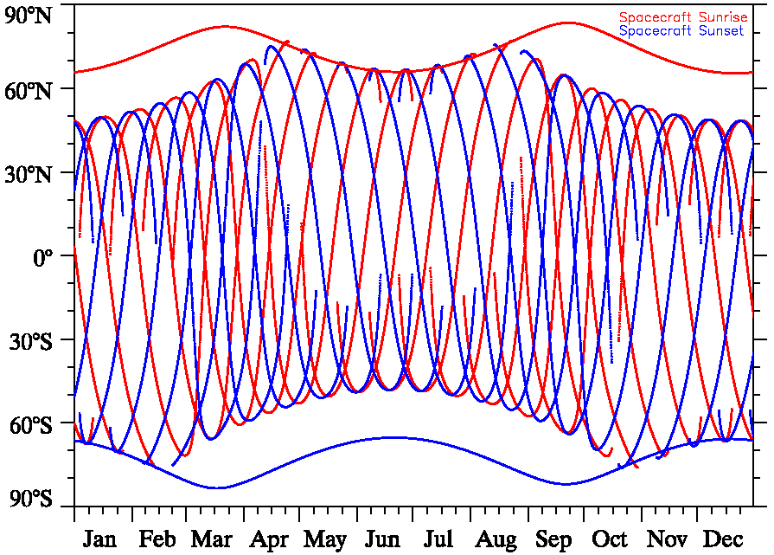
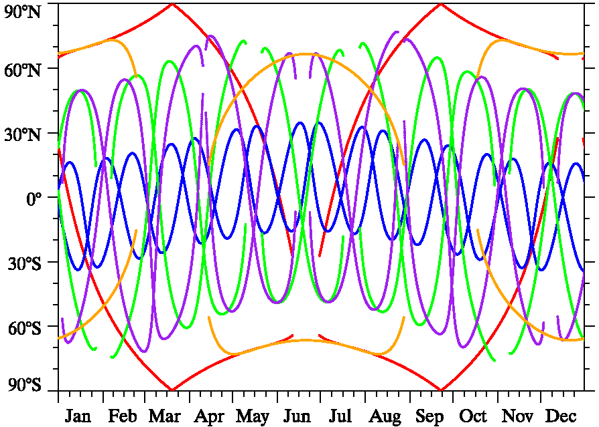
Examples of multiple instruments

