Slide 1
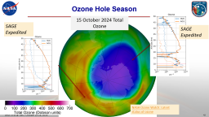
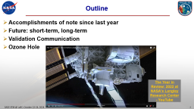

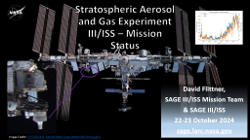
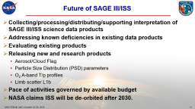
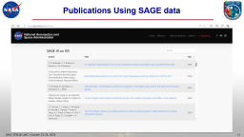
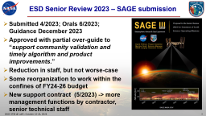

Slide 2
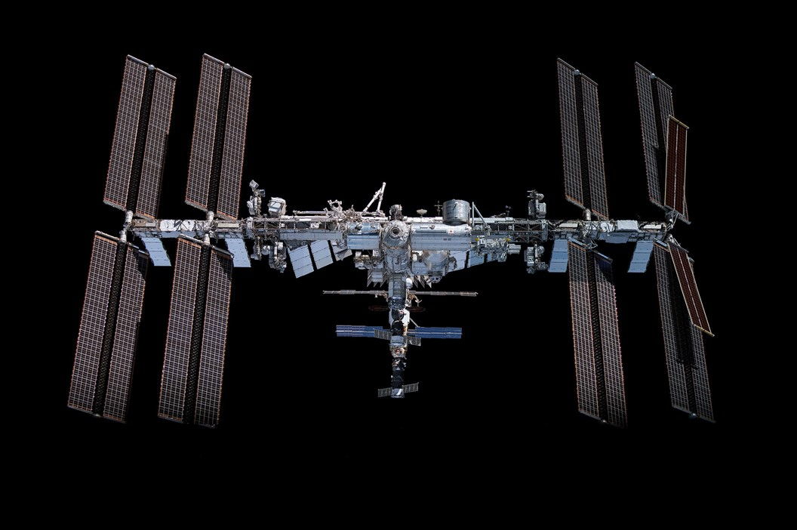

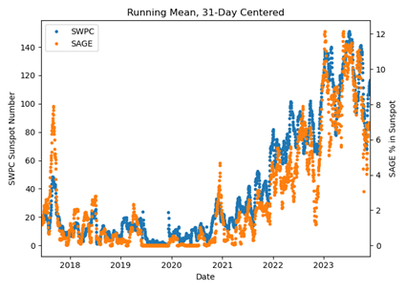
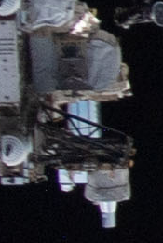
Stratospheric Aerosol and Gas Experiment III/ISS – Mission Status
David Flittner,
SAGE III/ISS Mission Team
& SAGE III/ISS
22-23 October 2024
sage.larc.nasa.gov
Image Credit: 51752252125_be036501b8_k.jpg (2048×1361) (nasa.gov)
Notes:
Observe the instrument in the Space Walk photo.

Slide 3
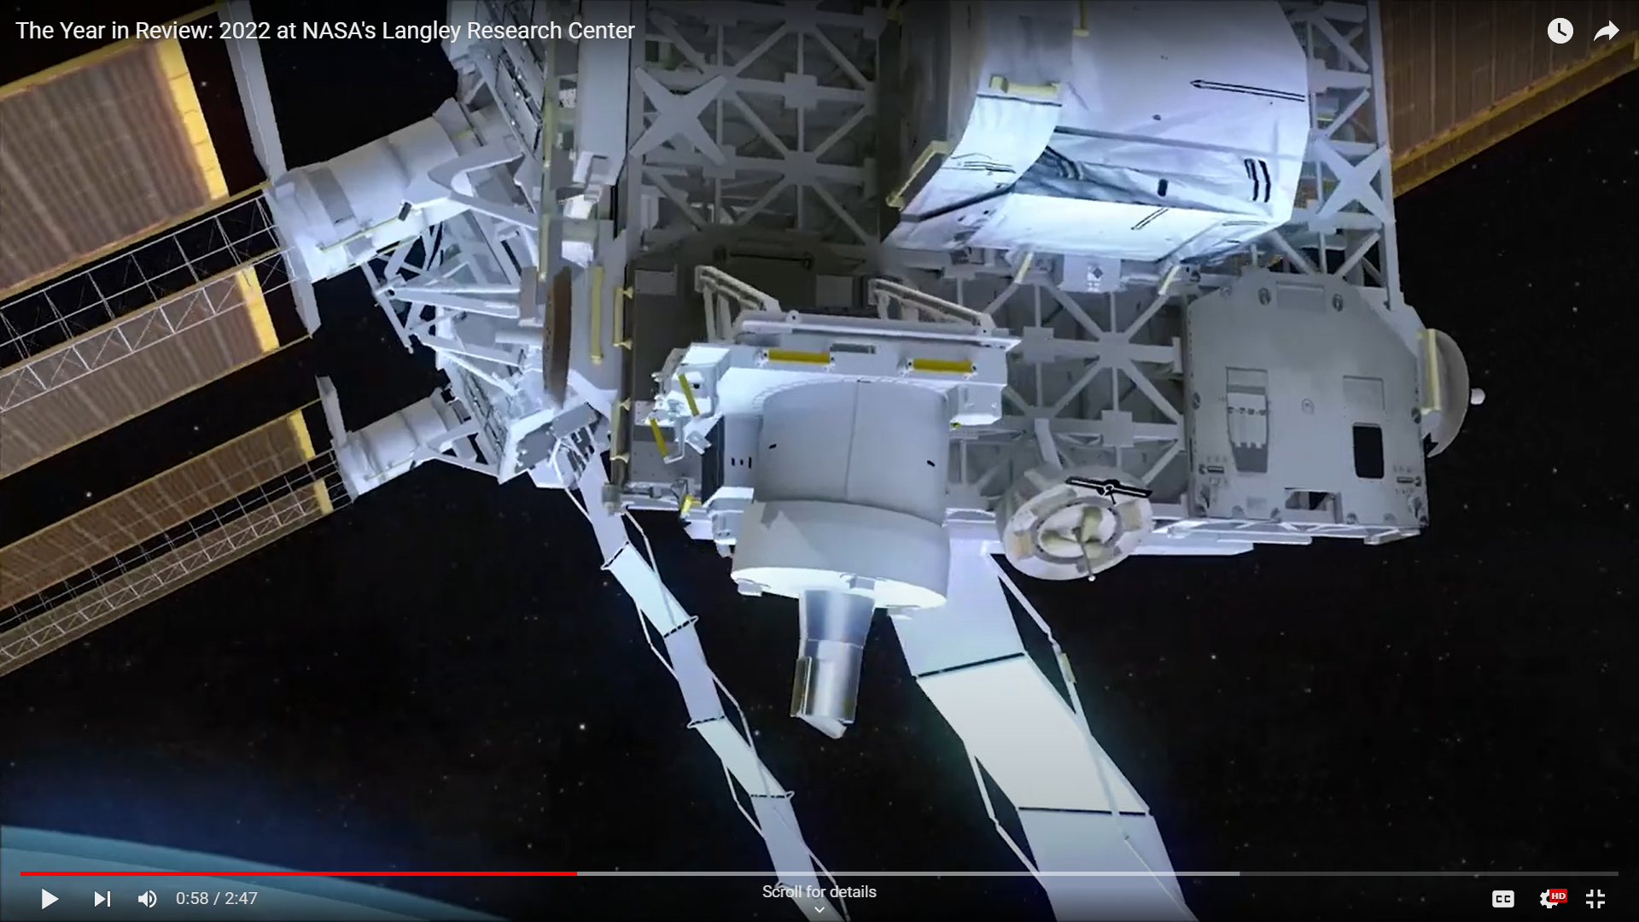
Outline
Accomplishments of note since last year
Future: short-term, long-term
Validation Communication
Ozone Hole
The Year in Review: 2022 at NASA's Langley Research Center - YouTube

Slide 4
SAGE III/ISS STM - Thank You!
Thank you to Allison McMahon & Tracy May for planning, organizing and making it happen!
Thank you to Jun Wang & Rich Ekman for crafting the meeting.
Thank you for taking the time to join the meeting and contributing to science advancements fueled by SAGE data and your curiosity.

Slide 5
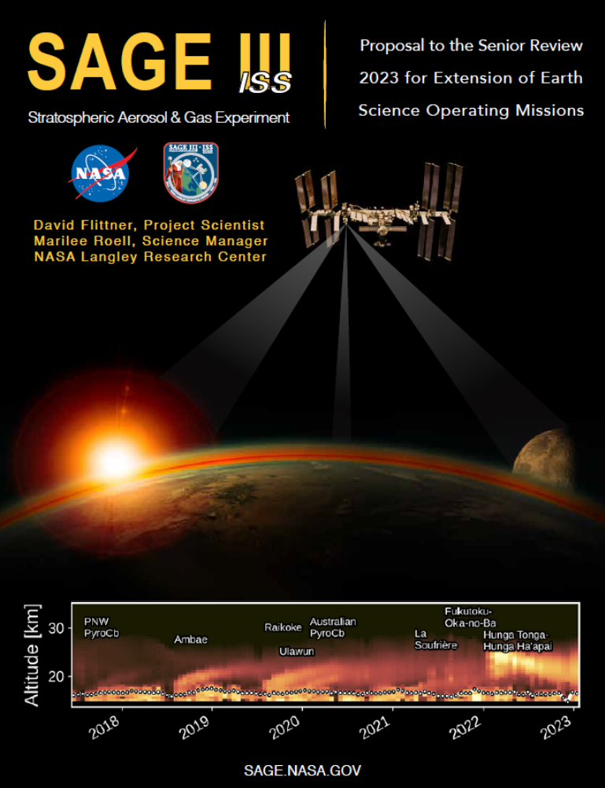
ESD Senior Review 2023 – SAGE submission
Submitted 4/2023; Orals 6/2023; Guidance December 2023
Approved with partial over-guide to “support community validation and timely algorithm and product improvements.”
Reduction in staff, but not worse-case
Some reorganization to work within the confines of FY24-26 budget
New support contract (5/2023) -> more management functions by contractor, senior technical staff

Slide 6
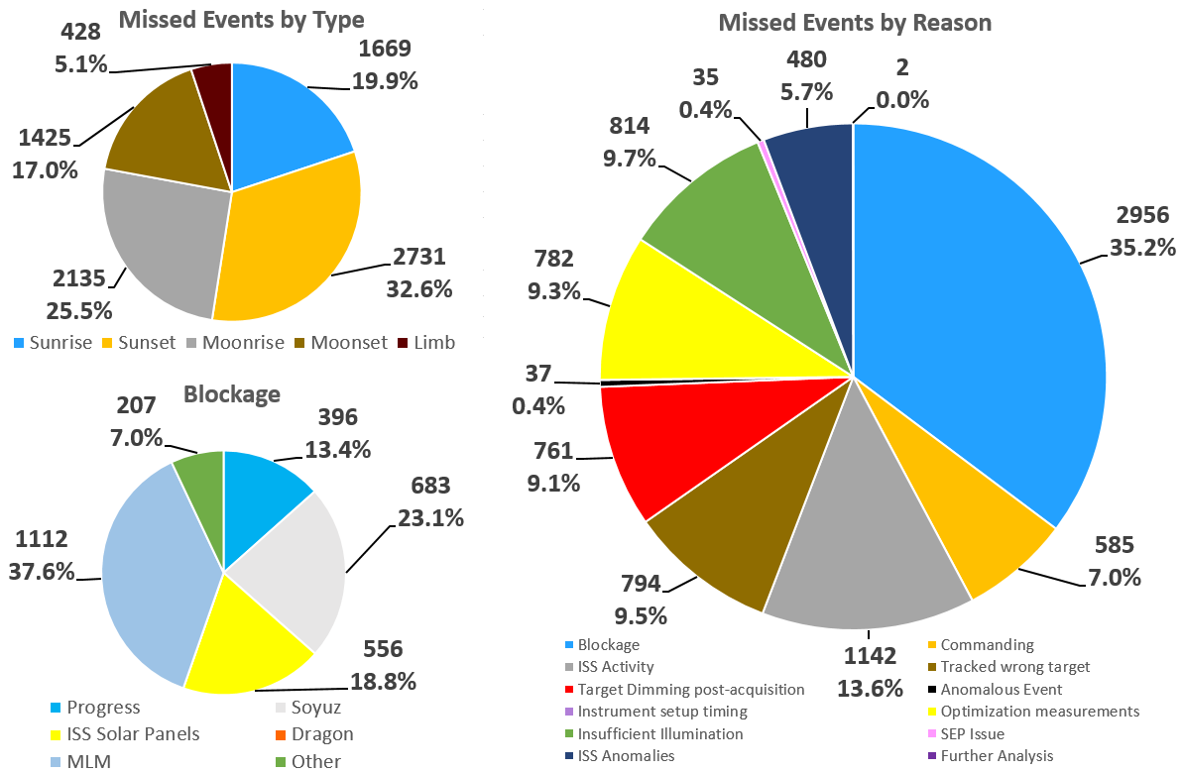
Extended Mission – Missed Events
See presentation by:
Jamie Nehrir: Operations

Slide 7
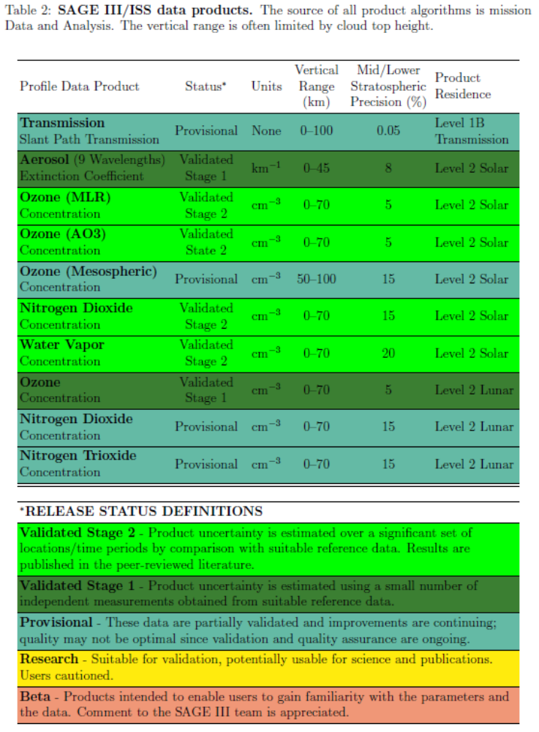
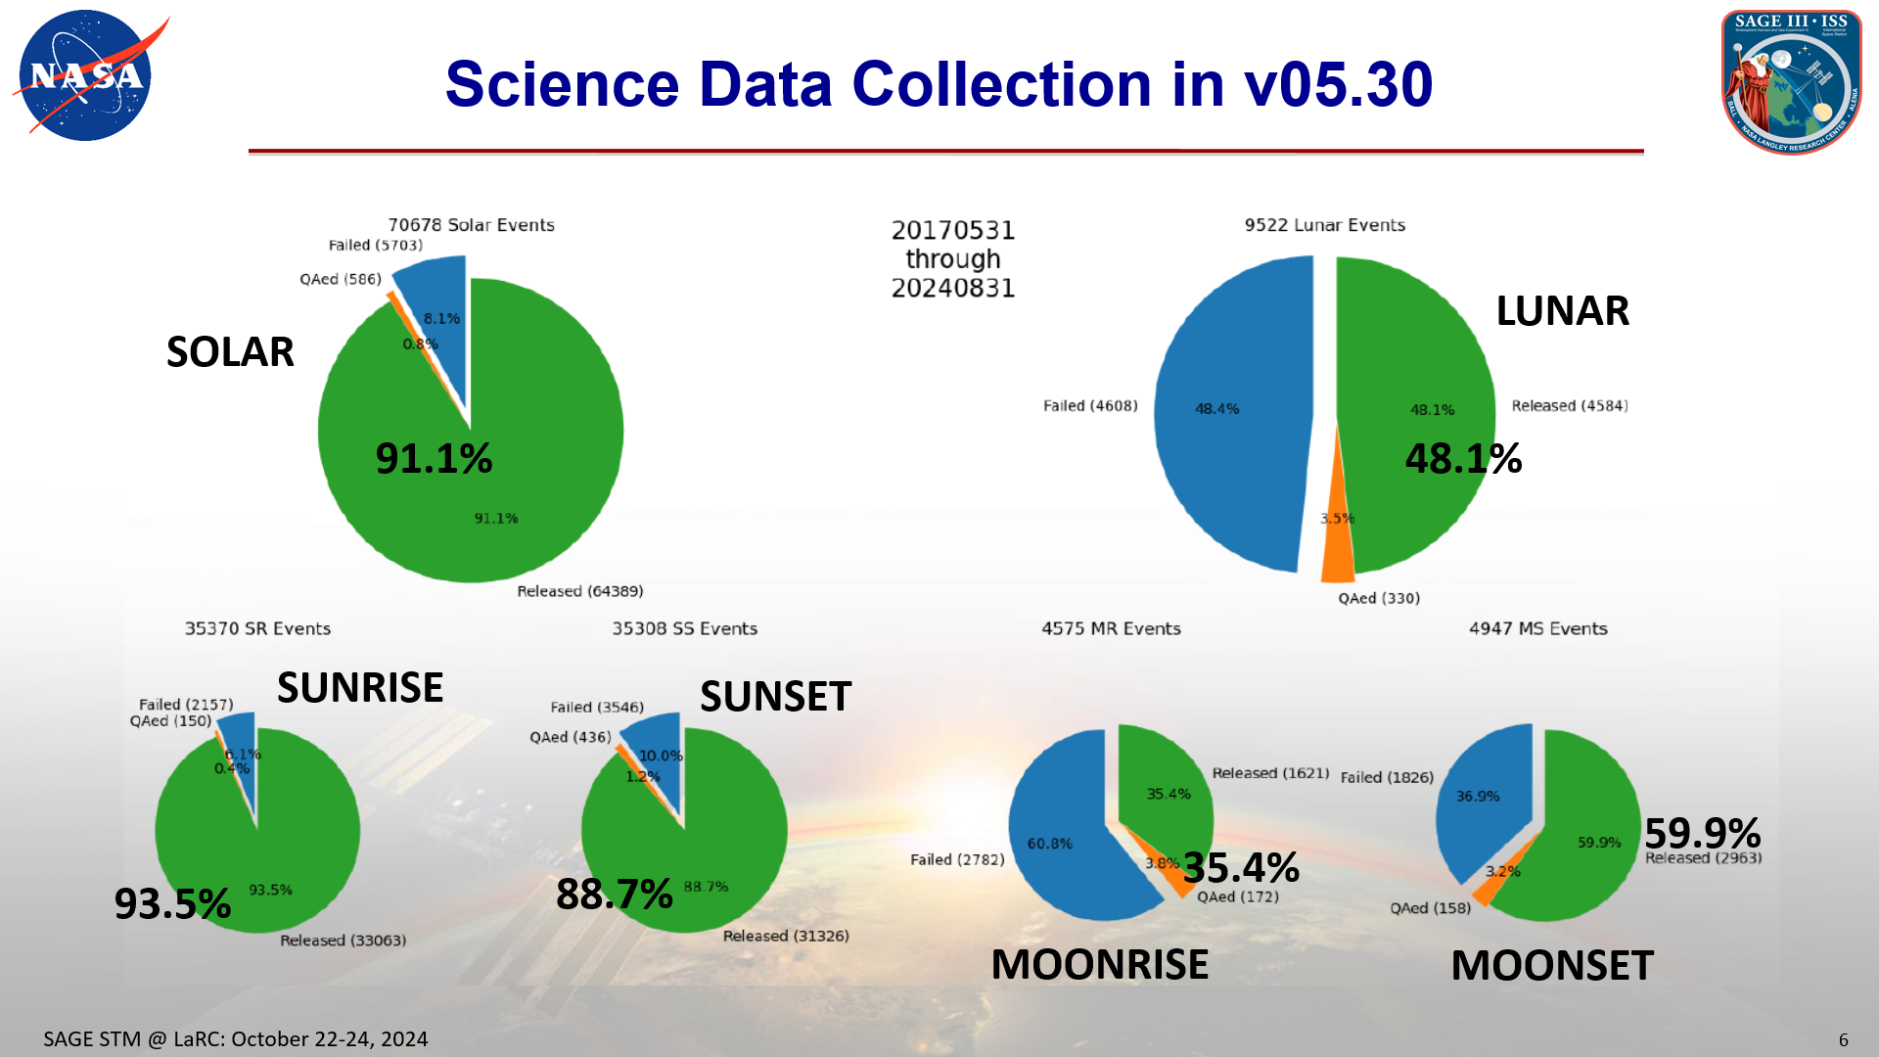
Data Processing and Distribution
v5.3 Level 1 & 2 released February 2023
  v5.2 still available through Jan. 31, 2023
Looking forward to next version
See presentation by:
Robbie Manion: Algorithm

Slide 8
Interns
NASA Internship and Fellowship opportunities: NASA Intern
SAGE III/ISS has a vibrant & sought-after internship program
  Typically 3-5 interns during summer
Interns work on real tasks benefiting the SAGE III/ISS mission
Fantastic program teaching necessary skills/habits for successful science/engineering careers, e.g.:
  Python programing
  Configuration management (git)
  Self documenting code techniques
  Linux shells and scripting
Always looking for exceptional candidates – Dr. Charles Hill

Slide 9
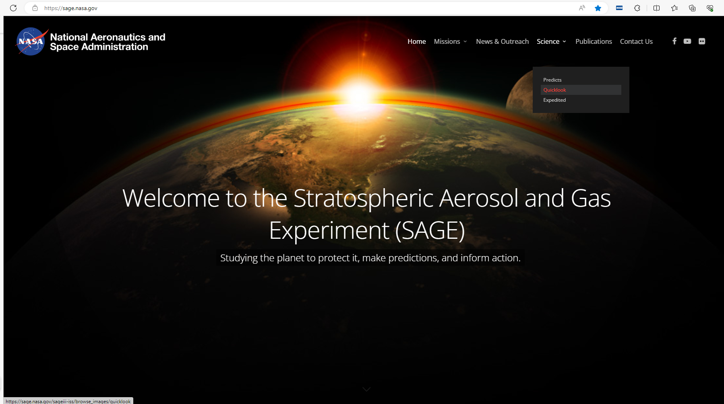
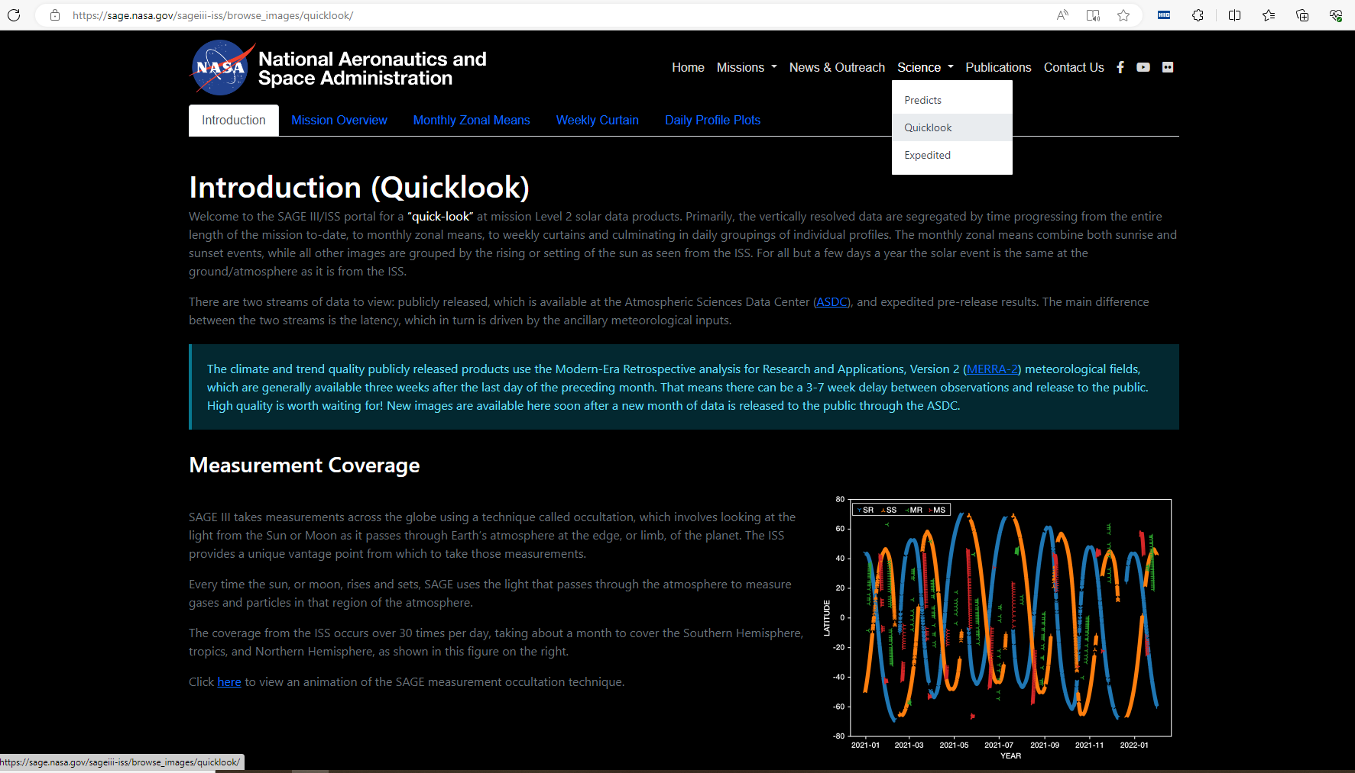
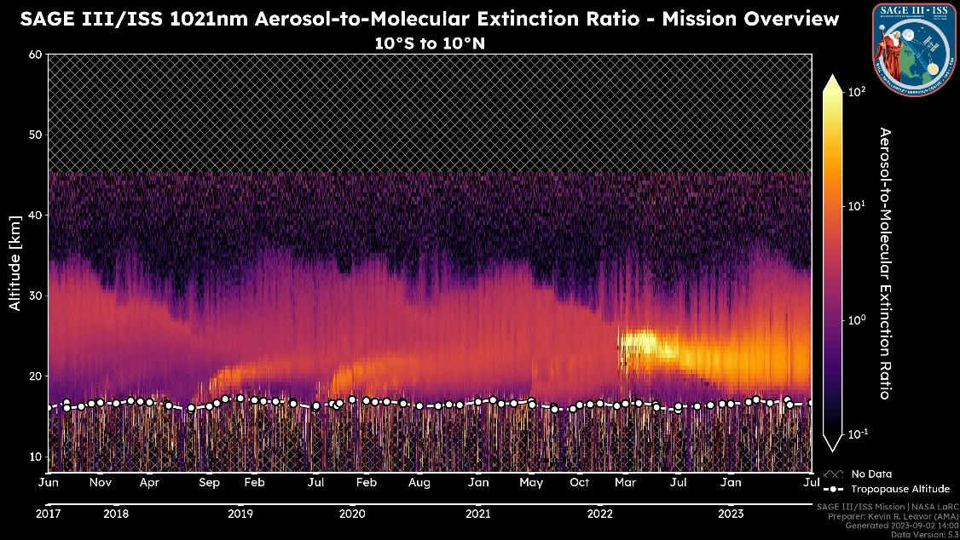

Mission Webpage Support & Innovate
For more details see presentation by K. Leavor Wednesday afternoon
A chief architect of website was Danny Mangosing - sadly, passed away 7-4-2023
  Fantastic contributor to many LaRC science missions

Slide 10
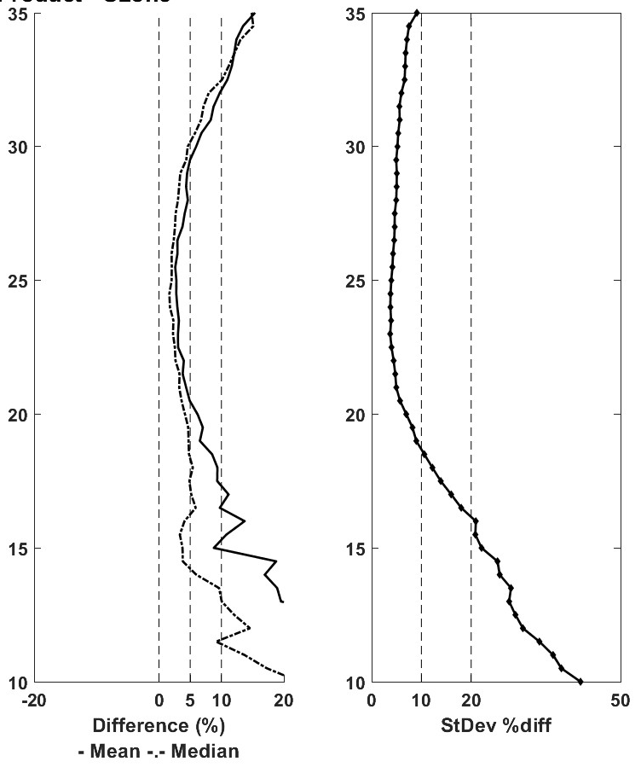
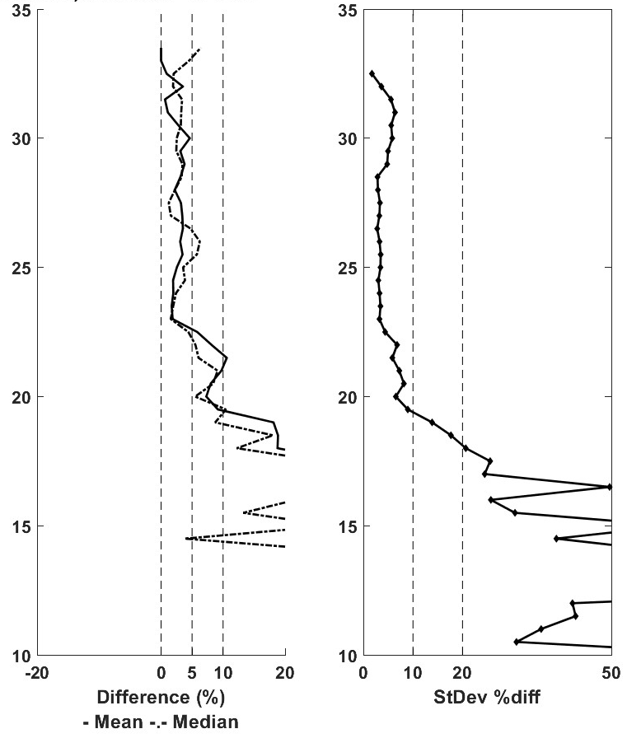
Ground-based Correlative Measurements Help Assess Algorithm Improvements
35
35
Ozone: SAGE vs. All Sondes
Ozone: SAGE vs. Costa Rica
More details and improved graphics Wednesday afternoon by M.C. McKee
25
25
ALTITUDE [km]
~ 5%
ALTITUDE [km]
15
15
0
10
Thanks for using the overpass website to improve coincidences.

Slide 11
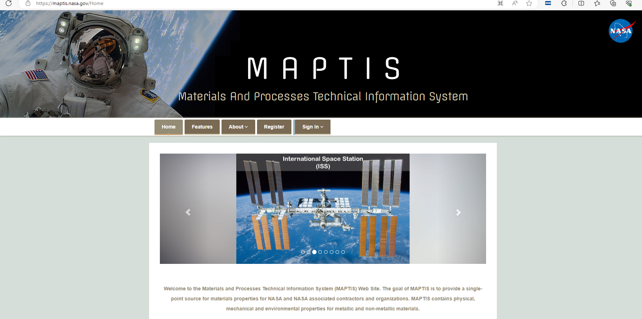
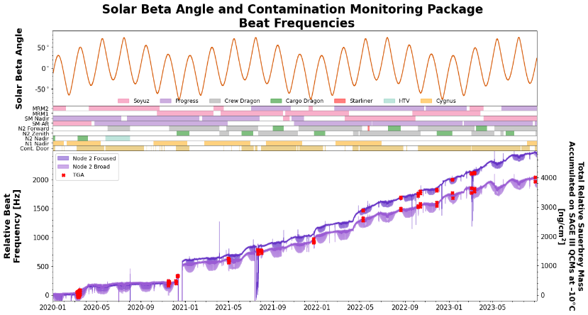
Contamination Monitoring Package Data
Data from the Contamination Monitoring Package (CMP) is available for NASA approved users via the Materials and Processes Technical Information System (MAPTIS)
  Satellite Contamination and Materials Outgassing Knowledgebase

Slide 12
SAGE III/ISS Mission Teams
Management – Marilee Roell, Dave Flittner, Sherry Beimler, Charles Hill
Operations – Jamie Nehrir, Sam Porter, Caitlyn Stone, Donald Cleckner, James Losey, Kenta Funada
Ground Systems – Greg Paxton, Andrew Peterson, Jim Farmer, Rick Farmer
Science – David Flittner, Charles Hill, Kevin Leavor, Mary Cate McKee, Mahesh Kovilakam, Travis Knepp, Mike Pitts
Science Processing – Rob Damadeo, Robbie Manion, Mike Heitz, Marsha Larosee
Validation - Kevin Leavor, Mary Cate McKee, Caitlyn Stone
Public Engagement – Allison McMahon
Web Development – Rick Farmer, Jim Farmer, Kevin Leavor
Emergencies – Kaitlin Liles, Shane Wolf, Tom Johnson

Slide 13
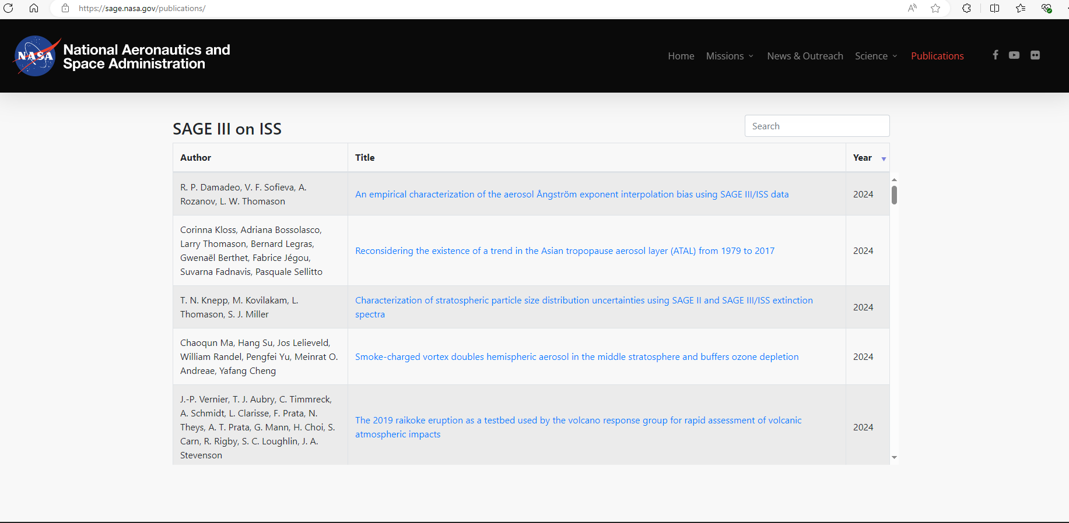
Publications Using SAGE data

Slide 14
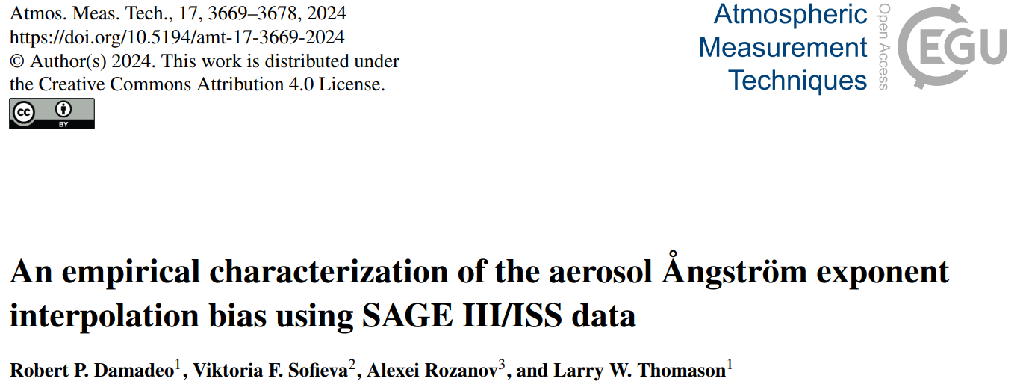
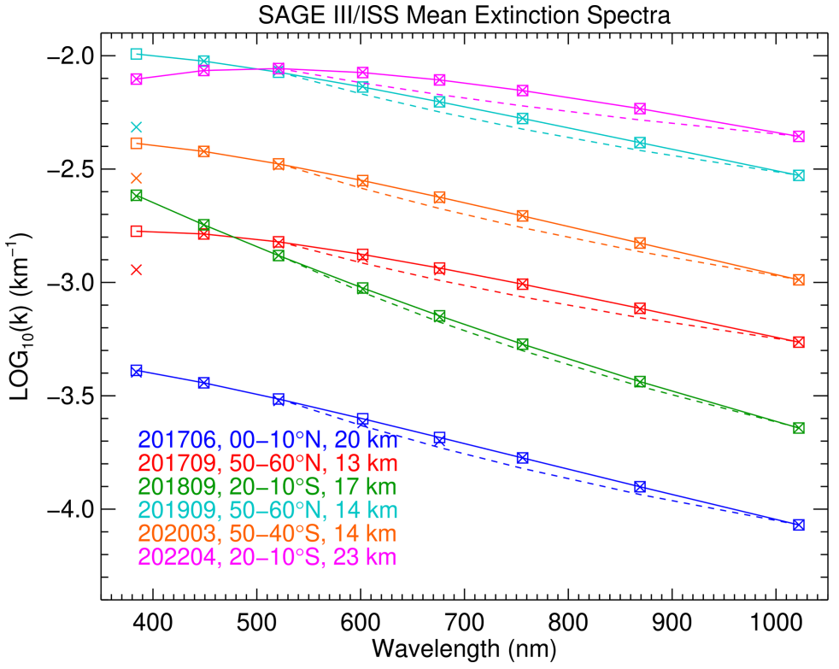
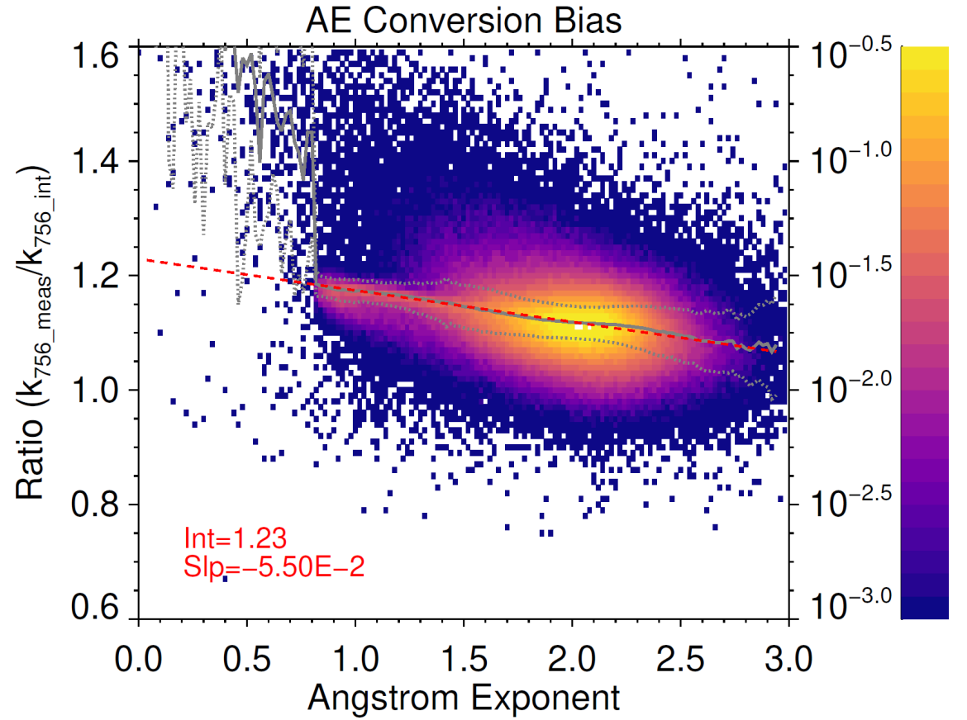
Aerosol Spectral Behavior

Slide 15
Future of SAGE III/ISS
Collecting/processing/distributing/supporting interpretation of SAGE III/ISS science data products
Addressing known deficiencies in existing data products
Evaluating existing products
Releasing new and research products
  Aerosol/Cloud Flag
  Particle Size Distribution (PSD) parameters
  O₂ A-band T/p profiles
  Limb scatter L1b
Pace of activities governed by available budget
NASA claims ISS will be de-orbited after 2030.

Slide 16
Important planned activities for the next 3-yrs
Supporting the 2026 WMO International Ozone Assessment
  Release improved Solar/Lunar products (CY2024)/ support interpretation of data
Review Level 1 processing for best practices based on SAGE II
Determine root cause of aerosol extinction coefficient low bias in 500-700 nm range
  Leading candidate is 1-2% overestimate of ozone.
Examine product’s sensitivity to increased aerosol loading (HTHH)
Introduce research and new products
Continue routine data collection and public distribution
Bridging current climate observing system to future sensors
  Especially ozone and water vapor
Vibrant internship program: Engagement Opening: SAGE III ISS Mission Science Internship (nasa.gov)

Slide 17
Updated Products
Improvements, in priority order:
  Aerosol Biases – Examine with goal to significantly reduce/eliminate; most likely linked with ozone retrieval
  Aerosol interference in trace gases – Examine sensitivity to increased aerosol loading (not seen during M3M)
  H₂O – Explore methods to reduce noise
  NO₂ Biases – Improved spectroscopy
  Homogeneity Assumption – Incorporate dependence in retrieval (NO₂ most likely candidate)
  Mesospheric Ozone – Improve stray light correction and modeling for strong absorption across channel
  Lunar Altitude registration – more robust
  Lunar NO₂/NO₃ – Reduce noise; improved spectroscopy (based on solar experience)
See presentation by:
Robbie Manion: Algorithm

Slide 18
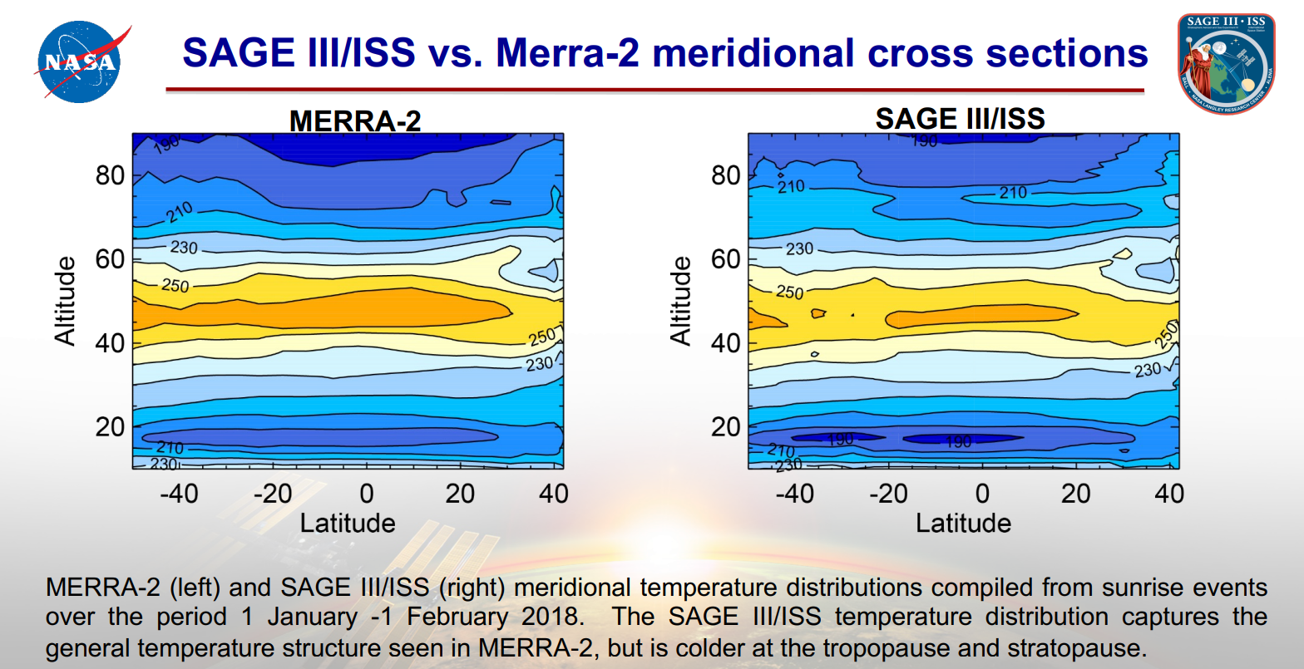
Research Products
Birthing research products like the temperature/pressure profiles derived from oxygen-A band absorption can be released independently.
T/p for SAGE III/M3M mission not successful - caused by latent issues in the instrument.
Those were remediated in the SAGE III/ISS version and performance is greatly improved over the previous mission.
  See presentation at 2023 STM by M. Pitts on current performance.
  Working with SCF to produce, evaluate & (most likely) release T/p within the next ~1 yr. (timing of releasing new products is impacted by the level of staffing enabled by funding.)
The limb scatter level L1b requires more work on the area of stray light correction in order to feel comfortable widely distributing (progress to date relied on summer interns and excellent they have been). 2024 summer focused on incorporating DMP attitude data; continues this 2024 fall with intern Riley Runyon (W & J).
Notes:
Birthing research products like the temperature/pressure profiles derived from the oxygen-A band absorption will not be tied to the 2nd revision and can be released whenever they are mature enough for our colleagues to spend their time looking at the data. In particular, this product encountered significant challenges for the SAGE III/M3M mission caused by latent issues in the instrument. Those have been addressed in the SAGE III/ISS version and the results are greatly improved over the previous mission – temperature profiles look very good but there is a significant pressure bias (maybe caused by the representation of the instrument in the forward model). Again, the timing of releasing new products is impacted by the level of staffing enabled by funding.
The limb scatter level L1b requires more work on the area of stray light correction in order to feel comfortable widely distributing (progress to date relied on summer interns and excellent they have been). However, as mentioned in the ROSES call for the next SAGE III/ISS science team (due Nov. 3, 2023) data is available on request for those wishing to prepare proposals.
It was not mentioned in the proposal, but the mission is planning to add a new product to the monthly release that should help the user screen the aerosol extinction profiles for cases contaminated by clouds. This utilizes an algorithm developed by Kovilakam et al. (2023) to improve the cloud clearing in the Global Satellite Stratospheric Aerosol Climatology (GloSSAC). The hope is to have this included by the end of CY23.

Slide 19
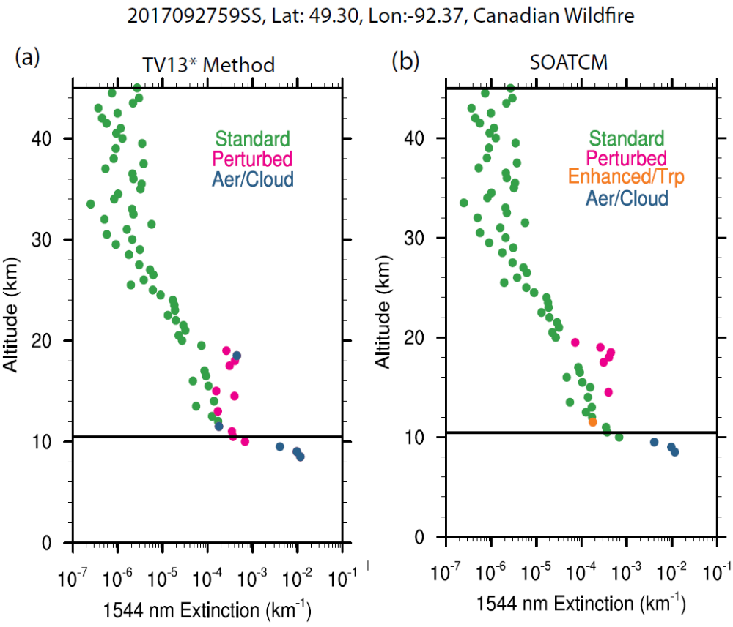
New Products -1
It was not mentioned in the proposal, but the mission is planning to add a new product to the monthly release that should help the user screen the aerosol extinction profiles for cases contaminated by clouds.
This utilizes an algorithm developed by Kovilakam et al. (2023) to improve the cloud clearing in the Global Satellite Stratospheric Aerosol Climatology (GloSSAC). The hope is to have this included early CY24.
Courtesy M. Kovilakam
Notes:
It was not mentioned in the proposal, but the mission is planning to add a new product to the monthly release that should help the user screen the aerosol extinction profiles for cases contaminated by clouds. This utilizes an algorithm developed by Kovilakam et al. (2023) to improve the cloud clearing in the Global Satellite Stratospheric Aerosol Climatology (GloSSAC). The hope is to have this included by the end of CY23.

Slide 20
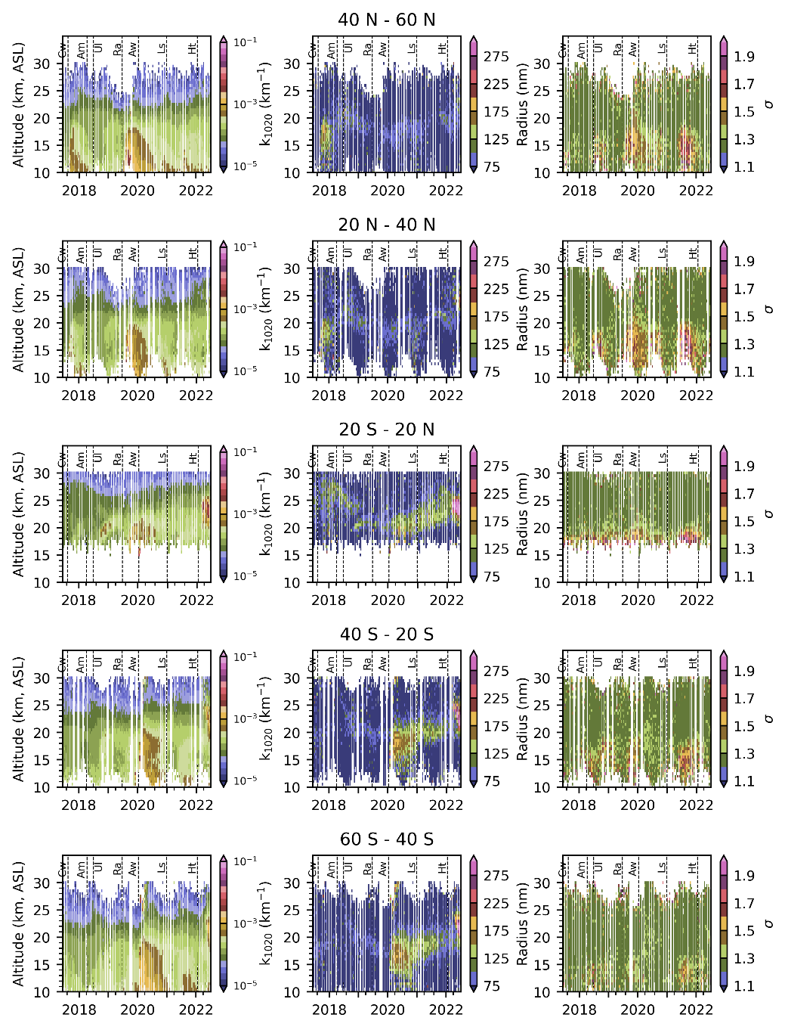
New Products - 2
Implementation Knepp et al. (2024) algorithm for particle size distribution parameters
Plan is to incorporate this into the routine processing, similar to what was done for the aerosol/cloud flag, and include in a future version of the Level 2 solar products.
In the meantime, Knepp is processing separately and making data products available via ASDC as part of the above publication
Courtesy T. Knepp

Slide 21
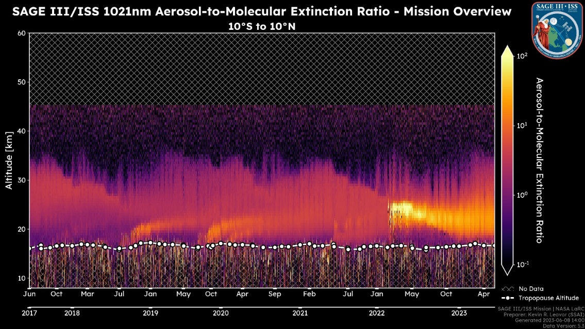
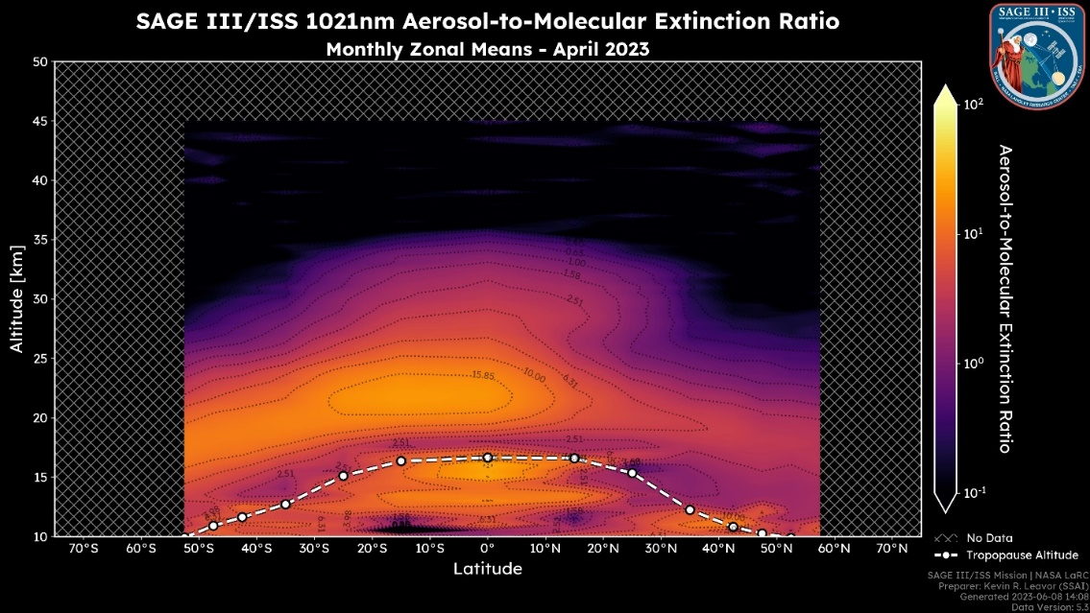
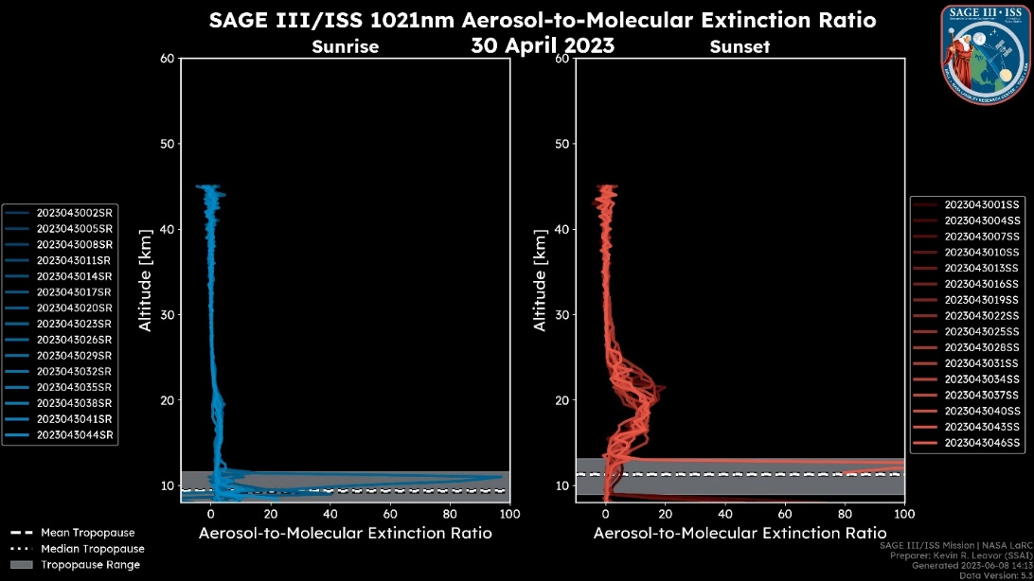
Mission will continue to support Quicklook & Expedited Portals as resources allow
Mission Summary
Monthly Zonal Mean
Daily Profiles

Slide 22
Topic for Discussion
What are your recommended priorities over the next 3 yrs for the algorithm/data product teams?

Slide 23
Summary
SAGE uniquely provides geophysical reference standards for vertically resolved stratospheric concentrations of ozone, water vapor, nitrogen dioxide, and multi-wavelength aerosol extinction coefficient.
SAGE III/ISS datasets have matured notably and are widely used for reference, science investigations (synergistically with other datasets and/or models) and trend studies.
SAGE III/ISS is in excellent position to extend the uniquely valuable science records throughout this decade, improve their quality and bridge to future missions.
2023 ESD Senior Review rated SAGE III/ISS as Excellent/Very Good and confirmed the mission exclusive contributions to the climate observing system.
ESD leadership augmented in-guide FY24-26 budget for additional activities:
  Perform algorithm sensitivity studies
  Continue coordination of community ground-based correlative measurements
Mission thanks ESD review leaders and Senior Review Panel Members for their dedication to a through review and providing useful feedback.

Slide 24
SAGE III/ISS Validation Communications
Caitlyn Stone
NASA Langley Research Center
10/22/2024

Slide 25
Validation Efforts
The validation team has continued efforts to validate the SAGE III/ISS data product against in-situ & satellite measurements collected via a variety of sources
Ground-Based Measurements: Lidar & Sonde Data
  Actively participating NDACC, SHADOZ, and WOUDC stations
Satellite-Based Measurements
  Aura Microwave Limb Sounder (MLS) v5
  Atmospheric Chemistry Experiment Fourier Transform Spectrometer (ACE‐FTS) v5.2
  Ozone Mapping and Profiler Suite (OMPS) Limb Profiler (LP) v2.6

Slide 26
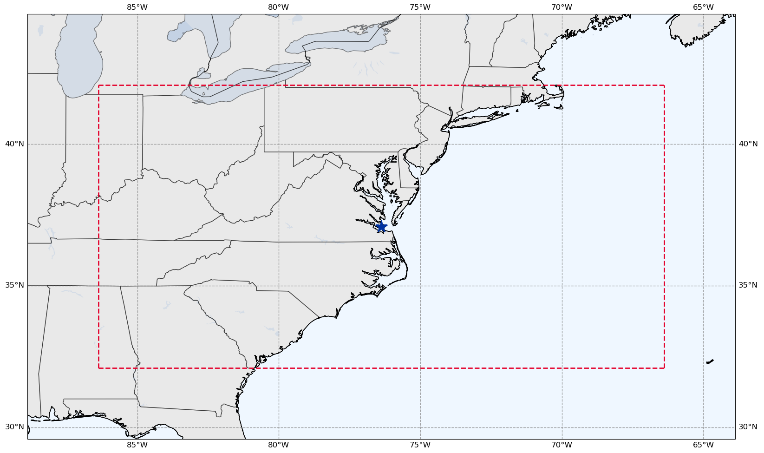

Validation Criteria
Species of Interest: Ozone, Water Vapor
  Plan to include Nitrogen Dioxide & Aerosol
Coincidence Criteria:
  ± 24 Hours
  ± 5 Deg Latitude
  ± 10 Deg Longitude
SAGE III/ISS Event Types:
  Solar Occultation
  Plans to include lunar
  occultation & limb events
Langley Research Center
(37.09N, 76.38W)

Slide 27
SAGE III/ISS Predictions
SAGE III/ISS has a public facing website that allows users to input coordinates & timeframes to view any SAGE III/ISS events that match the selected criteria.
  https://science-data.larc.nasa.gov/sage-data/validation/
    Note the URL change from previous years
    Previous URL should redirect to the new one
Prediction Website Curator: SAGE III/ISS Ground Systems
  Rick Farmer

Slide 28
Contact Information
If you’re interested in receiving weekly emails and/or long-term predictions or have any questions comments, concern, feedback, etc., contact the SAGE III Validation Team at:
  larc-dl-sage-predictions@mail.nasa.gov
Please include the following for predictions:
  Station Name and Location (Lat. & Lon.)
  Email addresses of everyone to receive the predictions
  Duration of predictions you’d like to receive
    i.e: Short Term (3 Weeks) or Long Term (6 Months)

Slide 29
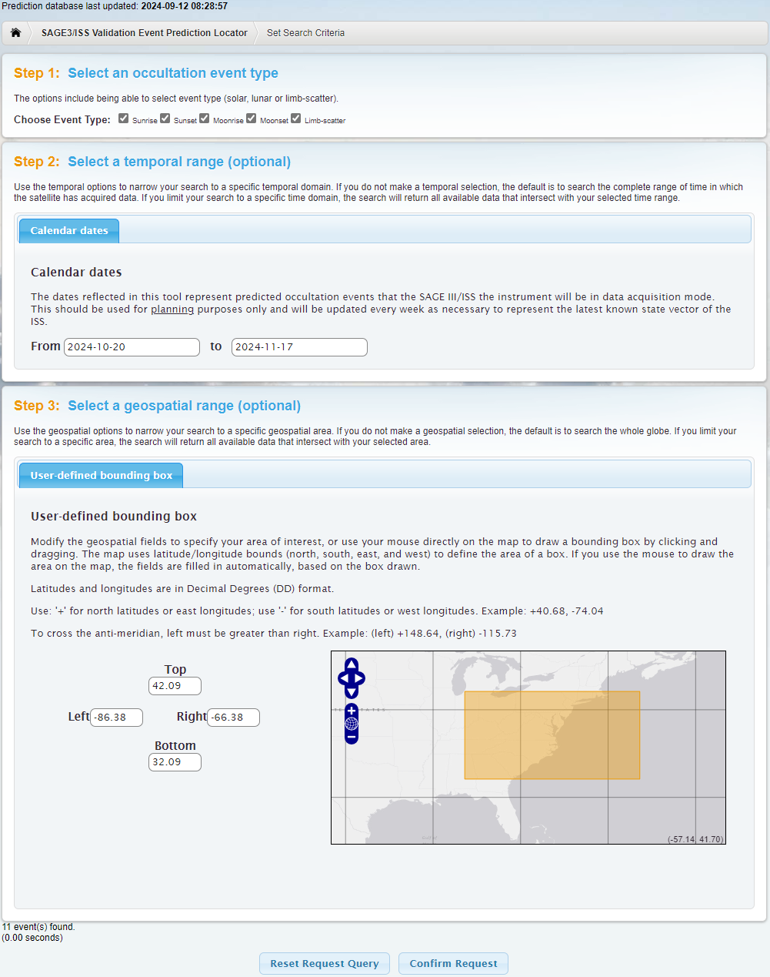
SAGE III/ISS Predictions
Choose Event Type(s)
  Sunrise, Sunset, Moonrise, Moonset, and/or Limb-Scatter
    Note: Limb-scatter events currently not shown in predictions
Select a Data Range
  2024-10-20 to 2024-11-17
Select an Area
  Using LaRC as the center point with the coincidence criteria as the bounds
Click “Confirm Request”

Slide 30
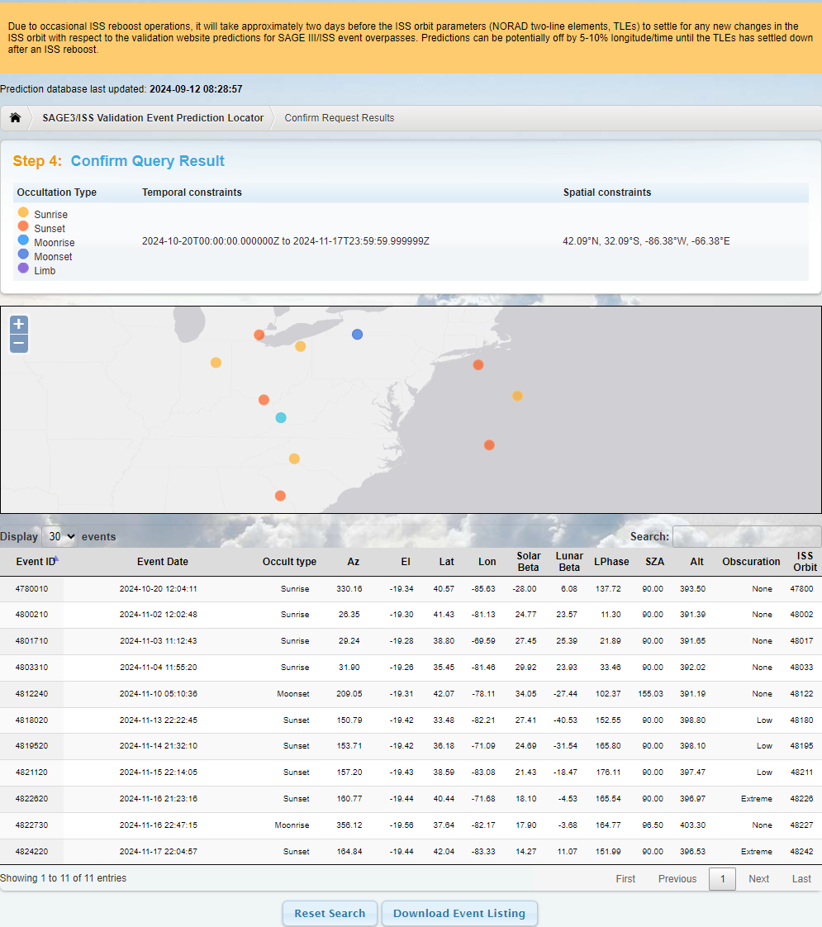
SAGE III/ISS Predictions
Reboost warning banner
Date prediction database was last updated
Occultation Type selected and user input Temporal & Spatial Constraints
Map of predicted events
Table of predicted events
  Includes additional information
Button to Download Events
  Downloads as a text file

Slide 31
Interested in Participating in Validation Efforts?
Interested in participating in validation efforts but don’t have the time to dive into the website to plan for coincident events?
  The Validation Team can bring weekly updates directly to YOU
Each participating station or PI will receive weekly emails. Emails Include:
  Coincident measurements approximately 3 weeks out
    Ensure the accuracy of the SAGE III/ISS event predictions & allows stations to have advance planning for possible coincident measurements.
  Upcoming activities that may affect predictions & science data collection
The SAGE III/ISS Team is always looking to add new participants

Slide 32
Long Term Event Predictions
Long term predictions are available on the Validation website and via email to interested stations & PIs
Long term predictions are useful for long term planning but come with the caveat that the events are likely to shift in time & location
Predictions are approximately 6 months out but are not guaranteed
  Highly variable in both time & space due to activities in the coming months that can affect predictions

Slide 33
Activities that Affect Predictions
ISS Re/Deboosts
  Needed periodically for altitude maintenance
  Predictions may be slightly skewed in time & location until ISS TLEs have settled
    Typically takes 2-4 days for TLEs to settle out following re/deboosts
  Detailed in weekly emails and noted on the prediction website via warning banner
Blockages
  Visiting Vehicles, Modules, or Solar Panels can obstruct the view of SAGE III/ISS
  Blockage levels are: None, Low, Medium, High, & Extreme
    High & Extreme levels of blockages may still acquire but are not guaranteed
Station Activities & Maneuvers
  May sometimes miss events for scheduled activities & large attitude changes
  Activities & maneuvers that affect events are detailed in weekly emails

Slide 34
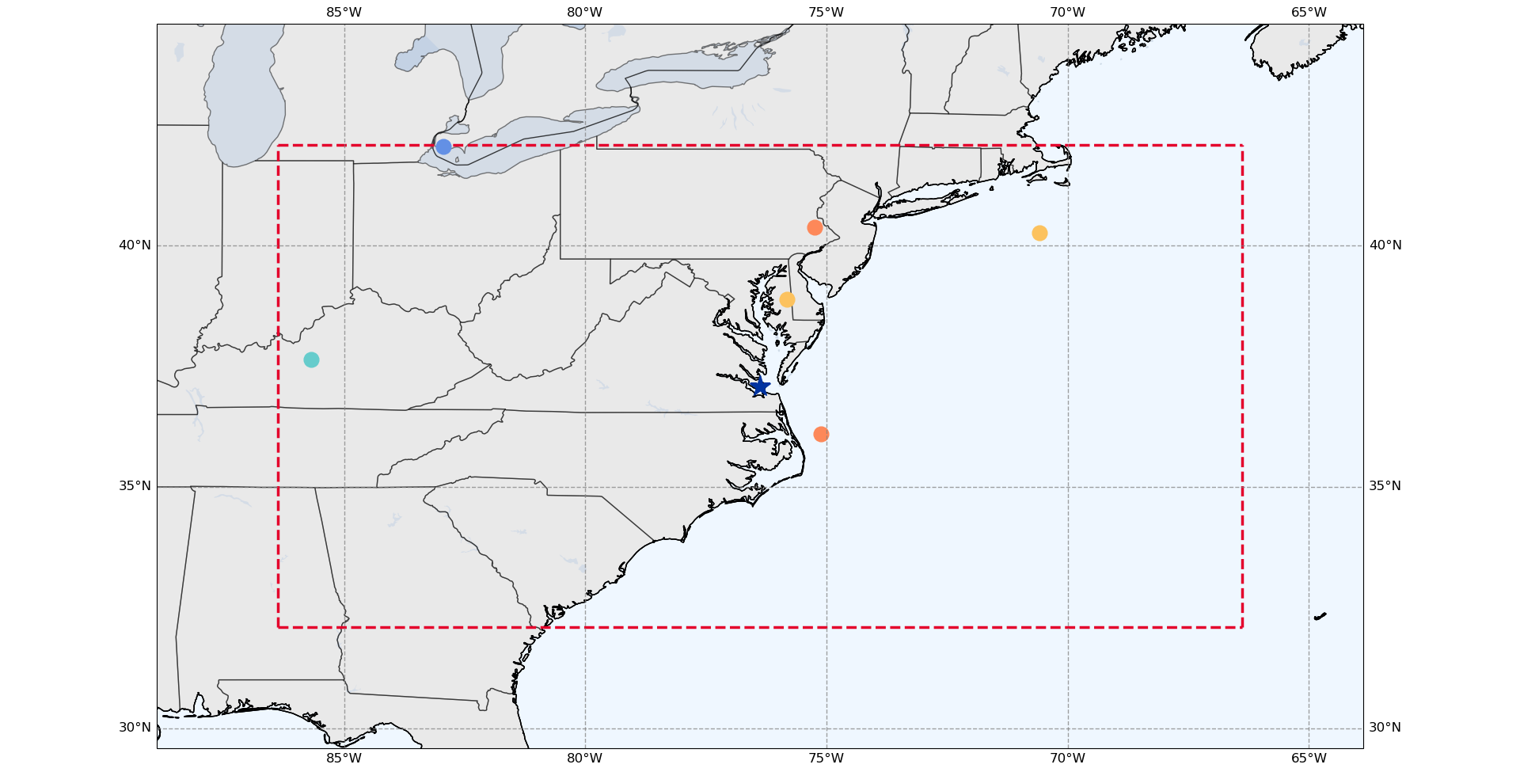
Predicted Events Before Reboosts
Oct. 20 – Nov. 17, 2024
Moonrise
16 Nov 2024 23:01:43
(37.64, -85.68)
Prediction File Generated: 2024-08-21
● Sunrise ● Sunset ● Moonrise ● Moonset

Slide 35
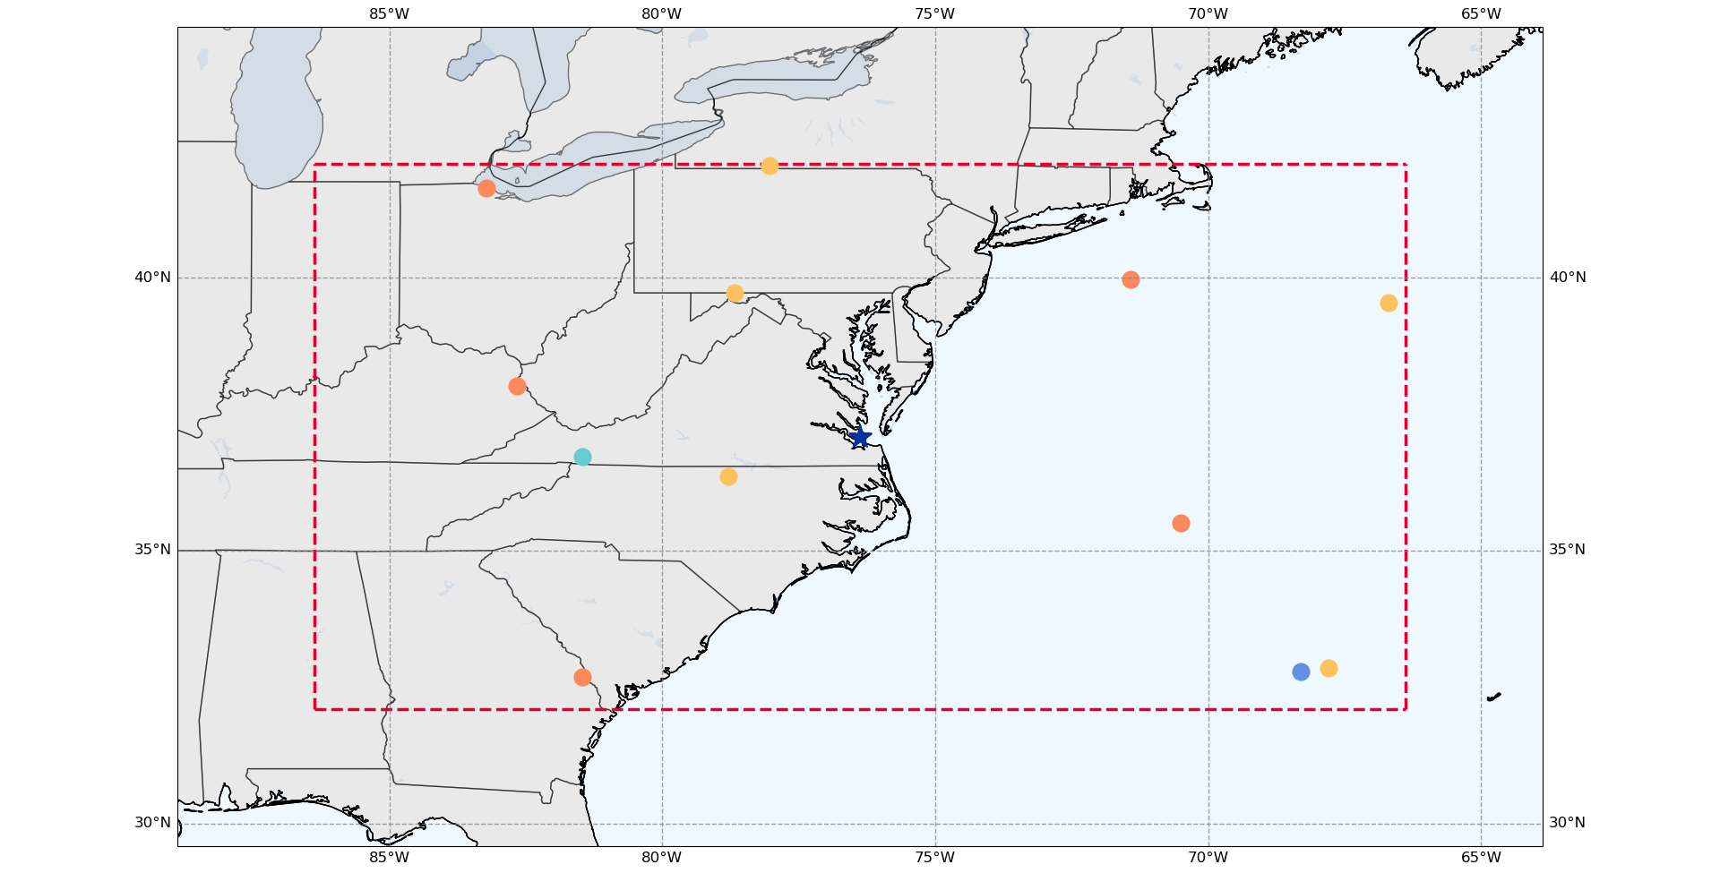
Predicted Events After Reboosts
Oct. 20 – Nov. 17, 2024
Moonrise
16 Nov 2024 22:47:26
(36.72, -81.47)
Prediction File Generated: 2024-09-13
● Sunrise ● Sunset ● Moonrise ● Moonset

Slide 36
Validation Communications Backup Slides

Slide 37
Downloaded Events Text File
# List generated: Thu Sep 12 05:26:20 2024
# Mission Name: SAGE3ISS
# Occultation type(s): [Sunrise][Sunset][Moonrise][Moonset][Limb]
# Temporal constraints: 2024-10-20T00:00:00.000000Z,2024-11-17T23:59:59.999999Z
# Spatial constraints: 42.09&deg;N, 32.09&deg;S,-66.38&deg;E,-86.38&deg;W
Event ID | Cycle ID | Event date | Event type | Azimuth | Elevation | Latitude | Longitude | Solar Beta Angle | Lunar Beta Angle | Lunar Phase | Solar Zenith Angle | Altitude | ISS Orbit | Obscuration | Notes
4780010 |  | 2024-10-20 12:04:11 | Sunrise | 330.1581 | -19.34374 | 40.56586 | -85.63167 | -28.00407 | 6.07685 | 137.725 | 89.99754 | 393.4992 | 47800 | None | N/A
4800210 |  | 2024-11-02 12:02:48 | Sunrise | 26.35157 | -19.30104 | 41.43395 | -81.13433 | 24.76801 | 23.56879 | 11.298 | 89.99753 | 391.3877 | 48002 | None | N/A
4801710 |  | 2024-11-03 11:12:43 | Sunrise | 29.23517 | -19.28232 | 38.79577 | -69.58694 | 27.45259 | 25.38956 | 21.887 | 89.99753 | 391.6451 | 48017 | None | N/A
4803310 |  | 2024-11-04 11:55:20 | Sunrise | 31.89774 | -19.26053 | 35.45394 | -81.46194 | 29.92374 | 23.92535 | 33.456 | 89.99753 | 392.016 | 48033 | None | N/A
4812240 |  | 2024-11-10 05:10:36 | Moonset | 209.046 | -19.30755 | 42.06685 | -78.10965 | 34.05468 | -27.44401 | 102.368 | 155.02544 | 391.1856 | 48122 | None | N/A
4818020 |  | 2024-11-13 22:22:45 | Sunset | 150.7857 | -19.41657 | 33.48341 | -82.20781 | 27.4075 | -40.53225 | 152.551 | 89.99753 | 398.8035 | 48180 | Low | N/A
4819520 |  | 2024-11-14 21:32:10 | Sunset | 153.7122 | -19.42354 | 36.17918 | -71.0896 | 24.68764 | -31.53777 | 165.804 | 89.99753 | 398.1036 | 48195 | Low | N/A
4821120 |  | 2024-11-15 22:14:05 | Sunset | 157.2015 | -19.43021 | 38.58645 | -83.08376 | 21.43343 | -18.47171 | 176.11 | 89.99753 | 397.4712 | 48211 | Low | N/A
4822620 |  | 2024-11-16 21:23:16 | Sunset | 160.769 | -19.43544 | 40.44382 | -71.6752 | 18.09574 | -4.53122 | 165.54 | 89.99753 | 396.9739 | 48226 | Extreme | N/A
4822730 |  | 2024-11-16 22:47:15 | Moonrise | 356.1224 | -19.56033 | 37.63534 | -82.17452 | 17.90372 | -3.67578 | 164.774 | 96.49689 | 403.3034 | 48227 | None | N/A
4824220 |  | 2024-11-17 22:04:57 | Sunset | 164.8437 | -19.43981 | 42.04152 | -83.32846 | 14.27323 | 11.07221 | 151.991 | 89.99752 | 396.5321 | 48242 | Extreme | N/A

Slide 38
Weekly Email Content Breakdown
(Sent Sept. 11, 2024)
Hello all,
Attached is a list of predictions for future SAGE III/ISS events near your station. This list contains 29 possible overpass events over the next 6 months.
Please be aware of a handful of activities coming up over the next month. Another reboost was for next week. Third time’s a charm for all the activities coming up. Again, quite a few things coming up that can affect predictions and events in some shape or form.
Continuing with the gauntlet of activities from the last several weeks, new for this week is yet another reboost added for October 4th (GMT 278).
For this week, there was the Inertia Data Collection that occurred September 9-10 (GMT 254-255), a set of OPMs and the Soyuz 72S docking September 11-12 (GMT 255 – 256), 2024. The OPM on GMT 255 occurred between 0615-0815 UTC, and we have already resumed science taking activities. The 72S docking occurs later in the day on GMT 255 but should have no effect on science taking activities. The last activity is a second OPM on GMT 256 between 0700-0905 UTC. For the activity on GMT 256, we will have science taking disabled between 0530 UTC and 1040 UTC for the maneuver.
Another Progress 89P reboost was recently added to the schedule for October 4 (GMT 278), 2024, from 0740-0845 UTC.
During each of the OPMs, we will not be taking science events. I have gone ahead and removed any potentially impacted events from the attached prediction file based on information that I currently have available, though be aware this may change as times for maneuvers do occasionally change.
Following the 89P Reboost, prediction times and locations can potentially be off until orbital parameters have settled out.
Please let me know if you all have any questions, comments, concerns, etc.
Number of Coincident Events and Duration of Search Window
  Blue: Number of Events
  Yellow: Duration of Search Window
Upcoming Activities
Activity Effects on Predictions

Slide 39
Prediction File for LaRC
PREDICTED SAGE III/ISS OVERPASS EVENTS RUN 2024-09-16 11:03:38.312250+00:00; Bounding Box +/-(lat/lon) = 5.00/10.00
SAGE EVENT PREDICTION FILE USED: <path\to\prediction\file>\AllEvents_SUT_20240913_20250312.csv
STATION = LaRC has 19 possible overpass events.
The table below may have less based on ISS activities.
Search window covers 12.0 weeks into the future from 2024-09-16 11:03:38.312250+00:00 .
DATE TIME (UTC) | Latitude [deg] | Longitude [deg] | EVENT TYPE | Obscuration Likelihood | Notes
29 Sep 24 22:40:26 | 38.87 | -74.94 | Sunset | None | N/A
18 Oct 24 11:37:46 | 32.37 | -81.83 | Sunrise | None | N/A
19 Oct 24 10:50:13 | 36.29 | -68.70 | Sunrise | None | N/A
20 Oct 24 11:35:14 | 39.72 | -78.67 | Sunrise | None | N/A
02 Nov 24 11:51:38 | 42.06 | -78.03 | Sunrise | None | N/A
03 Nov 24 11:02:33 | 39.55 | -66.69 | Sunrise | None | N/A
04 Nov 24 11:46:13 | 36.36 | -78.79 | Sunrise | None | N/A
05 Nov 24 10:57:10 | 32.85 | -67.79 | Sunrise | None | N/A
11 Nov 24 05:53:53 | 32.78 | -68.30 | Moonset | Extreme | N/A
13 Nov 24 22:21:17 | 32.69 | -81.46 | Sunset | Low | N/A
14 Nov 24 21:31:17 | 35.50 | -70.51 | Sunset | Low | N/A
15 Nov 24 22:13:45 | 38.02 | -82.67 | Sunset | Low | N/A
16 Nov 24 21:23:25 | 39.97 | -71.42 | Sunset | Extreme | N/A
16 Nov 24 22:47:26 | 36.72 | -81.47 | Moonrise | None | N/A
17 Nov 24 22:05:34 | 41.65 | -83.23 | Sunset | Extreme | N/A
27 Nov 24 21:18:04 | 41.81 | -72.99 | Sunset | None | N/A
28 Nov 24 21:59:21 | 39.94 | -82.04 | Sunset | None | N/A
29 Nov 24 21:08:05 | 37.64 | -67.71 | Sunset | None | N/A
30 Nov 24 21:49:31 | 34.40 | -76.05 | Sunset | None | N/A
Date/Time File was Generated (UTC)
Prediction File Used
  Start Date & End Date of prediction file
Number of Possible Coincident Events
Duration of Search Window
  Number of Weeks & Search Window Start Date (UTC)
Table of Predicted Events
  Predicted Start Date & Time
  Lat. & Lon.
  Event Type
  Possibility of Obstructions (Blockages)

Slide 40
Predictions Before and After Reboosts for LaRC
Oct. 20 – Nov. 17, 2024
Before Reboosts
Prediction File Generated Aug. 21, 2024
After Reboosts
Prediction File Generated Sept. 13, 2024
Datetime | Lat. | Lon. | Event Type | Obscuration Likelihood
20 Oct 2024 11:03:34 | 40.26 | -70.59 | Sunrise | None
03 Nov 2024 11:37:51 | 38.89 | -75.82 | Sunrise | None
10 Nov 2024 05:30:57 | 42.06 | -82.94 | Moonset | None
14 Nov 2024 21:48:28 | 36.09 | -75.11 | Sunset | Low
16 Nov 2024 21:37:43 | 40.38 | -75.25 | Sunset | Extreme
16 Nov 2024 23:01:43 | 37.64 | -85.68 | Moonrise | None
Datetime | Lat. | Lon. | Event Type | Obscuration Likelihood
20 Oct 2024 11:35:14 | 39.72 | -78.67 | Sunrise | None
02 Nov 2024 11:51:38 | 42.06 | -78.03 | Sunrise | None
03 Nov 2024 11:02:33 | 39.55 | -66.69 | Sunrise | None
04 Nov 2024 11:46:13 | 36.36 | -78.79 | Sunrise | None
05 Nov 2024 10:57:10 | 32.85 | -67.79 | Sunrise | None
11 Nov 2024 05:53:53 | 32.78 | -68.3 | Moonset | Extreme
13 Nov 2024 22:21:17 | 32.69 | -81.46 | Sunset | Low
14 Nov 2024 21:31:17 | 35.5 | -70.51 | Sunset | Low
15 Nov 2024 22:13:45 | 38.02 | -82.67 | Sunset | Low
16 Nov 2024 21:23:25 | 39.97 | -71.42 | Sunset | Extreme
16 Nov 2024 22:47:26 | 36.72 | -81.47 | Moonrise | None
17 Nov 2024 22:05:34 | 41.65 | -83.23 | Sunset | Extreme
In the time since the earlier prediction file was generated, three reboot activities have occurred.

Slide 41
Reboost Schedule
Jan. 2024 – Early Oct. 2024
2024/01/12 – 85P Reboost
2024/01/24 – 85P Reboost
2024/02/23 – 87P Reboost
2024/03/14 – 87P Reboost
2024/04/26 – 87P Reboost
2024/05/24 – Cygnus20 Reboost 1
2024/05/24 – Cygnus20 Reboost 2
2024/06/08 – Cygnus20 Reboost
2024/06/15 – 87P Reboost
2024/06/29 – 87P Reboost
2024/07/31 – 87P Reboost
2024/08/22 – Cygnus21 Reboost
2024/08/28 – 89P Reboost
2024/09/05 – 89P Reboost
2024/10/04 – 89P Reboost
Note: Starliner (CST-100) docked on 2024/06/06 and undocked 2024/09/06

Slide 42
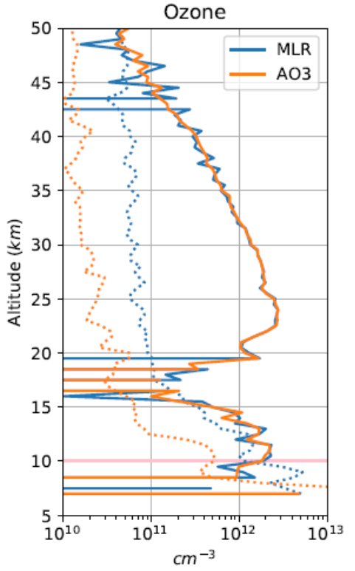
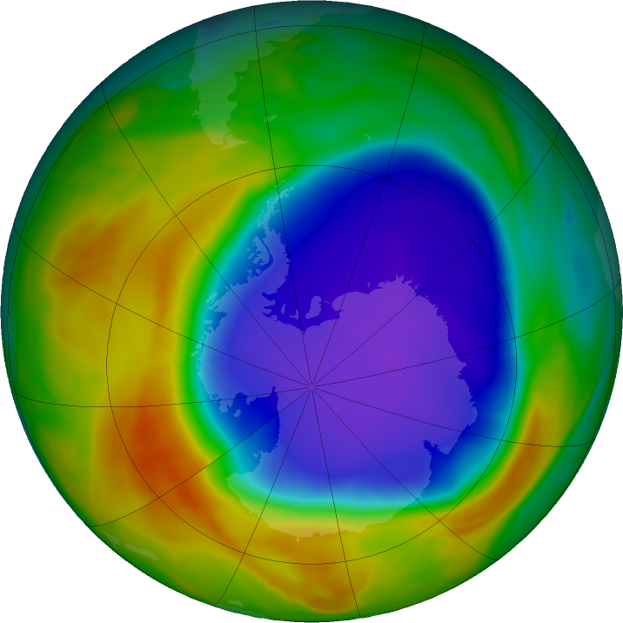
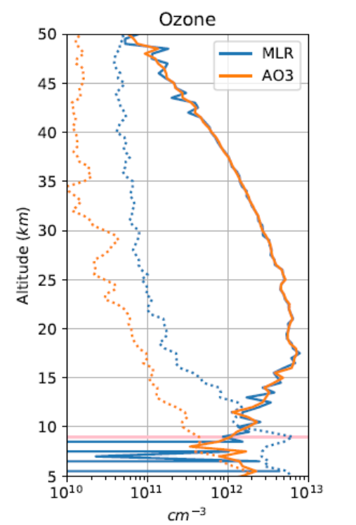

Ozone Hole Season
15 October 2024 Total Ozone
SAGE Expedited
SAGE Expedited
NASA Ozone Watch: Latest status of ozone

Slide 43
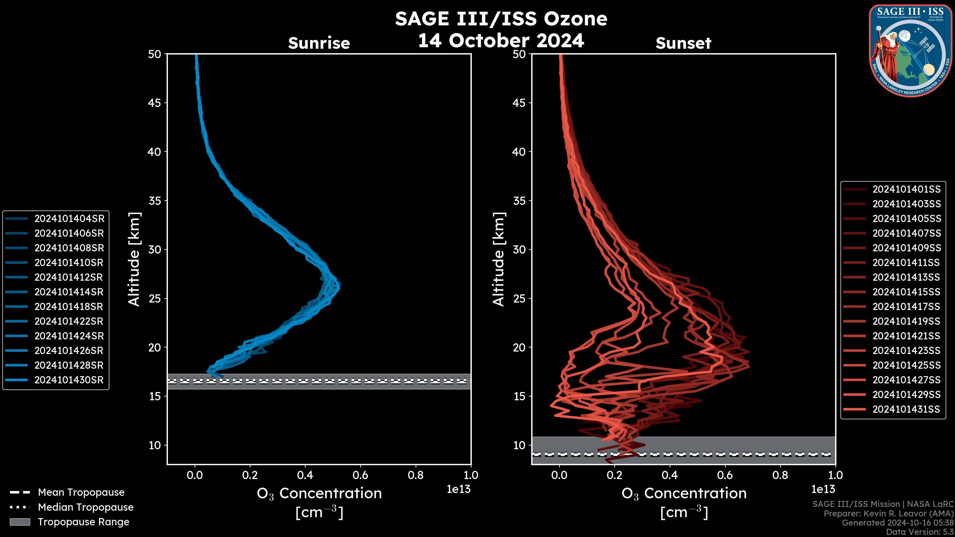
Daily Ozone

