Slide 1
Status of Oxygen A-Band Temperature/Pressure Research Products
Michael Pitts

Slide 2
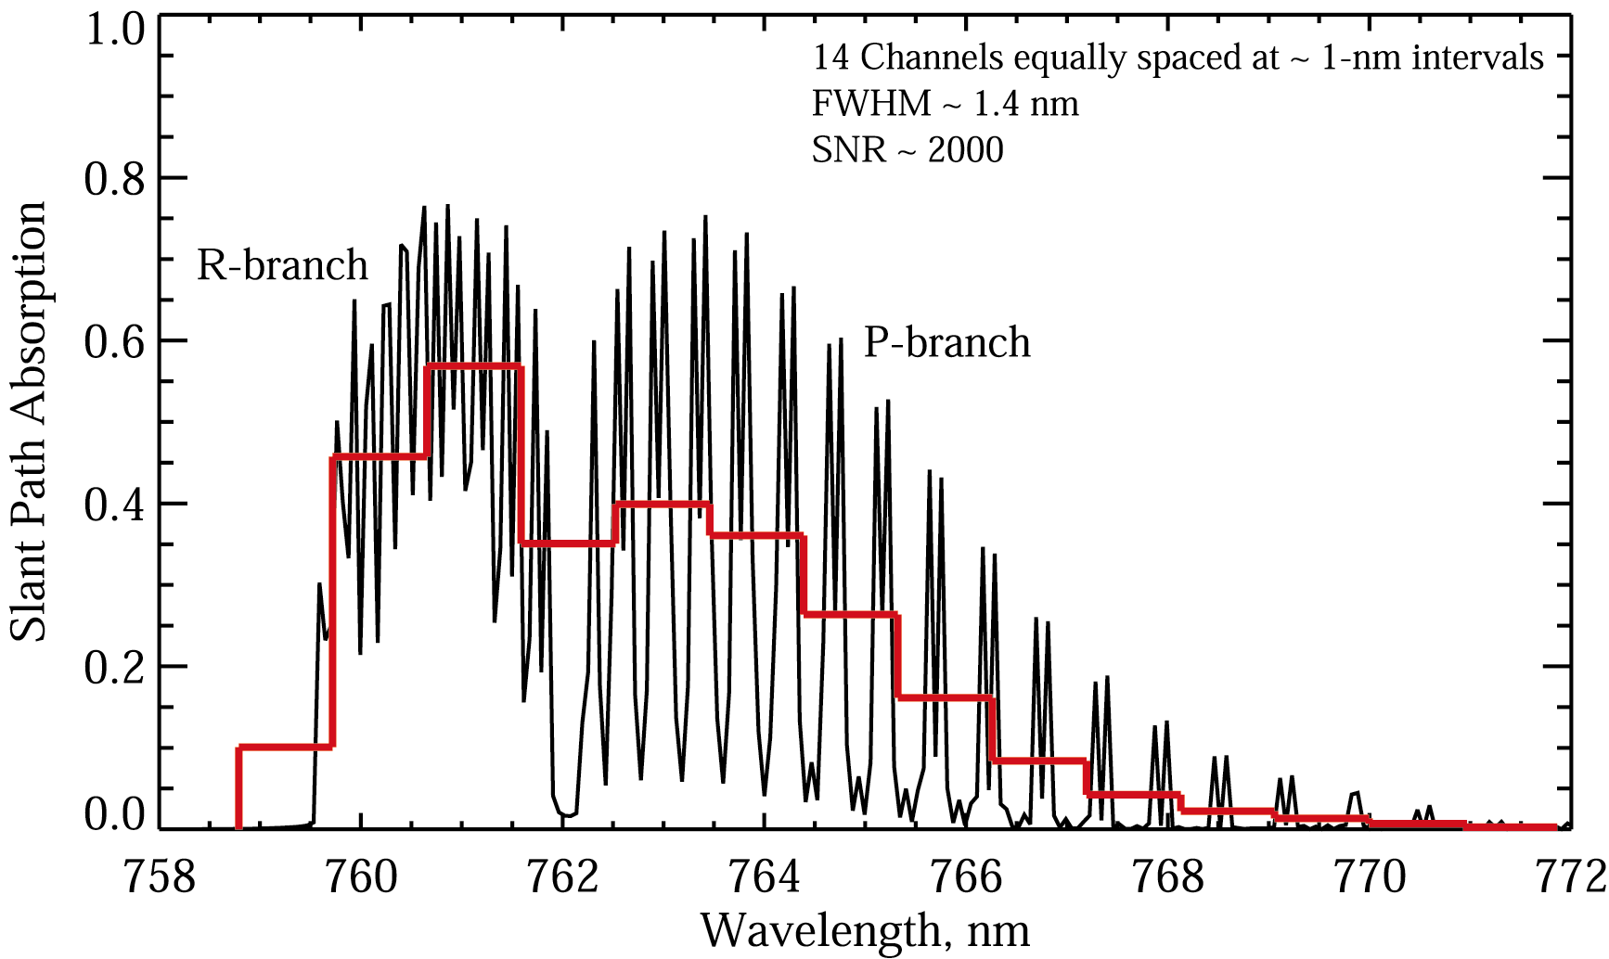
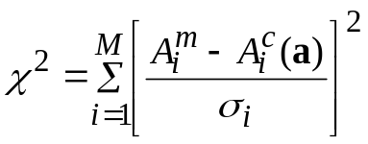
Strategy for Temperature/Pressure Retrievals
Iterative approach required due to non-linear nature of problem
Uses non-linear least squares fitting routine (Levenberg-Marquardt)
  Simultaneously fits measured A-band spectra from all 14 channels and 90 tangent altitudes
    Includes O₂ absorption, Rayleigh scattering, aerosol extinction, and O₃ absorption components
  Solves for successive adjustments to trial T,p profiles by minimizing residuals between measured and modeled absorption
  Includes non-rigid hydrostatic constraint
14 Channels at ~ 1-nm intervals
FWHM ~ 1.4 nm
SNR ~ 1500
A-band contains ~290 individual absorption lines with the distinctive R-branch and P-branch structure. Broad features are still visible at SAGE III resolution (red line)

Slide 3

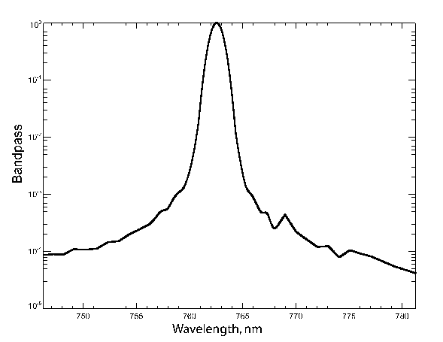
Forward Model Elements
Forward model simulates SAGE III/ISS LOS transmission measurements in 14 O₂ A-band channels using LBL radiative transfer calculations
Inputs:
  Initial guess T/p profiles
  Pathlength matrix
  O₂ Spectroscopic parameters (HITRAN 2016)
  Initial guess aerosol (linear fit: slope + intercept)
  Initial guess ozone (cross sections + ozone number density)
  Channel wavelength map
  Channel point spread function (PSF)
Outputs
  LOS transmission (O₂ + Rayleigh + aerosol + O₃)
14 Channels at ~ 1-nm intervals
FWHM ~ 1.4 nm
SNR ~ 1500
PSF
FWHM
A-band contains ~290 individual absorption lines with the distinctive R-branch and P-branch structure. Broad features are still visible at SAGE III resolution (red line)

Slide 4
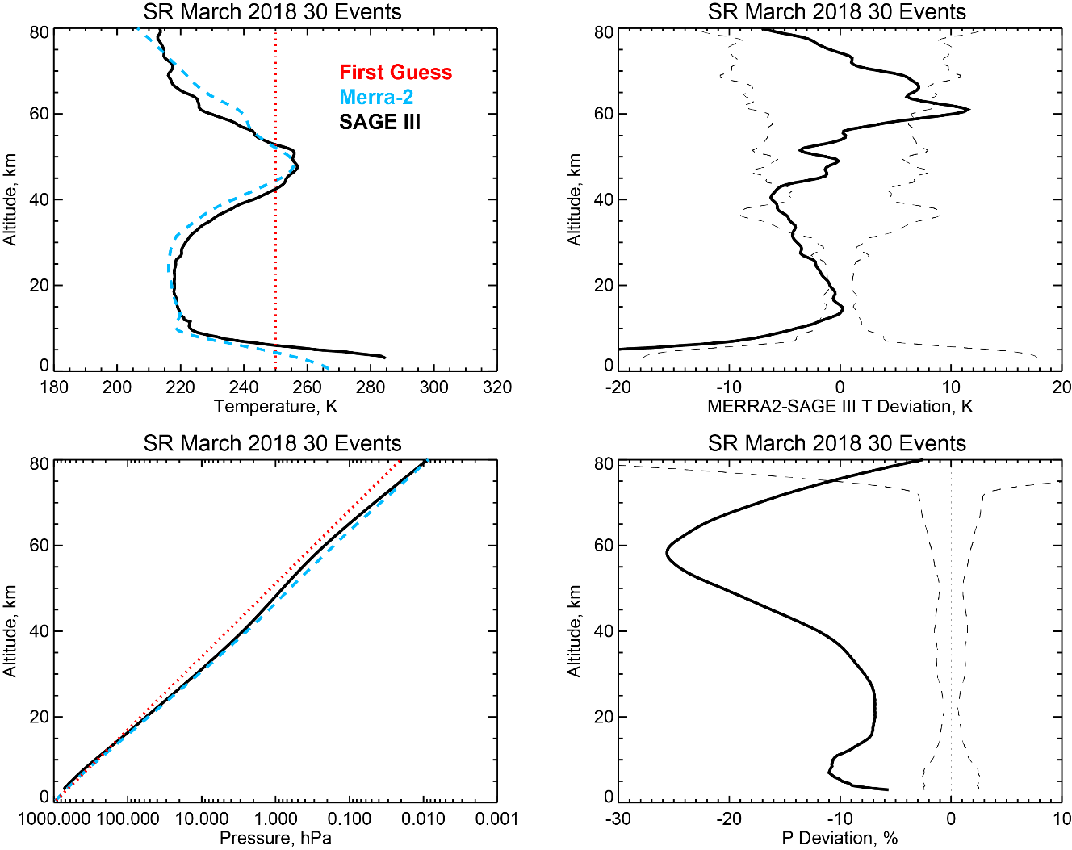
Baseline Retrievals (Sunrise Events)
First Guess
MERRA2/GRAM95
SAGE III
Mean SAGE III/ISS retrieved temperature and pressure profiles from 30 sunrise events during March 2018 with baseline wavelength map and PSF widths
~50º-55º N latitude

Slide 5
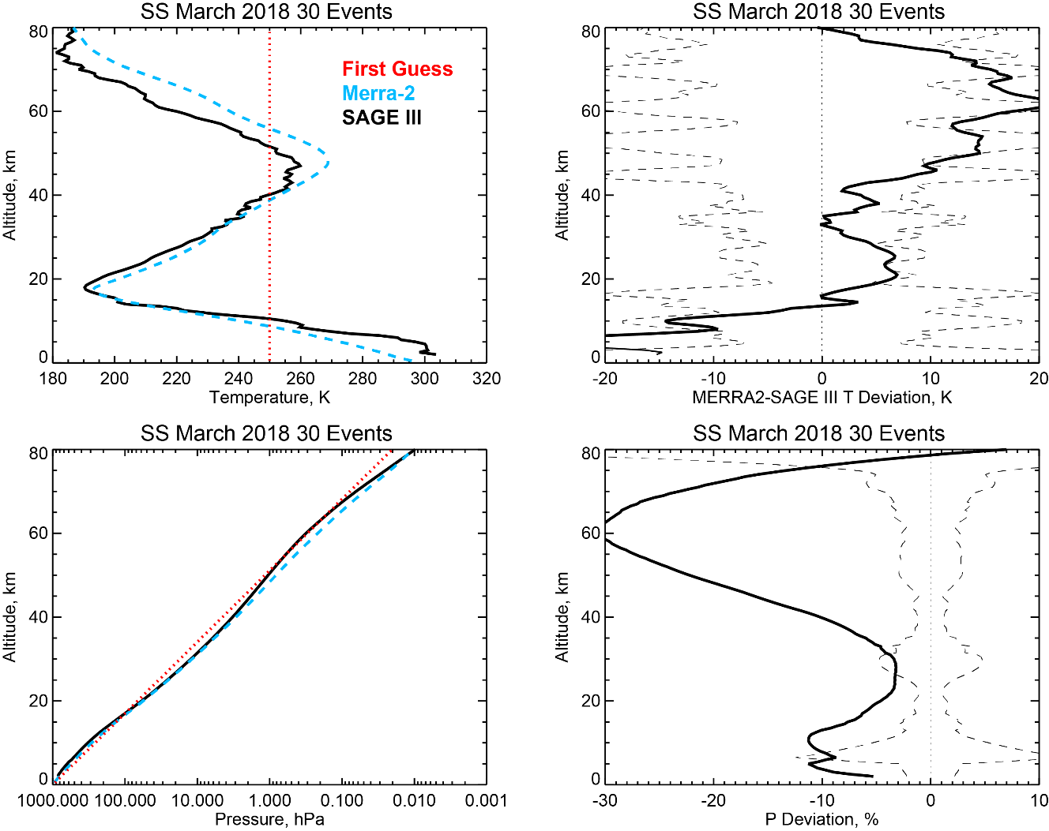
Baseline Retrievals (Sunset Events)
First Guess
MERRA2/GRAM95
SAGE III
Mean SAGE III/ISS retrieved temperature and pressure profiles from 30 sunset events during March 2018 with baseline wavelength map and PSF widths
~5º-30º S latitude

Slide 6
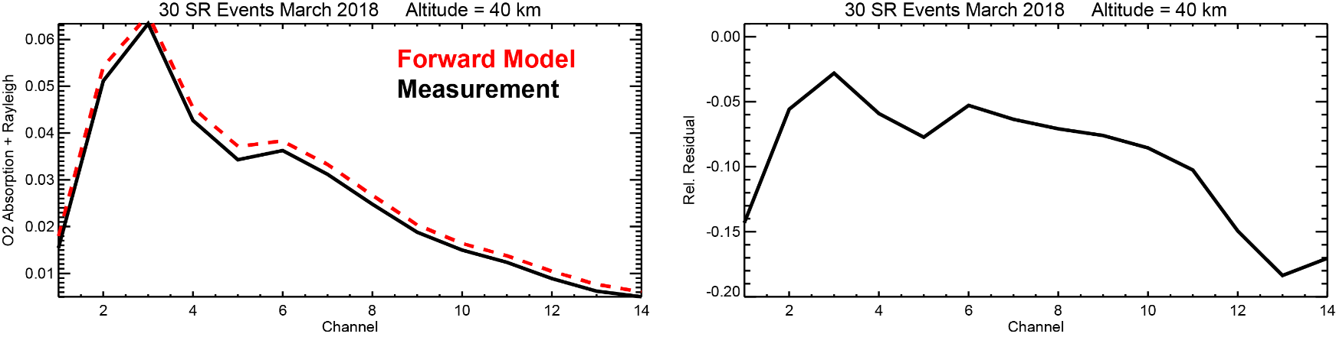
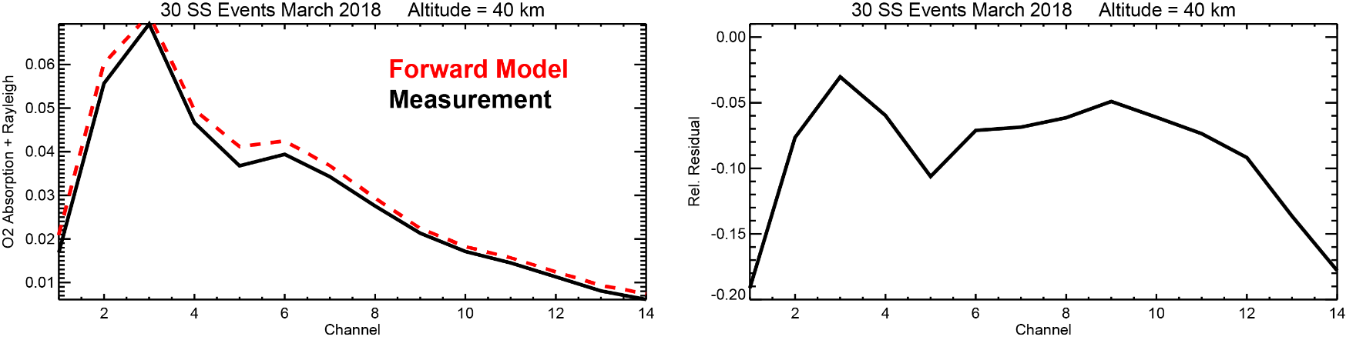
Measured vs. Modeled O₂ + Rayleigh Components
Baseline wavelength registration and instrument response functions
Modeled spectra too broad and misregistered in wavelength

Slide 7
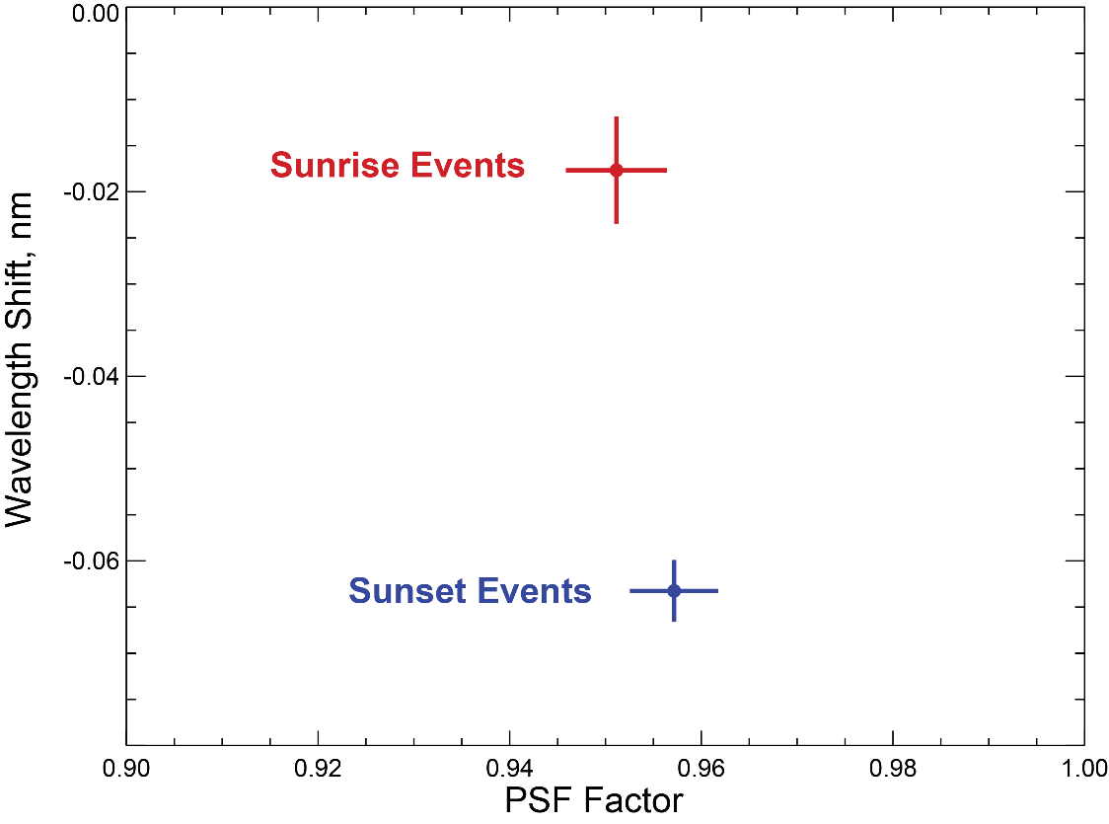
Wavelength and PSF Factor Adjustments
100
Assume MERRA2/GRAM95 T/p profiles are truth
Retrieve adjustments (mean ± 1 σ) to baseline wavelength map and PSF widths required to best fit measured spectra
Channel PSF
45
FWHM

Slide 8
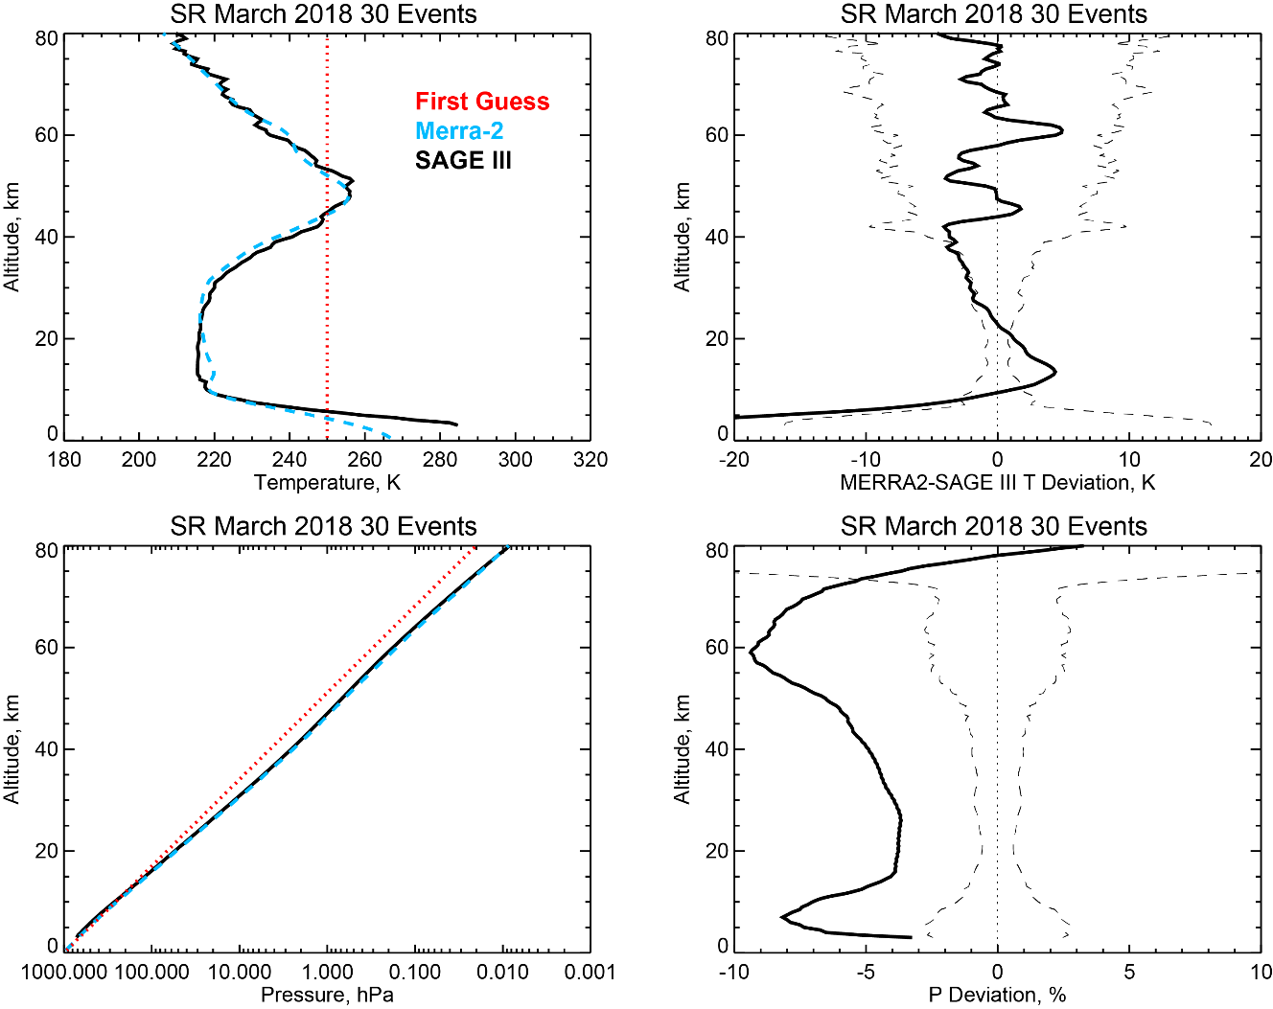
Retrievals Using Adjusted Wavelength & PSF
First Guess
MERRA2/GRAM95
SAGE III
Mean SAGE III/ISS retrieved temperature and pressure profiles from 30 sunrise events during March 2018 with adjusted wavelength map (-0.018 nm) and PSF factor (0.95)
~50º-55º N latitude

Slide 9
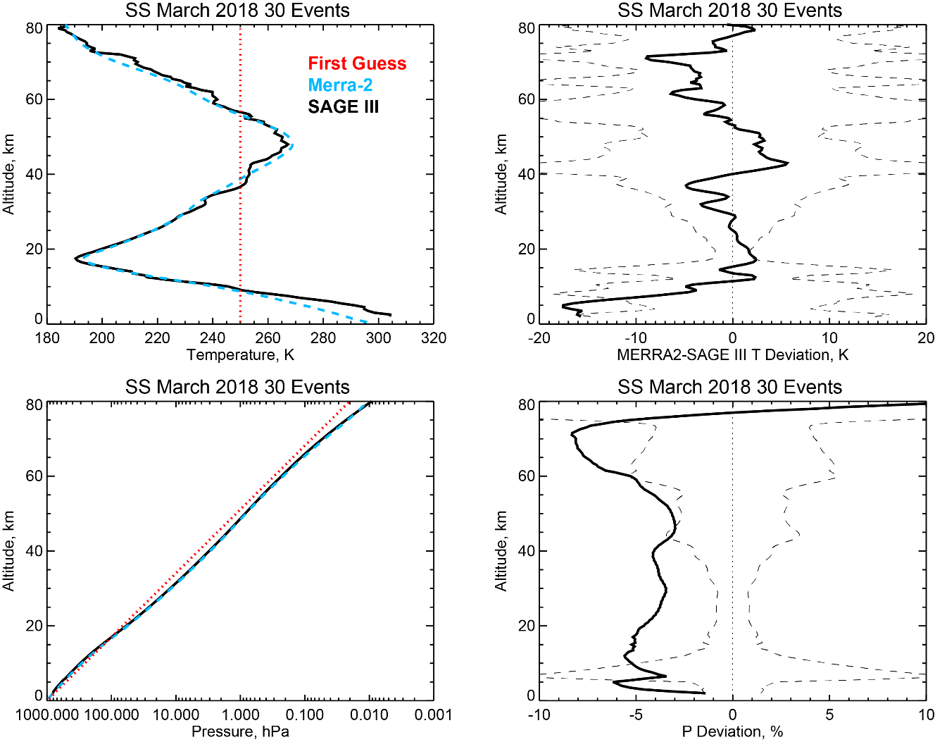
Retrievals Using Adjusted Wavelength & PSF
First Guess
MERRA2/GRAM95
SAGE III
Mean SAGE III/ISS retrieved temperature and pressure profiles from 30 sunset events during March 2018 with adjusted wavelength map (-0.063 nm) and PSF factor (0.95)
~5º-30º S latitude

Slide 10
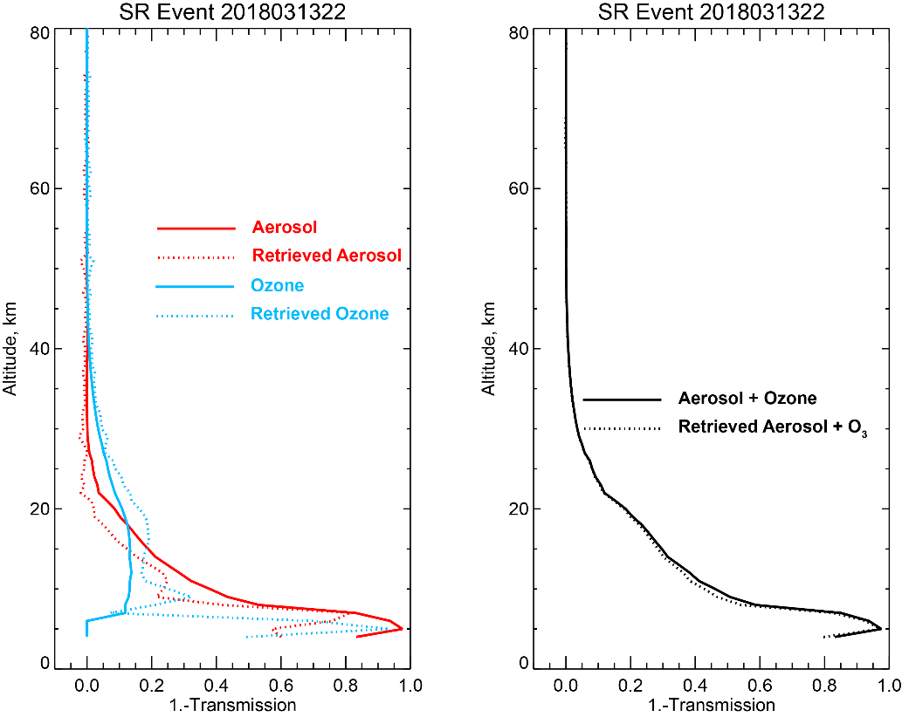
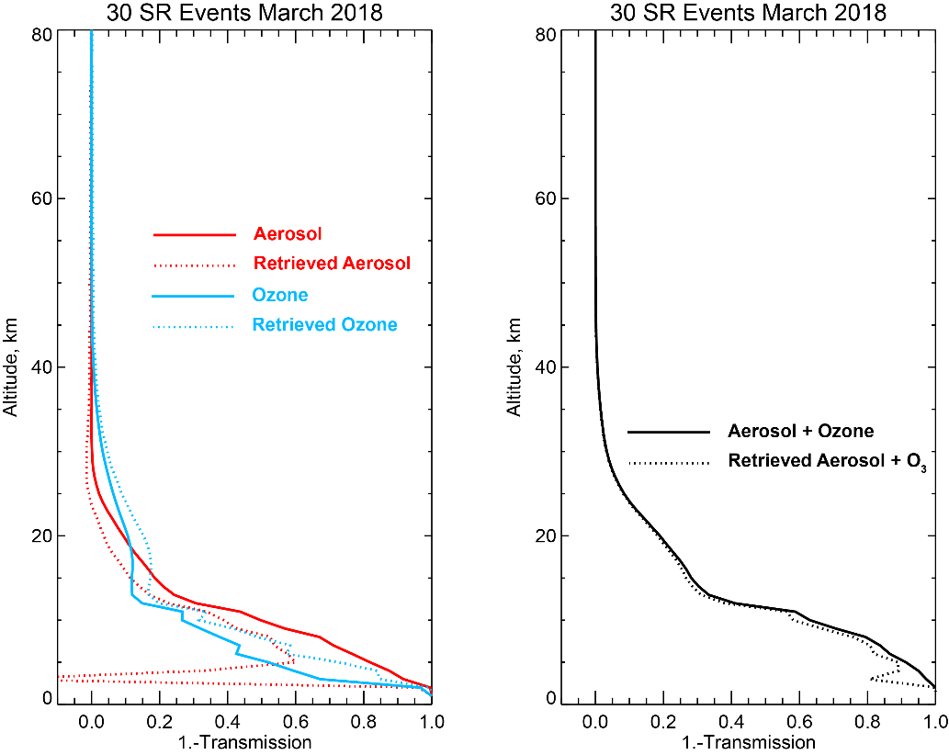
Aerosol and Ozone Fitting
Retrieved aerosol and ozone components compared with measurements (aerosol interpolated from standard aerosol channels and ozone from AO3 ozone product)

Slide 11
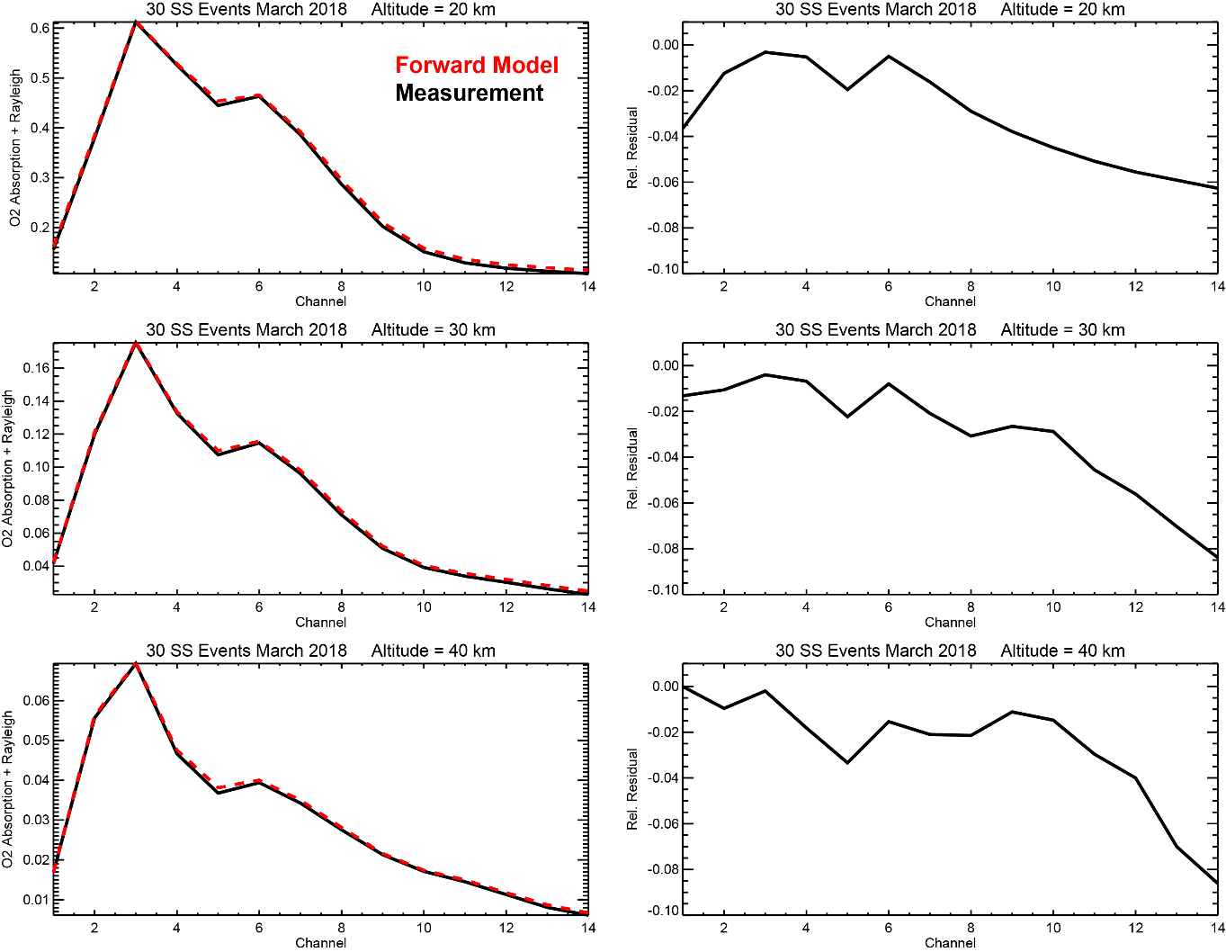
O₂ + Rayleigh Fitting
Mean measured vs. modeled O₂ absorption + Rayleigh scattering for 30 SS events
Forward model parameters:
Δλ = -0.063
PSF Factor = 0.95
Systematic shape of residuals may indicate that some component is not being properly fitted

Slide 12
Summary and Future Work
Forward Model Assessment:
  Small wavelength shifts are apparent in A-band spectra relative to baseline registration (approximately -0.018 nm for sunset and -0.063 nm for sunrise events)
  Baseline PSFs too broad- fits are improved using narrower (0.95 x baseline) widths
Retrievals with adjusted forward model parameters look encouraging with near science quality temperature products, but some issues remain, especially in pressure products
Future Work:
  Continue examining sensitivity to forward model parameters
    Bandpass (width, wings, etc.)
    Spectroscopy (line intensities, line shape)
    Potential altitude offset
    Aerosol + O₃ components
  Exclude weaker channels at higher altitudes
  Explore alternative retrieval approaches to L-M (e.g., Newton-Raphson)
  Perform more detailed comparisons with correlative measurements (e.g.,radiosondes, lidar, MLS, and global analyses) to better quantify precision and accuracy of T/p products

Slide 13
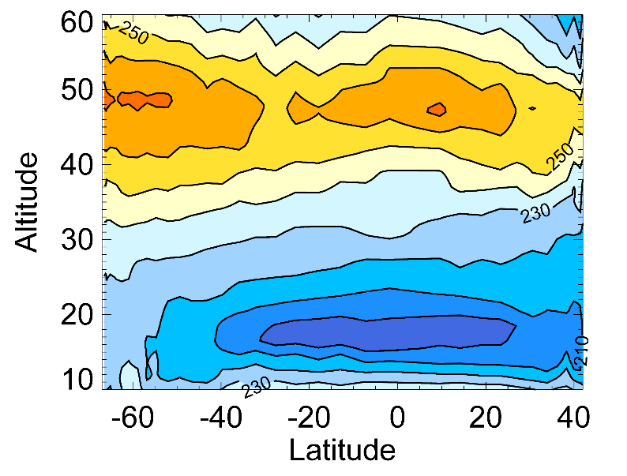
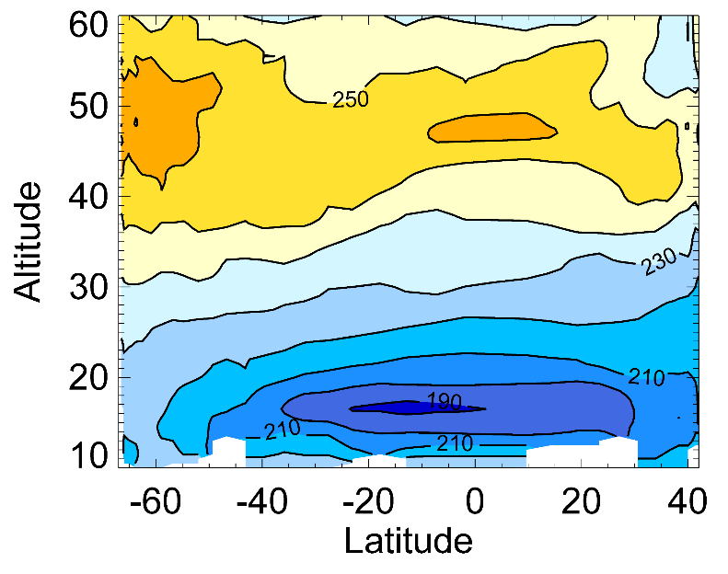
SAGE III/ISS vs. Merra-2 zonal cross sections
MERRA-2
SAGE III/ISS
MERRA-2 (left) and SAGE III/ISS (right) meridional temperature distributions compiled from sunrise events over the period 1 January -15 February 2018. The SAGE III/ISS temperature distribution captures the general temperature structure seen in MERRA-2, but is colder at the tropopause and stratopause, and somewhat noisier at higher altitudes.

