Slide 1
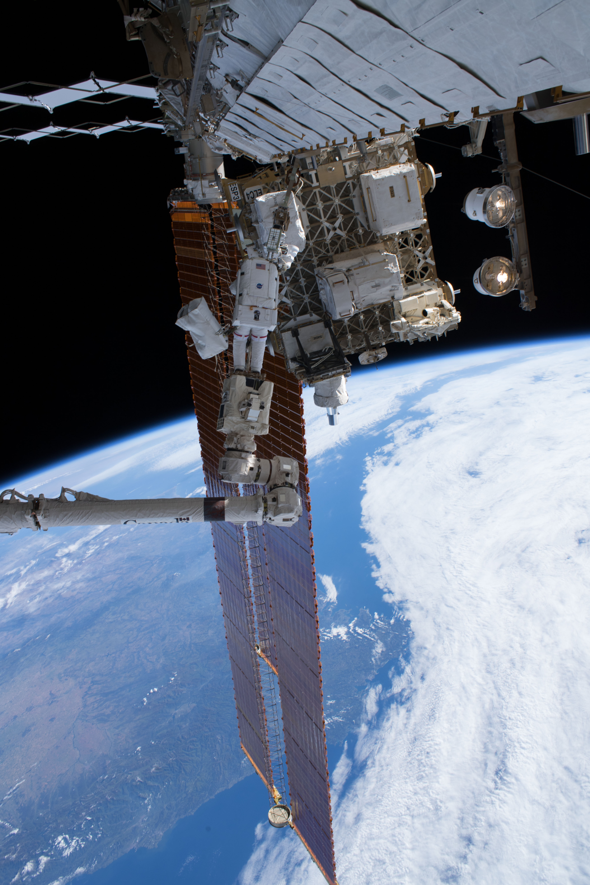
Stratospheric Aerosol and Gas Experiment III/ISS – Mission Status
David Flittner,
SAGE III/ISS Mission Team
& SAGE III/ISS
13 October 2022
sage.nasa.gov
Image Credit: NASA Astronaut Ricky Arnold
Notes:
Observe the instrument in the Space Walk photo.

Slide 2
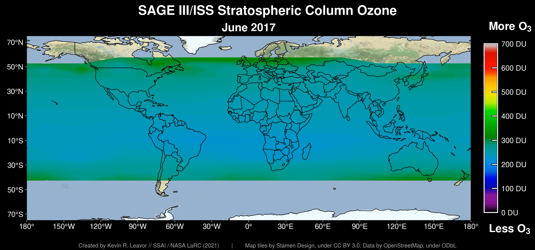
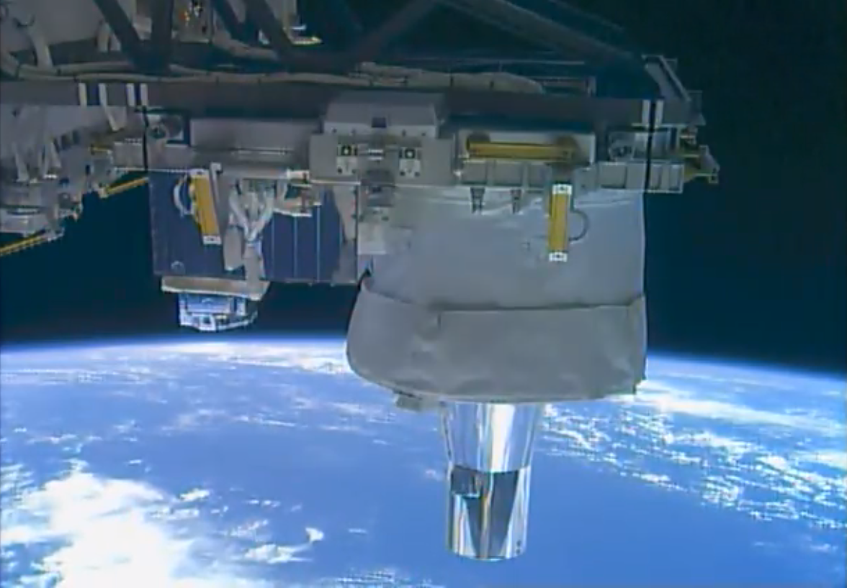
SAGE III/ISS Overview
STRATOSPHERIC OZONE
SAGE produces high vertical resolution profiles of aerosols, ozone, water vapor, and other trace gases in the stratosphere and upper troposphere using the very stable occultation technique
Core element of WMO International Ozone Assessment and WCRP SPARC
Acquired >50k occultation events June 2017 - October 2022
5 ¼ years science mission; in year 3 of extended mission; anticipating 2023 Senior Review
Current data products V5.2; V5.3 in works
ROSES Science Team, 2nd cycle, entering 2nd year
37 peer-reviewed papers using SAGE III/ISS data products, with others in review
Vibrant internship program with ~5 NIFS students/yr
Notes:
With support from HQ, LaRC, ISS Program and Payload Operations I? Center (MSFC) operated throughout COVID-19 era with no reduction in data efficiency or health risks to SAGE personnel.
Occultation collection efficiency is 87% for solar and 53% for lunar. The overall success rate is 83% vs. a requirement of 75%. For the lunar

Slide 3
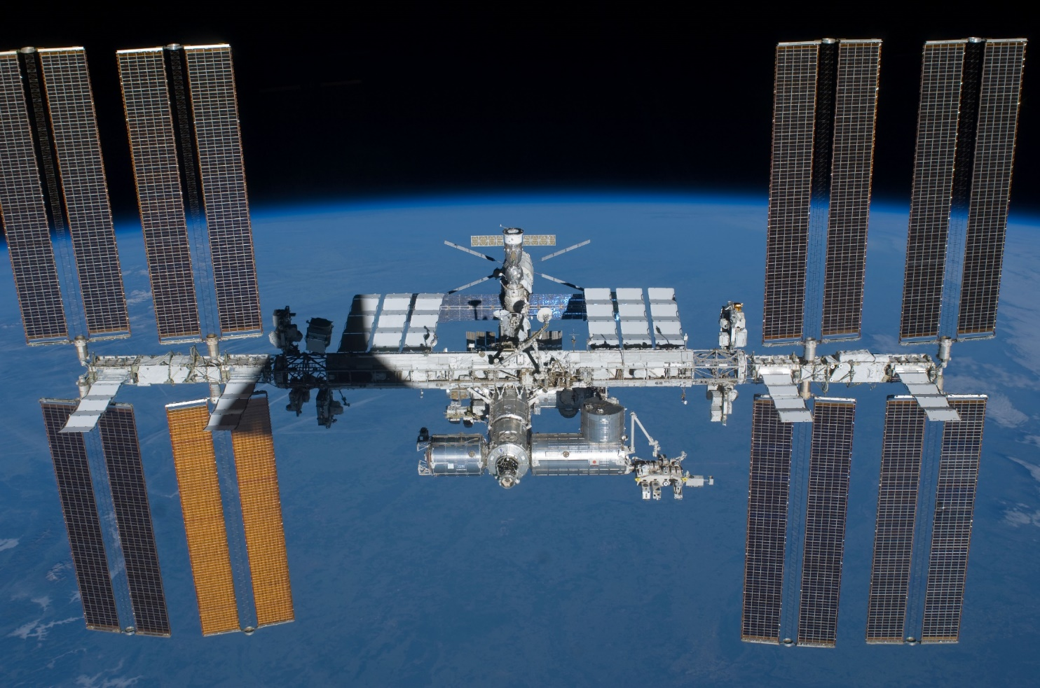
SAGE III’s location

Slide 4
SAGE III/ISS Mission Teams
Mission is organized into teams with specific roles/responsibilities with a relatively flat structure
Some personnel are members of multiple teams
  Management Team – Marilee Roell
  Operations Team – Jamie Nehrir
  Ground Systems Team – Andrew Peterson
  Science Team (LaRC) – David Flittner
  Science Processing Team (aka Algorithm & SCF) – Rob Damadeo/Robbie Manion
  Validation Team – Carrie Roller/Kevin Leavor
  Public Engagement Team – Allison McMahon
  Web Development Team – Danny Mangosing

Slide 5
SAGE III/ISS Operations
With support from HQ, LaRC, ISS Program and Payload Operations Center (MSFC) operated throughout COVID-19 era with no reduction in data efficiency or risks to SAGE personnel or hardware – Things are back to ‘new normal’
Payload is operating within nominal limits
See presentation by the Mission Operations Manager (aka MOM) Jamie Nehrir today for more (better) details
Contamination Monitoring Package (CMP) data available at Materials and Processes Technical Information System (MAPTIS)
Notes:
And

Slide 6
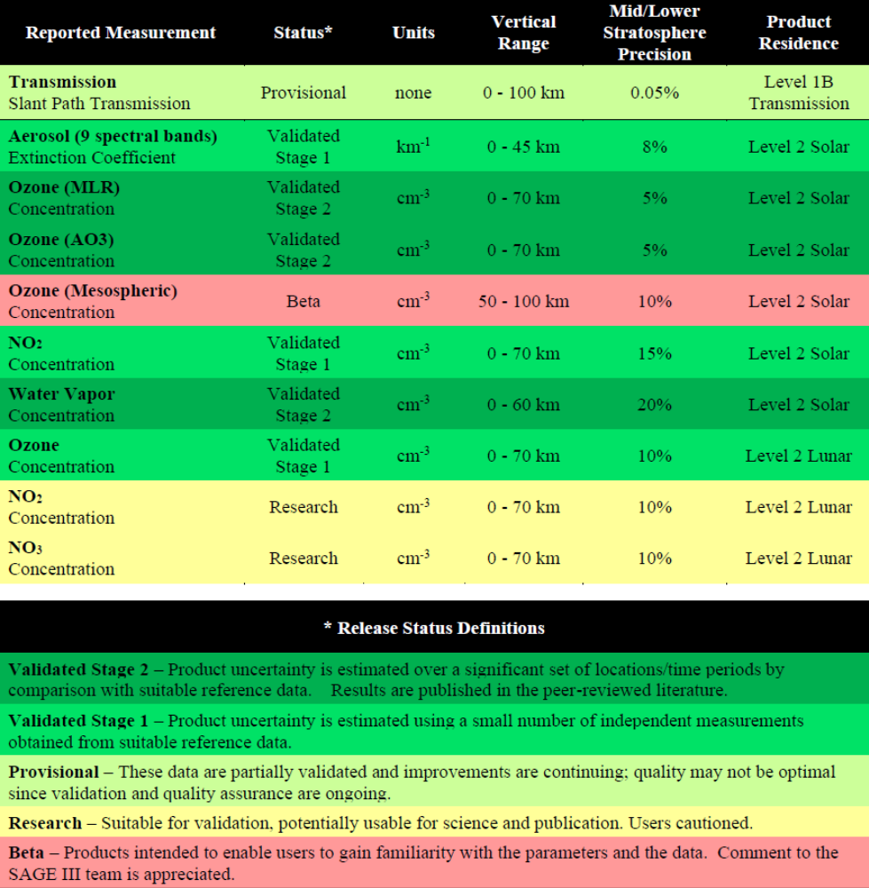
SAGE III/ISS Data Products
V5.2 Data Product User’s Guide
v5.2 is the current version of processing algorithm, (https://search.earthdata.nasa.gov/search?q=SAGE%20III/ISS)
  v5.1 still available for Jun 2017-Feb 2021
  Monthly netcdf packaging of events, in addition to single event files

Slide 7
Current and Near-term Work
Assess impact of Multiple Logistic Module (MLM) to ISS configuration
  Configuration for which the SAGE payload was designed
  Updating blockage prediction tools
Data visualization tools for mission team and web-site
Algorithm Improvements
  Main focus is Level 1 product (Transmission) & quality assurance
  See presentations by Robbie Manion & Charles Hill today
Evaluation of internal validation activities and correlative data sets

Slide 8
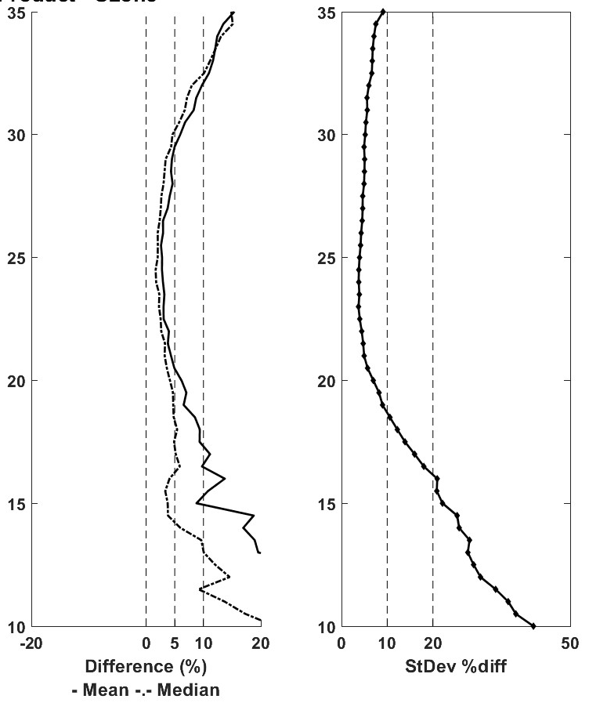
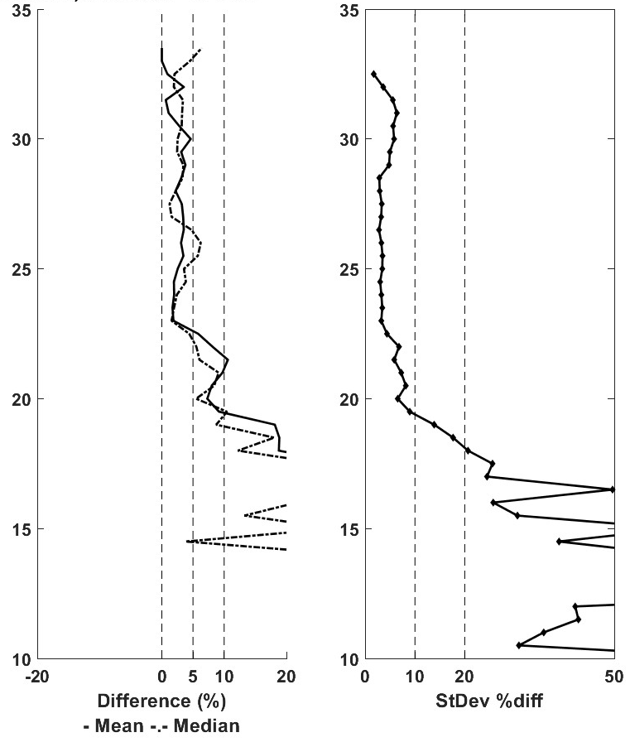
Ground-based Correlative Measurements Help Assess Algorithm Improvements
35
35
Ozone: SAGE vs. All Sondes
Ozone: SAGE vs. Costa Rica
25
25
ALTITUDE [km]
~ 5%
ALTITUDE [km]
15
15
0
10
Thanks for using the validation website to improve coincidences.

Slide 9
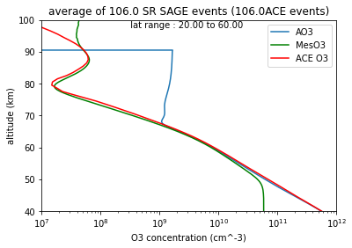
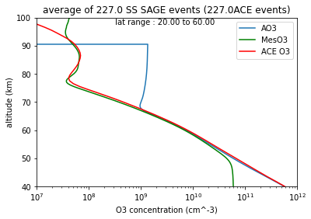
Mesospheric Ozone
Mesospheric ozone product using UV-B channels (~ 290 nm)
  Residual stray light in channels – corrected using approach from SAGE Meteor
  At release of V5.2 was deemed BETA
  Further examination indicates RESEARCH is more appropriate
  Continuing to scrutinize performance and explore improvements
    Improve stray light correction with ground characterization
    Mass-path dependance of channel cross-sections
SUNRISE
SUNSET

Slide 10
Regular vs. Expedited
Main driver in latency of SAGE III/ISS public science products is availability of meteorological inputs – currently MERRA2
To be in-tune with current instrument/algorithm performance the Mission does process daily downlinks with GEOS for internal use
Algorithm/processing team briefly examined influence of met. data

Slide 11
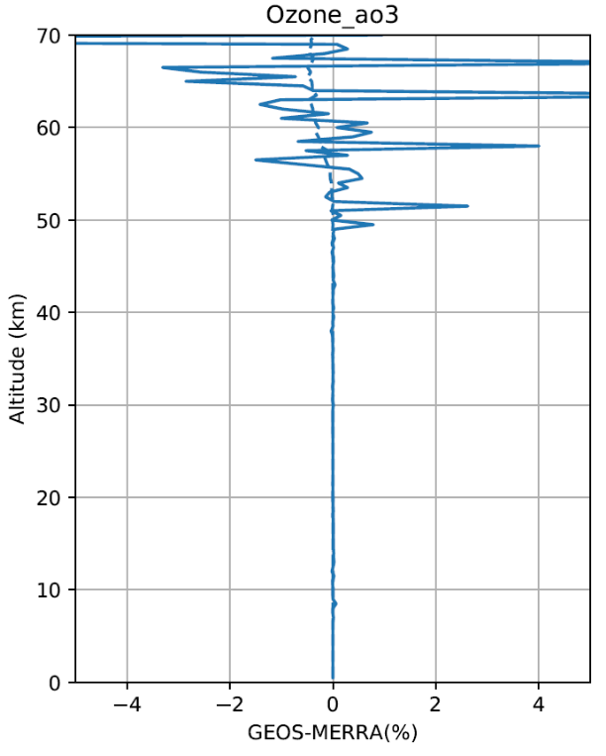
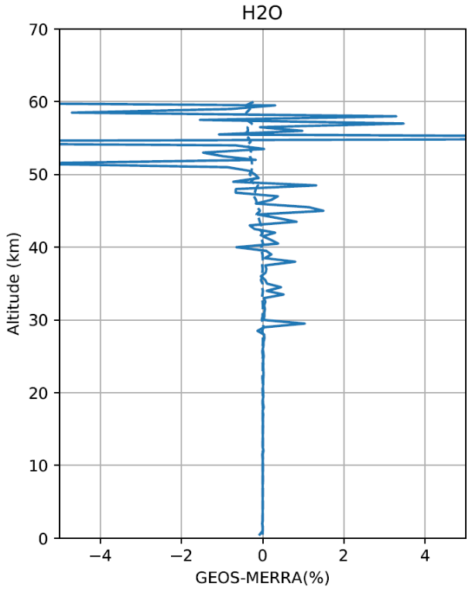
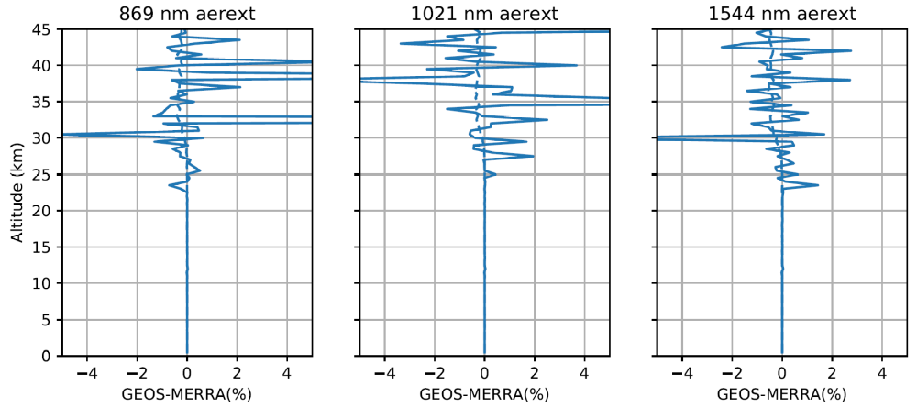
MERRA vs GEOS
On average, SAGE III/ISS products are similar when using MERRA vs. GEOS inputs
Uncertainties are ~ 0.5% lower with MERRA
Mission is developing public webpage providing browse images for ‘expedited’ (aka GEOS) products, and more in D. Mangosing presentation tomorrow
698 events between 2021090201SR and 2021093046SS

Slide 12
New Data Files/Products
Level 3 Cloud Filter
  Using aerosol extinction coefficient profiles to identify altitudes possibly contaminated by clouds on an event-by-event basis
  Approach is documented in M. Kovilakam et al. (2022) “SAGE III/ISS aerosol/cloud categorization and its impact on GloSSAC”
  Release is expected later this year
    Released on monthly cadence (same as current products)
v5.3 Level 1 & 2 - Manion
Gather single event granules into a “monthly” file (netcdf)
  Same content as single event files, but for ~ month
    Last day of previous month thru next to last day of current month
  Available via Atmospheric Science Data Center (DAAC)

Slide 13
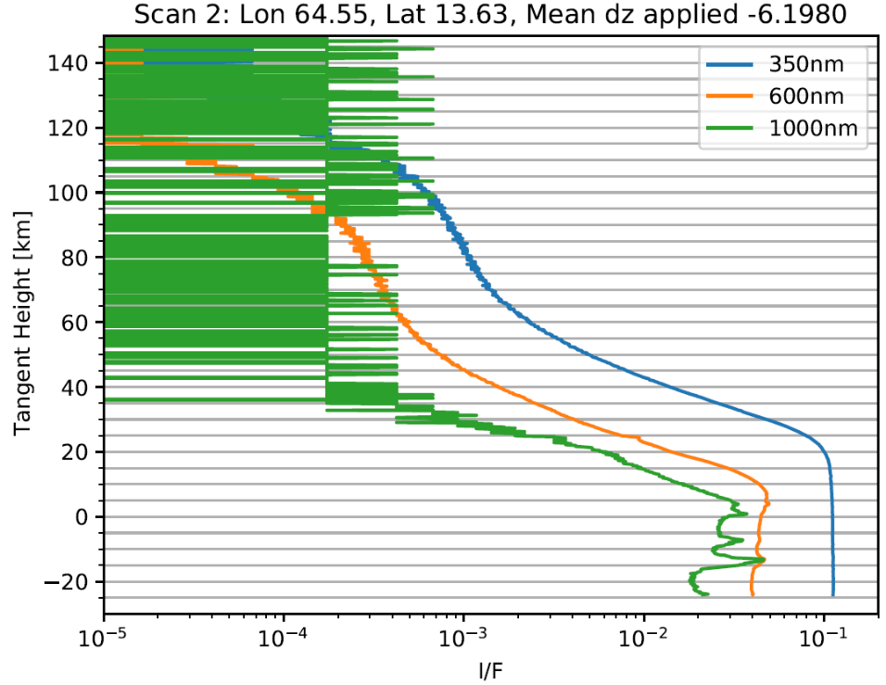
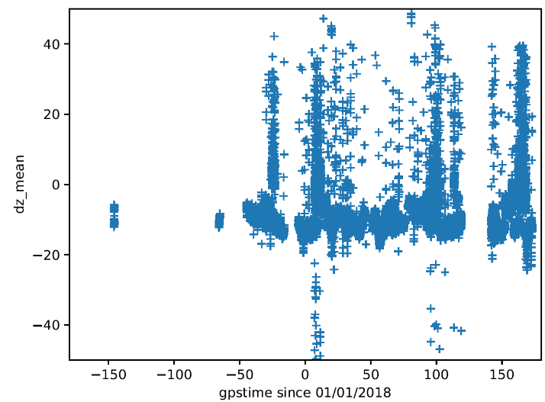
Limb Scatter Data
Maturity of Limb L1 product greatly improved this summer by Emma McIntyre (Columbia U.)
  Correction for dual ISS attitude solutions
  Ephemeris interpolation – flag
  Processing meta-data
  RSAS attitude estimate w/ std. atmosphere
Future work:
  Correlate RSAS correction with Off-nadir angle from Disturbance Monitor Package
  Disturbance Flag derived from recent solar occultation work
  Multi-wavelength stray light estimate

Slide 14
2023 Senior Review
Letter requesting participation in SR23 ~ Dec22
Proposals due early Mar23
ROSES Science Team can help by making sure the mission is aware of research results utilizing SAGE III/ISS data products
Missions tally of published articles is:
  Microsoft Word - SAGE_III_ISS_Publications_List_9162022.docx (nasa.gov)

Slide 15
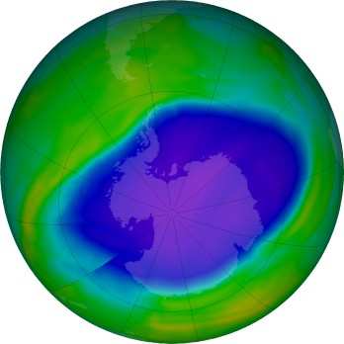
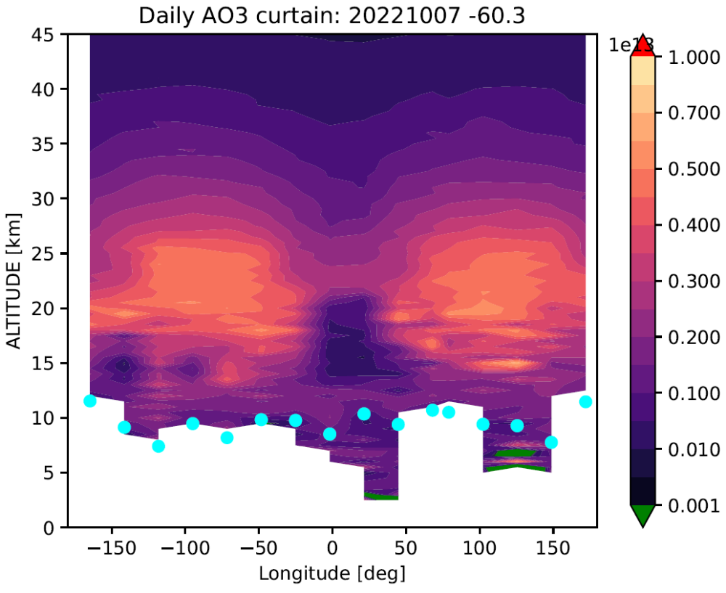
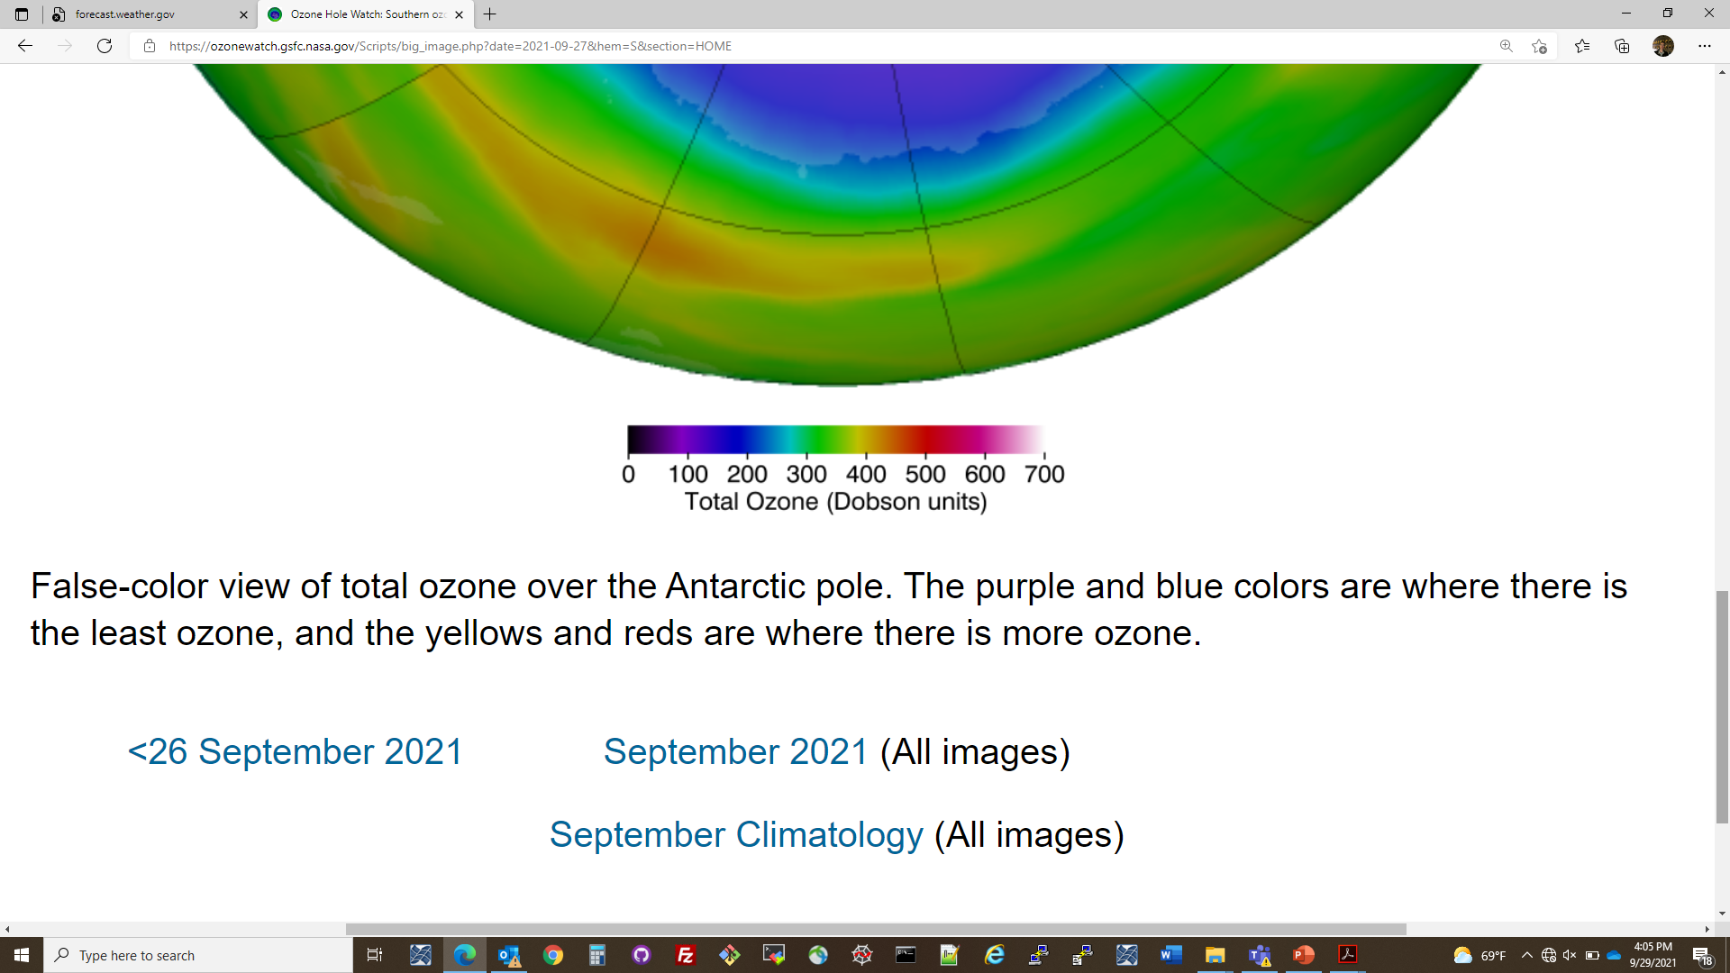
SP Ozone Hole & SAGE III/ISS – 2022
SAGE III/ISS @ 60S
Ozone [#/cc]
07 October 2022
TOTAL OZONE
Prime Meridian
ozonewatch.gsfc.nasa.gov

