Slide 1
Science Team Meeting
NASA Langley Research Center
10/14/2022

Slide 2
Quicklook / Validation
Danny Mangosing
Senior System Engineer/Web Developer

Slide 3
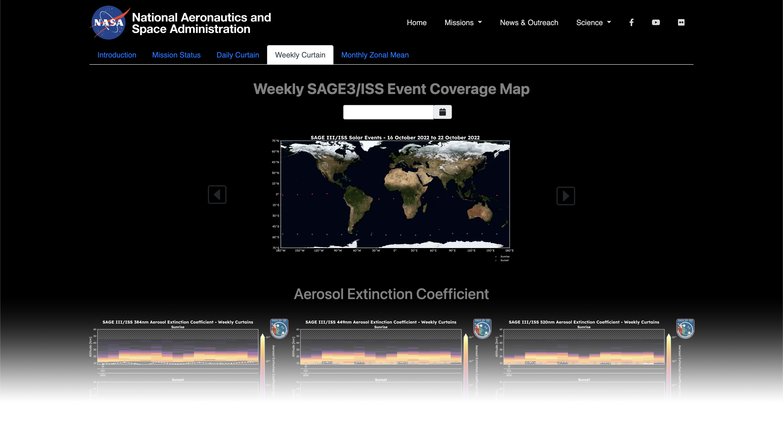
Outline
Quicklook Website Overview

Slide 4
Quicklook Website Overview
Overview
  The website builds on work that Dr. Kevin Leavor developed over a year ago as a potential analysis tool for SAGE III/ISS Science team members and partners.
  This is the first incarnation (V1.0) of the web-based tool.
  Static imagery is categorized into four different plot types:
    Mission overview plots
    Monthly zonal mean plots
    Weekly curtain plots
    Daily profile plots
  The website is currently under internal review and will be made public at a TBD date.
Demo

Slide 5
Questions

