Slide 1
Data Product Status
SAGE III/ISS Science Computing Facility

Slide 2
The “SCF”
The Team
  Robbie Manion, Mike Heitz, Marsha Larosee, Carter Hulsey, Darrell Dolliver
What We Do
  Maintain, develop, and operate the algorithms which process SAGE III/ISS data into vertical profiles of aerosol and gas species
Where
  Four dedicated servers at LaRC
When
  Daily internal evaluation with “expedited” processing (GEOS FP-IT Met)
  Public products on monthly cadence with ~3 week latency (MERRA-2 Met)
Notes:
- Currently provided to NASA as part of the STARSS III contract

Slide 3
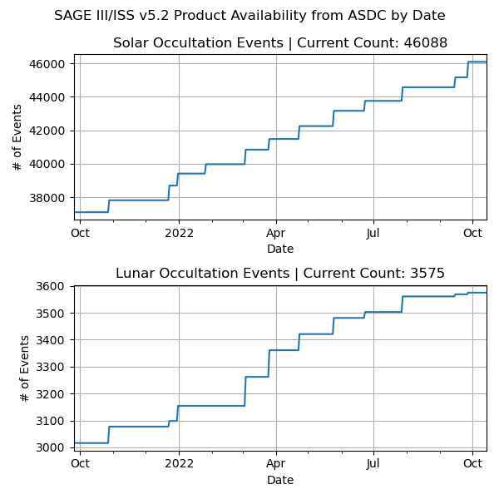
Version 5.2
Products
  Level 1 and Level 2 products for solar occultation; Level 2 for lunar
  Event-by-event: unformatted, HDF5
  Whole month (1-day offset): netCDF4
  Distributed by Atmospheric Science Data Center
Minor increment v05.20 → v05.21
  Starting with events on 31-May 2022
  Reflects OS & compiler upgrades; no algorithm changes
Notes:
Did not back-process v05.21; treat as a continuation of v05.20

Slide 4
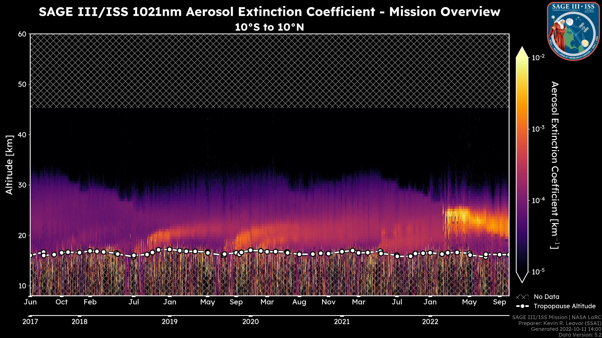
N. Hemisphere
Wildfires
Australia Wildfires
Hunga Tonga
Ambae
Raikoke
La Soufrière

Slide 5
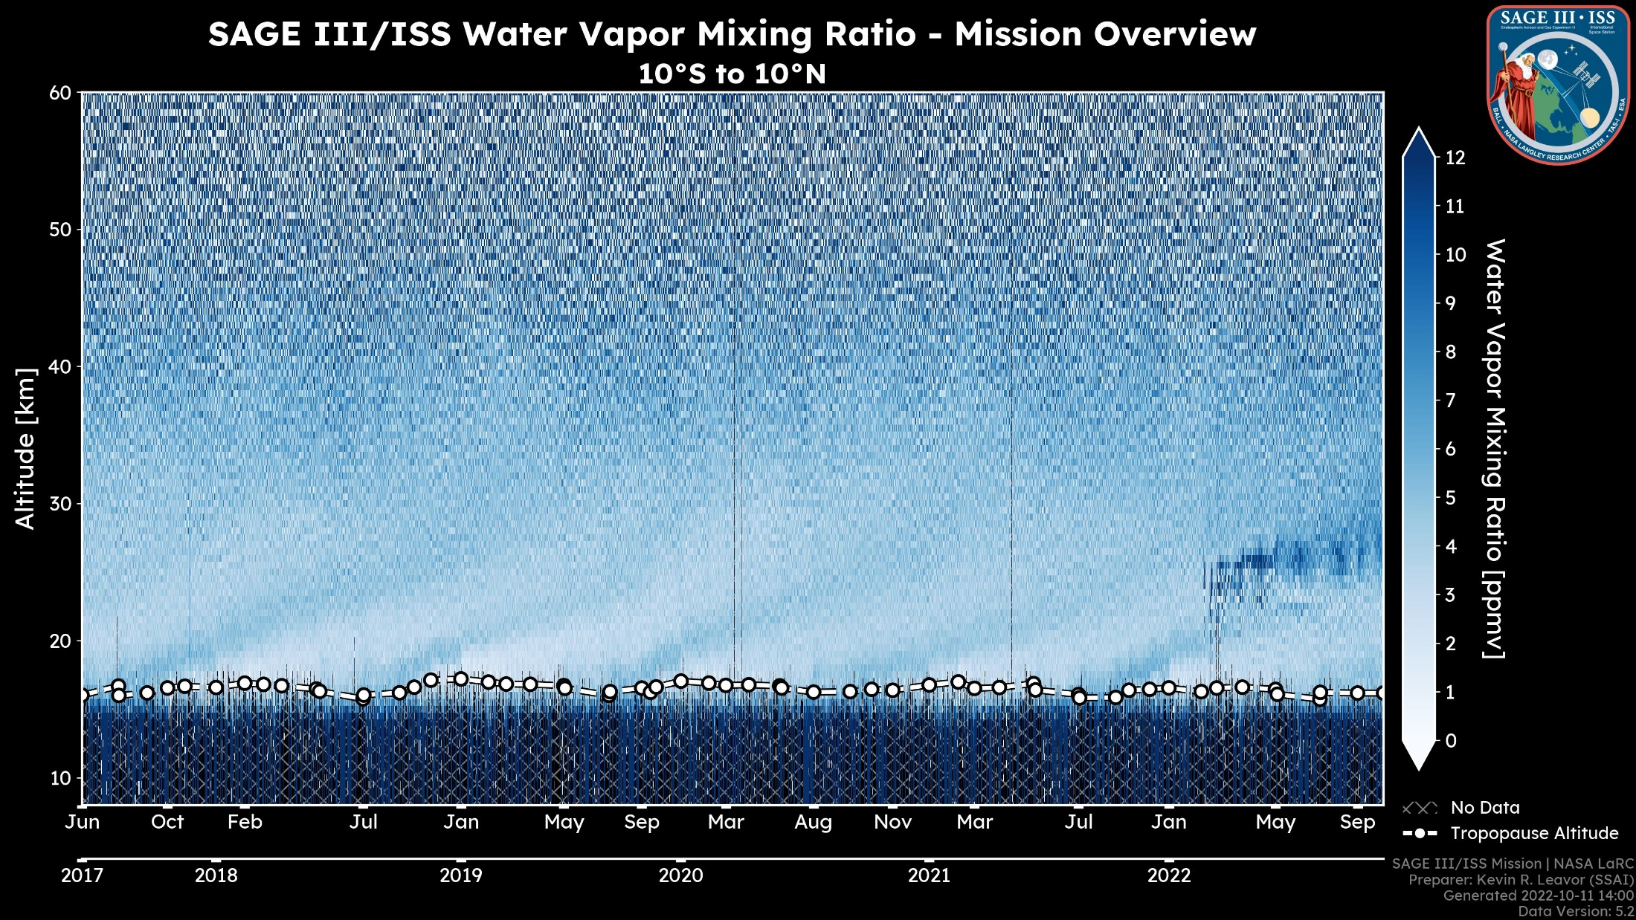

Slide 6
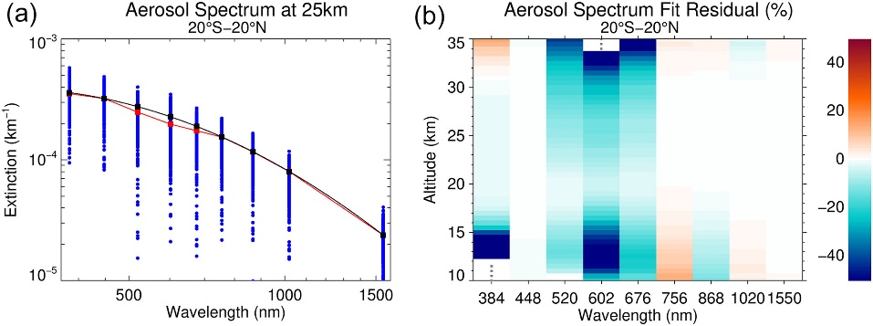
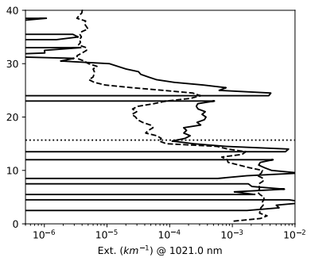
Known Problems
“Aerosol seagull”
Physical disturbances flagged but not otherwise accounted for
Data quality flags largely unpopulated
Misregistration of data in the presence of optically thick layers (top-edge obscuration)
Overzealous automated QA following Hunga Tonga eruption
Wang, et al (JGR Atmospheres, 2020)
1021 nm Aerosol Extinction
2022020734SS
Notes:
- In any of our products, you could point to opportunity for improvement, but a few problems have broader impact.

Slide 7
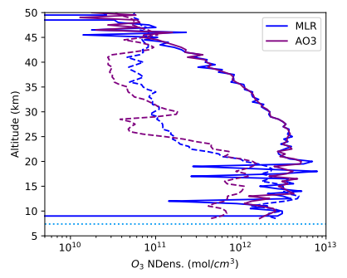
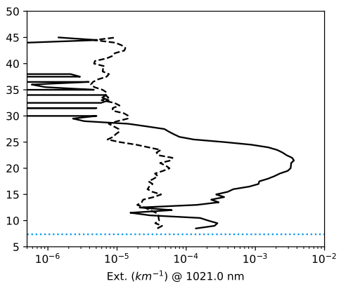
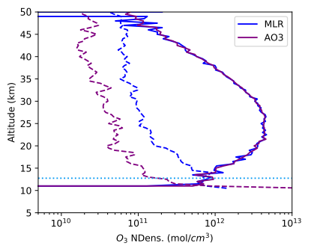
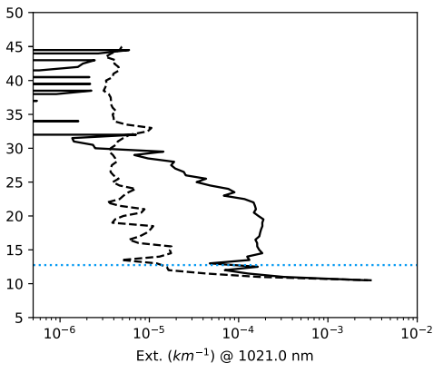
Automated QA
QA before v5.2: 👀; QA now: 🤖
  Triggers include fill-dominated profiles, known instrument errors, suspected blockage, eclipse, etc.
  Less than 1% of solar occultation events are withheld (380 out of 46469)
Of interest lately: Events withheld when “AO3” and “MLR” differ around the ozone maximum
  Through 30-August 2022, 68 solar occultation events withheld because of this criterion
  Only 2 of those prior to Feb 2022
We can adjust QA criteria, but first we should examine what this is telling us about our ozone products
Withheld Event 2022080141SR
Typical Event 2022080107SS
Notes:
66 events is a big chunk of QA, and it’s affecting a period when the data is interesting
Keep 3E-3 aerosol at 21km in mind for the next slide

Slide 8
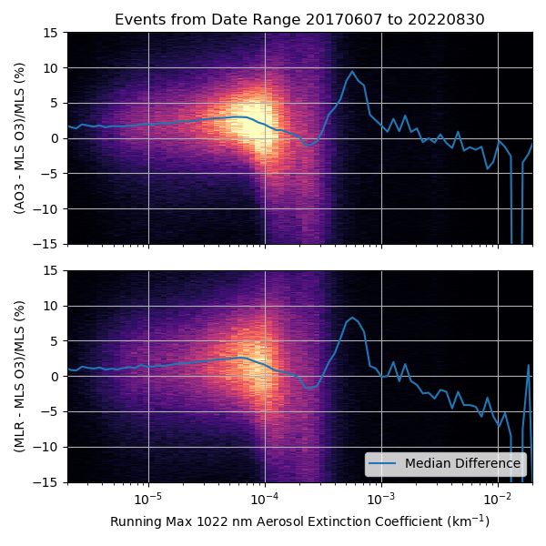
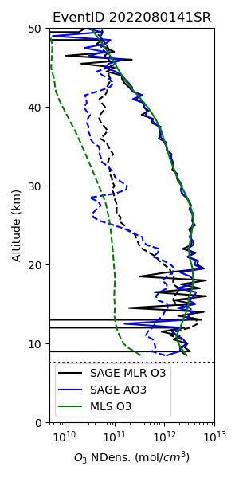
Ozone Products
We use 40570 MLS v4.2 coincidences to check our ozone product response to aerosol loading
  Increasing noise with increasing aerosol, especially with extinction coefficients near and above 10⁻⁴
  Positive bias for most of the dataset turns more negative under high aerosol loading
Looking at the withheld events individually, we find good agreement with MLS despite the noise
Bottom line: We have reason to be confident in our ozone products, particularly “AO3”, and we will release withheld events in the next version with a note on the apparent aerosol-dependent bias
Notes:
2deg latitude, 1000km, 24hrs
Tropopause to 30km
Assuming MLS not affected by aerosol in the same way

Slide 9
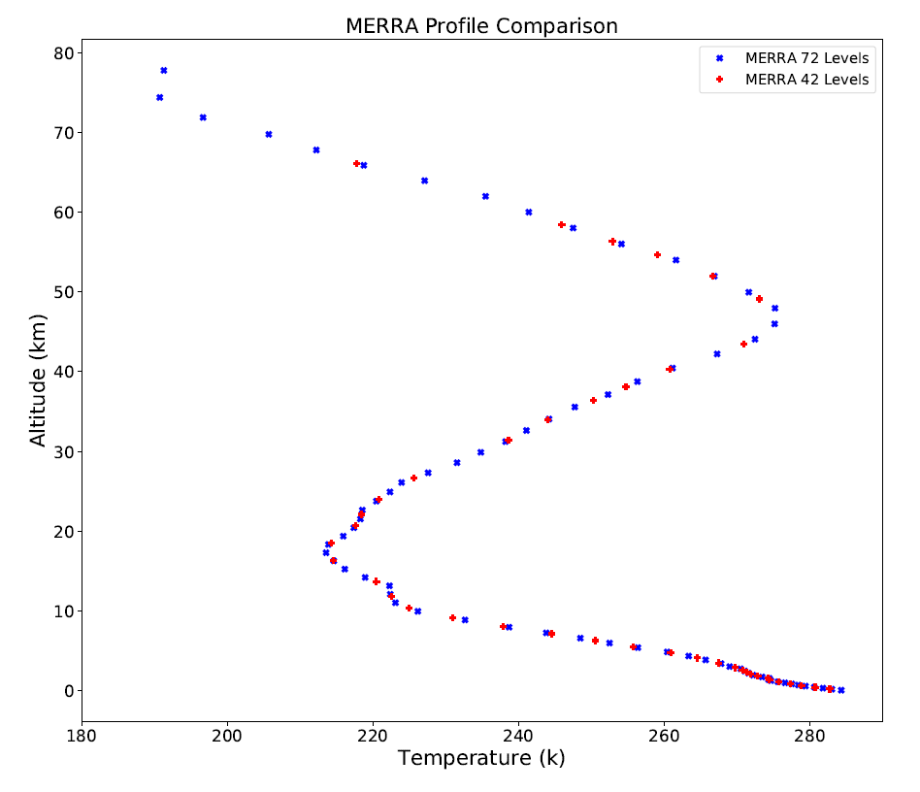
Announcing Version 5.3
Motivated by withheld Hunga Tonga events
Headlined by physical disturbance corrections (next talk – Charles Hill)
(Re-)populating some data quality flags
A change to meteorological input (higher extent, better resolution)
Minor bug fixes, of course
Targeting release by end-of-year
Notes:
inst3_3d_asm_Np (42 pressure levels) -> inst3_3d_asm_Nv (72 model layers)
Met change produced no significant product differences one way or the other through the reliable part of the L2 profiles

Slide 10
Beyond Version 5.3
Algorithm (re-)development
  Focusing on level 1: additional improvements to on-target position & altitude registration, refraction, stray light correction
Housekeeping for existing products
  File formats, extensions (.h5, .dat, .nc4), documentation
  Improved versioning, behind-the-scenes info (input specifics, compiler info, etc.)
Additional products
  Expedited data website – see Danny Mangosing’s talk tomorrow
  Level 3 product – see Mahesh Kovilakam’s talk tomorrow
  Retrieved meteorological profiles – see Michael Pitts’s talk tomorrow

Slide 11



Thanks!
Robbie Manion, Science Computing Facility Lead
robert.manion@nasa.gov
We speak…
Rob Damadeo, Lead Algorithm Scientist
robert.damadeo@nasa.gov
David Flittner, Project Scientist
david.e.flittner@nasa.gov

Slide 12



Ozone Products: Outlier Effect on Median
As shown: No filter
+/- 50% Only
+/- 500% Only
+/- 100% Only
Notes:
2deg latitude, 1000km, 24hrs
Tropopause to 30km
Assuming MLS not affected by aerosol in the same way

