Slide 1



Comparisons with Stratospheric Aerosol and Gas Experiment-III (SAGE III-ISS) Ozone Profiles and Umkehr by Irina Petropavlovskikh, Koji Miyagawa, Jeannette Wild, Larry Flynn
October 13, 2022, SAGE III/ISS ST meeting

Slide 2
Data
SAGE III (v5.2), AO3 retrieval
  SAGE II (1985-2005), SAGE III (2017.06-2022.03)
  Matched time +/- 3 hrs
  Latitude +/- 2 degree ~200 km
  Longitude +/- 2 degree ~200 km
  Individual profile, applied Aks smoothing
  https://asdc.larc.nasa.gov/data/SAGE_III_ISS/g3bsmnc.052/
UMKEHR (UMK)
  UMK Optimized
  Umkehr 61 layers pressure interpolation
Ozonesonde (SND)
  NOAA GML processing
  With Umkehr AK smoothing
Aura MLS (MLS) V4
  Station overpass data from AVDC archive
  https://avdc.gsfc.nasa.gov/pub/data/satellite/Aura/MLS/V04/L2GPOVP_Prof/O3
Notes:
Longitude difference is 2 degrees

Slide 3
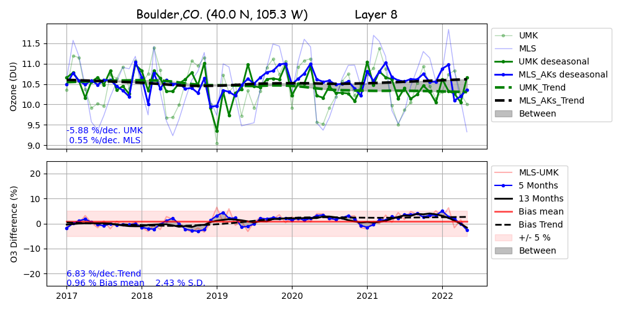
Comparisons between MLS and Umkehr
Boulder, 4-2 hPa, 40-45 km

Slide 4
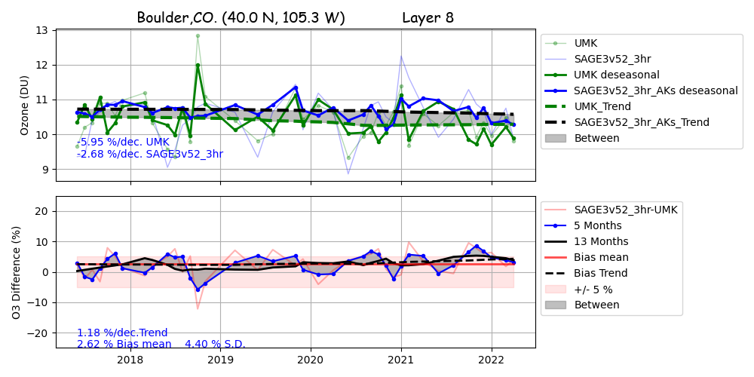
Comparison between SAGE III/ISS and Umkehr
Boulder, 4-2 hPa, 40-45 km

Slide 5
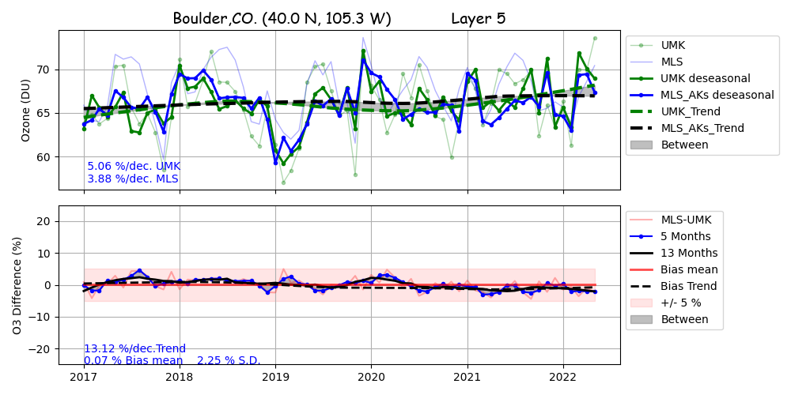
Comparison between Aura MLS and Umkehr
Boulder, 32-15 hPa, 25-30 km
Enhanced Sampling in MLS

Slide 6
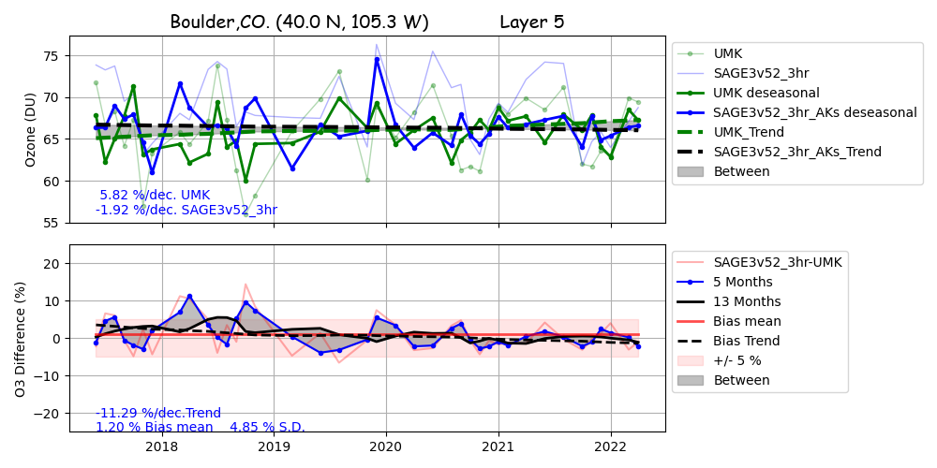

Comparison between SAGE III/ISS and Umkehr
Boulder, 32-15 hPa, 25-30 km
Reduced Sampling in SAGE III/ISS

Slide 7
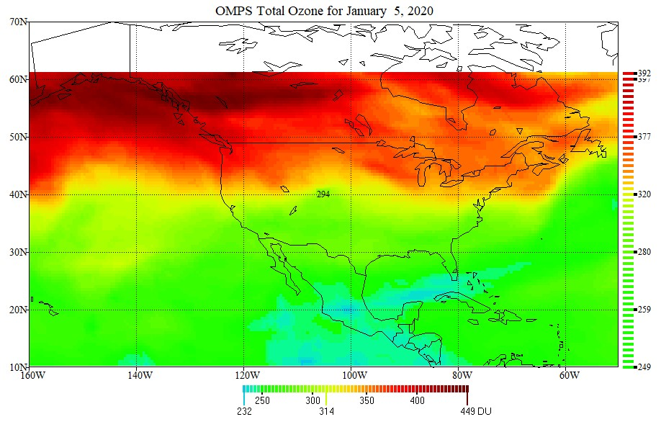
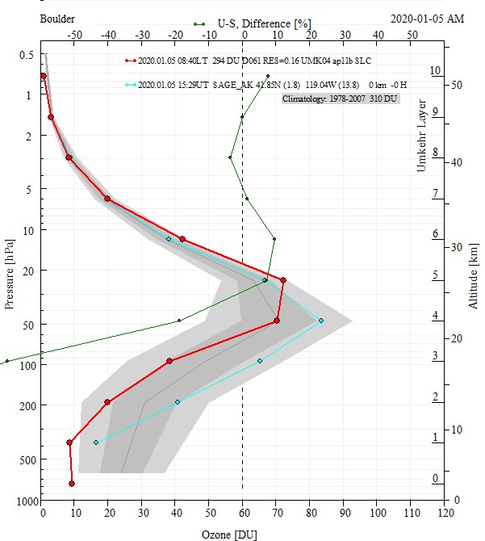
343
SAGE III
BDR

Slide 8
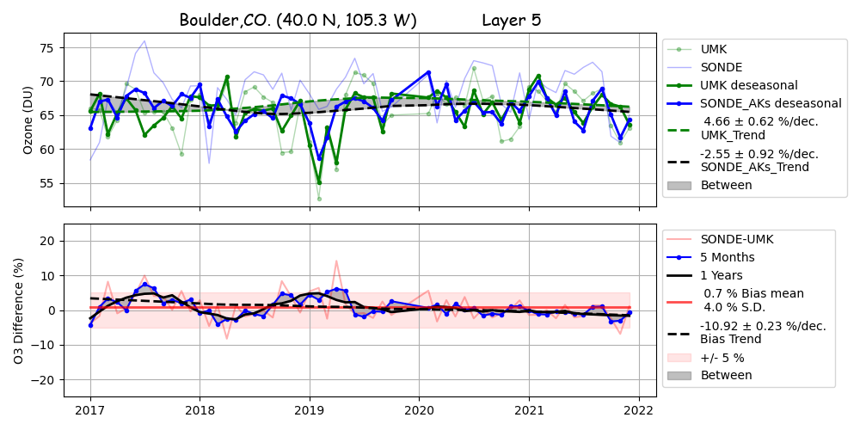
Comparison between sonde and Umkehr
Boulder, 32-15 hPa, 25-30 km

Slide 9
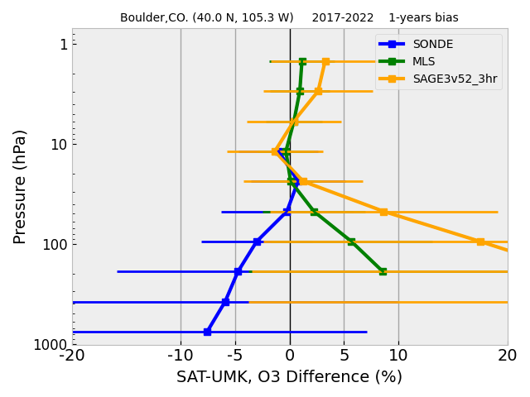
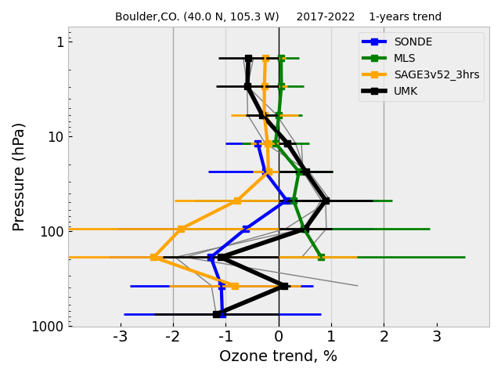
Bias and 5-year tendency in SAGE III-ISS/sonde/Aura MLS/ Umkehr, Boulder

Slide 10
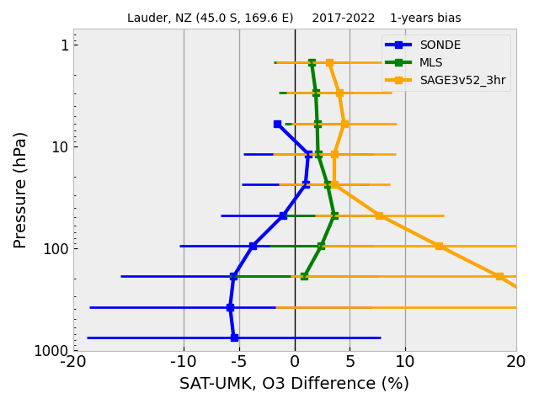
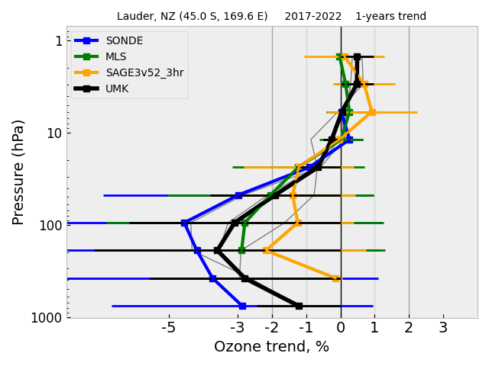
Bias and 5-year tendency in SAGE III-ISS/sonde/Aura MLS/ Umkehr, Lauder

Slide 11
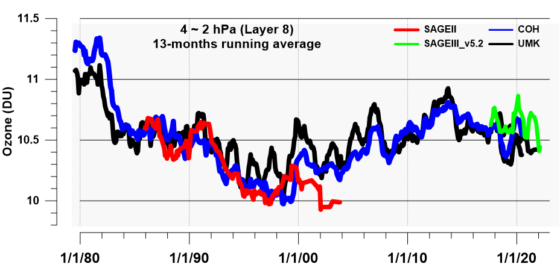
Time series of Umkehr data (MM), SAGE II and SAGE III, and COH in layer 8 (40-45 km), Boulder

Slide 12
LOTUS 2nd Phase
2nd phase (2019 – 2022)
Seasonal trends (Szelag et al., 2020)
Regional trends (Sofieva et al., 2021)
Updated trends based on the LOTUS regression model
Contribution to the WMO Ozone Assessment 2022
Godin-Beekmann, et al, 2022
https://acp.copernicus.org/articles/22/11657/2022/acp-22-11657-2022.pdf
Published September 2022
LOTUS Workshop, TREND 2022, Helsinki, Finland, 30/05 – 03/06/2022

Slide 13
Merged satellite ozone records
Data used in LOTUS19
In LOTUS22
SAGE-MIPAS-OMPS replaced by SAGE-SCIAMACHY-OMPS
All data sets extended to 2020
New version of SBUV MOD and SBUV COH
LOTUS Workshop, TREND 2022, Helsinki, Finland, 30/05 – 03/06/2022

Slide 14
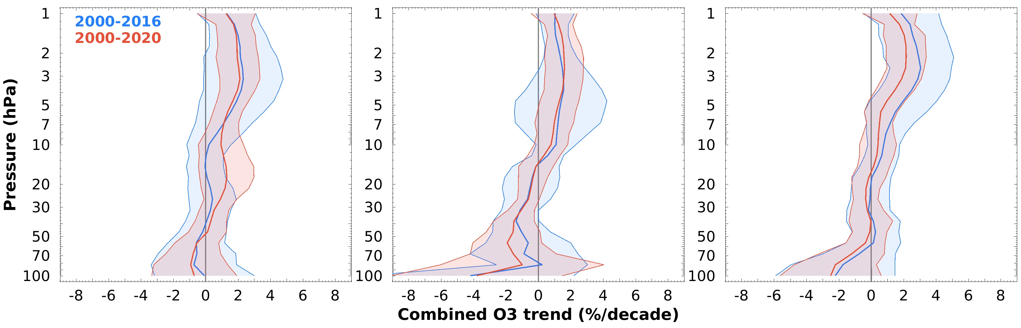
Combined merged satellite trends
60ºS – 35ºS
20ºS – 20ºN
35ºN – 60ºN
Godin-Beekmann, et al, 2022
Generally smaller error bars in LOTUS22 compared to LOTUS19
Positive trends in the upper stratosphere in the 3 broad latitude bands
Similar trends in the middle stratosphere except in SH
Negative trends in the tropics in the lower stratosphere mostly non significant
LOTUS Workshop, TREND 2022, Helsinki, Finland, 30/05 – 03/06/2022

Slide 15
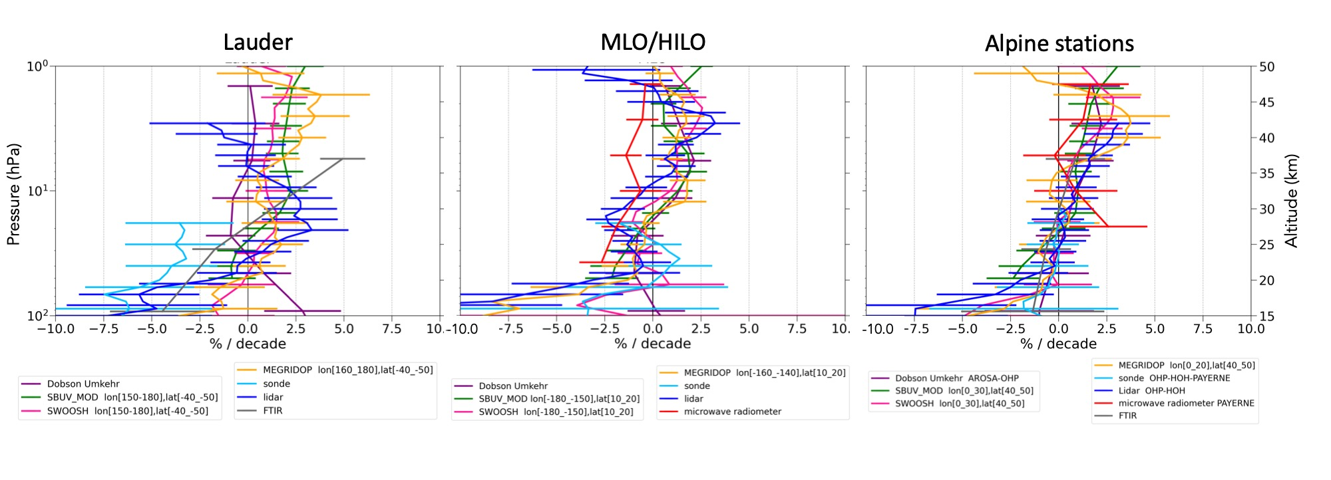
Comparison with ground-based trends
Satellites (longitudinally resolved): MEGRIDOP, SWOOSH & SBUV MOD
GB: O3 sondes, lidar, MWR, FTIR, Umkehr
Godin-Beekmann, et al, 2022
MWR MEGRIDOP
Lidar SBUV MOD
Sondes SWOOSH
Umkehr
FTIR
Alpine stations:
Lidar: Hohenpeissenberg – OHP
Sondes: Hohenpeissenbeg – OHP – Payerne
Umkehr: Arosa – OHP
MWR: Payerne
FTIR: Jungfraujoch – Zugspitze
LOTUS Workshop, TREND 2022, Helsinki, Finland, 30/05 – 03/06/2022

Slide 16
Conclusions
New O3 V5.2 is comparable with the previous version
SAGE III/ISS is stable (considering limited sampling) wrt GB observations
Importance of high vertical resolution ozone, aerosols and WV observation in the absence of MLS to track AC change in the UTLS
Continuation of the SAGE II record is important for verifying the combined satellite records and trend analyses.
Consistency in GB and satellite records is important for ozone recovery monitoring

