Slide 1
SAGE III/ISS Science Team Meeting
Mahesh Kovilakam
Larry Thomason, Travis Knepp
A New Level 3 Aerosol Product for SAGE III/ISS

Slide 2
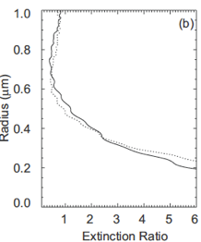
Motivation for this work was to develop a cloud free aerosol product for SAGE III/ISS
Cloud screening algorithm is developed based on a method proposed by Thomason and Vernier (2013) (TV13).
Thomason and Vernier 2013
Notes:
Our goal was to develop a cloud free aerosol extinction product for SAGE III/ISS that can eventually be used for GloSSAC data product.
Thomason and Vernier have implemented this algorithm for volcanically quiescent period. Figure shows a density plot of extinction ratio versus 1020 nm extinction. The vertical green line shows the separation between primary aerosol and enhanced aerosols/ aerosol cloud mixture. The vertical green line is computed using median absolute deviation statistics for the ratios greater than 2.0. The red cure represents an empirical model based on aerosol centroid and an artificial cloud centroid with extinction ratio of 1 and an extinction coefficient of 10-1 km-1. And the data in the tail of the distribution that fall below the curve are flagged as aerosol/cloud mixture. So, for the background period this works reasonably well. However, following perturbed events such as volcanoes/PyroCb, there could be an underestimation of extinction if we use this method as there could be large particle present that may be indistinguishable from clouds.

Slide 3
Volcanic/PyroCb Events
Event Name | Event date | Latitude
Canadian Wildfire | 17 July 2017 | 51⁰N
Ambae eruption | 28 July 2018 | 15⁰S
Ulawun eruption | 22 June 2019 | 5⁰S
Raikoke eruption | 03 August 2019 | 48⁰N
Australian wildfire | 06 January 2020 | 34⁰S
California creek fire | 01 September 2020 | 37⁰N
La Soufriere | 22 April 2021 | 13⁰N
McKay Creek Fire | 29 June 2021 | 54⁰N
Hunga Tonga Eruption | 14 January 2022 | 21⁰S
For SAGE III/ISS, a negative bias is reported recently in aerosol channels (521, 602, and 672 nm) (Wang et al., 2020).
For our analyses, we use version 5.2 data and a wavelength combination of 756 and 1544.
Notes:
So, here we list some of the volcanic/PyroCb events that occurred during SAGE III/ISS mission. Before we, get to the analysis part, here are some points that we noticed. So, for SAGE III/ISS, a negative bias is reported recently in aerosol channels at 521, 602 and 672 nm. We, therefore use a spectrum interpolation at 525 nm using 450 and 756 nm to estimate extinction at 525 nm. And, for all our analyses here, we use 756 and 1544 nm instead of 525 and 1020 nm. While the most commonly used wavelength combinations for SAGE series of measurements are 525 and 1020 nm, we prefer to use a 756 and 1544 nm because 756 and 1544 is a wavelength range of factor of 2 similar to 525 and 1020. Moreover, unlike 525 nm, event termination is less likely to occur at 756 nm channel significantly above 1544 nm channel, particularly when larger aerosols/clouds are encountered.
Since the beginning of the SAGE III/ISS mission, we have witnessed several wildfire and volcanic events that perturbed the stratosphere.

Slide 4
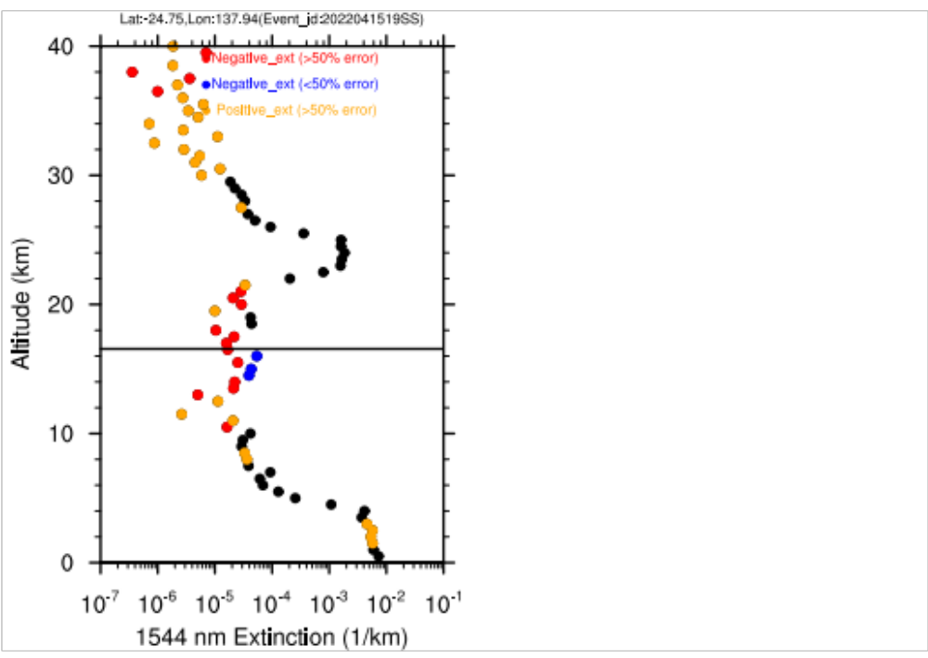
Quality Check of extinction profiles
Notes:
If number of negative and positive extinction datapoints (> 50%) exceeds 1/3rd of total number of data points between tropopause and 25 km then the entire profile is discarded. Using 1/3rd to be on the conservative side.

Slide 5
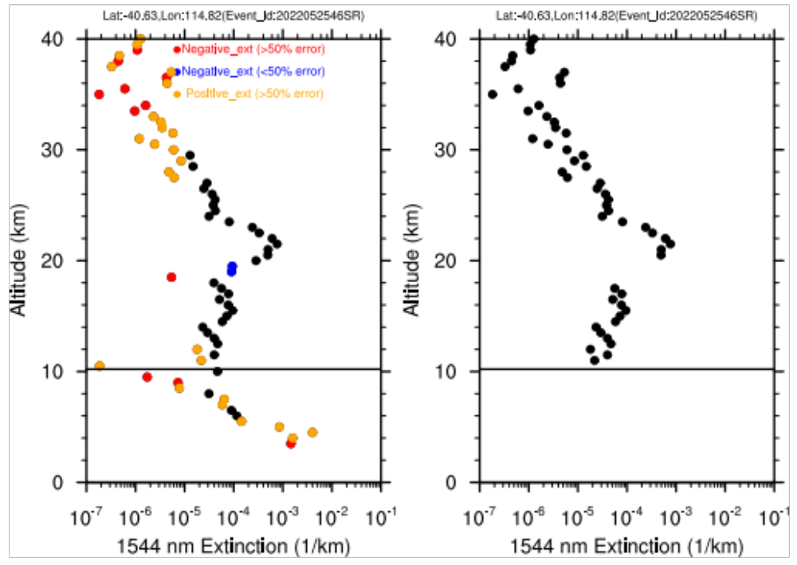
Quality Check of extinction profiles
Notes:
We notice that some profiles report in the vicinity of large positive values. In this case, we remove negative extinction value and the extinction values at adjacent altitudes resulting in the removal of three data points. However, when a negative extinction is observed belo negative extinction in the UTLS region. Here, we have color coded some extinction values. Blue represents negative extinction with less than 50% error whereas red represent negative extinction with error bar greater than 50%. The filtering algorithm here scans negative extinctions are retained. However when they occur at lower altitudes is a sign that measurements are less reliable. for negative values from the top of the profile downward, starting at an altitude of 25 km down to where the profile terminates. The negative extinctions at higher altitudes (> 25) is not unexpected and this happens due to noise and errors in the removal of ozone and molecular scattering, therefore higher altitude
Here, in this between 12 and 14 km near the tropopause region we notice a negative extinction value with error bars less than 50% and is occurringw the tropopause altitude, the screening algorithm is hard coded to terminate the profile at the altitude just above where the negative extinction is observed. The right hand side plot shows the profile after screening.

Slide 6
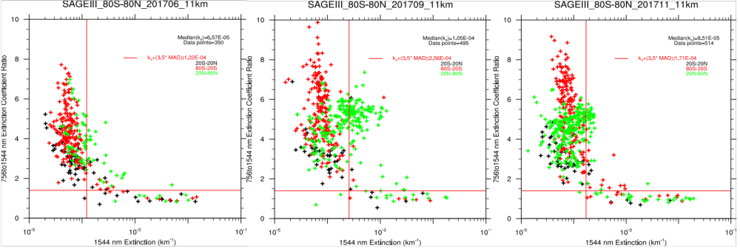
Influence of Volcanic/PyroCb events
Canadian Wildfire (51 N)
Notes:
The vertical red line the separation between primary aerosol and enhanced aerosol. The median absolute deviation statistics. K0 = ka+3.5*MAD, where ka is the median extinction coefficient of the distribution and MAD is the median absolute deviation. We use a factor of 3.5 to estimate outlier based on modified Z-score of simulation study that shows an absolute value of 3.5 can be used to define potential outlier in the above equation.

Slide 7
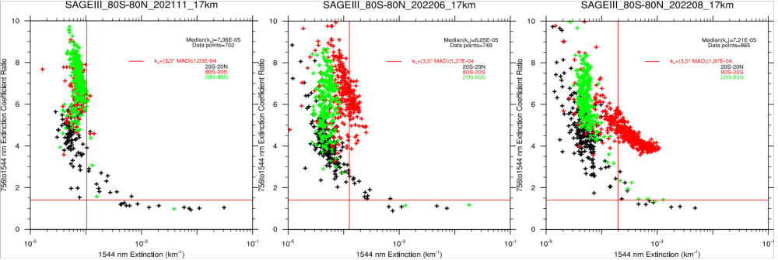
Influence of Volcanic/PyroCb events
Hunga Tonga Eruption (21 S)
Notes:
The vertical red line the separation between primary aerosol and enhanced aerosol. The median absolute deviation statistics. K0 = ka+3.5*MAD, where ka is the median extinction coefficient of the distribution and MAD is the median absolute deviation. We use a factor of 3.5 to estimate outlier based on modified Z-score of simulation study that shows an absolute value of 3.5 can be used to define potential outlier in the above equation.

Slide 8
The New Method
Based on the scatterplots, it is clear that there is inter-hemispheric differences in the data
The monthly data is divided into two latitude bands (80S-20N, 20N-80N). Due to lack of tropical data for the statistical analyses, we decided to add tropical latitude band (20S-20N) to the southern hemispheric latitude band (80S-20S).
Median absolute deviation statistics is used (k₀= Median + 3.5*MAD) to identify enhanced extinction values.
Based on the k₀ time series, the timeframe of volcanic/fire influence on the data is determined. For this, a 20-degree latitude band is considered, centered at the volcanic/fire event latitude.
Notes:
The revised method works reasonably well for the periods during and following perturbed events such as volcanic/PyroCb. We use a time frame to estimate how long the perturbed event influence the aerosol loading in the stratosphere. The influence of any perturbed activity in the stratosphere is estimated from the monthly time series of k0, which is computed using median absolute deviation statistics and is now incorporated in the algorithm so that analyses that fall in this time frame is considered as "Perturbed" due to enhancement in k0 value when compared against the "background" aerosol. Additionally, we use temperature based tropopause to classify the aerosols that are present in the vicinity of the tropopause which is otherwise flagged as "aerosol/cloud mixture".

Slide 9
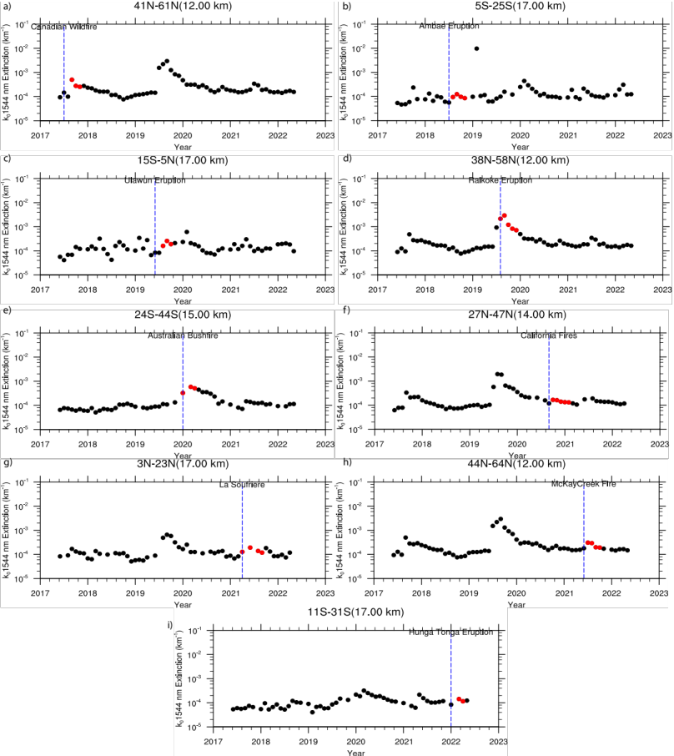
k₀ time series

Slide 10
The New Method (contd..)
Locating aerosol centroid is challenging, especially following perturbed events as it is evident that there is more than one centroid based on the scatter plots
An unsupervised machine learning clustering algorithm (k-medoid clustering) is used to locate aerosol centroid of clusters
We use different flags for Standard (background), Perturbed, Enhanced Aerosol/Tropopause cloud, and Aerosol/Cloud mixture. Additionally, we provide flags for screening of negative extinction values (“Transmission Anomaly”).
Notes:
The revised method works reasonably well for the periods during and following perturbed events such as volcanic/PyroCb.We use a time frame to estimate how long the perturbed event influence the aerosol loading in the stratosphere. The influence of any perturbed activity in the stratosphere is estimated from the monthly time series of k0, which is computed using median absolute deviation statistics and is now incorporated in the algorithm so that analyses that fall in this time frame is considered as "Perturbed" due to enhancement in k0 value when compared against the "background" aerosol. Additionally, we use temperature based tropopause to classify the aerosols that are present in the vicinity of the tropopause which is otherwise flagged as "aerosol/cloud mixture".

Slide 11
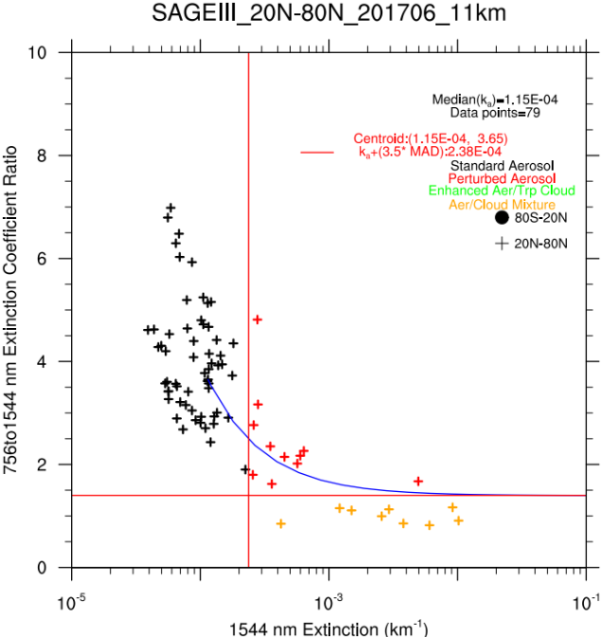
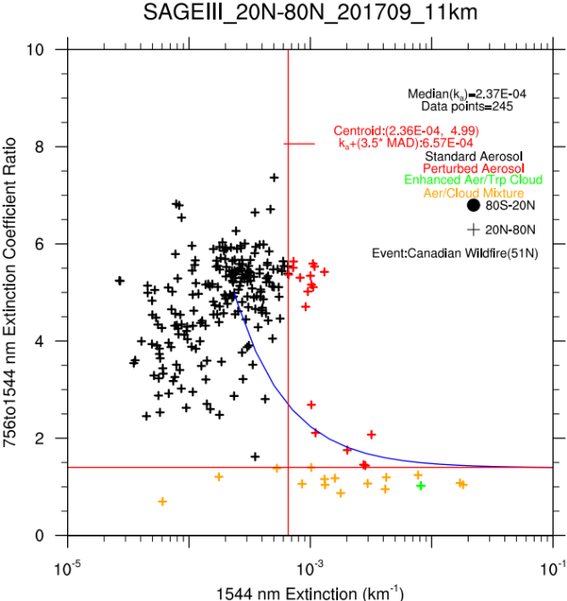
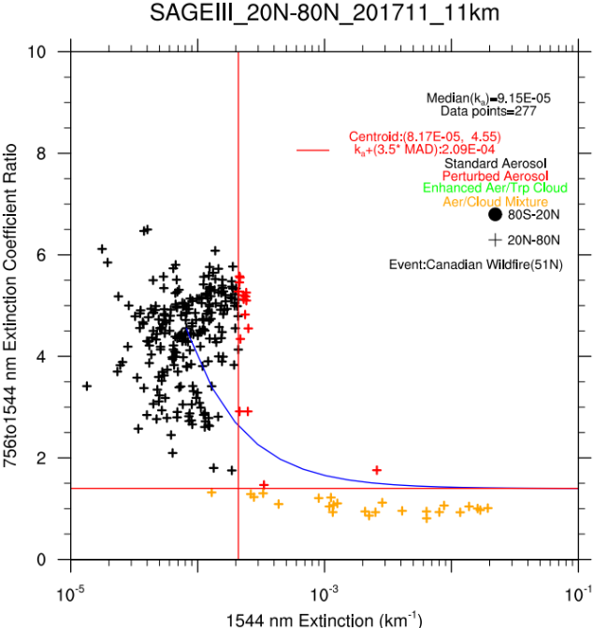
The New Method (contd..)
Notes:
The revised method works reasonably well for the periods during and following perturbed events such as volcanic/PyroCb.We use a time frame to estimate how long the perturbed event influence the aerosol loading in the stratosphere. The influence of any perturbed activity in the stratosphere is estimated from the monthly time series of k0, which is computed using median absolute deviation statistics and is now incorporated in the algorithm so that analyses that fall in this time frame is considered as "Perturbed" due to enhancement in k0 value when compared against the "background" aerosol. Additionally, we use temperature based tropopause to classify the aerosols that are present in the vicinity of the tropopause which is otherwise flagged as "aerosol/cloud mixture".

Slide 12
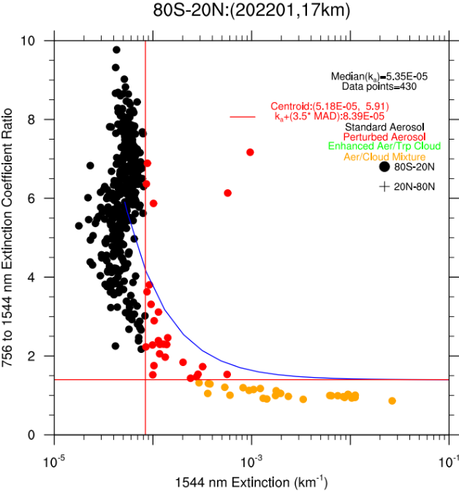
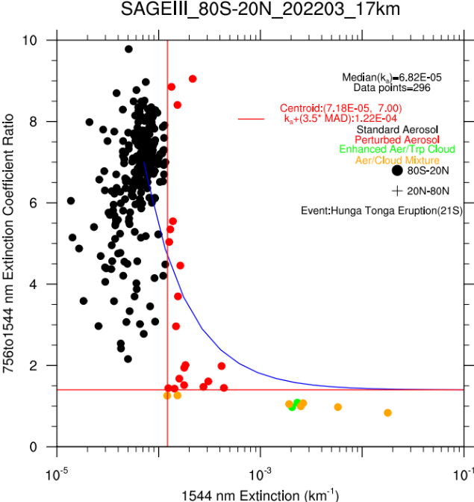
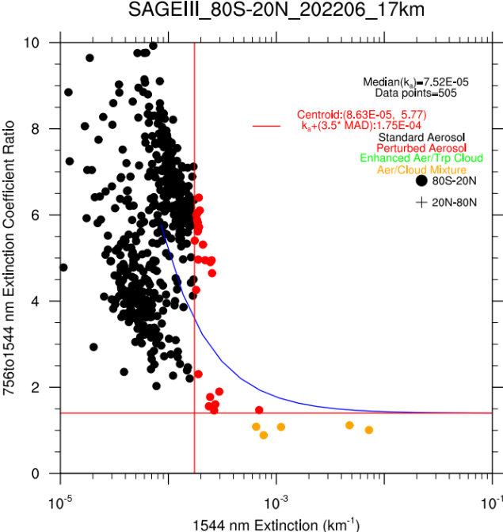
The New Method (contd..)
Notes:
The revised method works reasonably well for the periods during and following perturbed events such as volcanic/PyroCb.We use a time frame to estimate how long the perturbed event influence the aerosol loading in the stratosphere. The influence of any perturbed activity in the stratosphere is estimated from the monthly time series of k0, which is computed using median absolute deviation statistics and is now incorporated in the algorithm so that analyses that fall in this time frame is considered as "Perturbed" due to enhancement in k0 value when compared against the "background" aerosol. Additionally, we use temperature based tropopause to classify the aerosols that are present in the vicinity of the tropopause which is otherwise flagged as "aerosol/cloud mixture".

Slide 13
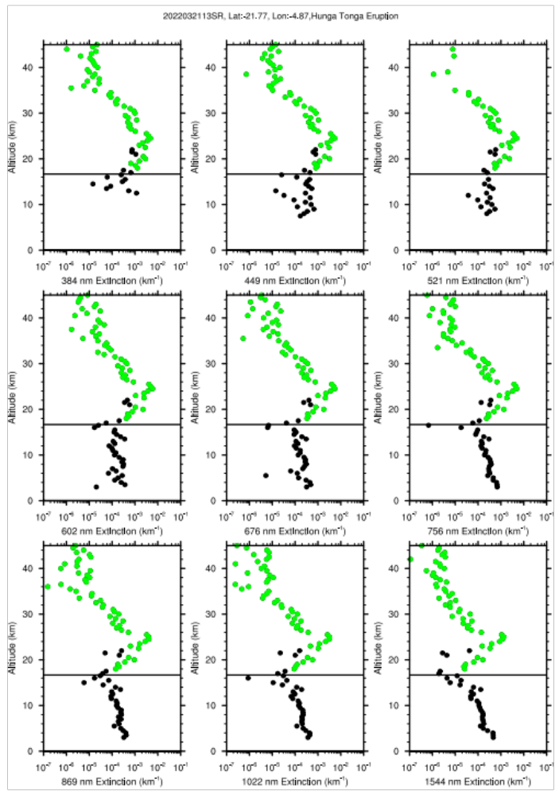
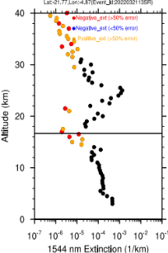
Notes:
Comparison plots of before and after cloud filtering. Black is unfiltered and green is filtered. Flags used for aerosol only (green dots) profile are, “background”, “perturbed”, and “enhanced aerosol/tropopause cloud”.

Slide 15
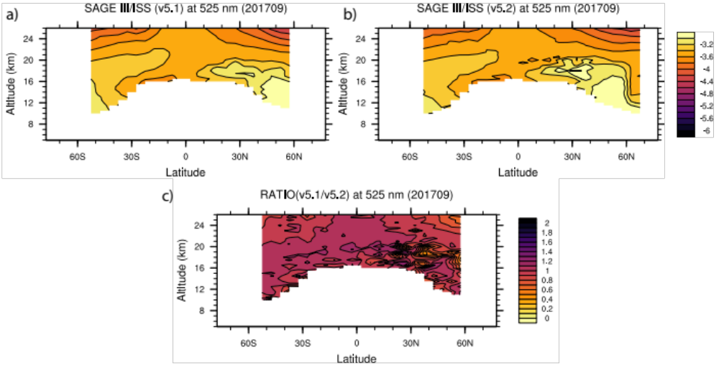
Impact on GloSSAC
Cloud-free SAGE III/ISS data is zonally averaged and binned into 5-degree latitude bands on a monthly basis and at 0.5 km altitude resolution for incorporating the data into GloSSAC.

Slide 16
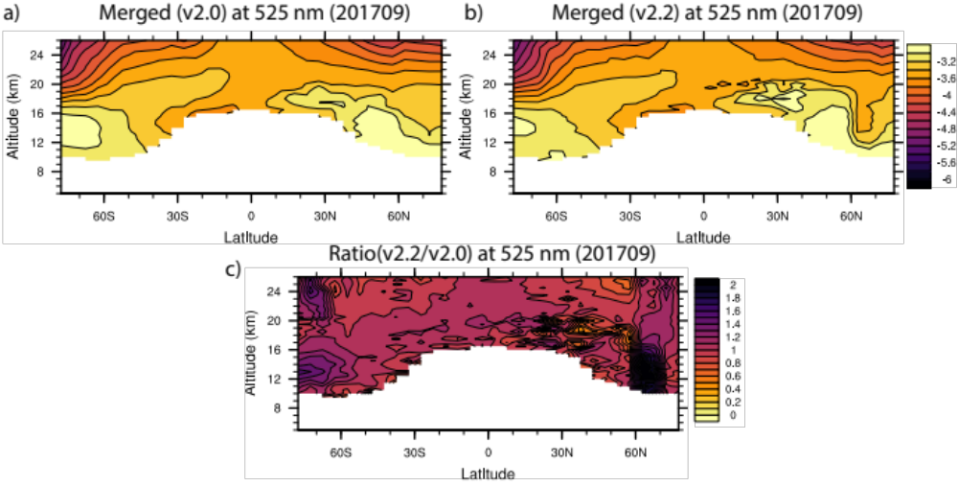
Impacts on GloSSAC
OSIRIS and CALIOP data are used to fill in gaps in the data for the post-2005 time period.
A conformance process for OSIRIS and CALIOP data is used before merging individual data.
Notes:
“Conformance follows the basic paradigm of v1.0 but has changed in some instances to reflect better understanding of instrumental differences. The need for long-term consistency among data sets effectively requires that OSIRIS be brought into conformance (bias reduced as much as possible) with SAGE II measurements (Kovilakam et al., 2020)”.

Slide 17
Summary
Revised cloud screening algorithm works reasonably well, accounting for perturbed events.
The new Level 3 product consists of flags which can be used to filter out possible aerosol/cloud mixtures. We plan to make the Level 3 product publicly available by mid November.
Different flags are provided: Standard (background), Perturbed, Enhanced Aerosol/Tropopause cloud, Aerosol/Cloud mixture, and PSC. Additionally, we provide flags for screening of negative extinction values (“Transmission Anomaly”).
For aerosol only data, we recommend to use flags that are “background aerosol”, “perturbed aerosol”, and “enhanced aerosol/tropopause cloud” .
We incorporate this data into the latest GloSSAC (v2.2). Differences between this version and the previous version (v2.0) are attributable to version differences of individual data sets, and improved cloud screening of SAGE III/ISS data

Slide 18
Backup Slides

Slide 19
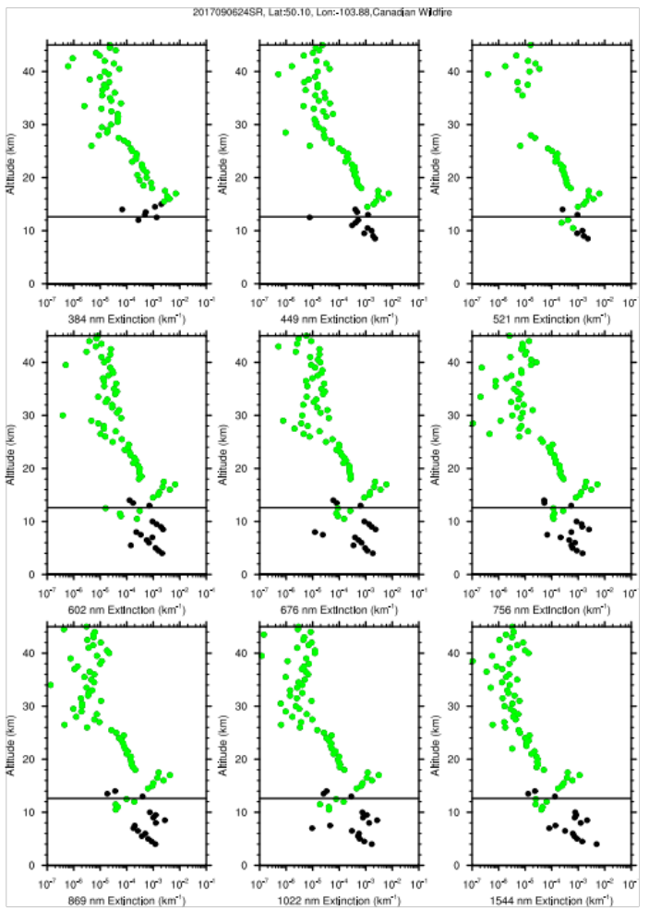
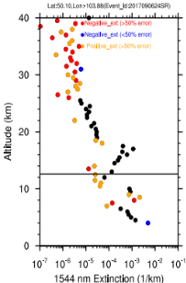
Notes:
Comparison plots of before and after cloud filtering. Black is unfiltered and green is filtered. Flags used for aerosol only (green dots) profile are, “background”, “perturbed”, and “enhanced aerosol/tropopause cloud”.

