Slide 1
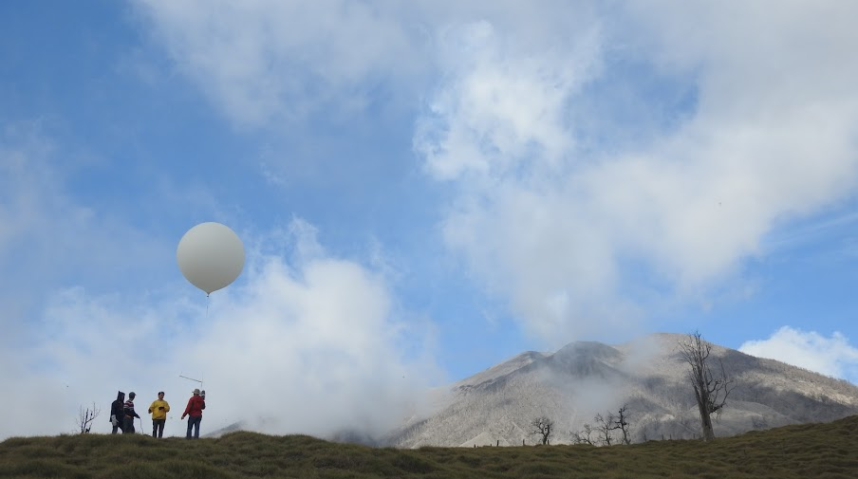


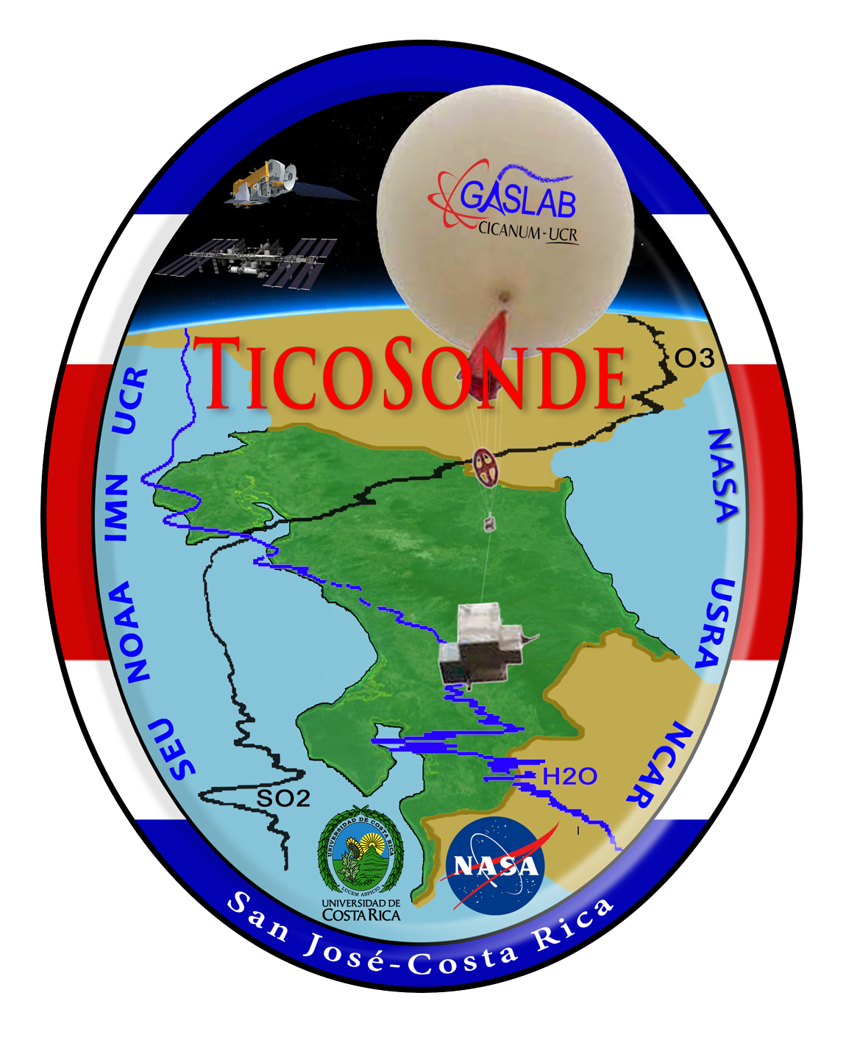

Ticosonde: 16 Years of Balloon-borne Ozone and Water Vapor Profiles in Costa Rica for Satellite and Model Evaluation
NASA: Ryan Stauffer* (NASA PI); Julie Nicely (UMD PI); Anne Thompson; Megan Damon; Ghassan Taha; Susan Strahan; Rennie Selkirk; Debra Kollonige. UCAR: Holger Vömel. NOAA: Sean Davis; Bryan Johnson.
UCR: Elian Conejo; Ernesto Corrales; Alfred Alan; Andrés Diaz
*Email: ryan.m.stauffer@nasa.gov
SAGE III/ISS Science Team Meeting
5 November 2021

Slide 2
Talk Roadmap
Ticosonde quick facts and status update: Four more years!
Comparisons with SAGE-III/ISS, Aura MLS, satellite ozone
  Improvements to both SAGE v5.2 and Aura MLS v5 water vapor
  Update to the ozonesonde stratospheric low bias “dropoff”
Model ozone comparisons: Costa Rica is a difficult case!

Slide 3


Ticosonde Quick Facts (2005-Present)
Ozonesonde Profiles (SHADOZ): >650
CFH Water Vapor Profiles (NDACC): >230
Only long-term in-situ tropical (10° N) water vapor sounding data set in existence
Cryogenic Frostpoint Hygrometer (CFH) water vapor and ozonesonde soundings are currently coordinated with SAGE III/ISS occultations
Ticosonde featured annually in the AMS State of the Climate Report
Website: https://acd-ext.gsfc.nasa.gov/Projects/Ticosonde/index.html

Slide 4
Ticosonde Updates
Successful NASA UACO Proposal Early 2021: Four more years of water vapor and ozonesonde profiles in San Pedro!
^Also includes ozonesonde profiles from San Cristóbal (reactivated SHADOZ station) and Quito, Ecuador (data since 2014)
Team Additions: J. Nicely (UMD PI), E. Conejo (UCR PI; thank you, Andrés!), M. Cazorla (USFQ PI), E. Herrera (USFQ Quito), A. Pila (USFQ San Cristóbal)

Slide 5
Comparisons with Satellite Data

Slide 6
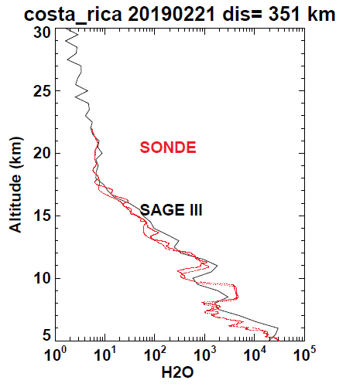
Ticosonde Water Vapor vs. SAGE-III/ISS
CFH scheduling for SAGE-III/ISS Overpasses allows for water vapor comparisons into the mid-to-upper troposphere. Thanks to Carrie Roller for overpass notifications!
Figure: Water vapor structure well-represented down to 5 km in SAGEv5.2 on 21 Feb 2019 profile
Coincidence Criteria: 6° lat, 30° lon, same day: 47 SAGE-III/ISS and Costa Rica water vapor matches (includes multiple coincidences for single CFH sonde)
Water vapor mixing ratio profiles for CFH and SAGE on 21 Feb 2019. Credit: G. Taha

Slide 7
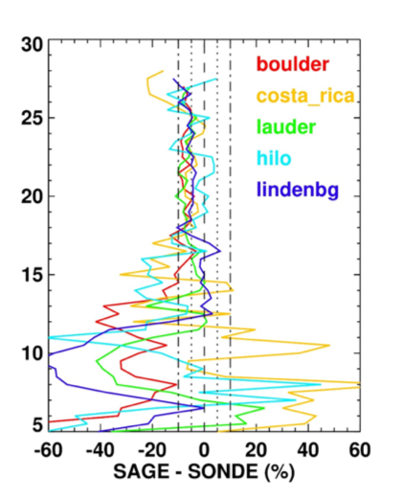
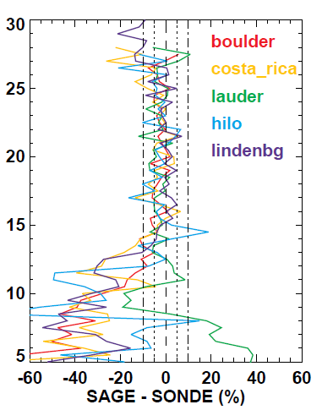
Ticosonde Water Vapor vs. SAGE-III/ISS
v5.1 Water Vapor
v5.2 Water Vapor
Left: v5.1 Water Vapor. ~5-10% SAGE-III/ISS dry bias above 20 km
Right: v5.2 Water Vapor. 0-5% agreement even down to 15 km and above
Thanks to G. Taha for SAGE-III/ISS comparison figures
Summary mean differences at NDACC water vapor hygrometer sonde stations. Left: Versus SAGE-III/ISS v5.1. Right: Versus v5.2. Credit: G. Taha

Slide 8
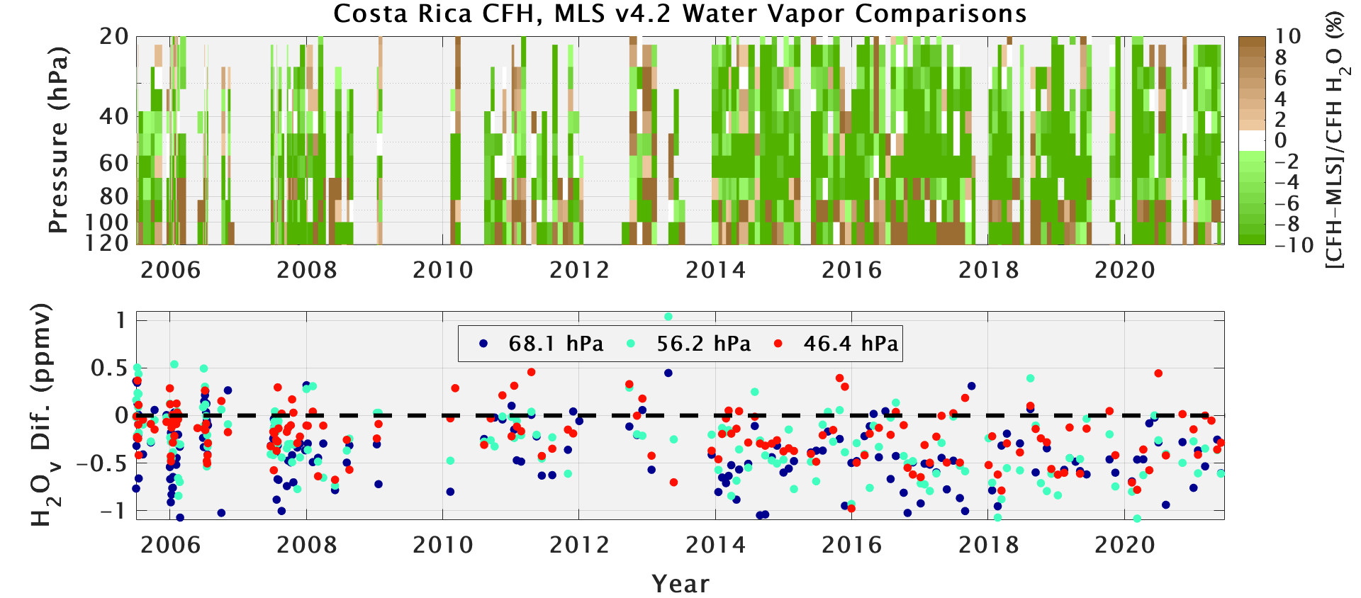
Ticosonde Water Vapor vs. Aura MLS v4.2
Comparisons with Aura MLS on MLS pressure levels. Green = MLS higher, Brown = MLS lower
A global survey of frost point sonde comparisons with the Aura MLS record (Hurst et al., 2016) showed a positive drift in MLS of ~1%/year
The drift was less severe at Costa Rica, but it is still apparent (MLS wet bias)
Time series of Costa Rica CFH water vapor profile comparisons with Aura MLS v4.2 data

Slide 9
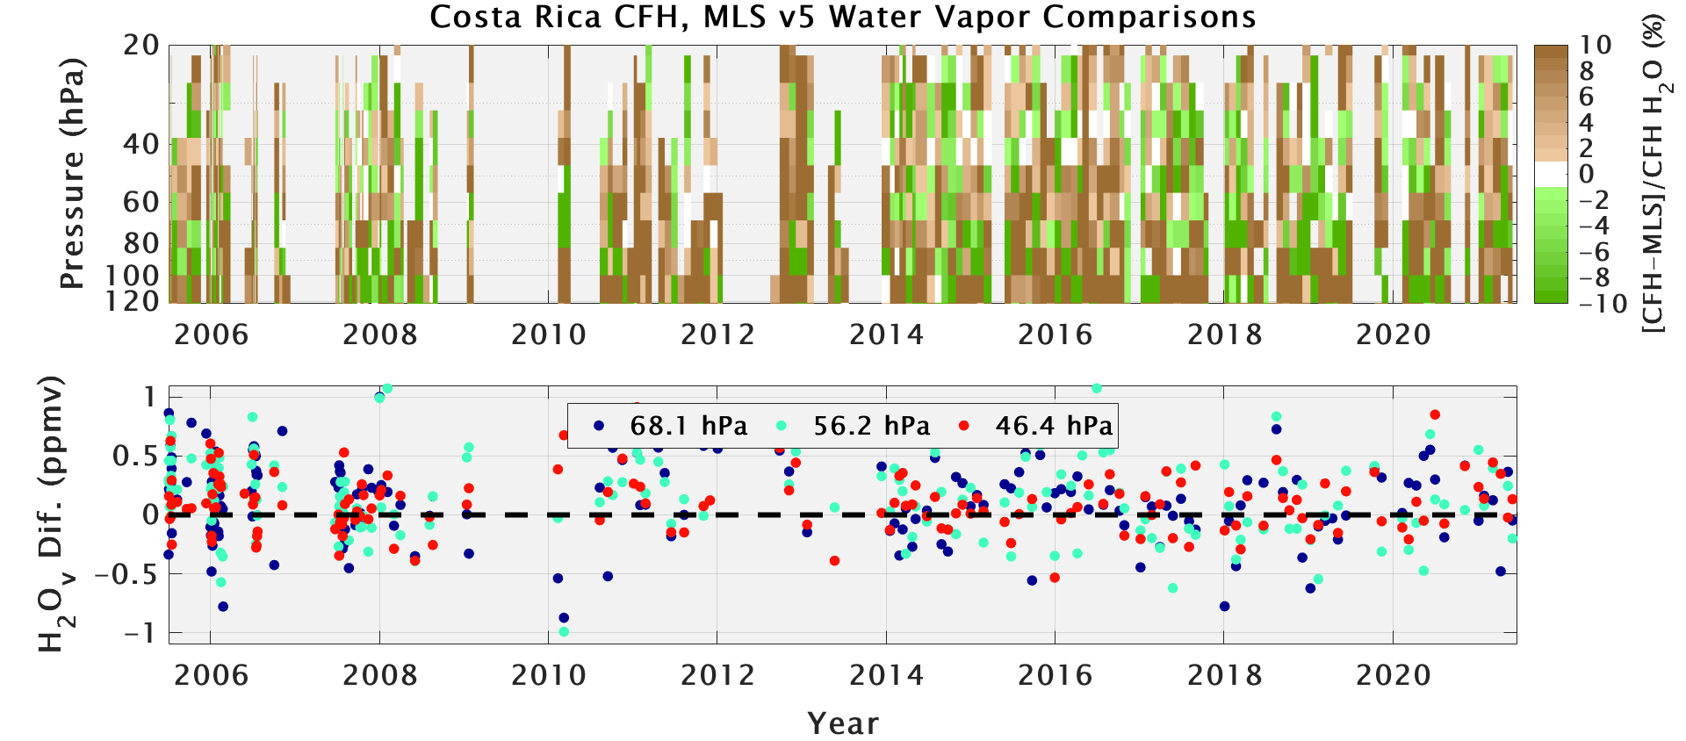
Ticosonde Water Vapor vs. Aura MLS v5
Comparisons with Aura MLS on MLS pressure levels. Green = MLS higher, Brown = MLS lower
New v5 Aura MLS water vapor data
Livesey et al. (2021) published updated comparisons showing no MLS v5 drift relative to ACE-FTS, and reduced drift compared to sondes
v5 comparisons with Costa Rica CFH data are improved
Time series of Costa Rica CFH water vapor profile comparisons with Aura MLS v5 data

Slide 10
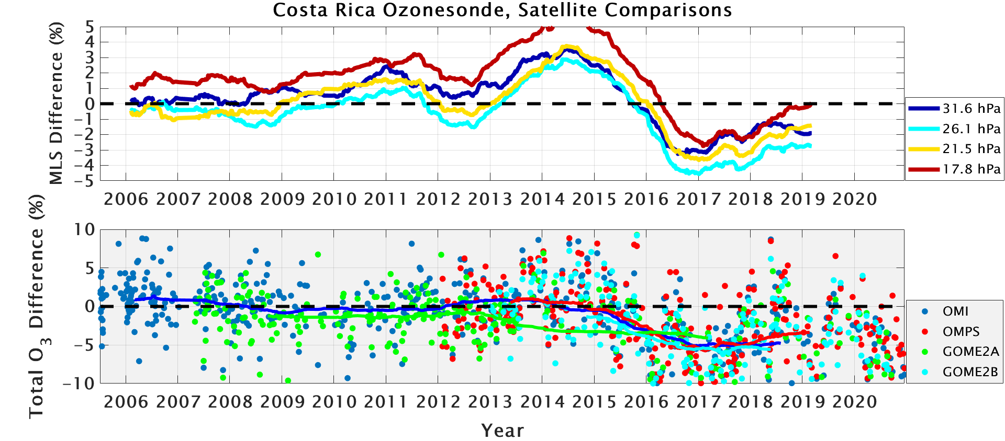
Ticosonde Ozone (“Dropoff”)
Moving average of comparisons with Aura MLS v5 ozone on MLS pressure levels
Post-2013 ozonesonde “dropoff” (Stauffer et al., 2020) continues to affect Costa Rica O₃ data
Costa Rica *is not* the only station with this issue
Update: We have a promising lead on manufacturing changes that may cause this. We are performing tests at the Costa Rica station to examine this change
Total O₃ drop of ~5 %
Total O₃ comparisons with OMI, OMPS, and GOME2A and 2B overpasses

Slide 11
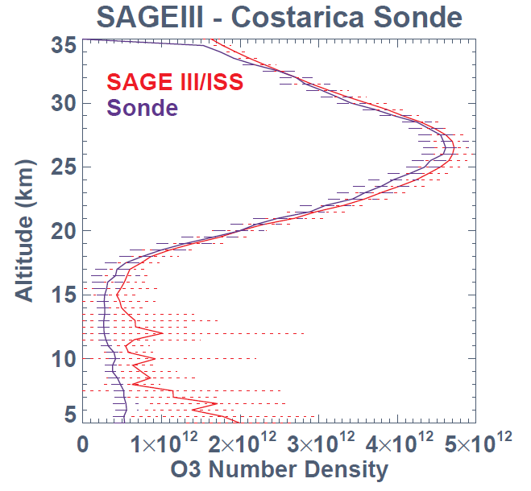
Ticosonde Ozone (“Dropoff”)
Post-2013 ozonesonde “dropoff” (Stauffer et al., 2020) continues to affect Costa Rica O₃ data
Costa Rica *is not* the only station with this issue
Update: We have a promising lead on manufacturing changes that may cause this. We are performing tests at the Costa Rica station to examine this change
The low bias likely also affects SAGE-III/ISS comparisons (N = 70). Credit: G. Taha

Slide 12
NASA/GSFC Model Ozone Comparisons

Slide 13
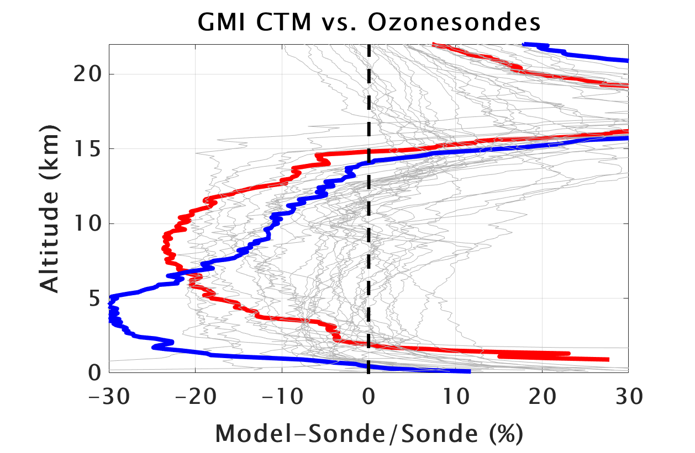
Costa Rica Ozone vs. GMI CTM Model
← Model biased low
Model biased high →
NASA/GSFC Global Modeling Initiative (1980-2016) model simulation
Match model ozone profile output to same hour as ozonesonde launches
Comparisons (2005-2016) show that the model performs the worst at Costa Rica and San Cristóbal out of 37 global stations analyzed (Stauffer et al. 2019; JGR). MERRA-2 GMI model is similar
Notable high bias in UT/LS and near the surface at most stations
Costa Rica
San Cristóbal
Mean ozone profile comparisons between GMI CTM and 37 global ozonesonde sites (1980-2016)

Slide 14
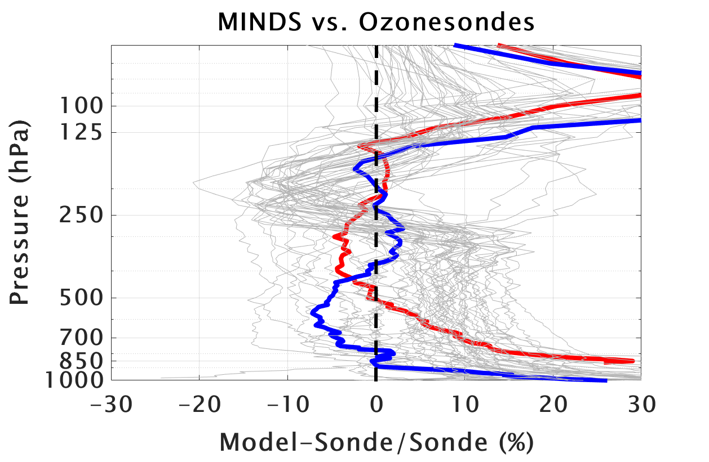
Costa Rica Ozone vs. “MINDS” Model
← Model biased low
Model biased high →
NASA/GSFC “MINDS” (1995-2020) model simulation. Updates to chemistry and emissions vs. GMI CTM
Match model ozone profile output to same hour as ozonesonde launches
Comparisons (2005-2020) show vast improvements in the model ozone low bias at Costa Rica and San Cristóbal (57 global stations shown here). UT/LS bias remains
Working with NASA/GSFC modelers to continue to improve model ozone simulations
Costa Rica
San Cristóbal
Mean ozone profile comparisons between MINDS and 57 global ozonesonde sites (1995-2020)

Slide 15
Summary
The 16-year Ticosonde program has amassed hundreds of in-situ ozone and water vapor profiles for satellite and model evaluation. Four more years of funding
Improvements in latest SAGE-III/ISS v5.2 and Aura MLS v5 water vapor compared to Costa Rica sonde measurements
Ozonesonde “dropoff” problem affects comparisons with satellite ozone measurements, but we are making progress on solving the issue
Modeling ozone profiles over Costa Rica is difficult, but NASA/GSFC is making significant improvements

Slide 16
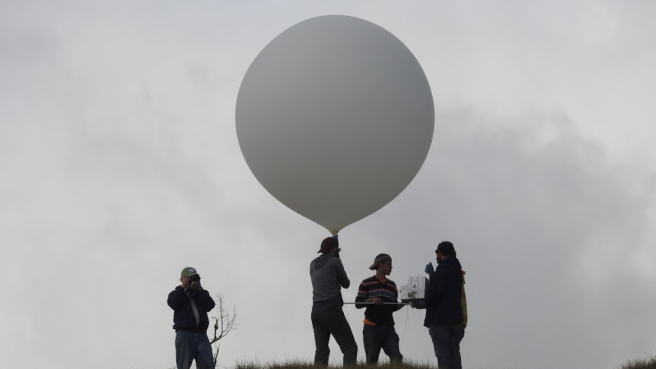
Thank You!
*K. Jucks, UACO Program Manager and NASA HQ for continued support of Ticosonde*
Data:
SHADOZ Ozone: https://tropo.gsfc.nasa.gov/shadoz/CostaRica.html
NDACC H₂O: https://www-air.larc.nasa.gov/missions/ndacc/data.html
AVDC SO₂ (Turrialba & Poás): https://avdc.gsfc.nasa.gov/pub/tmp/TICOSONDE_SO2_archive/data/
Select References:
Vömel, H., et al. (2016), An update on the uncertainties of water vapor measurements using cryogenic frost point hygrometers, Atmos. Meas. Tech., https://doi.org/10.5194/amt-9-3755-2016.
Stauffer, R. M., et al. (2019), The effects of a 1998 observing system change on MERRA‐2‐based ozone profile simulations, J. Geophys. Res. Atmos., https://doi.org/10.1029/2019JD030257.
Stauffer, R. M., et al. (2020), A post‐2013 dropoff in total ozone at a third of global ozonesonde stations: Electrochemical concentration cell instrument artifacts? Geophysical Research Letters, https://doi.org/10.1029/2019GL086791.
Vömel, H., et al. (2020), A new method to correct the ECC ozone sonde time response and its implications for “background current” and pump efficiency, Atmos. Meas. Tech. https://doi.org/10.5194/amt-2020-62

Slide 17
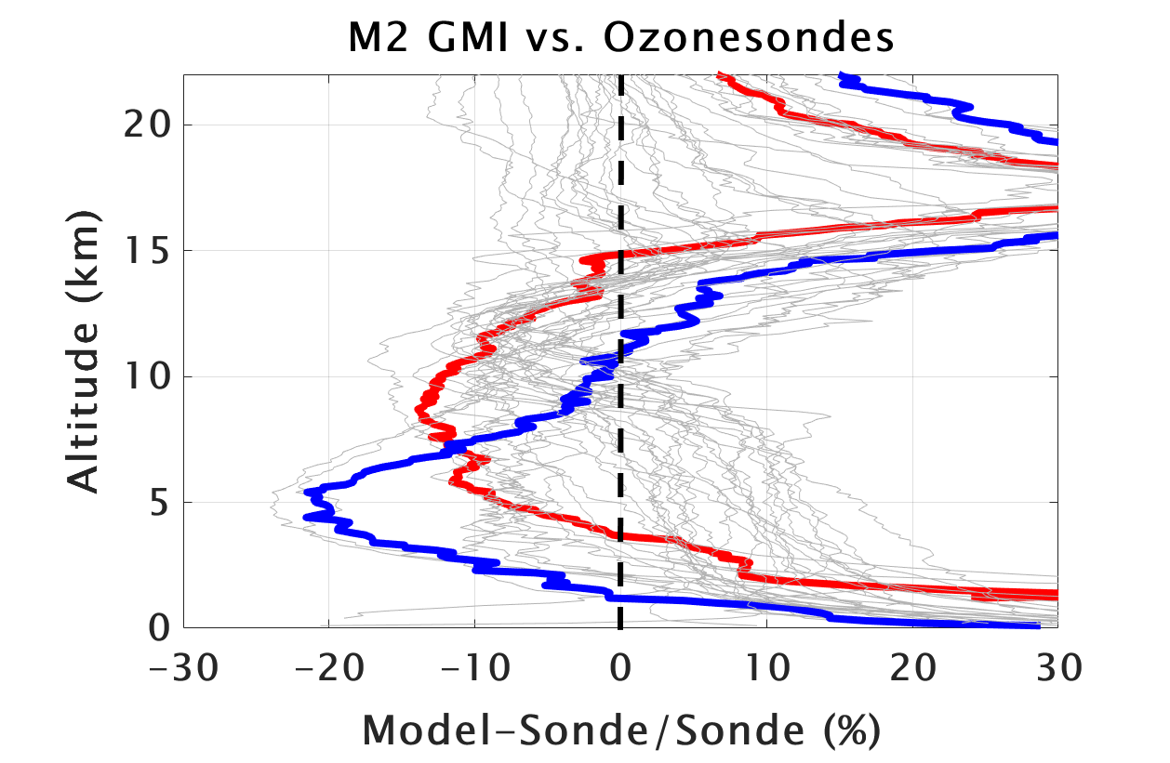
Costa Rica Ozone vs. MERRA-2 GMI Model
← Model biased low
Model biased high →
NASA/GSFC MERRA-2 GMI (1980-2016) model simulation. Some updates to chemistry and emissions, and transport from CTM
Match model ozone profile output to same hour as ozonesonde launches
Comparisons (2005-2016) show that the model still performs among the worst at Costa Rica and San Cristóbal out of 37 global stations analyzed (Stauffer et al. 2019; JGR)
High bias near the surface at all stations is worse. UT/LS high bias remains
Costa Rica
San Cristóbal
Mean ozone profile comparisons between M2 GMI and 37 global ozonesonde sites (1980-2016)

