Slide 1
SAGE III Limb Scatter Retrievals
Glen Jaross, Natalya Kramarova | NASA Goddard Space Flight Center
Ghassan Taha | Universities Space Research Association
SAGE 3 STM, 4-Nov, 2021

Slide 2
Proposed effort
Improve ozone and aerosol product performance
  evaluate performance using more LS data
  refine technique for Tangent Height determination
  adjust stray light correction as needed
Create operational products
  transition from mimicking OMPS to true SAGE retrievals
  use of SAGE Occultation aerosols in ozone retrieval
  performance diagnostics
Demonstrate / document SAGE LS performance
  ozone comparisons with MLS (via MERRA-2), SAGE Occ., etc.
  extinction comparisons with SAGE Occ. zonal means
  ATBD
Multi-wavelength aerosol extinction retrievals
  if adequate performance can be achieved

Slide 3
OMPS LS retrieval algorithms
Aerosol v1.5 algorithm
Ozone v2.5 algorithm
Computes extinction profile at 675 nm;
Radiances are normalized at 40 km;
Gamma size distribution in Mie calculation;
Chahine’s non-linear relaxation algorithm;
Cut off at cloud top;
Residuals calculated at 8 wavelengths.
3 UV pairs and 1 VIS triplet;
Radiances are normalized at 55 km for UV and 40 km for VIS ranges (no retrievals above);
Include the explicit aerosol correction by using LP-derived aerosols;
Algorithm uses realistic a priori covariance matrices instead of Tikhanov regularization;
Limited wavelengths allow us to better isolate instrumental issues

Slide 4

ISS SAGE LS operations
Limb Scatter scan pattern
4 – 20 min. on day side (solar beta dependent)
typically equatorial
fast scans to 250 km every 6th scan
We’ve been working with 6 orbits of 9-13 scans each
Forward Scatter
1 orbit
Back Scatter
1 orbit
Side Scatter
4 orbits
Notes:
Scan head heats up after use, so operators desire to limit heating
Approximately one scan per minute

Slide 5
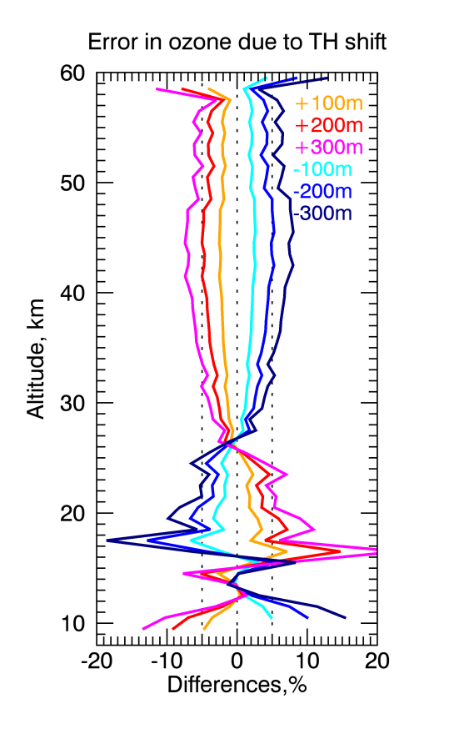
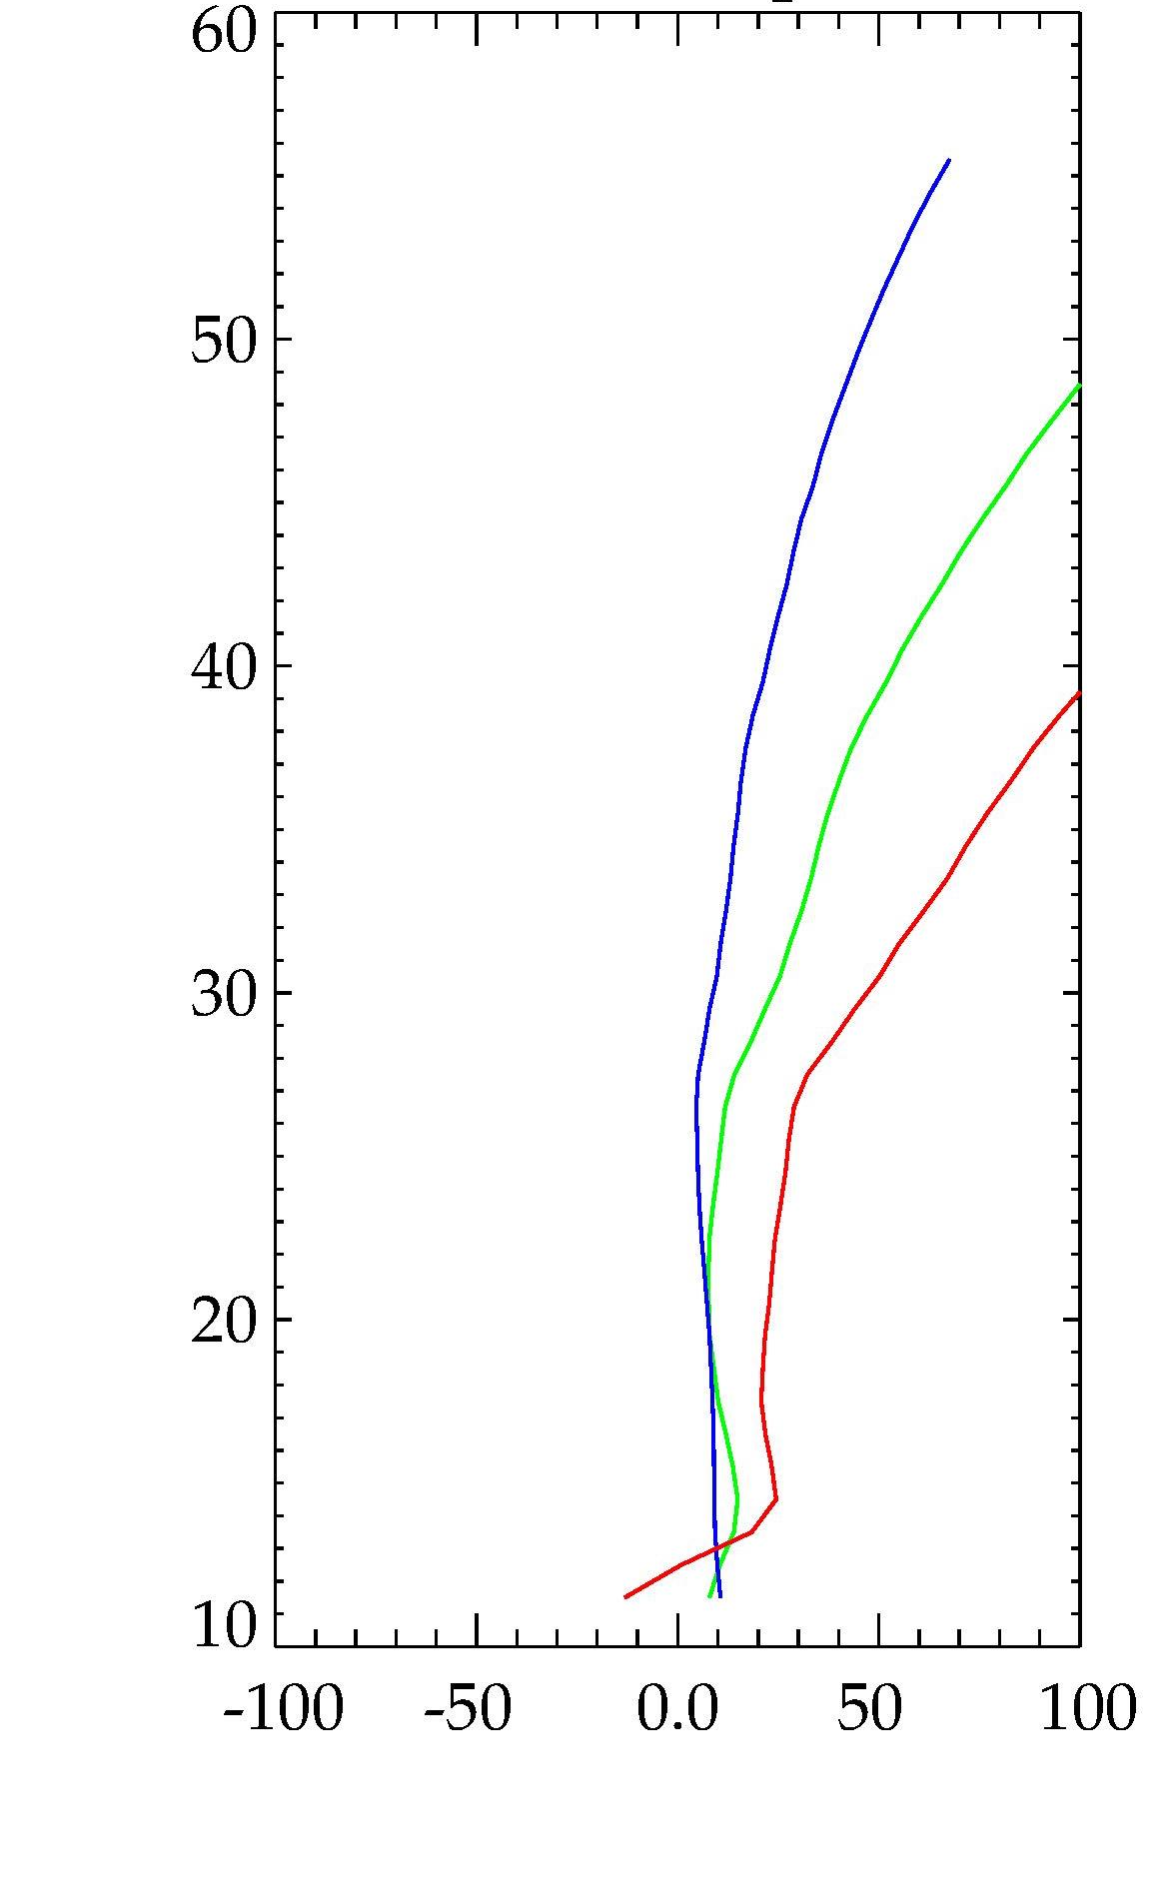
Stray light and tangent height remain greatest problems
Rayleigh Residual
353 nm
508 nm
675 nm
Tangent Height (km)
Percent Residual

Slide 6
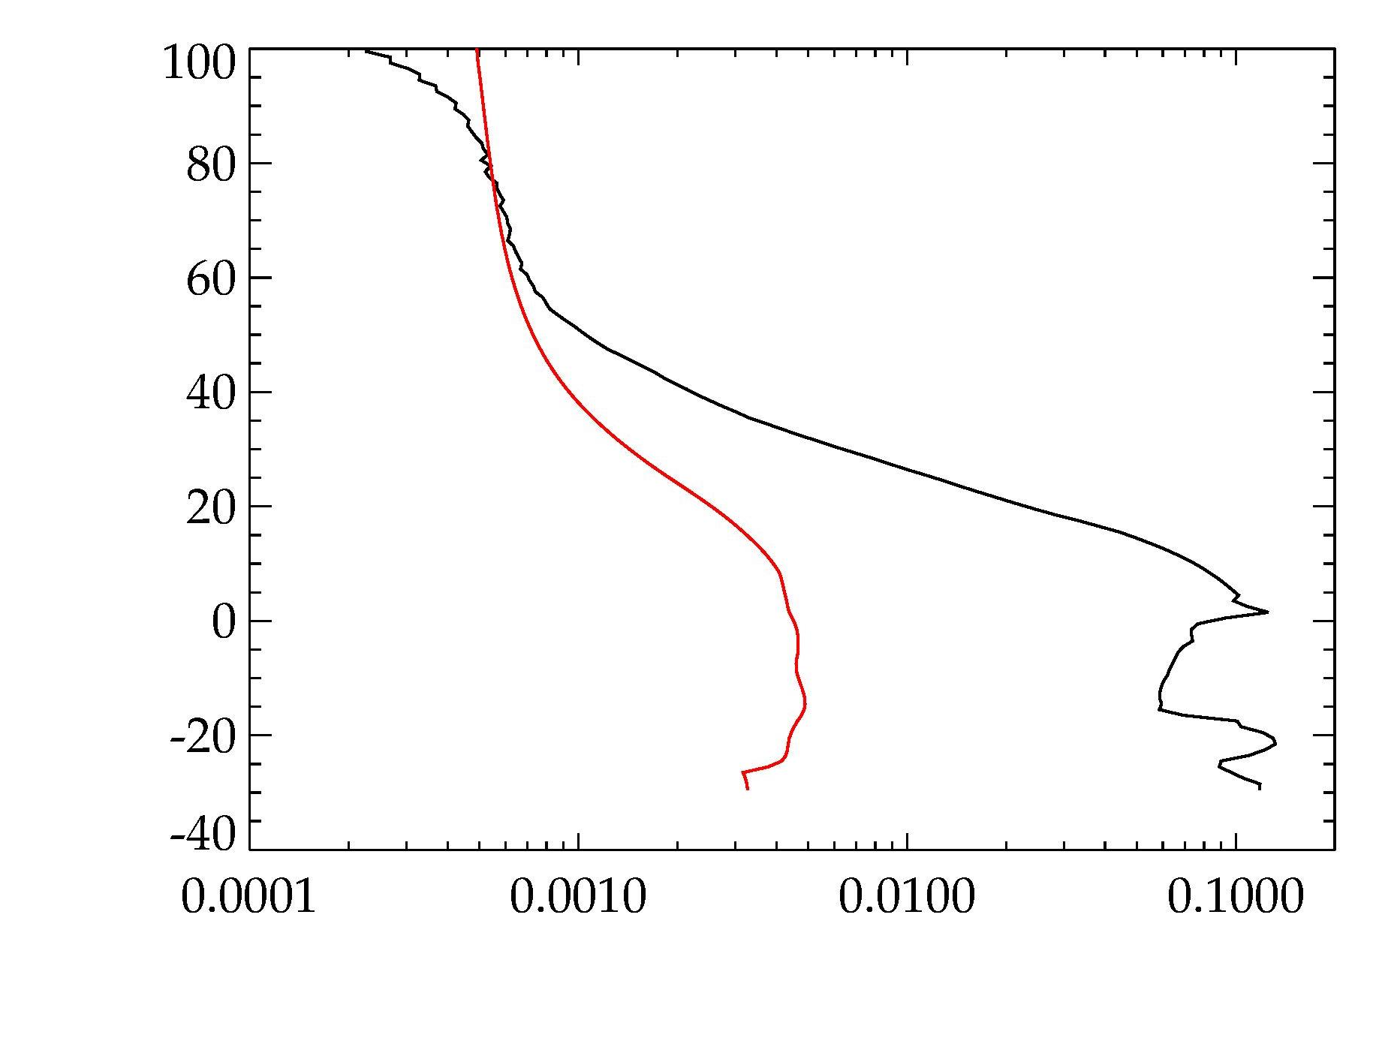
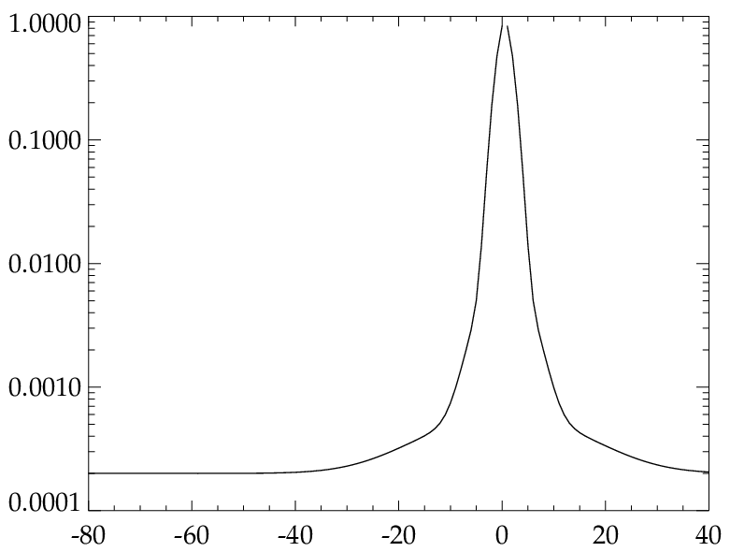
Carrying forward 2 stray light correction methods
PSF for deconvolution
675 nm
Fit Range
Loosely based on Harvey-Shack surface scatter model
Tangent Height (km)
Fit Stray Signal
PSF Stray Signal
Radiance Signal
Target – Source Distance (km)
Each method independently tuned to coincident OMPS LP data
Both yield comparable product performance (for our 6 orbits)
Critical range of PSF

Slide 7
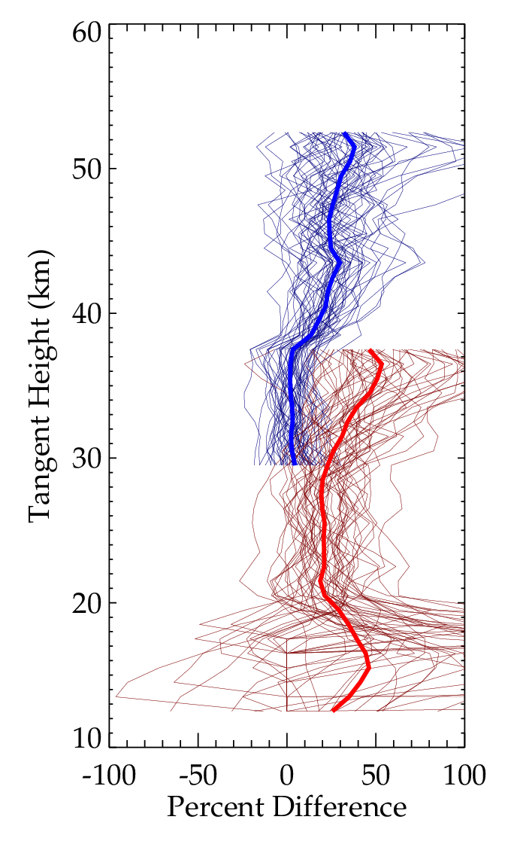
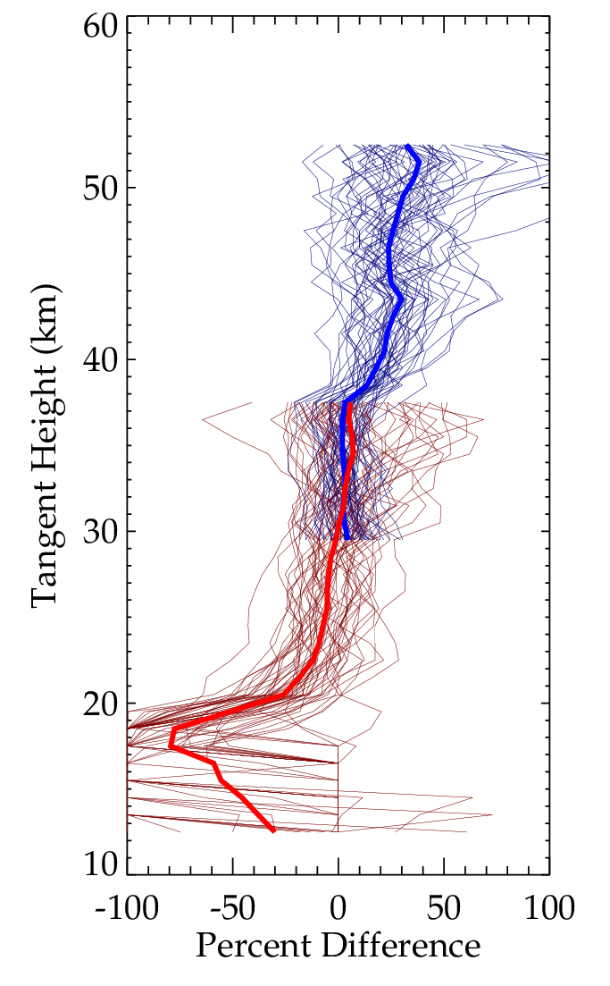
TH misregistration still an issue
ROSES 2017 Ozone result
(4 side-scatter orbits)
After simple scaling of 600 nm radiance*
Baseline TH correction based on RSAS
SAGE LS – OMPS LP
SAGE LS – OMPS LP
UV
VIS
Evidence of TH error even after initial correction
* likely needed because of SAGE – OMPS bandpass difference

Slide 8
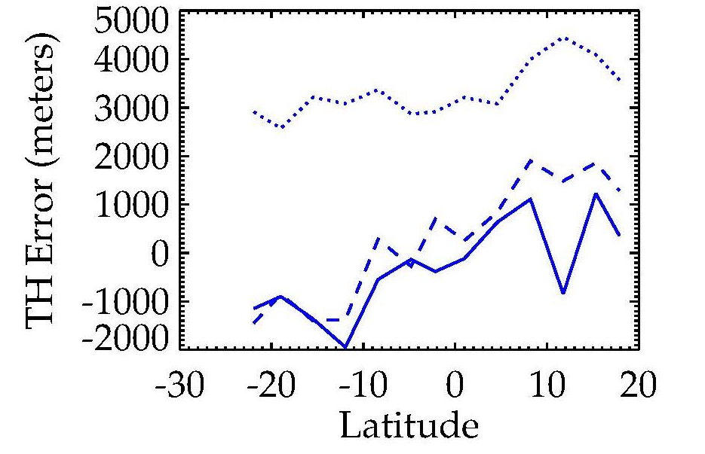
Comparison of tangent height methods
TH Error Relative to ISS-derived pointing
Orbit F18020402.03
RSAS is default TH method
Based on altitude ratios at ~350 nm
Prone to errors from LOS inhomogeneity, stray light, & aerosols
ARRM
OMPS O3
RSAS
ARRM is based on high altitude radiances < 305 nm
Clear problems with short UV radiances in SAGE
Ozone comparison confirms RSAS systematically underestimates TH error by ~1 km

Slide 9
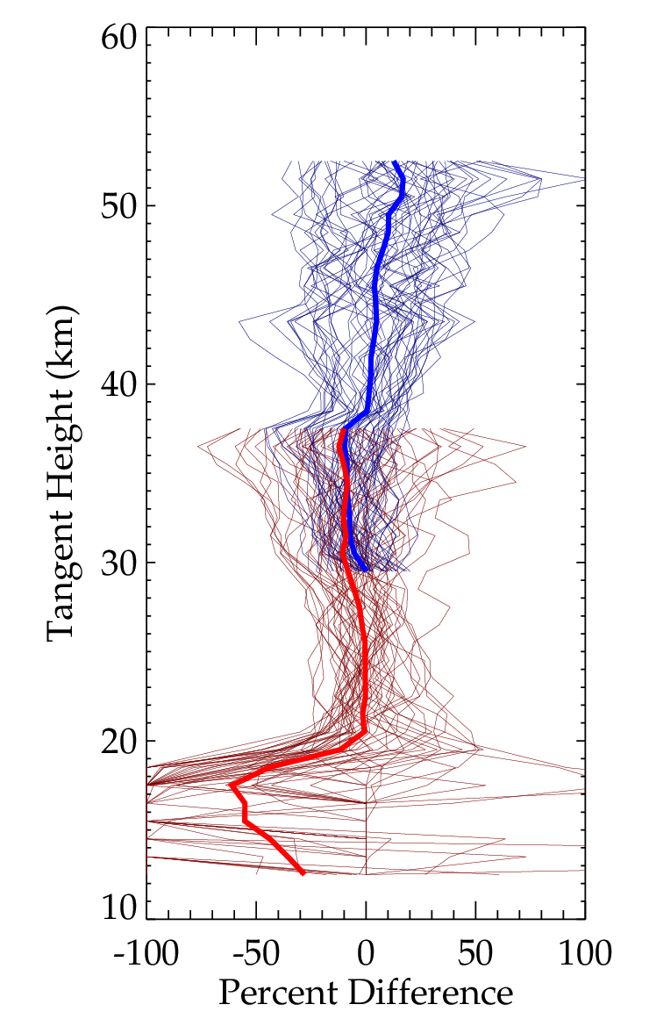
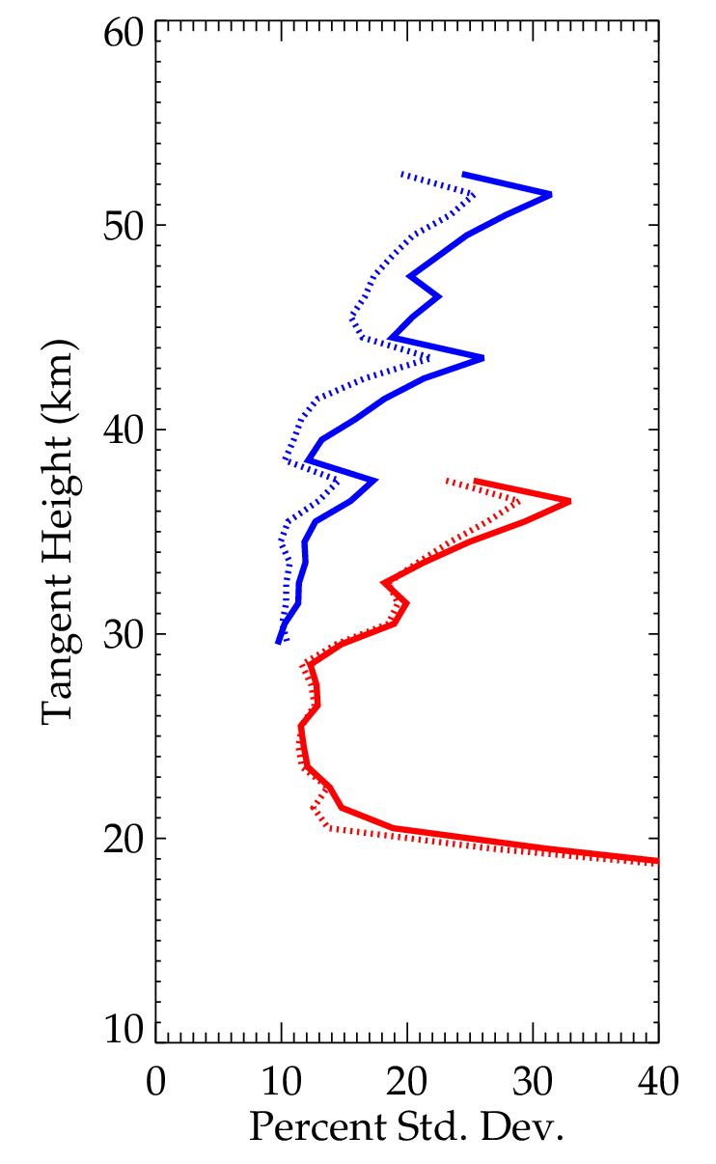
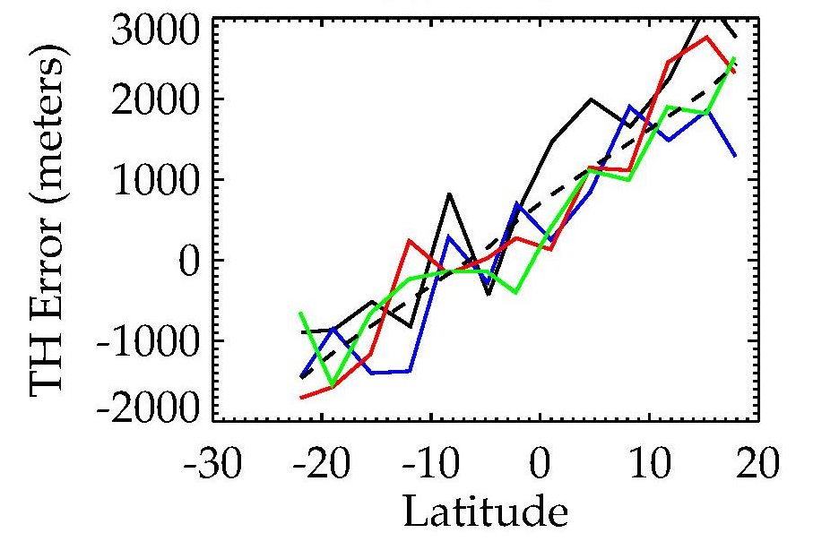
Pointing varies smoothly thru orbit ?
SAGE - OMPS O₃ Diff.
(after TH adj.)
Scan-to-scan Std. Dev.
UV
VIS
OMPS-based TH error – 4 consecutive orbits
Scan-by-scan results
4-orbit Fit
We can use orbital smoothing of RSAS, but must fix bias

Slide 10
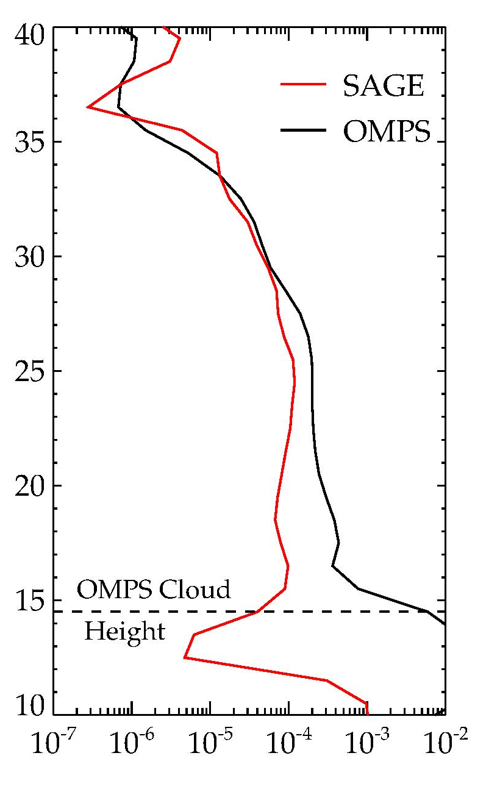
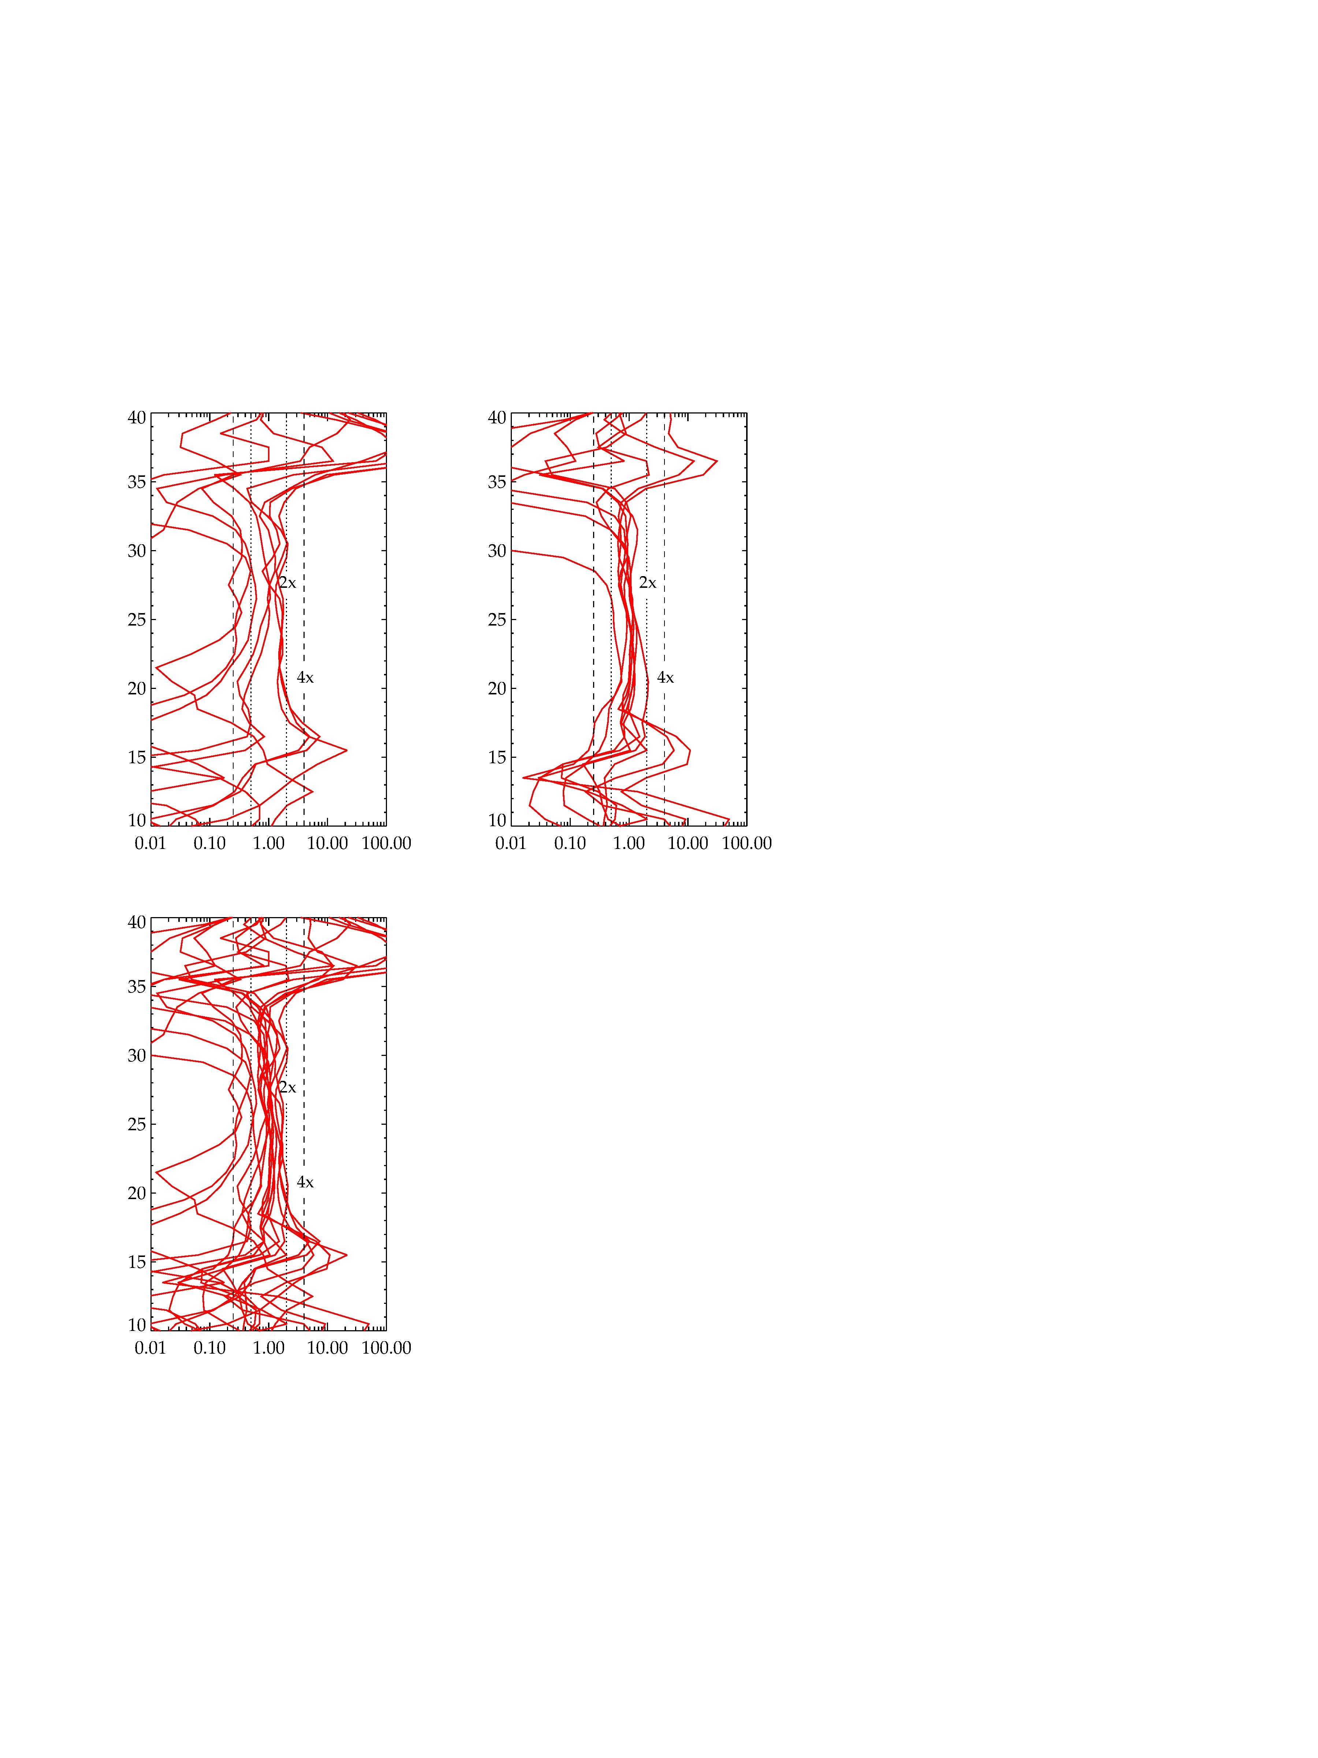
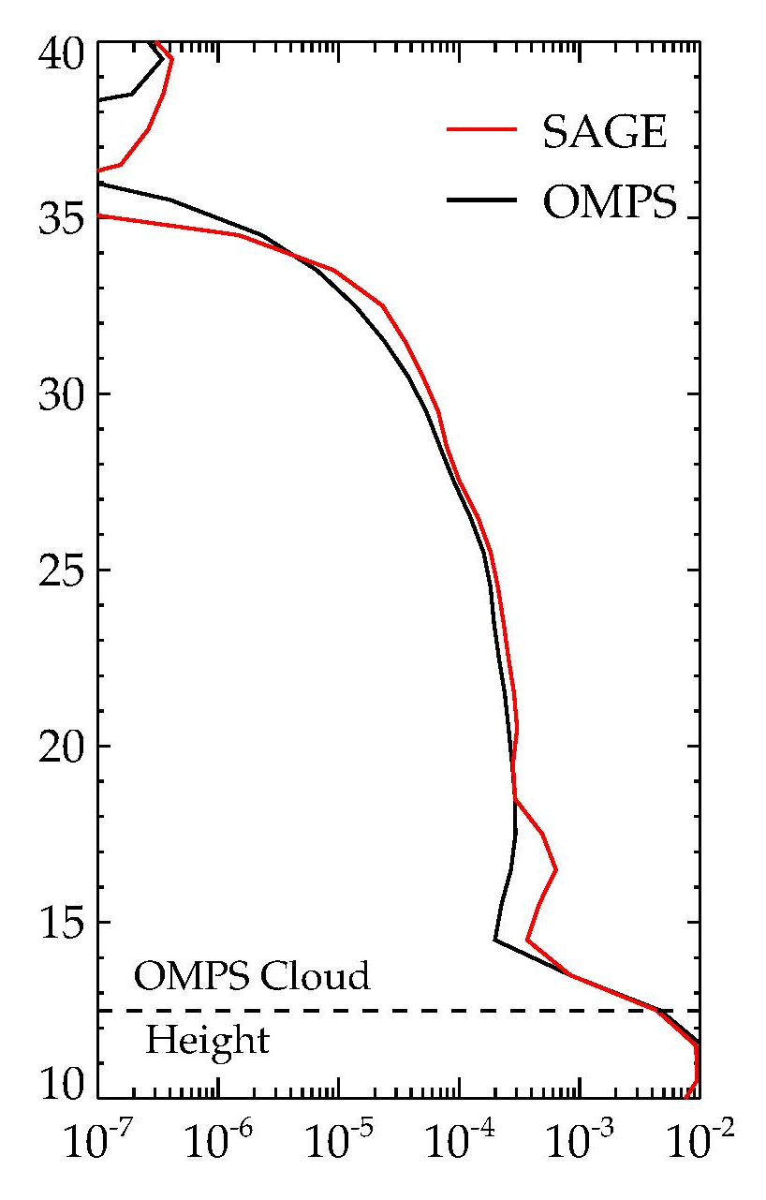
SAGE aerosol extinction (675 nm) compared to OMPS
Backward Scatter Orbit
Forward Scatter Orbit
Sample scan
9 scan comparison
Sample scan
9 scan comparison
Tangent Height (km)
Tangent Height (km)
Extinction Coeff. (km⁻¹)
Extinction Ratio
Extinction Coeff. (km⁻¹)
Extinction Ratio
Backscatter retrievals have weak aerosol signals and are more sensitive to radiance errors such as stray light
Notes:
Backscatter example neither best nor worst

Slide 11
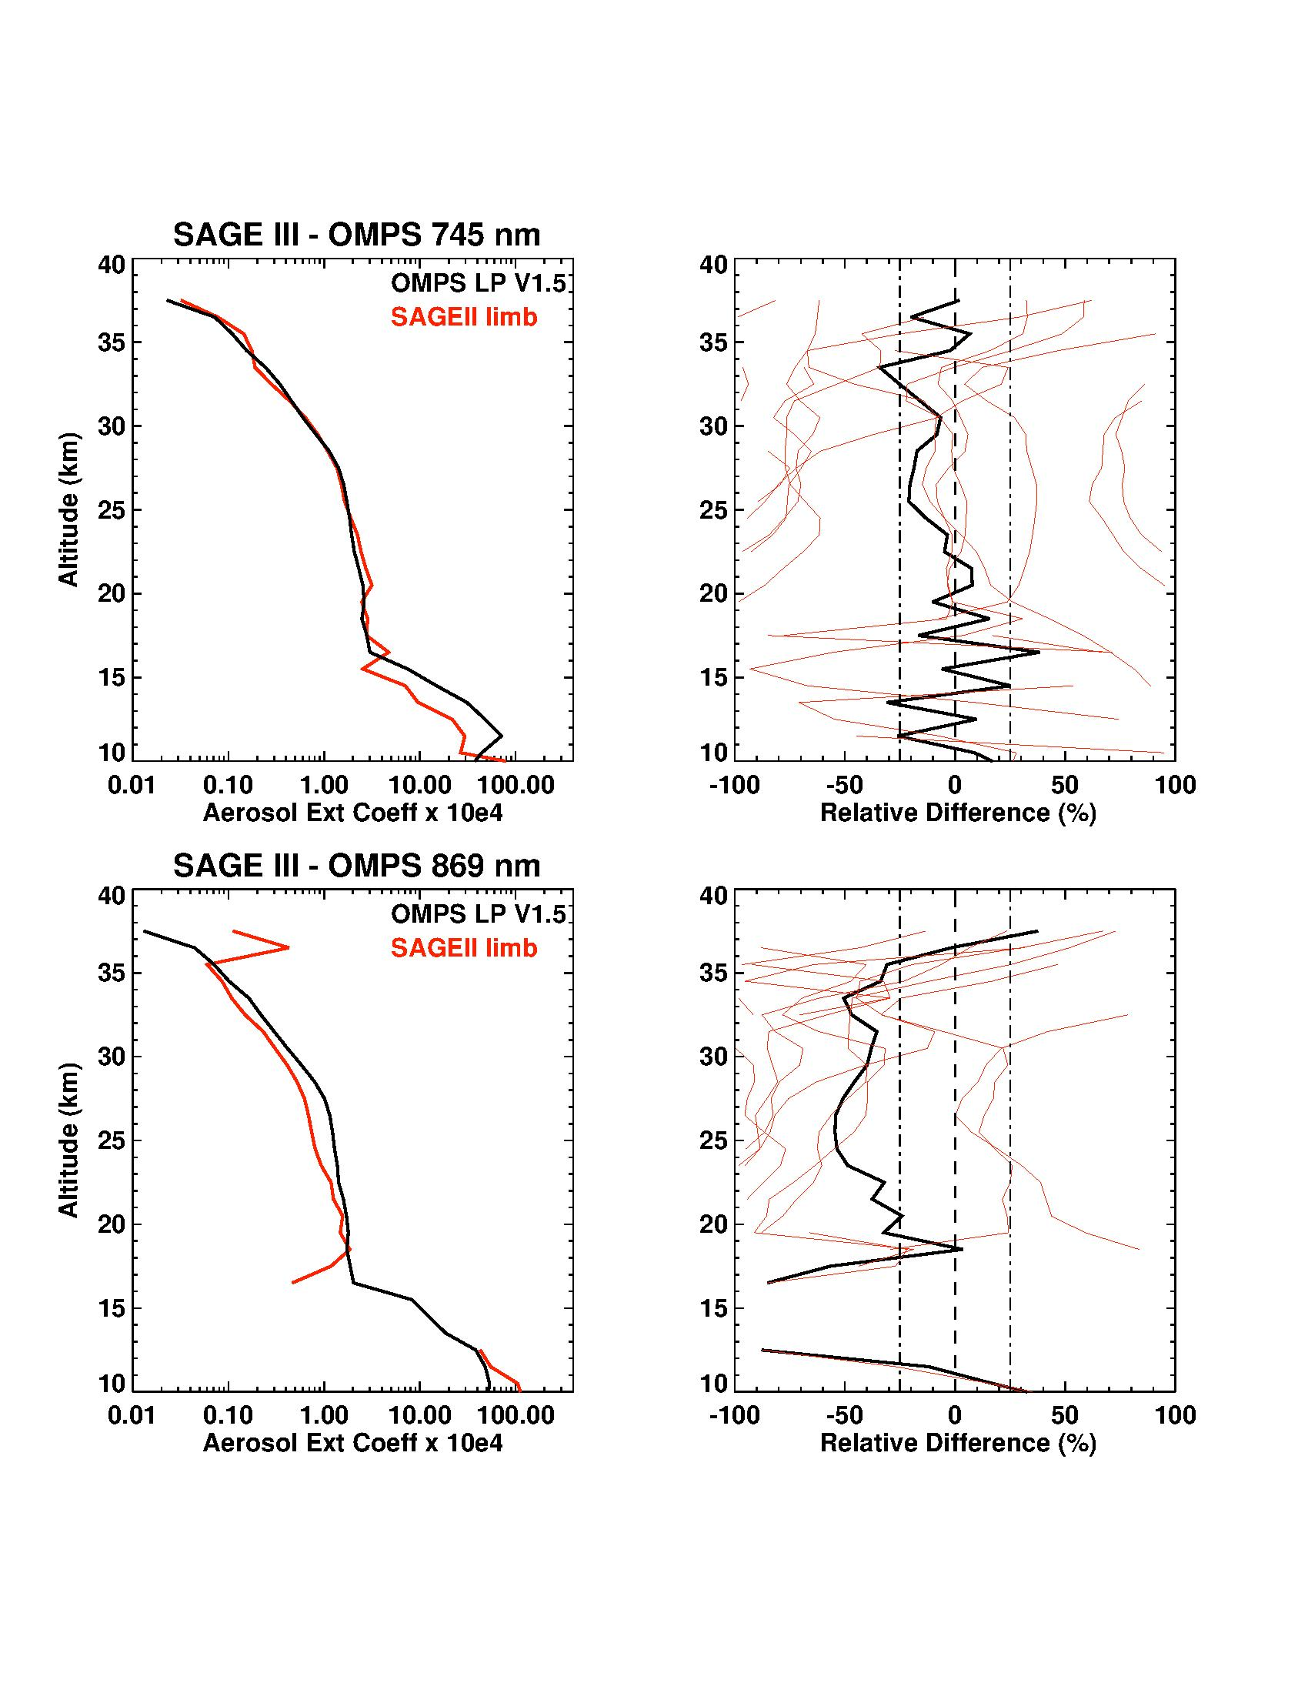
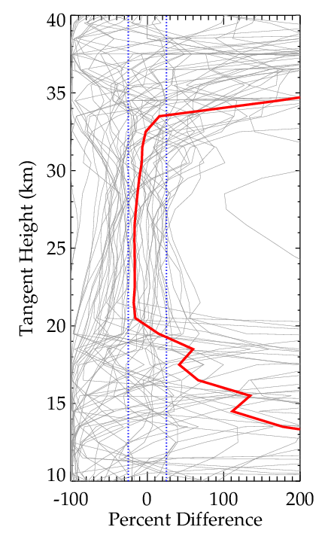
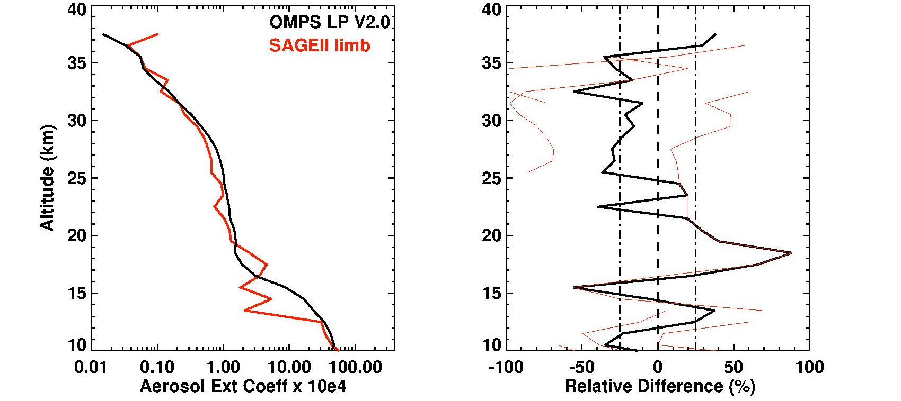
Aerosol extinction comparisons to OMPS
Orbit F18020406.40
52 Side-scatter scans
745 nm
675 nm
869 nm
997 nm
Have we tuned our stray light correction to 675 nm ?

Slide 12
Conclusions
Stray light correction may be ‘good enough’ for forward scatter data
Tangent Height correction necessary but currently has large errors
We’ve squeezed as much as we should out of narrow comparisons with OMPS. Broaden comparisons. More data.
Path Forward
Concentrate LS operations on forward scattering
Find a way to tune RSAS tangent height corrections
Expand to multi-wavelength aerosol extinctions
Continue de-OMPSifying retrievals

Slide 13
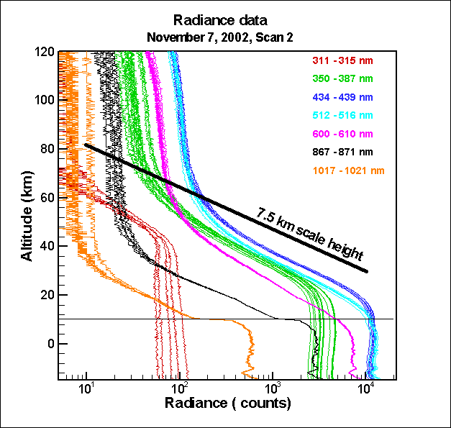
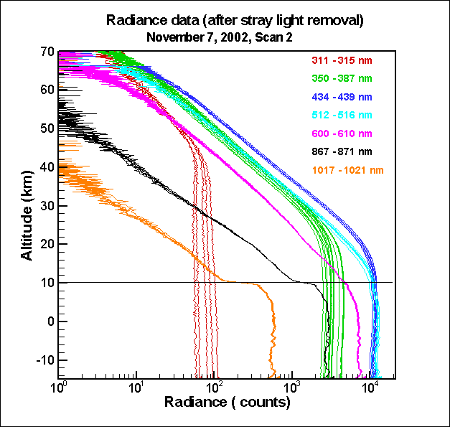
Out-of-Field stray light is primary challenge
M3-SAGE LS Signal
M3-SAGE LS Signal
Telescope scatters bright Earth signal into higher altitude angles (in-band)
Excess signal at retrieval normalization altitude
Primarily a VIS/NIR problem

Slide 14
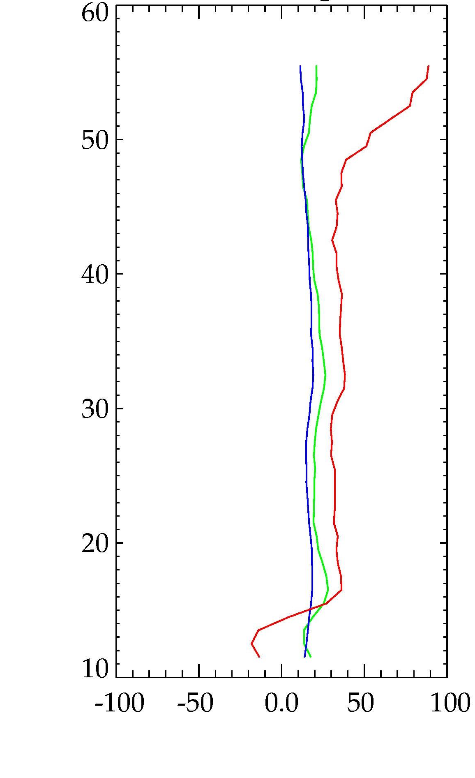
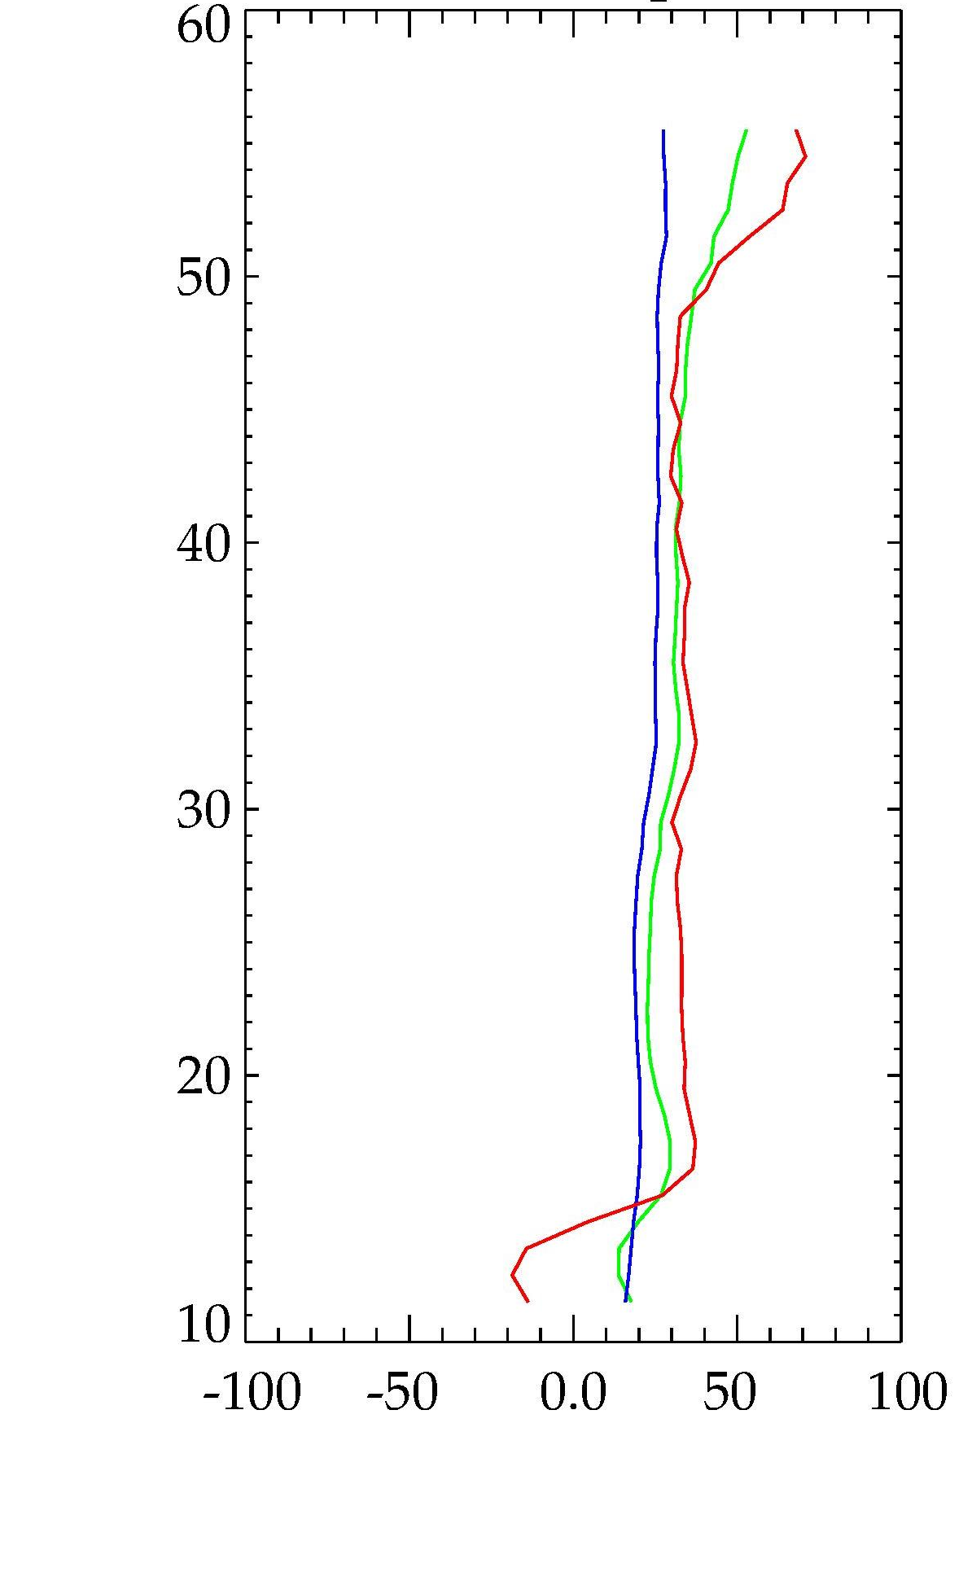
Post-correction Rayleigh residuals
Radiance Fit Method
PSF deconvol. Method
353 nm
508 nm
675 nm
Tangent Height
Tangent Height
Percent Residual
Percent Residual
There are significant differences, but hard to say which method is better

