Slide 1
Searching for (global) ozone recovery – an update
B. Hassler
Deutsches Zentrum für Luft- und Raumfahrt (DLR), Institut für Physik der Atmosphäre, Oberpfaffenhofen, Germany
SAGE III/ISS Science Team Meeting
04-05 November 2021

Slide 2
Introduction and outline
Work for the WMO Ozone Assessment 2022 is under way (FOD is with reviewers at the moment)
Results presented here are shown in Chapter 3 of the new assessment
Total column ozone evolution: WMO Ozone Assessment 2018 and update to its findings
Vertically resolved ozone evolution: WMO Ozone Assessment 2018 and update to its findings
New findings about ozone return dates based on CMIP6 model simulations

Slide 3

WMO Ozone Assessment 2018
Global ozone evolution is discussed in Chapter 3; results from total column ozone, vertically resolved ozone, and multi-decadal ozone simulations are shown
Often based on activities like LOTUS
But also, relevant figures from peer-reviewed literature
WMO, Scientific Assessment of Ozone Depletion: 2018, Report No. 58, 588 pp., Geneva, Switzerland, 2018.

Slide 4
Why do we expect different results compared to WMO Ozone Assessment 2018?
4 years more data - more robust results from the applied statistical methods
Updated, reprocessed and additional datasets
Updates to the applied statistical methods
New model simulations

Slide 5
Total column ozone

Slide 6
Used data for the analysis period 1984-2020
Merged Dataset | Instruments and Data Version
SBUV NASA MOD | Nimbus 4 BUV v8.7 Nimbus 7 SBUV v8.7 NOAA 11 SBUV/2 v 8.7 NOAA 14 SBUV/2 v8.7 NOAA 16 SBUV/2 v8.7 NOAA 17 SBUV/2 v8.7 NOAA 18 SBUV/2 v8.7 NOAA 19 SBUV/2 v8.7 S-NPP OMPS NP NOAA v2.8
SBUV NOAA COH | Nimbus 7 SBUV v8.6 NOAA 11 SBUV/2 v 8.6 NOAA 14 SBUV/2 v8.6 NOAA 16 SBUV/2 v8.6 NOAA 17 SBUV/2 v8.6 NOAA 18 SBUV/2 v8.6 NOAA 19 SBUV/2 v8.6 S-NPP OMPS NP NASA v2.6
Merged Dataset | Instruments and Data Version
GTO | GOME/ERS-2 SCIAMACHY/Envisat GOME-2/MetOp-A OMI/Aura GOME-2/MetOp-B
GSG | GOME/ERS-2 SCIAMACHY/Envisat GOME-2/MetOp-A
v8.7
*
+ datasets constructed from ground-based measurements
*

Slide 7
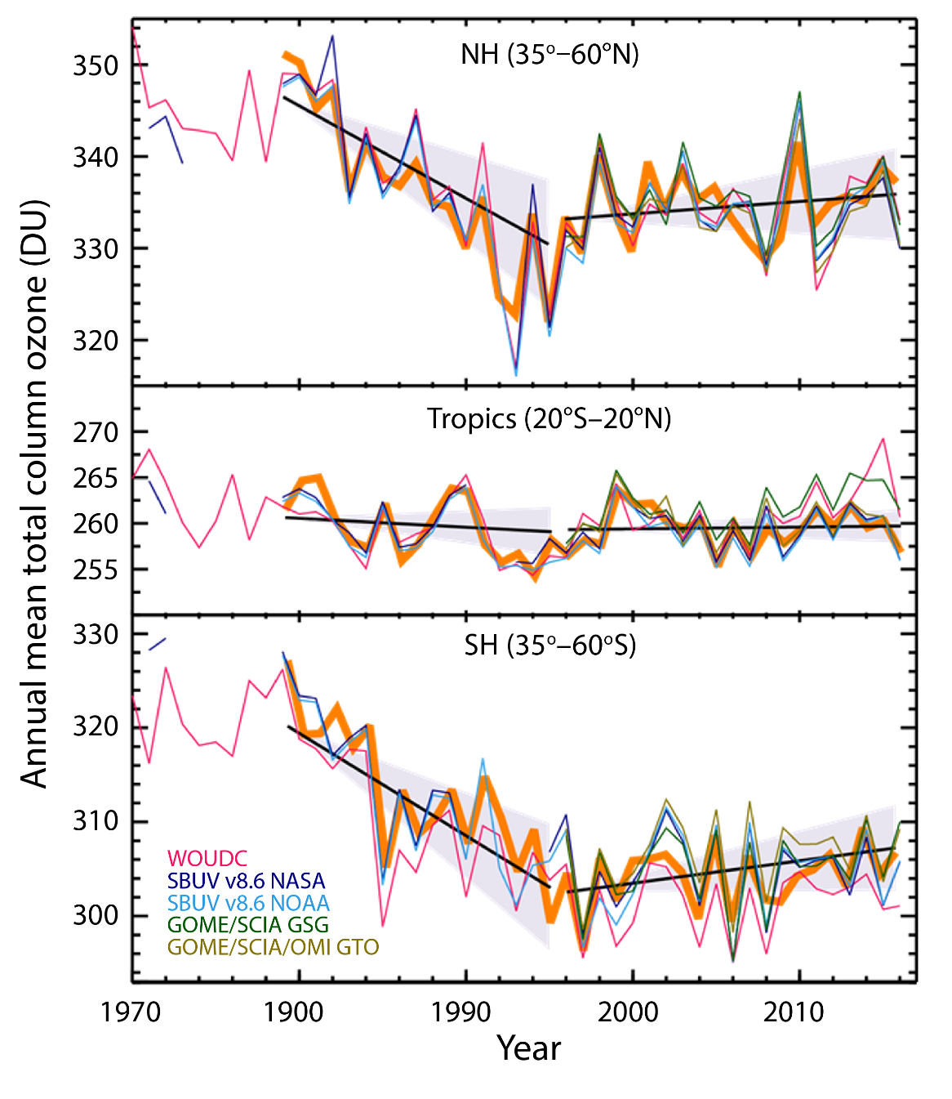
WMO Ozone Assessment 2018 – total column ozone
Figure 3-11 Ozone Assessment 2018
Annual mean total ozone time series of five bias-corrected, merged datasets in the 35°-60°S, 35°-60°N and 20°S-20°N latitude bands. The thick orange lines are the result from applying a multiple linear regression (MLR) model. The solid black lines indicate the linear trends before and after the ODS peak in 1997, respectively. The shaded areas show the 2σ uncertainty of the MLR trend estimates. Adapted from Weber et al. (2018).
no statistically significant trend in near-global (60°S–60°N) column ozone over the 1997–2016 period
Braesicke, P. and Neu, J. (lead authors), Chapter 3 in Scientific Assessment of Ozone Depletion: 2018, WMO Report No 58.

Slide 8
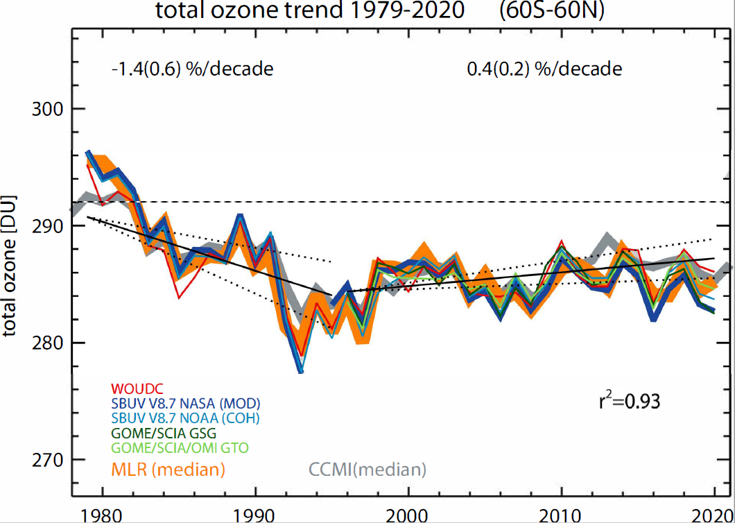
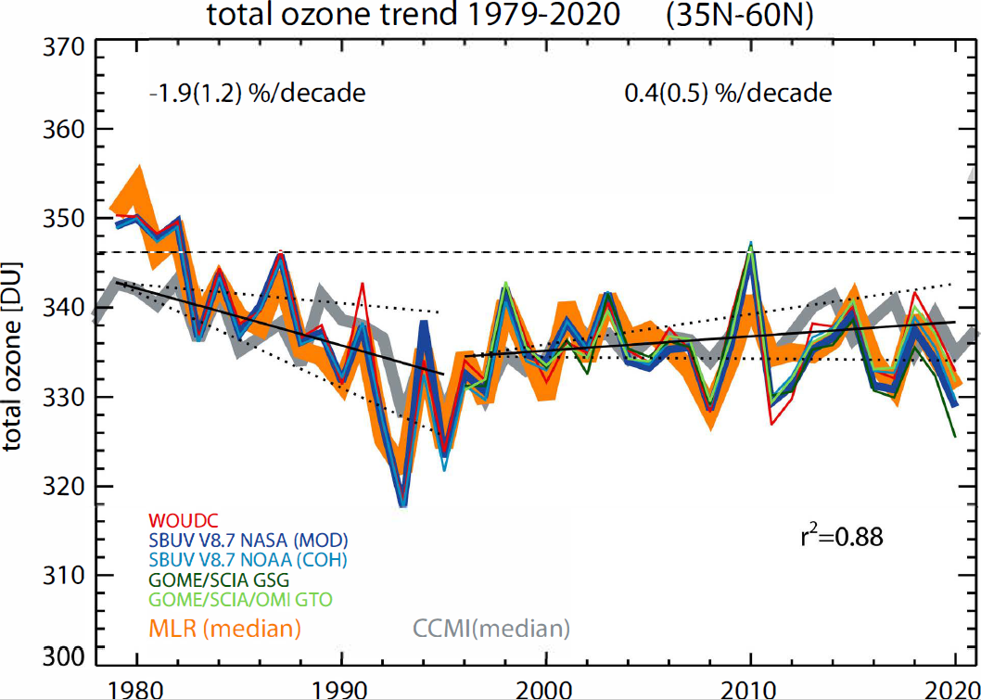
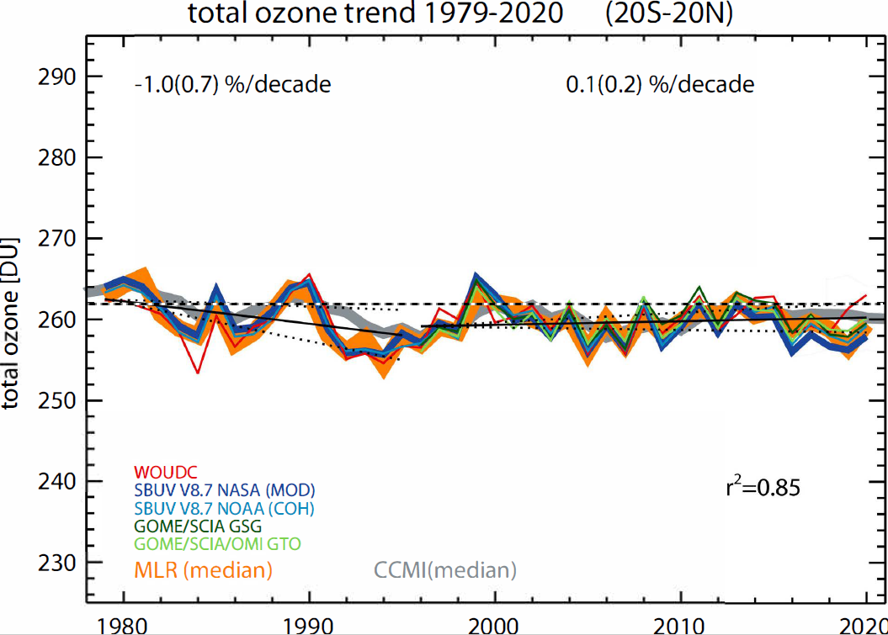
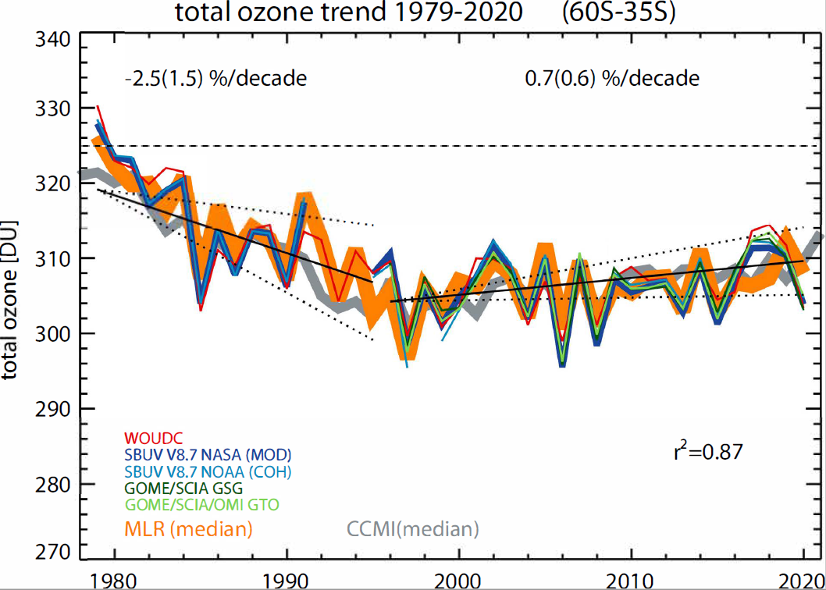
Update to WMO Ozone Assessment 2018
Observations indicate small, but statistically significant trends of 0.4 ± 0.2% decade⁻¹ in near-global (60°S–60°N) total column ozone over the 1997–2020 period.
Update to Weber et al., 2018.

Slide 9
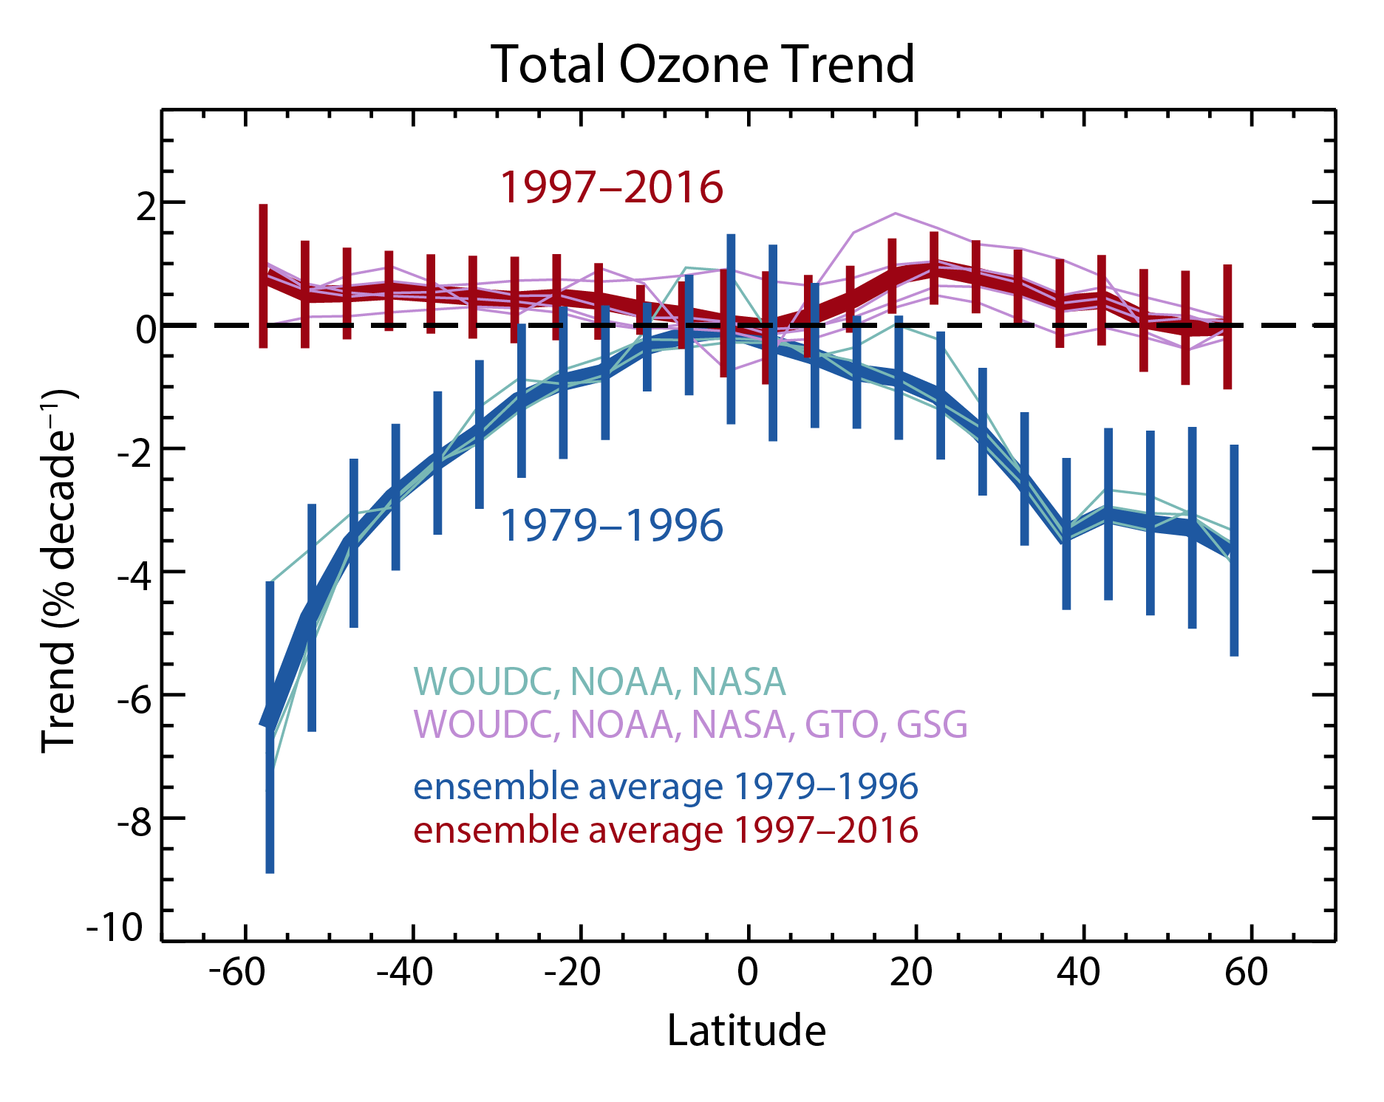
Update to WMO Ozone Assessment 2018
Figure 3-12 Ozone Assessment 2018
Total ozone linear trend in % decade⁻¹ as a function of latitude for 1979–1996 (bluish colors) and 1997–2016
(reddish colors) estimated for NASA MOD, NOAA SBUV, GTO, GSC, and WOUDC datasets. The thick blue line with blue 2σ error bars and the thick red line with red 2σ error bars represent a weighted mean trend from the five (or three before 1996) datasets for 1979–1996 and 1997–2016, respectively. Adapted from Weber et al. (2018).
Braesicke, P. and Neu, J. (lead authors), Chapter 3 in Scientific Assessment of Ozone Depletion: 2018, WMO Report No 58.

Slide 10
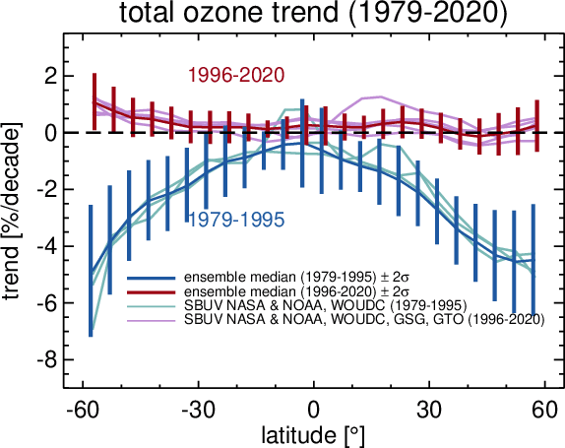
Update to WMO Ozone Assessment 2018
Update to Weber et al., 2018.

Slide 11
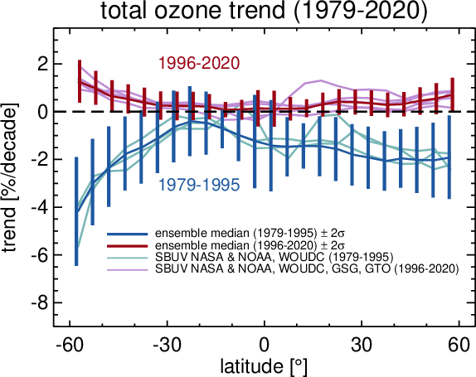
Update to WMO Ozone Assessment 2018
Update to Weber et al., 2018.
MLR - standard:
zero trends at NH mid-latitudes and inner tropics after 1996 (contribution from dynamics and ODS)
larger trends in the NH before 1996
overall larger uncertainties in post-1996 trends
MLR - including dynamical proxies:
ozone recovery at SH mid-latitude
zero trends after 1996 in the tropic
Non-significant small positive trend at NH mid-latitudes (~0.5%/decade)

Slide 12
Vertically resolved ozone

Slide 13
Used data for the analysis period 1984-2020
Merged dataset | Instruments and data versions
SBUV NASA MOD | Nimbus 4 BUV v8.7 Nimbus 7 SBUV v8.7 NOAA 11 SBUV/2 v 8.7 NOAA 14 SBUV/2 v8.7 NOAA 16 SBUV/2 v8.7 NOAA 17 SBUV/2 v8.7 NOAA 18 SBUV/2 v8.7 NOAA 19 SBUV/2 v8.7 S-NPP OMPS NP NOAA v2.8
SBUV NOAA COH | Nimbus 7 SBUV v8.6 NOAA 11 SBUV/2 v 8.6 NOAA 14 SBUV/2 v8.6 NOAA 16 SBUV/2 v8.6 NOAA 17 SBUV/2 v8.6 NOAA 18 SBUV/2 v8.6 NOAA 19 SBUV/2 v8.6 S-NPP OMPS NP NASA v2.6
GOZCARDS | SAGE I v5.9_rev, SAGE II v7.0, HALOE v19, Aura MLS v4.2
Merged dataset | Instruments and data versions
SWOOSH | SAGE II v7.0, HALOE v19, UARS MLS v5, SAGE III v4, Aura MLS v4.2
SAGE II-CCI- OMPS | SAGE II v7 OSIRIS v5.10 MIPAS v7 SCIAMACHY UBr v3.5 GOMOS ALGOM 2s ACE-FTS v3.5/3.6 OMPS USask v1.1.0
SAGE II-OSIRIS- OMPS | SAGE II v7 OSIRIS v5.10 OMPS USask v1.1.0
SAGE II- SCIAMACHY-OMPS | SAGE II v7 SCIAMACHY UBr v3.5 OMPS UBr
BASIC_{SG} | SWOOSH v2.6 GOZCARDS v2.20
v8.7
*
*
*
*

Slide 14
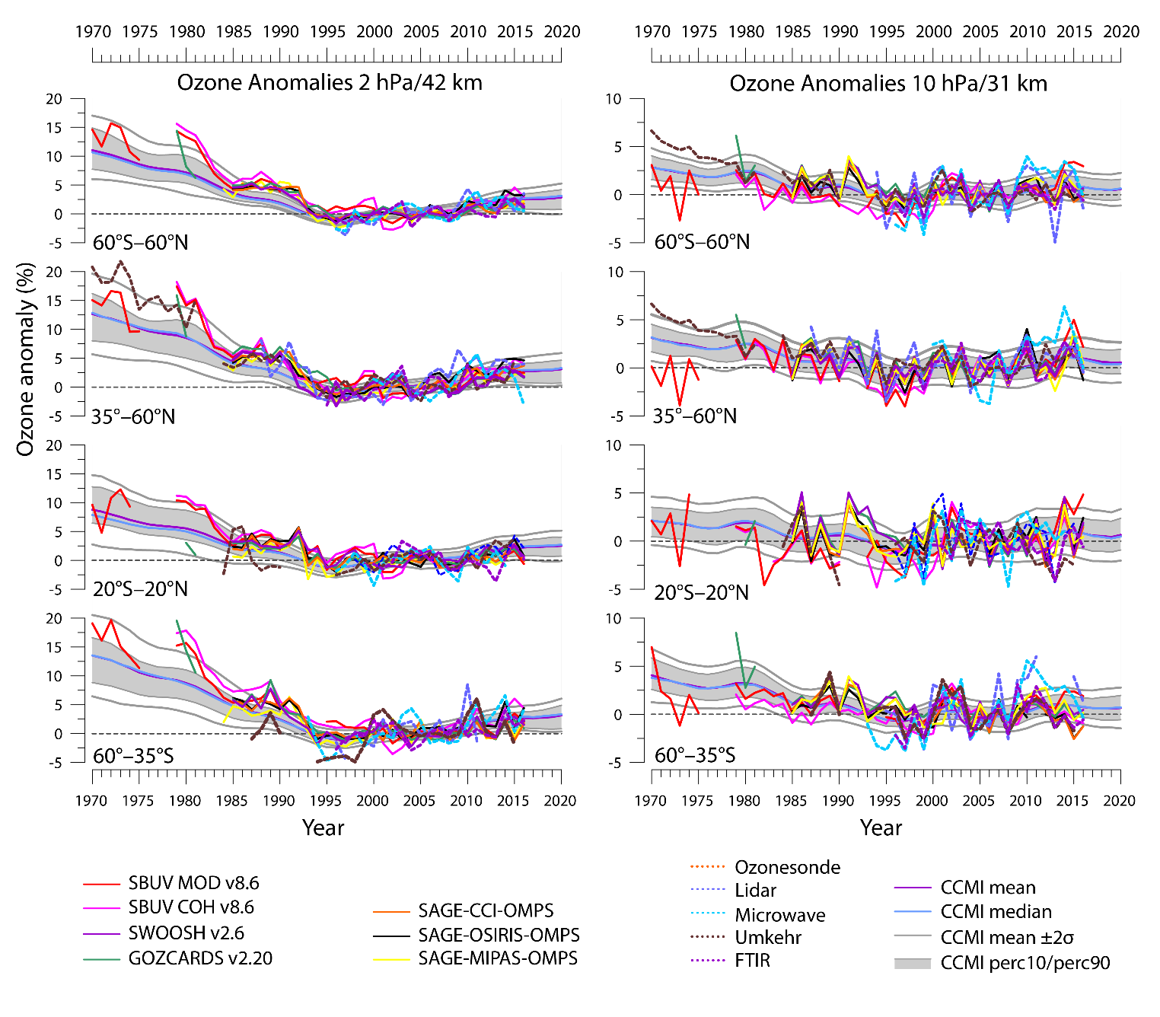
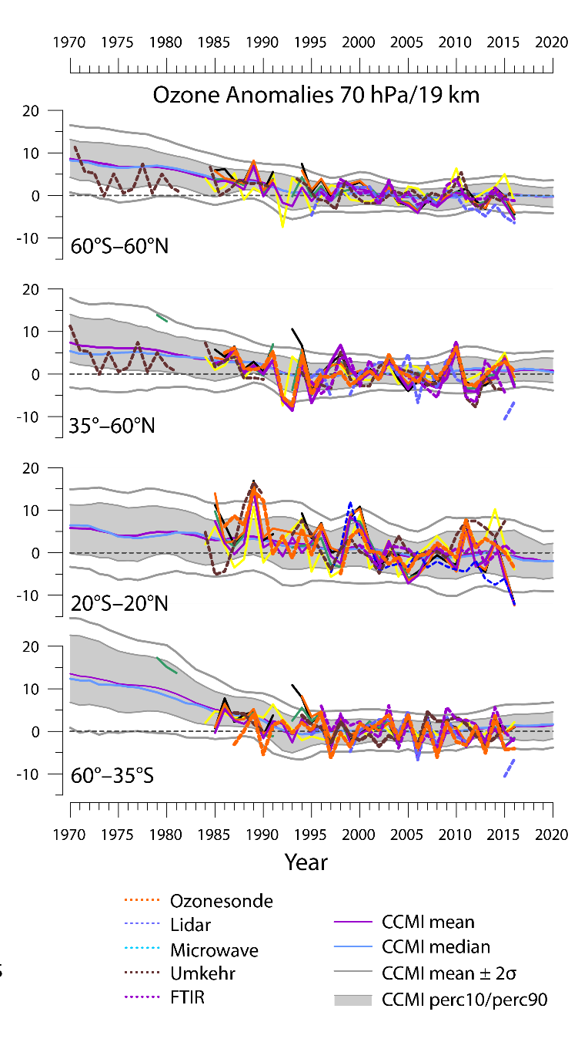
WMO Ozone Assessment 2018
Figure 3-15/3-16 Ozone Assessment 2018
Evolution of annual mean deseasonalized ozone anomalies at the 2-hPa/42-km (left column) and 70-hPa/19-km (right column) levels. Satellite data and measurements from ground-based stations are averaged over four different latitude bands. Gray shadings correspond to the 10th–90th percentiles of the CCMI-1 model results. The model mean and median are also plotted, together with the ±2σ range of the models (gray lines). All anomalies are calculated relative to the base period 1998–2008. Adapted from LOTUS (2019).
Braesicke, P. and Neu, J. (lead authors), Chapter 3 in Scientific Assessment of Ozone Depletion: 2018, WMO Report No 58.

Slide 15
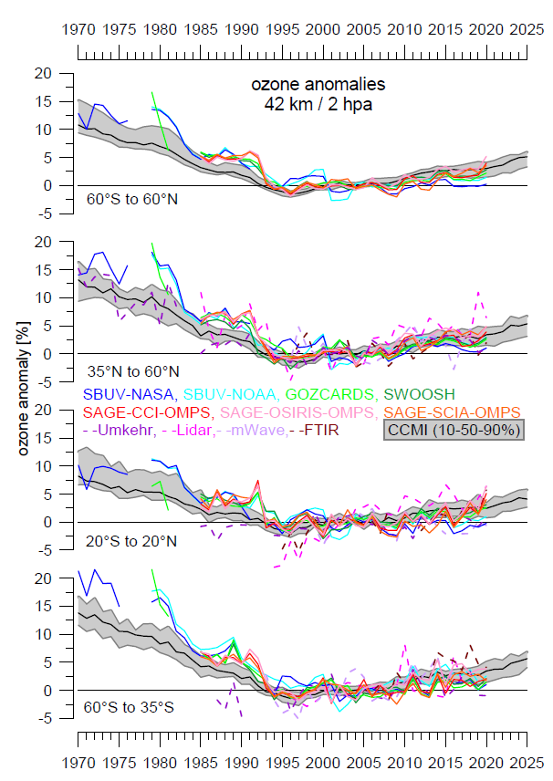
Update to WMO Ozone Assessment 2018
Continued increase in upper stratospheric ozone
Statistically significant in more regions than reported in WMO Ozone Assessment 2018
Dunn et al. (Eds.), BAMS, 2021.

Slide 16
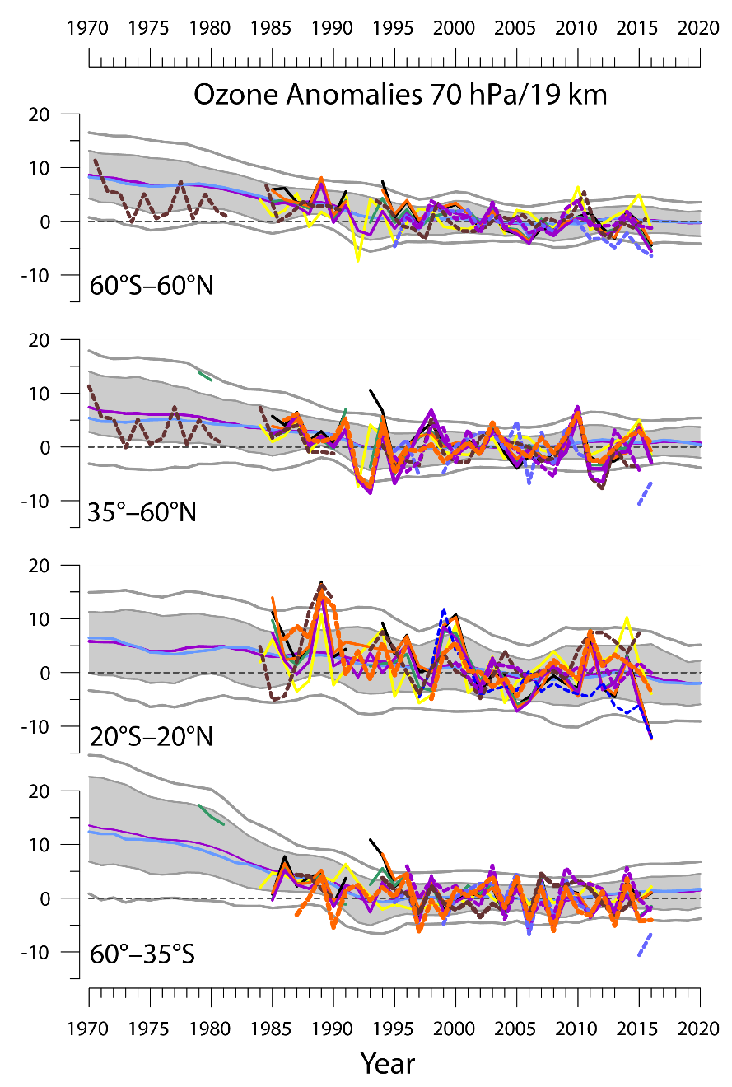
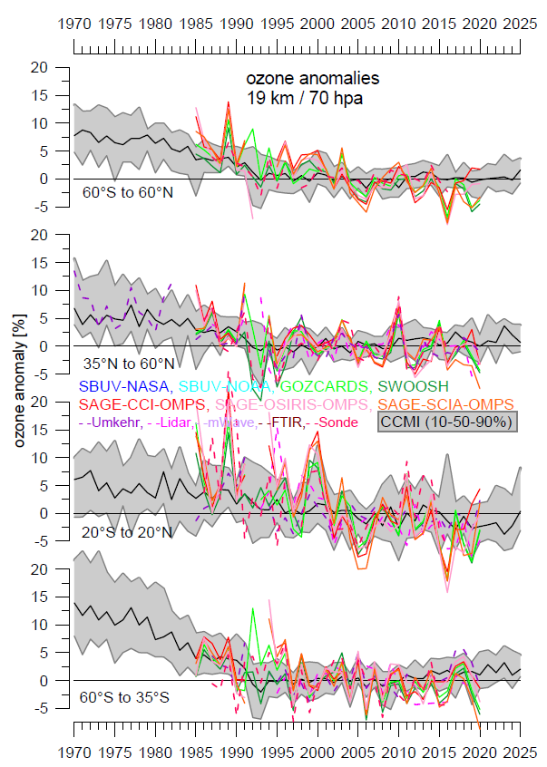
Update to WMO Ozone Assessment 2018
Year-to-year variability is large in the lower stratosphere, but there is confidence in a decrease in the tropics
A decrease since 2000 is more probable than not for the mid-latitudes, particularly in the Northern Hemisphere
Dunn et al. (Eds.), BAMS, 2021.

Slide 17
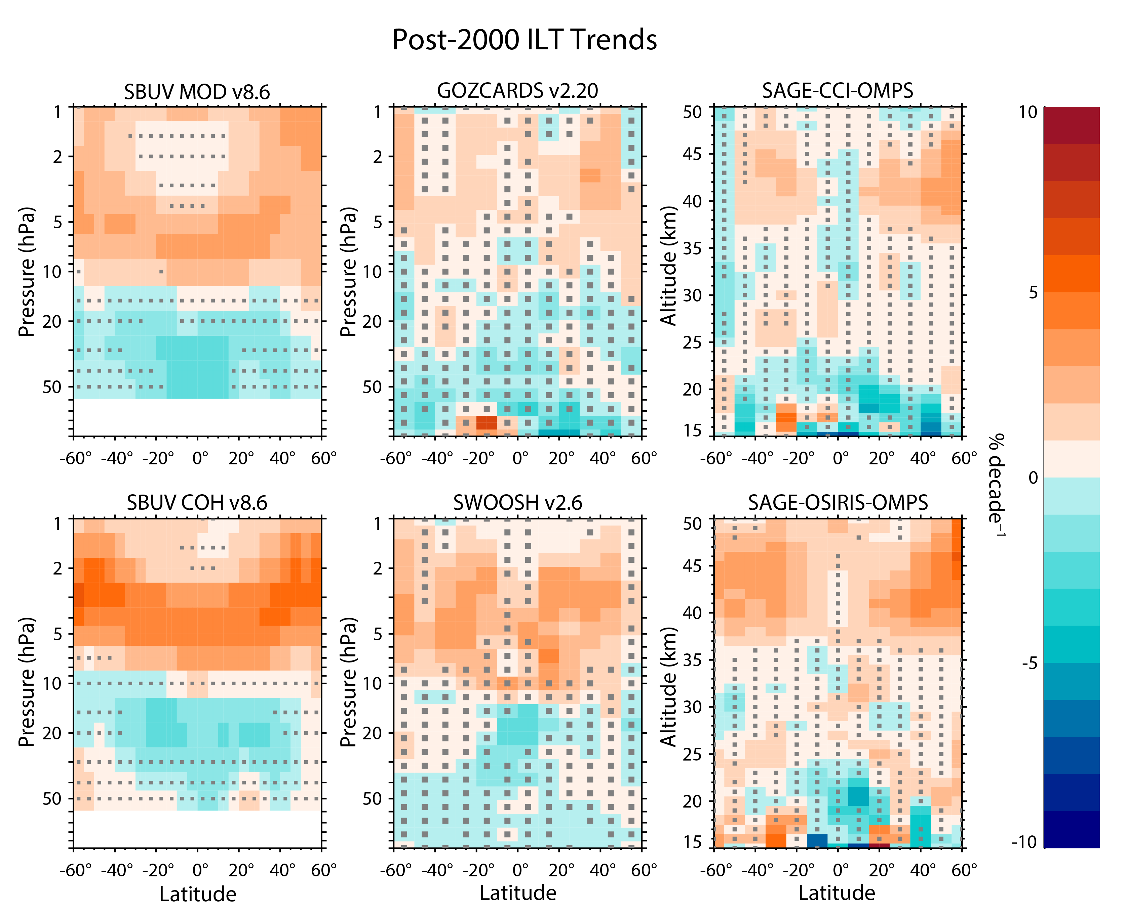
WMO Ozone Assessment 2018
Figure 3-18 Ozone Assessment 2018
Ozone trends for the period 2000–2016 estimated from six satellite data records using the independent linear trend (ILT) model. Gray stippling denotes results that are not significant at the 2σ level. Data are presented on the latitudinal grid and vertical coordinates associated with each dataset. Adapted from LOTUS (2019).
Braesicke, P. and Neu, J. (lead authors), Chapter 3 in Scientific Assessment of Ozone Depletion: 2018, WMO Report No 58.

Slide 18
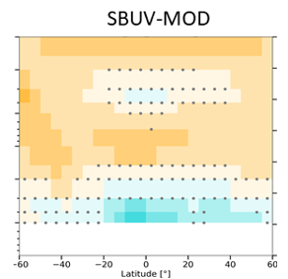


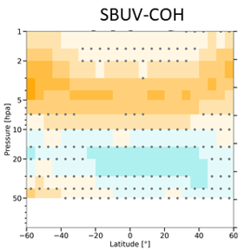
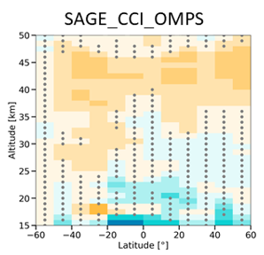
Update to WMO Ozone Assessment 2018
More regions with significant trends (non-stippled areas)
In upper stratosphere almost all latitudes
In lower stratosphere not much change
Updated from LOTUS Report, SPARC/IO3C/GAW, 2019.

Slide 19
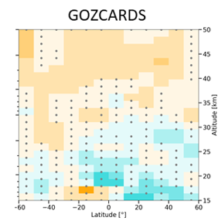
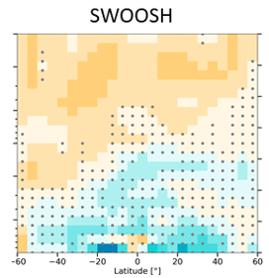
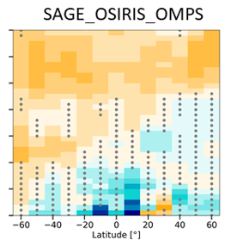
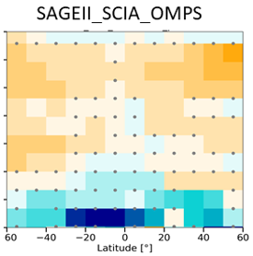
Update to WMO Ozone Assessment 2018
More regions with significant trends (non-stippled areas)
In upper stratosphere almost all latitudes
In lower stratosphere not much change, but almost in all latitudes ozone decrease
Updated from LOTUS Report, SPARC/IO3C/GAW, 2019.

Slide 20
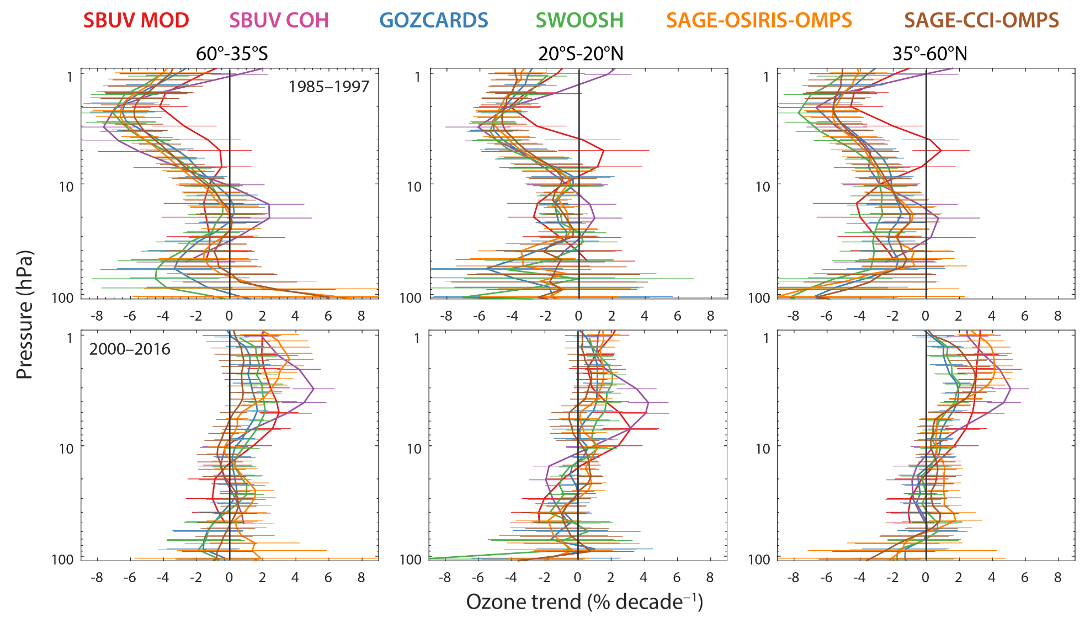
WMO Ozone Assessment 2018
Figure 3-19 Ozone Assessment 2018
Ozone profile trends with 2σ uncertainties for the 1985–1997 (top row) and 2000–2016 time periods (bottom row) from the ILT regression for latitude bands 35°–60°S (left column), 20°S–20°N (center column), and 35°–60°N (right column). Colored lines are the trend estimates from six individual merged datasets on their original vertical grid. Adapted from LOTUS (2018).
Braesicke, P. and Neu, J. (lead authors), Chapter 3 in Scientific Assessment of Ozone Depletion: 2018, WMO Report No 58.

Slide 21
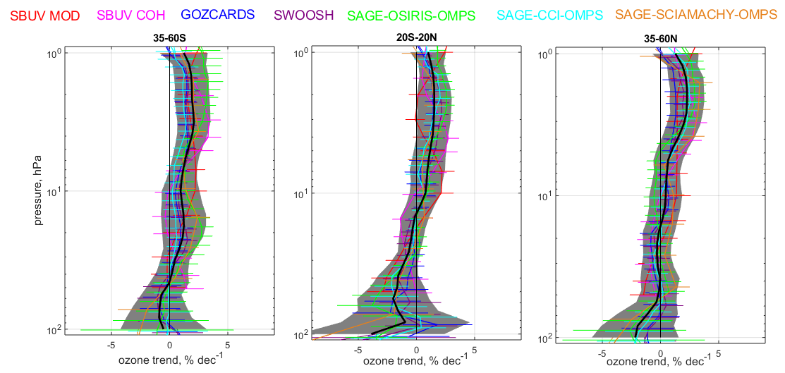
Trend updates since WMO 2018
Updated from LOTUS Report, SPARC/IO3C/GAW, 2019.
Ozone profile trends with 2σ uncertainties for the period 2000–2020 for latitude bands 35°S–60°S (left), 20°S–20°N (center), and 35°N–60°N (right). Colored lines are the trend estimates from seven individual merged datasets on their original vertical grid. Black lines represent the mean (combined) trends and grey shading indicates the 2σ uncertainty intervals for the combined trends.

Slide 22
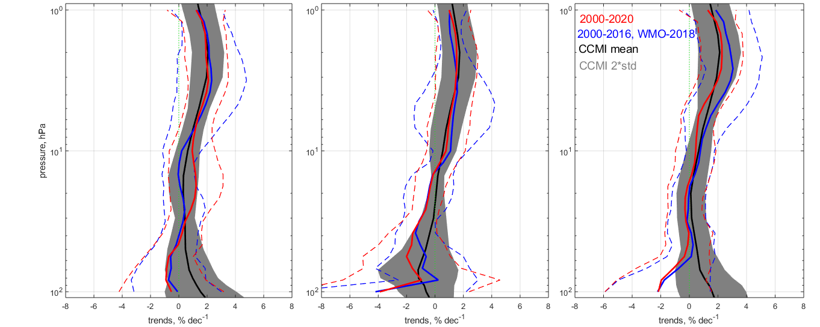
Trend updates since WMO 2018
35-60S
20S-20N
35-60N
Updated from LOTUS Report, SPARC/IO3C/GAW, 2019.
Comparison of post-2000 ozone profile trends combined from different merged satellite datasets for the latitude bands 35°S–60°S (left), 20°S–20°N (center), and 35°N–60°N (right) and their 2σ uncertainties. Results from the last Assessment for the period 2000-2016 are shown in blue, results for the updated period 2000-2020 are shown in red. The black line represents the multi-model mean calculated from 16 CCMI-1 ref-C2 simulations, and the grey shading indicates 2σ uncertainty of the model trend estimates. Updated from SPARC/IO3C/GAW (2019).

Slide 23
Trend updates since WMO 2018
35-60S
20S-20N
35-60N
Updated from LOTUS Report, SPARC/IO3C/GAW, 2019.
Comparison of post-2000 ozone profile trends combined from different merged satellite datasets for the latitude bands 35°S–60°S (left), 20°S–20°N (center), and 35°N–60°N (right) and their 2σ uncertainties. Results from the last Assessment for the period 2000-2016 are shown in blue, results for the updated period 2000-2020 are shown in red. The black line represents the multi-model mean calculated from 16 CCMI-1 ref-C2 simulations, and the grey shading indicates 2σ uncertainty of the model trend estimates. Updated from SPARC/IO3C/GAW (2019).

Slide 24
Ozone return dates

Slide 25
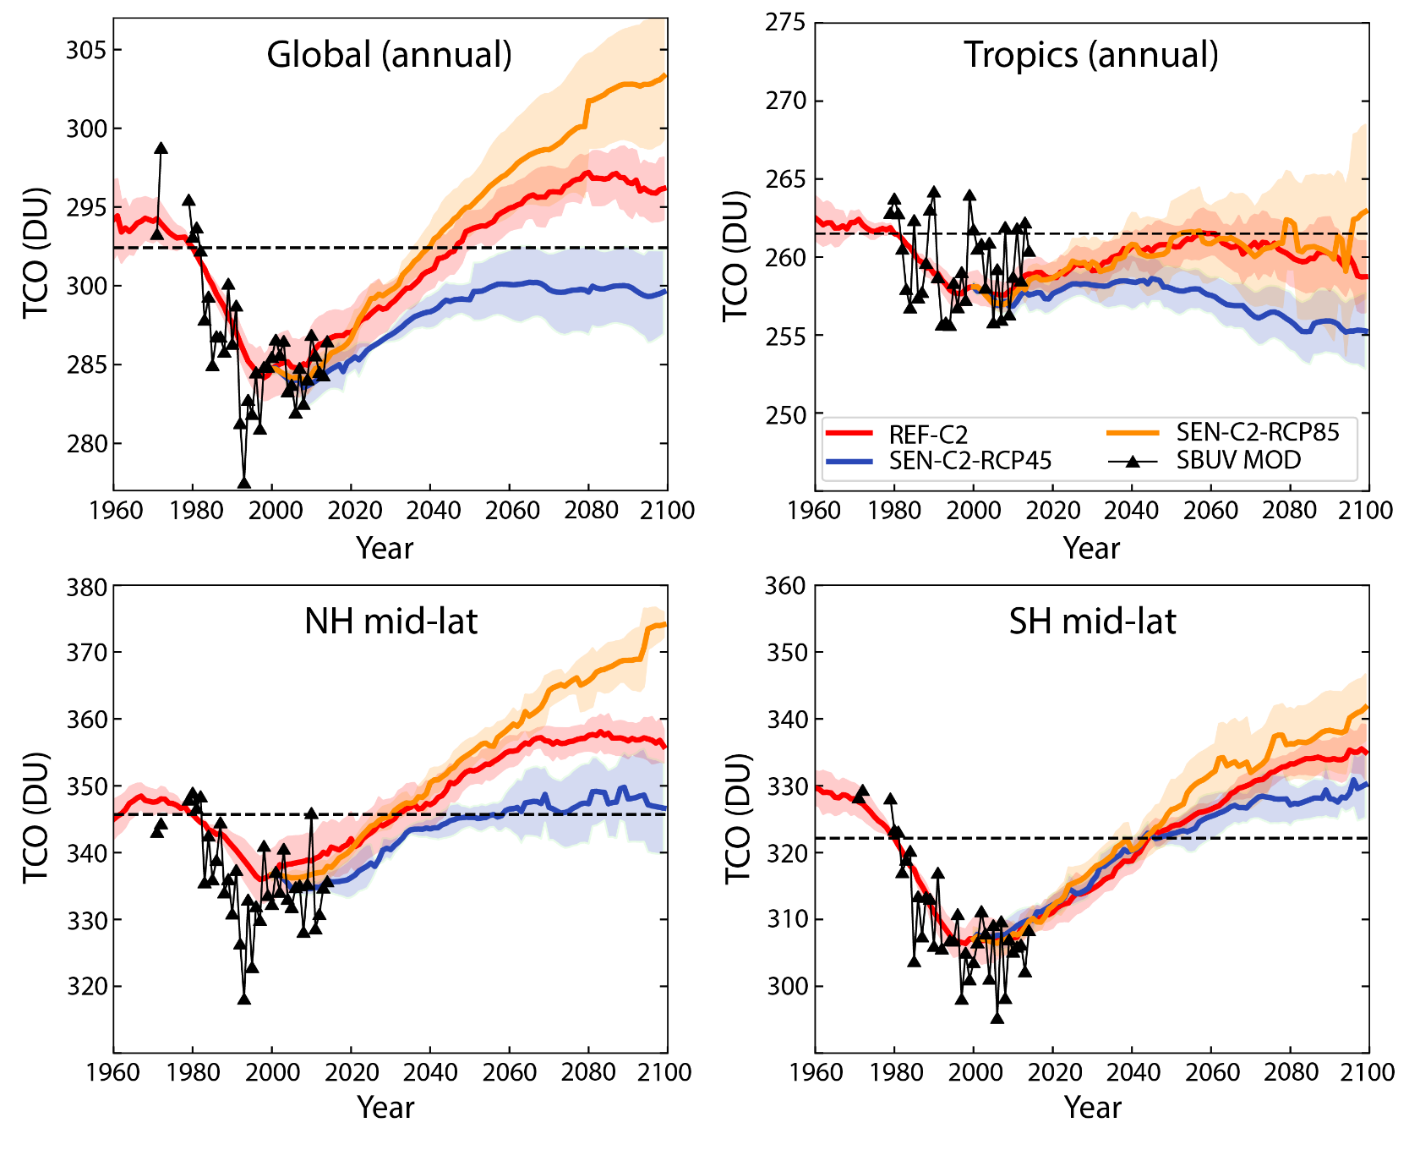
Ozone return dates (TCO) from WMO 2018
Figure 3-19 Ozone Assessment 2018
Adjusted and smoothed multi-model mean time series of annual mean TCO from observations (solid black lines and symbols) and for RCP scenarios from CCMI models: REF-C2=RCP-6.0 (red lines), SENC2-RCP45=RCP-4.5 (blue lines), and SEN-C2-RCP85=RCP-8.5 (orange lines). The black dashed lines represent 1980 values of TCO. From Dhomse et al. (2018).
Braesicke, P. and Neu, J. (lead authors), Chapter 3 in Scientific Assessment of Ozone Depletion: 2018, WMO Report No 58.

Slide 26
CMIP6 scenarios
Simulation name(s) | Type | Purpose | Features
historical | Hindcast simulation of the period 1850–2014 | To produce realistic simulations of the past atmospheric state | GHGs, ODSs, volcanic aerosol, solar variability, ozone and aerosol precursors, are prescribed from observations. Uses coupled ocean model for SSTs and SI
SSP1-1.9 SSP1-2.6 SSP2-4.5 SSP3-7.0 SSP4-3.4 SSP4-6.0 SSP5-8.5 | Future simulations of the period 2015–2100 | To produce estimates of future atmospheric composition and climate changes given specific emissions assumptions | GHGs, ODSs, volcanic aerosol, ozone and aerosol precursors, are prescribed following the named SSP scenario (SSP1-1.9 etc). Uses coupled ocean model for SSTs and SICs

Slide 27
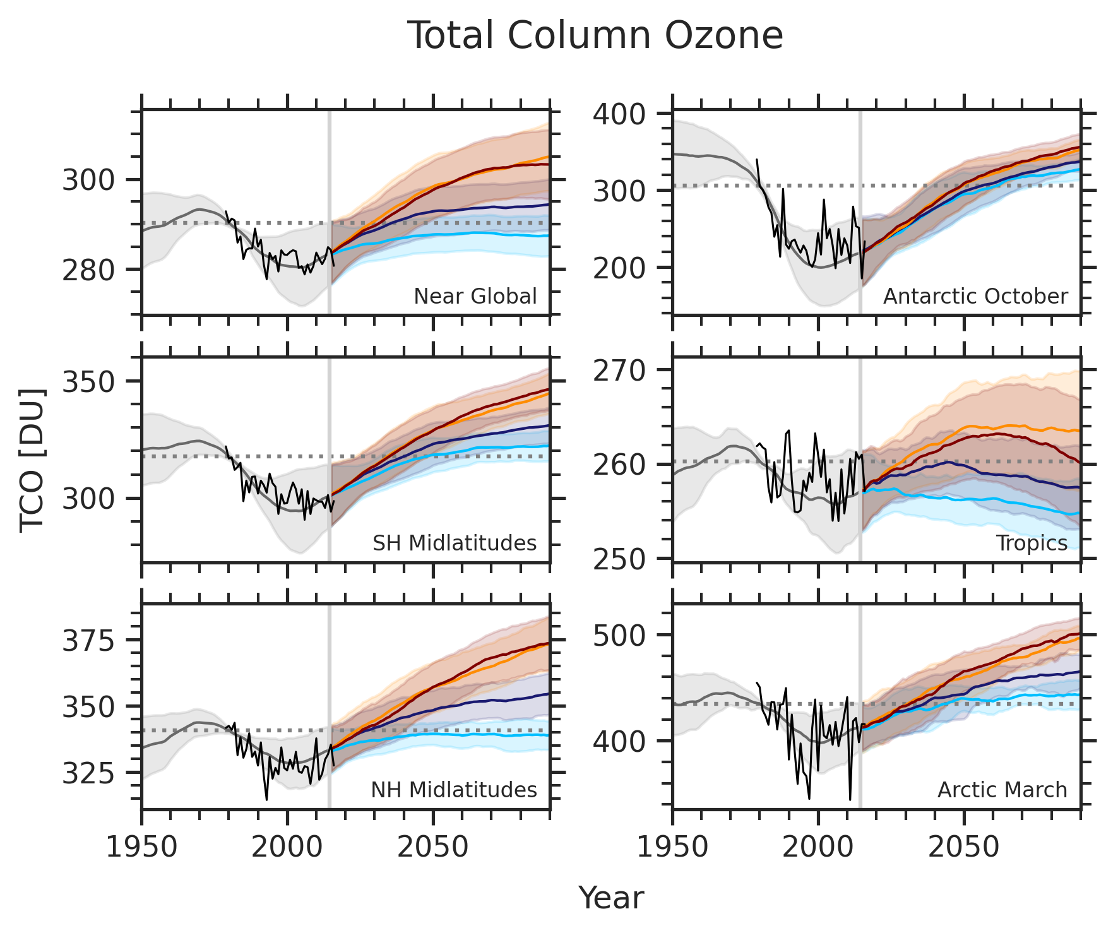
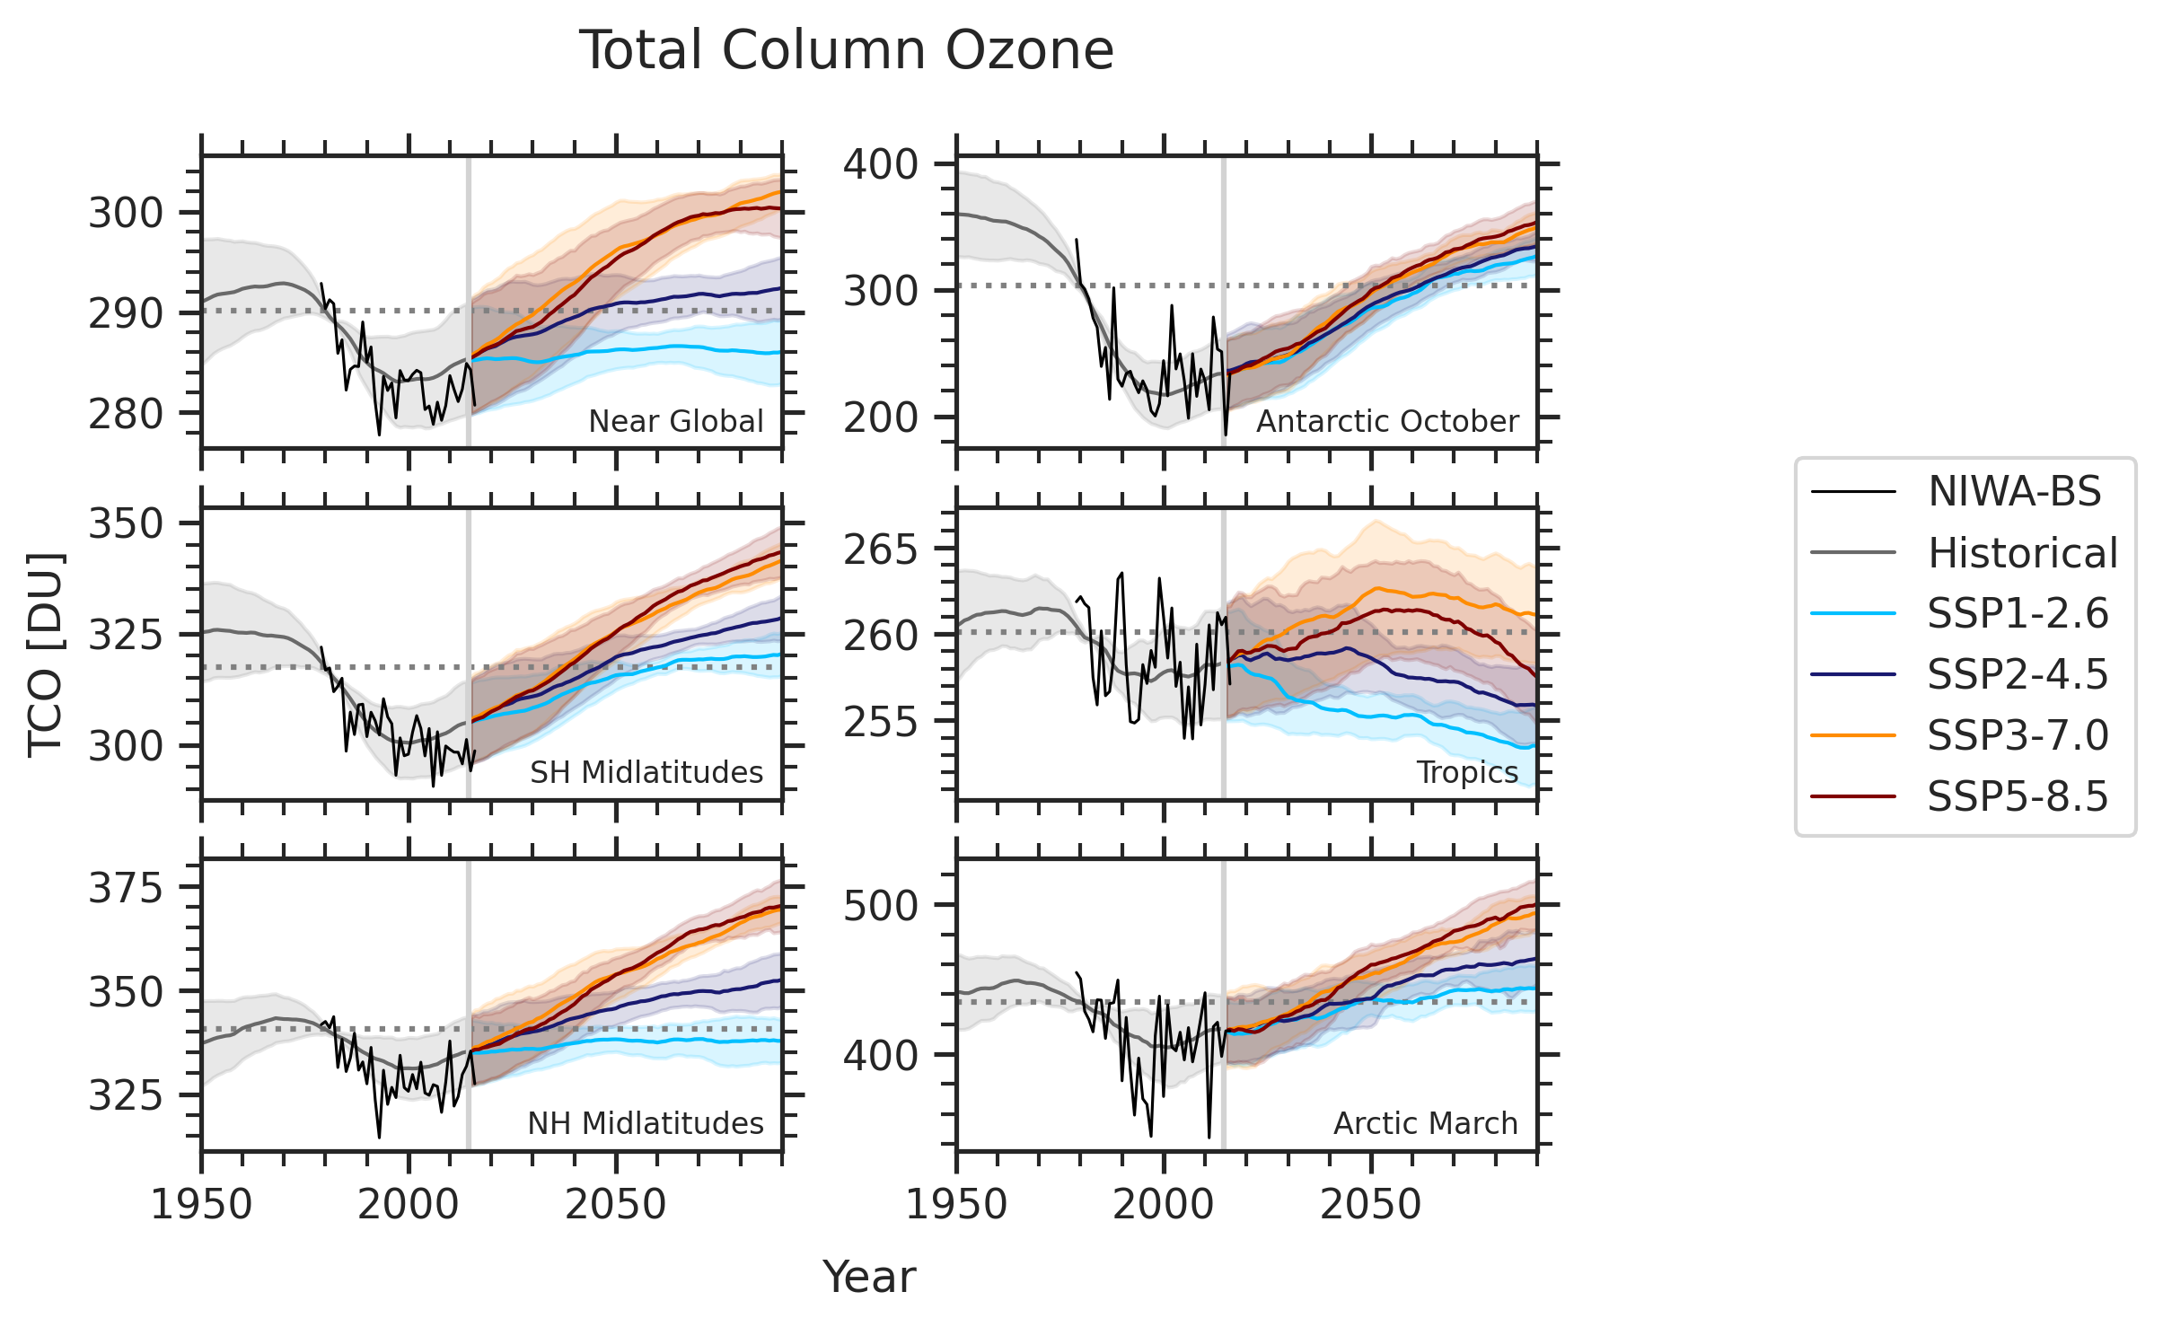

Ozone return dates (TCO) from CMIP6
Depending on the scenario ozone return dates can vary significantly
Scenarios that assume larger emissions of greenhouse gases have total column ozone that returns to 1980 values sooner than scenarios with smaller greenhouse gas emissions
Based on models that ran the simulations with interactive chemistry
Keeble et al., 2022, in prep.

Slide 28
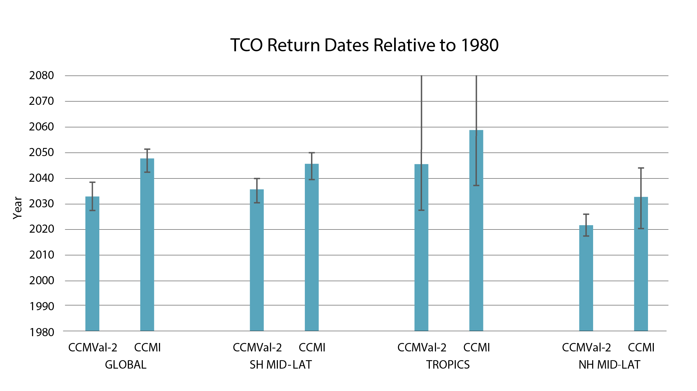
Ozone return dates (TCO) from WMO 2018
Figure 3-27 Ozone Assessment 2018
Bar chart comparing WMO (2014) projected 1980 return dates (labeled CCMVal-2) to this Assessment’s CCMI-1 1980 return dates as analyzed from the multi-model mean (MMM1S) time series. The global mean refers to 90°S–90°N for WMO (2014) and to a near-global mean (60°S–60°N), consistent with the observations presented in this chapter) in the case of MMM1S. The true and near-global mean should be very similar (Dhomse et al., 2018). A comprehensive table with more details is provided by Dhomse et al. (2018).
mid-
century
mid-
century
~2035
Braesicke, P. and Neu, J. (lead authors), Chapter 3 in Scientific Assessment of Ozone Depletion: 2018, WMO Report No 58.

Slide 29
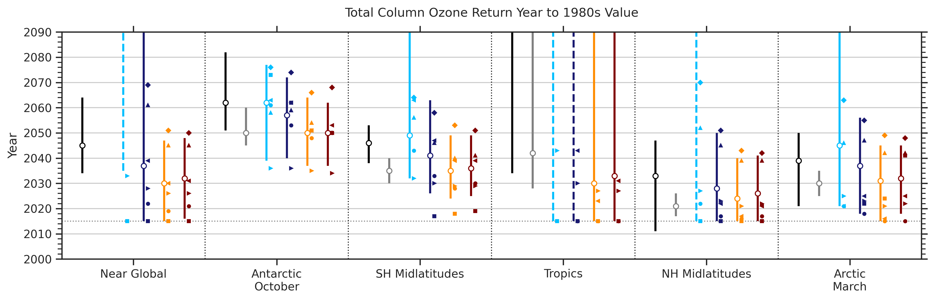
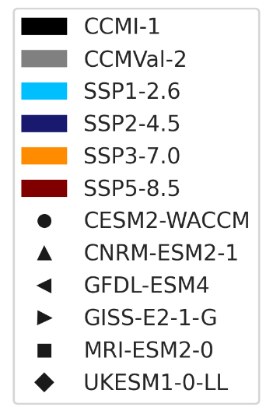
Ozone return dates (TCO) from CMIP6
~2040
~2045
~2035
Estimated years are based on the middle-of-the-road scenario SSP2-4.5
Results are very similar to findings in WMO Ozone Assessment 2018
Keeble et al., 2022, in prep.

Slide 30
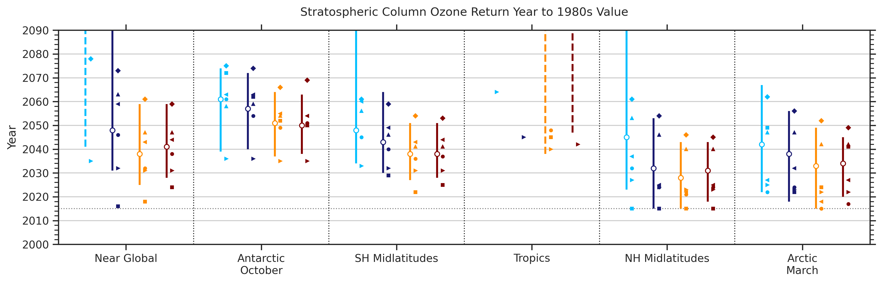
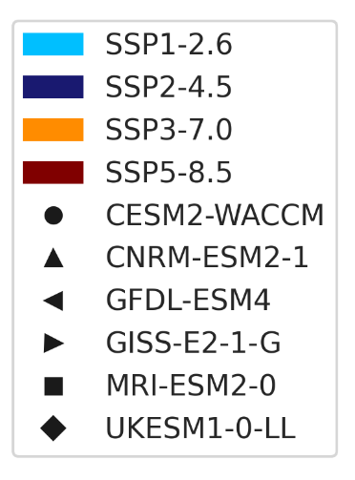
Ozone return dates (SCO) from CMIP6
Stratospheric column ozone
Based on the middle-of-the-road scenario SSP2-4.5
No recovery in the tropics
Keeble et al., 2022, in prep.

Slide 31
Summary
Total column ozone: Observations indicate small, but statistically significant trends of 0.4 ± 0.2% decade⁻¹ in near-global (60°S–60°N) total column ozone over the 1997–2020 period
Vertically resolved ozone: Continued increase in upper stratospheric ozone; statistically significant in more regions than reported in WMO Ozone Assessment 2018; not much change in the lower stratosphere ozone
Ozone return dates: based on CMIP6 simulations; scenarios that assume larger emissions of greenhouse gases have total column ozone that returns to 1980 values sooner than scenarios with smaller greenhouse gas emissions; NH mid-latitudes: ~2035, SH mid-latitudes: ~2045, near-global: ~2040

Slide 32
Thank you!

Slide 33
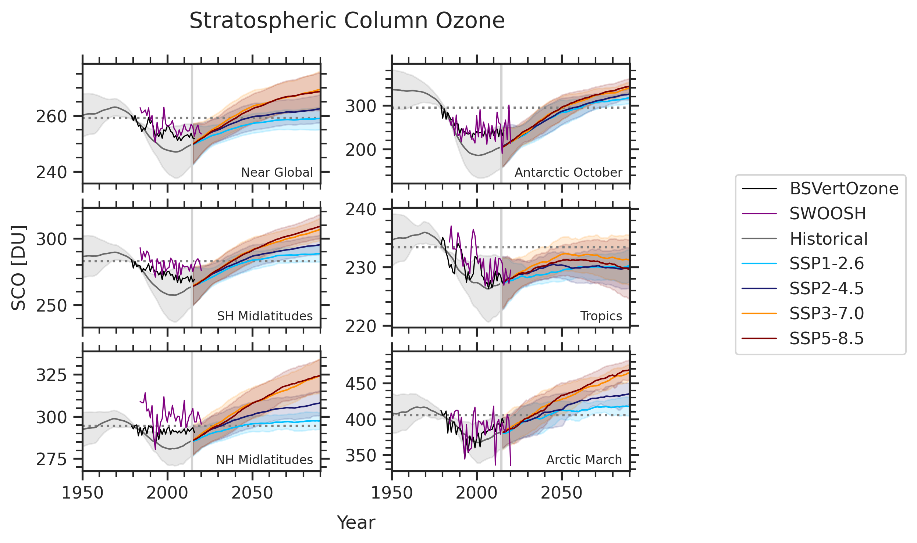
Ozone return dates (SCO) from CMIP6
Keeble et al., 2022, in prep.

