Slide 1
SAGE III/ISS Communications &
Public Outreach
Allison McMahon
SAGE III/ISS Communications Lead

Slide 2
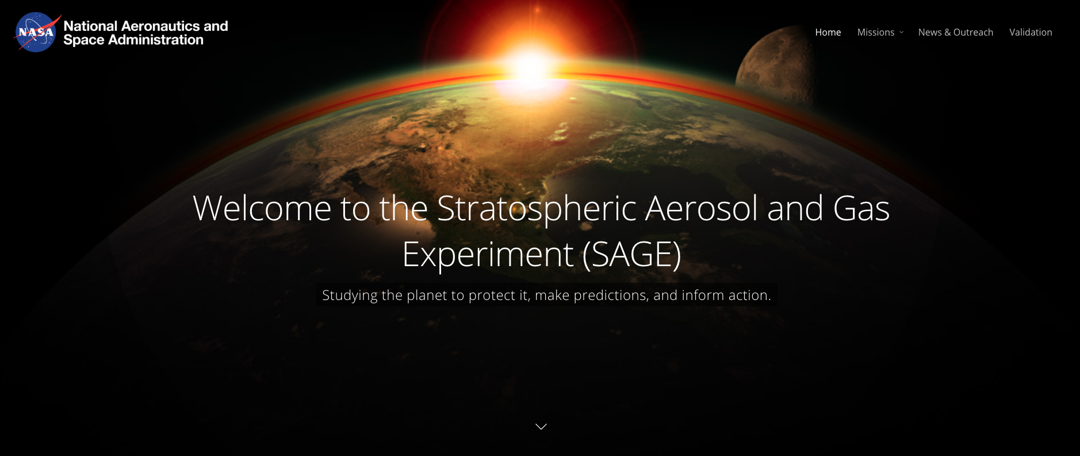
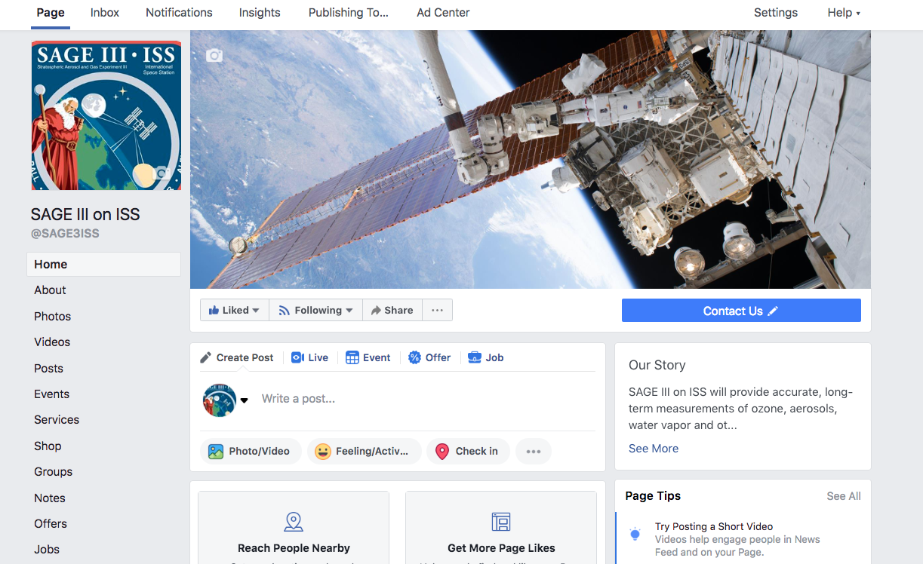
SAGE III/ISS Online
sage.nasa.gov
Follow @SAGE3ISS on Facebook!
Slides from this meeting will be posted under Missions →
About SAGE III on ISS→
Science Team

Slide 3
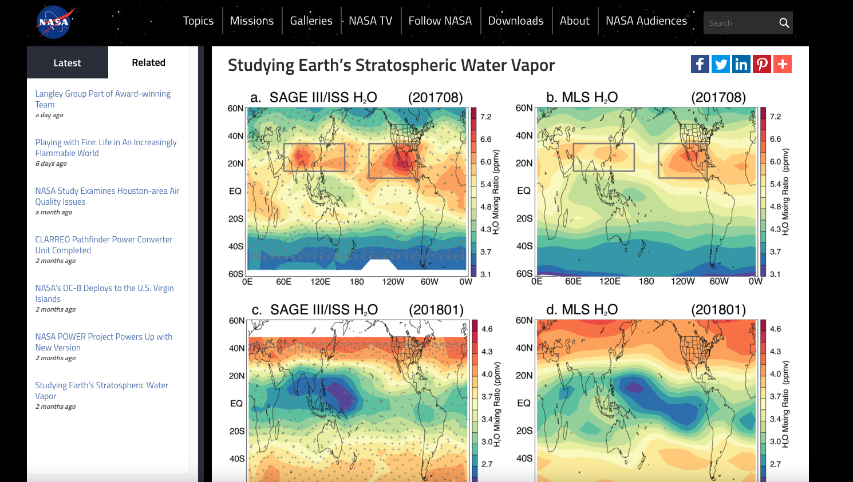
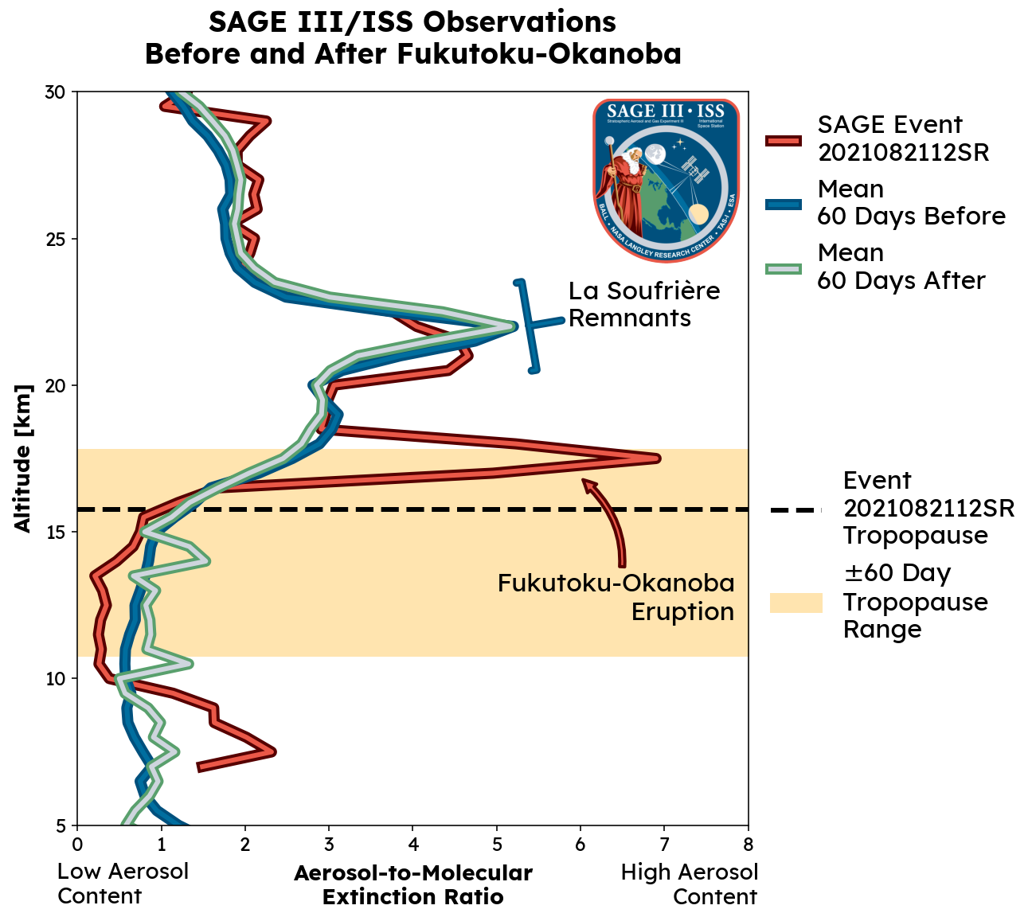
In the News...
Studying Earth’s Stratospheric Water Vapor
Upcoming: Enhanced Stratospheric Aerosols from Fukutoku-Okanoba Eruption

Slide 4
Outreach Events
Nov. 10, 2020: ODU Lunch & Learn
  Marilee Roell and Jamie Nehrir participated in the ODU lunch and learn: “Women in Science” Zoom seminar series.
Dec. 7-11, 2020: American Geophysical Union 2020
  Rob Damadeo was co-convener for the session "Recent Findings from Spaceborne Observations of the Middle Atmosphere" at the virtual AGU Fall Meeting 2020.
Jan. 10-15: American Meteorological Society (AMS) 2021

Slide 5
Outreach Events (cont.)
Jan. 28 - Feb. 4, 2021: Committee on Space Research (COSPAR) Scientific Assembly
  David Flittner presented a virtual talk titled "Three years of observations from the International Space Station (ISS) by the Stratospheric Aerosol and Gas Experiment III (SAGE III)" in the session "Observing the Anthropocene from Space."
April 19 - 30, 2021: European Geosciences Union (EGU) 2021
  Susan Kizer and Mike Pitts attended the virtual event. Susan presented the results of comparisons between v5.1 and v5.2 ozone and water vapor data. Mike
  co-convened the Session "Polar Ozone and Polar Stratospheric Clouds" with contributions in various presentations.

Slide 6
Outreach Events (cont.)
May 10-13, 2021: 11th International Limb Workshop
  David Flittner, Rob Damadeo, Marilee Roell, Susan Kizer, Michael Heitz, and Travis Knepp participated in the virtual 11th International Limb Workshop. This conference included renown limb scientists from around the world to discuss the current state of their research, and the future for collection of important atmospheric science data using various limb measurement techniques.
May 24-28, 2021: NOAA GMAC virtual workshop
  Susan Kizer, Carrie Roller, and Travis Knepp attended the virtual 2021 NOAA Global Monitoring Annual Conference (GMAC) where Susan Kizer presented the comparisons of the in-situ sonde data products with SAGE III/ISS v5.2 data products (SAGE III/ISS Validation of Ozone and Water Vapor V5.2 Data Using Collocated Balloon-borne Measurements).

Slide 7
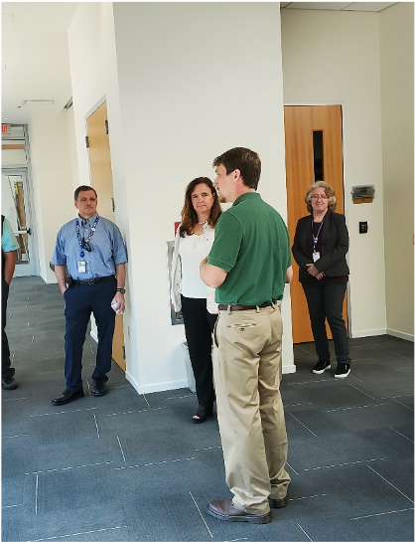
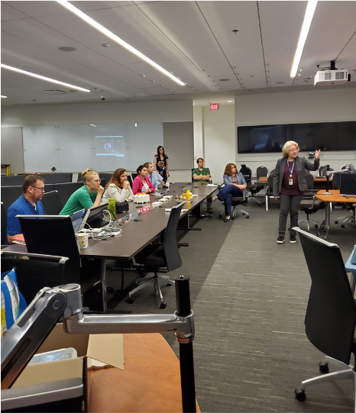
Outreach Events (cont.)
July 7, 2021: Karen St. Germain, NASA Earth Science Division Director, Visits LaRC
  The SAGE team gave a presentation on the history of SAGE III and the state of the science data product in a video presentation; a Flight Mission Support Center tour of mission operations; and a presentation on the follow-on SAGE IV prototype instrument being developed at NASA Langley.

Slide 8
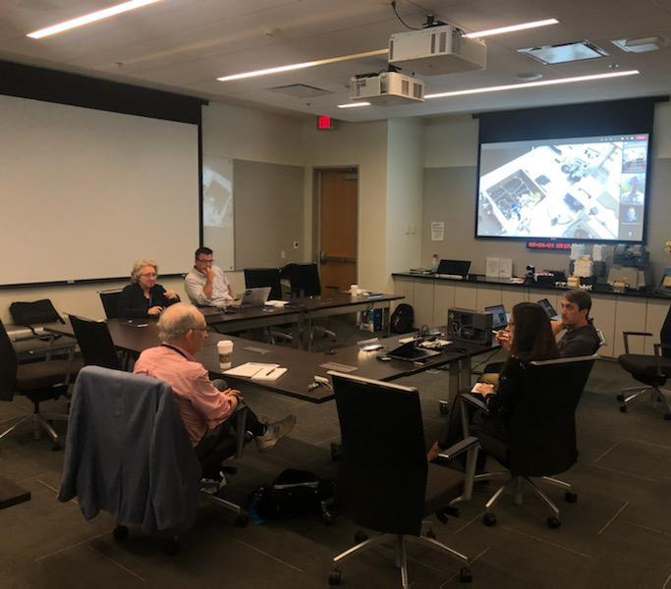
Outreach Events (cont.)
July 26, 2021: Jack Kaye, NASA Associate Director for Research of the Earth Science Division, Visits LaRC
  Jack Kaye visited NASA Langley facilities to share information on the various science missions hosted by the Science Directorate. David Flittner, Marilee Roell, Charles Hill, Rob Damadeo, and Jamie Nehrir presented, in a blended meeting format, the SAGE III state of the science data products, a Flight Mission Support Center tour of mission operations, and a virtual tour of the follow-on SAGE IV prototype instrument being developed at Langley.

Slide 9
Outreach Events (cont.)
August 16, 2021: International Space Station Research & Development Conference
  David Flittner presented a summary of the first four years of SAGE III science data products during the earth science session at the ISS R&D virtual conference. This was well received followed by a Q&A section that was fully utilized for the 20 minutes of allotted time.
October 3-9, 2021: Quadrennial Ozone Symposium
  David Flittner, Robert Damadeo, Robbie Manion, Marsha Larosee, Susan Kizer, and Marilee Roell attended the international virtual QOS conference held every four years to update the science community on the state of the ozone recovery in the stratosphere and other important atmospheric changes and discoveries.

Slide 10
SAGE III/ISS Video
Continuing Important Observations of the Stratosphere

Slide 11
Contact Information
Please contact me if you are interested in featuring your work on our website and/or Facebook page!
Allison McMahon
SAGE III/ISS Communications Lead
757.864.4563
allison.b.mcmahon@nasa.gov

Slide 12
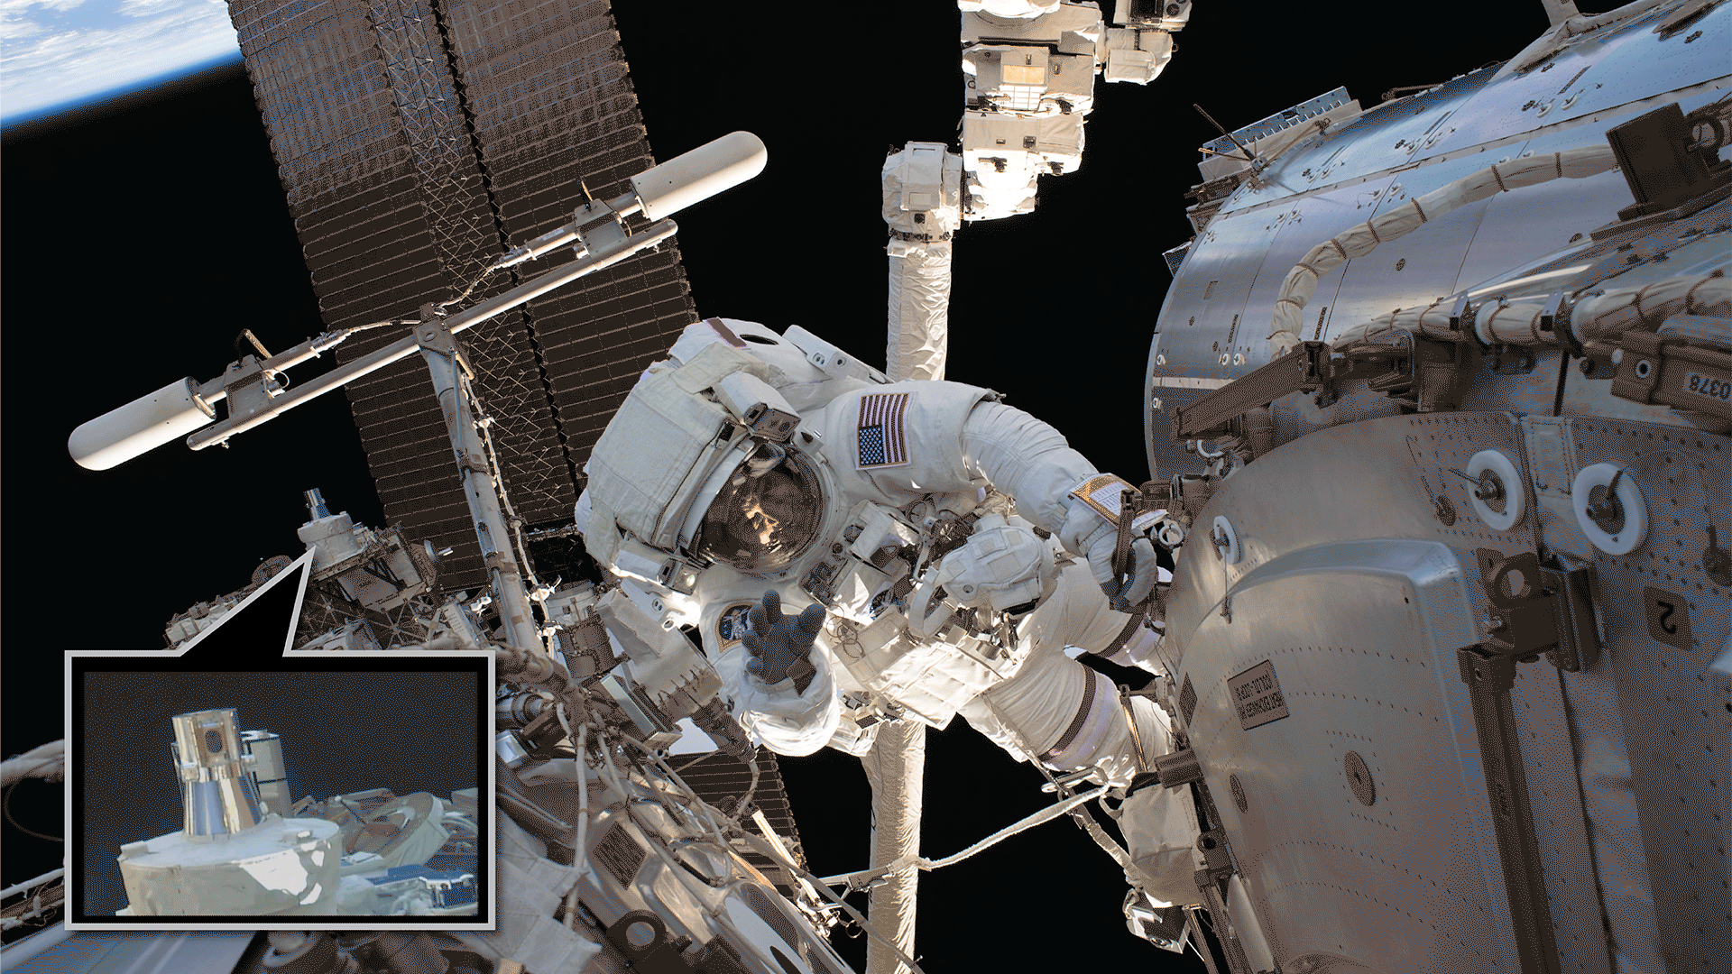

Questions?

