Slide 1
SAGE III/ISS Contamination Monitoring Package Updates
Tyler Dawson
tyler.t.dawson@nasa.gov
NASA Langley Research Center
04 November 2021

Slide 2
Agenda
2021 Contamination Overview
New Dragon Visits
  Cargo and Crew Dragon Dockings
Multipurpose Laboratory Module (MLM) Nauka
  New Russian ISS Module Installed
Window Transmission Trending
External Flux Derivation
  Yearly Sauerbrey Thickness Calculated
Publications
  MAPTIS
  IEST Journal

Slide 3
2021 Contamination Overview

Slide 4
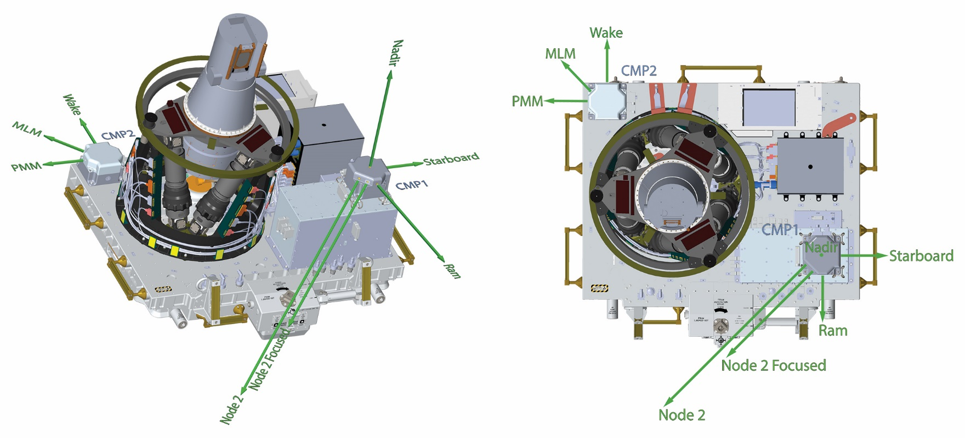
SAGE III/ISS CMP Sensor Locations

Slide 5
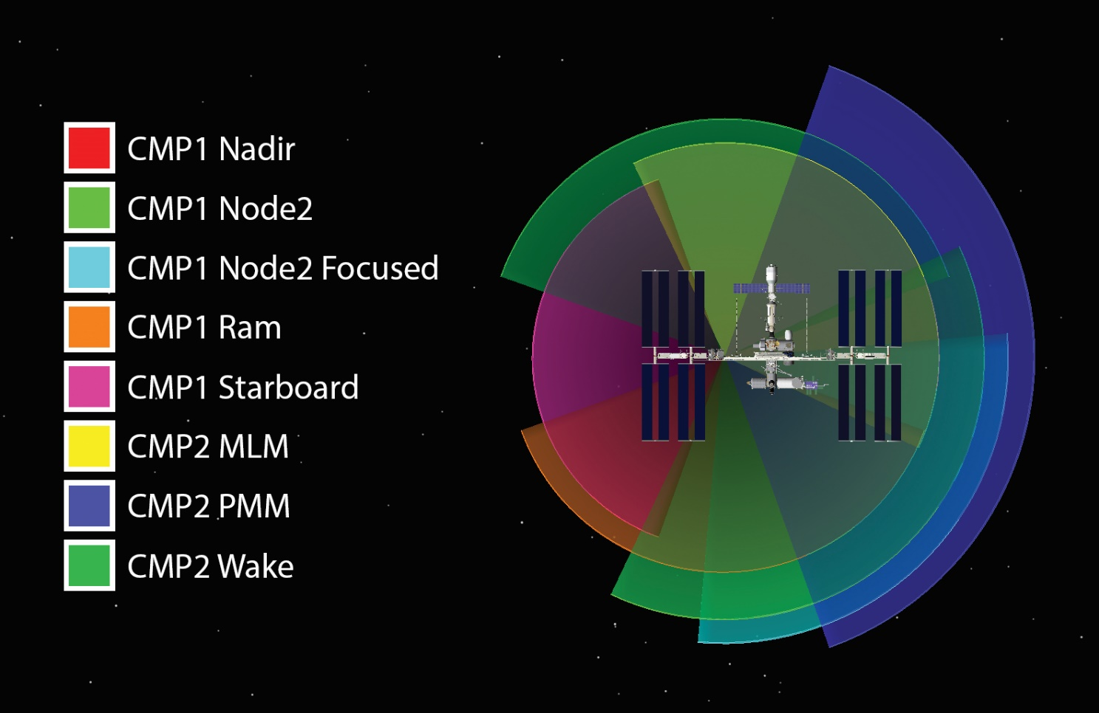
SAGE III/ISS CMP Sensor Locations

Slide 6
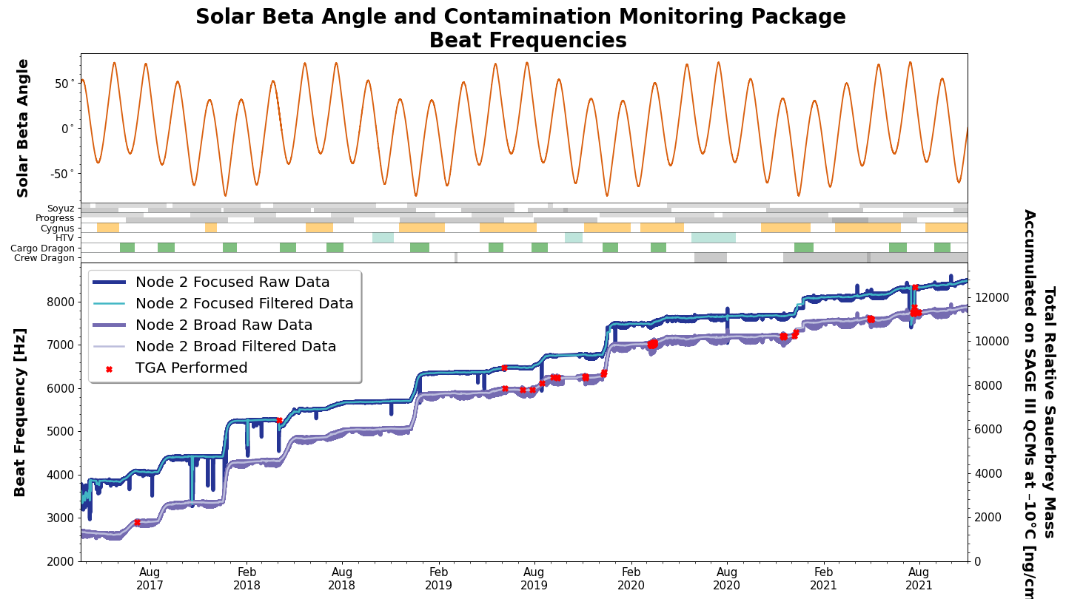
CMP1 Node 2 Sensors

Slide 7
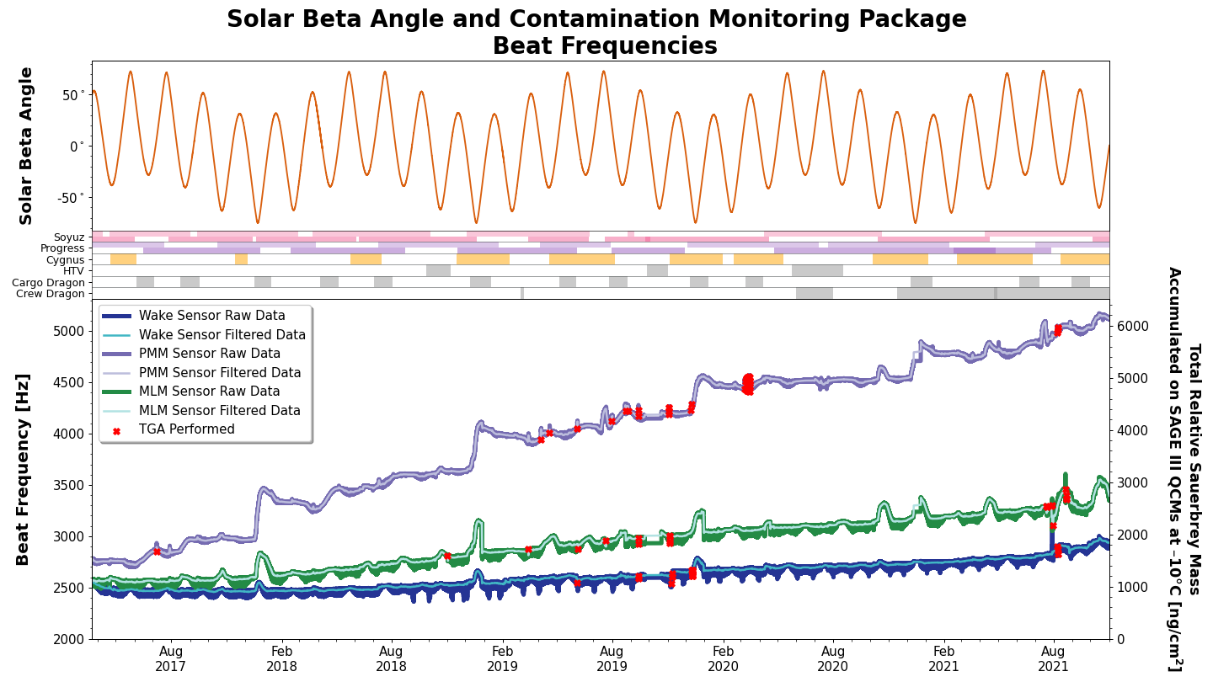
CMP2 Sensors

Slide 8
Dragon Visits

Slide 9
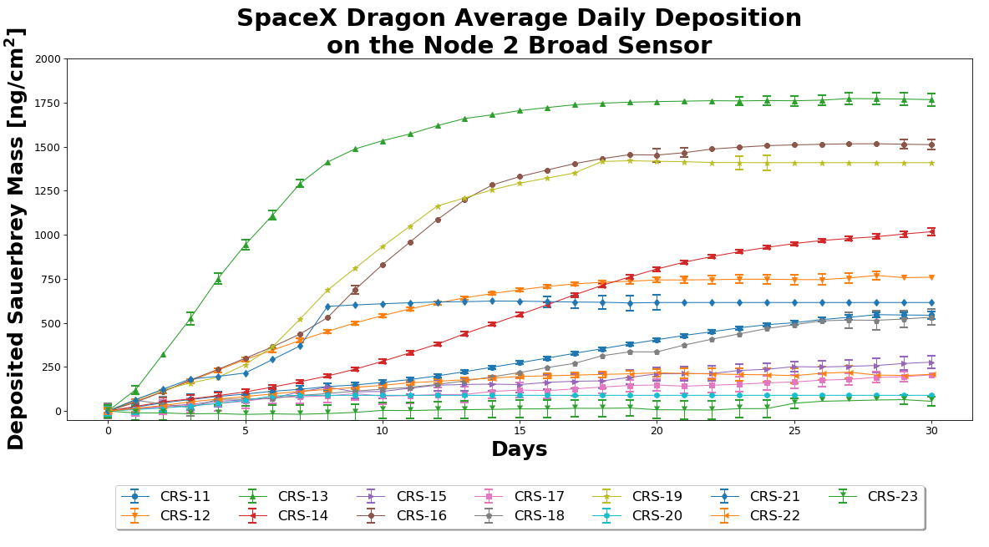
Dragon Outgassing – Node 2 Broad

Slide 10
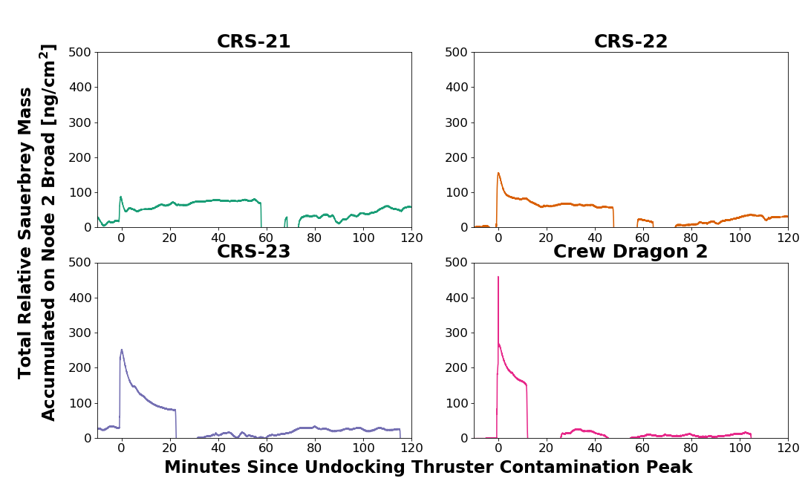
Dragon Undocking Thruster Impulses

Slide 11
MLM Nauka Docking

Slide 12
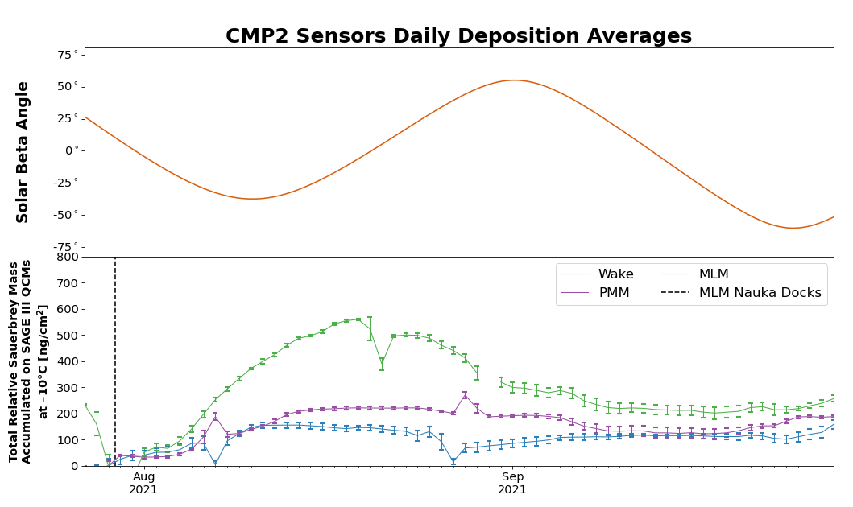
CMP2 Sensors Daily Deposition Averages

Slide 13
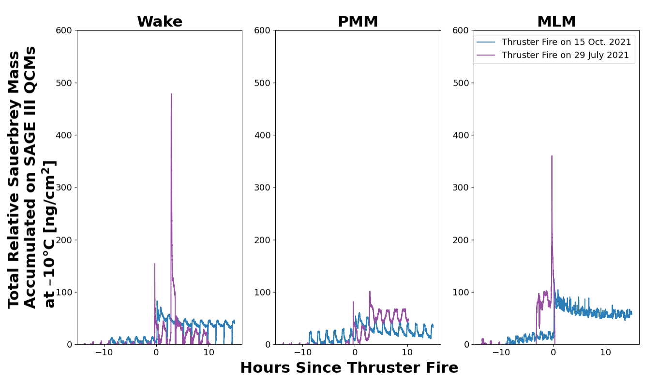
Unexpected Thruster Fires

Slide 14
Window Transmission Trending

Slide 15
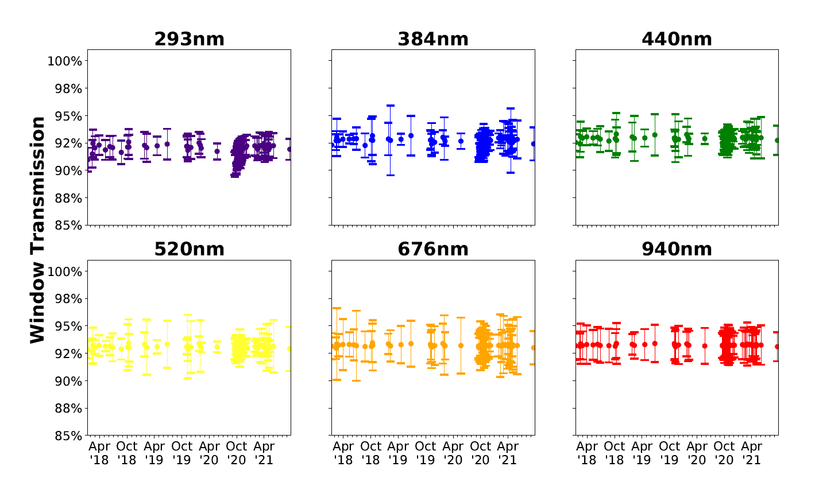
Window Transmission Trending

Slide 16
External Flux Derivation

Slide 17
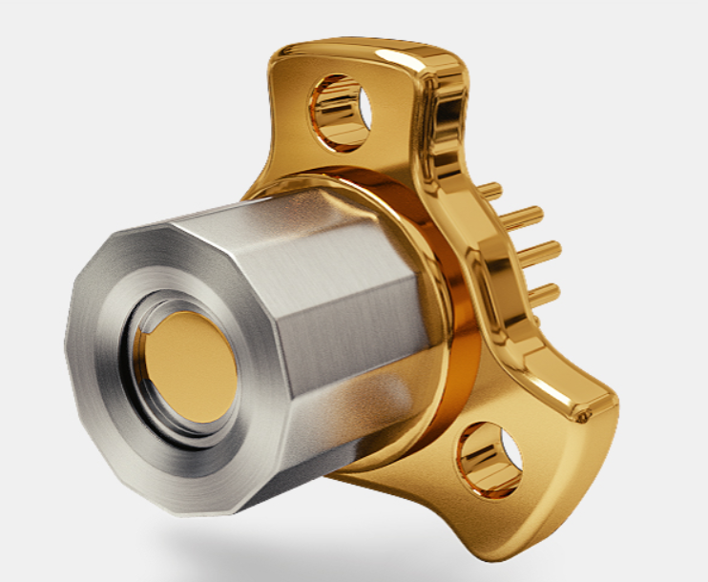
Mark24 TQCM

Slide 18
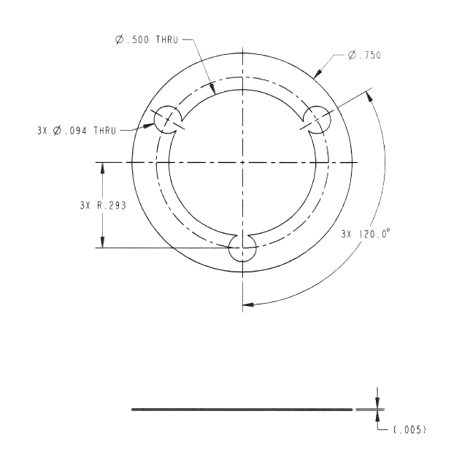
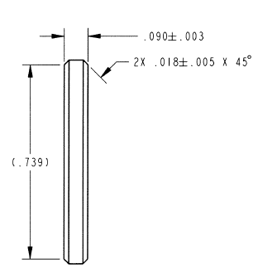
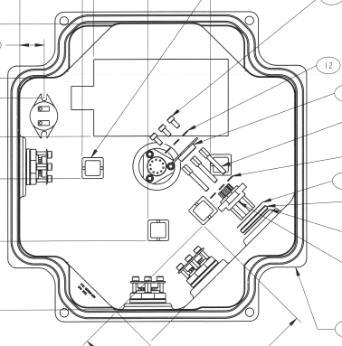
Recessed Sensors
CMP1 Lid Assembly
Thermal Pad
TQCM Spacer

Slide 19
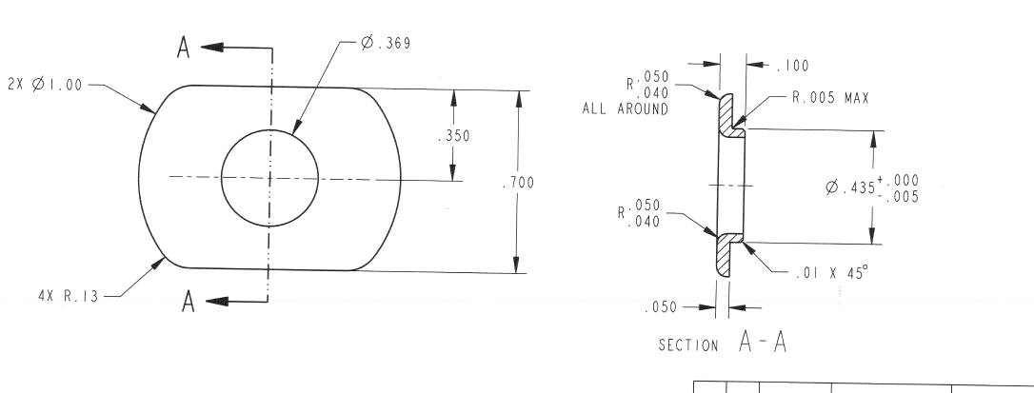
Recessed Sensors Node 2 Focused

Slide 20
Setting Up the Derivation
Find the lengths and diameters of the component pieces.
  SAGE III CMP Engineering Drawings
Use those values to calculate the transmission probability.
  Foundations of Vacuum Science and Technology by JM Lafferty
Derive the minimum and maximum external flux values within the mechanical tolerances of the Engineering models.

Slide 21
Results From Derivation
SAGE III/ISS Contamination Monitoring Package Sensor | Standardized Sauerbrey Thickness [Å/Year]
Starboard | 33
RAM | 31
Node 2 Focused | 196
Node 2 Broad | 210
Nadir | 5
WAKE | 18
PMM | 85
MLM | 27

Slide 22
Derivation Conclusions
This analysis cannot be directly compared to the Boeing Space Environments (BSE) model results.
  BSE uses surface properties and temperatures to adjust external flux to deposition rate.
  We only measure external flux.
  To accurately compare their results to ours, we would need to use their external flux input values.
This calculated deposition thickness is for a sensor stored at -10°C so it should be treated as a worst case scenario for the payload.

Slide 23
Publications

Slide 24
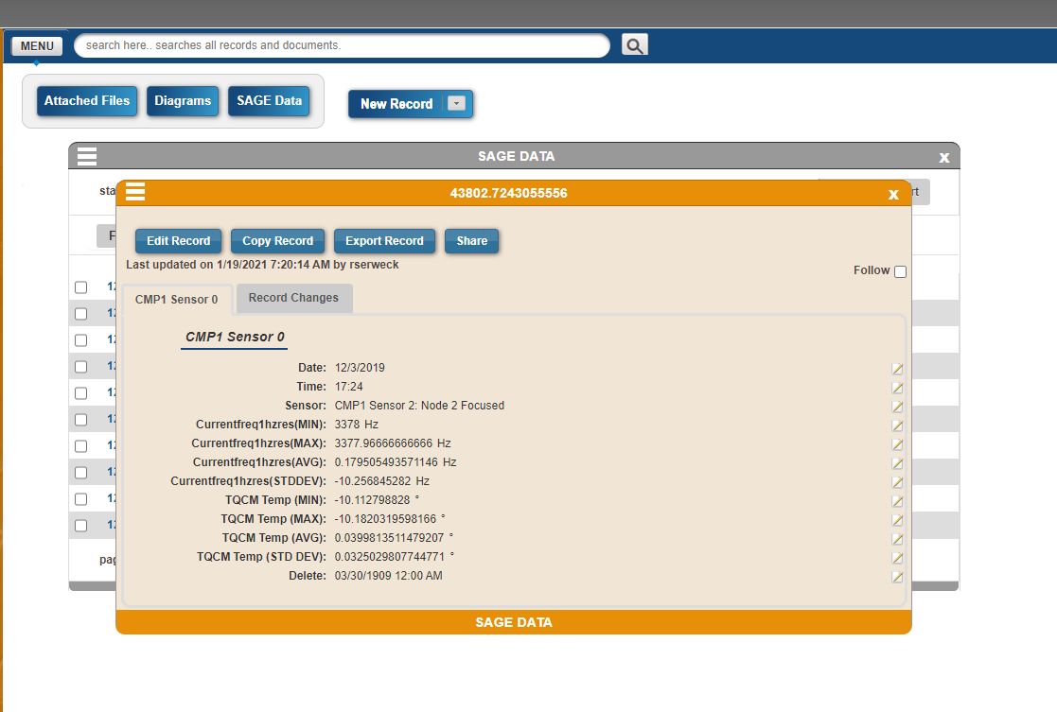
SAGE III/ISS CMP Data Available Soon
Partnership with MAPTIS/Athena team at MFSC to host the CMP data for the duration of the mission.
  Will continue updating the database as the payload continues to age.
  Data will become available after a NAMS request is processed.

Slide 25
Paper Accepted for Publication
Contamination Analyses of ISS Vehicle Visits
  Authored by: Tyler Dawson, Gugu Rutherford, Charles Hill, Amy Rowell, Kevin Leavor, Marilee Roell
  To Be Published In: Journal of the IEST

Slide 26
