Slide 1

Stratospheric Aerosol and Gas Experiment III/ISS
SAGE III/ISS Mission Team
04 November 2021
sage.nasa.gov
Image Credit: NASA Astronaut Ricky Arnold
Notes:
Observe the instrument in the Space Walk photo.

Slide 2
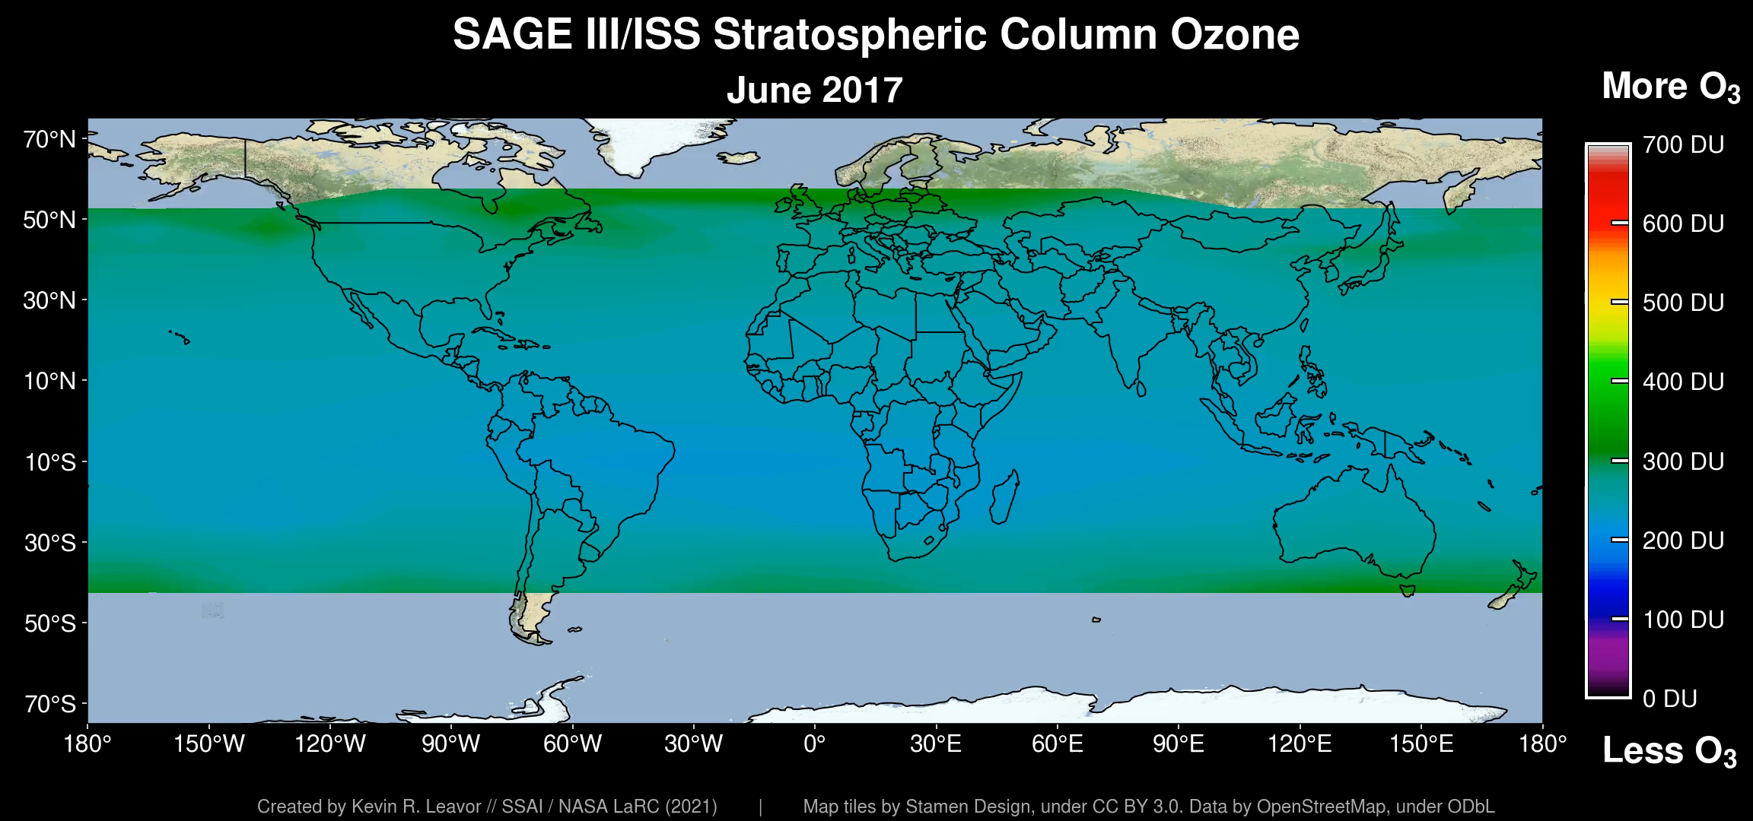
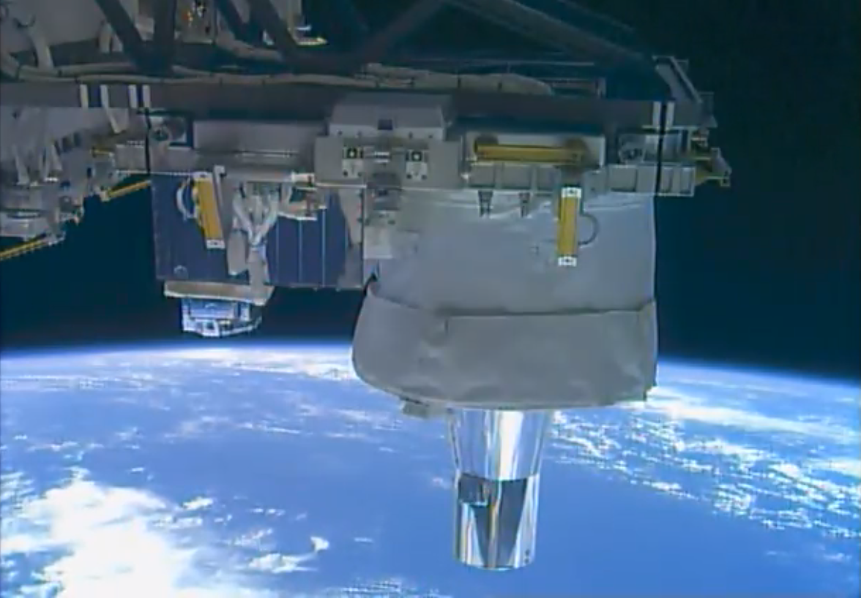
SAGE III/ISS Overview
STRATOSPHERIC OZONE
SAGE produces high vertical resolution profiles of aerosols, ozone, water vapor, and other trace gases in the stratosphere and upper troposphere using the very stable occultation technique
Core element of WMO International Ozone Assessment and WCRP SPARC
Acquired >40k occultation events June 2017 - October 2021; No COVID-19 related data loss
Transitioned to extended mission after successful 2020 Senior Review & End of Prime Mission Review
New algorithm (V5.2) w/ improved water vapor
ROSES Science Team, 2nd cycle, selected
27 peer-reviewed papers using SAGE III/ISS data products, with others in review
Vibrant internship program with ~5 NIFS students/yr (1024 applicants for summer 2021!)
Notes:
With support from HQ, LaRC, ISS Program and Payload Operations I? Center (MSFC) operated throughout COVID-19 era with no reduction in data efficiency or health risks to SAGE personnel.
Occultation collection efficiency is 87% for solar and 53% for lunar. The overall success rate is 83% vs. a requirement of 75%. For the lunar

Slide 3
SAGE III/ISS Operations
With support from HQ, LaRC, ISS Program and Payload Operations Center (MSFC) operated throughout COVID-19 era with no reduction in data efficiency or risks to SAGE personnel or hardware.
Update of flight software in mid-July during high solar beta when nominally no solar science is obtained
Payload is operating within nominal limits
Contamination Monitoring Package (CMP) data to be available at Materials and Processes Technical Information System (MAPTIS) – See Tyler Dawson presentation today for examples of CMP data
See presentation by the Mission Operations Manager (aka MOM) Jamie Nehrir today for more (better) details
Notes:
And

Slide 4
SAGE III/ISS Data Products
Newly released updated version of processing algorithm, v5.2, (https://search.earthdata.nasa.gov/search?q=SAGE%20III/ISS)
  V5.1 still available for Jun 2017-Feb 2021
See R. Manion presentation at Oct. 2020 STM for more details
Important characteristics:
  Major improvement in stability of H₂O
  Wavelength map and channel band pass refined:
    H₂O increased by ~10%
    NO₂ decreased by ~7%
    O₃ about the same
  No vertical smoothing applied so users can see full resolution
    Increased layer-to-layer variability
    Users can average as they see appropriate
V5.1 DID apply smoothing
V5.2 does NOT apply smoothing

Slide 5
Current and Near-term Work
Mission recently completed informational video
Flight software updated in July 2021
Prepared for addition of Multiple Logistic Module (MLM) to ISS configuration
  Configuration for which the SAGE payload was designed
  Updating blockage prediction tools
Data visualization tools for mission team and web-site
Algorithm Improvements
  Main focus is Level 1 product (Transmission)
  See presentations by Marsha Larosee and Darrell Dolliver today for two examples
Evaluation of internal validation activities and correlative data sets

Slide 6
Algorithm Improvement Objectives
Level 1 SOLAR Spectral Transmission
  Review SAGE III & SAGE II Software & implement practical elements of SAGE II
  Organize code to improve maintenance and support improved product flags
  Utilize data from Disturbance Monitoring Package (DMP) in processing of Level 1 Transmission product (See M. Larosee)
Review/Improve QA Flags
Improve Automated Filtering of Bad or Contaminated Events
  Leading cause is partial blockage by ISS or visiting vehicles
Advance maturity of Meso. O₃: Beta -> Research (See D. Dolliver)
Increase vertical resolution of input meteorological fields
Determine cause of 520nm aerosol ext. coef. low bias
Stabilize H₂O in upper stratosphere

Slide 7
New Data Files/Products
Gather single event granules into a “monthly” file (netcdf)
  Same content as single event files, but for ~ month
    Last day of previous month thru next to last day of current month
  Available via Atmospheric Science Data Center (DAAC) starting in late November
Level 3 Cloud Filter
  Using aerosol extinction coefficient profiles to identify altitudes possibly contaminated by clouds on an event-by-event basis
  AGU invited talk "SAGE III/ISS aerosol/cloud categorization and its impact on GloSSAC“ by Mahesh Kovilakam in A14B. Advances in remote sensing and modeling of vertical distributions of aerosols and clouds
  Release is expected before next Science Team Meeting☺
    Released on monthly cadence (same as current products)

Slide 8
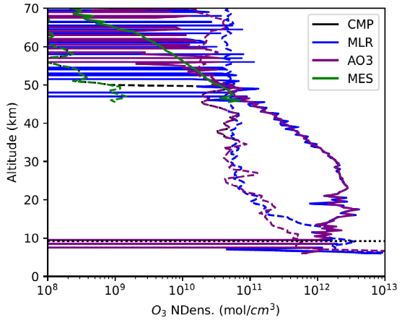
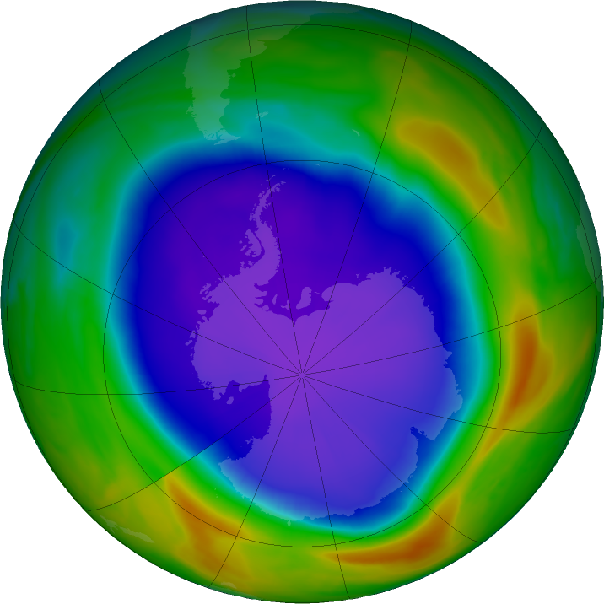
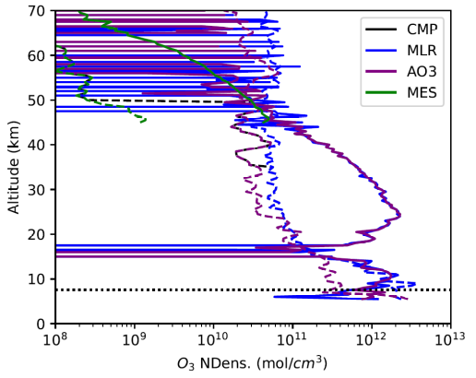
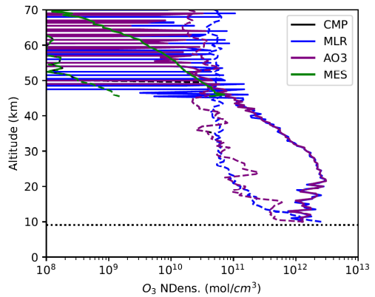
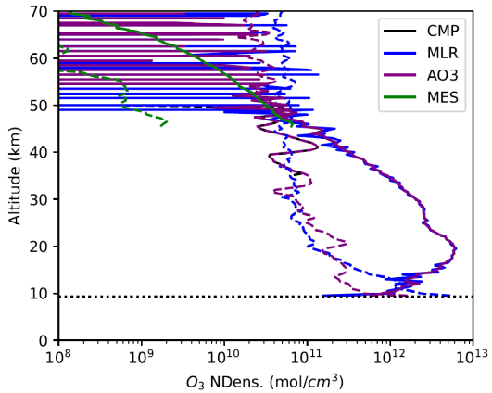
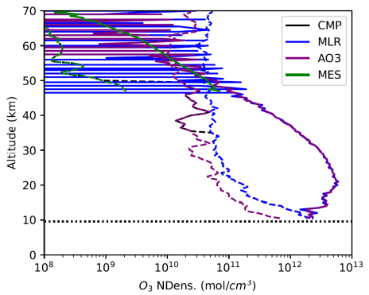
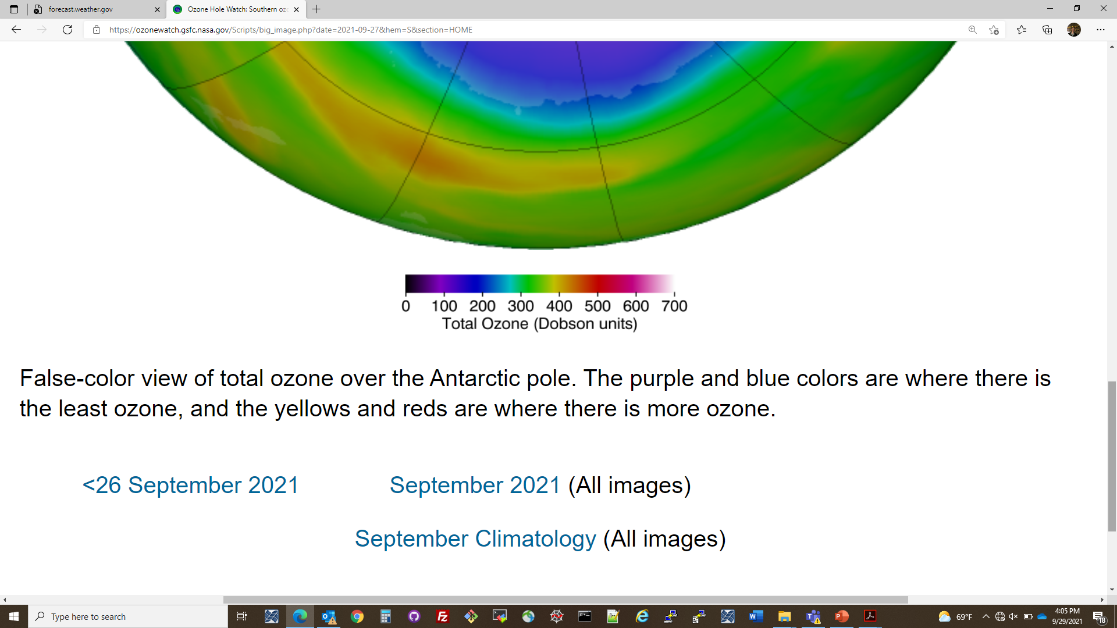
SP Ozone Hole & SAGE III/ISS
10 October 2021
TOTAL OZONE
Prime Meridian
ozonewatch.gsfc.nasa.gov

