Slide 1
Science Team Meeting
NASA Langley Research Center
11/04/2021

Slide 2
Mission Operations
Jamie Nehrir
Mission Operations Manager

Slide 3
Outline
Mission Operation Overview
What Has Change in the Last Year
Future Work

Slide 4
Ops Overview
Mission Operations Goals
  Commanding and downloading data on a weekly/daily basis
  Maintaining the health and safety of the SAGE III payload
    Daily engineering checks
    Trending of engineering data and science metrics
  Process and distribute SAGE III data
    Process Ground Support Equipment (GSE) and Solid State Memory Card (SSMC) in near real-time (8-5 ET)
    Processes 24 hours of SSMC data daily
    Generates daily SCF files
      Level 0 and ancillary data
    Generates daily ESA/TASI data files

Slide 5
Ops Team
SAGE III Payload Operations Center
Jamie Nehrir | Mission Operations Manager
Greg Paxton | Ground Systems Lead
Andrew Peterson | Deputy Mission Operations Manager
Robert Borchardt | Lead Technical Payload Engineer
Jonathan Hicks | Ground Systems Engineer
James Farmer | Ground Systems Engineer
Samuel Porter | Payload Engineer
Joshua McDonald | Payload Engineer
Caitlyn Stone | Payload Engineer
Tyler Dawson | Payload Engineer
Daniel Larrowe | Payload Engineer
Donald Cleckner | Payload Engineer

Slide 6
Phase-E Totals
7/1/2017 00:00 to 10/13/2021 09:00
Event Type | Total Planned | Total Acquired | Total % Acquired (vs. Planned)
Sunrise | 21773 | 19522 | 89.7%
Sunset | 21772 | 18449 | 84.7%
Moonrise | 2880 | 1195 | 41.5%
Moonset | 3173 | 1991 | 62.7%
All Occultation | 49598 | 41157 | 83%
Limb | 15056 | 14602 | 97%

Slide 7
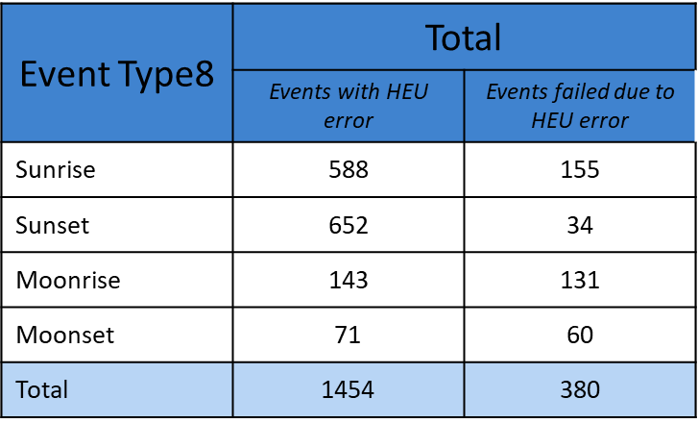
ISS Pitch Before MLM
Effects of ISS pitch outside of Hexapod pointing capabilities:
  The 7° wedge that the hexapod currently sits on was to counteract the installation of the MLM on the ISS payload. When the ISS pitches forward over 0.5° the Hexapod pointing capabilities are outside of range and the Instrument Assembly is unable to fully point nadir for events
  From 5/25/2020 to 8/18/2020 the ISS pitch was outside the pointing capabilities of the SAGE III payload
  SAGE III/ISS lost ~26% of occultation events because the Hexapod was unable to prepoint

Slide 8
Flight Software Pitch Mitigation Efforts
The SAGE III payload identified the need for software changes to mitigate the affect of ISS pitch to SAGE III’s nadir pointing capability.
IAM Calculating Hexapod Prepointing and Hexapod Pointing Prediction Algorithm Correction
  The main algorithm predicts the Hexapod move to determine if the move is within the Hexapod ROM. If the predicted move does not exceed the Hexapod ROM, the science event will be executed as originally predicted with no change to the dynamic alignment quaternion. If the predicted move exceeds the hexapod ROM, a dynamic error quaternion is computed which will restrict the move to be within the Hexapod ROM. Updated instrument azimuth and elevation angles are computed, and a modified science event will be executed.
Instrument Assembly (IA) ICS Commanded Dynamic Error Correction Quaternion Upgrade
  Nominally the IA ICS uses the Dynamic Error Correction Matrices (DEM) found in the Instrument Configuration Control Table (ICCT) when communicating with the IAM to determine pointing for science acquisition. Analysis has determined that many of the lost science events that occur when the ISS is at unfavorable attitude can be performed with modifications to the IAM and IA ICS science pointing software. To support this the IA ICS was modified to support optional IAM direct commanding to override the hexapod Dynamic Error correction Matrix (DEM) parameters normally found in IA Instrument Control Table.

Slide 9
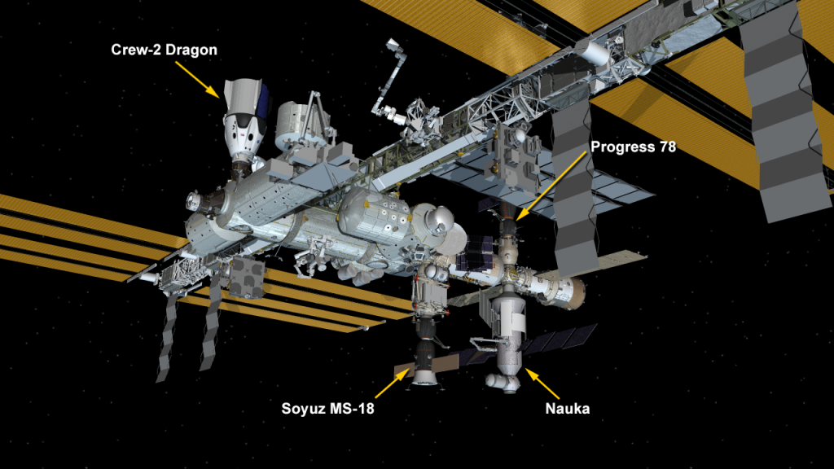
Pitch Following MLM Instillation
With MLM installed we now fall within the expected range of motion of the Hexapod but still have the capability for future events that might exceed the pointing capabilities of the hexapod.
  Prior to MLM the nominal pitch range of station was +3.1 to -5.1 degrees. This varied based on Visiting vehicles and attitude changes. With MLM now docked to station the nominal pitch range of station, depending on the visiting vehicle configuration, will range from -0.6 to -10.2 deg. So overall the ISS generally shifted ~4 to 5deg more negative.
With the 7 degree Wedge SAGE III is now within favorable pitch parameters to maintain nadir pointing.

Slide 10
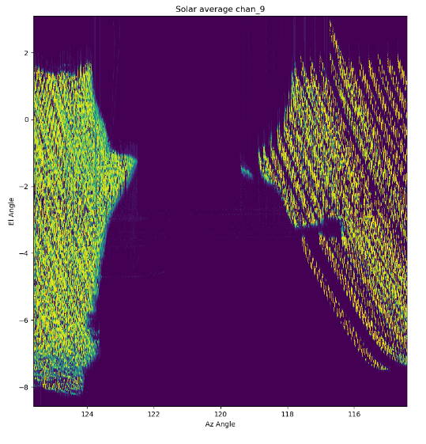
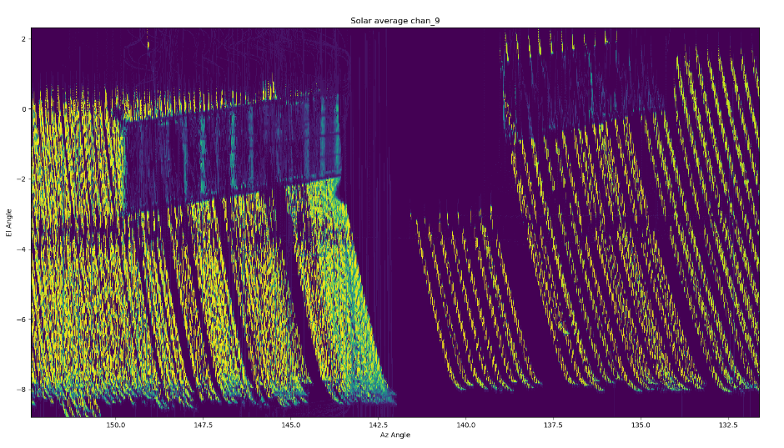
ISS Blockages for SAGE III
Following a TSIS presentation at POWIG the SAGE III operations team used Channel 9 Science Data to visualize what was causing SAGE III payload to miss events or terminate events early
This same process will be used to map out the new MLM configuration (with solar panels and docked payload) to determine the expected blockage map. A full sweep of betas is needed to create an accurate picture for the structure
Soyuz Visiting Vehicle
Progress Visiting Vehicle

Slide 11
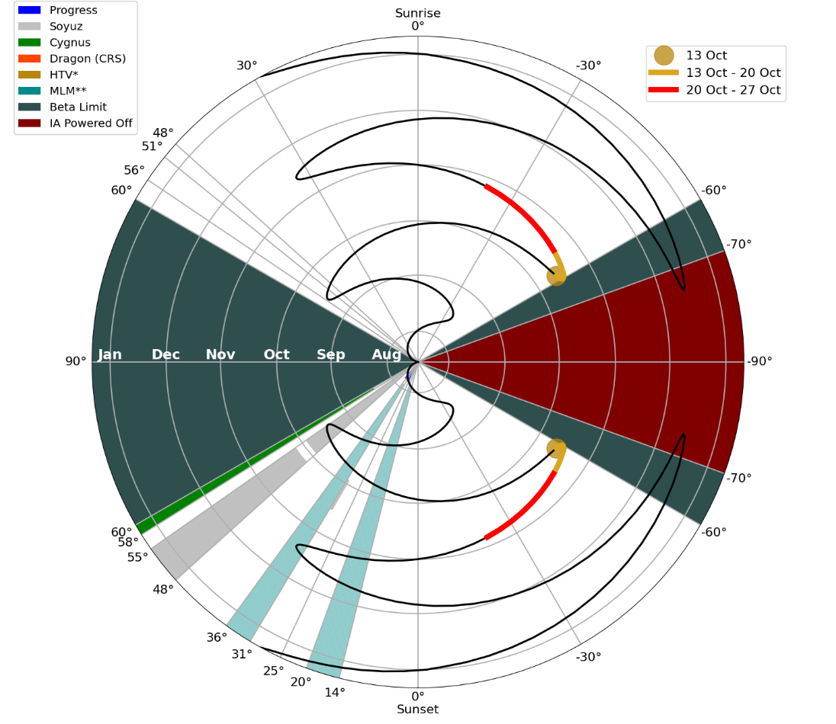
Additional Analysis of Blockages for SAGE III
Why is this important? By accurately predicting blockages we can share this information with our validation partners and have a better probability of capturing the events.

Slide 12
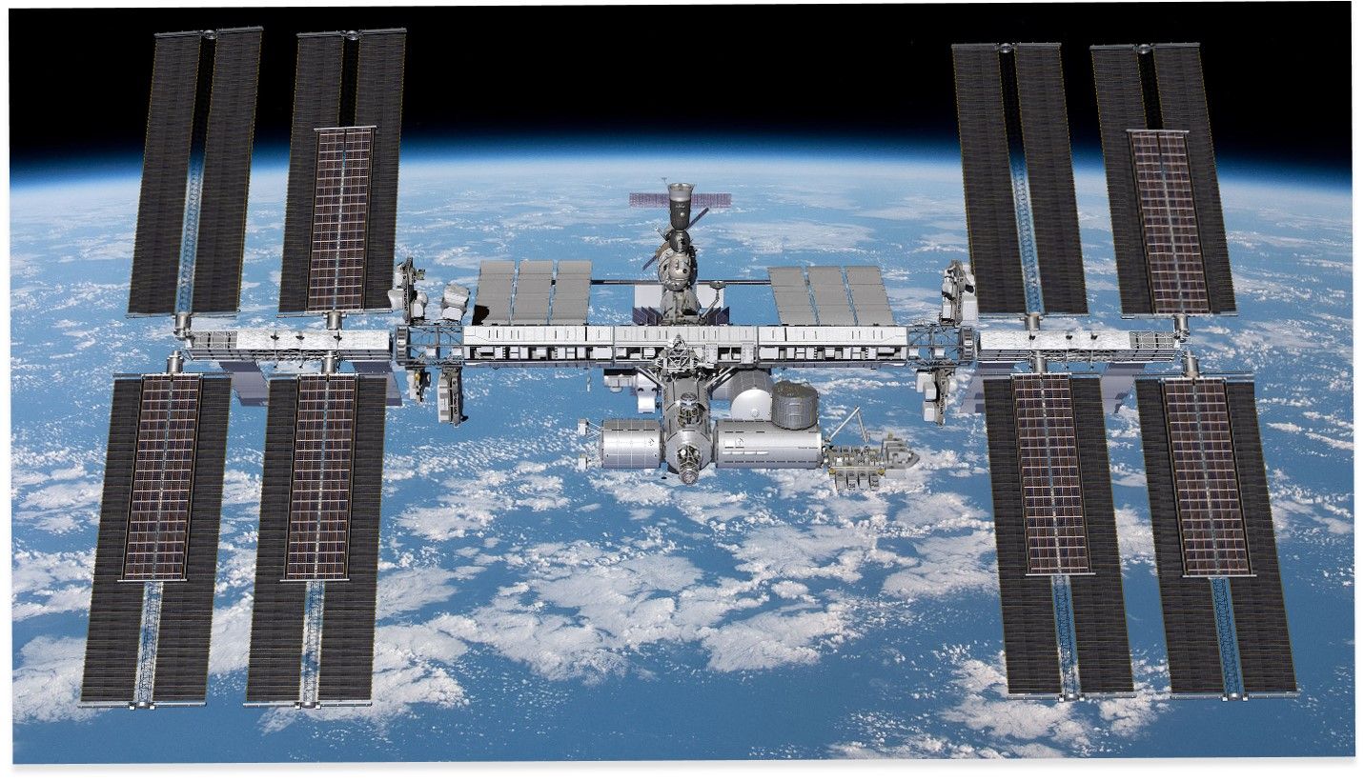
ISS Activities Upgrades
Roll Out of New ISS solar panels: ISS Roll Out Solar Arrays (iROSA)
  ISS Legacy Arrays are showing signs of degradation and therefore new solar panels have been installed onto ISS.
  iROSA will be positioned in front of the legacy solar arrays allowing for the new arrays to be electrically combined with the older arrays which results in an increase in power performance.
  With the new power allowance SAGE III no longer has any power restriction during high betas just thermal constraints.
iROSA
Solar Panels

Slide 13
SAGE III Limb Execution
SAGE III stopped taking Limb events from February of 2020 until November of 2020 because of elevation motor temperature violations.
To mitigate the chance of violating thermal limits the operations team have limited Limb operations to solar noon execution.
Though this is a limitation for the foreseeable future the operations team is working on a code change that will allow for the execution of limbs at all angles

Slide 14
Future Work
Update Instrument Assembly code to allow for automatic termination of Limb events.
  This will allow for the execution of limbs at all pointing possibilities without exceeding thermal limits
  As the payload ages thermal constraints will require the modification of limb durations. By having the automatic termination feature this will limit the amount of operator intervention if approaching thermal limits
Continue to refine the blockage predictions as ISS moves through all beta ranges and as different visiting vehicles dock to MLM

Slide 15
Questions

