Slide 1
Interannual variability of aerosols in the UTLS and its Connection to the climate variability, Asian summer monsoon strengths, and emissions
Mian Chin | NASA Goddard Space Flight Center, USA
Huisheng Bian | University of Maryland at Baltimore County/NASA GSFC, USA
Qian Tan | Bay Area Environmental Research Institute/NASA Ames, USA
Ghassan Taha | USRA/NASA Goddard Space Flight Center, USA
Michel Santee | Jet Propulsion Laboratory, USA
Xiaohua Pan | ADNET/NASA GSFC, USA
This work is in progress in the context of the following projects:
Aura: “Effects of the Asian summer monsoon dynamics on aerosol composition and interannual variability in the UTLS”
SAGE III/ISS: Leveraging the Aura project effort to assess the long-term, vertically resolved changes of aerosols in the UTLS
Acknowledgment:
NASA Earth Science programs for funding support
Valentina Aquila, Peter Colarco, and Mike Manyin for modeling help
University of Saskatchewan group (Landon Rieger, Adam Bourassa, Doug Degenstein) for L3 OSIRIS aerosol data
NASA Langley CALIPSO team (Jay Kar, David Winker) for L3 stratospheric aerosol data
University of Bremen group (John Burrows et al.) for L3 SCIAMACHY aerosol data
NCAR MOPITT team for tropospheric CO profile data
NASA Goddard Earth Sciences Data and Information Services (GES DISC) for data portal
SAGE III/ISS Science Team Meeting | November 5, 2021

Slide 2



UTLS is a crucial region for Earth’s climate, and the human activities have greatly modified the composition in the UTLS
Major sources of UTLS aerosols:
Summer monsoon convective transport of anthropogenic aerosols from the PBL to UTLS
Direct injection of volcanic and pyroCb biomass burning aerosols into the UTLS
Photochemical production from precursor gases (e.g., SO₂, VOC, OCS) in the UTLS
Photochemical production
Monsoon convective transport of pollution
Volcanic eruption

Slide 3
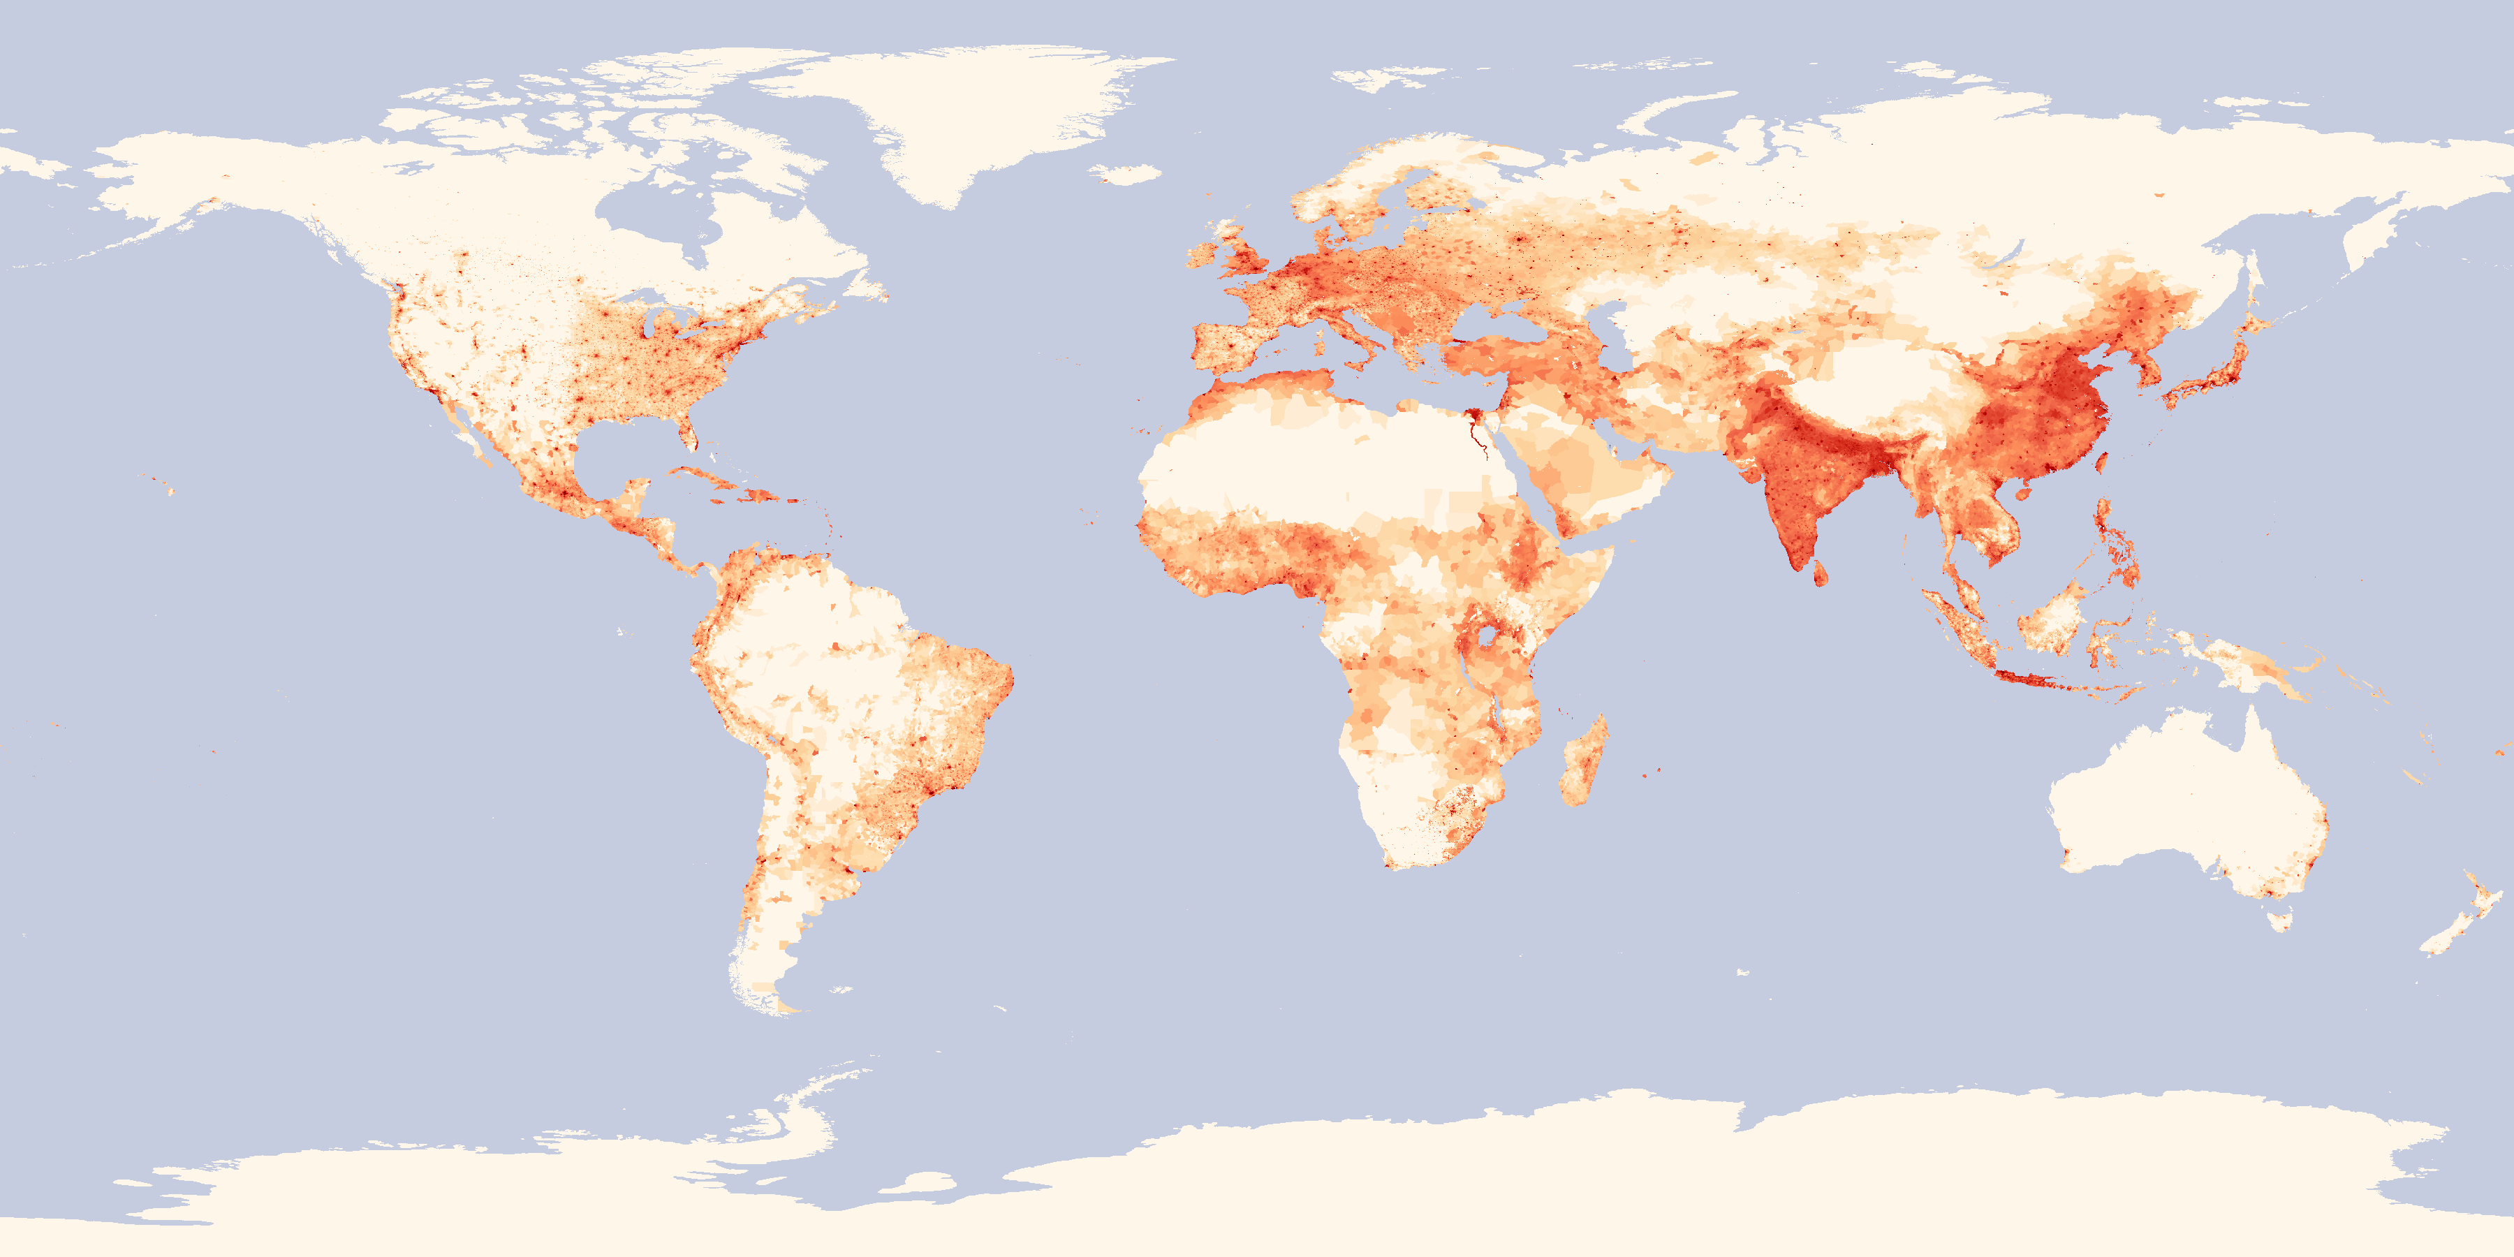

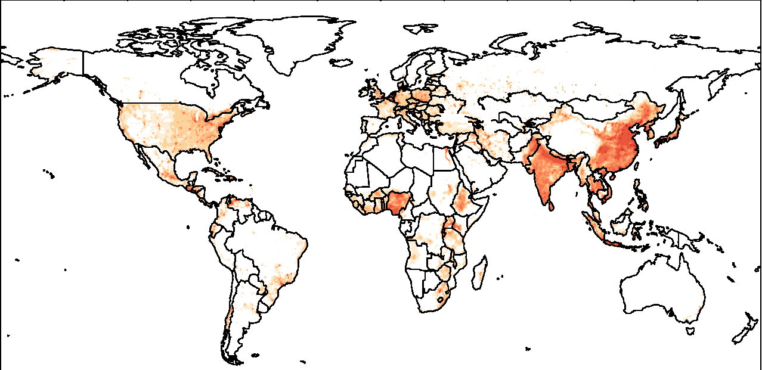
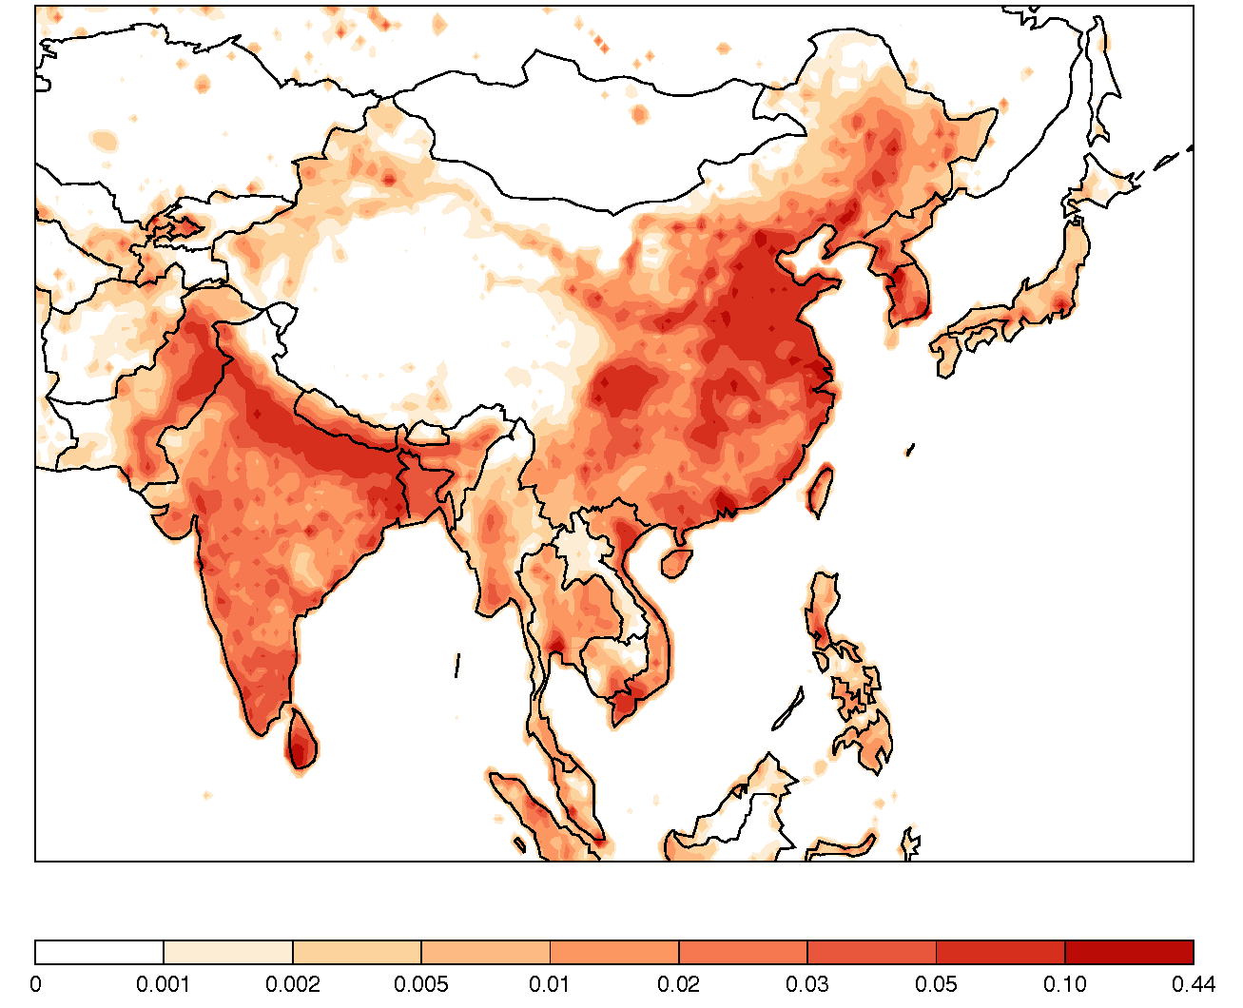
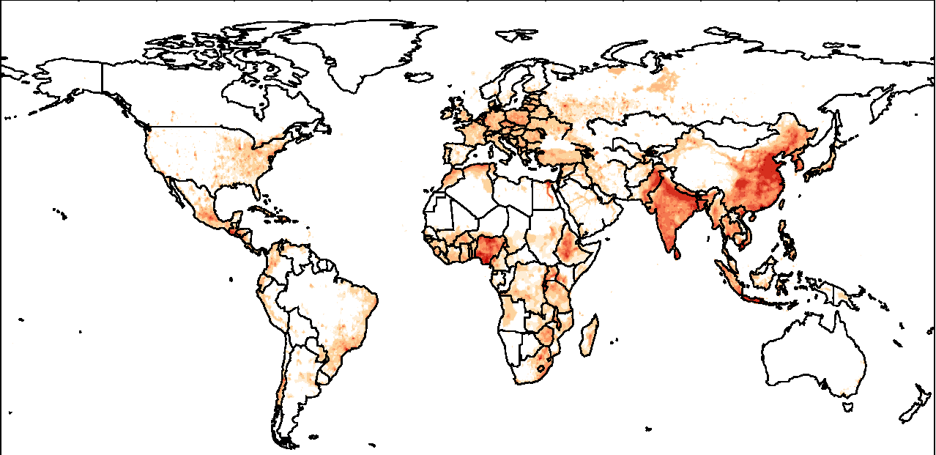
The Asian summer monsoon dynamic system coupled with other atmospheric circulation patterns to transport pollutants from the most polluted regions to UTLS over Asian summer monsoon area and beyond
Population density 2000
Fossil fuel + biofuel CO emission 2010
[ Figure adapted from CLIVAR, https://www.clivar.org/asian-australian-monsoon]
The Asian summer monsoon convective system features
  A low-level cyclonic flow over South and East Asia
  A persistent deep convective motion
  A strong upper-level anticyclonic circulation
  Sub-seasonal eddy shedding to the east and west
It connects to large-scale walker cell and Hadley cell circulations
Fossil fuel + biofuel BC+OC emission 2010
(Anthro emission source: Community Emissions Data System (CEDS), Hoesly et al., 2018)

Slide 4
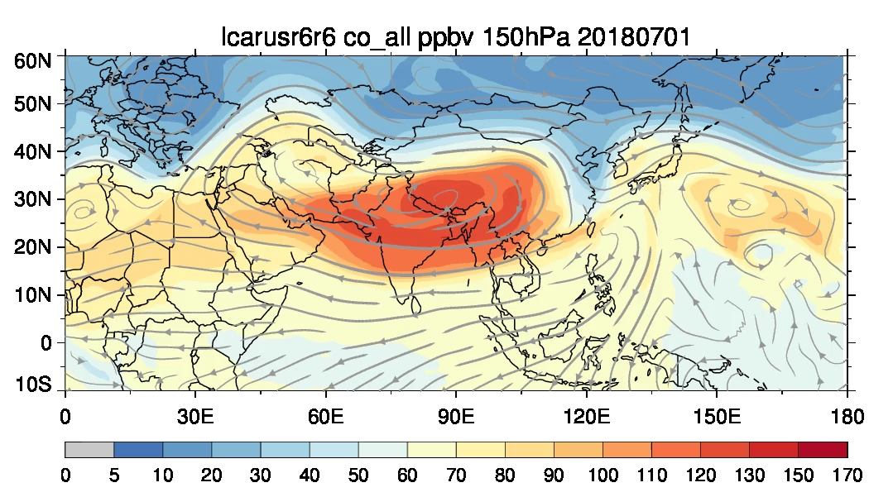
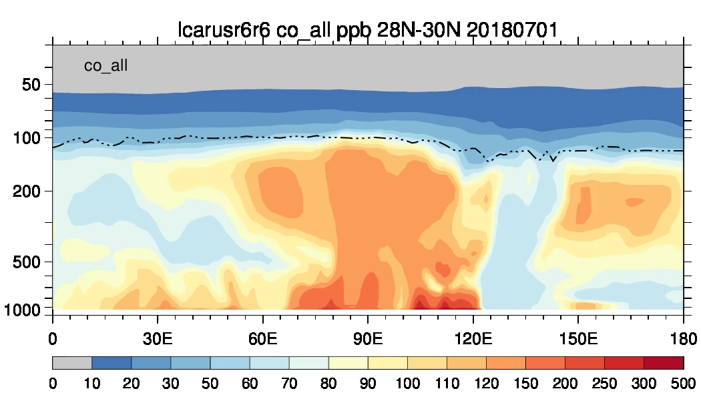
Satellite data showing evidence of pollutants hot spots near the tropopause over the ASM area
GEOS simulation showing the dynamic features of convective uplifting, westward and eastward spreading in the UT by jets and eddy shedding, and penetrating the tropopause (20180701-20180831)

Slide 5
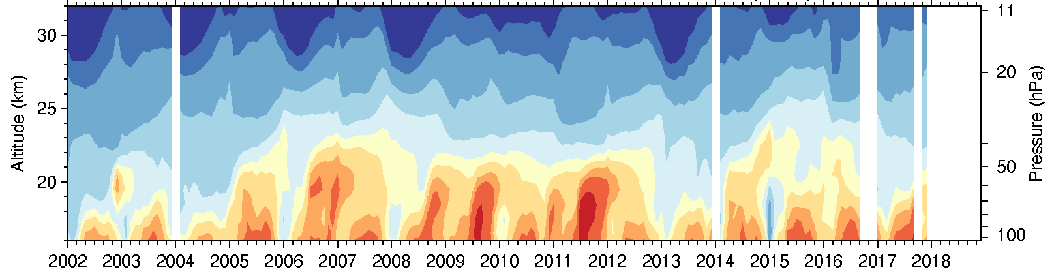
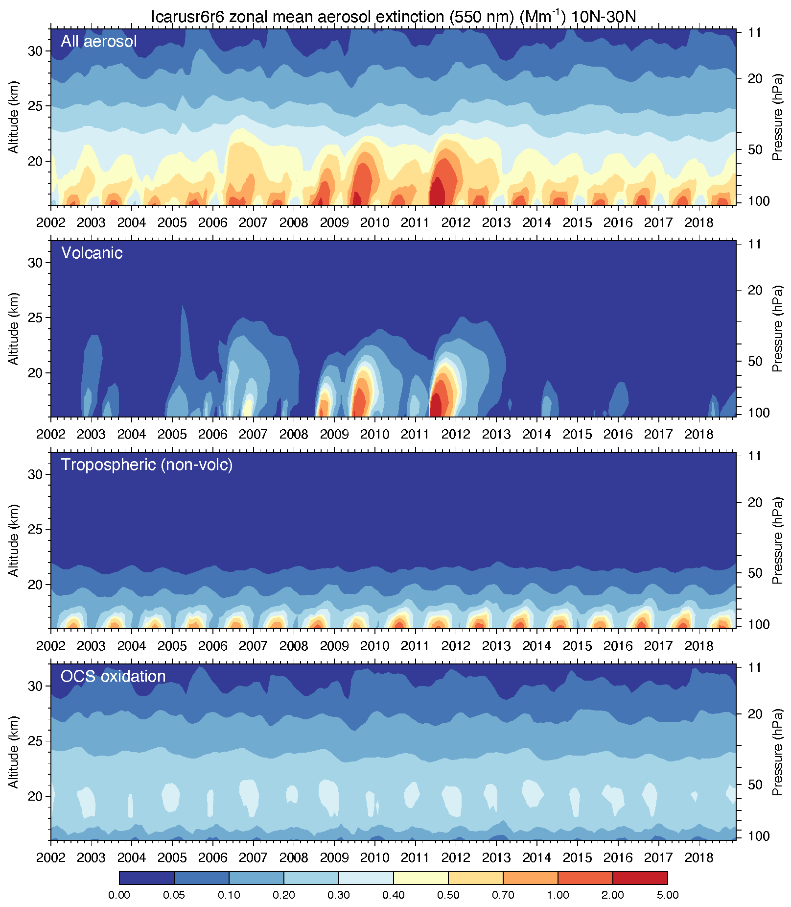
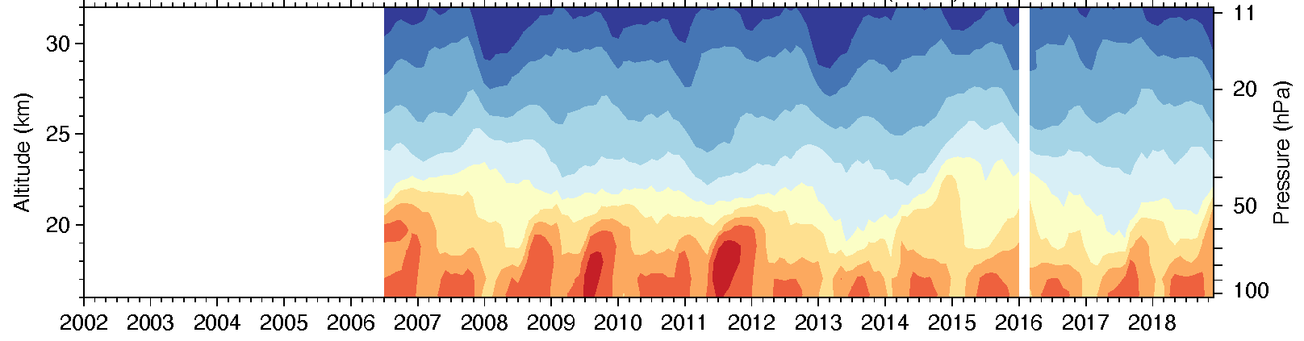
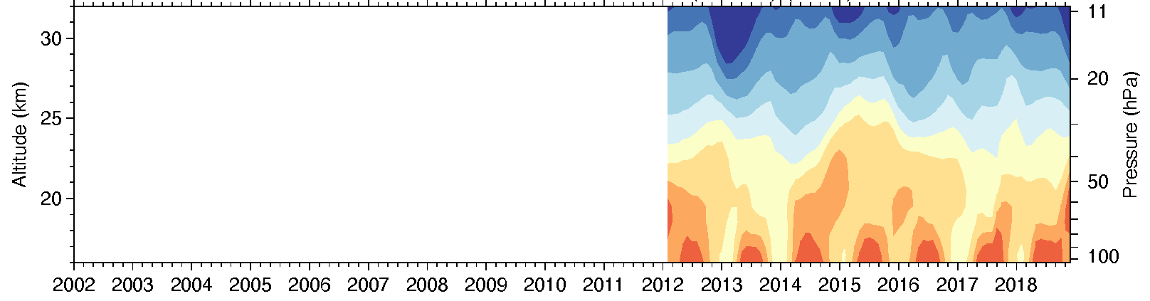
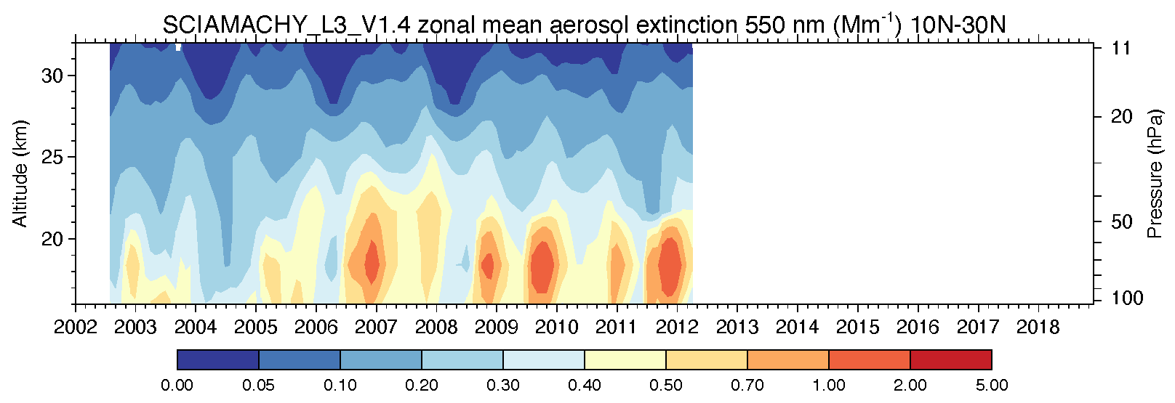
Zonal mean aerosol extinction ~550nm (Mm⁻¹), 10-30N, from satellite observations and GEOS simulations, 2002-2018
OSIRIS-usask v7
GEOS total
CALIOP strat v1.0
GEOS volcanic
Near tropopause: max every boreal summer
OMPS LP v2
GEOS tropospheric
Near tropopause: max every boreal summer
SCIAMACHY v1.4
GEOS OCS oxidation
Lack of near tropopause feature of seasonal cycle

Slide 6
This work uses the NASA GEOS model and satellite observations to investigate:
Interannual variability of aerosol in the UTLS over the Asian Summer Monsoon region
The connections between pollutants in the UTLS and Asian summer monsoon strengths

Slide 7
GEOS model simulations
Model simulation: 2002-2018
  GOCART aerosol component, driven by the MERRA2 reanalyzed meteorology
  Spatial resolution: 1°longitude x 1°latitude, 72 vertical levels from surface to 0.01 hPa
  Species: BC, OA, NH₄⁺, NO₃⁻, SO₄²⁻, dust, sea salt, CO
  Transport tracer: Prescribed CO source and 50-day lifetime (CO50) to diagnose interannual variability of transport
Emission:
  Anthropogenic emissions: Community Emission Data System (CEDS)
  Biomass burning emissions: Global Fire Emission Dataset (GFED) version 4.1s
  Volcanic emission: Satellite-based estimate (Carn et al., 2015, 2016)
  Dust, sea salt, biogenic: model-calculated from meteorological variables (winds, surface conditions)
Stratospheric background aerosols: from carbonyl sulfide (OCS) oxidation

Slide 8
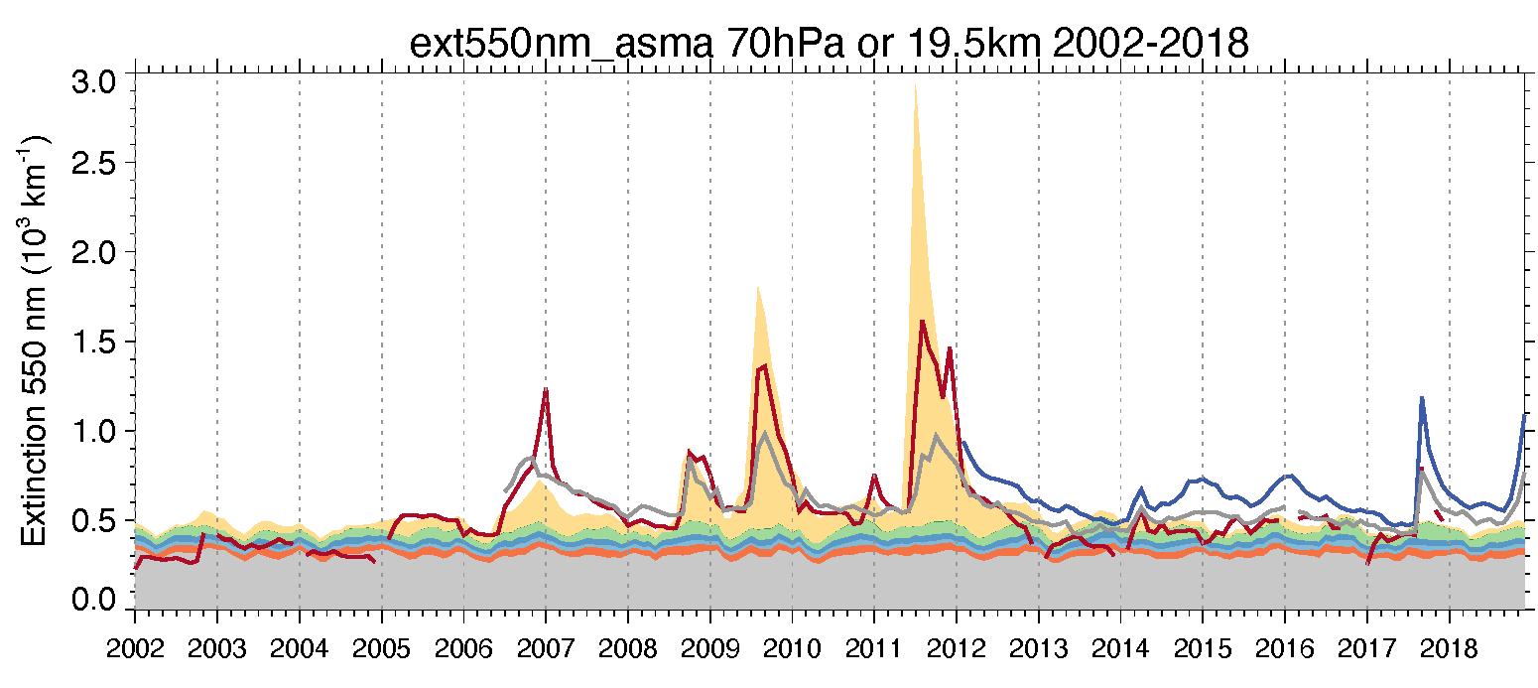
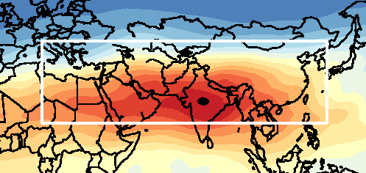
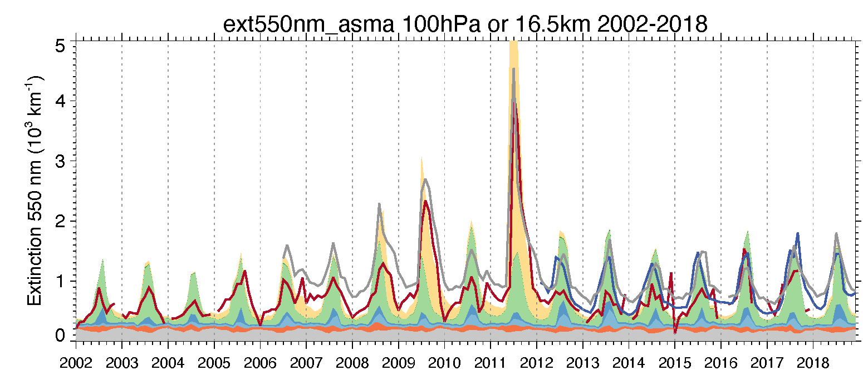
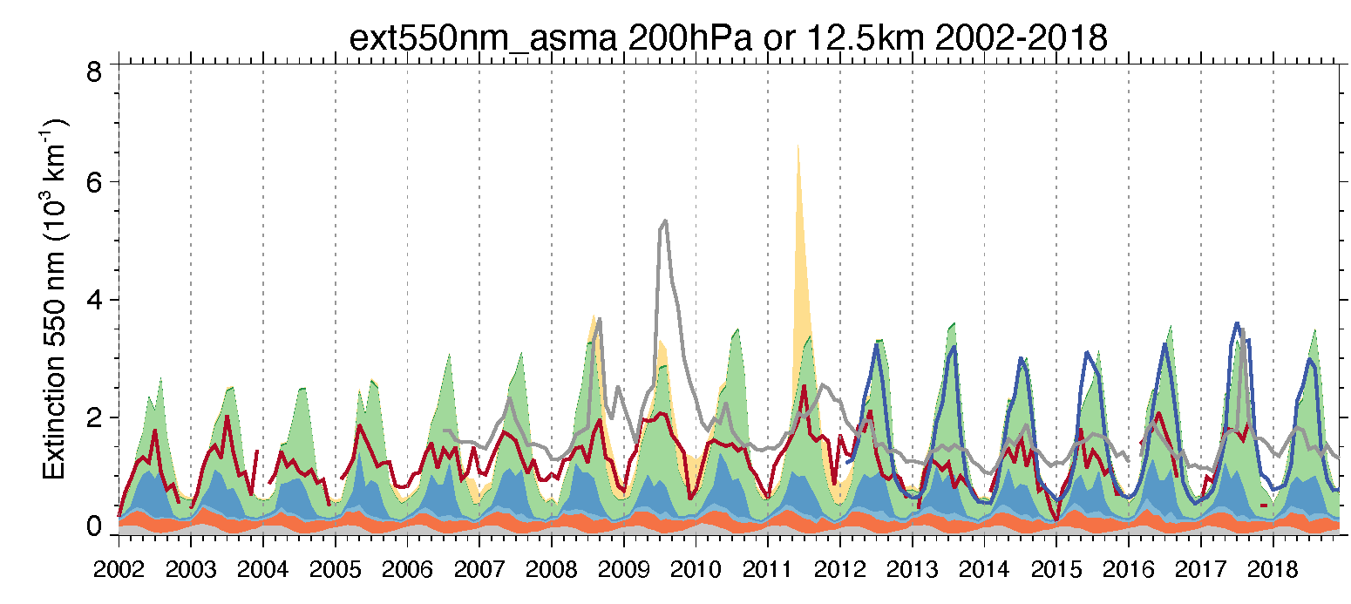
Aerosol extinction composition in UTLS over the ASMA region (15-45°N, 10-130°E)
CALIOP
19.5 km (obs)
70hPa (GEOS)
LS
OSIRIS
OMPS-LP
SO₄⁼ (Volc)
OA
NO₃⁻
SO₄⁼ (Trop)
In boreal summer over the Asian Summer Monsoon Anticyclone (ASMA), aerosol extinction in the UT and at the tropopause is dominated by aerosol with tropospheric origin, mostly OA, followed by nitrate
Relatively large volcanic eruptions causing significant disturbance of stratospheric composition, but the effects are not long-lasting
In the lower stratosphere (~20km), seasonal cycle diminished with sulfate aerosol from OCS oxidation as the dominate aerosol source
There are clear differences between satellite data and model and among different satellite datasets (will discuss later)
DU
SO₄⁼ (bkgd)
CALIOP
16.5 km (obs)
100hPa (GEOS)
Trop pause
(TP)
OSIRIS
OMPS-LP
SO₄⁼ (Volc)
OA
NO₃⁻
SO₄⁼ (Trop)
DU
SO₄⁼ (bkgd)
Altitudes
CALIOP
12.5 km (obs)
200hPa (GEOS)
UT
OSIRIS
OMPS-LP
SO₄⁼ (Volc)
OA
Q: How to explain the interannual variability/trend of the non-volcanic aerosol in ASMA region in terms of transport, removal, emissions, and chemistry?
NO₃⁻
SO₄⁼ (Trop)
DU
SO₄⁼ (bkgd)

Slide 9
CO50 as a transport tracer
CO50 is a transport tracer with a prescribed CO sources (with monthly resolution, same for every year) and a 50-day lifetime
It is a very helpful transport tracer to diagnose differences in transport characteristics because of fixed sources and lifetime
  Inter-model version differences
  Inter-time differences (e.g., August 2012 vs. August 2015)
  Inter-model differences (e.g., AeroCom or CCMI multi-model intercomparison)
The advantage of using CO50 as a transport tracer is that the transport characteristics / patterns can be compared with observations, even though not necessarily the absolute values

Slide 10
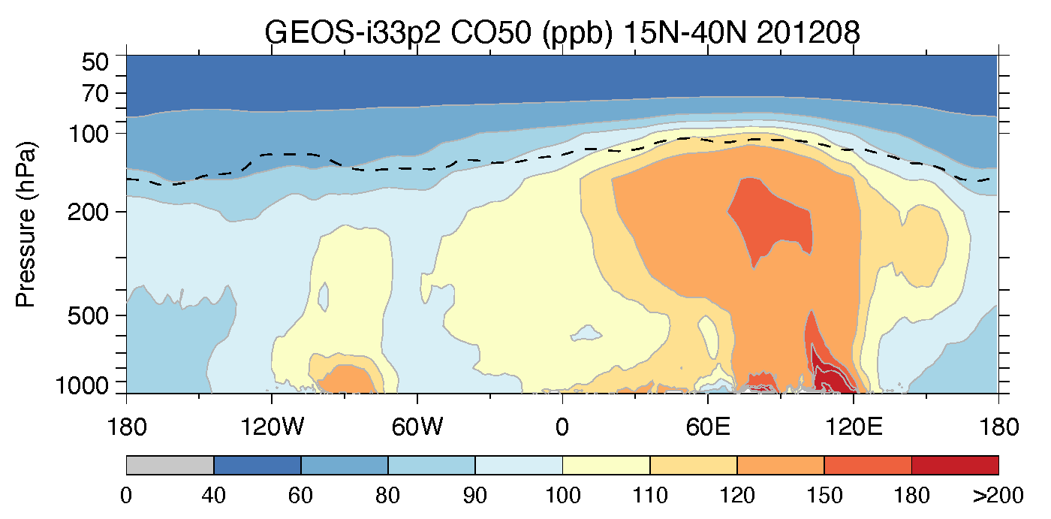
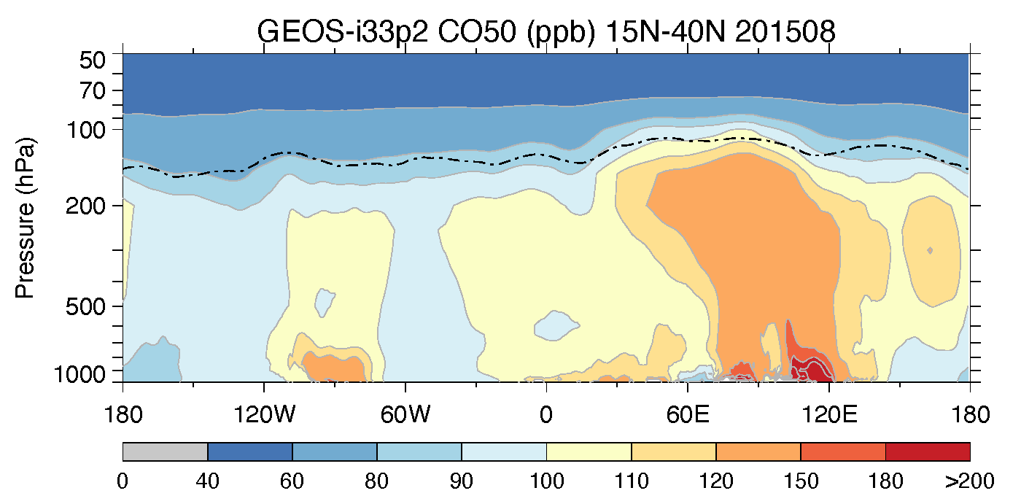
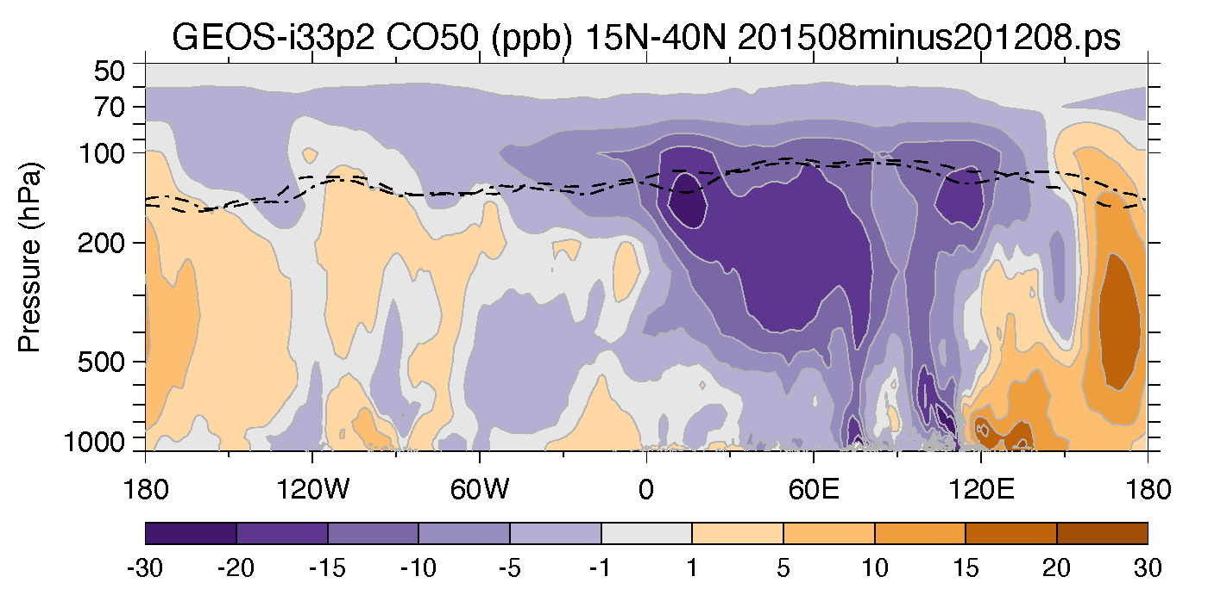
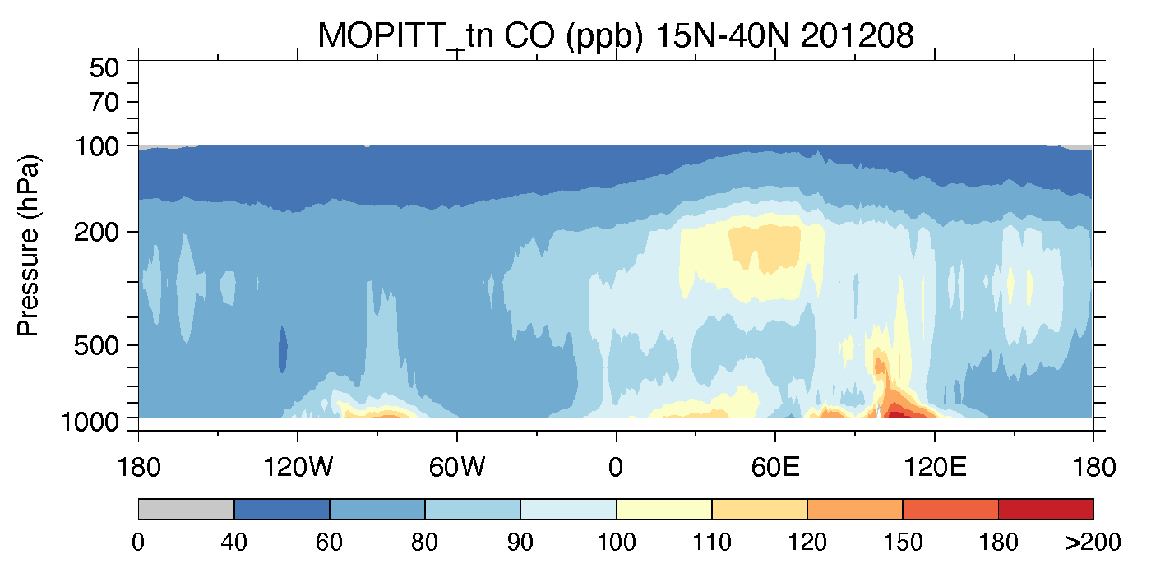
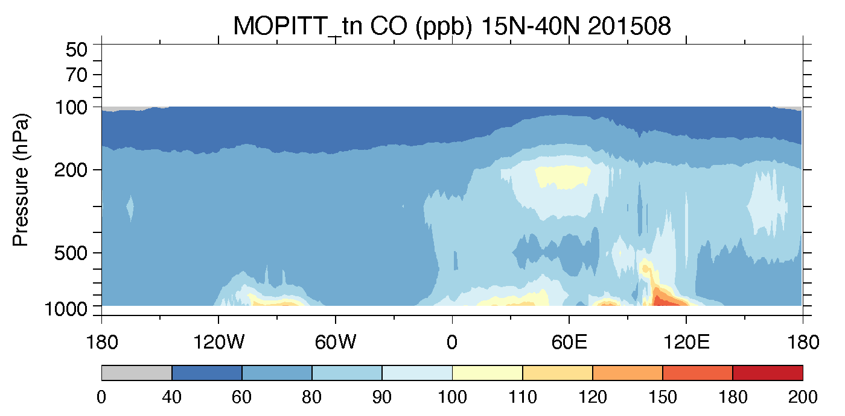
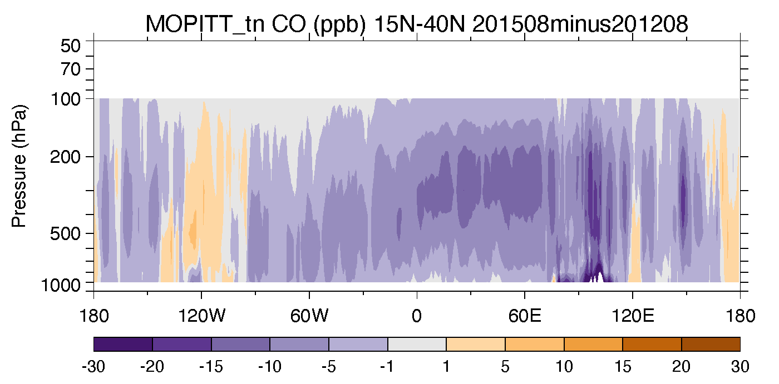
Similarities and contrasts between vertical profiles of CO50 tracer and MOPITT CO and between Aug 2012 and Aug 2015
August 2012, lon-prs 15-40N
August 2015, lon-prs 15-40N
August 2015 minus August 2012
GEOS CO50
GEOS CO50 tracer
MOPITT CO
GEOS and MOPITT showing strong convective transport patterns over the Asian summer monsoon and North American summer monsoon systems
GEOS shows that the convective transport over Asia is weaker in summer 2015 than in summer 2012, but the horizontal outflow from Asia to the Pacific seems stronger. MOPITT reveal some similar features

Slide 11
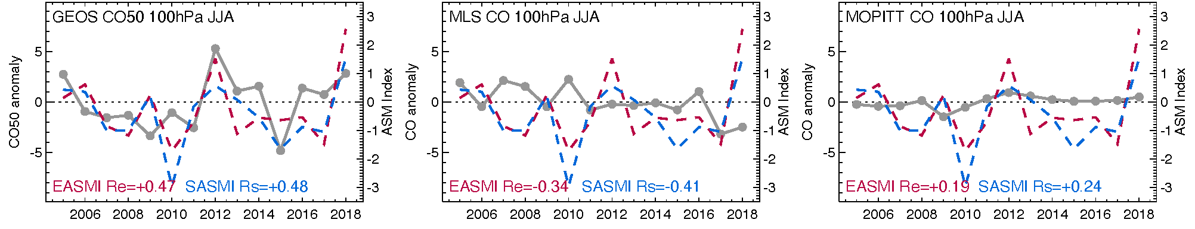
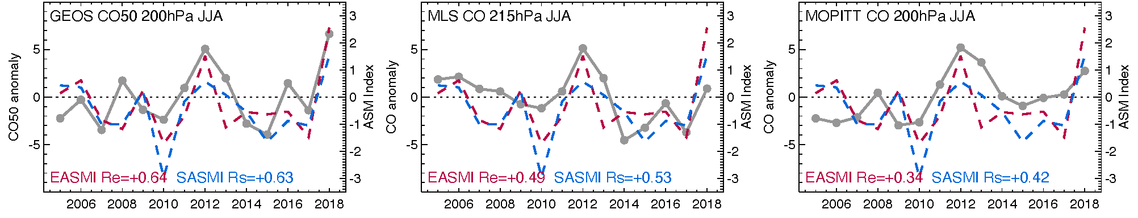
Transport-induced interannual variability in ASMA region, 2005-2018:
CO50 anomaly in UT & tropopause vs. Asian Summer Monsoon Indices
TP
SASMI (J. Li)
EASMI (J. Li)
CO anom.
UT
In UT (200 hPa): CO50 well correlated with both EASMI and SASMI: stronger summer monsoon pushes more pollutants to UT
Near TP (100 hPa): Correlation between CO50 and ASMI weakens
CO from satellite data showing similar patterns

Slide 12
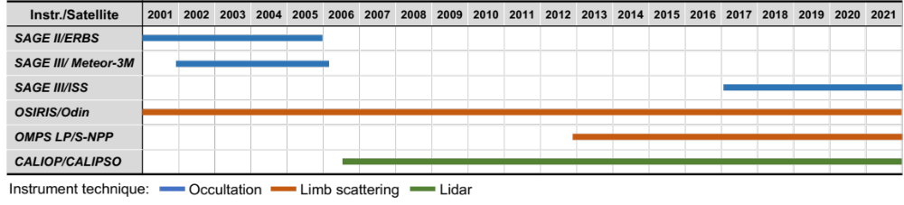
Assessing long-term, vertically resolved changes of aerosol composition in the upper troposphere and lower stratosphere using SAGE III/ISS and other satellite data and a global model
SAGE III/ISS project:
PI: Co-I: Collaborator: | Mian Chin¹ Huisheng Bian^{1,2}, Qian Tan^{3,4}, Ghassan Taha^{1,5} Xiaohua Pan^{1,6}, Peter Colarco¹
 | ¹NASA GSFC ²UMBC ³NASA ARC ⁴BAER ⁵USRA
Leveraging our effort of the current Aura project on UTLS aerosol process and composition, our goal here is to analyze the long-term aerosol trends in the UTLS using SAGE and other satellite data with the GEOS model

Slide 13
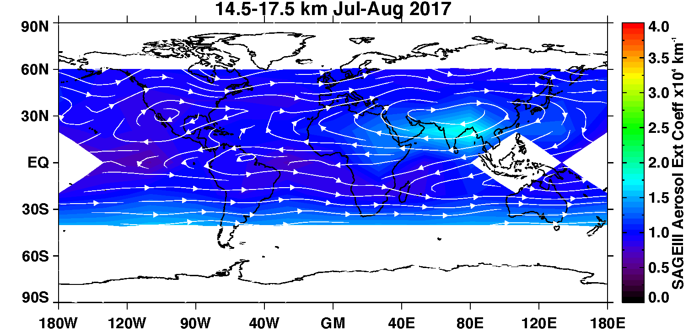
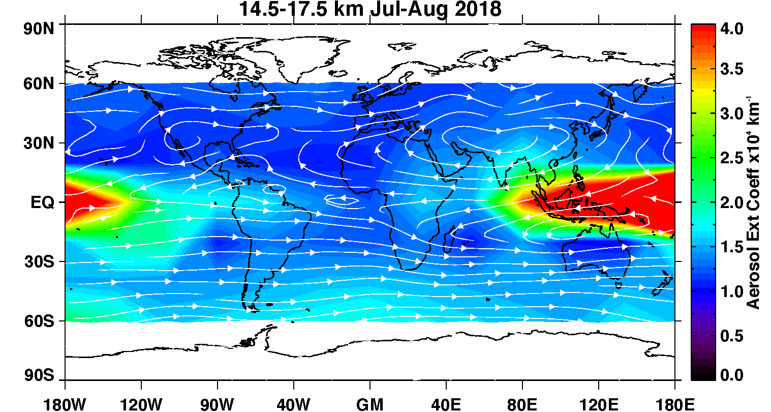
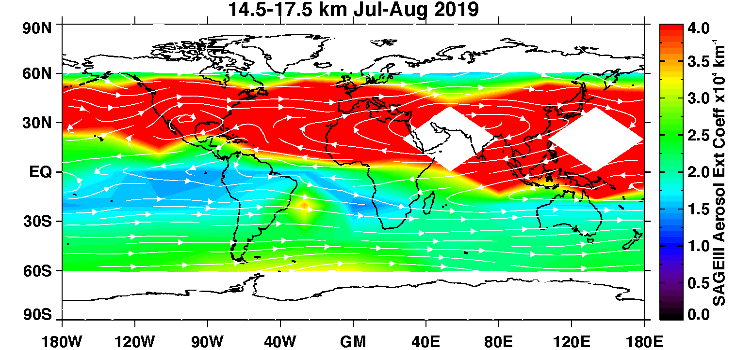
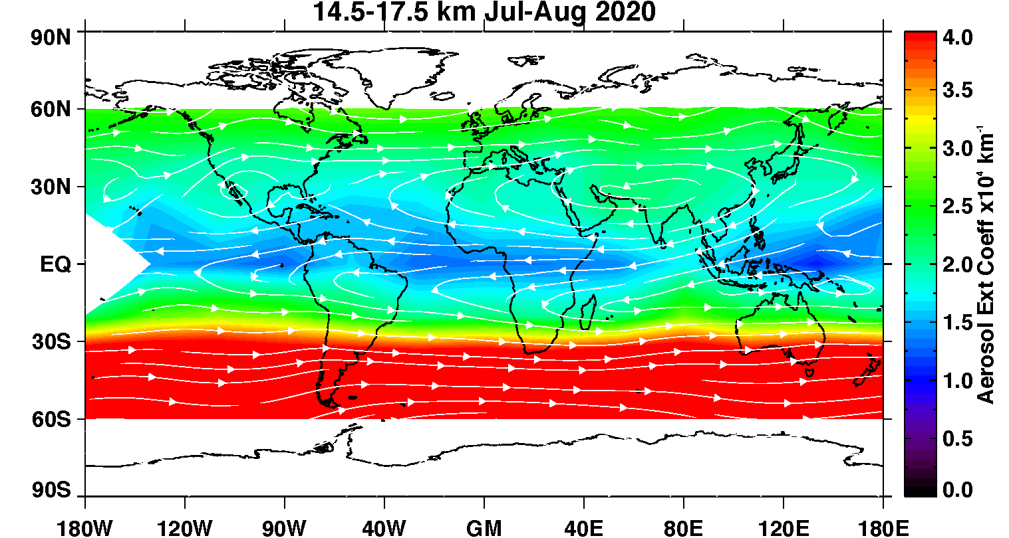
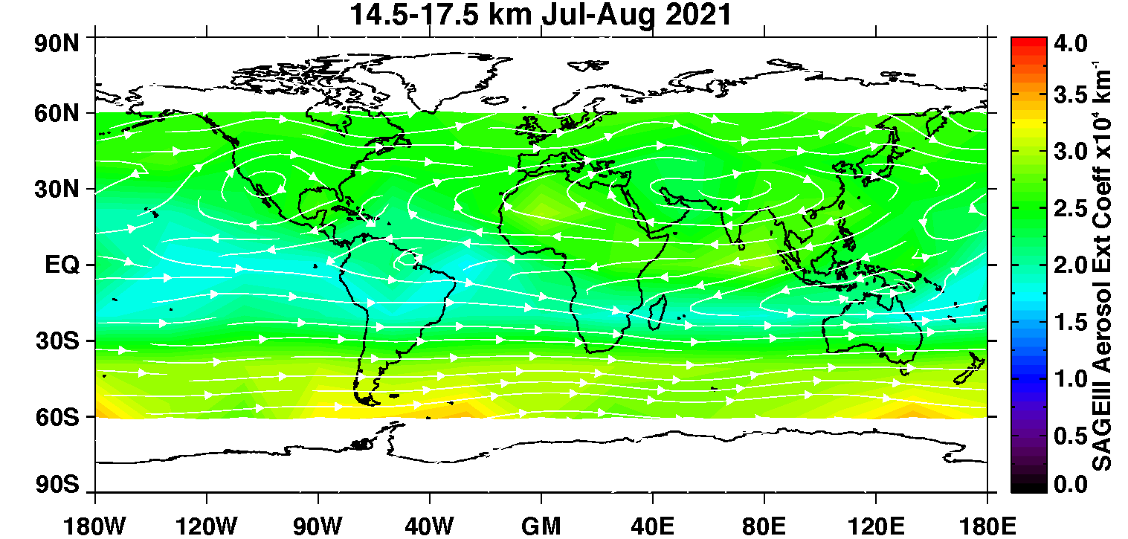
SAGE III/ISS UTLS aerosol extinction (1020 nm) in Jul-Aug
Raikoke
Ambae
Large perturbations of UTLS aerosol by volcanic eruptions and pyroCb in the SAGE III/ISS record, masking the anthropogenic signatures in the UTLS
Australian pyroCb
Gridded SAGE III/ISS data and plots by Ghassan Taha

Slide 14
A few remarks
Next steps:
  Work with SAGE data to place them into the context of multi-decadal trends
  Evaluate GEOS simulated aerosol composition in the ASM region with aircraft data (StratoClim-2017, ACCLIP-2022)
Challenges of using satellite aerosol data in the UTLS:
  The anthropogenic fingerprints could be difficult to quantify because of the ice cloud interference in the UT and near the tropopause. Cloud-screening approach is one of the major causes for large disagreement among satellite products. How to mitigate?
  More frequent pyroCb events in recent years that have long-lasting effects in the stratosphere, making the extraction of tropospheric influence more difficult
  Spatial/temporal sampling differences / biases in satellite data

