Slide 1
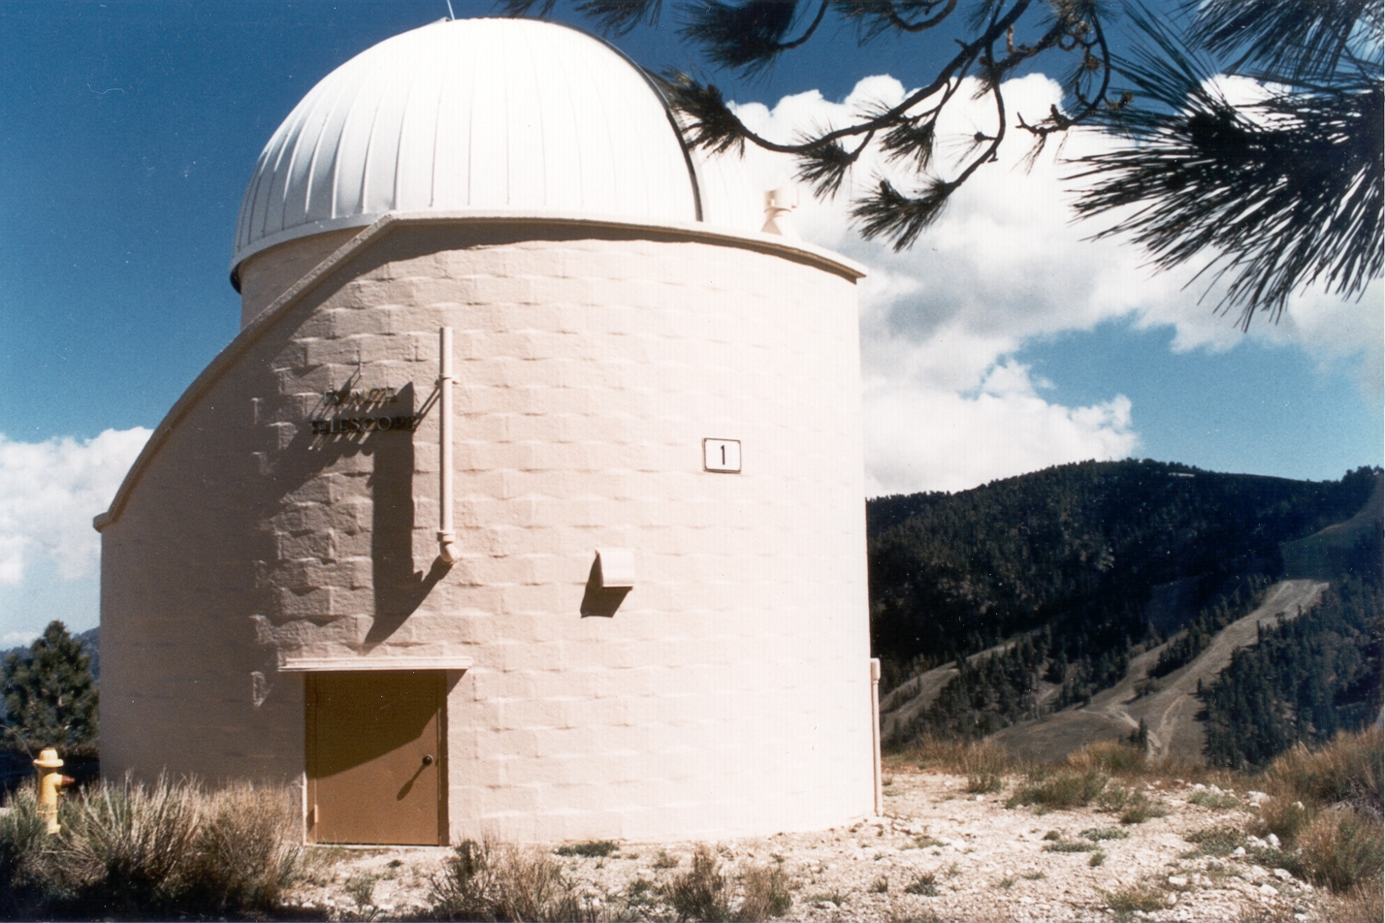

Ground-Based Diurnal Measurements of NO₂ and NO₃ in Support of SAGE-III/ISS Validation
Thomas J. Pongetti¹, King-Fai Li², Yuk L. Yung³, Steven S. Brown⁵, Zhao-Cheng Zeng^{2,4}, Stanley P. Sander^{1,2} and the SAGE-III/ISS Algorithm Team⁶
¹JPL/Caltech, ²Caltech, ³UC Riverside,⁴UCLA, ⁵NOAA, ⁶NASA/Langley
© 2021, California Institute of Technology. Government sponsorship acknowledged.

Slide 2
Objectives
Objective 1: Obtain direct solar/lunar measurements of NO₃ and NO₂ from Table Mountain Facility in support of SAGE III/ISS validation.
Objective 2: Analyze comparisons with coincident SAGE III/ISS measurements and work with the algorithm and science teams to interpret the comparisons and incorporate improvements into retrieval algorithms.
Co-Investigators and Collaborators
Thomas J. Pongetti, JPL | Data Acquisition/Analysis | Co-I
Yuk L. Yung, Caltech | 1-D Modeling | Co-I
King-Fai Li, UCR | 1-D Modeling | Collaborator
Zhao-Cheng Zeng, UCLA/Caltech | Retrievals | Collaborator

Slide 3
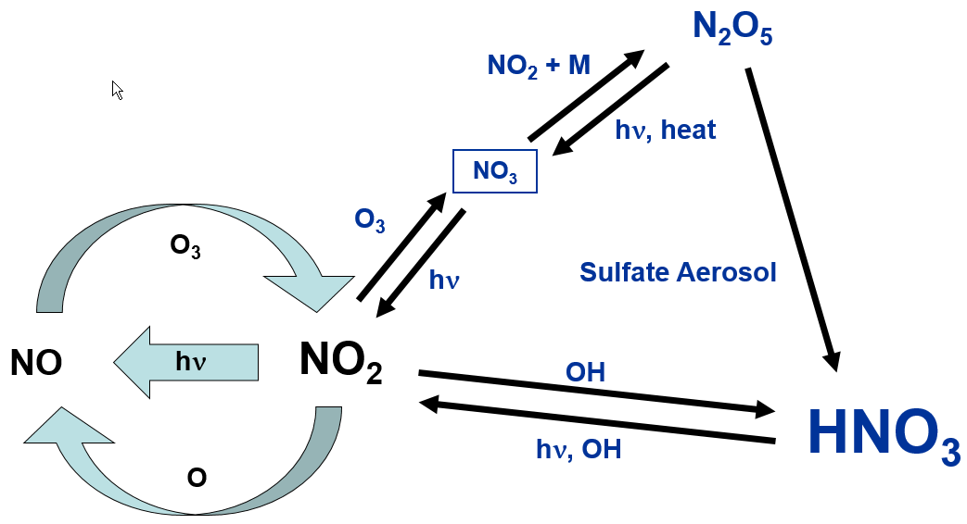
Key Processes in Stratospheric NO_{x}-NO_{y} Photochemistry
N₂O
hν, O(¹D)
Photochemical processes drive the partitioning within the NOx family
During SAGE III occultations, NOx changes very rapidly with zenith angle
Notes:
Coupling of Nox cycle with HNO3 explains the diurnal variability of NO2 and NO3
NO3 is zero during the day due to rapid photolysis

Slide 4
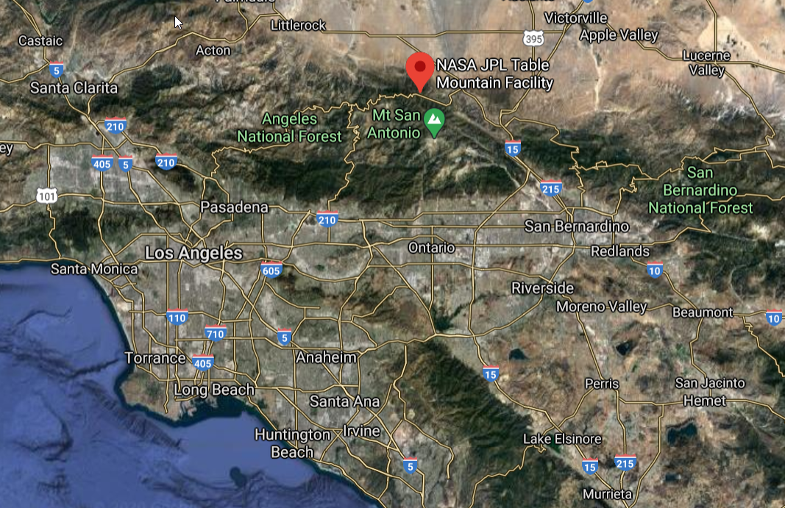
Ground-Based Diurnal Measurements of NO₂ and NO₃
Direct Solar/Lunar Spectroscopy at JPL Table Mountain Facility (2.3 km ASL)

Slide 5
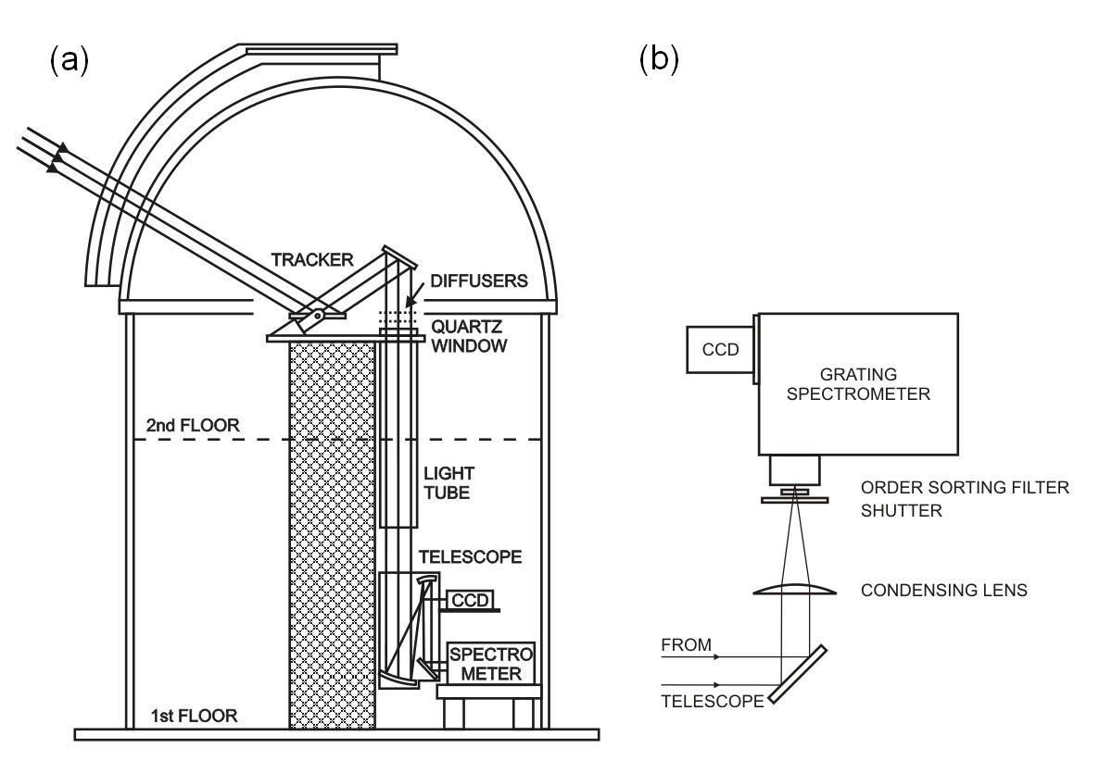
UV-Visible Grating Spectrograph (MUGS)
MUGS
Schematic of the instrument light path. (a) Light is collected by the primary of the heliostat (tracker) then through an off-axis telescope which also serves as a fine guider for the pointing system. (b) The light is directed through a condensing lens, shutter, order-sorting filter, and then into the spectrometer where it is dispersed and recorded by a CCD camera.
Notes:
Setup works for both solar and lunar occultation

Slide 6
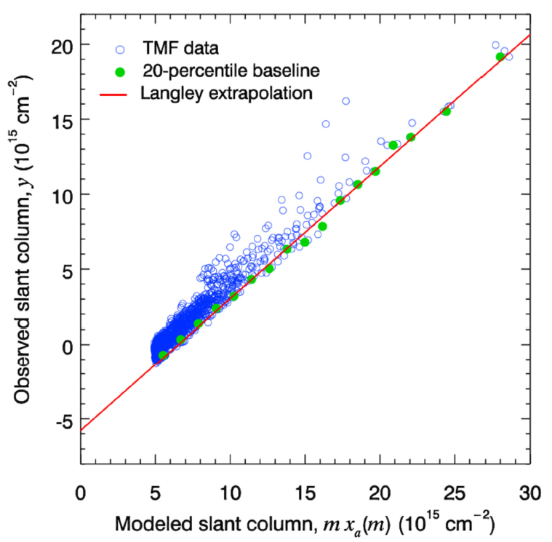
Modified Langley Extrapolation
Modeled slant column, AMF_{i} x VC_{o}(AMF) (10¹⁵ cm⁻²)
X-axis is transformed from AMF_{i} to AMF_{i} x VC_{o}(AMF) where the function VC_{o}(AMF) is derived from the model’s a priori time-dependence of NO₂
This transformation results in the correct value of the reference column abundance as determined from the y-intercept

Slide 7
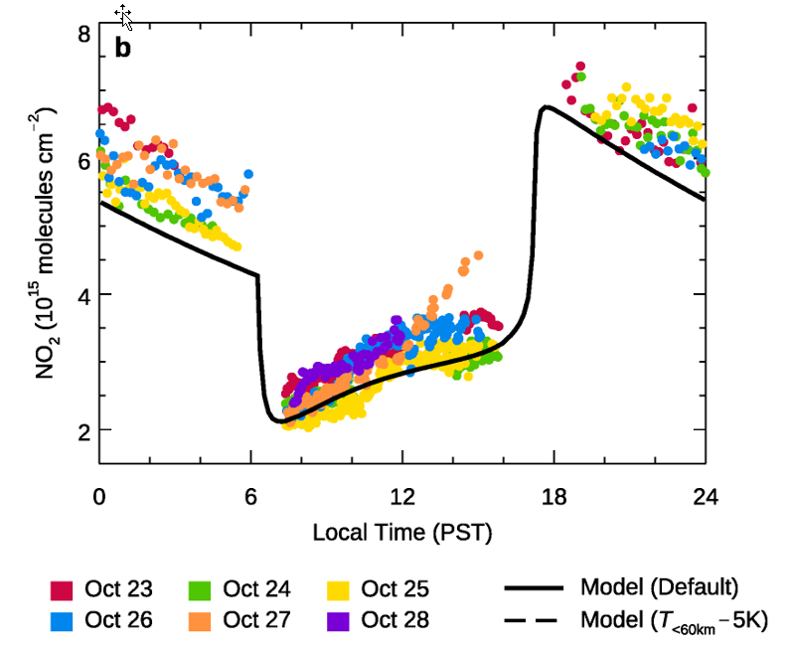
NO₂ Column Model-Measurement Comparison
Overall agreement is good; First continuous night/day record
MUGS cannot measure at the exact time of sunrise or sunset due to obstructions
Li et al., AMT, accepted for publication

Slide 8
MUGS Comparisons with SAGE-III/ISS

Slide 9
Issues Confronting Ground-Based Comparisons with SAGE III
Lower limit of SAGE III vertical profiles is 12-15 km
Ground-based occultations extend from 2.3 km to TOA
SAGE III solar occultations occur at sun rise/set
Ground-based solar occultation measurements are obtained diurnally except at sun rise/set
Both SAGE III and ground-based lunar occultations occur over a range of local times

Slide 10
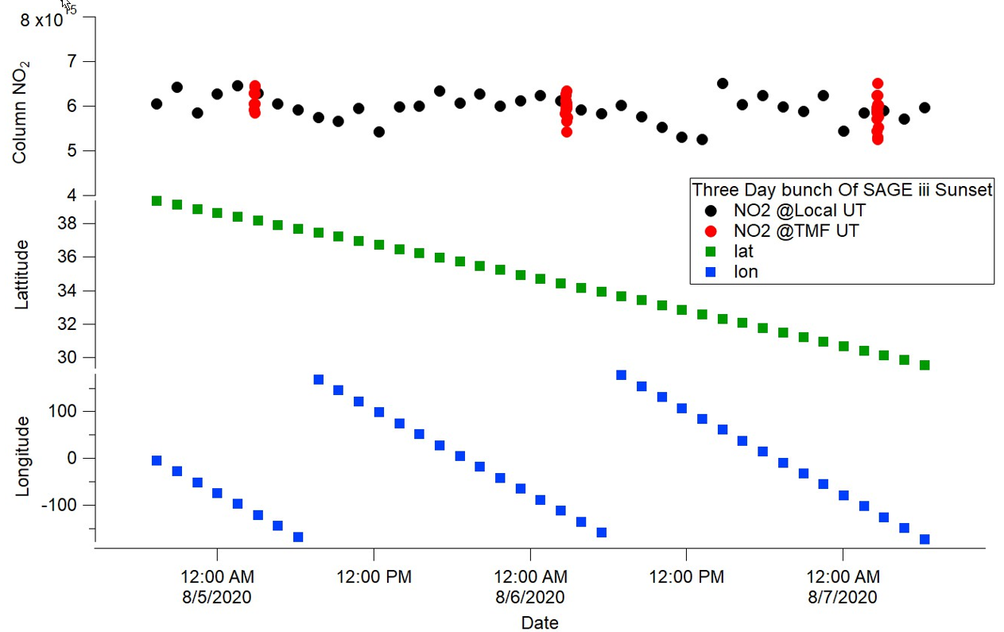
SAGE-III/TMF Coincidences
Exact coincidences between SAGE-III and TMF are infrequent
We consider coincidences within a global zone ± 5° latitude from TMF (34.4 °N)
SAGE occultations at other longitudes are converted to TMF local time
Notes:
Averaging all profiles with a zonal mean

Slide 11
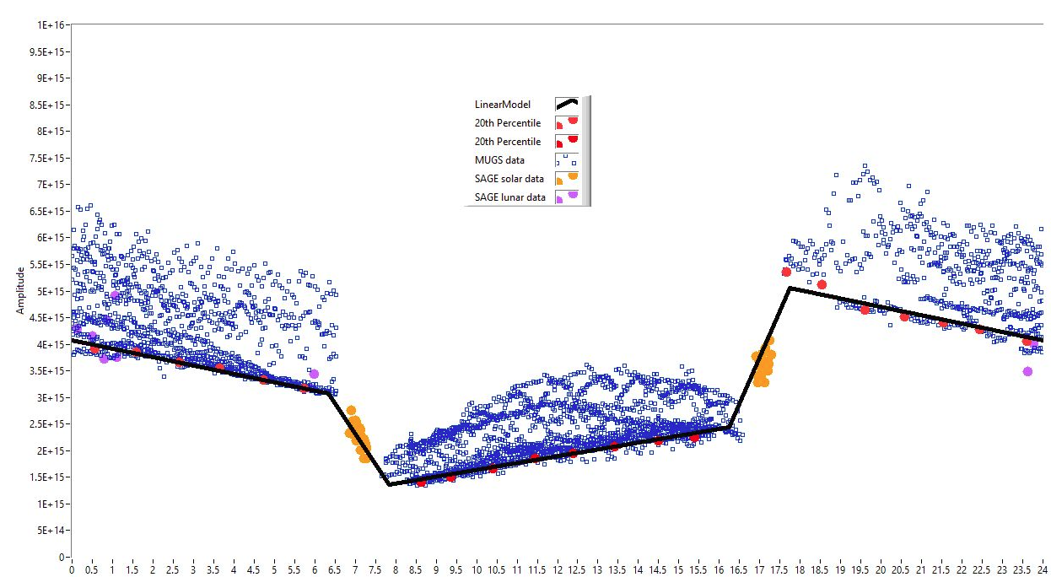
Diurnal Variation of NO₂ Column: SAGE III and MUGS
Composite of all January data
NO₂ Column, molec cm⁻²
Time of Day

Slide 12
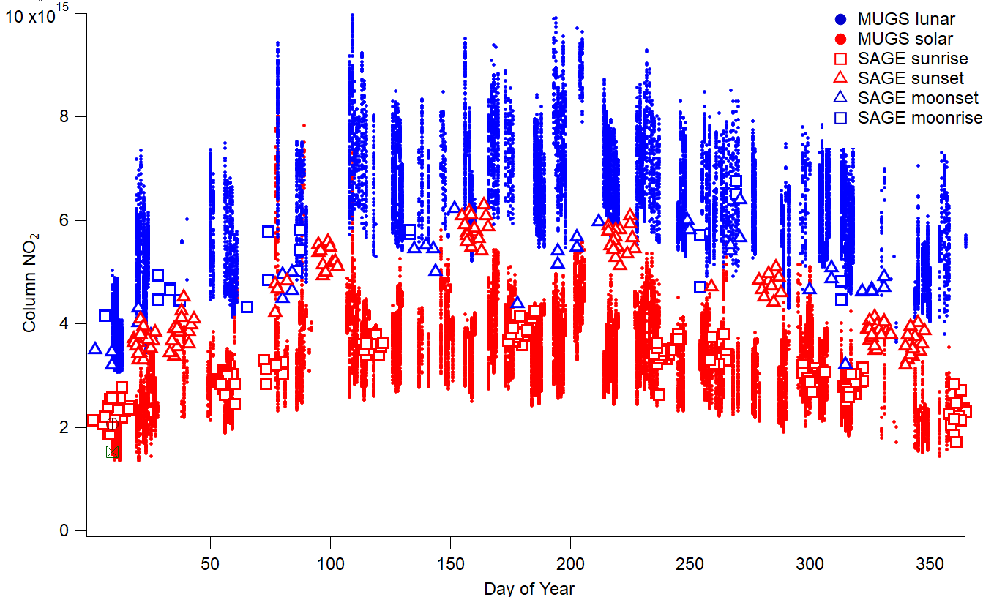
SAGE-MUGS NO₂ Comparison: year-over-year
Notes:
384 days of solar data, 74 days of lunar data

Slide 13
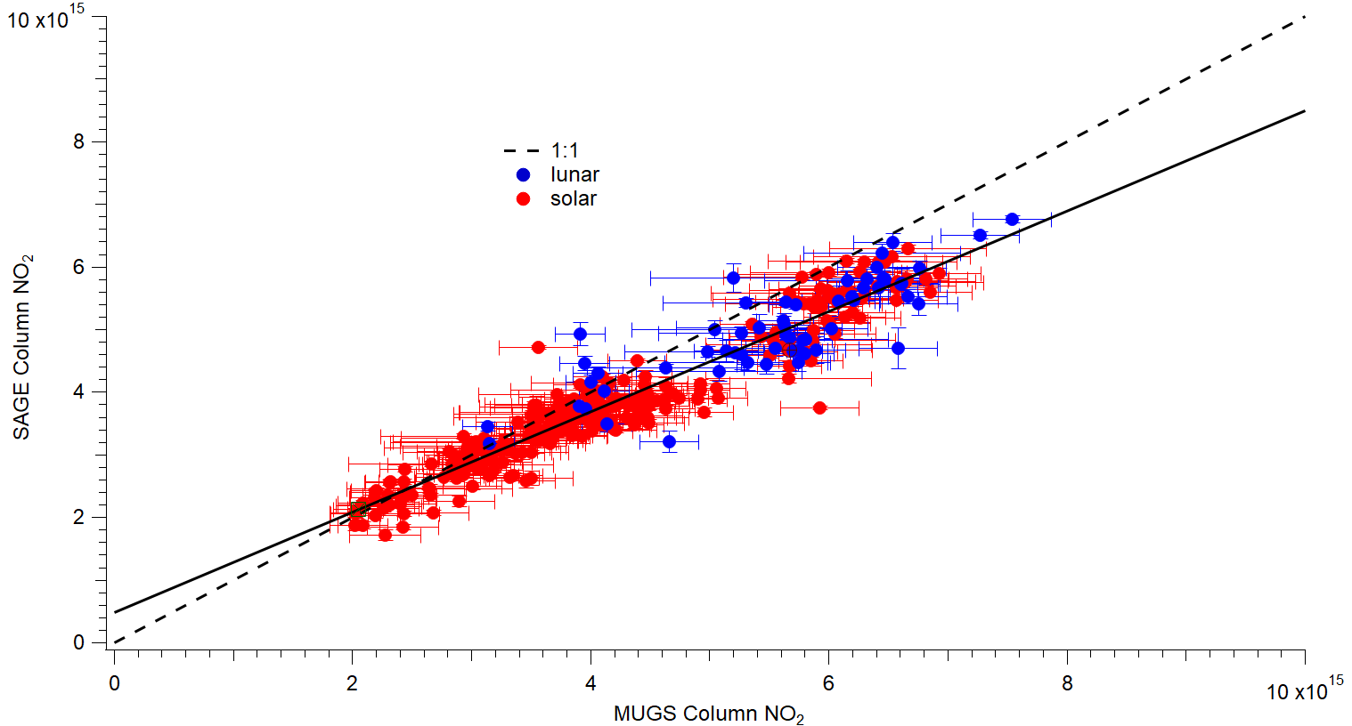
SAGE-MUGS NO₂ Correlation (Solar and Lunar)
r² = 0.91
Slope = 0.80
Intercept = 4.77x10¹⁴ cm⁻²
Scatter plot between monthly averages of SAGE-III columns (z>15 km) and MUGS total columns (± 2 hours from sunset or sunrise, 20th percentile)
Notes:
24 Points because comparing monthly over all years

Slide 14
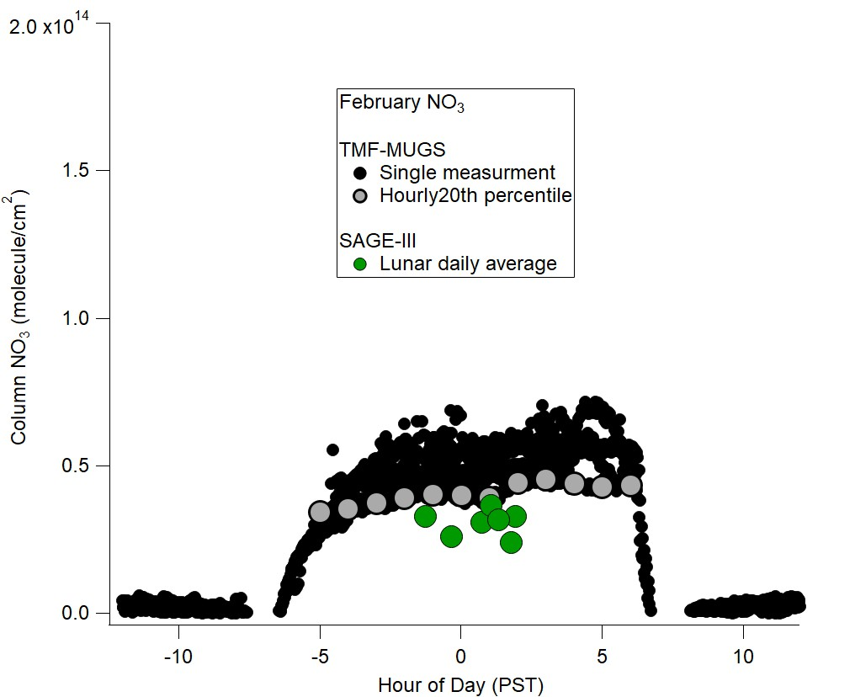
SAGE-MUGS NO₃ Comparison: February

Slide 15
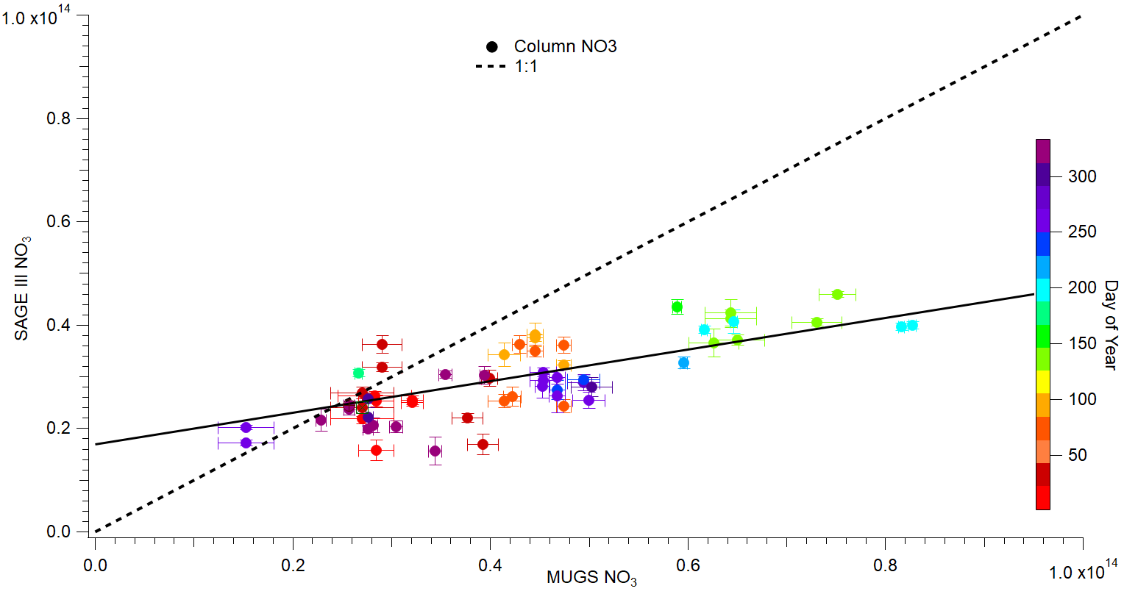
SAGE-MUGS NO₃ Comparison: year-over-year
r² = 0.41
Slope = 0.31
Intercept = 1.69x10¹³ cm⁻²

Slide 16
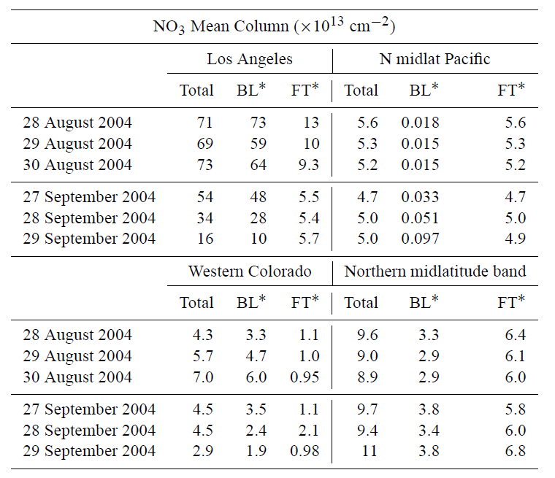
Tropospheric NO₃ Mean Column from GEOS-CHEM
C. Chen et al., ACP, doi: 10.5194/acp-11-963-2011
86

Slide 17
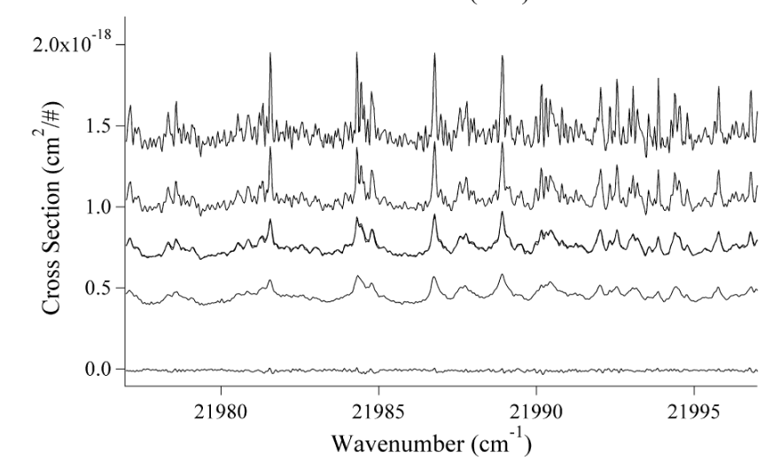
Coarse Vertical Profiling from Air Broadening of NO₂ Spectral Features
1.24 Torr
151.2 Torr
421.5 Torr
760.5 Torr
0.31 nm
High resolution laboratory NO₂ spectra in a narrow wavelength range near 455 nm (offset for clarity.) Ref: Nizkorodov et al., J. Phys. Chem. A (2004)

Slide 18
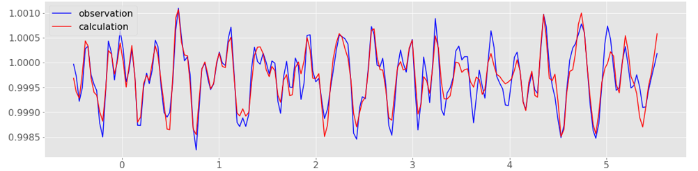
NO₂ Spectral Fits Using FTUVS at Table Mountain (Direct Solar)
Resolving Power ~ 350,000
Optical Depth
Frequency, cm⁻¹ (add 20190 cm⁻¹)
High resolution permits column separation into ~ 2 layers (DOFS = 1.8)
Langley plot not required
Works only for daytime NO₂

Slide 19
Conclusions
Ground-based TMF direct sun/moon total column measurements provide good comparisons with SAGE-III/ISS stratospheric partial columns because:
  High altitude (2.3 km) and remote location of TMF minimize PBL pollution contributions to the total column
  Modified minimum Langley method further discriminates against PBL pollution
  Sampling doesn’t coincide with SAGE III sunrise/sunset occultations
Both NO₂ and NO₃ comparisons are affected by free tropospheric contribution
Future work will focus on extending the ground-based climatologies, correcting for SAGE local time variation along the line of sight, correcting for FT partial column using model analysis

