Slide 1


SPECIATION OF SAGE-III/ISS AEROSOLS
  Peter Bernath, Keith LaBelle
  Old Dominion University, Norfolk, VA
  and
  Chris Boone
  University of Waterloo, Waterloo, ON

Slide 2
SAGE-III/ISS Science Team Proposal
Combine atmospheric extinction measurements of SAGE-III/ISS
with infrared spectra of the ACE-FTS (Atmospheric Chemistry
Experiment Fourier Transform Spectrometer) to determine
composition and physical properties of stratospheric sulfate aerosols
Both instruments use solar occultation and are complementary (IR and visible).
Find co-incident observations and use both data sets to determine
particle composition, size distribution and abundance

Slide 3
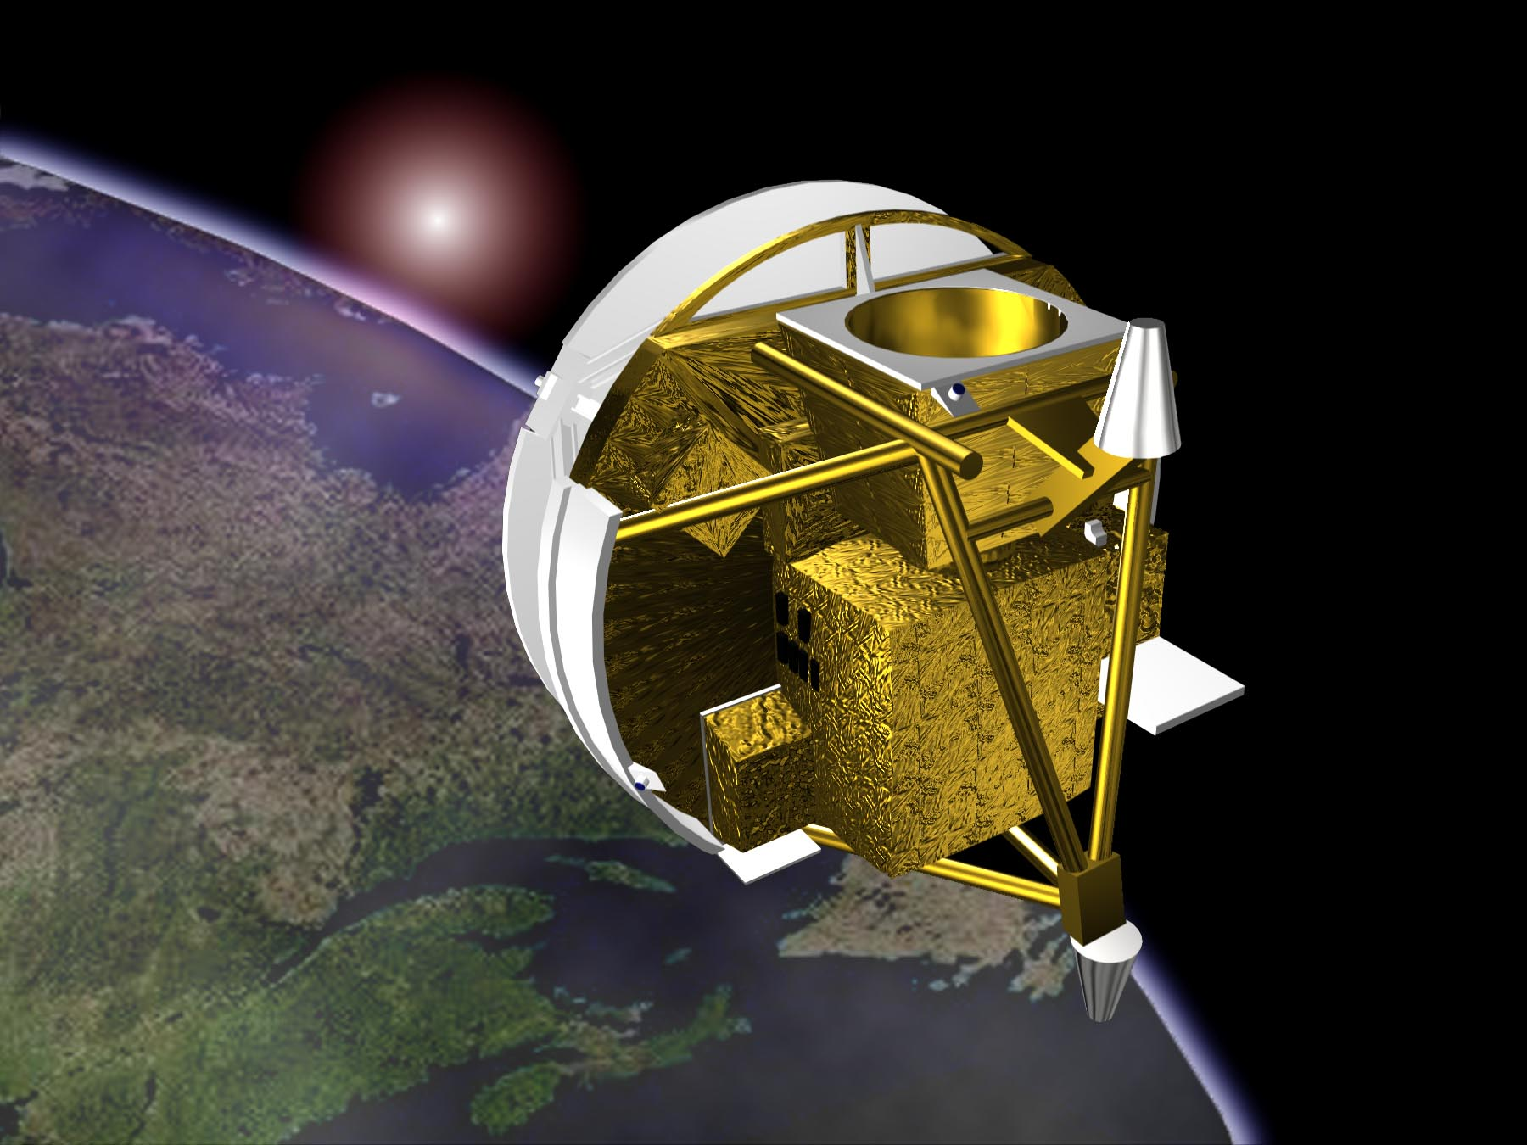
ACE Satellite
Bernath, JQSRT 186, 3 (2017); See http://www.ace.uwaterloo.ca/
Bernath, et al. Sixteen-year trends in atmospheric trace gases from orbit, JQSRT (2020)

Slide 4
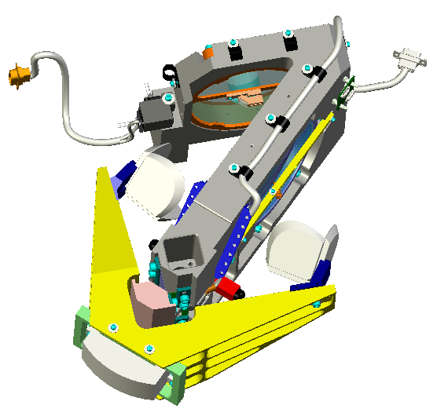
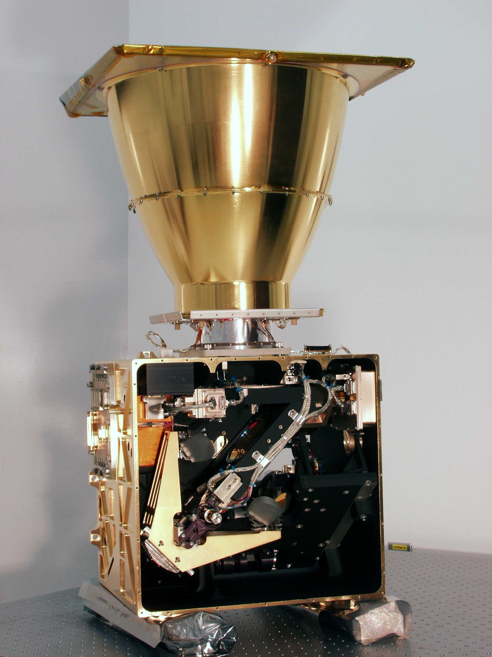
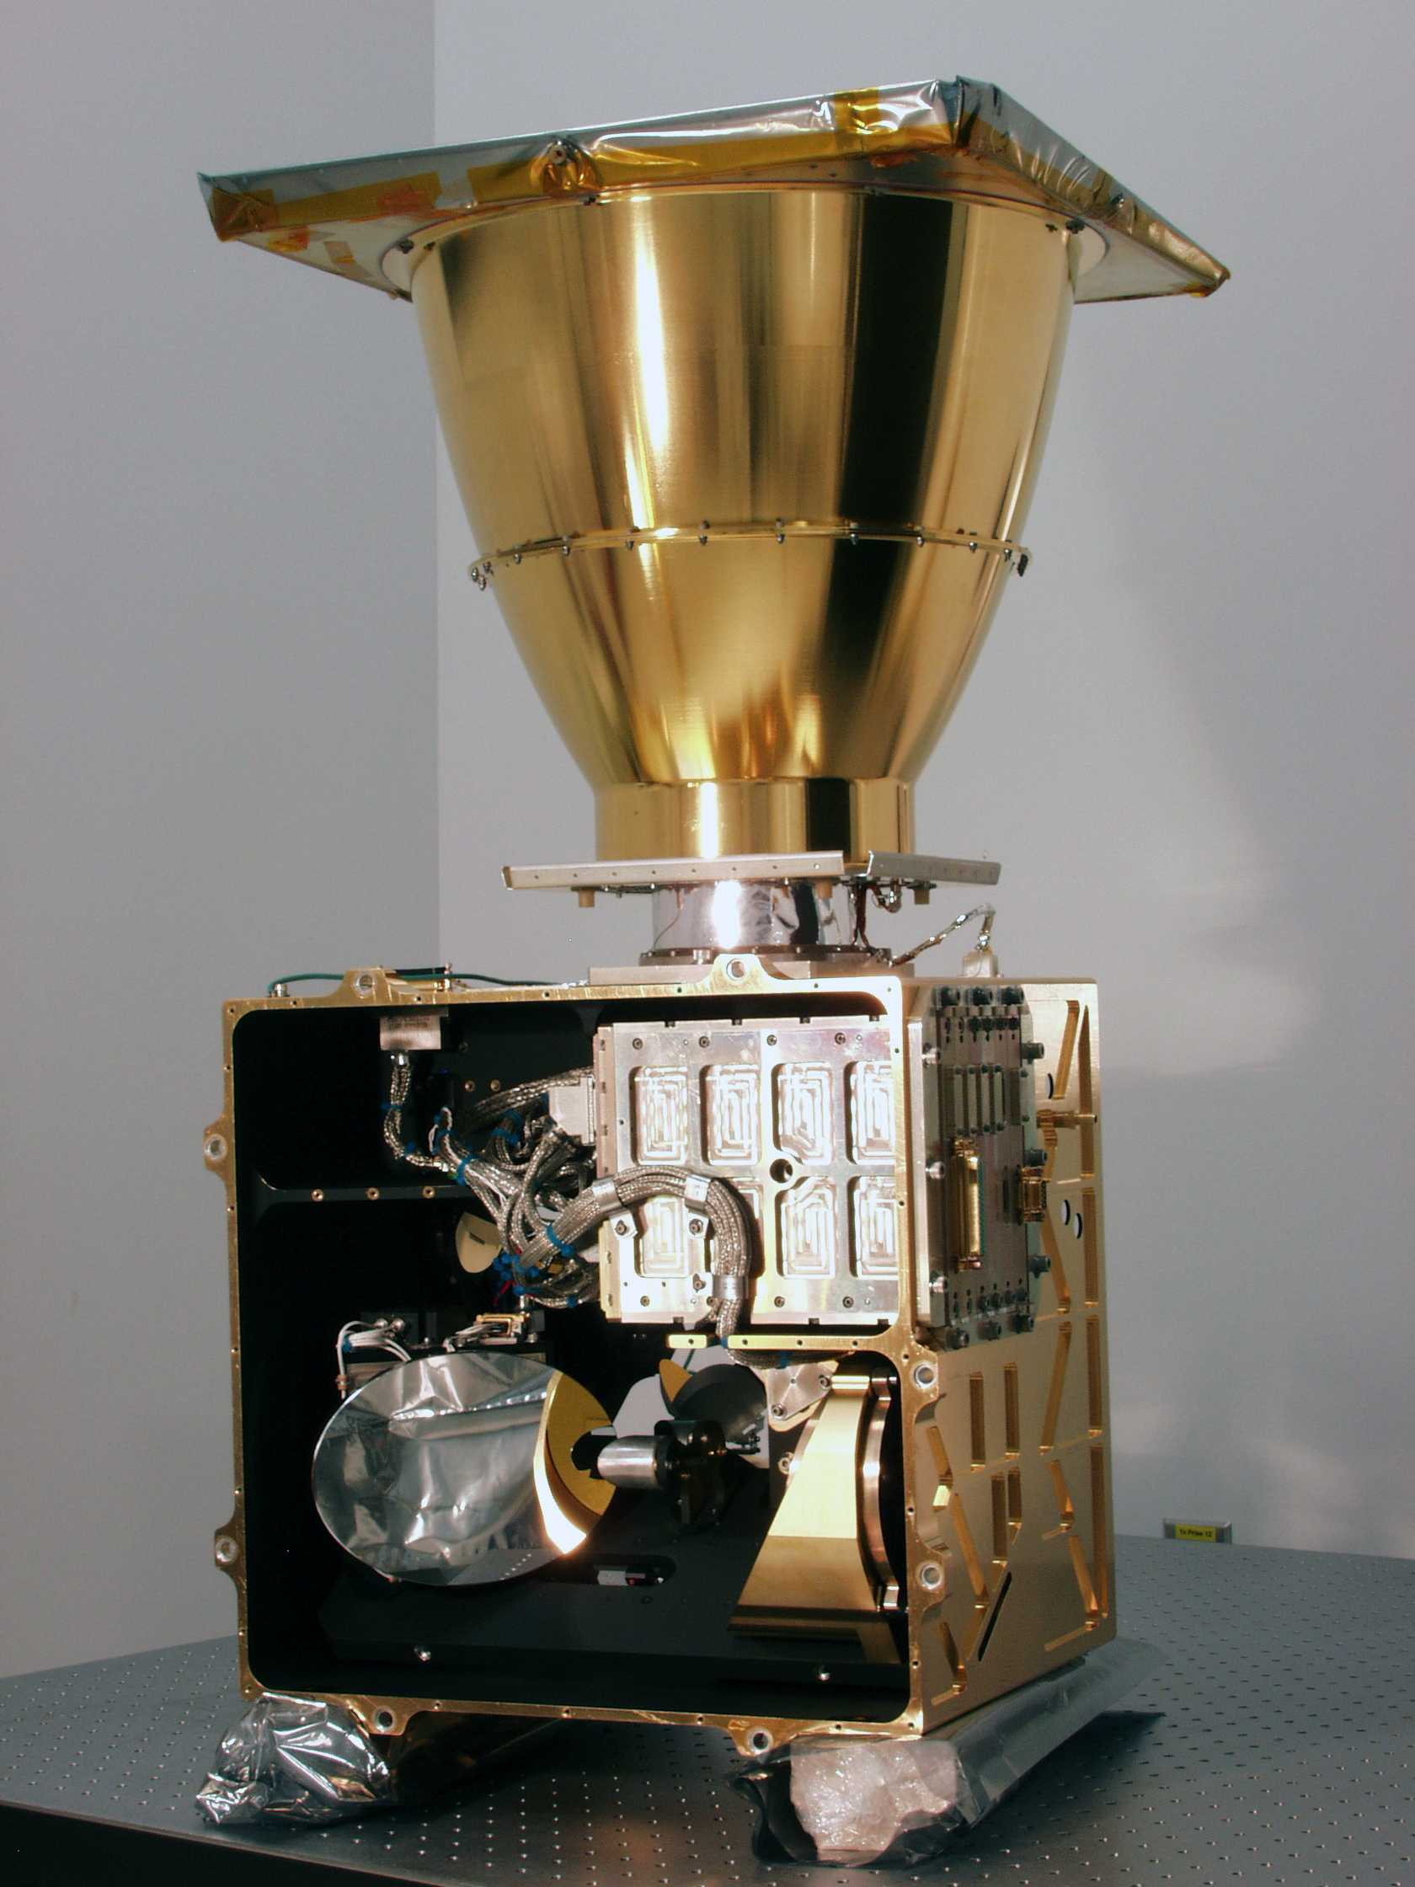
FTS design (ABB-Bomem)
Spectral resolution: 0.02 cm⁻¹
Spectral coverage: 750-4400 cm⁻¹
Vertical resolution: about 3 km
Also has 2 solar imagers at 1 & 0.5 µm
Interferometer side
Input side
Notes:
The enclosure is a cube of 40 cm on the side

Slide 5
ACE-FTS Version 4.1/4.2 & 5.0 Species
Tracers: H₂O, O₃, N₂O, NO, NO₂, HNO₃, N₂O₅, H₂O₂, HO₂NO₂, O₂, N₂, SO₂
Halogen-containing gases: HCl, HF, ClO, ClONO₂, CFC-11, CFC-12, CFC-113, COF₂, COCl₂, COFCl, CF₄, SF₆, CH₃Cl, CCl₄, HCFC-22, HCFC-141b, HCFC-142b, HFC-134a, HFC-23, HOCl, HFC-32
HOCl is a key new ACE molecule for stratospheric ozone depletion.
Carbon-containing gases: CO, CH₄, CH₃OH, H₂CO, HCOOH, C₂H₂, C₂H₆, OCS, HCN, CH₃C(O)CH₃, CH₃CN, PAN, high and low altitude CO₂ as well as pressure and temperature from CO₂ lines
Isotopologues: H₂¹⁸O, H₂¹⁷O, HDO, O¹³CO, OC¹⁸O, OC¹⁷O, O¹³C¹⁸O, ¹⁸OO₂, O¹⁸OO, O¹⁷OO, OO¹⁷O, N¹⁵NO, ¹⁵NNO, N₂¹⁸O, N₂¹⁷O, ¹³CO, C¹⁸O, C¹⁷O, ¹³CH₄, CH₃D, OC³⁴S, O¹³CS, ¹⁵NO₂, H¹⁵NO₃
New routine species in v.5.0 are in red.
ACE is now in its 19th year on orbit. This longevity makes trend analysis feasible (with care). The change in atmospheric composition is the primary driver of climate change.
ACE retrieves 46 molecules plus 24 isotopologues.

Slide 6
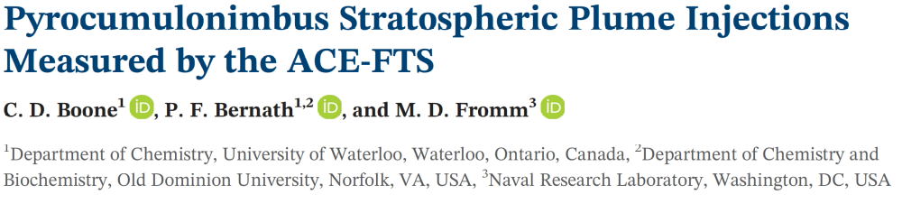
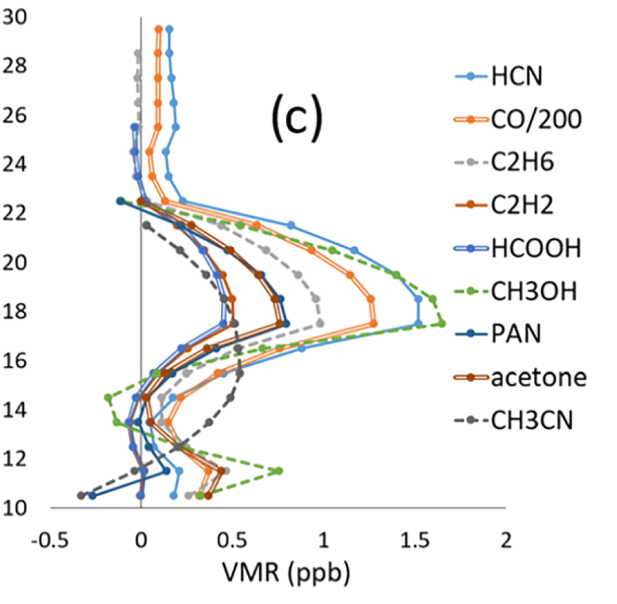
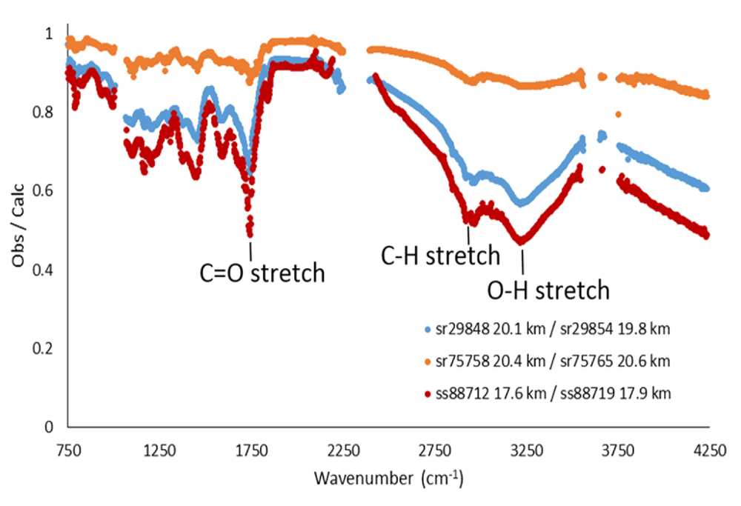
PyroCbs
GRL 47 (2020)
Altitude, km
Typical Australian fire spectrum in red at 17.5 km: oxygenated soot; no obvious H₂SO₄; strong C=O str.
Injection of organics into stratosphere

Slide 7
Eight Aerosol and Cloud Spectra
ACE-FTS records characteristic IR absorption spectra of particles
1. Polar Mesospheric Clouds (PMCs)
2. Smoke from fires
Polar Stratospheric Clouds (PSCs)
    3. Nitric acid trihydrate (NAT)
    4. Sulfuric/nitric acid and water (STS)
    5. Ice
6. Cirrus clouds (ice)
7. Ammonium nitrate (Asian monsoon)
8. Sulfate aerosols

Slide 8
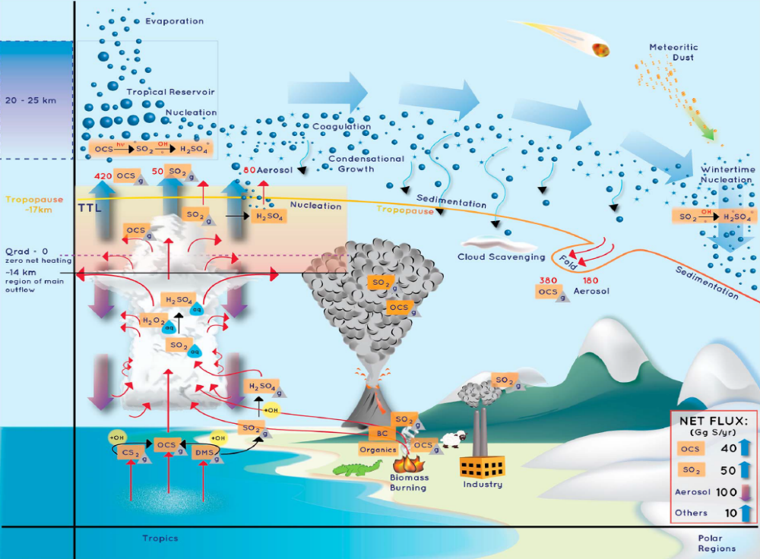
Lifecycle of Sulfate Aerosols
Kremser et al. 2016

Slide 9
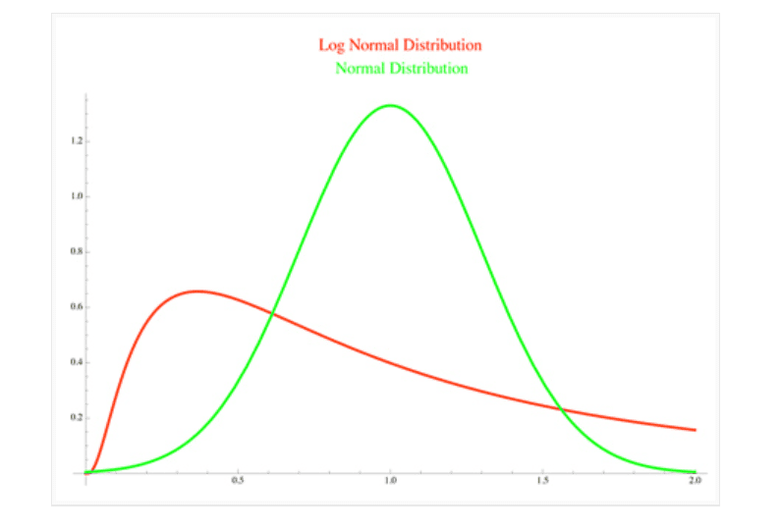
Aerosol Parameters (4)
1. Particle column density (particle density, N₀, particles/cm³ x Pathlength, cm)
2. Composition: % sulfuric acid
Size distribution: assume lognormal
  3. r_{m}: median radius
  4. σ : spread of distribution

Slide 10
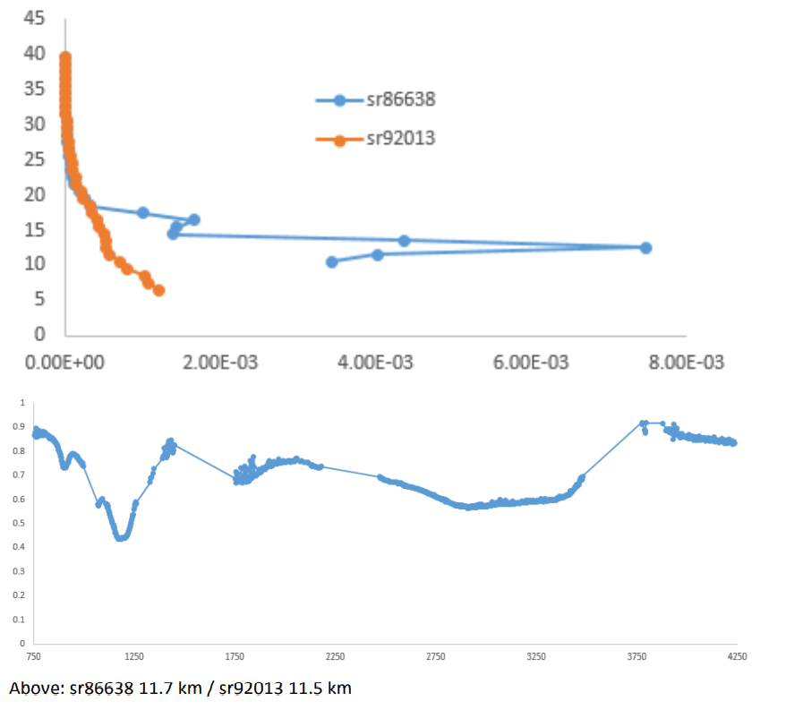
ACE-FTS “Residual” Spectra (Raikoke)
1 µ Imager
Altitude (km)
Extinction (km⁻¹)
Sulfate aerosol IR spectrum
Transmission
Wavenumber (cm⁻¹)
750
4250

Slide 11
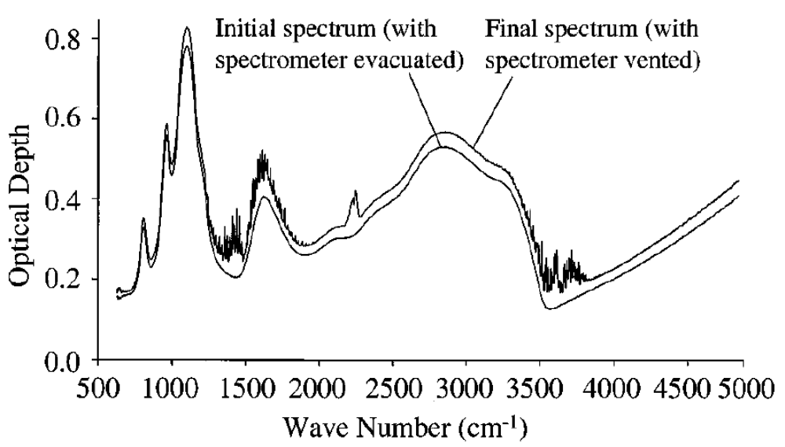
Lab Spectrum H₂SO₄ Aerosols
3
5
2
4
1
Room temperature, large particles; Heathfield et al. 1999

Slide 12

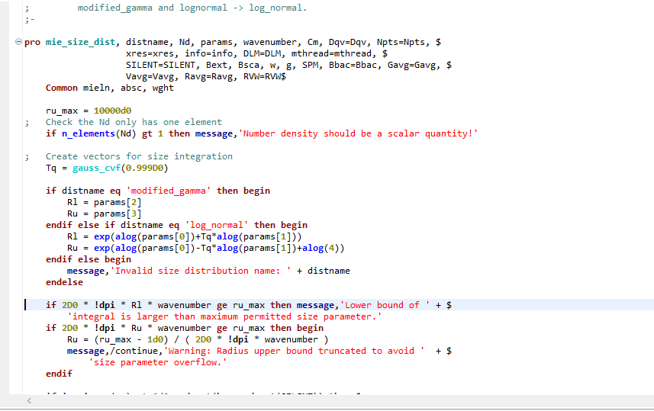
Modeling
Working with Mie scattering IDL programs
  Developed by Earth Observation Data Group at Oxford University
Two main programs used:
  Single Particle (mie_single.pro)
  Distribution (mie_size_dist.pr0)

Slide 13
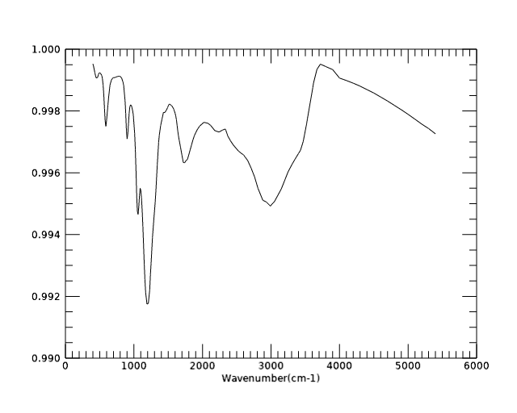
Modeling with IDL
Program input:
  Distribution type
  Pathlength
  Number density
  Median radius
  Spread of distribution
  Wavenumber (cm⁻¹)
  Complex refractive index (optical constants)

Slide 14
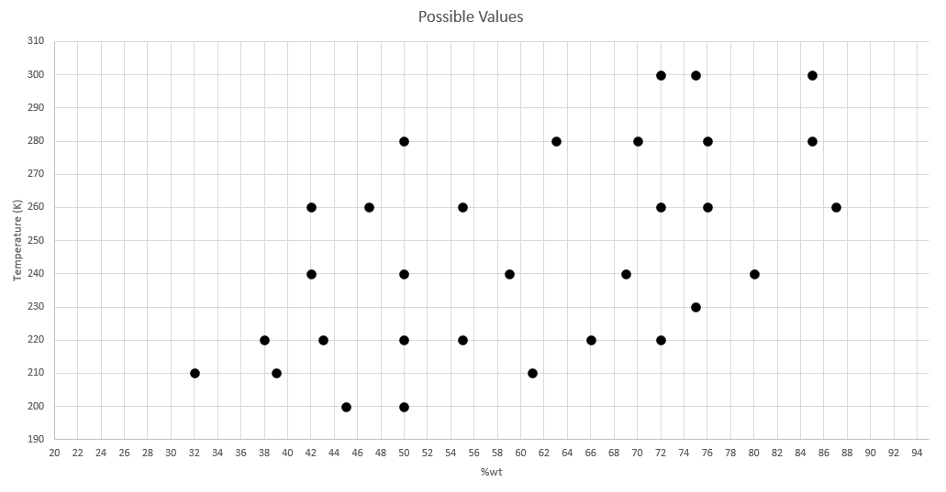
Optical Constants
Temperature and composition dependent constants by Niedzela et al. 1999
  31 sets for 32-87% H₂SO₄ for 200-300 K (bilinear interpolation program used)
Temperature (K)
Weight %

Slide 15
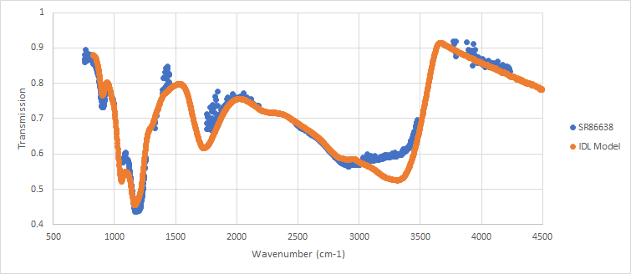
Observed and Calculated Comparison
Raikoke volcanic eruption
Temperature = 220 K
70% sulfuric acid
40 particles/cm³
300 km pathlength
Distribution spread 1.5
0.25 μm median radius
No obvious stratospheric smoke

Slide 16
Close Coincidence with SAGE III-ISS (Raikoke Volcanic Eruption)
SAGE III-ISS event 1887010
  11 Sept 2019 20.55 UTC
  Latitude: 57.7425° Longitude: 133.797°
ACE Event sr86638
  11 Sept 2019, 20.6 UTC
  Latitude: 58.149° Longitude: 133.009°

Slide 17
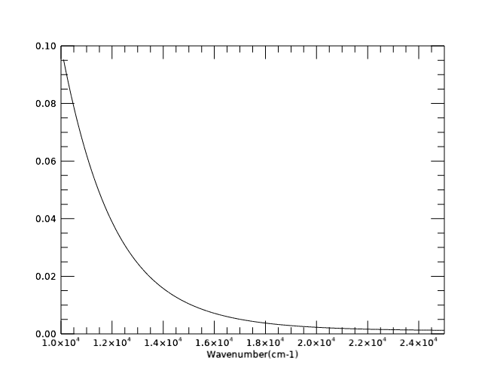
SAGE III-ISS
Used aerosol parameters from ACE spectrum and calculated the extinction at the 9 SAGE III aerosol wavelengths using Palmer and Williams optical constants
IDL Model Extinction
Channel | Wavelength (nm) | Peak Altitude (km) | SAGEIII Extinction/km | IDL Extinction/km
1 | 384.244 | 13.5 | 0.007 | 0.0224
2 | 484.511 | 13 | 0.0128 | 0.0215
3 | 520.513 | 12.5 | 0.025 | 0.0196
4 | 601.583 | 12.5 | 0.021 | 0.017
5 | 676.037 | 12.5 | 0.019 | 0.0149
6 | 755.979 | 12 | 0.014 | 0.0126
7 | 869.178 | 12 | 0.011 | 0.01004
8 | 1021.202 | 12 | 0.008 | 0.00756
9 | 1543.92 | 12 | 0.0029 | 0.00269
Transmission

Slide 18
What’s Next?
Keith LaBelle is currently calculating spectra for all 31 Niedzela et al. sets of optical constants for a range of lognormal distribution parameters
Similar calculations of extinction for SAGE III aerosol channels using Palmer and Williams optical constants
Using these calculations as input, Chris Boone will then adapt ACE-FTS fitting programs to obtain 4 sulfate aerosol parameters using co-incident ACE and SAGE data

Slide 19
Acknowledgements
Robin
Chris Boone
Jeff Crouse
Johnny Steffen
Dennis Cok
Ryan Johnson
Keith LaBelle
Randika Dodangodage
Doug Cameron
Jason Sorensen

Slide 20
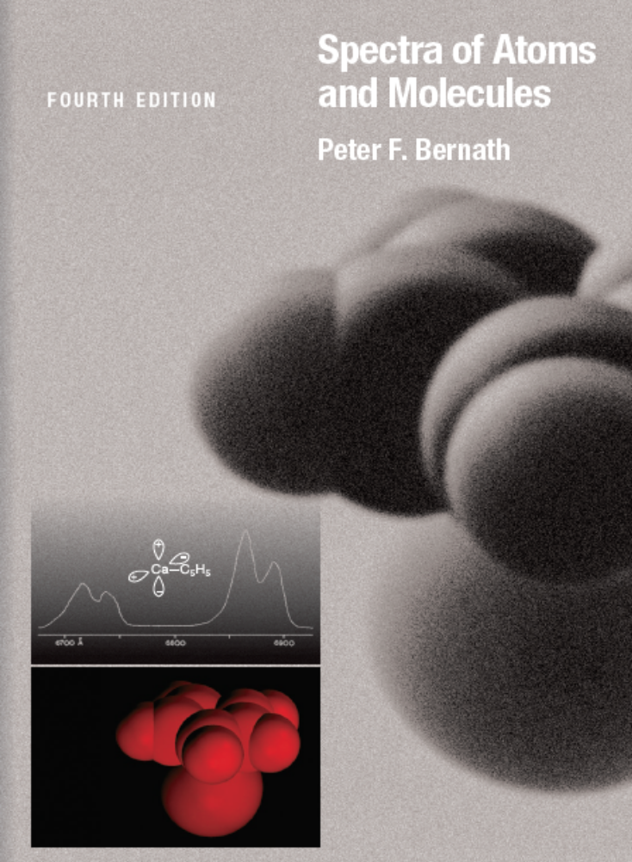
It’s All Spectroscopy
Textbook aimed at graduate students and senior undergrads. Particularly useful treatment of the confusing topic of line intensities needed for remote sensing. 4th edition has appeared (April 2020) including atmospheric and astronomical spectroscopy.

