Slide 1
Validation and Mission Planning Update
Carrie Roller
SAGE III Scientist/Engineer

Slide 2
Validation Partners - Update
During the validation campaign, the SAGE science team reached out to all currently participating NDACC lidar and sonde sites in an attempt to facilitate the coordination of SAGE III predicted events with in-situ data gathered at each site.
Each participating station receives weekly emails detailing all upcoming SAGE III events that will coincide with their location and meet validation criteria.
The SAGE team is always looking to add to new stations to this list.

Slide 3
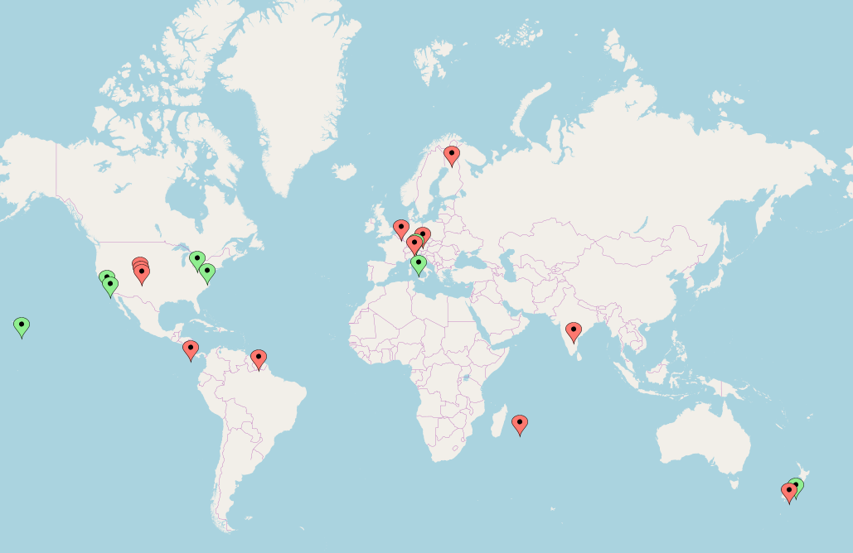


Validation Partners – Update cont.
- Boulder, Colorado, USA
- Lauder, New Zealand (sonde)
- Mauna Loa, Hawaii, USA
- Table Mountain, California, USA
- Sodankyla, Finland
- De Bilt, The Netherlands
- Paramaribo, Surinam
- Alajuela, Costa Rica
- London, Ontario, Canada
- Rome, Italy
- UC Boulder, Colorado, USA
- GSFC, Maryland, USA
- Lauder, New Zealand (lidar)
- Table Mountain, California, USA
(lunar)
- Hohenpeissenberg, Germany
- Reunion Island, France
- Praha, Czech Republic
(seasonal)
- Laramie, Wyoming, USA
-Hyderabad, India (campaign)
-Hampton University, Virginia, USA
-San Jose, Costa Rica
Sonde
Lidar

Slide 4
Validation Criteria
To be used for validation, in-situ data must be collected within ± 24 hours of a coincident SAGE III event.
Species of interest: stratospheric ozone, aerosol, water vapor
The latitude and longitude constraints for event matching are: ± 5 deg latitude, ± 10 deg longitude
The types of SAGE III science events that are used for validation are solar occultation events (Sunrise and Sunset), and lunar occultation events (Moonrise and Moonset). Limb events are not currently used for validation.

Slide 5
SAGE III Validation Website: Updates
The SAGE III validation website is:
  https://sage.nasa.gov/validation/
There were no significant updates this year to the SAGE III validation site. Please email me with bug fixes that are needed as well as any suggestions for site updates/additions.
Validation site curator: Danny Mangosing

Slide 6
Weekly Process - Recap
Each week, participating stations are sent emails detailing any coincident SAGE III events that will occur in approximately three weeks.
This time frame is used to ensure the accuracy of the SAGE III event predictions and allows stations to have advance planning for possible coincident measurements.
Coincident events for each specific station are determined using the SAGE III validation website.
Each event is then checked against the SAGE III operations calendar as well as the ISS schedule for any activities that may alter the planned event schedule.
Events are also checked for potential station-related blockage.

Slide 7
COVID-19 Update
Throughout the COVID-19 quarantines around the world, many validation stations experienced partial or full shutdowns during portions of 2020.
Validation event matching continued throughout the quarantine, though the number of sonde launches was reduced drastically during this time.
Most stations have now returned to operation in some capacity.

Slide 8
Long Term Predictions
Current status: The computer used to generate the long term predictions is down. Ground systems is working this issue and long term events will be sent out as soon as they are available again.
These predictions are available on the SAGE validation website and monthly via email to stations that request them.
Long term events are not guaranteed and are highly likely to vary in time and space because of reboosts, schedule changes, etc that may occur within the coming months.
These predictions are useful for long range planning with the caveat in mind that they are likely to change.
Please contact me if your station is interested in receiving monthly long term predictions via email.

Slide 9
ISS Reboost
Periodically, the ISS needs to complete a reboost (or deboost) for altitude maintenance.
Following an ISS reboost, it takes approximately 2–4 days for the ISS orbit parameters (Two-line elements, TLEs) to fully settle into the new changes in the ISS orbit.
During this time, predictions may be slightly skewed in time and longitude.
Reboost details are included in weekly emails, as applicable.
Once the orbit changes have settled out, all events are re-checked for accuracy to ensure that they still meet the constraints for validation.

Slide 10
Blockage
There are times when visiting vehicles, solar panels, or modules can obstruct the view of SAGE.
Expected blockage information can be found on the SAGE Validation website
  Levels are: none, low, medium, high, and extreme
Depending on the severity of the blockage, events may still acquire successfully.
Events sent to validation partners have blockage levels of medium or lower to ensure event success.
High and extreme levels of blockage may still acquire but are not guaranteed. These events are not sent to validation partners.

Slide 11
Validation Site Visits
All validation site visits planned for this year were put on hold due to Covid-19.

Slide 12
Contact Information
SAGE III is looking for additional validation partners to collaborate with! Please forward my contact information to anyone that may be interested in coordinating sonde launches or lidar operations with SAGE III events.
    Carrie Roller
    SAGE III Science, Engineer
    carrie.roller@nasa.gov

Slide 13
Questions?

