Slide 1
Utilization of Disturbance Monitoring Package (DMP) Data: Update
Andrew Peterson
Deputy Mission Operations Manager
Marsha Larosee, Robbie Manion, Kevin Leavor, Charles Hill

Slide 2
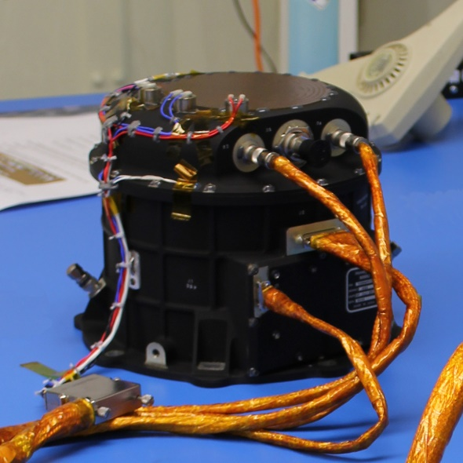
DMP Overview
The Disturbance Monitoring Package (DMP) is a Honeywell Miniature Inertial Measurement Unit comprised of three orthogonal ring laser gyros to measure angular rates in three orthogonal axes.
The DMP's primary requirement is to flag periods when vibration conditions can negatively impact the science data product.

Slide 3
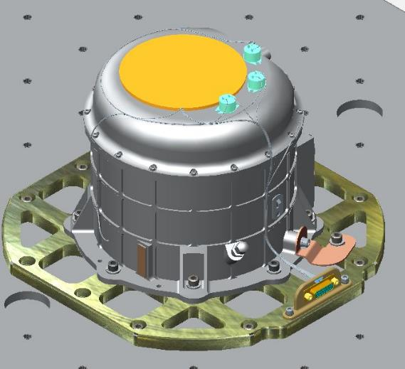
DMP Overview
The DMP can characterize stationary random vibration, shock disturbances, and attitude change events.
ISS attitude maneuvers have permitted the DMP MIMU axes to be mapped to the ISS Analysis Coordinate System (ACS).
DMP data regularly enable attribution of noisy science measurements and are being adapted to correct boresight scan rates for mechanical disturbances.
Apart from an EEPROM reset every three years (last perform 10/23/2018) the DMP does not require regular mission operations interactions.

Slide 4
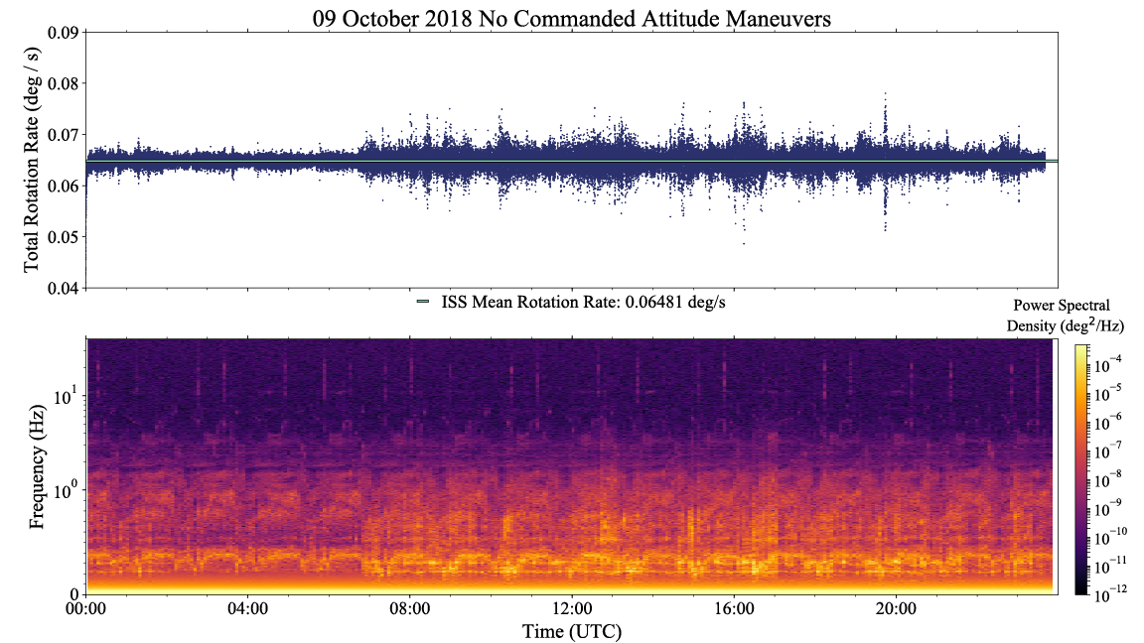
Quiescent Day as Observed from ELC-4

Slide 5
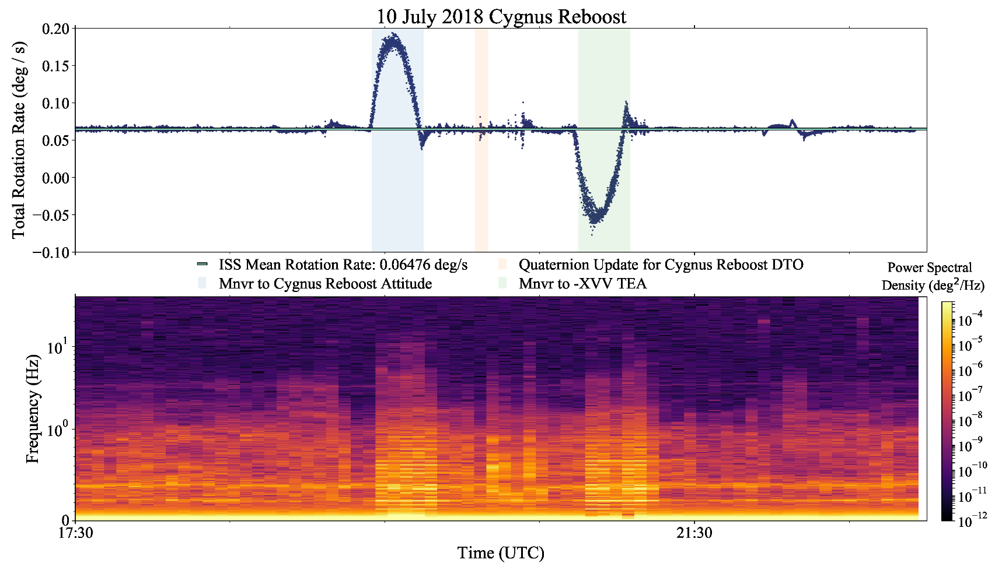
Large Shock from Reboost as Observed from ELC-4

Slide 6
DMP Partnerships
  Climate Absolute Radiance and Refractivity Observatory (CLARREO) Pathfinder/LASP
    SAGE III provided DMP and BAD raw data and plots in 2017 and 2018 as an example of the ISS mechanical environment.
    Data included both quiescent and active periods during nominal and off-nominal TEA, data during science collection and while SAGE III was off, and data while astronauts were awake and asleep.
  Boeing and ISS Mechanical Structures Engineers
    Provided plots of DMP rotational rate and power spectra to aid in the investigation of disturbances on the starboard truss noted by ISS in July 2019
  Total and Spectral Solar Irradiance Sensor (TSIS)/LASP
    Sharing of data plots and discussions at the ISS R&D Conference in 2018

Slide 7
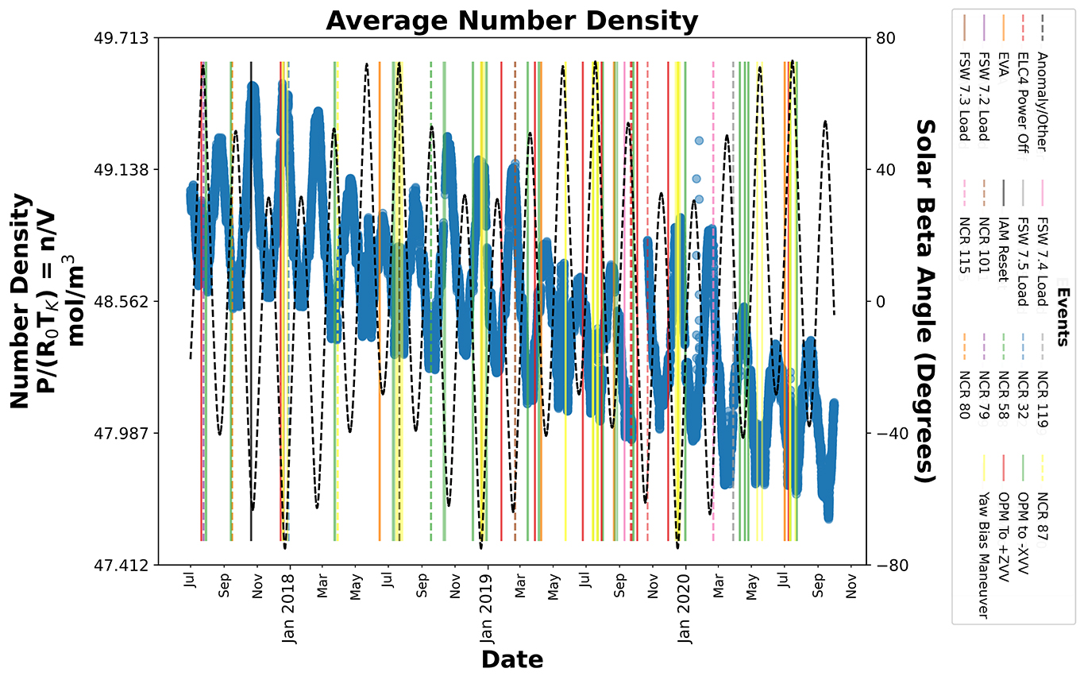
DMP Pressure Vessel Leak Rate
  Yellow Limit: 37.97 mol/m³ at 273K
  Red Limit: 34.93 mol/m³ at 273K

Slide 8
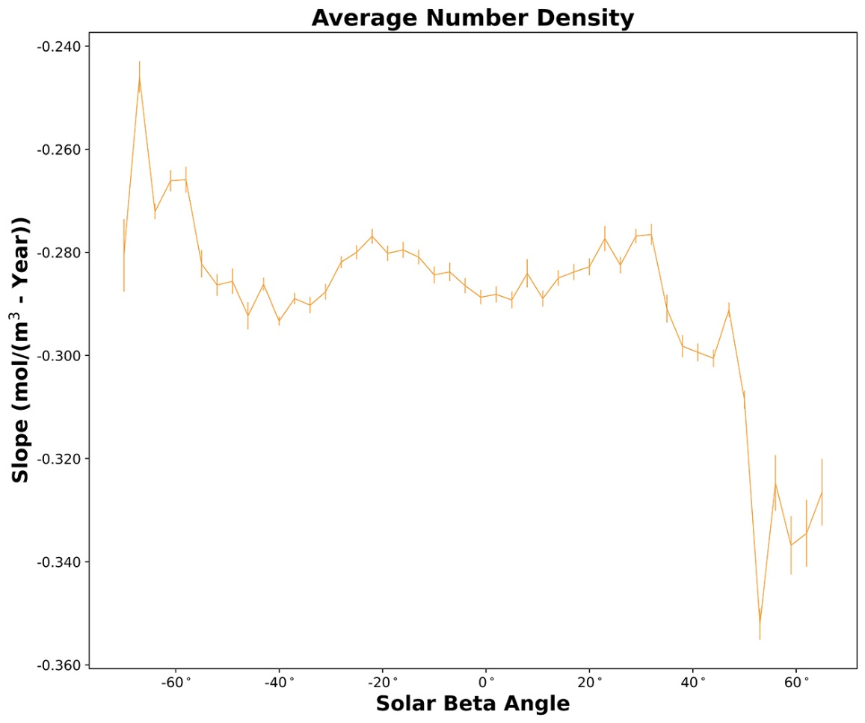
DMP Pressure Vessel Leak Rate
  Yellow Limit: > 30 years
  Red Limit: > 40 years

Slide 9
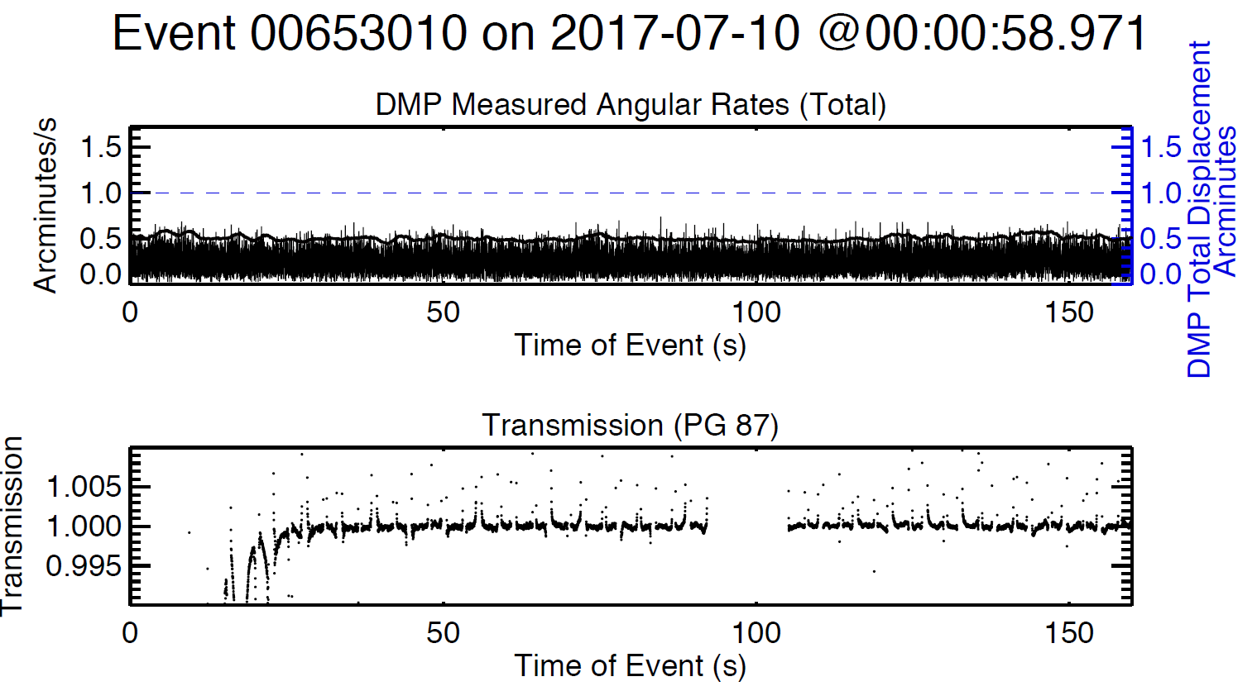
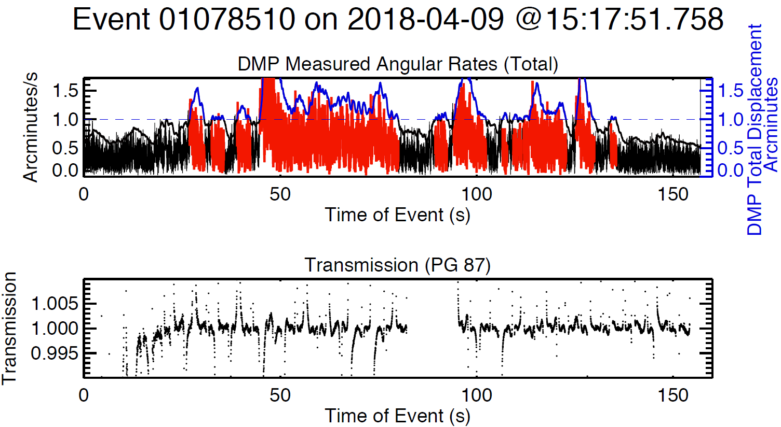
Current Use of DMP
The DMP flag appears to correlate with the transmission noise and additional quantitative analyses are in work.

Slide 10
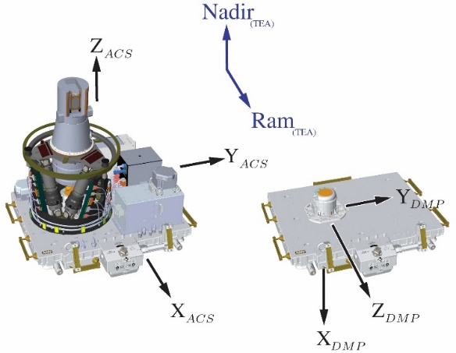
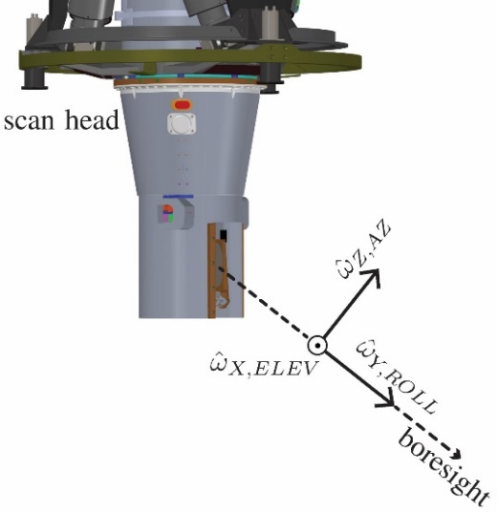
Next Steps: Projection of DMP Measured Angular Rates into Boresight Coordinates

Slide 11
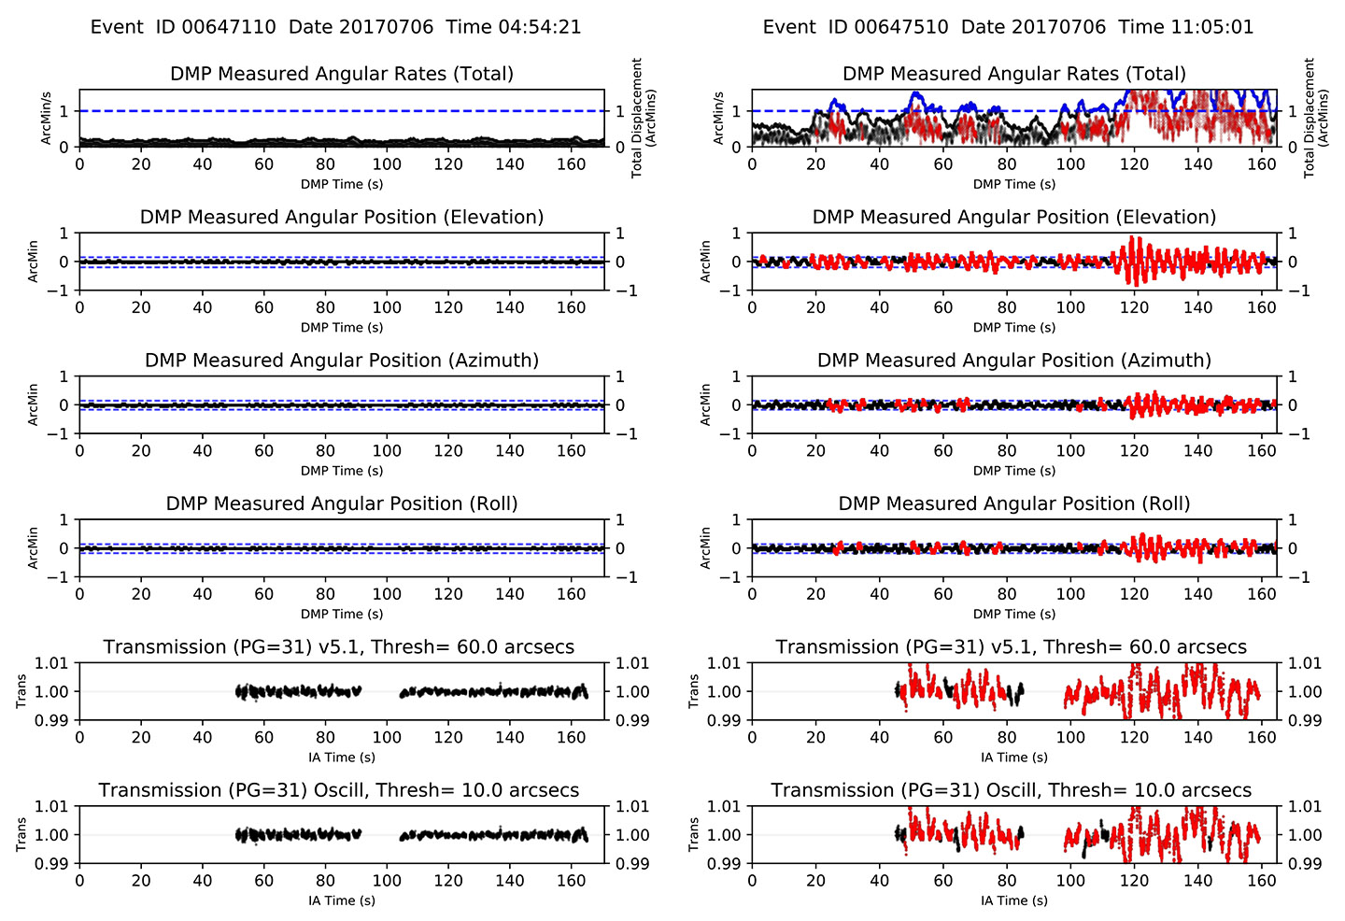

Slide 12
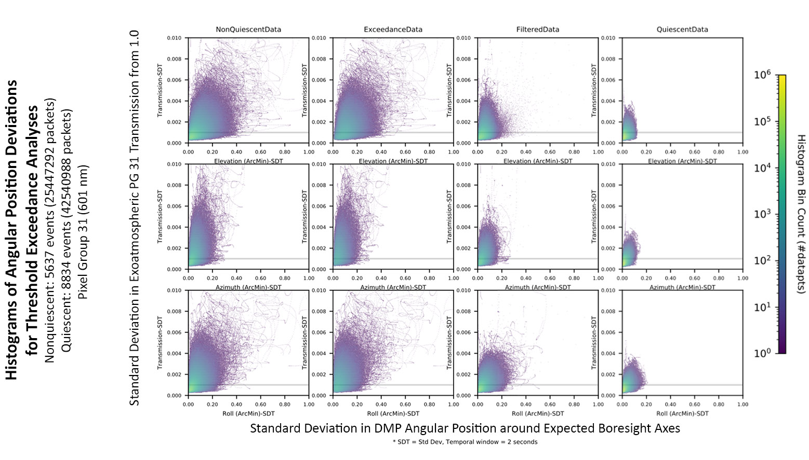

Slide 13
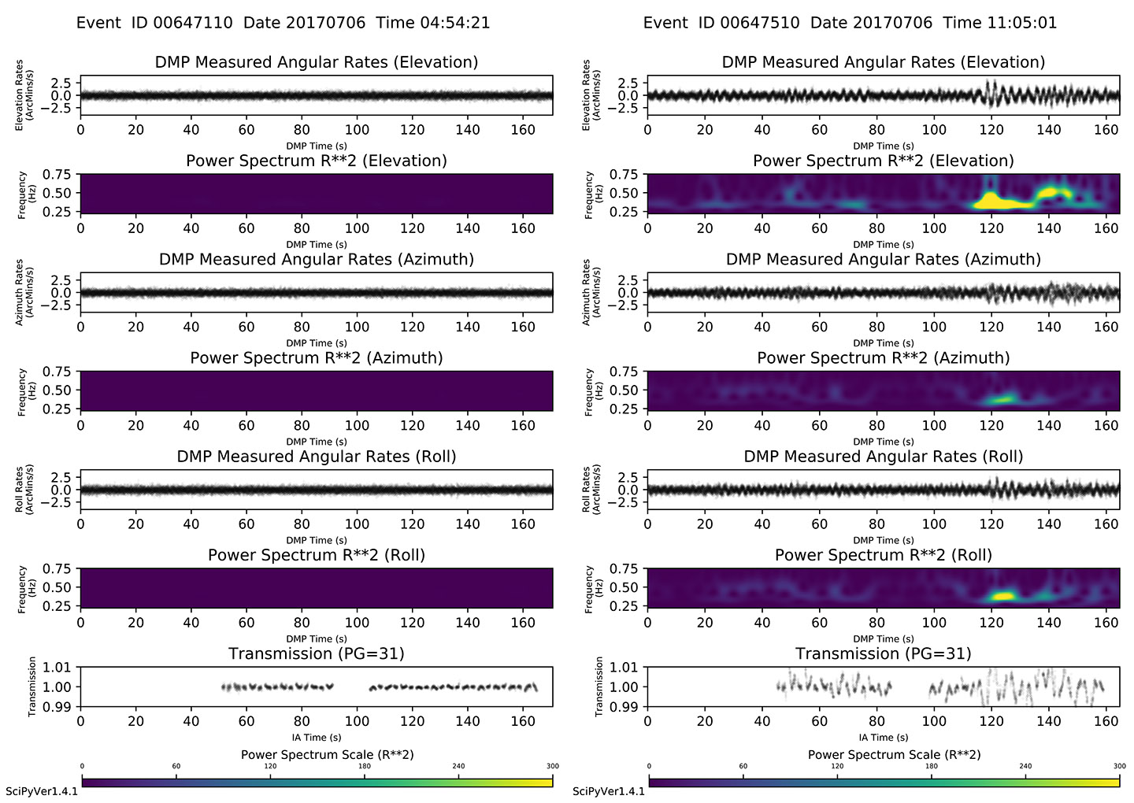

Slide 14
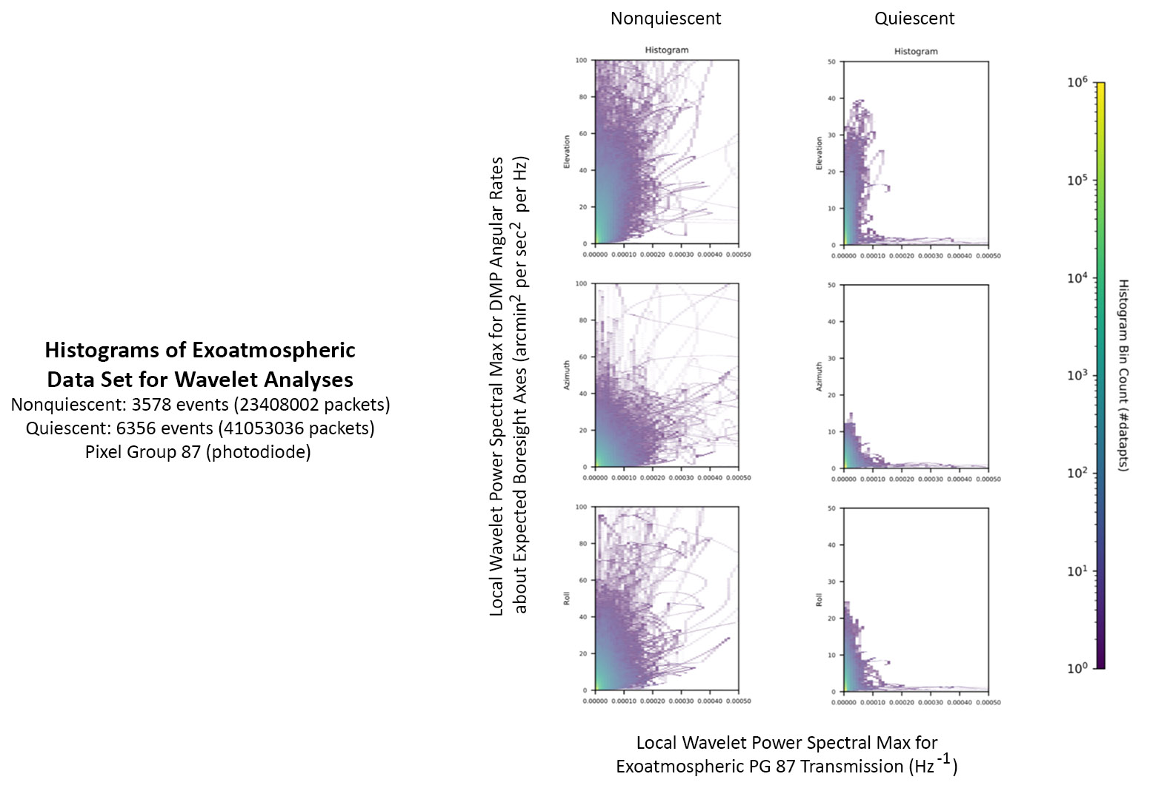

Slide 15
Forward Goals for Disturbance Flag
Update disturbance flag to utilize the DMP angular position exceedances with the most effective thresholds relative to the IA boresight axes.
Reconsider wavelet analysis incorporating transmission uncertainty to review previous analysis as well as to capture high frequency but low amplitude disturbances that might energize modes in the scan head.

Slide 16
A Lesson Learned
The DMP Transfer Function Isn’t Characterized
  What is the SAGE III scenario?
    The SAGE III mechanical transfer function between the DMP and the instrument scan head was not assessed during I&T.
    Vibration testing originally included a laser vibrometer characterization of the transfer function but was de-scoped because of schedule pressures and prioritization.
  Why is this important?
    To extend utilization of the DMP to correct (or filter) science data and boresight pointing for the ISS mechanical environment, the phase and amplitude response of the measured DMP vibration that is transmitted to the scan head and scan mirror needs to be understood.
    The mechanical transfer function can only practically be measured on the ground, and the DMP team is trying to back out a suitable transfer function from science data observations.
  How can this problem be avoided in future missions?
    De-scope will occur, but it’s important to recognize that de-scoped characterization testing has mission operational consequences only distantly related to the hardware delivery goals of I&T.

