Slide 1
3rd Annual SAGE III/ISS Science Team Meeting
NASA Langley Research Center
October 19-20, 2020

Slide 2
Welcome
David Flittner

Slide 3
Welcome!
Third annual SAGE III/ISS Science Team Meeting, first completely virtual version
Communicate to the ROSES Science Team the status of:
  Mission
  Operations
  Data products
Initiate and foster collaborations amongst the Science Team and the Mission Team
Do good science…and be flexible

Slide 4
LOGISTICS
WebEx information
  Meeting # & password: 1999494381 jkTFvFv@822
Call-in: 1-929-251-9612 or 1-415-527-5035 (see invite for other countries)
You are welcome to turn on video while presenting – bandwidth will dictate video use otherwise
Mute unless need to speak; Raise hand for questions
Presentations will be posted on mission web-page, with your approval
  sage.nasa.gov/missions/about-sage-iii-on-iss under “Science Team” tab
Lunch - on your own; will keep WebEx session live
Meeting facilities:
  Restrooms – down the hall
  Coffee, etc. in the kitchen

Slide 5
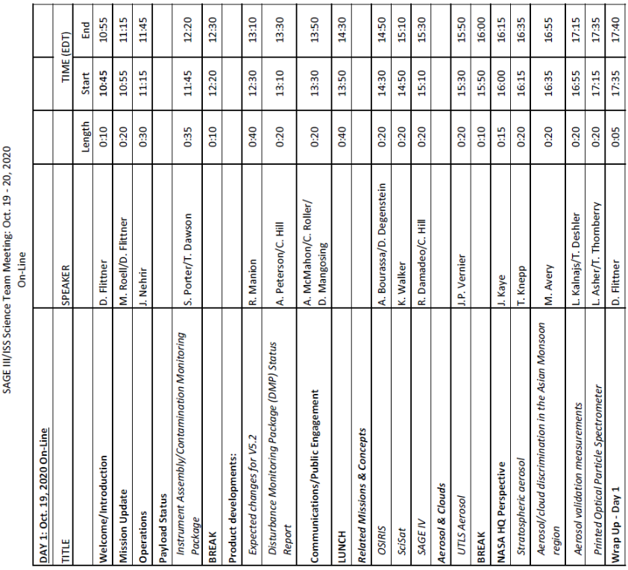
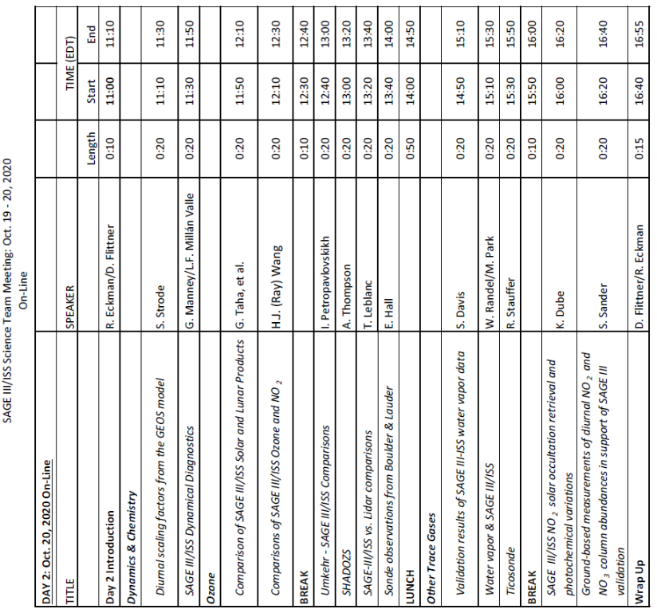
AGENDA

Slide 6
Mission Update
Marilee Roell
SAGE III/ISS Science Manager
David Flittner
SAGE III/ISS Project Scientist

Slide 7
Outline
Current status of mission
Road ahead

Slide 8
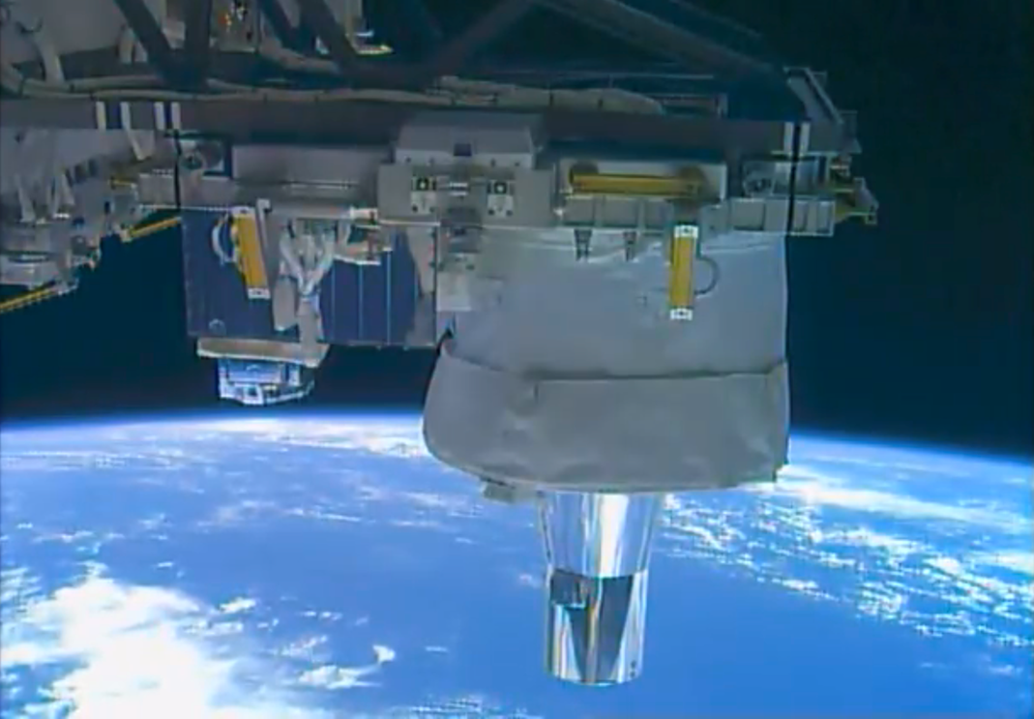
Business as Usual, under Covid-19
After 3+ yrs of on-orbit operations, the payload is behaving nominally
SMD & ISS Program fully supports normal science operations during Covid-19
Operations Team always learning about hosted payload life on ISS
Continuing to improve science accumulation w/ advancements in ground & flight S/W
Upgrading payload simulator
Processing algorithm update with V5.2
Upgrading science processing hardware

Slide 9
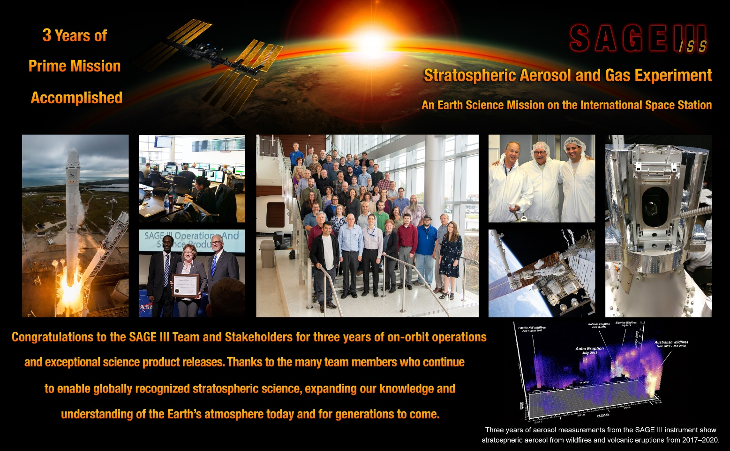
Prime Mission Complete

Slide 10
End of Prime Mission Review: Sep. 15, 2020 – PASSED!
3-yrs of Baseline science observations completed June 2020, > 25700 solar occultations
L1 and L2 science data products publicly released since Dec. 2017 on monthly cadence that are consumed nationally and internationally
Issues identified during operations are closed or have path to closure by FY21Q1
Instrument healthy with no impediments to achieving Extended Mission science objectives
Program-Level Requirements specified Earth Systematic Program Missions Plan, Appendix-Q are complete
Sharing SAGE payload data with ISS to understand contamination and disturbance environments – contributing to success of other ISS hosted payloads
Continuing to collect/process/release Baseline observations: 06/17 - present
Extended mission proposed to continue SAGE III/ISS Baseline science – extending stable, precise, high vertical resolution profiles of aerosol, ozone & other trace gases in the stratosphere and upper troposphere

Slide 11
Extended Mission Proposal
(aka Senior Review)
Proposal submitted March 6, 2020
Answers (written) to technical panel April 14, 2020
Presentation (virtual) to science review panel July 9, 2020
Proposed:
  Continuation of SAGE III/ISS Baseline science – extending stable, precise, high vertical resolution profiles of aerosol, ozone & other trace gases in the stratosphere and upper troposphere
  Accomplished by collecting observations, maturing data products & releasing to public, fostering scientific use of products
  Using current level of resources
Unofficial indication of mission extension within the proposed effort/cost

Slide 12
Extended Mission Proposal
(aka Senior Review)
The mission's most important accomplishment in the last three years
  The current V5.1 products are sufficient to re-establish the stable long-term record of stratospheric ozone concentration and aerosol extinction
    Ozone has been independently validated and is suitable for use in trend studies for the next WMO Scientific Assessment of Ozone Depletion
    Aerosol has been used to calibrate current scattering methods and re-baseline the record back to direct measurements of aerosol extinction that form the backbone of the Global Satellite Stratospheric Aerosol Climatology (GloSSAC-2)

Slide 13
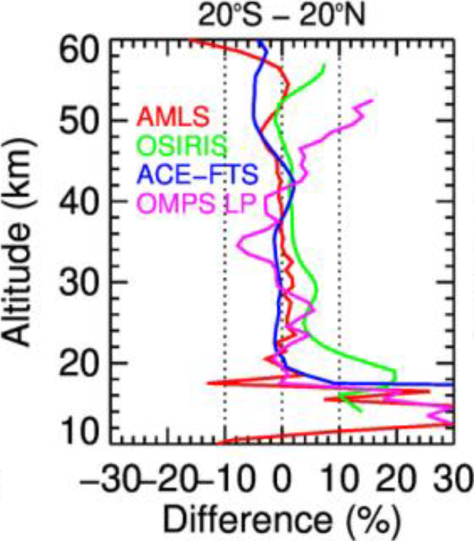
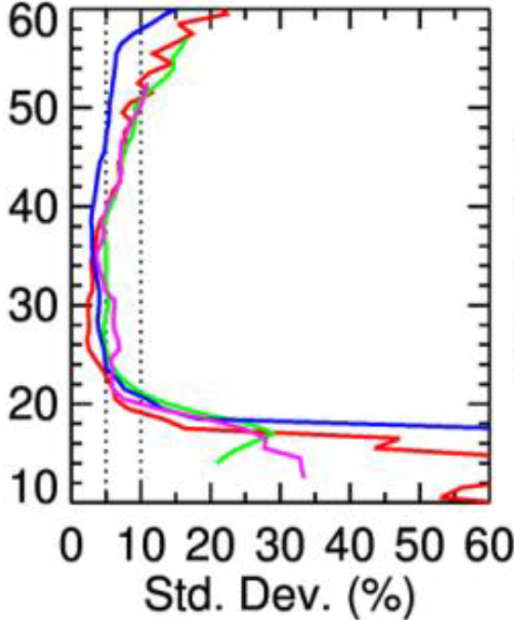
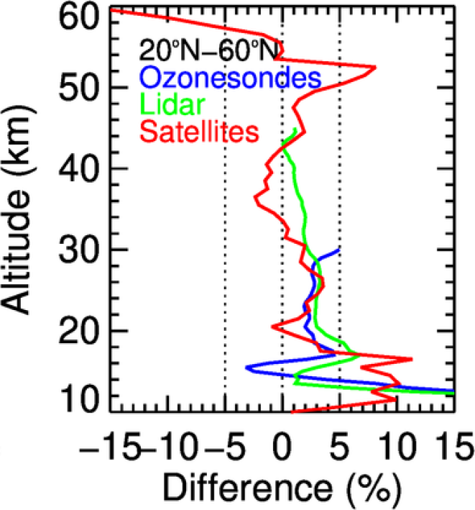
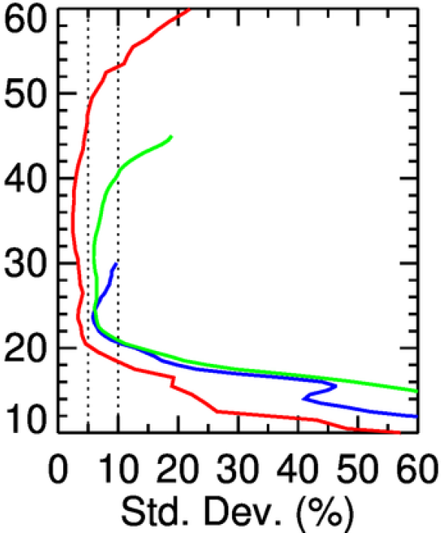
SAGE III/ISS Ozone Validation
Comprehensive validation of SAGE III/ISS v5.1 solar ozone data against correlative satellite, lidar, and sonde measurements
Agreement between measurement systems is as expected in the stratosphere (< 5%) and upper troposphere (< 10%)
Precision is < 3% through most of the stratosphere, relaxing in the lower mesosphere (10–15%) and upper troposphere (20–30%)
Identifies improvements that can be implemented in future versions
Data quality is suitable for stratospheric ozone trend studies
Wang et al., JGR, doi: 10.1029/2020JD032430, 2020
Notes:
Figures adapted from Figures 11 (top 2 panels) and 14 (bottom 2 panels) of Wang et al., 2020.
Top panels show mean (left) and standard deviation (right) of differences between SAGE III/ISS and 4 correlative satellite measurements in the tropics, though results are typical at mid-latitudes (relative to tropopause). Note that the standard deviation of the differences between two measurement systems is a combination of the precision of those two systems as well as geophysical variability between their coincidences.
Bottom panels show similar statistical comparisons between SAGE III/ISS and satellite (same as top panels only combined), lidar, and ozone sonde stations at Northern mid-latitudes, though results are typical at other latitudes. SAGE III/ISS has a positive bias in the troposphere and lowermost stratosphere, the cause of which has been identified and will be corrected for in future versions.

Slide 14
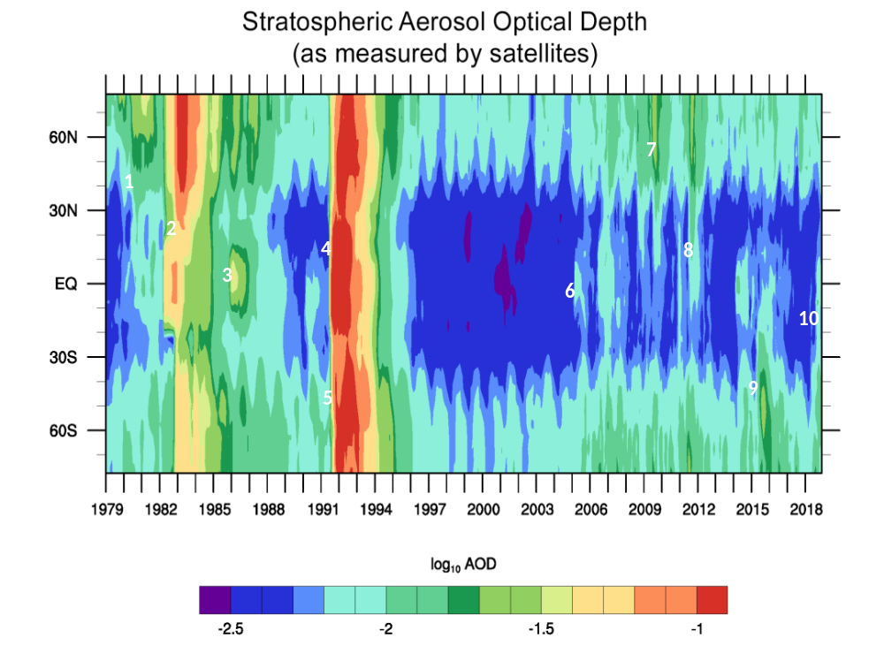
Stratospheric Aerosol Climatology Accuracy Greatly Improved
Stratospheric aerosols play important roles in radiation budget and ozone chemistry
SAGE III/ISS aerosol extinction profiles in great demand as calibration source for:
  OSIRIS, OMPS-LP, CALIOP, CATS, ground-based Stratospheric Lidars
Decade gap since the previous true measure of aerosol extinction (SAGE II) filled by less accurate methods – limb scatter (OSIRIS) and lidar backscatter (CALIOP)
SAGE III/ISS data, starting June 2017, provides correction factors for OSIRIS & CALIOP data – in some cases 10x – in the Global Satellite Stratospheric Aerosol Climatology (GloSSAC) V2
GloSSAC V2
1 – St. Helens
2 – El Chichon
3 – Ruiz/Nyamurgira
4 – Pinatubo
5 – Hudson
6 – Manam
7 – Kasatochi/Sarychev
8 - Nabro
9 – Calbuco
10 - Ambae
@ 525 nm
Kovilakam, et al.: A Global Space-based Stratospheric Aerosol Climatology (Version 2.0): 1979–2018, Earth Syst. Sci. Data Discuss., https://doi.org/10.5194/essd-2020-56, in review, 2020.
Notes:
Figure is monthly zonal mean stratospheric aerosol optical depth from GloSSAC V2.
Combines historical SAGE record (Starting with SAGE I & SAM II), OSIRIS, CALIOP, SAGE III/ISS and other datasets to construct continuous record.
Aerosol related articles using SAGE III/ISS data:
PUBLISHED
Chouza, F., Leblanc, T., Barnes, J., Brewer, M., Wang, P., and Koon, D.: Long-term (1999–2019) variability of stratospheric aerosol over Mauna Loa, Hawaii, as seen by two co-located lidars and satellite measurements, Atmos. Chem. Phys., 20, 6821–6839, https://doi.org/10.5194/acp-20-6821-2020, 2020.
Bourassa, A. E., Rieger, L. A., Zawada, D. J., Khaykin, S., Thomason, L. W., & Degenstein, D. A. (2019). Satellite limb observations of unprecedented forest fire aerosol in the stratosphere. Journal of Geophysical Research: Atmospheres, 124, 9510– 9519. https://doi.org/10.1029/2019JD030607
Kar, J., Lee, K.-P., Vaughan, M. A., Tackett, J. L., Trepte, C. R., Winker, D. M., Lucker, P. L., and Getzewich, B. J.: CALIPSO level 3 stratospheric aerosol profile product: version 1.00 algorithm description and initial assessment, Atmos. Meas. Tech., 12, 6173–6191, https://doi.org/10.5194/amt-12-6173-2019, 2019.
Rieger, L. A., Zawada, D., J, Bourassa, A. E., & Degenstein, D. A. (2019). A multiwavelength retrieval approach for improved OSIRIS aerosol extinction retrievals. Journal of Geophysical Research: Atmospheres, 124, 7286– 7307. https://doi.org/10.1029/2018JD029897
Kloss, C., Berthet, G., Sellitto, P., Ploeger, F., Bucci, S., Khaykin, S., Jégou, F., Taha, G., Thomason, L. W., Barret, B., Le Flochmoen, E., von Hobe, M., Bossolasco, A., Bègue, N., and Legras, B.: Transport of the 2017 Canadian wildfire plume to the tropics via the Asian monsoon circulation, Atmos. Chem. Phys., 19, 13547–13567, https://doi.org/10.5194/acp-19-13547-2019, 2019.
Pauly, R. M., Yorks, J. E., Hlavka, D. L., McGill, M. J., Amiridis, V., Palm, S. P., Rodier, S. D., Vaughan, M. A., Selmer, P. A., Kupchock, A. W., Baars, H., and Gialitaki, A.: Cloud-Aerosol Transport System (CATS) 1064 nm calibration and validation, Atmos. Meas. Tech., 12, 6241–6258, https://doi.org/10.5194/amt-12-6241-2019, 2019.
Chen, Z., Bhartia, P. K., Loughman, R., Colarco, P., and DeLand, M.: Improvement of stratospheric aerosol extinction retrieval from OMPS/LP using a new aerosol model, Atmos. Meas. Tech., 11, 6495–6509, https://doi.org/10.5194/amt-11-6495-2018, 2018.
SUBMITTED/IN REVIEW
Chen, Z., Bhartia, P. K., Torres, O., Jaross, G., Loughman, R., DeLand, M., Colarco, P., Damadeo, R., and Taha, G.: Evaluation of OMPS/LP Stratospheric Aerosol Extinction Product Using SAGE III/ISS Observations, Atmos. Meas. Tech. Discuss., https://doi.org/10.5194/amt-2019-360, in review, 2019.
Knepp, T. N., Thomason, L., Roell, M., Damadeo, R., Leavor, K., Leblanc, T., Chouza, F., Khaykin, S., Godin-Beekmann, S., and Flittner, D.: Evaluation of a Method for Converting SAGE Extinction Coefficients to Backscatter Coefficient for Intercomparison with LIDAR Observations, Atmos. Meas. Tech. Discuss., https://doi.org/10.5194/amt-2020-60, in review, 2020.
Kovilakam, M., Thomason, L., Ernest, N., Rieger, L., Bourassa, A., and Millán, L.: A Global Space-based Stratospheric Aerosol Climatology (Version 2.0): 1979–2018, Earth Syst. Sci. Data Discuss., https://doi.org/10.5194/essd-2020-56, in review, 2020.
Thomason, L. W., Kovilakam, M., Schmidt, A., von Savigny, C., Knepp, T., and Rieger, L.: Evidence for the predictability of changes in the stratospheric aerosol size following volcanic eruptions of diverse magnitudes using space-based instruments, Atmos. Chem. Phys. Discuss., https://doi.org/10.5194/acp-2020-480, in review, 2020.

Slide 15
Extended Mission Proposal
(aka Senior Review)
Important planned activities for the next 3-yrs
  Supporting the 2022 WMO International Ozone Assessment by releasing V5.2 Solar and Lunar products by FY21-Q2
  Implement Level 1 processing for product consistent with SAGE II
  H2O – reduce upper atmosphere noise and sensitivity to aerosol
  Continue routine data collection and public distribution

Slide 16
Evolution of Data Products
Two major releases of updated products are anticipated between now and 2024.
  The first will be V5.2 in FY21Q2, encompassing transmission, solar & lunar products
    Preparing a pre-release evaluation package for those interested in providing feedback
Updates to related products will be released as they are completed, i.e. Aer/O₃/NO₂, H₂O, Lunar
Improvements in items that are cross-cutting, e.g. transmission, spectroscopy, could trigger an update of all products.
For each release, typically allot 9-months for evaluation by Internal/External Sci. Team and final preparation

Slide 17
Algorithm Development: Solar 1/4
Release V5.2 - FY21Q2
  Address Internal/External Science Team findings in Level-2 O₃, Aerosol and H₂O
  Enhance quality flags
  Expected V5.2 contents discussed in a section later today
Level 1 Spectral Transmission – FY22Q1
  Review SAGE III & SAGE II S/W
  Implement practical elements of V7
  Organize code to improve maintenance and support improved product flags internal verification
  Release update to V5.2, if warranted

Slide 18
Algorithm Development: Solar 2/4
H2O – FY22Q4
  Decrease noise, especially above 35 km
  Decrease sensitivity to aerosol loading
  Improve termination at lowest altitude
  Evaluation by internal comparisons of correlative data
  Evaluation by external science team (ROSES)

Slide 19
Summary
SAGE III/ISS is a climate continuity mission addressing critical international science needs: sage.nasa.gov
SAGE III/ISS is operating nominally with additional data released at monthly intervals: https://asdc.larc.nasa.gov/project/SAGE%20III-ISS
Experience on ISS still accumulating, consistently collect 86% of solar opportunities, 82% solar+lunar.
Provisional Ozone/Aerosol Data w/ V5.1
Comparisons of mid-stratosphere ozone within ±10% of validated sources
Beta version of water vapor product w/ V5.1
Baseline mission is July 2017 – June 2020; continuation renewed in 3-yr cycles
Next dataset version (V5.2) targeted for FY21-Q2

Slide 20
Backup
https://youtu.be/mDyQBQE5YiA
Comic relief starts ~9:30

Slide 21
Algorithm Development: Solar 3/4
T/P (Temperature/Pressure) – FY23Q1
  Complete research retrieval algorithm
  Internal evaluation of research algorithm results
  Implement research algorithm in operational system
  Internal evaluation of operational algorithm results
  External ST evaluation of operational algorithm results

Slide 22
Algorithm Development: Solar 4/4
MesO3 – FY23Q3
  Develop correction for stray light: pre-flight characterization or ad-hoc
  Improve handling of spectral gradient in ozone absorption cross-section
  Evaluation by internal comparisons of correlative data
  Evaluation by external science team (ROSES)
  Prepare for public release and document results
Solar O₃/Aer/NO₂ – FY24Q2
  OZONE_AO3 (aka OZONE_AER) -> SAGE II V7
  OZONE_MLR – multi-spectral Chappuis band
  Investigate possible pressure dependence of NO₂ cross-sections
  Document results and prepare for public release

Slide 23
Algorithm Development: Lunar
Lunar Altitude Registration – FY22Q4
  Improve precision, robustness, accuracy
  Evaluation by internal comparisons of correlative data
  Evaluation by external science team (ROSES)
  Prepare for public release
Lunar NO₂/NO₃ – FY23Q3
  Develop method to decrease noise in retrievals
  Evaluation by internal comparisons of correlative data
  Evaluation by external science team (ROSES)
  Prepare for public release

