Slide 1
Mission Operations Briefing
NASA Langley Research Center
10/19/2020

Slide 2
Payload Overview

Slide 3
Phase-E Totals
7/1/2017 00:00 to 10/7/2020 09:00
Event Type | Total Planned | Total Acquired | Total % Acquired (vs. Planned)
Sunrise | 16606 | 14713 | 88.6%
Sunset | 16606 | 13975 | 84.2%
Moonrise | 2165 | 905 | 41.8%
Moonset | 2369 | 1425 | 60.2%
All Occultation | 37746 | 31018 | 82.2%
Limb | 11605 | 11193 | 96.4%

Slide 4
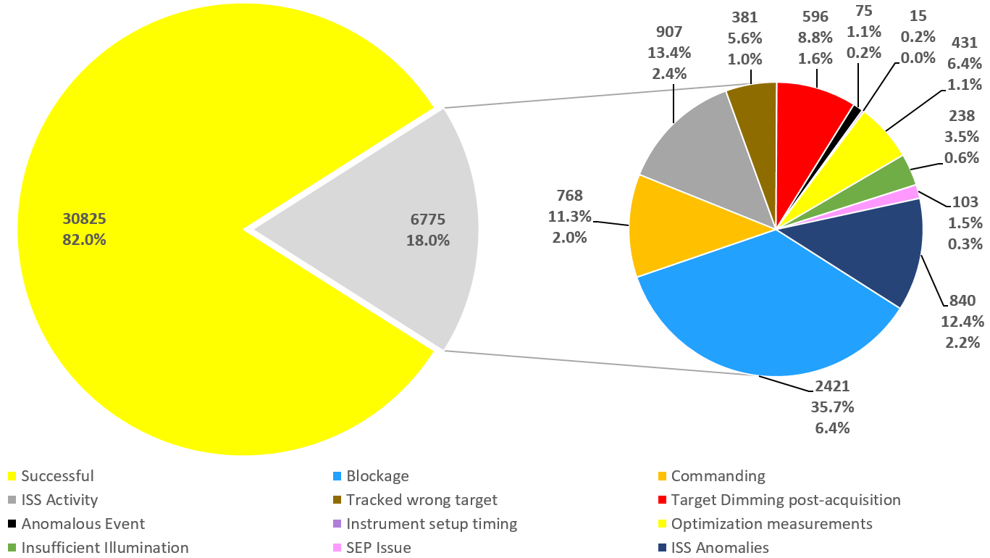
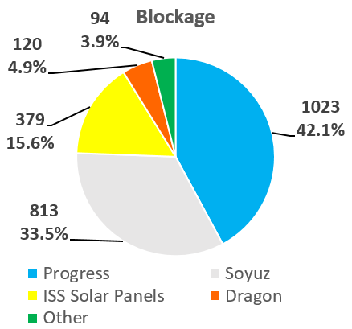
Events (7/1/2017 - 9/30/2020)

Slide 5
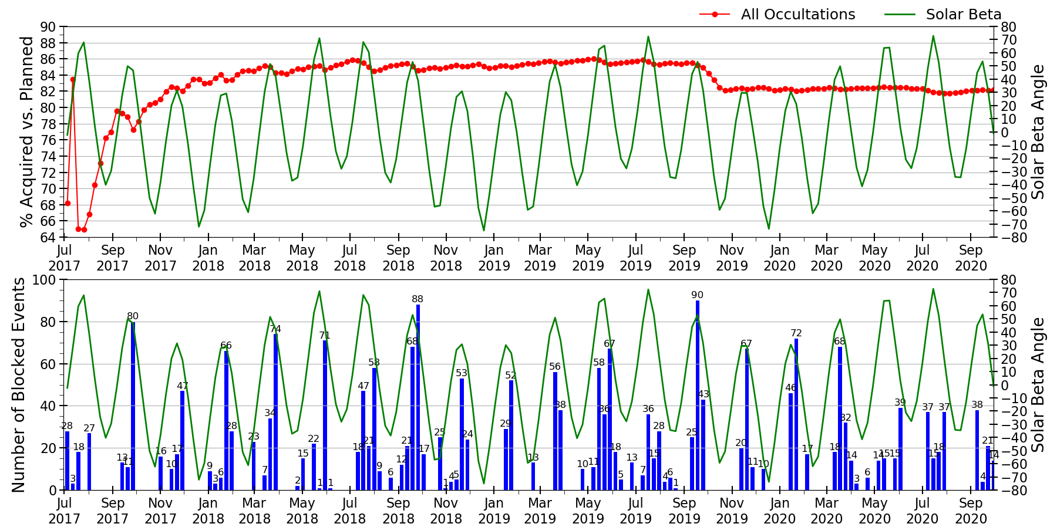
Phase-E – All Occultation
7/1/2017 00:00 to 9/30/2020 09:00

Slide 6
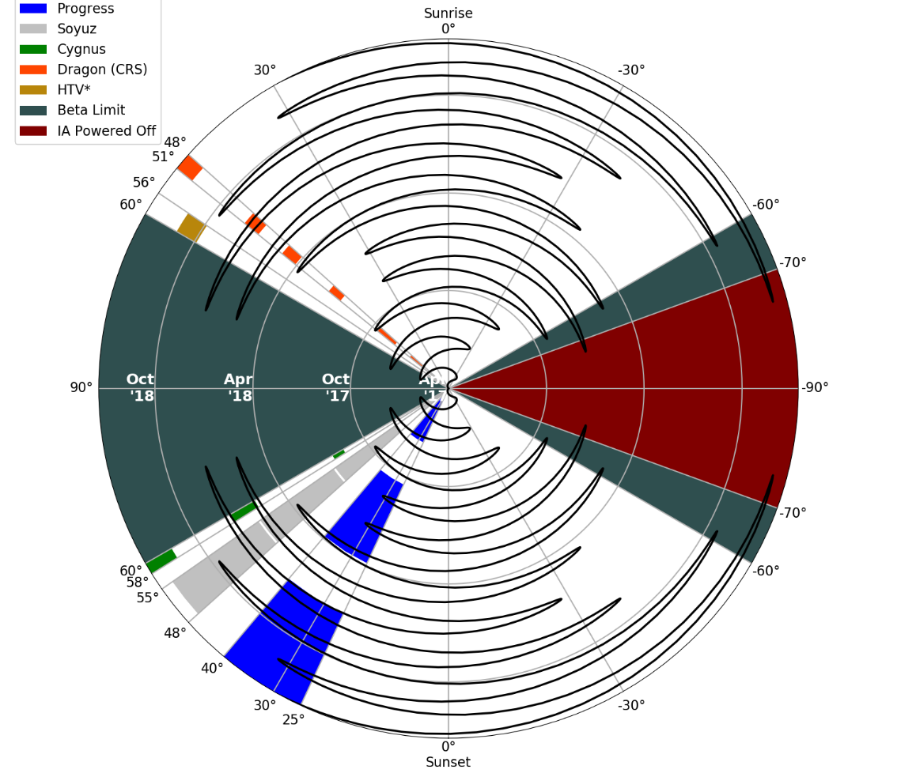
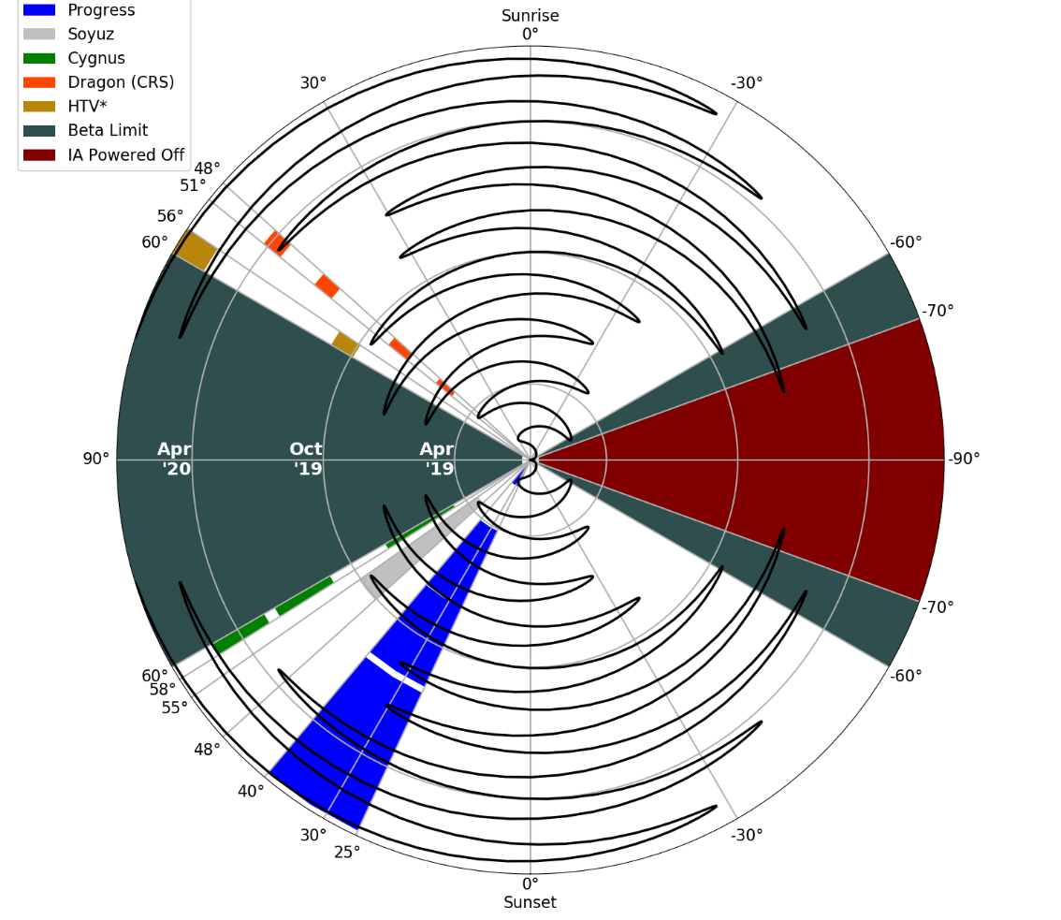
Possible Solar Blockage Compass
*limited data at unusual attitude, blockage range for HTV may change with more data

Slide 7
Down-time Tracking
(Auto SAFE-ing events)
Date | Time UTC | Lat/Lon | Subsystem | # of events lost (Operational Duration hh:mm)
22 Mar 2017 | 06:28 | −50°/84° (Outer Van Allen Belt) | HEU | 30 (15:19)
14 Apr 2017 | 16:07 | −42°/136° (Outer Van Allen Belt) | HEU | 13 (6:21)
27 Apr 2017 | 09:36 | −33°/142° (Over Australia) | IA | 19 (9:49)
1 May 2017 | 18:31 | −27°/−24° (SAA) | HEU | 42 (19:12)
8 May 2017 | 03:51 | −16°/−60° (SAA) | IAM | 33 (16:48)
22 May 2017 | 11:31 | 47°/−94° (Outer Van Allen Belt) | HEU | 3 (5:02)
30 May 2017 | 17:32 | −27°/50° (SAA) | HEU | 35 (21:19)
15 Jul 2017 | 00:09 | −47°/−127° (Outer Van Allen Belt) | IA | 176 (70:01)
16 Aug 2017 | 08:06 | −47°/−47° (SAA) | HEU | 3 (6:22)
28 Dec 2017 | 10:19 | 47°/−44° (Outer Van Allen Belt) | HEU | 13 (5:17)
29 Mar 2018 | 04:45 | −48°/108° (Outer Van Allen Belt) | IAM | 24 (12:17)
17 Sep 2018 | 12:04 | 51.6°/−161° (Outer Van Allen Belt) | IAM | 16 (7:54)
19 Feb 2019 | 20:05 | 35.5/−80.2 (over NA) | IAM | 10 (6:25)
20 Feb 2020 | 07:22 | 48.3°/13.6° (over Europe) | IAM | 35 (16:33)
28 Mar 2020 | 08:44 | -38.5 / -70 (SAA) | HEU | 15 (10:53)

Slide 8
Payload Trending Status Summary
The payload continues to operate as expected without notable degradation
  CCD performance is expected to continue to exceed requirements and easily meet needs of an extended mission (stable temperature, no significant trend in signal-to-noise ratio, small increase in dark noise)
  Contaminant species that collect on the window spontaneously desorb, allowing for continued science acquisition
  Hexapod is meeting pointing error requirements, with average pointing errors well within specification
  No areas of concern identified for the IAM, CMP, or DMP performance
  SA and Hexapod mechanisms show no sign of degradation
Some typical aging has been observed but does not present a barrier to extended ops
  Slight temperature increases for subsystems with silver Teflon surfaces
    ICE boards are expected to reach yellow limits first, projected to occur in ~2023 based on current rate of change
    Mitigation strategies such as reducing limb event durations in selected solar beta angle range and/or increasing yellow limits will be implemented as needed
  Slight upward trend in Hexapod 12V service current
    Small increase over the duration of the mission, trend is relatively constant, and values are well below limits
    Could indicate aging in DC/DC converter but does not signify a near-term problem
  Slight downward trend in Channel 9 response values
    Small decrease over the duration of the mission, trends is relatively constant, no impact to science quality
    Could indicate aging of diode but does not signify a near-term problem

Slide 9
Challenges Faced Since October 2019

Slide 10
ISS Pitch Affecting
Hexapod Pointing

Slide 11
Hexapod
The 7° wedge that the hexapod currently sits on was to counter act the installation of the MLM on the ISS payload. When the ISS pitches forward over 0.5° the Hexapod pointing capabilities are outside of range and the Instrument Assembly is unable to fully point nadir for events
From 5/25/2020 to 8/18/2020 the ISS pitch was outside the pointing capabilities of the SAGE III payload

Slide 12
ISS Pitch (HTV-9, Dragon 2) Events
Event Type8 | Total
 | Events with HEU error | Events failed due to HEU error
Sunrise | 588 | 155
Sunset | 652 | 34
Moonrise | 143 | 131
Moonset | 71 | 60
Total | 1454 | 380
SAGE III/ISS lost ~26% of occultation events because the Hexapod was unable to prepoint

Slide 13
Expected Pitch
Date | Vehicle | Pitch
Prior to 5/25/2020 | Nominal Payload config | +358.7
5/25/2020 | HTV Install | +0.5
5/31/2020 | Dragon Install | +1.0
7/8/2020 | 74 P Undocking | +2.3
7/23/2020 | 76 P Docking | +1.0
8/2/2020 | Dragon Undocking | +0.5
8/18/2020 | HTV Release | +355.0
10/03/2020 | Cygnus 14 Install | +358.6
10/14/2020 | 63S Docking | +358.0
10/21/2020 | 62S Undocking | +356.7

Slide 14
Mitigation Efforts
Modifying the Dynamic Error Quaternion within the Instrument Assembly (IA) to allow for the Hexapod to prepoint.
Actively working on a large code modification to the Interface Adapter Module (IAM) that would point the hexapod as close to nadir and then use additional pointing capabilities within the IA to acquire the events
Russia’s Nauka ISS module (MLM module) is at Baikonur. Launch and installation is still scheduled for April 2021. This will eliminate our pointing errors but will increase our blockage possibilities.

Slide 15
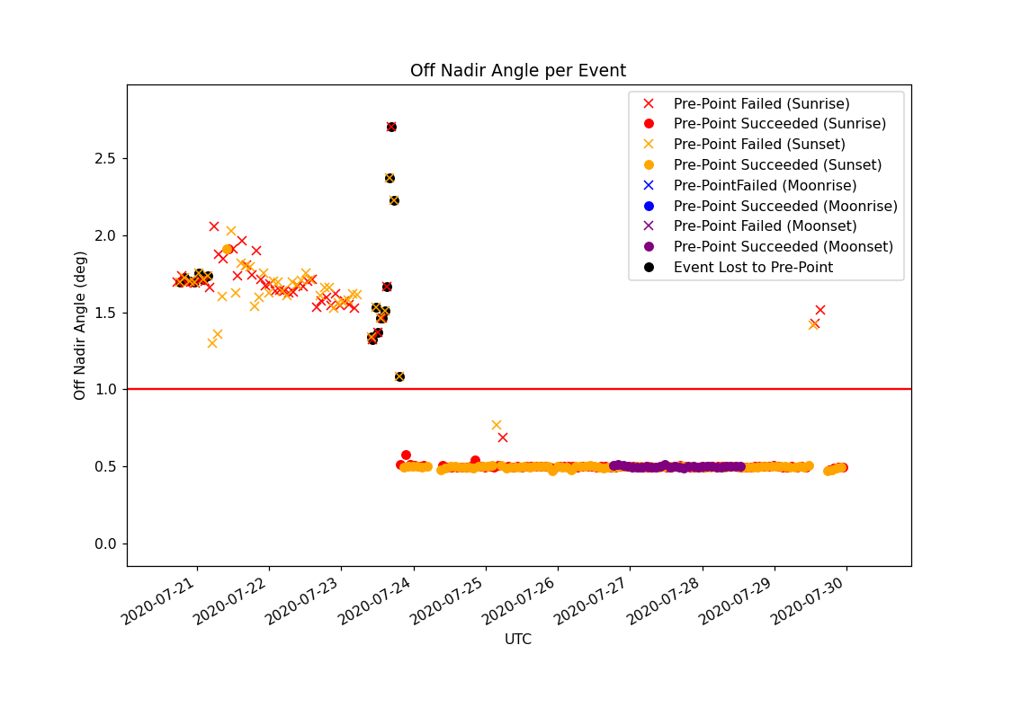
Off Nadir Angle per Event 7/20 to 7/29

Slide 16
Commanding During Covid

Slide 17
Teleworking Outline
Two teams will alternate on console for commanding and building the weekly load
Mission Operations team has minimized time on NASA base
  Limited downlinking data to twice a week if needed (Note: SAGE III has no missing data during this teleworking period)
  Demonstrated that 8 weeks of occultation commands can be loaded to the payload without any impact to science quality
  Time-tags to disable/enable SEM for all events on the ATL have will be used instead of transitioning the payload to Safe mode. This will minimize on console time while still maintaining the health of the payload
  With agreement from the Project Scientist, SAGE III temporarily stopped taking limb events, we are currently working on generating two weeks worth of limbs per load and will continue taking limbs within the next month.

