Slide 1
Instrument Assembly
Samuel Porter

Slide 2
Instrument Assembly
IA is healthy.
  No problems with Azimuth and Elevation motors.
  No significant degradation of the CCD.
  Contamination door closed for 6 months during lockdown.
Minor anomalies with IA.
  IA resetting with LIMB termination.
  Elevation motor temperature spike.
Currently working on updating the Instrument Control Software (ICS).
  Smart scanning to re-acquire target if lost.
  Fix integration time reset bug during CCD characterization events.
  Fix IA reset bug when terminating events with STOW command.

Slide 3
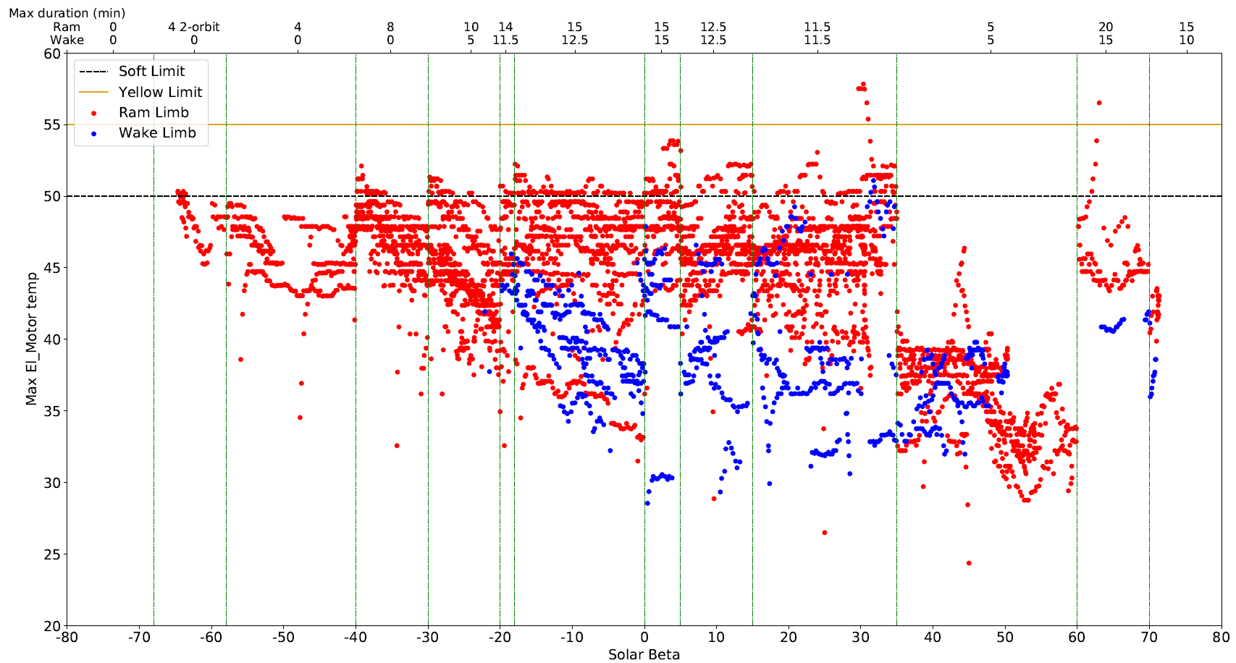
LIMB Events Elevation Motor Temperature

Slide 4
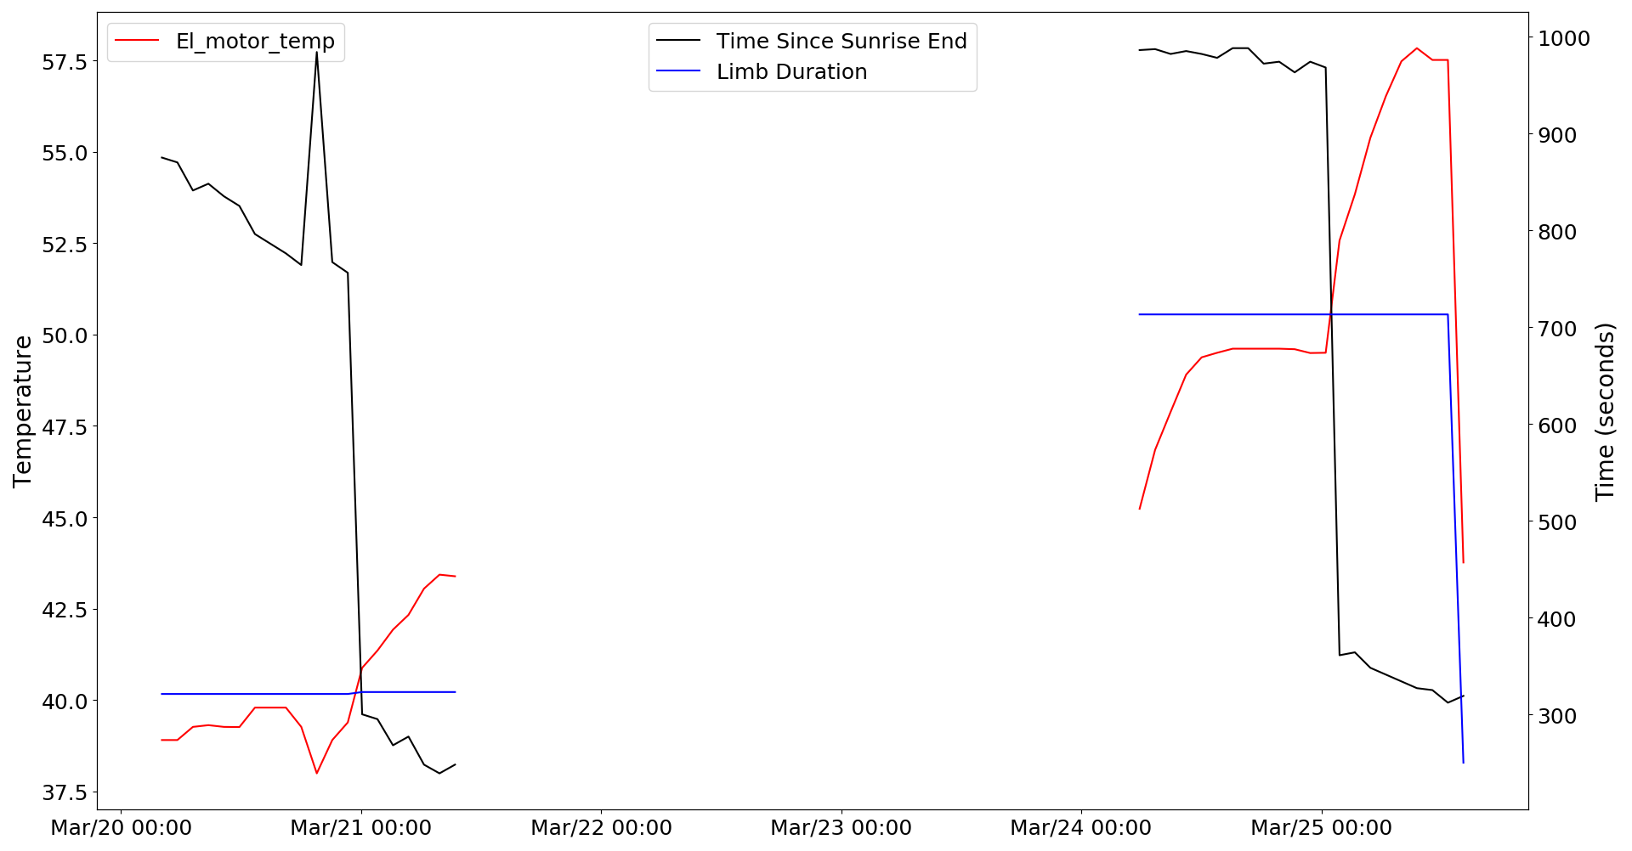
March 2020 Elevation Motor Temperature Anomaly
Spike in temperature cause by decrease in time between Sunrise and LIMB events.

Slide 5
SAGE-III CCD Performance

Slide 6
SAGE-III CCD
Custom CCD with 8 segments which can be commanded individually to use different integration times as necessary.
CCD temperature is controlled with a thermal electric cooler (TEC) to reduce thermal agitation which decreases ambient charge or dark current.
  TEC nominally set to 12.5°C.
A photodiode is attached to measure 1544nm ± 30nm wavelengths (channel-9).

Slide 7
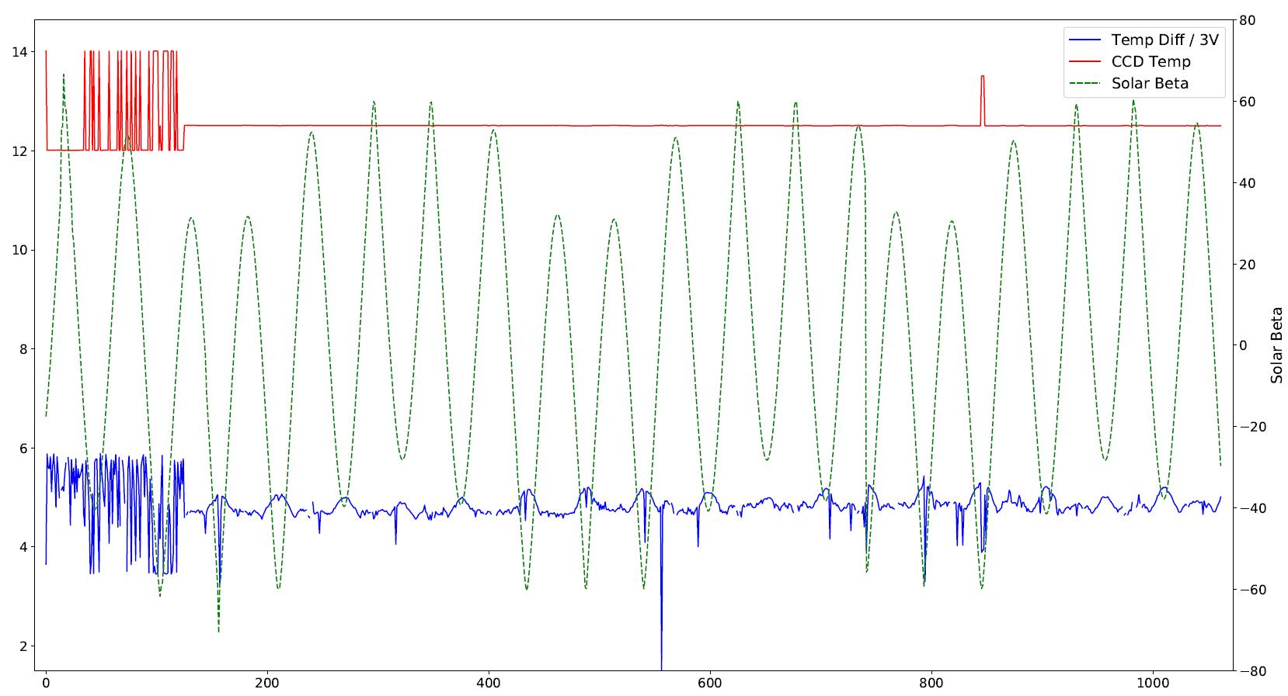
TEC Efficiency
CCD Temp stabilized Nov. 2017

Slide 8
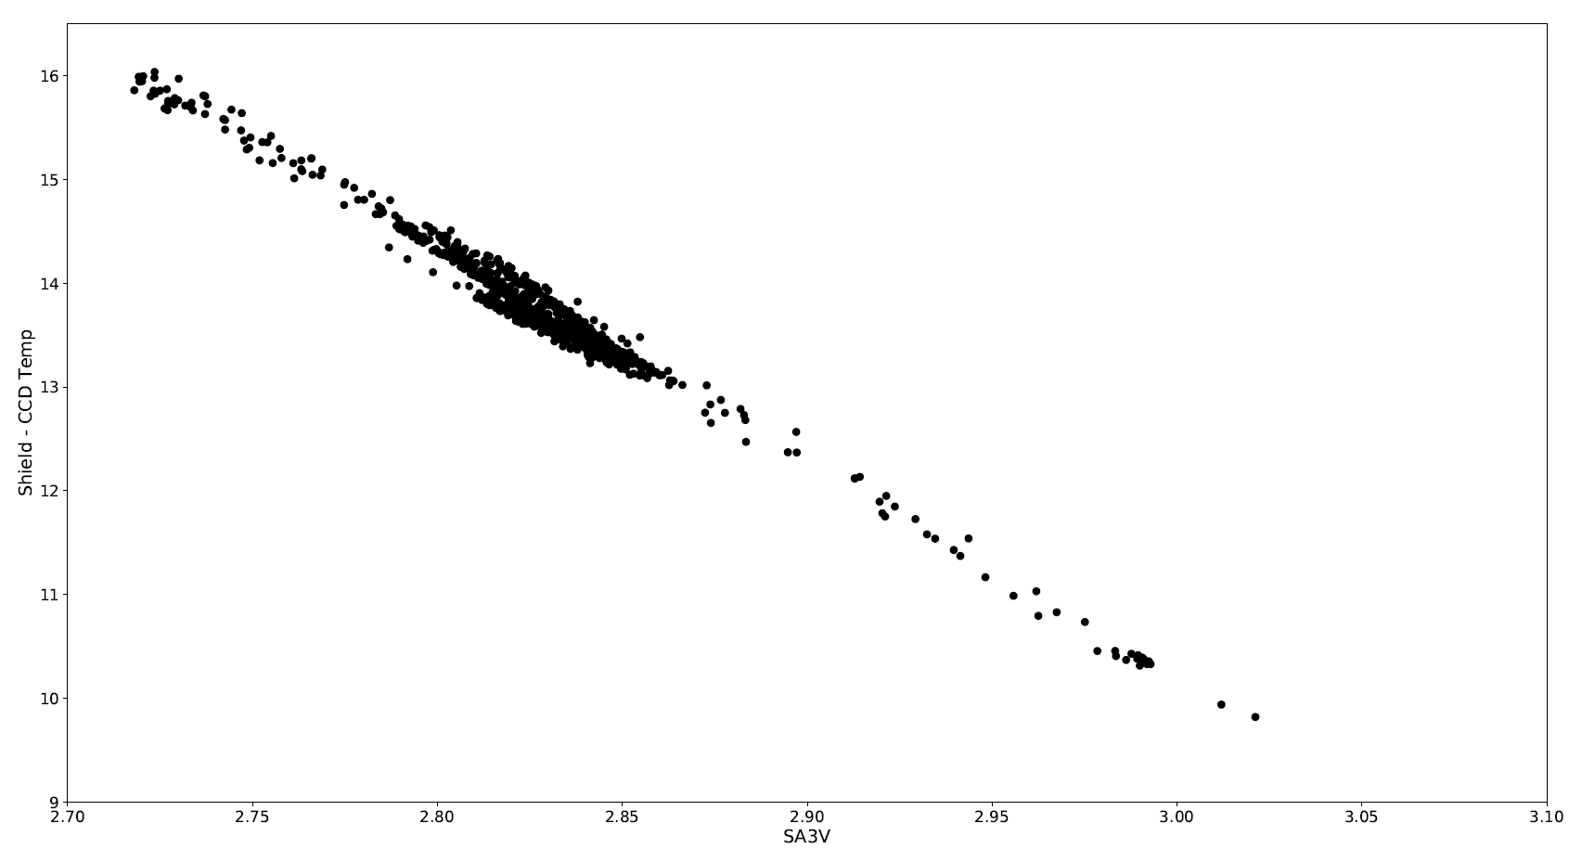
TEC Efficiency

Slide 9
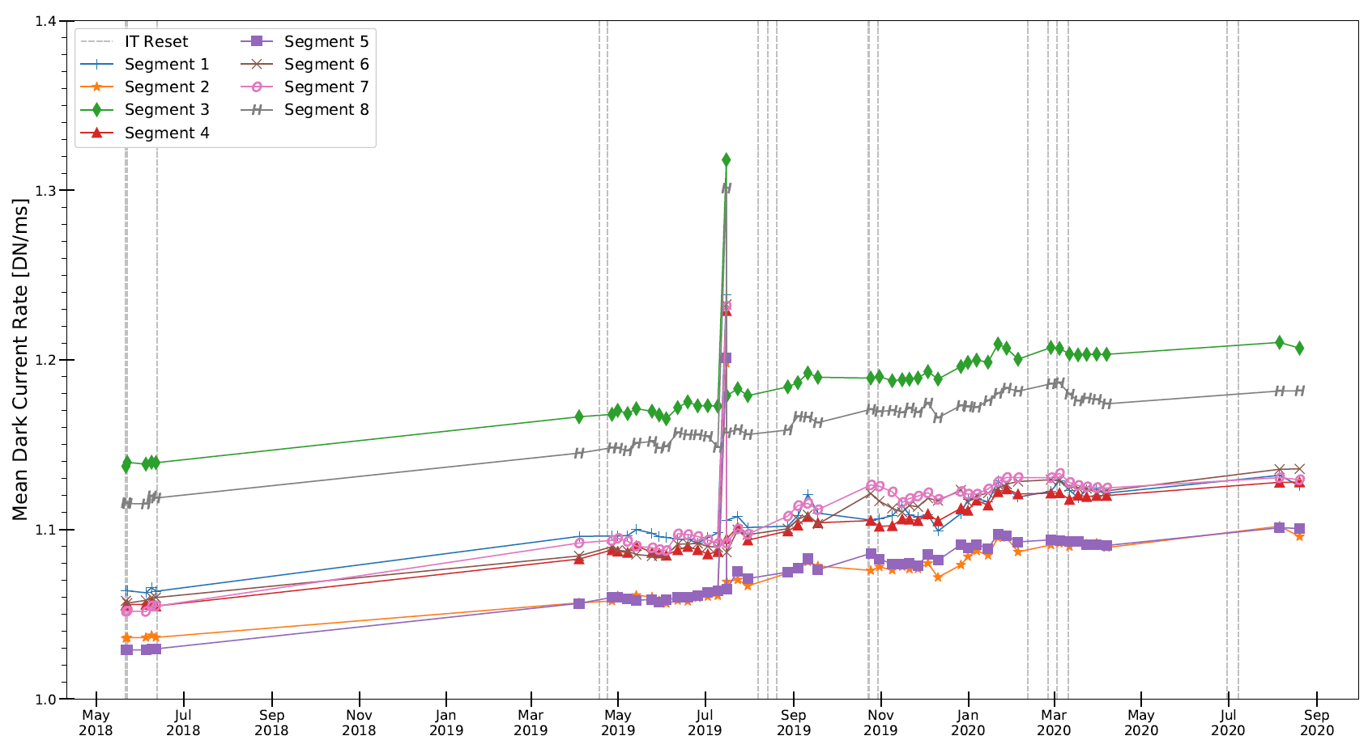
Dark Current
TEC set to 13.5°C

Slide 10
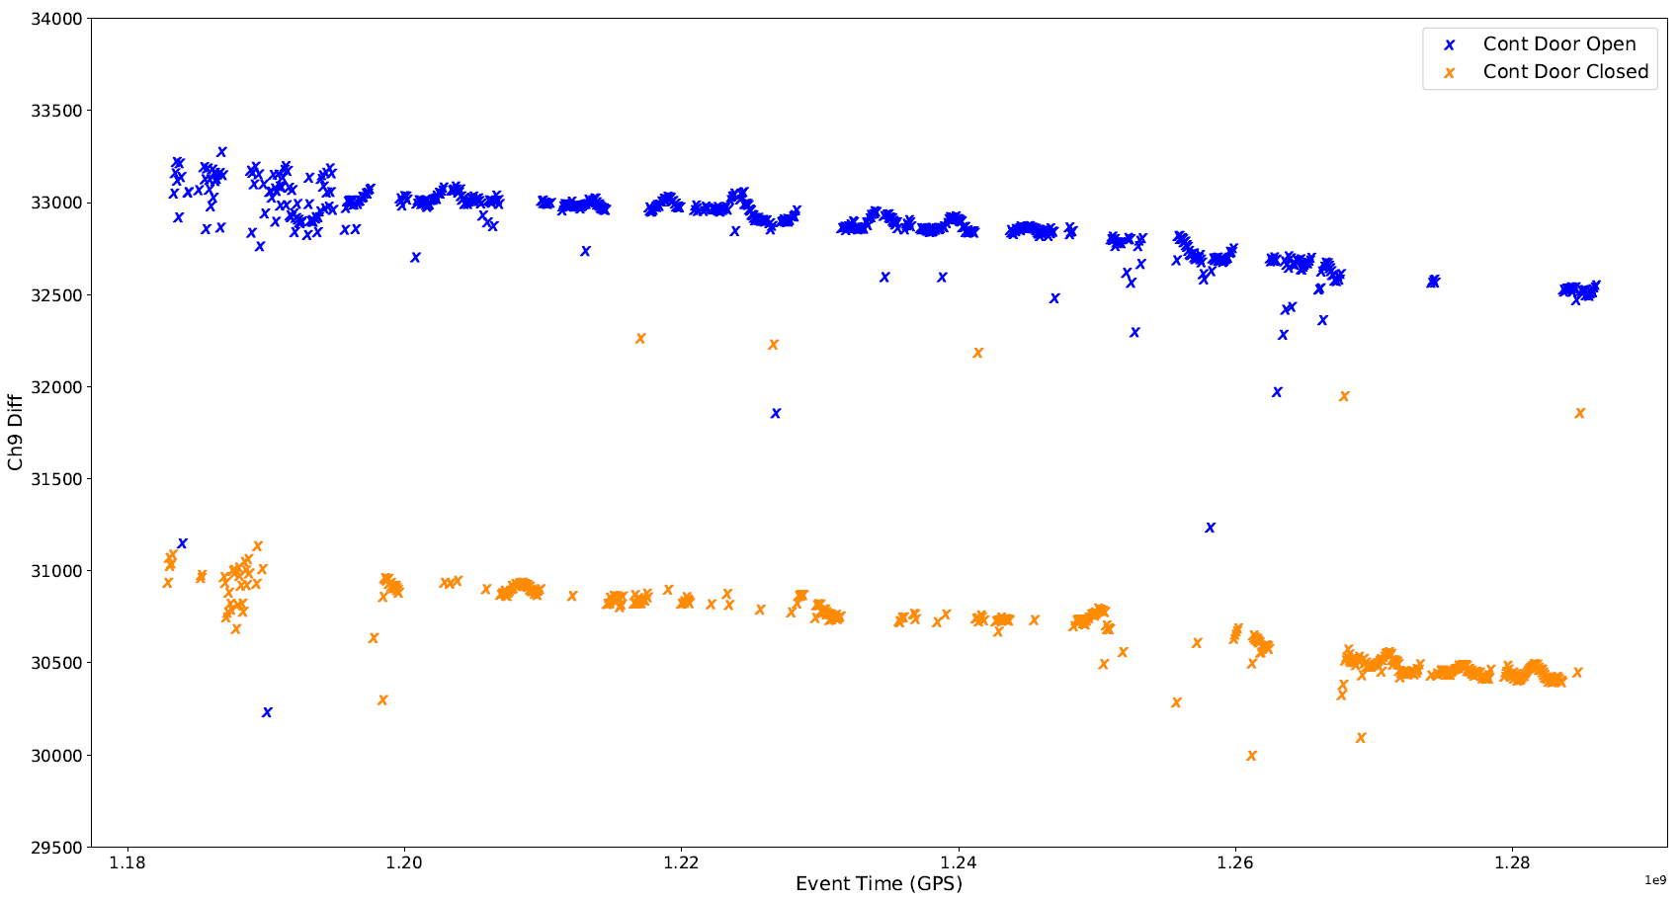
Channel-9 Response
Channel-9 response values are corrected to remove background.
Response values have decreased approximately 500 counts (1.43%) over 3 years.
Contamination door closed
during lockdown

Slide 11
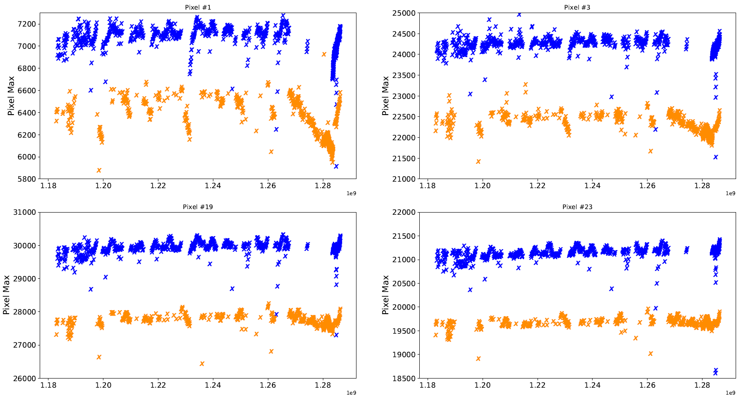
Blue Pixel Response

Slide 12
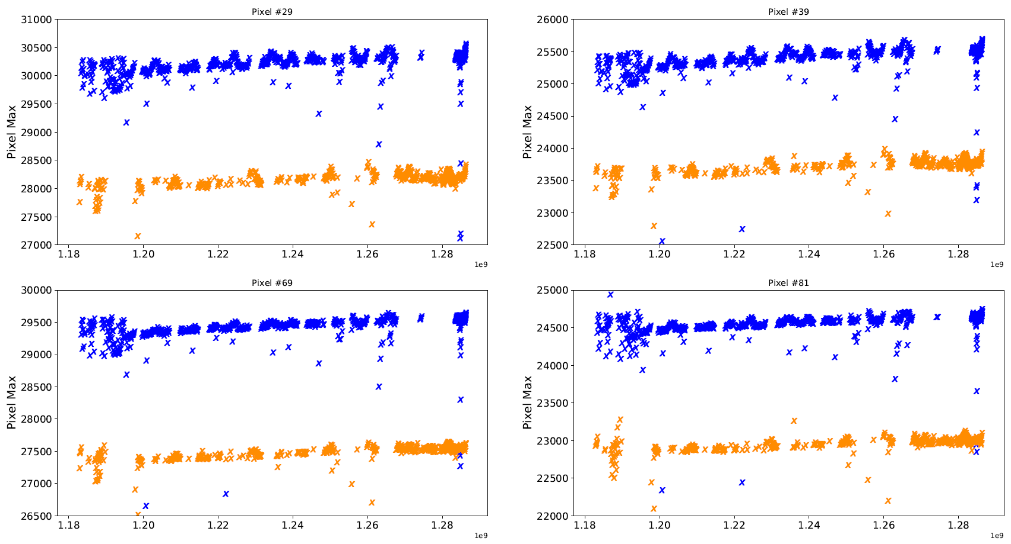
Red Pixel Response

Slide 13
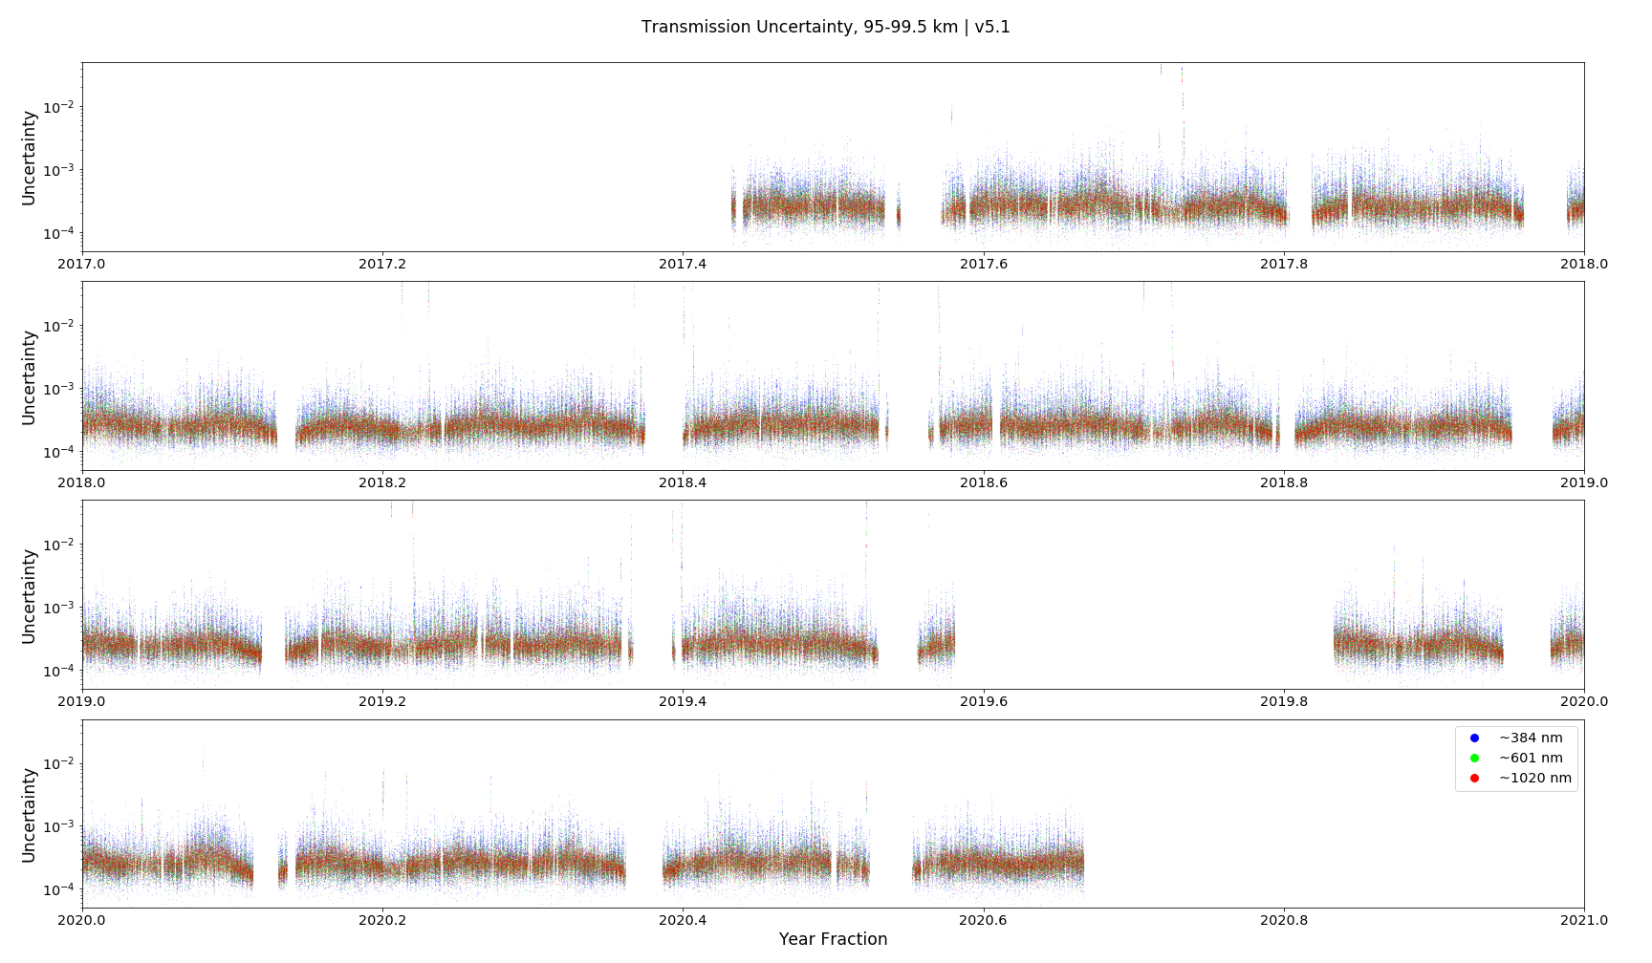
Transmission Uncertainty

Slide 14
Contamination Door Trending
Tyler Dawson

Slide 15
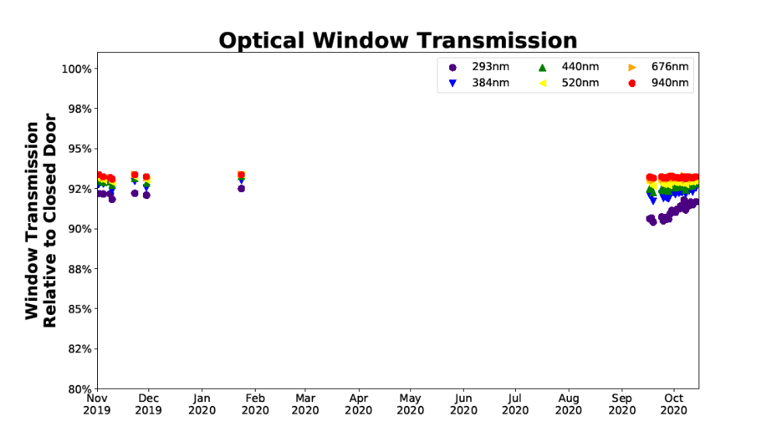
Window Trending

Slide 16
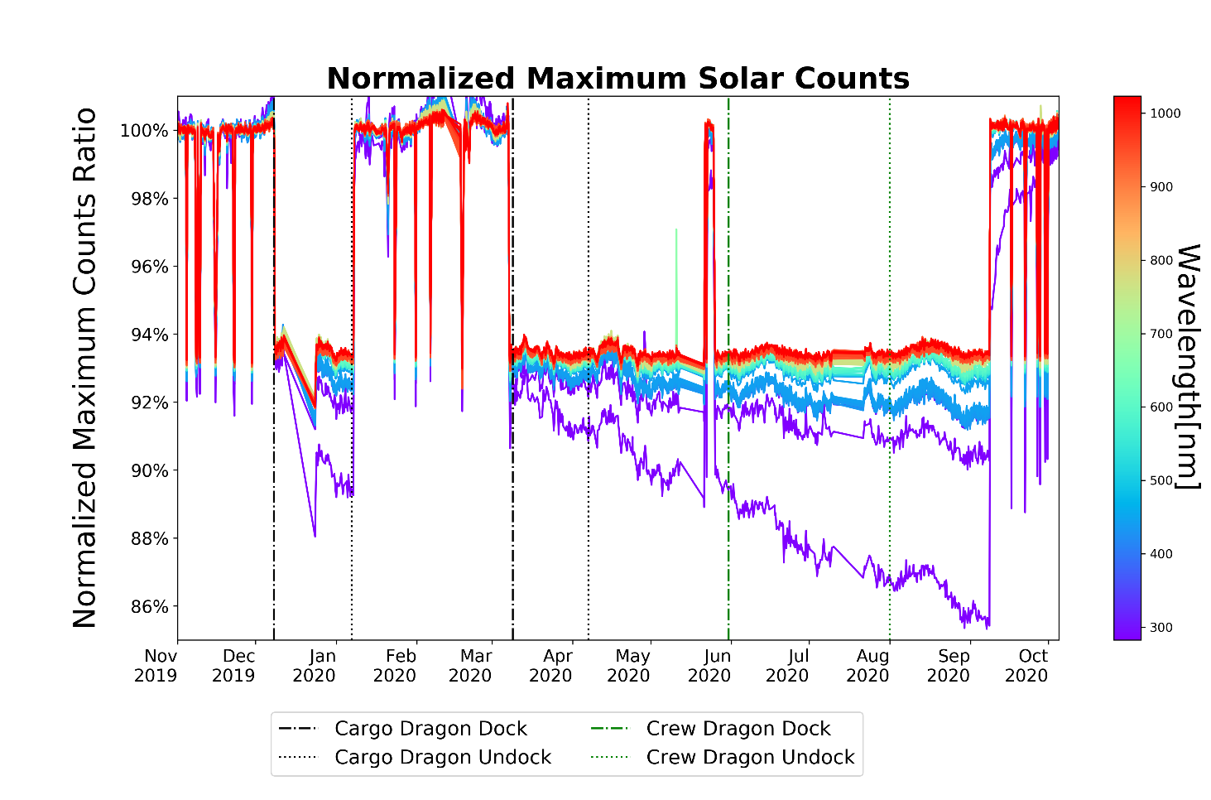
Maximum Solar Counts
*Normalized to
Nov. 23-28, 2019

Slide 17
Contamination Monitoring Package

Slide 18
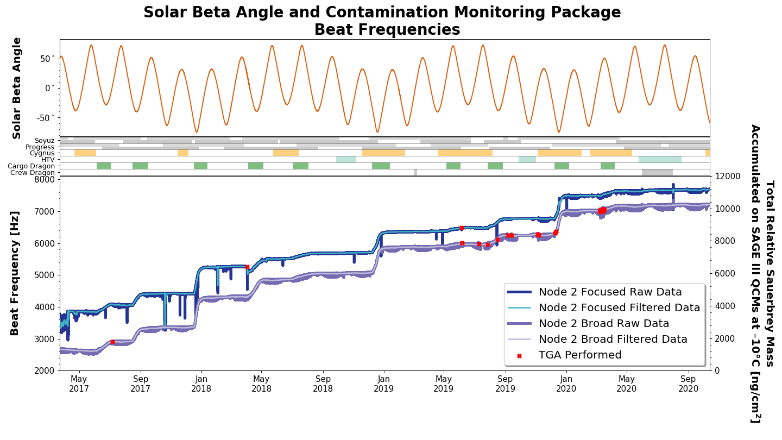
Node 2 and Node 2 Focused Beat Frequencies

Slide 19
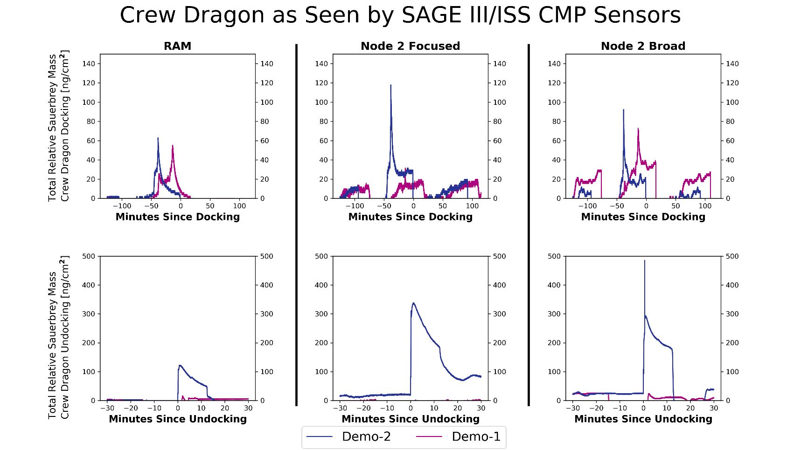
Crew Dragon Docking/Undocking

Slide 20
Thruster Fire Chemistry
Thruster Fire
  Hypergolic Propellant
    A mixture of monomethyl hydrazine and nitrogen tetroxide.
    The water should be vapor phase given the atmospheric pressure, but with enough of it firing it could be in the process of evaporating/sublimating on the way over.
Reaction for the propellant
  H2NN(CH3)2 + 2*N2O4 -> 2*CO2 + 3*N2 + 4*H2O
    Molar Mass of CO2: 44.01 g/mol X 2 molecules
    Molar Mass of N2: 28.0134 g/mol X 3 molecules
    Molar Mass of H2O: 18.01528 g/mol X 4 molecules
    Ratio of 2*CO2 & 3*N2 to 4*H2O = (88.02 + 84.0402) :: 72.06112 = 2.3877 :: 1
    That’s 29.5% by mass.

Slide 21
Thruster Fire Chemistry Cont.
Undocking reaction only lasted 15 minutes total
  Makes sense with AO
First large spike on the sensors corresponds exactly to the time of Departure Burn 0
  In video it is called out at 23:35
  Lasts about 12 seconds

Slide 22
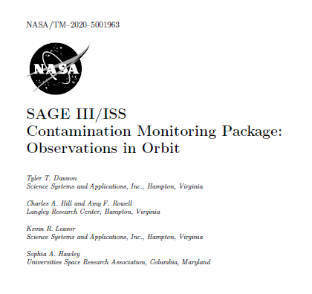
CMP White Paper Published!
SAGE III/ISS Contamination Monitoring Package: Observations in Orbit – TM 20205001963

Slide 23
