Slide 1
Expected changes in version 5.2
Robbie Manion,
Rob Damadeo, Dave Huber, Dave Flittner

Slide 2
Overview
v5.1 Recap
Minor Changes
Completed Changes
Changes in Development

Slide 3
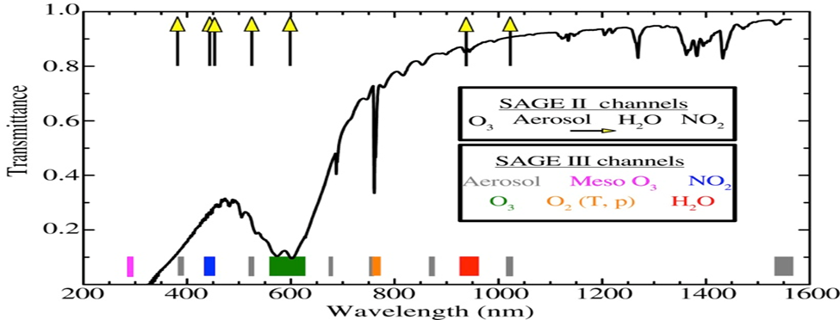
v5.1 Recap: Spectral Coverage
Si CCD (~280-1035nm)
Photodiode (1542±15nm)
O3, NO2, H2O, aerosol, T/p
Solar:
  87 “pixel groups”
  12 spectral “channels”
CCD is reprogrammed for lunar and limb

Slide 4
v5.1 Recap: Current Products
Solar
  Ozone
    MLR – Channels 3 & 5 to solve for O3 & NO2, aerosol has assumed shape in channels
    AO3 – Channels 3, 4, 5, 6, 7, 9, & 11 to solve for O3 and aerosol simultaneously
    Mes – Channel 1 to solve for O3 only, affected by spectral stray light (reentrance spectra)
  NO2 – comes from MLR retrieval (Channel 3)
  Aerosol – 9 wavelengths derived as residuals using MLR products
  H2O – Channel 10 (~940nm) to solve for H2O, O3, and aerosol independently
Lunar
  Ozone and NO3 – very similar to Meteor algorithm
Limb
  No released L1 or L2 products yet

Slide 5
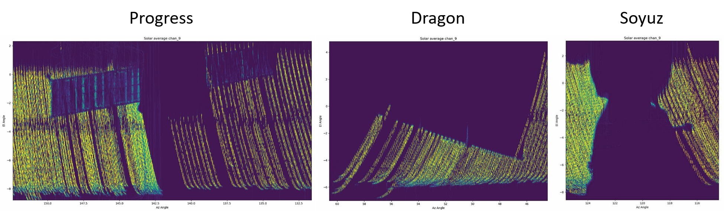
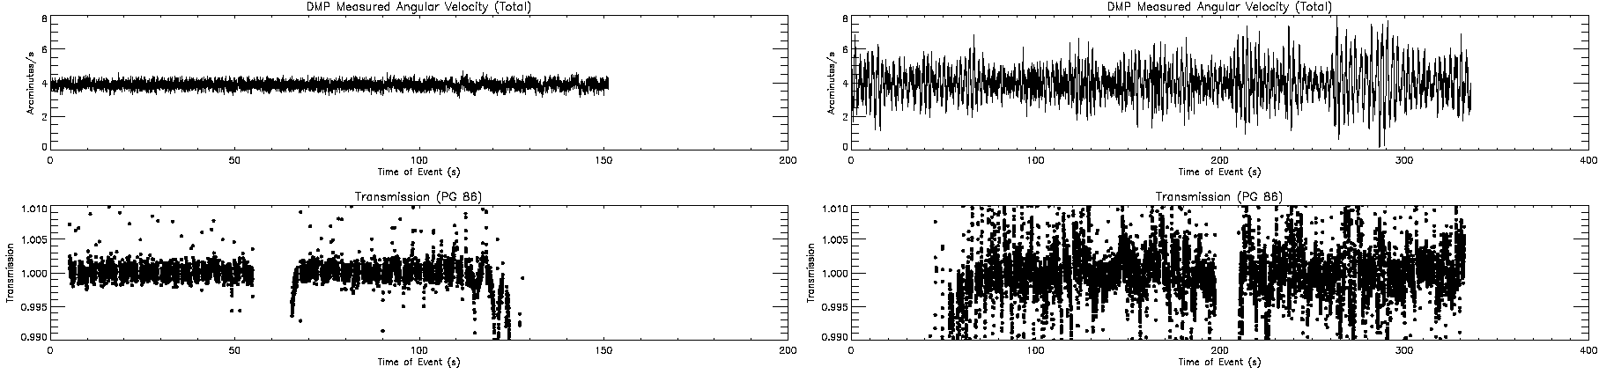
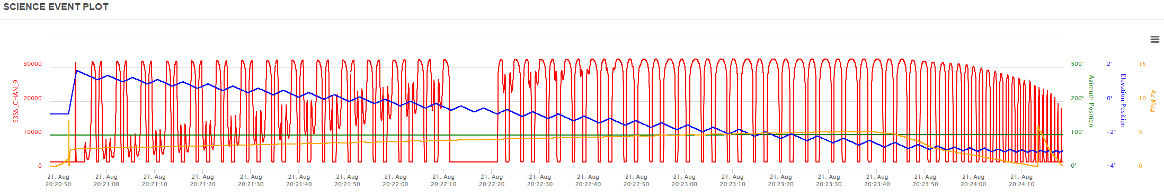
v5.1 Recap: Observational Anomalies
Visiting vehicles
  Contamination door closed
Solar Eclipse
Blockages
Disturbances

Slide 6
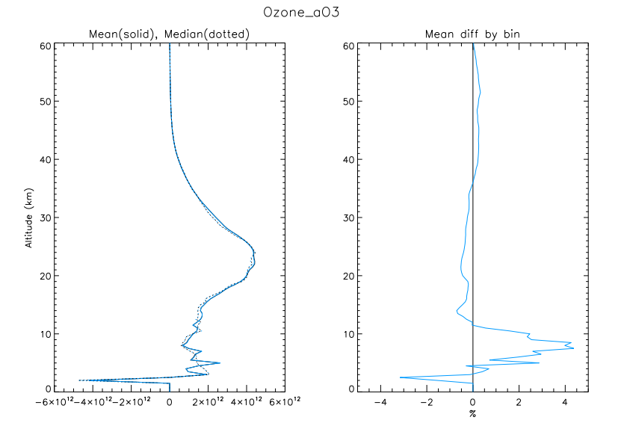
Minor Changes
Environment Migration
  Keeping up with NASA IT security
  Removing pay-to-use math libraries and compilers
Fixed some ephemeris and timing problems
  Sometimes causes algorithm to crash and events to drop
Fixed a bug in NO2 clearing
  NO2 contribution to LOS OD wasn’t removed from altitudes below NO2 profile
Slight adjustments to methodology for computation of effective absorption cross-sections
  Temperature, wavelength interpolation

Slide 7
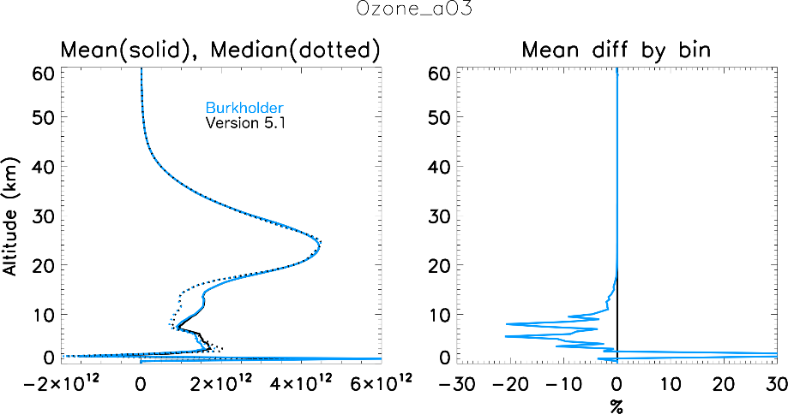
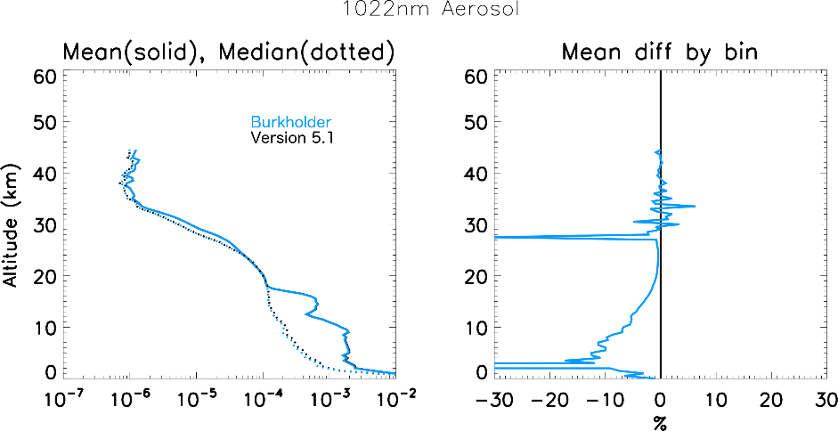
O4 Spectroscopy
v5.1 uses improper O4 spectroscopic model
O4 contributions are removed from Chappuis (and 1um) prior to species retrievals
Improper clearing resulted in systematically large O3 in troposphere and lowermost stratosphere (aerosol)

Slide 8
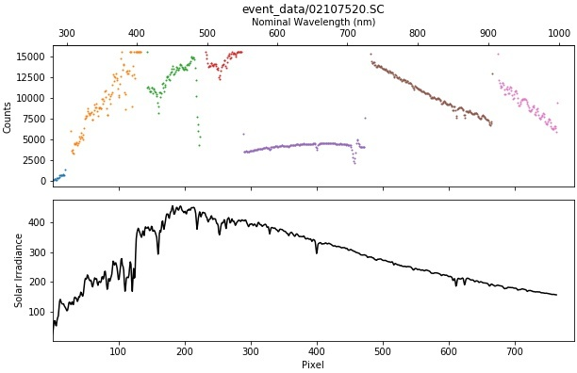
Wavelength Calibration Review
Pixel-wavelength relationship reviewed for the 809-pixel CCD
Improved upon similar work done for v5.1
  More complete consideration of atmospheric absorption in oxygen A-band (~760 nm) and water vapor band (~945 nm) to improve calibration in the longer wavelengths

Slide 9
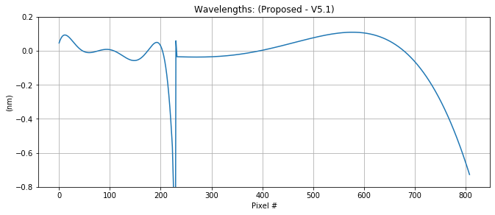
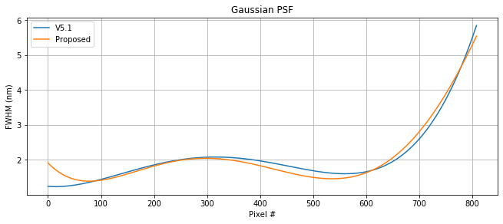
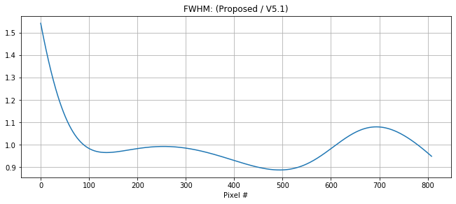
Wavelength Calibration Review
Nominal center wavelengths were little changed
  No solar spectral features or atmospheric absorbers to aid calibration ~1020nm, so red-end wavelengths are extrapolated
Full width at half-max of assumed gaussian point-spread function calibrated
H₂O
NO₂

Slide 10
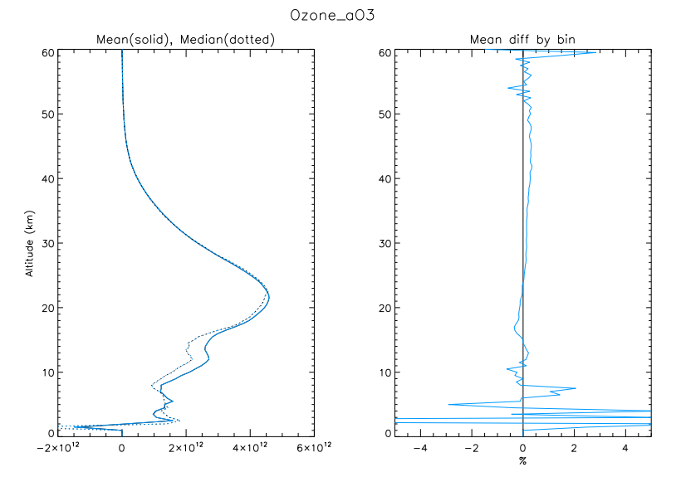
Inversion Adjustment
Inversion is simple global fit using Beer’s Law
  LOS Optical Depth =
  Path-Length Matrix * Extinction
  Mathematically assumes extinction is uniform in layer (i.e., entire contribution to OD in shell layer comes from extinction in the middle of the layer)
Reworked the math to assume linear gradient in extinction
Primary contribution to OD comes from bottom of tangent layer (~2/3) at tangent height but weighting shifts in higher shells

Slide 11
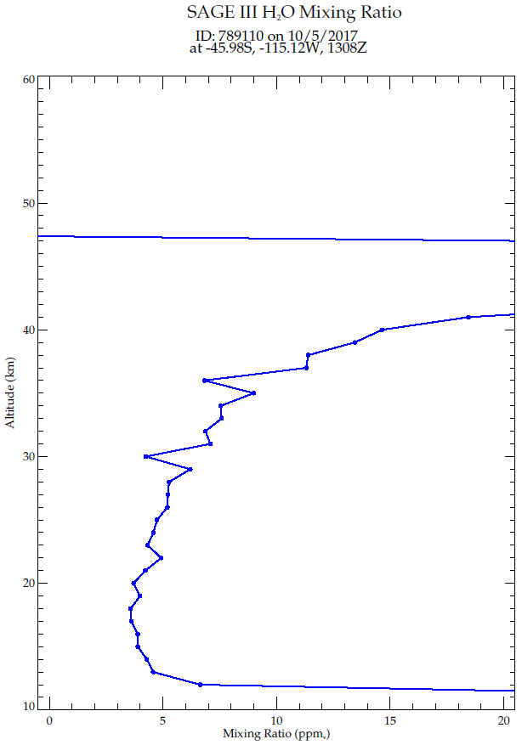
H2O Retrieval
Algorithm very similar to Meteor (CGA + LM fitting + onion peeling)
Bug in CGA routine resulted in frequent and persistent negative mixing ratios that crashed the retrieval or caused excessive number of “keel-over” profiles
  These have been mostly eliminated through a change to the H2O concentration initial guess and including negative mass paths in the lookup table for CGA

Slide 12
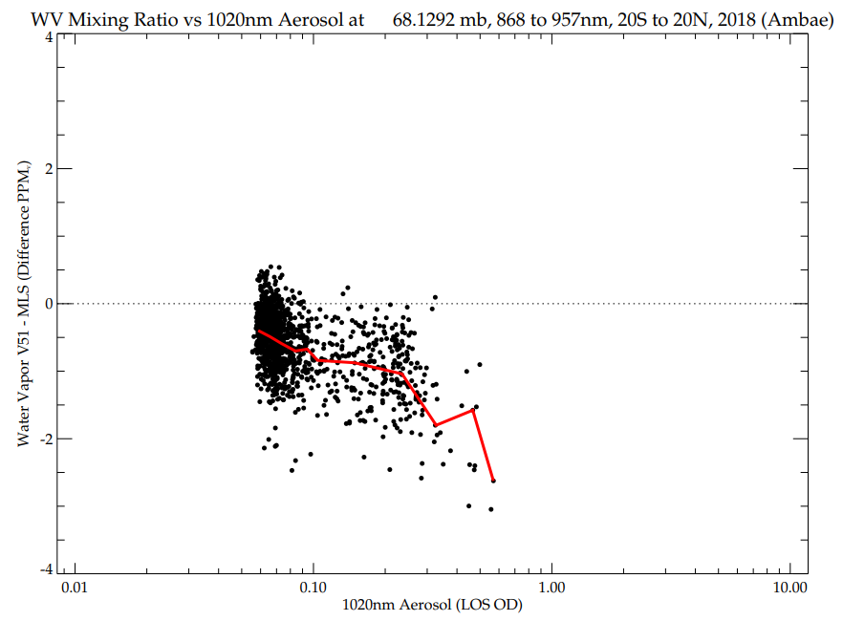
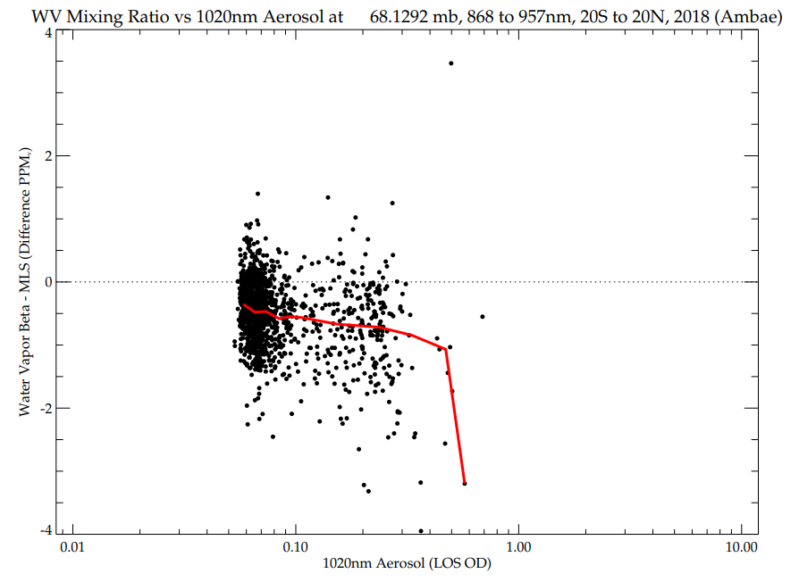
H2O Retrieval
v5.1 tends to produce lower H2O in presence of elevated aerosol.

Slide 13
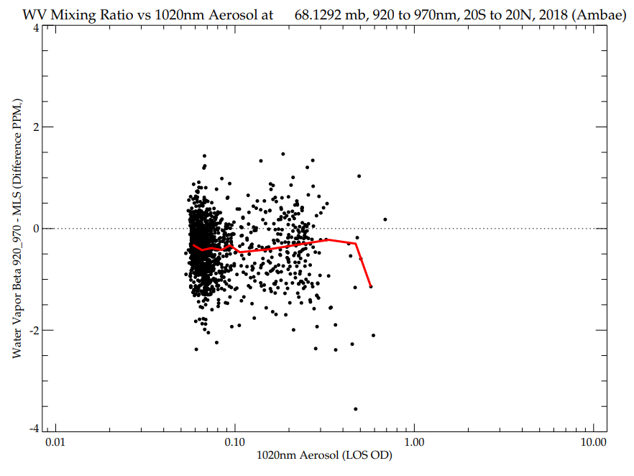
H2O Retrieval
Indexing bug in v5.1 included 868nm channel in water vapor retrieval. Channel selection will be corrected for v5.2.

Slide 14
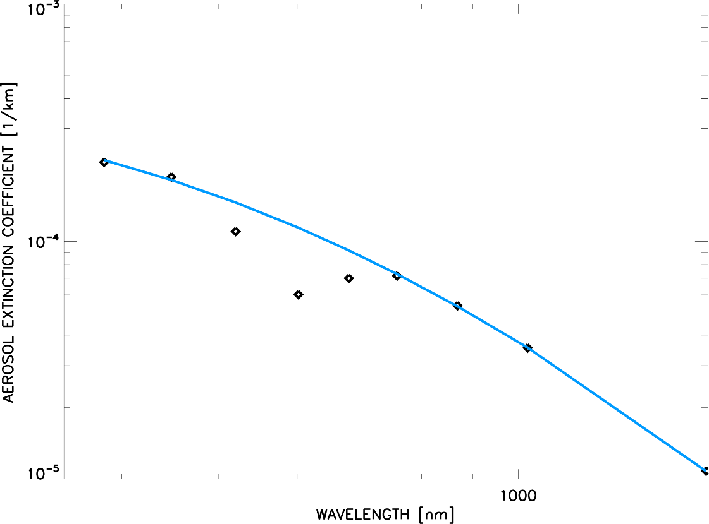
Aerosol Spectrum
Aerosol spectrum k_{ext}(λ) should be smoothly varying
“Dip” near Chappuis that scales with O3 cross-sections
Fit k_{ext}(λ) with 2nd order polynomial in log-log space using other aerosol channels and compute residuals
Residual

Slide 15
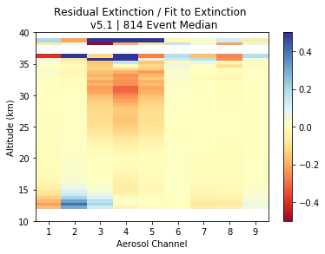
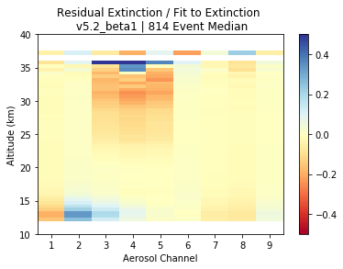
Aerosol Spectrum cont.
“Dip” in stratosphere scales with O3 spectroscopy and profile
Improvement at low altitudes results from O4 change
Change to temperature interpolation for effective absorption cross-sections is main contributor to improvement in stratosphere
Also considering “AO3” aerosol solution as an alternative

Slide 16
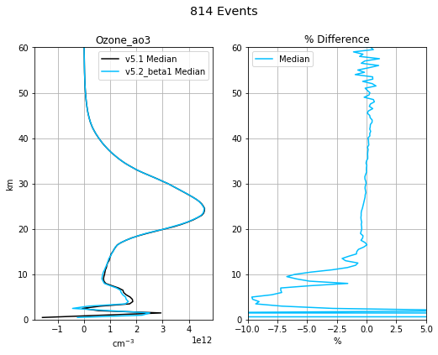
Quantitative Changes: Ozone
Slight increase above concentration peak
Decrease below the peak
Affected by:
  Extinction linear gradient (path length)
  Absorption cross section changes
  Updated O4 (low altitudes)
  NO2 Clearing (low altitudes)

Slide 17
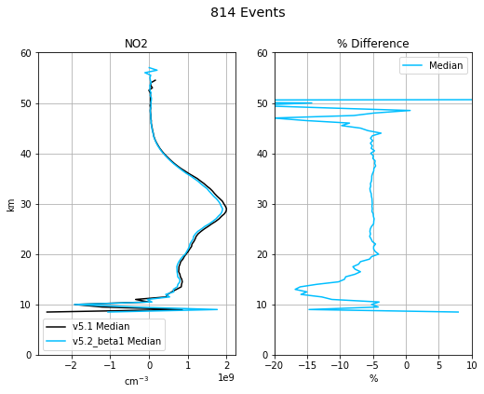
Quantitative Changes: NO2
Consistent decrease ~5% throughout profile
Affected by:
  Absorption cross section changes – primarily update to width of point-spread function
  Updated O4 (low altitudes)
  Extinction linear gradient (path length)

Slide 18
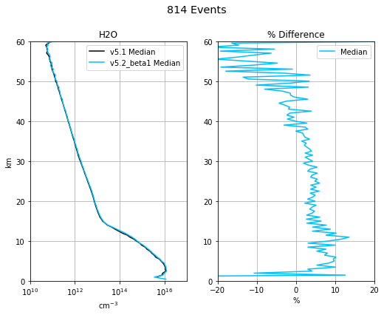
Quantitative Changes: Water Vapor
Generally increased below 40 km
Affected by:
  Absorption cross section changes – primarily update to width of point-spread function
Biggest improvement is recovery of “keel over” events.

Slide 19
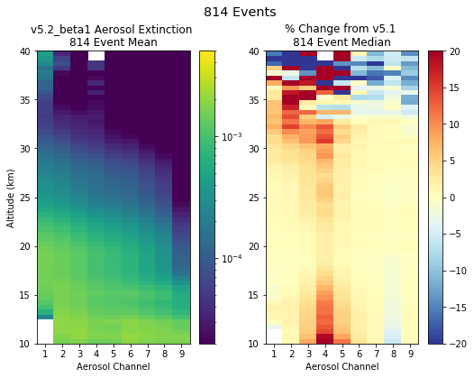
Quantitative Changes: Aerosol
Increases in the channels 3-5 (521-676 nm)
  “Seagull” still present though…
Affected by:
  Indirect effects from cross section changes for NO2 and O3, particularly those related to temperature interpolation change
  O4 cross section changes (low altitudes)

Slide 20
Algorithm “Future Work”
Continue to improve water vapor retrieval
  Fine tune aerosol clearing, coadding channels for better SNR
Mesospheric ozone product
DOAS-style retrieval?
Using physical disturbance monitoring to aid data filtering / altitude registration

Slide 21
Improved QA
Quality assurance process continues from SAGE III/M3M
Exclude blatantly broken events (e.g., missing data, obstruction)
Exclude blatantly broken H2O profiles (i.e., retrieval failures)
Problems:
  Subjective process – we don’t always agree about what looks “broken”
  Prone to human error – sometimes we miss some (particularly H2O)
Working on automating the process
  Requires strict criteria for “brokenness”
  Repeatable and documentable
  No need to stare at tens of thousands of profiles for next version release

Slide 22
New File Format
Current file formats are holdovers from SAGE III/M3M
  We don’t like them all that much either
Data binning:
  Single event files (kernel the algorithm runs on) with useful naming convention
  Monthly files for ease of distribution and use (NetCDF)
Will try to include additional useful information within the data files
  Still working on existing flags as well as new ones
  We’re open to suggestions by the community

Slide 23

Timeline
Goal is an improved dataset available for use in the 2022 International Ozone Assessment
Will work with the Science Team to assess the dataset before public release
Public release targeted for late 2020 / early 2021
robert.manion@nasa.gov

