Slide 1
SAGE III/ISS Communications and
Public Outreach
Allison McMahon
October 19, 2020

Slide 2
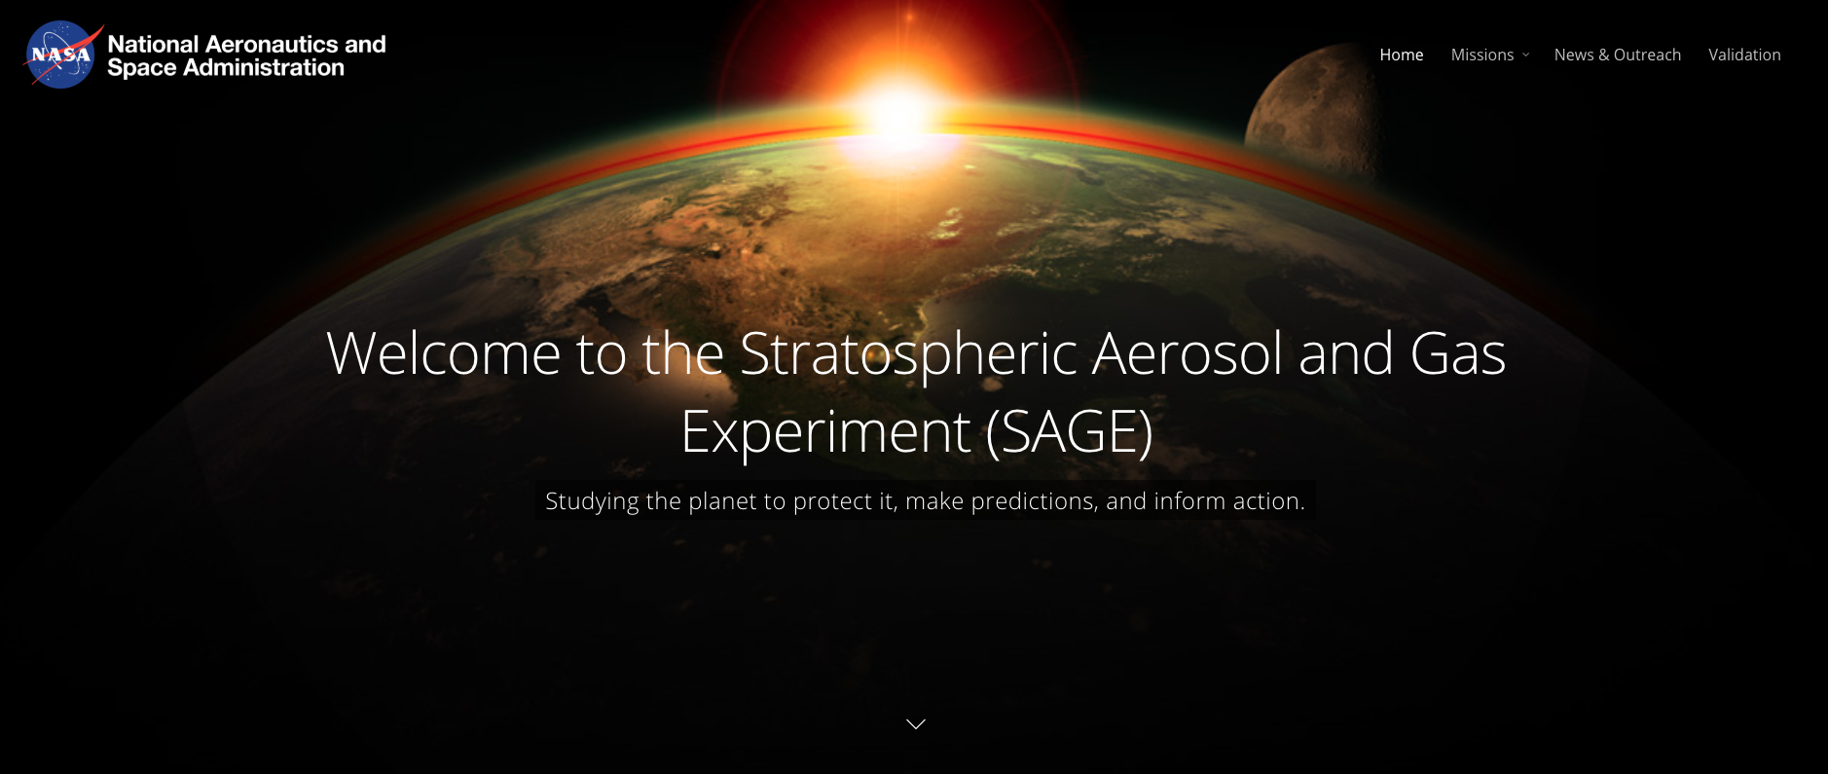
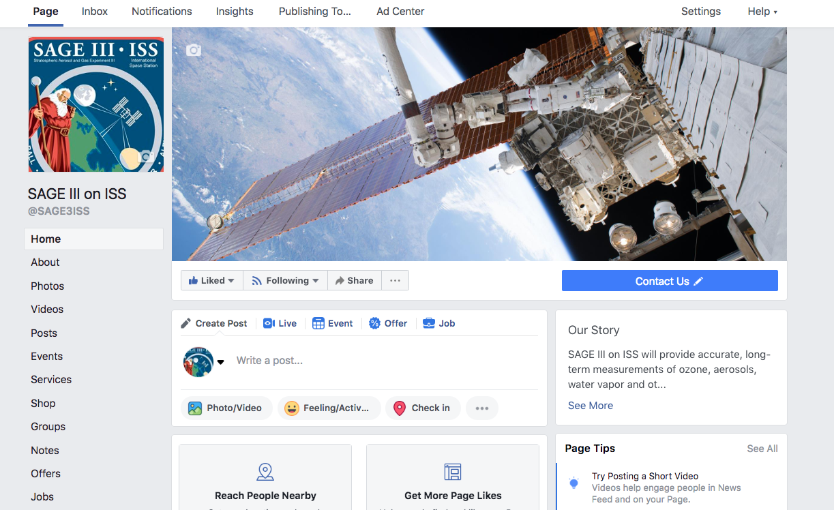
SAGE III Updates
sage.nasa.gov
Follow @SAGE3ISS on Facebook!
Slides from this meeting will be posted under Missions → About SAGE III → Science Team

Slide 3
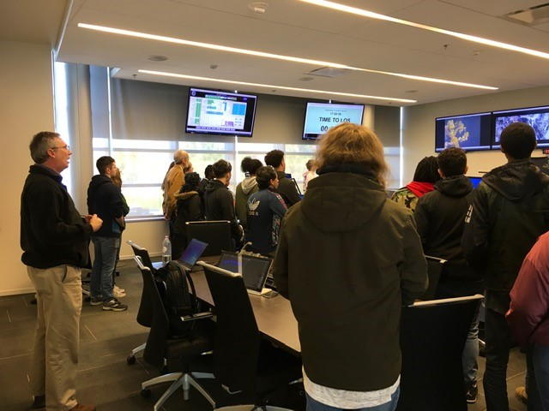
Public Outreach Events
November 13, 2019: Tour of the Flight Mission Support Center (FMSC) for Phoebus High School Manufacturing Academy Students:
  Greg Paxton (Ground Operations Manager) conducted a tour of the FMSC for the Phoebus High School Manufacturing Academy students where he provided information about the purpose of the SAGE III/ISS payload, along with information about the contamination and disturbance monitoring subsystems. He answered questions from the students about the basics of solar occultation and spectroscopy, as well as the interaction between the various NASA centers and ISS.

Slide 4
Public Outreach Events
December 9-13: AGU Fall 2019 (San Francisco, Calif.):
  Members of the SAGE III team attended the Fall AGU conference. Susan Kizer, Robbie Manion, Mike Heitz, Carter Hulsey, and Travis Knepp presented posters on various SAGE III science data product subjects and attended panels on a diverse group of subjects. Richard Eckman, SAGE III Program Scientist, gave a Hyperwall talk on ozone recovery at the conference.
January 12-16, 2020: American Meteorological Society 100th Annual Meeting (Boston, Mass.)
  Susan Kizer, David Huber, and Travis Knepp presented posters covering the SAGE III algorithm development and validation results at the AMS 100 conference.

Slide 5
Public Outreach Events
August 19: Ticosonde, a NASA-supported collaboration between the United States and Costa Rica, makes regular balloon sonde measurements of ozone and water vapor from the surface to the middle stratosphere over Costa Rica. Ticosonde launched water vapor and ozone sondes in the tropics that coincided with a SAGE III science data measurement. The profiles of water vapor and ozone from Ticosonde's measurements will be used to validate the accuracy of SAGE III data.
https://www.facebook.com/NASAExpeditions/posts/3366587223379710
September 14: Jamie Nehrir and Marilee Roell participated in an hour-long virtual STEM event hosted by RMIT University in Melbourne, Australia where ~300 women and girls viewed the “Women in STEM” NASA Event.

Slide 6
Public Outreach Events
September 23: 2020 International Space Station Research and Development Conference (2020 ISSRDC)
  The SAGE III/ISS team presented a poster at the 2020 ISSRDC virtual poster technical session. The poster "Three Years of Observations from the International Space Station by the Stratospheric Aerosol and Gas Experiment III" was presented by David Flittner. In a live Q/A session, he also fielded several questions from the online audience regarding pros/cons of a hosted payload on the ISS and future plans for the SAGE series of instruments.
Future: The SAGE III team will be working with the “Let's Go to Space” organization and The Georgia Space Grant Consortium to host monthly virtual classroom visits with K-12 students discussing STEM curriculum and SAGE III.

Slide 7
Contact Information
Please contact me if you are interested in featuring your work on our website or Facebook page, or if you are in need of SAGE III/ISS outreach materials for your organization.
Allison McMahon
SAGE III/ISS Communications Lead
757.864.4563
allison.b.mcmahon@nasa.gov

