Slide 1


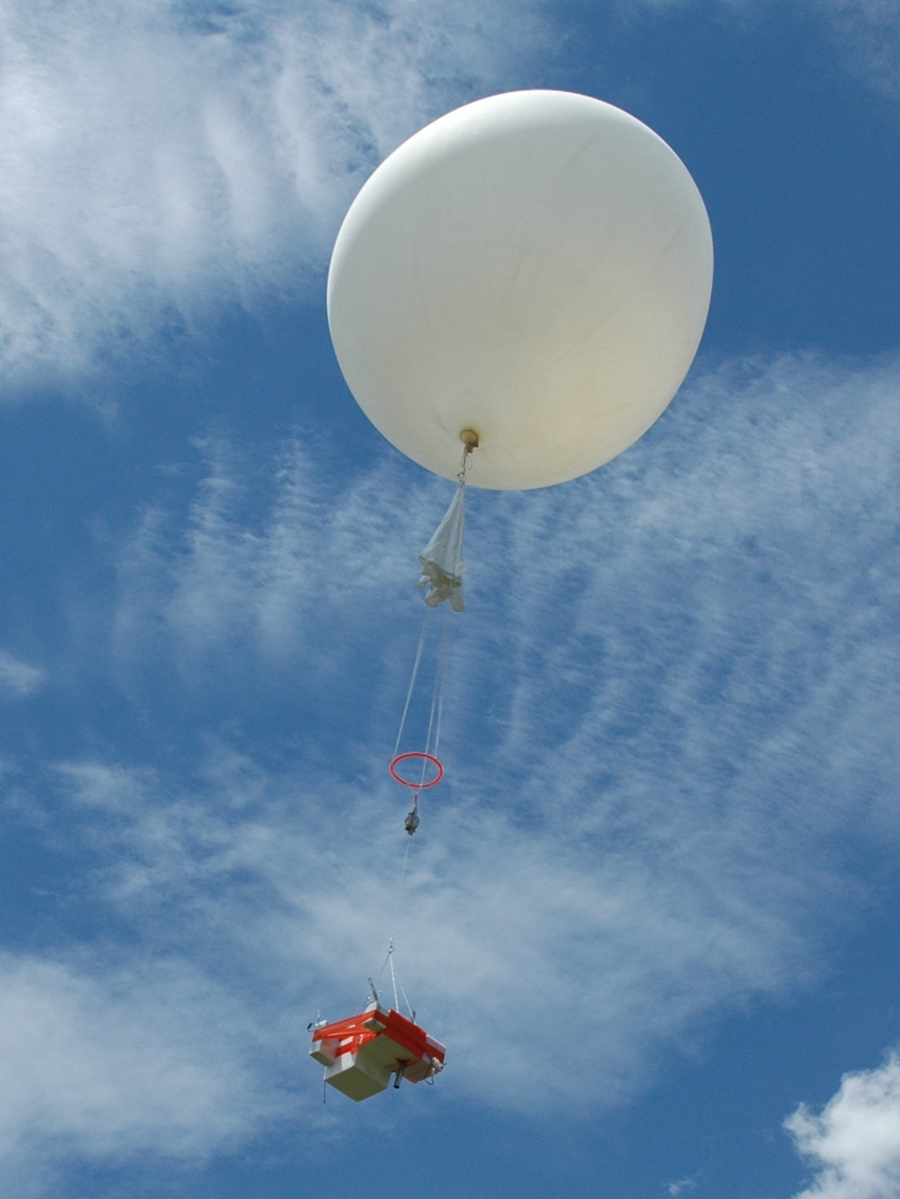
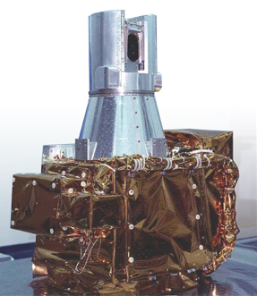
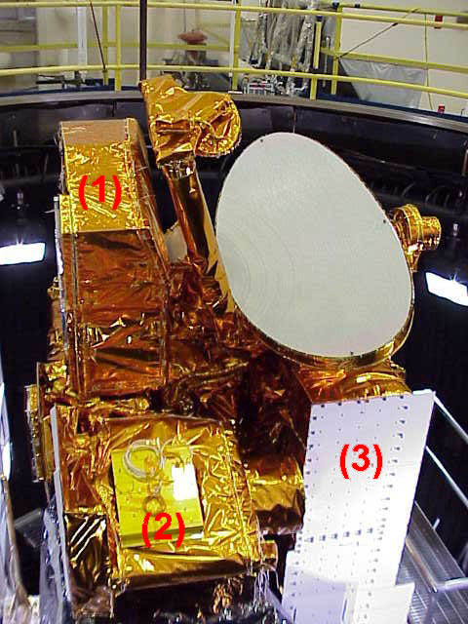
Validation of SAGE-III ISS Water Vapor in the Tropics and Comparisons with MLS
Henry Selkirk
Ghassan Taha
USRA and NASA/GSFC
Holger Vömel
NCAR
SAGE-III ISS
CFH Costa Rica
Aura MLS
SAGE-III Workshop, 29-30 October 2019, NASA Langley Research Center

Slide 2
TALK OUTLINE
MLS Water Vapor Observations vs. CFH
  Mean Profiles
  Seasonal Differences
  Scatter Diagrams MLS vs. CFH near Tropopause and in Upper Troposphere
Eight Coincidences of SAGE-III and CFH
  Individual Water Vapor Profiles
  Summary
SAGE-III ISS Coincidences at Other NDACC Stations
SAGE-III ISS vs MLS
Summary and Conclusions
Thanks and Acknowledgements
SAGE-III Workshop, 29-30 October 2019, NASA Langley Research Center

Slide 3
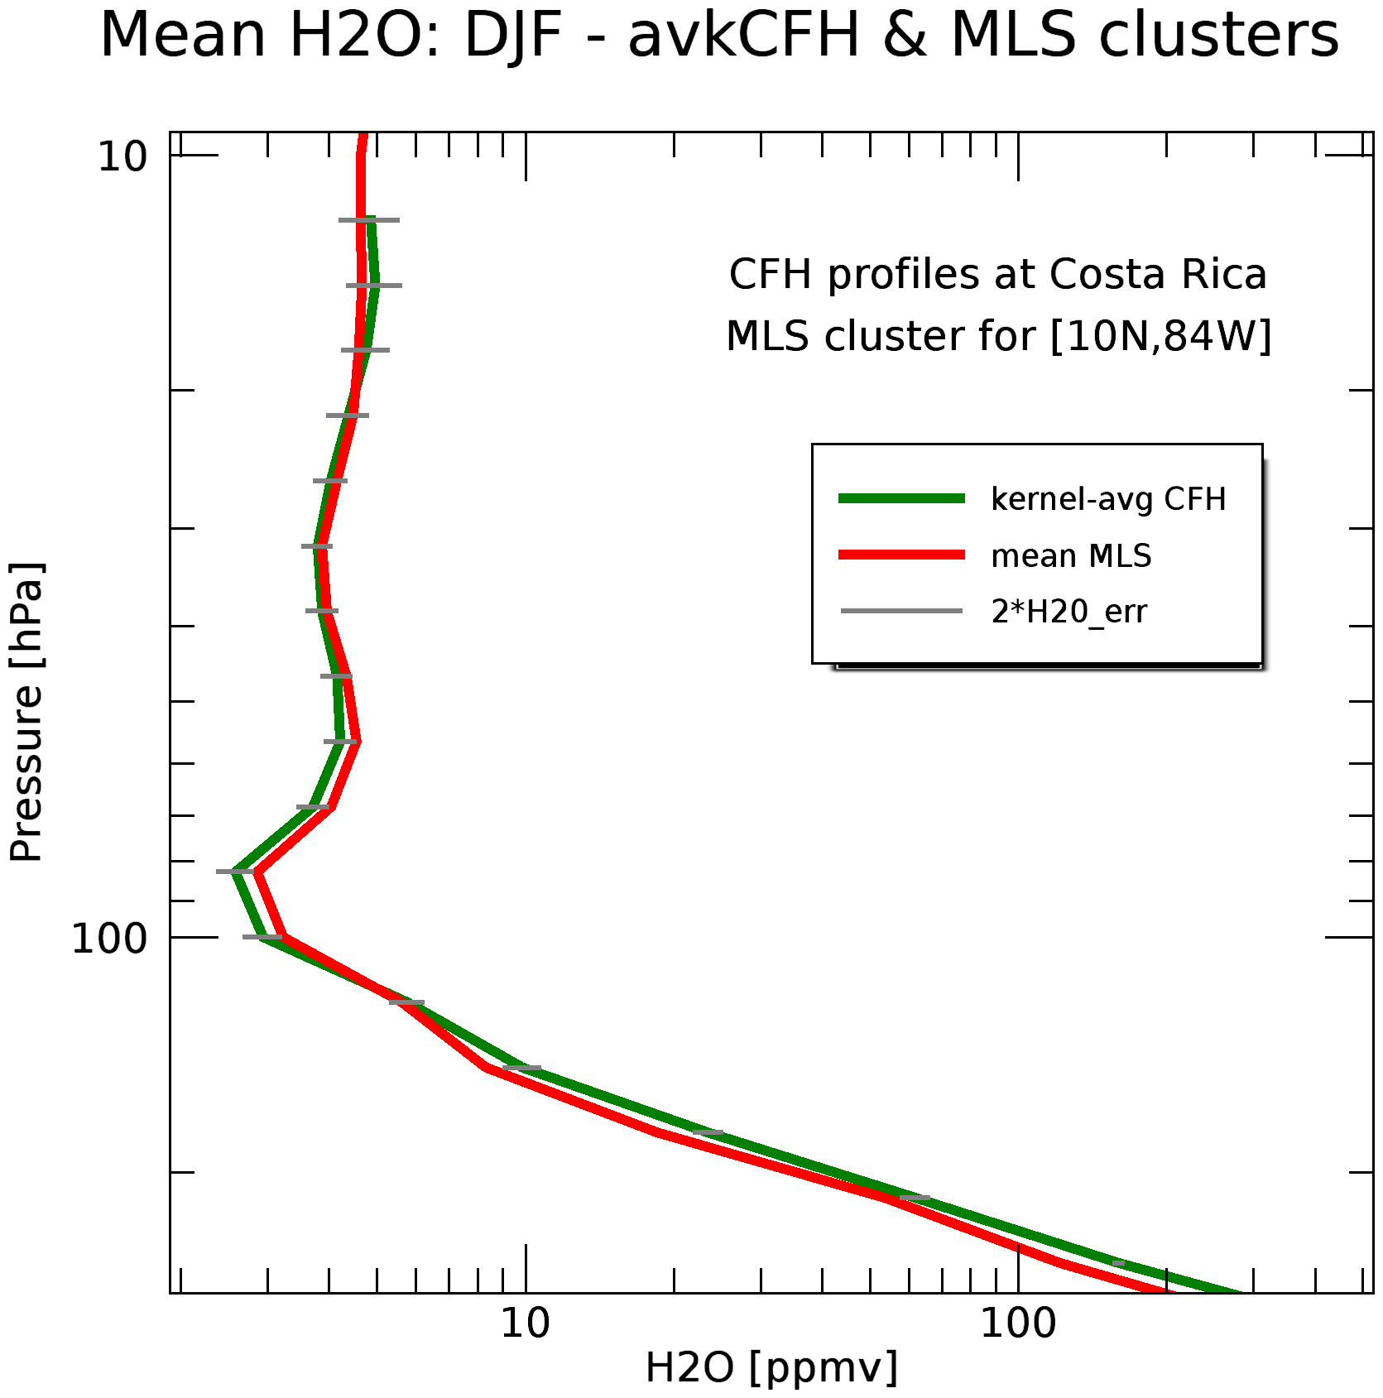
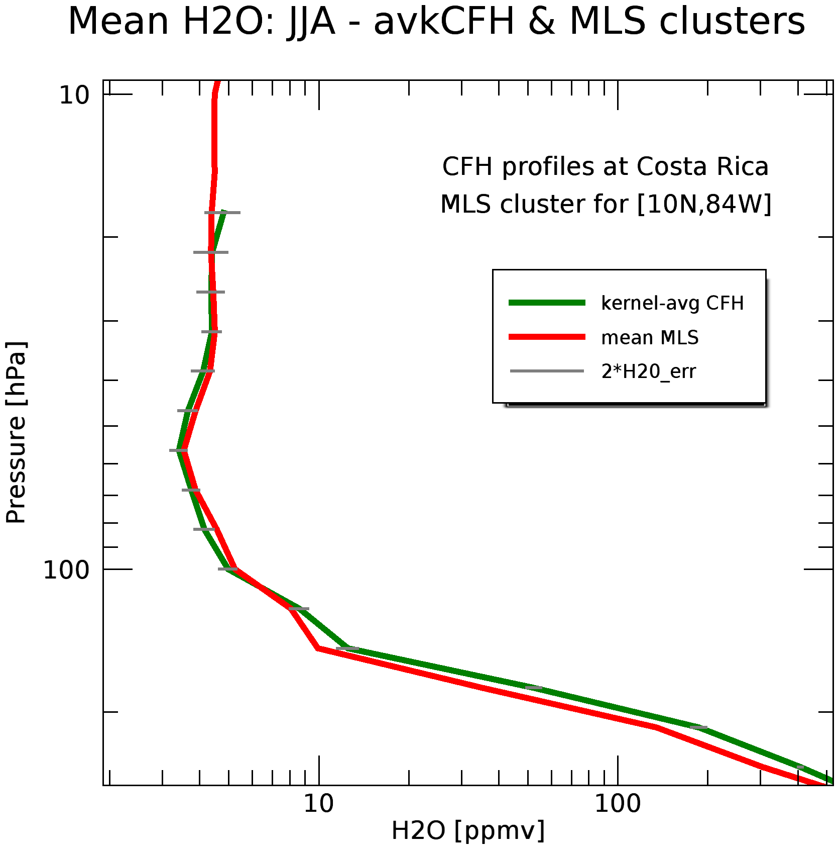
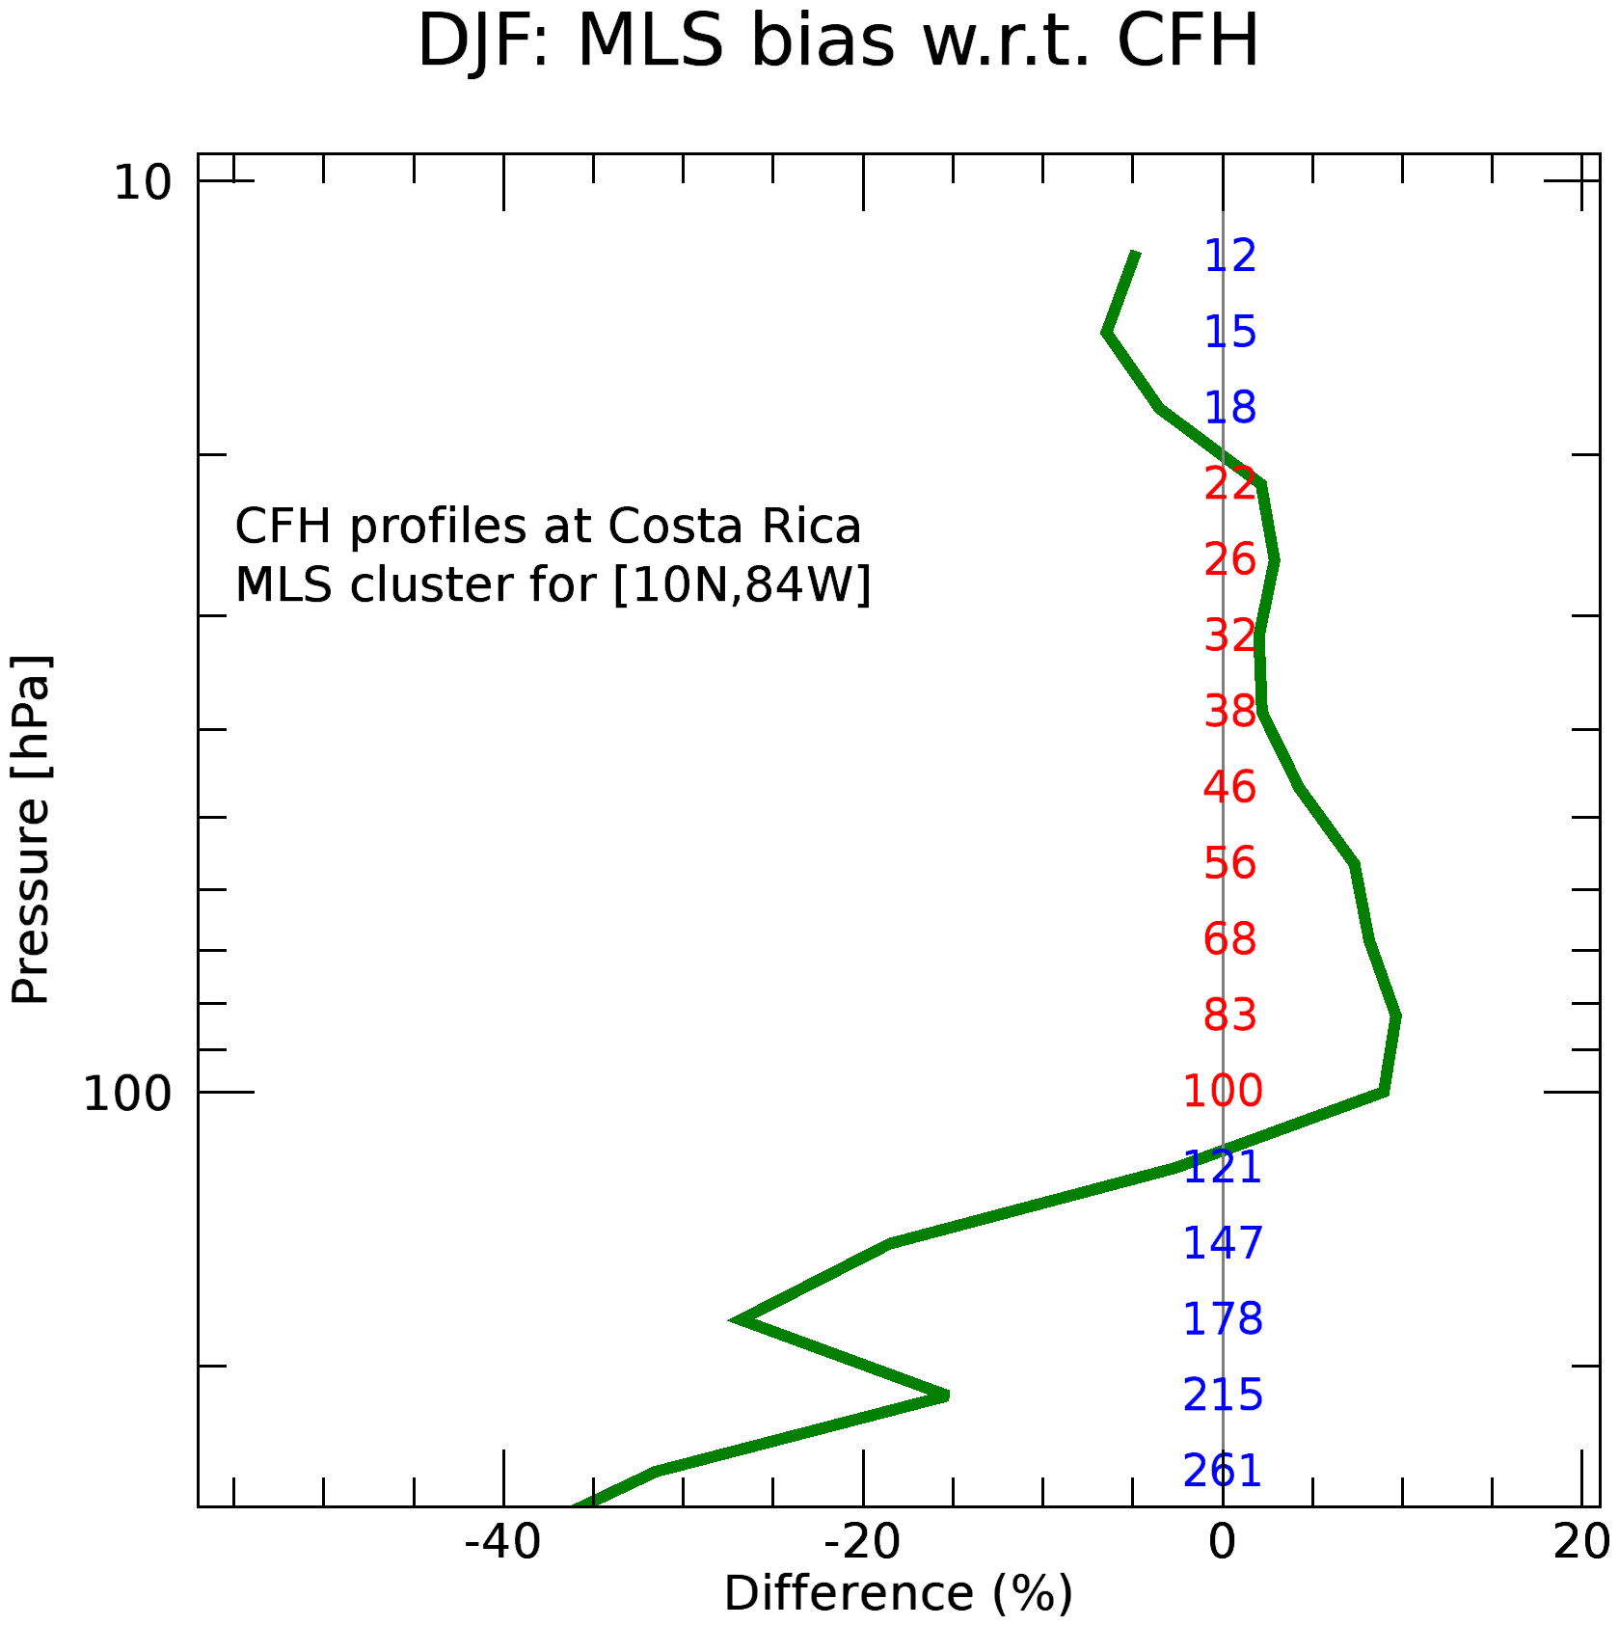
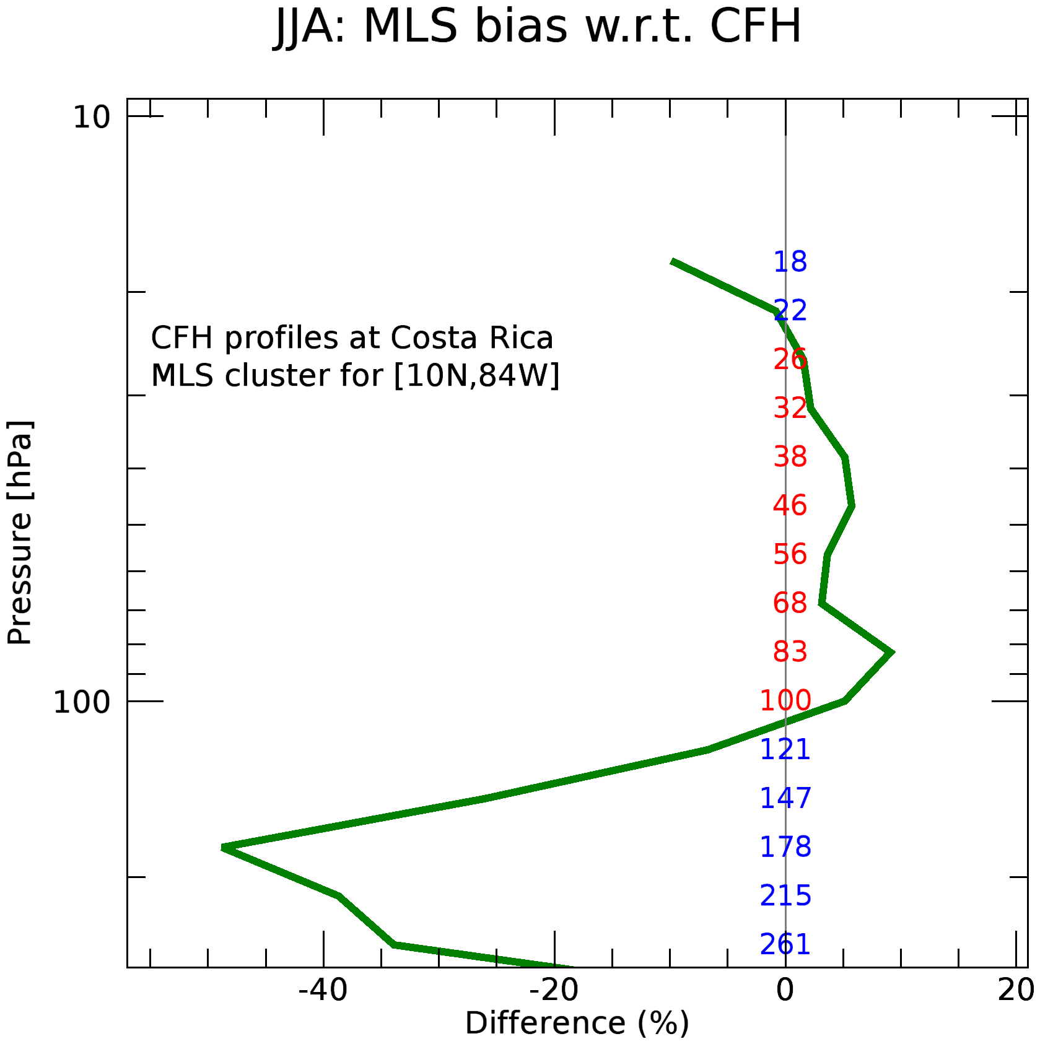
MLS H₂O vs. Ticosonde CFH
DJF: MLS vs. CFH
JJA: MLS vs. CFH
10
DJF hi-res CFH WV means
CPT min: 2.8 ppmv @ 84.2 hPa
TLS min: 2.6 ppmv @ 92.9 hPa
MLS @ 82/100: 2.9/3.3 ppmv
10
30
30
Pressure
Pressure
100
46 pairs
100
64 pairs
JJA hi-res CFH WV means
CPT min: 5.7 ppmv @ 104.1 hPa
TLS min: 5.3 ppmv @ 108.5 hPa
MLS @ 100/121: 5.2/8.0 ppmv
H₂O (ppmv)
3
30
100
3
10
30
100
H₂O (ppmv)
10
10
10
Hi-res CFH data filtered with MLS averaging kernel
30
30
Pressure
Pressure
100
100
Difference (%)
Difference (%)
-40
-20
0
20
-40
-20
0
20
SAGE-III Workshop, 29-30 October 2019, NASA Langley Research Center

Slide 4
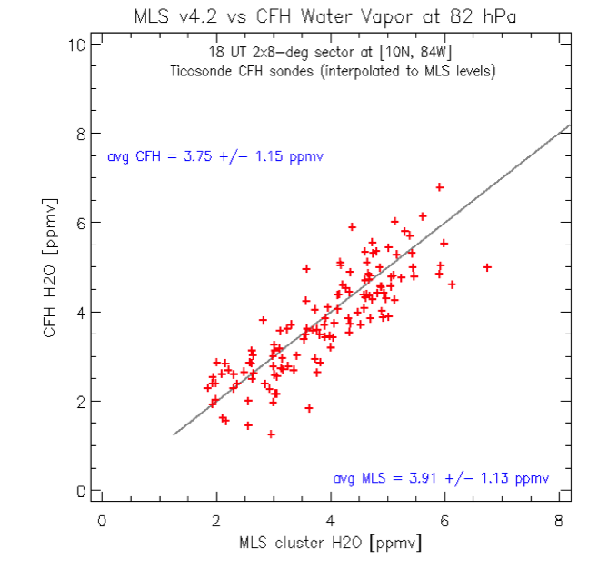
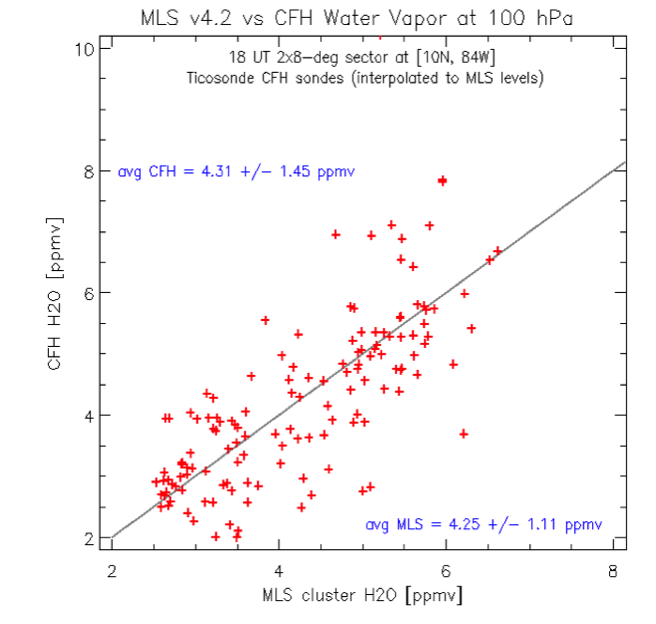
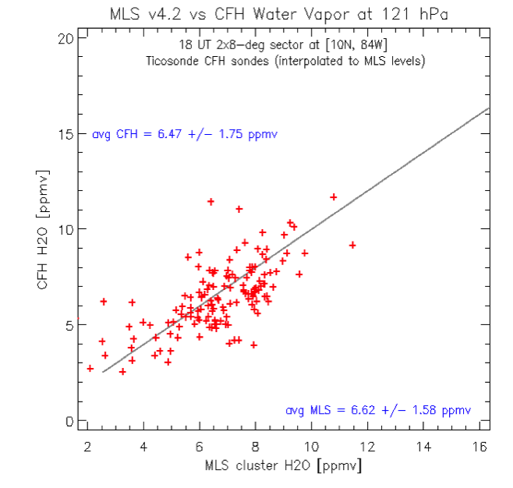
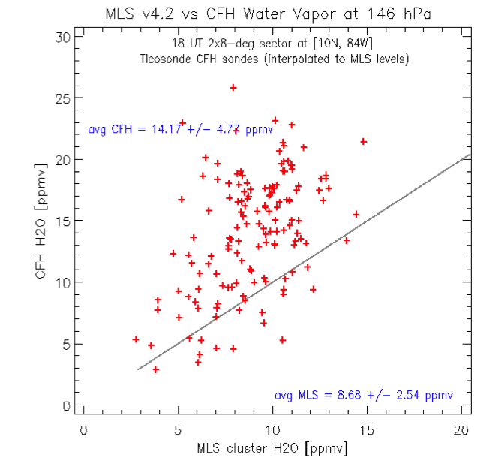
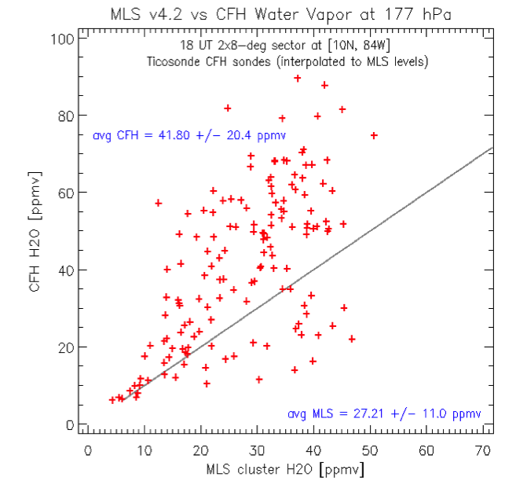
MLS H₂O vs. Ticosonde CFH
MLS and CFH water vapor show tight relationship in lower stratosphere and three MLS levels around the tropopause with MLS wetter by roughly 1/3 ppmv.
CFH H₂O [ppmv]
CFH H₂O [ppmv]
CFH H₂O [ppmv]
82 hPa
100 hPa
121 hPa
MLS H₂O [ppmv]
MLS H₂O [ppmv]
MLS H₂O [ppmv]
Below the tropopause layers, in the upper troposphere, MLS becomes increasingly drier than CFH as the latter increases
The reason for the relative dryness of MLS with respect to the frostpoint is not clear
CFH H₂O [ppmv]
CFH H₂O [ppmv]
147 hPa
178 hPa
MLS H₂O [ppmv]
MLS H₂O [ppmv]
SAGE-III Workshop, 29-30 October 2019, NASA Langley Research Center

Slide 5
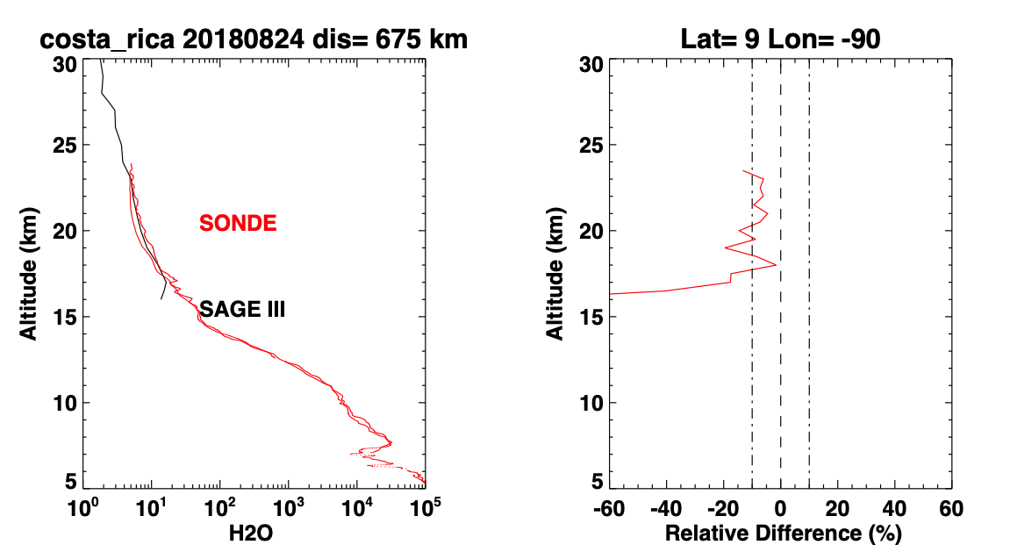
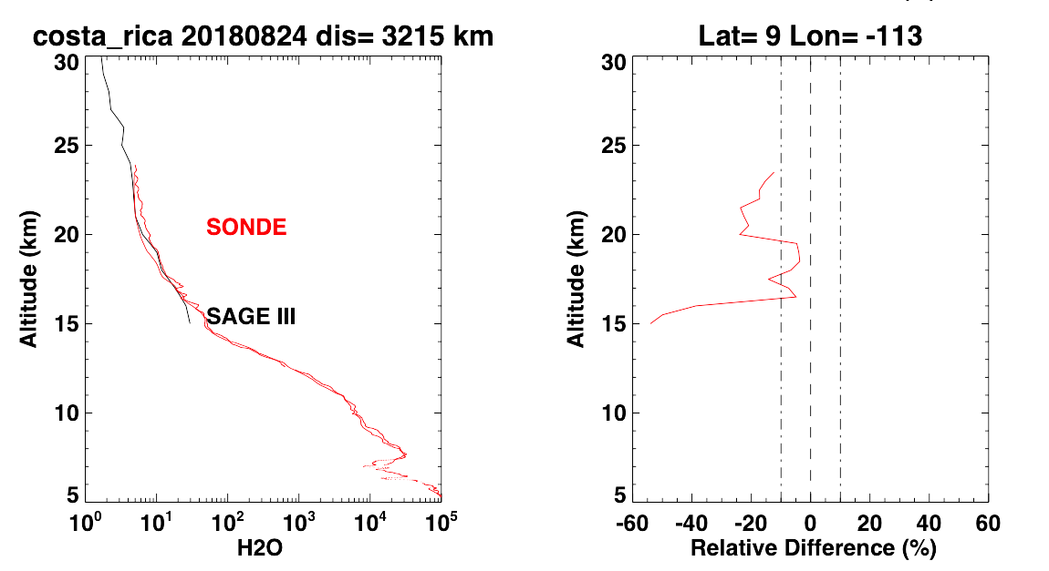
Sunrise occultation coincidences at Costa Rica – 1/8
24 August 2018
24 August 2018
Ascent & descent CFH profiles
Ascent profile only
Ascent & descent CFH profiles
Ascent profile only
CFH > SAGE-3
SAGE-3 > CFH
CFH > SAGE-3
SAGE-3 > CFH
Descent profile
SAGE-3 minus CFH (%)
SAGE-3 minus CFH (%)
[9°N, 90°W] Δ = 675 km
[9°N, 113°W] Δ = 3215 km
These rainy season SAGE-III profiles terminate near the tropopause, most likely due to cloud interference along the line of sight.
SAGE-III Workshop, 29-30 October 2019, NASA Langley Research Center

Slide 6
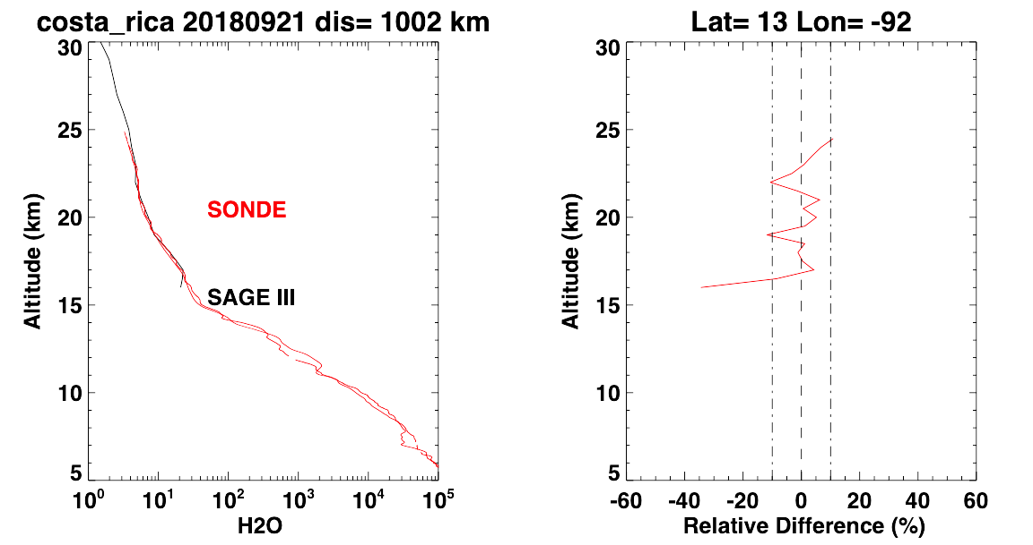
Sunrise occultation coincidences at Costa Rica – 2/8
21 September 2018
Ascent & descent CFH profiles
Ascent profile only
CFH > SAGE-3
SAGE-3 > CFH
Ascent profile only
[13°N, 92°W] Δ = 1002 km
This is about as good as it gets – in the lower stratosphere at least. Below 16 km the SAGE profile is truncated, probably by a cloud layer. Still in the rainy season!
SAGE-III Workshop, 29-30 October 2019, NASA Langley Research Center

Slide 7
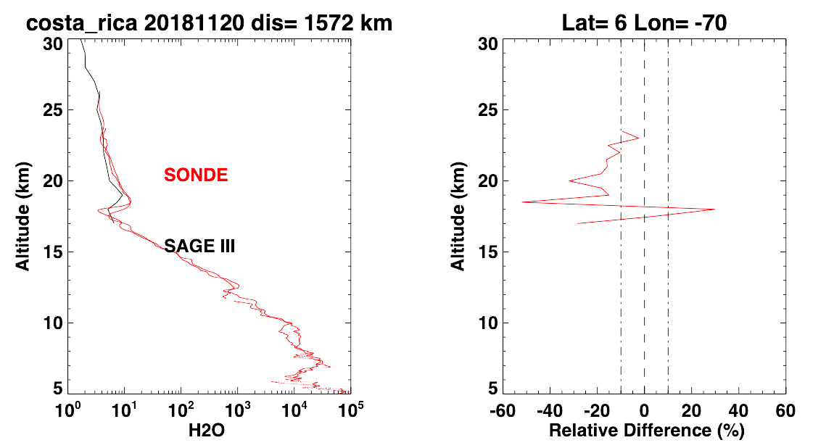
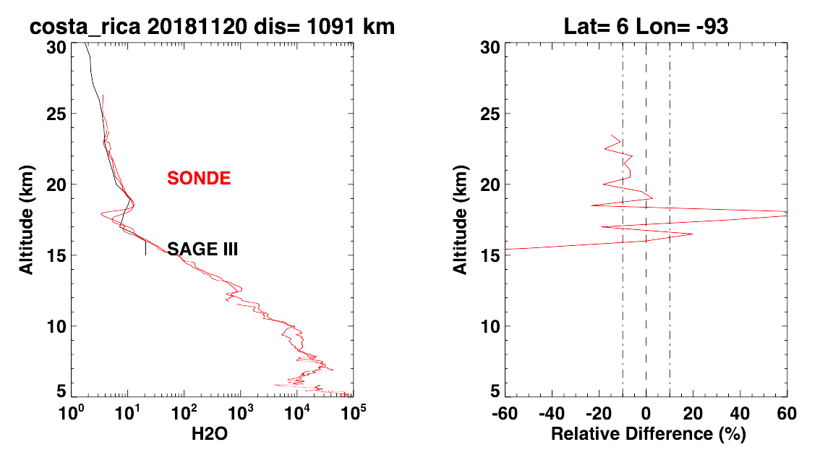
Sunrise occultation coincidences at Costa Rica – 3/8
20 November 2018
20 November 2018
Ascent & descent CFH profiles
Ascent profile only
Ascent & descent CFH profiles
Ascent profile only
CFH > SAGE-3
SAGE-3 > CFH
CFH > SAGE-3
SAGE-3 > CFH
Ascent profile only
SAGE-3 minus CFH (%)
SAGE-3 minus CFH (%)
[7°N, 70°W] Δ = 1572 km
[6°N, 93°W] Δ = 1091 km
The CFH profile shows a sharp minimum at 18 km (see arrow), very likely due to a wave event or nearby anvil cloud. However, despite its lower resolution, SAGE manages to catch the basic shape of the feature.
SAGE-III Workshop, 29-30 October 2019, NASA Langley Research Center

Slide 8
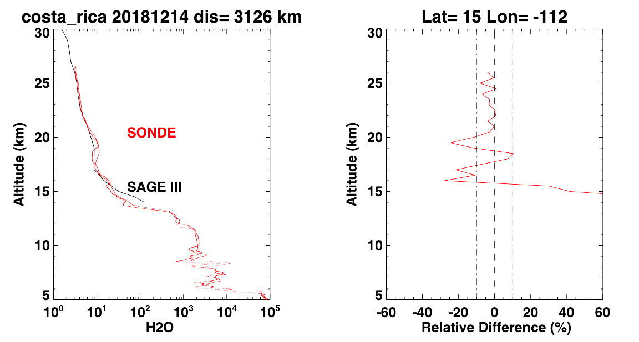
Sunrise occultation coincidences at Costa Rica – 4/8
14 December 2018
Ascent & descent CFH profiles
Ascent profile only
[15°N, 112°W] Δ = 3126 km
SAGE-III continues to do very good job capturing profile features on the scale of a few km.
SAGE-III Workshop, 29-30 October 2019, NASA Langley Research Center

Slide 9
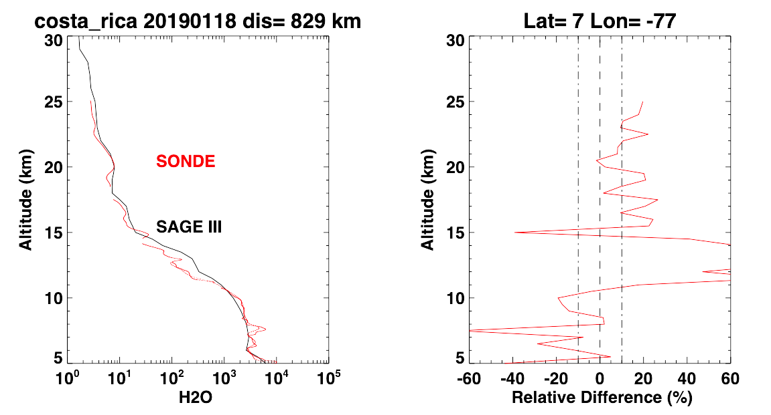
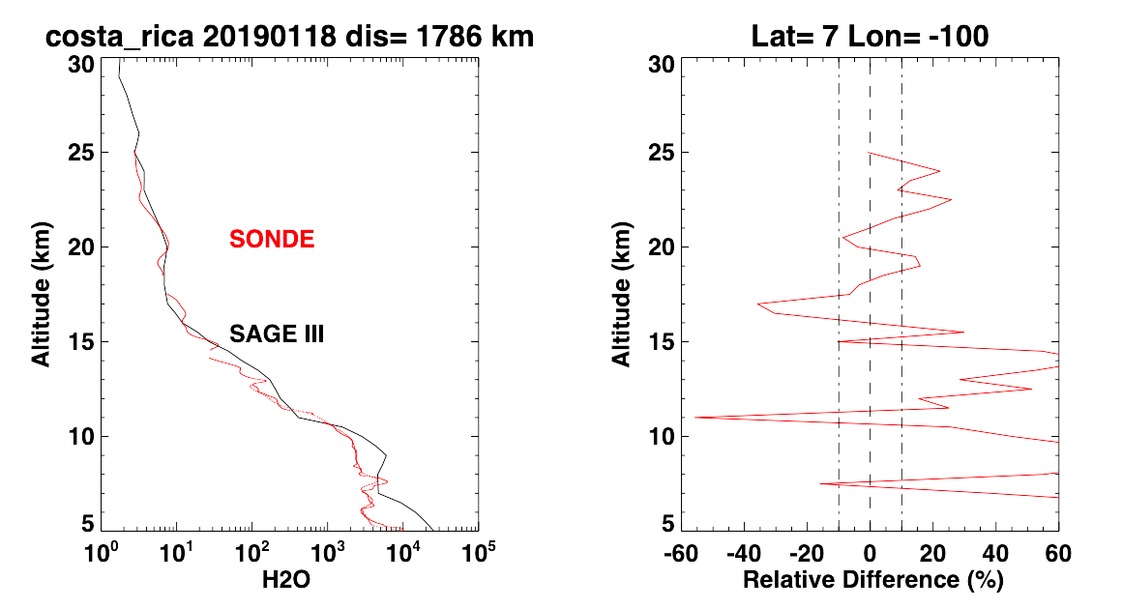
Sunrise occultation coincidences at Costa Rica – 5/8
18 January 2019
18 January 2019
Ascent & descent CFH profiles
Ascent profile only
Ascent & descent CFH profiles
Ascent profile only
CFH > SAGE-3
SAGE-3 > CFH
CFH > SAGE-3
SAGE-3 > CFH
SAGE-3 minus CFH (%)
SAGE-3 minus CFH (%)
[7°N, 77°W] Δ = 829 km
[7°N, 100°W] Δ = 1786 km
This is the first of our coincidences with the SAGE-III retrieving deep into the troposphere. And from 15 km down to ~11 km, SAGE is actually wetter than the sonde.
SAGE-III Workshop, 29-30 October 2019, NASA Langley Research Center

Slide 10
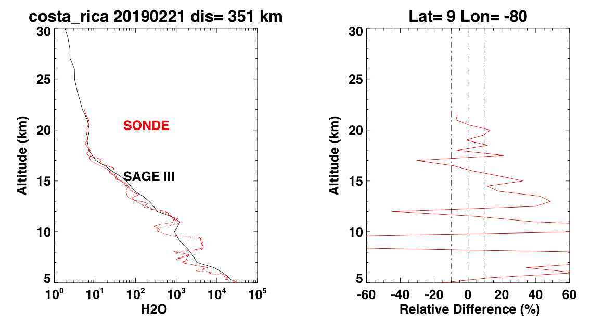
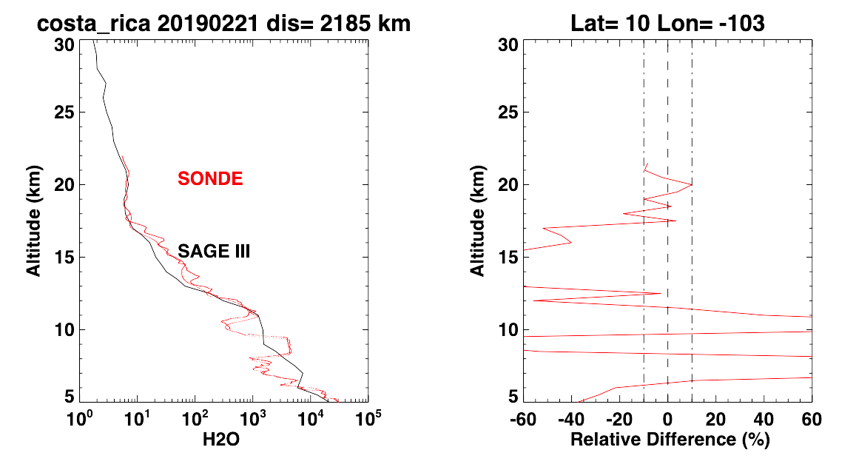
Sunrise occultation coincidences at Costa Rica – 6/8
21 February 2019
21 February 2019
Ascent & descent CFH profiles
Ascent profile only
Ascent & descent CFH profiles
Ascent profile only
CFH > SAGE-3
SAGE-3 > CFH
CFH > SAGE-3
SAGE-3 > CFH
SAGE-3 minus CFH (%)
SAGE-3 minus CFH (%)
[9°N, 80°W] Δ = 351 km
[10°N, 103°W] Δ = 2185 km
SAGE-III showing that it can track the essential shape of the profile deep into the troposphere.
SAGE-III Workshop, 29-30 October 2019, NASA Langley Research Center

Slide 11
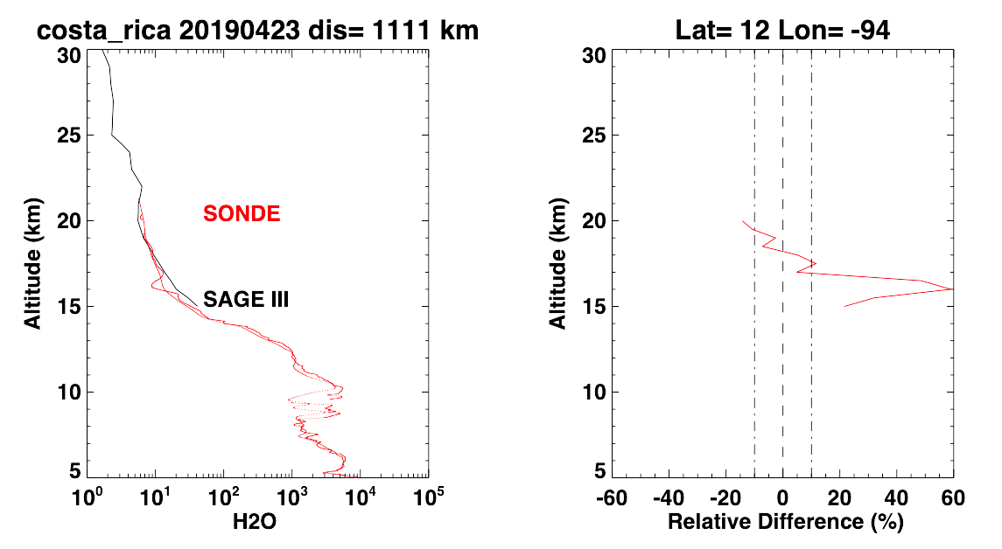
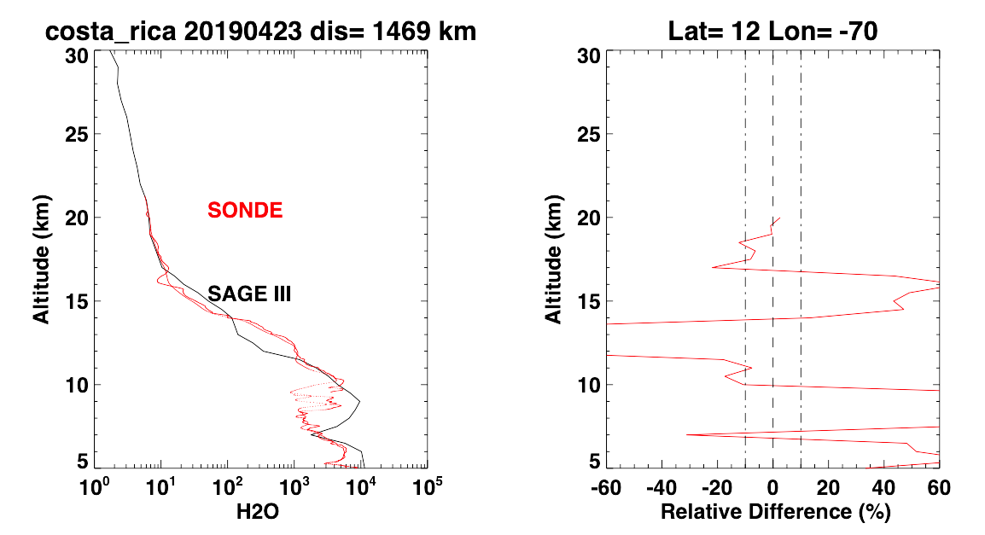
Sunrise occultations near Costa Rica – 7/8
23 April 2019
23 April 2019
Ascent & descent CFH profiles
Ascent profile only
Ascent & descent CFH profiles
Ascent profile only
CFH > SAGE-3
SAGE-3 > CFH
CFH > SAGE-3
SAGE-3 > CFH
SAGE-3 minus CFH (%)
SAGE-3 minus CFH (%)
[12°N, 94°W] Δ = 1111 km
[12°N, 70°W] Δ = 1469 km
Both profiles here do not fully capture the coldpoint tropopause feature in the CFH profile, but neither is particularly close to the sonde location.
SAGE-III Workshop, 29-30 October 2019, NASA Langley Research Center

Slide 12
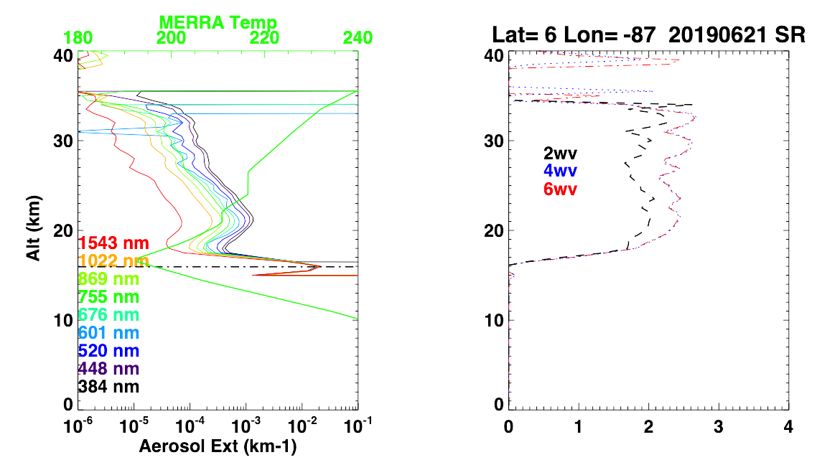
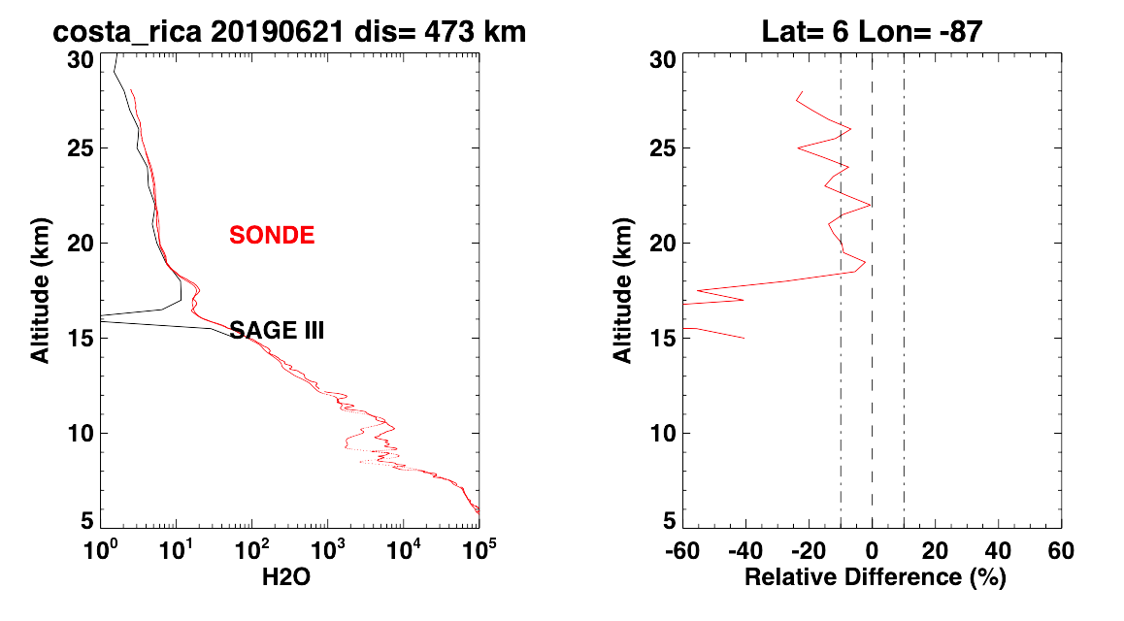
Sunrise occultations near Costa Rica – 8a/8
In the sonde profile below left, the S-shape at 16-18 km bears the hallmarks of tropopause-level wave uplift and overlying subsidence.
21 June 2019
Ascent & descent CFH profiles
Ascent profile only
21 June 2019
CFH > SAGE-3
SAGE-3 > CFH
15
15
SAGE-3 minus CFH (%)
[6°N, 87°W] Δ = 473 km
Angström coefficient
At 16 km there is clearly interference in the SAGE-III water vapor. This is almost certainly due to ice particles associated with wave-induced cooling at the tropopause, and …
… the aerosol retrievals from this occultation are consistent with this interpretation.
SAGE-III Workshop, 29-30 October 2019, NASA Langley Research Center

Slide 13
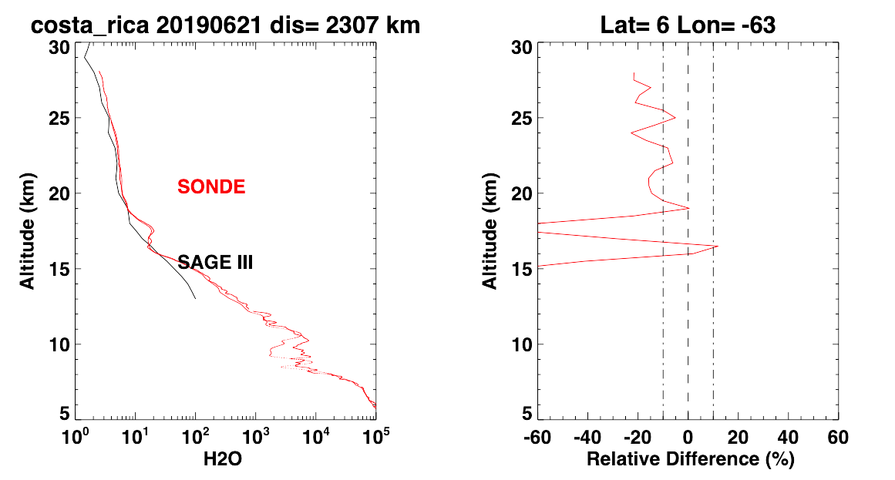
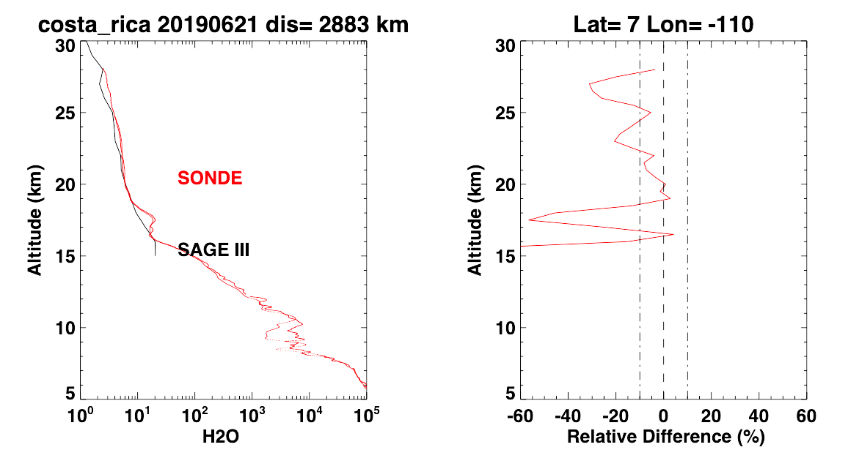
Sunrise occultations near Costa Rica – 8b/8
21 June 2019
21 June 2019
Ascent & descent CFH profiles
Ascent profile only
Ascent & descent CFH profiles
Ascent profile only
CFH > SAGE-3
SAGE-3 > CFH
CFH > SAGE-3
SAGE-3 > CFH
SAGE-3 minus CFH (%)
SAGE-3 minus CFH (%)
[6°N, 63°W] Δ = 2307 km
[7°N, 110°W] Δ = 2883 km
Both profiles here do not fully capture the coldpoint tropopause feature in the CFH profile, but neither is particularly close to the sonde location.
SAGE-III Workshop, 29-30 October 2019, NASA Langley Research Center

Slide 14
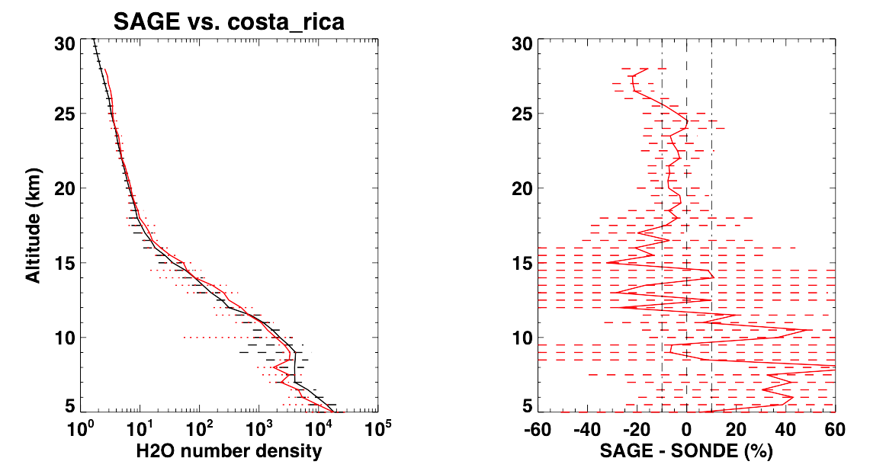
Summary – SAGE-III vs CFH Costa Rica
STRATOSPHERE
(above 18 km ⇒ 26 km)
In the mean, SAGE-III is ~5% dry relative to CFH Water Vapor throughout most of the lower stratosphere.
Tropical Tropopause Layer
(18-15 km)
Below the tropopause, SAGE-III trends drier (not unlike MLS) and variability increases substantially.
Troposphere
(below 18 km)
Looks promising, though still too few coincidences yet at Costa Rica for meaningful statistics.
CFH > SAGE-3
SAGE-3 > CFH
CFH
SAGE-III
± 1σ
SAGE-III Workshop, 29-30 October 2019, NASA Langley Research Center

Slide 15
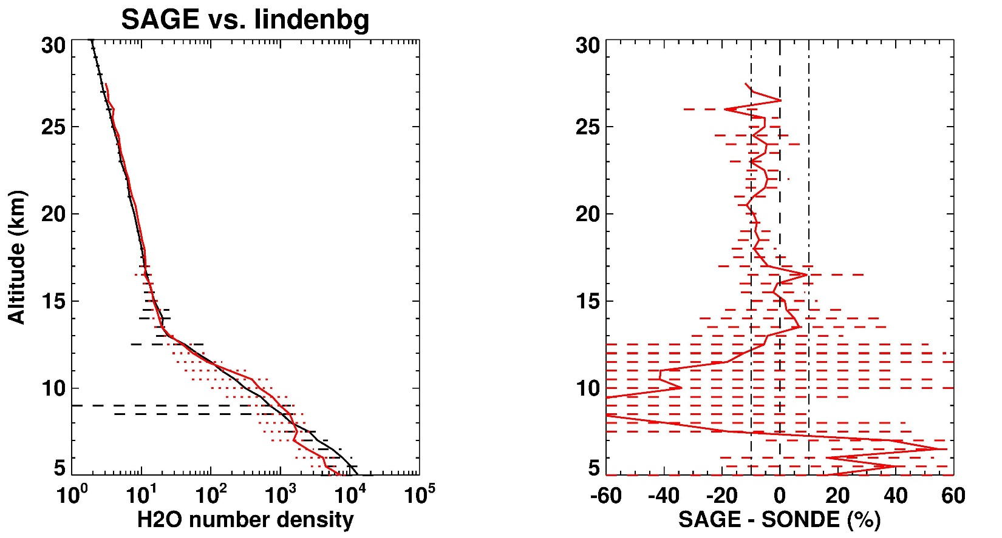
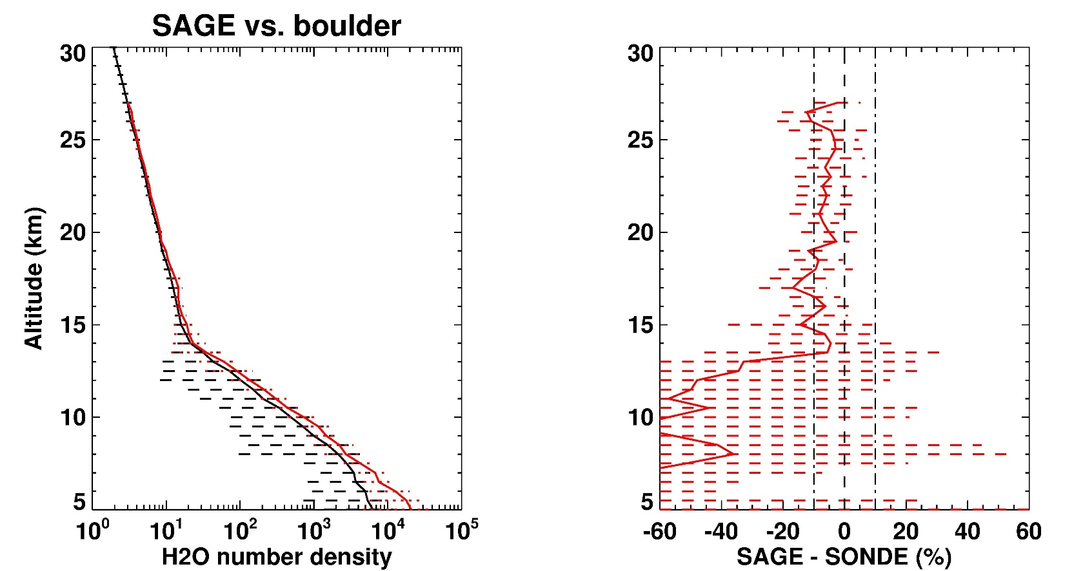
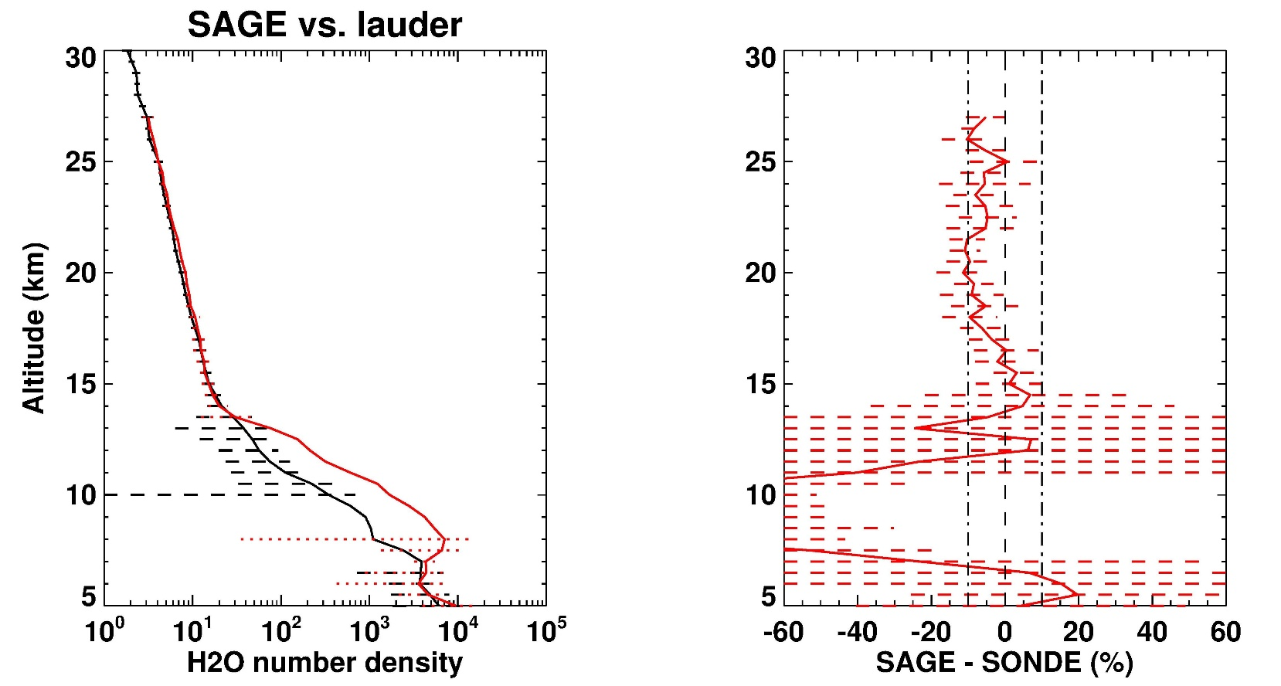
Other NDACC* sites
*Network for Detection of Atmospheric Composition Chane
Lindenberg
Germany (CFH)
BOULDER: More comparisons to date and SAGE-III has data to lower troposphere. But stratospheric bias similar to Costa Rica and also very dry tropospheric values
LINDENBERG: Results generally similar to Boulder, except for lowermost stratosphere where in rough agreement with CFH
LAUDER: Like Lindenberg, except more substantial tropospheric dry bias
Boulder, CO (FPH)
Lauder, NZ (FPH)
SAGE-III Workshop, 29-30 October 2019, NASA Langley Research Center

Slide 16
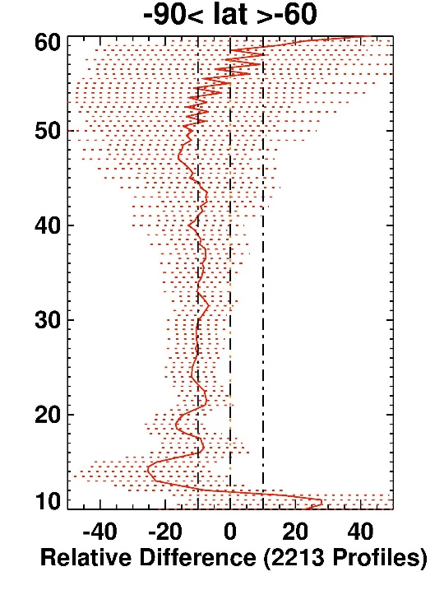
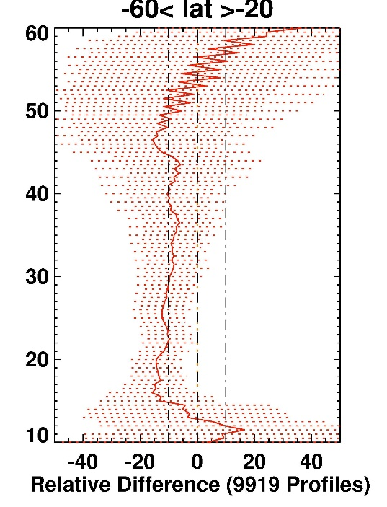
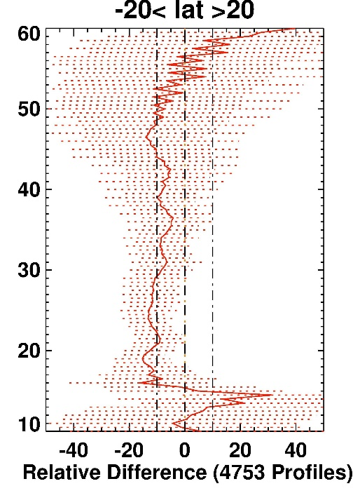
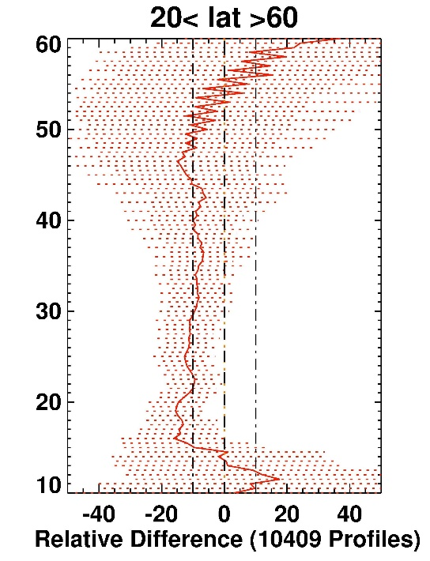
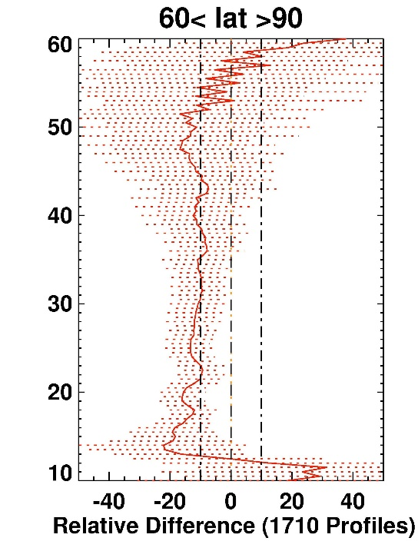
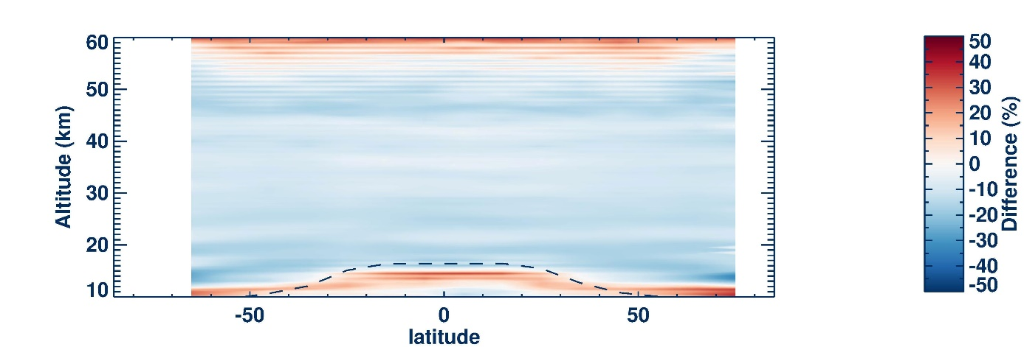
SAGE III/ISS minus MLS
In all latitude bands, from ~50 km down to ~20 km, SAGE-III averages approximately 10% lower than MLS.
In the uppermost troposphere, the low bias of SAGE-III is even larger.
SAGE-III Workshop, 29-30 October 2019, NASA Langley Research Center

Slide 17
SUMMARY and CONCLUSIONS
MLS vs CFH Water Vapor
MLS significantly drier than CFH in upper troposphere - and in all seasons
Conversely, MLS is significantly higher than CFH in lower stratosphere and in all seasons
Though at upper levels, the differences are only 2-3 times the instrumental uncertainty
SAGE-III ISS vs Ticosonde CFH Water Vapor
Unlike MLS, SAGE-III ISS water vapor is about 5% drier than CFH in lower stratosphere
Promising results in troposphere, though as yet an insufficient number of profiles for robust statistics
SAGE-III water vapor profiles can track water vapor features on scale of ~3 km
In some cases, close to resolving wave-induced water vapor features at the tropopopause.
In one coincidence (June 21, 2019) we got really lucky and were able to see an ice-cloud at the tropopause that explains the backward S-shaped feature in the hygrometer’s profile
SAGE-III ISS vs CFH in context of MLS vs. CFH
SAGE-III ISS through stratosphere is consistently 10% lower than MLS – in all latitudes bands
Below ~15 km, SAGE-III is significantly higher than MLS, though MLS becomes increasingly unreliable below ~12 km
SAGE-III Workshop, 29-30 October 2019, NASA Langley Research Center

Slide 18
Thanks and Acknowledgments
Our colleagues on the Ticosonde science team: Jorge Andrés Diaz, Anne Thompson, Sean Davis, Gary Morris and Lenny Pfister
The SAGE-III team: Carrie Roller, Dave Flittner and Marilee Roell
The GasLab team in Costa Rica, including Ernesto Corrales, Alfred Alan, Marco Madrigal, Pablo Madrigal and Daniela Diaz
The Instituto Meteorológico Nacional: Jose Joaquin Aguerro Porras and Adolfo Alvarado Gonzáles
Ken Jucks and the NASA Upper Atmosphere Composition Observations (UACO) program and Rich Ekman
The Aura Science team past and present, including Mark Schoeberl, Anne Douglass, and Bryan Duncan
SAGE-III Workshop, 29-30 October 2019, NASA Langley Research Center

