Slide 1
Validation of SAGE III/ISS Solar Products
Ghassan Taha^{1,2}
Luke Oman², Sarah Strode^{1,2}, and Mark Schoeberl³
¹Universities Space Research Association, ²NASA GSFC, ³Science and Technology Corporation

Slide 2
Outline
Introduction
Ozone validation
  SAGE III/ISS sunrise/sunset diurnal difference
    Comparison with MLS day/night measurements
  Ozone comparison with MLS V04 night, OSIRIS V5.10, OMPS LP V2.5, ACE-FTS V3.6, ozonesondes and Lidar measurements
  Diurnal corrections from GEOS model (see Luke Oman’s presentation tomorrow)
Aerosol validation
  SAGE III/ISS monthly zonal mean time series
  Comparison with CALIPSO L3, OMPS LP V1.5, and OSIRIS V7.0
Water vapor validation
  Comparison with MLS, ACE-FTS and Frostpoint hygrometer (See Henry Selkirk’s presentation tomorrow)
NO₂ validation
  Comparison with ACE-FTS V3.6 and OSIRIS V6.03
    Diurnal corrections from GEOS model (see Luke Oman’s presentation tomorrow)
Summary

Slide 3
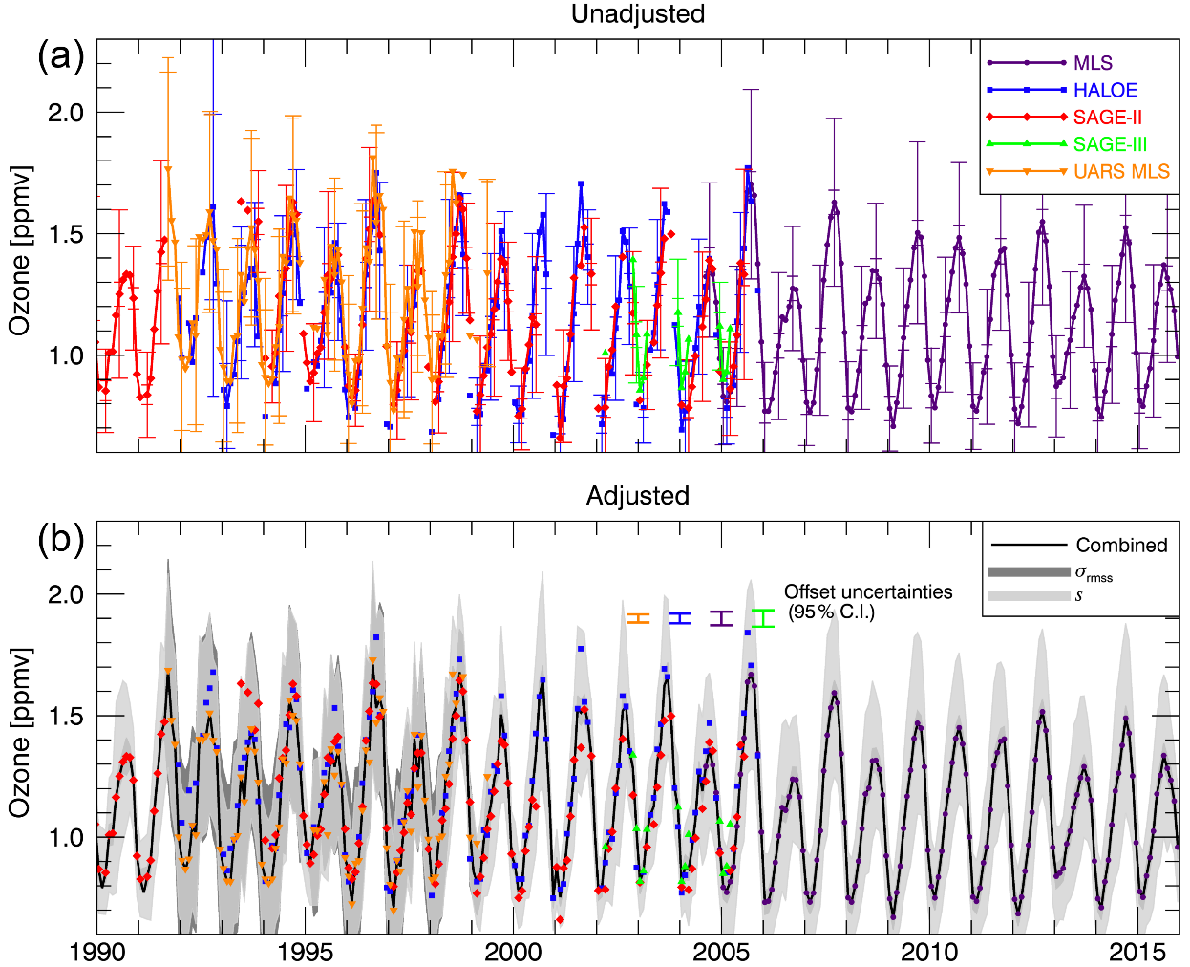
Introduction
SAGE I/II measurements of ozone and aerosol profiles have been the benchmark for studies related to stratospheric changes, trend analysis, climate, and international assessments.
  1978-2005
New generation of limb instruments in orbit
  Mostly MLS, OSIRIS, and OMPS LP
Validation of SAGE III/ISS measurements will help linking the SAGE III ozone and aerosol measurements to the current records
Davis et al., 2016

Slide 4
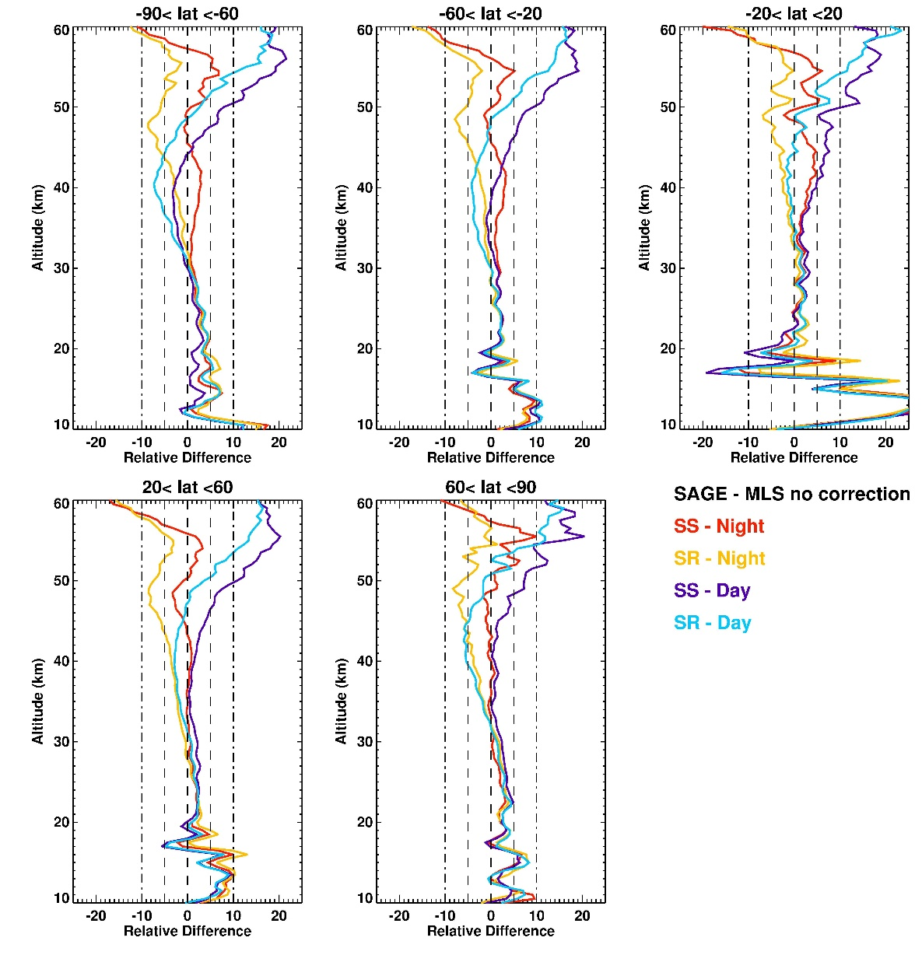
SAGE III/ISS vs. MLS (No corrections)
-Understanding the differences between SAGE and MLS is critical for linking the SAGE MLS records
-SAGE sunrise/sunset vs. MLS day/night
-SS/night shows best agreement
-Differences are mostly within ±5% up to 45km
-Difference is caused by ozone diurnal variability above 35km

Slide 5
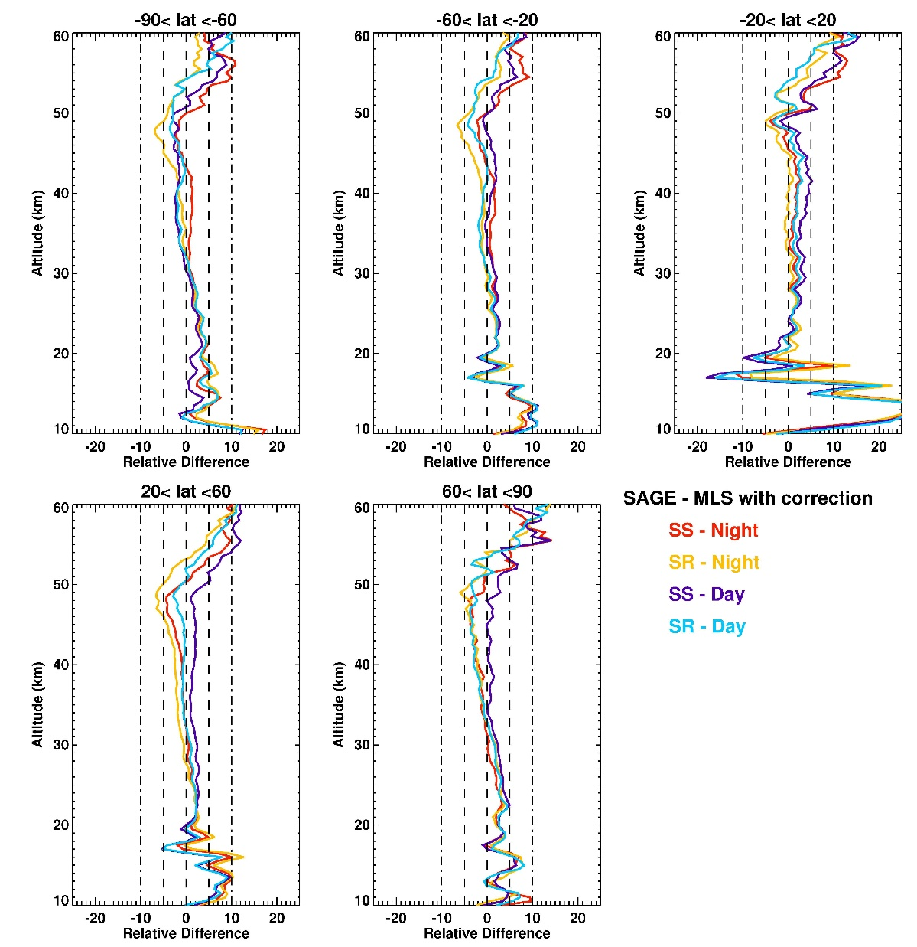
SAGE III/ISS vs. MLS (With diurnal corrections)
-MLS is corrected using model diurnal scale factors
-Difference is reduced and less than 5% up to 50km

Slide 6
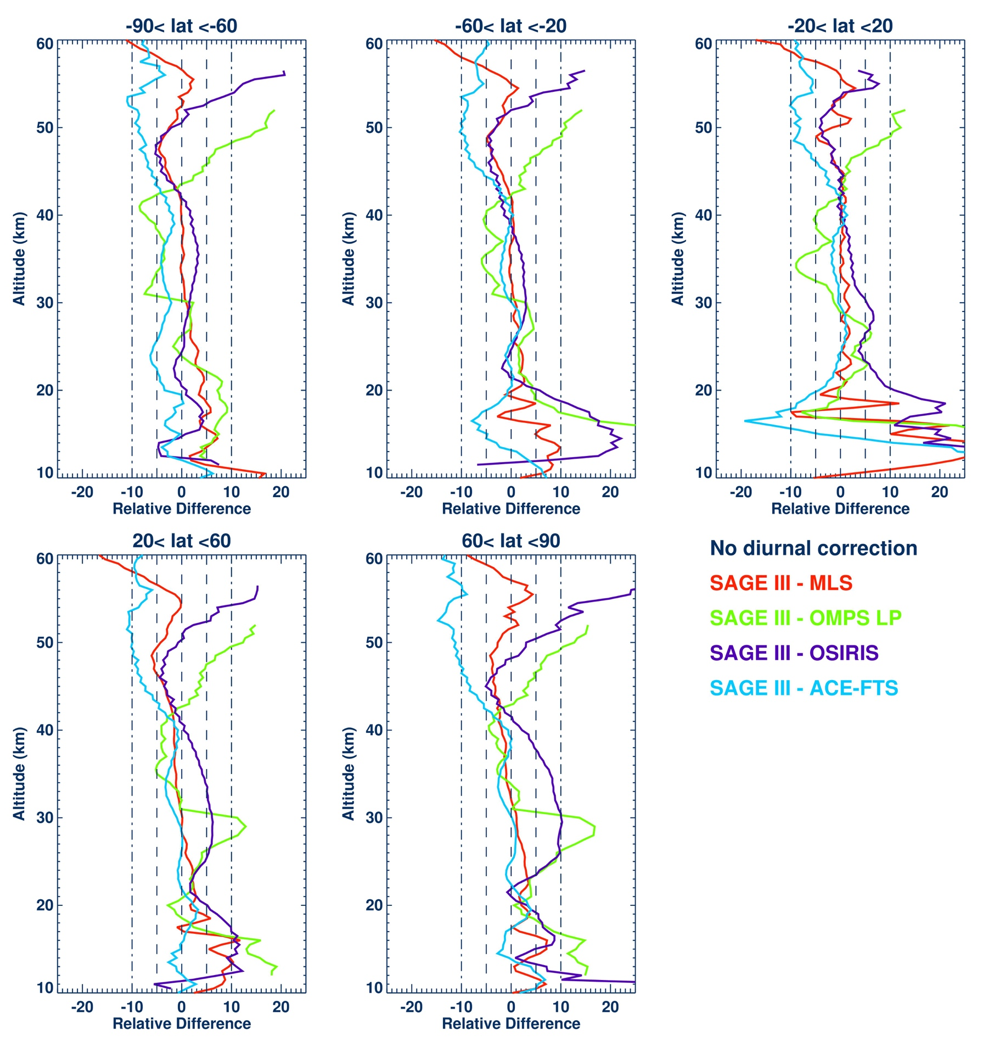
Summary of ozone comparison
-No diurnal corrections
-Most instruments are within ±5%
-Some diurnal effect above 35km
-ACE-FTS 10% above 45km
-OMPS LP difference is 15% 25-30km in NH
-OSIRIS difference is 5-10% in NH

Slide 7
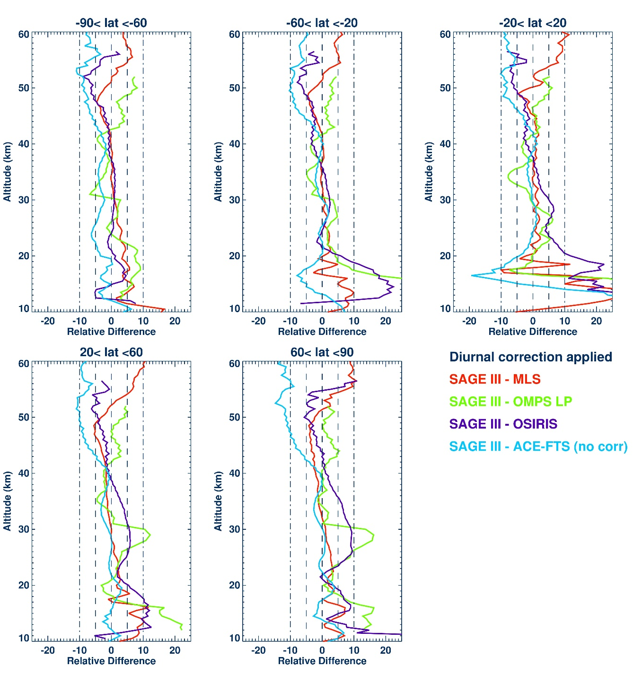
Summary of ozone comparison (corrected)
-Diurnal corrections applied
-Noticeable improvement above 40 km to 5%

Slide 8
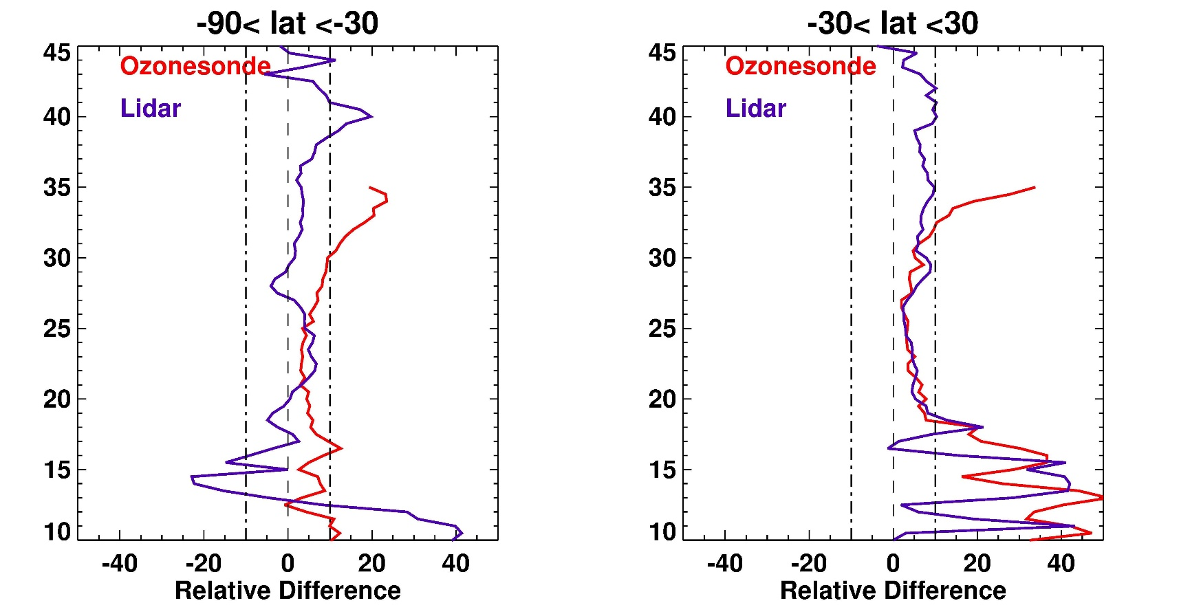
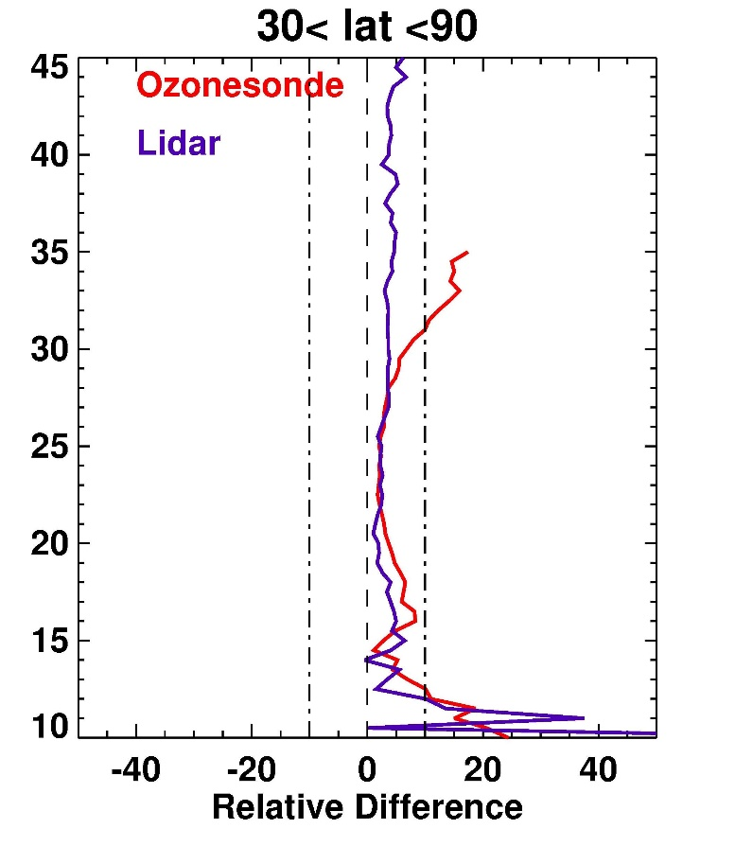
SAGE III/ISS vs. ozonesondes and lidars
-Ozonesondes and lidars agree with SAGE to within 5%
-larger bias at higher altitude for the ozonesondes and near the UT/LS (low ozone)

Slide 9
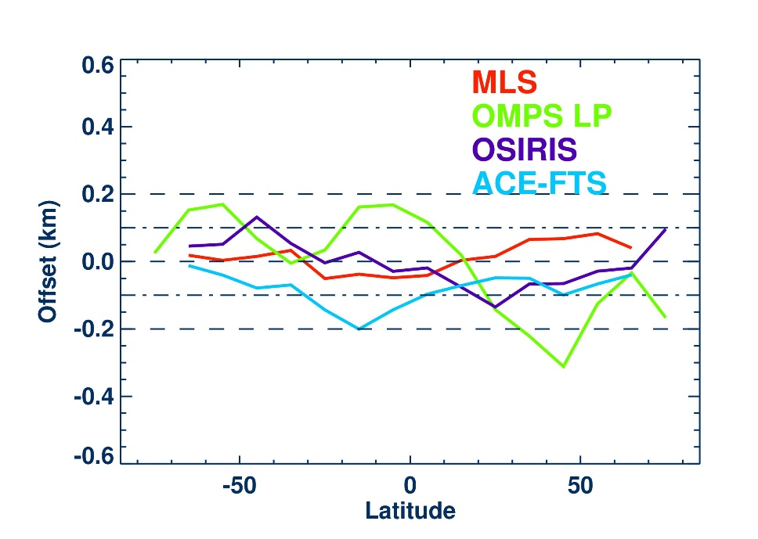
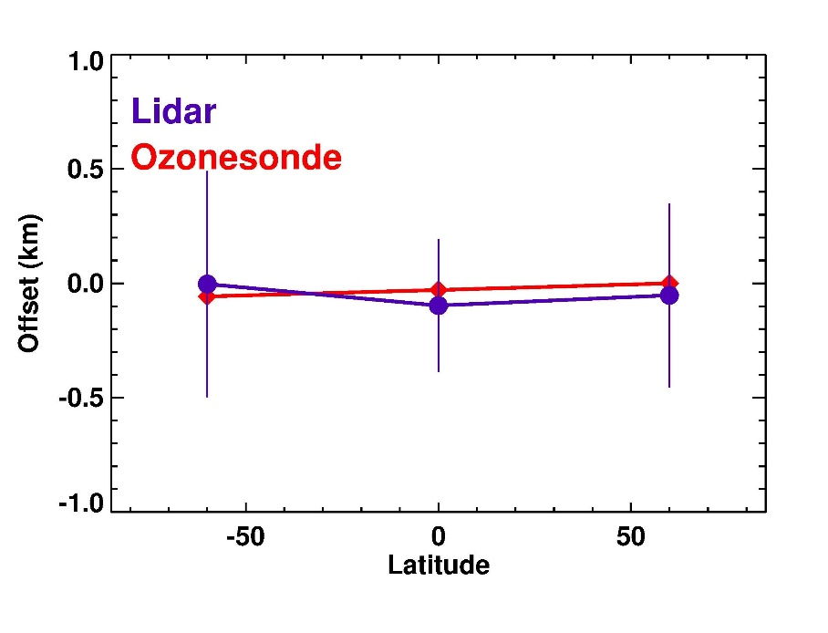
Tangent Height Accuracy
-Using correlative measurements to estimate TH accuracy
TH offset is less than 100m compared to MLS, groundbased and ozonesondes
± 100 m compared to OSIRIS and ACE-FTS
±200 m compared to OMPS

Slide 10
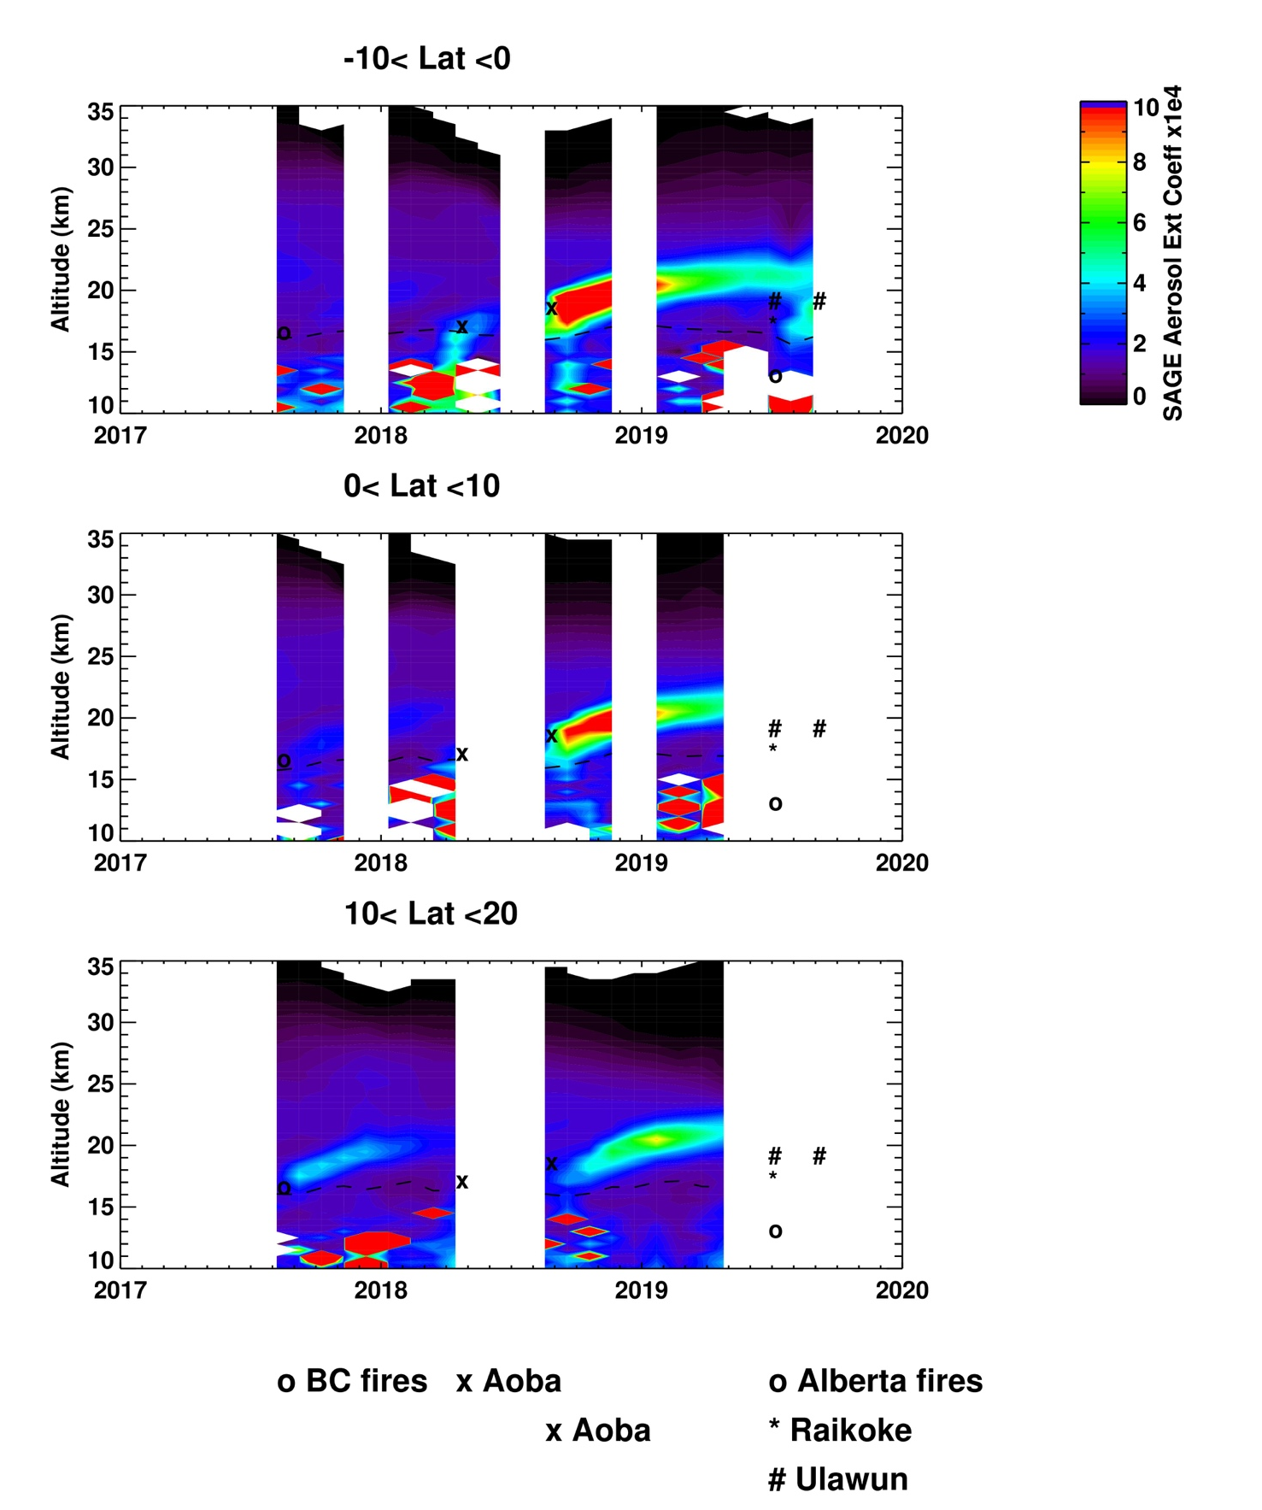
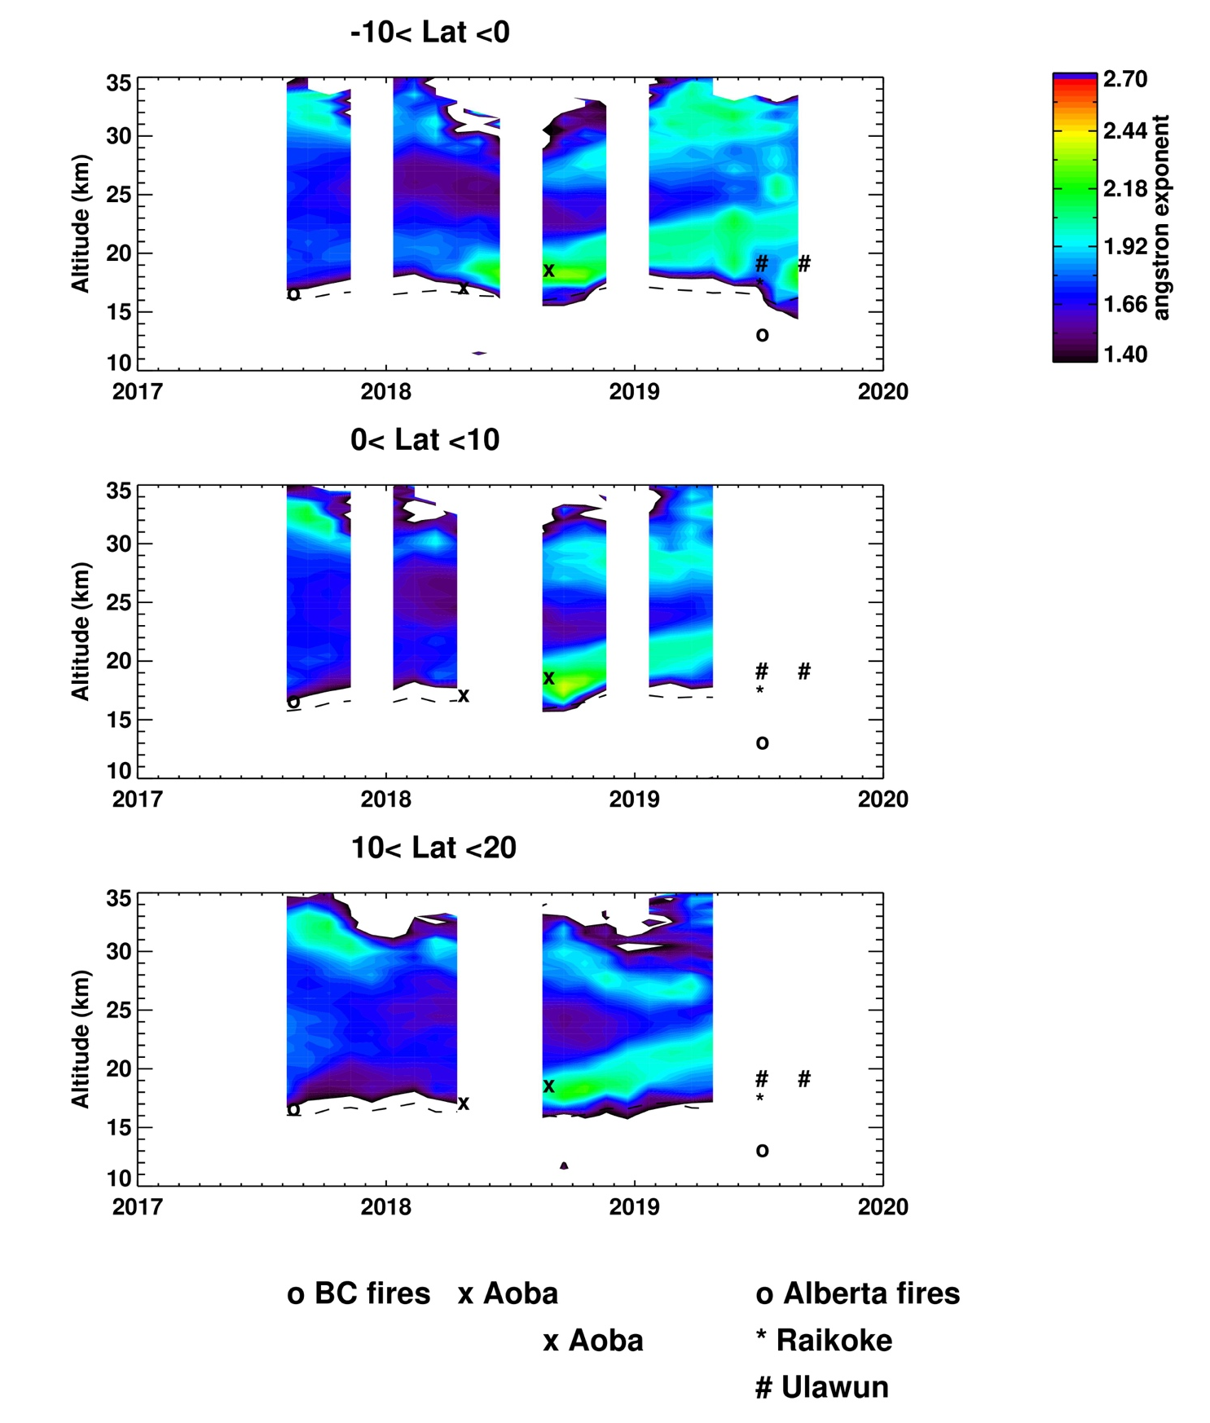
SAGE III/ISS aerosol extinction and angstrom exponent monthly zonal means
Angstrom Exponent
Aerosol extinction coefficient
Two volcanic eruptions in the tropics and one in NH
Two PyroCb events in NH
Angstrom Exponent indicate large particle size for carbonaceous aerosol, and smaller particle size for volcanic (sulfate) aerosol

Slide 11
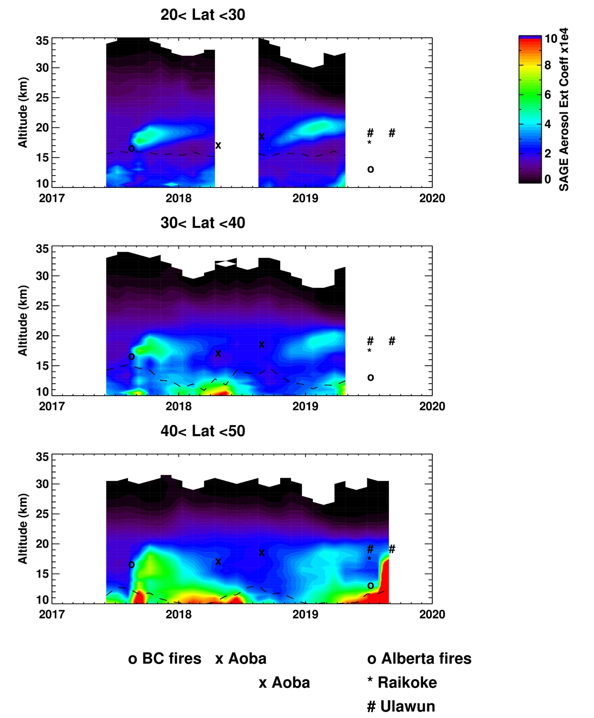
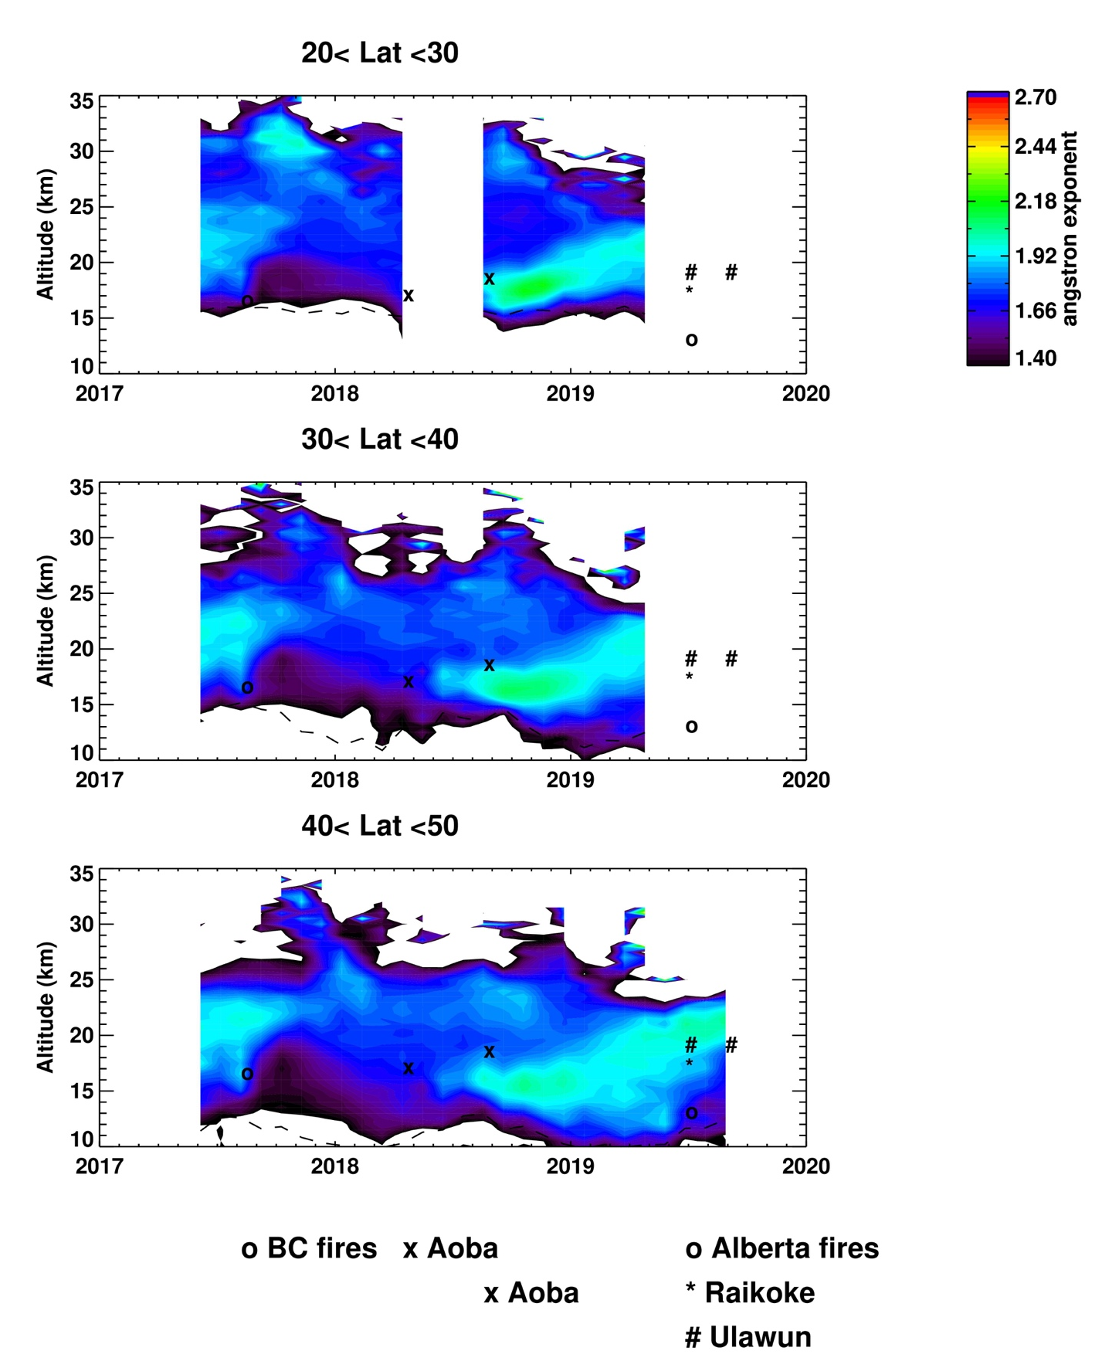
SAGE III/ISS aerosol extinction and angstrom exponent monthly zonal means
Angstrom Exponent
Aerosol extinction coefficient
Two volcanic eruptions in the tropics and one in NH
Two PyroCb events in NH
Angstrom Exponent indicate large particle size for carbonaceous aerosol, and smaller particle size for volcanic (sulfate) aerosol

Slide 12
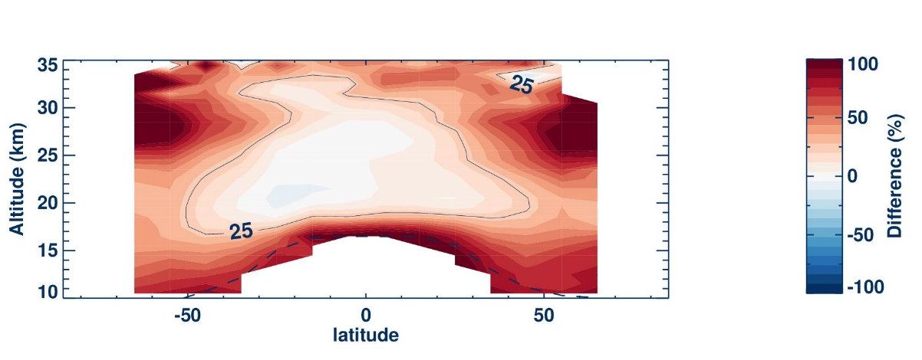
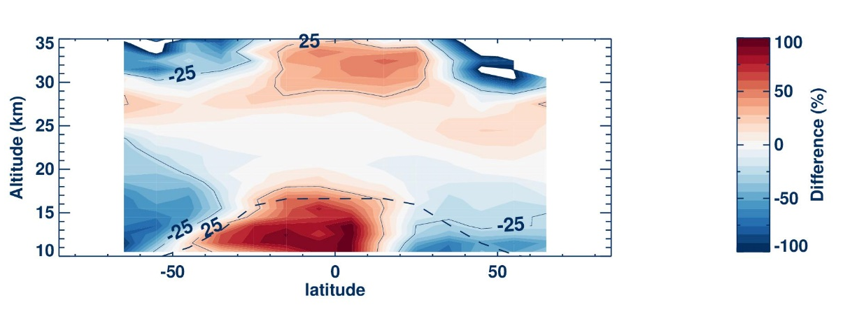
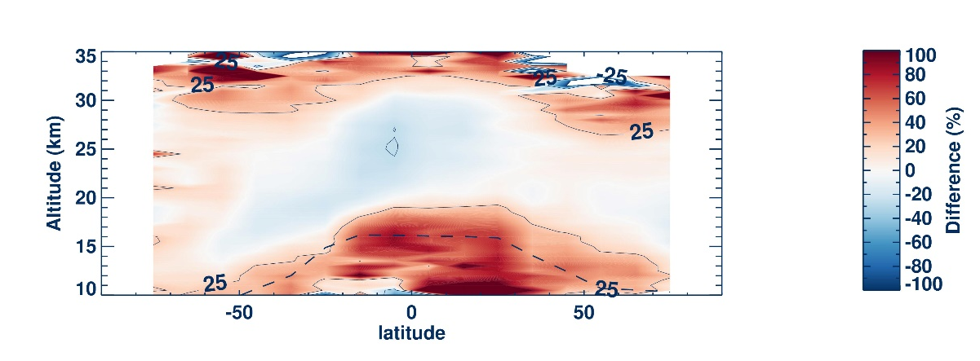
Aerosol mean difference -Summary
CALIPSO – SAGE III
OMPS LP – SAGE III
OSIRIS – SAGE III
Using 520 nm for CALIPSO, 676 nm for OMPS LP, and 755 for OSIRIS.
Differences are mostly <25% or better between -50 & 50 latitude, and 18-25km altitude, better for OSIRIS
Larger difference below 18km in the tropics, mostly caused by cloud contamination
Larger difference above 30km where aerosol is very small, mostly caused by instrument and retrieval uncertainties
OMPS LP shows a negative bias in SH lower altitudes
CALIPSO is high <18km (cloud contamination?)

Slide 13
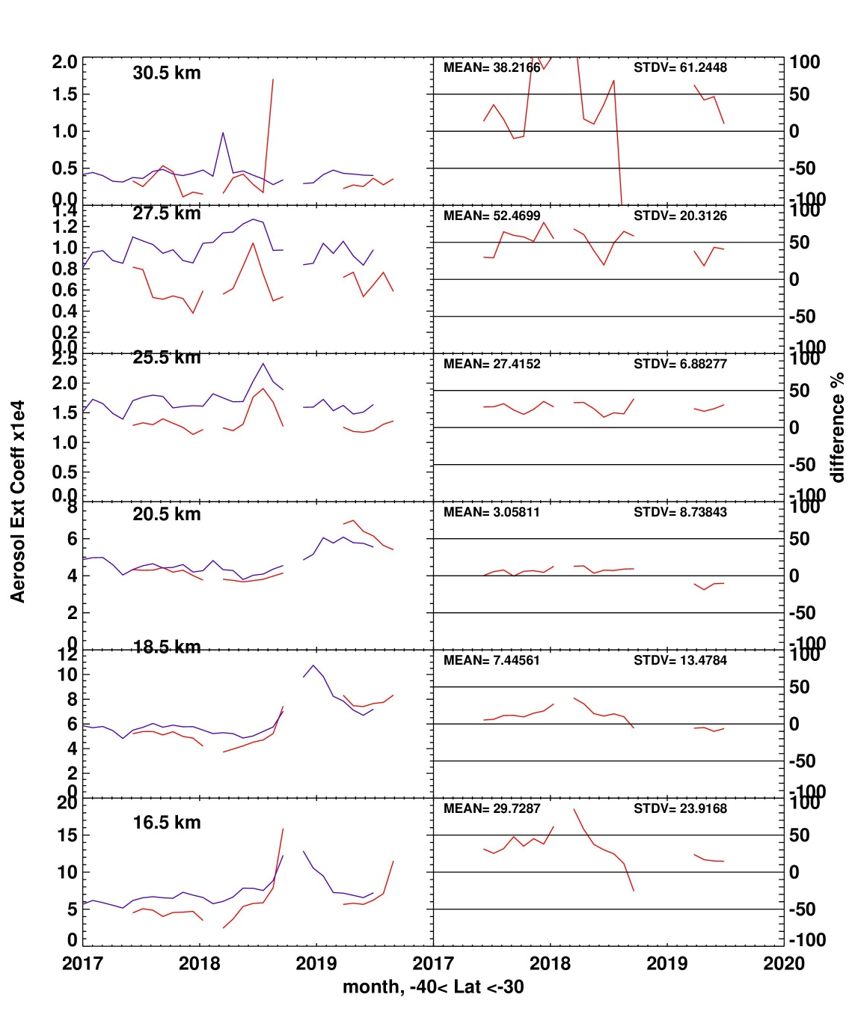
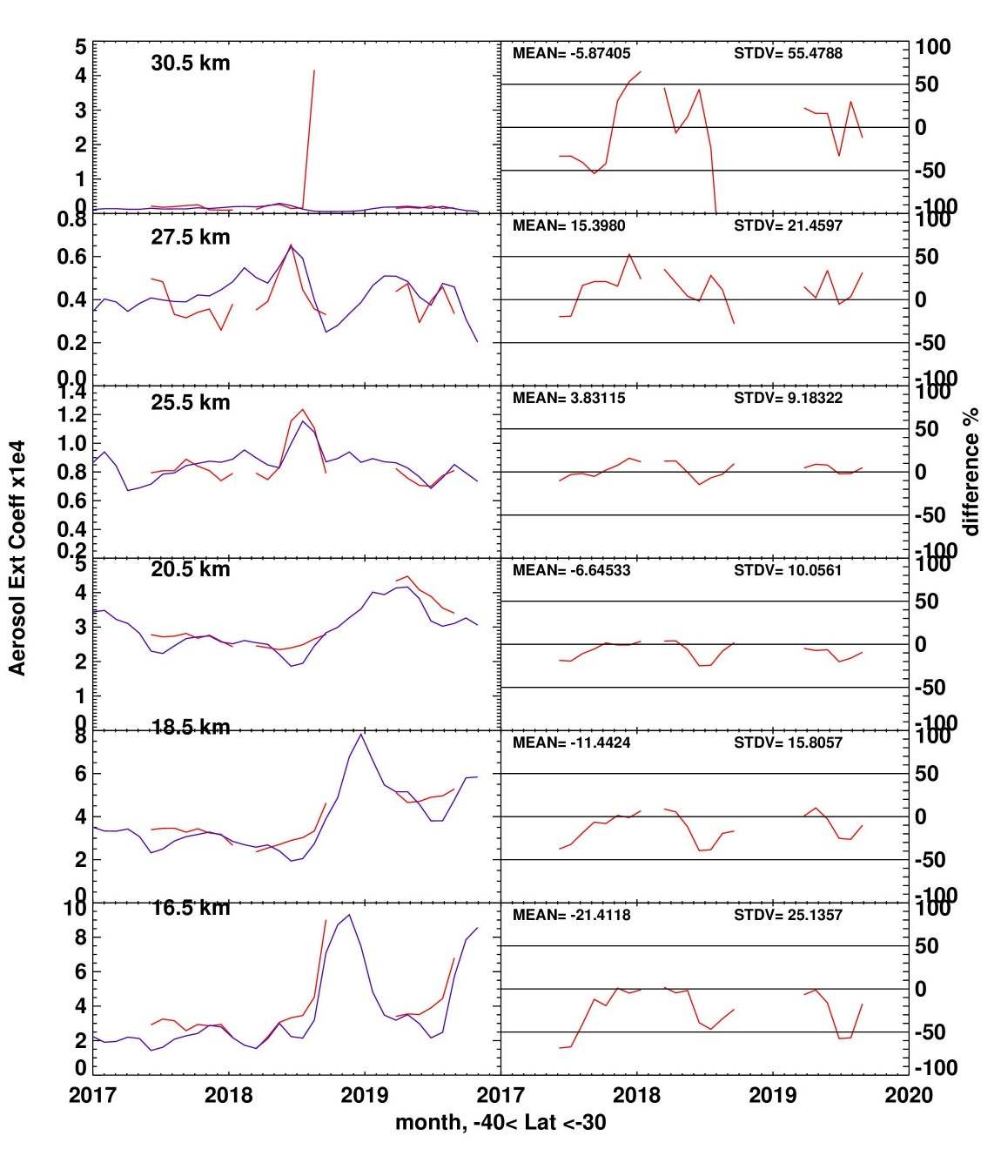
SAGE III monthly zonal means vs. CALIPSO &OMPS (SH)
CALIPSO - SAGE III
OMPS LP - SAGE III

Slide 14
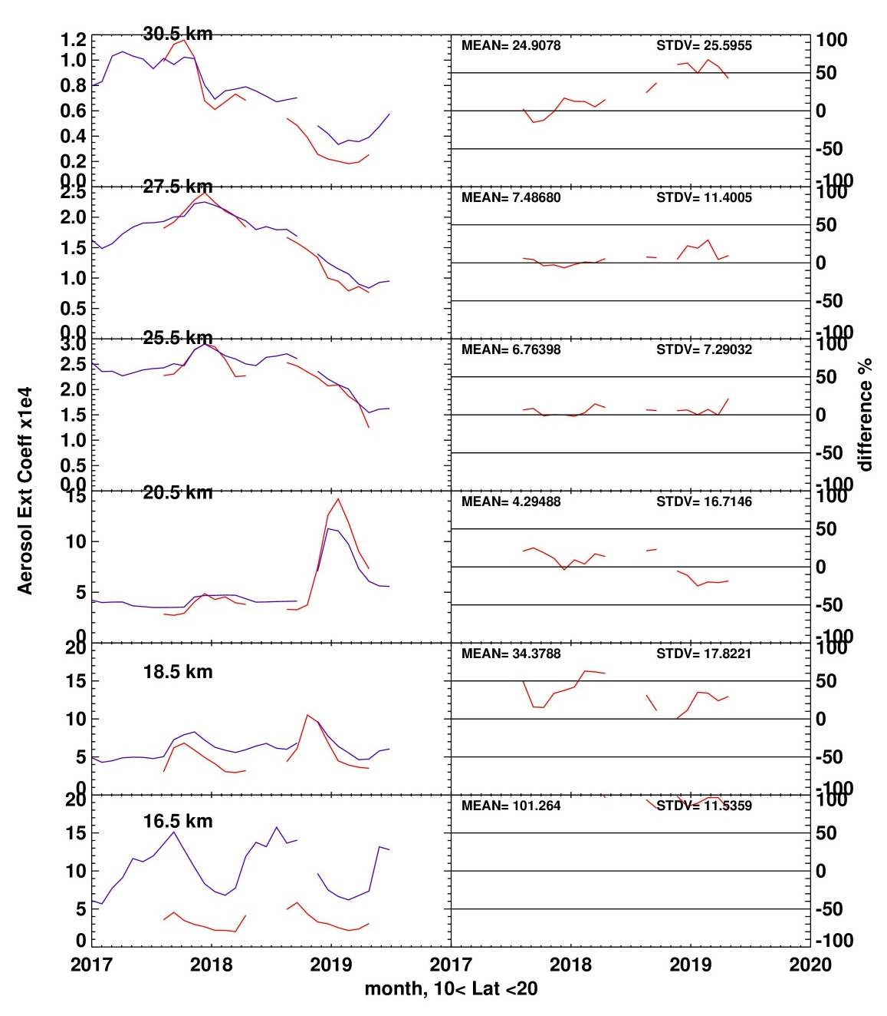
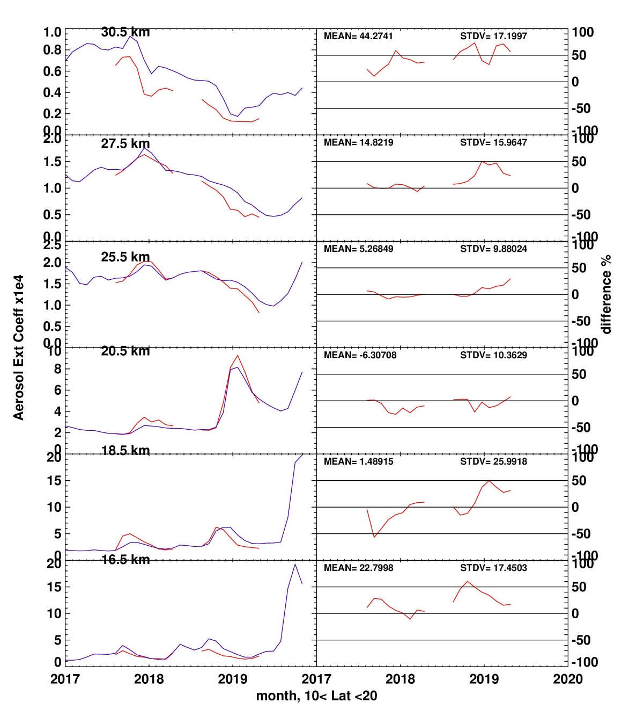
SAGE III monthly zonal means vs. CALIPSO &OMPS (tropics)
CALIPSO - SAGE III
OMPS LP - SAGE III

Slide 15
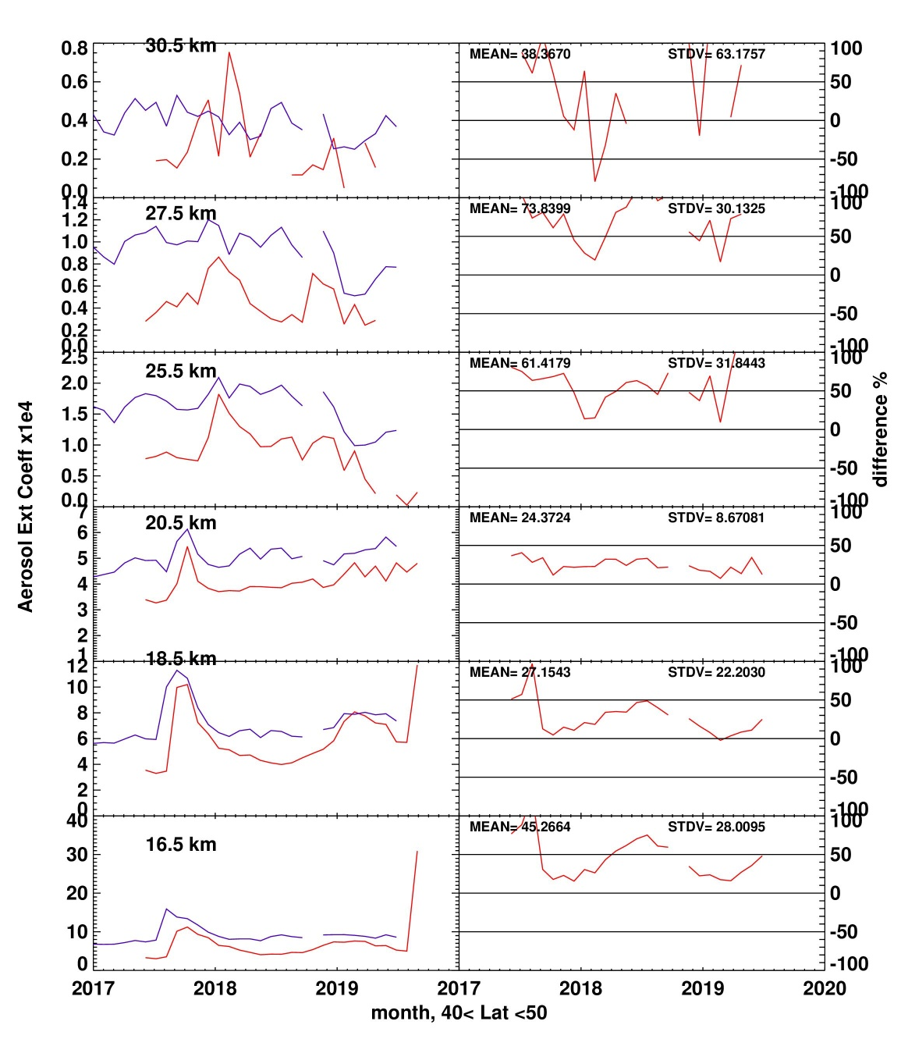
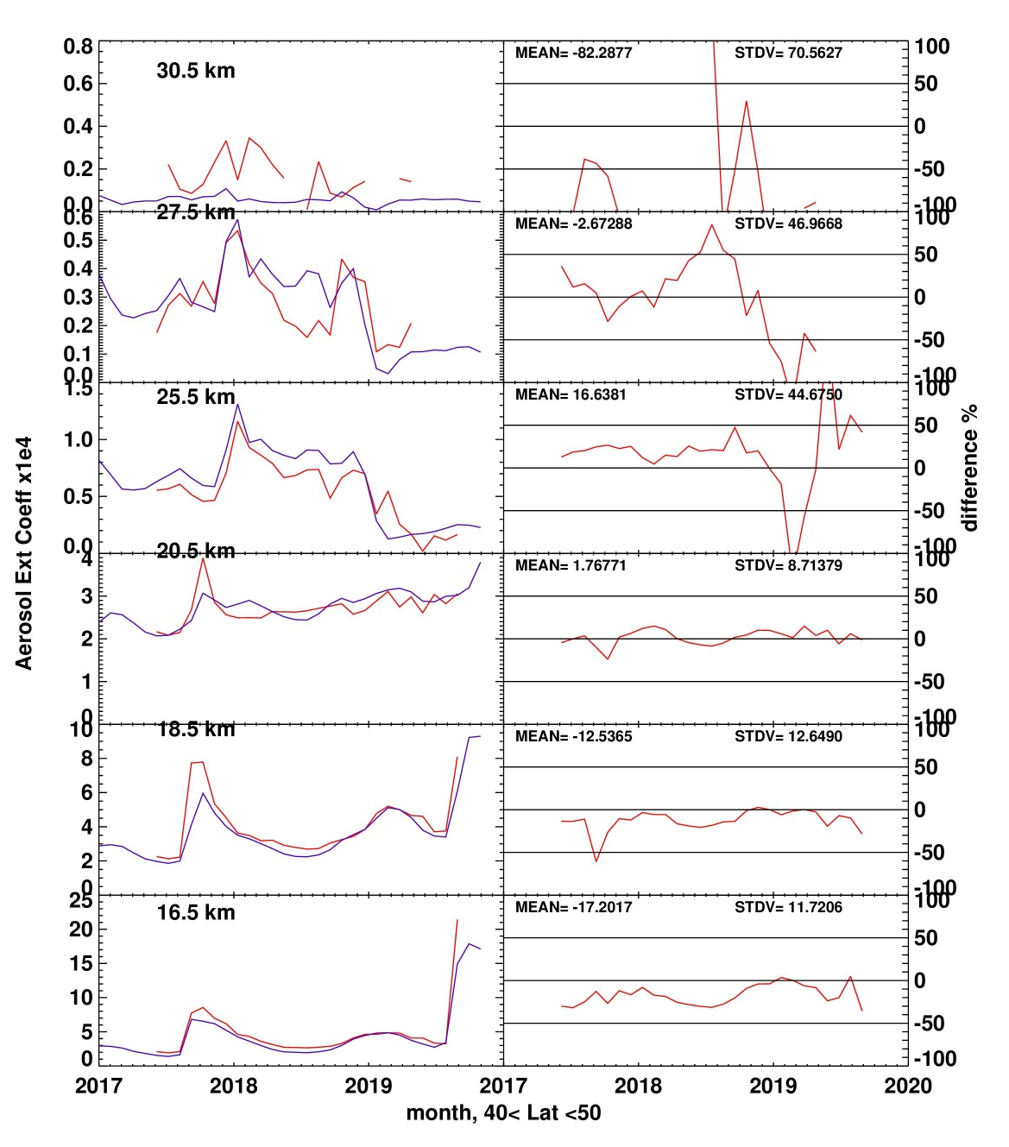
SAGE III monthly zonal means vs. CALIPSO &OMPS (NH)
CALIPSO - SAGE III
OMPS LP - SAGE III

Slide 16
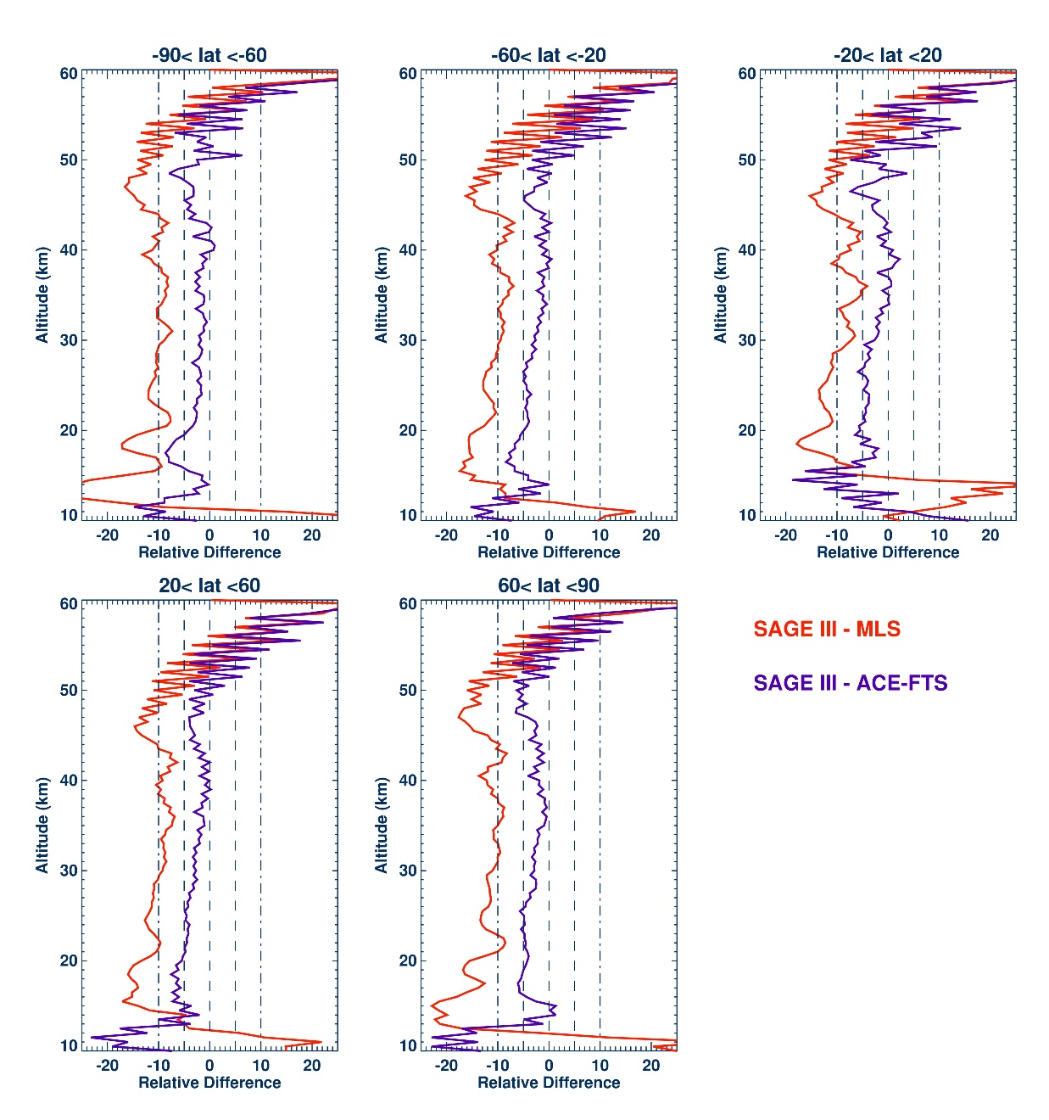
SAGE III H₂O vs. MLS & ACE-FTS
Difference is < 5% with ACE-FTS and 10% with MLS
  Larger difference at 20km in the tropics, mostly caused by aerosol contamination
Noisy profiles above ~48 km

Slide 17
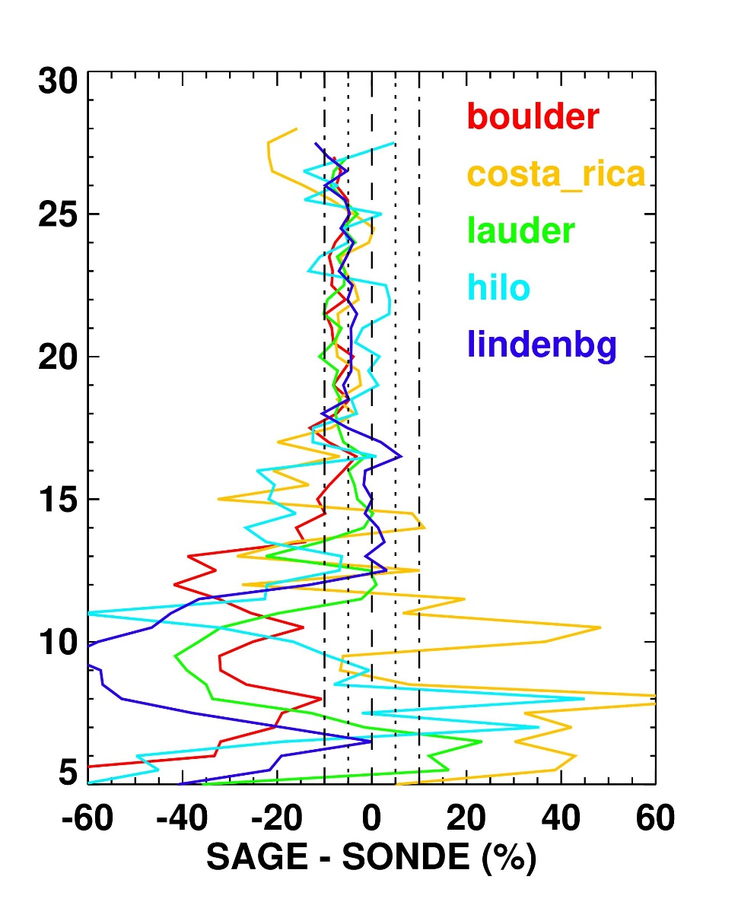
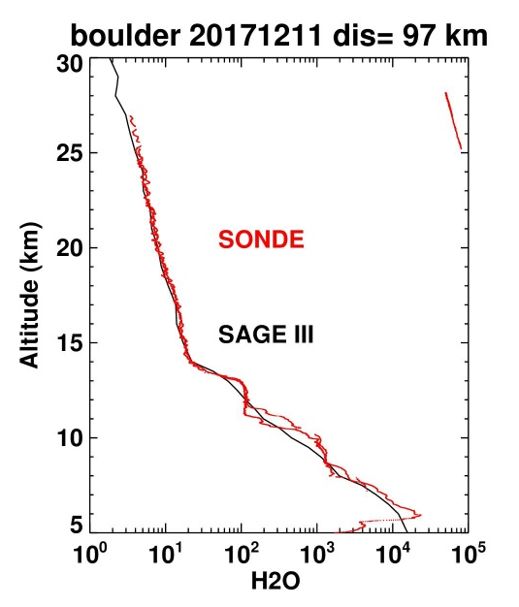

SAGE III H₂O vs Frostpoint Hygrometer
Difference with Frostpoint is 5-10% in the stratosphere, larger in the troposphere
Closer coincidence criteria is needed in the troposphere

Slide 18
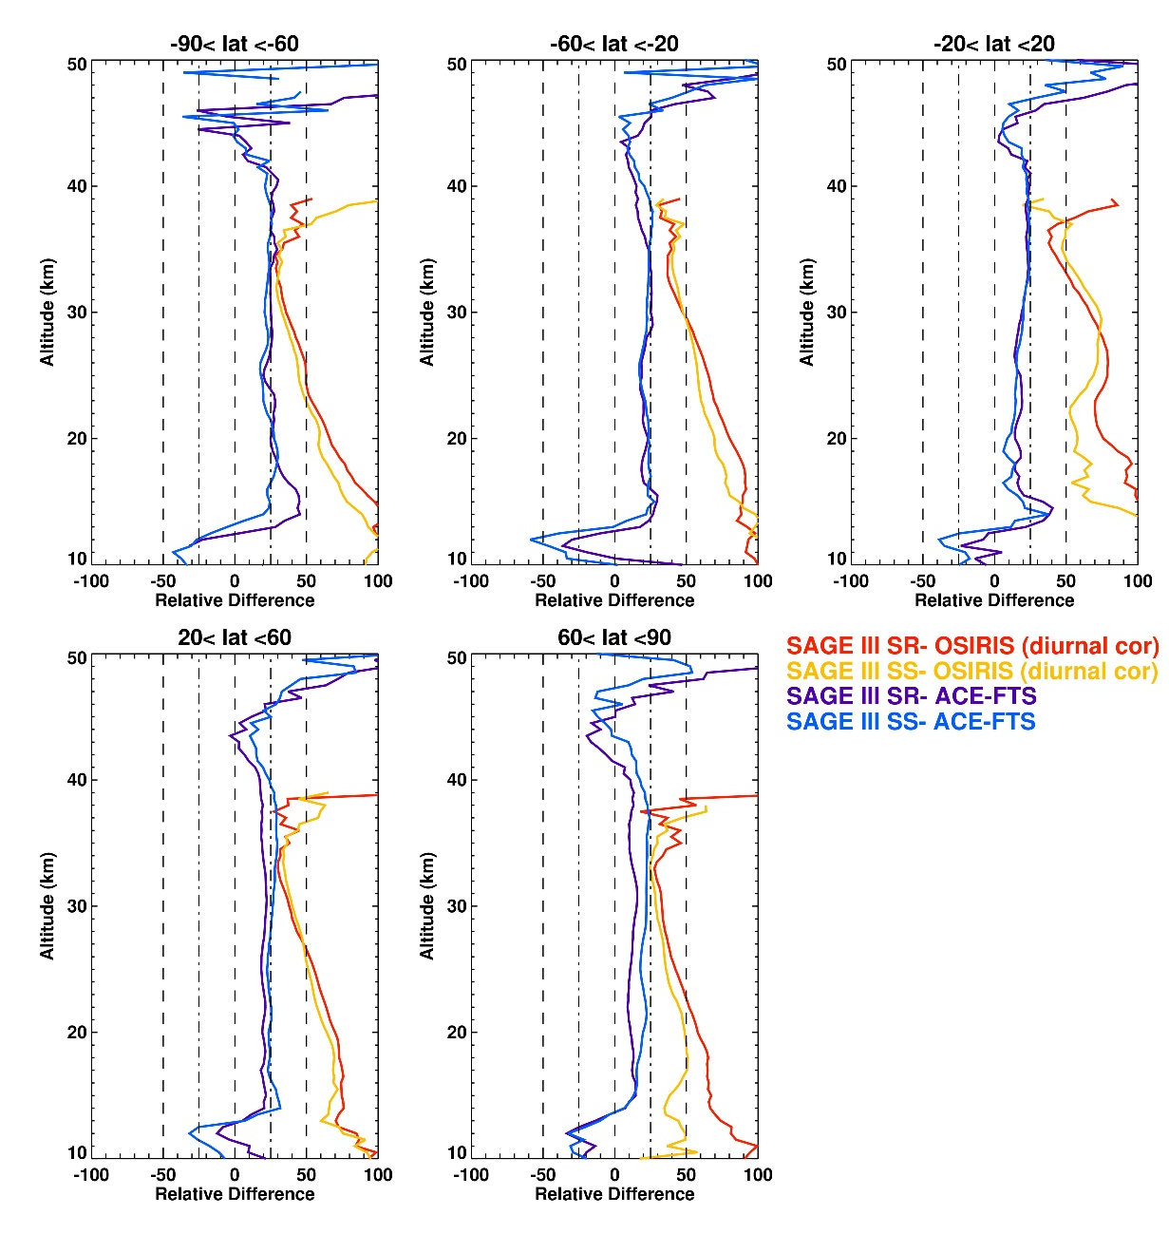
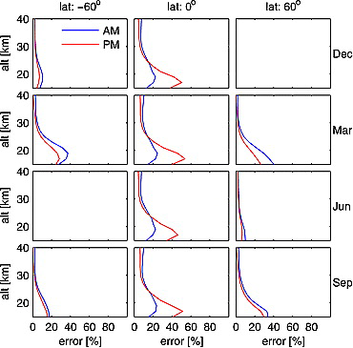
SAGE III NO₂ vs. ACE-FTS & OSIRIS
SAGE III is 25% greater than ACE-FTS
SAGE III is ~30% greater than OSIRIS at 30-40km after applying diurnal corrections
larger bias at lower altitudes because of the diurnal effect of NO₂ variations along SAGE line-of-sight
Brohede at al., 2007 Fig 9: Estimated NO₂ diurnal errors for a typical occultation instrument for a selection of latitudes and months. Diurnal errors arise due to inhomogeneous NO₂ concentrations along the line of sight in conjunction with increasing optical depth at low tangent altitudes.

Slide 19
Summary and conclusion
Ozone
  SAGE III/ISS ozone agrees with MLS within 5%, and with ACE, OSIRIS and OMPS to within 5-10% at altitude range 10-50km.
    Similar agreement with ozonesonde and lidar.
  Model derived diurnal correction improve the comparison with limb instruments above 35km
  SAGE III/ISS tangent height agrees with MLS within 100m.
    SAGE can be used to assess and improve limb scattering instruments’ tangent height registration.
  SAGE III/ISS ozone measurements can be used to continue and improve the ozone long-term records
Aerosol
  SAGE III aerosol measurements agree with OMPS and OSIRIS within 25%
    Can be used to continue and improve the stratospheric aerosol records
    Can provide good information about the aerosol particle size of recent events

Slide 20
Summary and conclusion
Water Vapor
    5% dry compared to ACE and 10 % compared to MLS. Difference with Frostpoint hygrometer is 5-10%
    Promising measurements in the troposphere but needs tighter coincidence criteria or trajectory mapping for better validation.
      Bias low in the presence of high aerosol loading or clouds
  NO₂
  Positive bias of 25-30%
    Larger biases with OSIRIS because of the diurnal effect of the NO₂ variations along SAGE line-of-sight

