Slide 1
Validation of SAGE III/ISS solar ozone data with correlative satellite and ground based measurements
H.J. (Ray) Wang¹, Robert Damadeo², David Flintter², Natalya Kramarova³, Ghassan Taha⁴, Sean Davis⁵ , Anne Thompson³, Susan Strahan⁴, Yuhang Wang¹, Lucien Froidevaux⁶, Doug Degenstein⁷, Adam Bourassa⁷, Wolfgang Steinbrecht⁸, Kaley Walker⁹
¹Georgia Institute of Technology, Atlanta, GA USA;
²NASA Langley Research Center, Hampton, VA USA;
³Earth Science Division, NASA/code 614, Greenbelt, MD USA;
⁴Universities Space Research Associaton, NASA/code 614, Greenbelt, MD USA;
⁵NOAA ESRL Chemical Sciences Division, Boulder, CO USA;
⁶Jet Propulsion Laboratory, California Institute of Technology, Pasadena, CA, USA ;
⁷Institute of Space and Atmospheric Studies, University of Saskatchewan, Saskatoon, Saskatchewan, Canada;
⁸Deutscher Wetterdienst, Hohenpeissenberg, Germany;
⁹Department of Physics, University of Toronto, Canada;
SAGE III-ISS Science Team Meeting, NASA Langley, VA, USA Oct. 29-30, 2019

Slide 2
Outline
SAGE III/ISS retrieved (v5.1) solar ozone data
  AO3, MLR, MES ozone
  Which ozone product is better?
  What’s the accuracy and precision?
Correlative measurements and methodology used to validate SAGE III/ISS ozone data
  Aura MLS, OSIRIS, ACE-FTS, OMPS LP
  Ozonesondes, lidar
Validation results/Summary
Caveats of v5.1 algorithm and future works

Slide 3
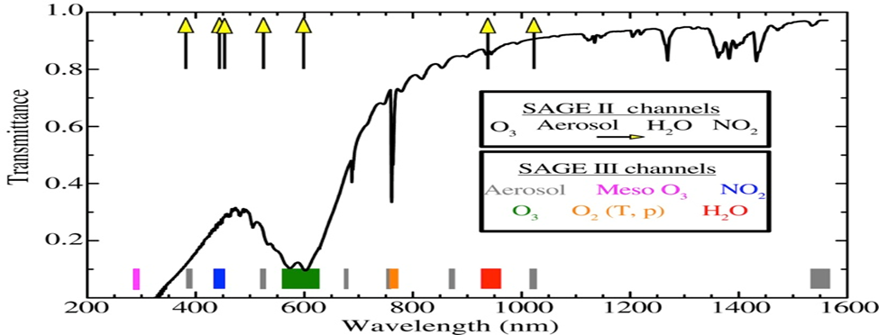
SAGE III-ISS retrieved solar ozone data
There are three solar ozone products
  AO3, MLR ozone (visible channel)
  MES ozone (UV channel)

Slide 4
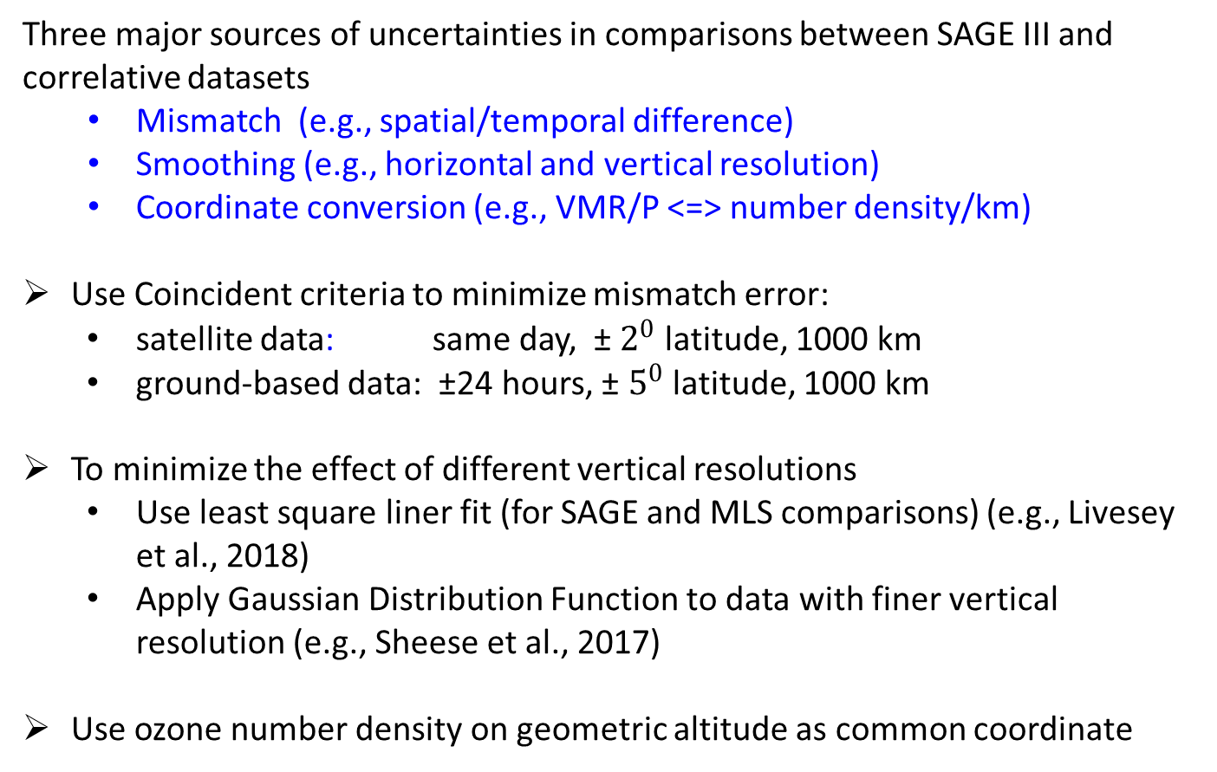
Methodology
Three major sources of uncertainties in comparisons between SAGE III and correlative datasets
  Mismatch (e.g., spatial/temporal difference)
  Smoothing (e.g., horizontal and vertical resolution)
  Coordinate conversion (e.g., VMR/P <=> number density/km)
Use Coincident criteria to minimize mismatch error:
  satellite data: same day, ± $2^{0}$ latitude, 1000 km
  ground-based data: ±24 hours, ± $5^{0}$ latitude, 1000 km
To minimize the effect of different vertical resolutions
  Use least square liner fit (for SAGE and MLS comparisons) (e.g., Livesey et al., 2018)
  Apply Gaussian Distribution Function to data with finer vertical resolution (e.g., Sheese et al., 2017)
Use ozone number density on geometric altitude as common coordinate

Slide 5
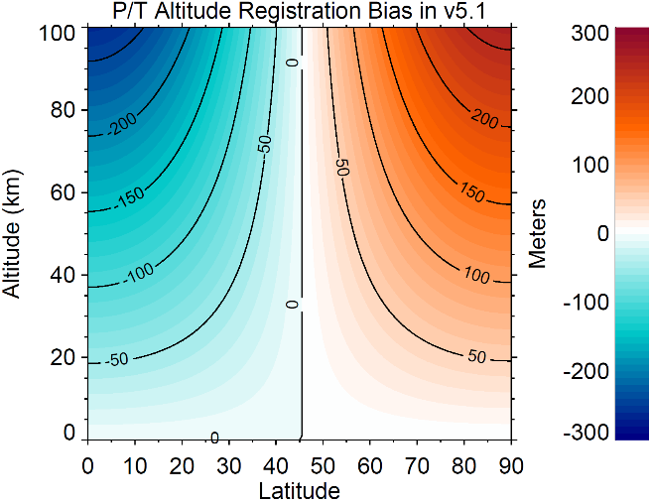
Methodology (continue)
Use ozone number density on geometric altitude as common coordinate
  There is an altitude registration error of ~100 m in SAGE III/ISS (v5.1) T/P profiles (simplicity of conversion from MERRA-2 geopotential height to geometric altitude)
  Use MERRA-2 T/P data to convert Aura MLS ozone from VMR/P to number density/km coordinate

Slide 6
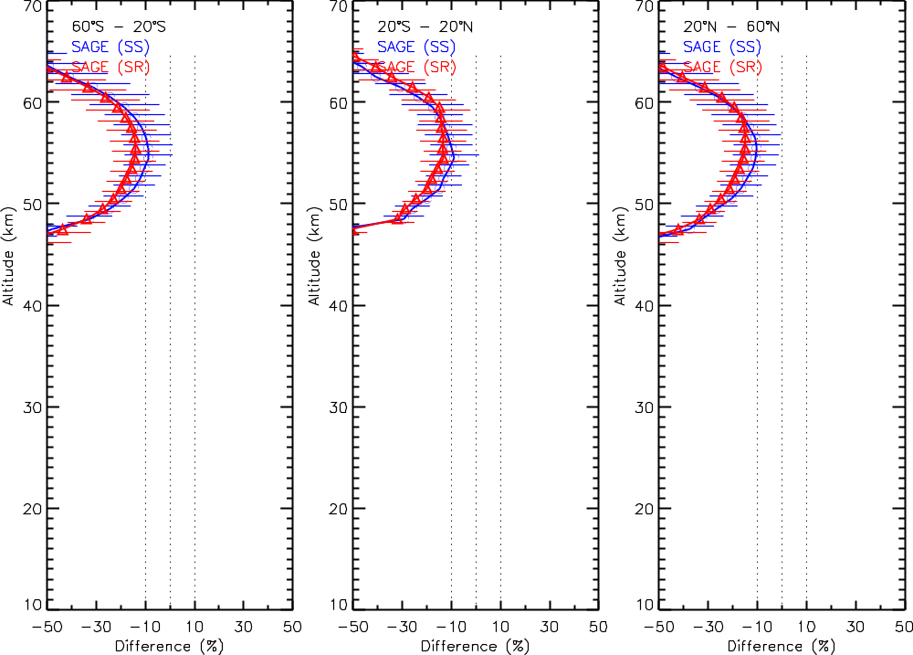
Mean diff. and std. dev. between SAGE III MES (v5.1) O3 and Aura MLS (nighttime), (sage3 –mls)/mls *100%
Mesospheric (“MES”) ozone product is affected by stray light (negative impact on retrieved ozone), and not recommended for scientific study

Slide 7
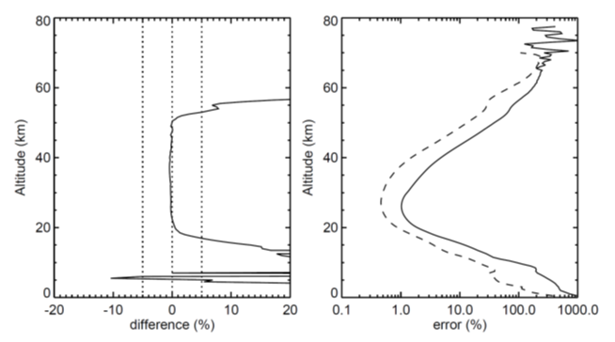
“AO3” vs “MLR” ozone product
Mean differences and reported errors between SAGE III/ISS MLR and AO3 ozone data (between June 2017 and May 2019)
(MLR-AO3)/AO3*100%
reported uncertainty
MLR ozone values are larger than AO3 for altitudes below 20 km and above ~50km
AO3
MLR
MLR ozone values show larger uncertainties

Slide 8
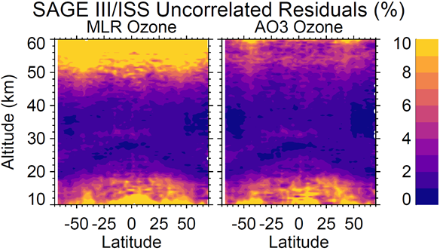
Comparisons of uncertainty between “AO3” and “MLR” ozone product
Spreads of the uncorrelated residuals (by regression model, e.g., Damadeo et al., 2014)
The uncorrelated residuals between AO3 and MLR are similar (~1-3%) for most stratosphere
The MLR ozone, however, are nosier in the UT/LS and above the upper stratosphere

Slide 9
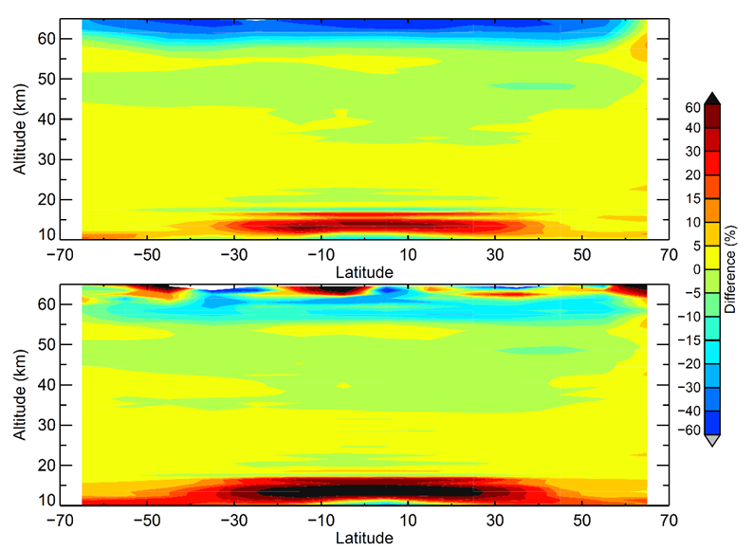
Mean percentage differences between SAGE III/ISS and correlative Aura MLS nighttime ozone data (between 6/2017 and 5/2019)
“AO3” vs “MLR” ozone product
(AO3-MLS)/MLS
(MLR-MLS)/MLS

Slide 10
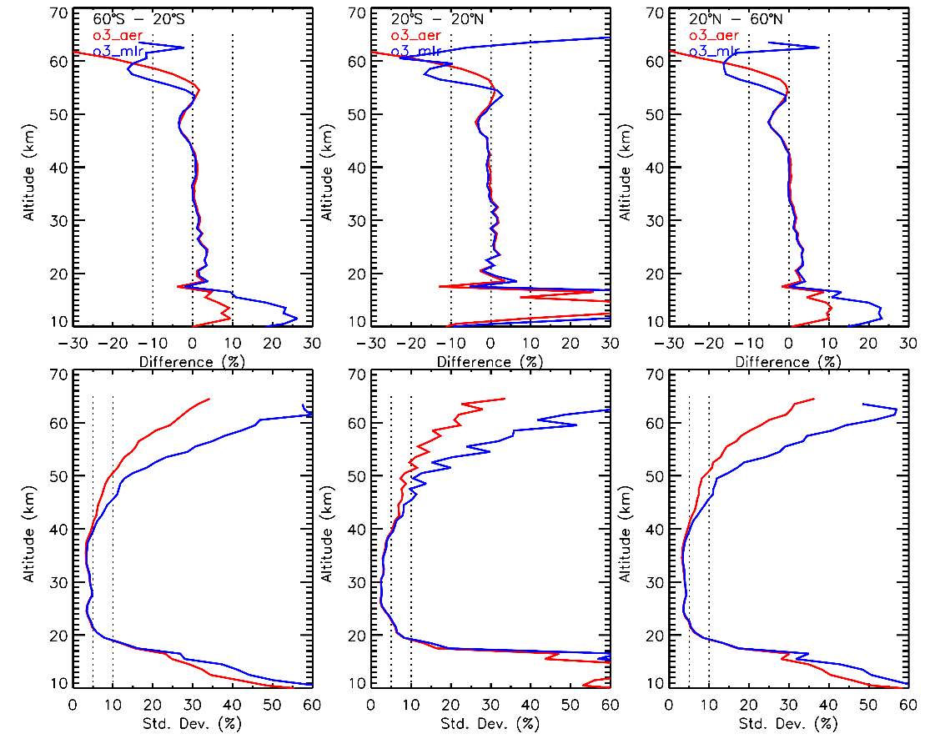
Mean Differences and Standard Deviations between Aura-MLS (V4.23) (nighttime) and SAGE III/ISS (V5.1) Ozone, (sage3-mls)/mls*100%
AO3 MLR
AO3 is better than MLR ozone product
MLR ozone values show larger biases and uncertainties In the UT/LS and above the upper stratosphere
Similar results can be seen in comparisons with other satellites (figures not shown)

Slide 11
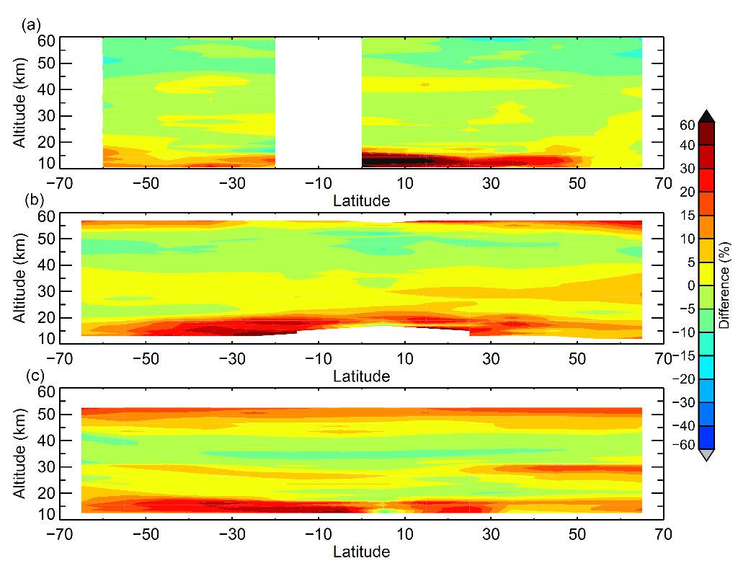
Mean percentage differences between SAGE III/ISS AO3 and correlative satellite measurements
(SAGE3 - ACE-FTS)
(SAGE3 - OSIRIS)
(SAGE3 – OMPS LP)
thermal sensitivity problem in OMPS LP (Kramarova et al., 2018)

Slide 12
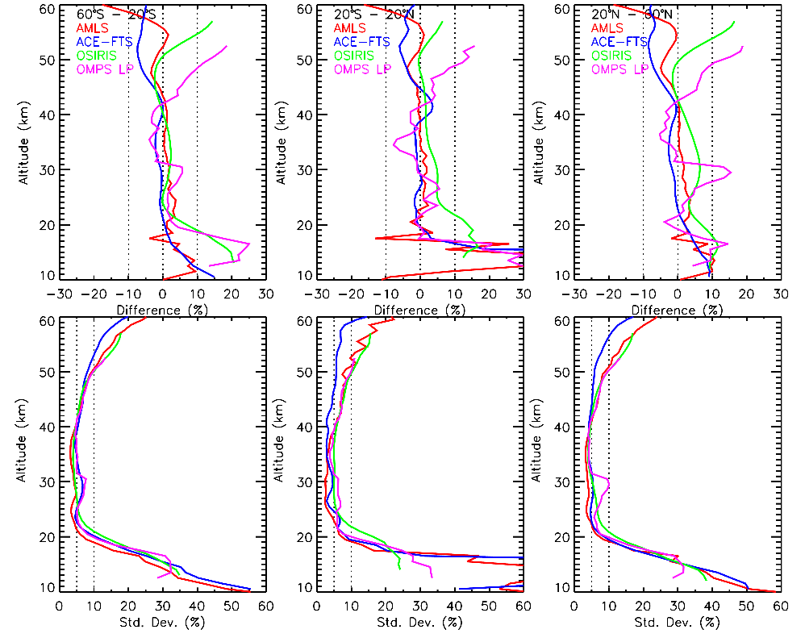
Mean Differences and Standard Deviations between SAGE III/ISS (V5.1) and Correlative Satellite Ozone Measurements, (sage3-other)/other*100%
Aura MLS (v4.23)
ACE-FTS (v3.6)
OSIRIS (v5.1)
OMPS LP (v2.5)

Slide 13
Collocated ozonesonde data (6/2017-5/2019)
Station | Latitude | Longitude | Data source | Coincident profiles
Hohenpeissenberg | 47.80 | 11.00 | WOUDC | 53
Payerne | 46.49 | 6.57 | WOUDC | 56
Trinidad Head | 41.06 | -124.15 | NOAA | 13
Boulder | 39.95 | -105.20 | NOAA | 21
Tsukuba | 36.06 | 140.13 | WOUDC | 17
Huntsville | 34.73 | -86.85 | NOAA | 8
Hilo | 19.40 | -155.40 | SHADOZ/NOAA | 8
Costa Rica | 9.94 | -84.04 | SHADOZ | 5
Paramaribo | 5.80 | -55.20 | SHADOZ | 1
Kuala Lumpur | 2.73 | 101.70 | SHADOZ | 7
Nairobi | -1.30 | 36.80 | SHADOZ | 6
Natal | -5.40 | -35.40 | SHADOZ | 3
Ascension Is. | -7.56 | -14.22 | SHADOZ | 5
Am. Samoa | -14.20 | -170.60 | SHADOZ/NOAA | 3
Fiji | -18.10 | 178.40 | SHADOZ | 5
La Reunion Is. | -21.10 | 55.50 | SHADOZ | 1
Irene | -25.90 | 28.20 | SHADOZ | 4
Broadmeadows | -37.69 | 144.95 | WOUDC | 13
Lauder | -45.04 | 169.68 | WOUDC | 29
Macquarie Is. | -54.50 | 158.94 | WOUDC | 13

Slide 14
Collocated lidar data (6/2017-5/2019)
Station | Latitude | Longitude | Data source | Coincident profiles
Hohenpeissenberg | 47.80 | 11.00 | NDACC | 38
OHP | 43.92 | 5.71 | NDACC | 46
Table Mtn. | 34.5 | -117.7 | NDACC | 45
Mauna Loa | 19.47 | -155.60 | NDACC | 30
Lauder | -45.04 | 169.68 | NDACC | 13

Slide 15
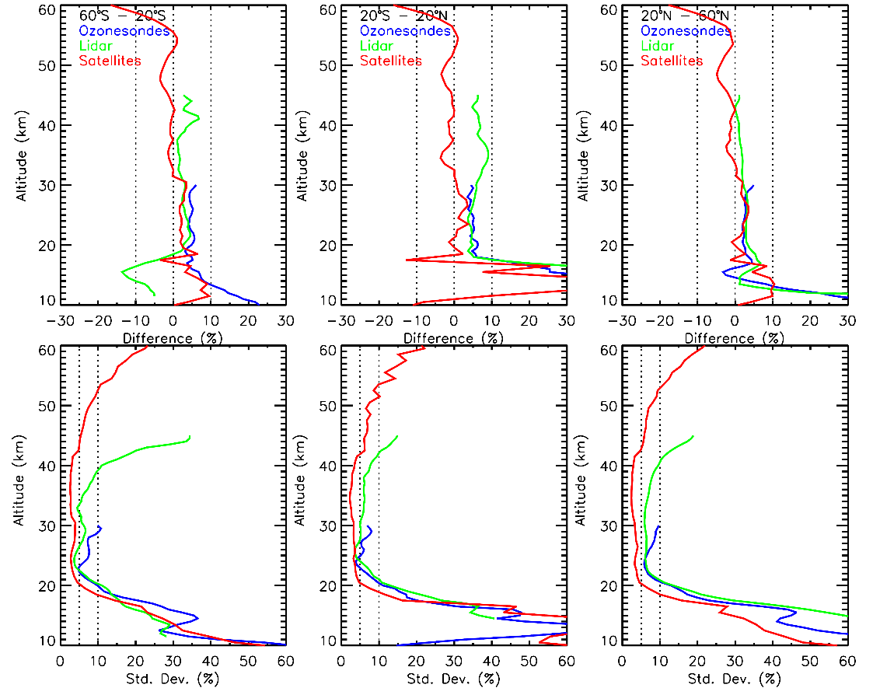
Mean Differences and Standard Deviations between SAGE III/ISS (v5.1) and Correlative Ozone Measurements, (sage3-other)/other*100%
Satellites
Ozonesondes
Lidars
Standard deviations are not suitable for estimated precisions in the UT/LS

Slide 16

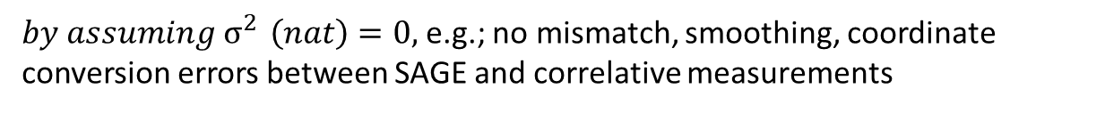
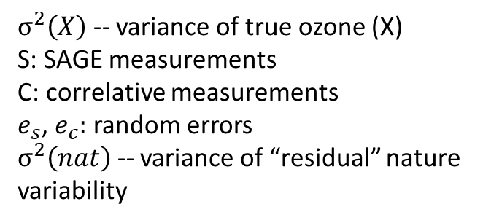

Estimating Ozone Variability and Measurement Uncertainties
$$σ^{2}\left(S\right)=σ^{2}\left(X\right)+σ^{2}\left(e_{s}\right)$$
$σ^{2}\left(X\right)$ -- variance of true ozone (X)
S: SAGE measurements
C: correlative measurements
$e_{s}$, $e_{c}:$ random errors
$σ^{2}\left(nat\right)$ -- variance of “residual” nature variability
$$σ^{2}\left(C\right)=σ^{2}\left(X\right)+σ^{2}\left(e_{c}\right)$$
$$σ^{2}\left(S−C\right)={σ^{2}\left(e_{s}\right)}^{ }+σ^{2}\left(e_{c}\right)+σ^{2}\left(nat\right)$$
${by assuming σ}^{2 }\left(nat\right)=0,$e.g.; no mismatch, smoothing, coordinate conversion errors between SAGE and correlative measurements
$σ^{2}\left(X\right)={1/2(σ}^{2}\left(S\right)+σ^{2}\left(C\right)$ $−{ σ}^{2}(S−C))$
${σ^{2}\left(e_{s}\right)}^{ }={1/2(σ}^{2}\left(S\right)−σ^{2}\left(C\right)$ $+{ σ}^{2}(S−C))$
${σ^{2}\left(e_{c}\right)}^{ }={1/2(σ}^{2}\left(C\right)−σ^{2}\left(S\right)$ $+{ σ}^{2}(S−C))$
from Fioletov et al. (2006)

Slide 17
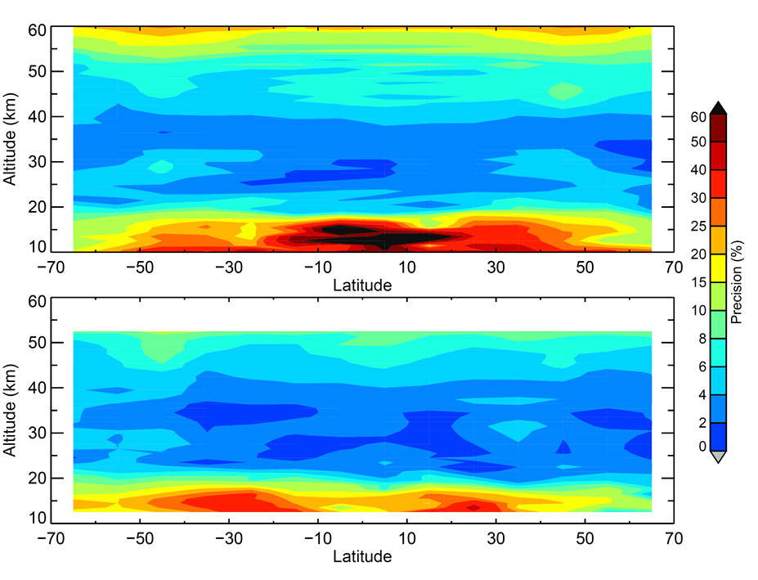
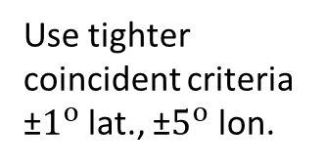
Estimated precisions of SAGE III/ISS (v5.1) AO3 ozone by comparisons with correlative satellite data
Compared with Aura MLS
Use tighter coincident criteria ±$1^{o}$ lat., ±$5^{o}$ lon.
Compared with OMPS LP

Slide 18
Summary
Among the three SAGE III/ISS solar ozone products, the AO3 ozone has the best accuracy and precision.
  “MES” ozone retrieval is affected by stray light and not suitable for scientific study
  “MLR” ozone is almost identical to “AO3” ozone except in the UT/LS and above the upper stratosphere, where it shows larger biases (by ~10% or higher) and uncertainties (by a factor 2 to 3).
AO3 (v5.1) ozone | In the mid-latitudes | In the tropics
Accuracy | within 5% ( ~15 – 55 km) | within 5% (~20 – 55 km)
 | ~10% (positive bias) near the tropopause
Precisions | ~3% (20 – 40 km)
 | ~10-15% (in the lower stratosphere, ~55 km)
 | ~20-30% (near the tropopause)

Slide 19
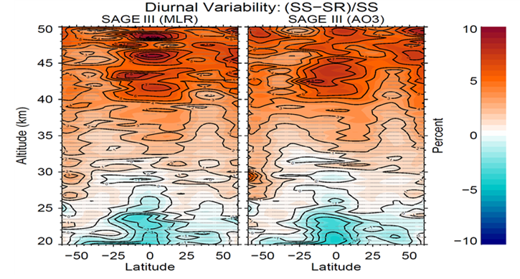
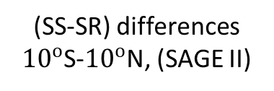
Known caveats in SAGE III/ISS v5.1 algorithm
(sunrise/sunset differences)
(SS-SR) differences ${10}^{o}$S-${10}^{o}$N, (SAGE II)
(SS-SR) differences
(SAGE III/ISS)
(Sakazaki et al., 2015)

Slide 20
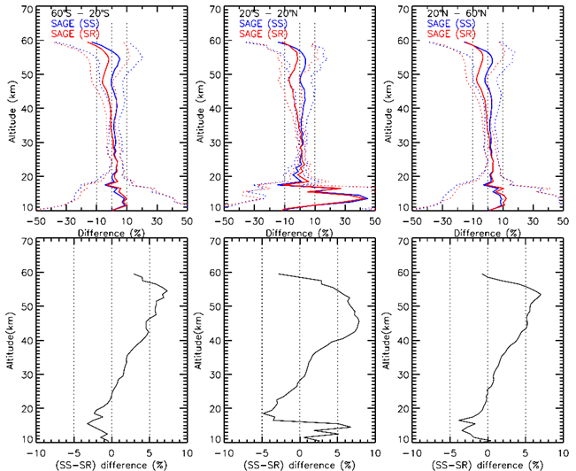
Known caveats in SAGE III/ISS v5.1 algorithm
(sunrise and sunset differences)
(SAGE-MLS)/MLS
(SS-SR)/MLS

Slide 21
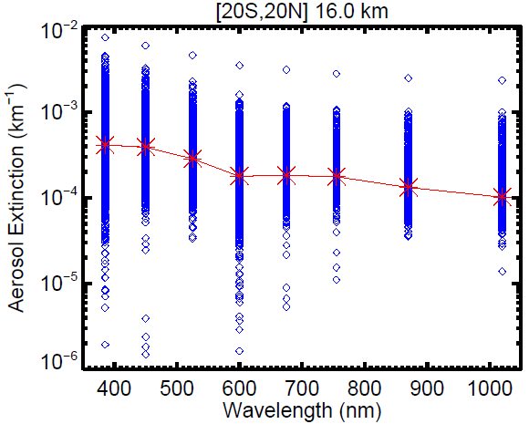
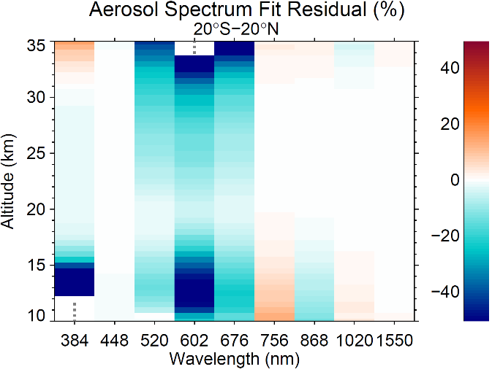
Known caveats in SAGE III/ISS v5.1 algorithm
(positive ozone biases in the UT/LS)
Aerosol extinctions (from MLR algorithm) show a “dip” near 600 nm in the UT/LS
The deviation (“dip”) increases with decreasing altitudes
Preliminary studies indicate the contributions of oxygen dimer are not appropriately removed from ozone channel (cause positive biases)

Slide 22
Summary: known caveats in SAGE III/ISS v5.1 algorithm (Future Works)
“MES” ozone retrieval is affected by stray light problem
Altitude registration error of ~100 m in auxiliary T/P profiles
Larger sunrise/sunset differences (~5-8%)
  reason is still unknown
  occurs in both SAGE II and SAGE III (it suggests it could be algorithm related)
Positive ozone biases in the UT/LS
  Preliminary studies indicate it mainly results from oxygen dimer not being appropriately removed from ozone channel

