Slide 1
Validation of SAGE-III/ISS Ozone and Aerosol Profiles
Using the JPL Lidars at Table Mountain Facility, CA
and Mauna Loa Observatory, HI
Thierry Leblanc, Fernando Chouza
and the JPL-TMF Lidar Tech Team:
M. Brewer
D. Koon
P. Wang
Jet Propulsion Laboratory, California Institute of Technology
Wrightwood, CA USA

Slide 2
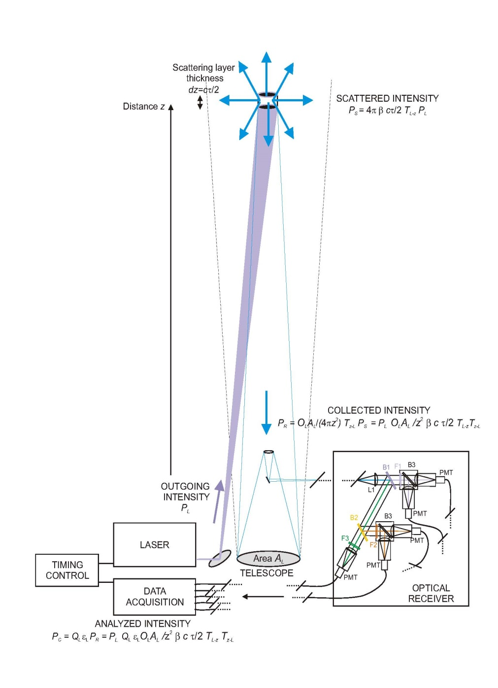
Ozone DIAL Principle
DIfferential Absorption Lidar
2
1. Two laser beams of different wavelengths
are sent in the atmosphere
2. Light is backscattered by molecules and
particles
3. Light is collected in optical channels
3
4. Signals are sampled as a function of
time (i.e., altitude)
1
4

Slide 3
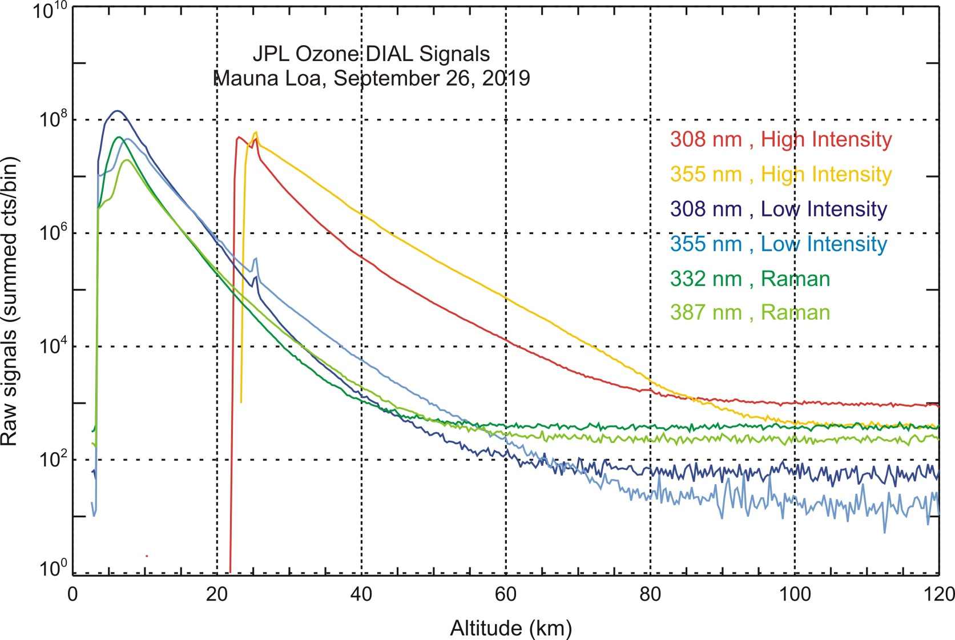
Ozone DIAL Retrieval
5. One beam is more absorbed by ozone than the other beam
Ozone Number Density is computed from the difference of
signal slope at the two wavelengths
5

Slide 4
JPL Stratospheric Ozone Lidars Quick Facts
Mauna Loa stratospheric Ozone DIAL (MLSOL):
- Emitter uses 2 excimer lasers (308 nm) and 1 Nd:YAG laser (355 nm)
- 6-channel receiver :
- Rayleigh 308/355 nm, high intensity, for z > 30 km
- Rayleigh 308/355 nm, low intensity, for z < 35 km
- Raman 332/387 nm, z < 35 km
- Retrieved species:
- Ozone, 15-50 km, effective vertical resolution: 0.5 to 4 km
- Temperature, 15-90 km , effective vertical resolution: 0.5 to 2 km
- Aerosol backscatter, 15-50 km , effective vertical resolution: 0.5 to 2 km
- 3-4 nighttime profiles per week
- Full dataset covers period 1993 – Present
Table Mountain stratospheric Ozone DIAL (TMSOL):
- Instrumentation and design similar to MLSOL
- Same retrieved species as MLSOL
- 4-5 nighttime profiles per week
- Full dataset covers period 1988 - Present

Slide 5
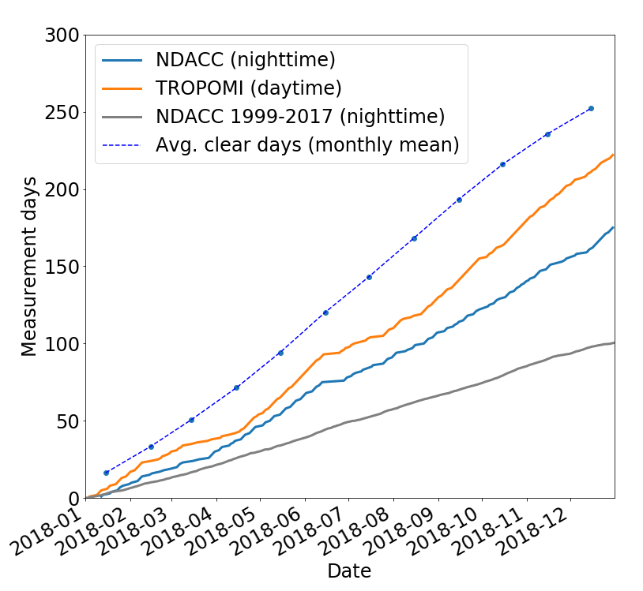
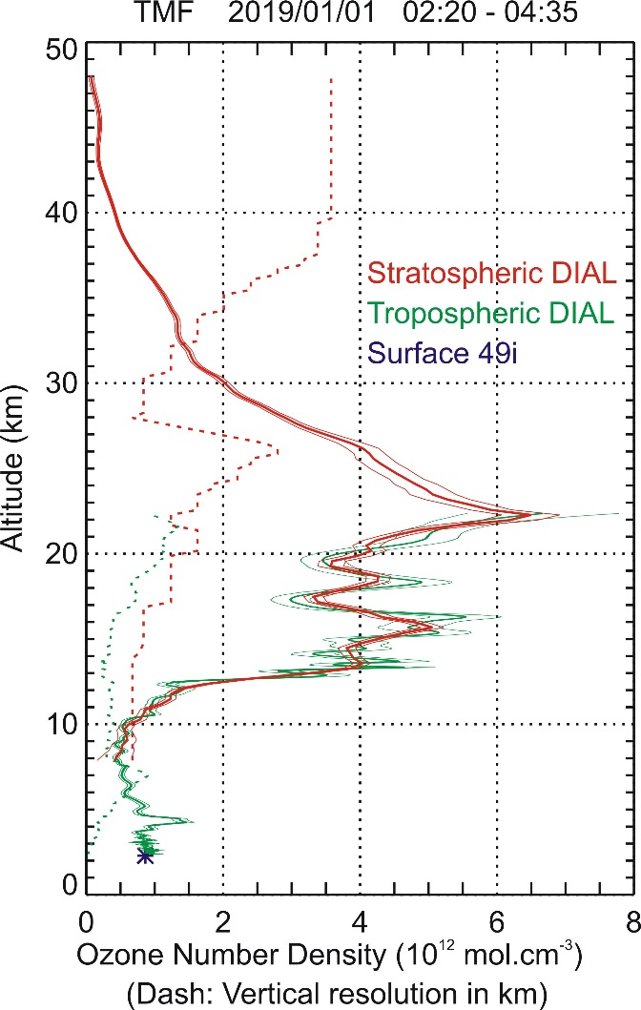
What’s new since 2018: TMF Lidars Upgraded
Automation:
Very-near range channel on Tropo DIAL:
More measurements, any day, any time
Now covering altitudes down to 90 m a.g.l.
In 2018
1999-2017 average
➔ Now easier to get measurements for
ALL SAGE-III/ISS coincident events
Full O3 column, ground to 50 km, using combination ⬅
of surface, UAV, tropo. DIAL and strato. DIAL
Chouza, F., et al., 2019: Atmos. Meas. Tech., http://doi.org/doi:10.5194/amt-12-569-2019

Slide 6
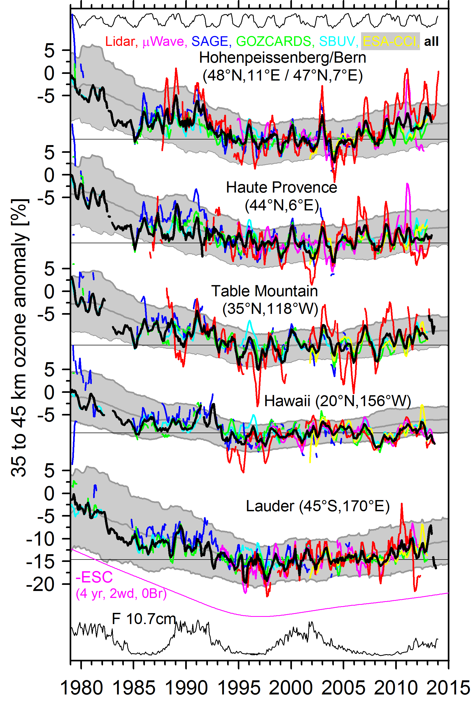
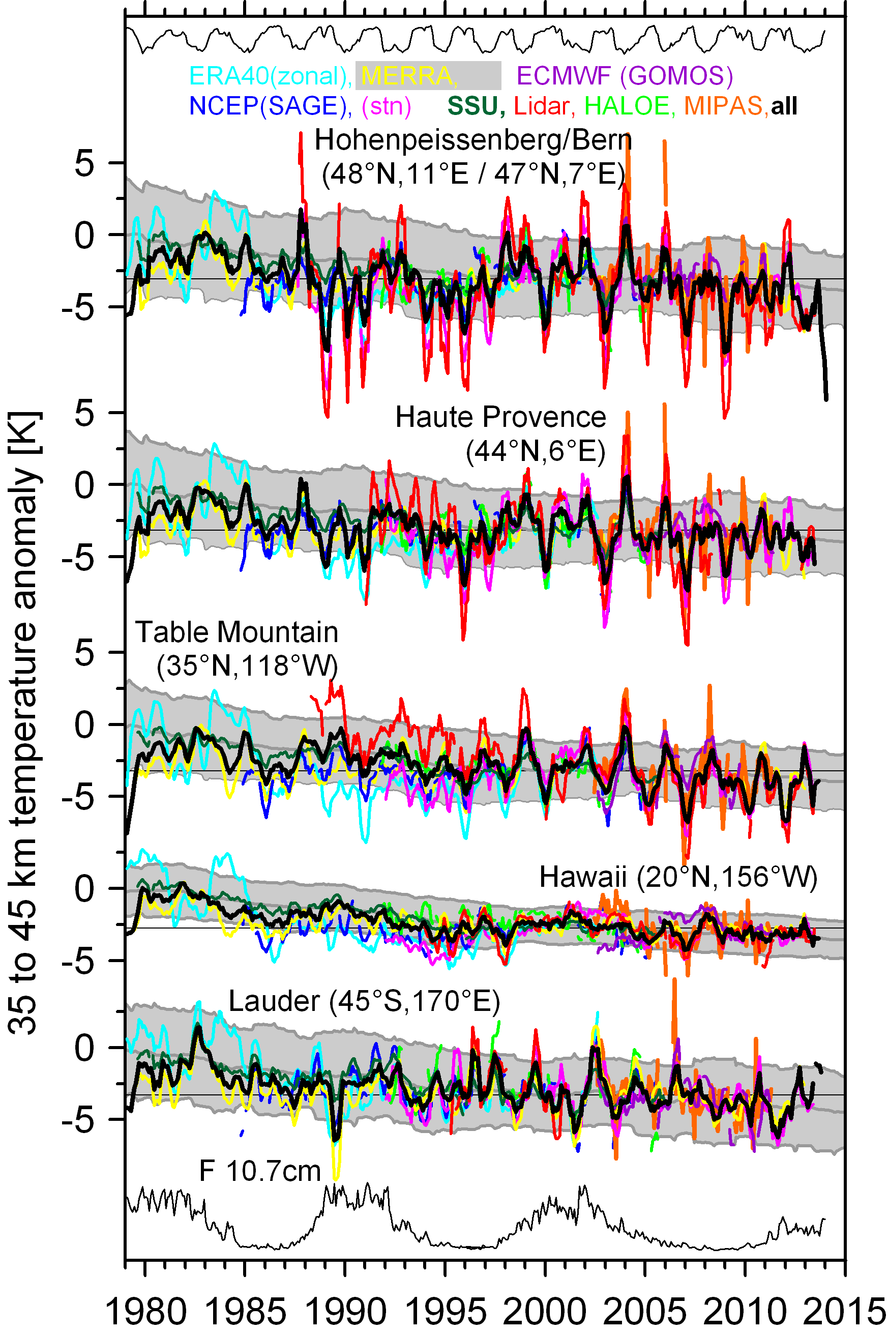
Ozone and Temperature Long-term Records at TMF and MLO
Stratospheric ozone
Temperature
Contribute to
the ground-based
datasets used for
the assessment of
long-term trends
Courtesy of
Wolfgang Steinbrecht

Slide 7
Comparisons with SAGE-III/ISS
Products
- Lidar: GLASS v1 O3 ND (new data processing for NDACC, to be archived 2019)
- SAGE-III/ISS AO3 v5.1 O3 ND, all event types (SR, SS, lunar)
- Aura-MLS v4.2 O3 VMR converted to ND (vs. geom. alt.) using MERRA-2 P/T
- For MLO only: Hilo ozonesonde O3 PP converted to ND using sonde T
Coincidences:
SAGE-III/ISS: All occultation events within 1000 km of lidar sites and +/- 12 hours
Aura-MLS: All profiles within 1000 km of lidar sites and +/- 12 hours
Ozonesondes: All Hilo profiles within +/- 12 hours

Slide 8
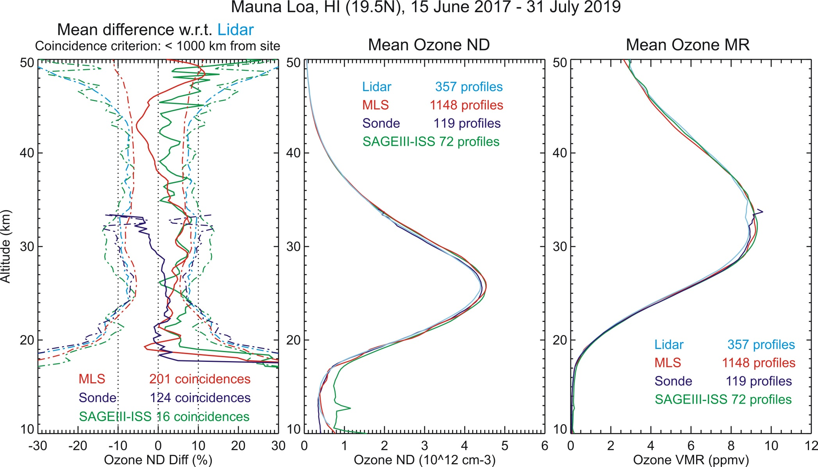
Lidar vs. SAGEIII-ISS, MLS and ozonesonde (O3)
Lidar vs. SAGE-III/ISS mean difference: ~ 5% between 20 and 45 km

Slide 9
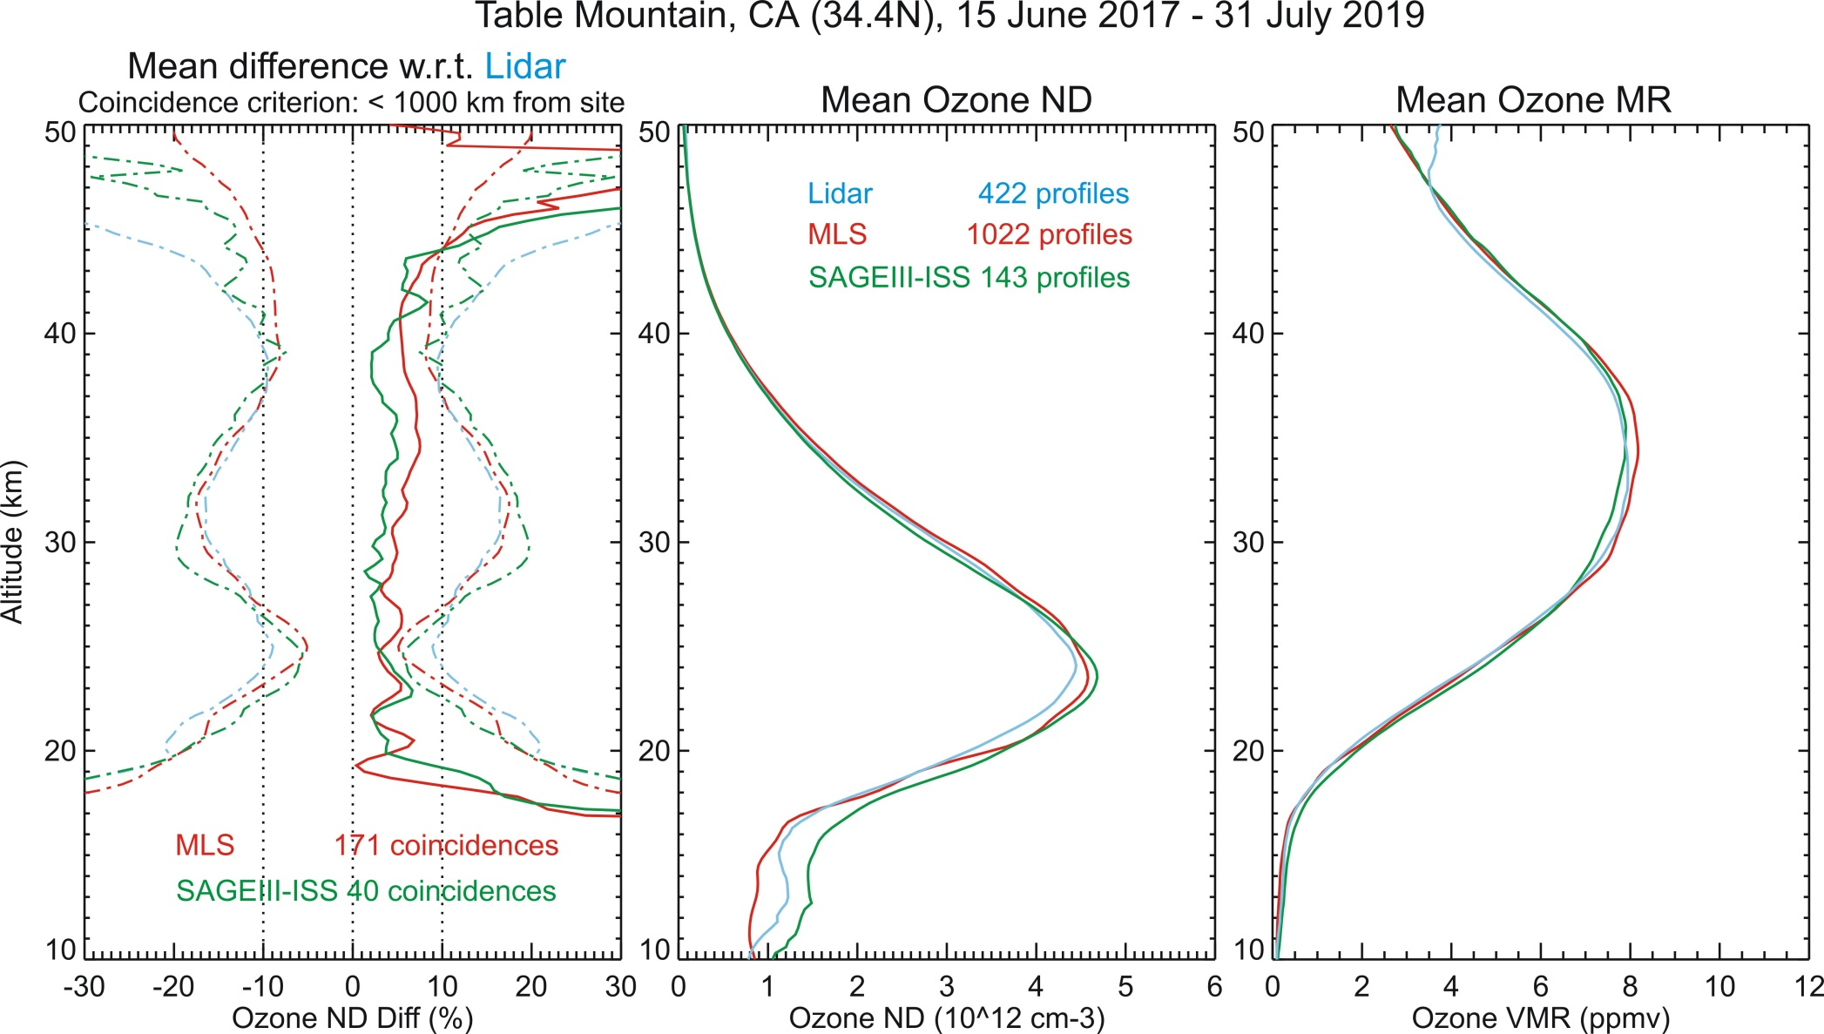
Lidar vs. SAGEIII-ISS, MLS and ozonesonde (O3)
Lidar vs. SAGE-III/ISS mean difference: ~ 3% between 20 and 40 km

Slide 10
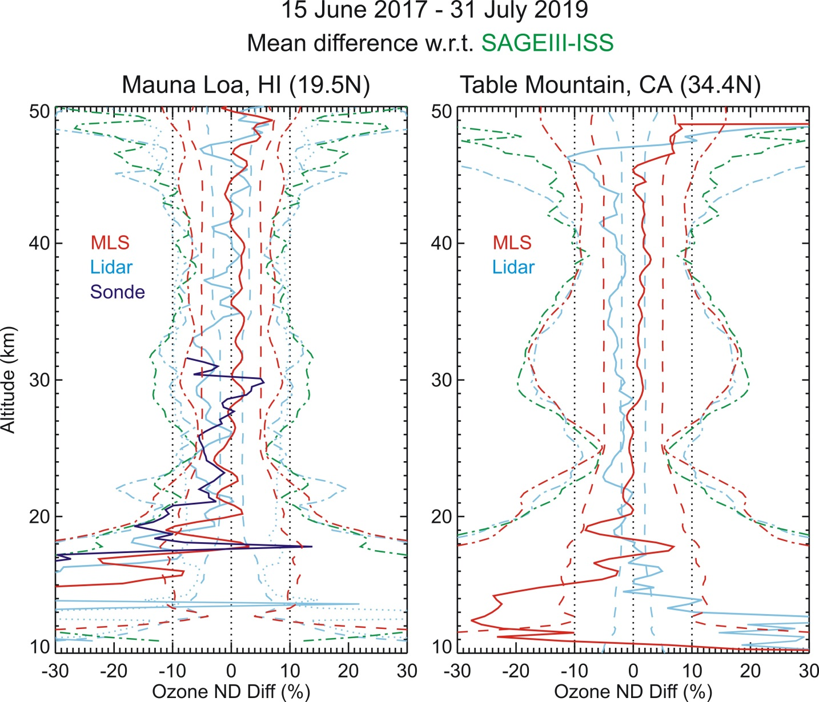
SAGEIII-ISS vs Lidar, MLS and ozonesonde (O3)
SAGE-III/ISS
is now the reference
All instruments within 5%
between 20 and 45 km
Within reported total
uncertainty in most
cases
Exception below 20 km
(cf. discussions on
O4 dimer/extinction)

Slide 11
Aerosols

Slide 12
Aerosol Retrieval
Rayleigh channels impacted by aerosol backscatter, Raman channels NOT impacted
➔ Ratio of 355 / 387 L1B signals provides aerosol backscatter

Slide 13
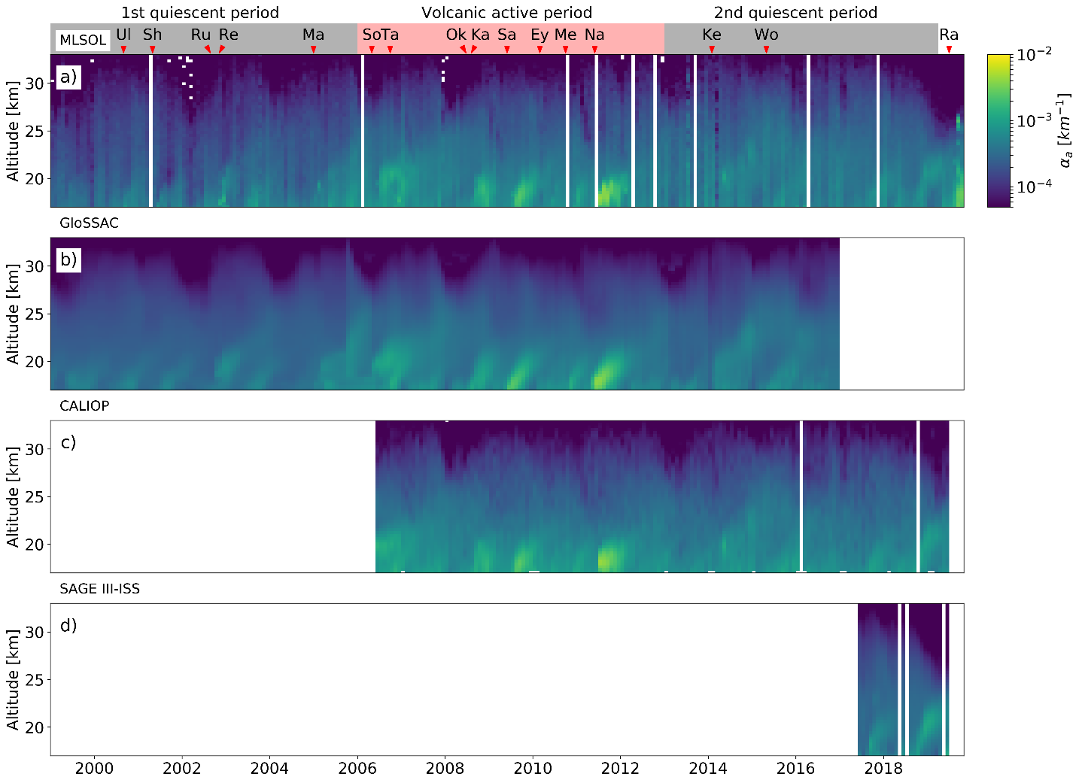
Aerosol Extinction Coefficient above MLO
MLSOL Lidar backscatter coefficient at 355 nm converted to 532 nm using å = 1.6
MLSOL Lidar extinction coefficient computed from backscatter using L = 50 sr
Raikoke
MLSOL Lidar
PyroCb
2017
GLOSSAC
CALIOP L3
SAGEIII/ISS

Slide 14
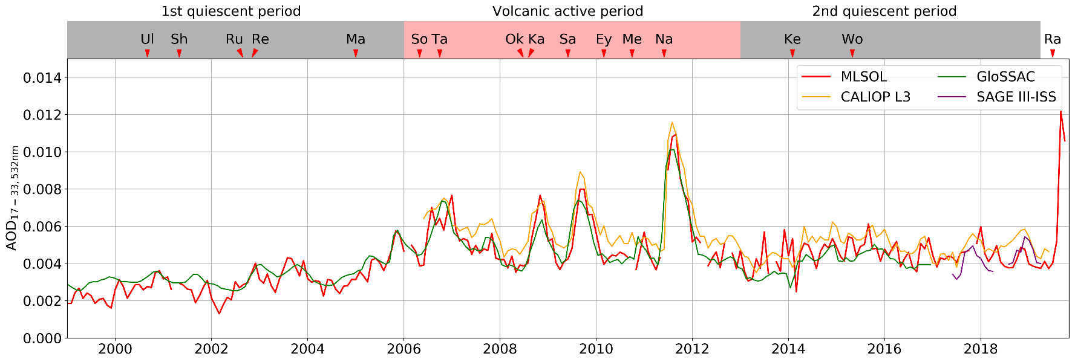
Stratospheric Aerosol Optical Depth above MLO
Generally good agreement between lidar, GLOSSAC, CALIOP L3, and SAGE-III/ISS
CALIOP L3 systematically higher than the others
SAGE-III/ISS below lidar in 2017, then above lidar
Strong lidar signature of Raikoke volcanic eruption in Sept. 2019, possibly enhanced by active fire season in Siberia

Slide 15
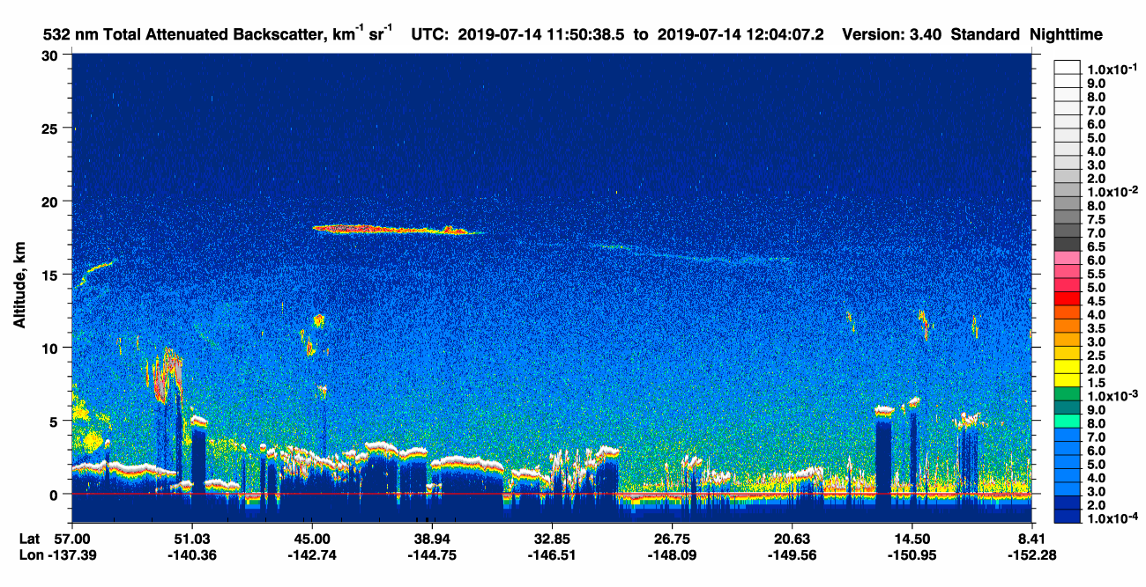
Raikoke Elevated Plume
CALIPSO Attenuated backscatter coefficient, July 14, 2019
At 18 km
https://www-calipso.larc.nasa.gov/tools/data_avail

Slide 16
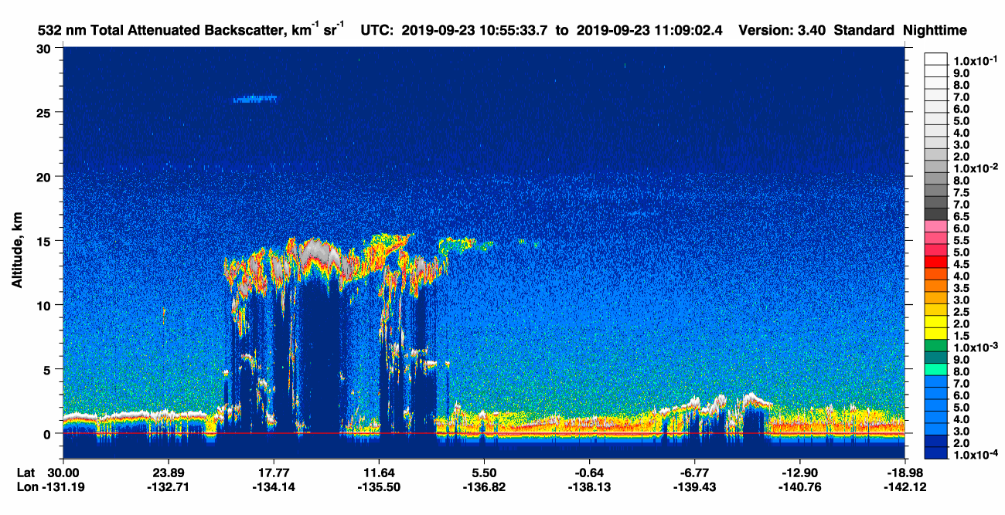
Raikoke Elevated Plume
CALIPSO Attenuated backscatter coefficient, September 23, 2019
At 26 km
https://www-calipso.larc.nasa.gov/tools/data_avail

Slide 17
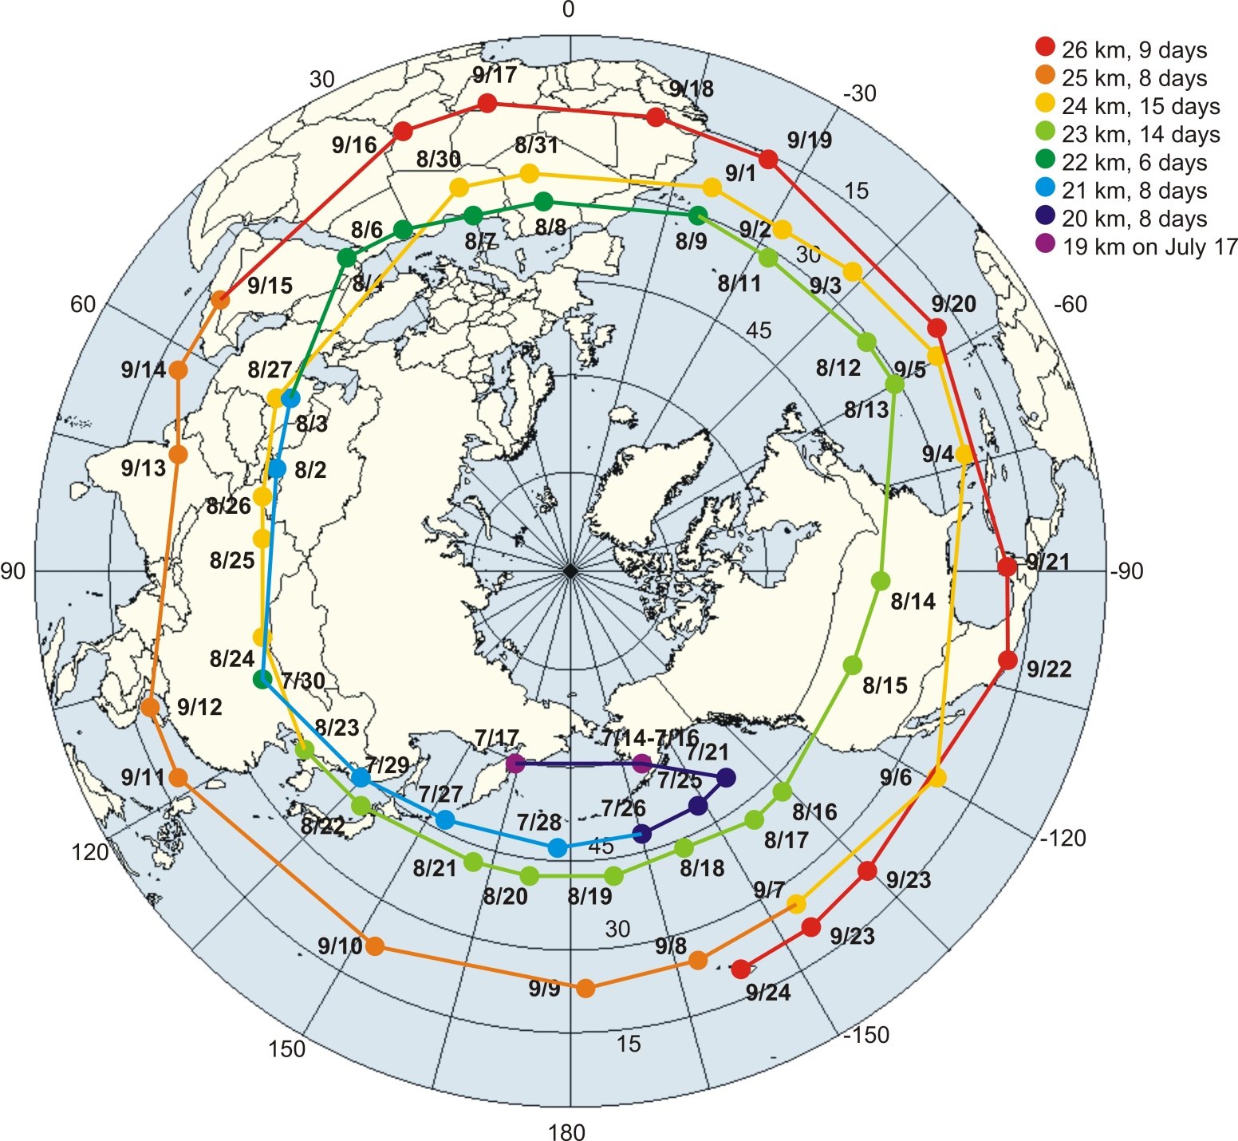
26 km and rising….
Plume trajectory derived from CALIPSO
backscatter coefficient, orbit-by-orbit visual inspection
Journey starts in the Aleutian Highs
(3 weeks residence there?)
Plume circled NP 3 times before its detection at MLO on September 24
7 km rise in 2 months
(late July to late Sept.)
https://www-calipso.larc.nasa.gov/tools/data_avail

Slide 18
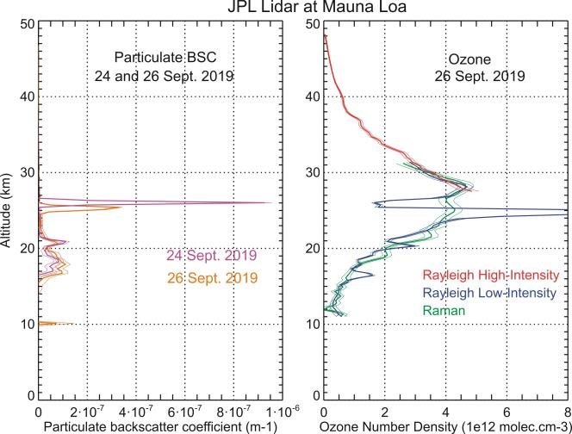
Raikoke Plume Impact on Ozone
Left plot (Backscatter coefficient):
Plume detected at MLO on
Sept. 24 and Sept. 26
at around 26 km altitude
Right plot (Ozone):
Plume affects Rayleigh channels (blue)
Raman channels (green) must be used to retrieve proper ozone below 28 km
➔ First critical use of MLSOL’s Raman channels since Pinatubo era!

Slide 19
Conclusion / Future Plans
2017-2019 comparisons SAGE-III/ISS AO3 vs. JPL Lidar O3 at MLO
and TMF show 3-5% agreement for altitudes 20-45 km (SAGE-III high)
Quite good considering low number of coincidences
2017-2019 lower stratosphere turned out to be quite “dirty”
➔ Looking forward to next data processing version,
with UTLS issues resolved…
JPL Lidars not limited to MLO and TMF stratospheric DIAL
➔ Next validation efforts will involve TMF Tropo O3 DIAL,
TMF Water vapor Raman lidar, and temperature...
THANK YOU

