Slide 1
Validation and Mission Planning Update
Carrie Roller
SAGE III Scientist/Engineer

Slide 2
Validation Partners - Update
During the validation campaign, the SAGE science team reached out to all currently participating NDACC lidar and sonde sites in an attempt to facilitate the coordination of SAGE III predicted events with in-situ data gathered at each site.
Since the 2018 SAGE science team meeting, 6 new external partners have been added to the weekly distribution list.
Each participating station receives weekly emails detailing all upcoming SAGE III events that will coincide with their location and meet validation criteria.
The SAGE team is always looking to add to new stations to this list.

Slide 3
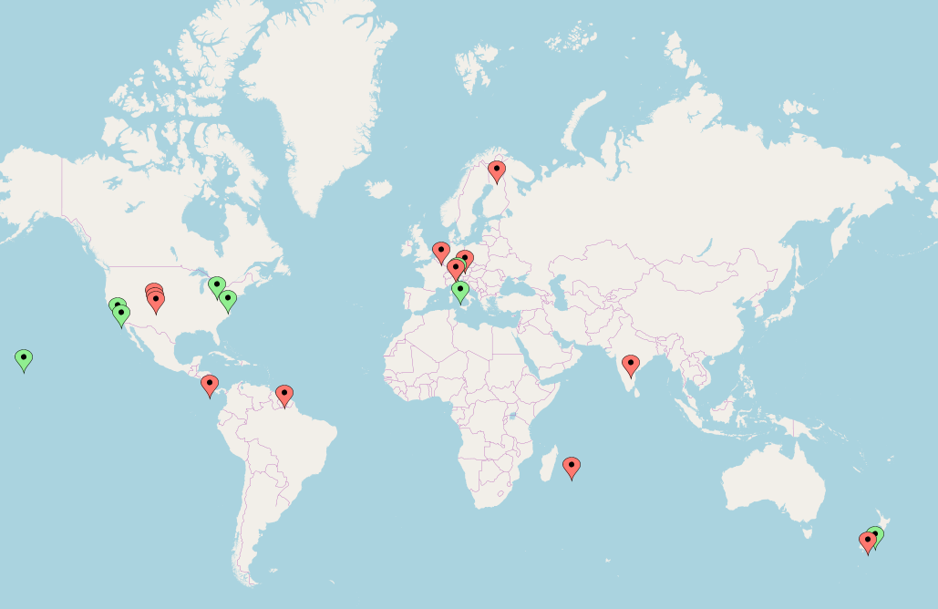


Validation Partners – Update cont.
- Boulder, Colorado, USA
- Lauder, New Zealand (sonde)
- Mauna Loa, Hawaii, USA
- Table Mountain, California, USA
- Sodankyla, Finland
- De Bilt, The Netherlands
- Paramaribo, Surinam
- Alajuela, Costa Rica
- London, Ontario, Canada
- Rome, Italy
- UC Boulder, Colorado, USA
- GSFC, Maryland, USA
- Lauder, New Zealand (lidar)
- Table Mountain, California, USA
(lunar)
- Hohenpeissenberg, Germany
- Reunion Island, France
- Praha, Czech Republic
(seasonal)
- Laramie, Wyoming, USA
- Hyderabad, India (campaign)
Sonde
Lidar

Slide 4
Validation Criteria
To be used for validation, in-situ data must be collected within ± 24 hours of a coincident SAGE III event.
Species of interest: stratospheric ozone, aerosol, water vapor
The latitude and longitude constraints for event matching are: ± 5 deg latitude, ± 10 deg longitude
The types of SAGE III science events that are used for validation are solar occultation events (Sunrise and Sunset), and lunar occultation events (Moonrise and Moonset). Limb events are not currently used for validation.

Slide 5
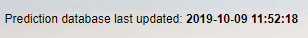
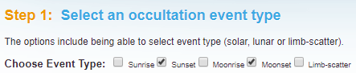
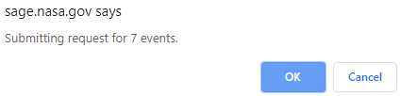
SAGE III Validation Website: Updates
The SAGE III validation website is:
  https://sage.nasa.gov/validation/
A banner now indicates the date and time that the prediction database was last updated.
The ‘occultation event type’ bug has been fixed. All event types can now be selected/deselected as desired without errors.
Before a request is confirmed, a pop-up will appear letting users know the total number of events that will be pulled.

Slide 6
Weekly Process
Each week, participating stations are sent emails detailing any coincident SAGE III events that will occur in approximately three weeks.
This time frame is used to ensure the accuracy of the SAGE III event predictions and allows stations to have advance planning for possible coincident measurements.
Coincident events for each specific station are determined using the SAGE III validation website.
Each event is then checked against the SAGE III operations calendar as well as the ISS schedule for any activities that may alter the planned event schedule.
Events are also checked for potential station-related blockage.

Slide 7
Automated Emailing
New this year: the weekly process for sending the event emails has been automated.
This involves connecting Excel, Word, and Outlook.
Matched events from the validation site are copied into an Excel sheet. This spreadsheet contains information for each station including site names, PI email addresses, and the timeframe that was used to match events.
The information from the Excel sheet is then pulled into a Word document that fills in the email templates accordingly.
Word then uses ‘Mailings’ to send email messages through Outlook with one click!

Slide 8
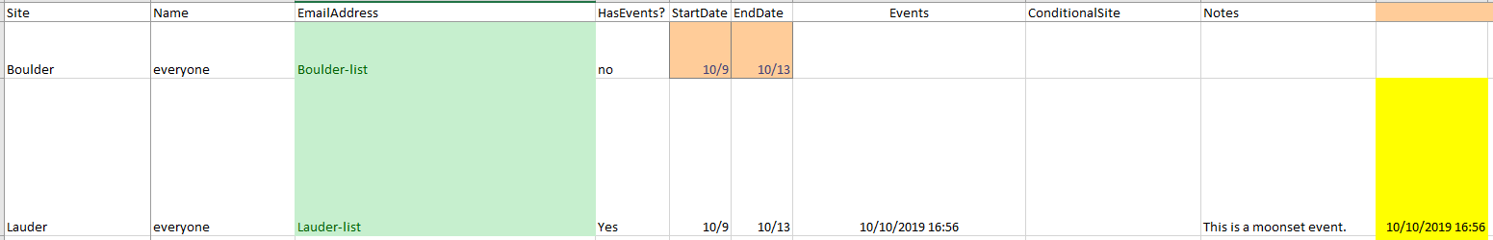
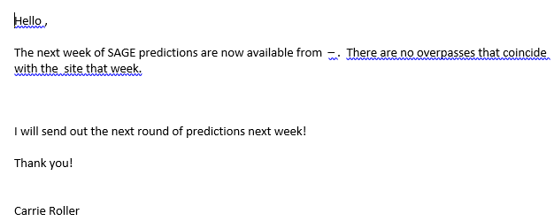
Automated Emailing cont.
Excel
Word

Slide 9
Long Term Predictions
New this year: longer term predictions for events that are 6 months out are also now available by request.
These predictions are available on the SAGE validation website and monthly via email to stations that request them.
Long range events are not guaranteed and are highly likely to vary in time and space because of reboosts, schedule changes, etc that may occur within the coming months.
These predictions are useful for long range planning with the caveat in mind that they are likely to change.
Please contact me if your station is interested in receiving monthly long term predictions via email.

Slide 10
ISS Reboost
Periodically, the ISS needs to complete a reboost for altitude maintenance.
Following an ISS reboost, it takes approximately 2–4 days for the ISS orbit parameters (Two-line elements, TLEs) to fully settle into the new changes in the ISS orbit.
During this time, predictions may be slightly skewed in time and longitude.
Reboost details are included in weekly emails, as applicable.
Once the orbit changes have settled out, all events are re-checked for accuracy to ensure that they still meet the constraints for validation.

Slide 11
Blockage
There are times when visiting vehicles, solar panels, or modules can obstruct the view of SAGE.
Expected blockage information can be found on the SAGE Validation website
  Levels are: none, low, medium, high, and extreme
New update this year: blockage information can now be found in the ‘obscuration’ column directly on the ‘confirm request’ page of the validation site. No download required.
Depending on the severity of the blockage, events may still acquire successfully.
Events sent to validation partners have blockage levels of medium or lower to ensure event success.
High and extreme levels of blockage may still acquire but are not guaranteed. These events are not sent to validation partners.

Slide 12
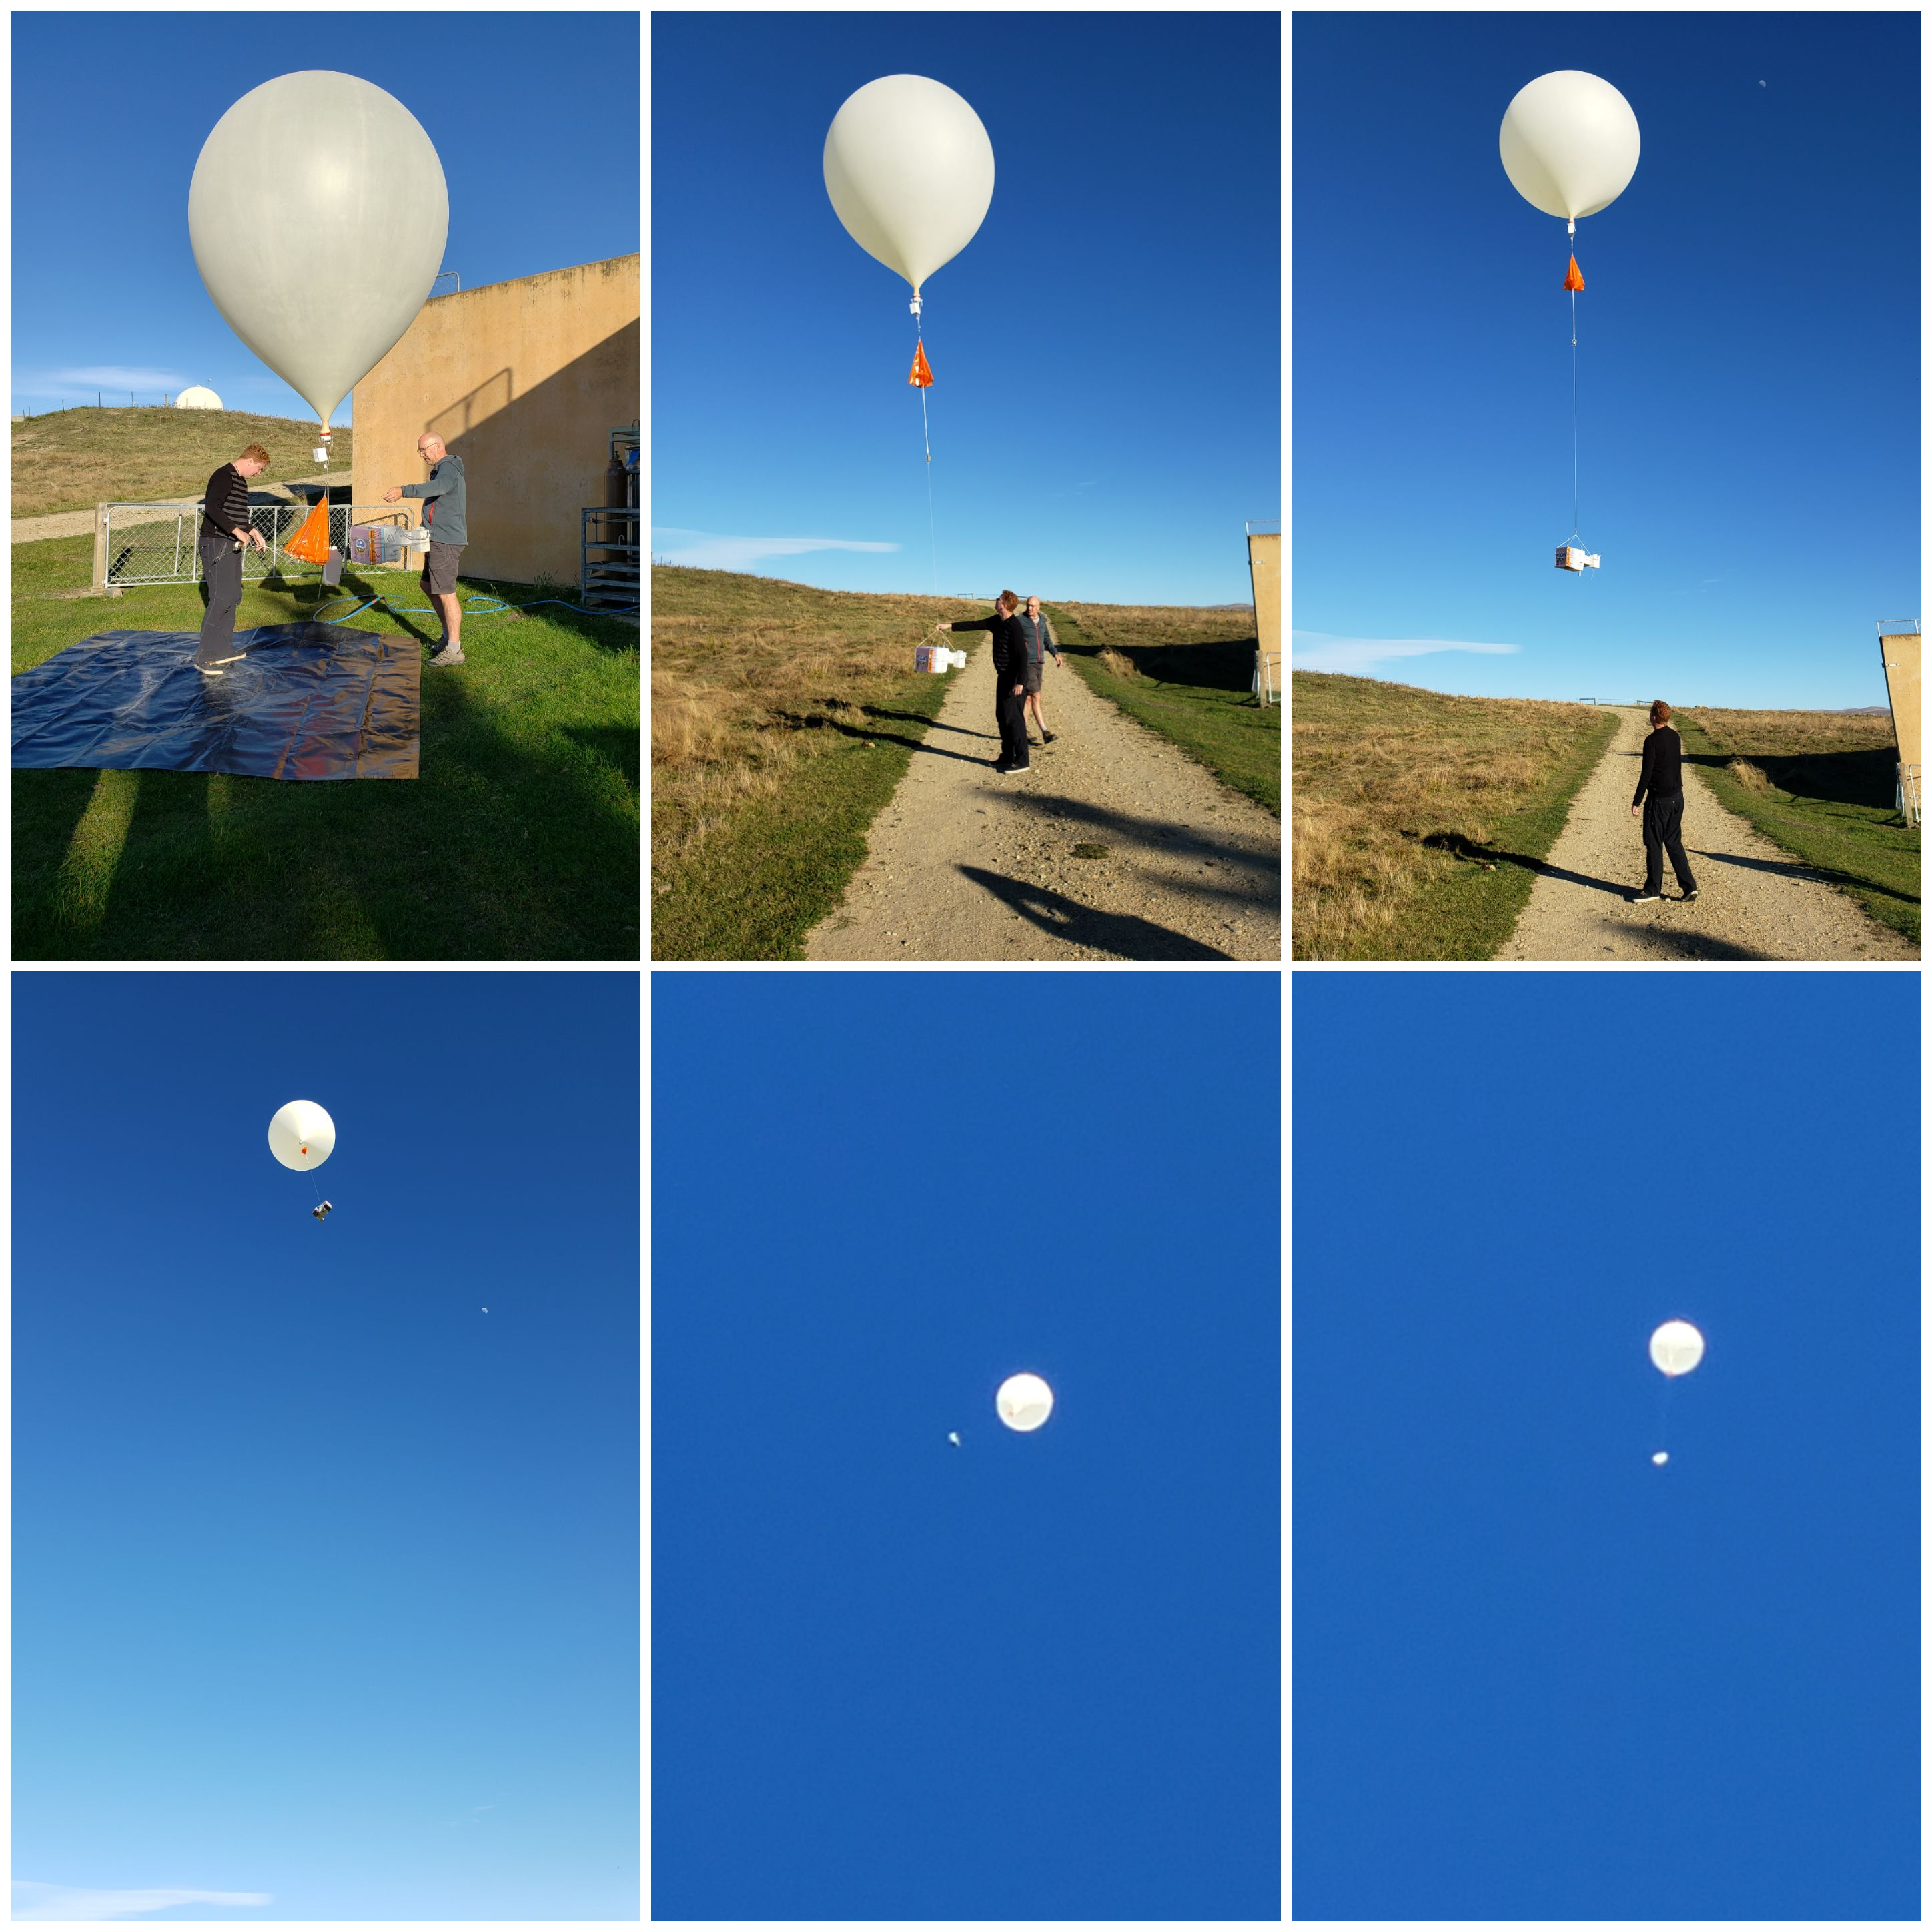
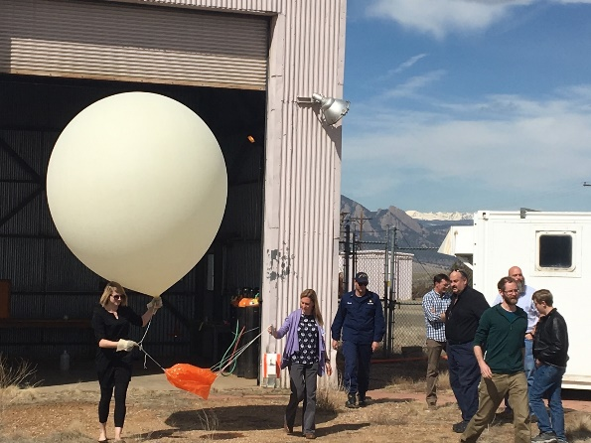
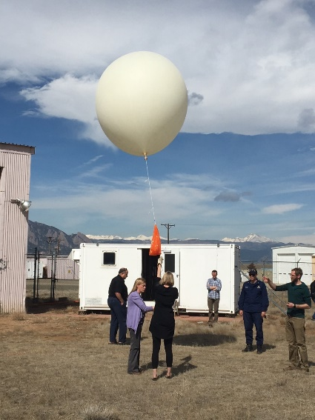
Validation Site Visits
Members of the SAGE III validation team traveled to Boulder, Colorado and Lauder, New Zealand this year to collaborate with validation partners.
The team participated in sonde launches at both sites, discussed instrumentation, and planned for future work.
SAGE team participates in balloon launches in Boulder, Colorado and Lauder, New Zealand in Spring 2019

Slide 13
Contact Information
SAGE III is looking for additional validation partners to collaborate with! Please forward my contact information to anyone that may be interested in coordinating sonde launches or lidar operations with SAGE III events.
    Carrie Roller
    SAGE III Science, Engineer
    carrie.roller@nasa.gov
    Desk: 757-864-9520

Slide 14
Questions?

