Slide 1
The Printed Optical Particle Spectrometer
Stratospheric Aerosol Measurements for SAGE III-ISS Validation
Troy Thornberry†, Elizabeth Asher†, Steve Ciciora, Laurel Watts† and Ru-Shan Gao
NOAA Earth System Research Laboratory, Chemical Sciences Division
†and CIRES, University of Colorado-Boulder

Slide 2
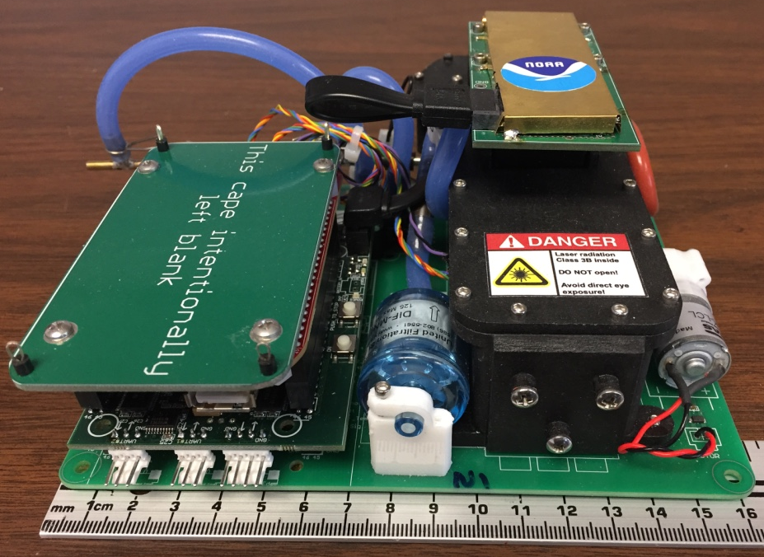
Printed Optical Particle Spectrometer
POPS specifications:
Single-particle detection
140 – 3000 nm diameter range
3 cm³/s sample flow
550 g
5 Watts
Gao et al., AS&T 2016

Slide 3
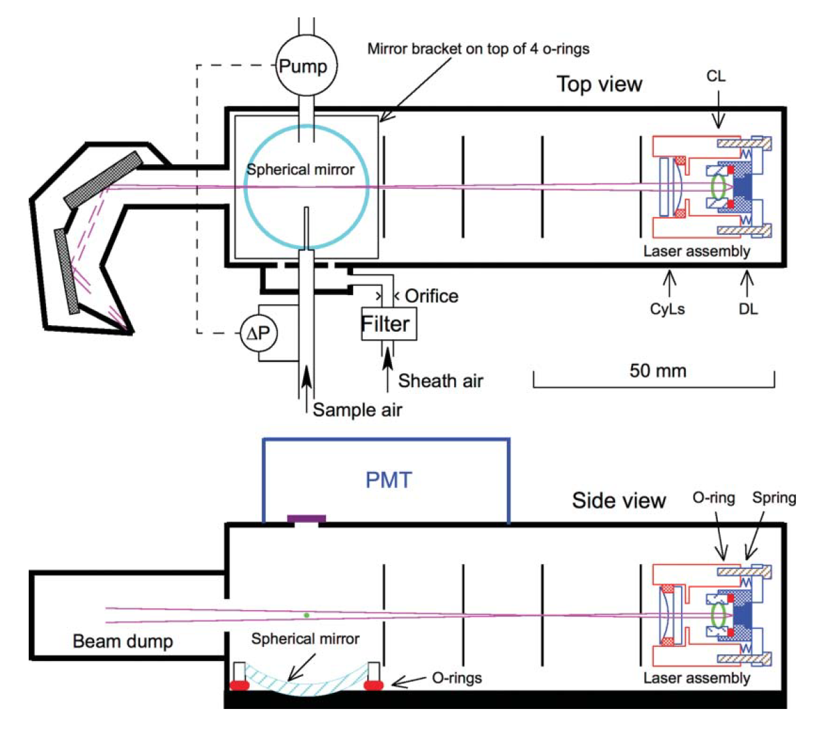
Printed Optical Particle Spectrometer
POPS Flow:
Sample flow rate measured using a laminar flow element to provide clean sample flow path
LFE ∆P provides feedback for flow control
Particle free ”sheath” flow set by restriction~ equal to sample flow

Slide 4
Printed Optical Particle Spectrometer
POPS optics:
405 nm laser diode, ~60 mW
Beam profile shaped by a series of lenses and apertures
Scattered light collected by spherical mirror subtending
38° - 142° (~2.4 sr)
Observed instrument response closely matches Mie theory calculation for spherical particles

Slide 5
POPS Operation at Stratospheric Pressures
POPS measurement issues at low pressure:
At ambient pressures below ~200 hPa, particle transit through the beam slows, suggesting the inlet jet is diverging
Below ~70 hPa, particle losses were observed as the beam diverged

Slide 6
POPS Operation at Stratospheric Pressures
Two modifications yielded improved function at low pressure
Install small diameter exhaust nozzle closer to the laser beam
(similar to inlet nozzle)
Increased sample flow rate (also increases ”sheath” flow)

Slide 7
POPS Operation at Stratospheric Pressures
Increased flow and change in geometry both contribute to improved sample jet coherence at low pressure
Optimal performance maintained down to P < 30 hPa, where pump efficiency limits sample flow rate

Slide 8
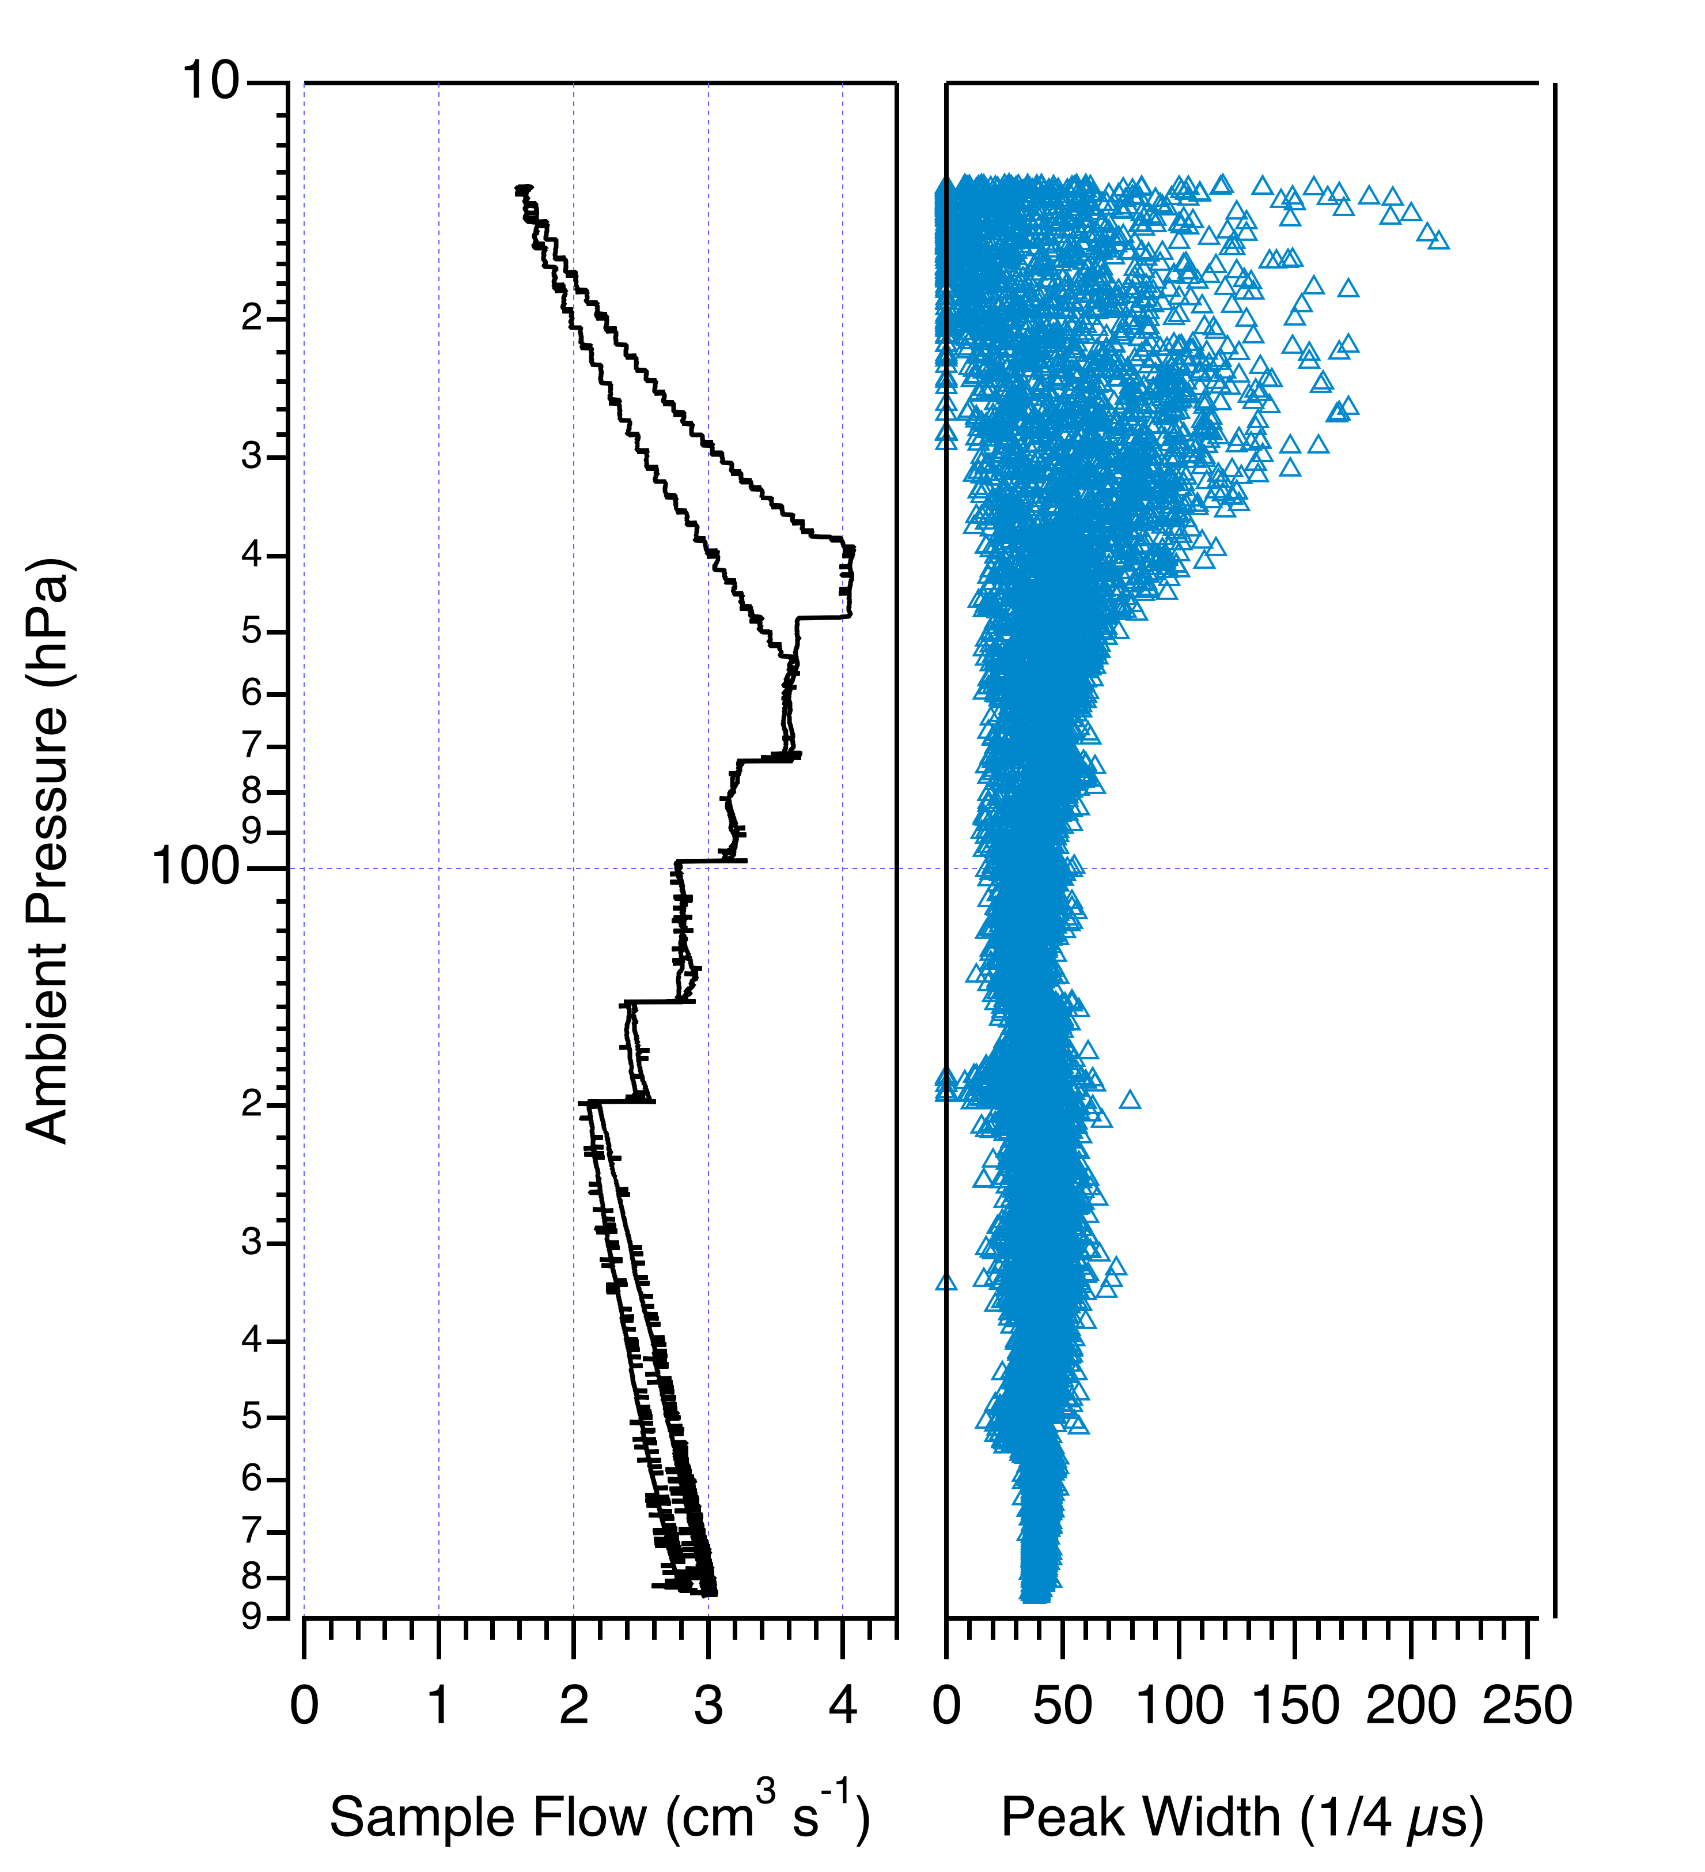
POPS Operation at Stratospheric Pressures
Boulder 20190628

Slide 9
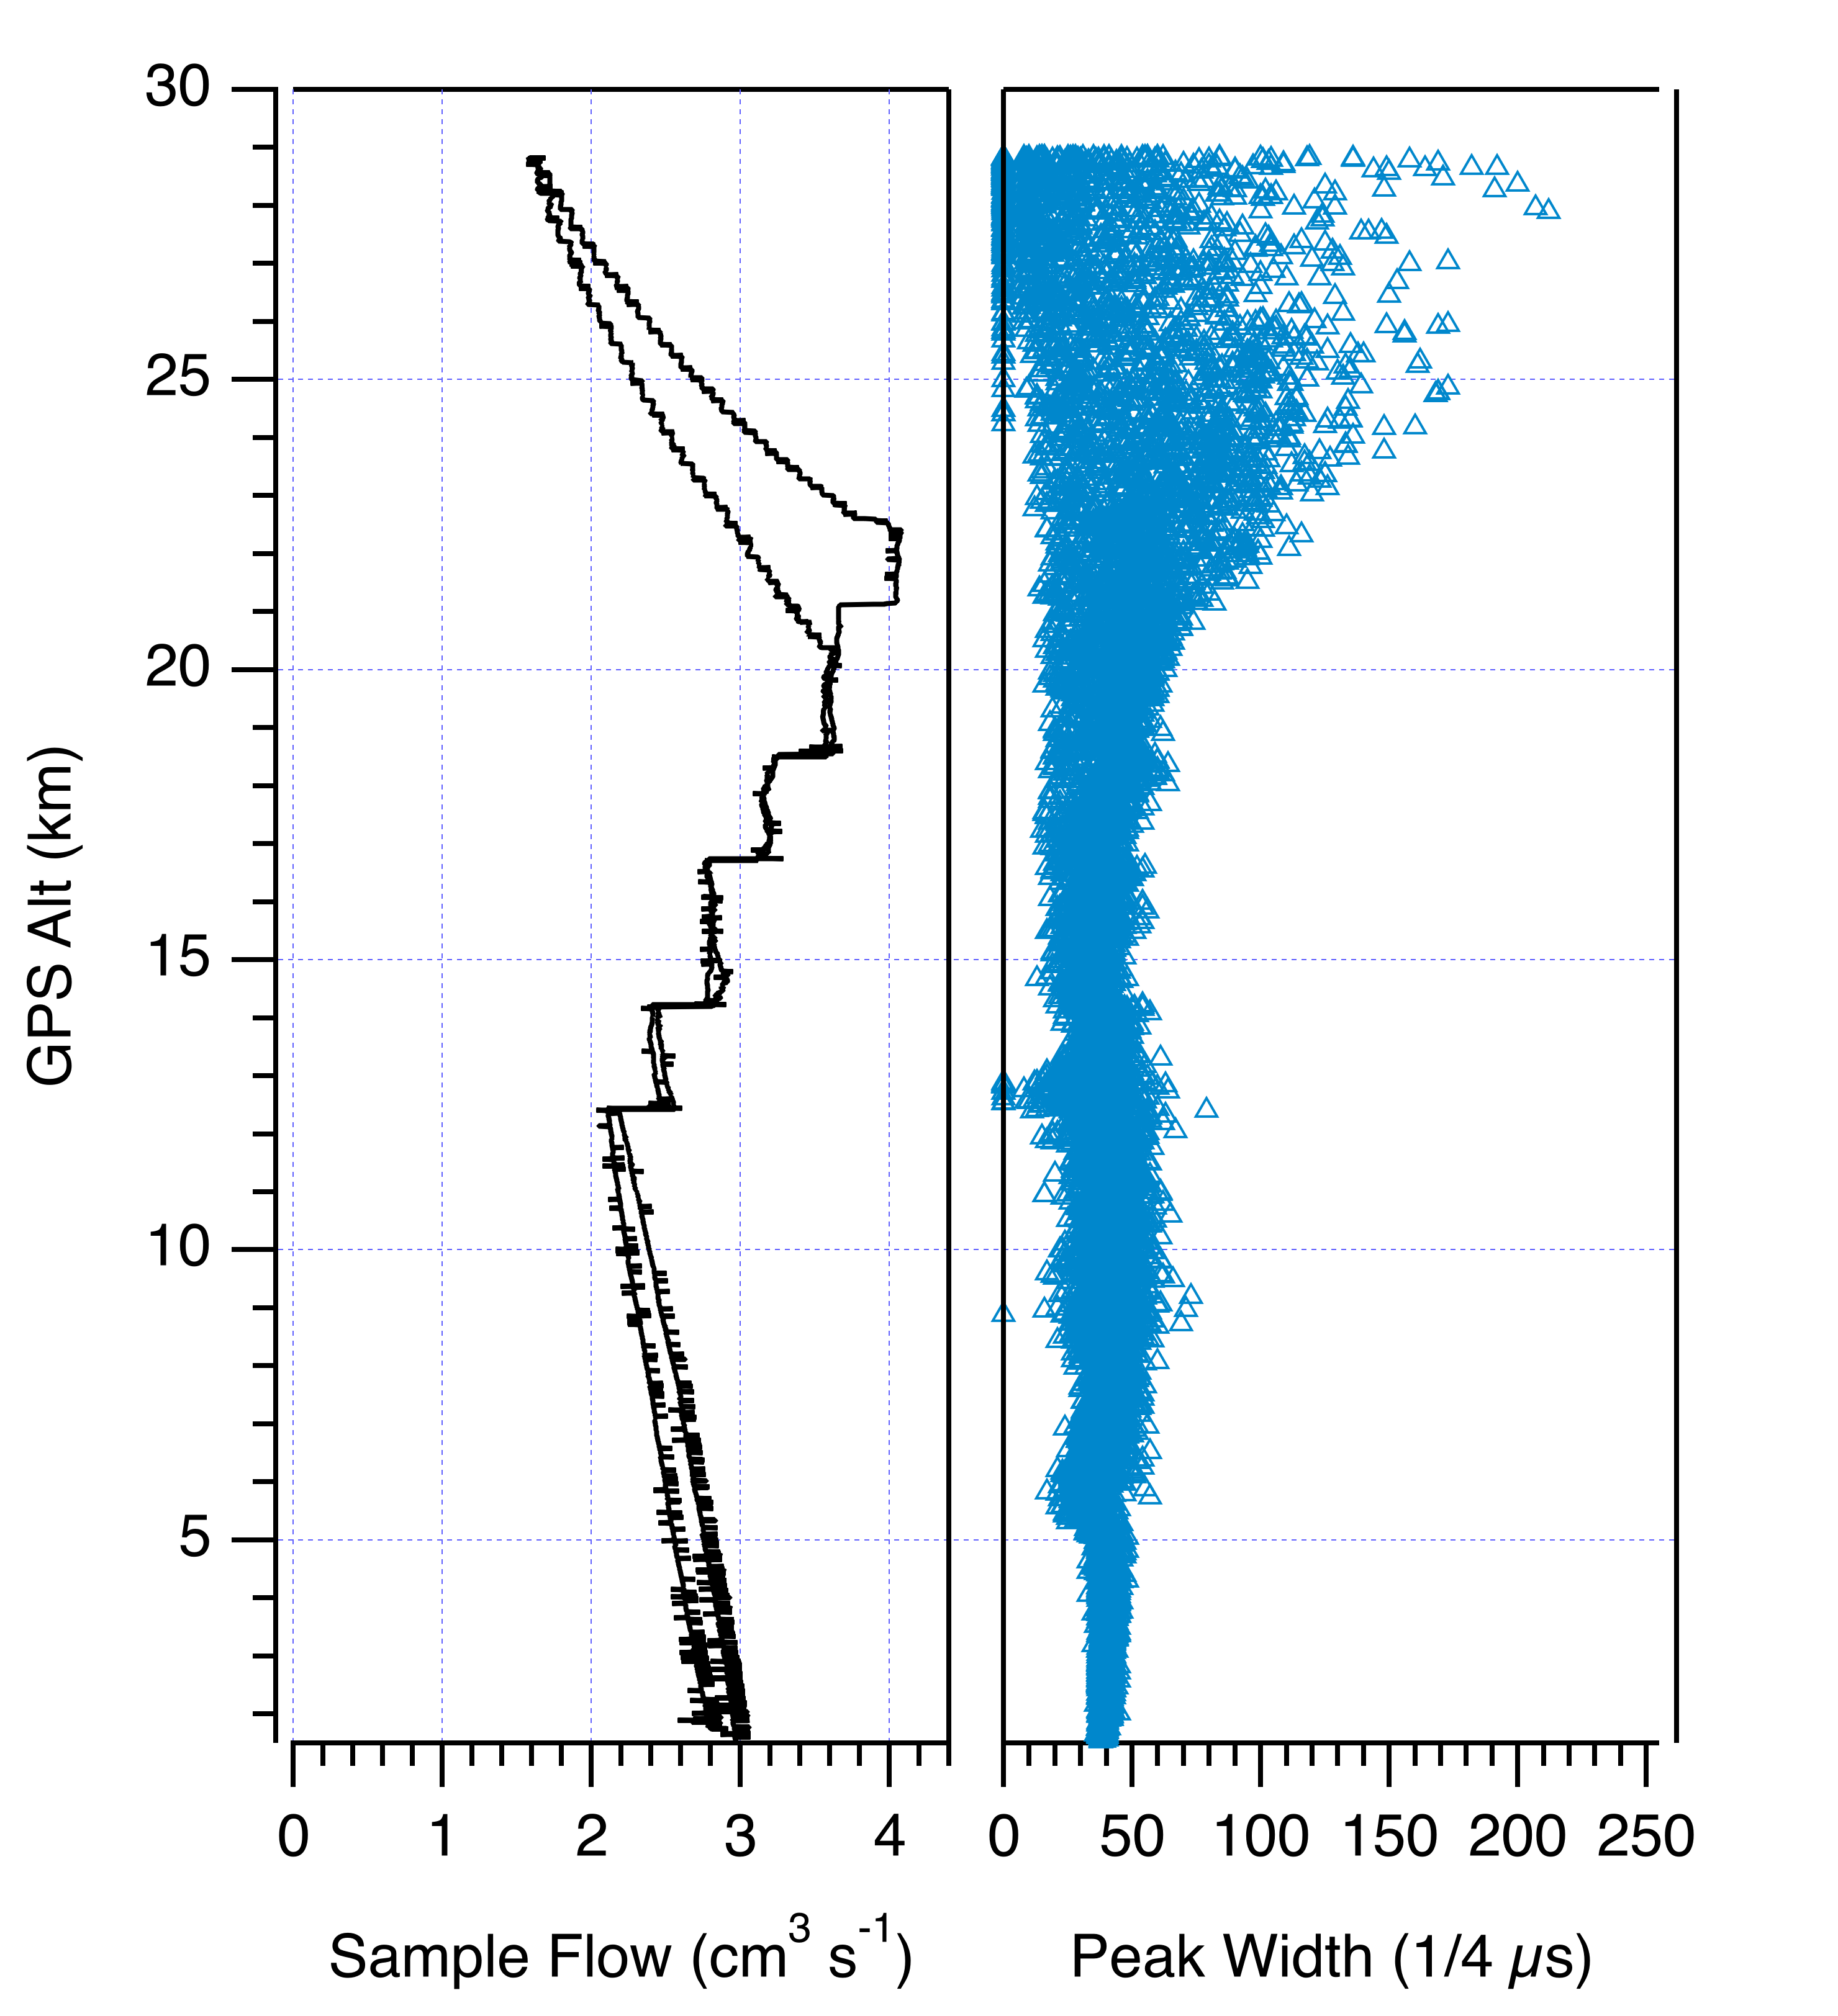
POPS Operation at Stratospheric Pressures
Boulder 20190628

Slide 10
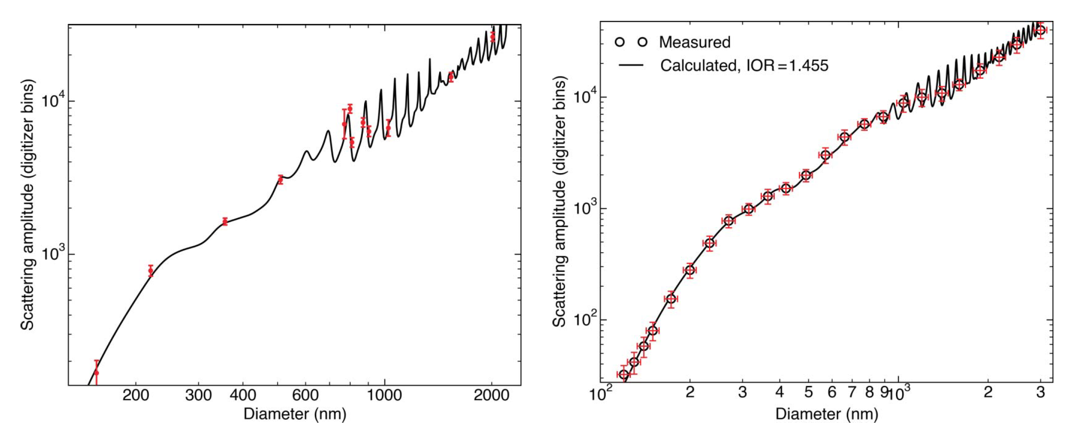
POPS Particle Size Determination
Calibration with PSLs, n = 1.61 + 0i
Calibration with DMA size-selected dioctyl sebacate, n = 1.45 + 0i

Slide 11
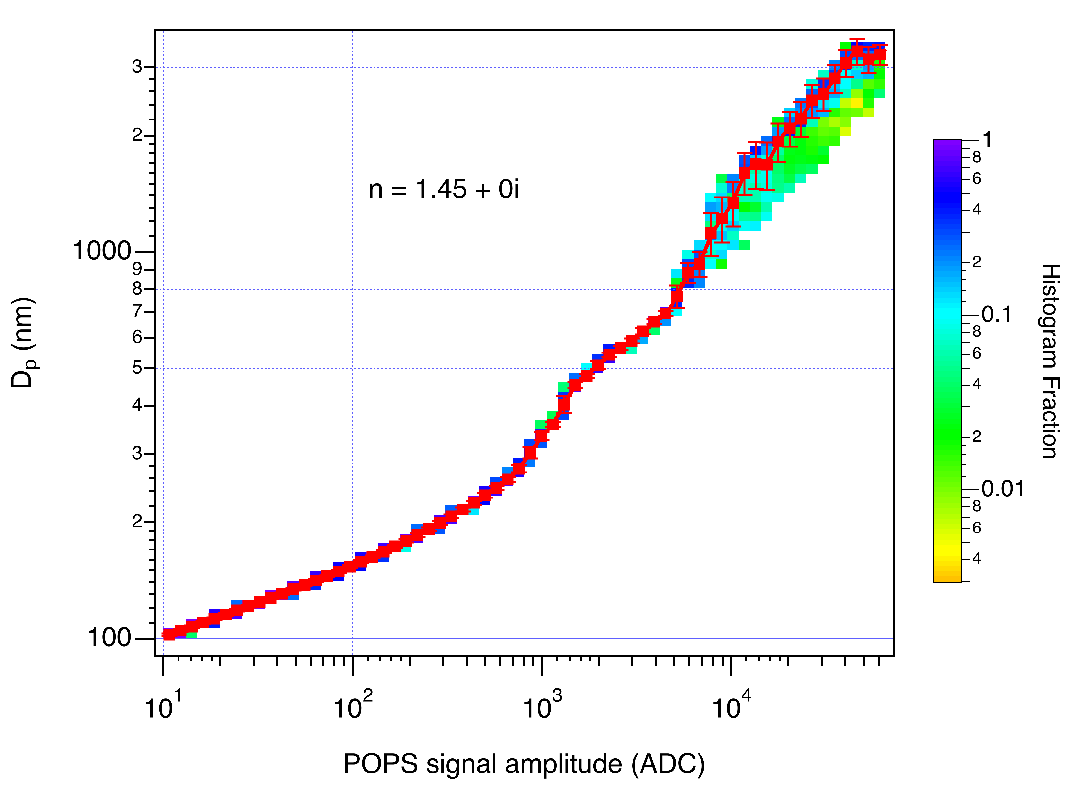
POPS Particle Size Determination
Mie resonances create non-monotonicity in the D_{p} vs POPS signal amplitude relationship
Histogram D_{p} in narrow signal bins and calculate median values
Construct single-valued smoothed curve through median values to estimate D_{p} from measured signal amplitude

Slide 12
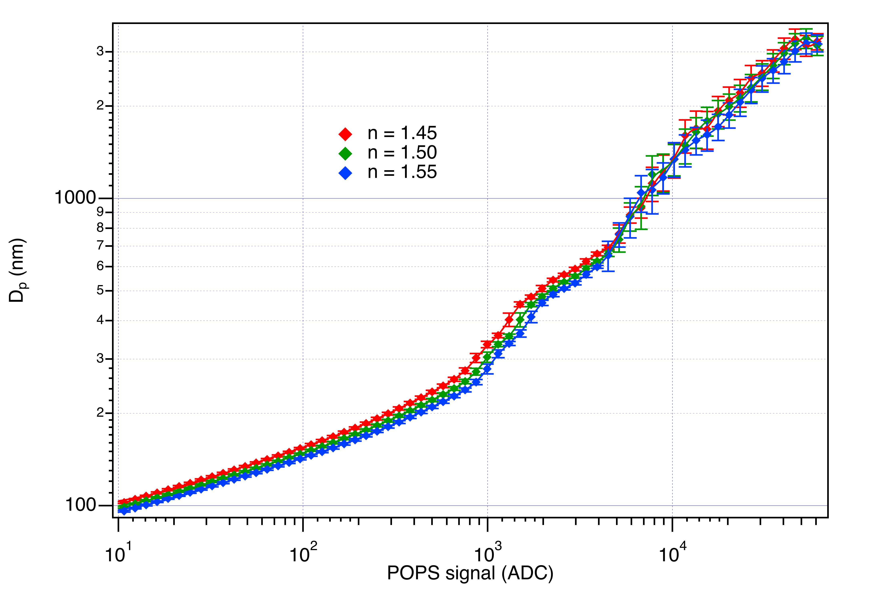
Index of Refraction
Most OPCs, including POPS, need to assume an aerosol index of refraction as well as spherical shape in order to calculate D_{p} from scattered light
Leads to potential error in particle sizing

Slide 13
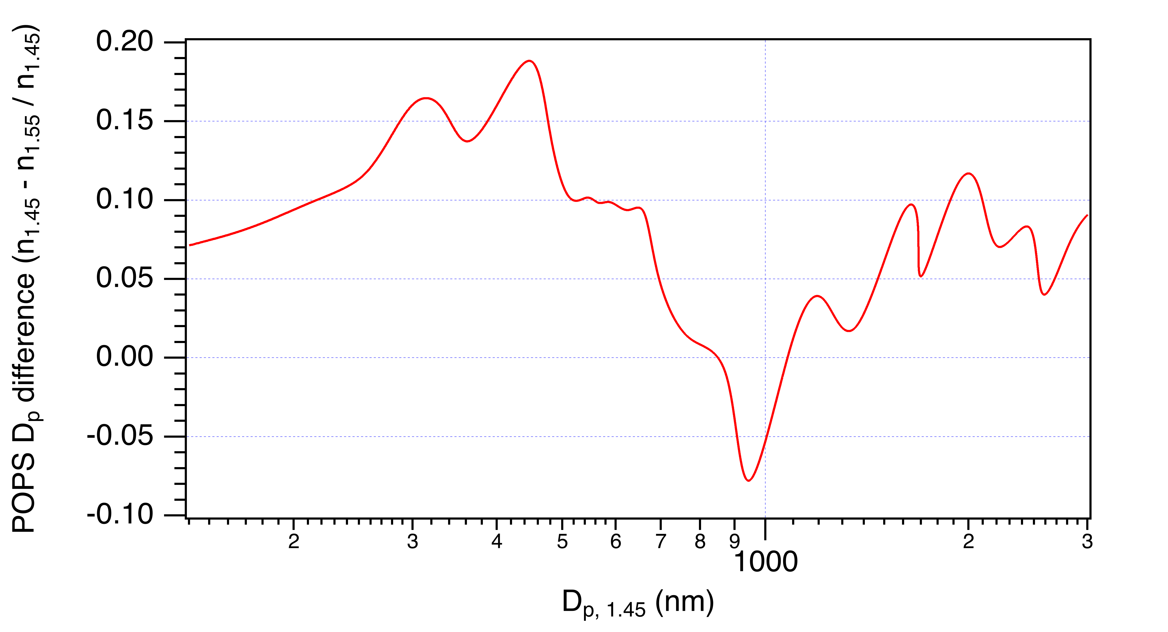
Index of Refraction
Most OPCs, including POPS, need to assume an aerosol index of refraction as well as spherical shape in order to calculate D_{p} from scattered light
Leads to potential error in particle sizing

Slide 14
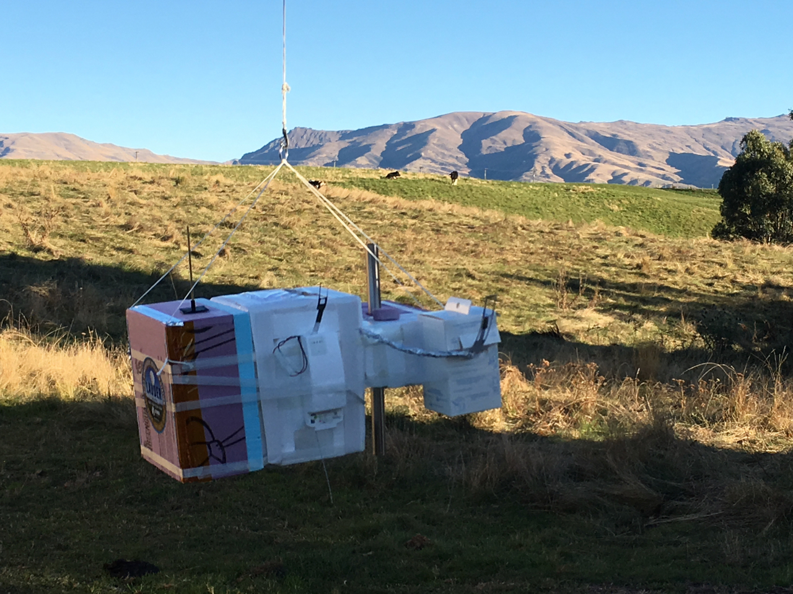
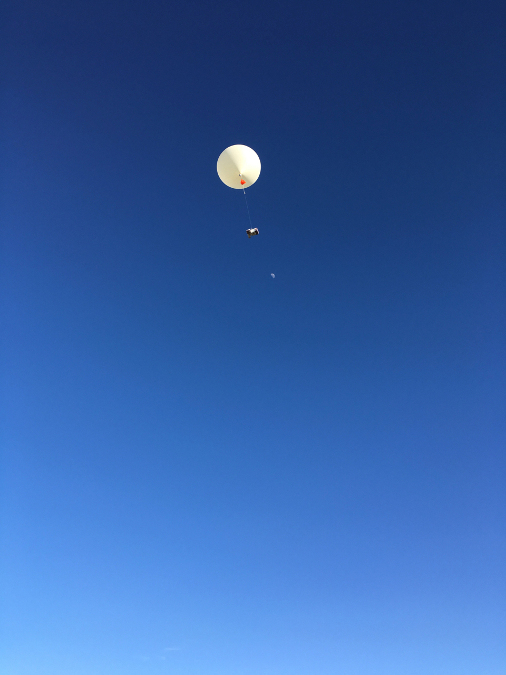
POPS sonde launches

Slide 15
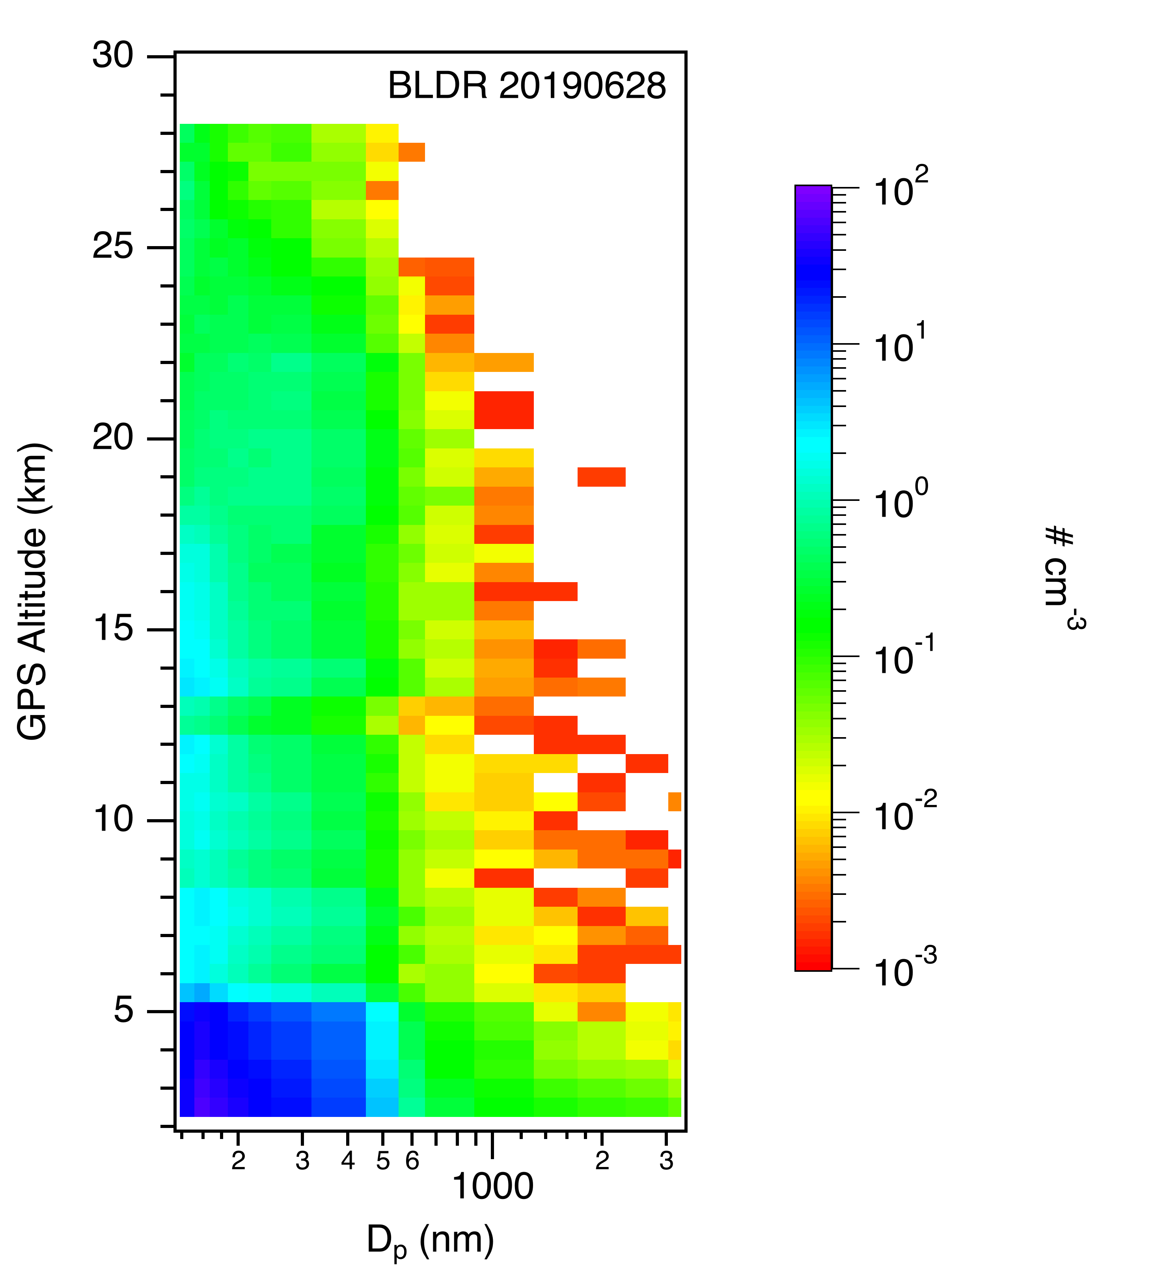
POPS sonde launches

Slide 16
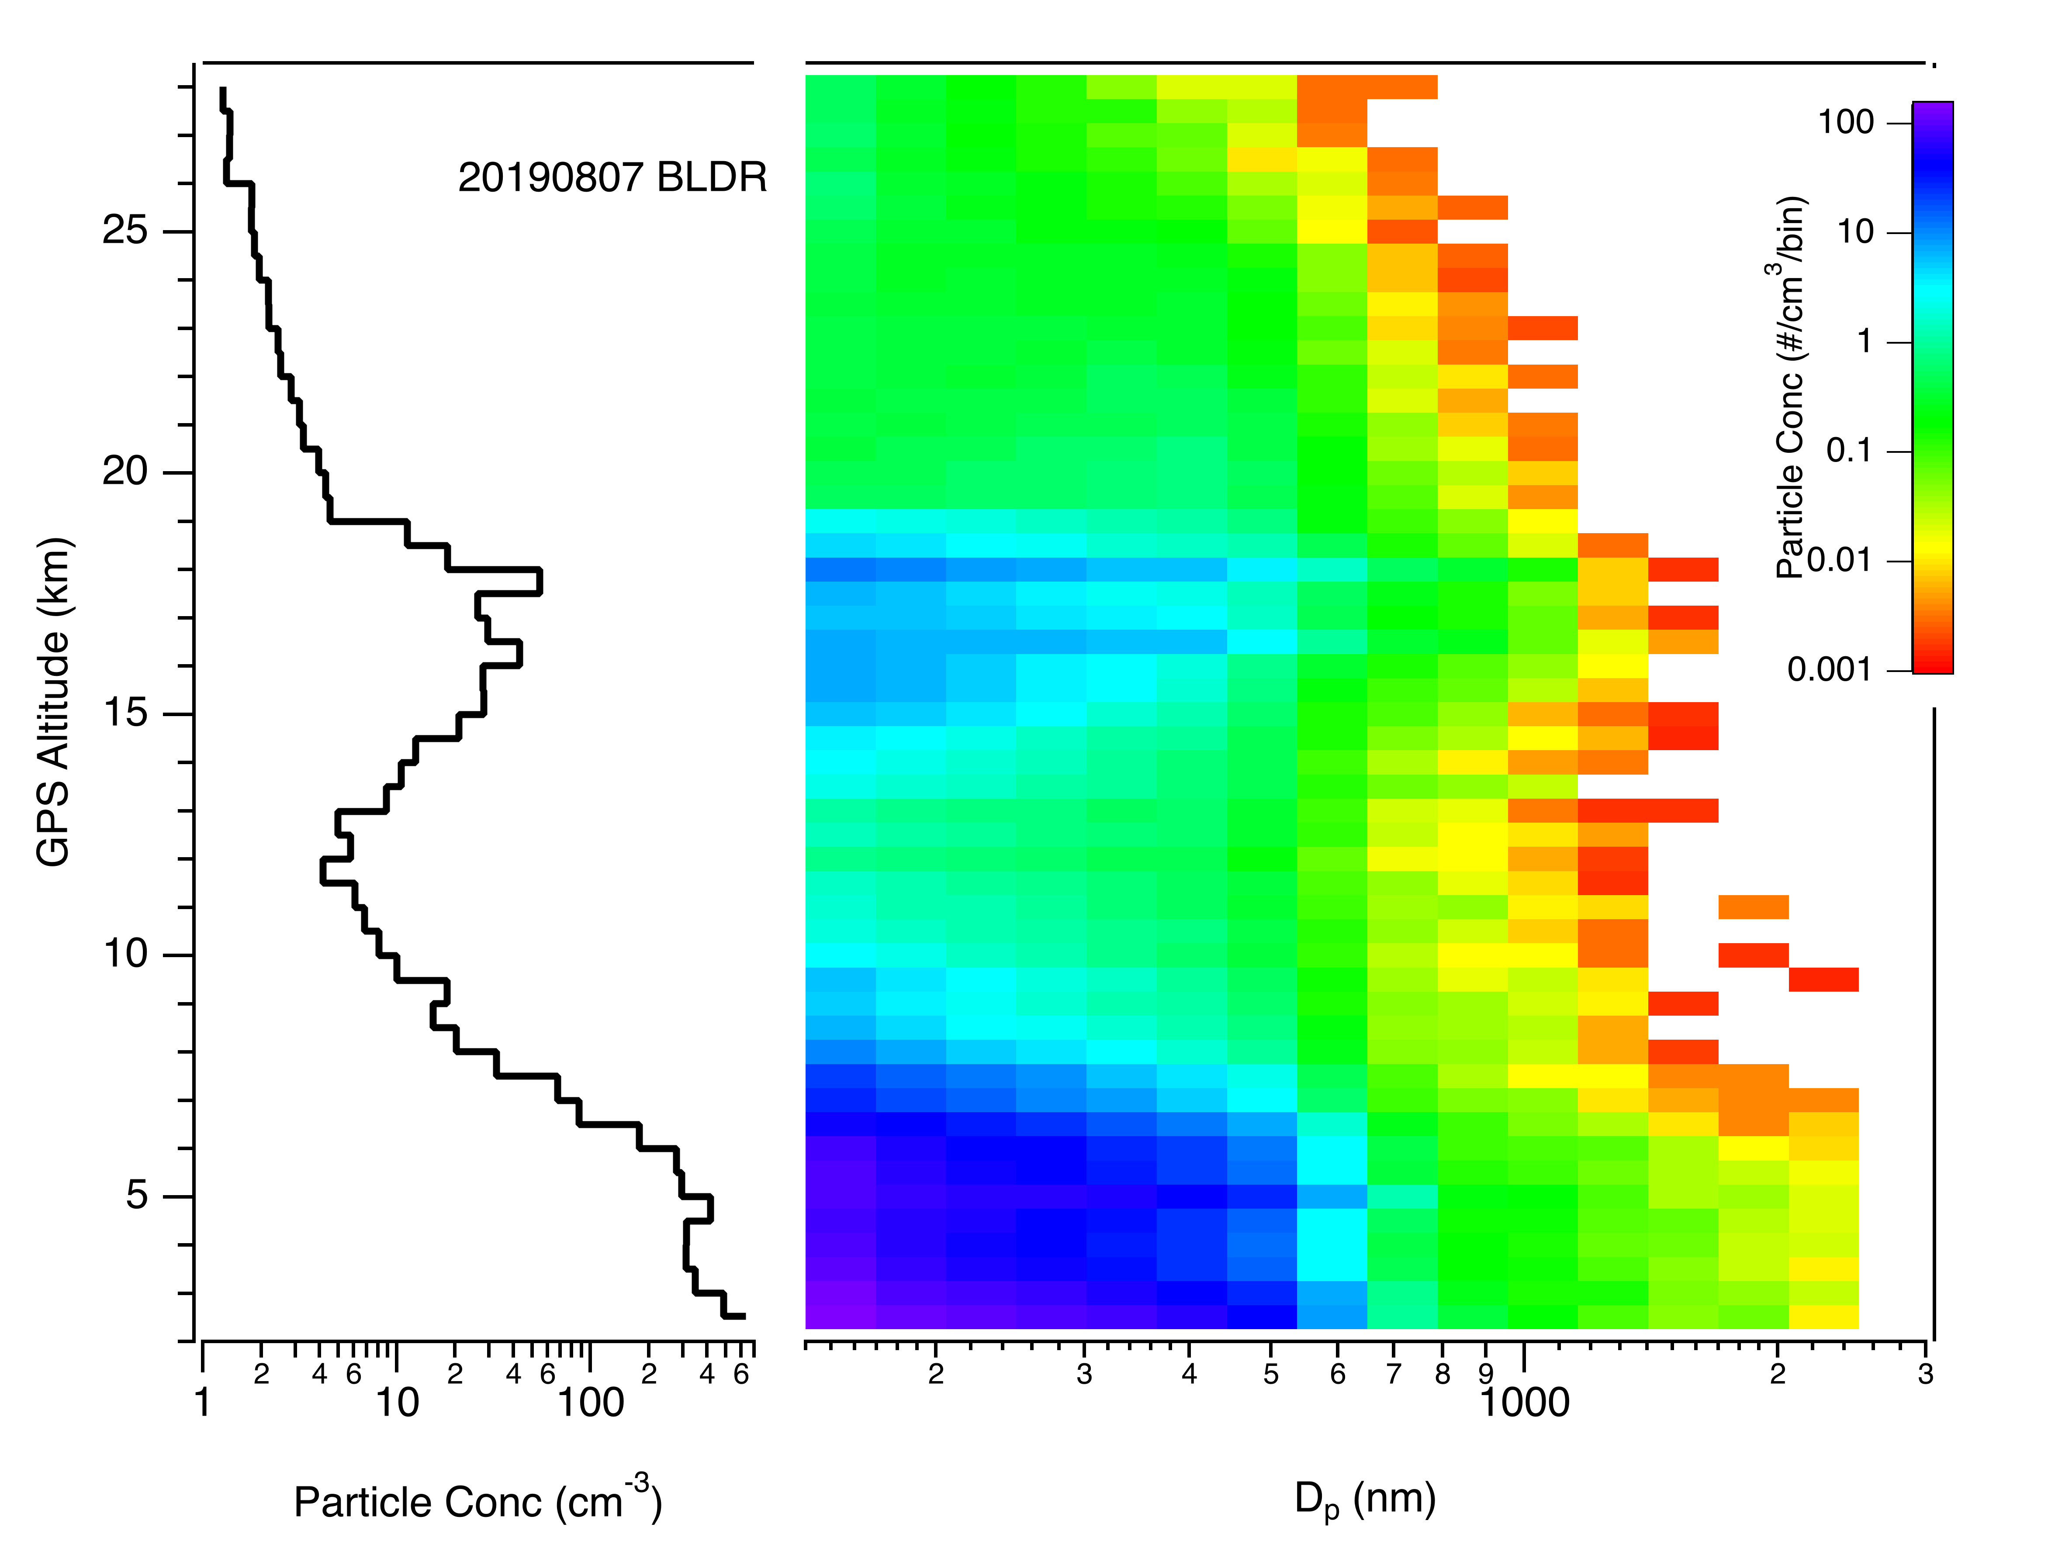
POPS sonde launches

Slide 17
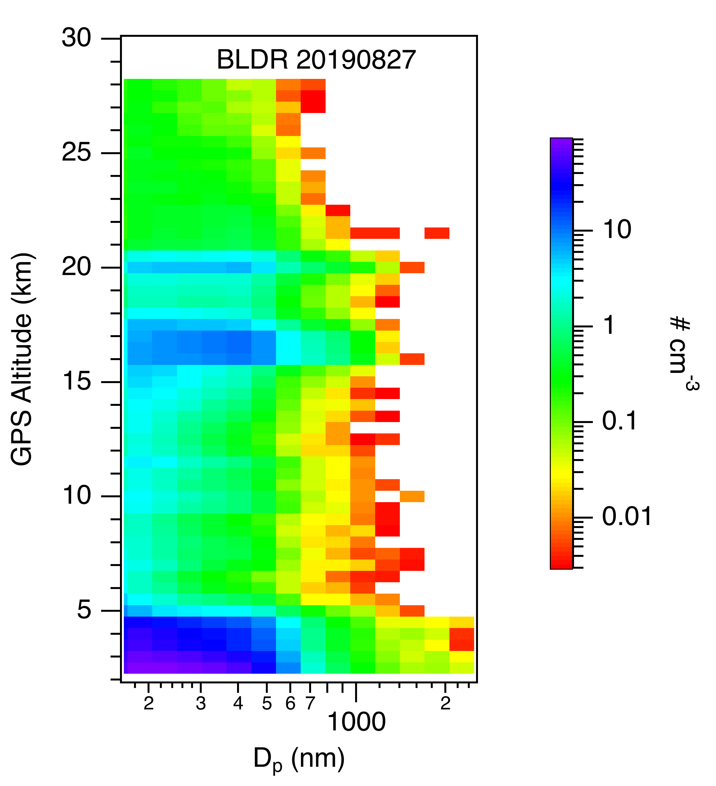
POPS sonde launches

Slide 18
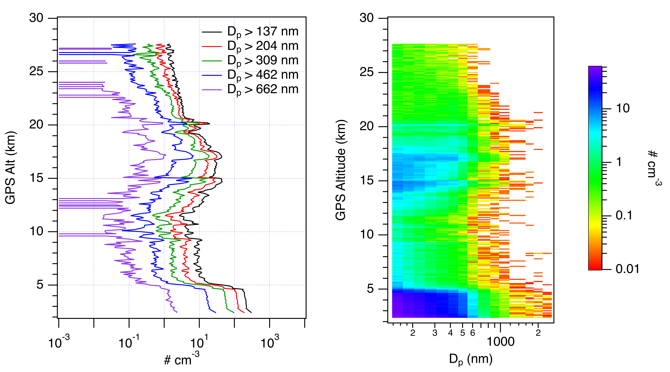
POPS sonde launches
UWY 20190828

Slide 19
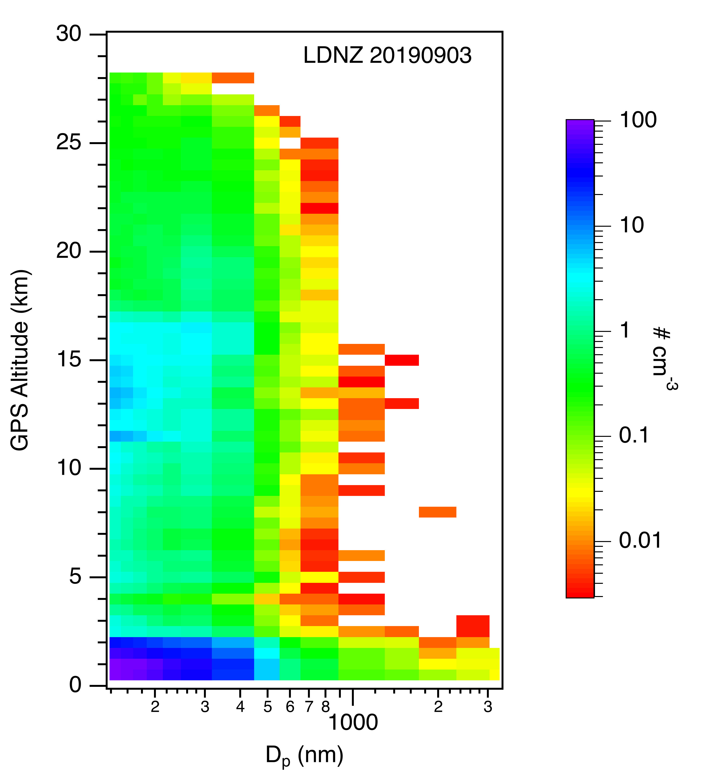
POPS sonde launches

Slide 20
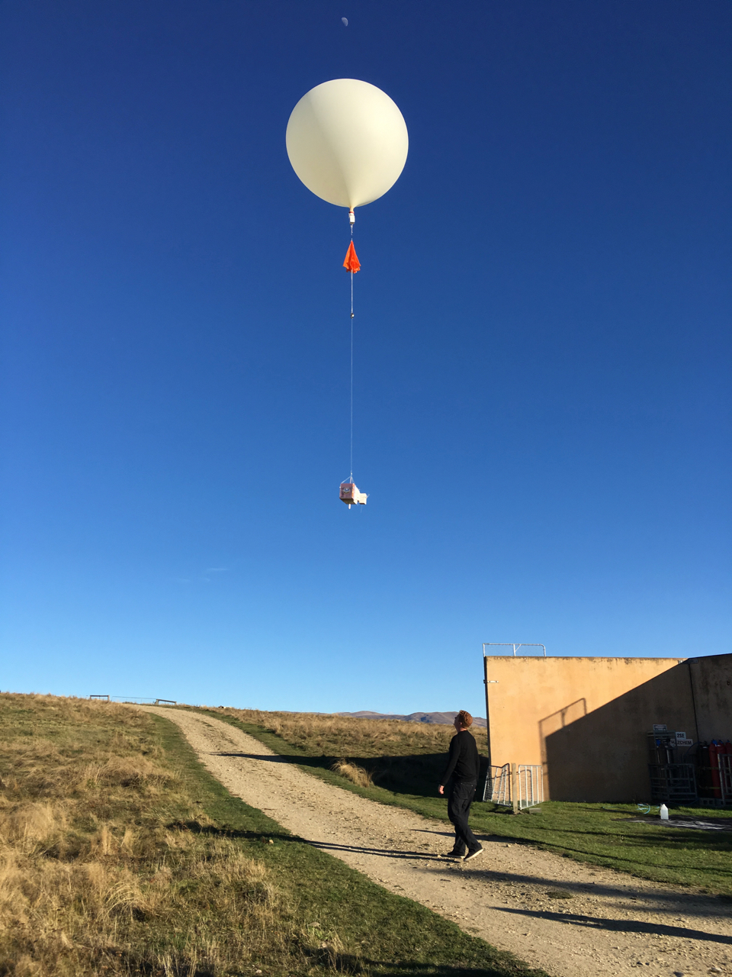
Acknowledgements
Hagen Telg, NOAA ESRL GMD (formerly CSD)
Emrys Hall and Allen Jordan, NOAA ESRL GMD
Lars Kalnajs (CU LASP) and Terry Deshler (U Wyoming)
Wills Dobson, Michael Kotkamp and Richard Querel, NIWA Lauder
Frank Erdesz, NOAA ESRL CSD
NASA SAGE III-ISS Validation Project
Marilee Roell, Carrie Roller, Susan Kizer, Travis Knepp, Kevin Leavor

